Slide 1


Typical operation issue and relevant experience of CAFE/CAFE2 SRF linac
Andong Wu, Shihui Wei, Tiancai Jiang, Yuan He, Teng Tan, Hao Guo
(On behalf of SRF group)
Linac Centre, Institute of Modern Physics, CAS
Paris, France
2026·06·10
Notes:
Good afternoon, everyone.
Thank you for being here.
My name is [Your Name]. Unfortunately, my colleague, [Colleague's Name], who was unable to attend TTC2026 in Paris due to unforeseen circumstances.
So, I will deliver his presentation. The title of this topic is:"Typical operation issues and relevant experience of the CAFE/CAFE2 SRF linac."

Slide 2
Outline
Development of SC linac and CAFE/CAFE2 facility at IMP
Field emission induced Coupler Ceramic Window Failure
CAFE: FE Mitigation and Performance Evolution (2016-2020)
CAFE2: FE Mitigation and Online Processing (2020-2025)
Summry

Slide 3
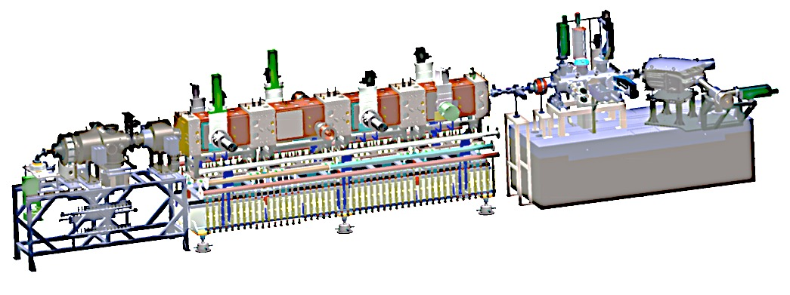
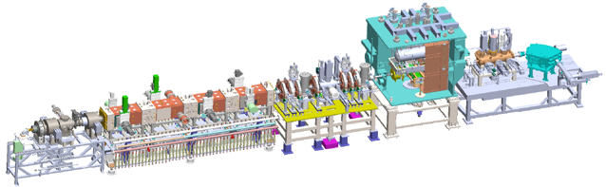
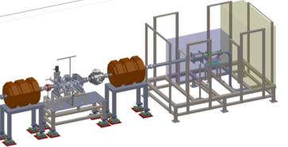
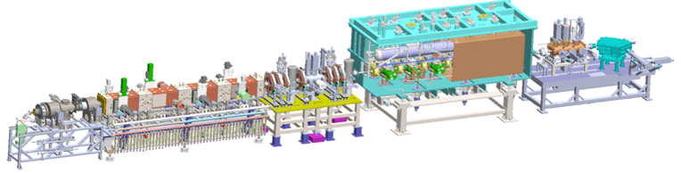
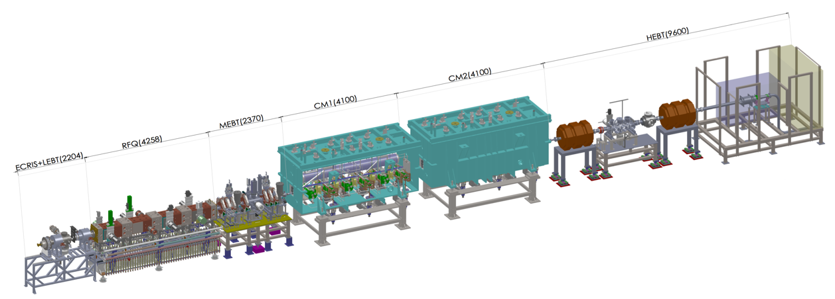
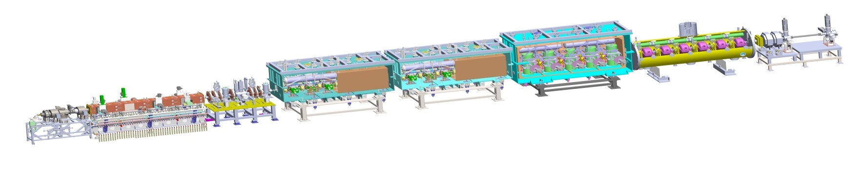
Development of intense SC linac in IMP
History of SC HWR linac
Commission stage | First CW beam | Max Energy (MeV) | Beam time (hours) | CW beam time Total (hours) | Max CW Current (mA) | Max CW Power (kW)
RFQ | Jun. 21, 2014 | 2.15 | 2036 | 90/~120 | 11 | 23
TCM1 | Nov. 24, 2014 | 2.55 | 208 | 22.5 | 11 | 28
TCM6 | Jun. 24, 2015 | 5.3 | 400 | 20 | 4 | 21
Inject II | Sep. 24, 2016 | 10.2 | 327 | 11 | 2.7 | 26
CAfE | Jun. 7, 2017 | 26.1 | ~600 | ~140 | 10 | 200
CAFE2 | Feb. 6, 2022 | 4.5~7 MeV/u | >5000 | >3000 | A/q < 3, 5 puA
1
162.5 MHz RFQ
2
162.5 MHz HWR010
3
2014.06.06——2014.07.24, RFQ
2014.09.14——2015.02.13, TCM1
2015.03.26——2015.06.29, TCM6
2015.10.28——2016.01.21, TCM6 beam commissioning
2016.05.01——2016.12.17, ADS Inject II, 10 MeV
2017.10.03——2018.01.23, CAFe, stable operation research 10mA
2019.01.04 ——2 mA
162.5 MHz HWR010
4
N. Bohr
E. Schrodinger
162.5 MHz HWR010
5

Slide 4
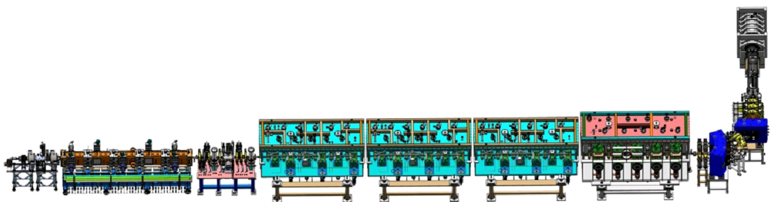
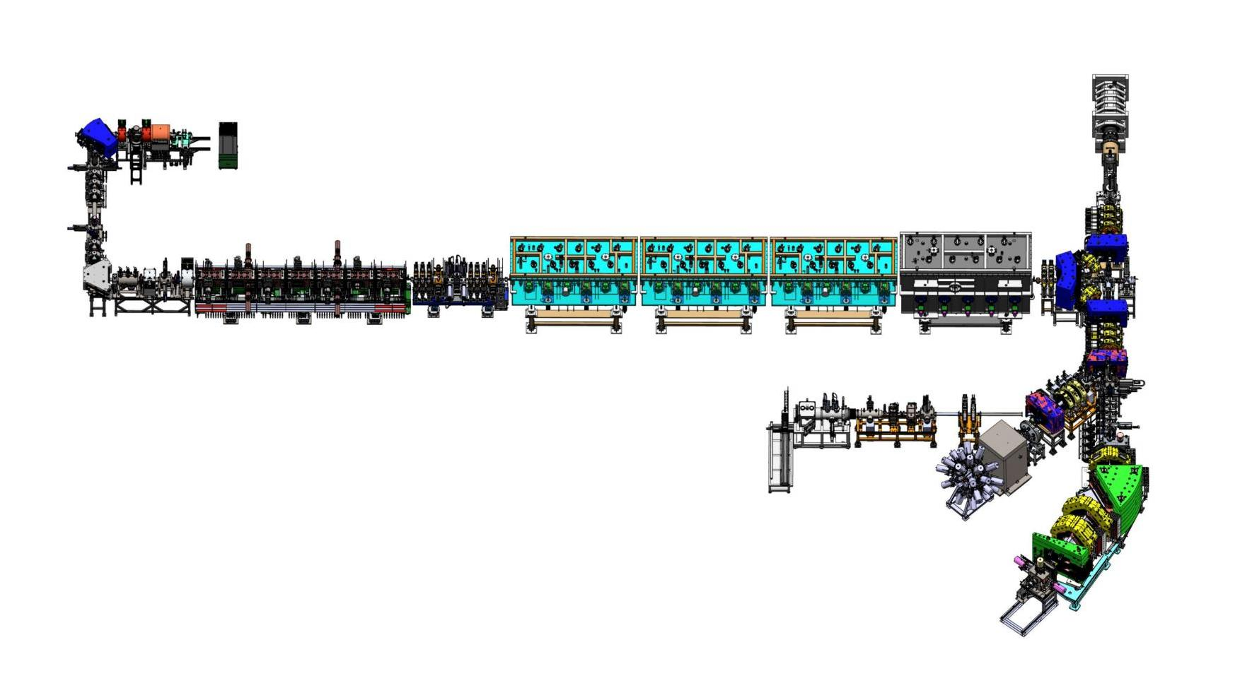
Development of intense SC linac in IMP
History of SC HWR linac
Commissioning campaigns
Mar. 2021, CAFe achieved nominal specification, CW beam
20 MeV, 10 mA, 200kW, Proton;
17.3 MeV, 7.2 ~ 10 mA, 174 kW, 120 h.
2022.02.06, CAFE2 first beam.
2022.03—now, user experiments
2024: World-record ⁴⁰Ar heavy-ion beam, 14.8 pμA
CAFe
China ADS Front-end demo linac
Ion source, LEBT, RFQ and MEBT have been replaced for heavy-ion beam. Cryomodules unchanged, identical to the proton beam configuration.
CAFE2 parameters for heavy ion facility
 | Parameters | Parameters | Units
Ions | Ca～Zn | P/He | -
A/q | 3 | 1/2 | -
Energy | 4.0-6.5 | 20/10 | MeV/u
Current | 1-10 | 1000 | puA
Modes | Pluse/CW | Pluse/CW | -
CAFE II
China Accelerator Facility for super-heavy nEw Elements
Since 2021, the proton linac has been upgraded to a heavy ion accelerator for new element synthesis.

Slide 5
Development of intense SC linac in IMP
Super-heavy Element Synthesis at CAFE2 (2022–2025)
Years | Num. | Particles | Target（17） | Total energy（MeV）（39） | CW current(puA)
2022 | 1 | ⁴⁰Ar¹³⁺ | ¹⁶⁹Tm | 178、219 | 3.4
 | 2 | ⁴⁰Ca¹³⁺ | ¹⁶⁹Tm | 216、217、218、219、200、223、225、227、228 | 2.8
 | 3 | ⁵⁵Mn¹⁷⁺ | ¹⁶⁹Tm、¹⁵⁹Tb、²⁰⁹Bi | 238、 257、270 | 2.7
2023 | 1 | ⁵⁴Cr¹⁷⁺ | ¹⁵⁹Tb、¹⁶⁵Ho 、¹⁶⁹Tm、¹⁷⁵Lu 、²⁰⁹Bi 、¹⁸¹Ta、¹⁹⁷Au | 213、215、223、225、229、235、237、241、245、247、250、253、256、258、259、263、264、265、270、274、276、290 | 1.8
 | 2 | ⁴⁰Ar¹²⁺ | ¹⁹⁷Au、²⁰⁹Bi、¹⁵⁹Tb、²³²Th | 170、175、176、182、187、193、198、204、211、206、215、221、234、 | 5.2（更新）
 | 3 | ⁴⁸Ca¹⁴⁺ | ²⁴³Am | 256 | 1.2
2024 | 1 | ⁵⁴Cr¹⁷⁺ | ²⁴³Am、²³²Th | 299.5、334 | 3.52
 | 2 | ⁴⁰Ar¹²⁺ | ²³⁸U | 224.2 | 14.5
 | 3 | ⁴⁸Ca¹⁴⁺ | ¹⁶⁹Tm | 259 | 1.4
2025 | 1 | ⁴⁸Ca¹⁴⁺ | ²⁴³Am | 249.6~268.8 | 1.2
 | 2 | ⁵⁴Cr¹⁷⁺ | ²⁴³Am、²³⁸U | 259.2-313.2 | 2.0
 | 3 | ⁴⁰Ar¹³⁺ | ²³⁸U | 172~228 | 14.8
 | 4 | ⁵²Cr¹⁷⁺ | ²⁰⁹Bi | 270.4~312 | 1.0

Slide 6
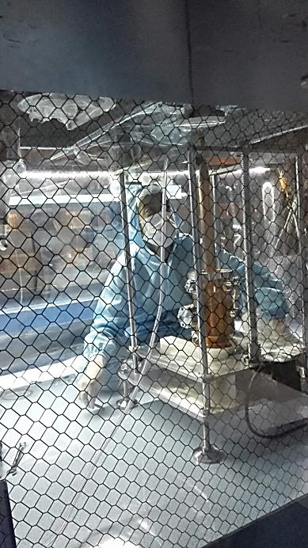
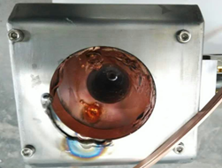
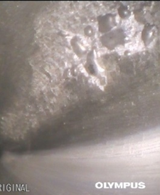
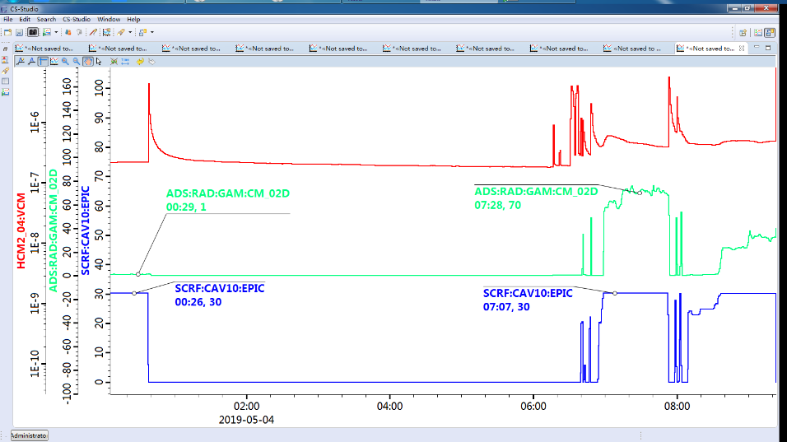
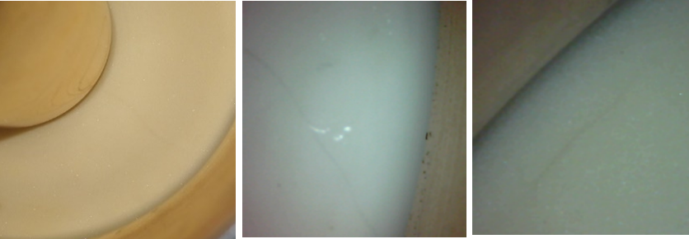
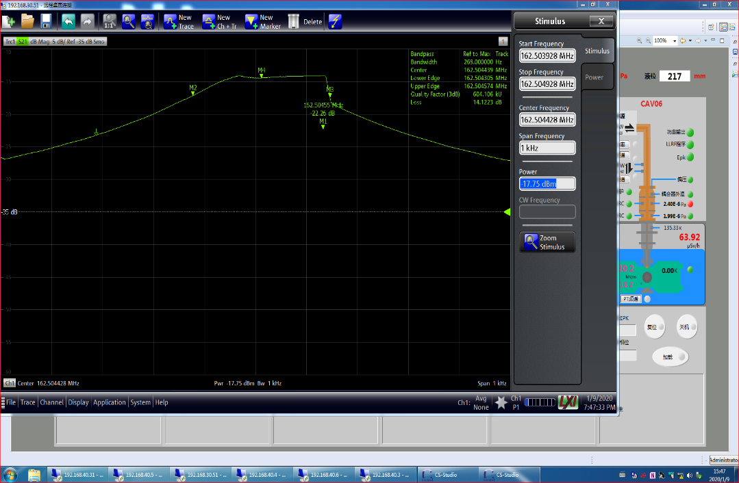
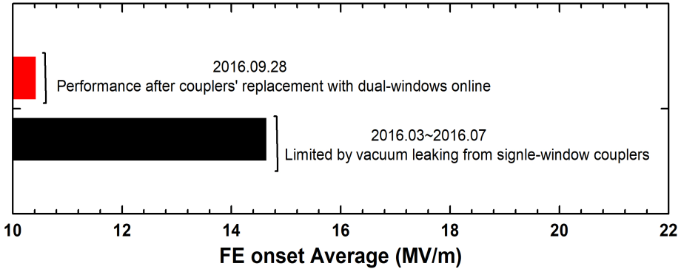
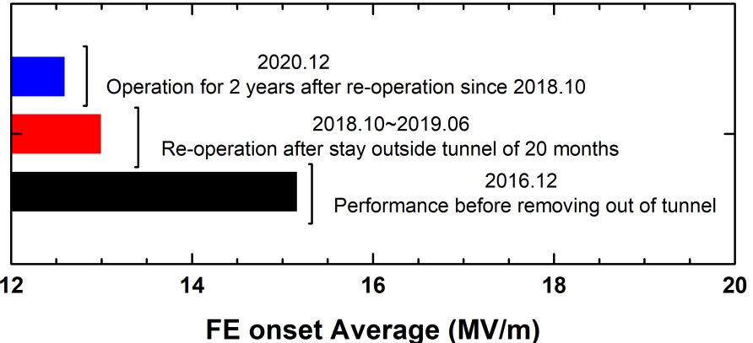
Performance degradation and related contamination
Degradation from single-window coupler leakage and replacement online
Degradation from particle migration from RT part
Degradation due to gas desorption from the coupler surface
Vacuum of coupler
Radiation from cavity
Epk of cavity
Unknown contamination in assembly
Field emission is one of the main factors for extra thermal loading, vacuum breakdown and dark current.

Slide 7
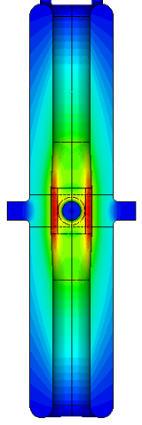
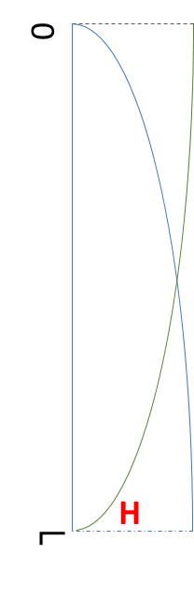
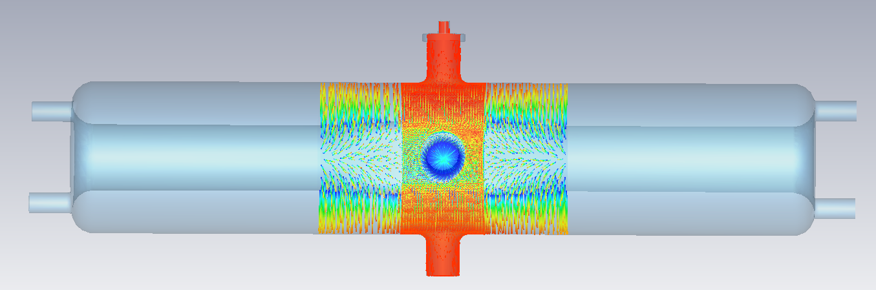
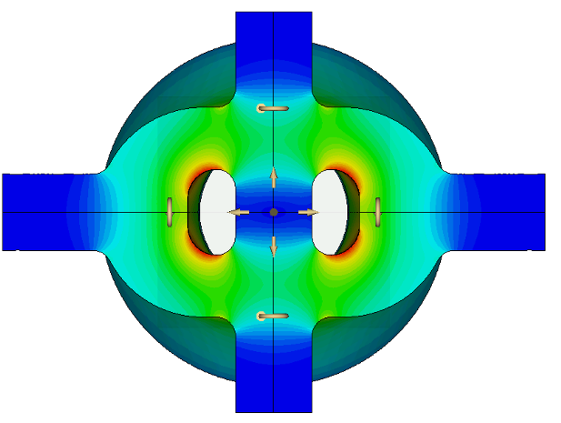
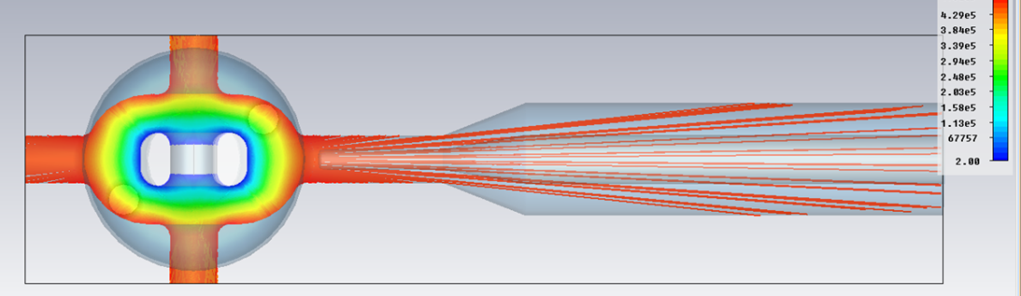
1. Field emission induced Coupler Ceramic Window Failure
FE properties in HWR SRF Cavities vs. FPC and Pt coupler
Both the FPC and the Pt ports are located in the strong electric field region of the coaxial structure.
Highest surface field areas were designed not to face the pickup ports.
FE electrons can see the windows of FPC and Pt.
Electrons on ceramic discharge when accumulating to a certain value
beam port
Pt port
Trajectory of FE electrons
beam port
Pt port
Electric Field Distribution of HWR Cavities
FPC window

Slide 8
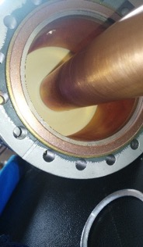
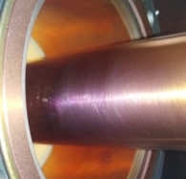
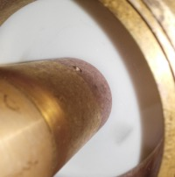
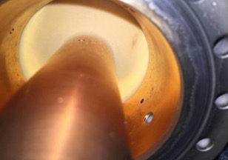
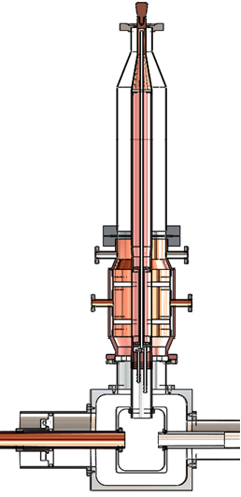
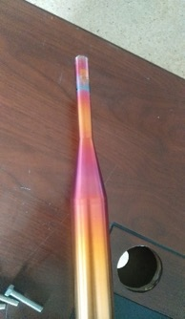
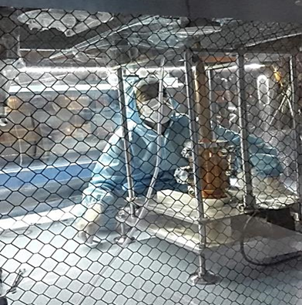
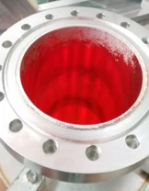
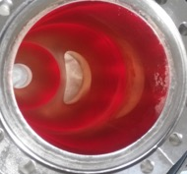
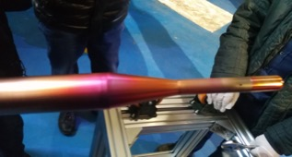
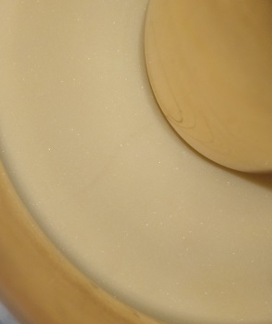
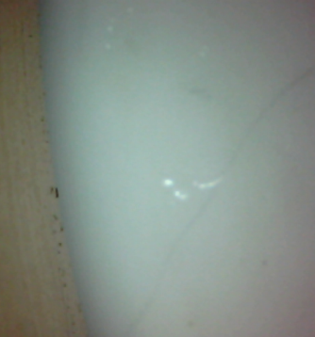
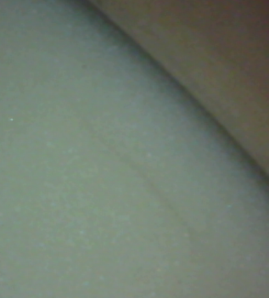
1. Field emission induced Coupler Ceramic Window Failure
Failure of Single-Window Coupler and Optimization of Dual-Window Structure
Field-emitted electrons accumulate on the FPC ceramic window, causing discharge and damage.
And these damage leads to vacuum breakdown, cavity performance degradation and unstable.
A novel dual-window coupler is adopted for improved vacuum redundancy, and an electron barrier is equipped to block electron bombardment and prevent FPC ceramic discharge failure.
From 2016 to 2017, all single-window couplers on the CAFE facility were replaced online with dual-window.
Electron barrier
Broken windows in 2015, Operated for 6 months after broken
Dual windows
Couplers replacement online

Slide 9
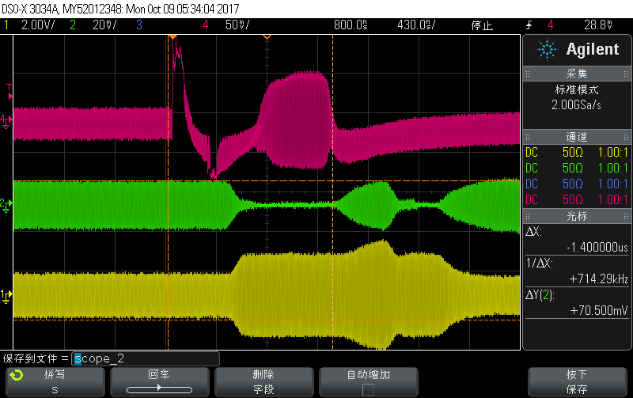
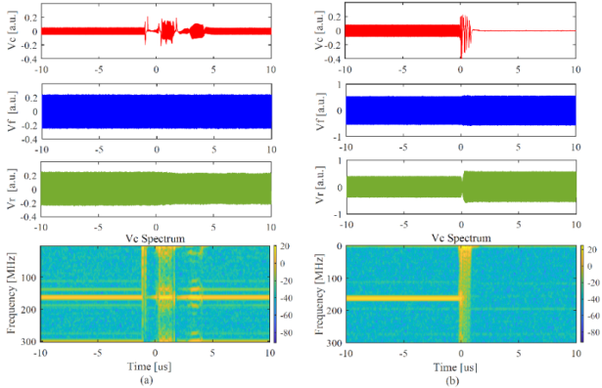
1. Field emission induced Coupler Ceramic Window Failure
Pt window failure and flashover
During operation, abnormal signal flashovers were detected in the LLRF control loop and oscilloscope.
The frequency of flashovers correlates with accelerator gradient, matching the characteristics of field emission dose.
This confirms that electron bombardment on the Pt ceramic window causes discharge and flashover.
These flashover signals then trigger LLRF feedback loop faults and eventually lead to electrical quench failure.
Pt
Pf
Pr
Oscilloscope-detected signal faults
Flashover frequency is positively correlated with radiation dose.
Electrical quench was detected in the LLRF system.
Courtesy of F. Qiu

Slide 10
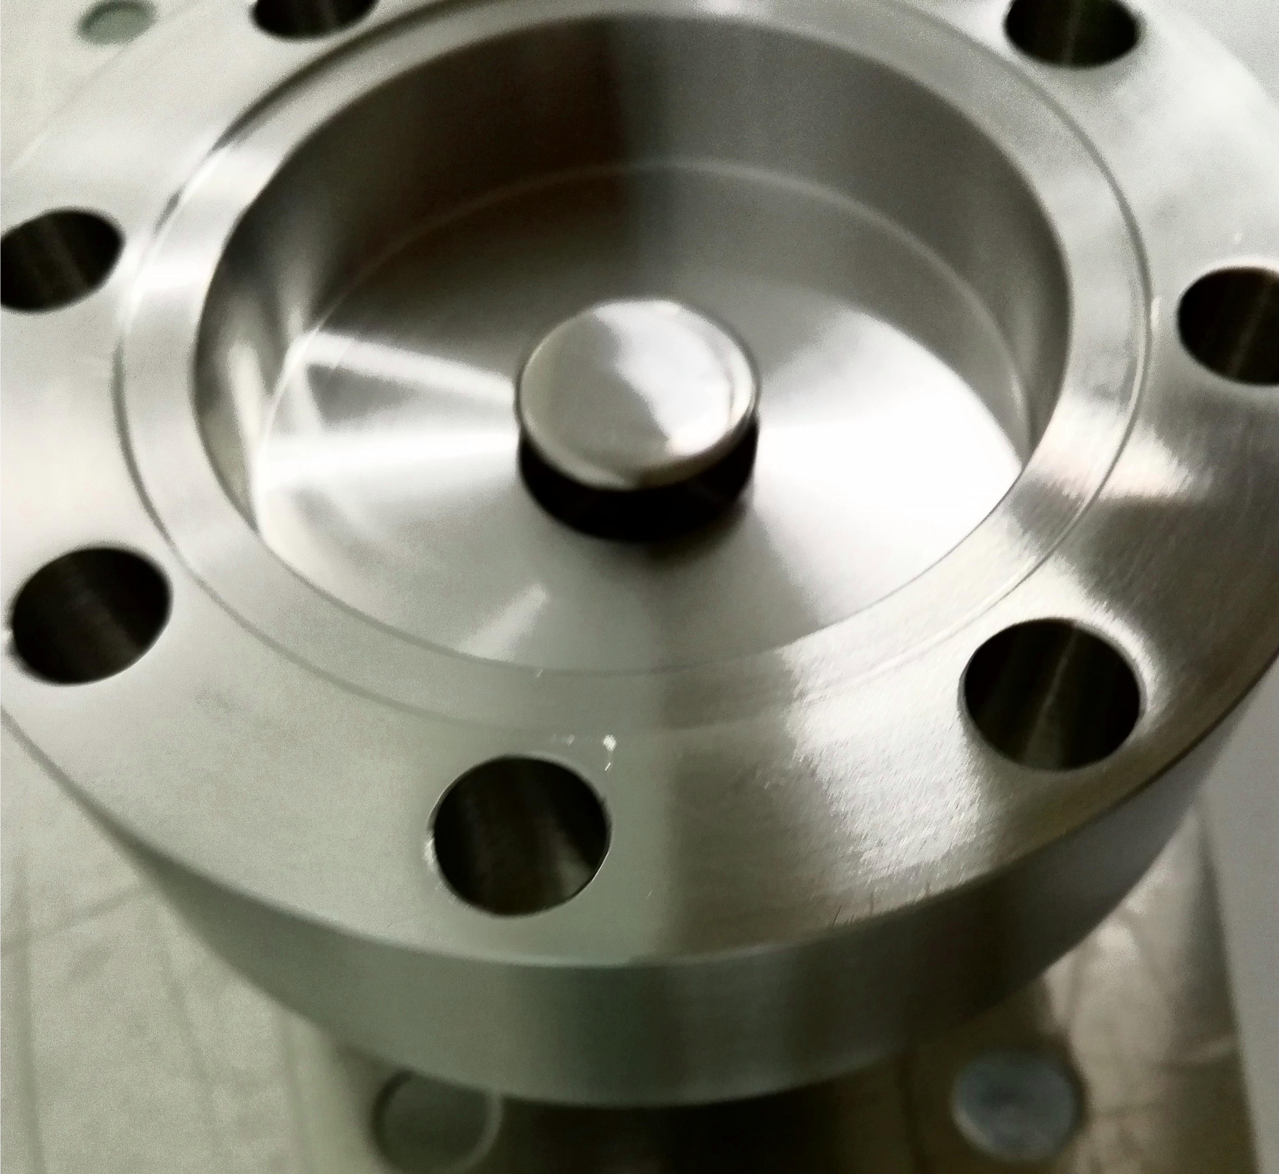
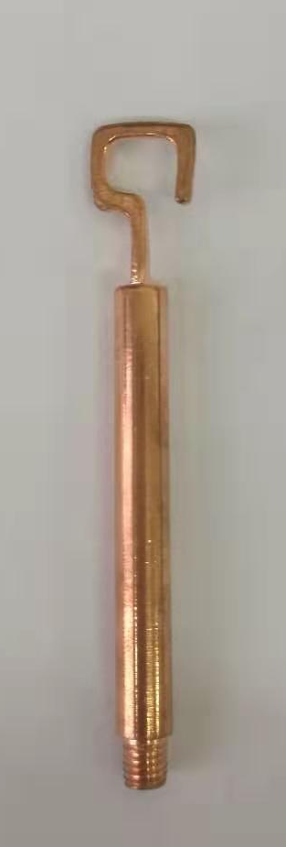
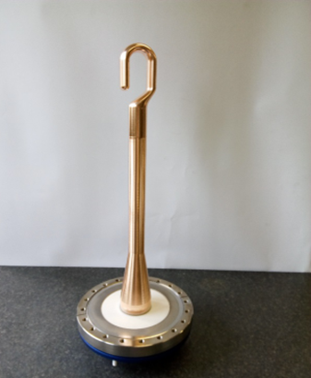
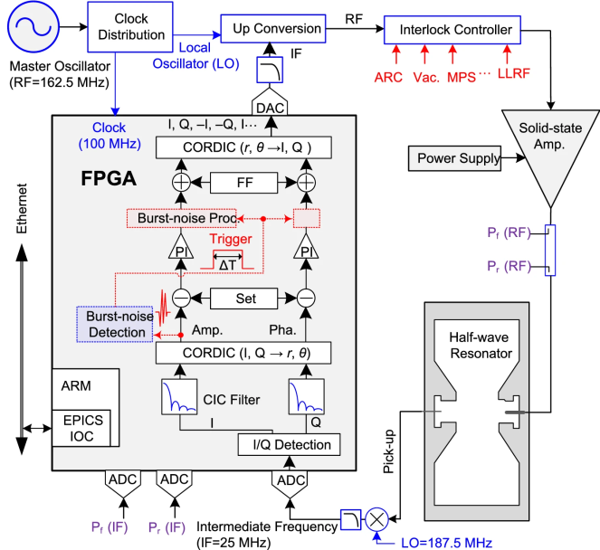
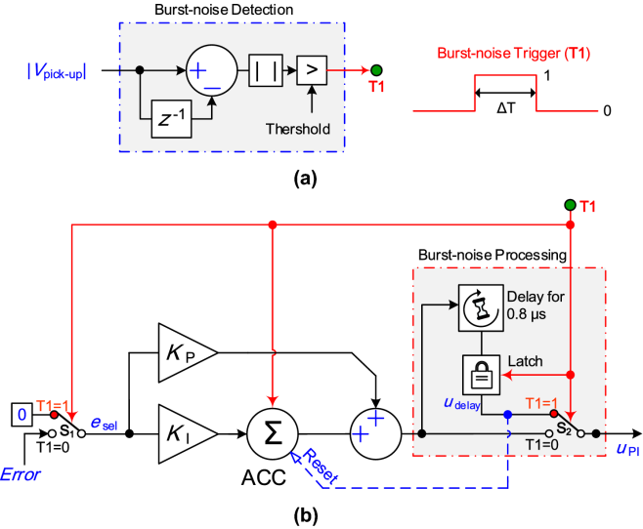
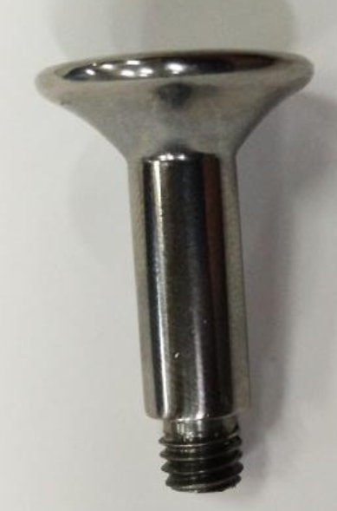
1. Field emission induced Coupler Ceramic Window Failure
Mitigation strategies for Pt’s flashover and electrical quench
Mushroom-shaped antenna in electric field region: not effective, the flashover still persisted.
Optimizing the Pt pickup antenna with a loop antenna for the strong magnetic field region: highly effective, no flashover occurred on HIAF and IP-SAFE facilities.
An integrated burst-noise detection algorithm in the LLRF controller mitigates the E-quench-like faults
Mushroom-shaped antenna in electric field region
Not effective ×
Loop antenna for the strong magnetic field region
Effective ✔
In situ mitigation strategies for field emission-induced cavity faults using low-level radiofrequency system.
Effective ✔
Courtesy of F. Qiu

Slide 11
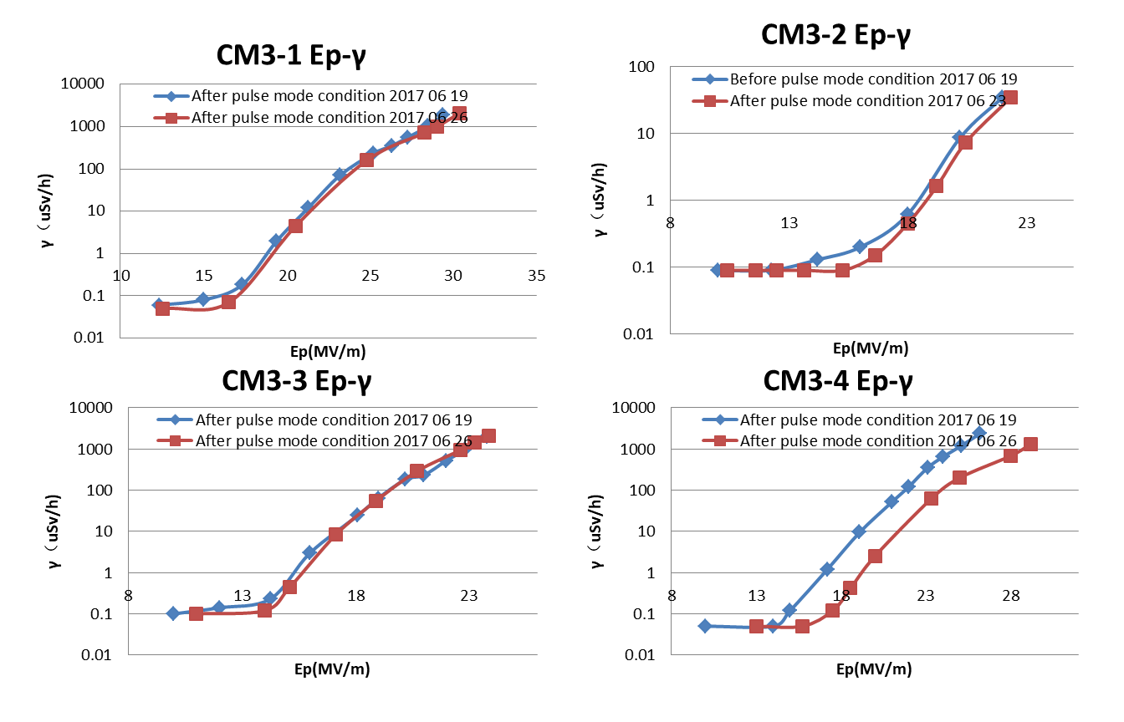
2. CAFE: FE Mitigation and Performance Evolution (2016-2020)
Pulsed power conditioning（2016~2017 CM3 taper HWRs）
2016-2017, CM3 used the new tapered HWR015 cavities. The first four HWR015 (CM3-1 to CM3-4) leak 5 times than CM3-5 in cleanroon. Pulsed power conditioning was thus applied to these cavities.
Pulse mode RF on/off: 10ms/1s
Power forward~3.8kW, Ep~35MV/m
Self excited mode
Qext: 8.5E5
Bandwidth: ~200Hz
Fill-time: 1.6mS
RF pulse mode condition by this way is not very effective for reduce FE

Slide 12
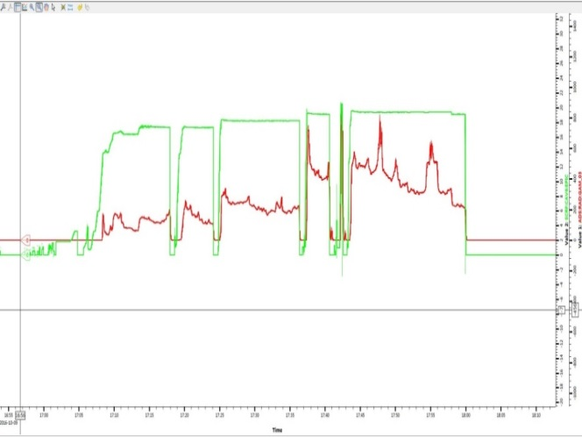
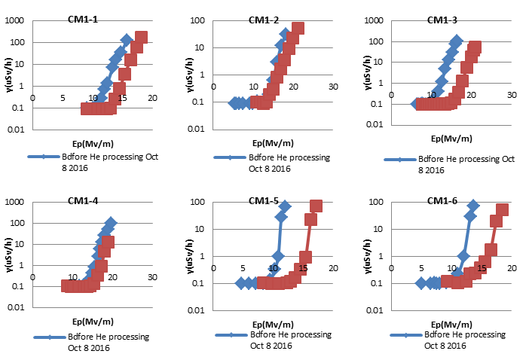
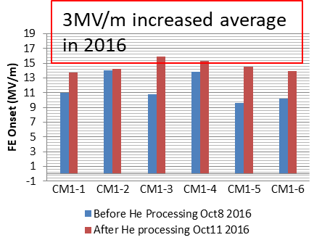
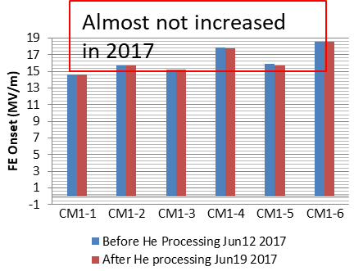
2. CAFE: FE Mitigation and Performance Evolution (2016-2020)
Helium conditioning（2016~2017 CM1 HWRs）
In 2016, helium processing was introduced for the first time in CM1, followed by a second round of application trials in 2017.
Ep
X-ray reduced with same Ep during He conditioning
FE onset increased！
Supplying helium on the beam line
RF conditioning with helium
Bumping and warm up to 30K
Cooling down to 4.2 K
First helium processing effective, but no further improvement with repeats.
The FE onset limited at 17 MV/m, probably residual chemical contamination.

Slide 13
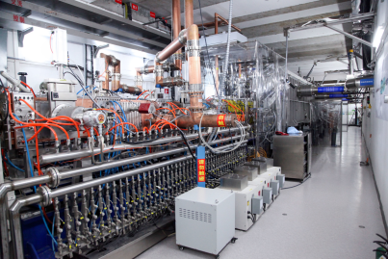
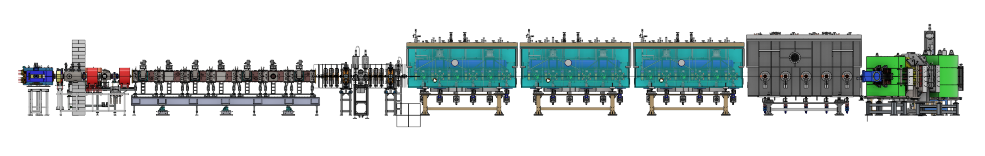
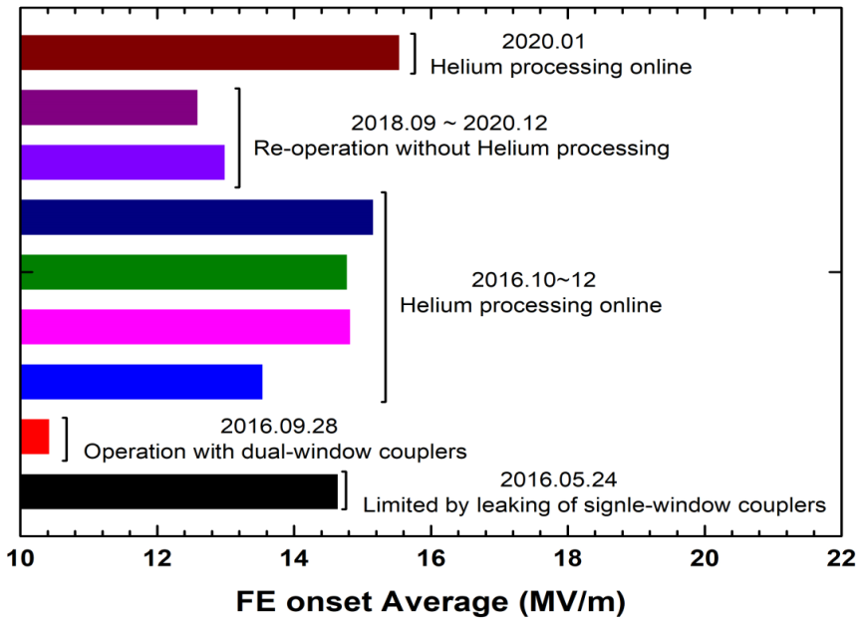


2. CAFE: FE Mitigation and Performance Evolution (2016-2020)
Cryomodule performance evolution with different approaches over time
Superconducting section of CAFe facility consisted with 4 HWRs’ cryomodules
MEBT
HEBT
CAFE for ADS & isotope research
CM1
CM2
CM3
CM4
SRF cavity performance inevitably degrades during cryostat tunnel installation and long-term operation.
Dual-window coupler replacement, cleanroom retreatment and online helium conditioning can recovery the performance.
In 2021, contributed to achieving the unprecedented operation of a high-current CW 10mA/100kW/100h proton beam.

Slide 14

3. CAFE2: FE Mitigation and Online Processing (2020-2025)
Performance recovery after vent events via online surface processing
Superconducting section of CAFe facility consisted with 4 HWRs’ cryomodules
MEBT
HEBT
Valve leaking location
CAFE2 for isotope research
CM1
CM2
CM3
CM4
The accident and recovery of CM4
2020.6.21 Baseline acquisition.
2020.7.03 Helium Processing at 4 K.
2020.8~9 Mistake operation during the upgrade for the commission of 200 kW, the air was vented to atmosphere induced by valve leaking at 300K. (The performance degradation due to this vacuum accident was not test because the cryogenic system in overhauling)
2020.10.16 Plasma cleaning with Ne/O₂ plasma to remove possible contaminations on inner surface of CM4.
Online reactive oxygen plasma and helium conditioning achieves full performance recovery after severe vent events.

Slide 15

3. CAFE2: FE Mitigation and Online Processing (2020-2025)
FE distribution vs. location: potential impurity migration room-temperature region
Superconducting section of CAFe facility consisted with 4 HWRs’ cryomodules
MEBT
HEBT
CAFE2 for isotope research
CM1
CM2
CM3
CM4
In Jan 2021, by helium conditioning, the average gradient of 4 cryomodule increase 3.0、2.7、3.2、1.2 MV/m, respectively.
Cavities that are closer to room temperature part are inferior. This might relate to the migration of contaminants.

Slide 16



3. CAFE2: FE Mitigation and Online Processing (2020-2025)
Combined using oxygen plasma and helium conditioning effectively suppresses FE
Superconducting section of CAFe facility consisted with 4 HWRs’ cryomodules
MEBT
HEBT
CAFE for ADS & isotope research
CM1
CM2
CM3
CM4
Helium conditioning and reactive oxygen plasma cleaning raise average FE onset and gradient by ~15% respectively.
The combined use yields a 31.5% improvement.
This improvement ideated that the surface roughness and carbide contamination dominate FE in SRF cavities at same time.

Slide 17

3. CAFE2: FE Mitigation and Online Processing (2020-2025)
Recurrent failure of performance-recovered cavities due to unknown reasons
Superconducting section of CAFe facility consisted with 4 HWRs’ cryomodules
MEBT
HEBT
CAFE for ADS & isotope research
CM1
CM2
CM3
CM4
The failure and recovery of CM1-2
2024. January-July
Acceleration gradient not available even with self excitation loop for RF power input
2024. October
Oxygen plasma was conducted, and RF performance was recovered with FE onset at 10MV/m.
2024. November
30 mins of RF condition was conducted, and FE onset was increased from 10 to 18 MV/m.
2025. March
The SRF cavity failed to reach self-excited loading again.
30mins of RF condition
The SRF cavity degraded again after half a year of operation post plasma cleaning. No identifiable cause has been found.

Slide 18






3. CAFE2: FE Mitigation and Online Processing (2020-2025)
Regular use of in-situ online oxygen plasma and helium conditioning
Superconducting section of CAFe facility consisted with 4 HWRs’ cryomodules
MEBT
HEBT
CAFE2 for isotope research
CM1
CM2
CM3
CM4
2021 CM1- CM4
Helium processing
2021 CM2
Combing use
2023 CM1
Helium processing
2023 CM2
Oxygen plasma
2024 CM1&CM3
Helium processing
2024 CM1
Oxygen plasma
In-situ performance recovery technology has achieved long-term routine application on the CAFE2.
It can be conveniently implemented during summer maintenance windows, which keeps the performance of SRF cavities stable in the long run, and improves operational efficiency.

Slide 19


3. CAFE2: FE Mitigation and Online Processing (2020-2025)
Status of SC modules: performance has degraded, and in-situ treatment is pending
Average Epk for beam in 2023
Average Epk for beam in the first half of 2024
Average Epk for beam in the second half of 2024
Courtesy of W.L. Chen and J.Y. Ma
Average Epk for beam in 2025
Due to the schedules for terminal experiments, in-situ cleaning was not performed in 2025.
The performance of RF cavities degraded, yet the total beam energy still met operational requirements by increasing the charge state of heavy ions.
In-situ cleaning of SRF cavities will be conducted from 2026 to 2027 to improve accelerator gradient.

Slide 20
Summary
Before 2020, FE was suppressed via FPC replacement, Pt optimization, and cavities retreatment in cleanroom.
In the CAFE2 phase, in-situ surface treatment has been routinely applied with remarkable results.
Combined use of reactive oxygen plasma and helium conditioning achieves excellent performance.
Further in-situ surface processing will be implemented on CAFE2 to improve acceleration performance.

Slide 21
Thanks for your attention !
Question?
antonwoo@impcas.ac.cn

