Slide 1
Performance degradation and component failures of Superconducting cavity system in SuperKEKB operation
Takafumi Okada
on behalf of SRF group at SuperKEKB

Slide 2
Outline
SuperKEKB accelerator overview
SuperKEKB RF system overview
  Superconducting cavity parameters
Long term operation history and performance degradation
Recovery and mitigation methods of trips
Statistics of cavity trip during operation
Diagnostics of trips at SuperKEKB
Summary

Slide 3
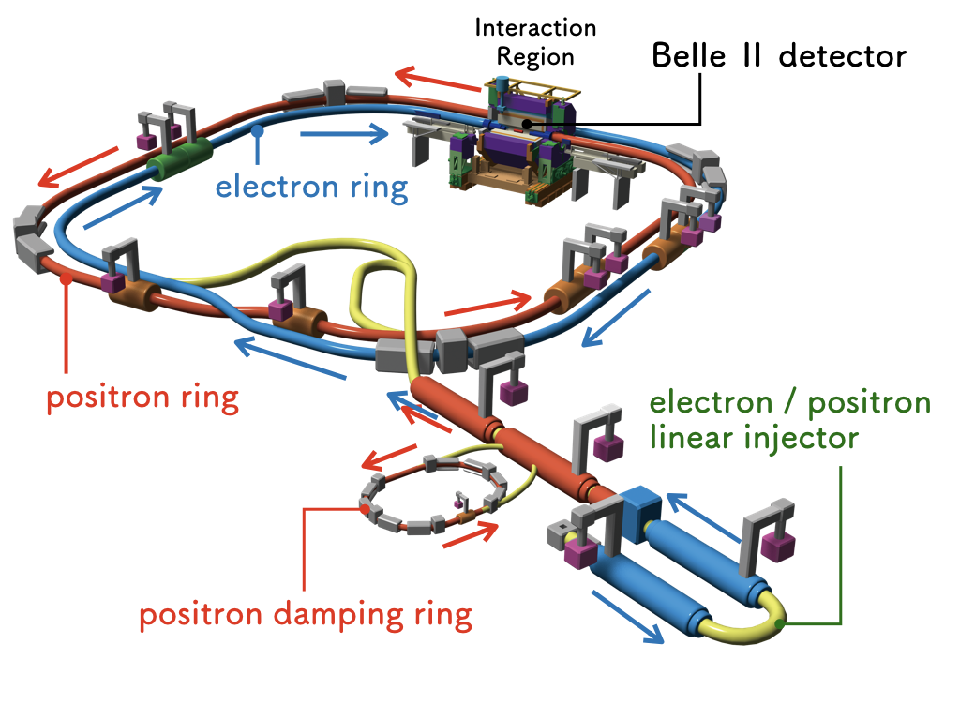
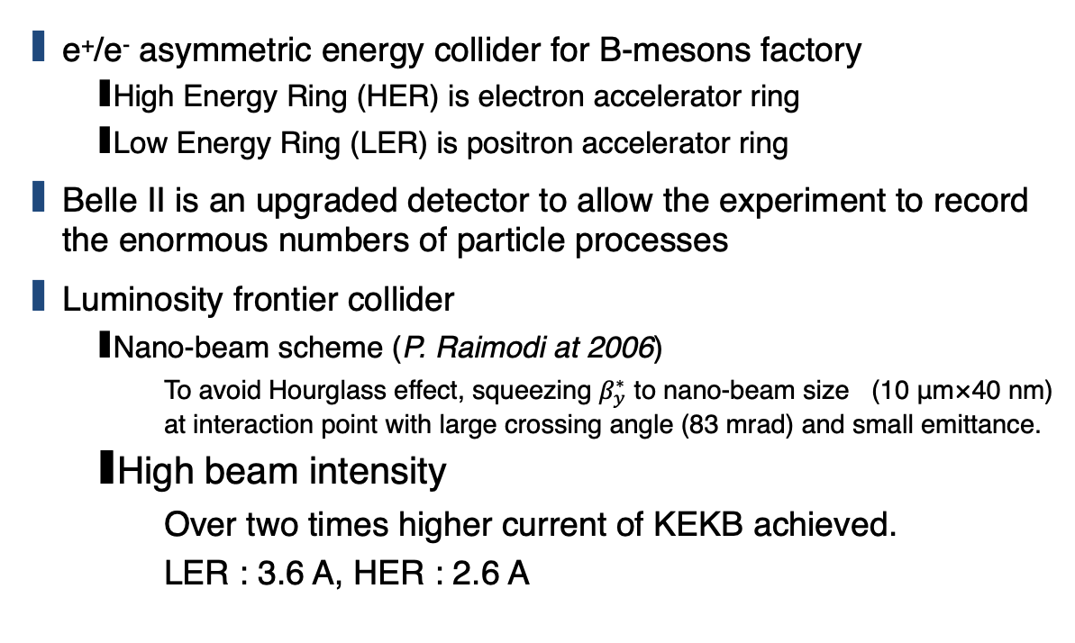
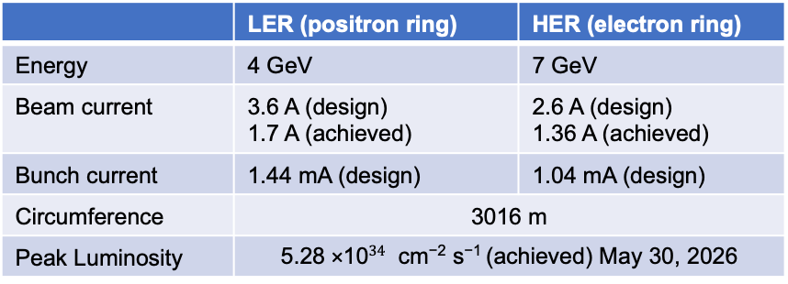
SuperKEKB accelerator in Japan
e⁺/e⁻ asymmetric energy collider for B-mesons factory
  High Energy Ring (HER) is electron accelerator ring
  Low Energy Ring (LER) is positron accelerator ring
Belle II is an upgraded detector to allow the experiment to record the enormous numbers of particle processes
Luminosity frontier collider
  Nano-beam scheme (P. Raimodi at 2006)
    To avoid Hourglass effect, squeezing $β_{y}^{∗}$ to nano-beam size (10 μm×40 nm) at interaction point with large crossing angle (83 mrad) and small emittance.
  High beam intensity
    Over two times higher current of KEKB achieved.
    LER : 3.6 A, HER : 2.6 A
 | LER (positron ring) | HER (electron ring)
Energy | 4 GeV | 7 GeV
Beam current | 3.6 A (design) 1.7 A (achieved) | 2.6 A (design) 1.36 A (achieved)
Bunch current | 1.44 mA (design) | 1.04 mA (design)
Circumference | 3016 m | 3016 m
Peak Luminosity | 5.28 ×10$34$ cm⁻² s⁻¹ (achieved) May 30, 2026
The RF system needs to be upgraded with reinforcements to run this massive beam power of SuperKEKB
Notes:
SuperKEKB is an electron and positron asymmetric energy collider for the discovery new physics experiment of Belle 2
HER is an electron and High energy, LER is low energy for positron
SuperKEKB is an upgrade machine from KEKB accelerator that is also e+/e- collider for luminosity frontier
These accelerators focus on the high luminosity.
SuperKEKB adopted the two method, Nano-beam scheme and high beam intensity.
The design current of SuperKEKB is 3.6 A and 2.6 A for positron and electron.
That is twice higher than the KEKB achieved current.

Slide 4
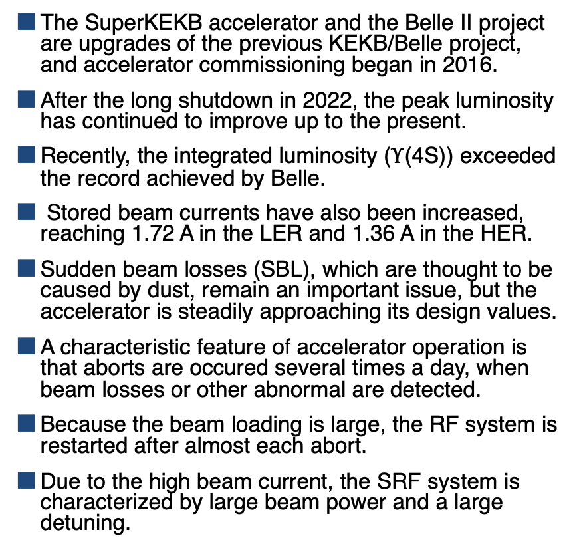

Accelerator operation history
The SuperKEKB accelerator and the Belle II project are upgrades of the previous KEKB/Belle project, and accelerator commissioning began in 2016.
After the long shutdown in 2022, the peak luminosity has continued to improve up to the present.
Recently, the integrated luminosity ($Υ$(4S)) exceeded the record achieved by Belle.
Stored beam currents have also been increased, reaching 1.72 A in the LER and 1.36 A in the HER.
Sudden beam losses (SBL), which are thought to be caused by dust, remain an important issue, but the accelerator is steadily approaching its design values.
A characteristic feature of accelerator operation is that aborts are occured several times a day, when beam losses or other abnormal are detected.
Because the beam loading is large, the RF system is restarted after almost each abort.
Due to the high beam current, the SRF system is characterized by large beam power and a large detuning.
e⁻ beam current
e⁺ beam current
Luminosity
$5.28×{10}^{34}$ cm⁻²s⁻¹

Slide 5
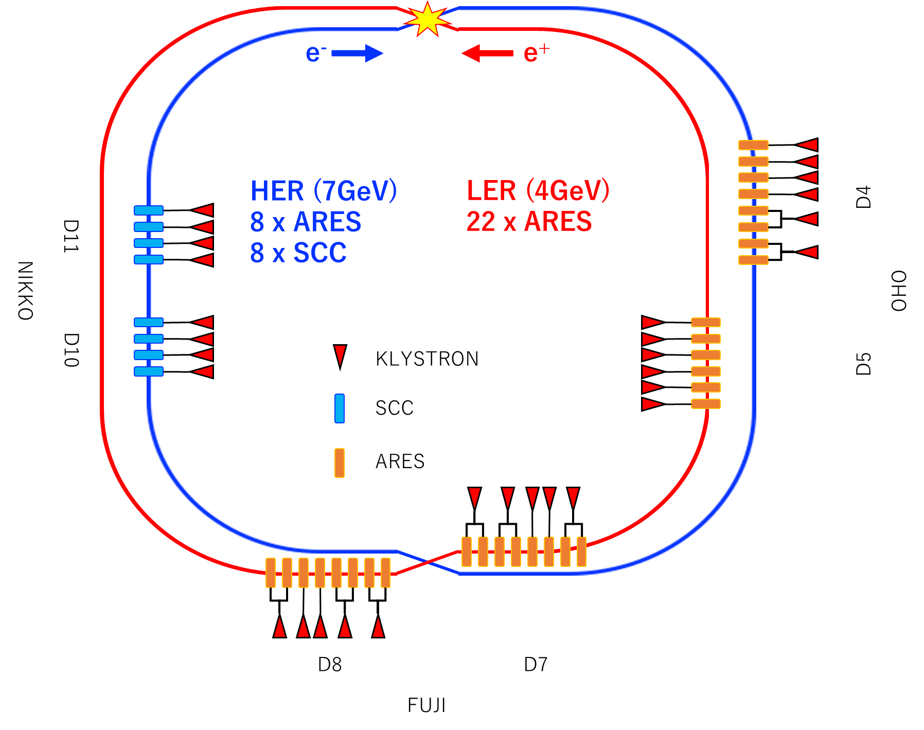
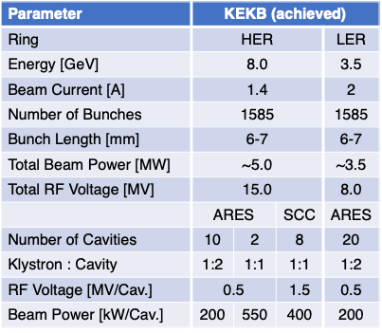
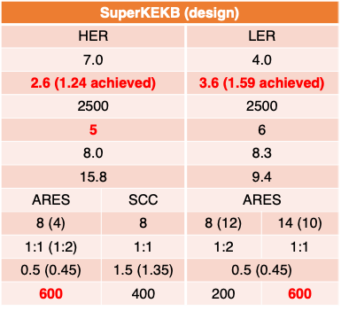
SuperKEKB RF system
Parameter | KEKB (achieved)
Ring | HER |  |  | LER
Energy [GeV] | 8.0 |  |  | 3.5
Beam Current [A] | 1.4 |  |  | 2
Number of Bunches | 1585 |  |  | 1585
Bunch Length [mm] | 6-7 |  |  | 6-7
Total Beam Power [MW] | ~5.0 |  |  | ~3.5
Total RF Voltage [MV] | 15.0 |  |  | 8.0
 | ARES |  | SCC | ARES
Number of Cavities | 10 | 2 | 8 | 20
Klystron : Cavity | 1:2 | 1:1 | 1:1 | 1:2
RF Voltage [MV/Cav.] | 0.5 |  | 1.5 | 0.5
Beam Power [kW/Cav.] | 200 | 550 | 400 | 200
SuperKEKB (design)
HER |  | LER
7.0 |  | 4.0
2.6 (1.24 achieved) |  | 3.6 (1.59 achieved)
2500 |  | 2500
5 |  | 6
8.0 |  | 8.3
15.8 |  | 9.4
ARES | SCC | ARES
8 (4) | 8 | 8 (12) | 14 (10)
1:1 (1:2) | 1:1 | 1:2 | 1:1
0.5 (0.45) | 1.5 (1.35) | 0.5 (0.45)
600 | 400 | 200 | 600
Distribution of RF stations
Superconducting cavities
SuperKEKB main ring uses two types of RF cavities: ARES cavities, which are normal conducting cavities, and superconducting cavities.
The electron ring has eight superconducting cavity and RF stations and eight normal conducting RF stations, in order to provide higher beam energy than in the positron ring.
The positron ring has 22 normal conducting RF stations.
Compared with the KEKB era, upgrades of the RF stations are planned, mainly including reinforcement of the high-power systems such as klystrons, as well as the installation of additional ARES cavities.
The installing of a digital LLRF system is planned; however, because of the high cost, the SRF system currently uses an analog LLRF system.
A particularly serious issue is the aging of the infrastructure. Many basic components have been in use since the TRISTAN or KEKB era.
Failure due to infrastructure issue accounts for a non-negligible fraction of the failures in the overall RF system.

Slide 6
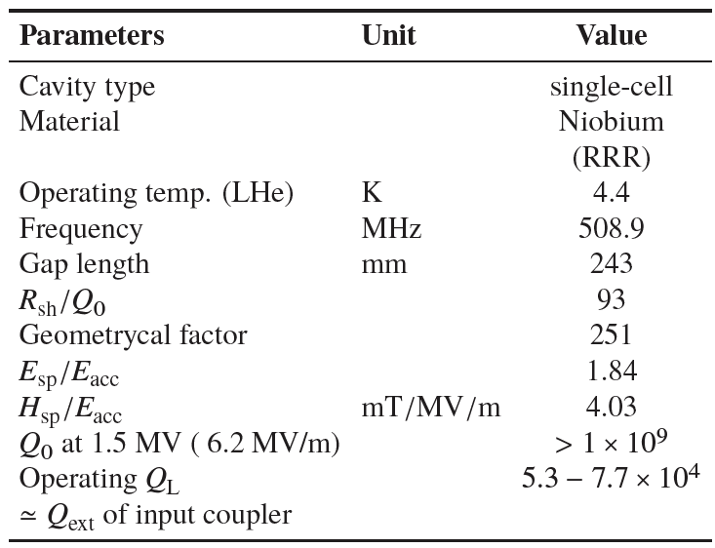
HOM damped superconducting cavity
Doorknob
Input coupler
The cavity is a 509 MHz niobium single-cell HOM-damped cavity, and eight units are installed in the ring.
Large-diameter ferrite (IB004) HOM dampers are installed at both ends.
A coaxial input coupler is used, with a maximum power capability of 400 kW with beam.
In SuperKEKB, to cope with the increasing HOM power due to high current and short bunch, additional HOM absorbers will be installed between cavities.
Tuner
Gate valve
Ferrite
HOM damper
SBP side
LBP side
Gate valve
Ion pump
Ion pump
(RRR~200)

Slide 7
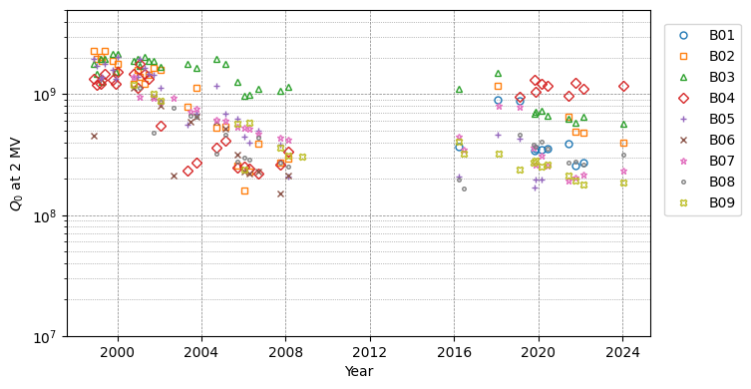
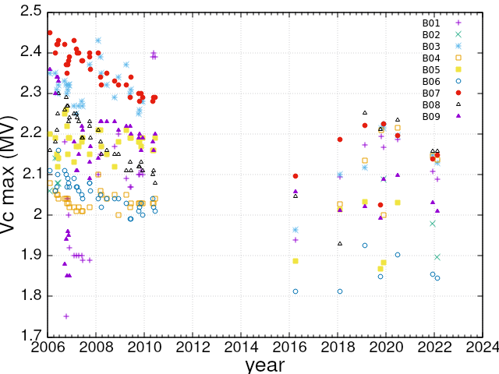
Superconducting operation history and performance degradation
HHPR
These cavities have been in operation for more than 20 years.
They are warmed up twice per year for maintenance required by regulations in Japan.
Before cooldown, coupler conditioning is performed at room temperature.
During accelerator operation, cavity conditioning was previously performed once every two weeks; it is now performed approximately once per month.
The standard conditioning procedure consists of three cycles at 2 MV (~8 MV/m).
In addition, as part of the tuning phase scan, degassing is performed through low-temperature coupler conditioning with a detuning of ±30 degrees.
At the start of fabrication, the surface treatment was carried out by electropolishing and ozonated-water rinsing, and the cavities showed no field emission below 2 MV accelerator field and Q₀>1x10⁹.
KEKB era
SuperKEKB era
Vc re-calib.
KEKB era
SuperKEKB era
Re-calibrated

Slide 8
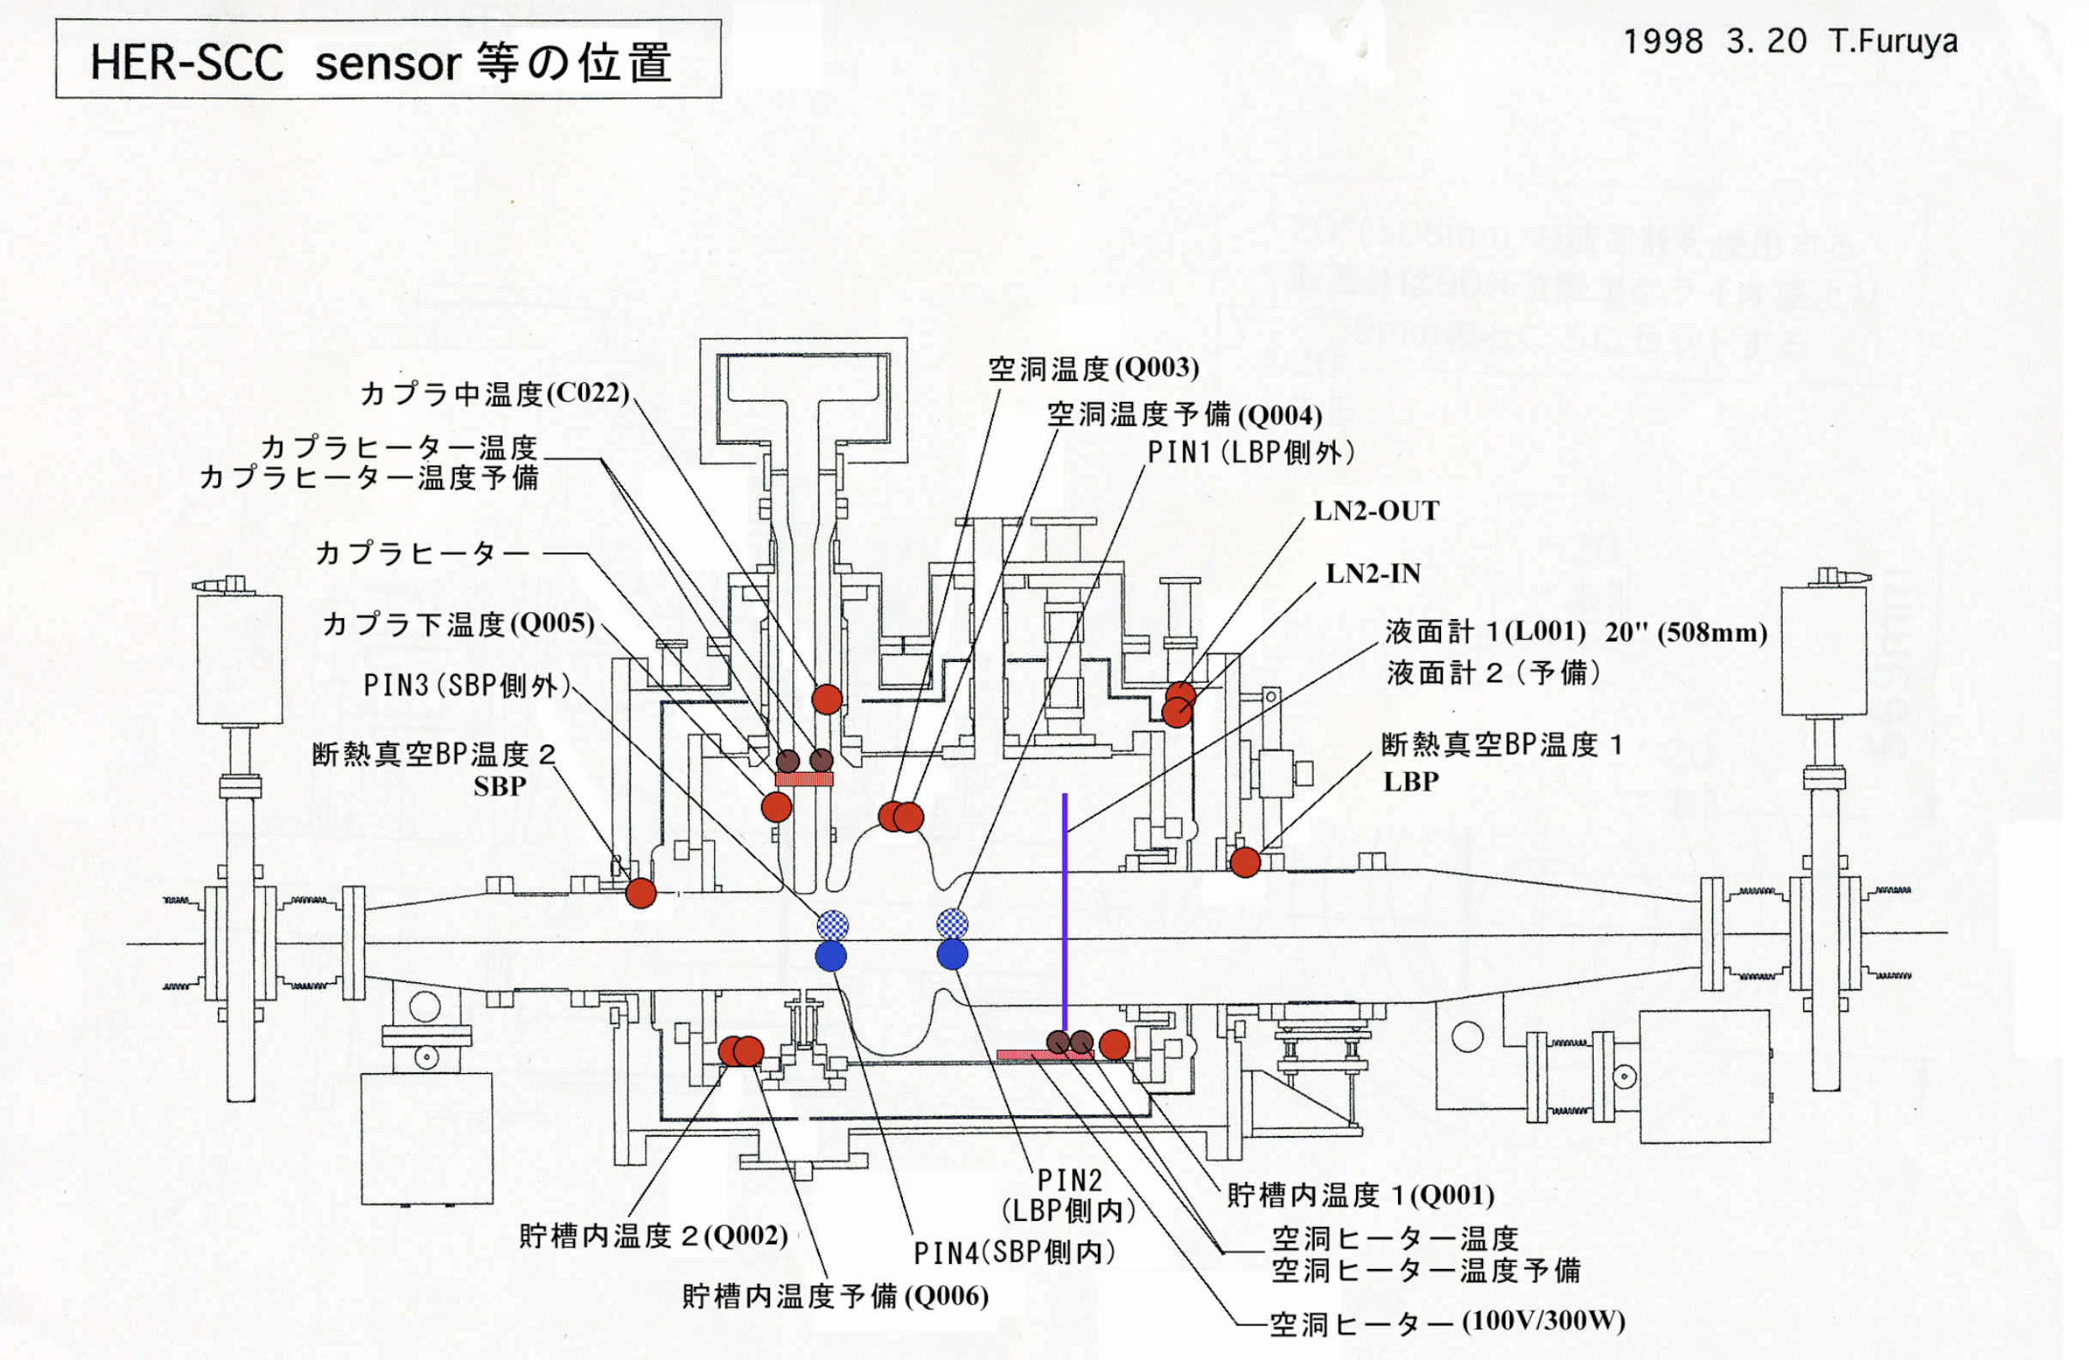
Routine maintenance is performed to mitigate trips
PIN diode
Four PIN diodes are installed at the iris section of each cavity. They are used for relative comparison of the increase and decrease of field emission in each cavity.
The effect of conditioning is also checked using the electron detector and pressure gauges, such as the coupler vacuum gauge, cavity vacuum gauge, and ion pump.

Slide 9
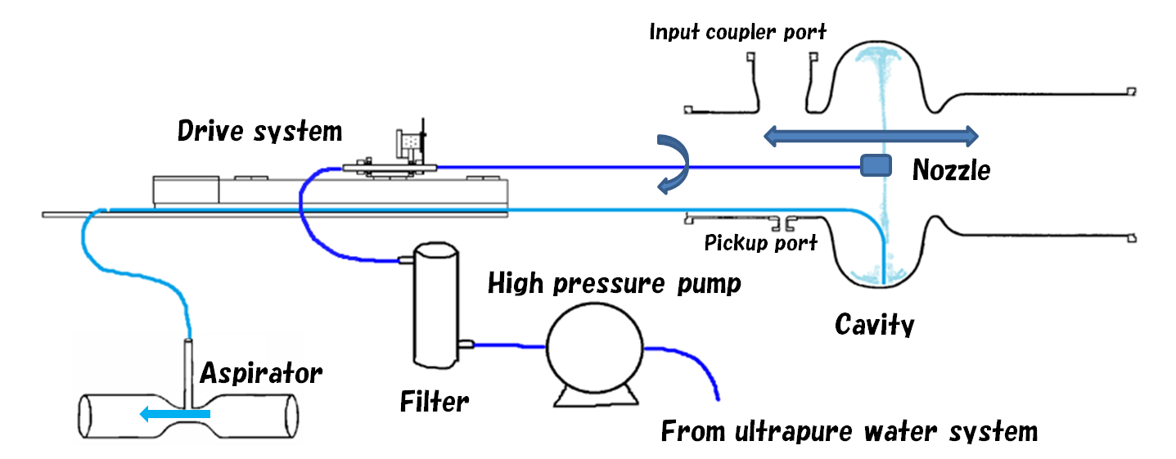
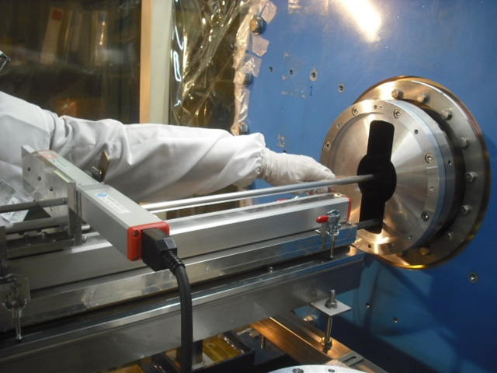
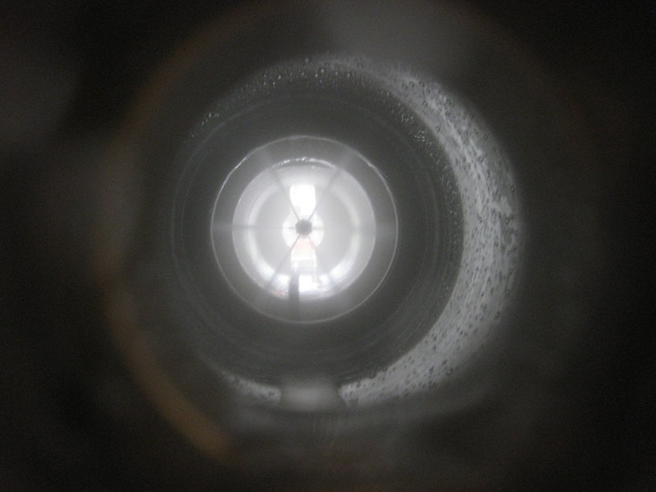
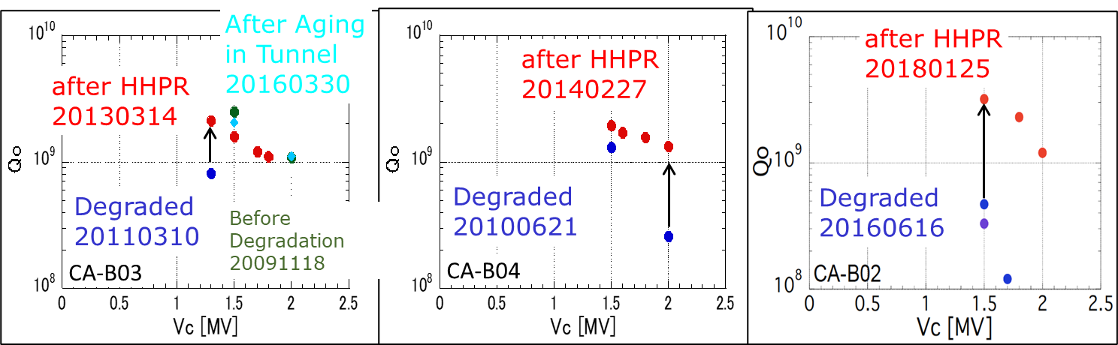
Performance recorvery using Horizontal High Pressure Rinsing
However, cavity vacuum leaks cause unacceptable performance degradation.
High-pressure rinsing is an effective treatment for mitigating field emission.
A horizontal high-pressure rinsing system was developed to perform HPR without disassembling the module (Y. Morita).
The treatment has been applied three times to cavities actually installed in the ring, and performance recovery was achieved in all cases.
This treatment makes it possible to recover cavities whose performance has degraded beyond what can be restored by conditioning, without requiring additional surface treatment.
HHPR Parameters
Water Pressure | 7 MPa
Nozzle | Φ0.54mm x 6
Driving speed | 1 mm/sec.
Rotation speed | 6 deg./sec.
Rinsing time | 15 min.
Y. Morita

Slide 10
Statistics of cavity trips during operation
During the whole operation period, the trip rate of SRF system is small and is not a main cause of downtime.
Multipacting rate becomes larger depending on the accumulated operation time. Piezo breakdowns were much reduced by humidity countermeasures.
Mean Time Between Failure is more than 10 days. This is not bad, but further efforts are necessary to reduce the number of failures.
We would like to continue conditioning and more detailed analysis for high current and long term operation of SRF cavity.
Beam Aborts caused by | Recovery time | 2019 | 2020 | 2021 | 2022 | 2024 | 2025 | 2026
MP in Cavity | 2-3 min. | 2 | 2 | 12 | 7 | 8 | 1 | 10
Piezo breakdown | < 1 hour | 6 | 5 | 1 | 0 | 5 | 0 | 0
Chiller failure | < 1 hour | 1 | 1 | 3 | 0 | 0 | 0 | 0
Others |  | 0 | 0 | 2 | 2 | 3 | 1 | 2
Total |  | 9 | 8 | 18 | 9 | 16 | 2 | 12
Trip Rate [/day/8 cavities] |  | 0.06 | 0.04 | 0.09 | 0.07 | 0.07 | 0.04 | 0.09
MTBF [days/8 cavities] |  | 16.5 | 22.5 | 10.9 | 13.4 | 14.6 | 24 | 11
Operation days |  | 149 | 180 | 196 | 121 | 233 | 48 | 132(-6.6)
Total number of beam aborts (>50mA, including LER single) *except injection tuning |  | - | ~650* | ~1100 | ~730 | ~1800 | ~109 | ~660

Slide 11
Detailed trip statistics
In the present 2026 run, the trip rate is kept low by maintenance conditioning once a month.
The trip frequency is not uniform, especially for D11A. This may be related to the fact that it is the oldest cavity.
In this run, RF was turned off several times by fake signals from the cryogenic system due to so old.
Overall, stable operation has been achieved.
D11A tends to have a larger number of trips.
No clear feature has been found during conditioning.
We are continuing the investigation based on detailed analysis and statistics.

Slide 12
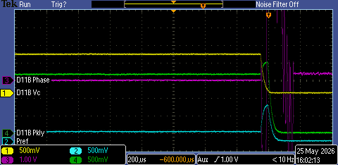
Diagnostics of each trip
Voltage
The types of trips include:
  Cavity breakdown
  Multipacting
  Coupler discharge
  Tuner failure
  HOM damper chiller failure
  LLRF trouble
  Klystron and high-power system trouble
  Cryogenics trouble
Analog output signals are monitored using oscilloscopes and long-range loggers, and the type of trip is identified and recorded based on the time sequence of the signals.
Throughout SuperKEKB, diagnosis and classification of abort causes are being carried out with the aim of reducing dead time in the overall accelerator operation.
This is an example where the cavity voltage suddenly dropped, and the breakdown detector detected it. The abort and RF-off were performed normally.
At the same time, the pressure in side the cavity slightly increased. Therefore, this event is considered to be multipacting inside the cavity.
In the case of LLRF trouble, there was an event started to change several hundred milliseconds before the trip.
Long range logger (before 1 sec.) is used for trip diagnosis.

Slide 13
Summary
SuperKEKB aims to achieve extremely high luminosity by using the nano-beam scheme and high-current operation.
The RF system is being continuously upgraded to handle the increasing beam power.
SRF system has operated stably so far, with a low trip rate.
Superconducting cavity performance can degrade over time or due to leaks, but HHPR is effective for performance recovery.
The 2026 operation is ongoing, and the RF system will continue to be upgraded for higher beam current and higher luminosity in SuperKEKB.
For each RF trip, signals are recorded to diagnose and classify the trip. This trip-recording system is mainly used to identify the cause of problems and prevent aging-related issues from becoming more serious. It also helps separate RF-system problems from other possible causes, enabling more efficient troubleshooting.
Statistics and classification of breakdowns for each cavity will be studied in more detail.
The causes of cavity-dependent breakdown behavior will be investigated. Since the trip rate shows cavity-to-cavity variation, the origin of these individual differences needs to be clarified.
Long-term operational data will be continuously monitored to understand aging effects and identify potential issue of SRF cavities for high current machines.
Notes:
What is the best strategy for maintenance conditioning in long-term SRF operation?
How should cavity dependent trip behavior be evaluated and classified?
What diagnostics are most useful for identifying early signs of aging related failures?

