Slide 1
Particles measurement of beam line gate valves
VACHER Thierry
SERVOUIN Christophe
DRANT Julien
BERRY Stéphane
2026/06/10

Slide 2
Context:
In particle accelerators, cryomodule beam valves play a very important place, I will try to present the work we have done at CEA Saclay at LIDC2, DACM laboratory.
We will also try to answer the questions that were asked by ESS on the creation of particles when closing / opening these valves.
ESS: Influence of air pressure of the pneumatic actuator on particle generation?
PIP-II : prepare ourself to get clean valves for pre-serie cryomodule
        ESS
          Material
          Test under vacuum
          Test at atmospheric pressure
        PIP-II
          Cobot cleanning
          evaluations of particle levels per cycle
Outline:

Slide 3
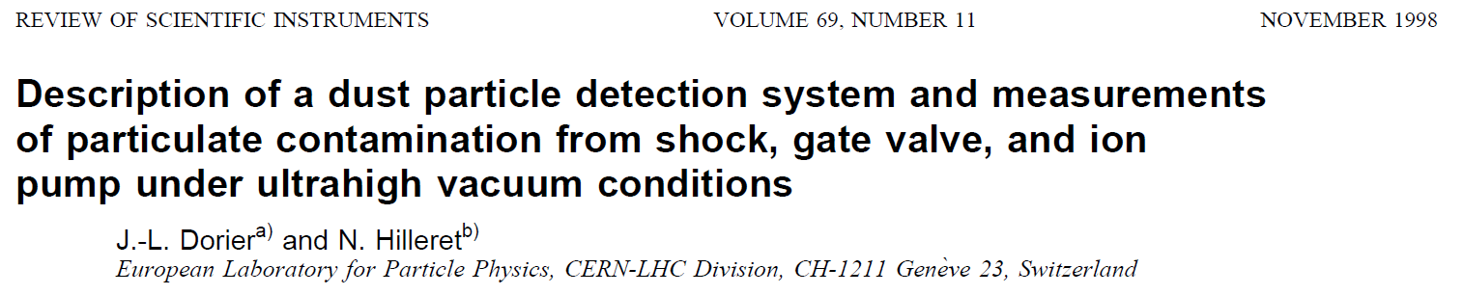
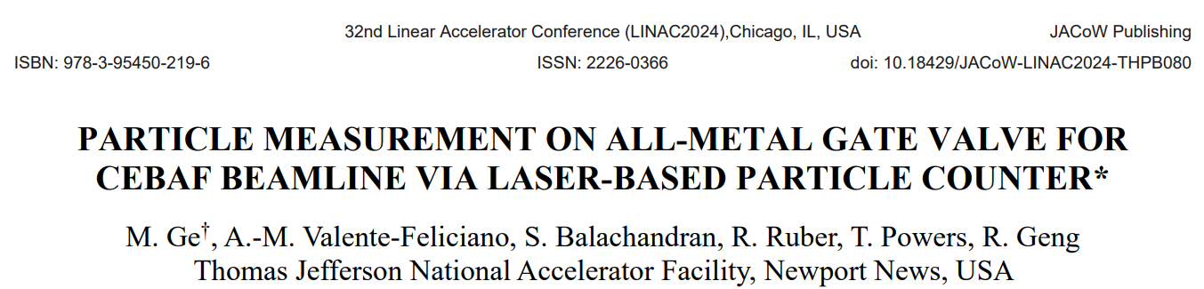
History
The community knows that all-metal valves are a superior choice for long-term applications compare to Viton gate valve.
This evidence comes from CERN work
And more recent work from JLAB
ESS and PIP-II projects selected all-metal gate valves

Slide 4
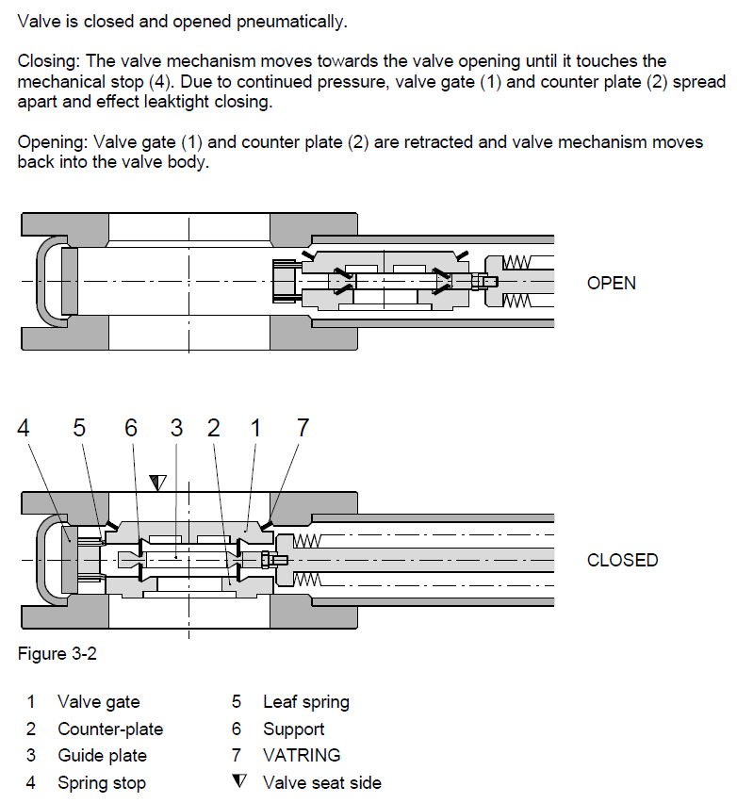
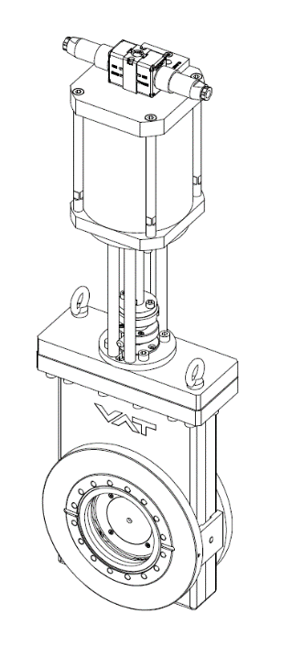
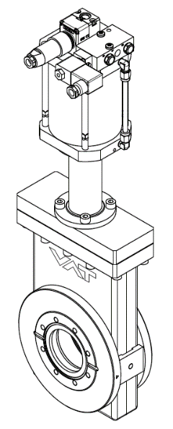
All-metal valve :
VAT Valve 48 series

Slide 5

In Vacuum Particles counting for ESS Project
2026/06/10
Ord. N°: 48240-CE24 - DN100CF

Slide 6
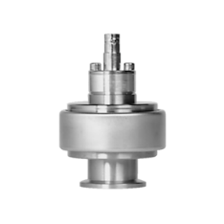
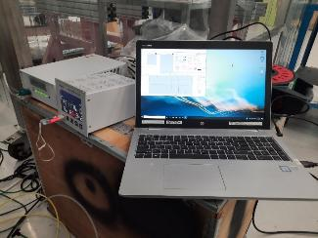
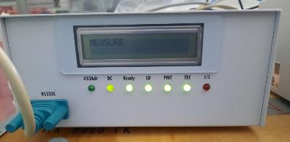
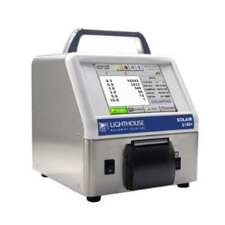
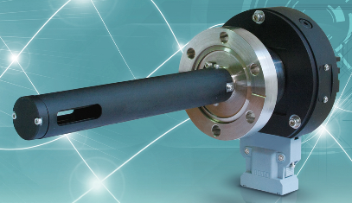
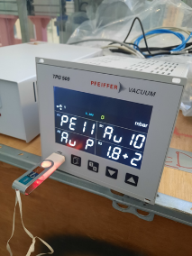
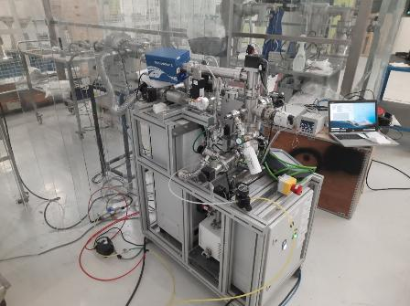
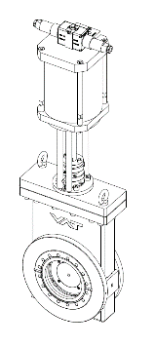
Material :
VAT Valve 48 series
Vacuum particle counter.
Classical particule counter.
Slow venting/pumping cart.
Vacuum gauge.
Assembly area ISO5

Slide 7
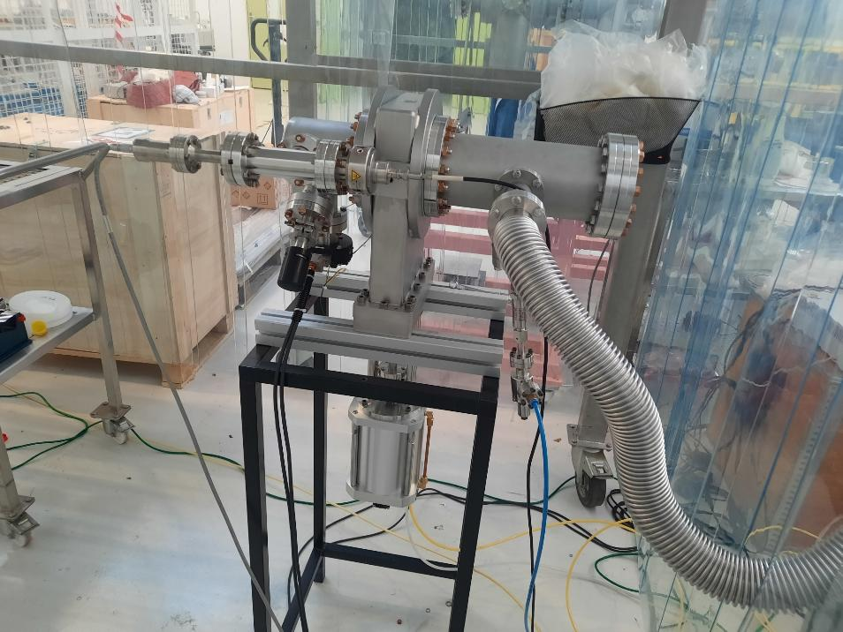
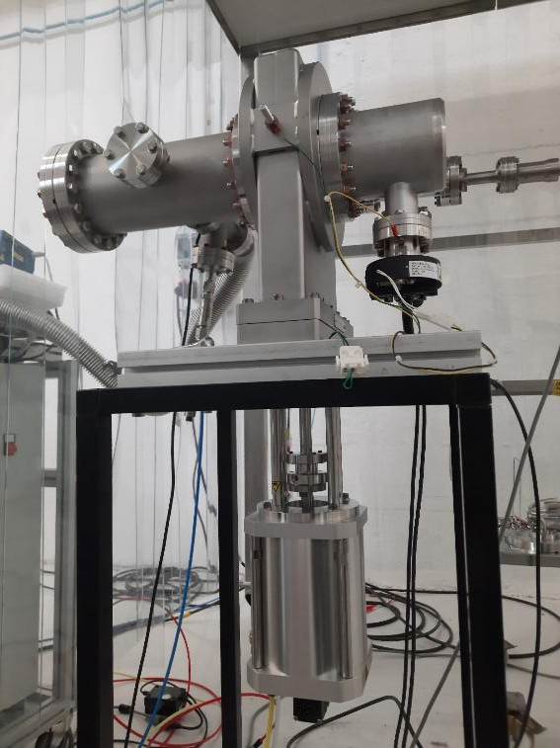
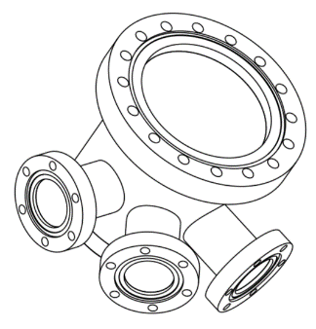
Photos :
IKR60
VAT valve
Relief valve
ESS pumping cross
Valve seat side near to particle counter (counter same as cavity side)

Slide 8
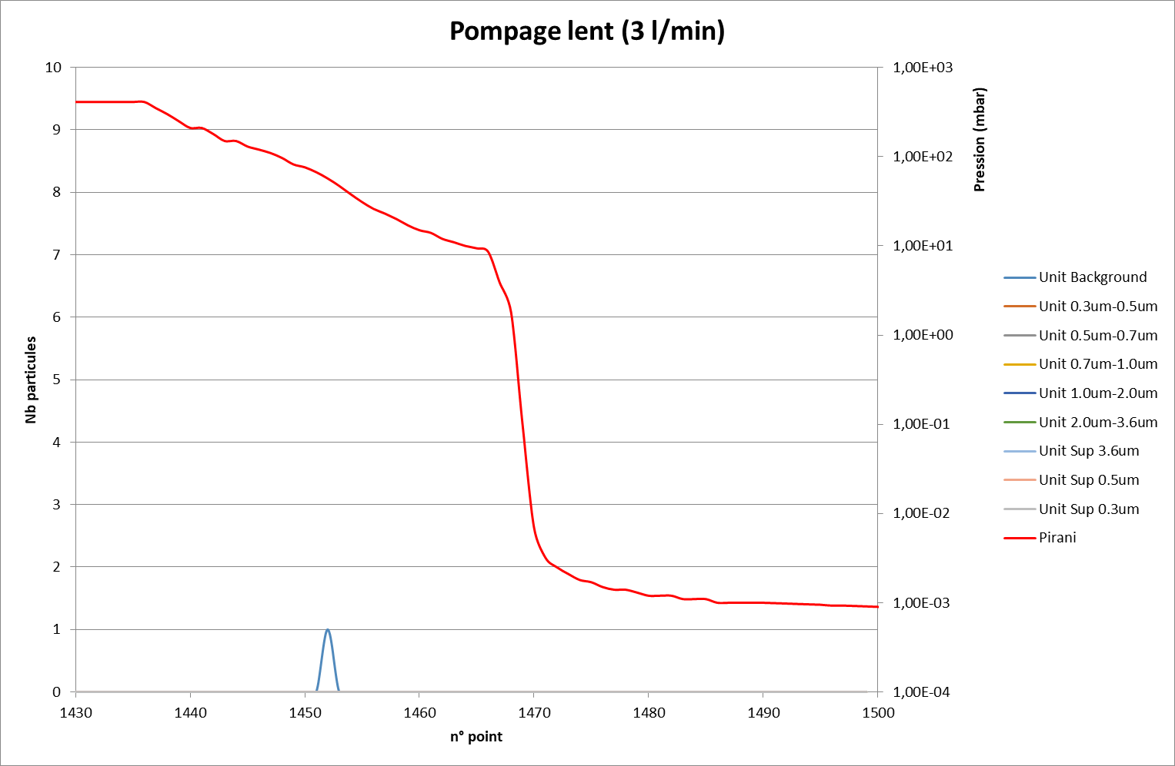
Pumping down with 3 l/min of a clean system (pumping cross):
Pressure (mbar)
Pressure (mbar)
Particles counts
BG
Background signal means particle size < 0,3 μm
records (~seconds)

Slide 9
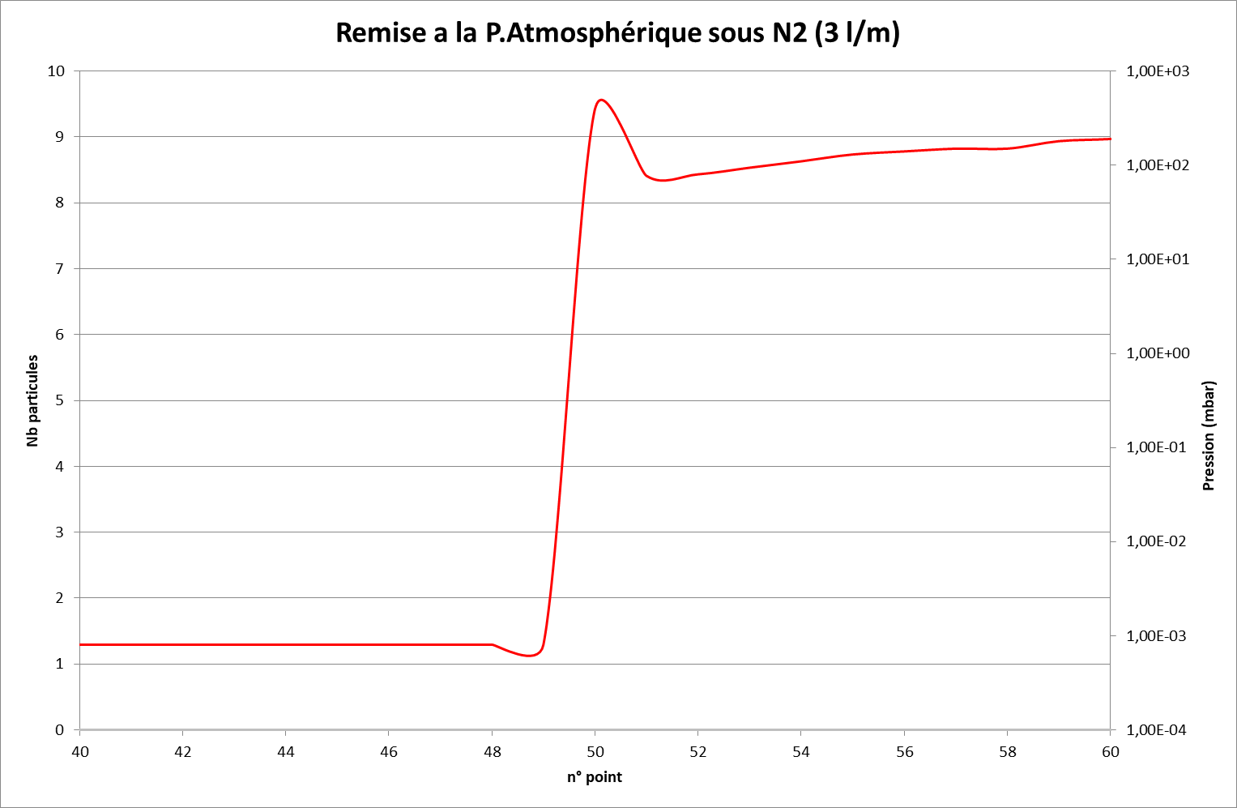
Venting to atmospheric pressure at 3 l/min with nitrogen of a clean system:
No particle during the venting to atmospheric pressure.
Particles counts
Pressure (mbar)
Pressure (mbar)
records (~seconds)

Slide 10
Test under vacuum
typical Opening / Closing cycle :
Background signal means particle size < 0,3 μm
Here one cycle among 20
We mesure about 100 particles > 0,3 µm, at the opening of the valve.
Valve’s manufacturer announces between 100 and 1000 particles of size greater than 0.3µm
.
Particles counts
Pressure (mbar)
Pressure (mbar)
records (~seconds)

Slide 11
Test under vacuum
5 (Opening/Closing) for each pressure
We repeat with pressure of compressed air beetween 3 and 6 bars.
About 20 sec. interval between each actuation of the gate valve
Particles counts
Under vacuum, there is no difference in the number of particles or their distribution depending on the pressure applied to the actuator.
records (~seconds)

Slide 12
Test under vacuum
5 (Opening/Closing) for each pressure
Different view of same datas presented in cumulative view.
Maximal size measured is 2 µm
Total particules amount in the system ?
Particles counts
records (~seconds)

Slide 13
Test at the Atmospheric Pressure
We only see particules when we open the valve.
The Nitogen flow doesn’t create particles, no particles observed when flushing;
does it clean ?
The slow rise after opening up to 45000 particles suggests a particles fog,
including particulates >3.6µm
Particles counts
venting
records (~seconds)

Slide 14
Testing after cleaning :
After all these tests we have decide to disassemble the pumping cart and all the components for cleaning.
We have applied to the VAT valve the cryomodule assembly procedure.
  (one difference in ISO 4 the gate valve full cleaning occurs after « Mounting Manual Mecanism »).
All the components have been clean again and mount on the system.
Pumping down.
Start counting again.

Slide 15
Test after typical cleaning
Particles counts
Under vacuum
Clean room config
As in clean room
Door openning
Full cleaning occurs here during string assembly

Slide 16
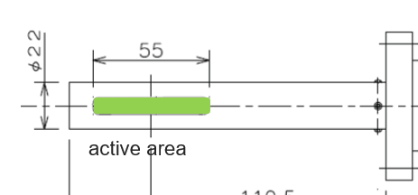
Test at Atmospheric pressure VAT Valve Open With / without Nitrogen flow
Particles counts
10 L/min Nitrogen flow doesn’t
drag particles.
The active volume of the detector is limited
Pressure (mbar)
records (~seconds)

Slide 17
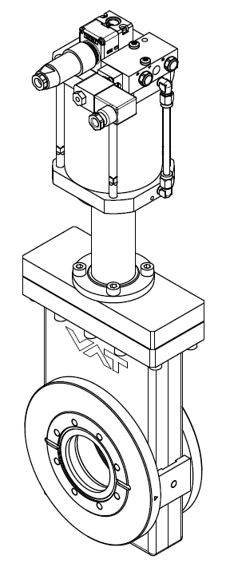
Air borne Particles counting for PIP-II Project
2026/06/10
Ord. N°: 48236-CE44 – DN63CF

Slide 18
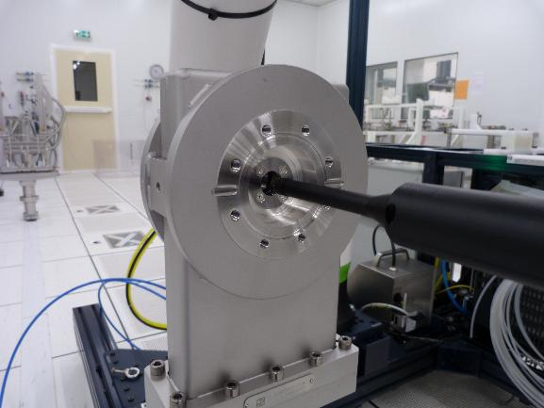
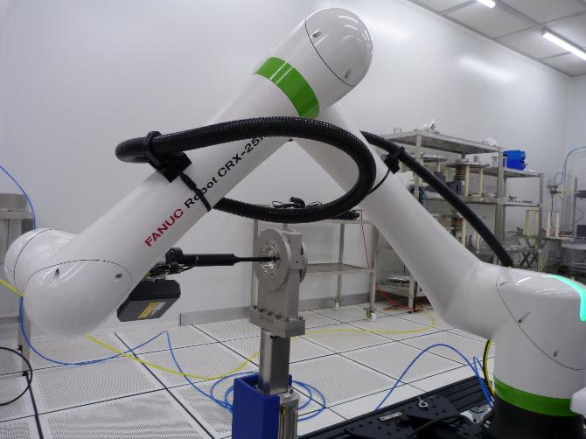
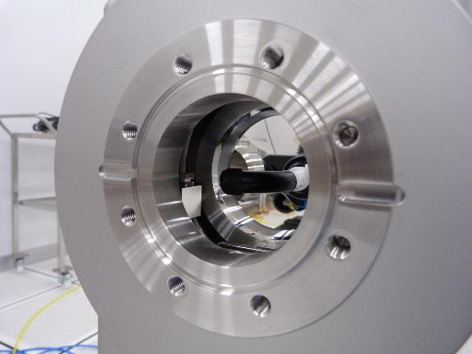
Cobot program for cleaning the VAT gate valve

Slide 19
Checking the effectiveness of the valve cleaning
Cycling the valve close/open
  About 3000 particles of 0.3 µm or bigger are blown out of the valve
  If the valve is clean, repeated valve operations followed by purging do not help remove particles.
few particles detected after the cobot cleaning
  Force of the Mykrolis (filtered air gun) used for the control is bigger than the robot force
  Still need of operator blowing for control (about 5-10 min)

Slide 20
Conclusion :
The are not so many VAT datas concerning the number of particles created during open / closing the valve (100 to 1000 particles > 0,3 μm), under vacuum (Data from 2016 VAT catalogue).
We measure around 100 particles > 0,3 μm per cycle (open/close) for serie 48 (but see JLAB data).
Concerning the pressure of the pneumatic actuator (VAT requirements are between 3 and 6 Bars), we considered that the influence of this pressure is not significant for particle generation point of view.
We advise to limit the number of closing/opening cycles.
The Nitrogen blowing with 10 litres per minute doesn’t drag particles.
Cobot cleaning of gate valve is efficient
Cryomodule assembly while beam vacuum is kept under vacuum (2µm versus >3.6 µm)?

Slide 21
Additional slides

Slide 22
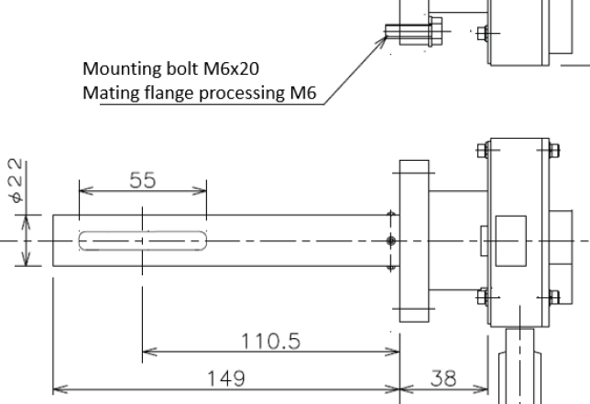
Wexx sensor
active area

Slide 23
REVIEW OF SCIENTIFIC INSTRUMENTS VOLUME 69, NUMBER 11 NOVEMBER 1998
Description of a dust particle detection system and measurements of particulate contamination from shock, gate valve, and ion pump under ultrahigh vacuum conditions J.-L. Dorier and N. Hilleret (CERN) : The number of released dust particles bigger in size than 0.5 mm is about 300 at opening and 150 at closing on average.
JLAB paper about gate valves installed in the CEBAF beamline (M. Ge, A.-M. Valente-Feliciano et al. (JLAB)
    Compare Viton and all metal: metal are superior
    evaluations of particle levels Viton more than 5 per cycle/ All metal less than 1 or 2 particle/cycle (depends on type)
    aging evaluation (over 1000 cycles)
    and analysis of the particle material (steel
    and Al-Mg alloy)
Wexx sensor
VAT 47.2 XHV RF All-Metal

Slide 24

Material :
Air borne particle counter (SOLAIR 3100) :
  $≥$0.1 µm
  1.0 CFM (28.3 LPM) flow rate
  Particle collected through the isocinetic probe and tube
Vacuum particle monitor (Developped by Wexx company)
  Principle: laser scattering / CCD
  Resolution: 0.3～3.6 µm
  Vacuum pressure:∼10-6mbar
  particles via the sensitive area (1.25 cm²) can be measured

Slide 25
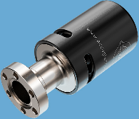
Material :
Vacuum gauge: Pfeiffer IKR 060.
Adjustable pressure relief valve:
Lewvac 2 psi
316L VAR UHP Inline Gas Filter, SC-01 Cleaned, 30 L/m | Swagelok
  Removal rating >99.9999999 % at 0.003 µm
Slow pumping slow venting cart (CEA design):
  Venting 3 lpm nitrogen.
  Pumping at 3 lpm down to 7 mbar
Assembly area certified ISO5 (2025)

Slide 26
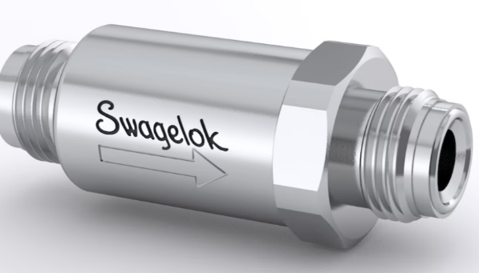
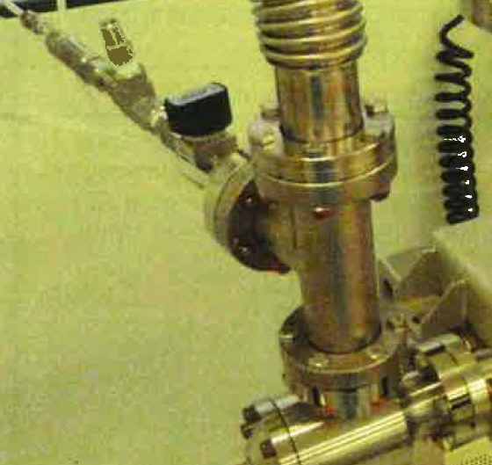
SWAGELOK FILTER
316L VAR UHP Inline Gas Filter, 3 in. (76.2 mm), 1/4 in. Male VCR Fitting, SC-01 Cleaned, 30 L/m | Swagelok
316LN material
Removal rating >99.9999999 % at 0.003 µm
Maximum Flow Rate | 30 std L/m
Swagelok filter installed on the pumping flex hose during XFEL time
Nitrogen pumping
Part to flush

