Slide 2
ESS Field emission experience
From module tests in test stand to first and second commissioning in ESS linac
PRESENTED BY cecilia Maiano
On behalf of LINAc team and ess colleagues

Slide 3
Agenda
Cryomodule Test Stand - TS2 - Test plans and FE measurements -
2 TS2 FE experience Radiation map Cavities activation (and not only) “Global Arc” experience
First Beam on Dump Run - BOD1 - experience Radiation form cavities/Radiation from beam losses “Global Arc” events
Second Beam on Dump Run - BOD2 - experience Radiation form cavities/Radiation from beam losses “Global Arc” events Cavity recovery strategy
5 Conclusions

Slide 4
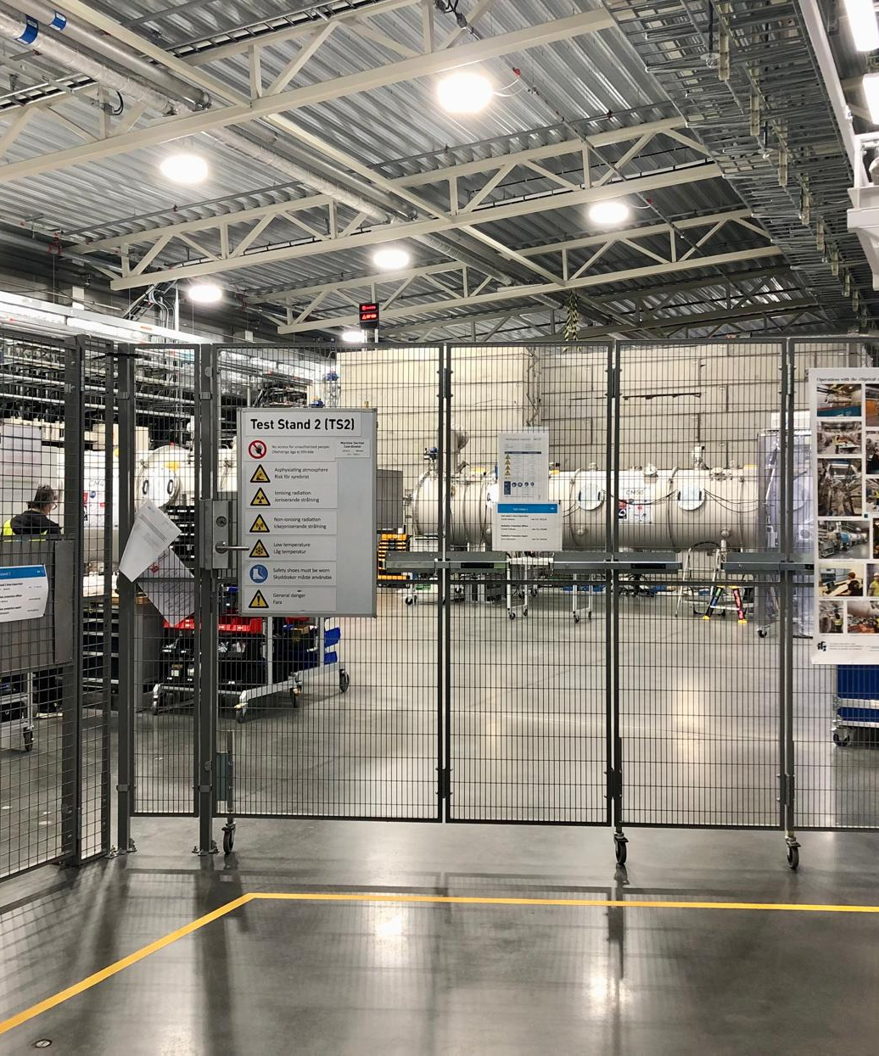
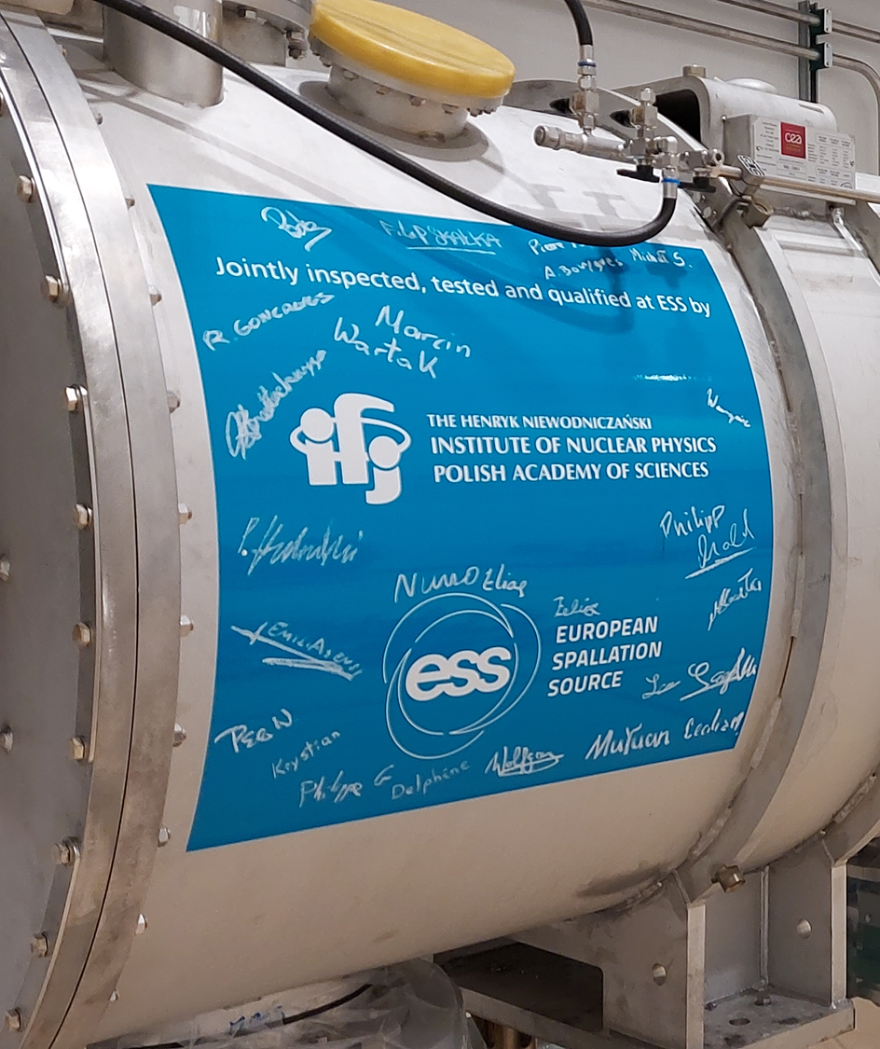






1
Cryomodule Test Stand - TS2 -
+

Slide 5
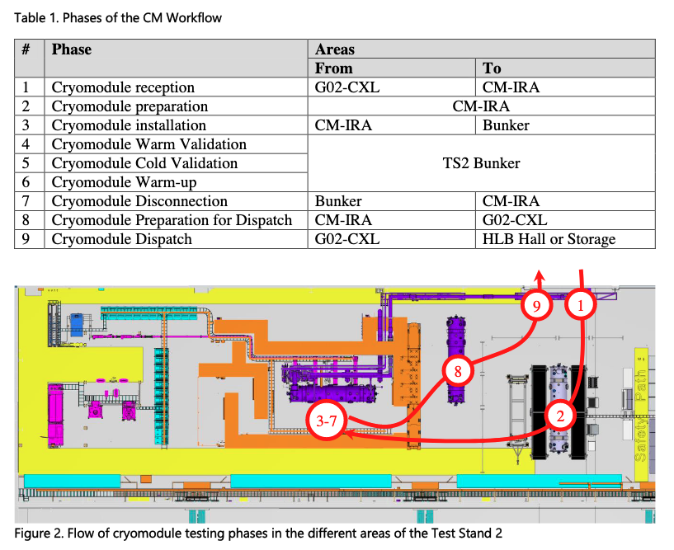
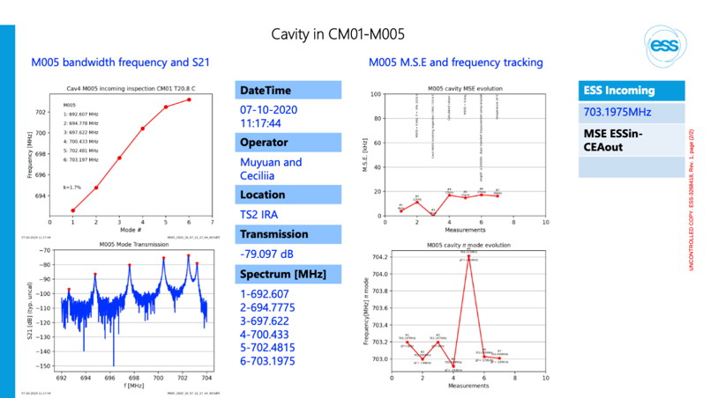
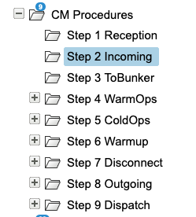
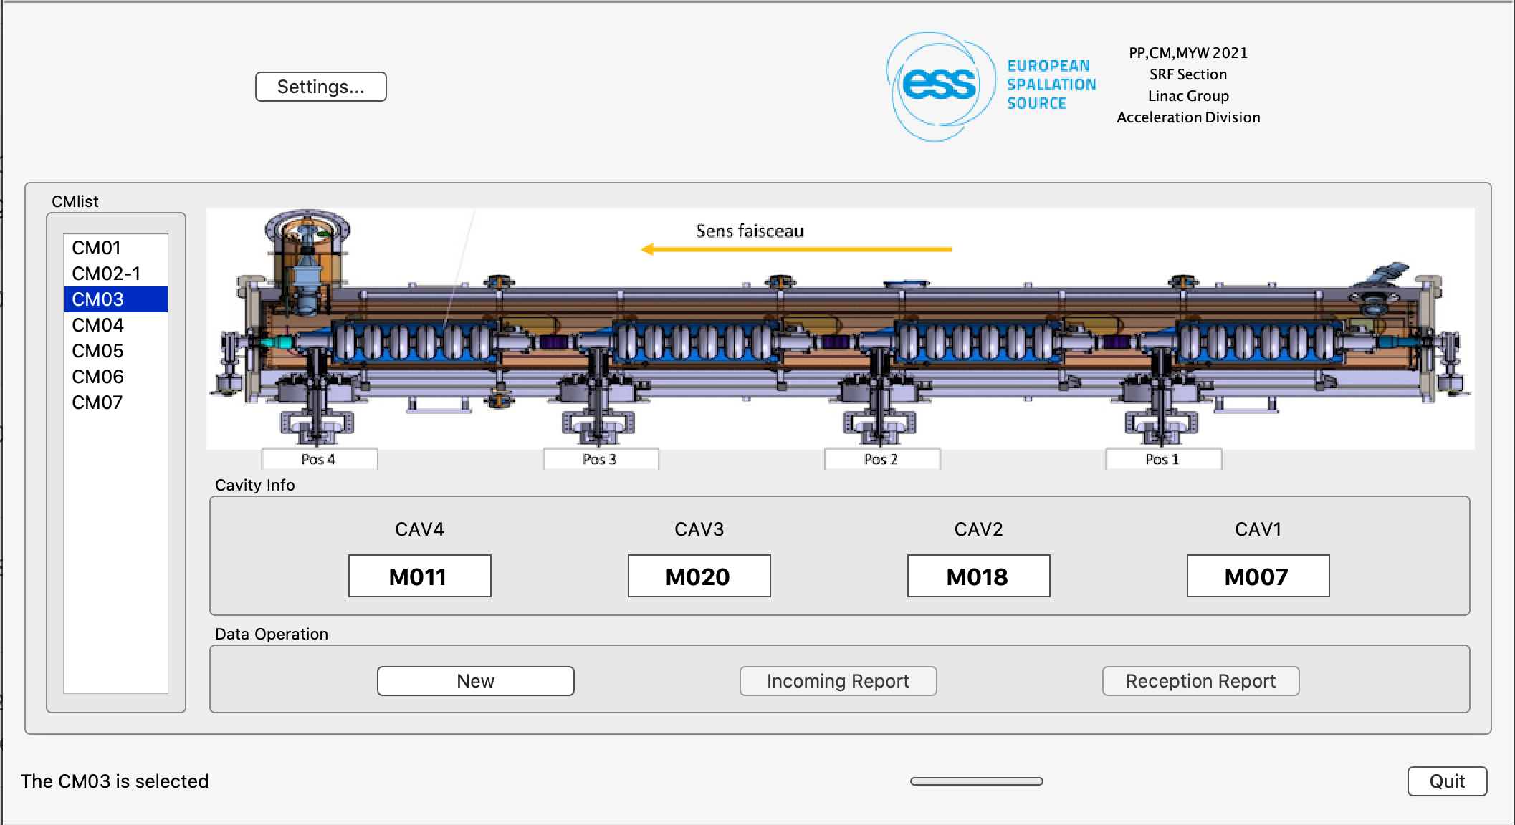
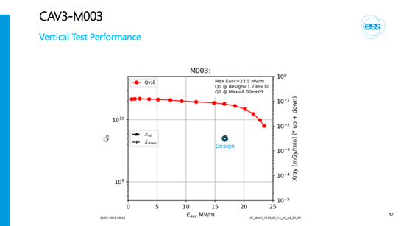
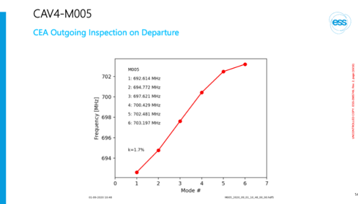
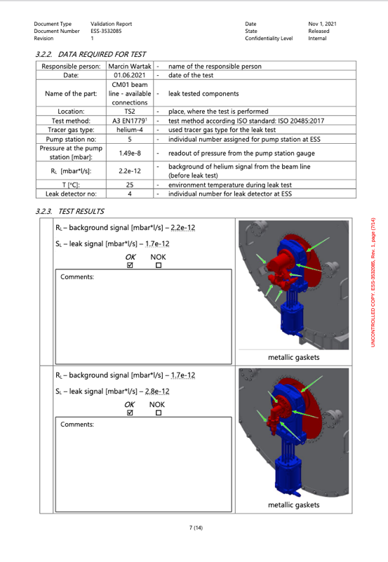
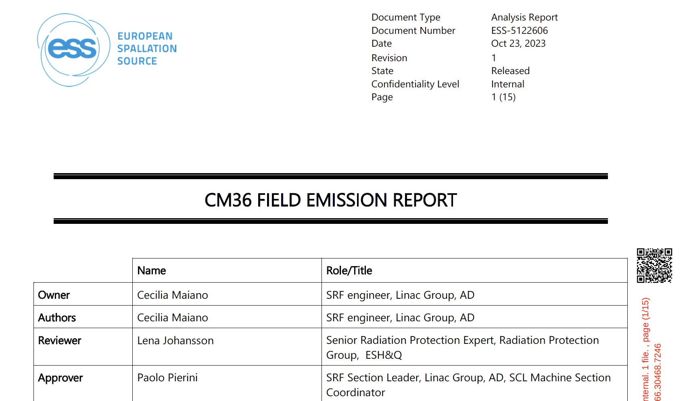
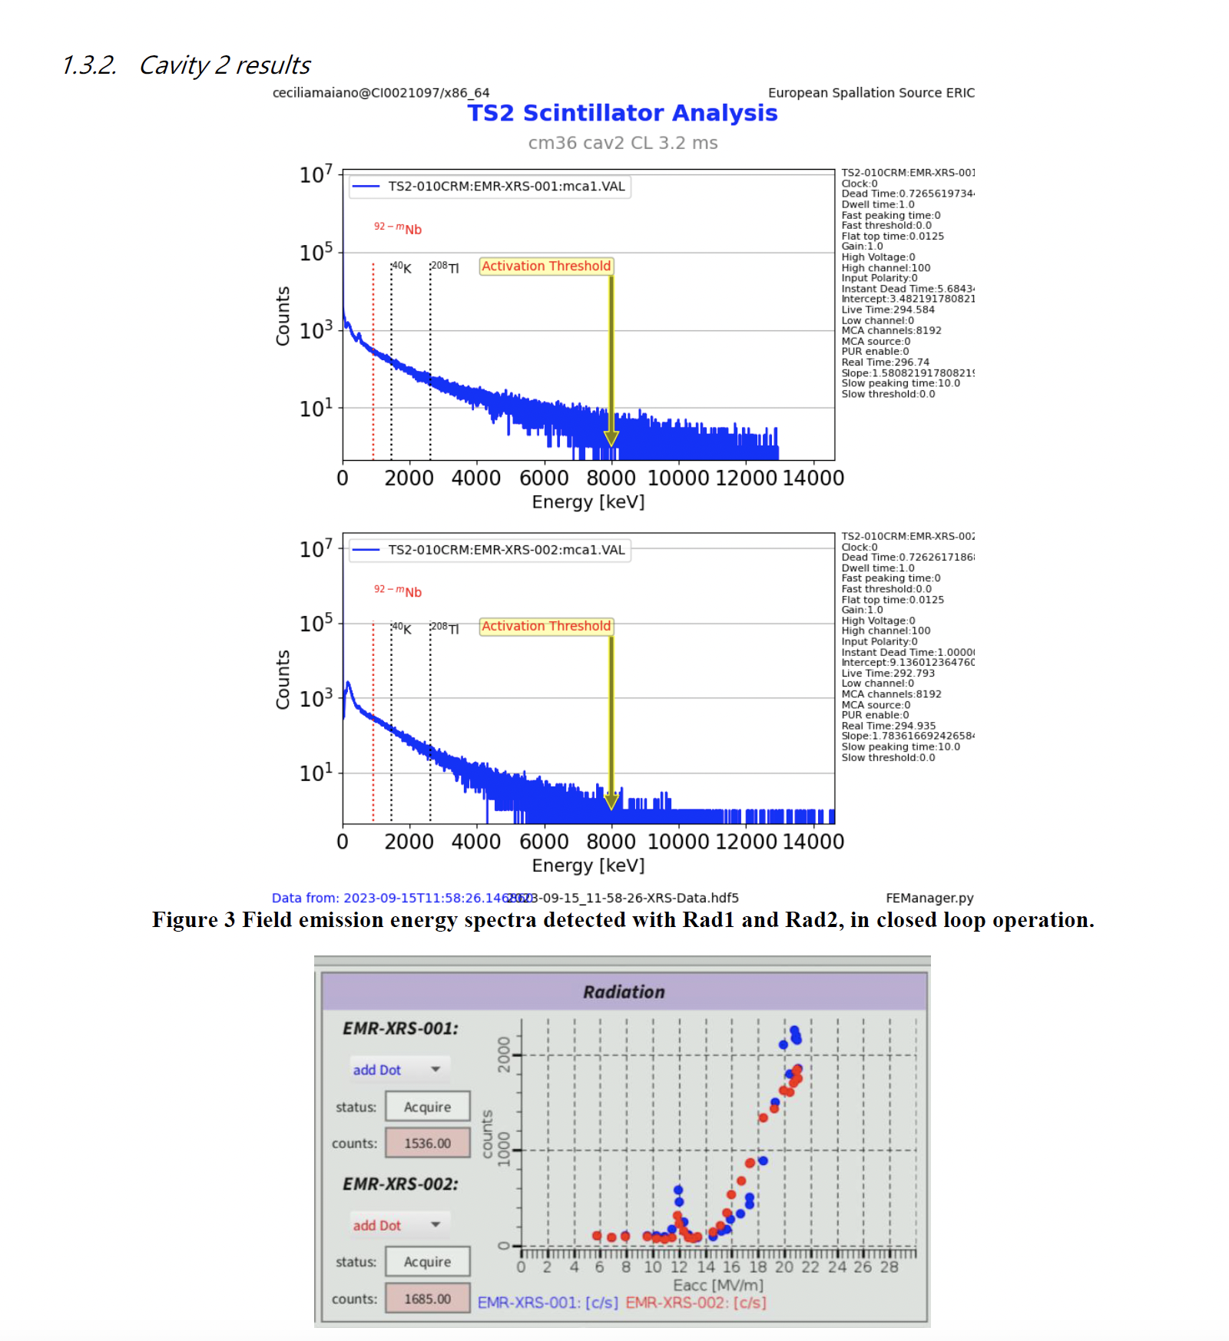
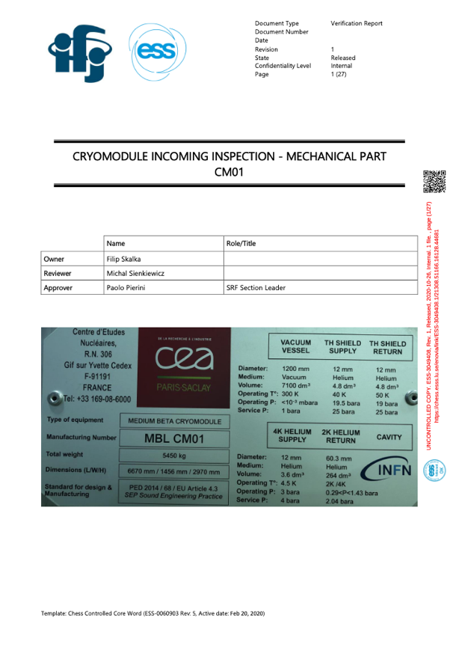
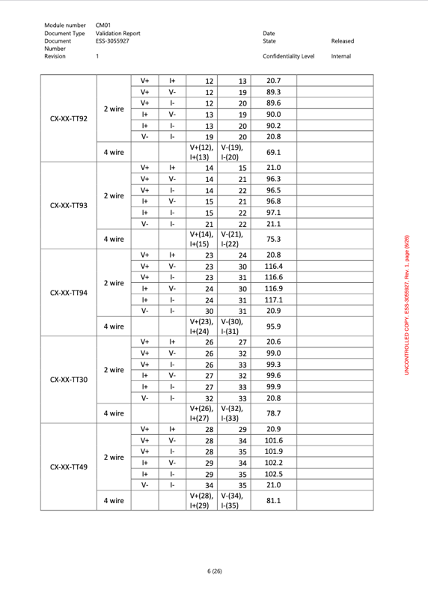
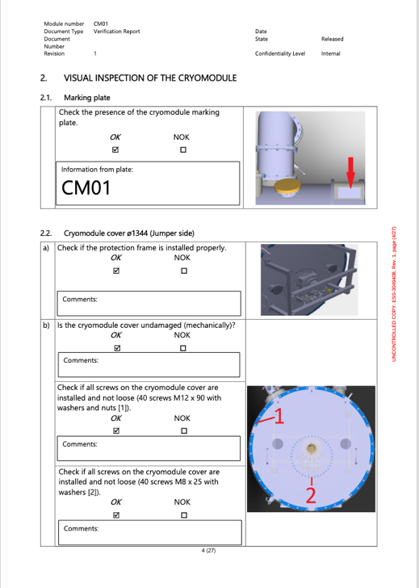
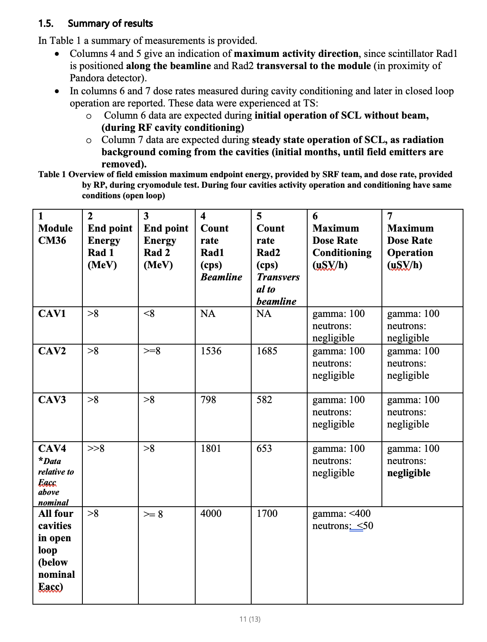
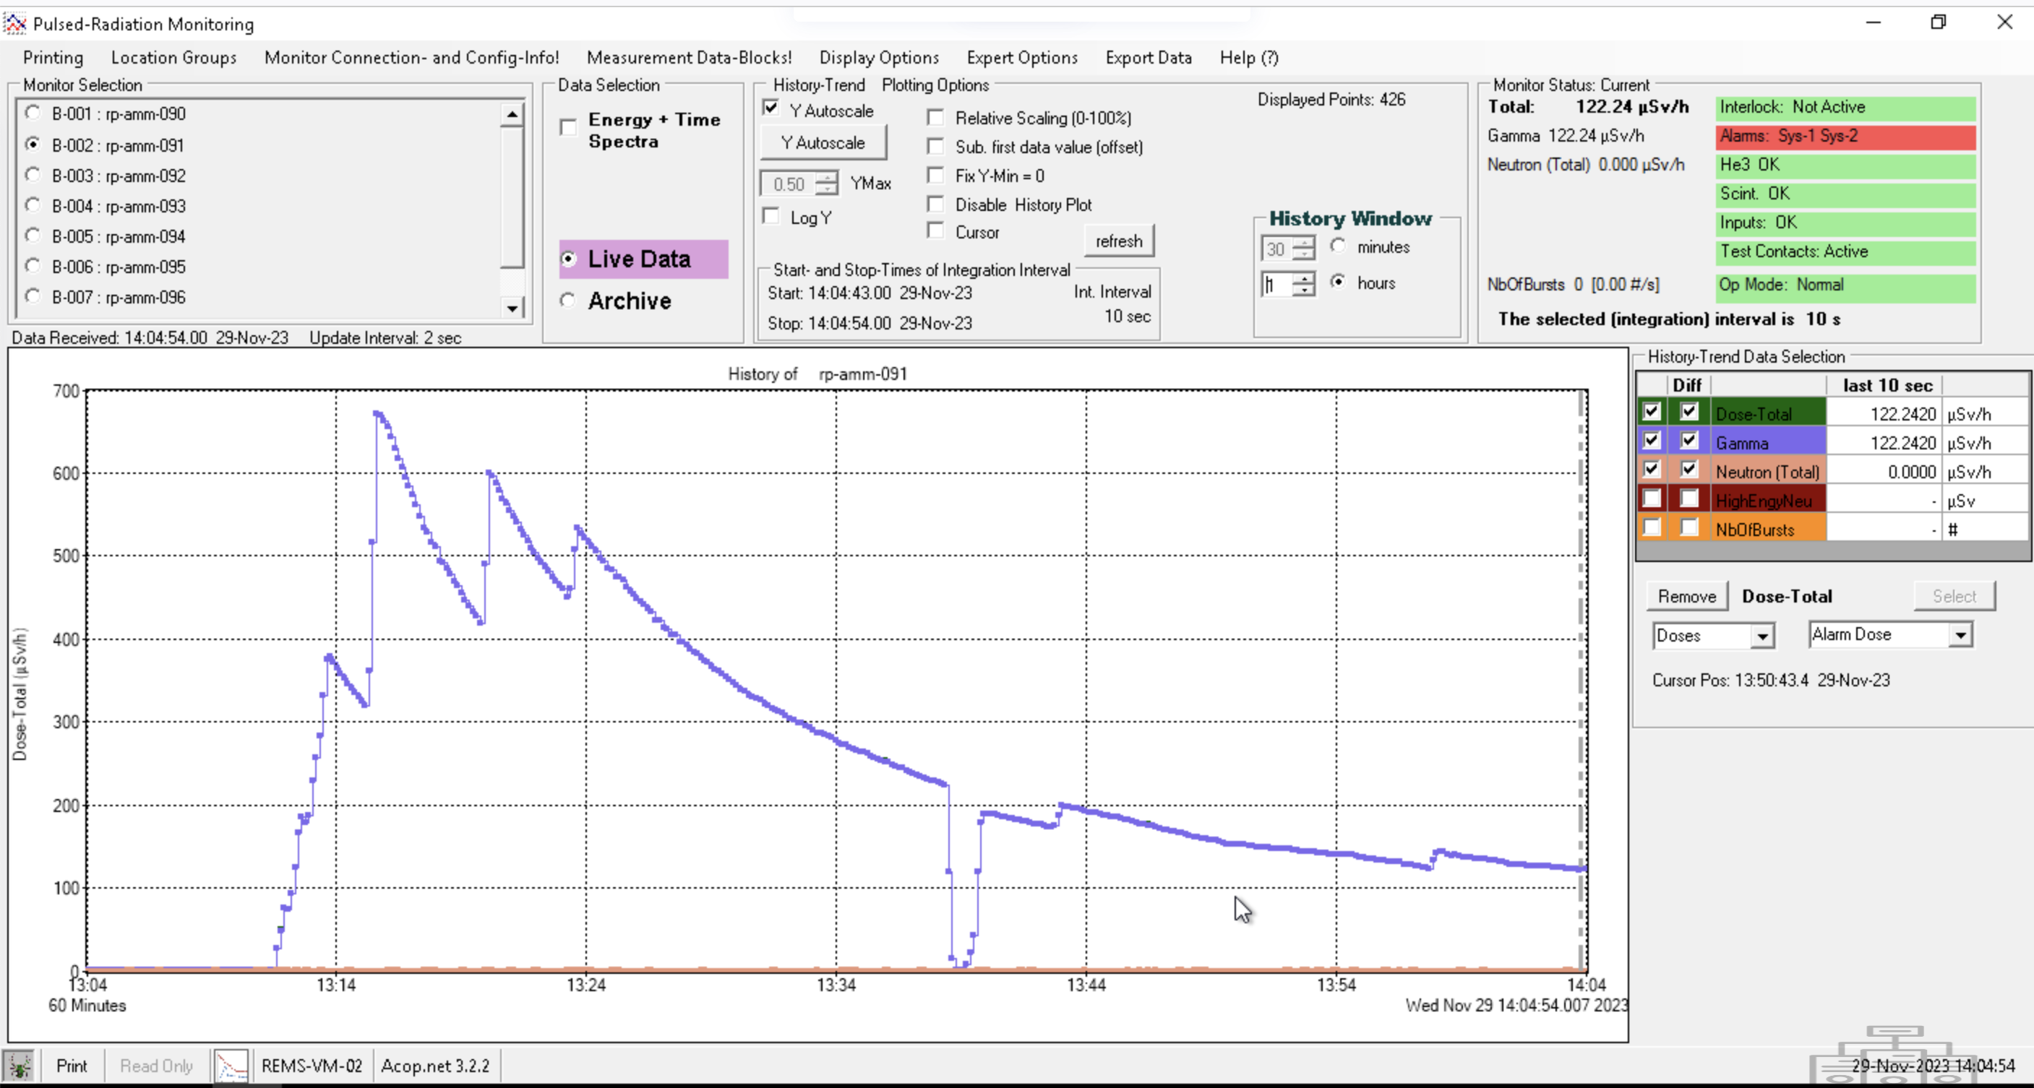
TS2 cryomodule test stand: the workflow
Site Acceptance Test of CM
The workflow and test is split in phases
CM lifecycle is intensively documented
  Cryomodule Assembly from (INFN/STFC) CEA
  Cryomodule testing phase (Mec/Vac/Cryo/SRF)
SRF
  Dedicate FE reports
After first HB cryomodule test (CM31) RP surveys have been agreed
Daily during HB CM operation 3-7
Before moving CM from RP Supervised Area
(< 3 uSv/h) to Storage white area (< 0.5 uSv/h) 8
Mechanical
Vacuum
Electrical
Field Emission

Slide 6
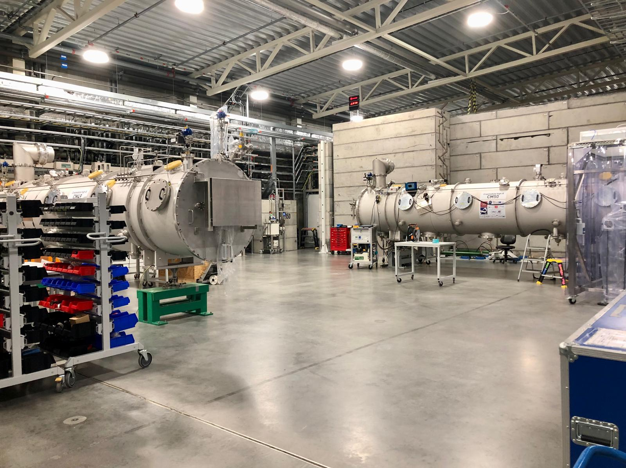

Slide 7
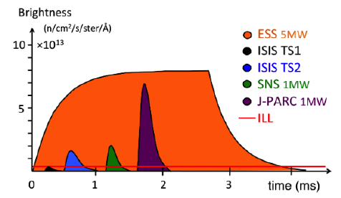
TS2 cryomodule test stand
ESS is a long Neutron pulse
Neutron pulse: 2.85 ms
RF pulse for cavities: ~ 3.2 ms
Elliptical cryomodules RF test phases
Off resonance
Incoming inspections + connections in bunker
Warm Coupler conditioning
Cool down (4K)
Cold coupler conditioning
Cold cable calibrations
Tuning to resonance
On resonance (in parallel dynamic heat loads)
Gradient calibration (kt CM)
Cavity conditioning in open loop (up to 0.5 ms, up to limiting gradient)
Cavity operation in closed loop (ramp up to 3.2 ms, piezo-assisted for HB, up to Limit/Admin)
Dynamic Heat loads at nominal operational parameters
Off resonance (again)
Detuning + warm up + disconnections + radioprotection surveys (before moving modules from supervised area)
warm
cold
Phases when potentially ionizing radiation happens
MBL
HBL

Slide 8
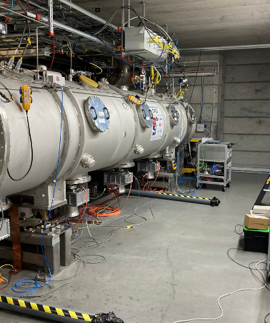

2
TS2 FE experience

Slide 9
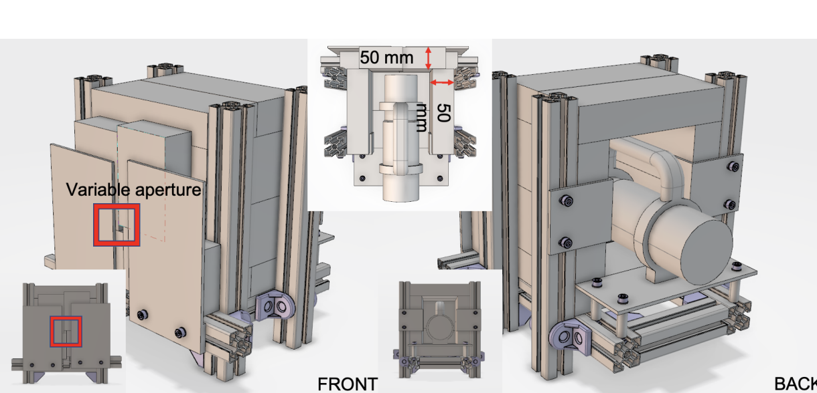
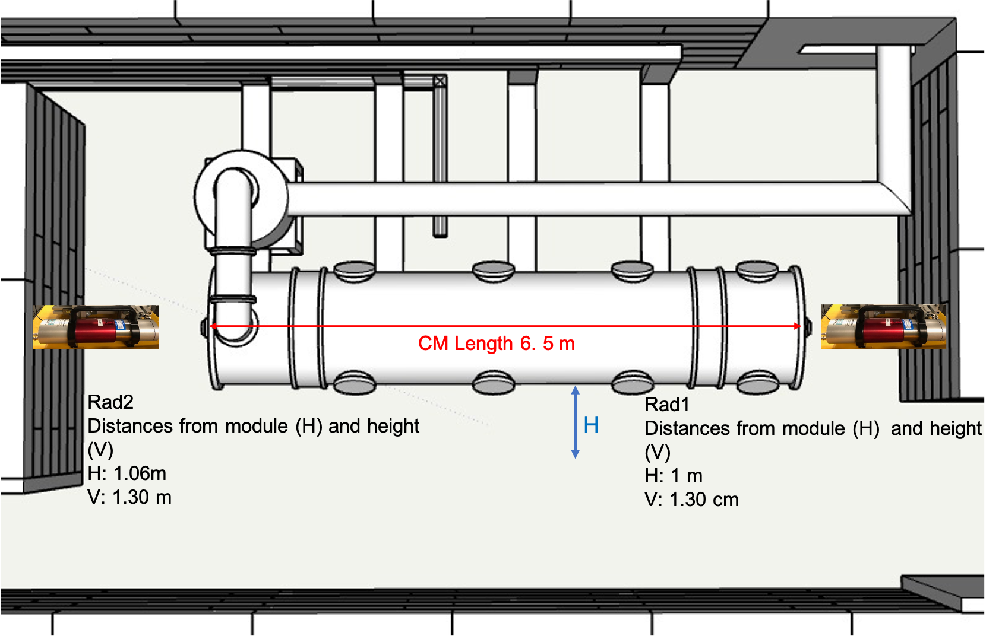
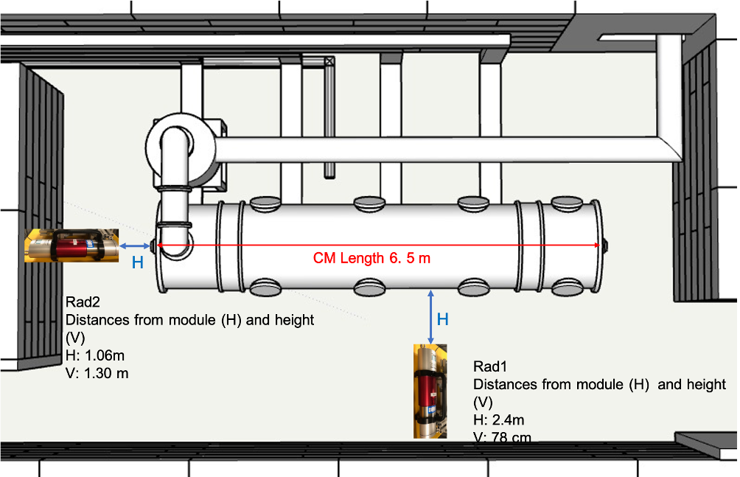
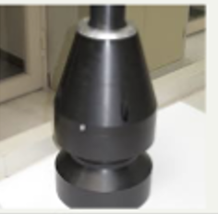
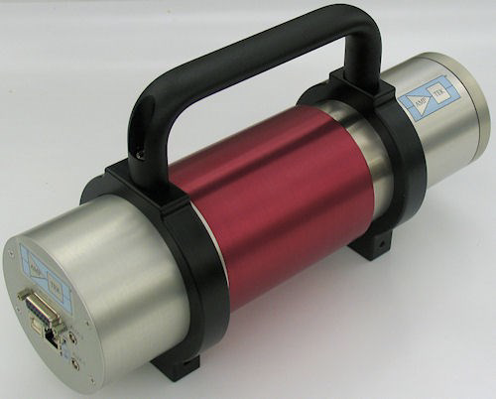
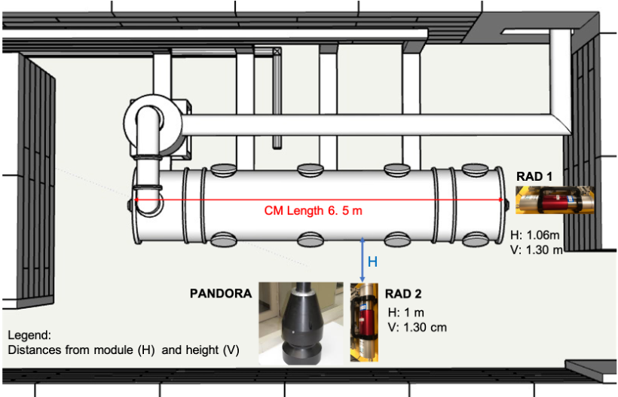
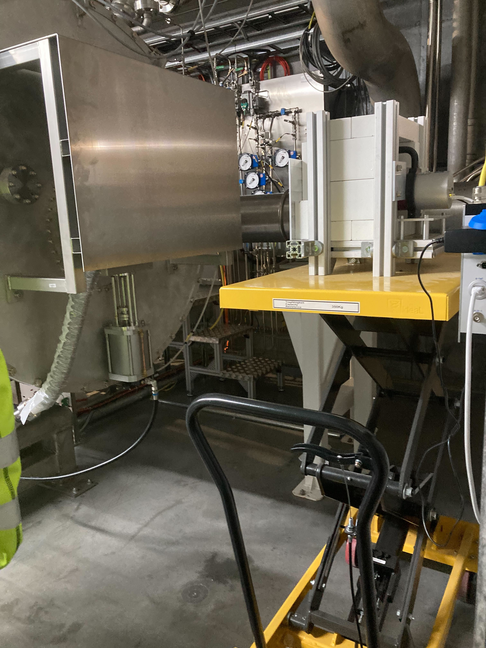
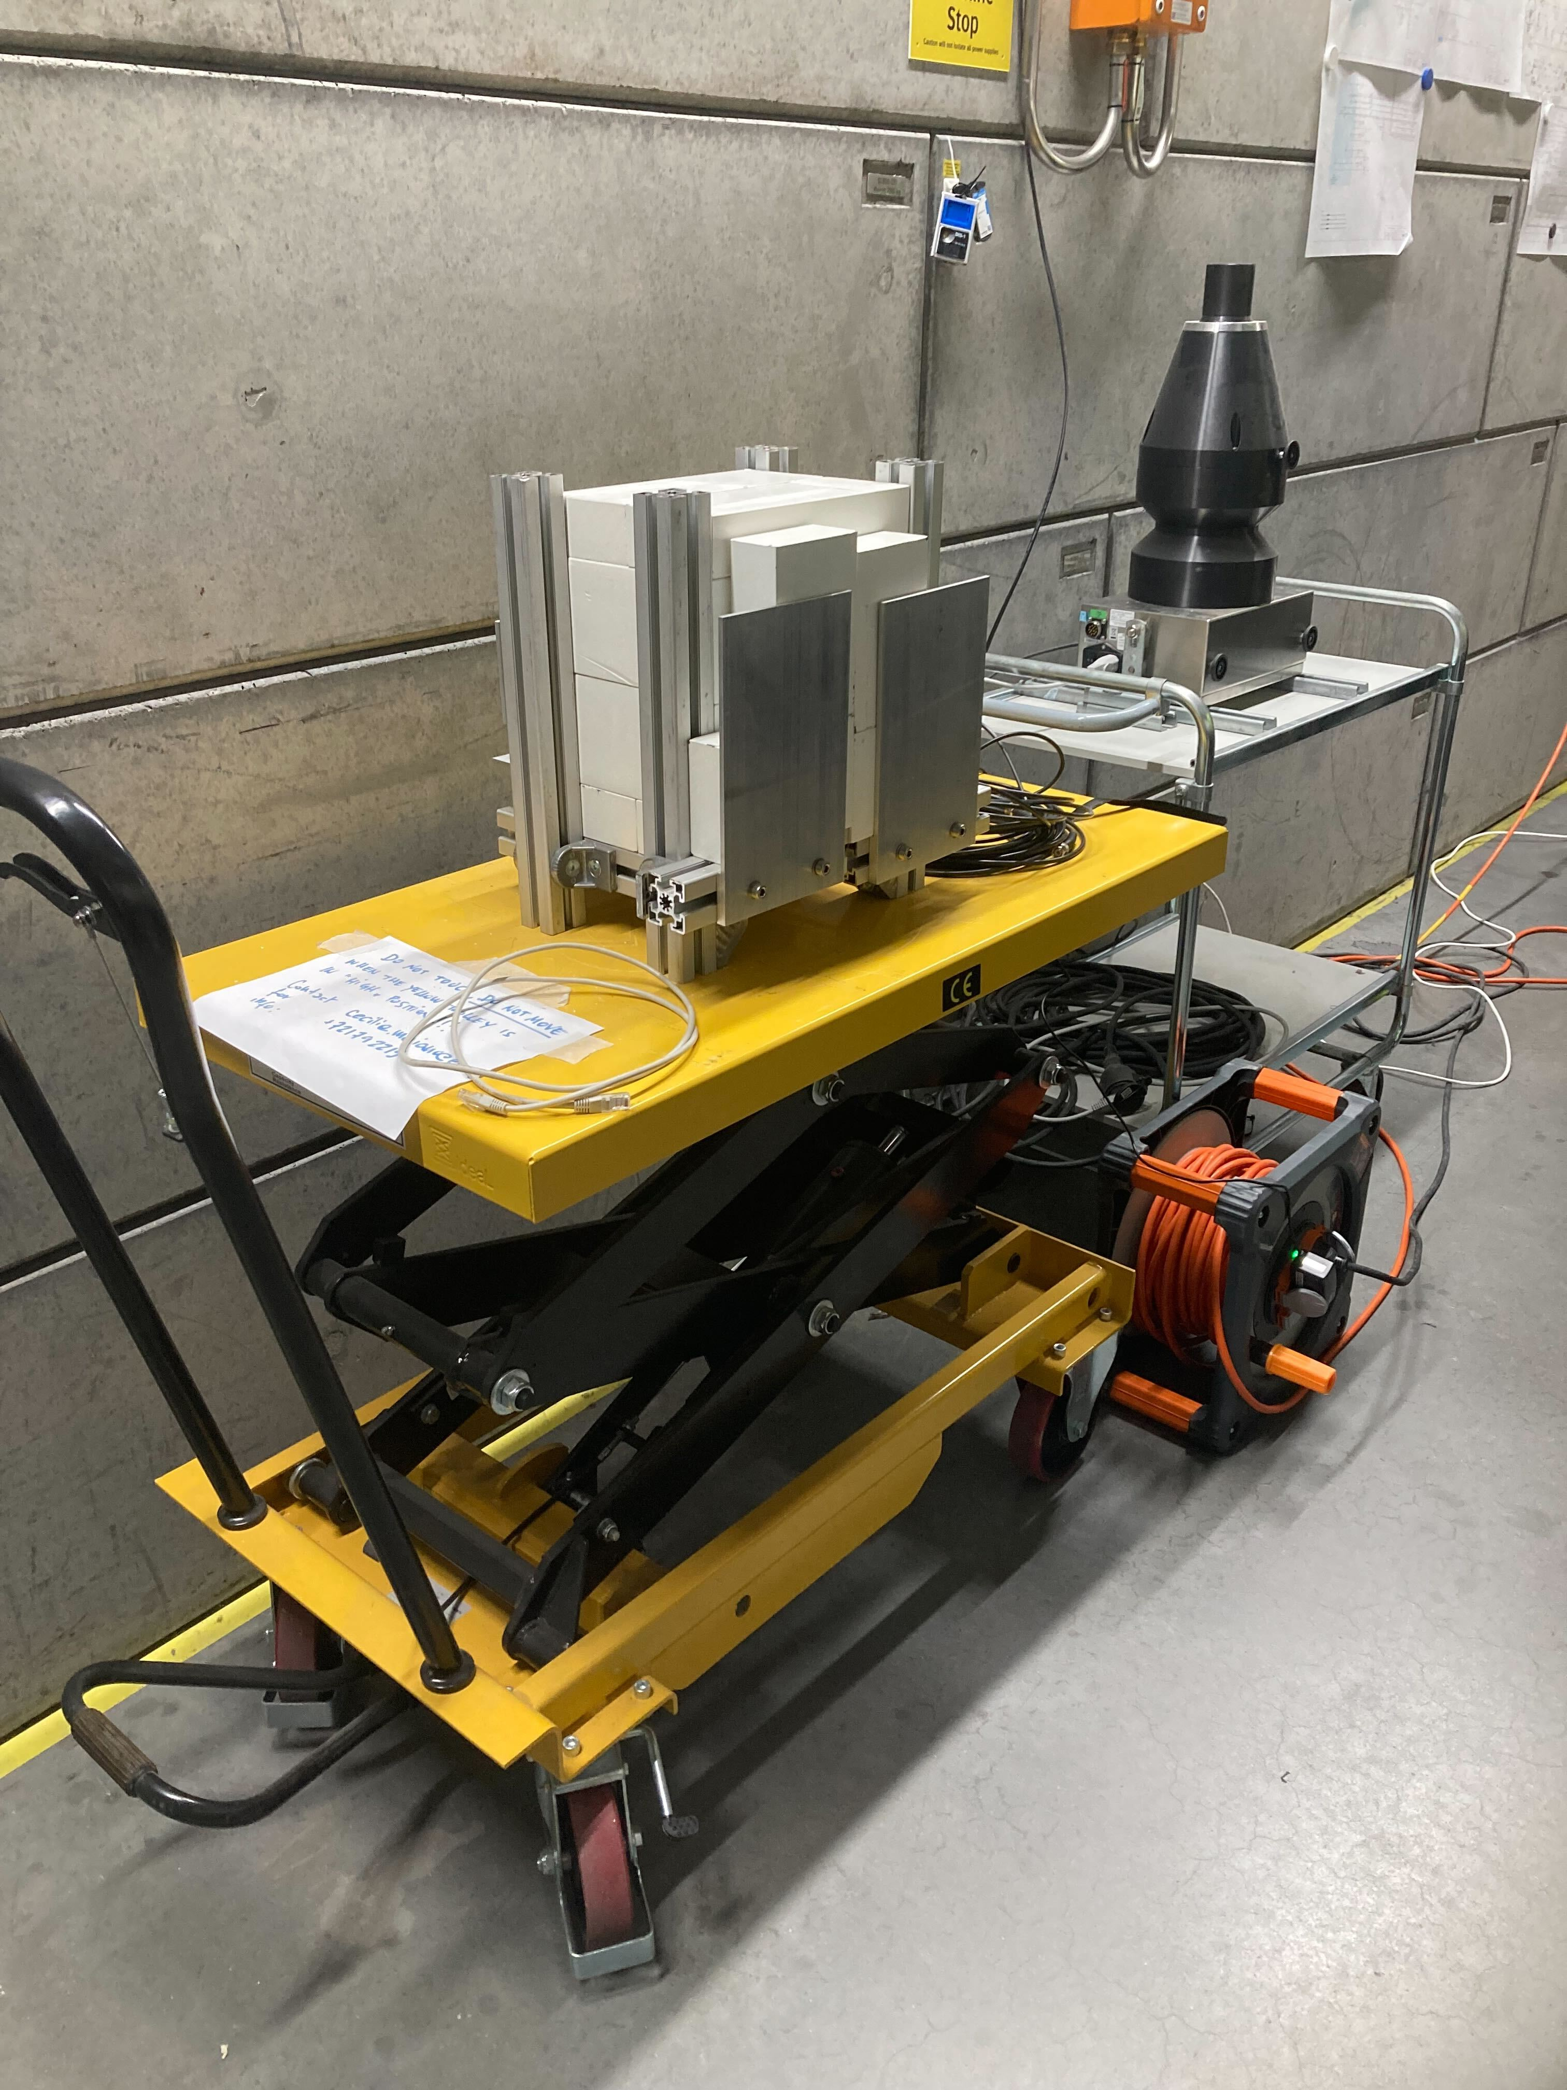
TS2 field emission instrumentation
We started with these…
Gammadata Sweden
A
B
Rad1
Pandora
C
Rad2
RP Pandora Dose rate: detector
Neutrons (low and high energy)
Gamma

Slide 10
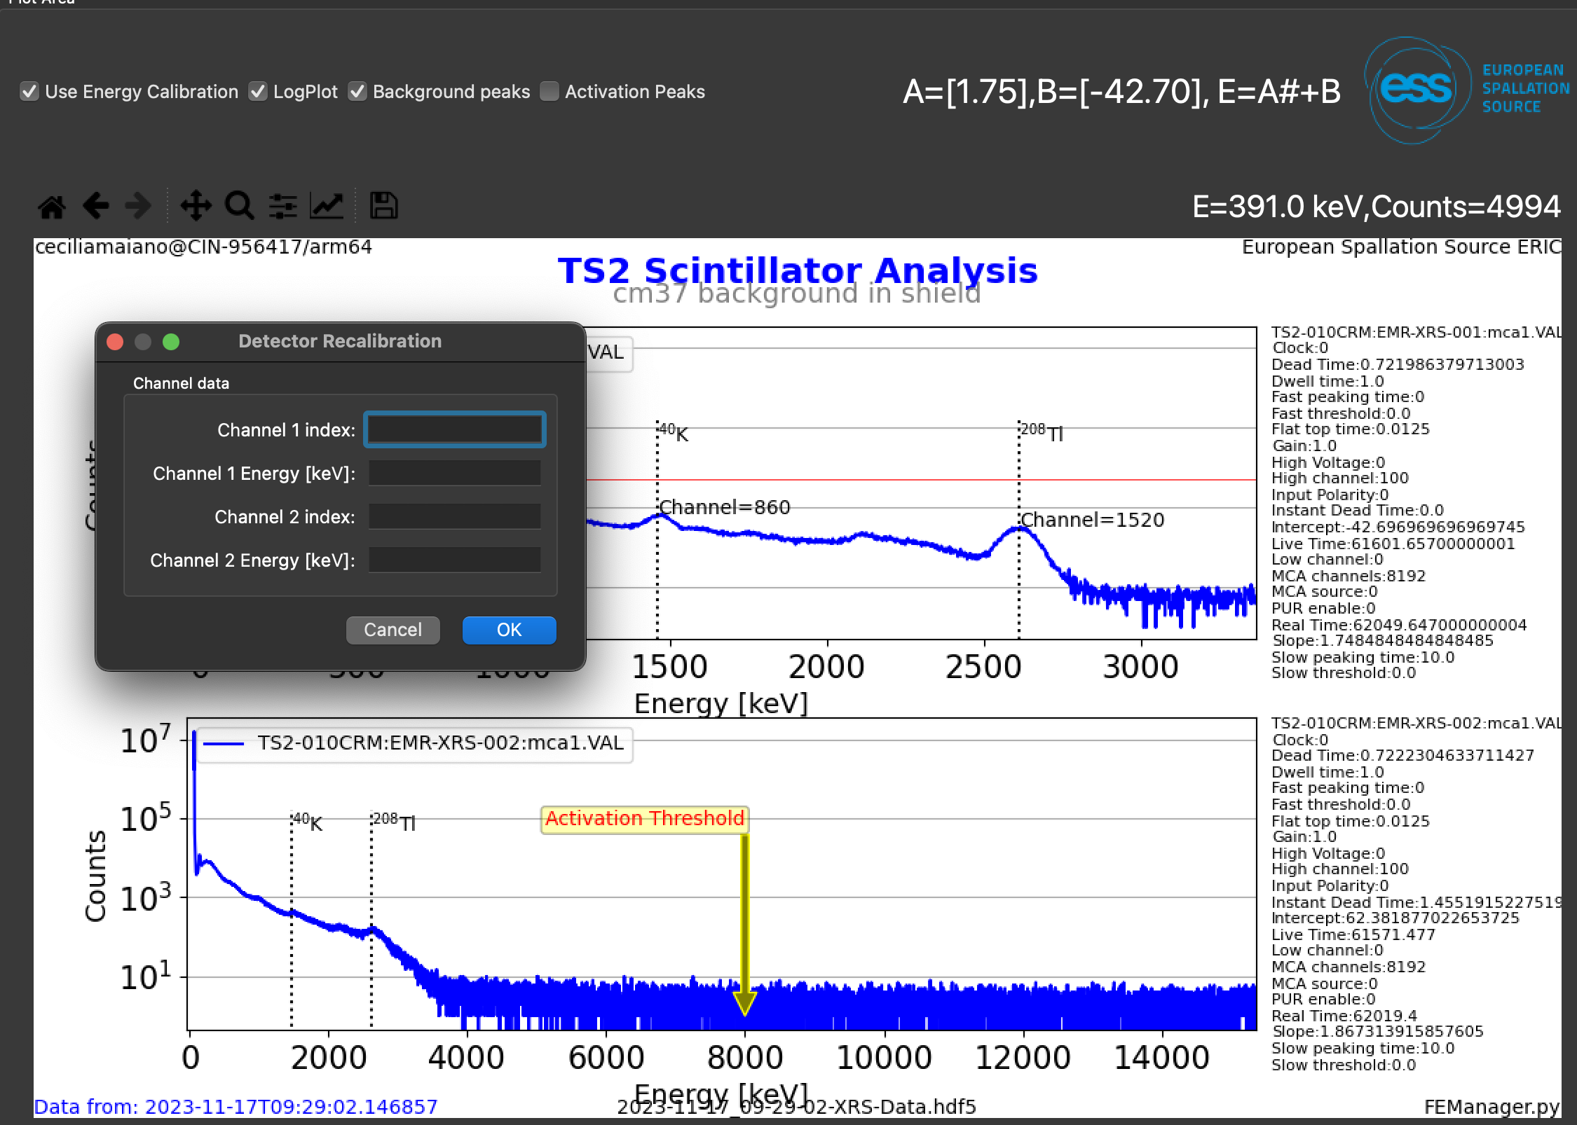
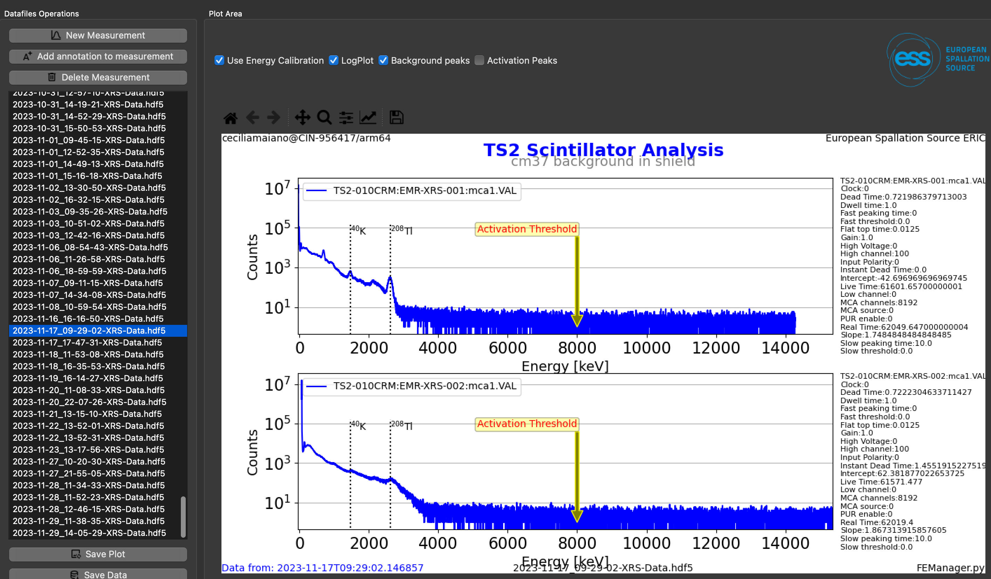
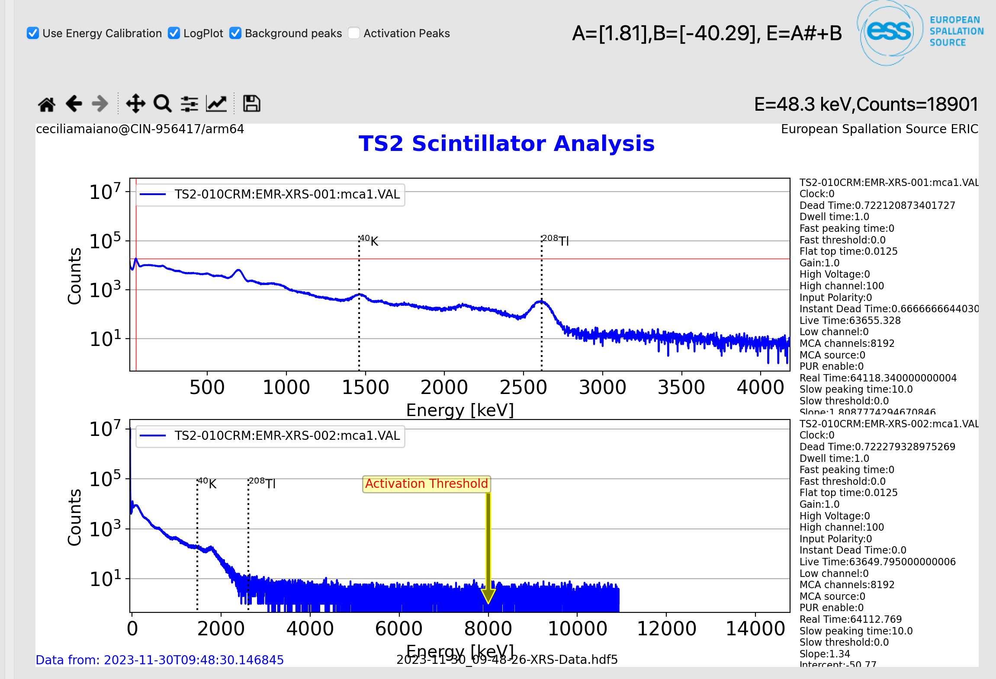
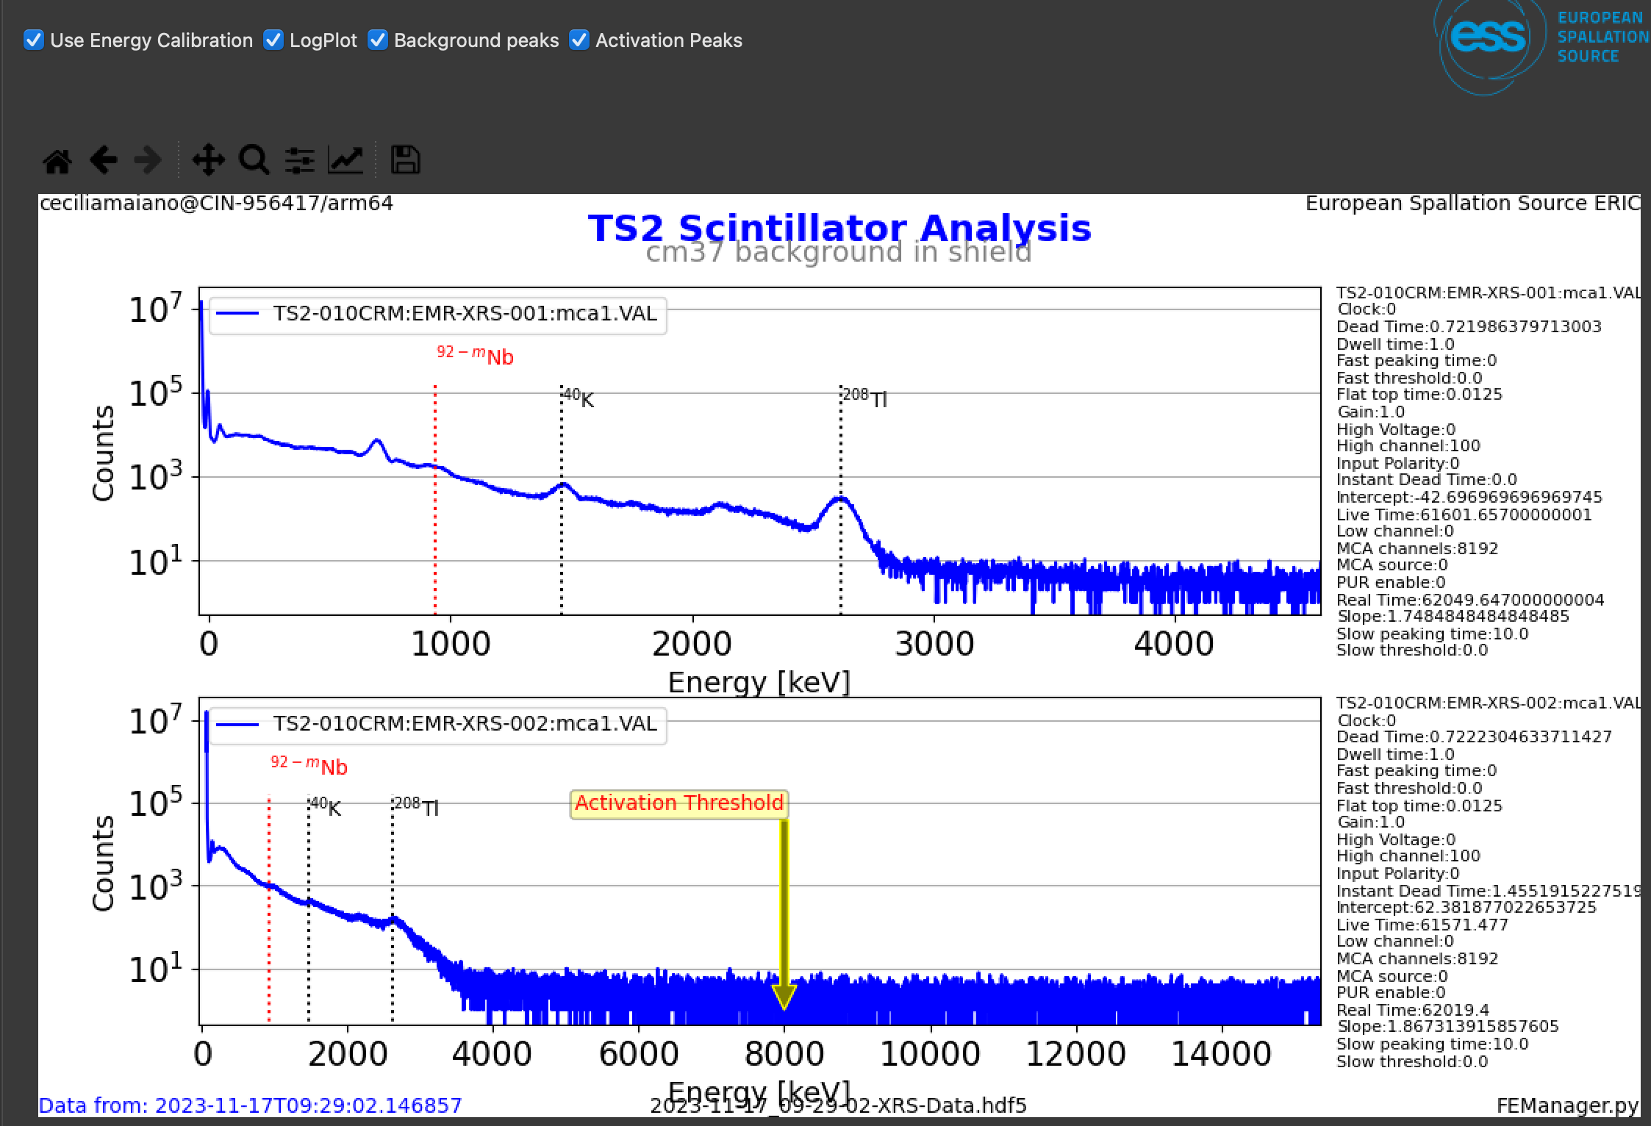
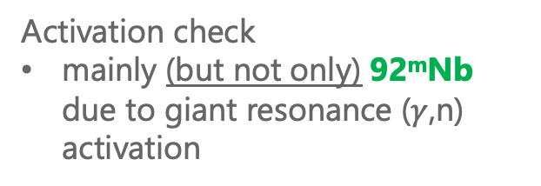
Acquisition and Analysis tool
NaI(Tl) integrated in EPICS
Tools with python scripts
Recalibration, using
208Tl
40K
Pb x-ray 46 keV
46 keV
Regular measurements
BKG
FE meas
Configuration parameters
92^{m}Nb monitoring
Activation check
mainly (but not only) 92^{m}Nb due to giant resonance ($γ$,n) activation

Slide 11

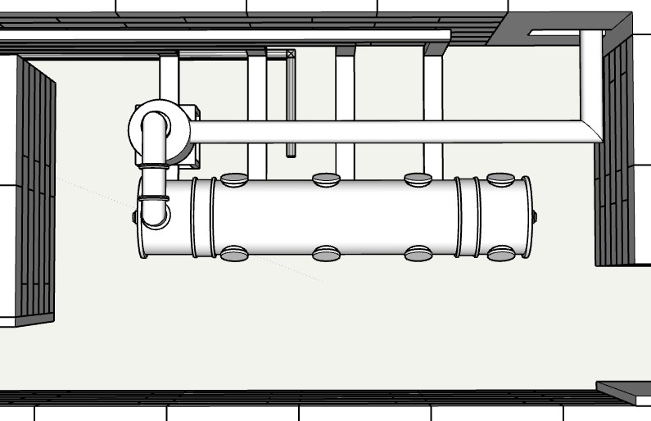
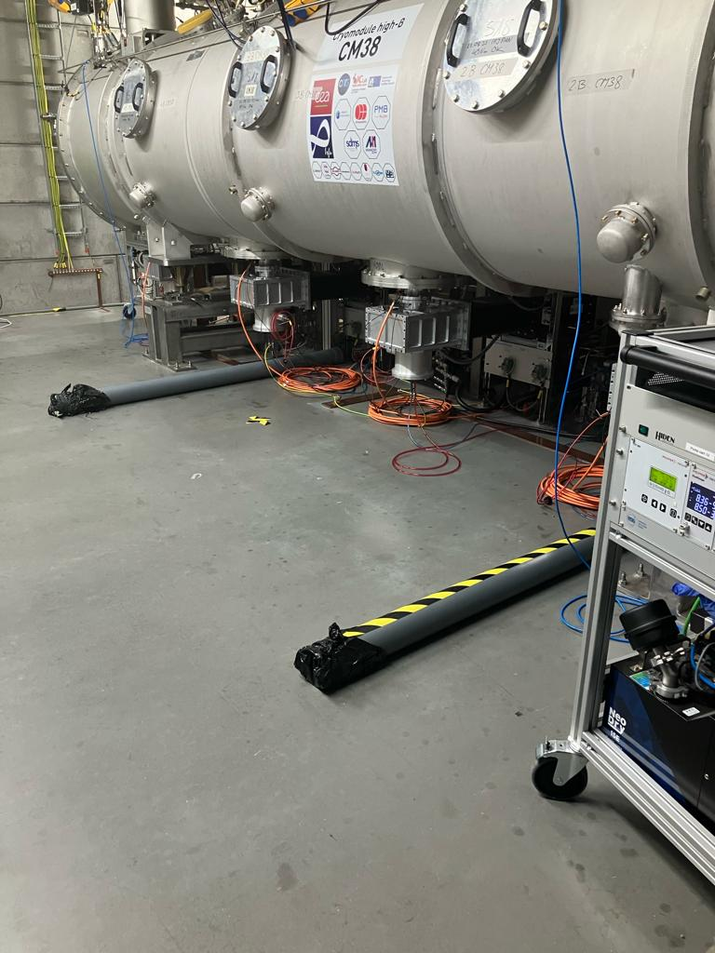
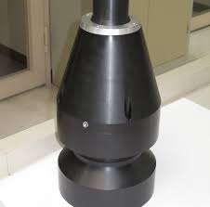
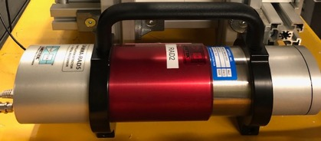
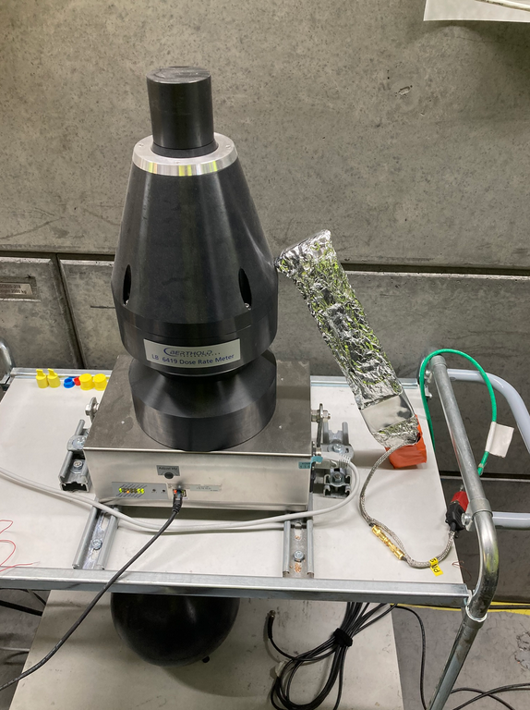
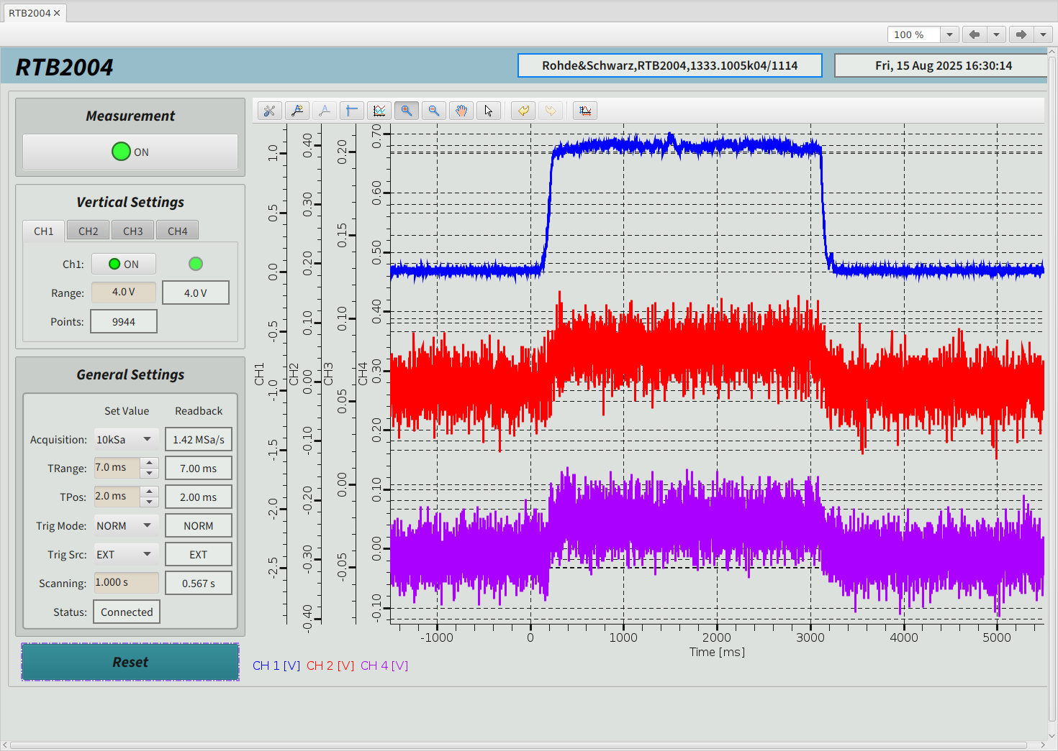
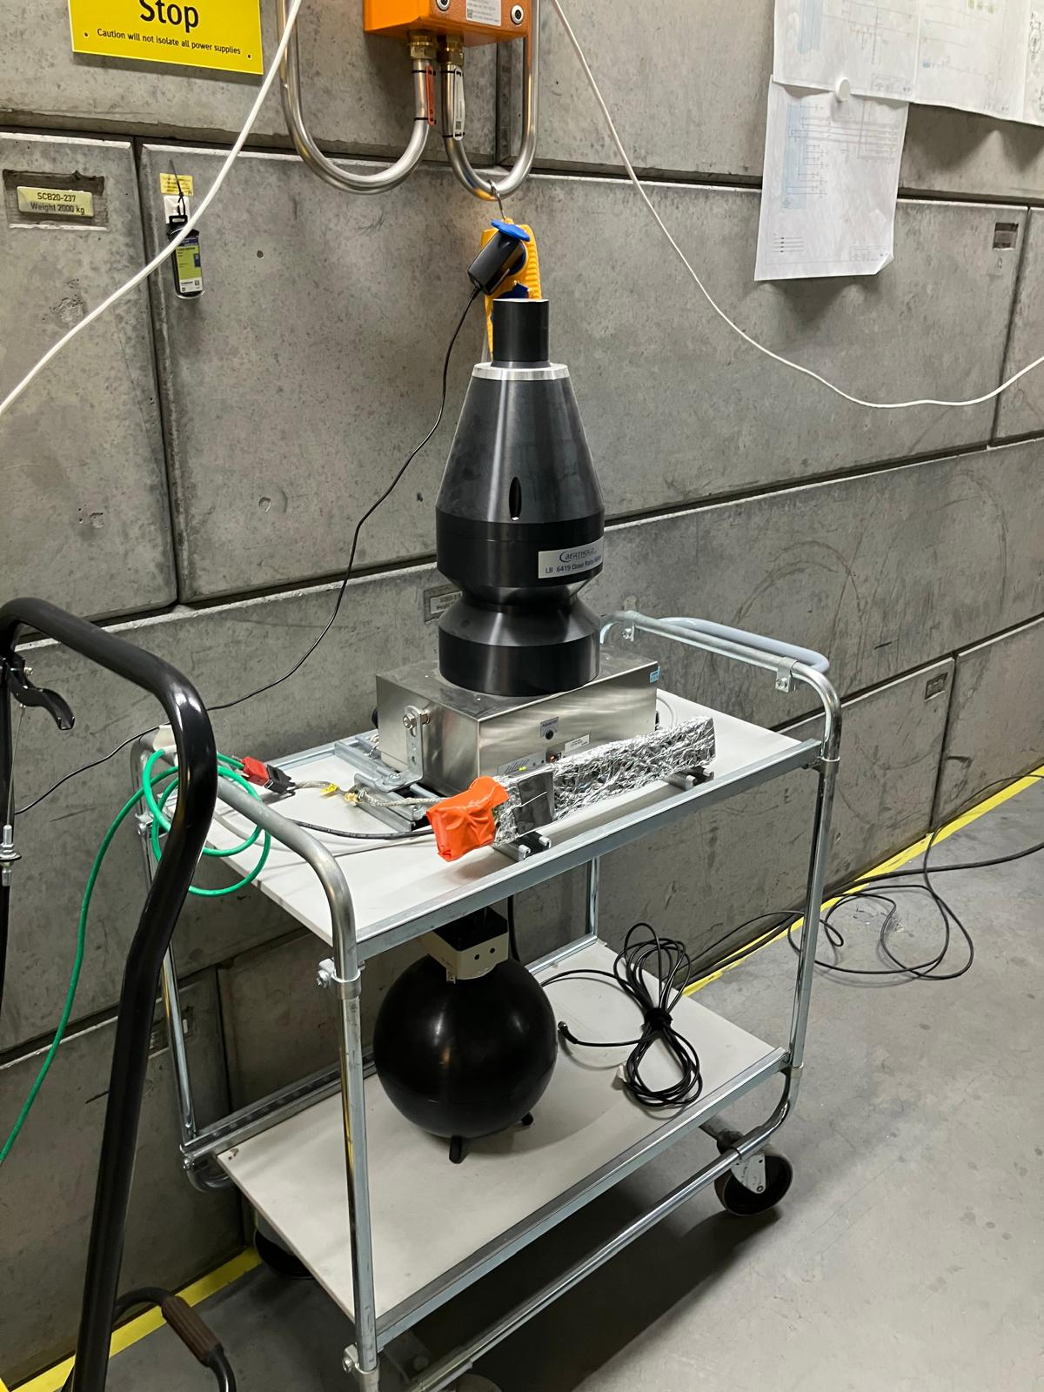
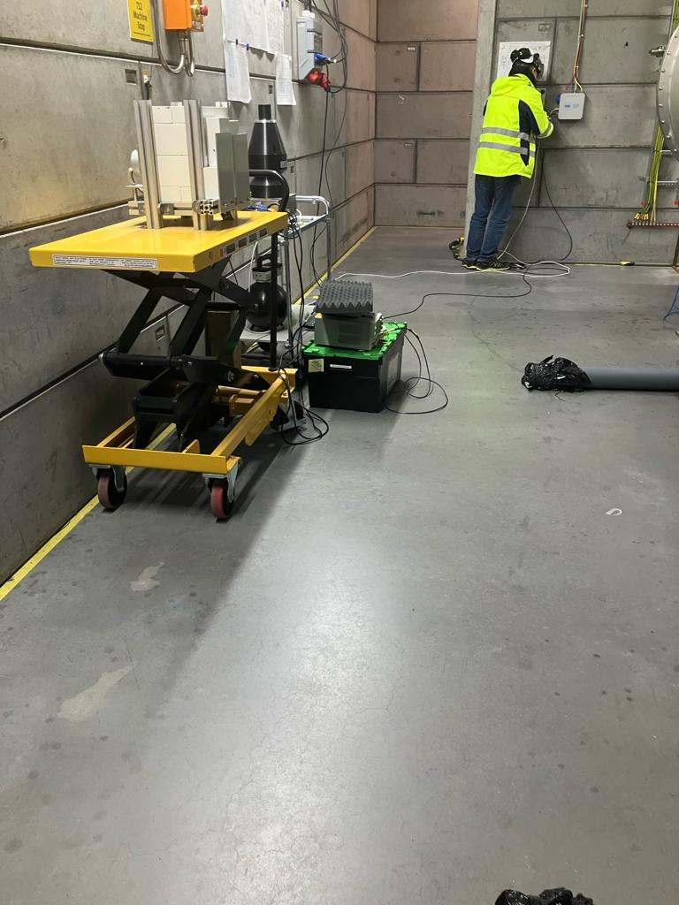
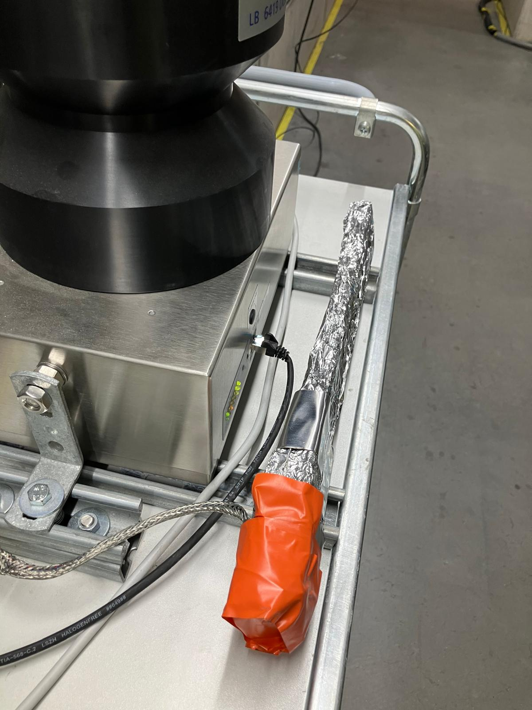
TS2 field emission instrumentation
We ended with these…
Chicane PANDORA
Gen I
Developed by CEA
Gen II
Photomultiplier + fast amplifier (Hamamatsu PM Amp)
Time resolution ~ 1 ns
Torre di Pisa developed by CEA
SB1 CEA
SB2 CEA
PANDORA

Slide 12
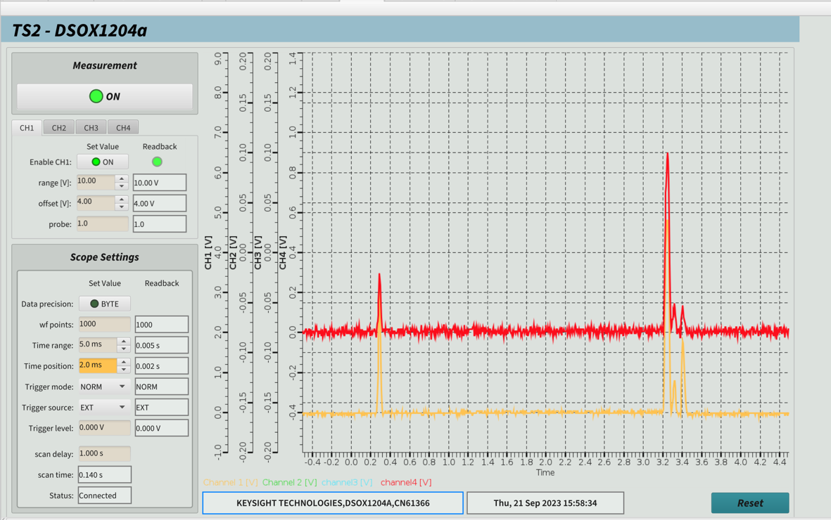
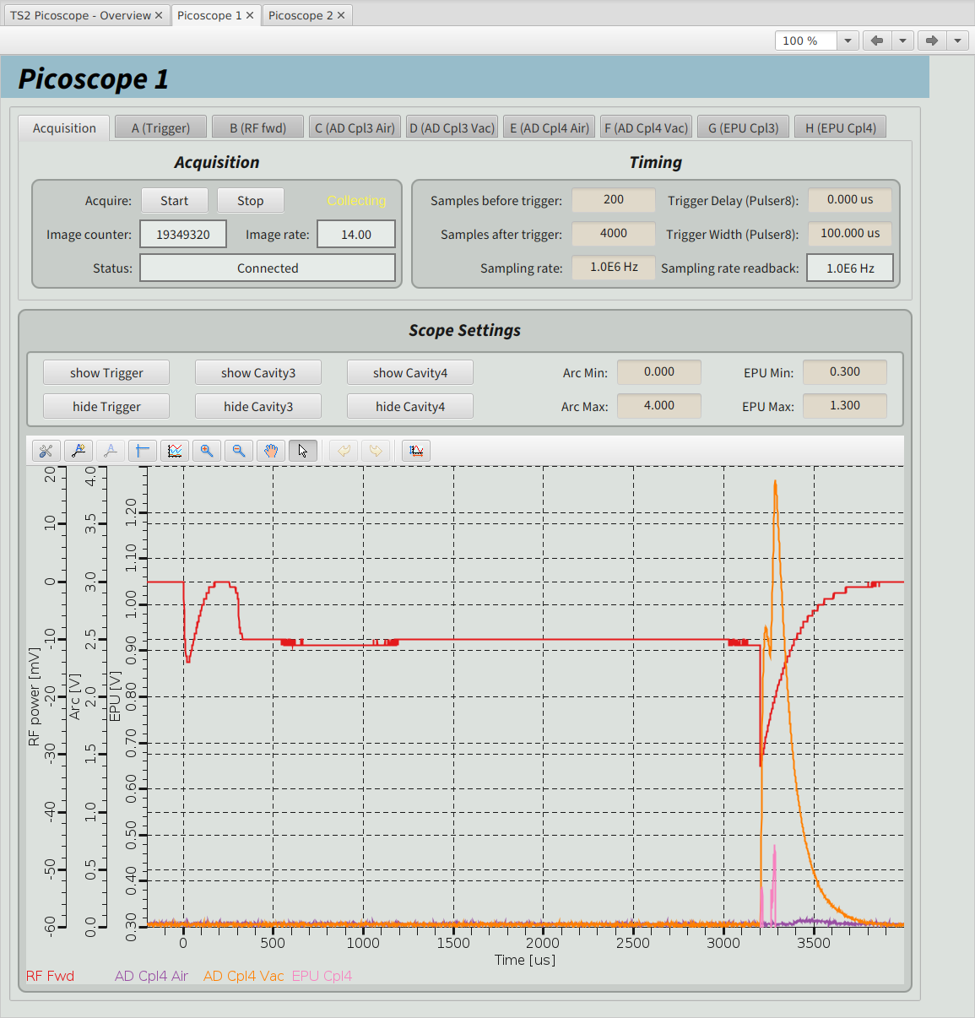
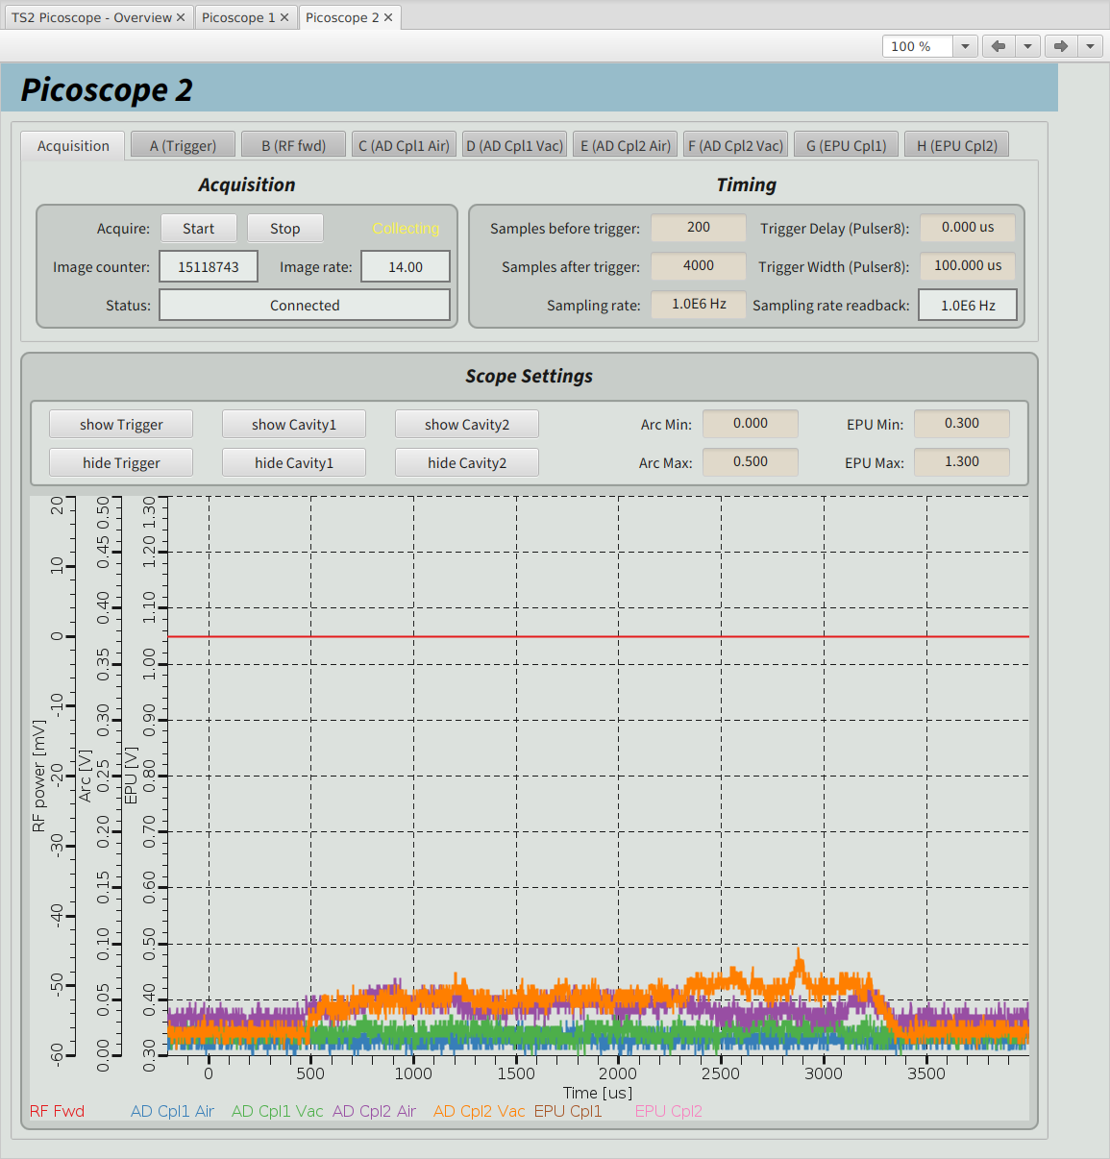
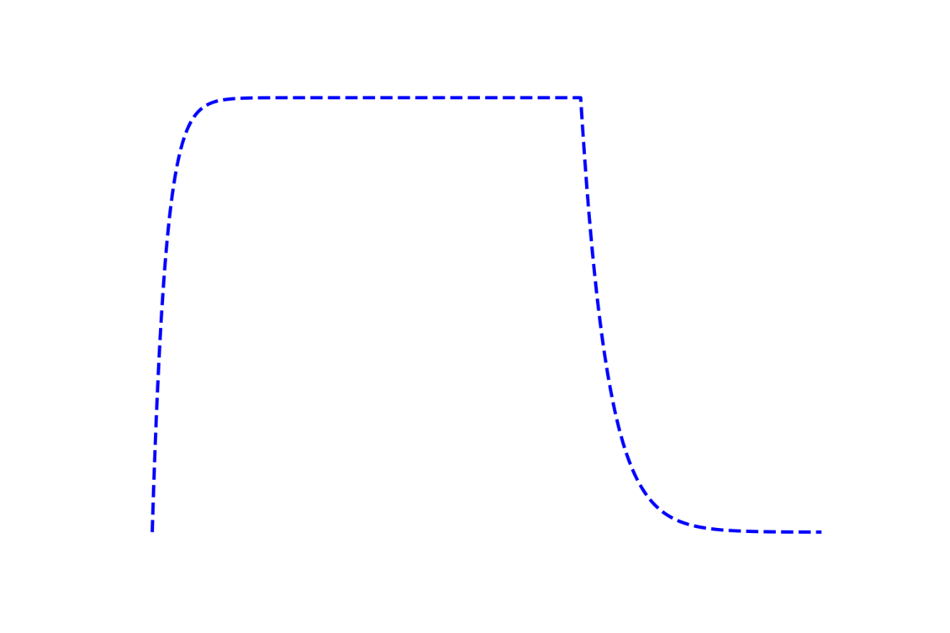
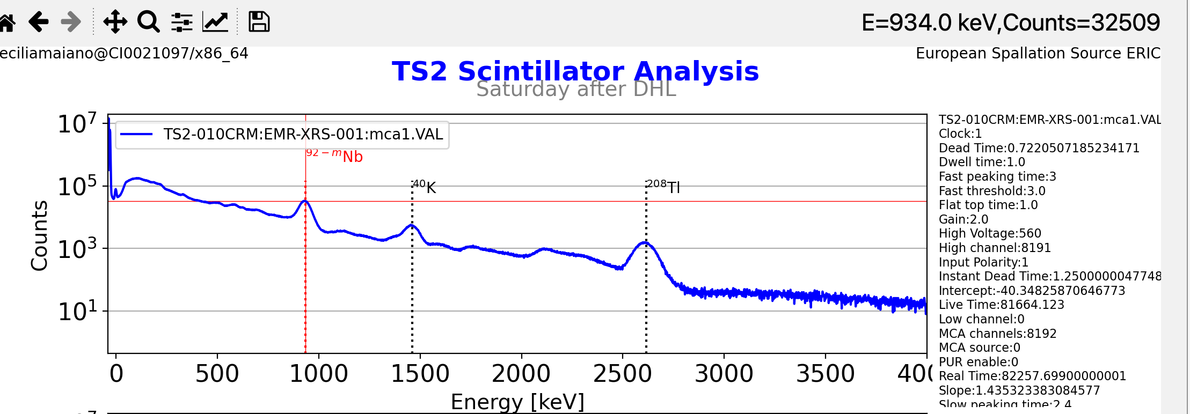
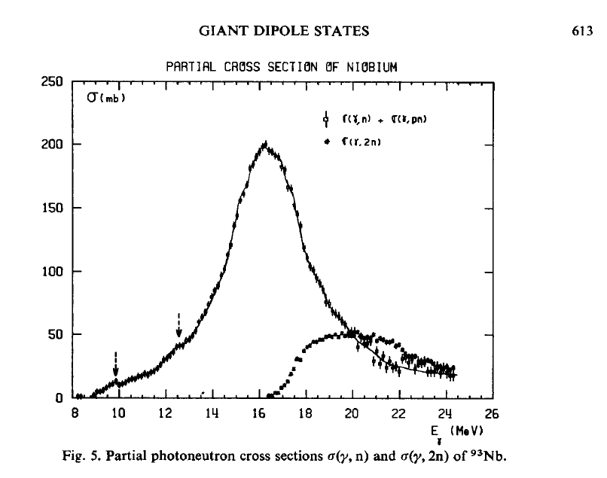
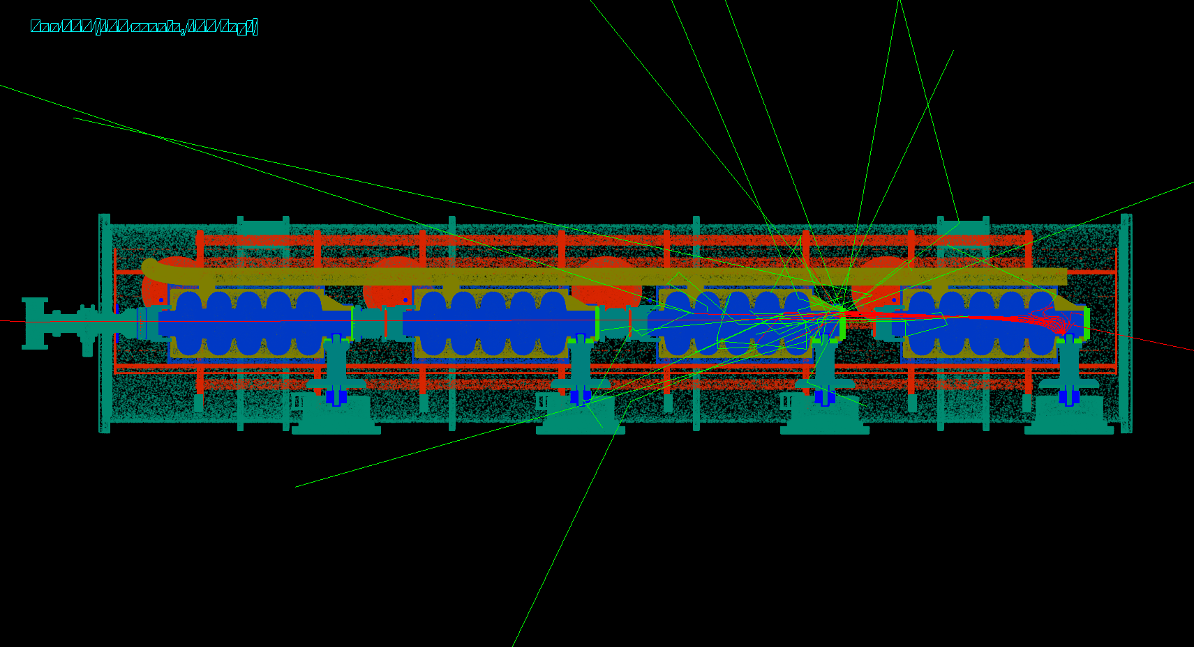

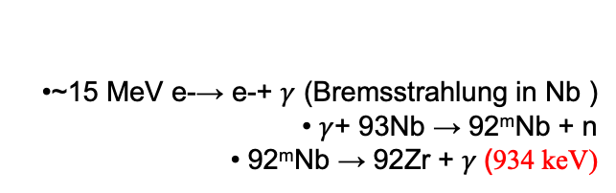
FPC feeding FE
Dashed line= cavity field as reference
DETECTED GAMMA RAY PULSE
FPC4 DIAGNOSTICS
AD and Electrons
(cav powered)
Scintillators SB1& SB2
FPC1 and FPC 2 DIAGNOSTICS
Only AD
[cav not powered]
Radiation only in fill/decay (TW mode)
•~15 MeV e-→ e-+ $γ$ (Bremsstrahlung in Nb )
• $γ$+ 93Nb → 92^{m}Nb + n
• 92^{m}Nb → 92Zr + $γ$(934 keV)
FPC4 low energy electrons (here 100 eV ~ threshold SEY>1 ) are captured by the cavity field, generate secondary tracks
FPC diagnostics is designed to detect optical
light from coupler viewports (AD)
SB has no optical path to coupler but
captures Cherenkov events from FE
e- from FPC area travel to cavity and lead
to radiation
Moderate 92mNb activation ($γ$,n) observed
thanks to 10µs time resolution, we can distinguish between FE and FPC electron emission (CEA detectors)
Courtesy of G. Devanz CEA

Slide 13
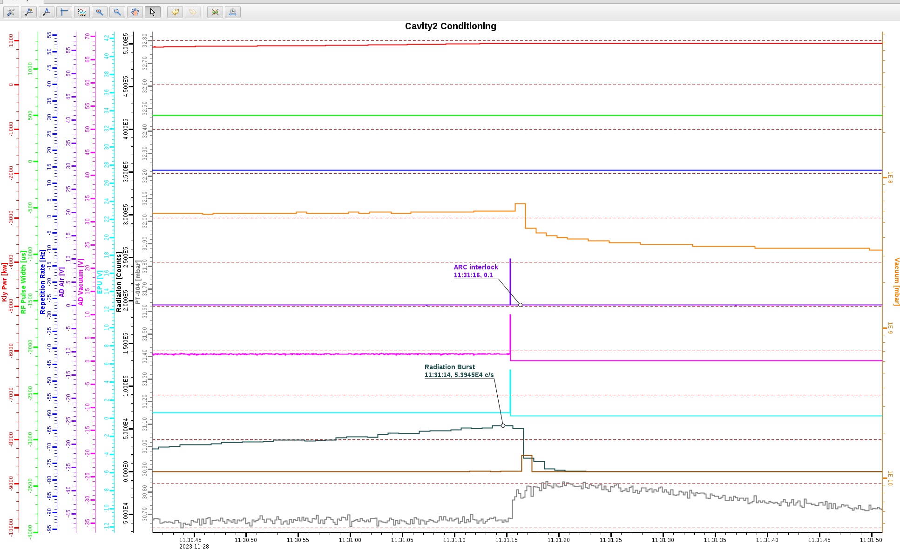



FE events triggering arcing protection
Fibers for arc protection close to coupler ceramic see Cherenkov from FE!
AD
EPU
interlocks
Correlated Dose rate jumps
Typically rise in neutron dose rate (only low energy in TS2 when max 2 cavities are operated)
ESS components in the tunnel are resilient to FE damage
No active electronics to damage
Everything is Rad-Hard (PT, CV, …)
FE bursts induce false triggers in the sensitive arc detectors that collect light from the coupler windows through non-scintillating fibers
Collective Arc events on all 4 couplers of the module, air side and vacuum side with the same timestamp.
Cryomodule test CM
VT Vertical Test

Slide 14

3 & 4
LINAC experience
BOD1 (1 ms, 1 Hz)
BOD2 (1 ms, 1 Hz to 3.2 ms, 14 Hz)

Slide 15


BOD1: Collective arcs (experienced in TS2)
FE radiation collected by fibers of the coupler arc detectors…
During cavity conditioning we had several events of field emission bursts which “lighted” all the fibers bringing the arc detector signals to the gallery PMTs (VAC/AIR side), all correlated with n burst, indicating high FE
Signal triggered at the same timestamp, interlocking many systems (and beam IL)
Still happening sporadically. Seen also by BLM.
Neutron burst observed
by pandora

Slide 16


BOD1: FE buildup in the HBL section & couplers showing MP
MP in the coupler region, when coupler is operating in TW mode during the fill time and the cavity decay
Typically appearing with the presence of EPU signal (47 V polarized antenna), which can show several bands.
Can be eliminated by 300-1000 V bias
  Few units during BOD1 - All units for BOD2
The worry:
Spurious arc interlocks
Masking real arc events
Pfwd
Pref
Arc Air
Arc Vac
Cavity field emission (along RF pulse, with no EPU)
It is Cherenkov light occurring in the fibers,
triggered by FE
EPU

Slide 17

Induced beam losses: Pandora surveys in TUNNEL
HBL-010
HBL-020
First HB module tested in TS2&CEA HBL-020 (CM31)
High FE and activation 92mNb
From TS2 experience: radiation going backward
Pandora

Slide 18

BOD1 2025-06-10
Beam in SCL
– induced losses-
80 uSv/h gammas,
up to 45 mSv/h neutron (E < 20 MeV)
NO Beam in SCL,
cavity induced radiation
- 80 uSv/h gammas,
- approx 20 uSv/h neutron
Beam in SCL

Slide 19





Arc Detector fiber signal and Dose Rate
Cherenkov light in fibers (e- travelling at speed higher than light in the medium)
Electrons from cavity surface
  Bremmstrahlung -> $γ$ -> ionizing → e-
Electrons captured from couplers
  Bremmstrahlung -> $γ$ -> ionizing → e-
Electrons from low E neutrons scattering
(beam losses)
  (n,n’) -> deexcitation $γ$-> ionizing -> e-
Collaboration with CEA

Slide 20

Dose rate BOD1/BOD2 – two different pandora locations and different RF parameter
BOD1 1 ms 1 Hz
BOD2 3.2 ms 14 Hz
HBL-010
Without beam, just increasing pulse length and repetition rate, we experienced a considerable increase in dose rate (both gammas nad neutrons) and appearance of high energy neutron dose rate:
Radiation coming only from cavities field emission
HBL-040
HBL-030
HBL-020
Pandora
Pandora
Pandora
80 uSv/h gammas, 20 uSv/h low energy neutrons
No uSv/h high energy neutrons
2 mSv/h gammas, 12 mSv/h low energy neutrons
Few uSv/h high energy neutrons

Slide 21

BOD2 Pandora by MBL-090: two jumps in dose rate (operational experience)
Stategy developed to recover cavities from FE degradation: TS2 strategy
Applied in In HBL section:
All HB modules in RF off (or at low field - 5 MV/m)
  => no emitters transport
Single cavity reconditioned with max power@short pulses (300 us and 500 us, no admin limit) and, as last step, with nominal RF pulse
  => conditioning of coupler in TW and cavity
Tue Feb 3rd 19:02
After maintenance day:
LWUs magnets OFF/ON
Peak in total dose rate 25 mSv/h
Total Dose rate trends
From 500 uSV/h to almost 2.5 mSv.h
Thu Feb 5th 17:25
Shutting down all LWUs
Jump form below 1 mSv/h to 2.5 mSv/h
In total dose rate
Gate Valve closure
LWU intervention
Not seen (in dose rate terms)
at position MBL-090

Slide 22



Dose rate at 3.2 ms/14 Hz and
1 ms/1 Hz
BOD2 2026-03-11
1 ms 1 Hz
gamma 80 uSv/h
Low E neutrons ~16 uSv/h
no high E neutrons
3.2 ms 14 Hz
1 ms 1 Hz
gamma 2 mSv/h
Low E neutrons ~ 12 mSv/h
few high E neutrons
3.2 ms 14 Hz
No HV available for all the systems during BOD1
All HV available for BO2
Only 17/82 systems have HV on at 1 ms and 1 Hz
=>
Radiation coming from coupler electrons is negligible, cavities FE is dominant
BOD2 dose rate at 1 ms, 1 Hz as BOD1
G. Devanz

Slide 23

Arc detectors provide relative FE development along linac
No AD signal above noise in the SPK/MBL section. FE dominant in HB.
Similar intensity Air/Vacuum side (i.e. it is not real coupler arcing)
RP surveys confirm ”hot areas” around the locations where fibers pick the strongest signals
AD sensitivity setup important to maintain coupler protection from arcing and avoiding spurious triggering
(noise level)

Slide 24





Arc Detector traces while operating at 1Hz - 1 ms with 5 us beam
SPK
RP surveys match max AD activity
Activeted istopes in agreement with MC simulations (G. Devanz)
MBL
Priority depending on T ½ | Isotope | T ½ | Energy of radiation decay mode | Ig %
1 | ⁵⁵Fe | 2.73 y | 5.9 keV x-ray Electron capture | 16.9
2 | ^{92m}Nb | 10.15 d | 934.4 keV gamma 912.6 keV gamma e+b⁺ | 99 1.78
3 | ⁵⁷Ni | 35 h | 1377.6 keV gamma e+b⁺ | 81.7
4 | ⁵⁶Mn | 2.6 h | 846.7 keV gamma b⁻⁻ | 98.9
HBL

Slide 25
Summary
Operating with FE: Nominal Gradients @ 14 Hz, 3.2 ms Achieved
The ESS tunnel environment is resilient to radiation damage
  High radiation hardness for materials and all electronics in surface gallery
  Activation will be eventually driven by beam losses
  We are thus currently exploring how “deep” we can operate reliably in the cavity FE regime, which affects mainly the HBL section.
  LLRF operation is not affected
  Cryo has wide margin for additional loads, no limit experienced so far
  FE may mask important arcing signals indicating coupler degradation and lead to spurious “Global Arc” events, tripping beam
    Under consideration: analisys of AD waveform trends with AI models
  Reconditioning with short high power pulses so far successful for curing onset of FE degradation

Slide 26
Thank you

Slide 27
Back up slides

Slide 28
Presentation headline
Moduli che hanno avuto attivazione in TS2 sono poi stati trovati attivati da RP ancora prima di avere il fascio
Differenza tra primo e secondo commissioning e dei conseguenti global arc
Esperienza dopo la Linac Warm Unit water leak: come la chiusura ed apertura della gate valve abbia mosso particolato e abbia provocato un incremento di FE della cavità 4 di HBL030 (e frequenti global arcs). Posso anche parlare della soluzione che abbiamo inventato di ricondizionare la cavità 4 (e pure la 3) con il resto della sezione High Beta in RF off, usando impulse corti.
Altra idea: della verifica (predetta dalle simulazioni di Guillaume) che nel linac che non solo la FE dovuta a emettitori nella zona del coupler, ma anche da emettitori in cavità va tendenzialmente backwards.

Slide 29

TS2 back up pictures

Slide 30


TS2 back up pictures

Slide 31
Image title

Slide 32

BOD2: Pandora in different location
In the tunnel
Pandora by HBL-050: stable dose rate
total dose rate 600 uSV/h
Low E neutrons 50 uSV/h
High E neutrons few uSv/h
Pandora by MBL-090:
total dose rate 600 uSV/h
Low E neutrons 50 uSV/h
High E neutrons few uSv/h
Pandora by MBL-090:
two jumps in total dose rate correlated with LWU ON/OFF
Pandora by HBL030 c1:
Peaks in total dose rate 20 mSv/h
Low E neutrons up to 17 mSV/h
High E neutrons few uSv/h
Pandora by HBL030 c1:
Much higher dose rate wrt HBL050 (after gate valve closure)
Pandora by HBL030 c4:
Peaks in total dose rate 12 mSv/h
Low E neutrons up to 3 mSV/h
High E neutrons few uSv/h
ALL HBL 20 MV/m
Pandora by HBL030 c4:
With HBL020 c1 at 10 MV/m and HBLs 3-4 at 18 MV/m
Total dose rate 1.8 mSv/h
Low E neutrons 20 uSv/h

Slide 33


Dose rate while operating at 1Hz - 1 ms with 5 us beam
Gammas: 80 uSv/h
Low E neutrons 150 uSv/h
Hgh E neutrons 20 uSv/h
Only slightly increase in low energy neutrons dose rate
Not zero high energy neutron dose rate (beam => neutrons scattering/capture)

