Slide 1


Cavity performance evolution from vertical test to on-line commissioning at SHINE
Jinfang Chen, SARI, CAS
For the SHINE cryomodule team
June 10, 2026
TTC 2026, Gif sur Yvette, France

Slide 2
Outline
Introduction
    Cavity performance in vertical test
    Performance in horizontal test
    Performance in tunnel commissioning
    Influence factors
Summary

Slide 3
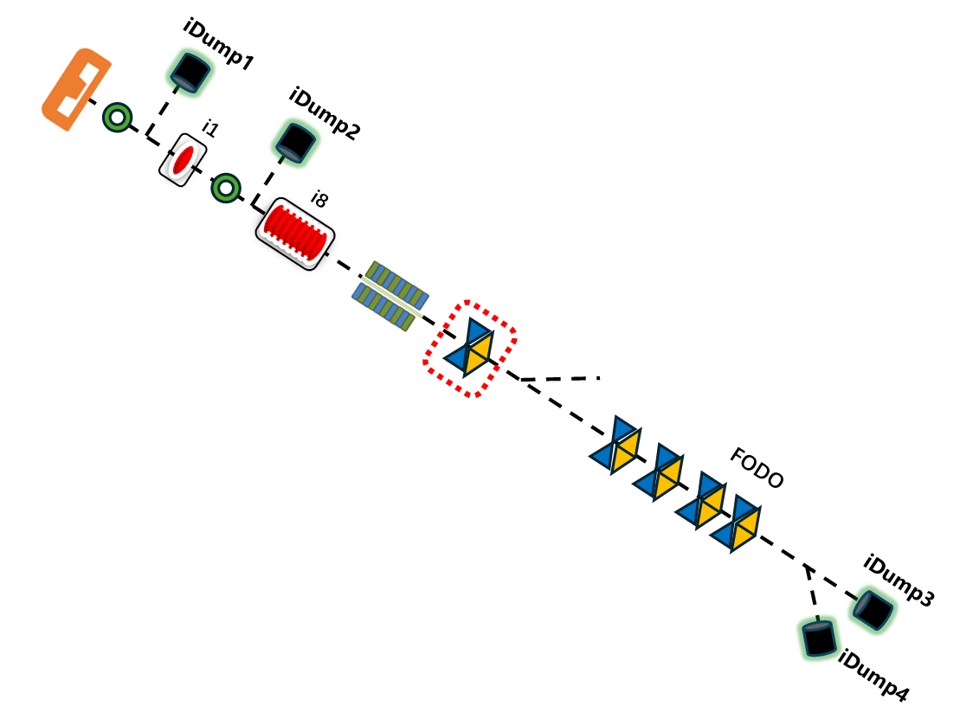
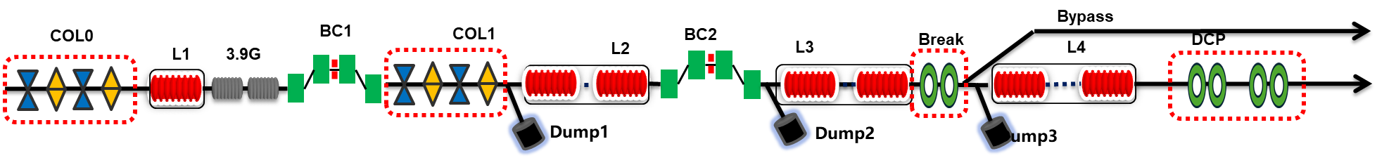
Introduction
Cryomodules requirements
  1 CM with one twin-FPC cavity
  1 CM with 8 cavities (FPC-ABBA orientation)
  54 CMs with eight 1.3 GHz high-Q cavities
  2 CMs with eight 3.9 GHz cavities
Accelerator design adjustment：
Energy 8.0 GeV，by pass 3.0-4.5 GeV
54 standard 1.3GHz high-Q CMs
20 MV/m, CM average Eacc
100pC
Status
Injector commissioned in Q4, 2024
L1 commissioned in Q3-Q4, 2025
L2-L3 installed, under cooling down now
L1:2
L2:18
L3:10
L4:24

Slide 4
Updated Requirements for High-Q Cavities and CMs
 | 1.3 GHz high-Q Cavities |  | 1.3 GHz high-Q CMs
 | Bef. Oct 2024 | Updated | Bef. Oct 2024 | Updated
Amount | 600 | 530 ordered | 75 | 54 (+2 spares)
Q₀ | 2.7E+10 at 16 MV/m | 3.0E+10 at 20 MV/m | 2.7E+10 at 16 MV/m | 3.0E+10 at 20 MV/m
Max E_{acc} | ≥ 19 MV/m | ≥ 22 MV/m |  | 26 MV/m(adm. limit)
FE onset |  | ≥ 22 MV/m
Usable voltage |  |  | ≥ 128 MV | ≥ 166 MV

Slide 5
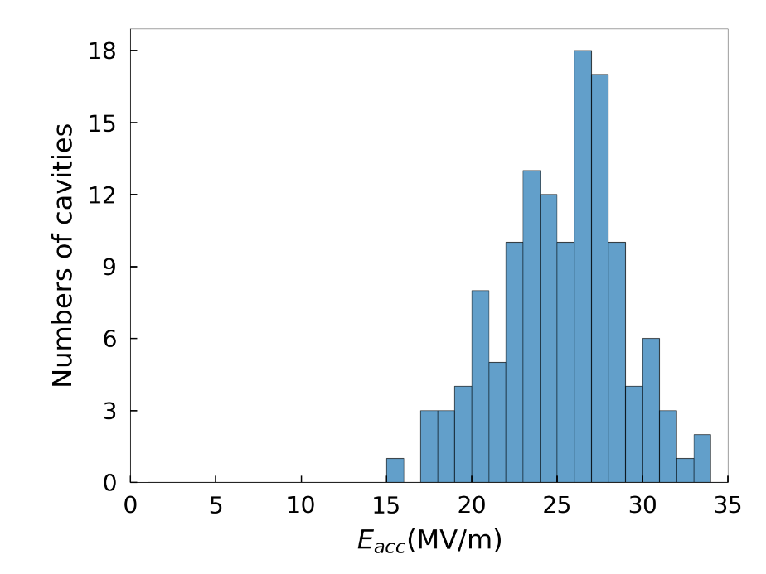
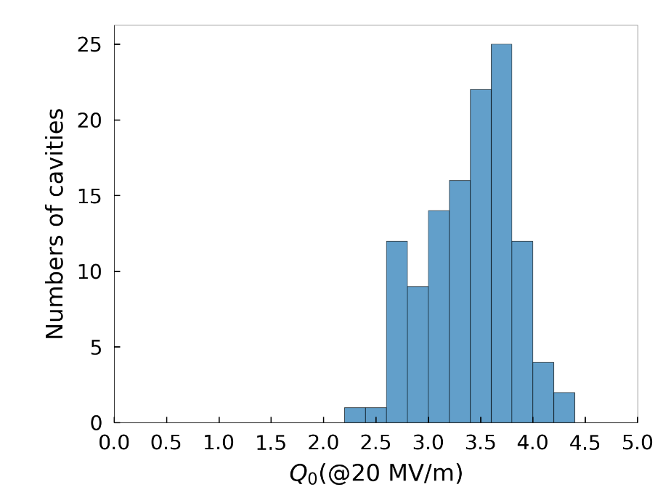
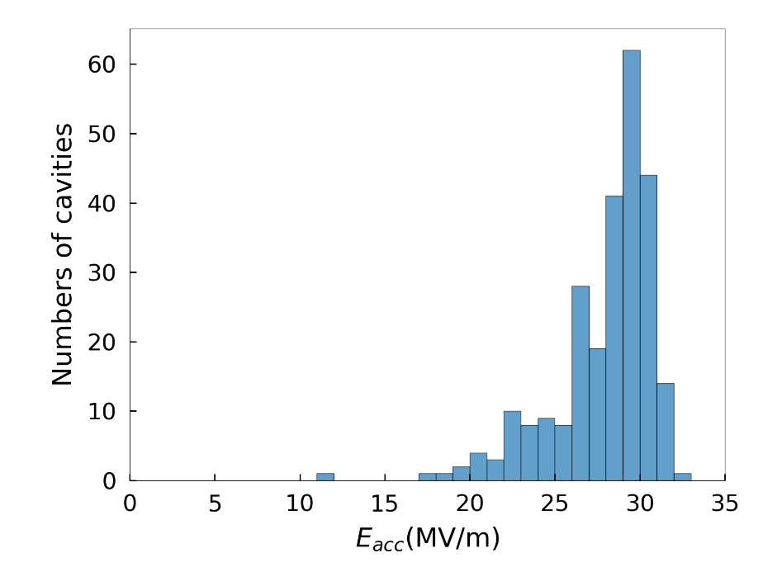
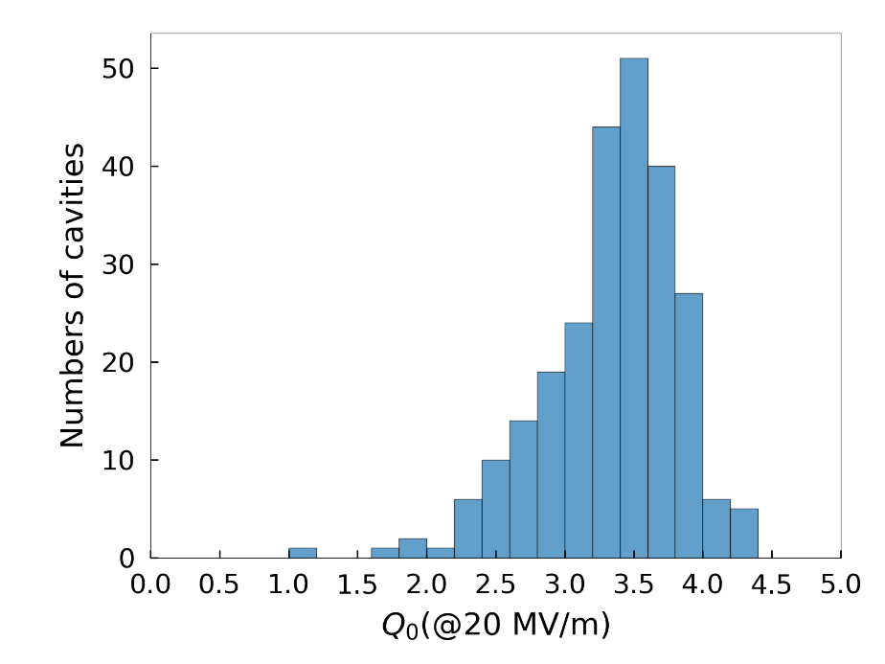
1.3GHz Dressed Cavity Performance in Vertical Test
As of May, 2026
SHINE updated VT specs
388 dressed cavities tested:
  138 N-doped
  250 mid-T baked
308 dressed cavities qualified (79%)
57 concessionally accepted for CM (15%):
  Eacc≥ 18 MV/m, or Q₀≥2.5E+10@20MV/m
Namely, 94% delivered for CM assembly
N-doping
<max E_{acc}>
25.2±3.5 MV/m
N-doping
< Q₀ >
3.4±0.4×10¹⁰
（including 0.8 nΩ flange losses）
Mid-T
<max E_{acc}>
27.9±2.9 MV/m
Mid-T
< Q₀ >
3.3±0.5×10¹⁰
（including 0.8 nΩ flange losses）

Slide 6
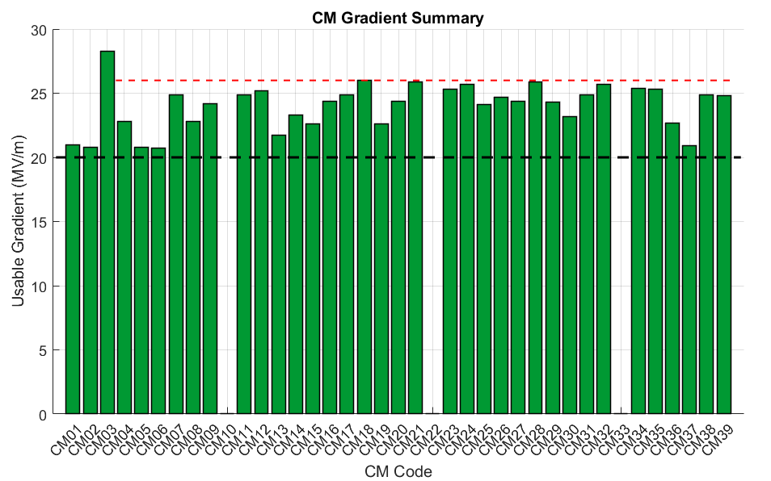
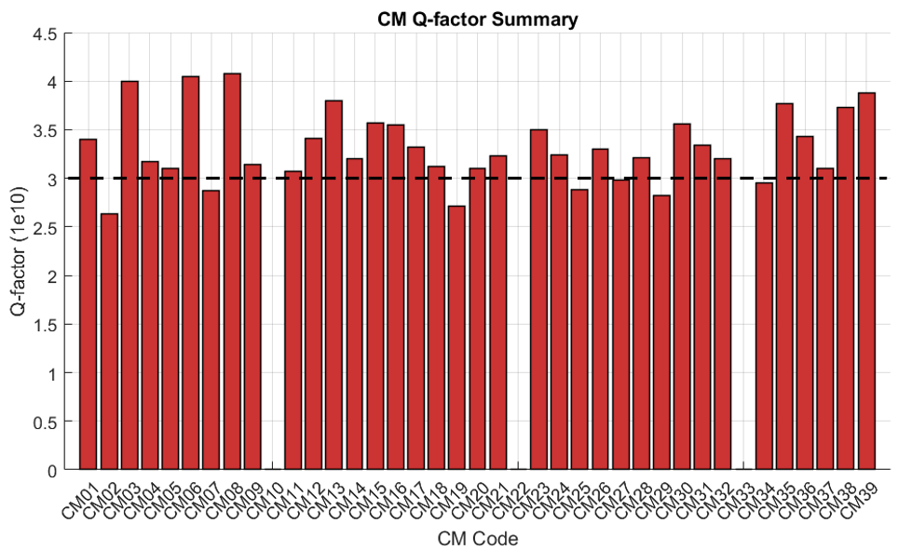
1.3GHz CM Performance in HT: Gradient and Q-factor
36 CMs (except CM10/22/33)：
Average Usable Gradient: 24.0 MV/m
Average Usable Voltage: 199.4 MV
Average Q₀ at 20 MV/m: 3.3 E+10
Admin limit
Note:
CM10-ND, low performance, dissembled and components reused in other CMs
CM22-MT, reworked, under horizontal test; CM33-MT, not tested

Slide 7
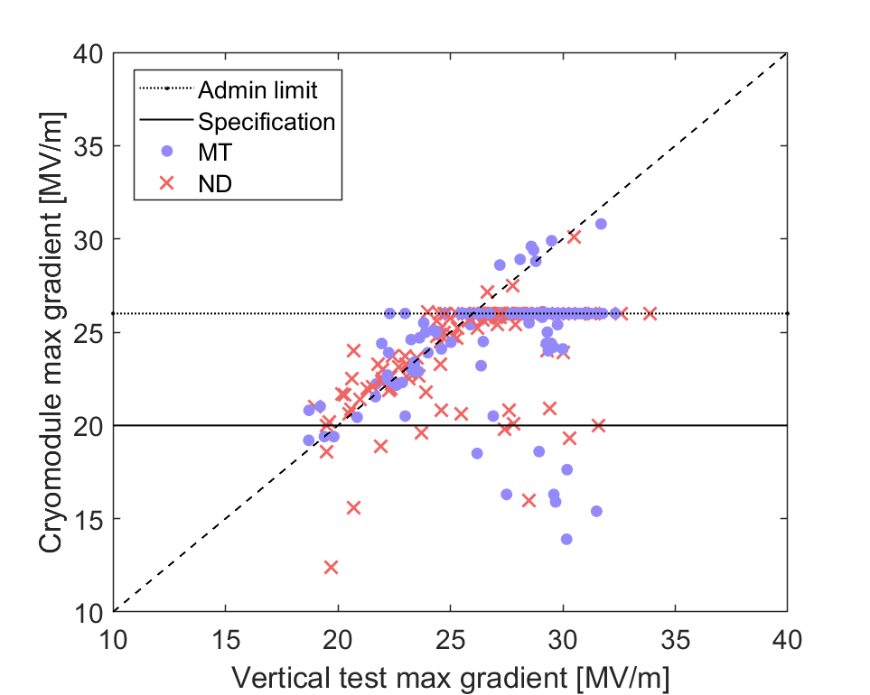
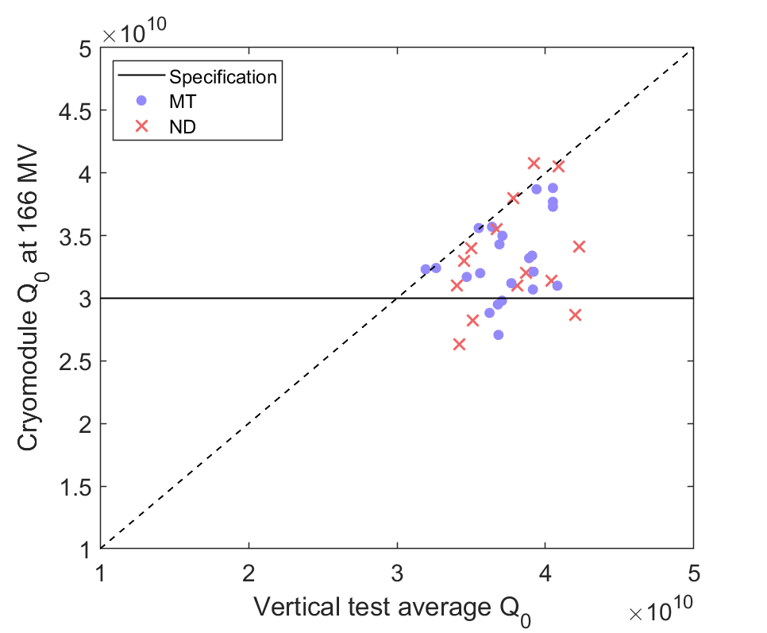

Change in Performance from VT to HT
Accelerating gradient(CM01-CM39, except CM10,22,33)
Average Q₀ at 20 MV/m
ΔEacc= -1.85 ± 4.00MV/m
ΔQ₀= $−0.44±0.37×{10}^{10}$
Excluding cavities by administrative limit, 26 MV/m since CM04.

Slide 8
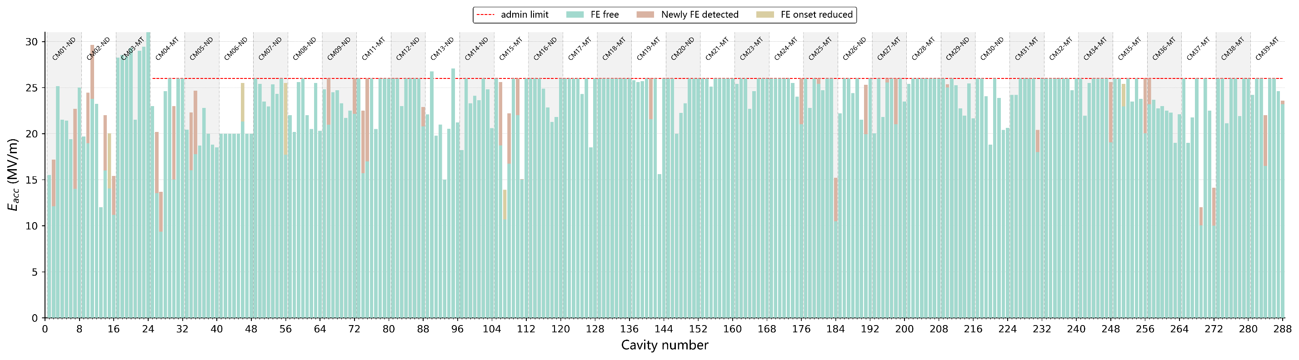
1.3 GHz CM Performance : Field Emission
86 % (247/288) of the cavities showed no degradation in FE performance from VT to HT
  84% FE-Free
  2% (5 cavities) exhibited FE during VT at gradient > 22 MV/m
14% of the cavities experienced FE degradation
  36 newly emerged FE
  5 reduction in FE onset gradient.
  Average FE onset gradient: 18.4 ± 4.7 MV/m
Note
ND: N-Doping
MT: Mid-T baking

Slide 9
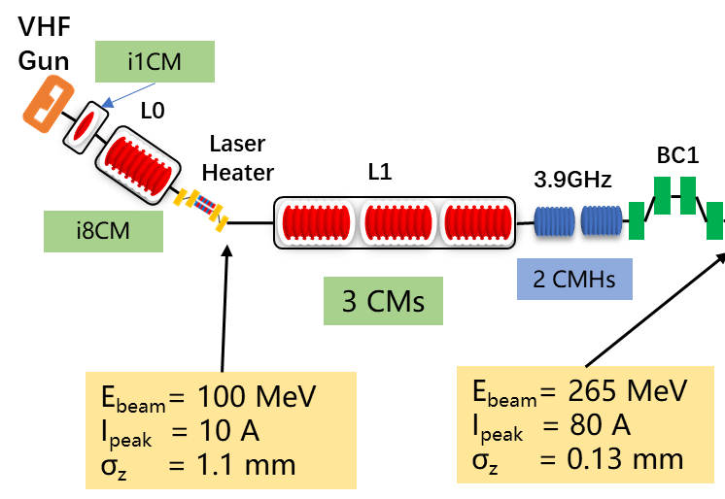
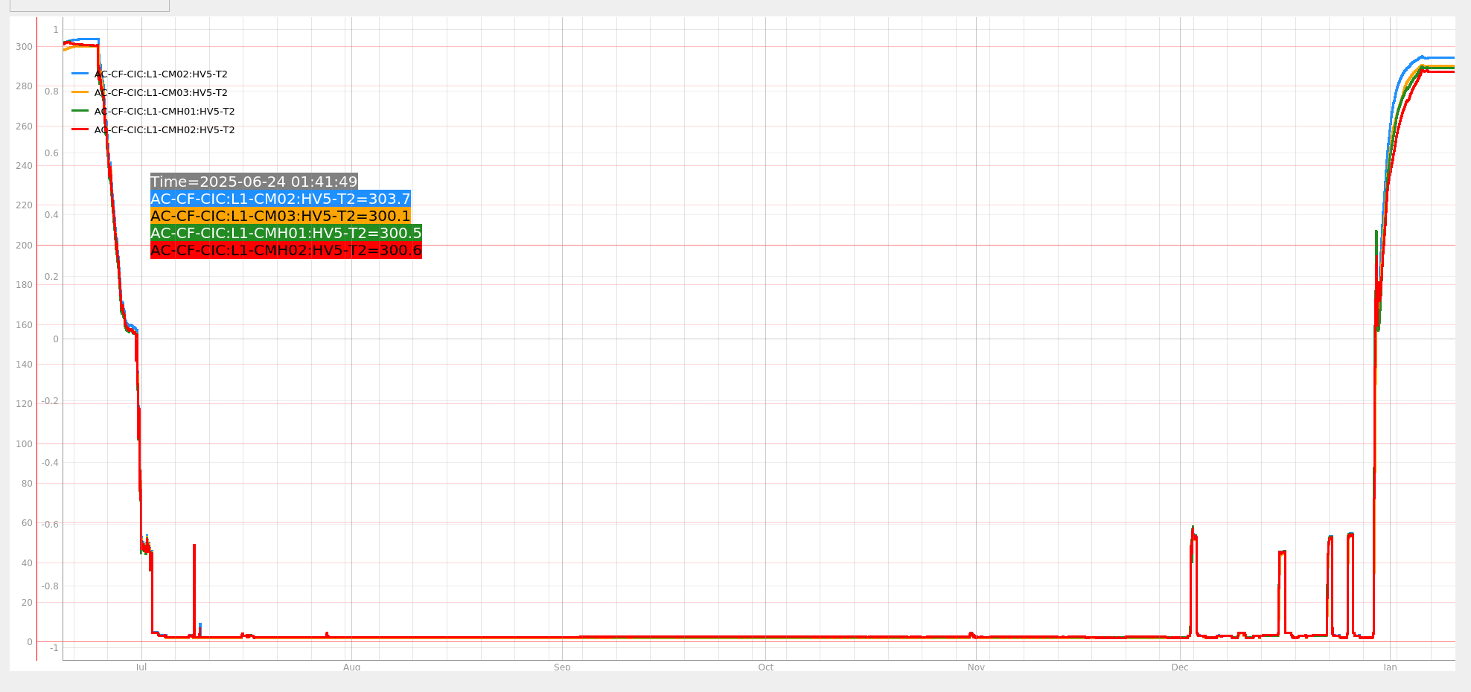
Commissioning for L1 section (1st cooling down)
Cooling down from 300 K to 160 K
June 24, 2025 ~June 30, 2025
2+1 CMs
Warm up
Dec 29, 2025 ~ Jan 04, 2026
160K to 45K (June 30 ~ July 2)
Studies on degaussing and fast cooling
( Nov 15 ~ Dec 28)
Fast cooling down
(July 02, 2025)
RF and beam commissioning for L1
(July 18, 2025 ~ Nov 14, 2025)

Slide 10
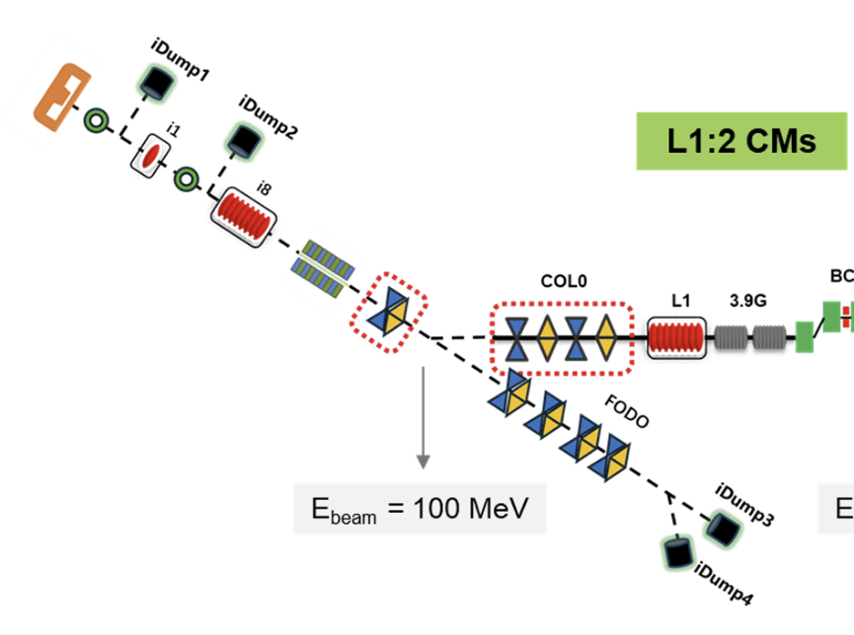
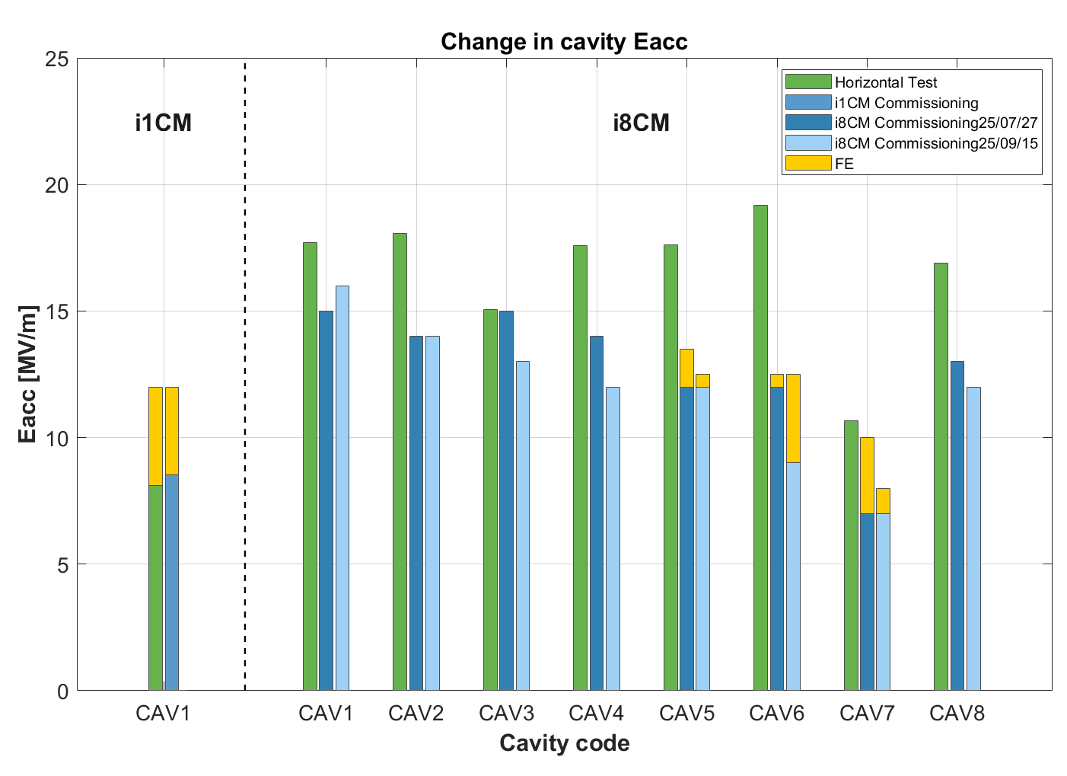
Performance change from HT to commissioning: injector CMs
Injector CMs: i1CM + i8CM
Courtesy of Yubin Zhao
Usable gradients not tested to their maximum in tunnel
Injector commissioning: 2024 Q4
+ L1 commissioning: 2025 Q3-Q4
i1CM: performance maintained
i8CM: FE onset degradation observed in 3 cavities, including 1 (cav6) further decreased during beam commissioning

Slide 11
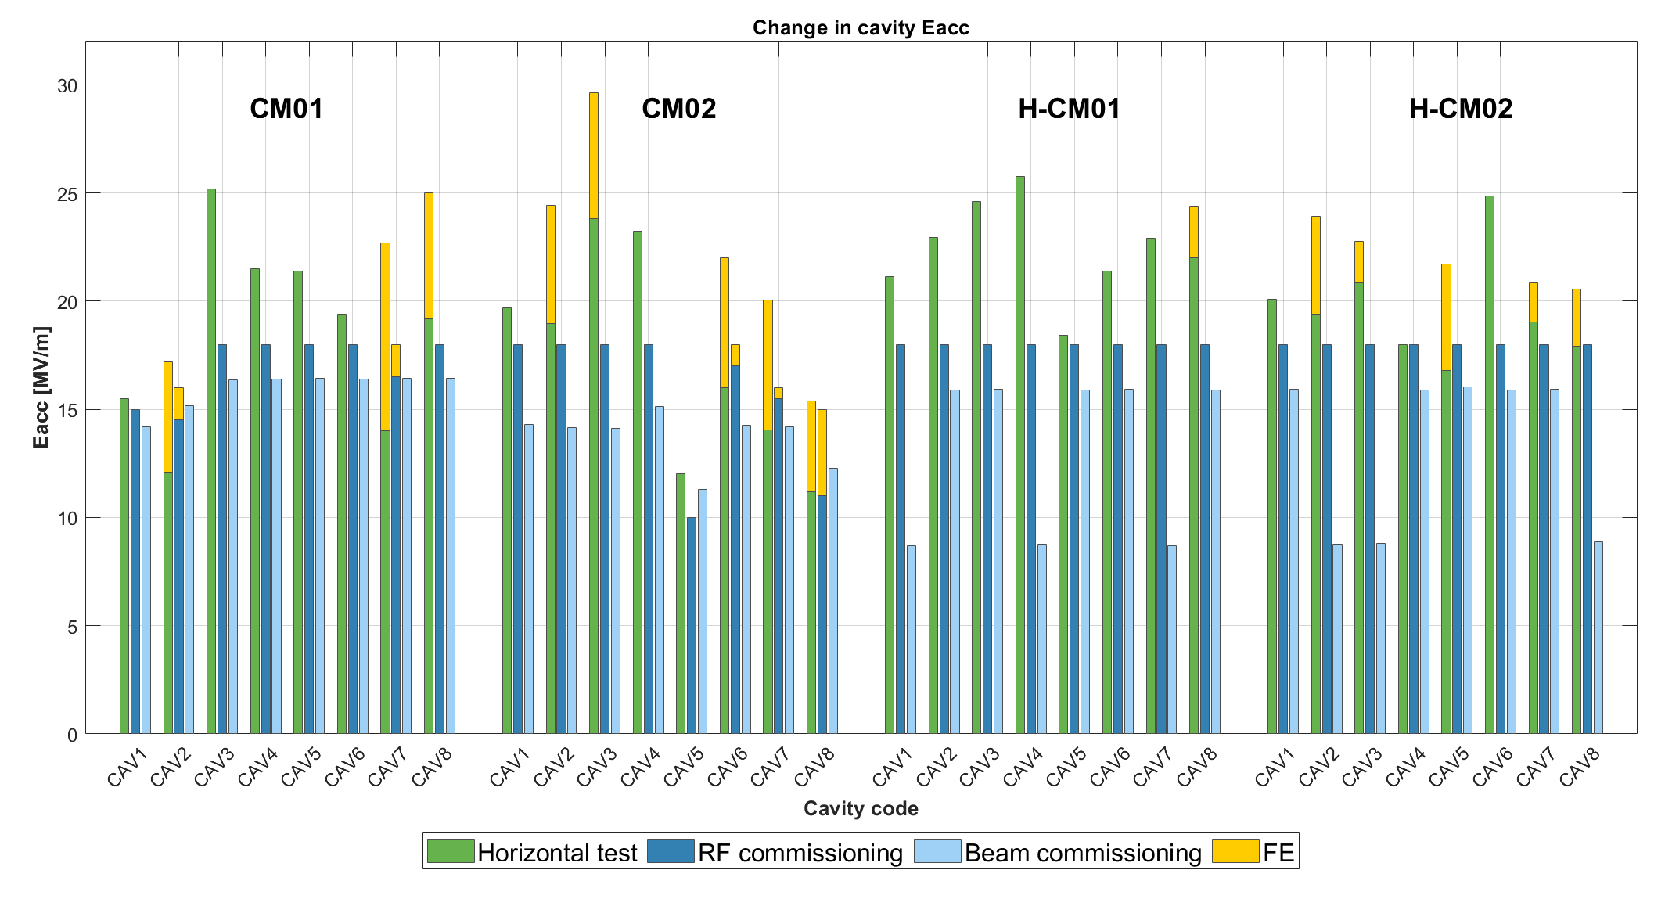
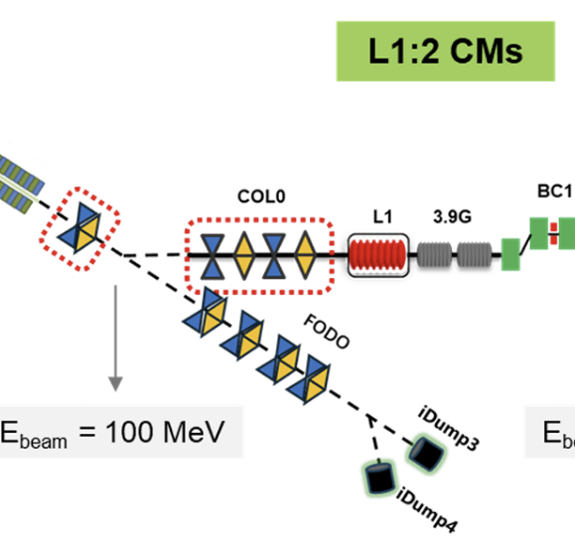

Performance change from HT to commissioning: L1 CMs
Cavities not tested to their maximum Eacc during RF and beam commissioning in tunnel
No FE degradation observed for all the cavities in L1 from HT to tunnel commissioning
(L1-CM02)
(L1-CM03)
E_{beam} = 265 MeV
L1 two 1.3 GHz CMs need providing:
250 MeV
Two 3.9 GHz CMs need providing:
- 65 MeV

Slide 12
Influence factors
Contamination? (suspected in 1 CM，CM10)
Vacuum leak (He-inlet pipe in 1 CM, BPM flange in 1 CM, HOM FT in 2 CMs)
HOM heating （typically, > 24 MV/m）
FE degradation (VT → HT, 14% cavities)
Fast Cooling（typical mass flow rate: 65g/s in HT → 40 g/s in L1）
Degaussing (under study in tunnel)

Slide 13
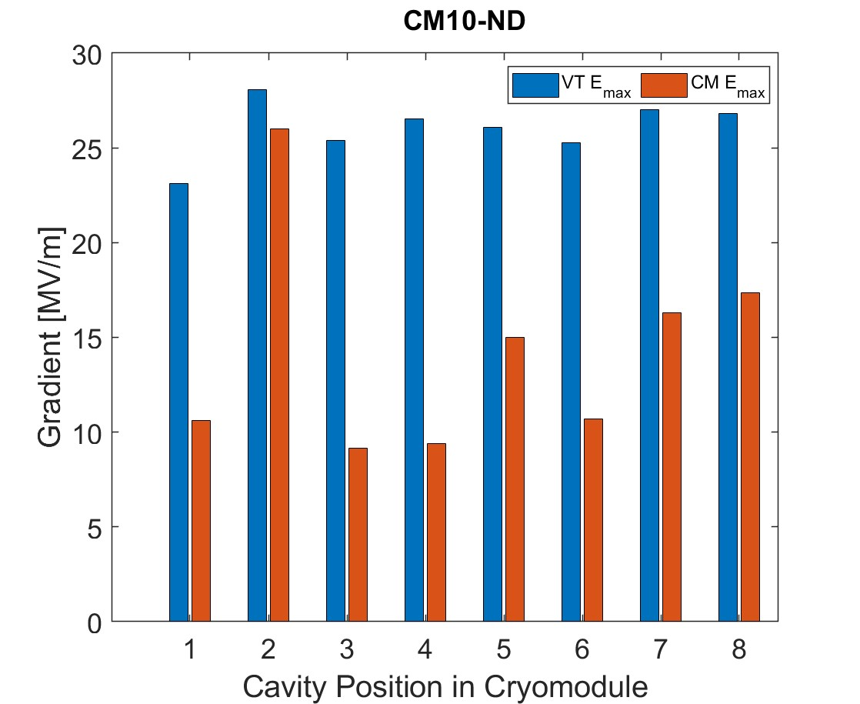
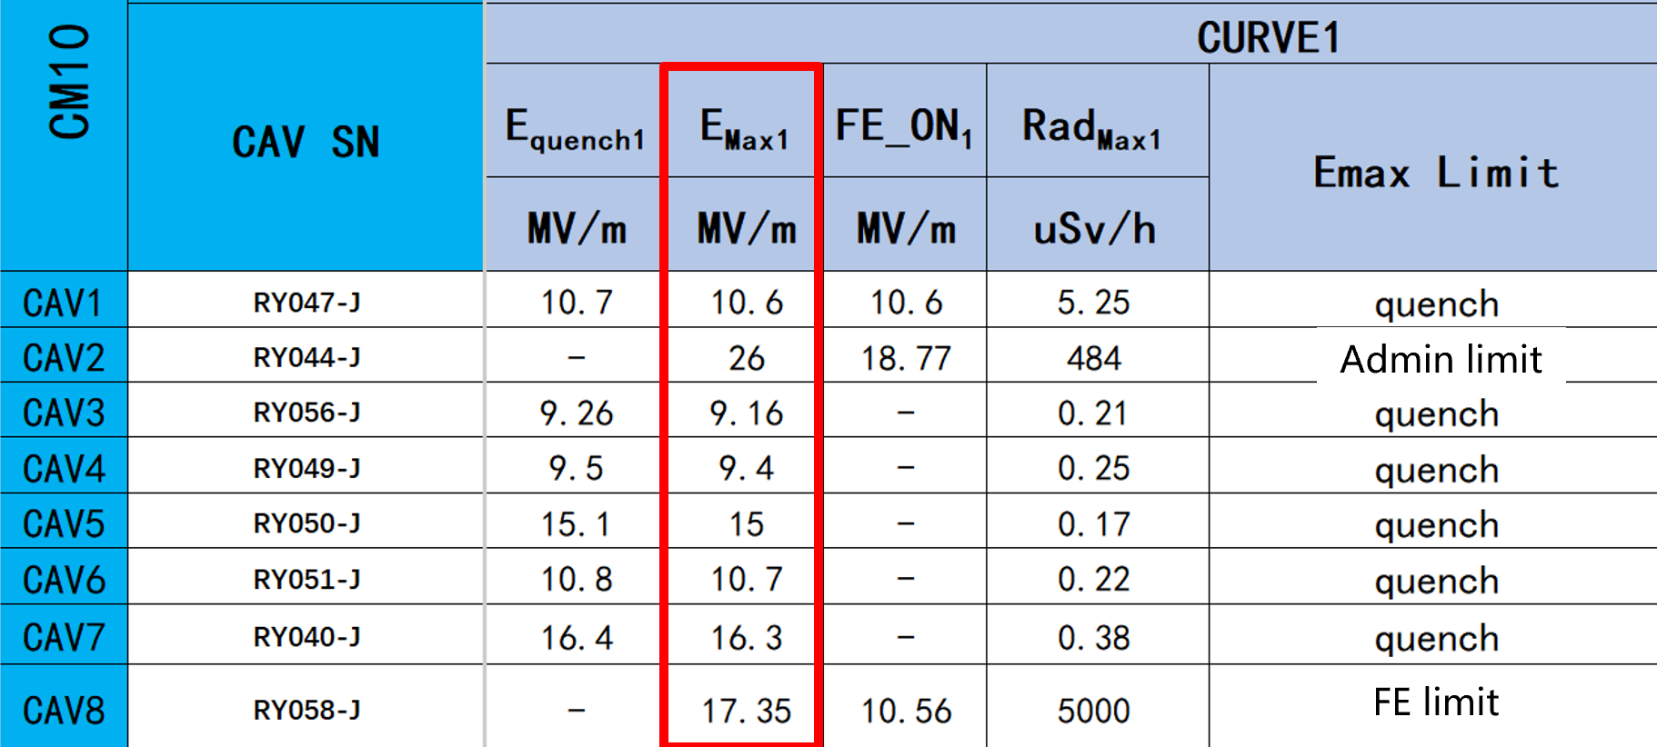
CM10-ND with abnormally low gradients in HT, contaminated?
HT: Q₀=3.4E+10 @ 112 MV
Likely contaminated in CM, cause unclear

Slide 14
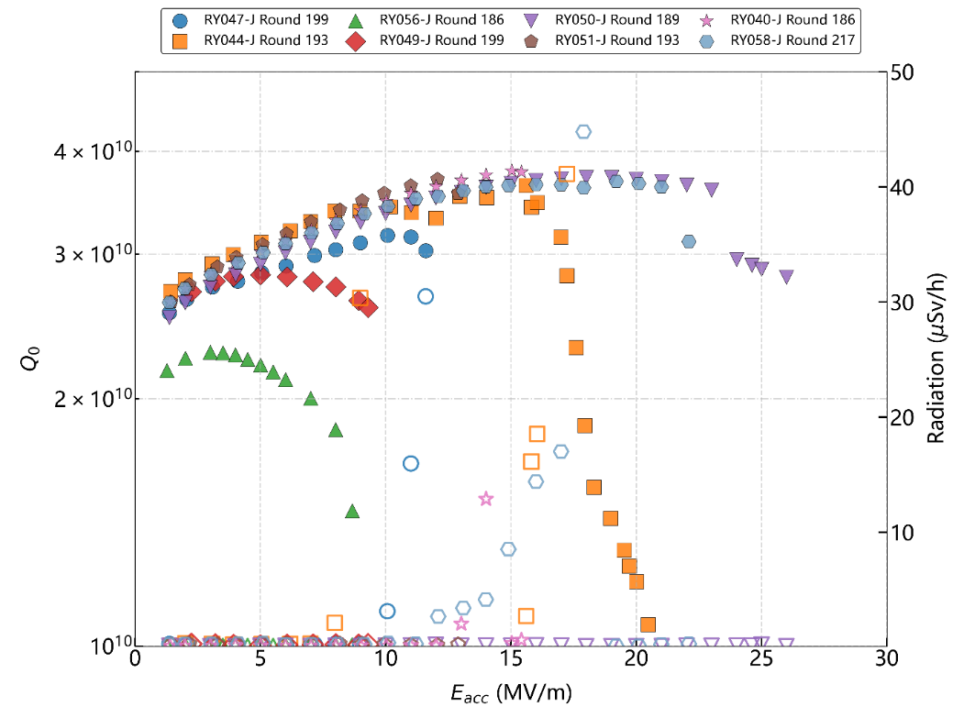
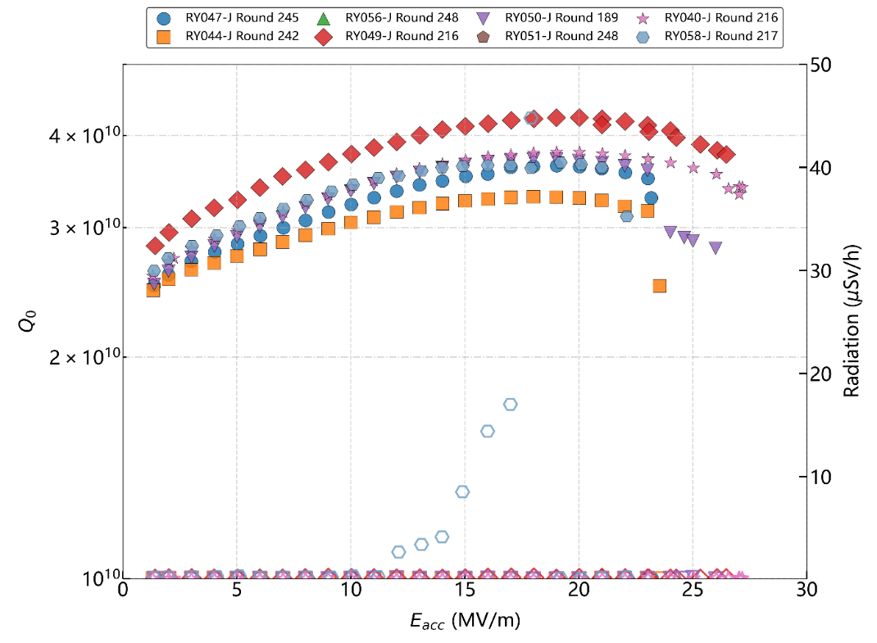
CM10-ND: cavities have been dissembled, repaired and reused
4 cavities (RY040-J, RY049-J, RY050-J, RY058-J)，recovered after HPR，reused in CM29 and CM30 ；
4 cavities (RY044-J, RY047-J, RY051-J, RY056-J), still unqualified after HPR, then recovered by light BCP polishing，and installed in CM36.
4 cavities recovered by BCP light polishing：
Average max Eacc:
13.5 →23.3 MV/m
~10 MV/m improved
Specs
(Flange losses not deducted)
RY058-J
Curve2 rad disappeared
VT after HPR (8 cav)
VT after recovery by（4 HPR + 4 BCP）

Slide 15

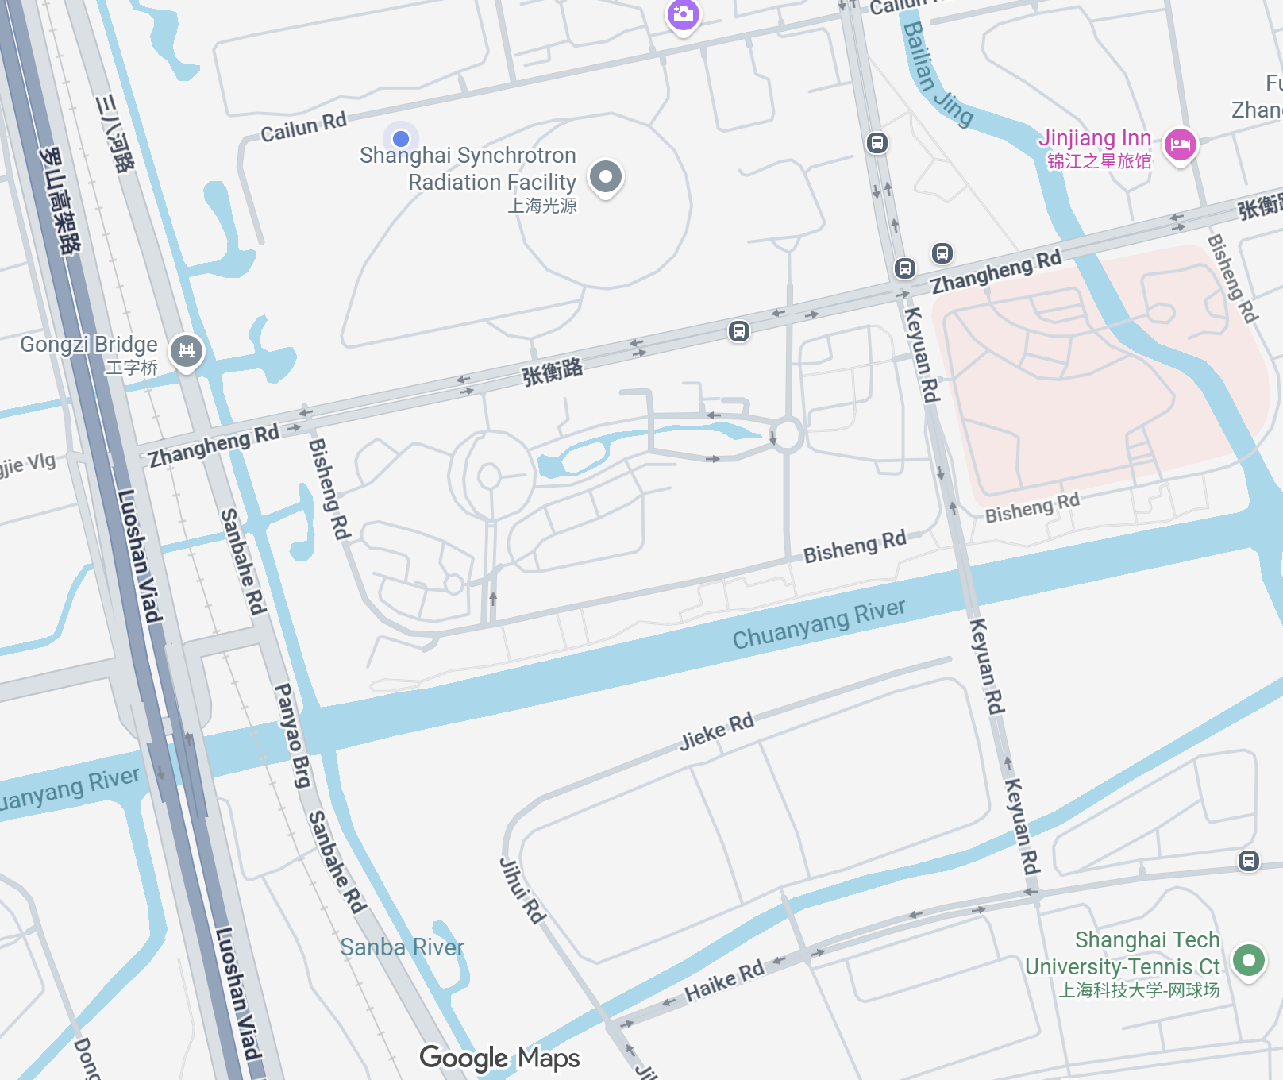
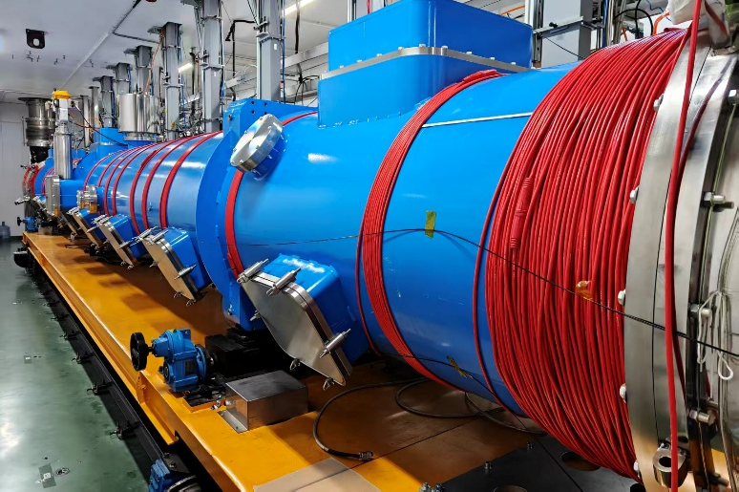
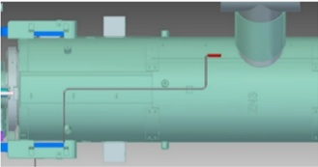
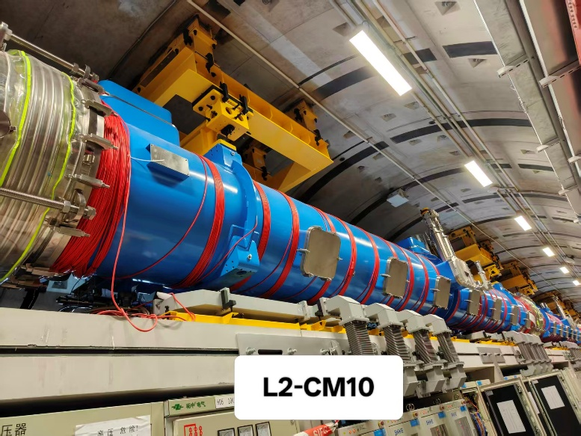
Degaussing
（typically, < 1 mGs reading can be achieved after degaussing）
HT stand (HTF1, CM31)
HT stands (~ east-west )
Flux gate location on cav1/5
SHINE Linac tunnel (~ north-south)
Degaussing may affect adjacent CMs in tunnel (under study)
Linac tunnel

Slide 16
Summary
High-Q cavities: high average performance achieved on both mid-T baked and N-doped cavities in VT, among them 365 cavities have been accepted for CM assembly so far.
VT →HT: 36 CMs have been tested, including 15 ND and 21 MT CMs, reached an average usable gradient at 24.0 MV/m and Q₀ of 3.3 E+10 at 20 MV/m. Slightly degradation observed from VT to HT: ~10% in gradient and Q_{0,} ~15% new FE.
HT →Tunnel commissioning (not tested to their maximum): No degradation of gradient found in i1CM and 4 CMs in L1 section, however, new FE appeared in 3 cavities of i8CM.
Influence factors: vacuum leak is the main issue caused CM rework, and CM degaussing in tunnel may be challenging due to mutual interference
CMs of L1-L3 are under cooling down, and first lasing is expected within 2026.

Slide 17
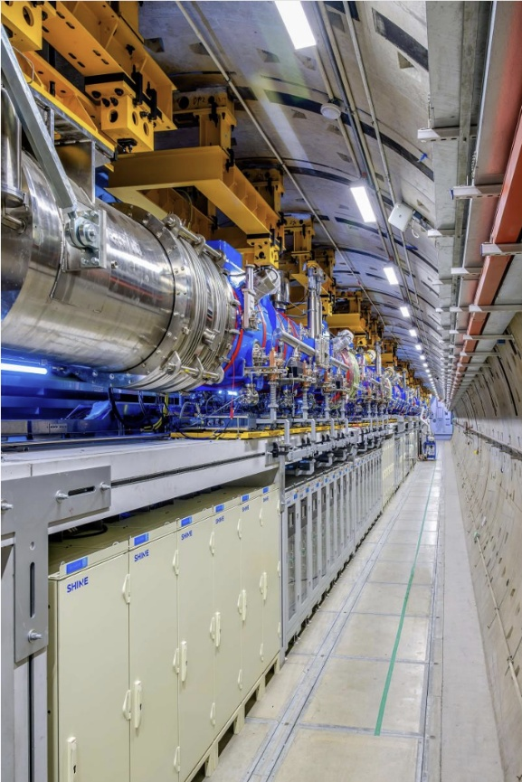
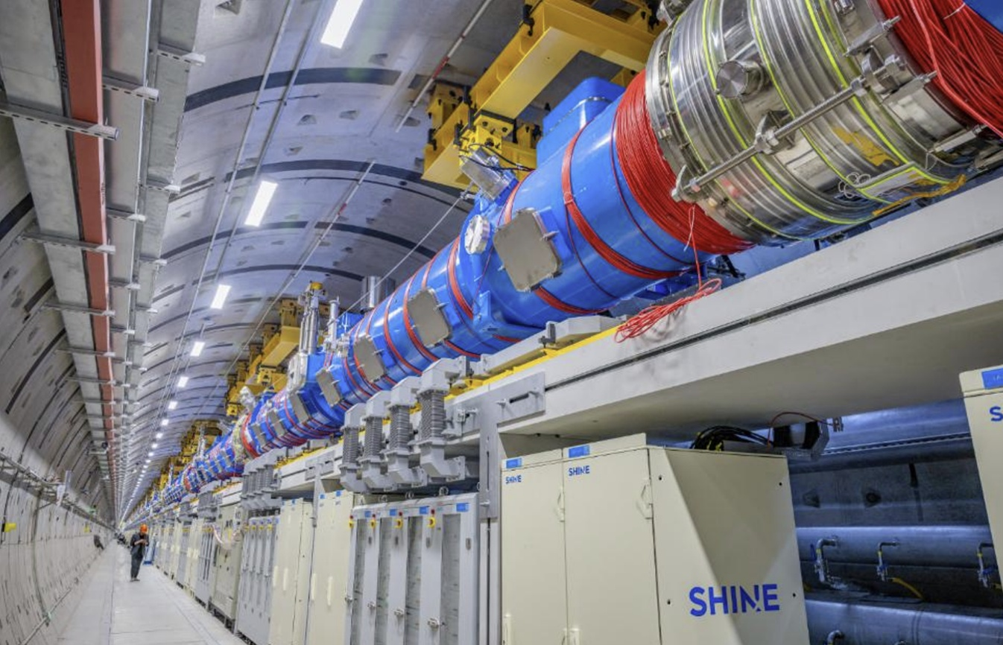
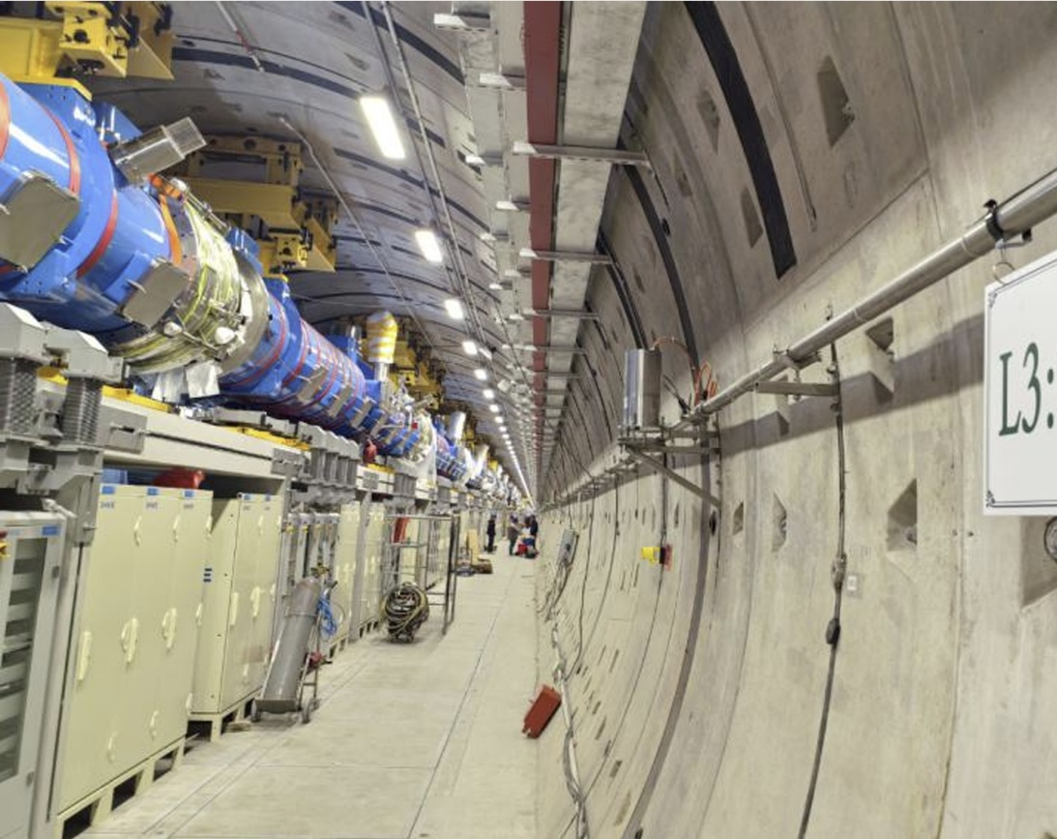
Acknowledgments
  Great effort by SHINE cryomodule team members
  Supports from SHINE cryogenic team, general technology team and undulator team
Thanks for your attention!
L1
L2
L3

