Slide 1


Plasma Processing of elliptical cavities at INFN - LASA
TTC 2026, WG2, Paris-Saclay
Elisa Del Core
LASA – INFN, Milan

Slide 2

Outline
  Plasma Processing
    ESS MB 704.4 MHz – unity coupler
    ESS MB 704.4 MHz – custom antenna
    ESS MB 704.4 MHz – spectrometer analysis
  Summary & Next steps
    ESS MB 704.4 MHz – FPC
    PIPII LB650
INFN – Laboratori Nazionali di Legnaro
Quarta Giornata Acceleratori 3-4 Aprile 2025

Slide 3
Outline
  Plasma Processing
    ESS MB 704.4 MHz – unity coupler
    ESS MB 704.4 MHz – custom antenna
    ESS MB 704.4 MHz – spectrometer analysis
  Summary & Next steps
    ESS MB 704.4 MHz – FPC
    PIPII LB650
INFN – Laboratori Nazionali di Legnaro
Quarta Giornata Acceleratori 3-4 Aprile 2025

Slide 4
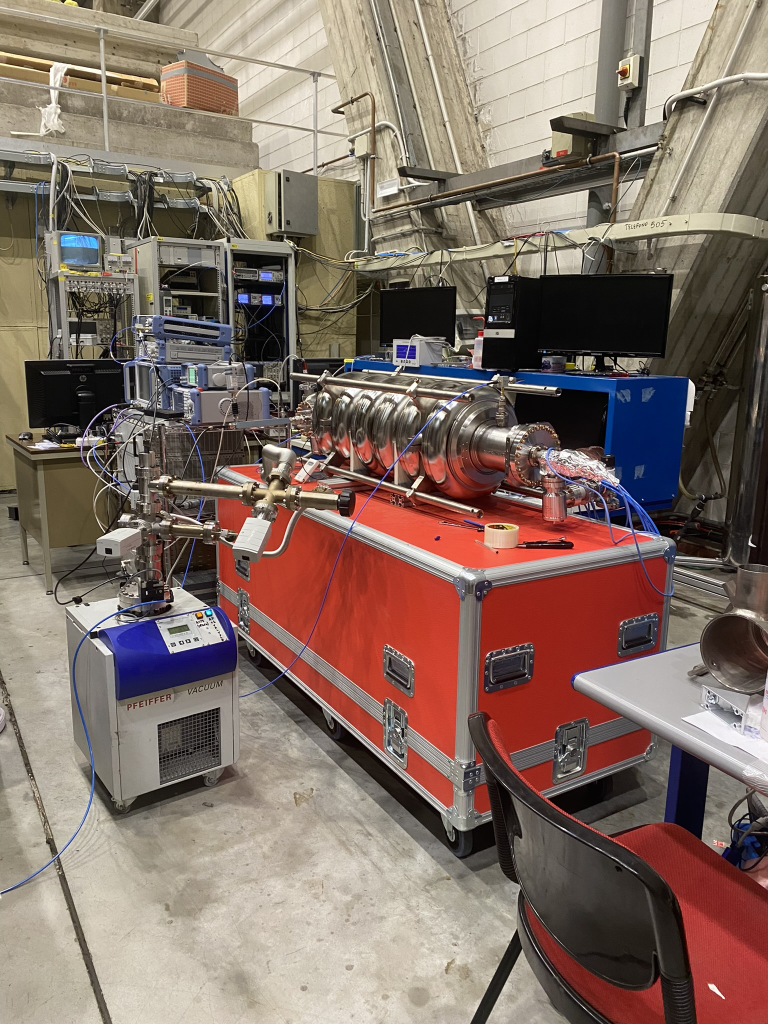
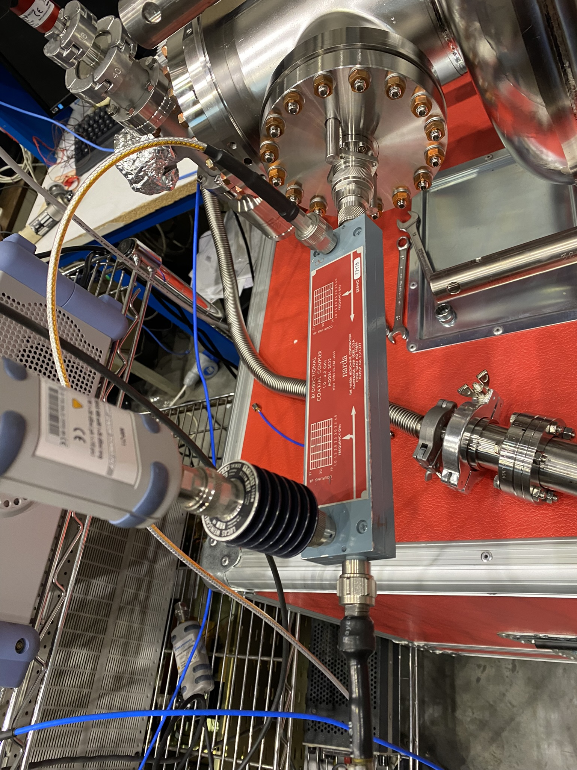
Plasma Processing @LASA
Initial Aim: develop a method to cure Field Emission both in situ and on the vertical test stand, for MB 704.4 MHz 6-cell ESS (β=0.67) and LB650 PIP-II 5-cell (β=0.61) cavities. We have started this activity in partnership with ESS, CEA and FNAL labs.
Currently: experimental activity on ESS MB cavities
& simulations on PIP-II cavity
Mitigate Field emission to reduce RF power consumption
Prevent the need of disassembling cavities from cryomodules, leading to lower costs, reduced time and longer lifetime.
Our setup:
No HOM ports → we have to use unity coupler (for VT configuration) or FPC
In the VT configuration both input and output gas ports on PU side → Is hydrocarbons removal efficient?

Slide 5
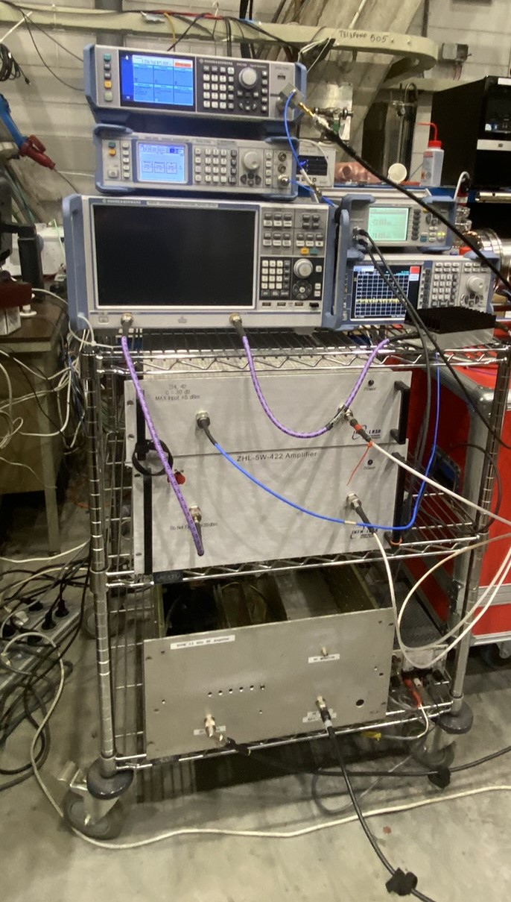
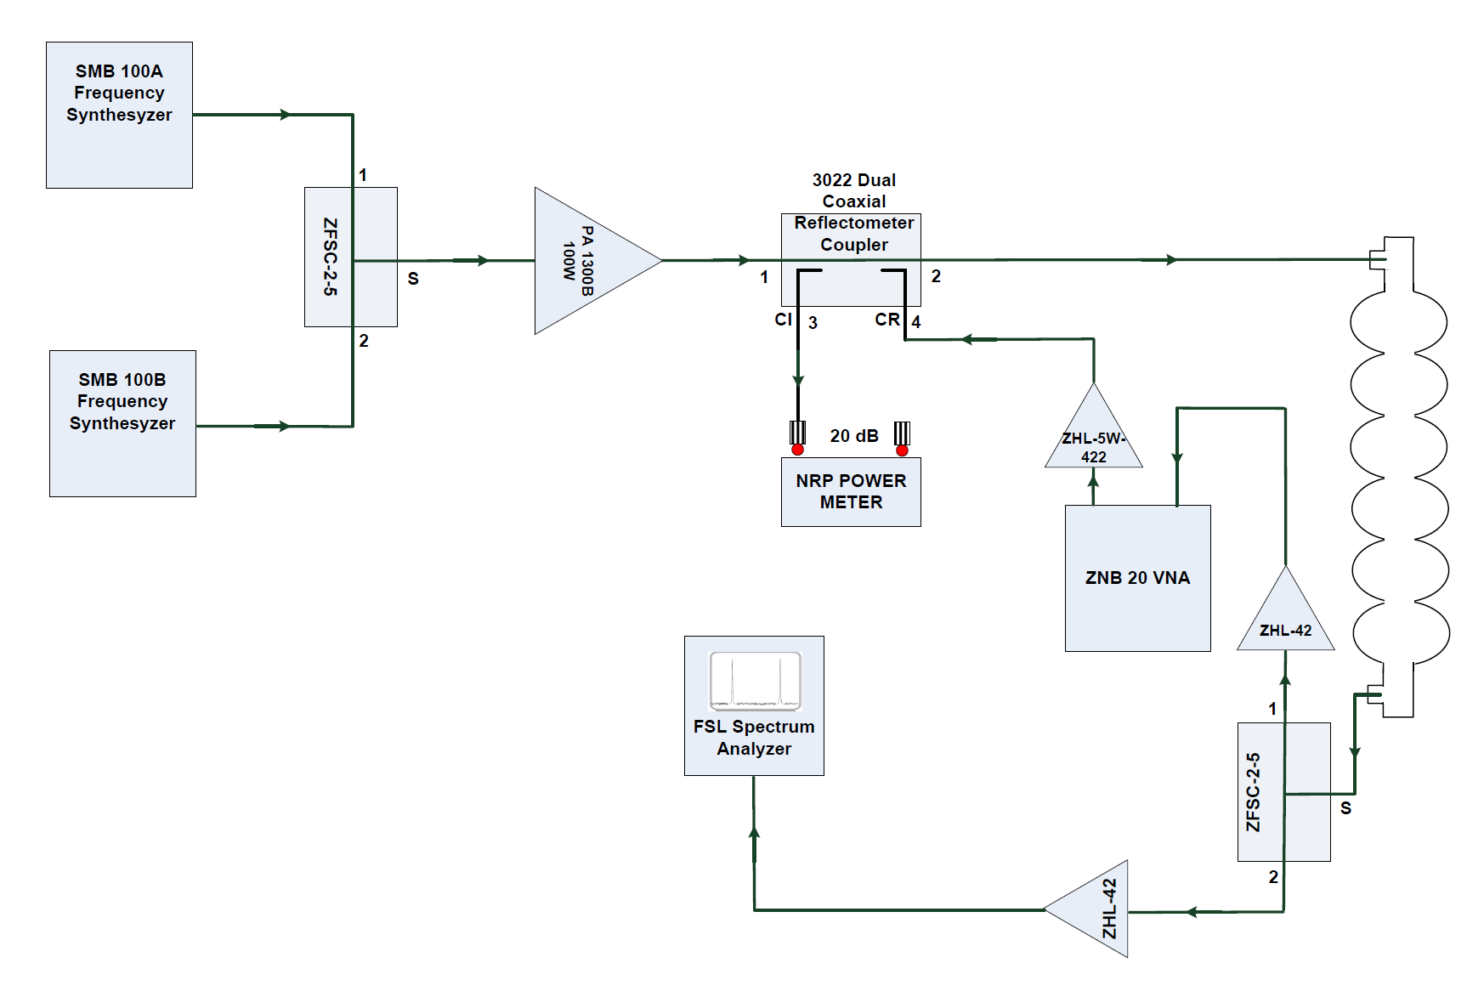
First RF setup
RF rack

Slide 6
Outline
  Plasma Processing
    ESS MB 704.4 MHz – unity coupler
    ESS MB 704.4 MHz – custom antenna
    ESS MB 704.4 MHz – spectrometer analysis
  Summary & Next steps
    ESS MB 704.4 MHz – FPC
    PIPII LB650
INFN – Laboratori Nazionali di Legnaro
Quarta Giornata Acceleratori 3-4 Aprile 2025

Slide 7
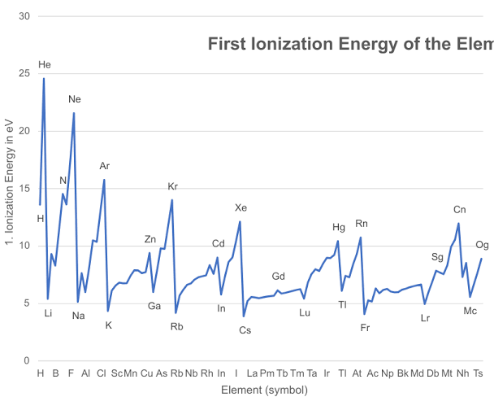
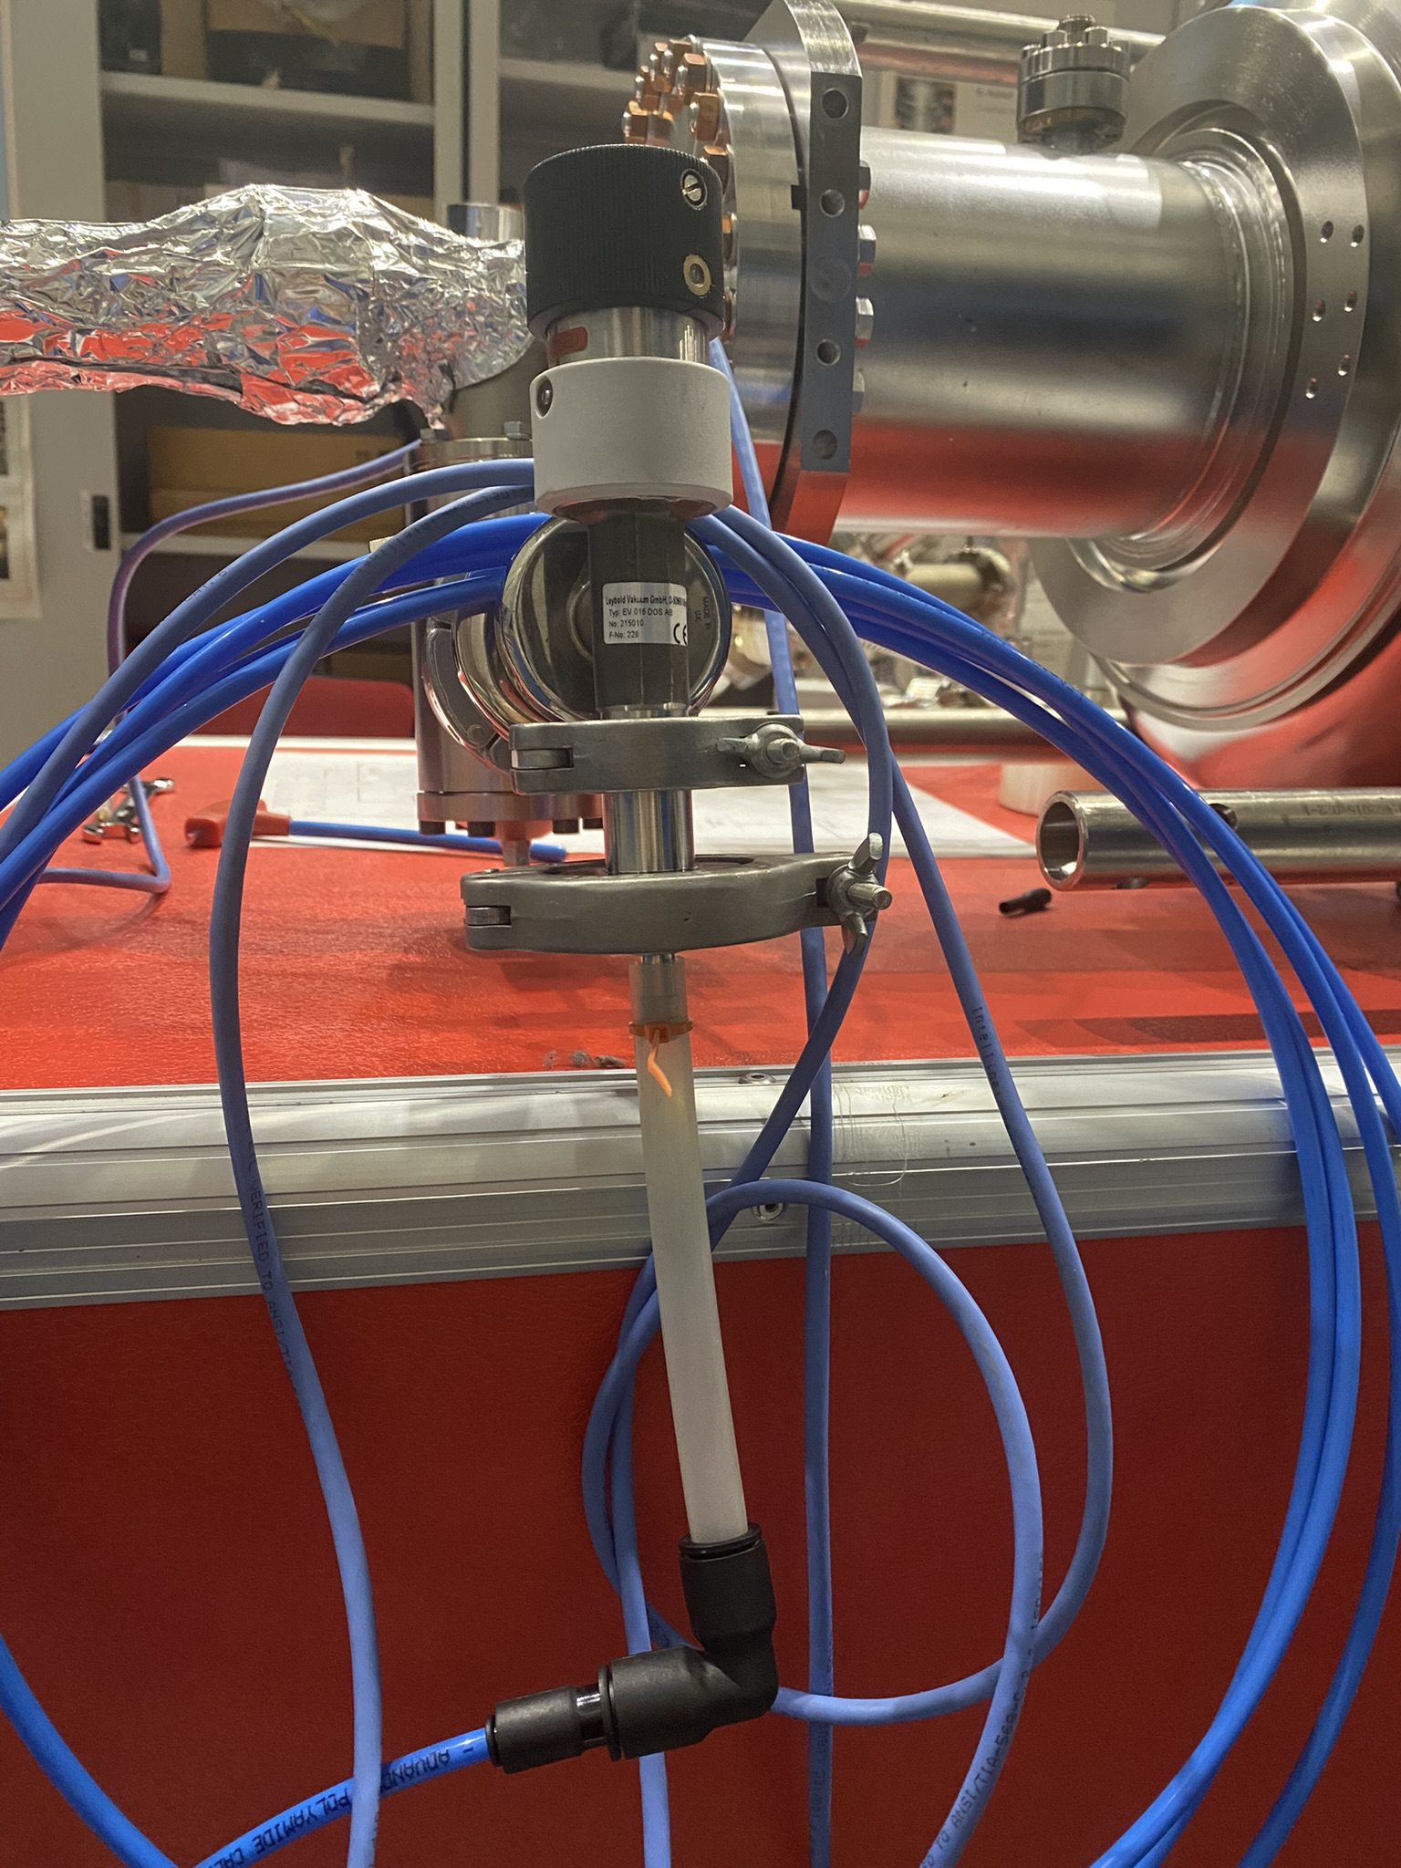
First Setup
1.2 - 1.4 GHz 500 W / 0.5 – 2.5 GHz 200 W amplifier
Range covered with measurements: 1.1 – 1.7 GHz
Vacuum pressure: 0.25 – 0.35 mbar
Ignition gas: Nitrogen
Two viewports + 1 camera
Unity coupler
RF power levels constantly monitored
ESS MB 704 MHz cavity MBLG002
RF IN
𝑁₂ first ionization energy ≈ 14.5 eV
𝑄₀ ≈ 10⁴ and a 𝑄_{𝑒𝑥𝑡} ≈ 6 ⋅ 10⁹
RGA not yet implemented
No active pumping
N2 IN
Experimental apparatus

Slide 8
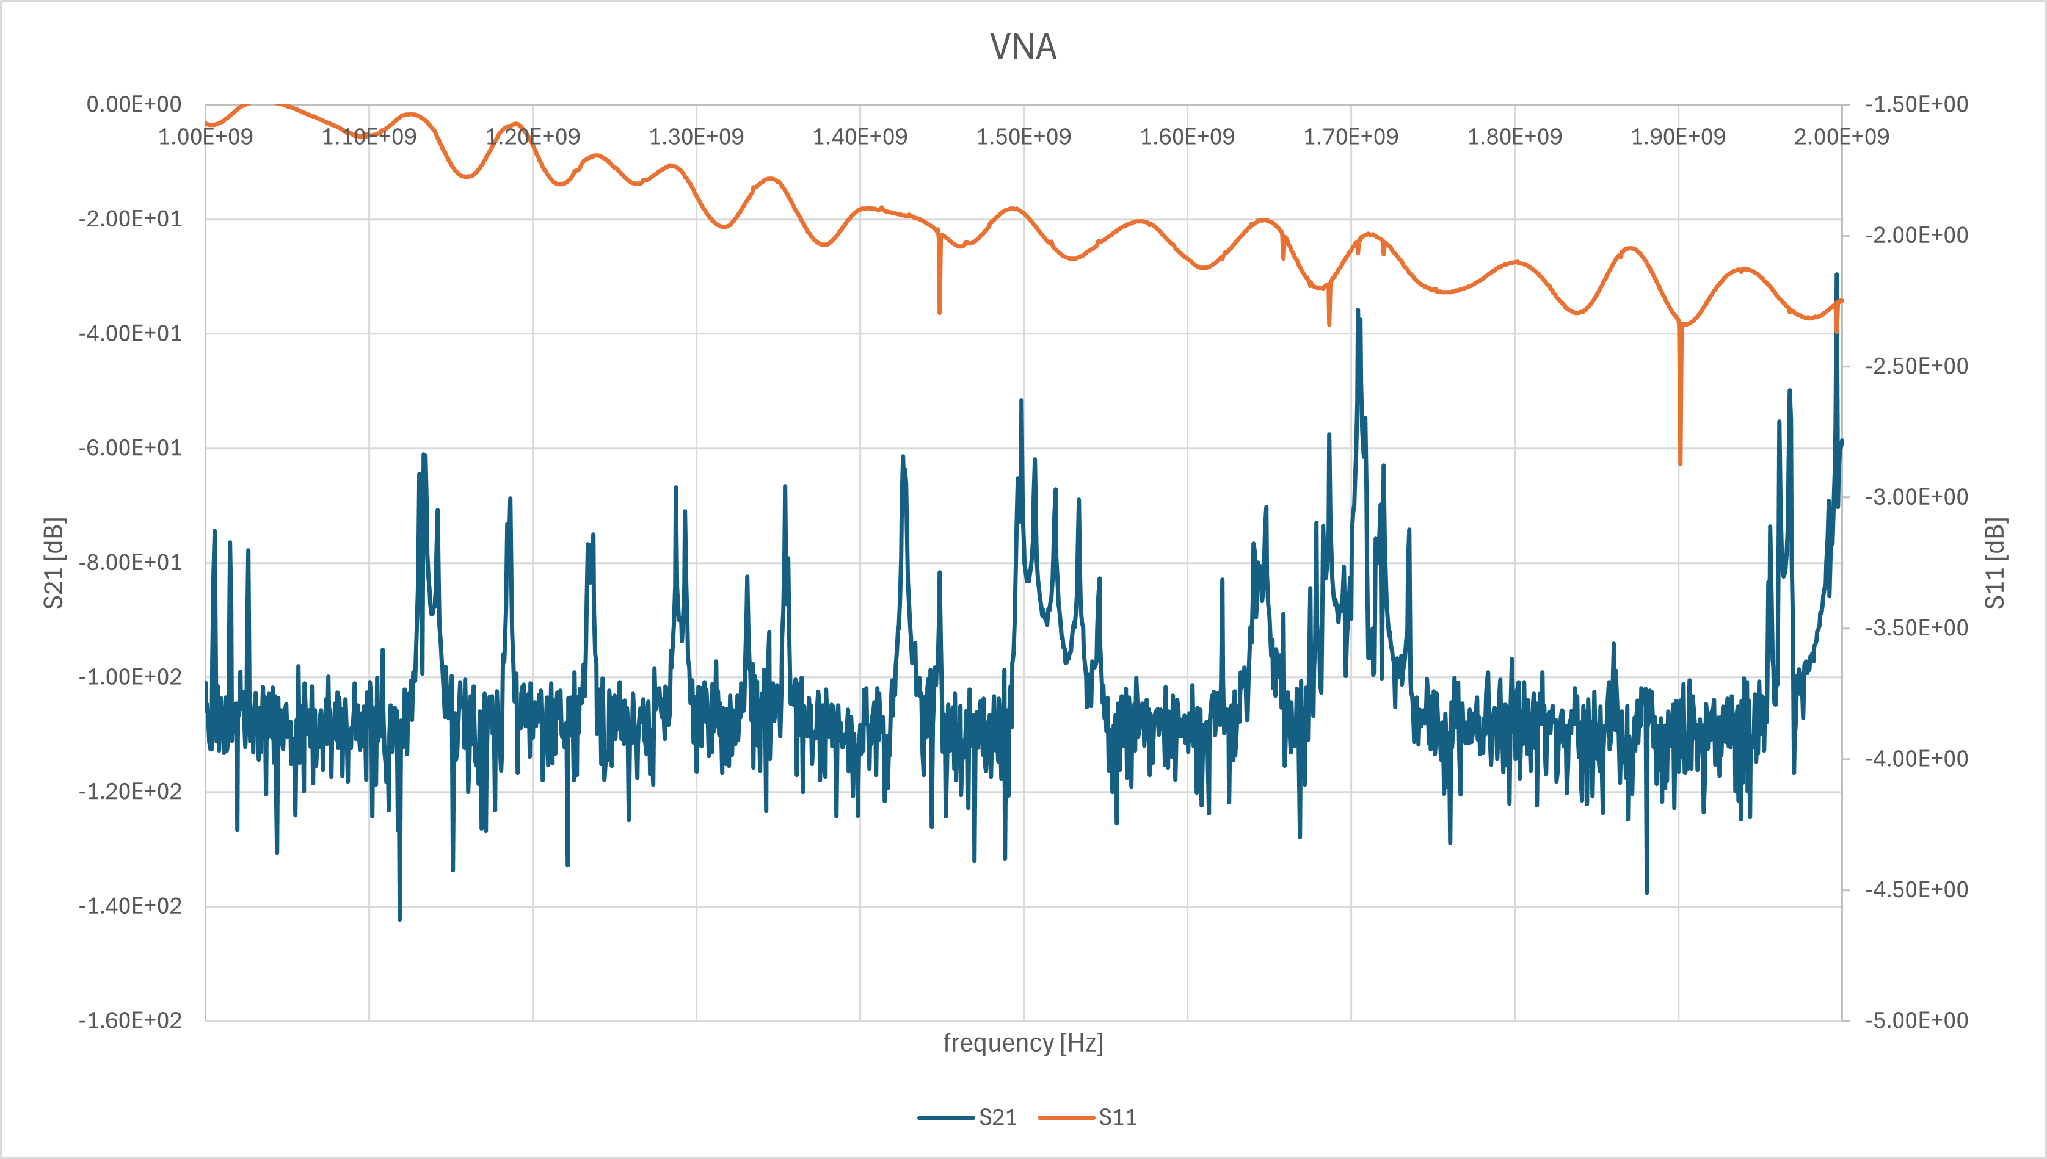
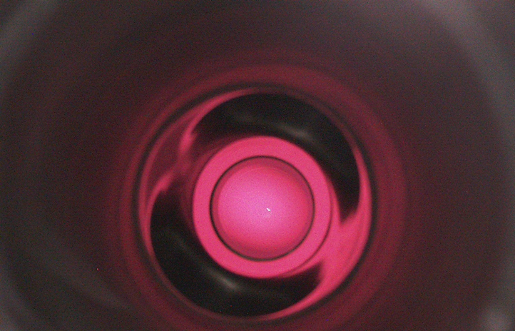
VNA S21 & S11 1 – 2 GHz - ESS
Mode for ignition: 1.44897 GHz
Excited mode localized in the beam tube, on the main coupler side
S11 not calibrated
Several modes exhibit reasonable coupling at room temperature. Lower coupling requires more forward power to achieve plasma ignition.
Modes tried

Slide 9
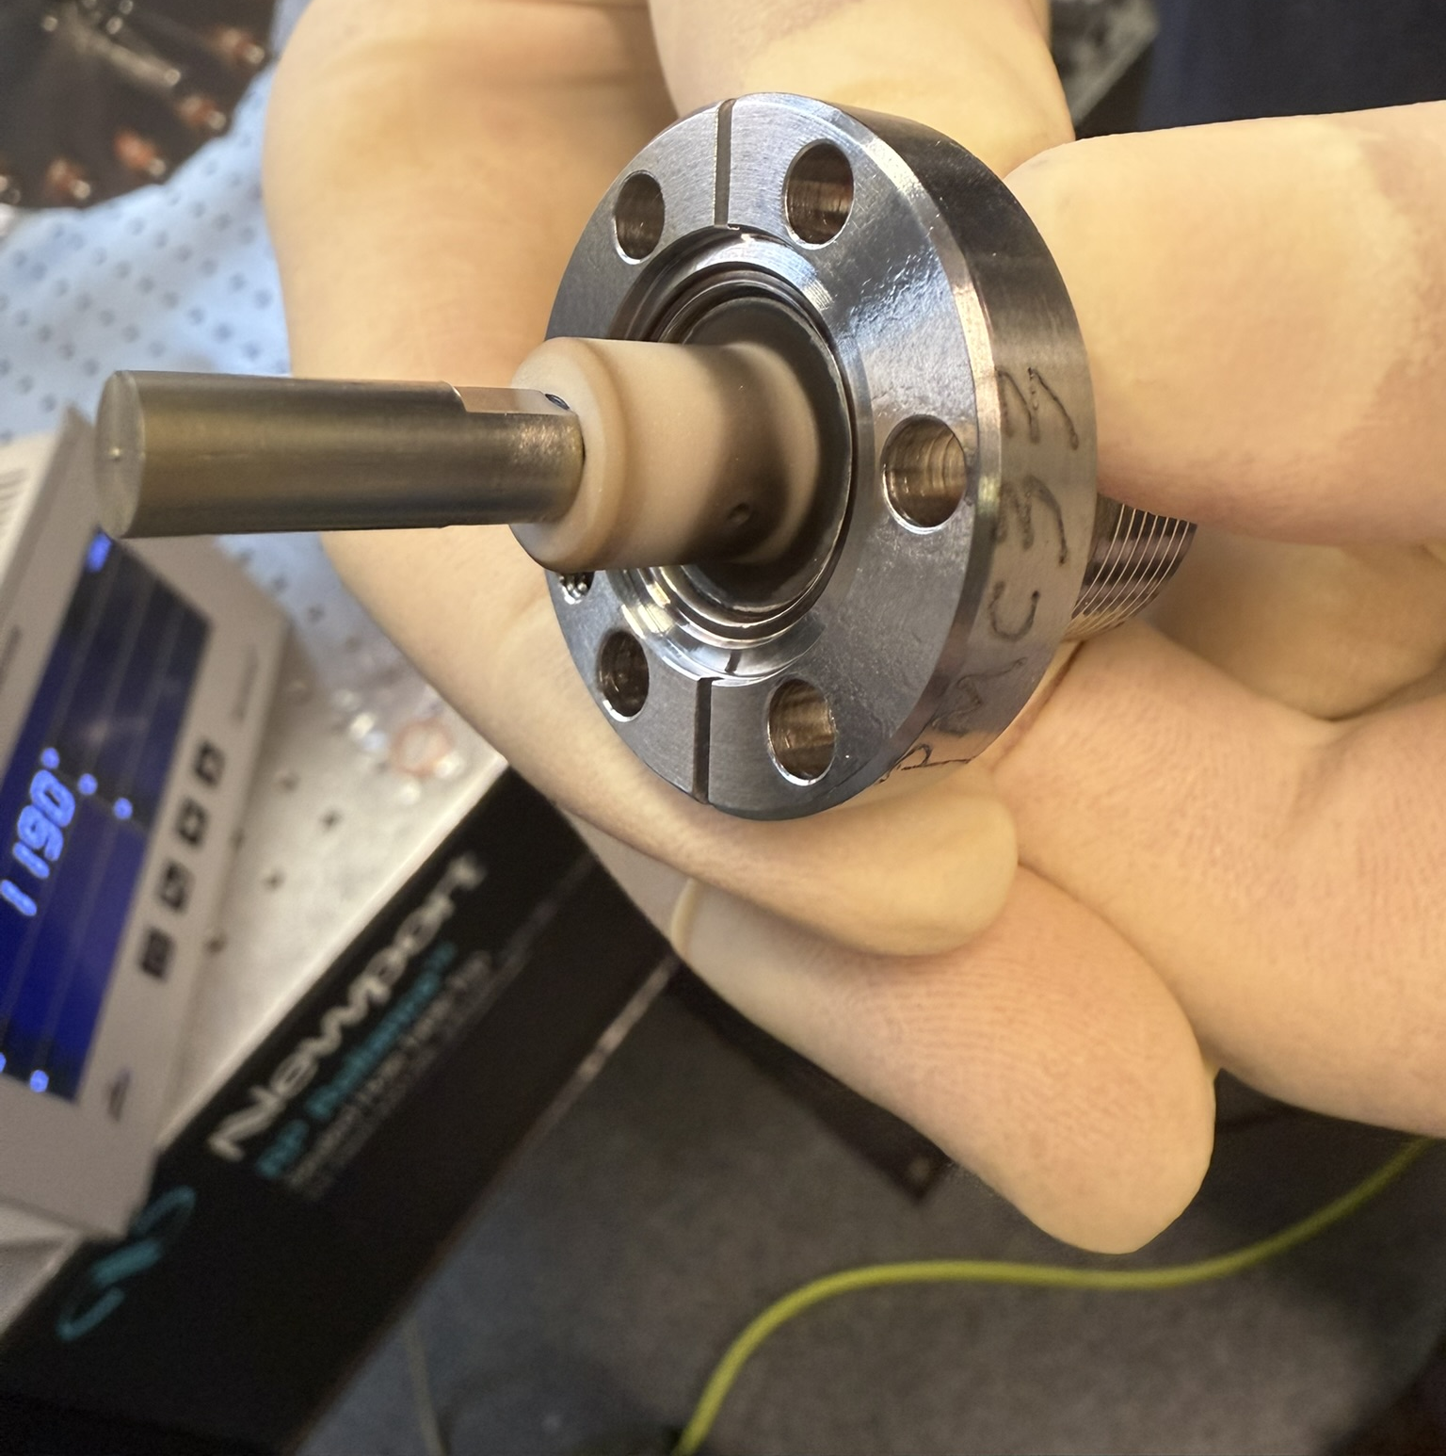
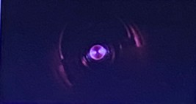
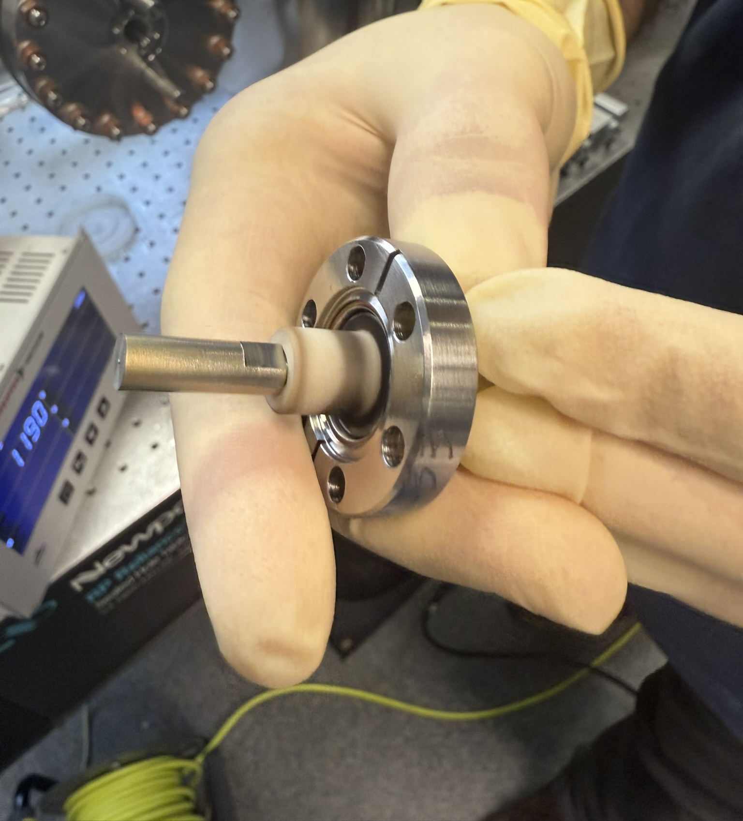
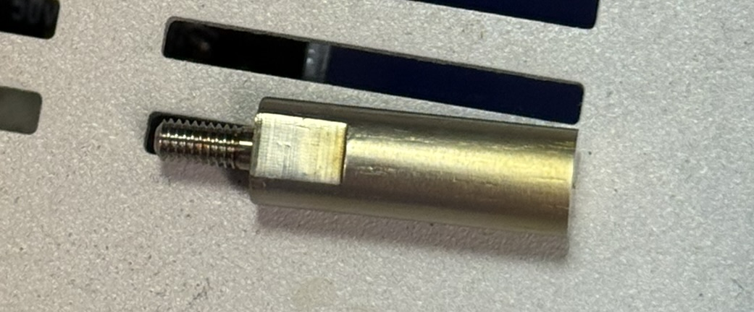
VT MC Antenna
During these tests, we unintentionally ignited the main coupler antenna several times, using different frequencies.
L ~ 18 mm
→ Tube inspection when FPC will be installed
Titanium nitride (?)

Slide 10
Outline
  Plasma Processing
    ESS MB 704.4 MHz – unity coupler
    ESS MB 704.4 MHz – custom antenna
    ESS MB 704.4 MHz – spectrometer analysis
  Summary & Next steps
    ESS MB 704.4 MHz – FPC
    PIPII LB650
INFN – Laboratori Nazionali di Legnaro
Quarta Giornata Acceleratori 3-4 Aprile 2025

Slide 11
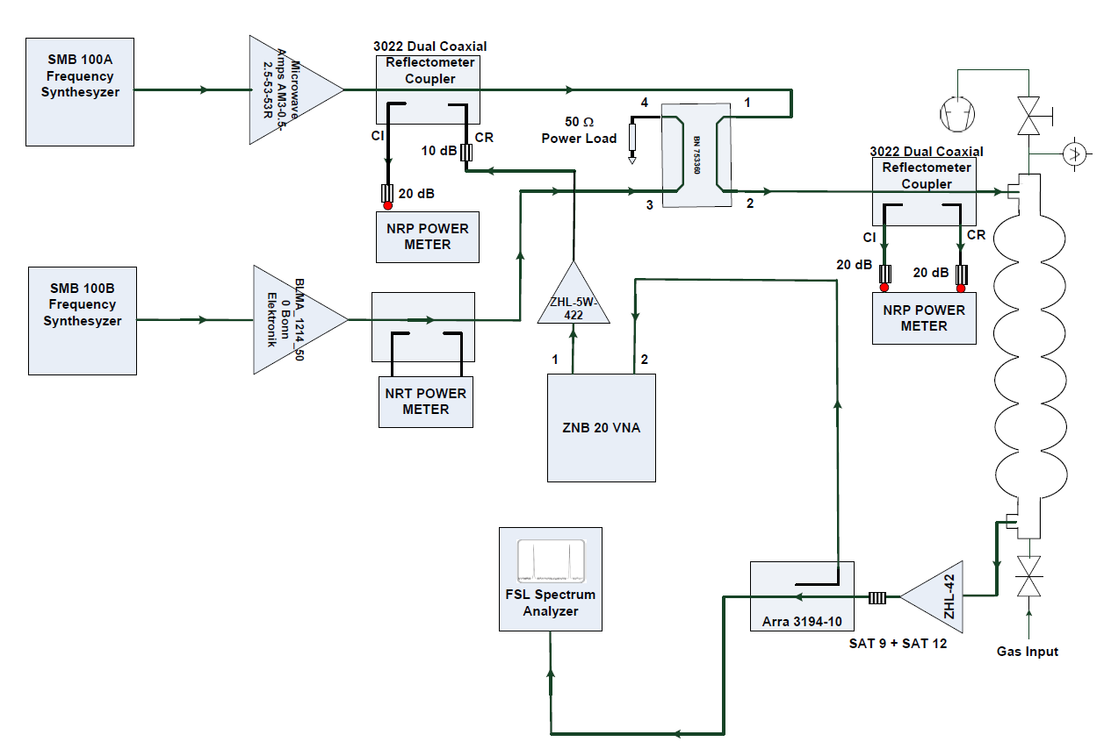
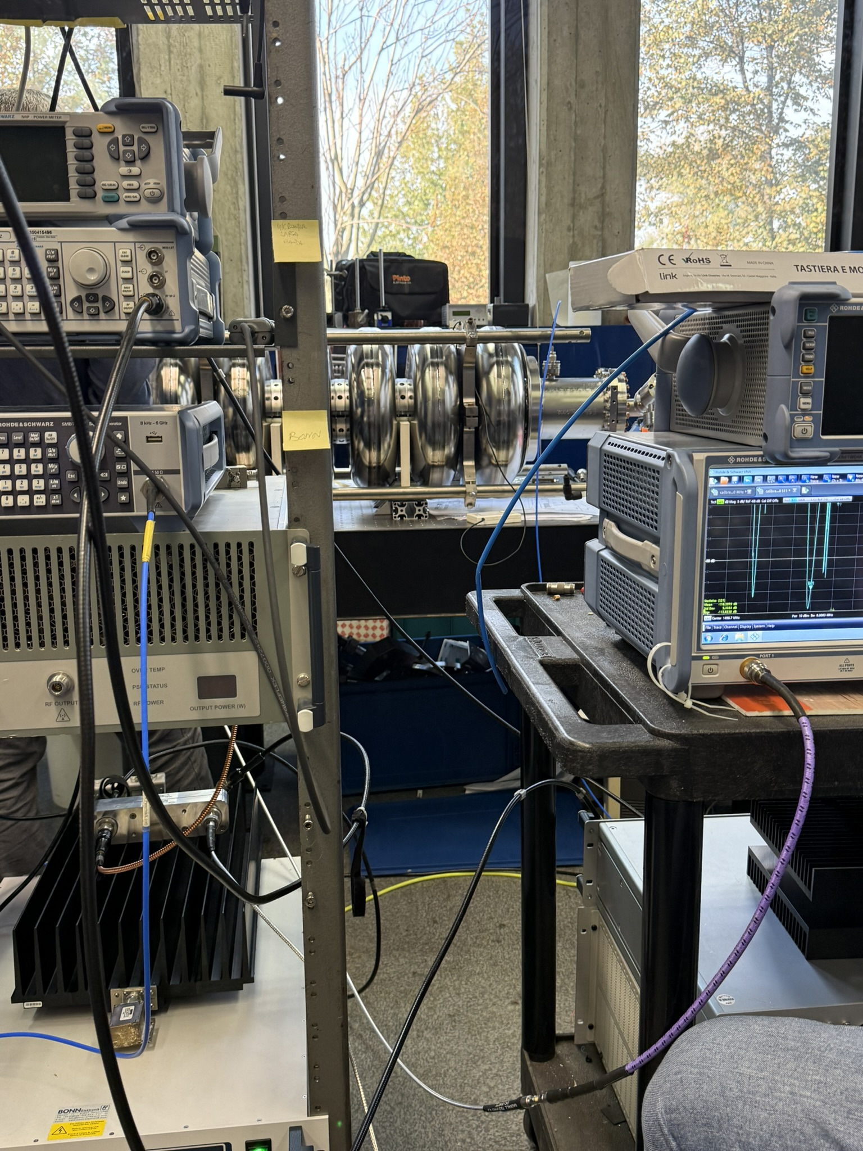
RF & vacuum setup

Slide 12
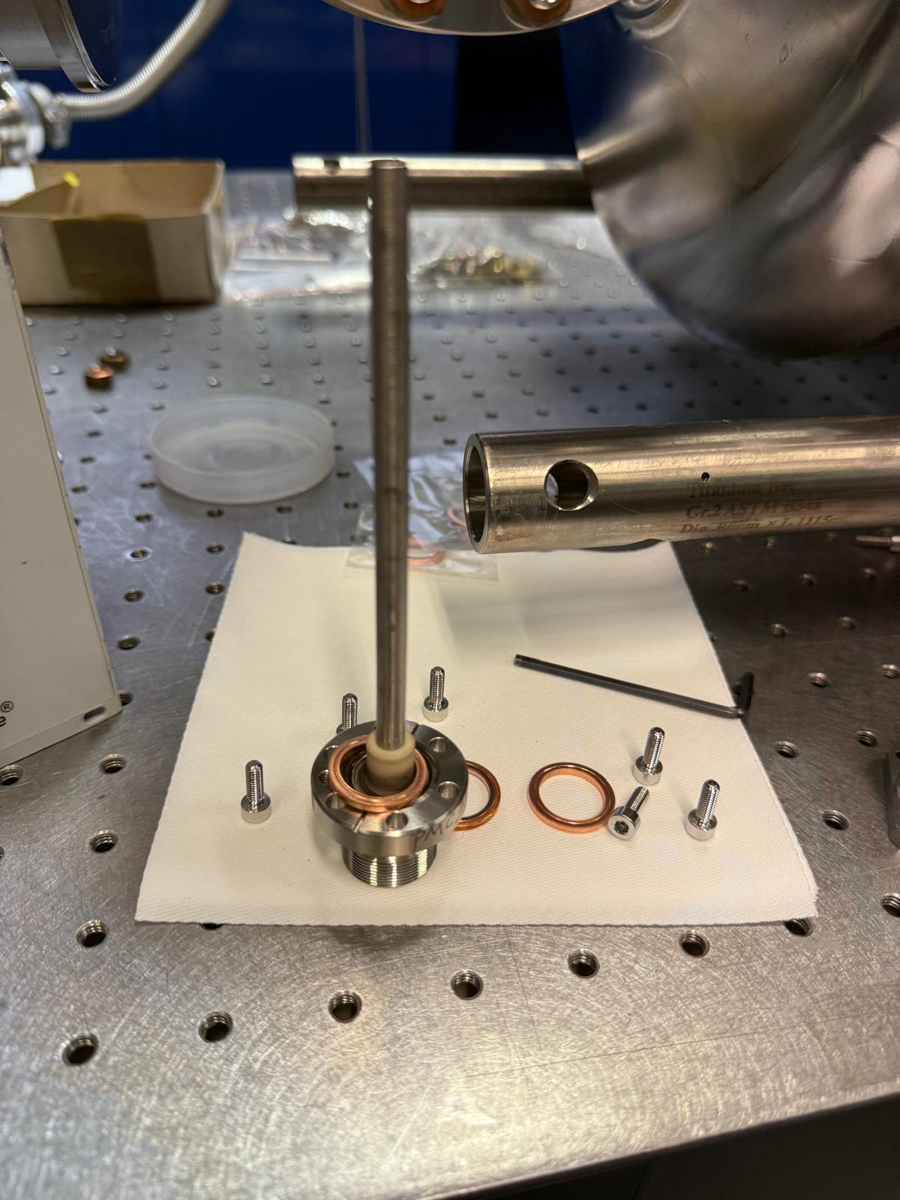
S21, S11 new custom antenna
L = 138 mm
Params
Q0 | 9600
QL | 8914
SWR | 12.014
Q_{ext} | 1.15E+05
βi | 0.083
Q_{ext} FPC ~ 7.5 E5

Slide 13
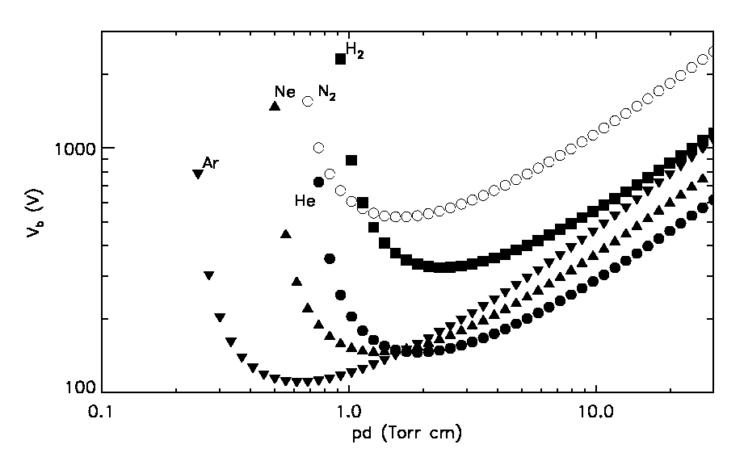
Paschen Curve – N₂
Theoretical Paschen curve
Experimental Paschen curve

Slide 14
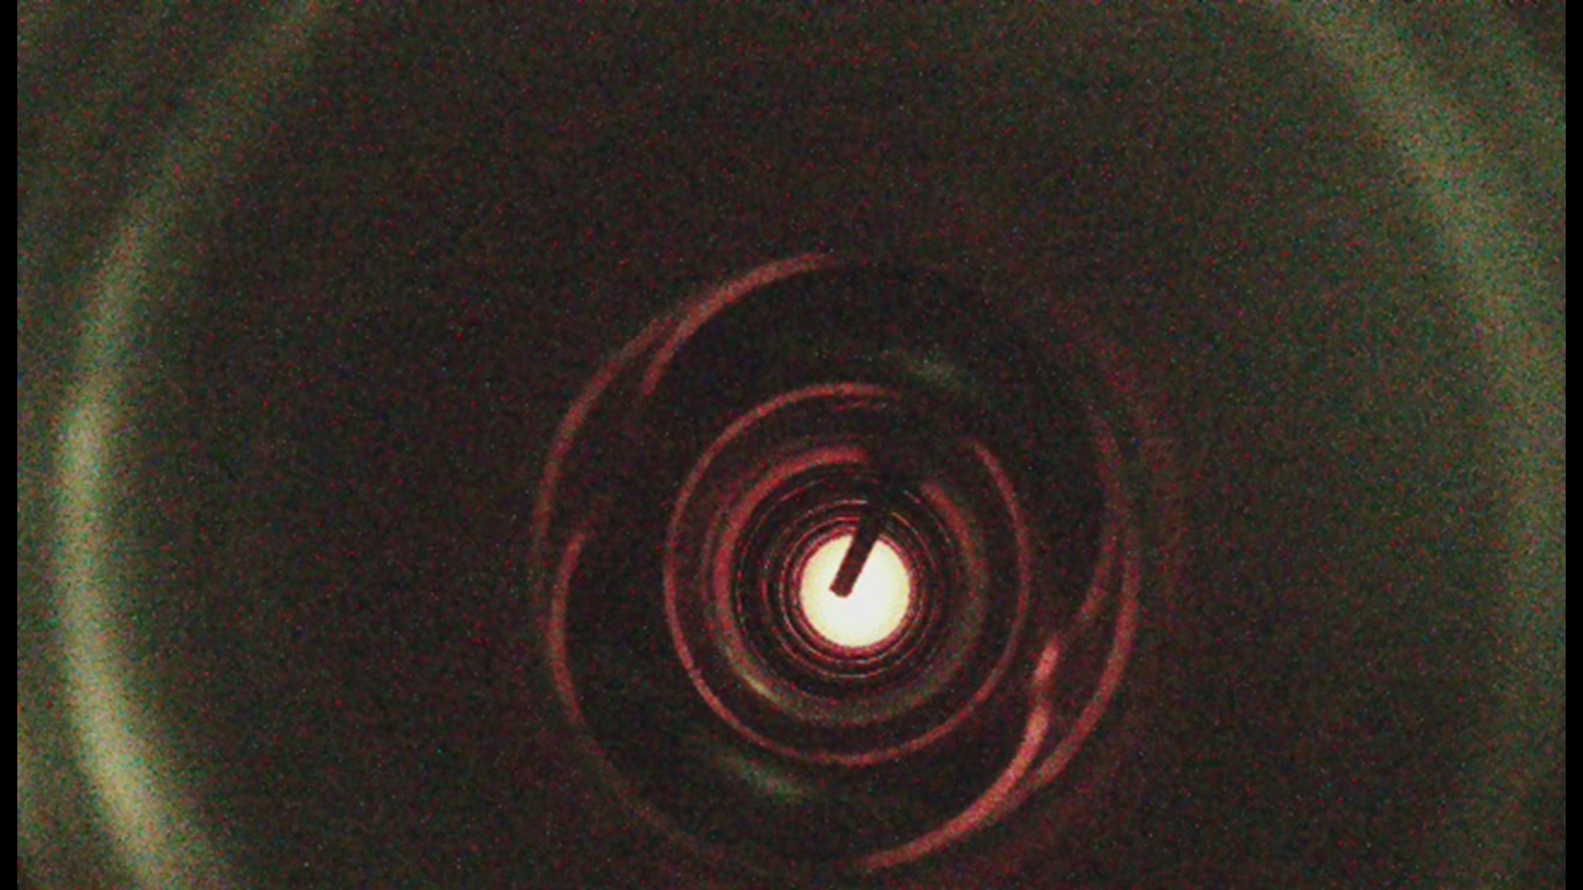
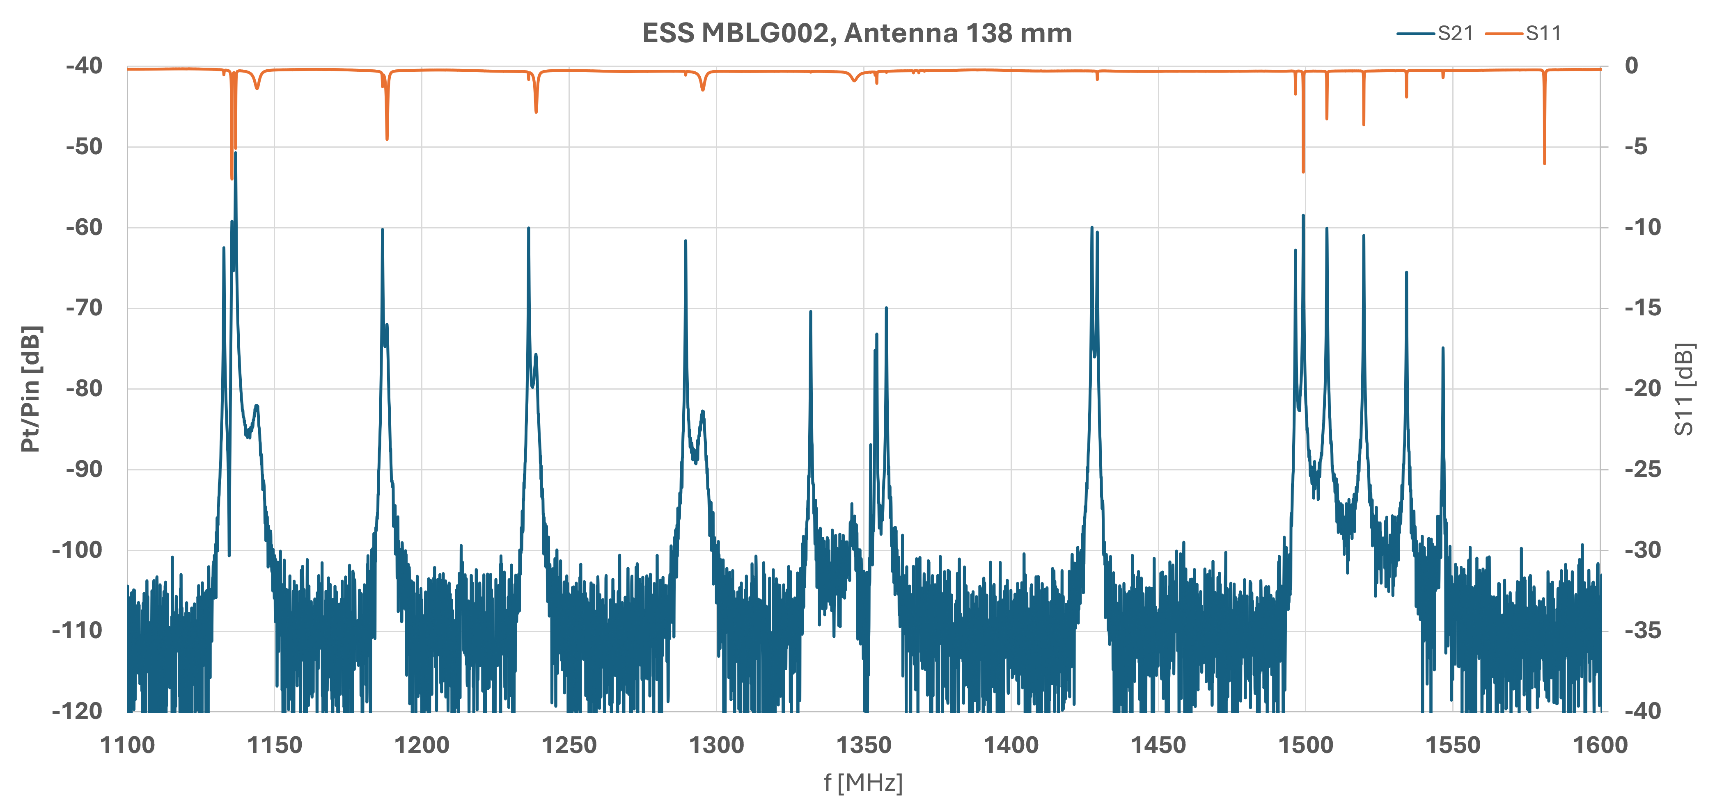
Propagation from cell to cell
Used modes
Successful ignition of several mode
Successful propagation from the 1st cell (PU side) to the last one (6th cell, MC side)

Slide 15
Outline
  Plasma Processing
    ESS MB 704.4 MHz – unity coupler
    ESS MB 704.4 MHz – custom antenna
    ESS MB 704.4 MHz – spectrometer analysis
  Summary & Next steps
    ESS MB 704.4 MHz – FPC
    PIPII LB650
INFN – Laboratori Nazionali di Legnaro
Quarta Giornata Acceleratori 3-4 Aprile 2025

Slide 16
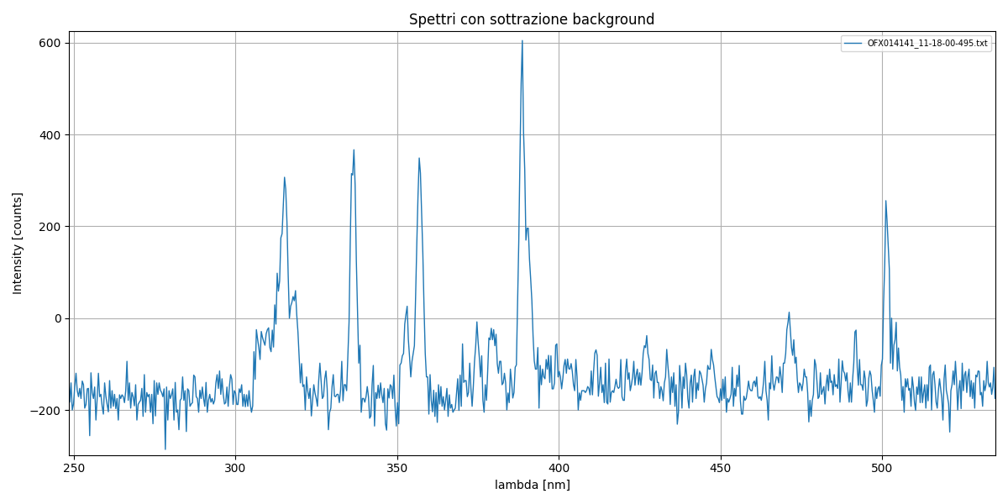
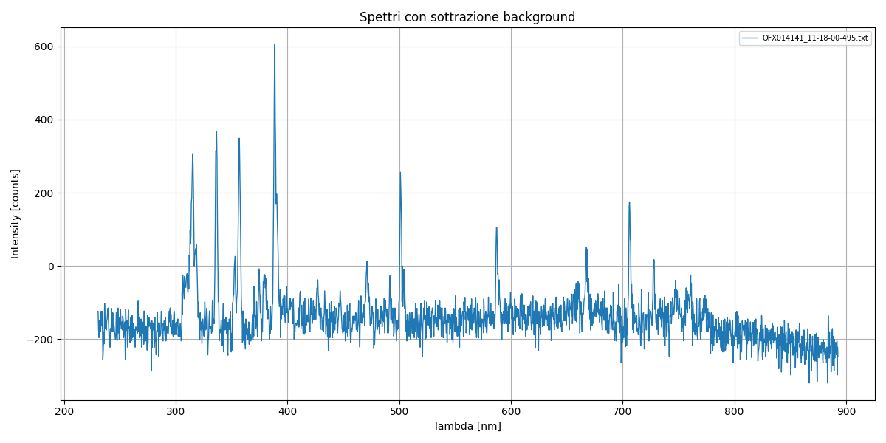
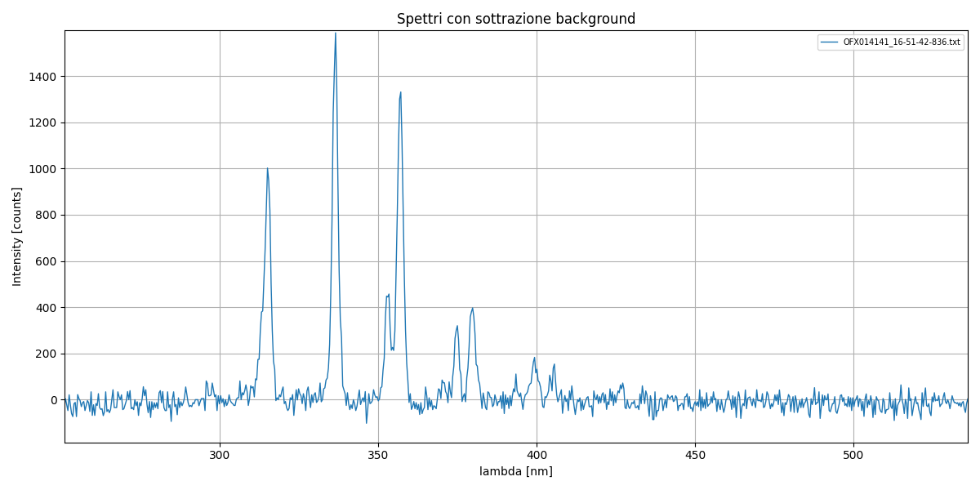
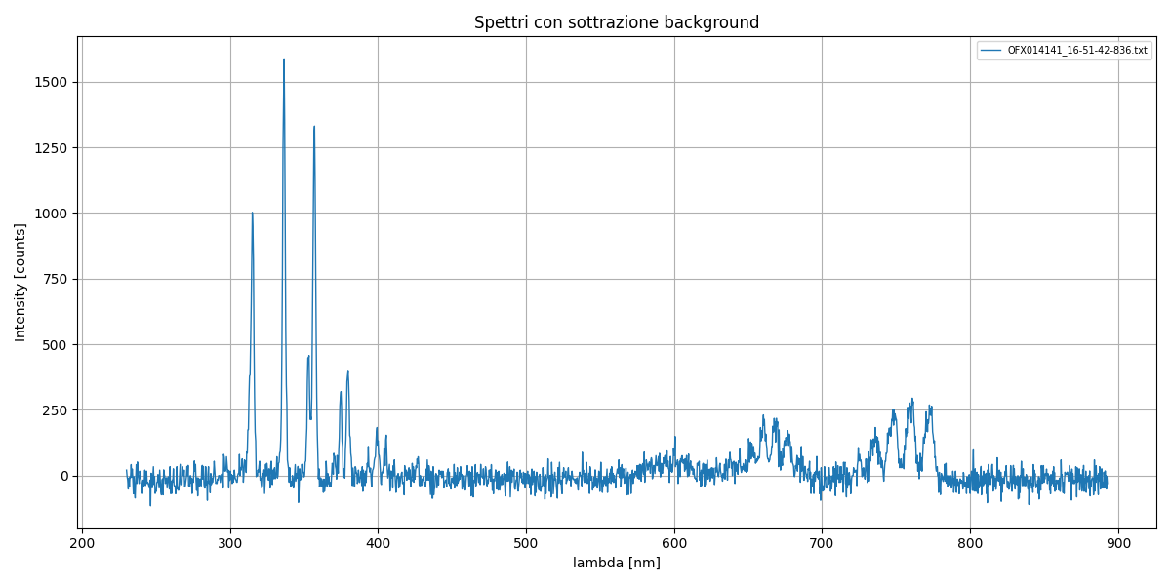
Spectrometer analysis
He gas injection
~ 380 nm
~ 337 nm
N₂ peaks
~ 315 nm
~ 357 nm
N₂ gas injection

Slide 17
Spectrometer analysis
~ 388.9 nm
He gas injection
~ 501.6 nm
Other N₂ peaks
N₂ gas injection

Slide 18
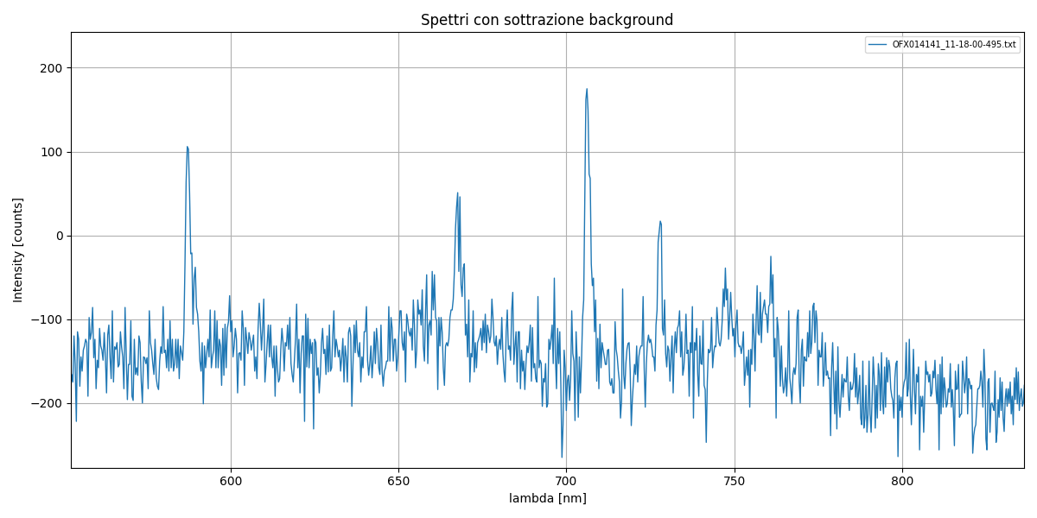
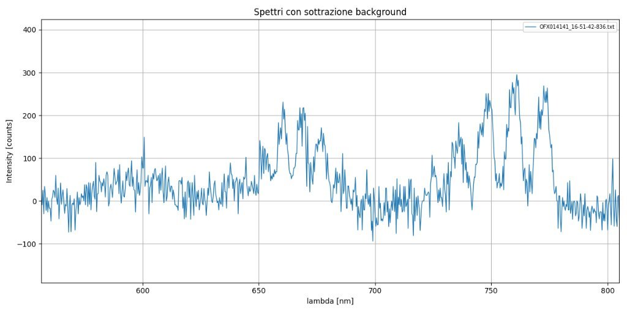
Spectrometer analysis
~ 587.6 nm
~ 706.5 nm
He gas injection
~ 728.1 nm
He peaks
~ 667.8 nm
N₂ gas injection
Other N₂ peaks
O₂

Slide 19
Outline
INFN – Laboratori Nazionali di Legnaro
Quarta Giornata Acceleratori 3-4 Aprile 2025
  LASA introduction
  Plasma Processing
    ESS MB 704.4 MHz – unity coupler
    ESS MB 704.4 MHz – custom antenna
    ESS FPC
  Summary & Next steps
    ESS MB 704.4 MHz – FPC
    ESS HB 704.4 MHz
    PIPII LB650

Slide 20
Summary ESS MB
Unity Coupler ESS MBLG002
This antenna configuration does not appear suitable for cavity processing → No additional modes are excited neither propagation observed
Antenna (L = 138 mm) – Test Results
Stronger coupling compared to the FPC
Ignition of several modes at relatively low power
Successful plasma bridging: propagation achieved from Cell I to Cell VI and vice versa, multiple times
→ Propagation strategy validated
Operating pressure: 1.13 × 10⁻¹ mbar
Repeat the procedure, using He instead of N₂
He₂ first ionization energy ≈ 24.6 eV
𝑁₂ first ionization energy ≈ 14.5 eV

Slide 21
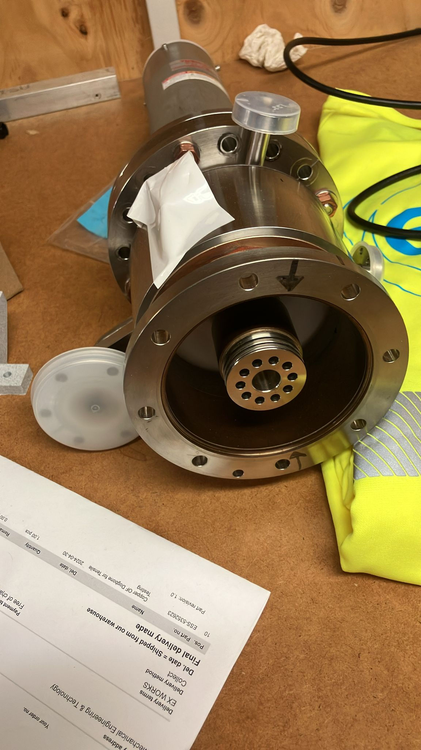
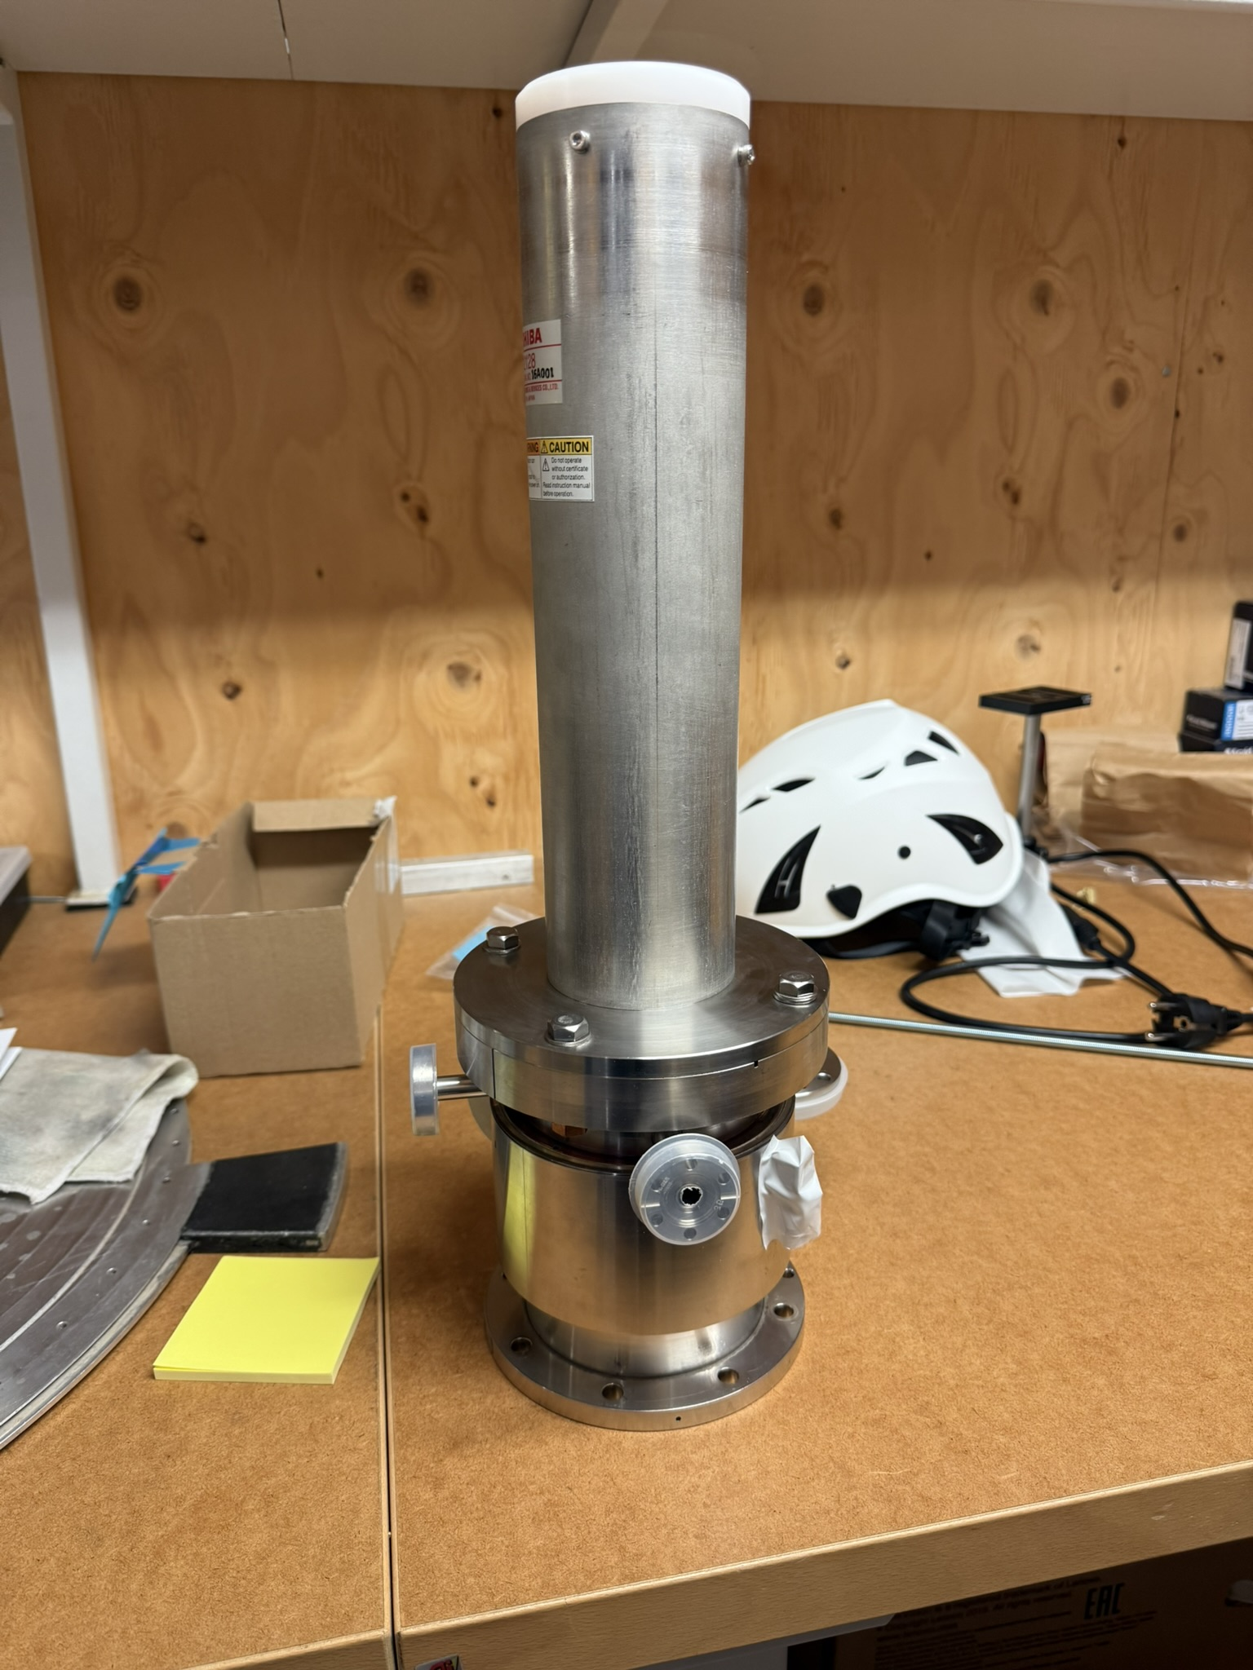
ESS MB: Next Steps
Plasma processing with FPC (from CEA/ESS FPC + coax-to-N type adapter)
Transition from static to dynamic pumping configuration
→ Vacuum + gas injection chart to be developed with ESS, taking as reference the FRIB model

Slide 22
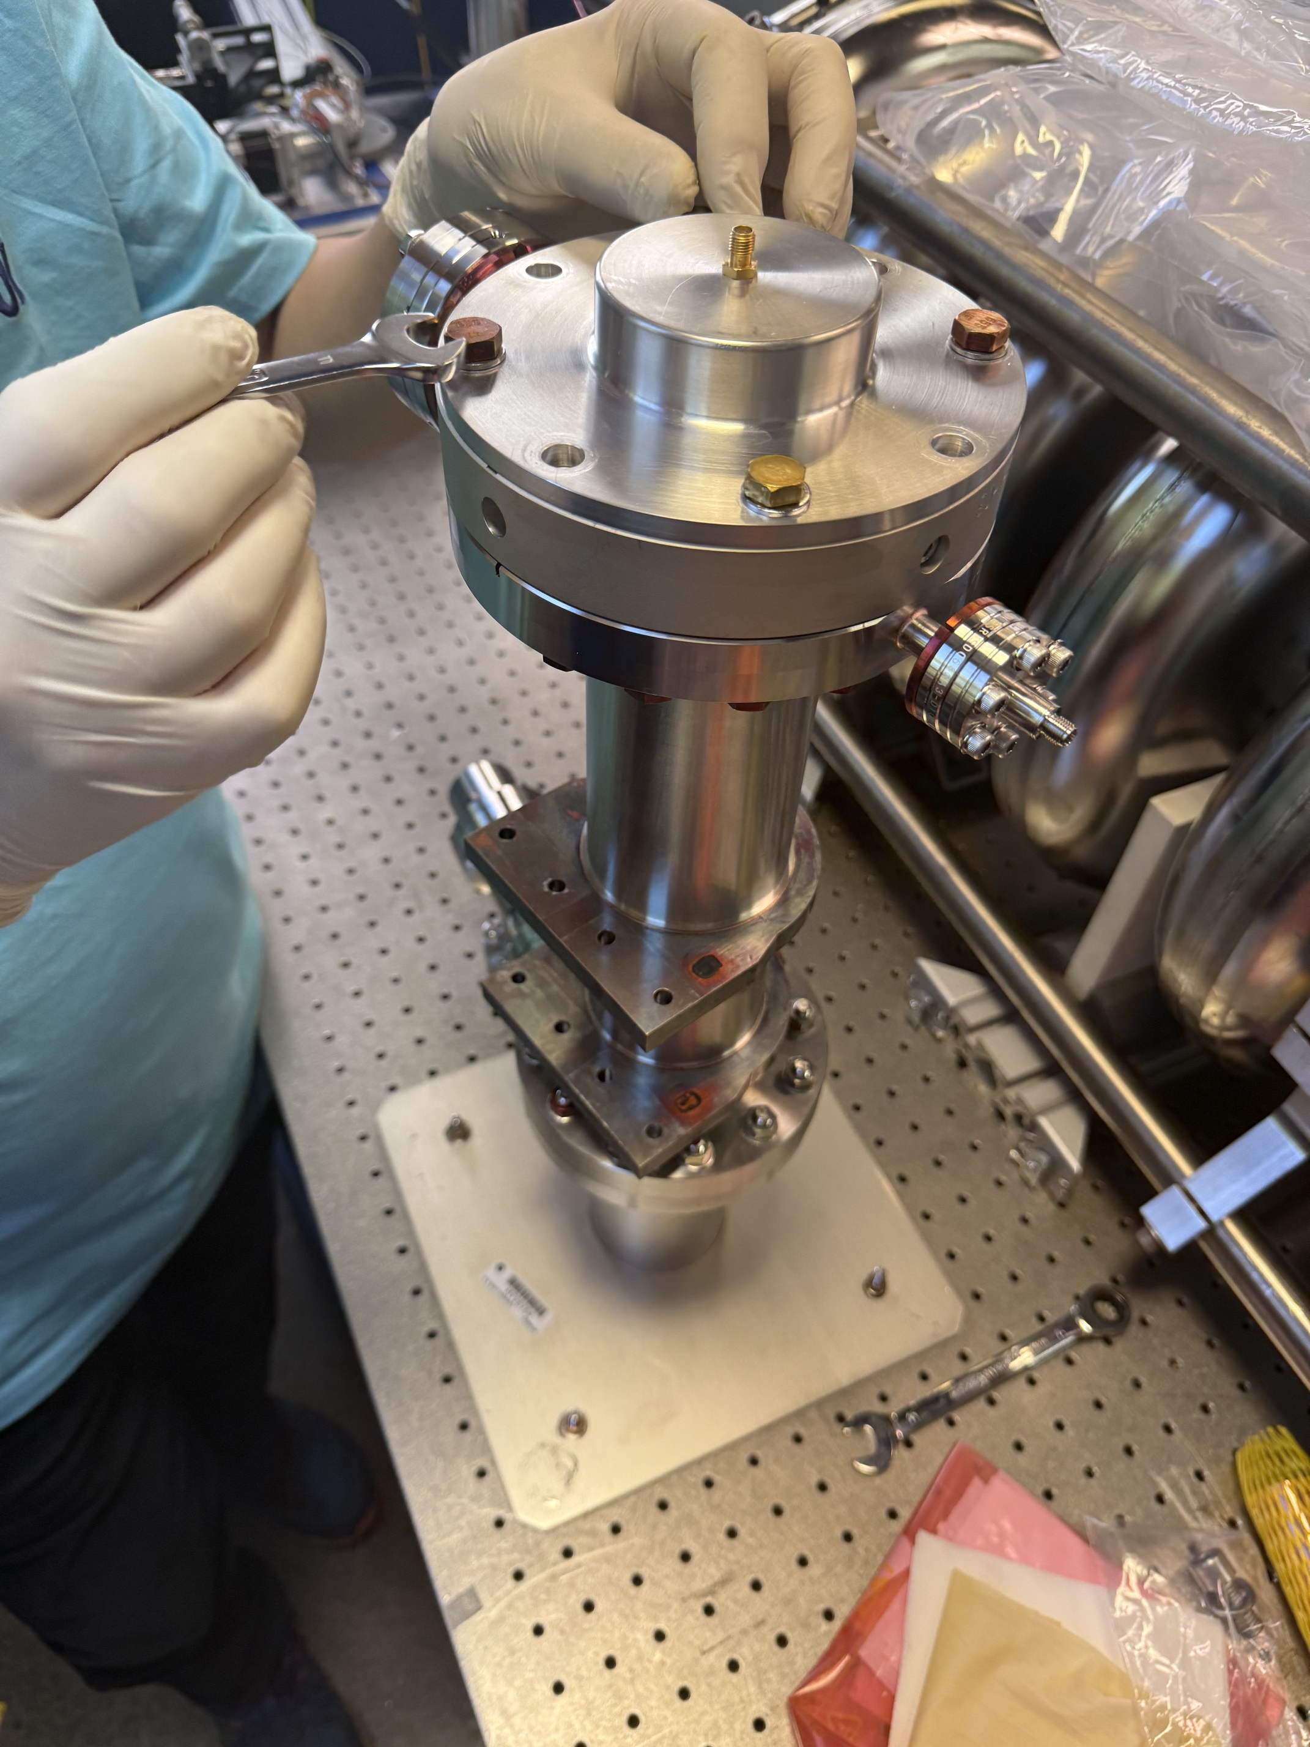
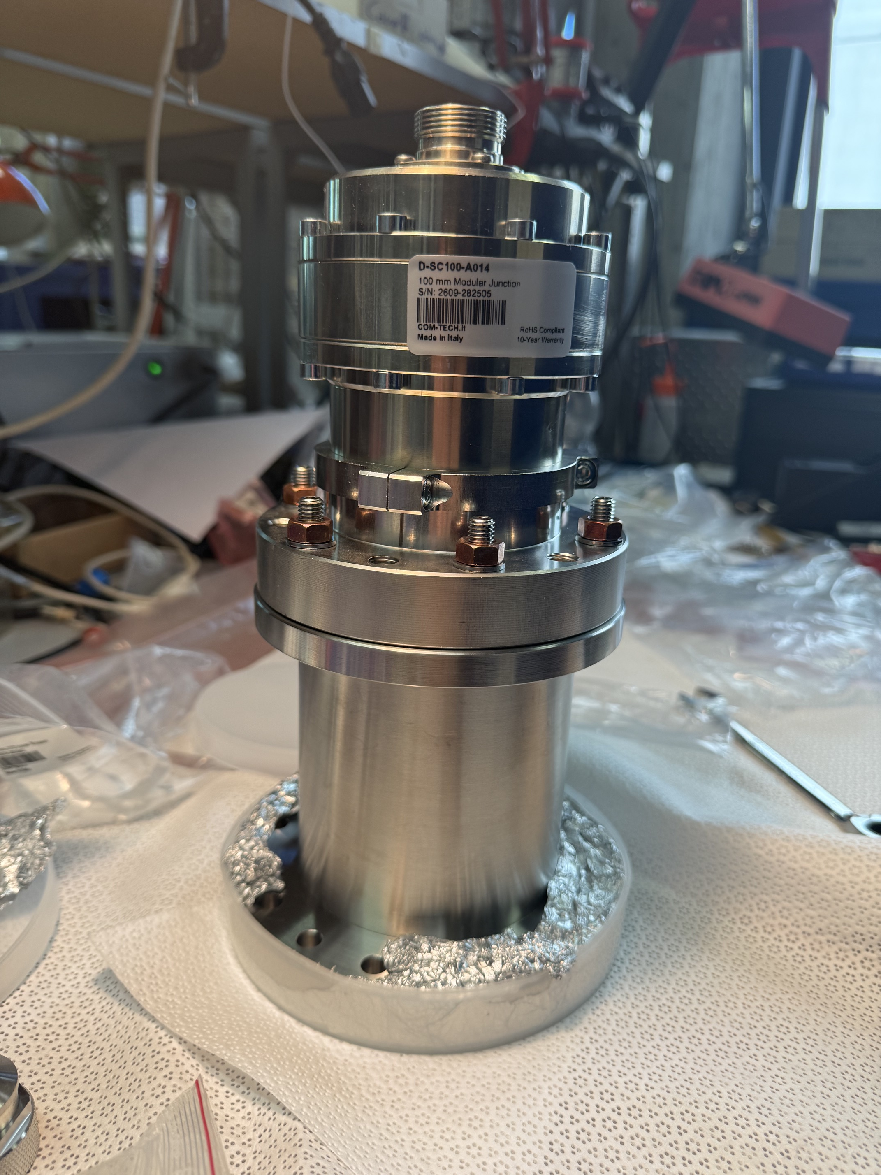
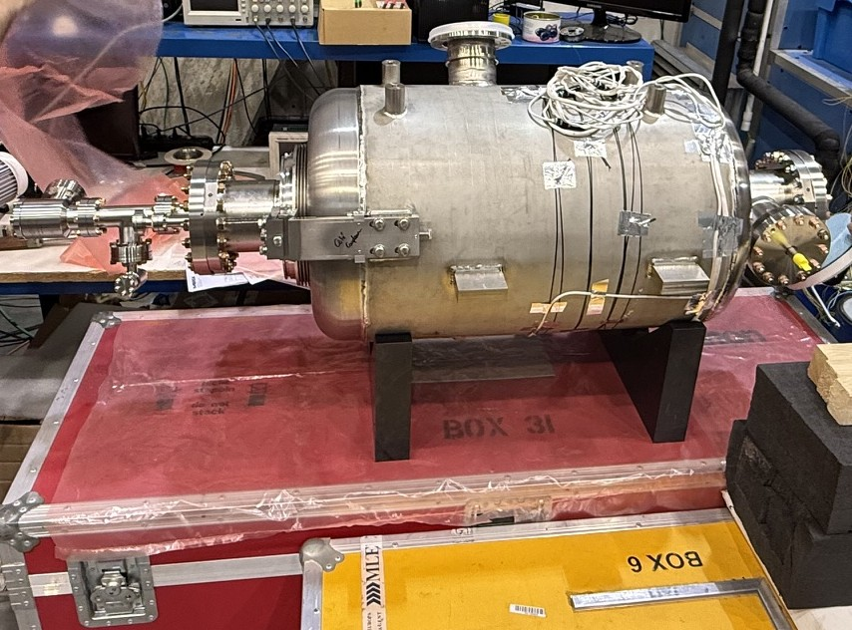
PIPII LB650
Activities developed in partnership with FNAL (B. Giaccone, T. Posos) and CEA
RF adapter
Simulations done → suitable modes identified
Unity coupler weakly coupled → FPC
Proto cavity B61-EZ-001 from CEA and FPC from FNAL already at LASA → next week assembly of FPC and first experimental activities with
Bianca Giaccone
FPC

Slide 23


ACKNOWLEDGEMENT
“This work was partially supported by the European Union’s Horizon Europe Marie Sklodowska-Curie Staff Exchanges programme under grant agreement no. 101086276.”

Slide 24
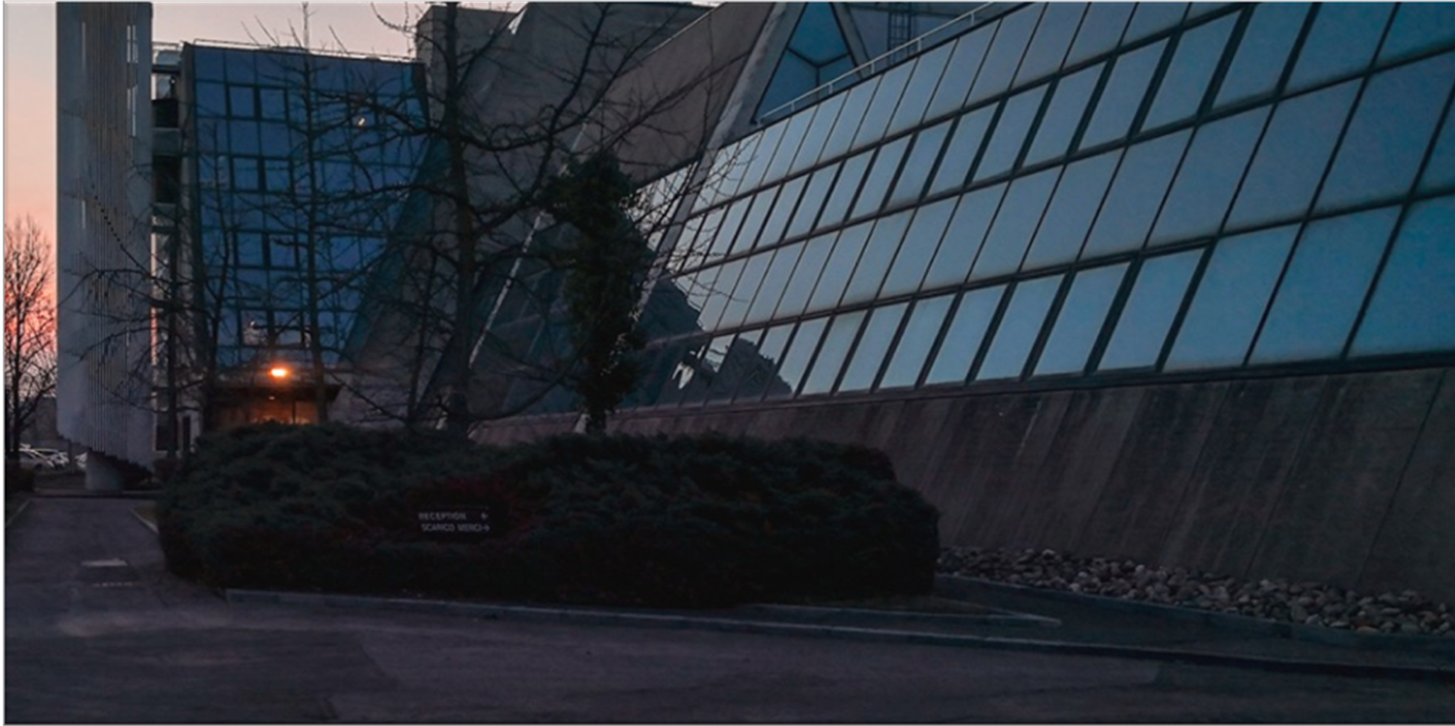
THANKS FOR YOUR ATTENTION

Slide 25
BACKUP SLIDES

Slide 26
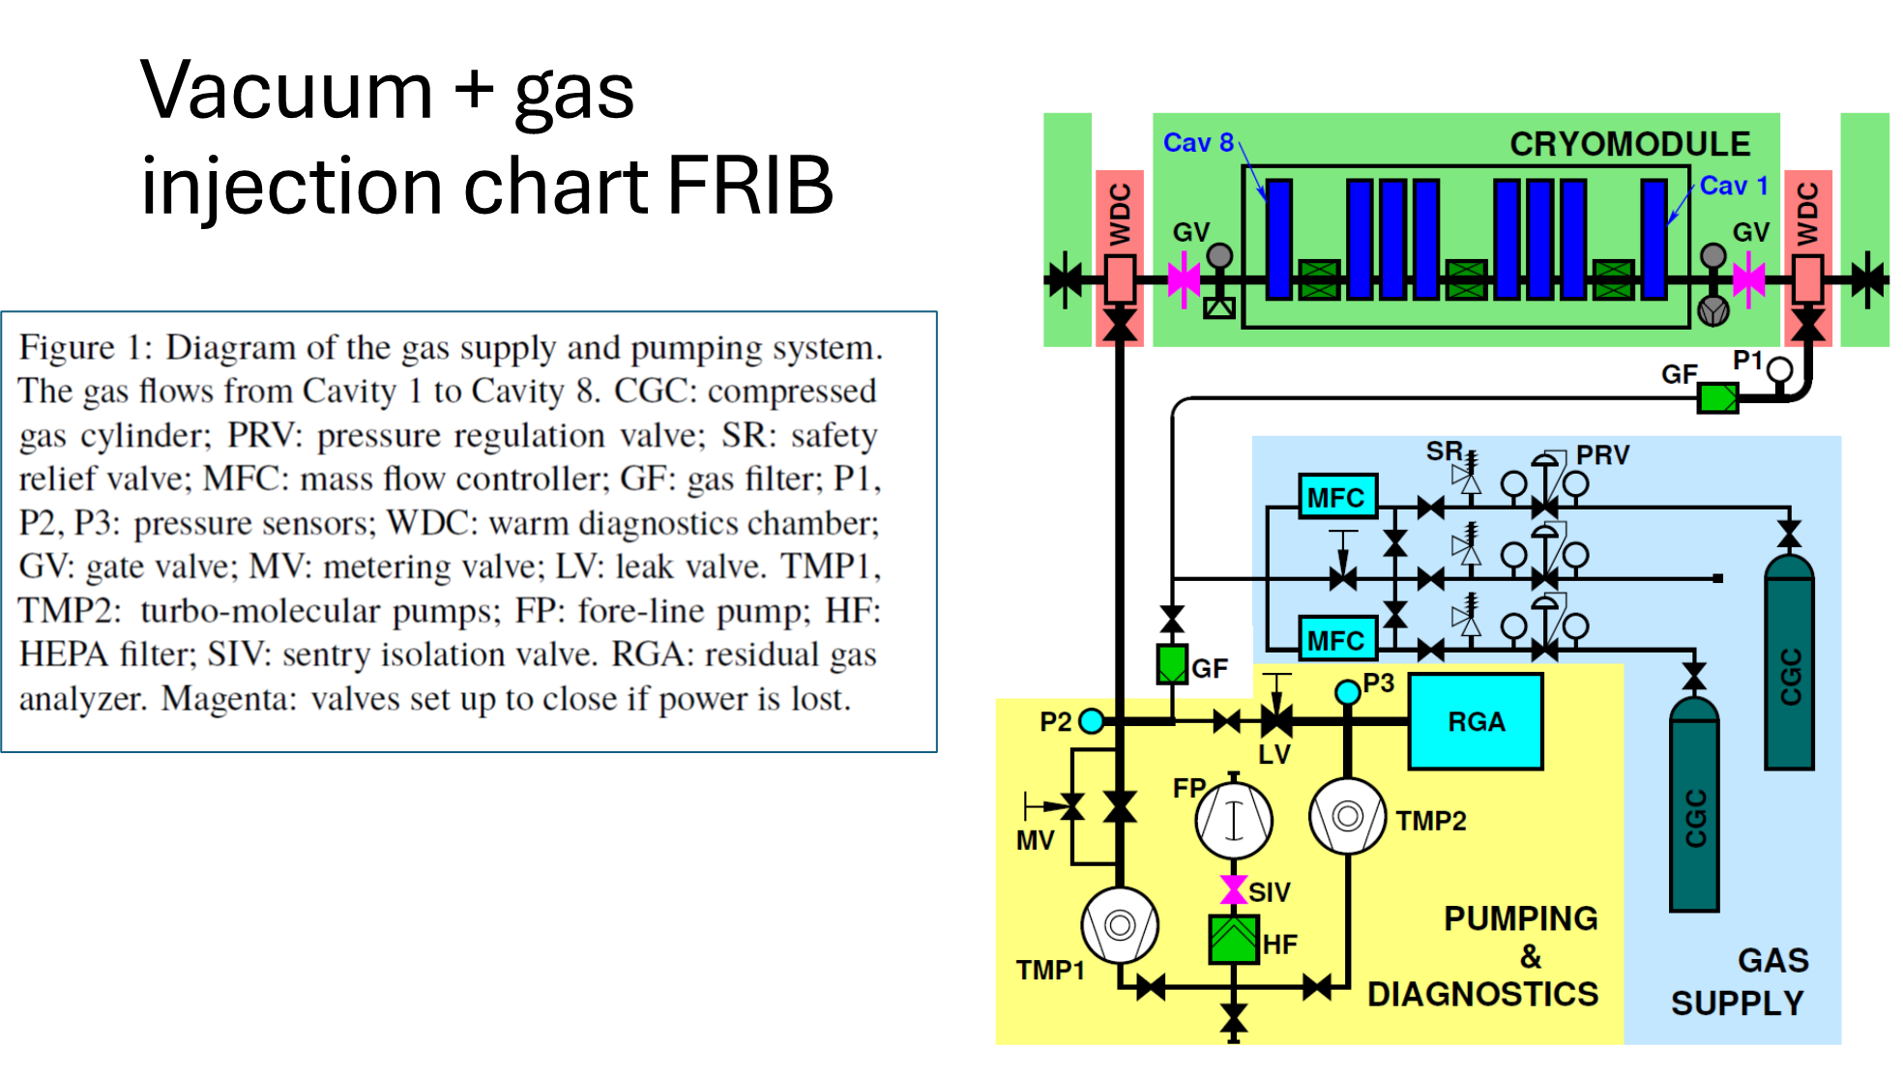
P. Tutt et al., "Plasma Processing of FRIB-Low Beta Cryomodules using Higher-Order-Modes", https://doi.org/10.48550/arXiv.2511.02151

Slide 27
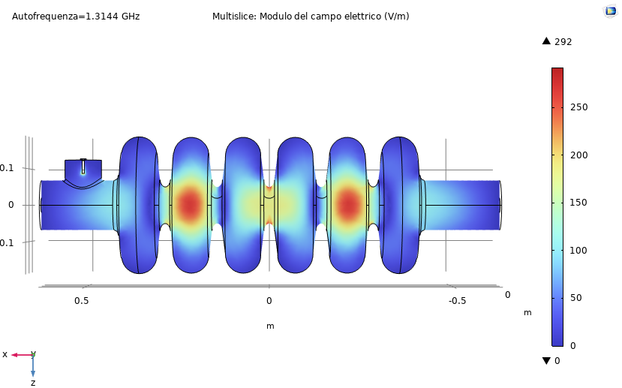
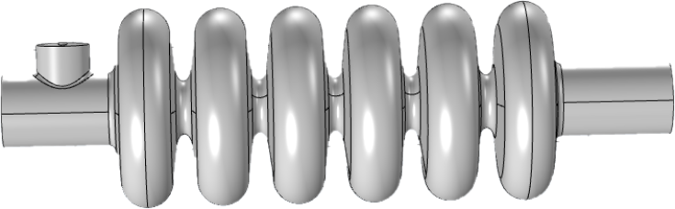
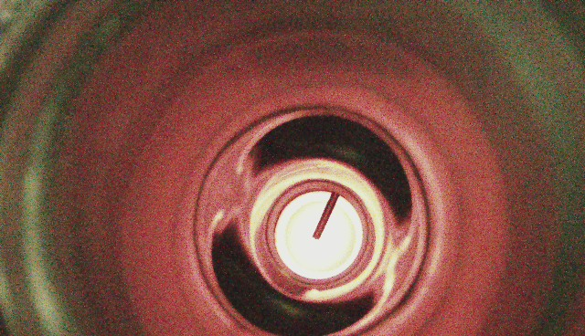
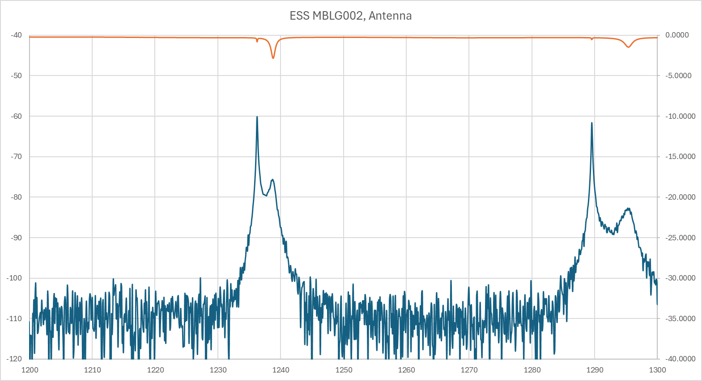
1295.16 MHz
8

Slide 28
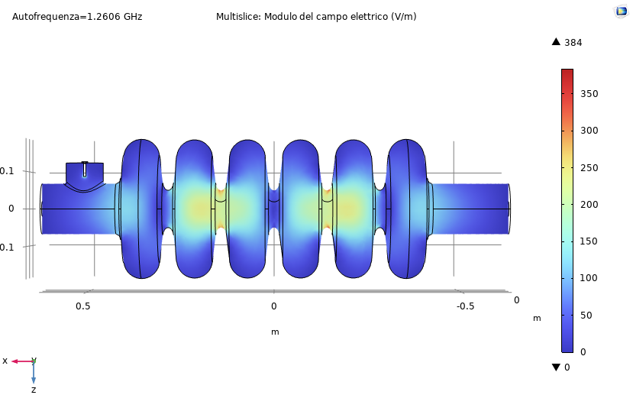
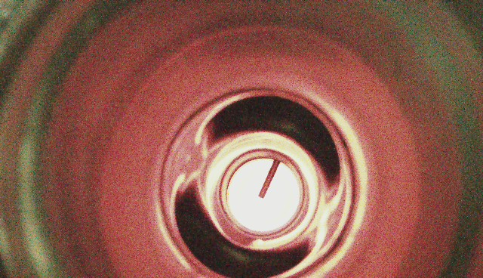
1238.97 MHz
9

Slide 29
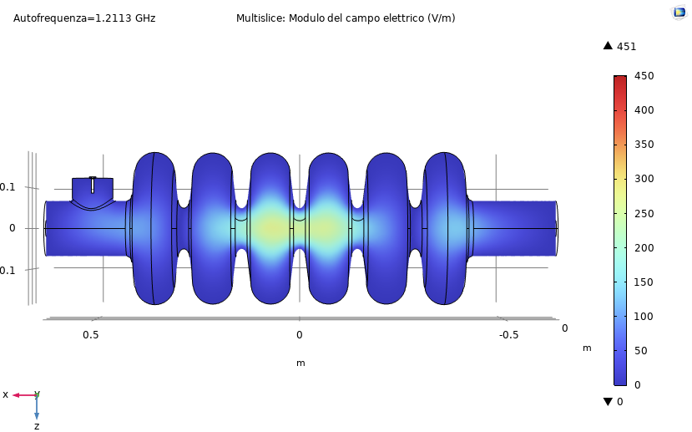
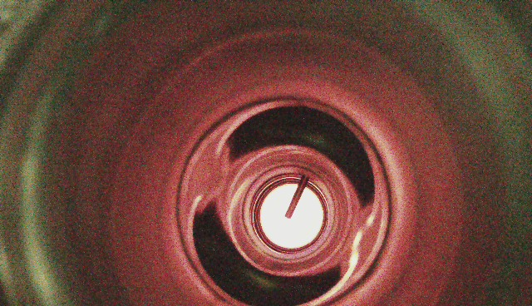
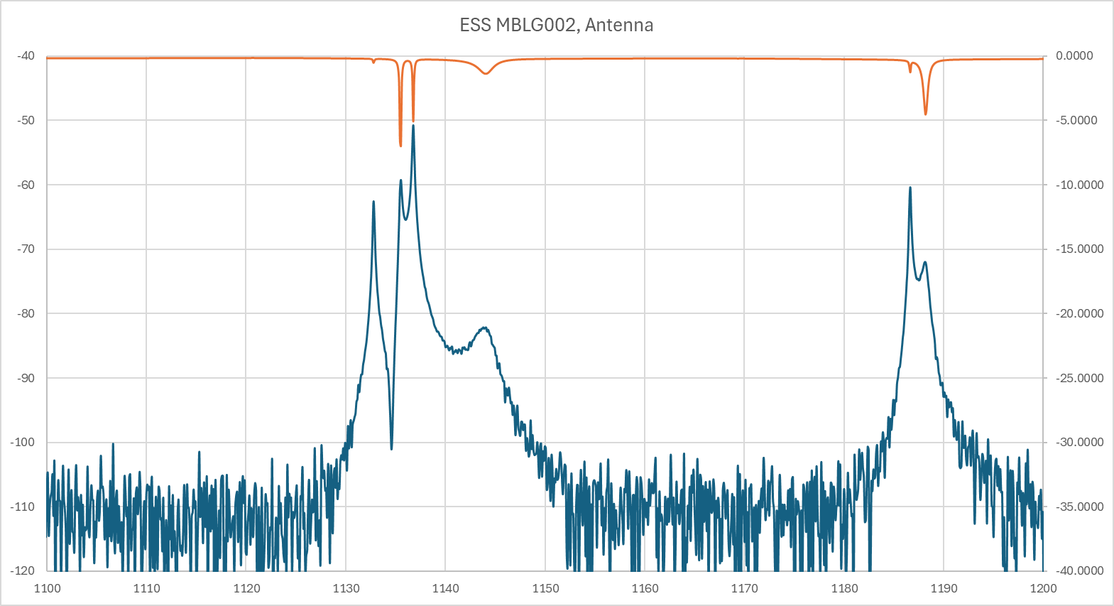
1188.26 MHz
10

Slide 30
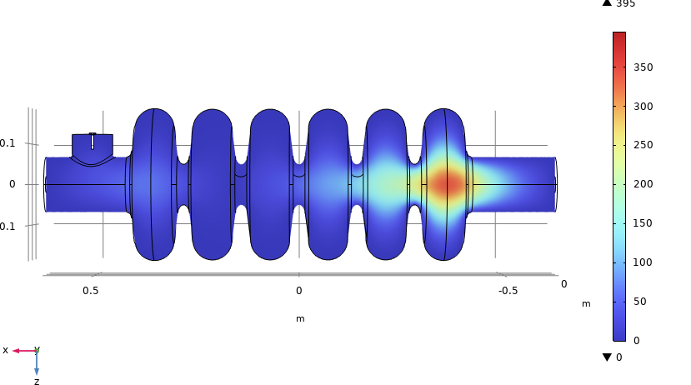
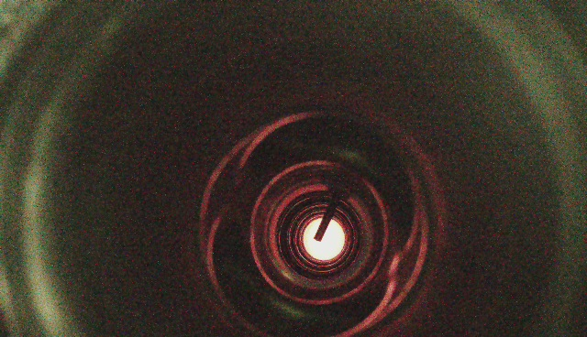
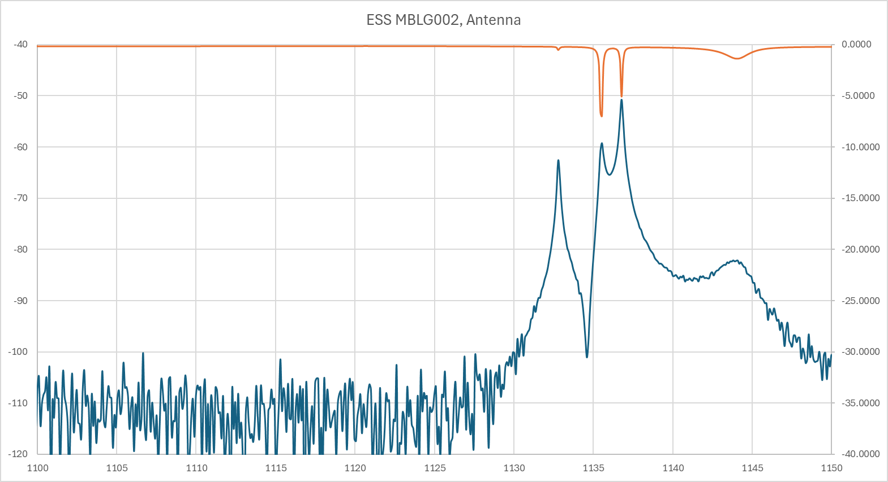
1135.598 MHz
11

Slide 31
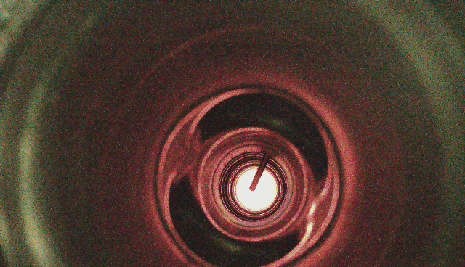
1238.64 MHz
12

Slide 32
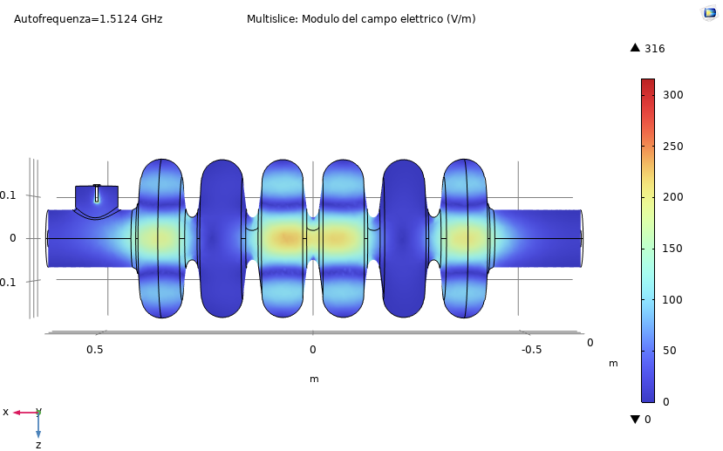
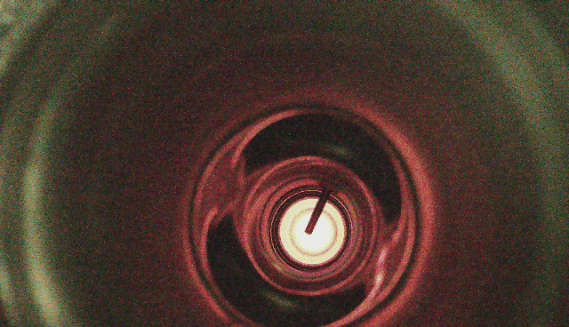
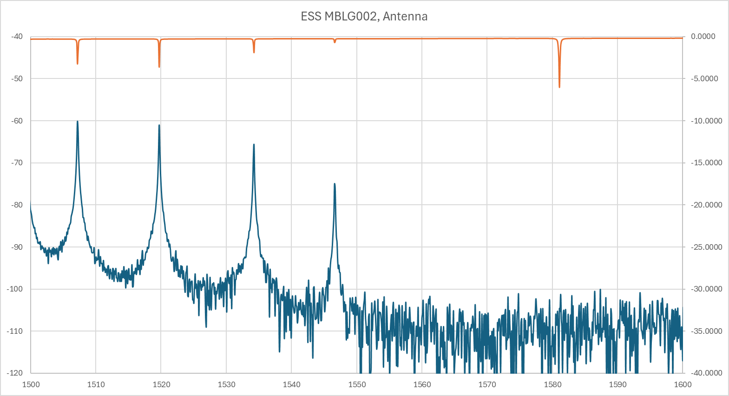
1507.2 MHz
13

Slide 33
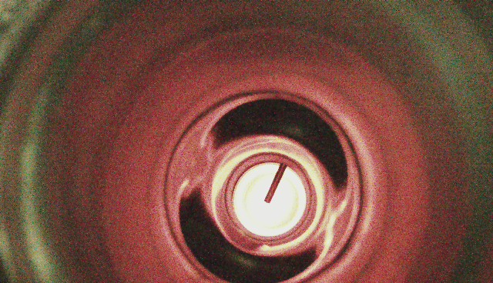
1238.71 MHz
14

Slide 34
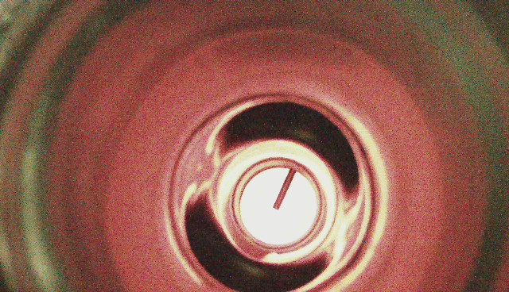
1295.6 MHz
15

Slide 35
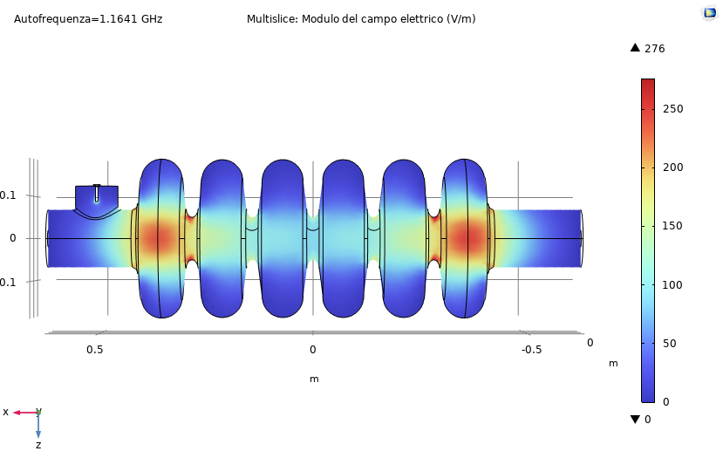

1144.6 MHz
16

Slide 36

FPC ESS

Slide 37




FPC ESS

Slide 38


