Slide 1



Plasma Processing Development at CSNS-II
Cong Zhang, Huachang Liu, Rui Ge，
Ahong Li, Wenzhong Zhou
CSNS，IHEP
2026.06.11

Slide 2


Outline
Why plasma processing technology
Plasma processing platform setup and initial experiments
Plasma processing experiments on SSR
Plasma processing experiments on multi-cell elliptical cavity

Slide 3
Why plasma processing technology?

Slide 4
SRF Cavity：
.large beam aperture，
.low power loss
.high accelerating gradient
SRF accelerators adopted by most accelerator facilities
During online operation, the performance inevitably degrades over time: Field Emission

Slide 5
Field Emission
Root Cause
Ramifications
clean room assembly
ambient RT section
outgassing and adsorption
errant beam impact
Decrease in the running gradient
Deterioration of operational stability
Vaccum sealing damagement
Field emission enhancement
Inevitable！
The onset and enhancement of field emission during long-term operation.
Online repair techniques must be employed to eliminate field emission.

Slide 6
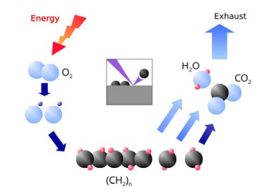
In-situ online plasma processing
Online plasma processing is internationally recognized as the most effective online remediation technique for eliminating field emission.
Inert gas+O₂ ，ionization in EM field.
Mechanism
Inert gas ions etch surface contaminants and machine burrs.
Oxygen atoms react with surface contaminants (e.g., hydrocarbons) on the superconducting cavity, forming volatile byproducts that are pumped out
Ar+，Ne+，He+

Slide 7
Plasma processing platform setup and initial experiments

Slide 8
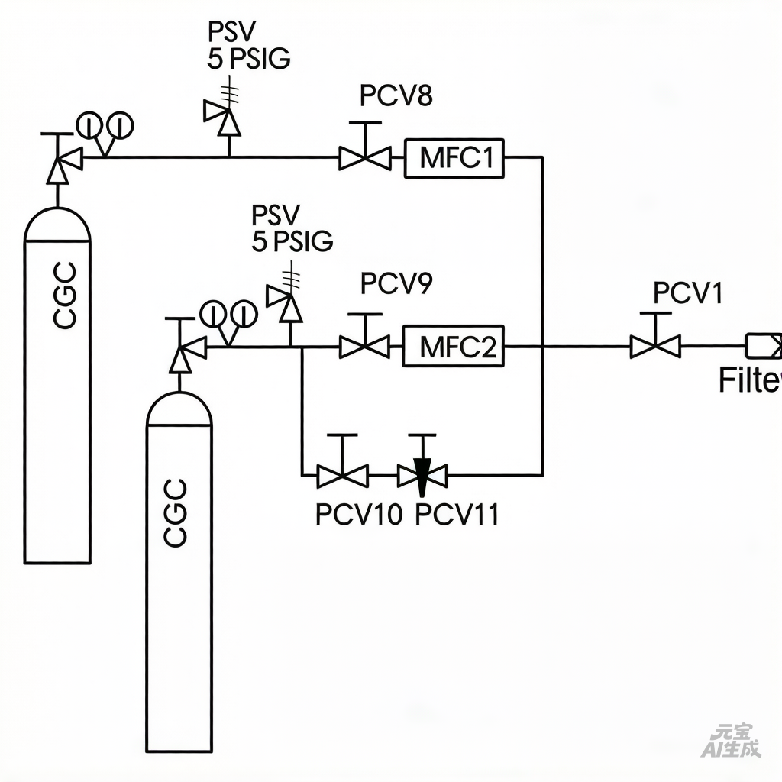
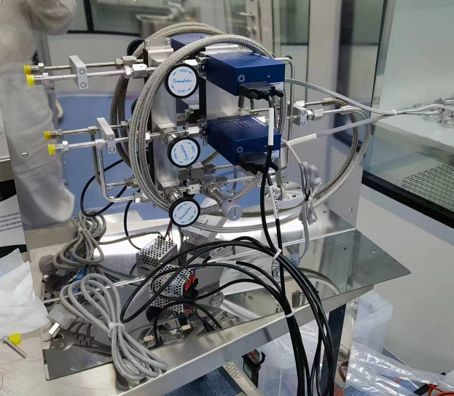
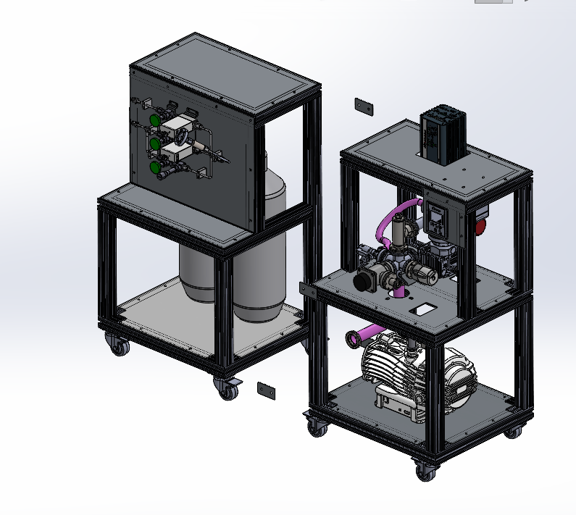
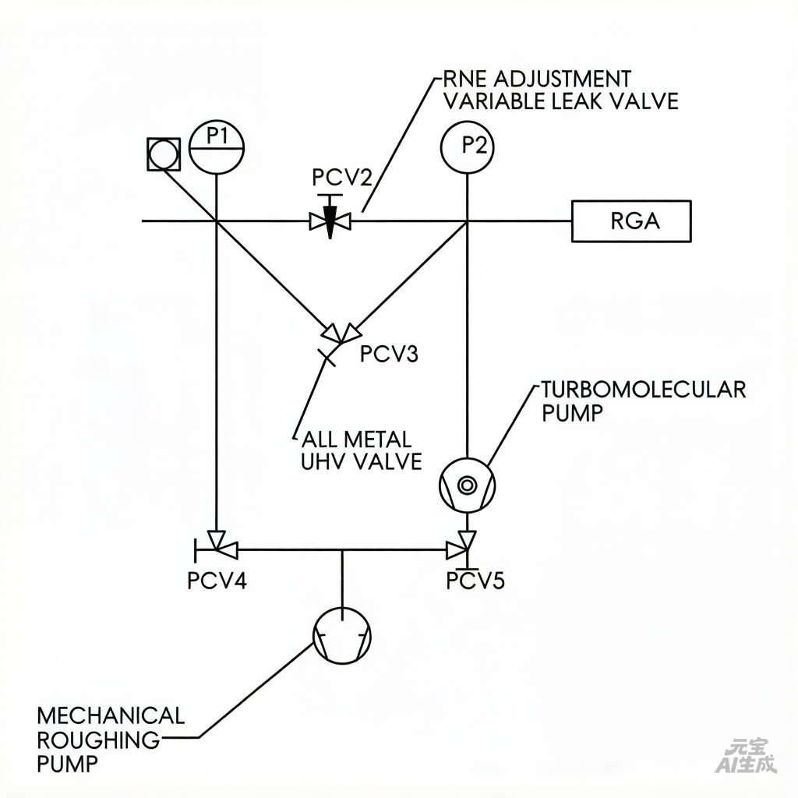
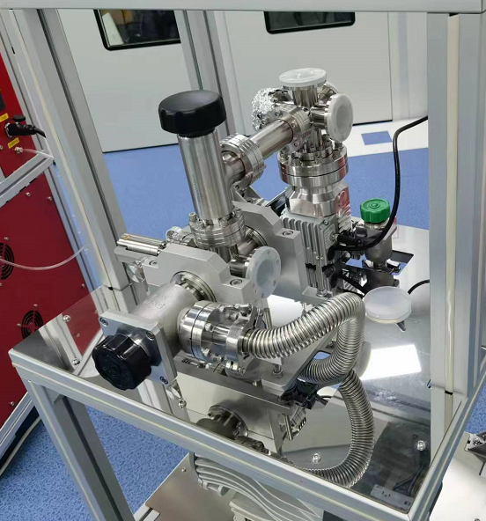
Platform setup
Gas system
Gas feeding
gas feeding
Gas pumping
gas pumping

Slide 9
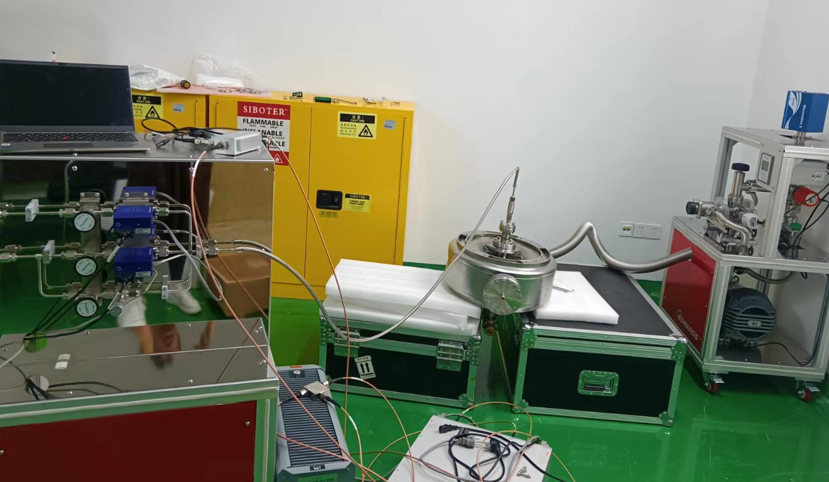
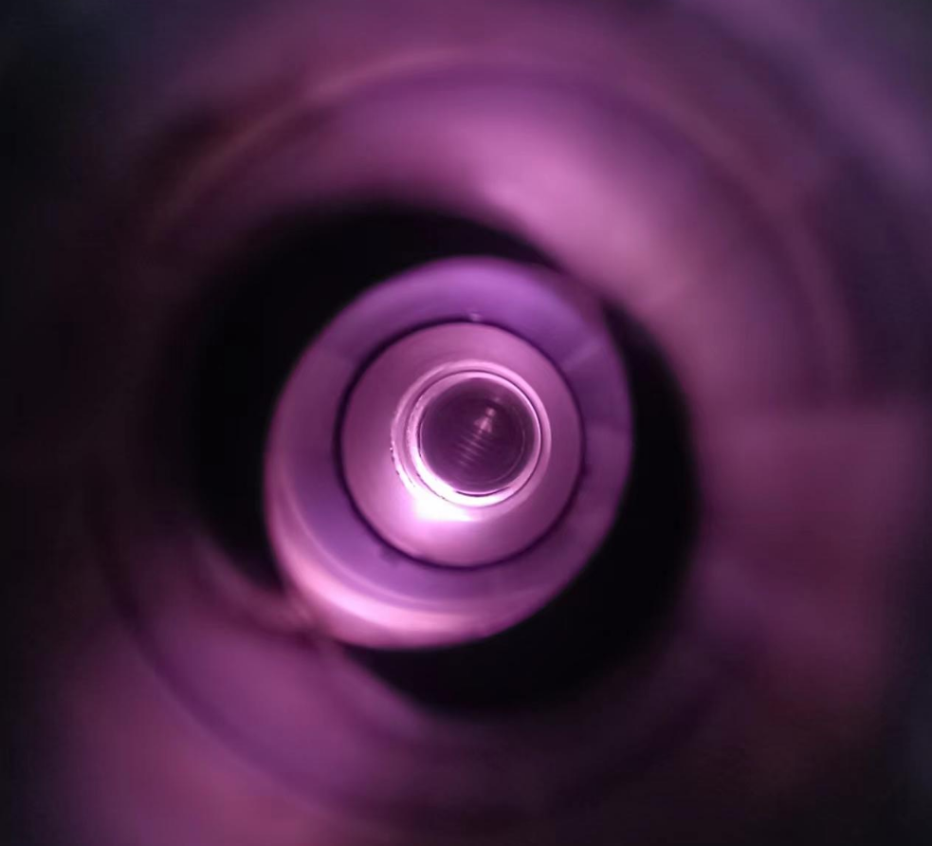
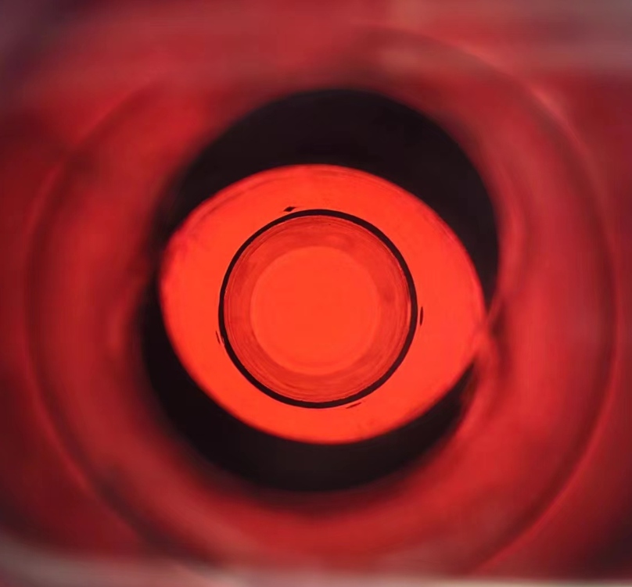
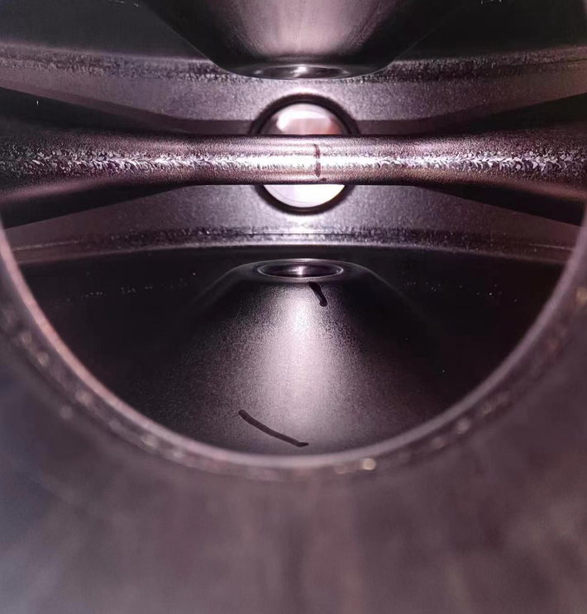
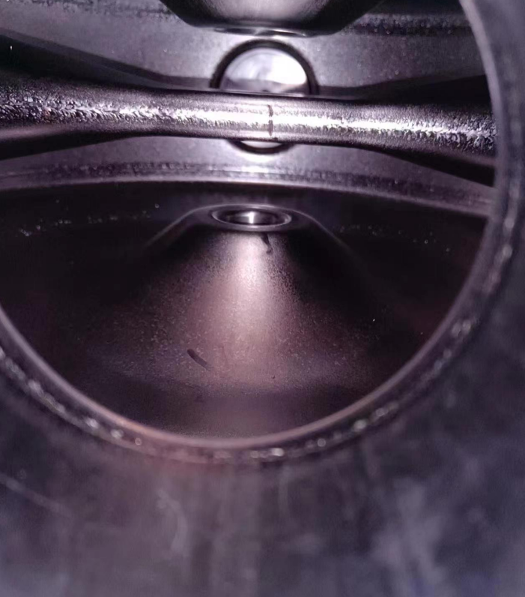
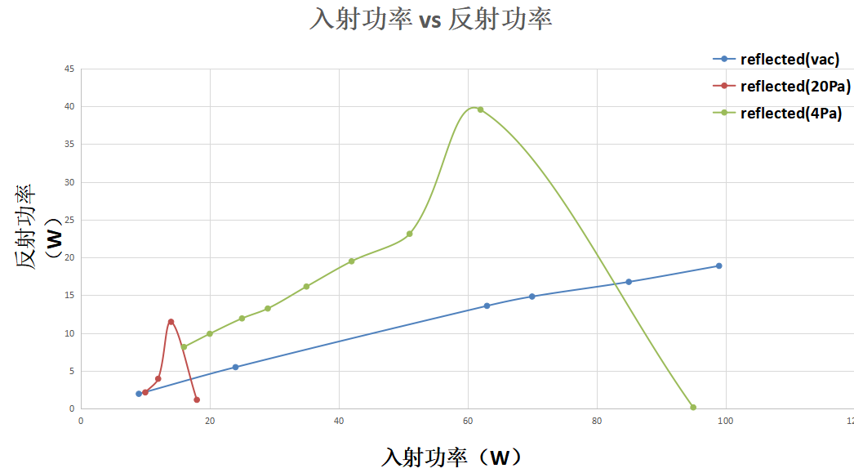
Initial experiments on 324MHz SSR
Plasma processing initial experiments on 324MHz SSR
324MHz SSR：cavity with severe welding defects, no chance for VT, can be
opened repeatedly to check the marker pen traces
plasma processing workbench
Ar Plasma
Ne Plasma
Pr vs. Pf
before
after

Slide 10
Plasma processing experiments on
648MHz single spoke cavity

Slide 11
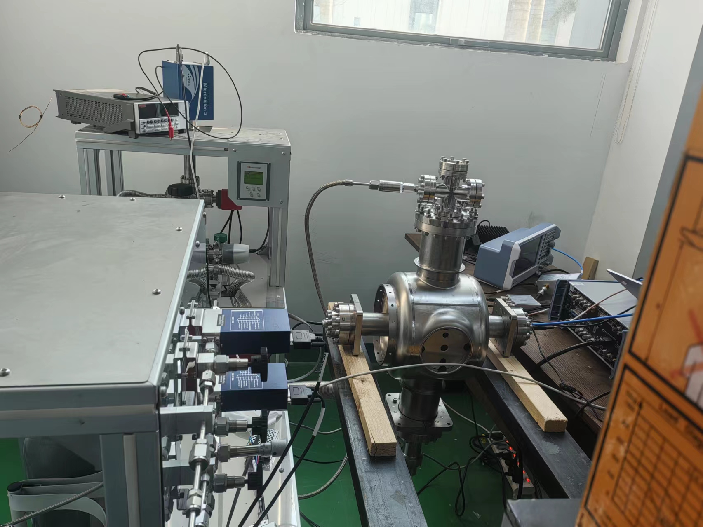
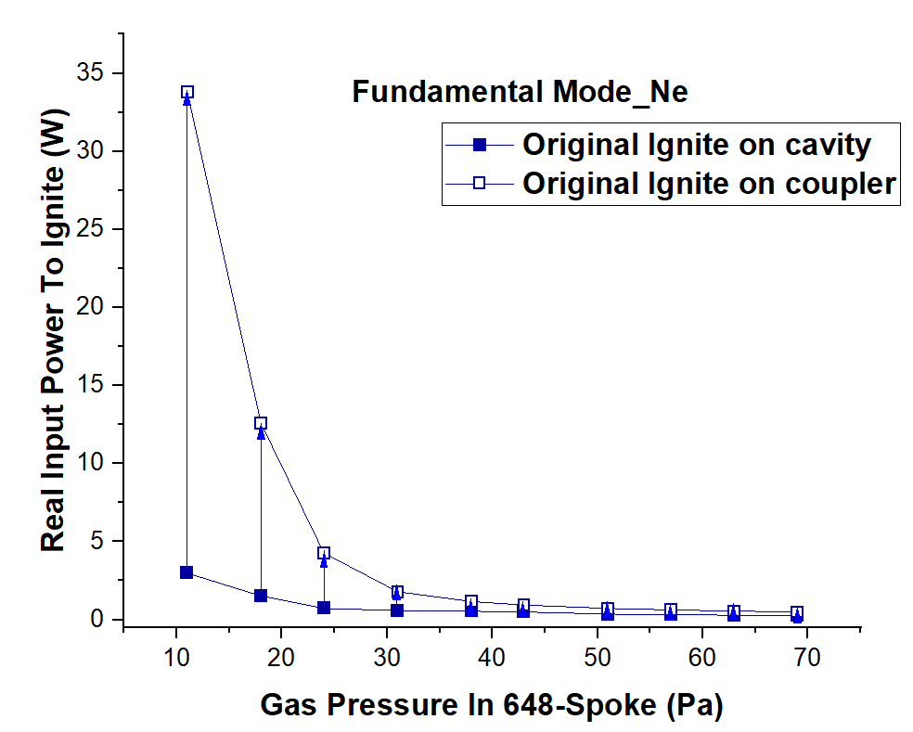
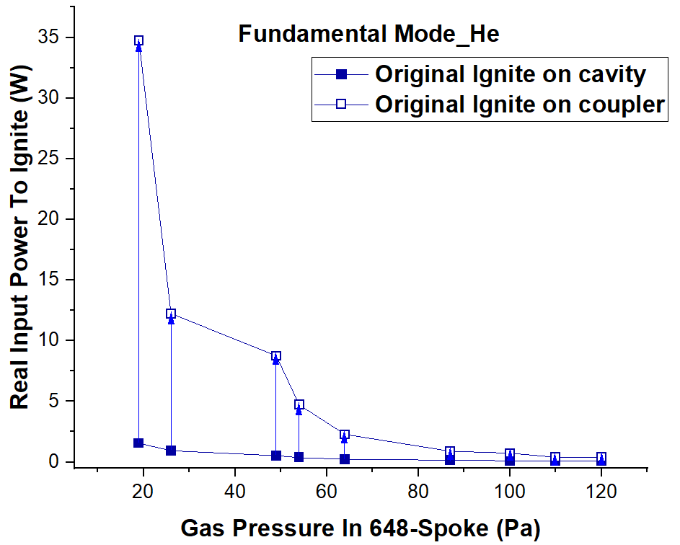
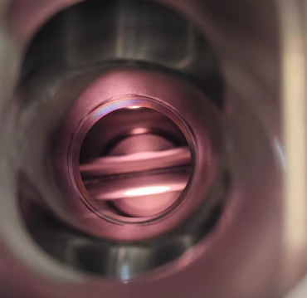
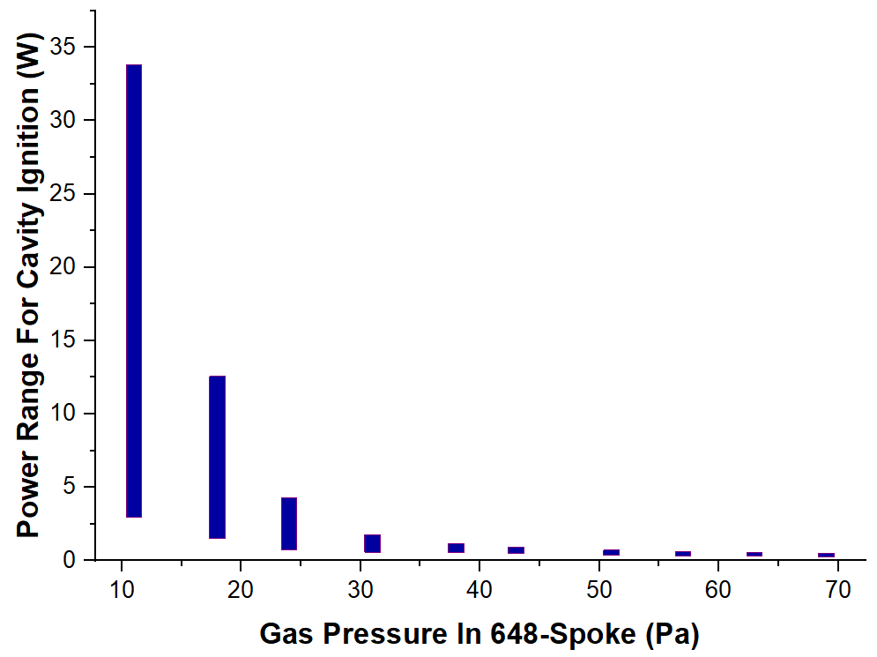
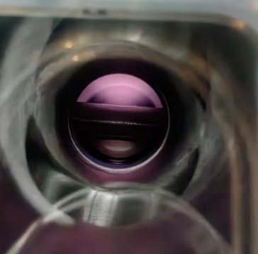
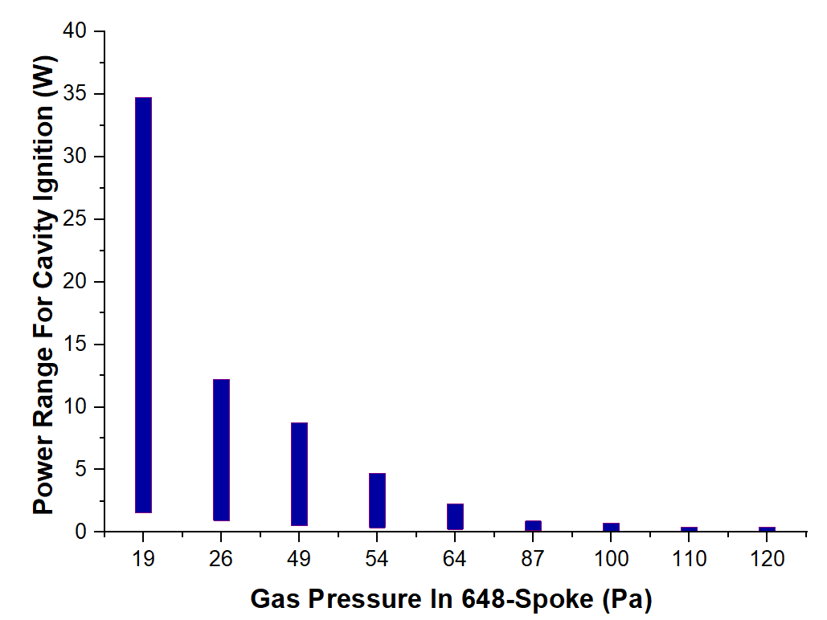
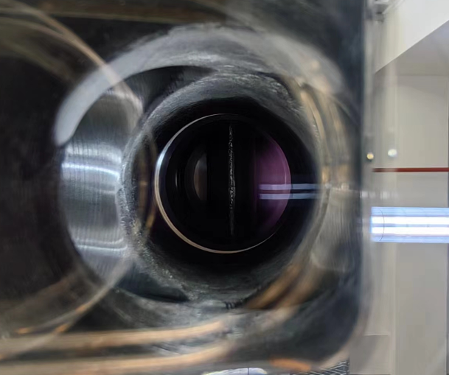
Plasma ignition in 648MHz SSR
648MHz SSR on Plasma Processing
648MHz SSR：
.geometry similar to CSNSII DSR，
.frequency identical to CSNSII elli
inert gas: Ne, He
.lower atomic number
.stronger cleaning efficacy
ignition power range：
.lower bound（ cavity initial ignition）
.upper bound（coupler initial ignition）
.Ne：low gas pressure:2.6W-34.2W
high gas pressure：1.4W-1.9W
.He：low gas pressure：2.4W-35W
high gas pressure：1.4W-1.8W
In medium-to-high pressure, plasma
igtion on coupler highly susceptible.
Power needed for Ne ignition
Power needed for He ignition

Slide 12
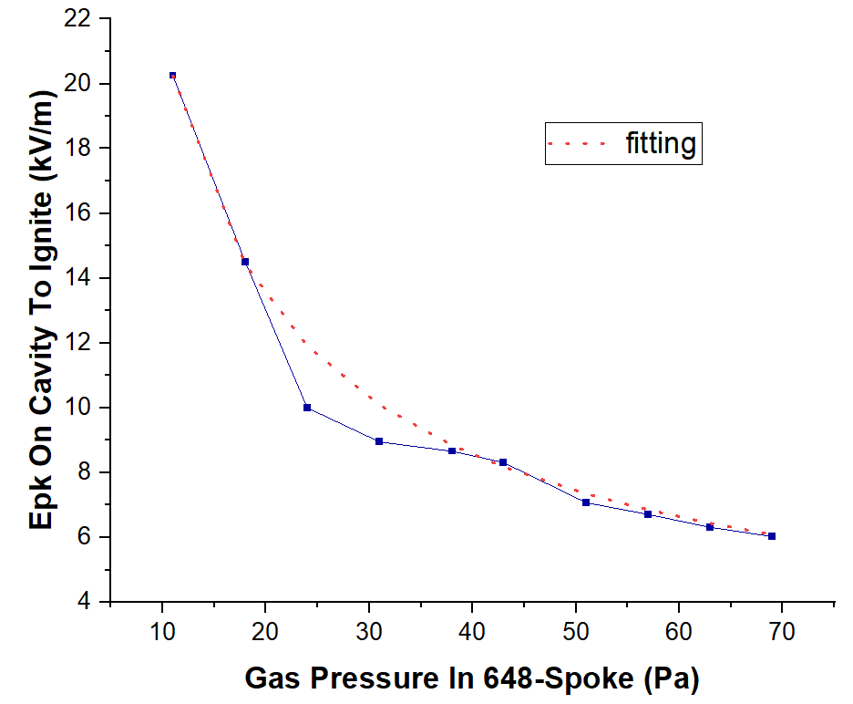
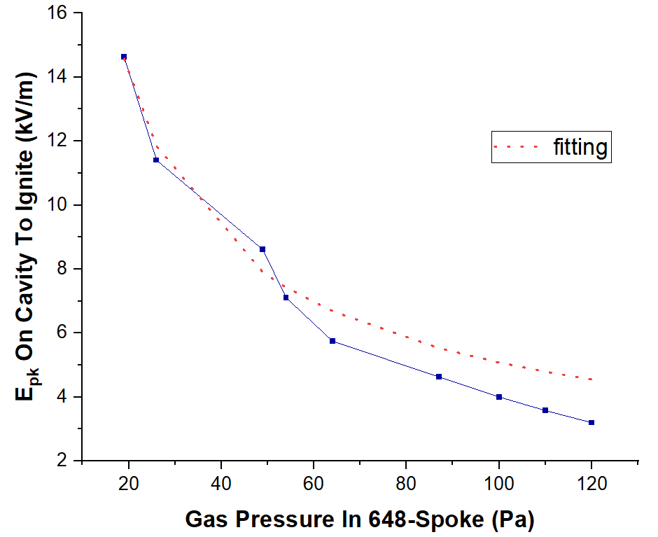
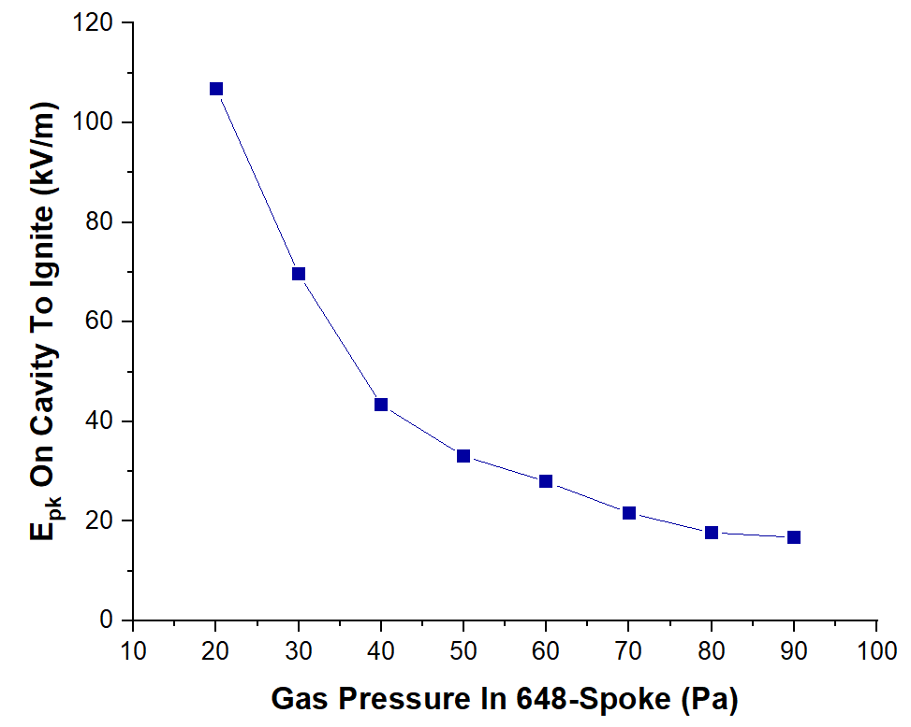
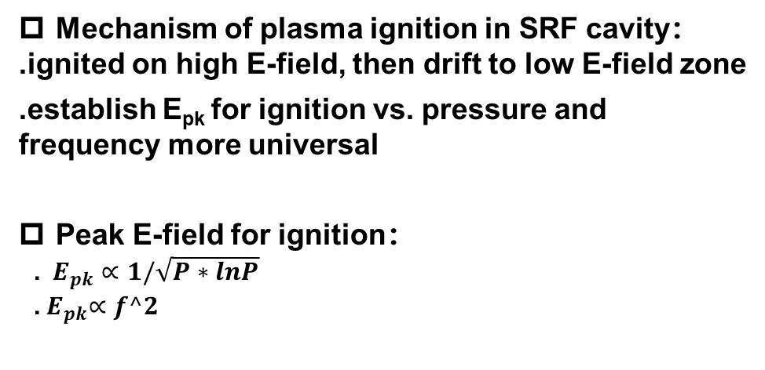
E_{pk} for plasma ignition VS. P&f
Ne:~648MHz
Mechanism of plasma ignition in SRF cavity：
.ignited on high E-field, then drift to low E-field zone
.establish E_{pk} for ignition vs. pressure and frequency more universal
Peak E-field for ignition：
.$E_{pk}∝1/\sqrt{P∗lnP}$
.${ E}_{pk}∝f^2$
$$E_{pk}≈104/\sqrt{P∗lnP}$$
He: ~648MHz
He: ~1.103GHz
*f^2
$$E_{pk}≈109/\sqrt{P∗lnP}$$

Slide 13
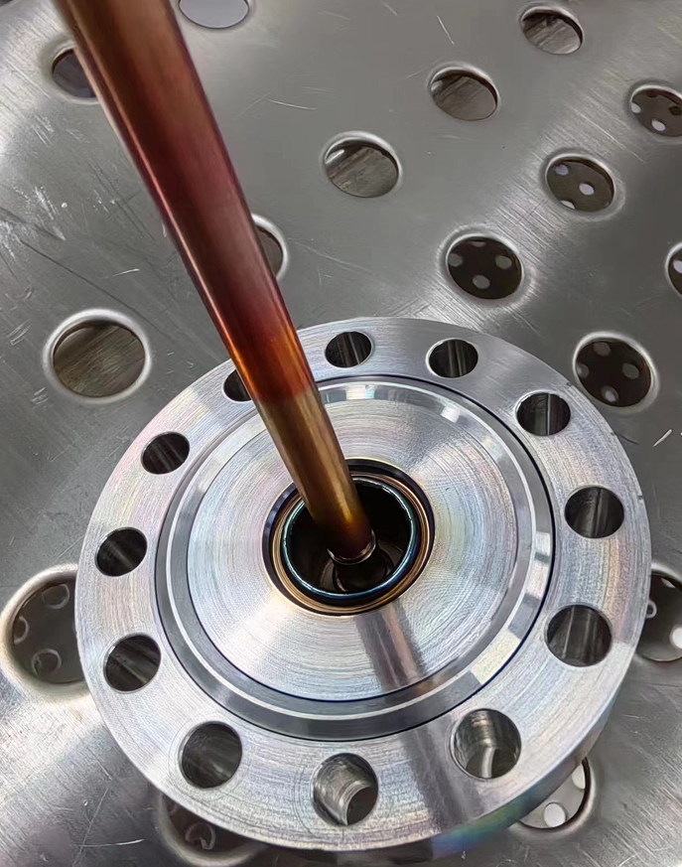
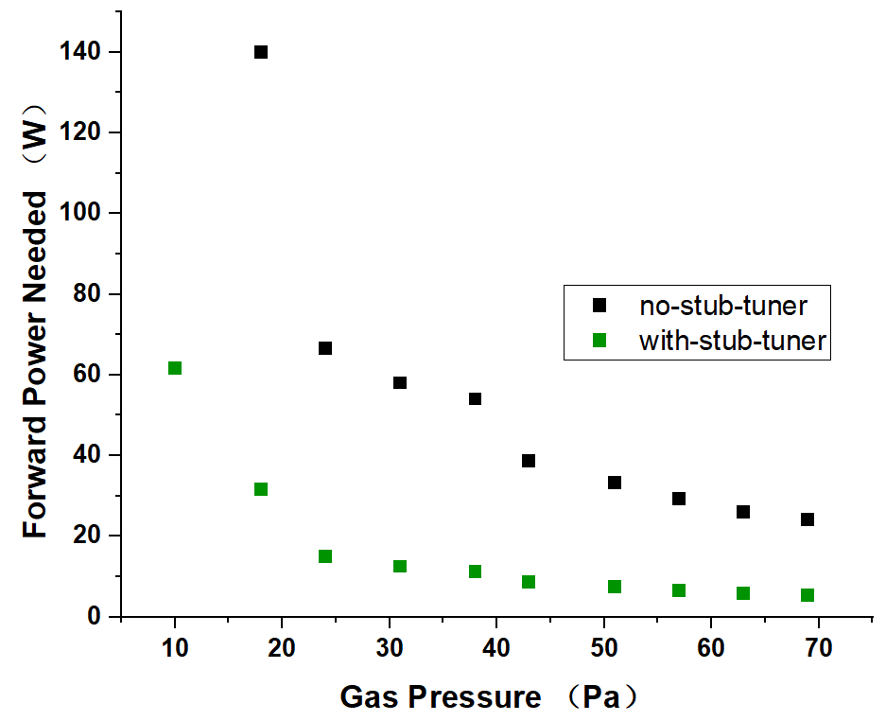
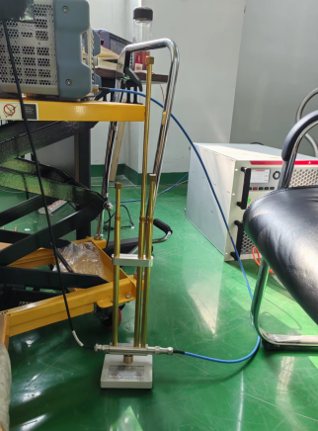
In-situ plasma processing issue: weak coupling
For in-situ plasma processing, cavity warmed up to RT at which coupler is at weak coupling status.
648 MHz SSR spoke + weak coupling antenna:
. coupler antenna adjusted manually to weak coupling
to simulate the in-situ status.
. stub-tuner for high frequency readily available from
market can be used to tune into good coupling.
. experiments confirm that stub tuner improves poor
coupling and cuts down ignition power.
before stub-tuner used：
high power caused oxidation
before and after stub-tuner used
stub-tuner used

Slide 14
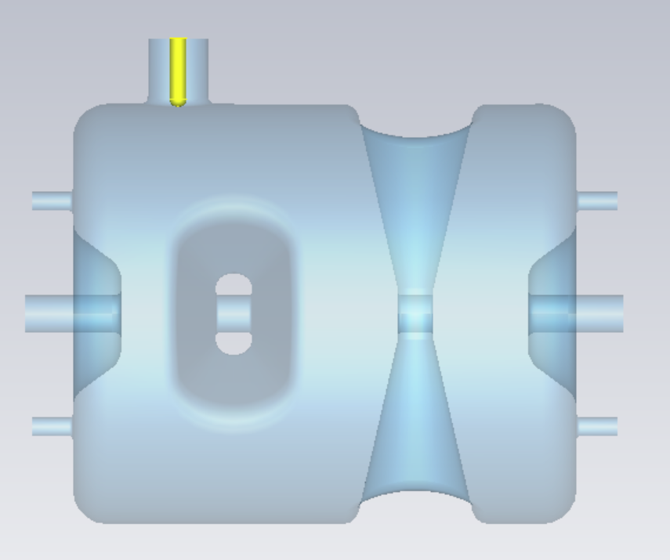
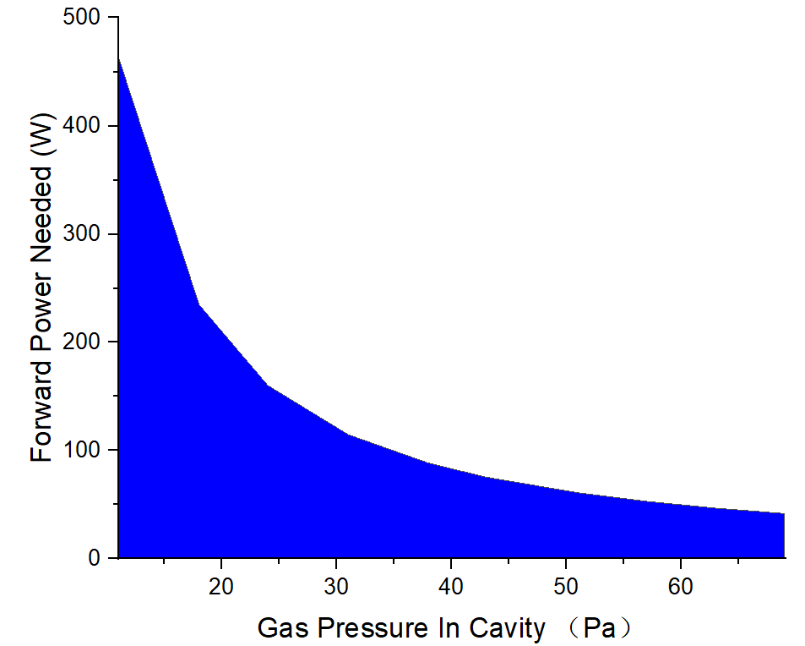
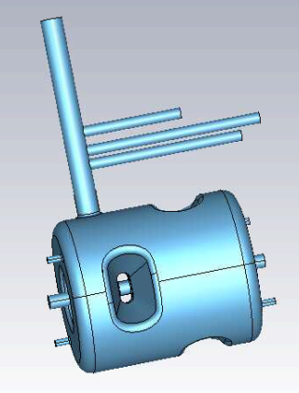
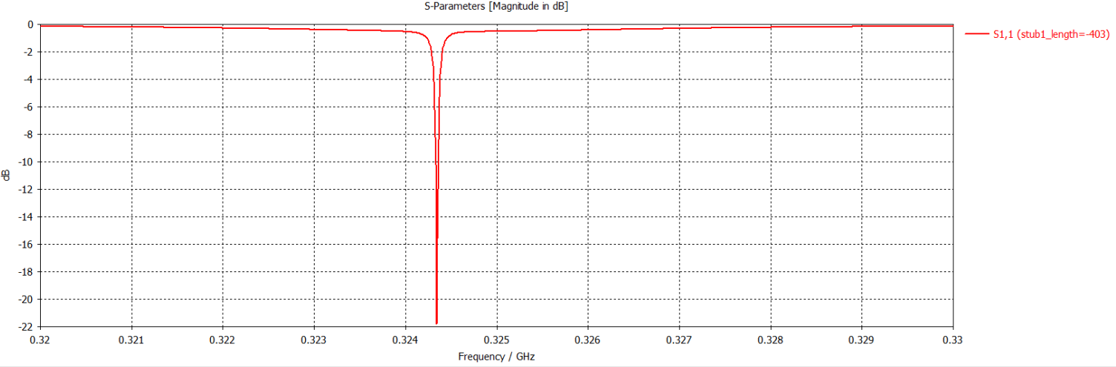
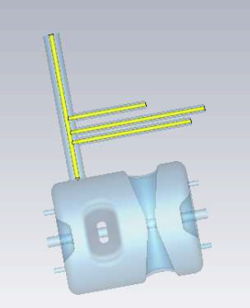
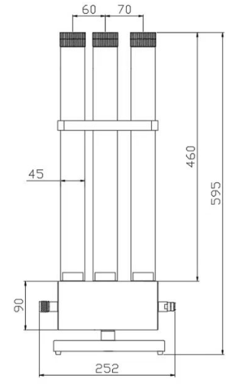


In-situ plasma processing issue: weak coupling
$$β=\frac{Q_{0}}{Q_{ext}}=0.02<<1$$
For CSNS-II DSR, 324MHz & β=0.02：
.~92% forward power reflected
.power needed for ignition ~100W to 400W
.the large disparity of power density between the
coupler and cavity, making the plasma ignition
inside cavity very difficult and readily triggering
plasma on coupler
.commercially available stub-tuner cannot cover
such low frequency of 324MHz, a customized
prototype designed and fabricated, which can
decrease the ignition power to ~30W
Plasma ignition power
without the stub-tuner
$$P_{in}/P_{f}=\frac{4β}{{(1+β)}^{2}}≈0.08$$
stub-tuner CST design
With stub-tuner：
S11=-22dB

Slide 15
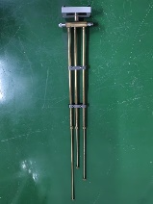
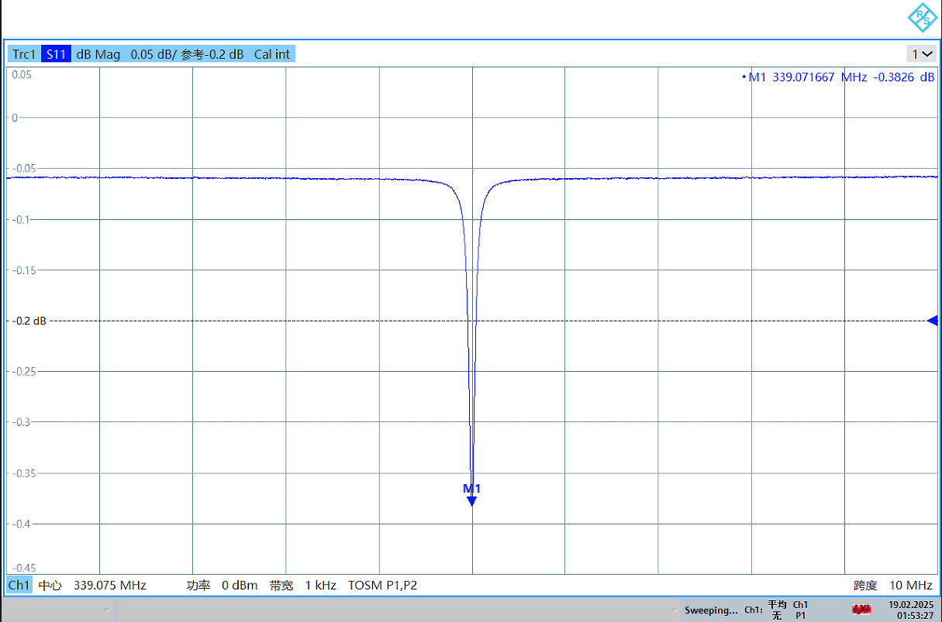
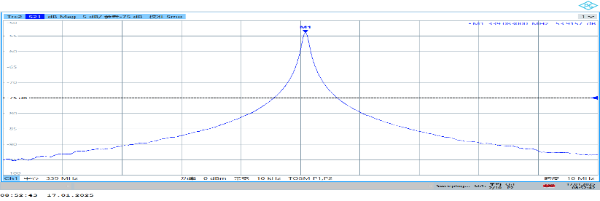
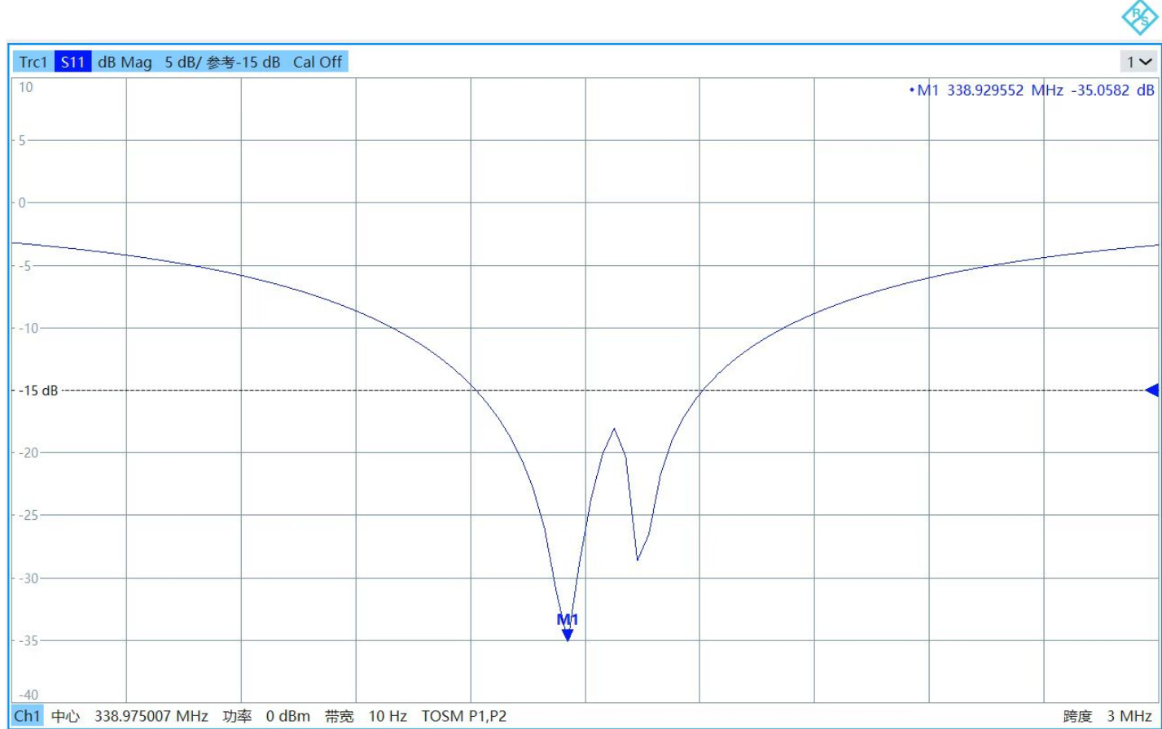
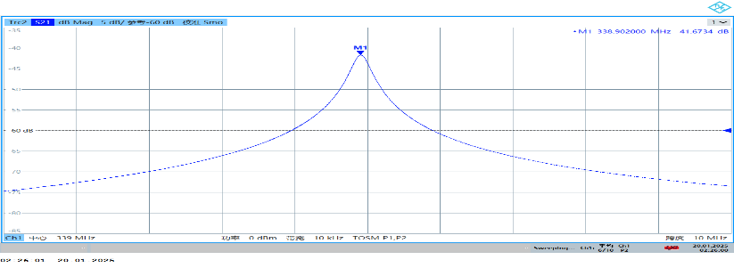
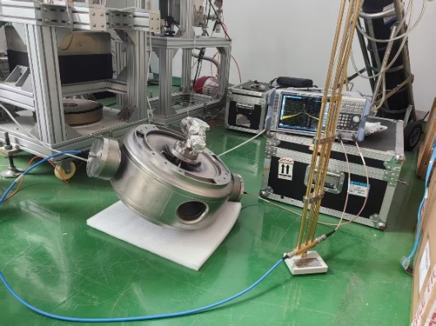
In-situ plasma processing issue: weak coupling
Tune the fabricated stub-tuner to good match
. Test the stub-tuner on 324MHz SSR
. Tuning performance： S11：-0.4dB→-35dB
S21：-53.9dB→-41dB
The power coupled into
the cavity increased by
a factor of 15.8
Without Stub-tuner：S11=-0.4dB
Without Stub-tuner：S21=-54dB
With Stub-tuner：S11=-35dB
With Stub-tuner：S21=-42dB

Slide 16
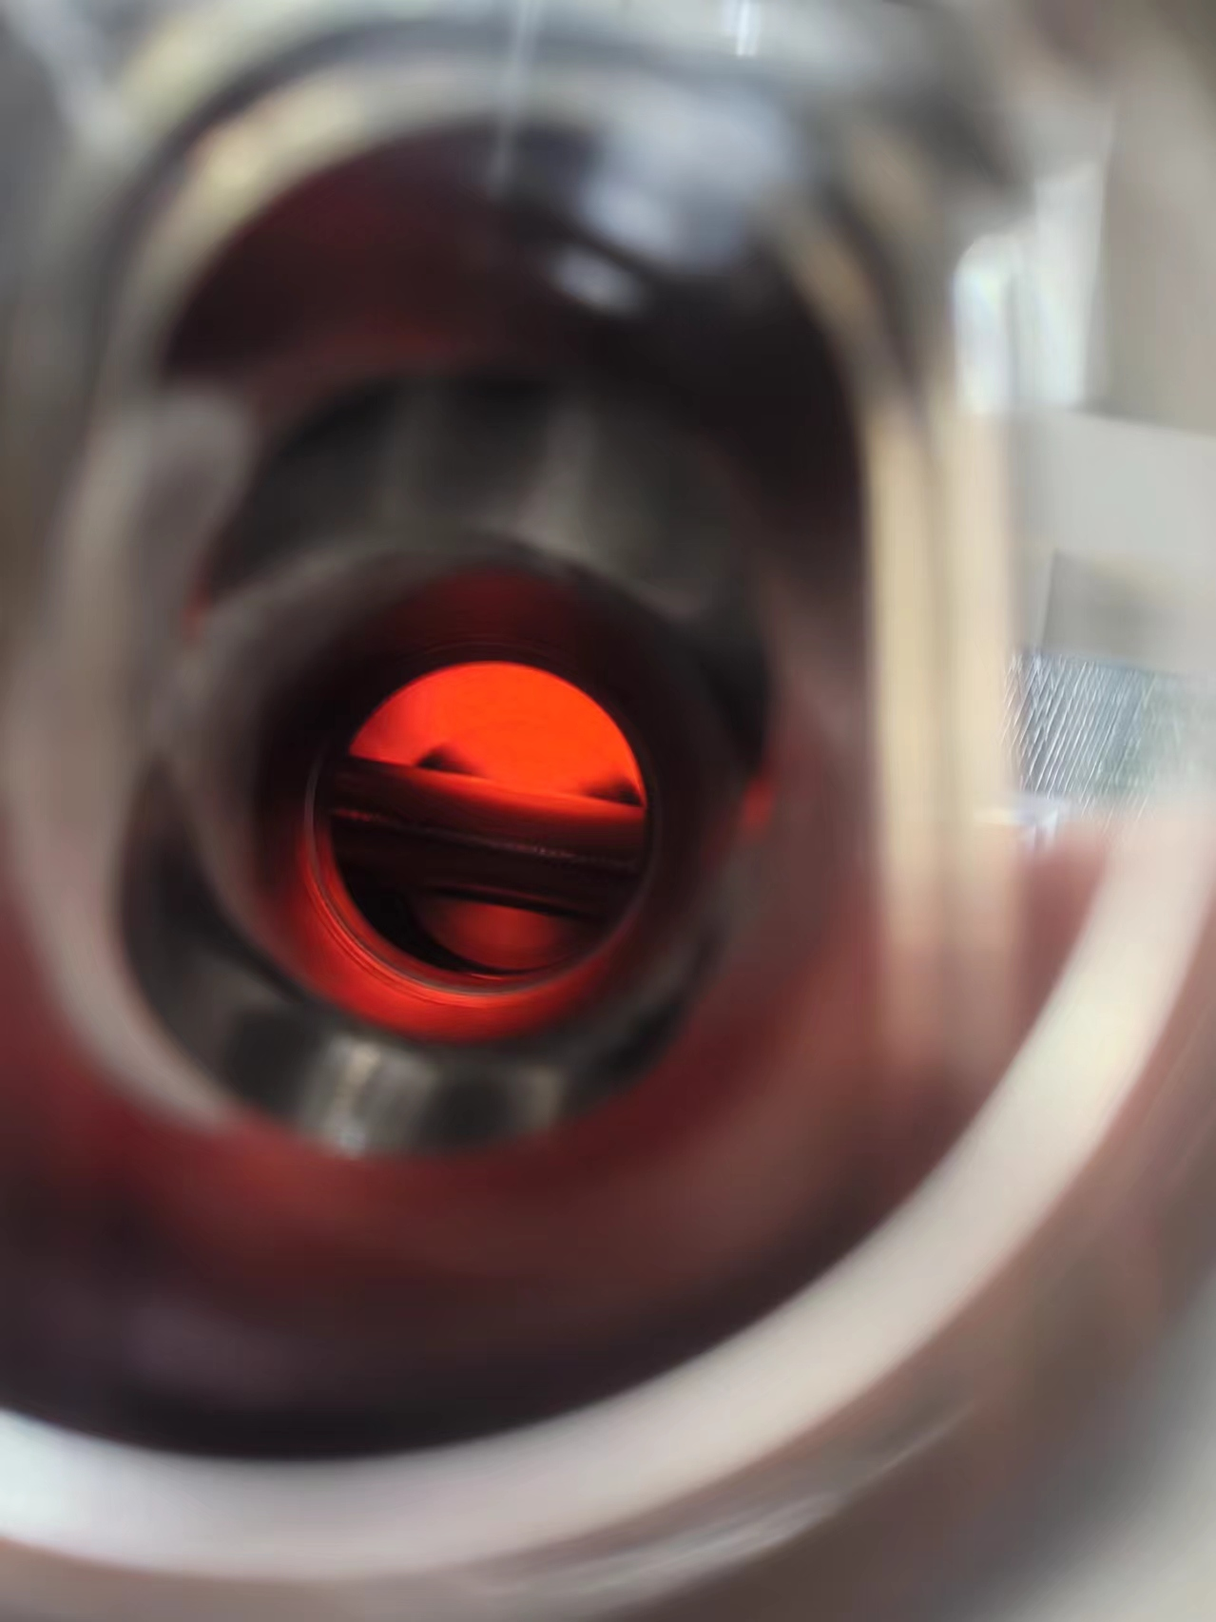
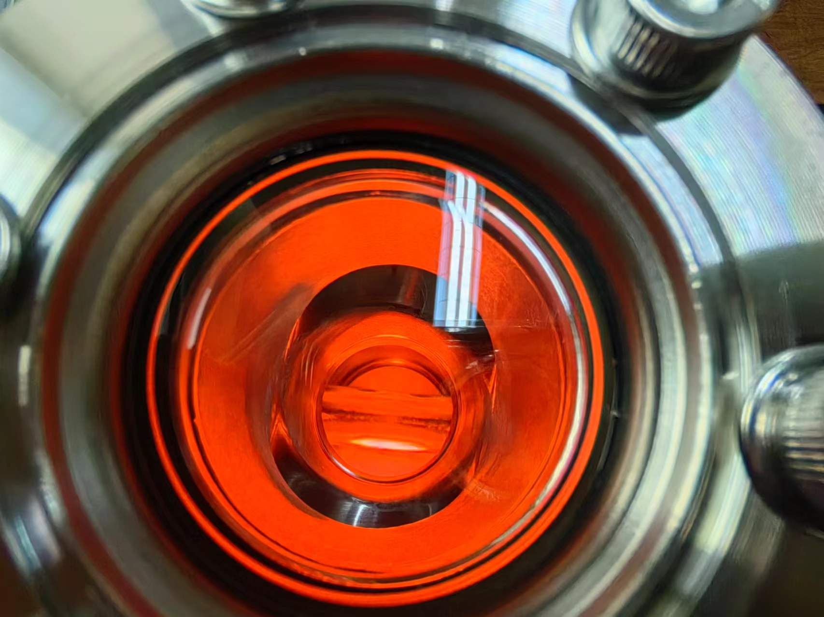
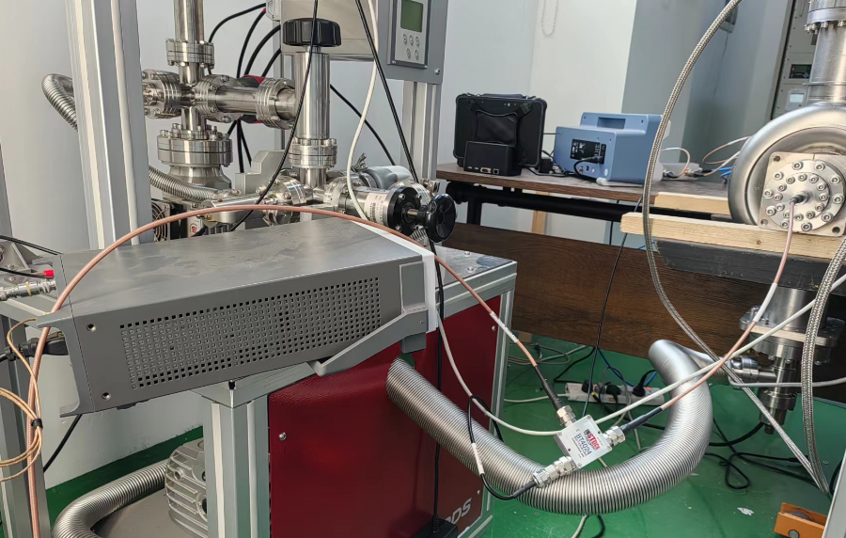
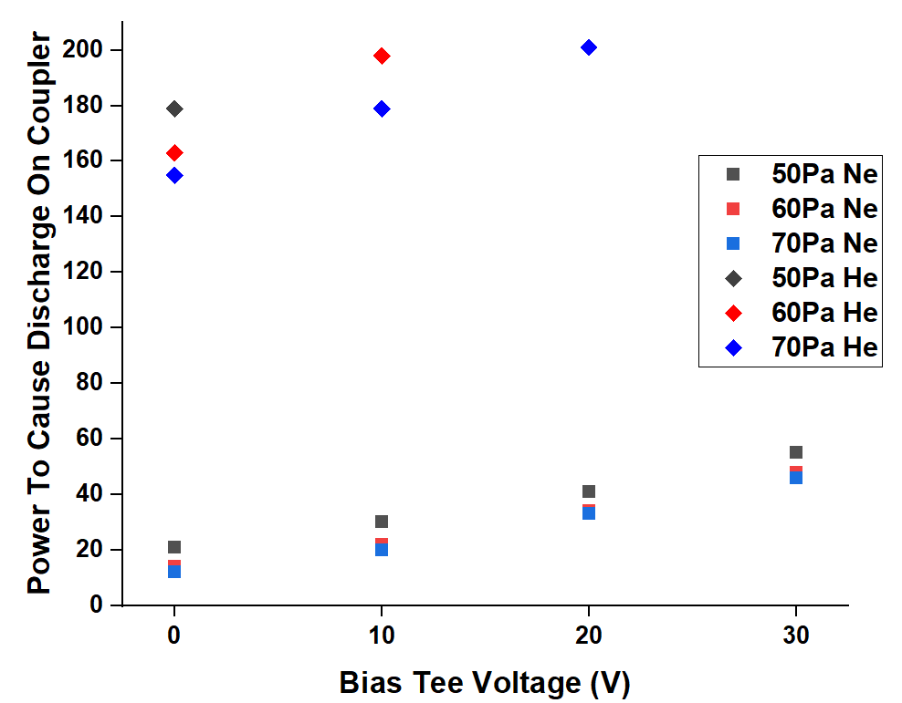
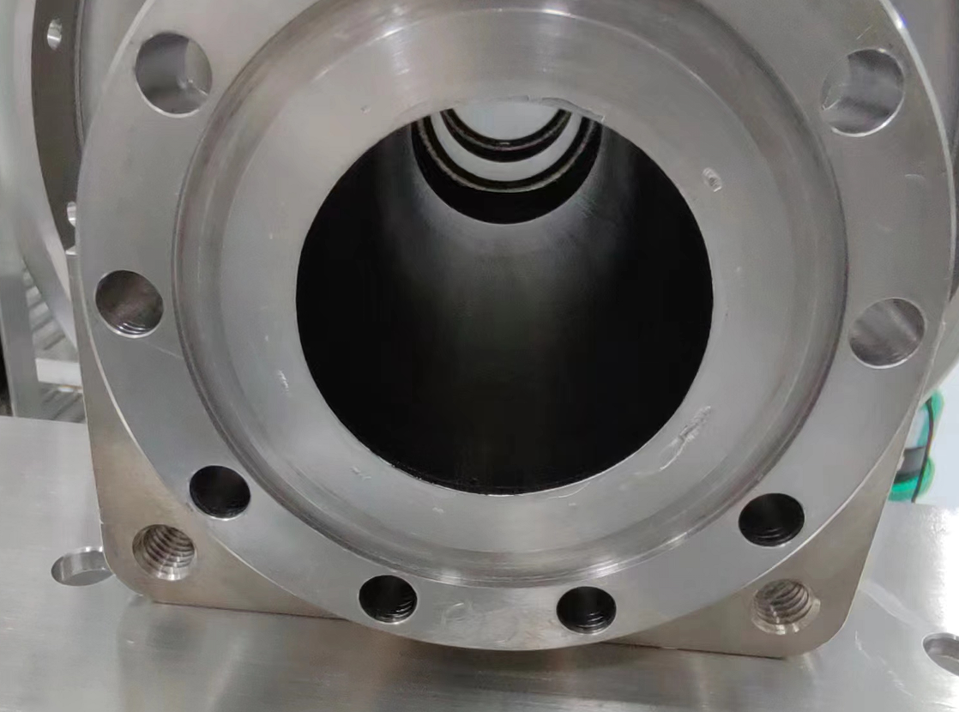
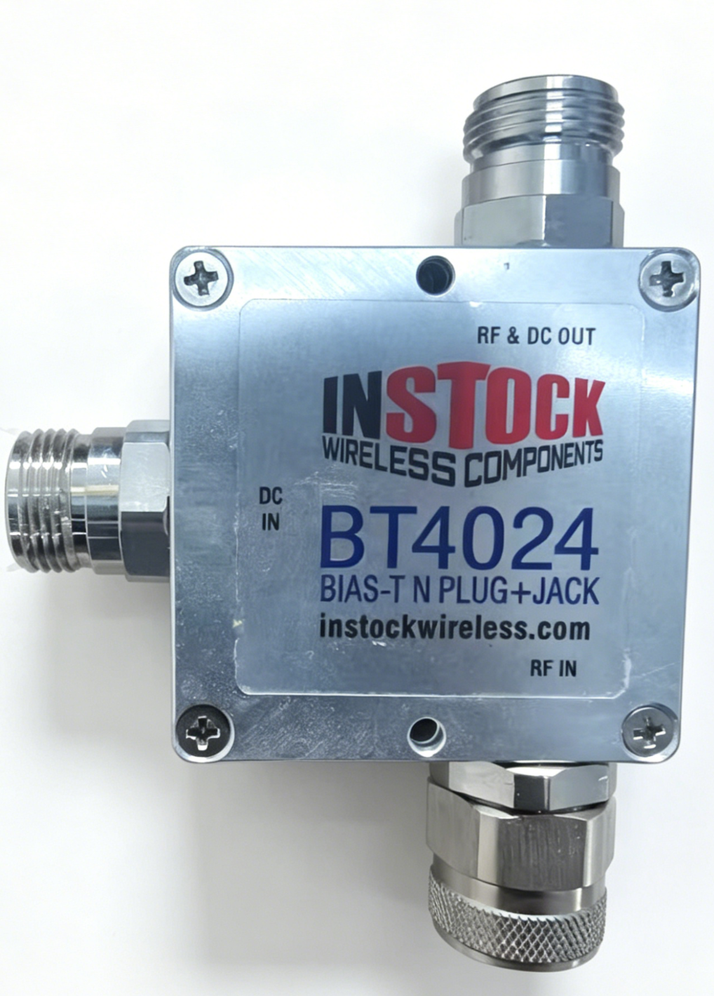
Plasma break down on coupler
ignition in cavity√
Plasma ignition on coupler may cause copper
sputtering contamination, which must be avoided.
For medium to high gas pressure, plasma prone to
ignite on coupler.
Applying a negative DC bias voltage to coupler
antenna via bias-tee can effectively suppress
plasma ignition on coupler
ignition on coupler×
Ignition on coupler threshold raised
No copper sputtering
after bias-tee used
RF+DC
RF
DC
Bias-tee

Slide 17
Plasma processing experiments on multi-cell elliptical cavity

Slide 18
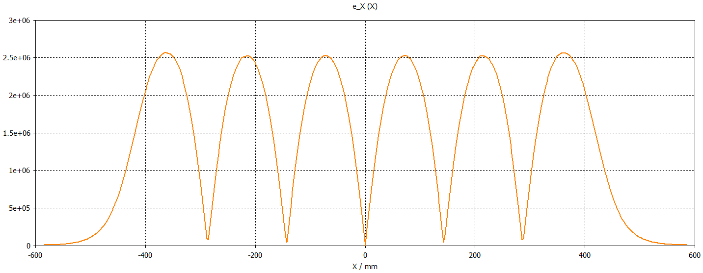
plasma ignition in multi-cell cavity
CSNS-II 6-cell elliptical cavity plasma ignition dilemma:
π mode field flatness of elliptical cavity
Field flatness of π mode cannot reach 100% due to machining tolerance, ~90% for CSNS-II 6-cell cavity.
A 10% field non-flatness of π mode may lead to failure of plasma ignition in some cells.
Therefore, conventional fundamental π-mode cannot guarantee plasma ignition in every cell to
accomplish full-cavity cleaning.

Slide 19
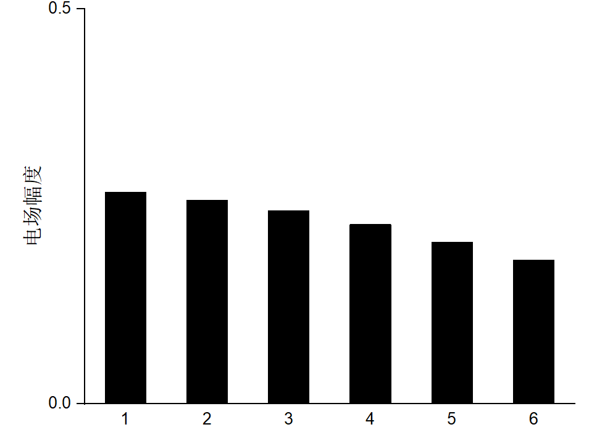
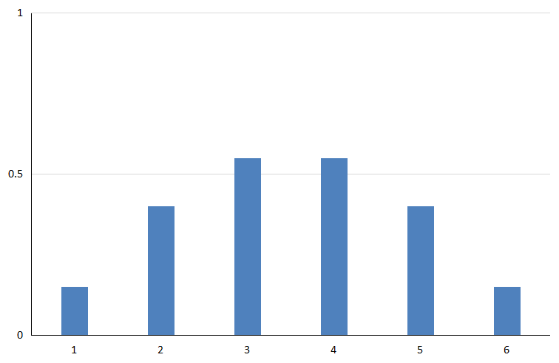
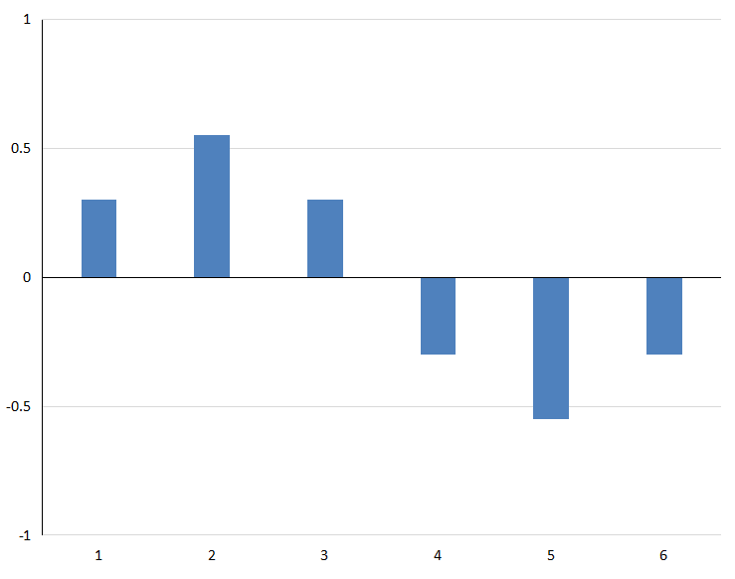
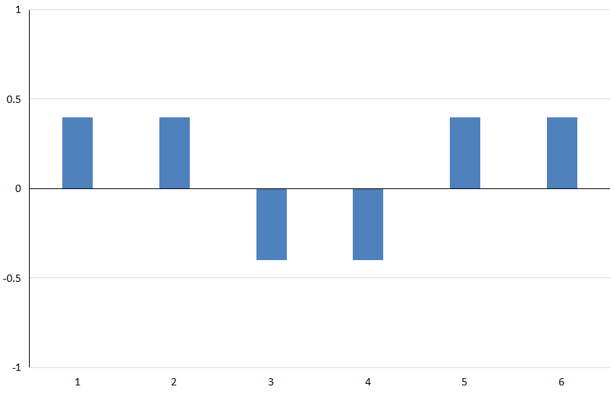








plasma ignition in multi-cell cavity
CSNS-II 6-cell elliptical cavity plasma ignition solution:
Discarding the conventional single-mode excitation scheme, a dual-mode superposition method is adopted to establish peak electric field sequentially in each cell for plasma ignition, ensuring all cells of the cavity are fully cleaned.
Mode 1：modes generating peak fields in two cells
Mode 2：artificial frequency detuning of π and 4π/6 as asymmetric fields modes
π mode
1/6π：3#，4#
2/6π：2#，5#
-∆f
+∆f
√
√
√
√
4π/6 mode
5/6π：1#，6#
-∆f
√
√
+∆f

Slide 20






plasma ignition in multi-cell cavity
Superposition of the two modes establishes peak electric fields individually inside each cell.
5/6 π+(π-Δf)
5/6 π+(π+Δf)
√
√
2/6 π+(π-Δf)
2/6 π+(π+Δf)
√
√
1/6 π+(4/6π-Δf)
1/6 π+(4/6π+Δf)
√
√

Slide 21






plasma ignition in multi-cell cavity
CST simulations verifying dual-mode superposition enables dominant E-field in every individual cell.
5π/6+（π-Δf）
Cell ignition | mode1 | mode2
1 | 5/6 π | π-Δf
2 | 2/6 π | π-Δf
3 | 1/6 π | 4/6π-Δf
4 | 1/6 π | 4/6π+Δf
5 | 2/6 π | π+Δf
6 | 5/6 π | π+Δf
√
2π/6+（π- Δf）
√
4π/6+（π/6- Δf)
√

Slide 22




plasma ignition in multi-cell cavity
Experimentally verified on a 6-cell copper cavity
dual-mode excitation circuit system
Plasma ignition test on copper cavity
Cell-by-cell
Ignition observation
Via viewports

Slide 23


plasma ignition in multi-cell cavity
Experimental Procedures for Plasma Cleaning of 2-Cell Elliptical SRF Cavity
Vertical test to get baseline
Introduce cryogenic CH₄ adsorption, validate performance degradation
Plasma processing
Vertical test to verify the effectiveness of plasma processing
CH₄ cryogenic adsorpotion
Vertical test results before and after CH₄ adsorption

Slide 24







plasma ignition in multi-cell cavity
2-cell cavity plasma processing with He+O₂：
2-cell cavity plasma processing
cell2
cell1
gas reaction during plasma processing
cell1ignition
cell2 ignition

Slide 25
Summary
CSNS-II plasma processing development, measurement and analysis have been done in several types of cavities.
. plasma processing with various gas and presure
. weak coupling issue
. plasma breakdown on coupler
Method optimization is a work in progress.
Need to test plasma processing with vertical test.

Slide 26
Thanks For Your Attentions！

