Slide 1
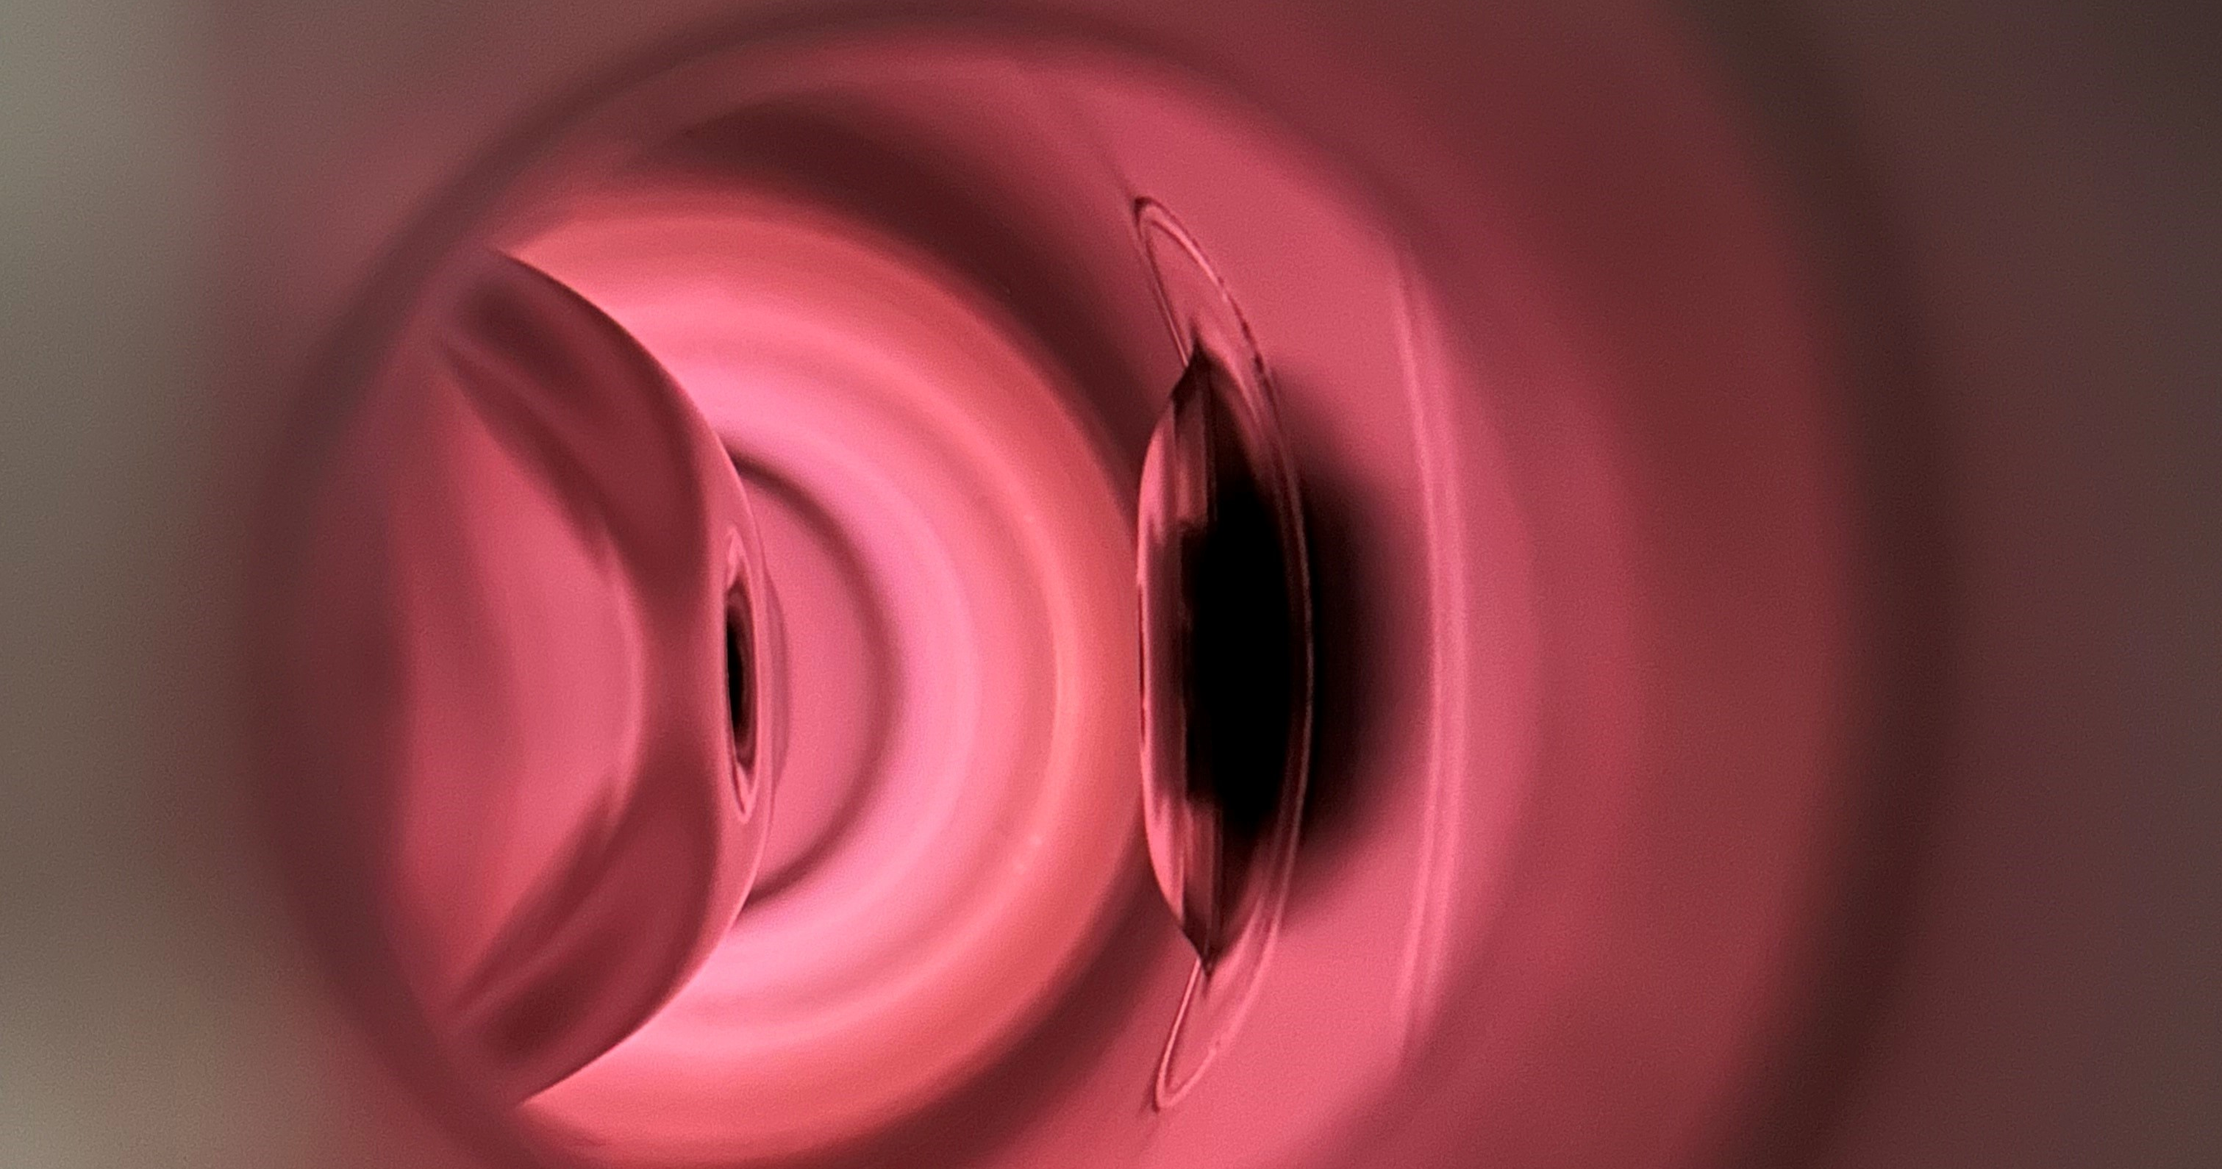
In-Situ Plasma Processing, Pulse Conditioning, Helium Pulse processing, and Thermal cycling on Low-beta Cavities in atlas
june 2026 – ttc meeting
Megan mcintyre
ANL ATLAS Operator
Physics Division
Mike Kelly
Troy Petersen
Gary Zinkann

Slide 2
Outline
ATLAS overview / target SRF cavities
Investigations + setup
  Pulse Conditioning (PC)
  Helium Pulse Processing (HPP)
  Plasma Processing (PP)
    Thermal cycle
Goals for investigations before/during/after scheduled winter 2026 maintenance period
Results and conclusions from investigations
Next steps/plans and discussion points

Slide 3
atlas facility
Cryostats of interest for HPP, PP, and Thermocycle
  A-tank:
    Seven 72 MHz QWR installed 2014: has not been refurbished since initial install (12 years operation)
    Regular pulse conditioning
    Possible leak from cold trap(s) causing frozen N2 on end cavities
    Degradation evident in heat load and radiation, not running at previous amplitudes
    2015 and 2016 exit valve struck with beam, degraded R217
      2016 Up to 4 pnA of 12C
      PC and conditioned, little improvement
  G-tank:
    Seven 109 MHz QWR installed 2002
    Refurbished, upgraded, and additional cavity re-install 2022
  ATLAS: Argonne Tandem Linac Accelerator System
    1986 first beam (happy 40th birthday ATLAS🥳)
    Over 6000 hrs/yr
    Beams H up to Ur, radioactive and stable
    One month winter maintenance in January
      2026 maintenance Jan. + Feb.
    53 SRF cavities
      23 split-rings still active
      30 QWR
Notes:
A-Tank and G-Tank cryostats. A-Tank has six QWR SRF cavities at 72 MHz. G-Tank has eight.

Slide 4
investigations
PULSE CONDITIONING
HELIUM PULSE PROCESSING
PLASMA PROCESSING
THERMAL CYCLE
COLD (4K)
COLD (4K)
WARM
COOL DOWN
Standard procedure used by operators
Use already installed equipment
Post shutdown commonly executed
Long or short pulse
Consistently improves performance if breakdowns are seen
Used in early operation (1979 split rings)
Equipment: normal RF circuit, gas filter, gas cylinder, and clean inlet line
Vacuum in cryostat normally E-9 Torr range, during HPP E-5 Torr range
Improves FE onset, no Q change seen
Ar/O2 Gas
10 WATTS PFWD, 50 – 100 mTorr
Improves FE onset, no Q change seen (for us)
Equipment: Gas mix, turbo cart w/ RGA, diagnostics (SA, NA, scope, etc.), fast acting valve, amplifier, SG, coupler protection
Can improve Q of cavities if particles frozen to surface
Can be implemented within scheduled maintenance
Goal: Desorb N2 frozen to end cavities
Could be combined with other processes for optimization

Slide 5

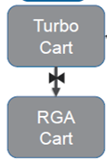
ATANK
LLRF AMPS
A-tank cryostat
CRYOGENIC EQUIPMENT
LOCKED
TRENCH
TRENCH
ELECTRONICS RACK
CTRL
SYS
LLRF RACK
ELECTRONICS RACK
ARIS
FWD POWER
DIAGNOSTIC
EQUIPMENT
INTERLOCK BOX

Slide 6
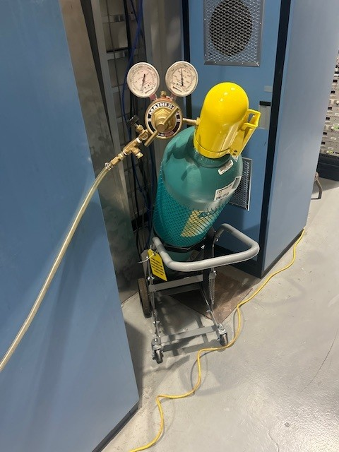
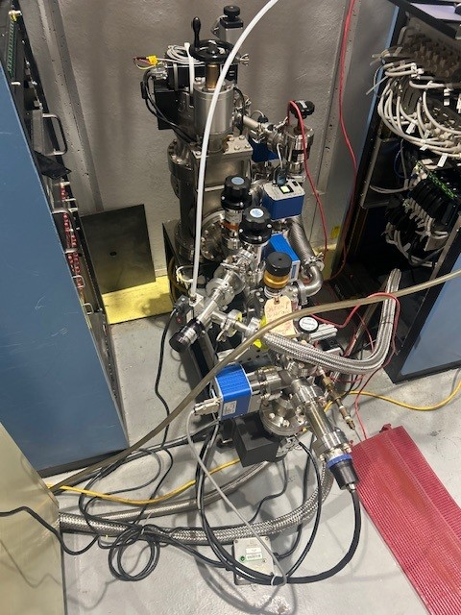
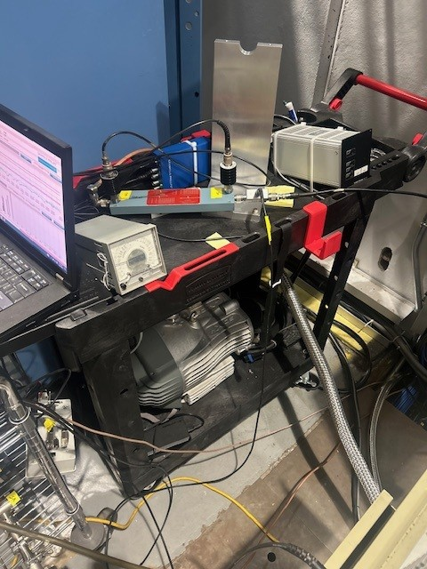
ATANK
LLRF AMPS
A-tank cryostat
CRYOGENIC EQUIPMENT
LOCKED
TRENCH
TRENCH
ELECTRONICS RACK
CTRL
SYS
LLRF RACK
ELECTRONICS RACK
ARIS
FWD POWER
DIAGNOSTIC
EQUIPMENT
INTERLOCK BOX

Slide 7
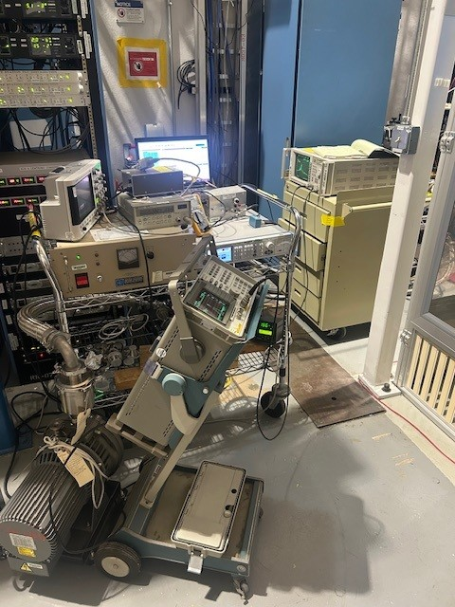
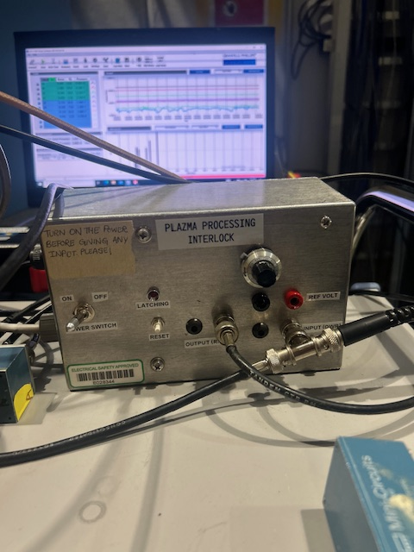
ATANK
LLRF AMPS
A-tank cryostat
CRYOGENIC EQUIPMENT
LOCKED
TRENCH
TRENCH
ELECTRONICS RACK
CTRL
SYS
LLRF RACK
ELECTRONICS RACK
ARIS
FWD POWER
DIAGNOSTIC
EQUIPMENT
INTERLOCK BOX

Slide 8
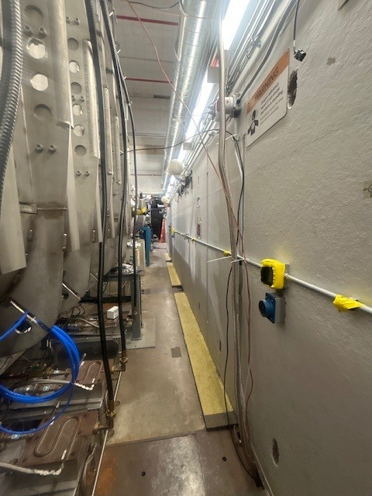
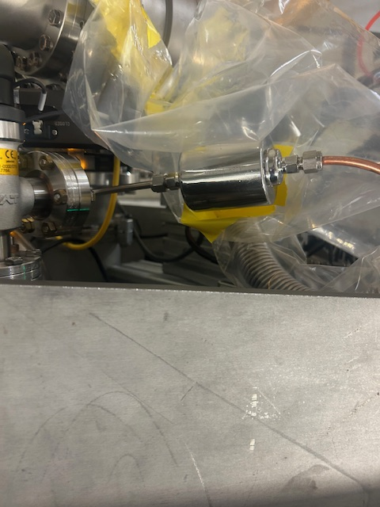
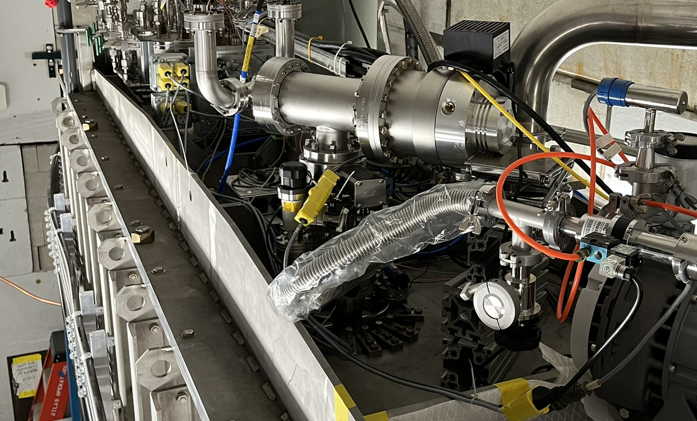
ATANK
LLRF AMPS
A-tank cryostat
CRYOGENIC EQUIPMENT
LOCKED
TRENCH
TRENCH
ELECTRONICS RACK
CTRL
SYS
LLRF RACK
ELECTRONICS RACK
ARIS
FWD POWER
DIAGNOSTIC
EQUIPMENT
INTERLOCK BOX

Slide 9
PROOF OF CONCEPT, PC, PP, HPP investigations AND RESULTS

Slide 10
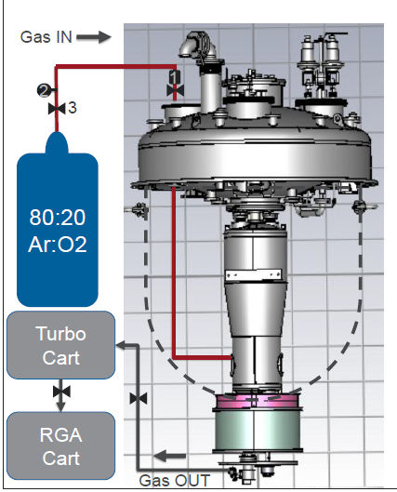
PROOF OF CONCEPT: TEST CRYOSTAT WITH A-Tank cavity DESIGN
Outside cave
Inside cave
72 MHz QWR bench top tests successful → pseudo in-situ w/ TC3
  Same cavity and coupler design as A-tank (moveable coupler by 3 in (7.62 cm))
  Fundamental eigenmode plasma ignition
  Clean room assembly: ultrasonic rinse, HPR, N2
  PC, HPP, and PP with before and after cold tests
Gas inlet: 1/8” cu line cleaned with HPR and N2
  0.01 micron filter on inlet
  PP: Pre-mixed 80:20 Ar:O2 gas cylinder
  HP: Pure He gas cylinder
Had to use higher power amplifier for HPP vs PP
Simulated valve incident: 50 Torr pure Ar gas into cavity space
  Cold test after then comparison of PC, HPP, PP
Parameters for PP:
  50-100 mTorr, ~10 watts, 72 hours total processing time
Parameters for HPP:
  ~5E-5 Torr vacuum, differential pumping
  Not using RGA during He conditioning only plasma
He
OR

Slide 11
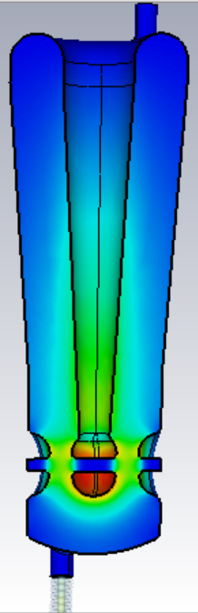
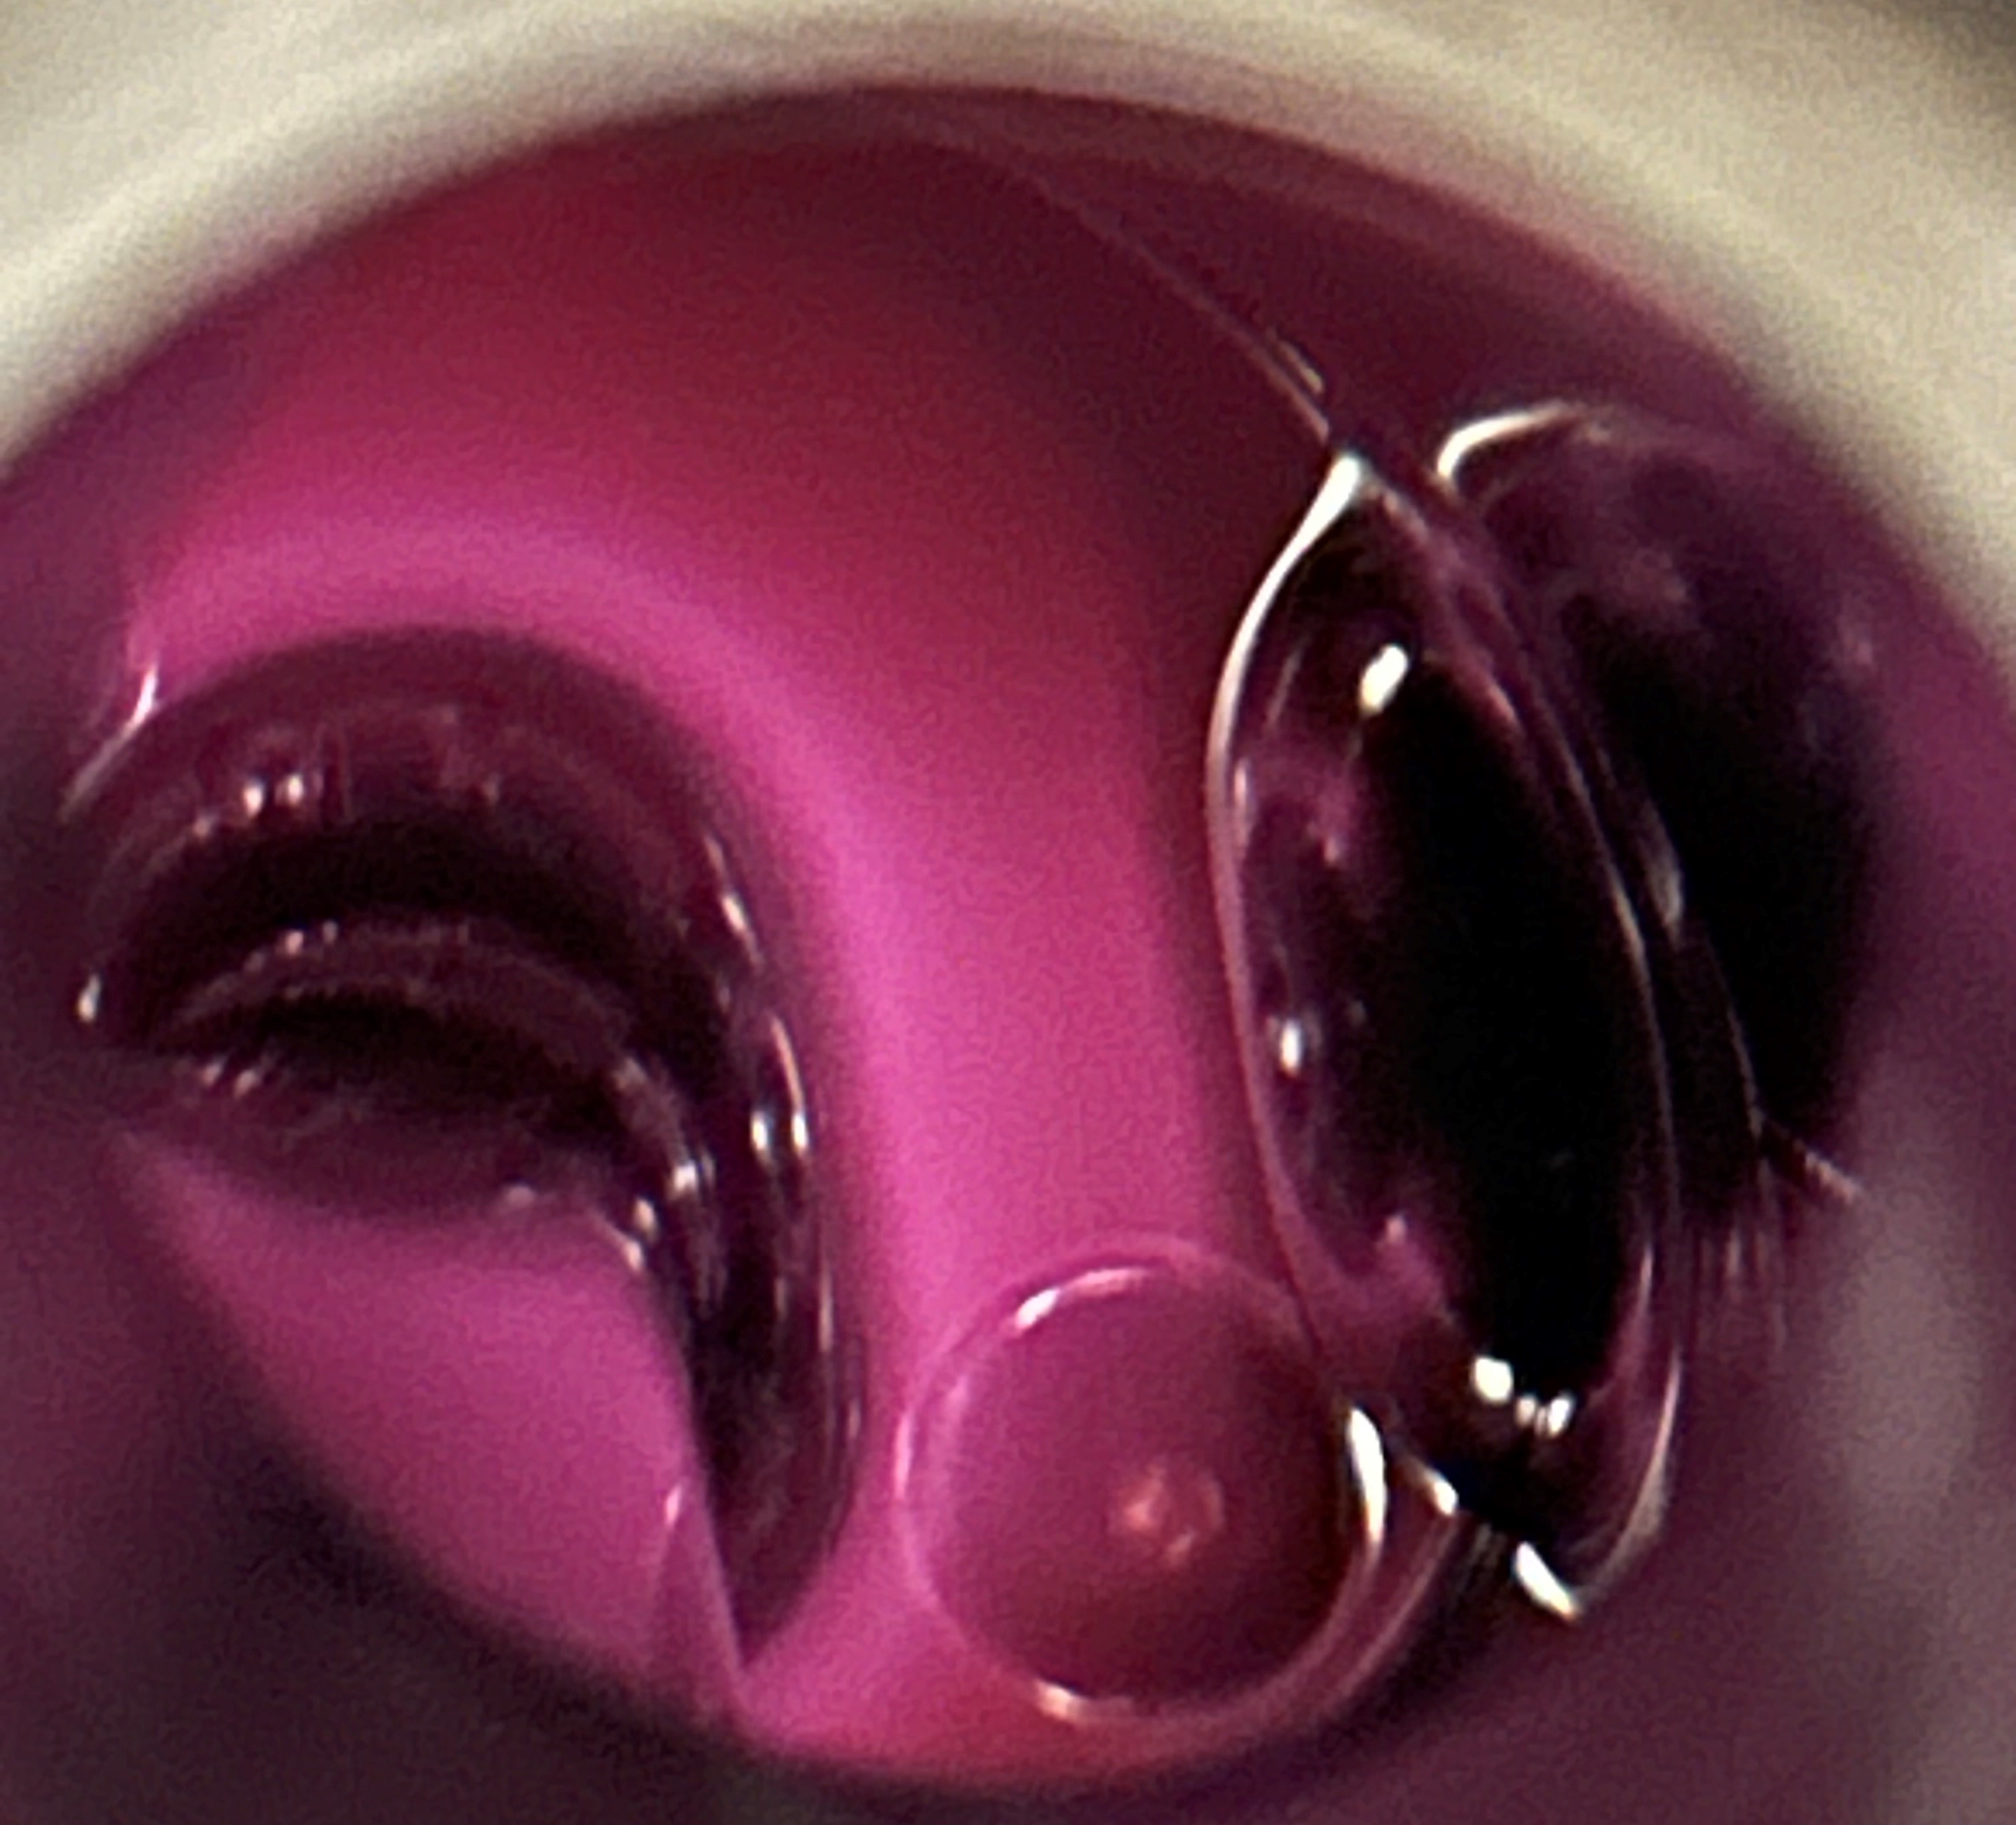
PROOF OF CONCEPT: TEST CRYOSTAT WITH A-Tank cavity DESIGN
Outside cave
Outside cave
Inside cave
Inside cave
72 MHz QWR bench top tests successful → pseudo in-situ w/ TC3
  Same cavity and coupler design as A-tank (moveable coupler by 3 in (7.62 cm))
  Fundamental eigenmode plasma ignition
  Clean room assembly: ultrasonic rinse, HPR, N2
  PC, HPP, and PP with before and after cold tests
Gas inlet: 1/8” cu line cleaned with HPR and N2
  0.01 micron filter on inlet
  PP: Pre-mixed 80:20 Ar:O2 gas cylinder
  HPP: Pure He gas cylinder
Had to use higher power amplifier for HPP vs PP
Simulated valve incident: 50 Torr pure Ar gas into cavity space
  Cold test after then comparison of PC, HPP, PP
Parameters for PP:
  50-100 mTorr, ~10 watts, 72 hours total processing time
Parameters for HPP:
  ~5E-5 Torr vacuum, differential pumping
  Not using RGA during He conditioning only plasma
DIAGNOSTIC
EQUIPMENT
He
OR
INTERLOCK BOX
Plasma ignites here!
Interlock box to prevent coupler ignition

Slide 12
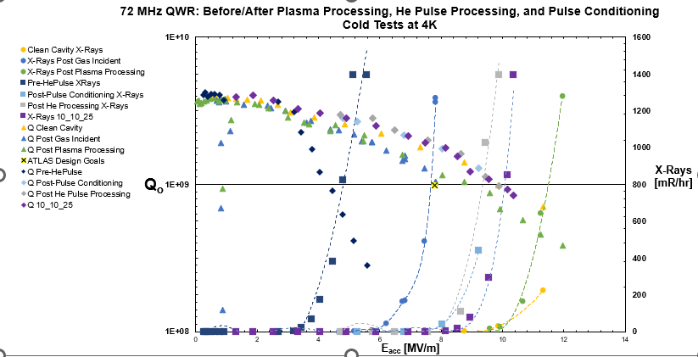
All Results

Slide 13
Clean Cavity

Slide 14
Pulse Conditioning

Slide 15
Helium Pulse Processing

Slide 16
Helium Pulse Processing

Slide 17
Plasma Processing

Slide 18
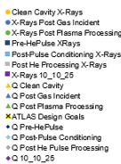
Proof of concept work conclusions
TC3 tests before A-Tank and/or G-tank work
PC works okay, HPP much better
HPP with higher power amplifier (100’s of Watts vs 1000’s) increases improvement
Plasma works great, though with AR:O2, very long processing time
  Proven later from IJC Lab work (SRF25, C. Chenney)
  Setup very possible with existing equipment, only need dedicated RGA and gas mixture
If HPP has He gas increase too quickly, dragging in room air, could recover
  Same for plasma gas mixture

Slide 19
In-situ tests with a-tank cryostat:
72 mhz qwr cavities

Slide 20
Timeline: experiments and a-tank in-situ
A-tank valve/beam incident ; R217 degrades
(2016)
Plasma processing investigation begins
(2023)
Proof of Concept:
TC3 A-tank 72 MHz QWR pseudo in-situ test
(winter/spring 2025)
A-tank WARM UP
ATLAS SHUTDOWN
SRF23
SRF25
A-tank installed
(2014)
G-tank (2002) upgraded/refurbished and reinstalled
(2022)
Bench top tests of plasma processing
(172 MHz HWR & 72 MHz QWR)
(2023 – 2024)
A-tank PC and HPP tests
(Fall/winter 2025)
Prep. Plasma Processing
IN-SITU
2014
2015
2016 - 2022
2023
2023 - 2024
2025
Dec. 2025 →
Notes:
DARKER MAKES IT LOOK LIKE IT HASN’T HAPPENED YET

Slide 21
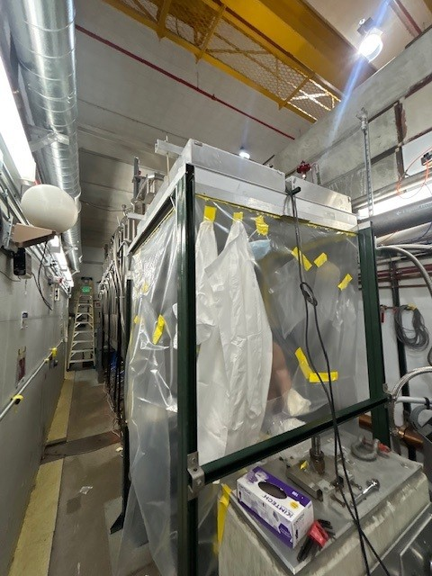
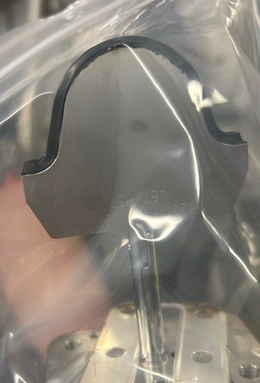
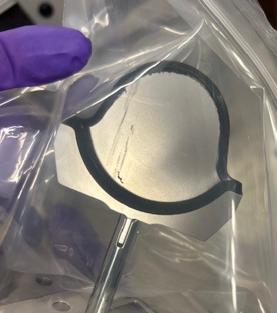
Maintenance work on a-tank before plasma processing
Thermal cycle adjustment(s) and pulse conditioning
Pulse conditioning generally done after long shut down periods (days, weeks, or month down time)
  Done before shutdown and after (but waited until post R217 plasma Q-curve)
Helium Pulse Process
Thermal cycle goal: desorb possible frozen nitrogen on A-tank end cavities, improve Q
  Investigate N2 leak when warming
Exit valve replacement on A-tank used portable clean room and HEPA filter(s)
  Cold trap transported clean and installed under portable clean room
THEN we can plasma process…

Slide 22
Timeline: experiments and a-tank in-situ
HPP in Fall/Winter 2025
Downstream valve replacement + COLD TRAP INSTALL
A-tank cool down (thermal cycle) (also investigated potential N2 leaks)
A-tank active
Winter 2026 ATLAS Maintenance
(Jan. – Feb. 2026)
Plasma Processing R217
Q-curve measurements
January 2026
February 2026
March 2026

Slide 23
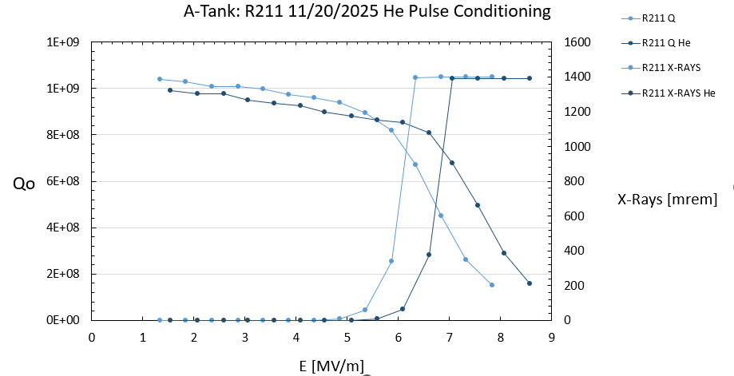
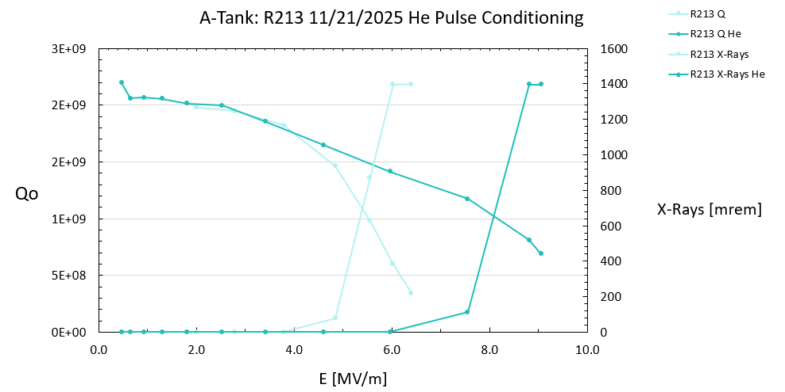
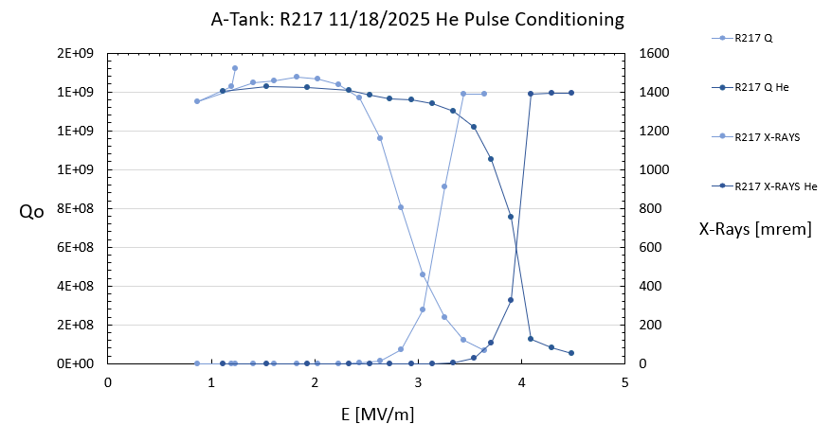
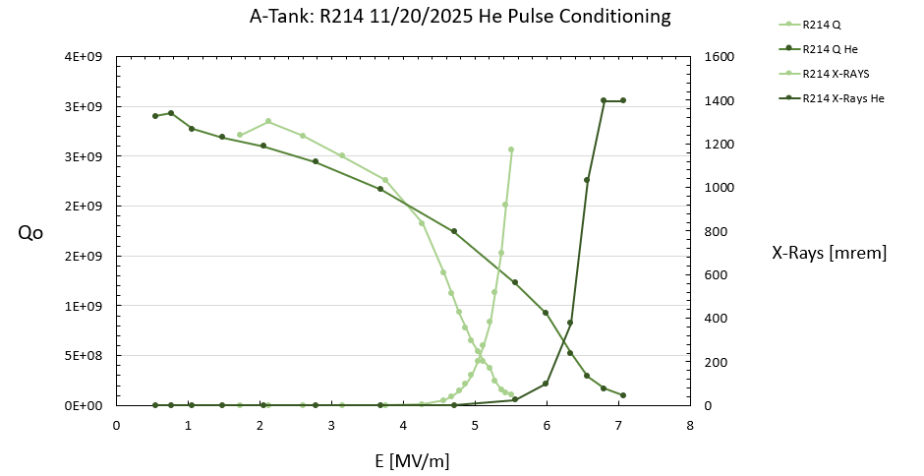
A-TANK Hpp RESULTS
Specific resonator results from cryostat
Pushed Q curve knee out for all cavities
FE onset pushed out
Total cryogenic capacity taken lowered by 10-15 watts
Currently running at higher amplitudes with overall less radiation
Overall energy gain from tank is ~10% more MeV

Slide 24
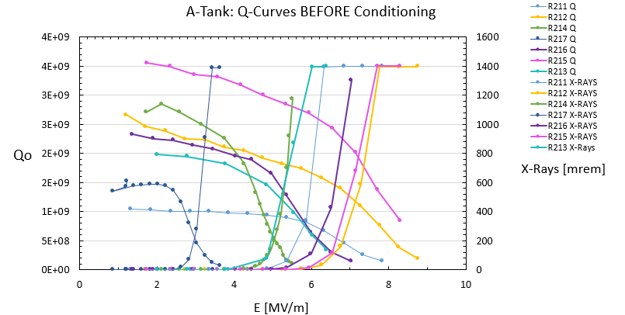
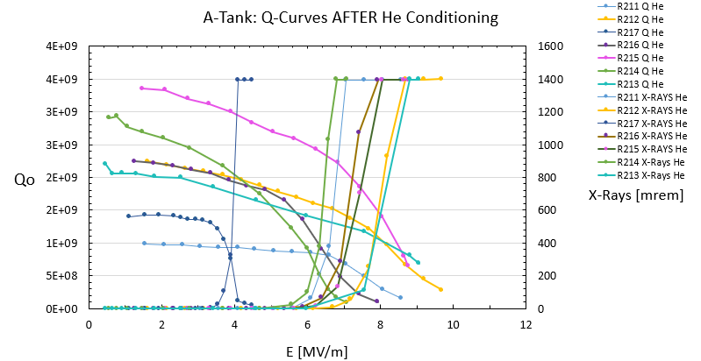
Hpp results promising, easy to implement
Executable in 1-2 days for whole cryostat
Key results for the specific resonators show great improvement, other resonators still improved but less so
R217 was barely on at 2.7 V, now consistently running 3.45 – 4.0 V
Implemented on G-tank cryostat June 2026:
  Gas was introduced to cavity space causing contamination
  Followed same procedure but adjusted for higher amplitude conditioning and similar vacuum space
  Operators could easily implement during overnight shifts
Thermal cycle was able to improve end cavities Q slightly
Slightly degraded FE on R211 after thermal cycle, He does enter in from the beam left side
  Could HPP from downstream and work backwards

Slide 25
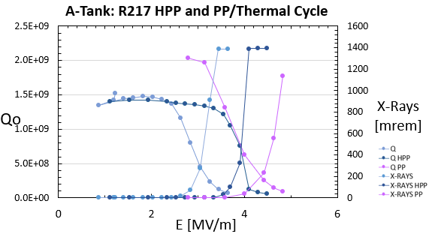
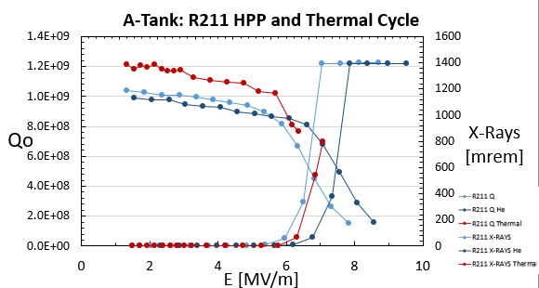
Plasma processing and thermal cycle
Executable in 1-2 days for whole cryostat
Key results for the specific resonators show great improvement, other resonators still improved but less so
R217 was barely on at 2.7 V, now consistently running 3.45 – 4.0 V
  Plasma processing pushed FE out even further
Implemented on G-tank cryostat June 2026:
  Gas was introduced to cavity space causing contamination
  Followed same procedure but adjusted for higher amplitude conditioning and similar vacuum space
  Operators could easily implement during overnight shifts
Thermal cycle was able to improve end cavities Q slightly
Slightly degraded FE on R211 after thermal cycle, He does enter in from the beam left side
  Could HPP from downstream and work backwards

Slide 26
Conclusions, next steps, Discussion…
  Helium pulse processing: easy to implement and operators can perform during downtime (during some development days we did this)
  Pulse conditioning eventually stops helping degradation, pro: general task operators do
  For higher power amplifiers, circulators on resonators need to be built to withstand the high-power pulse conditioning
  Plasma has excellent results in fundamental mode; if you have equipment around you can implement this at a low cost
    Recipe comparison; advantages disadvantages
    Ways to implement this without any modifications to already installed cryostats vs resonators being upgraded and what could be added to could help later processing
    HOM’s seem like good idea but have shown cavities degrading for some cases; needs more study
    What combination of PC, HPP, and Plasma could be most beneficial
      Degradation after time passes ?
  Currently HPP on G-tank 109 MHz QWRs after gas cell incident
    Showing improvement in radiation, heat load, and stability
  Depending on situation, could need different technique…

Slide 27
Thank you ☺

