Slide 1

Development of In-Situ Plasma Processing Procedures with the Fundamental Passband on 1.3GHz Multi-Cell SRF Cavities at TRIUMF
William Stokes
TTC2026 – Paris-Saclay
June 11th, 2026

Slide 2
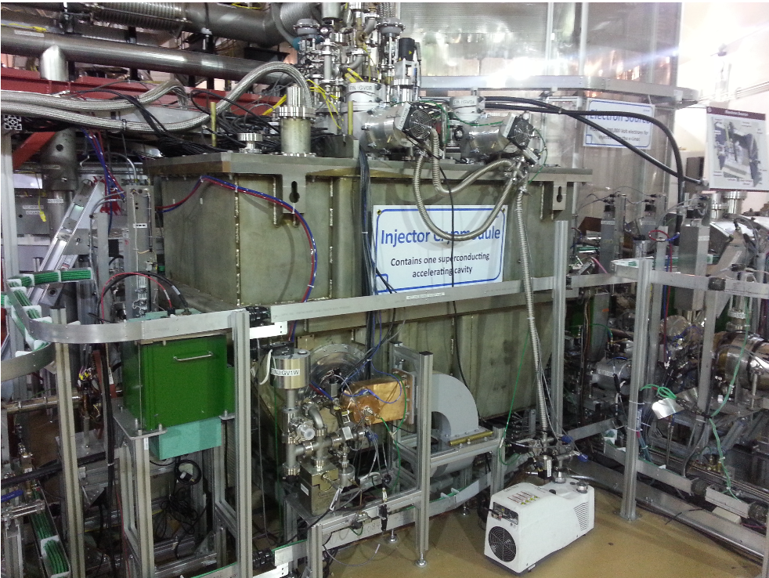
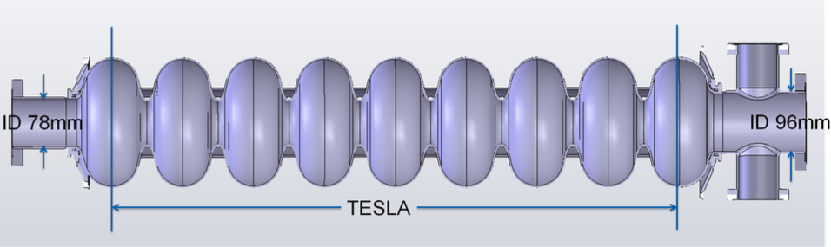
Advanced Rare Isotope Laboratory (ARIEL) e-Linac
Three 1.3GHz 9-cell SRF cavities (10MeV/cavity) in two cryomodules
ARIEL cavities damp HOMs with beamline dampers, and lack HOM couplers – only fundamental passband available
In-situ plasma processing development underway for removing hydrocarbon-based field emitters
Beamline dampers on end half-cells
(P. Kolb, 2016)
William Stokes

Slide 3
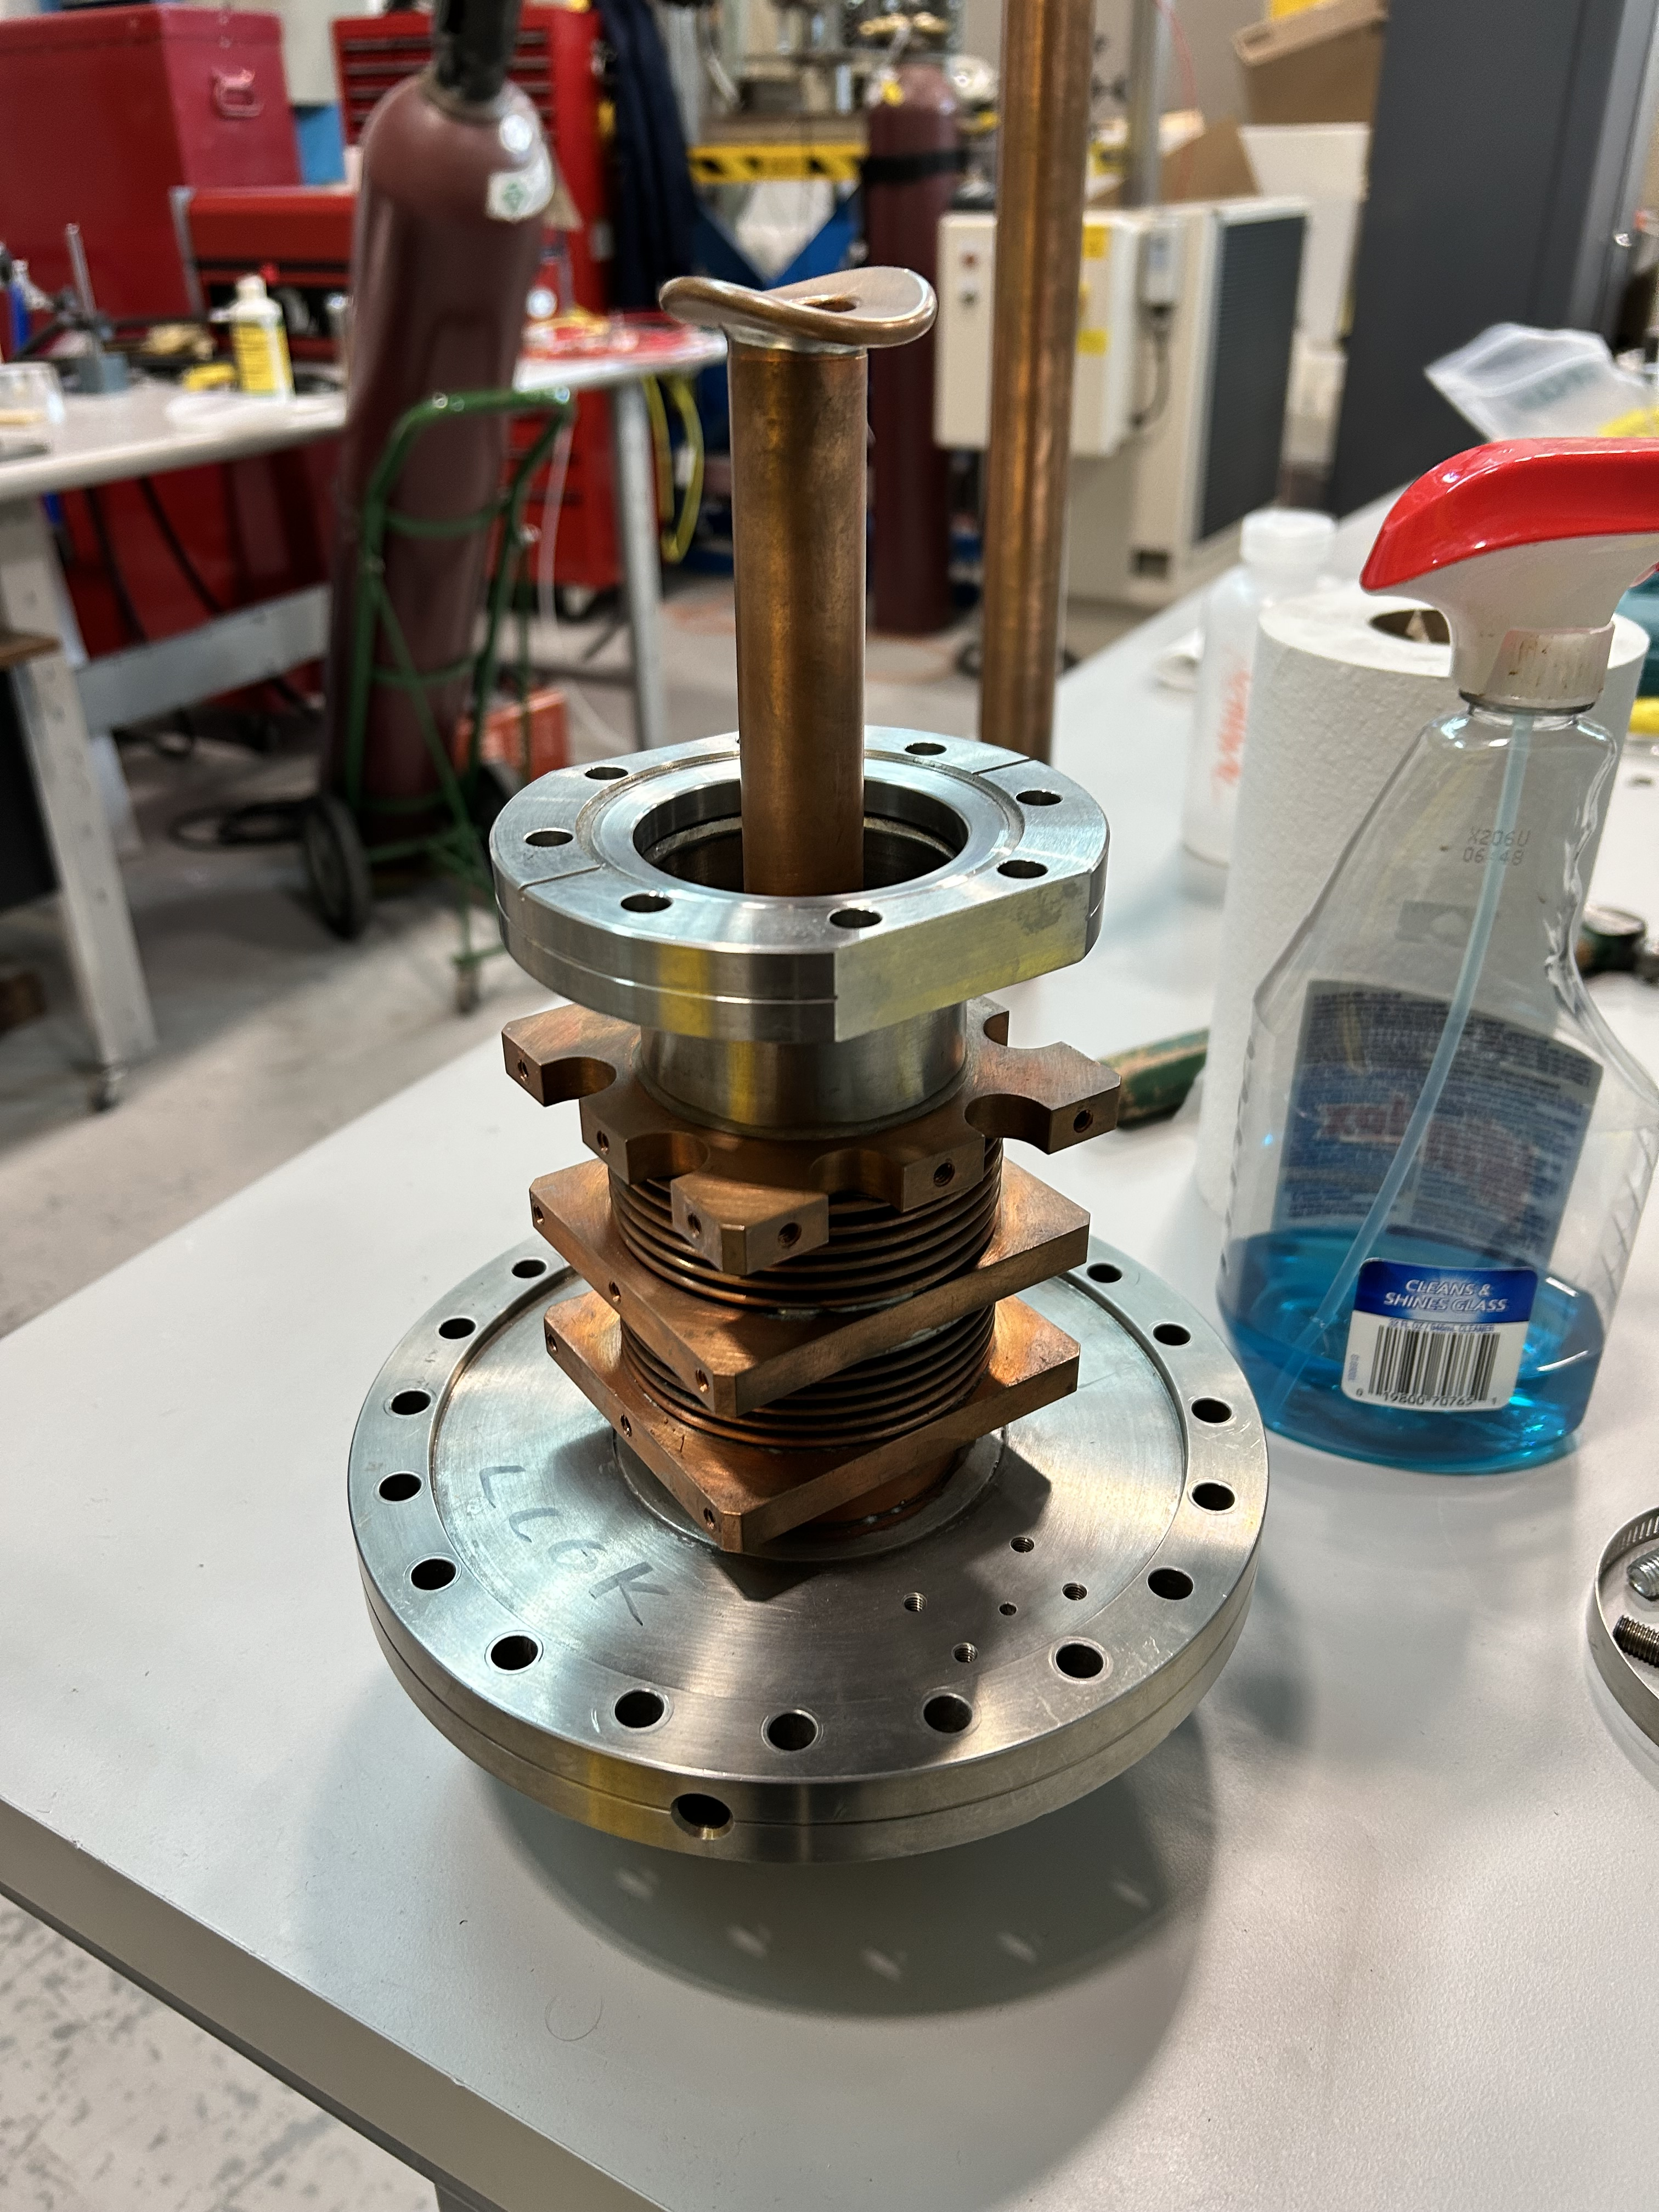
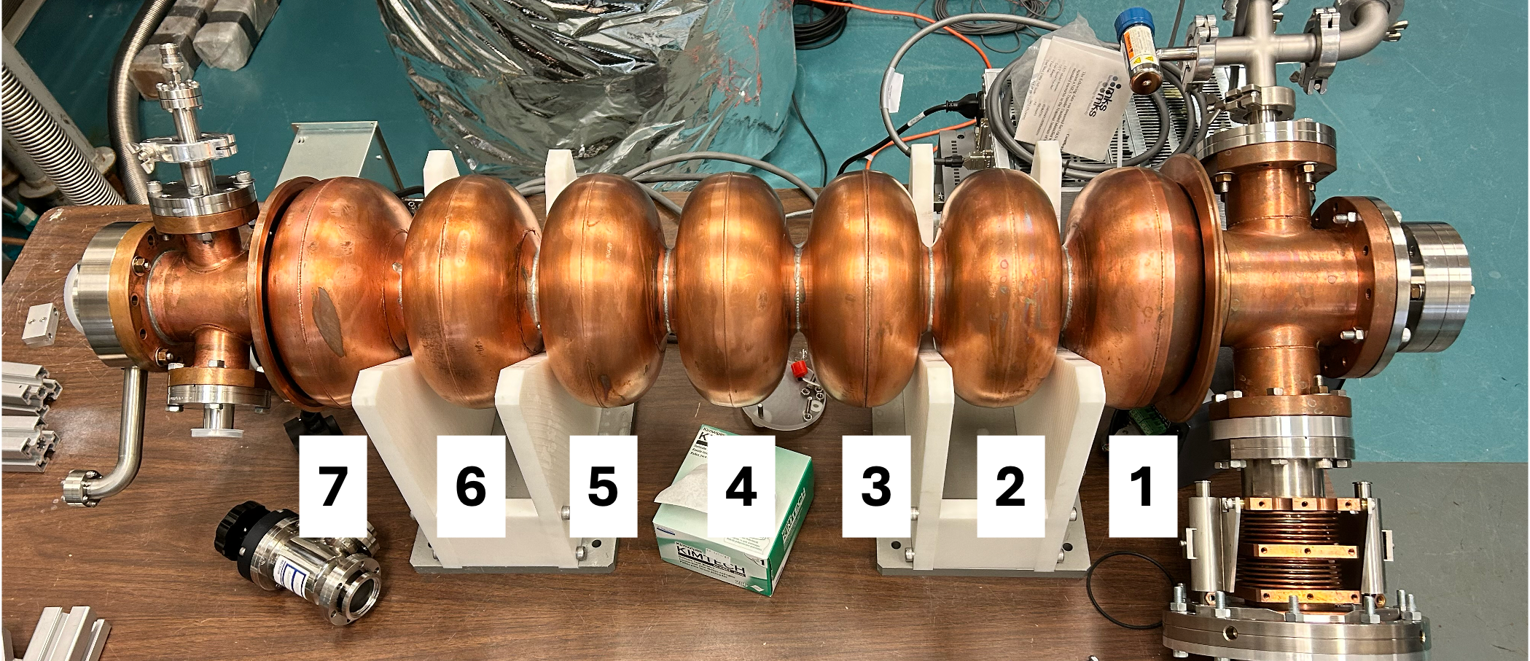
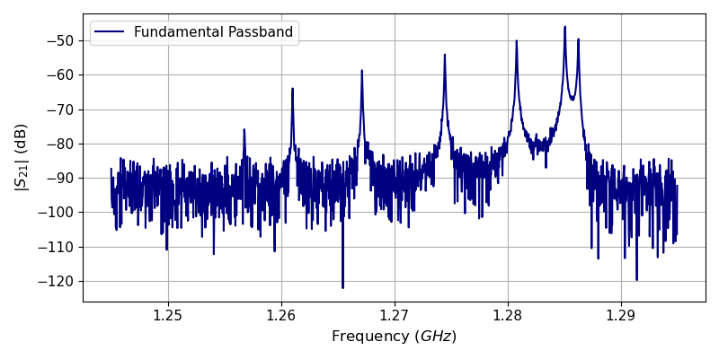
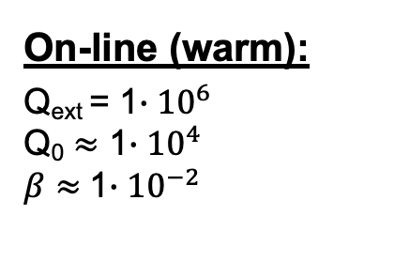
Developments Transferable to ARIEL Cryomodules
ARIEL mechanical mock-up FPC
ARIEL prototype - 1.3GHz copper 7-cell
On-line (warm):
Q_{ext} = 1$∙{10}^{6}$
Q₀ $≈$ 1$∙{10}^{4}$
$β$ $≈$1$∙{10}^{−2}$
William Stokes

Slide 4
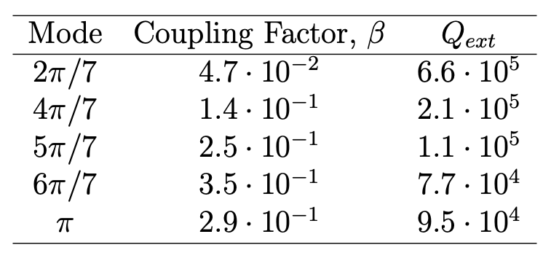
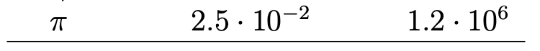
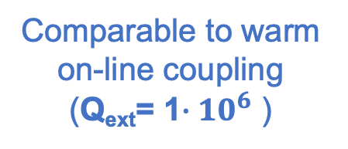
RF Coupling
Replicated warm coupling of on-line cryomodules
Two coupler positions were used for developing plasma processing methodology
No bellow displacement; neutral FPC position
Comparable to warm on-line coupling
(Q_{ext}= 1$∙{10}^{6}$ )
Extended bellows; warm ARIEL coupling
William Stokes

Slide 5

Plasma Processing Schematic
Scroll Pump
Ion Gauge
Leak Valves
CDG-500 Capacitance Gauge
RGA 100
Inline Gases
Cavity
Scroll Pump
Turbo Pump
Power Meters (FWD & REV)
Directional Coupler
Amplifier
Power Meter
(Pickup)
Signal Generators
Amplifier
Vector Network Analyzer
50$Ω$ Load
Circulator
Combiner
20 dB Attenuator
William Stokes

Slide 6
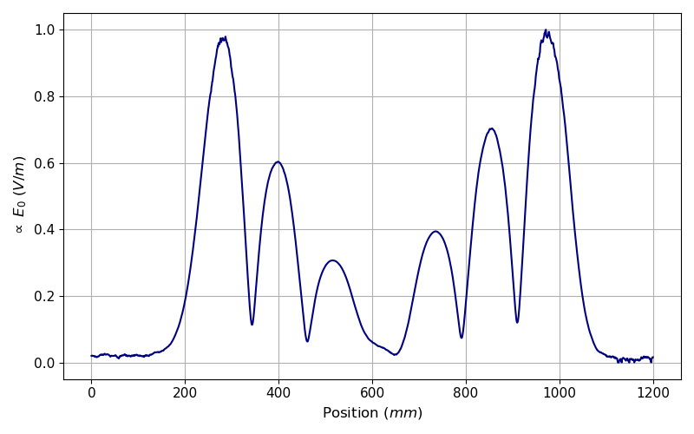
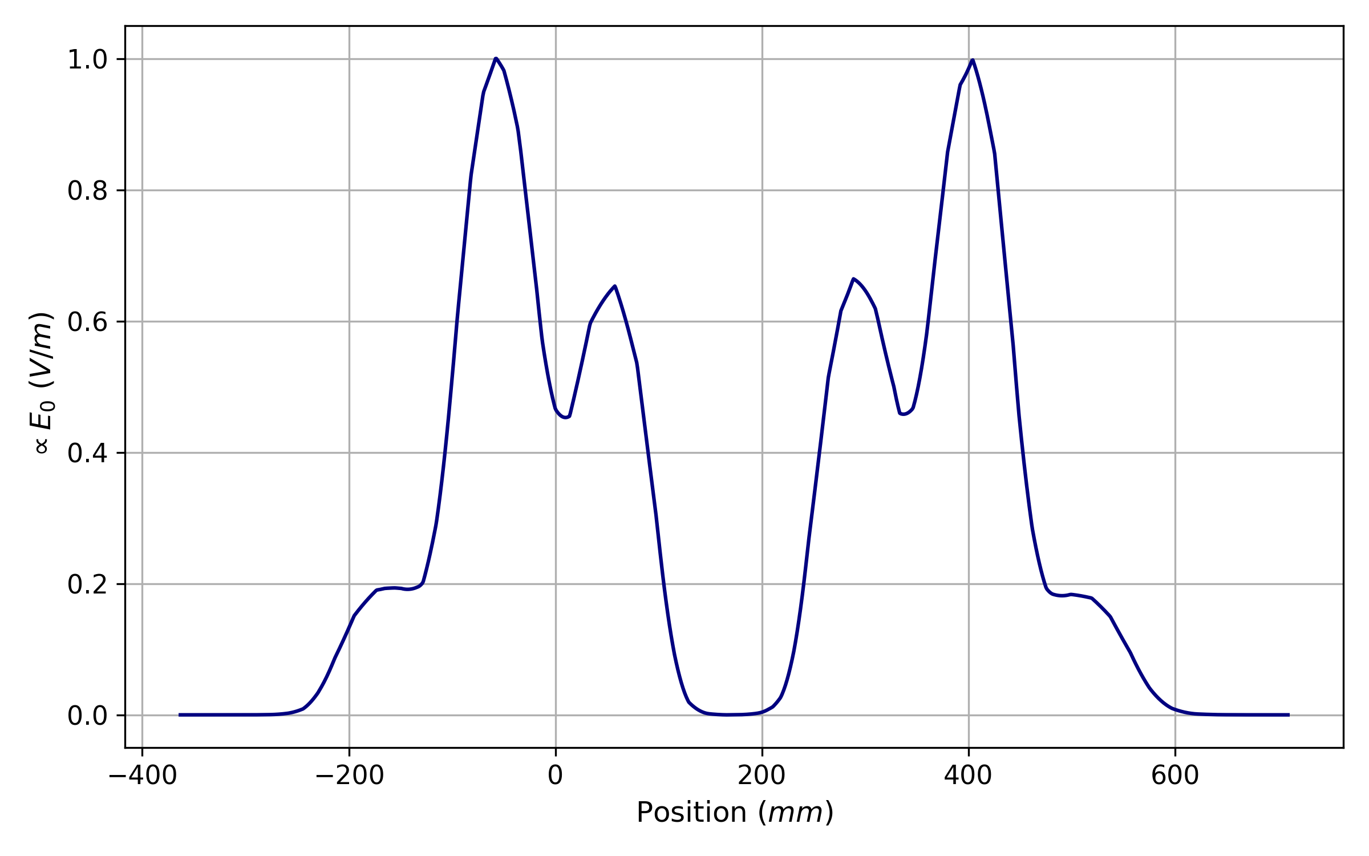
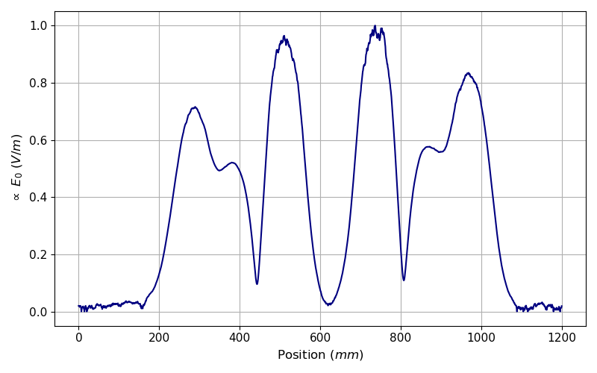
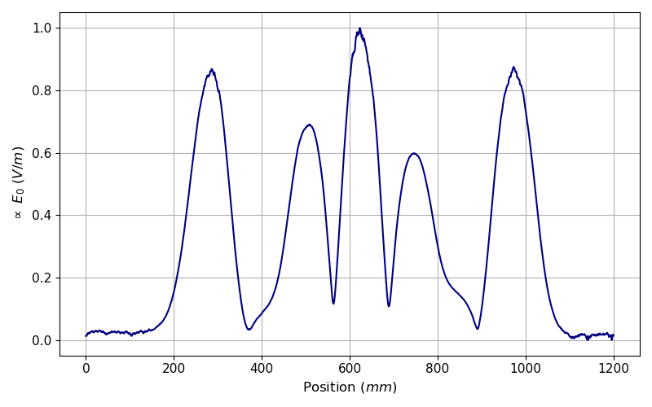
Electric Field Distributions of Fundamental Passband Modes
6𝜋/7
2𝜋/7
Field profiles were measured for prospective plasma ignition sites
Ignition in 4 cells on pickup end of cavity
Must ignite in all cells for comprehensive cavity cleaning
4𝜋/7
5𝜋/7
William Stokes

Slide 7
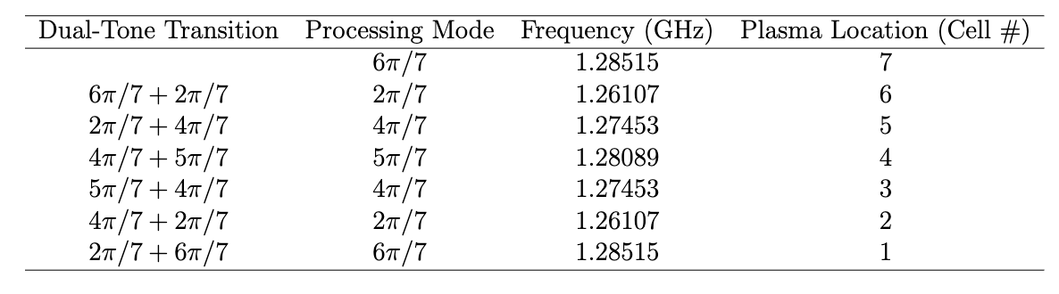
Plasma Sequence
Symmetric field distributions for plasma movement; modes reused for mirrored cell locations
Dual-tone excitation required for translating plasma between adjacent cells
RF attenuation through plasma permitted upstream ignition locations
6𝜋/7
TTC2026

Slide 8







Dual-Tone Excitation for Plasma Movement
Cell #:
7
6
5
4
3
2
1
Mode:
6$π$/7
2$π$/7
4$π$/7
5$π$/7
4$π$/7
2$π$/7
6$π$/7
SG1
Signal Generators
Combiner
SG2
William Stokes

Slide 9
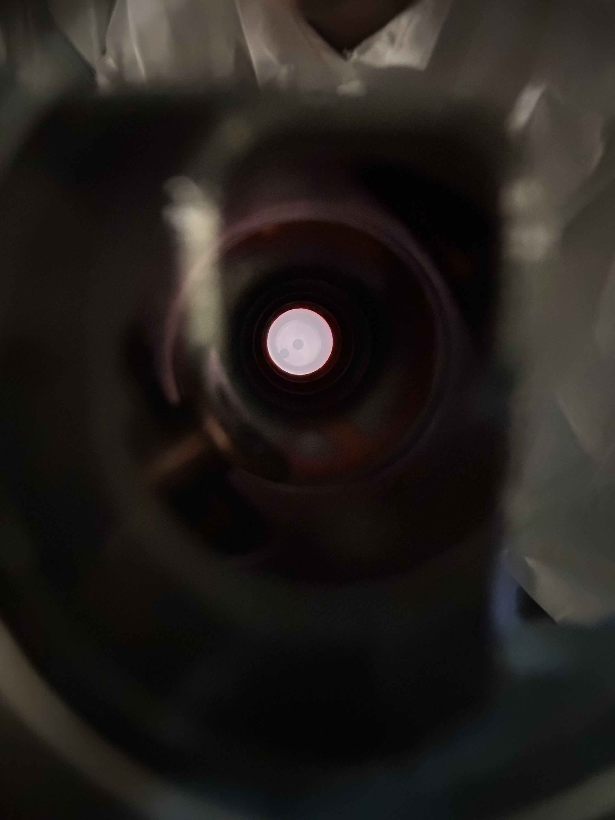
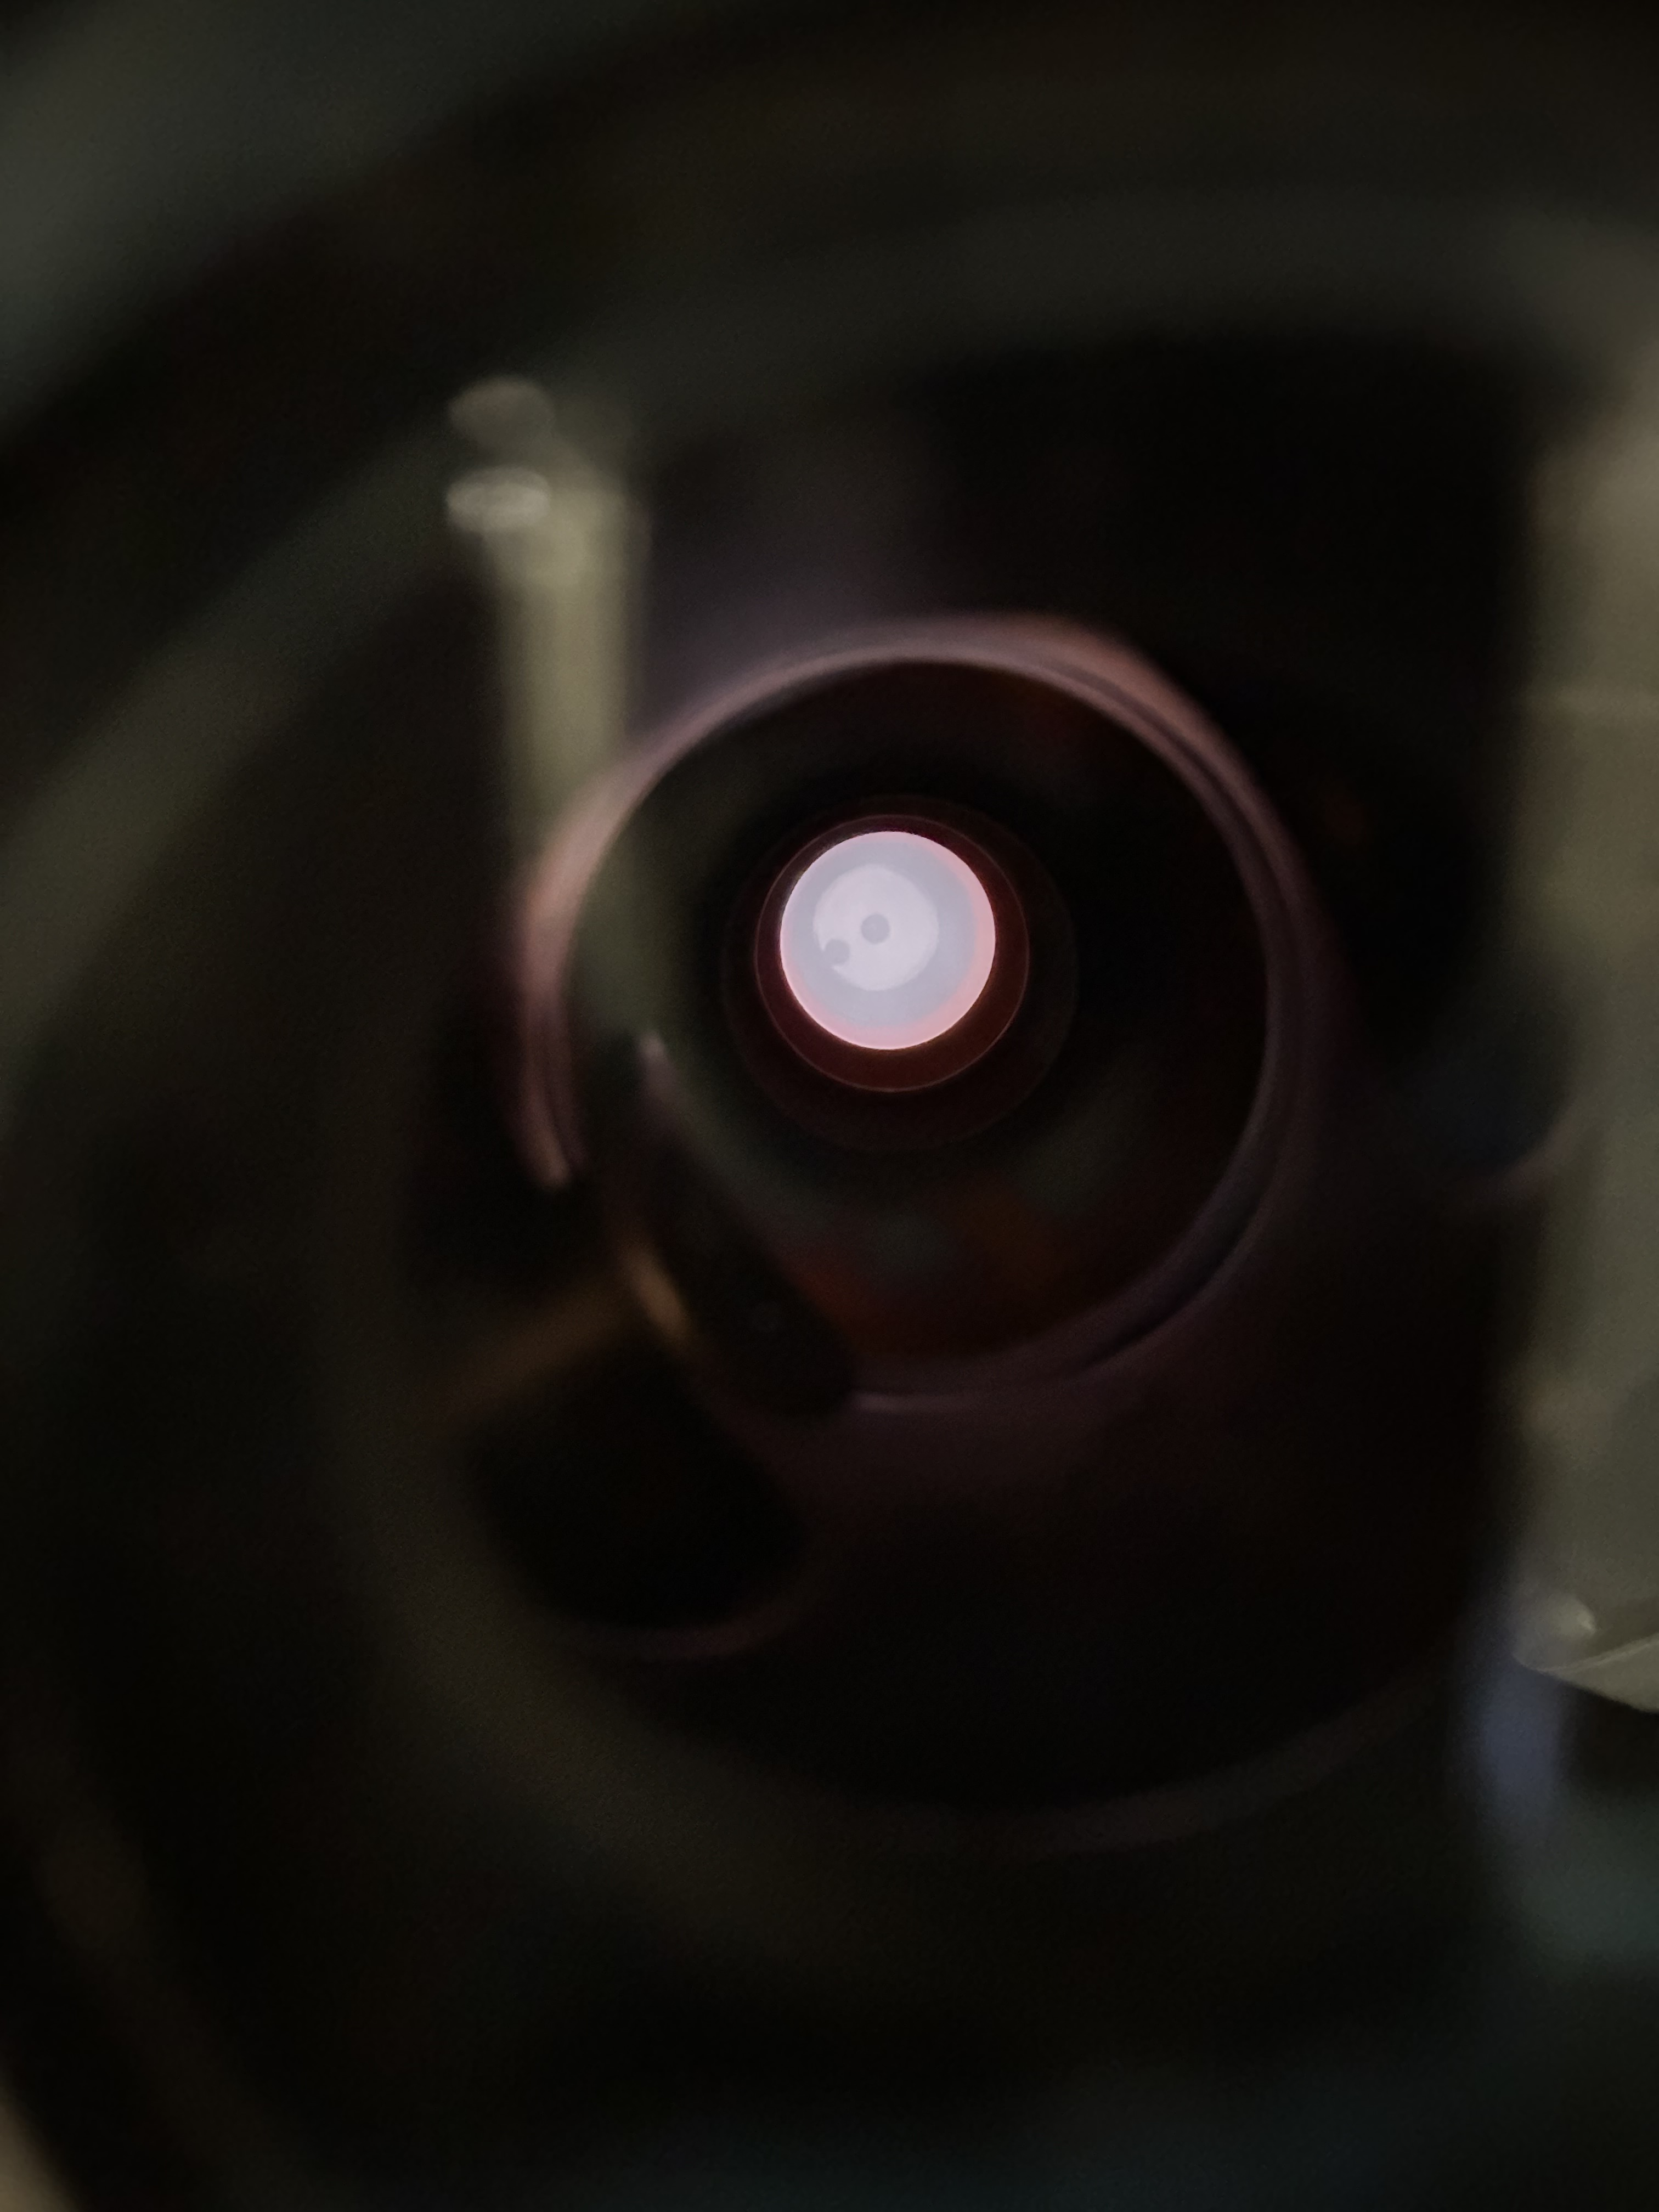
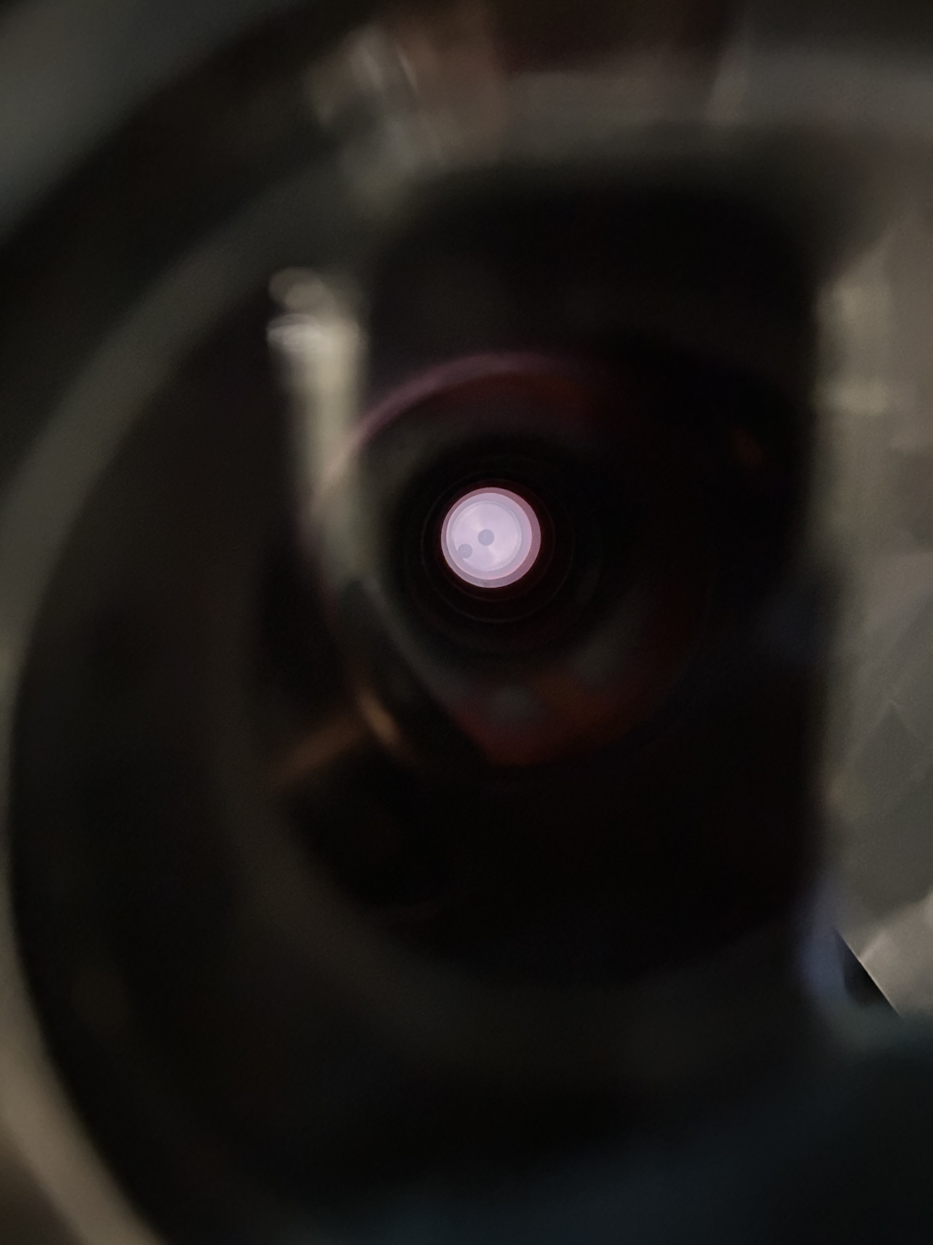
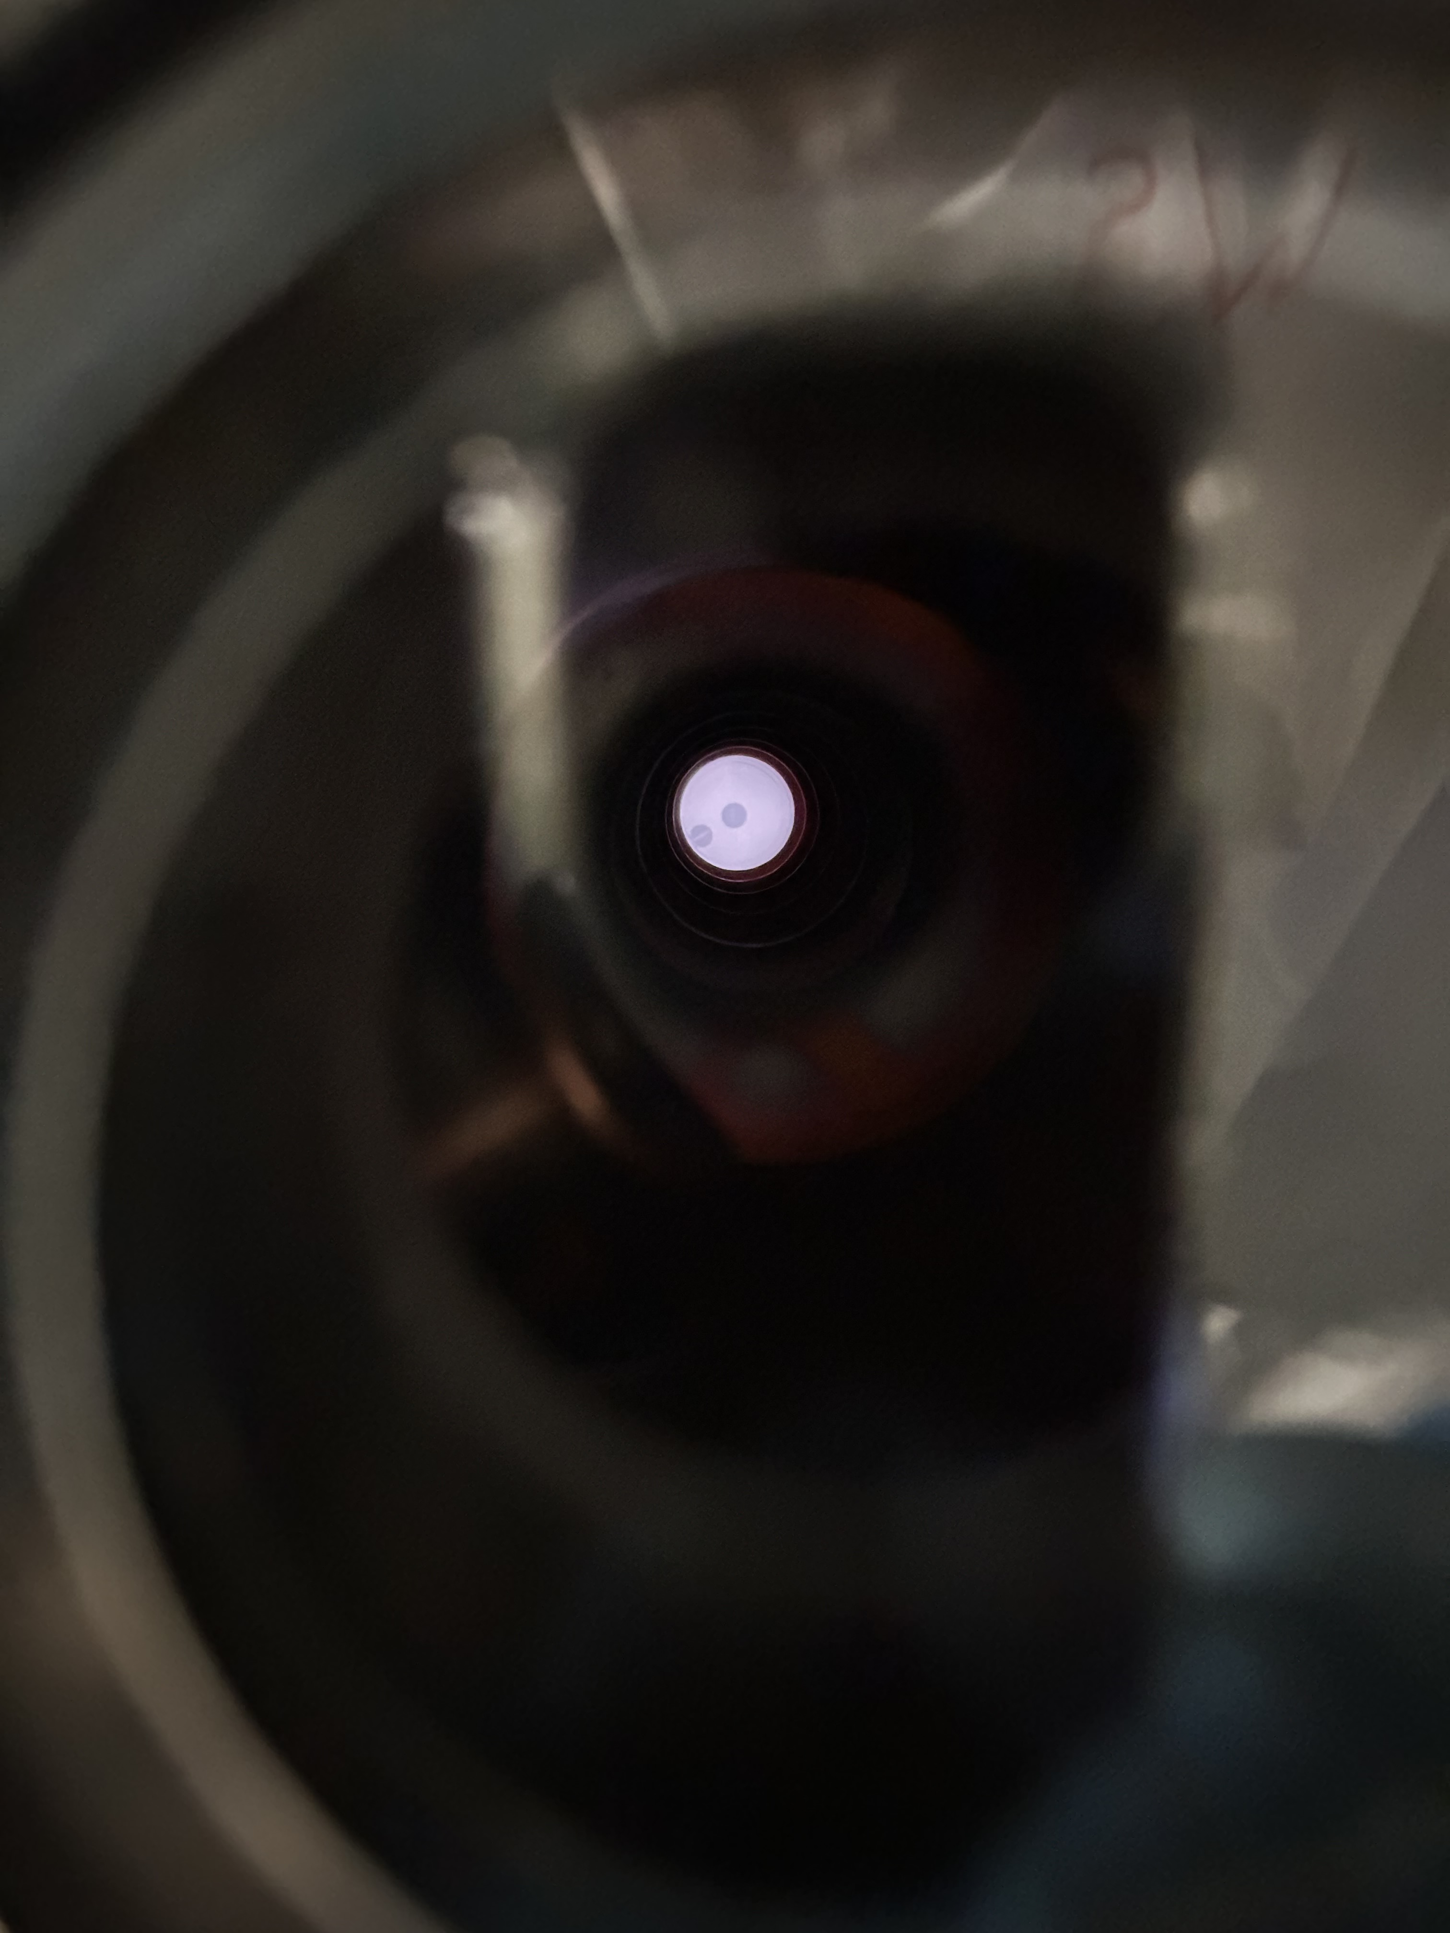
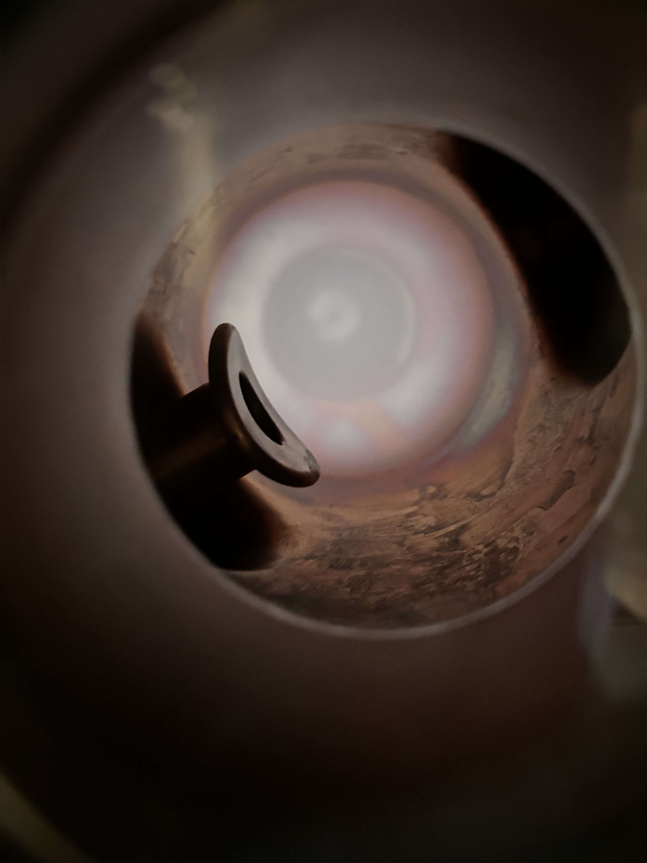
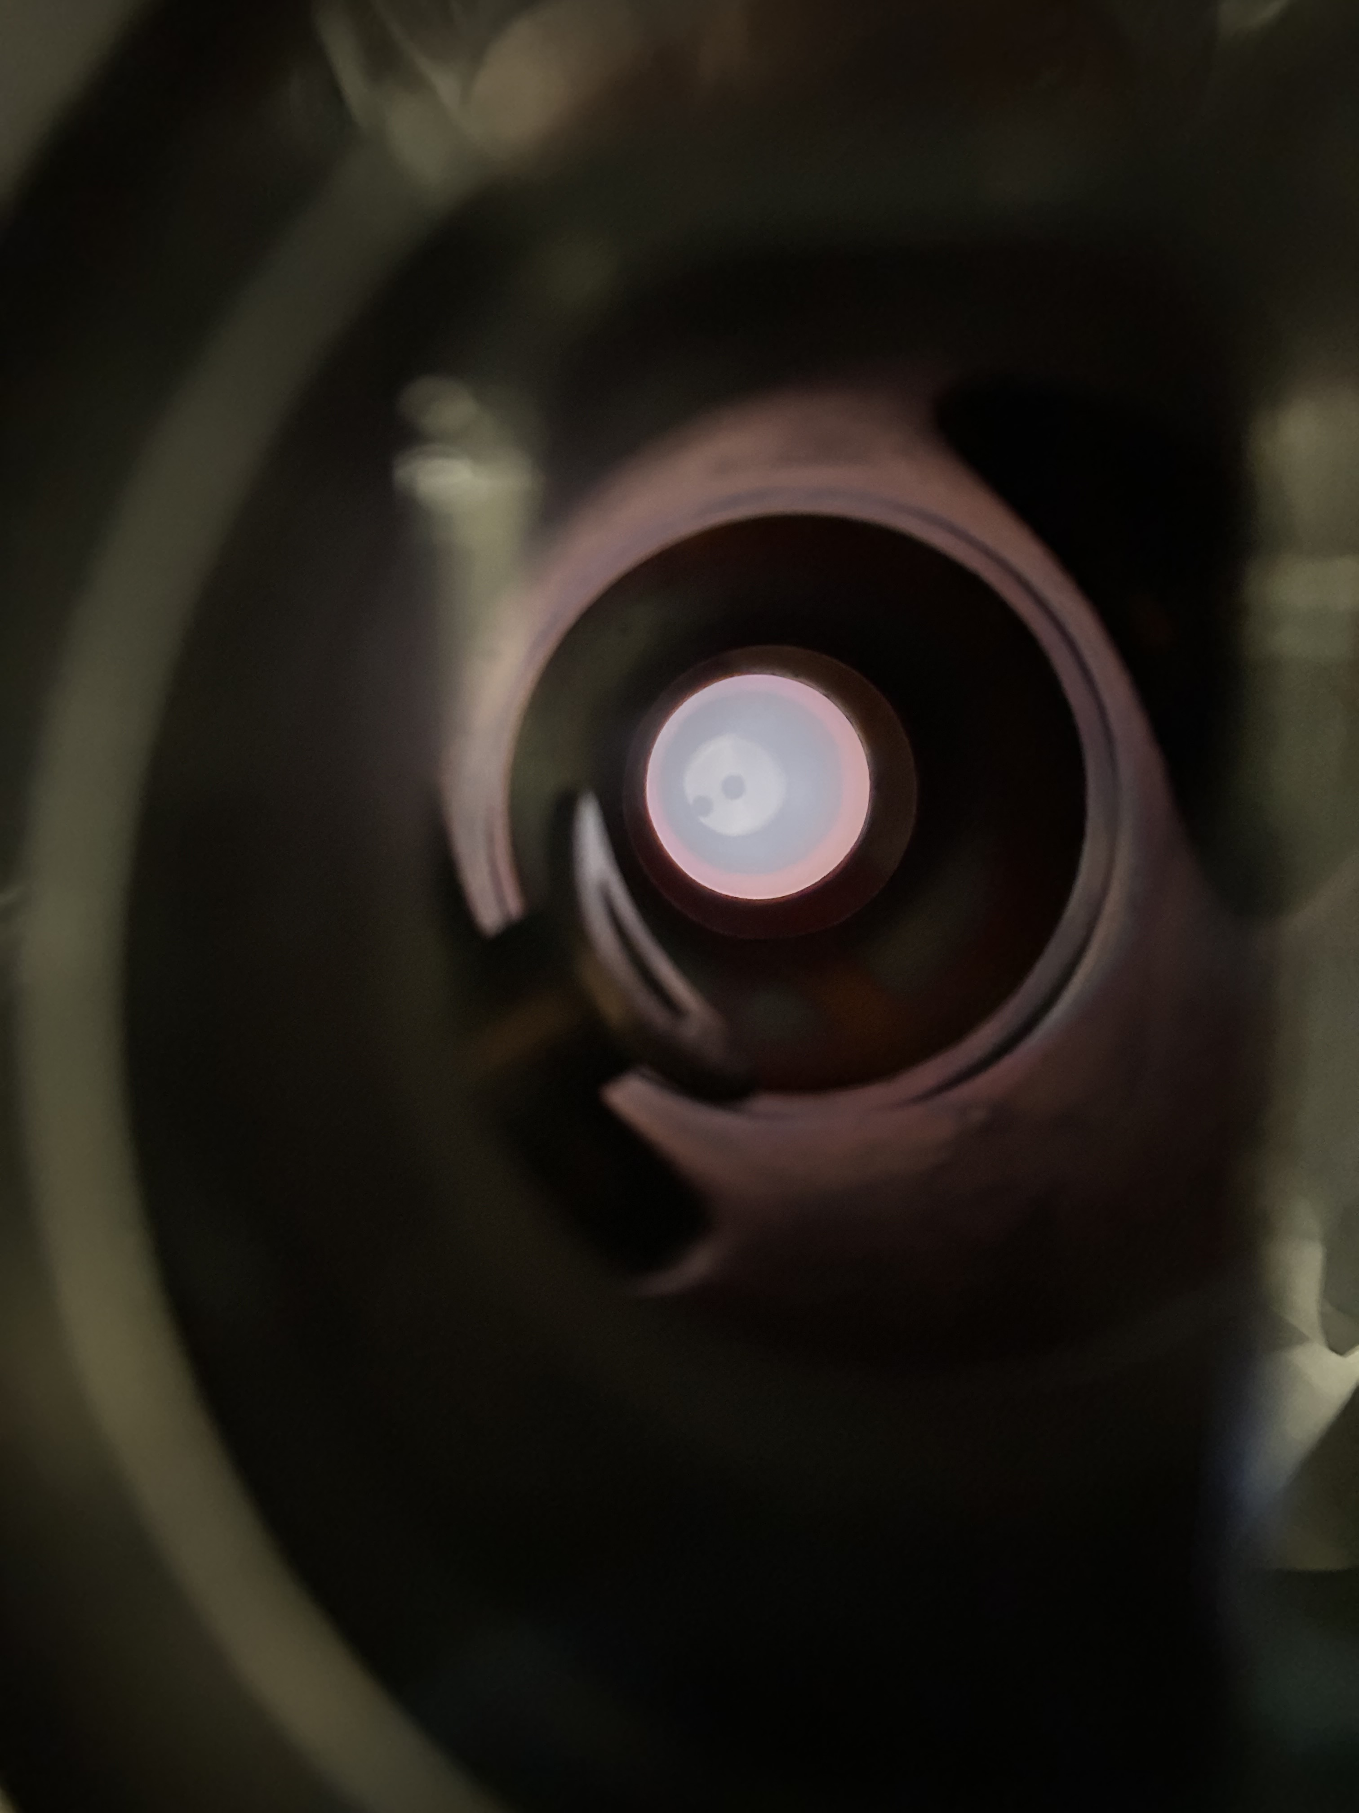
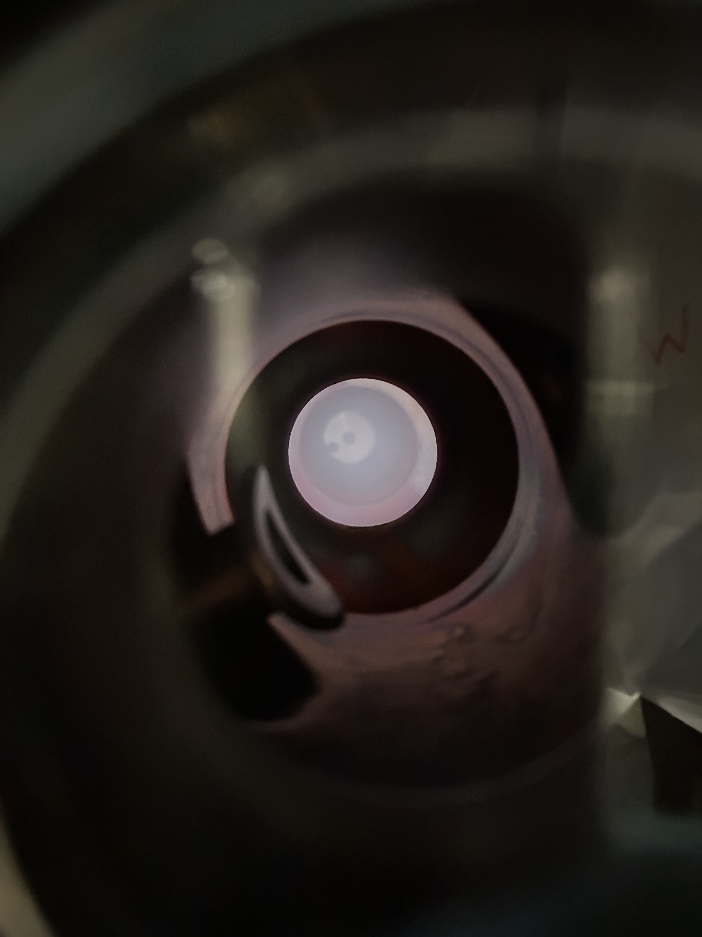







Plasma Translation
$$\frac{6π}{7}$$
$$\frac{2π}{7}$$
$$\frac{4π}{7}$$
$$\frac{5π}{7}$$
$$\frac{4π}{7}$$
$$\frac{2π}{7}$$
$$\frac{6π}{7}$$
William Stokes

Slide 10
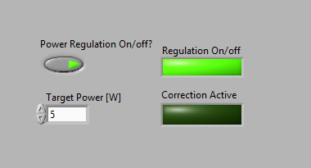
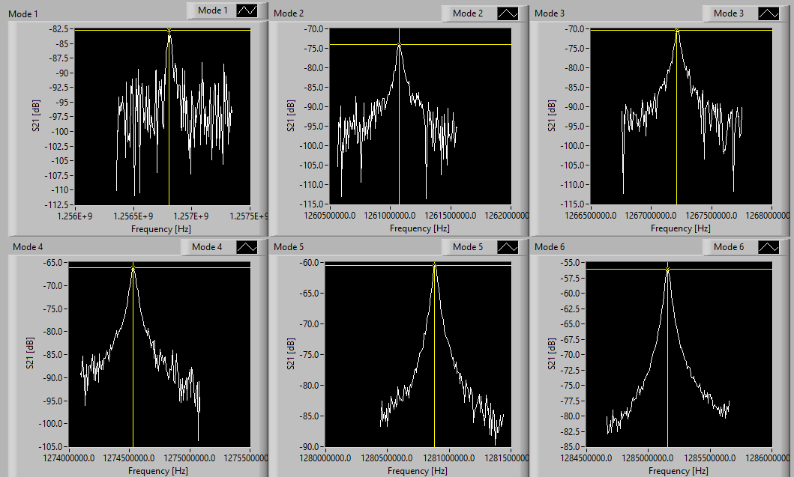
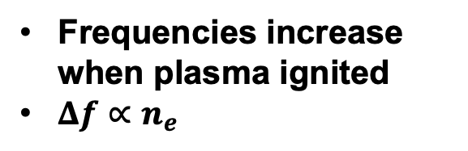
Instrument Control System
Target Power (P_{Cav}) to sustain
Regulate Cavity Power
Measure Resonant Frequencies
Estimate Plasma Location
P_{Cavity} = P_{Forward} – P_{Reflected}
Measurement of resonant frequencies
Frequencies increase when plasma ignited
$Δf∝n_{e}$
From modal electric field distributions and frequency shifts
William Stokes

Slide 11
Gas Recipes
95/5 He/CH₄ – Plasma Contamination
Cavity contaminated 30min/cell with 95/5 He/CH₄ plasma prior to plasma processing experiments (inspired by JLab)
CH₄ molecules dissociate in He dominated plasma
Ionized carbon and hydrogen species recombine, forming C_{X}H_{Y} chains
Adsorbed and purged from cavity
95/5 He/O₂ – Plasma Processing
Cavity processed with 95/5 He/O₂ plasma until by-product saturation realized
Ionized He species accelerated across plasma sheath, incident on C_{X}H_{Y} chains
Cracked C_{X}H_{Y} chains recombine with ionized O₂ species forming by-products (H₂, H₂O, CO, CO₂)

Slide 12
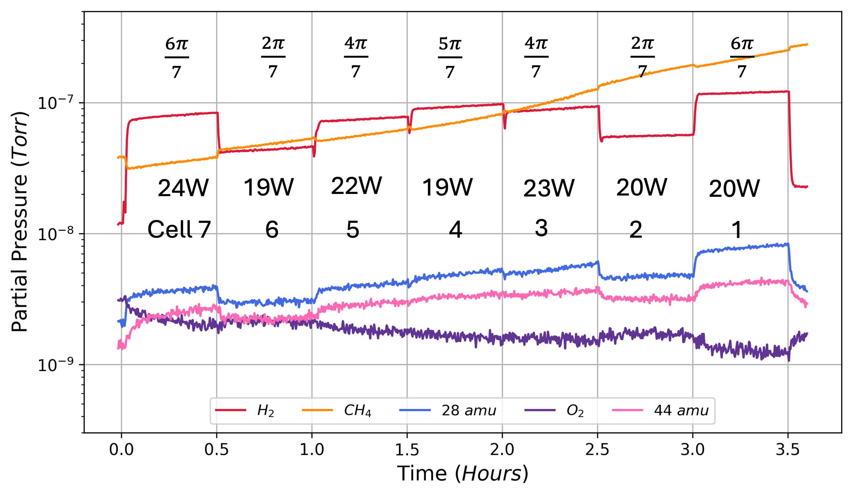
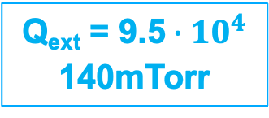
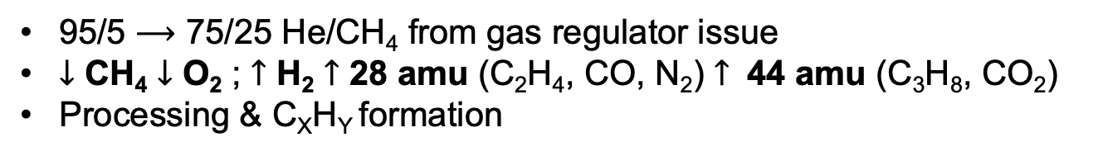
Inaugural Plasma Contamination
95/5 $⟶$ 75/25 He/CH₄ from gas regulator issue
$↓$ CH₄ $↓$ O₂ ; $↑$ H₂ $↑$ 28 amu (C₂H₄, CO, N₂) $↑$ 44 amu (C₃H₈, CO₂)
Processing & C_{X}H_{Y} formation
Q_{ext} = 9.5$∙{10}^{4}$
140mTorr
RF ON
0.0 hours
William Stokes

Slide 13
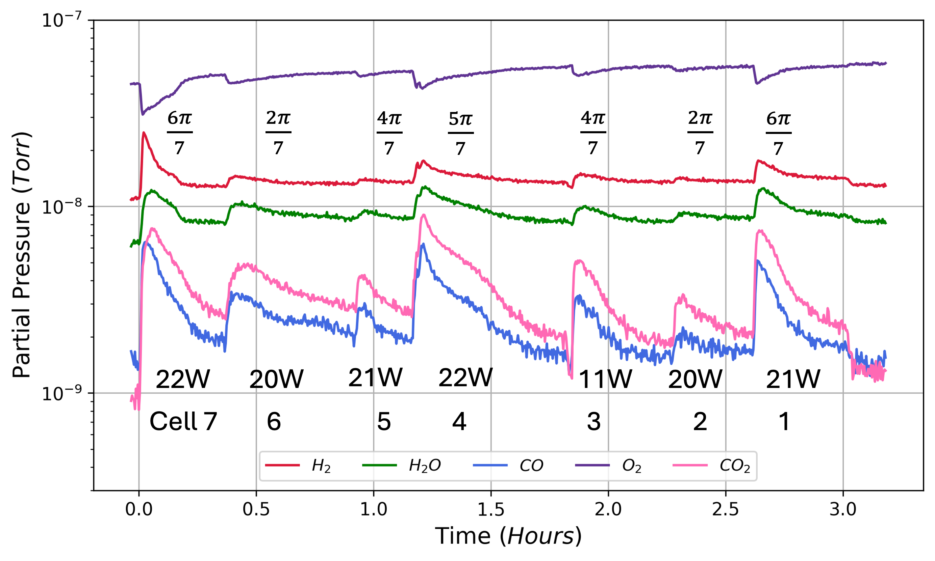
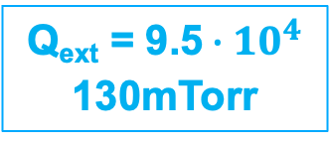
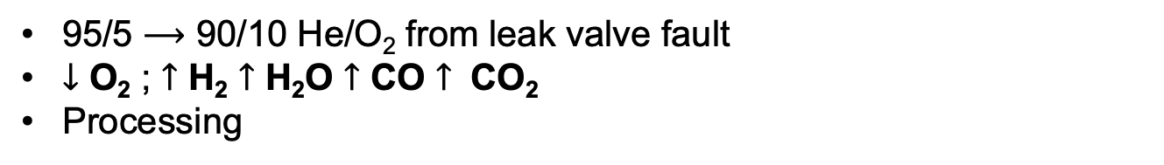
Inaugural Plasma Processing
95/5 $⟶$ 90/10 He/O₂ from leak valve fault
$↓$ O₂ ; $↑$ H₂ $↑$ H₂O $↑$ CO $↑$ CO₂
Processing
Q_{ext} = 9.5$∙{10}^{4}$
130mTorr
RF ON
0.0 hours
William Stokes

Slide 14
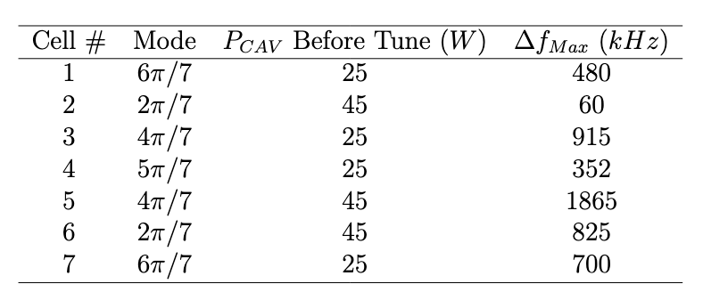

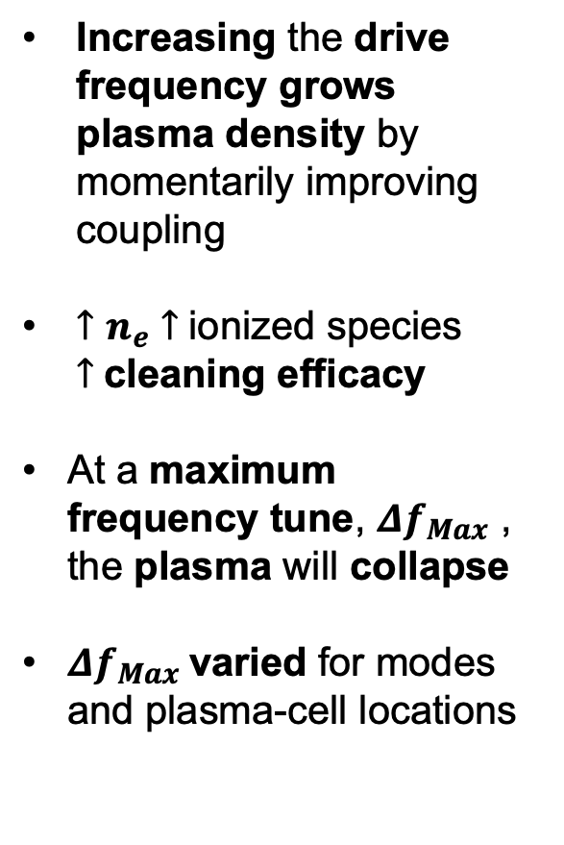
Optimizing Plasma Density
Frequency-Tuning
Drive signal
$∆$f
Increasing the drive frequency grows plasma density by momentarily improving coupling
$↑n_{e}$ $↑$ionized species $↑$cleaning efficacy
At a maximum frequency tune, ${Δf}_{Max}$ , the plasma will collapse
${Δf}_{Max}$varied for modes and plasma-cell locations
*Tune*
1.
2.
3.
4.
*Tune*
William Stokes

Slide 15
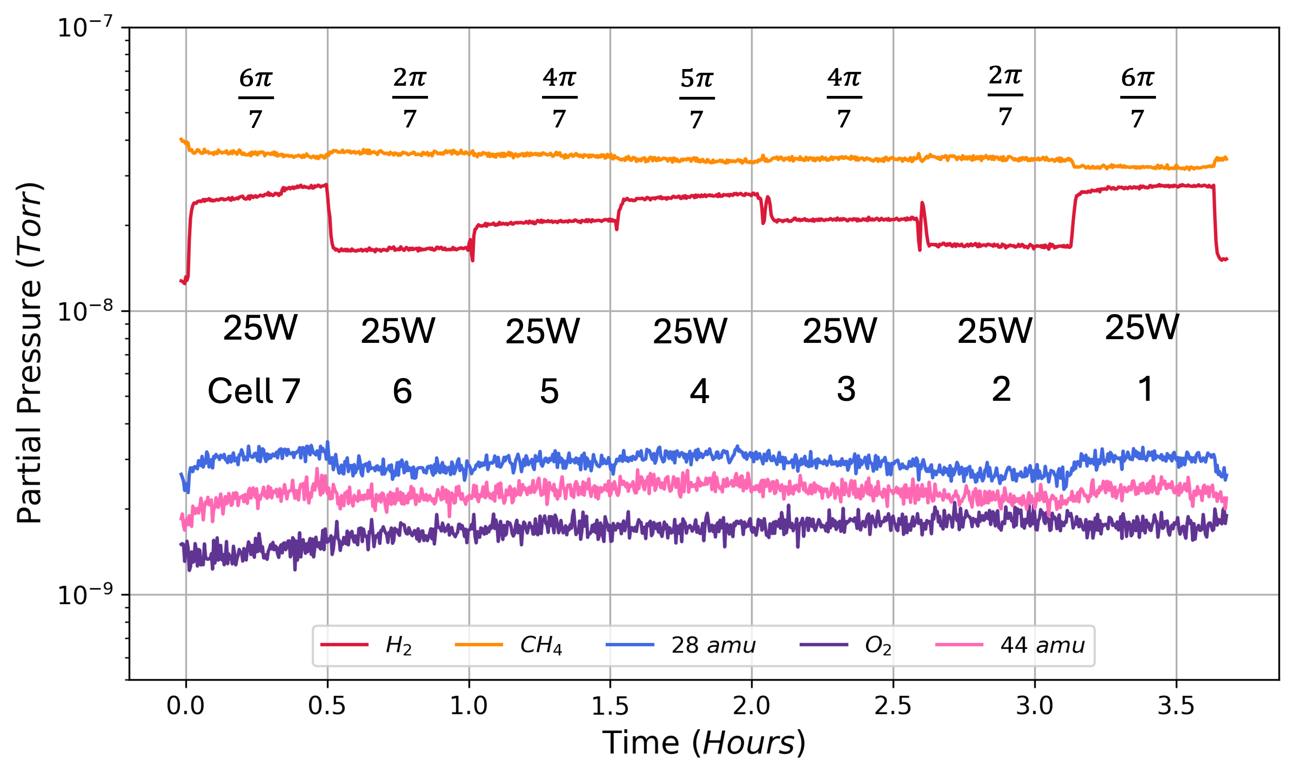
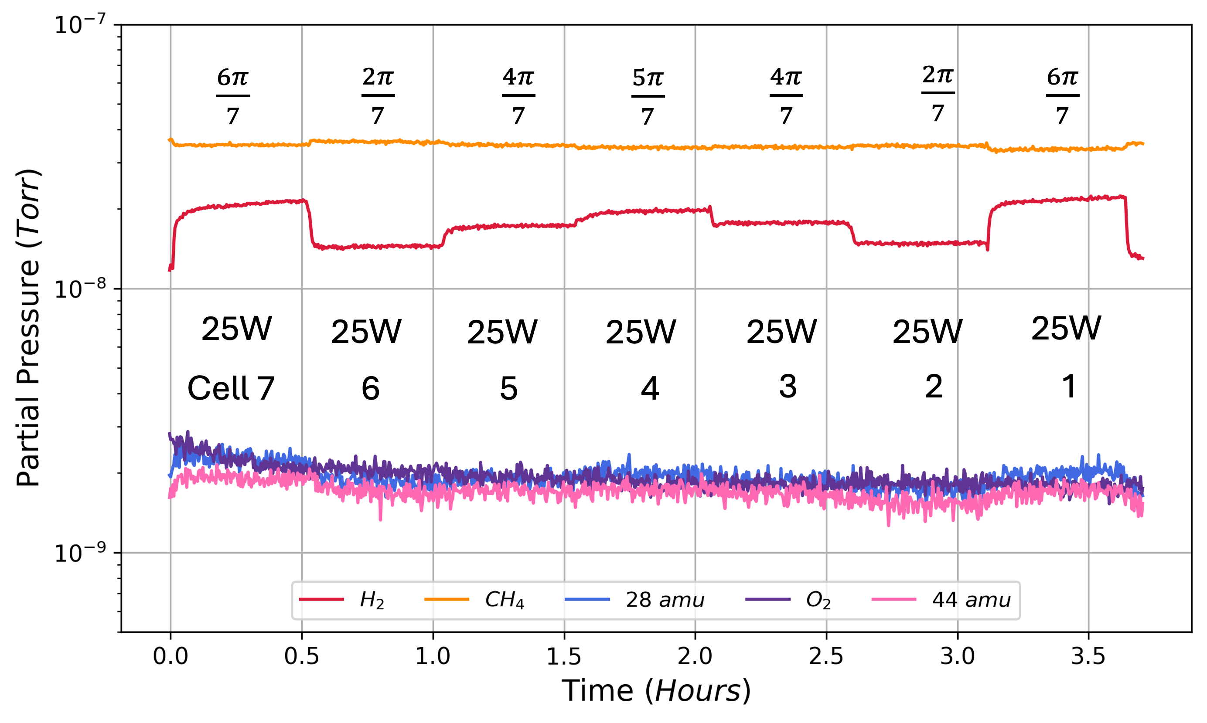
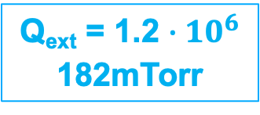
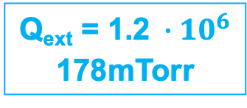
Warm ARIEL Coupling
(Contamination)
A
Q_{ext} = 1.2 $∙{10}^{6}$
182mTorr
95/5 He/CH₄
Near identical cavity pollutions
To test processing performance with frequency-tuning and without frequency-tuning
Q_{ext} = 1.2$∙{10}^{6}$
178mTorr
B
William Stokes

Slide 16
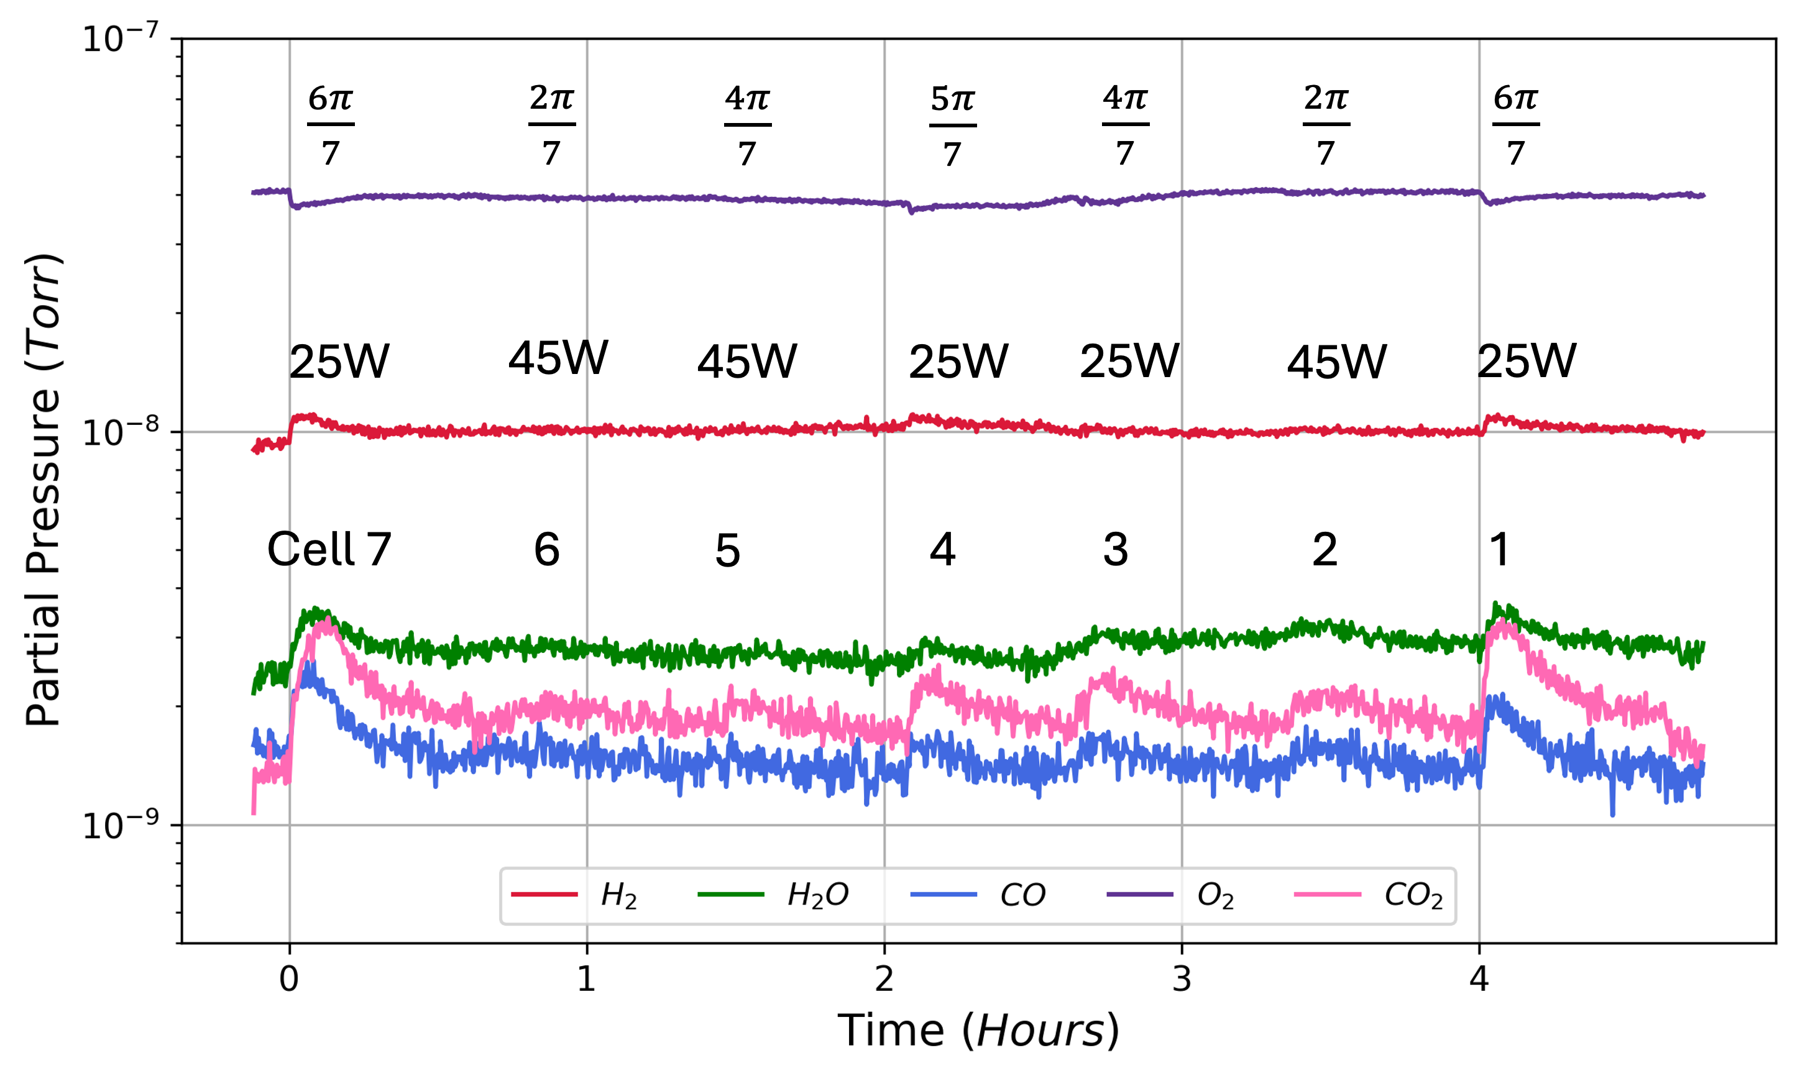
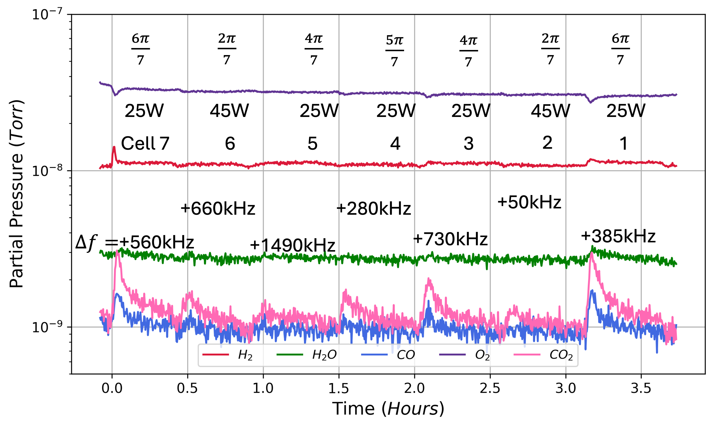
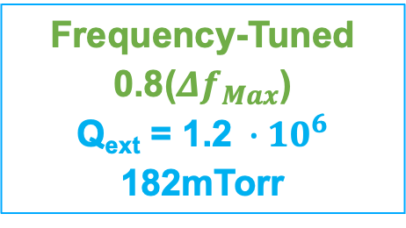
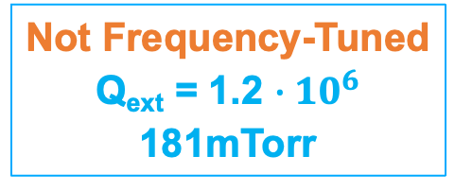
Warm ARIEL Coupling
(Processing)
A
Not Frequency-Tuned
Q_{ext} = 1.2 $∙{10}^{6}$
181mTorr
95/5 He/O₂
Frequency-Tuned
0.8(${Δf}_{Max}$)
Q_{ext} = 1.2$∙{10}^{6}$
182mTorr
B
Stronger by-product recombination signals
Reduced cleaning duration/cell
William Stokes

Slide 17
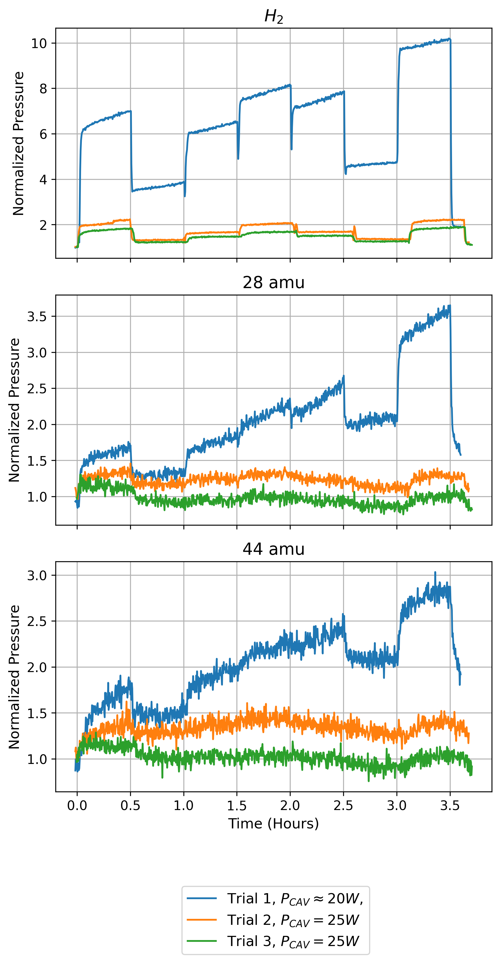
Contamination Trials
(He/CH₄)
By-product signals weakened over consecutive pollution trials
Contribution of H₂, CO and CO₂ to H₂, 28 amu and 44 amu species likely reduced over consecutive cavity pollutions
Reduction in processing reactions over He/CH₄ trials

Slide 18
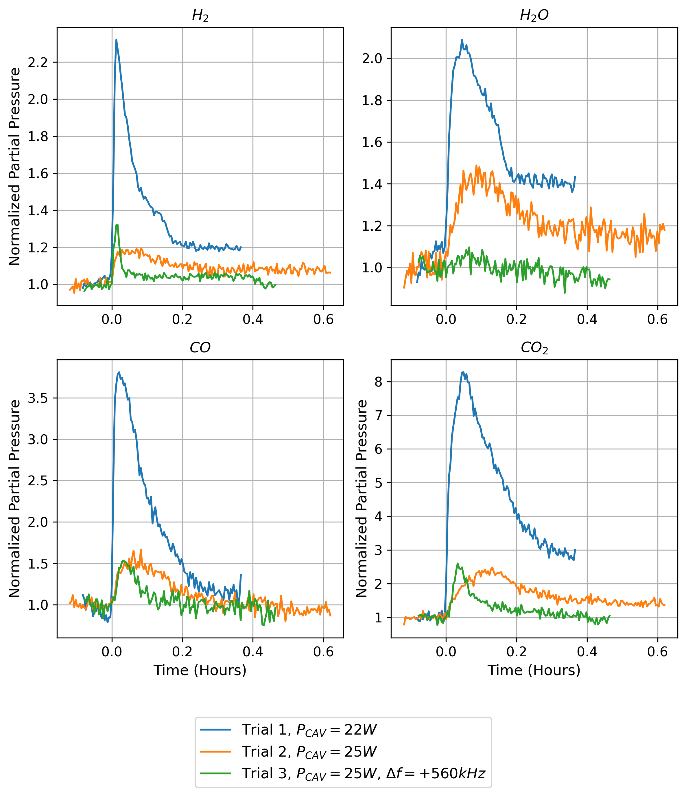
Processing Trials (He/O₂) – 7th Cell
Processing by-product signals weakened over consecutive trials
Reduction in hydrocarbon removal over consecutive processing trials
Minimal adsorption of hydrocarbon pollution from He/CH₄ trials
William Stokes

Slide 19
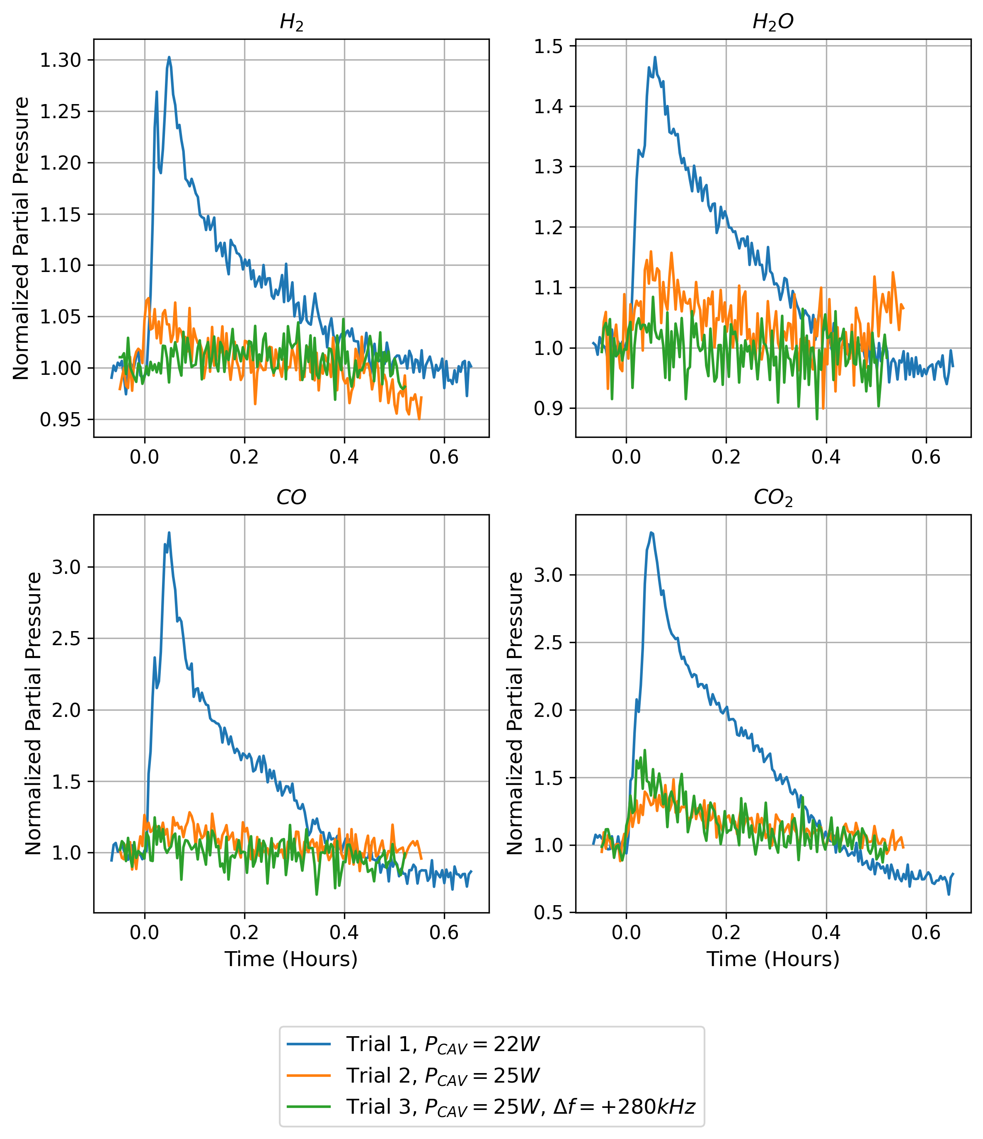
Processing Trials (He/O₂) – 4th Cell
Processing by-product signals weakened over consecutive trials
Reduction in hydrocarbon removal over consecutive processing trials
Minimal adsorption of hydrocarbon pollution from He/CH₄ trials
William Stokes

Slide 20
Conclusions
In-situ plasma processing procedures are possible with the fundamental passband, and are ready for on-line cryomodule testing at TRIUMF
Frequency-tuning the driven mode raises the plasma density, thereby increasing chemical recombination and reducing processing time per cell
Frequency-tuning allowances are unique to modes and plasma-cell locations
Hydrocarbons on the cavity interior reduced from consecutive contamination and processing trials, independent of plasma density
Pollution introduced with contamination plasma was minor relative to initial pollution
William Stokes

Slide 21
Thank you / Merci
William Stokes
wstokes@triumf.ca
TTC2026

