Slide 1
Advancing In-Situ Plasma Processing for SRF Cavities at Fermilab
June 11th, 2026
Bianca Giaccone
Associate Scientist, Quantum Technology and Materials Science Division
Fermi National Accelerator Laboratory
FERMILAB-SLIDES-26-0098-SQMS

Slide 2
Considerations on plasma processing development for elliptical vs low beta cavities
01

Slide 3
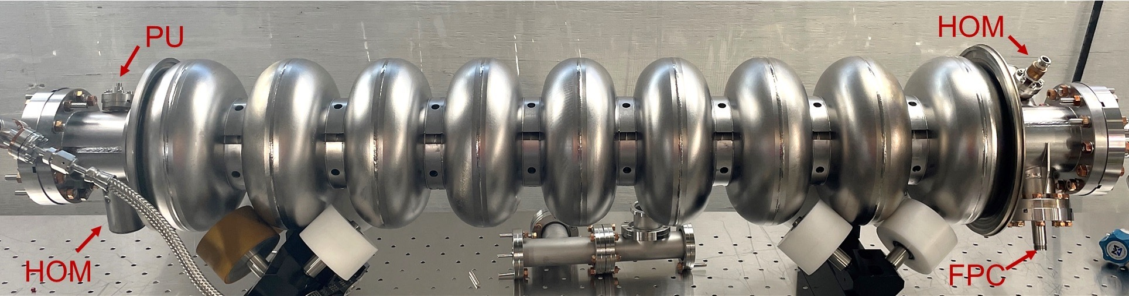
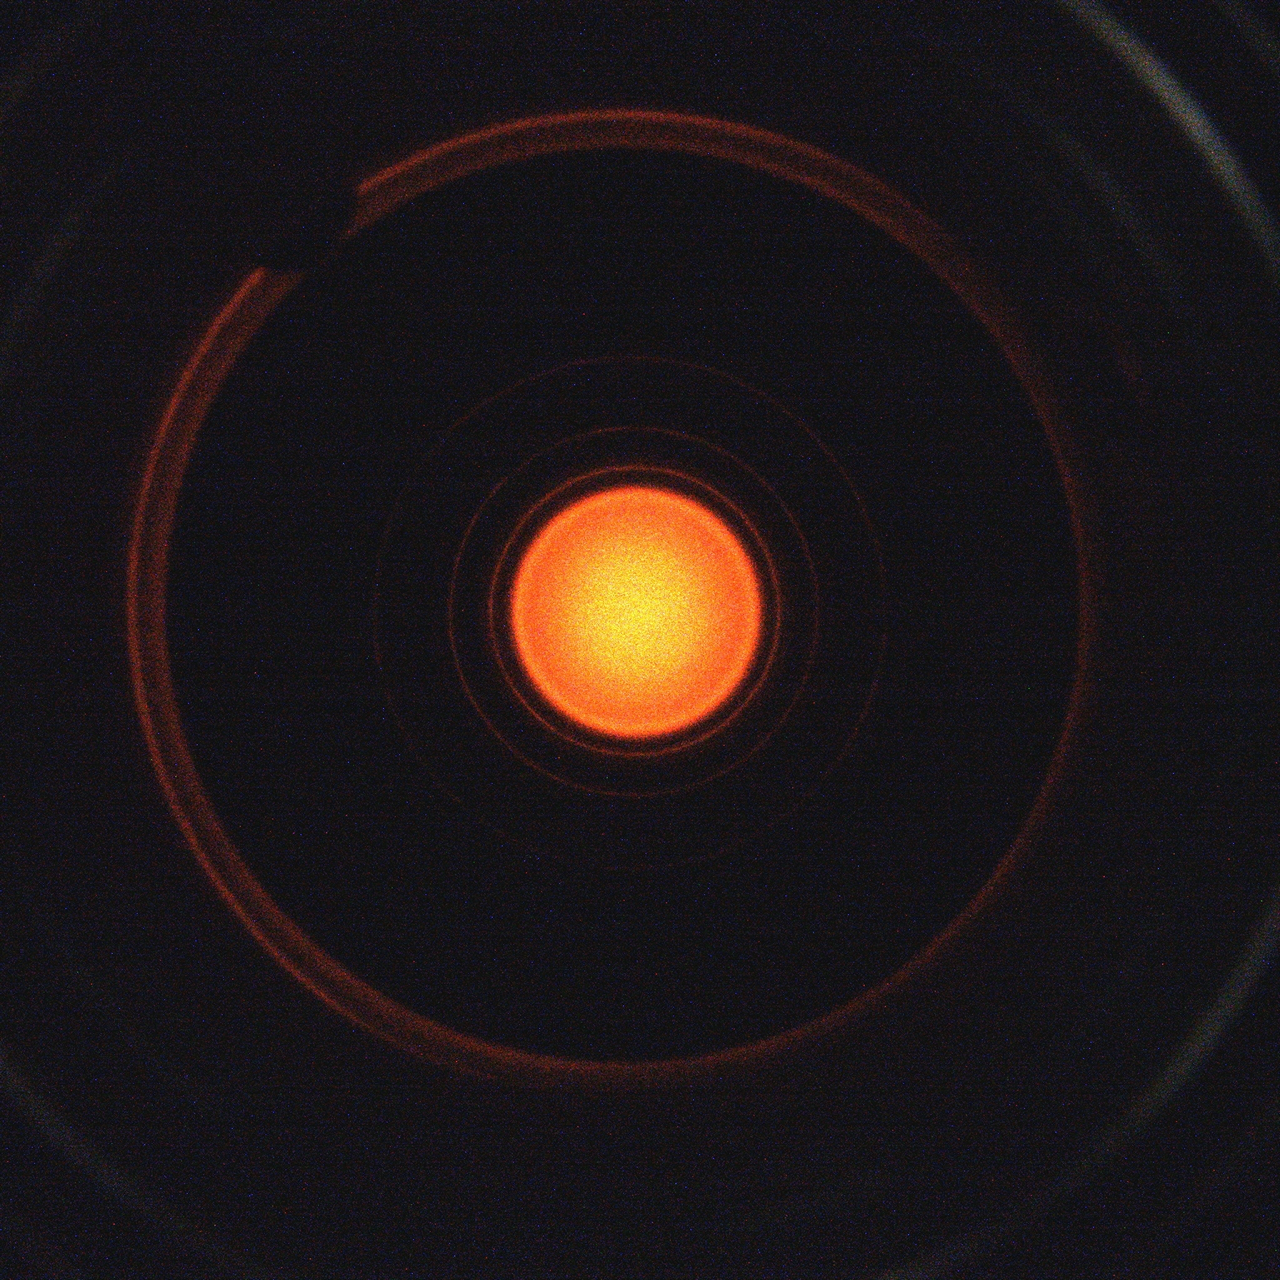
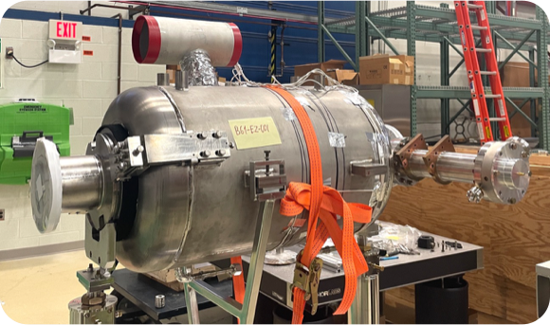
Elliptical Multicell Cavities
Challenge: reliable/repeatable technique to move the plasma from cell to cell. Technique resistant to microscopic cavity differences (HOMs are not tuned!)
Pro: modes generally have good reach within the cell volume. Same modes target FE (iris) and MP (equator) in 1.3GHz.
1.3 GHz
650 MHz
HOM couplers present
Good coupling to low HOMs
⚠ CM HOM cables → strict power constraints
No HOM couplers
⚠ Decreased coupling
✓ No strict power limit
(CM-style HPC)
⚠ Coupling varies: vacuum-only vs. vacuum+air assembly
VS

Slide 4
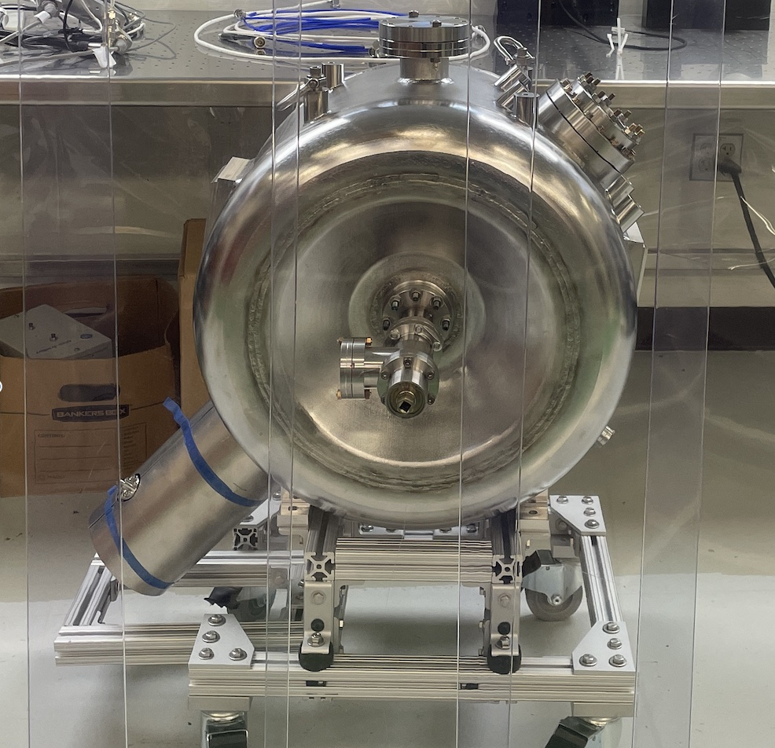
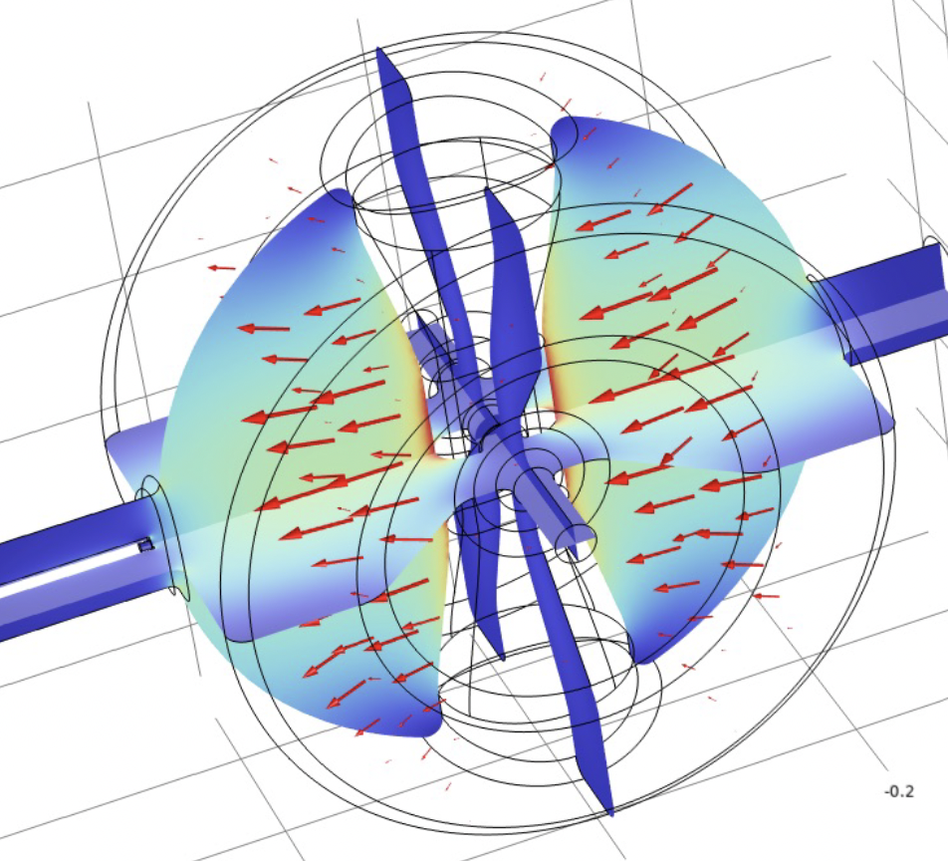
Low-Beta Cavities
  Mode localization around specific areas (spoke walls, gaps, etch)
  Many modes have zero fields on beamtube axis and symmetric fields on the either sides → how to extend the plasma around both sides of the spoke or viceversa to control each side individually and univocally?
  Gas flow and pressure distribution: narrow beamtubes + large cavity volume → reduced conductance paths but experimentally we haven’t observed issues
  Similarly to some elliptical cavities: no HOM couplers → no strict power limitation (CM-style High Power Coupler), like 650MHz, coupling depends heavily on the assembly configuration (vacuum-side only vs. vacuum + air side)

Slide 5
High-Beta vs Low-Beta: Key Differences
RF Period Discrepancies
Plasma Parameters
RF periods of selected HOMs differ by 2–4× between high- and low-beta structures
Different frequency ranges can alter the Electron Energy Distribution Function and plasma parameters
Surface Interactions
Recipe Transferability
Frequency-driven variations can impact carbon removal efficiency and the surface interactions
Different geometries and cryomodule design choices make direct plasma recipe transferability challenging

Slide 6
Plasma Processing Recipe Optimization
02

Slide 7
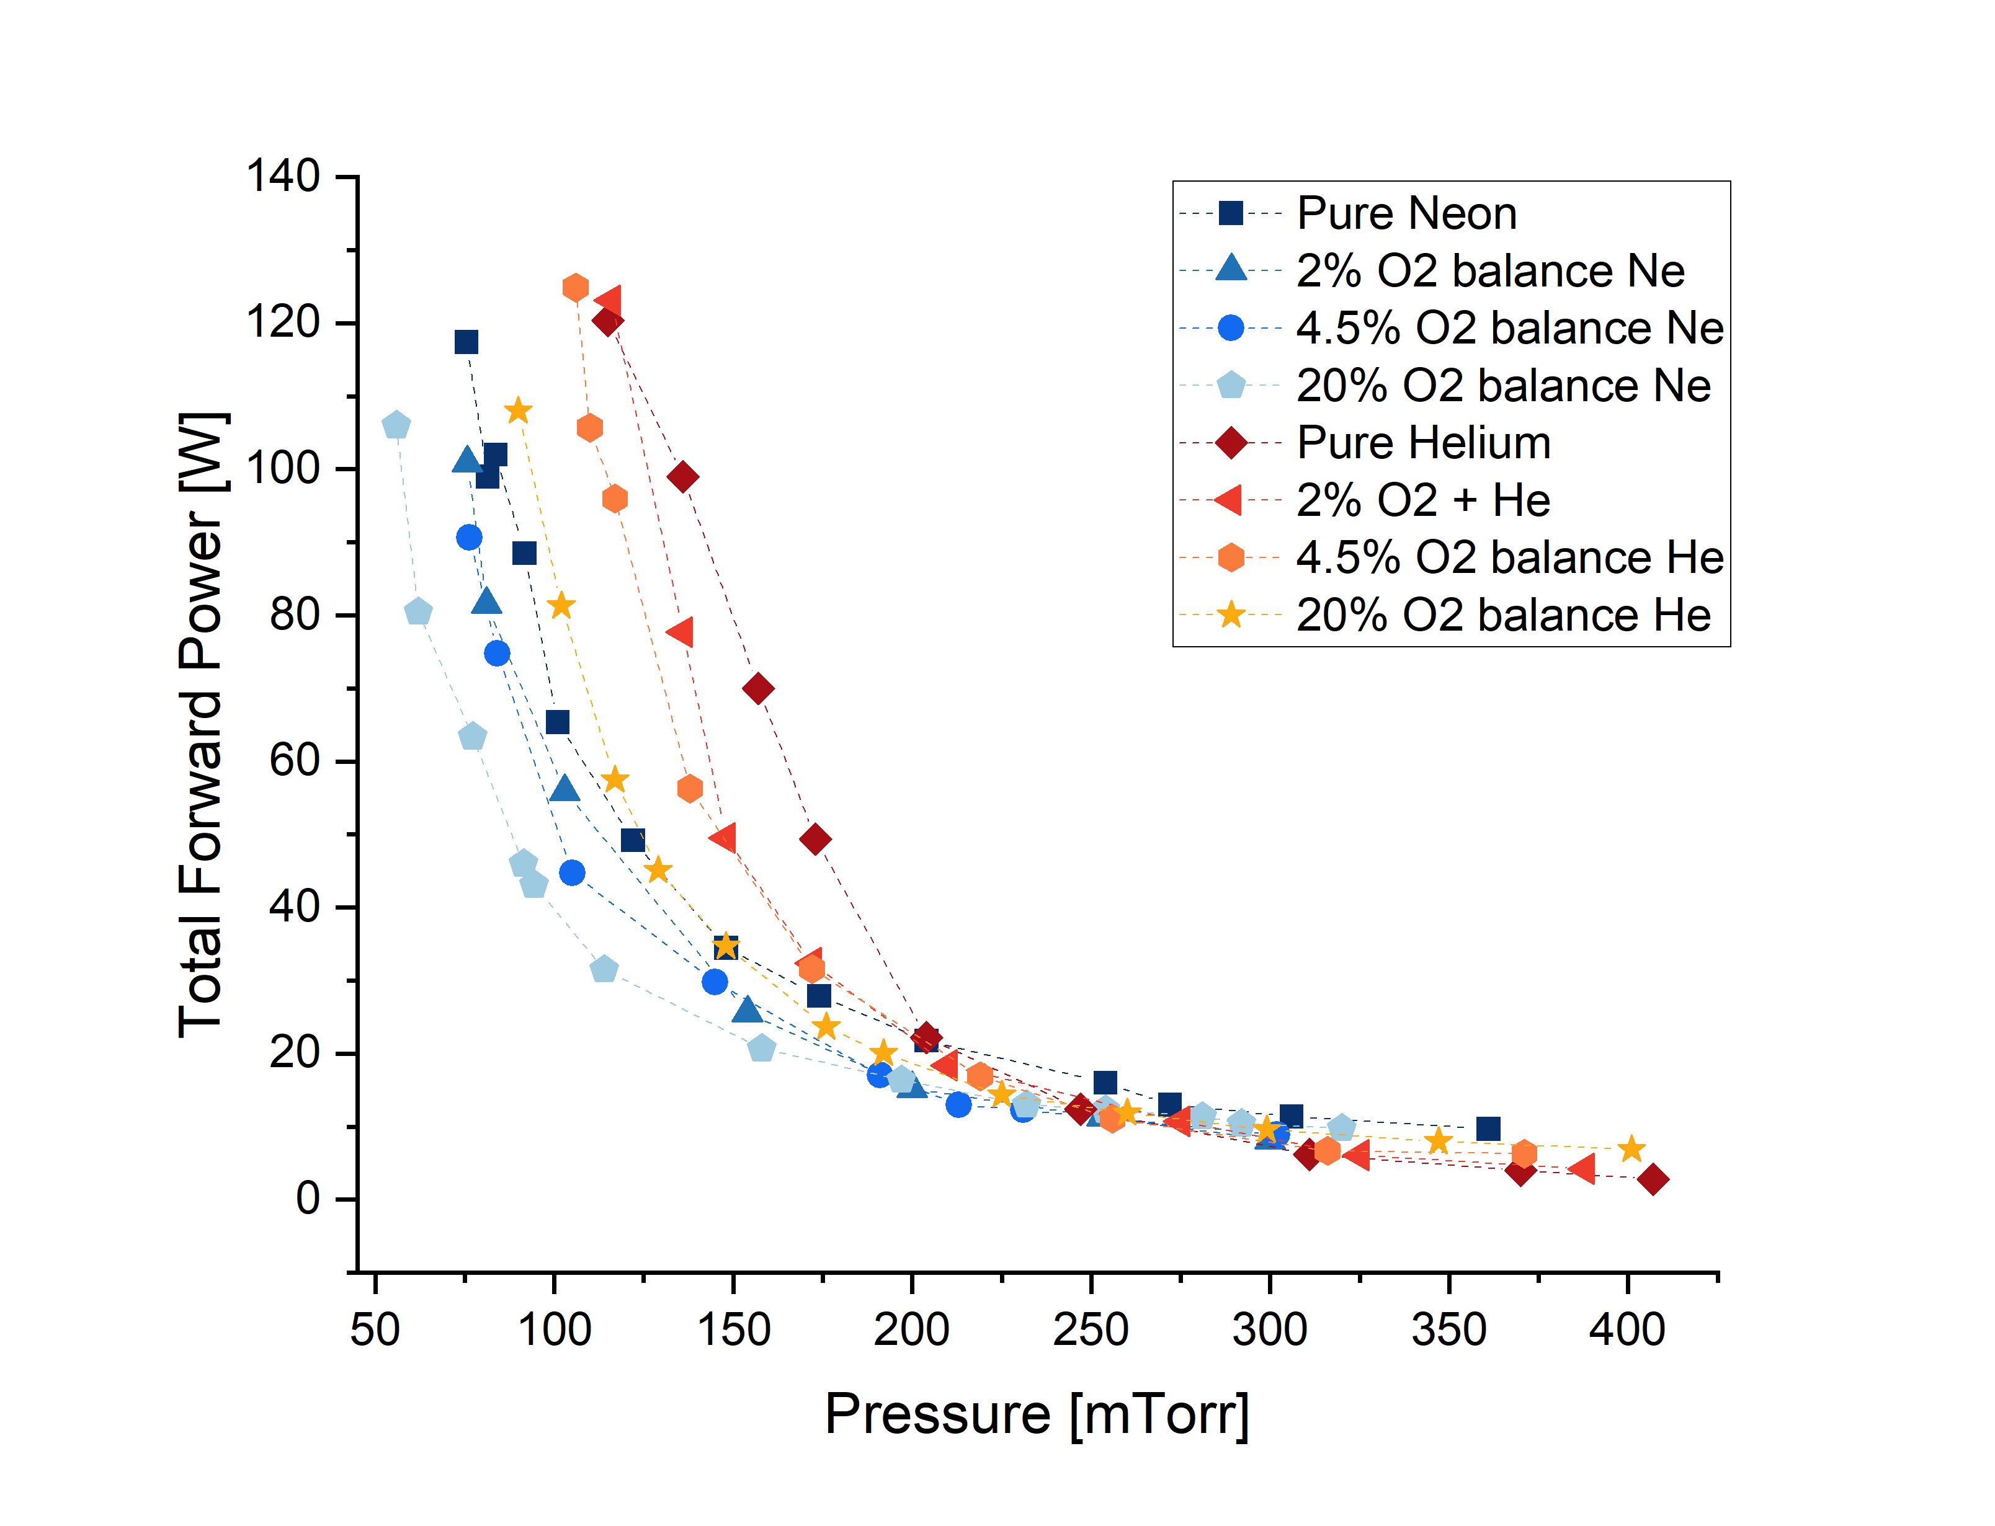
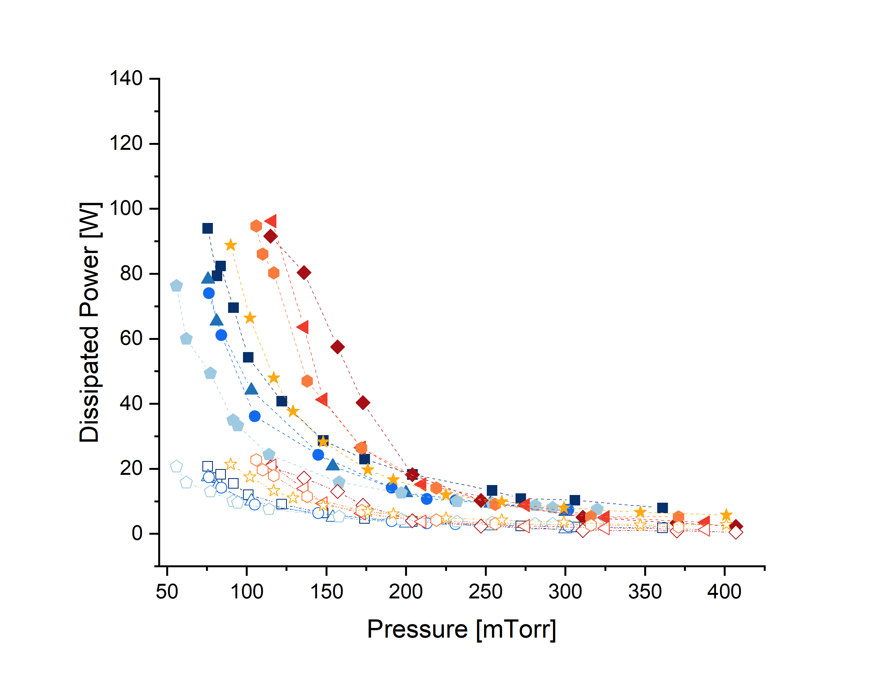
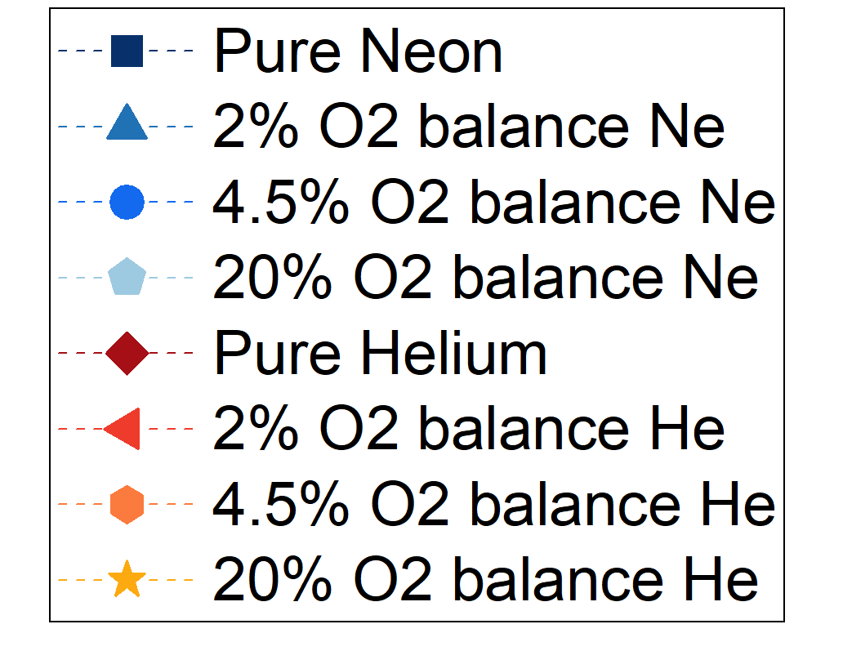
Paschen Curves for Neon and Helium
Measured on 9-cell 1.3GHz with LCLS-II HOM couplers, using standard 1.3GHz RF ignition procedure. Admin limit of P_{forward, max} = 125W
Filled markers: just before plasma ignition
Empty markers: after plasma ignition
Work conducted at Fermilab in collaboration with Elisa Del Core and Bastiano Vitali (INFN LASA)

Slide 8
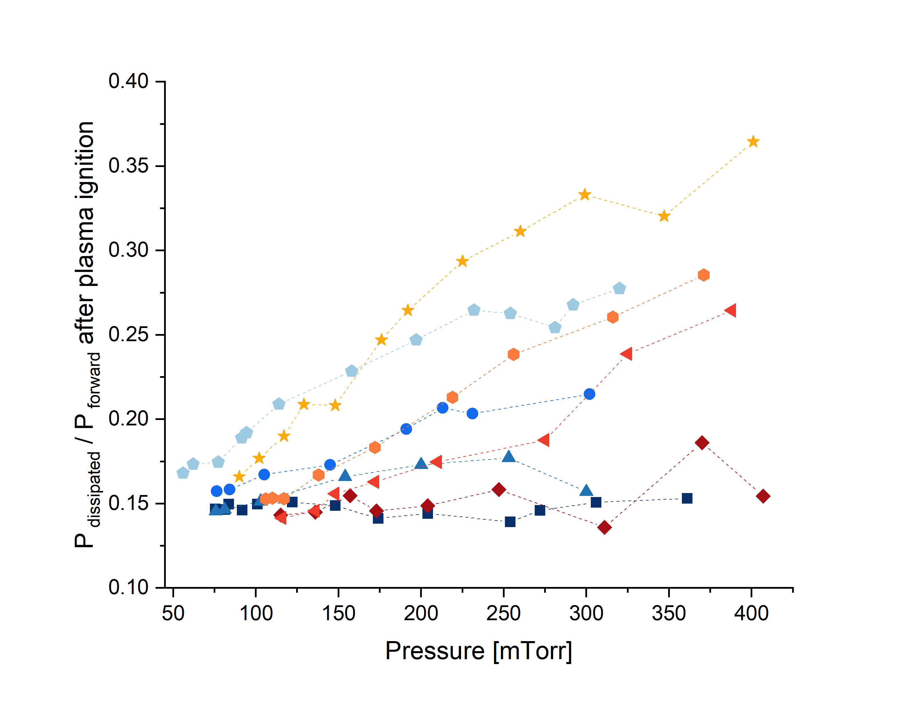
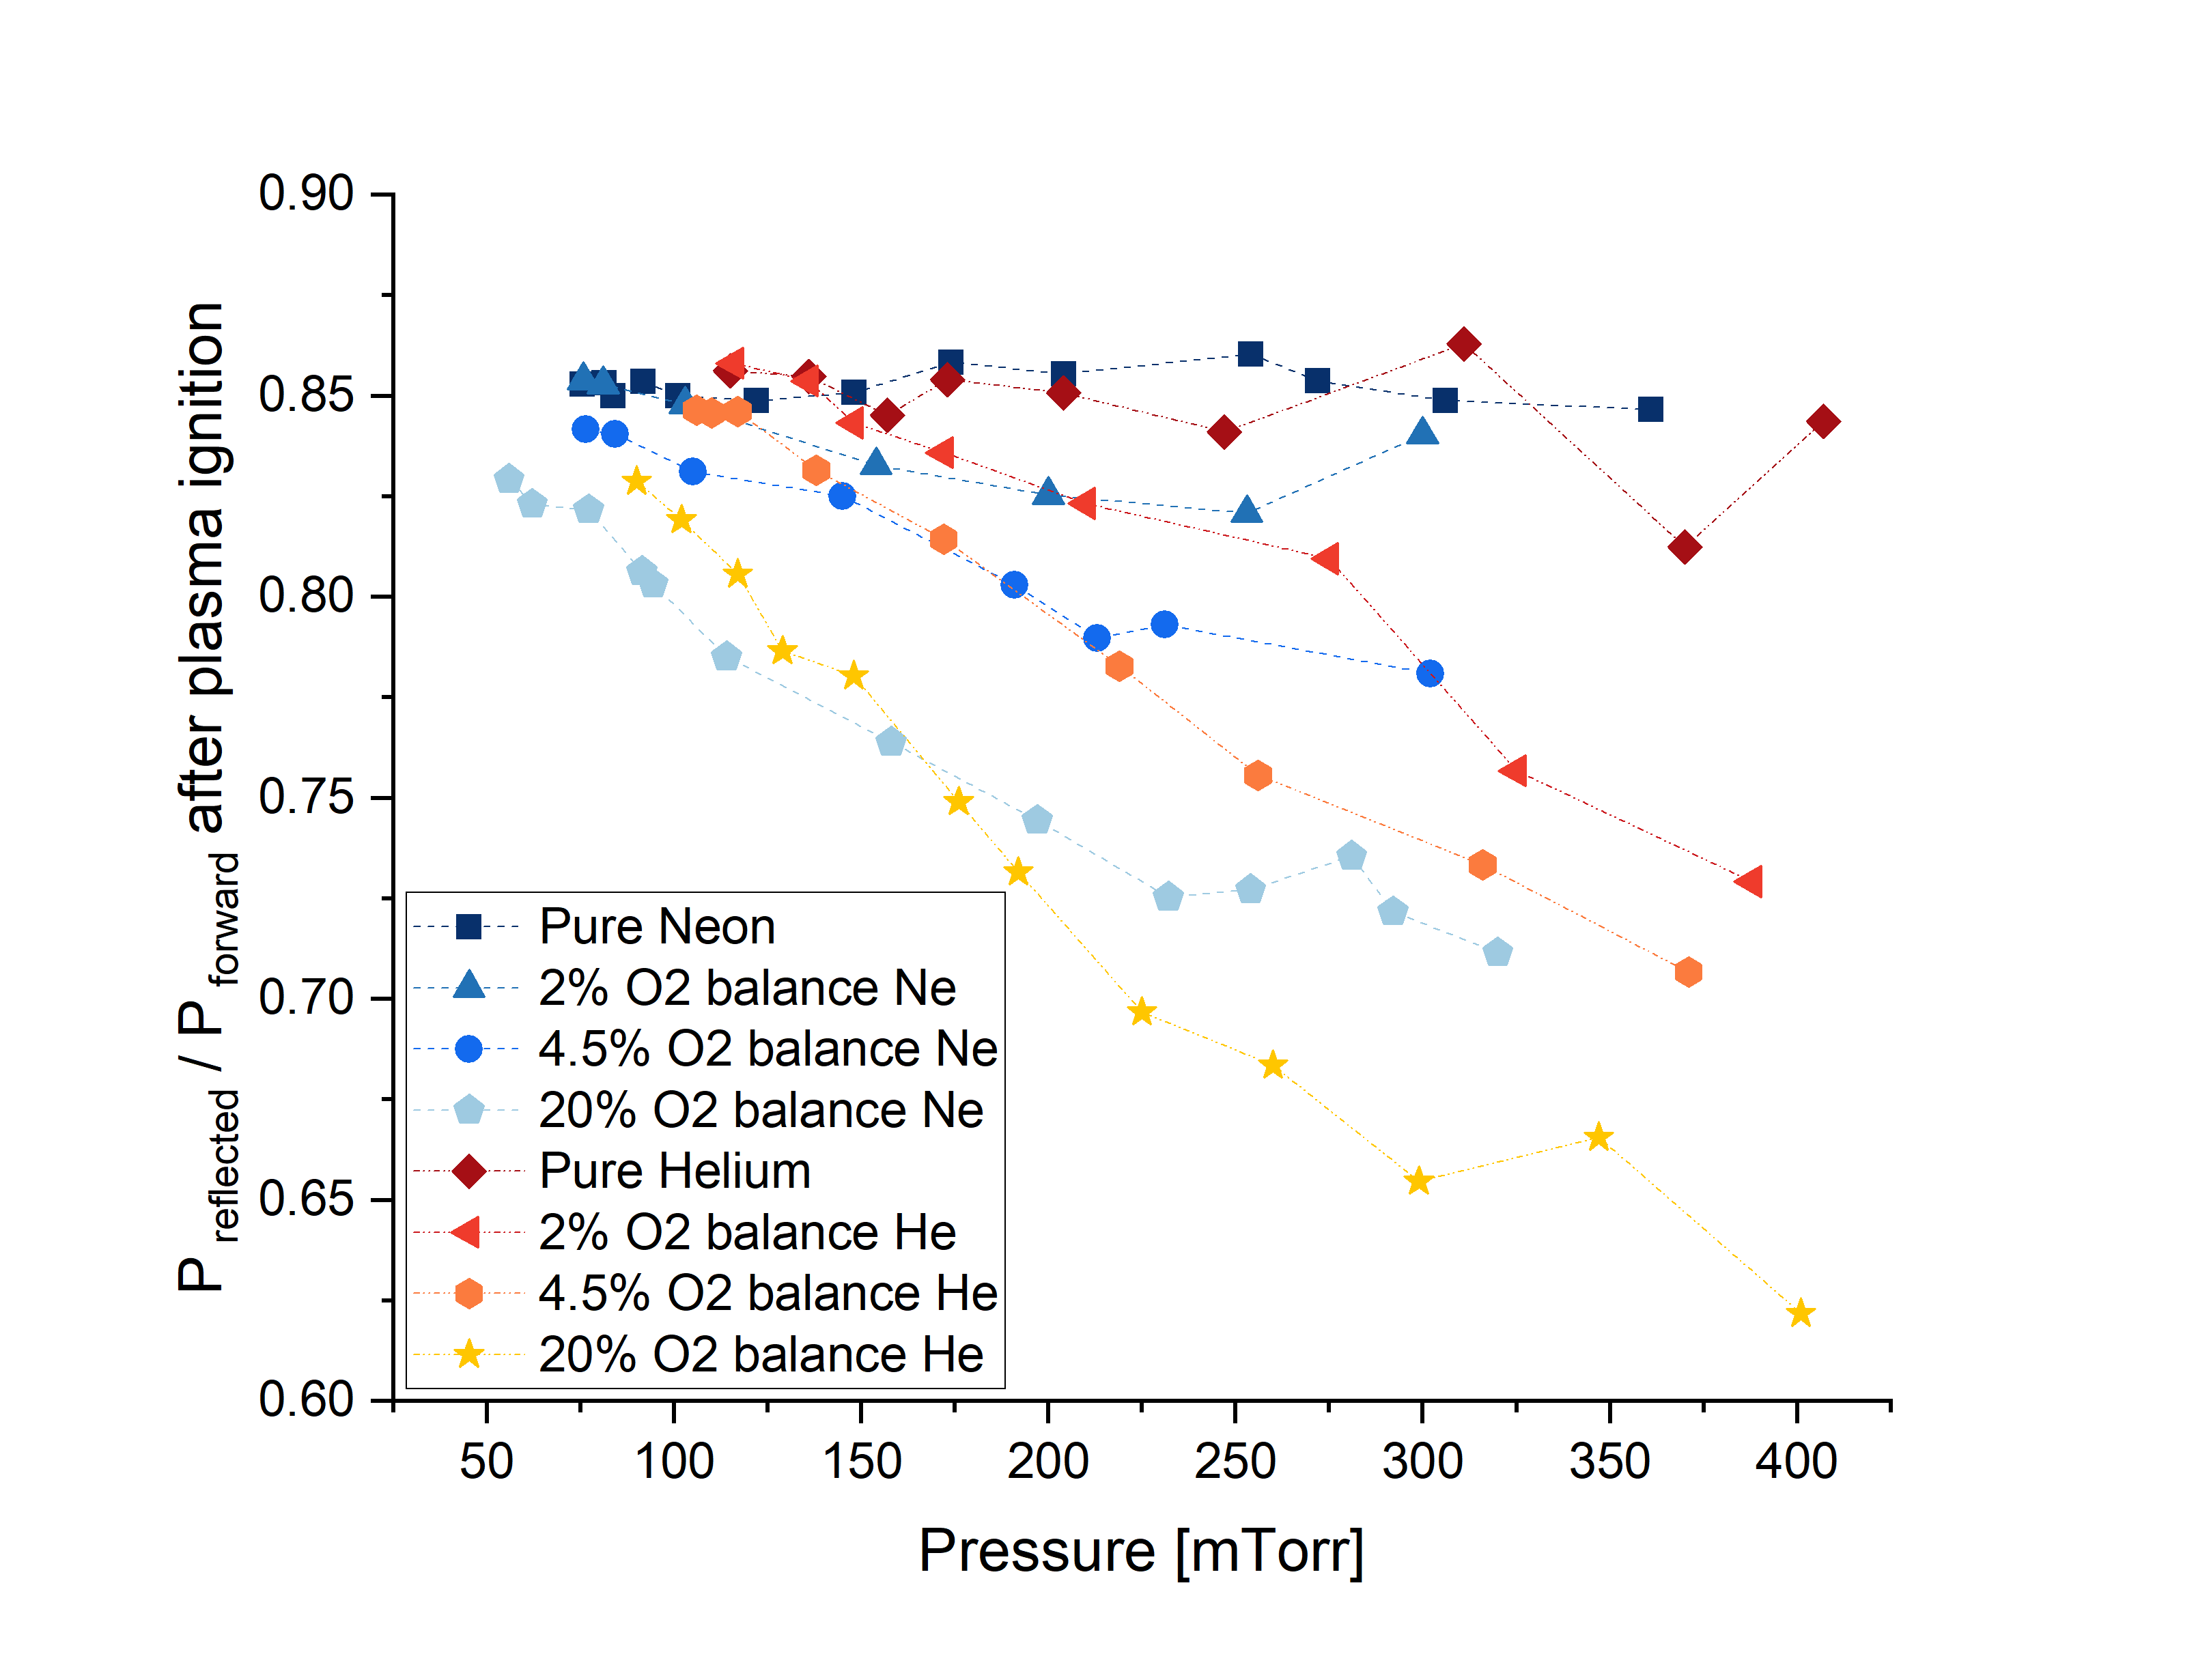
Power Level Changes
Measured on 9-cell 1.3GHz with LCLS-II HOM couplers, using standard 1.3GHz RF ignition procedure. Admin limit of P_{forward, max} = 125W
20% O2
Pure inert gas
Work conducted at Fermilab in collaboration with Elisa Del Core and Bastiano Vitali (INFN LASA)

Slide 9
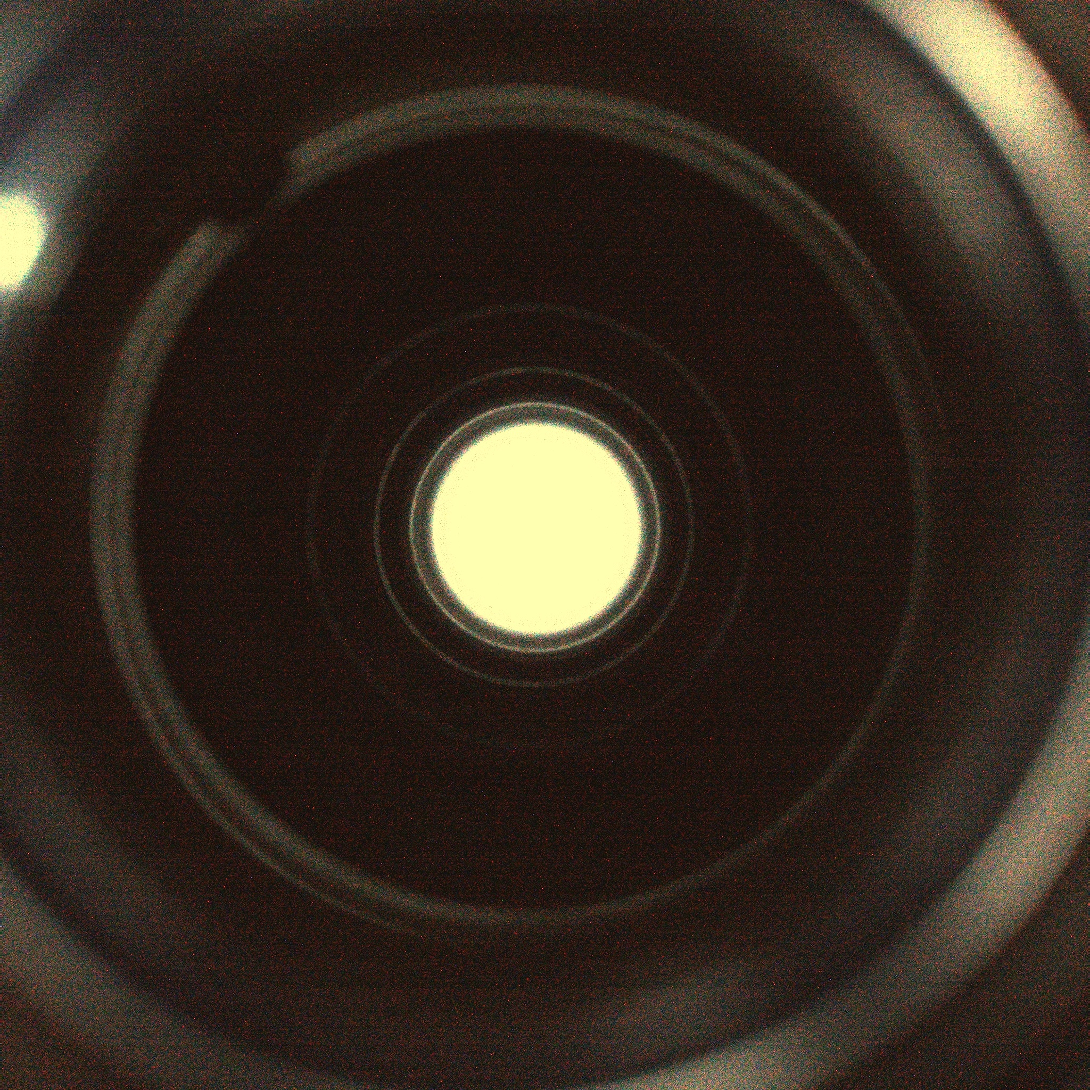
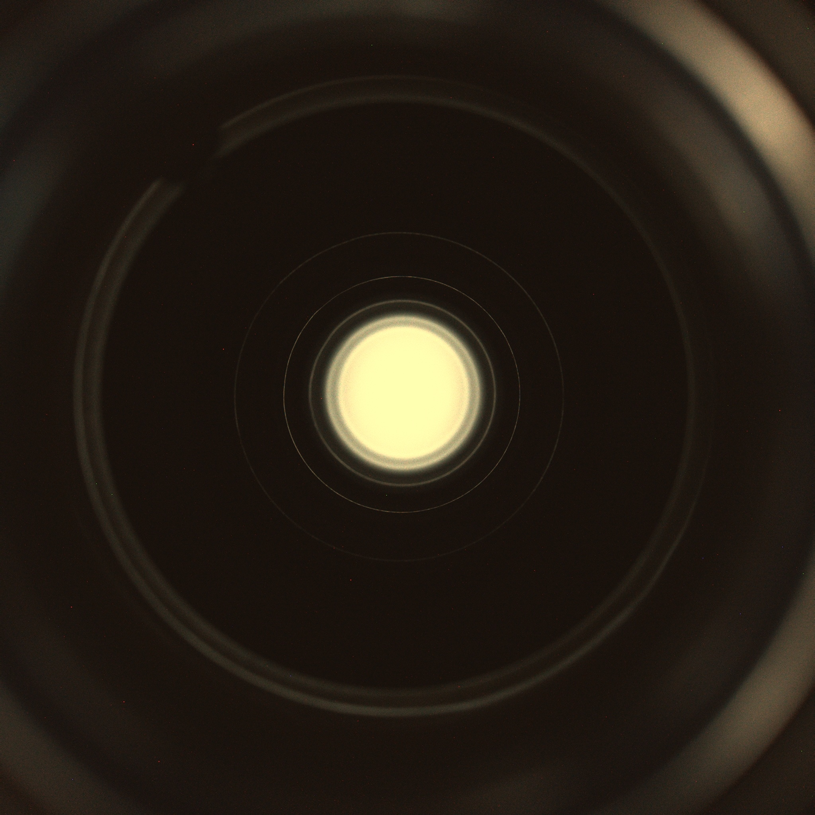
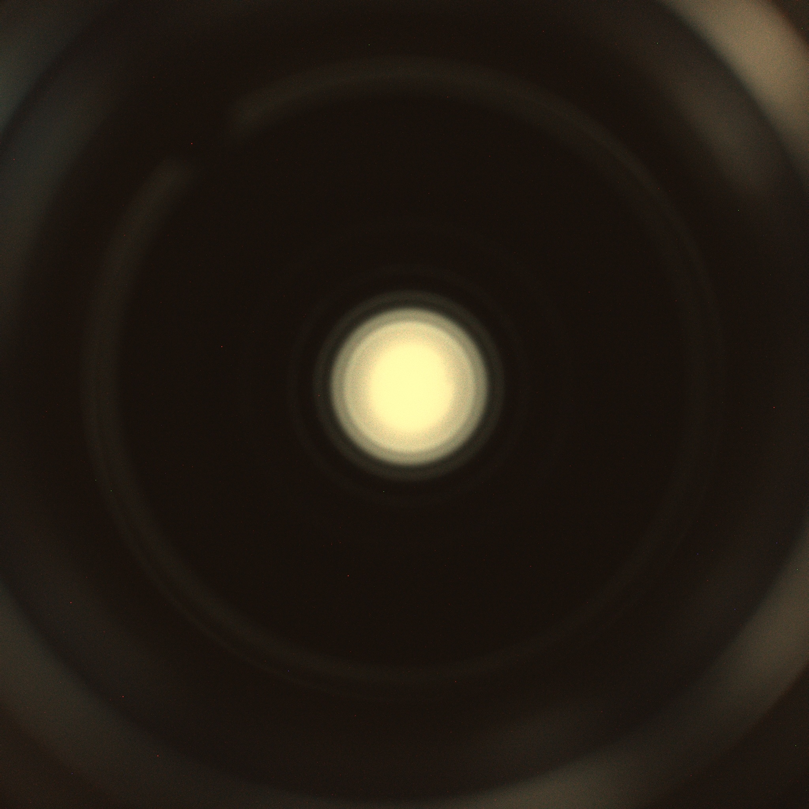
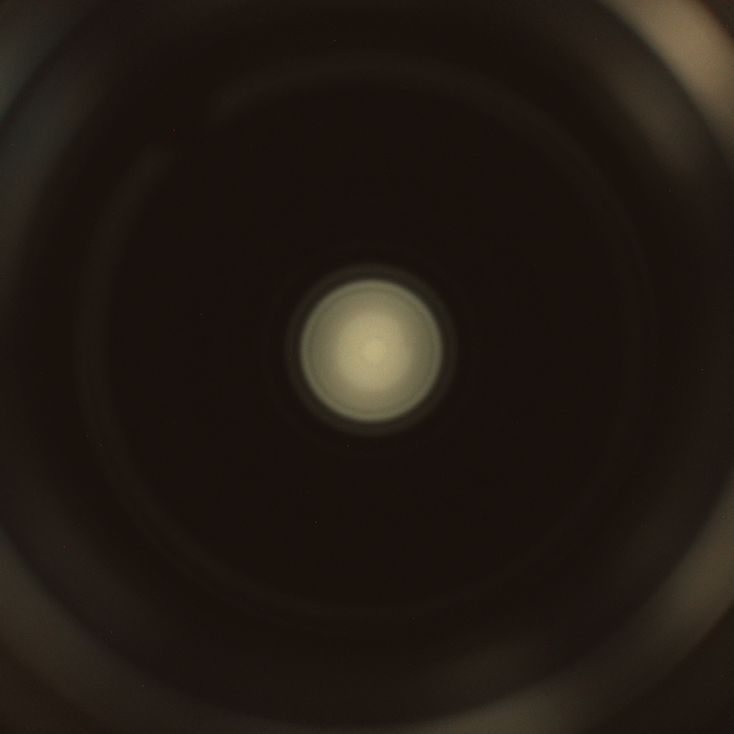
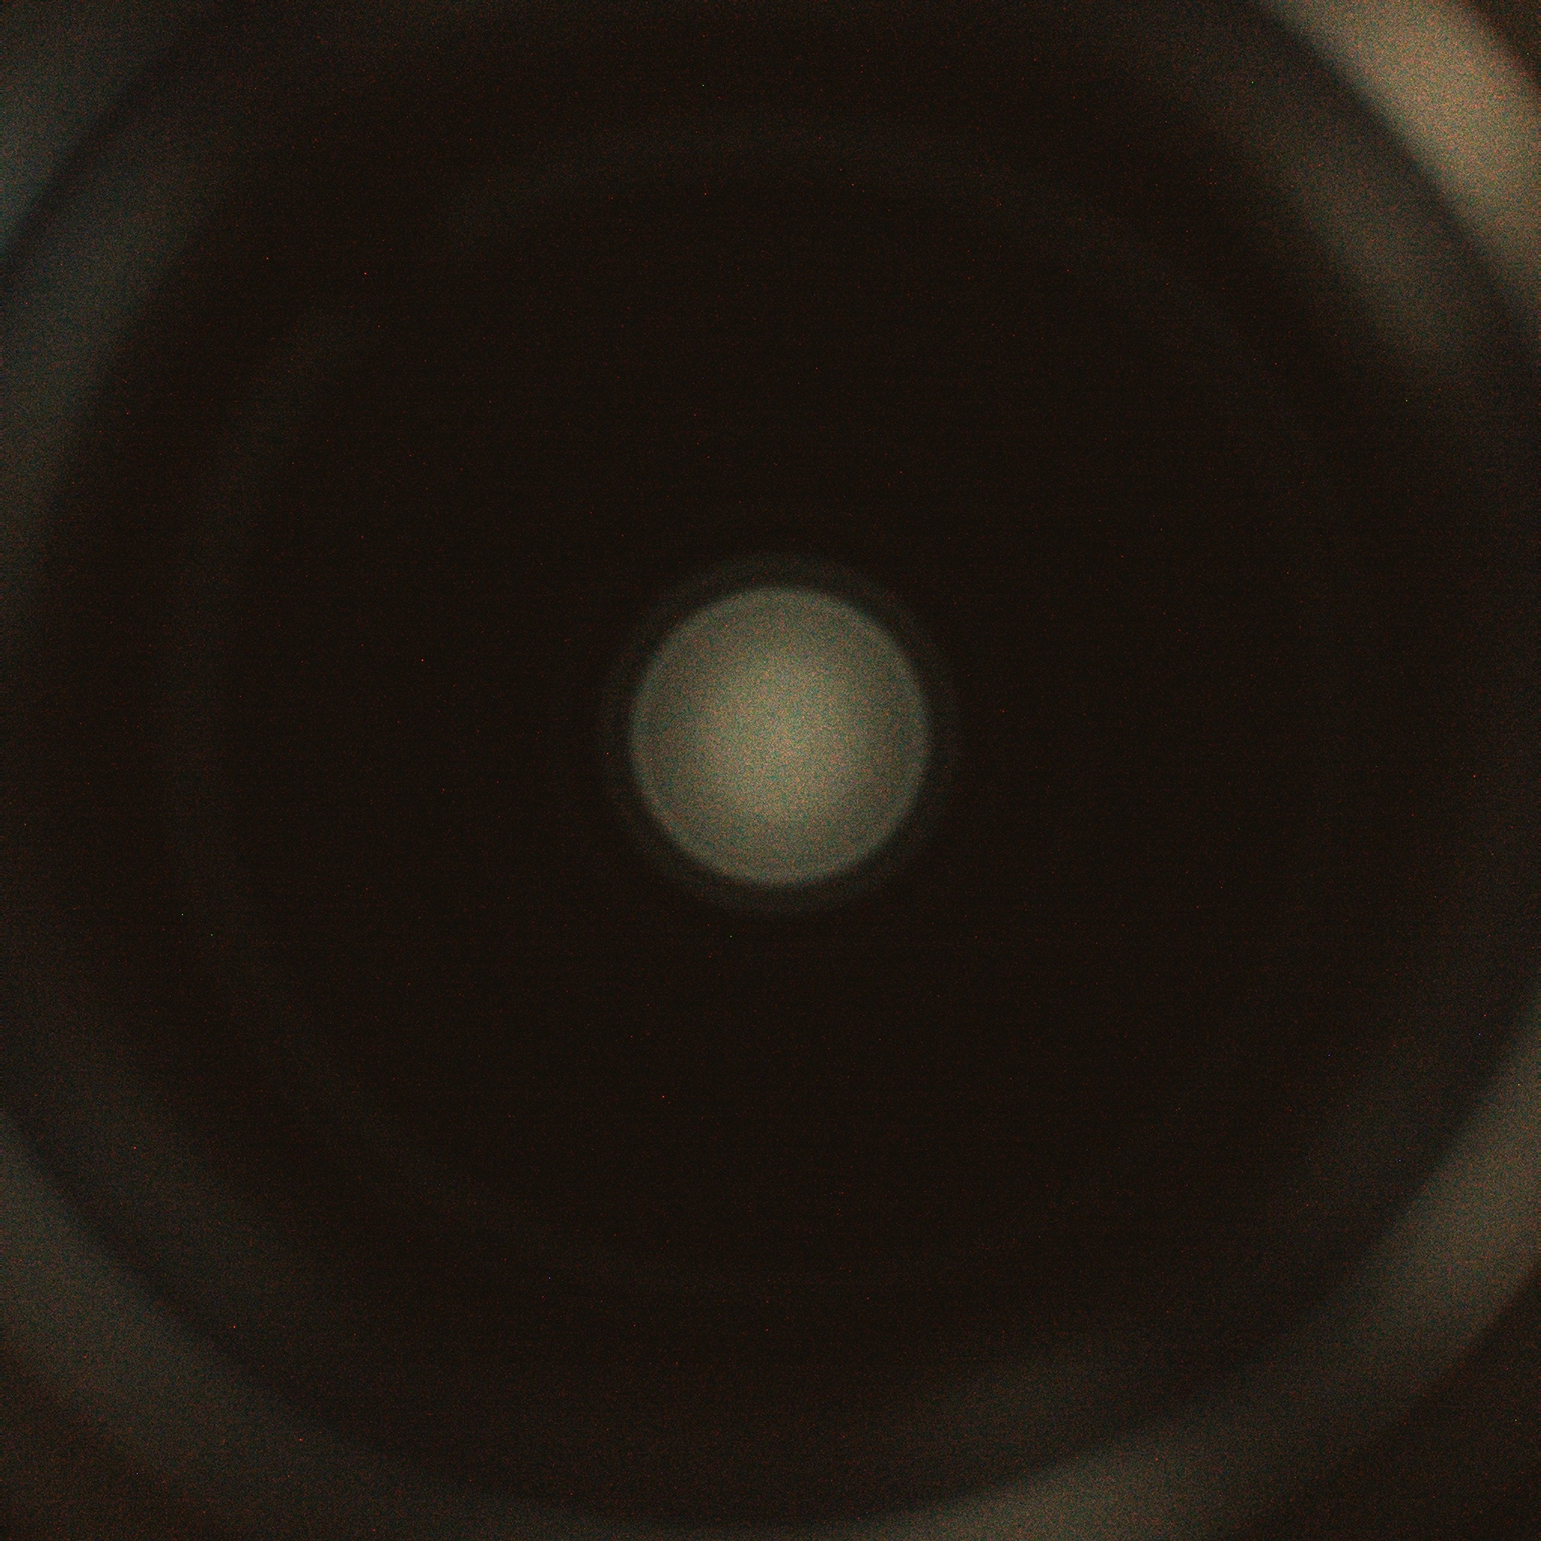
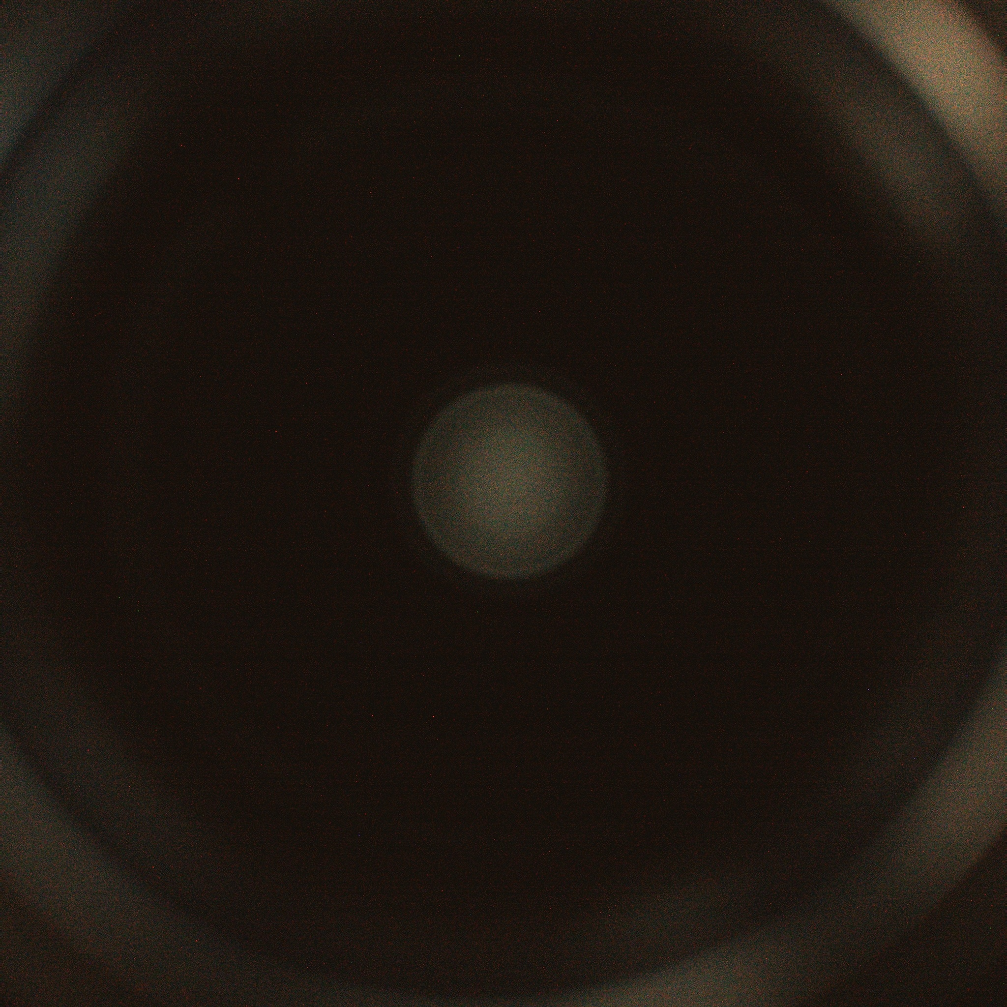
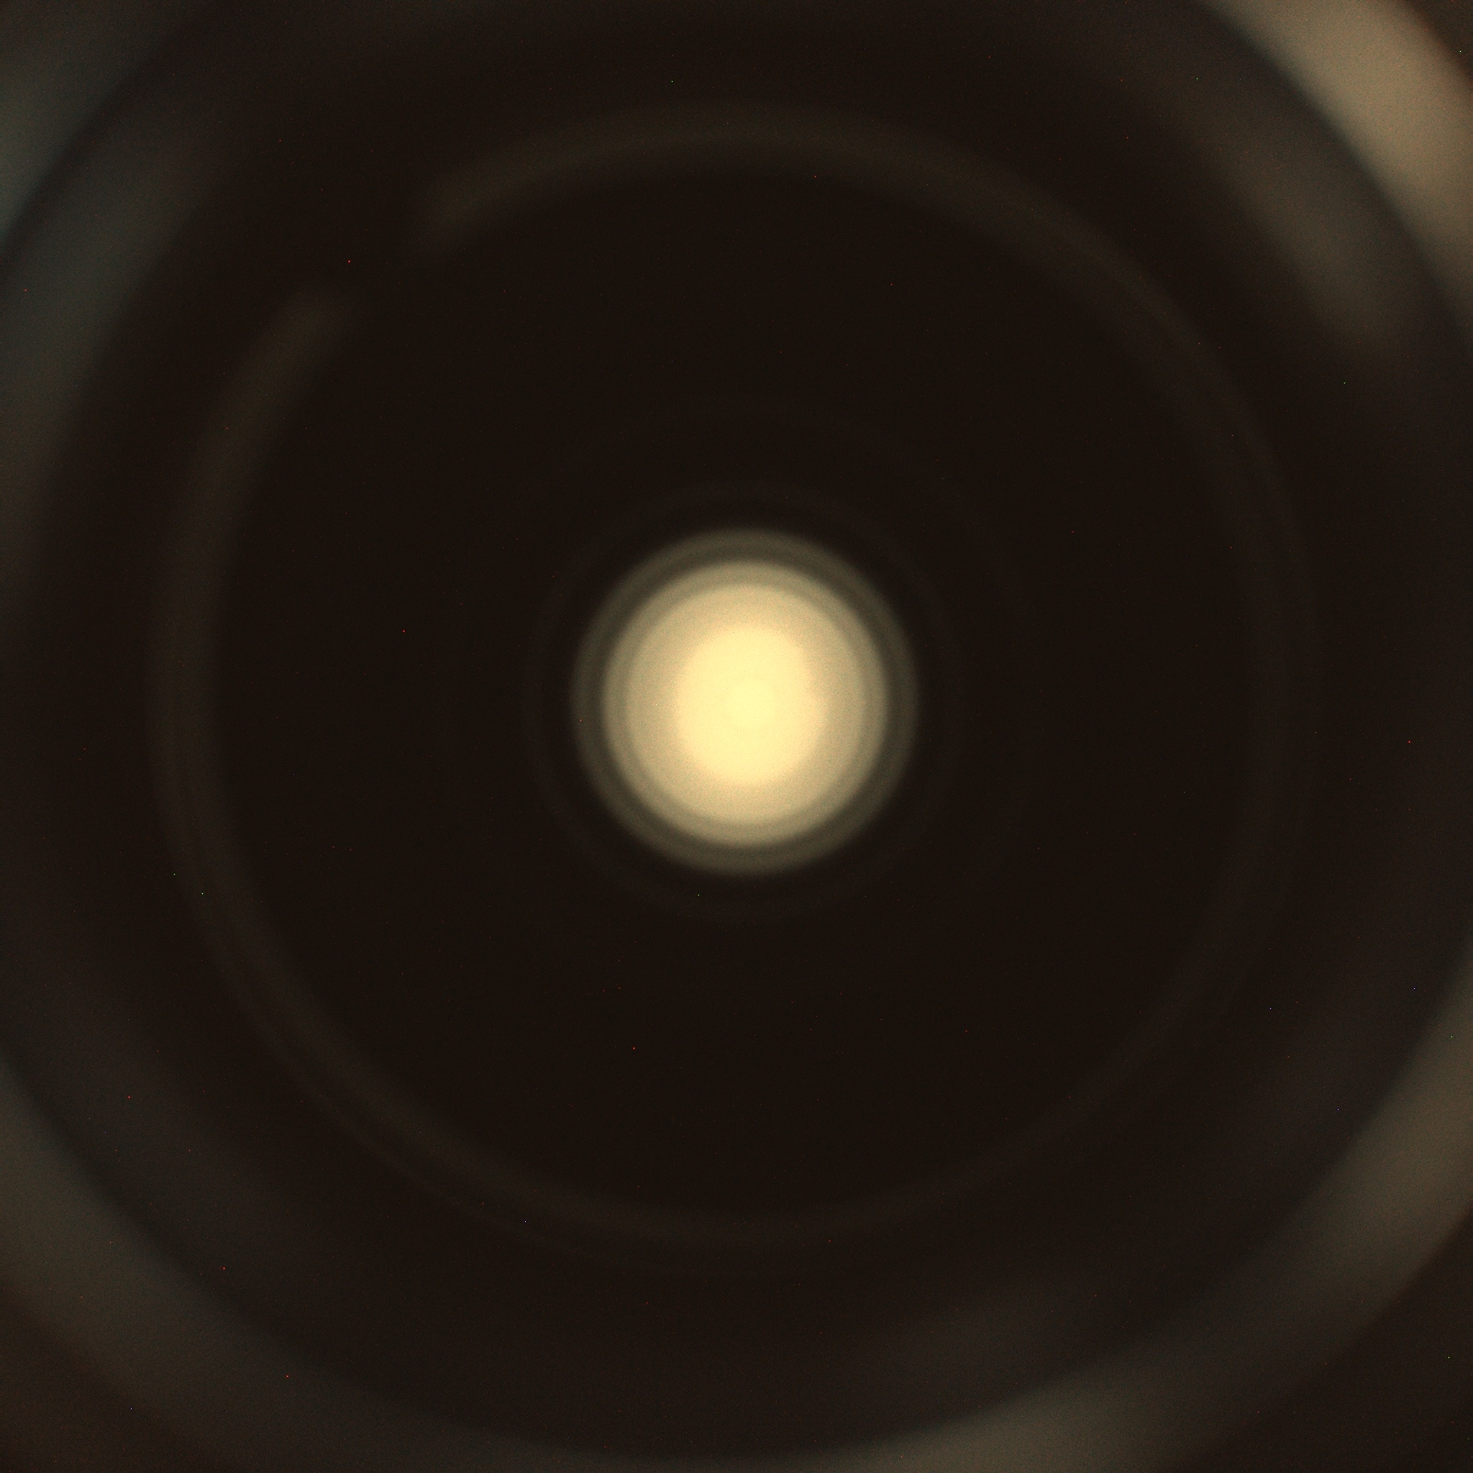
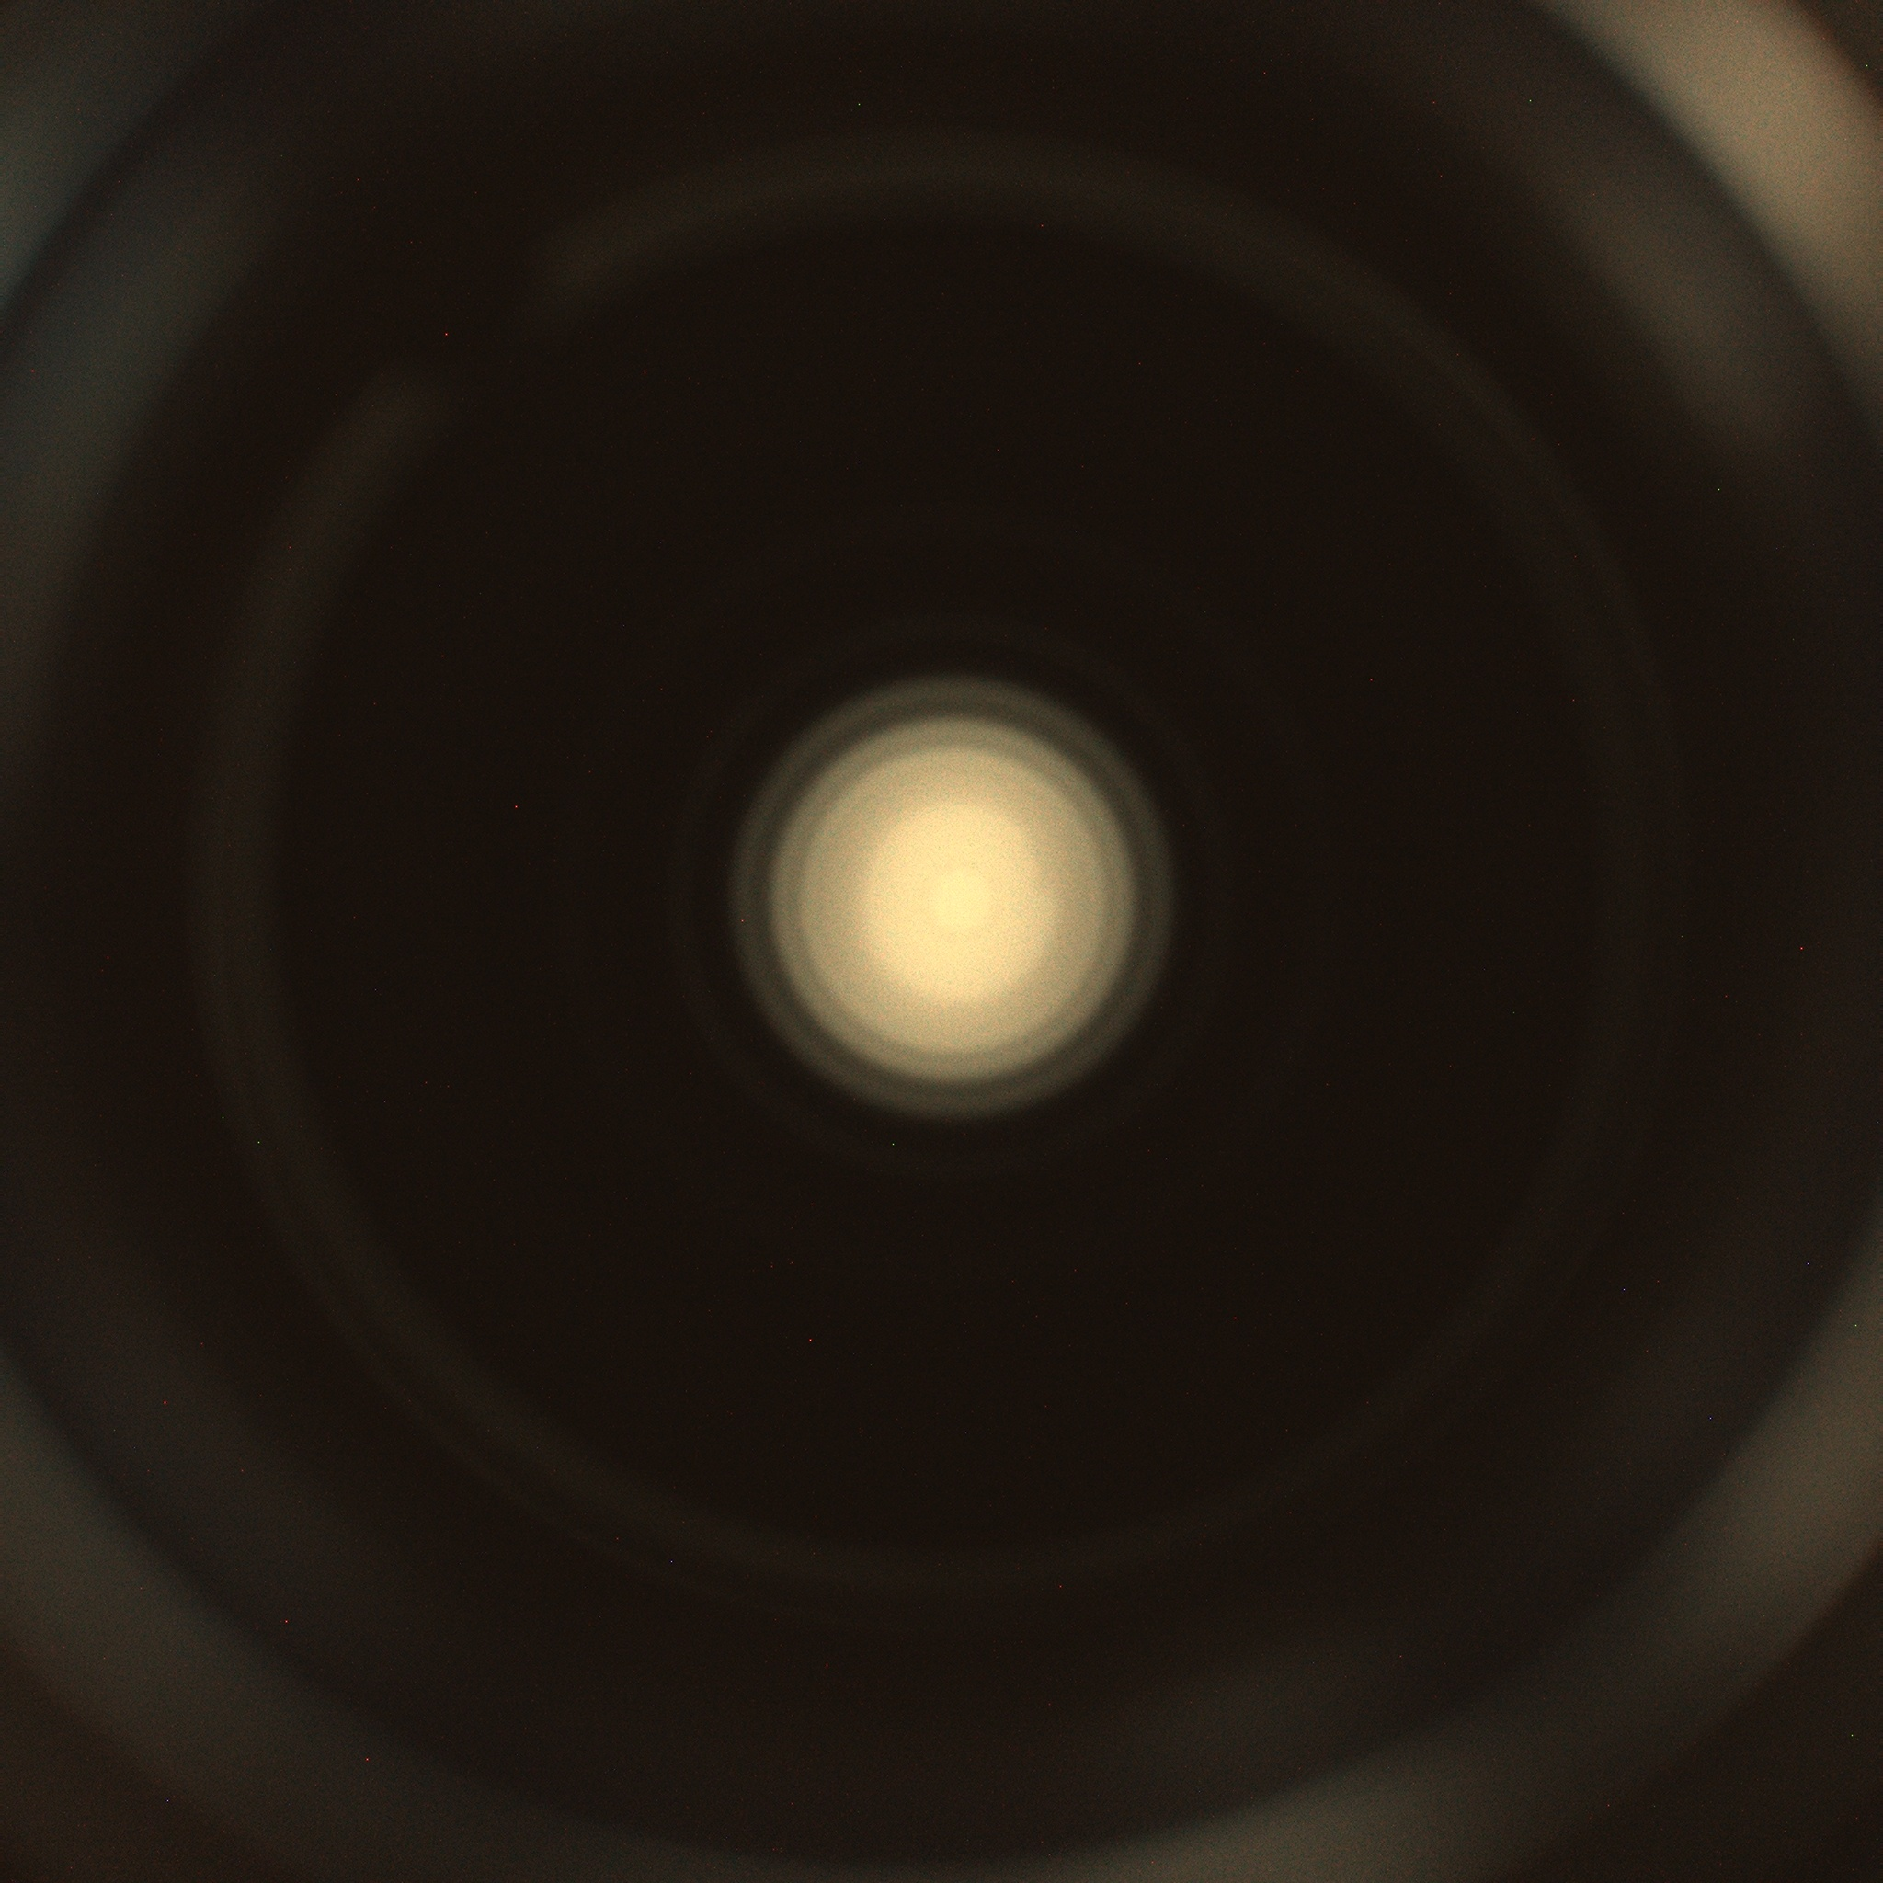
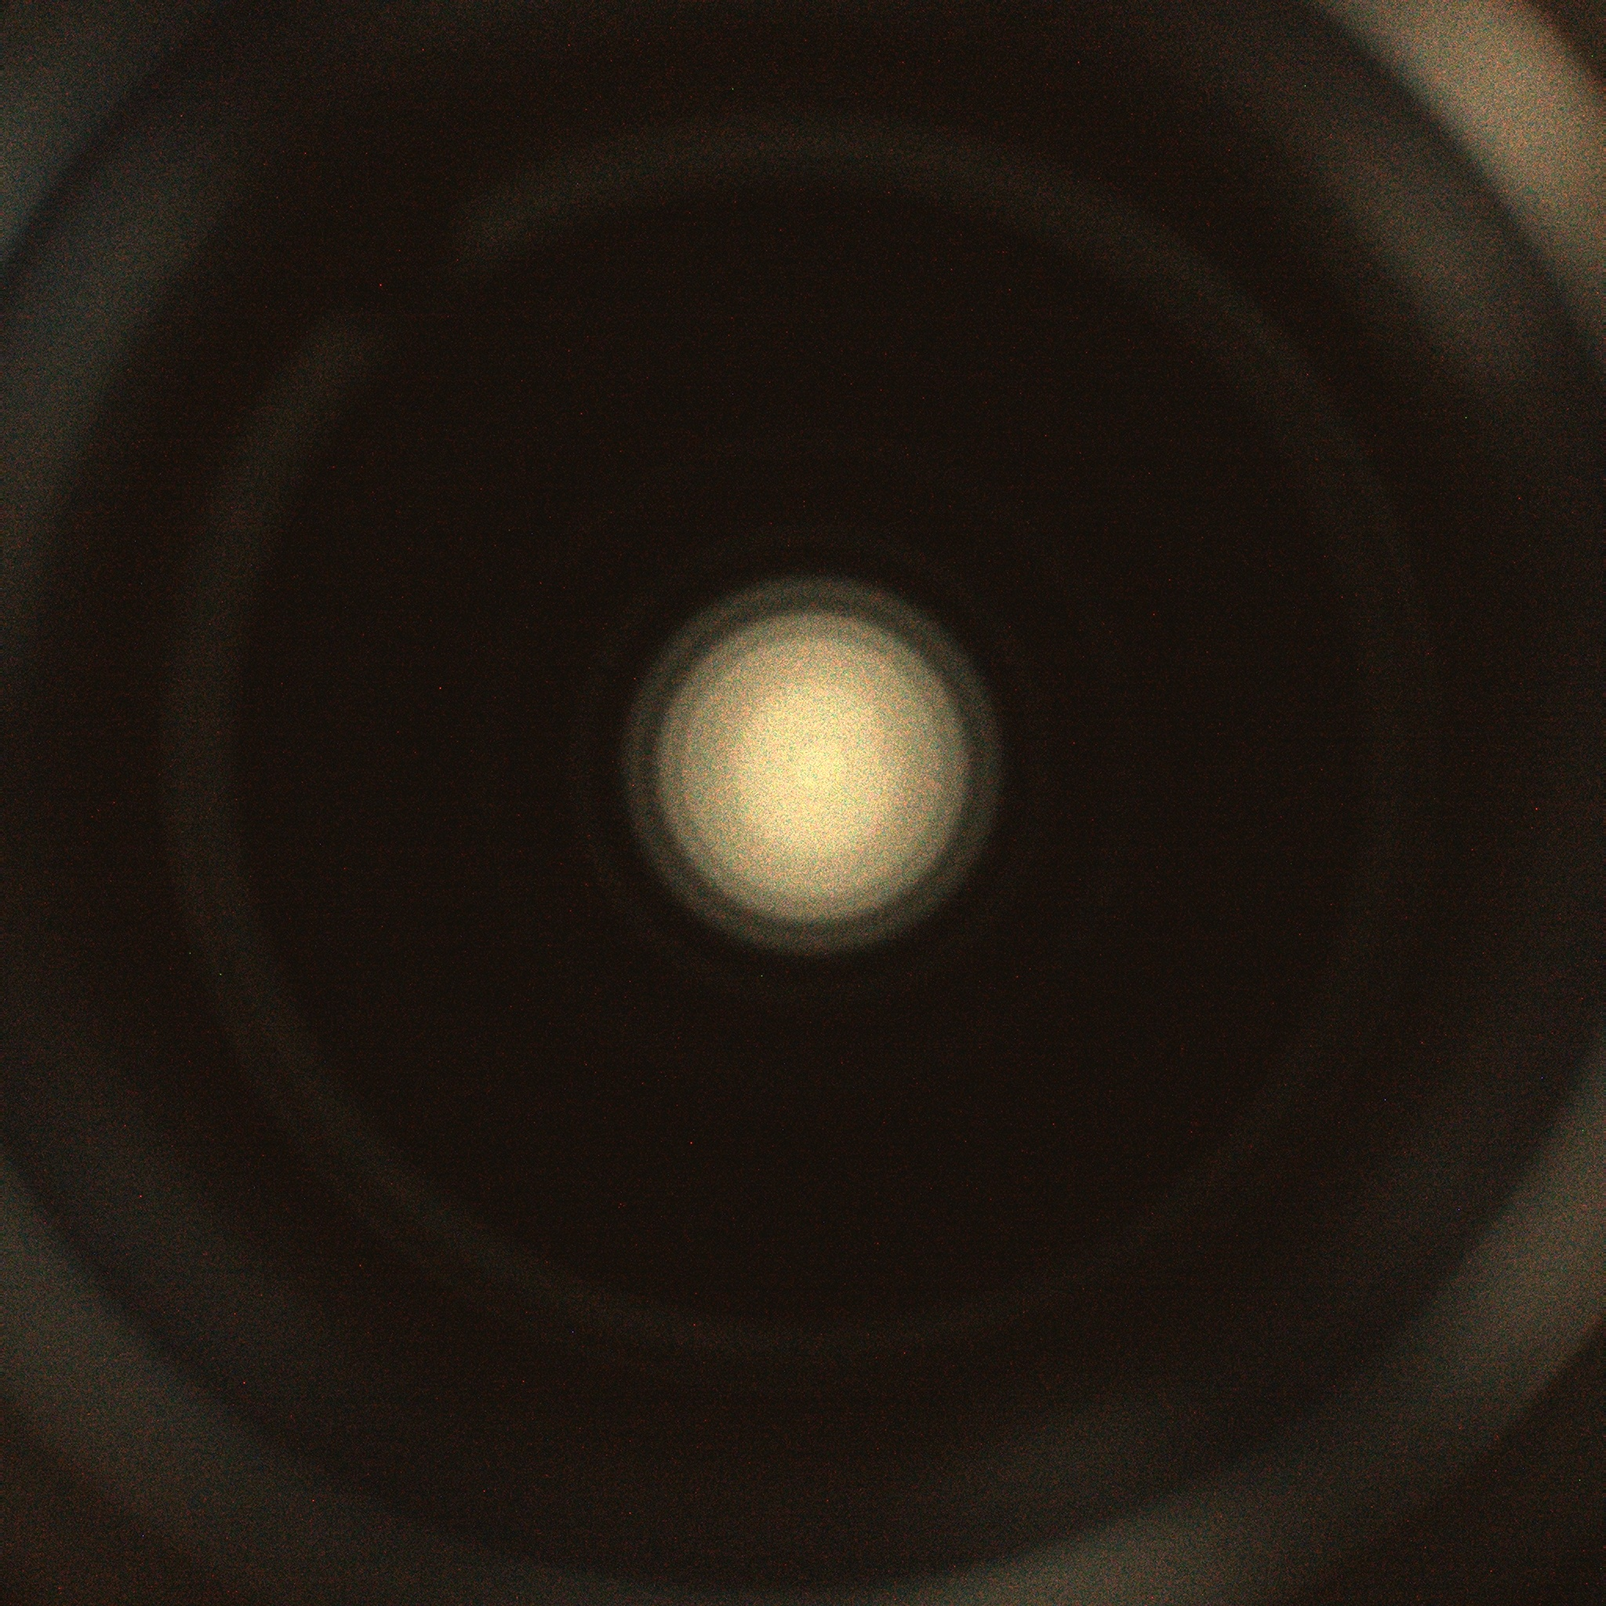

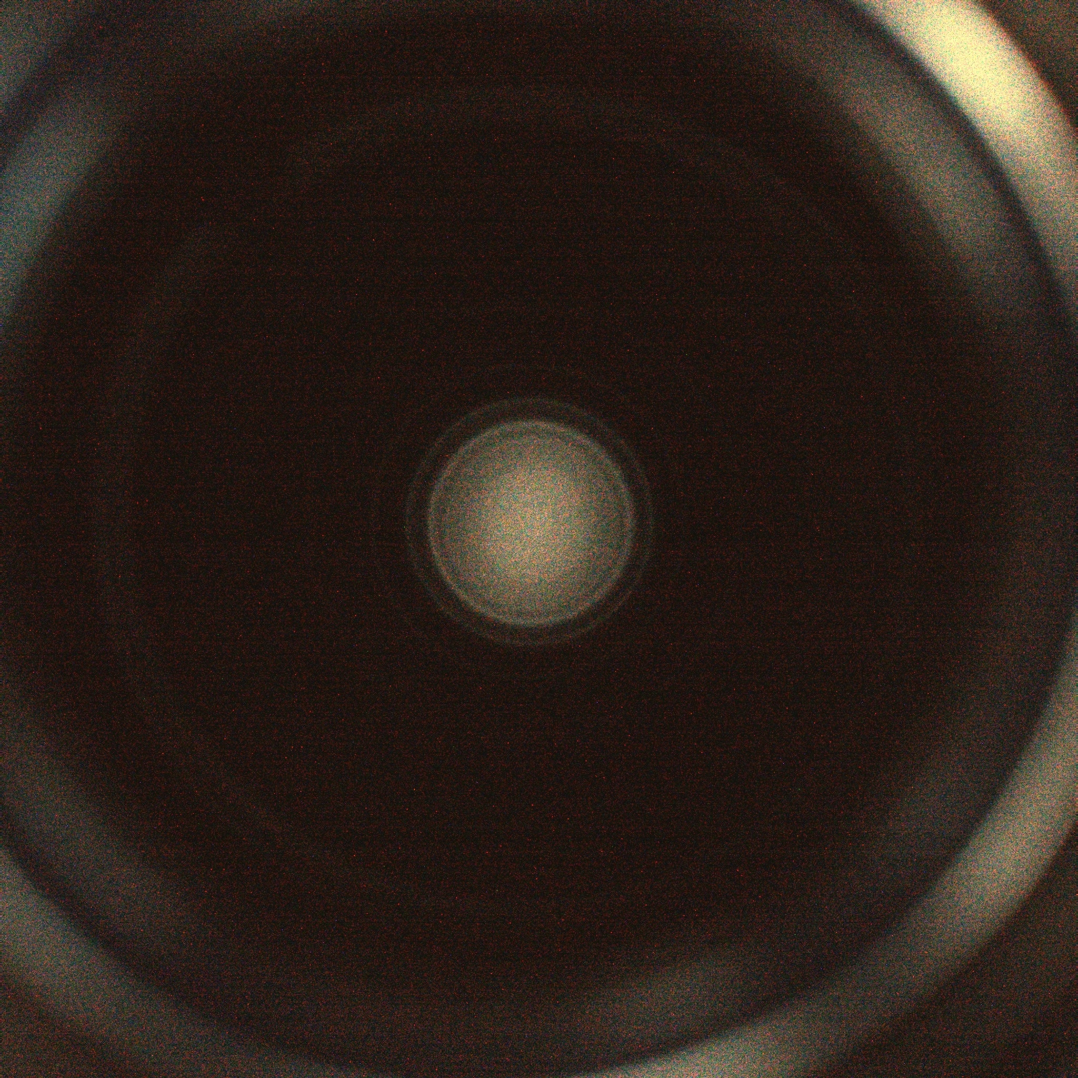
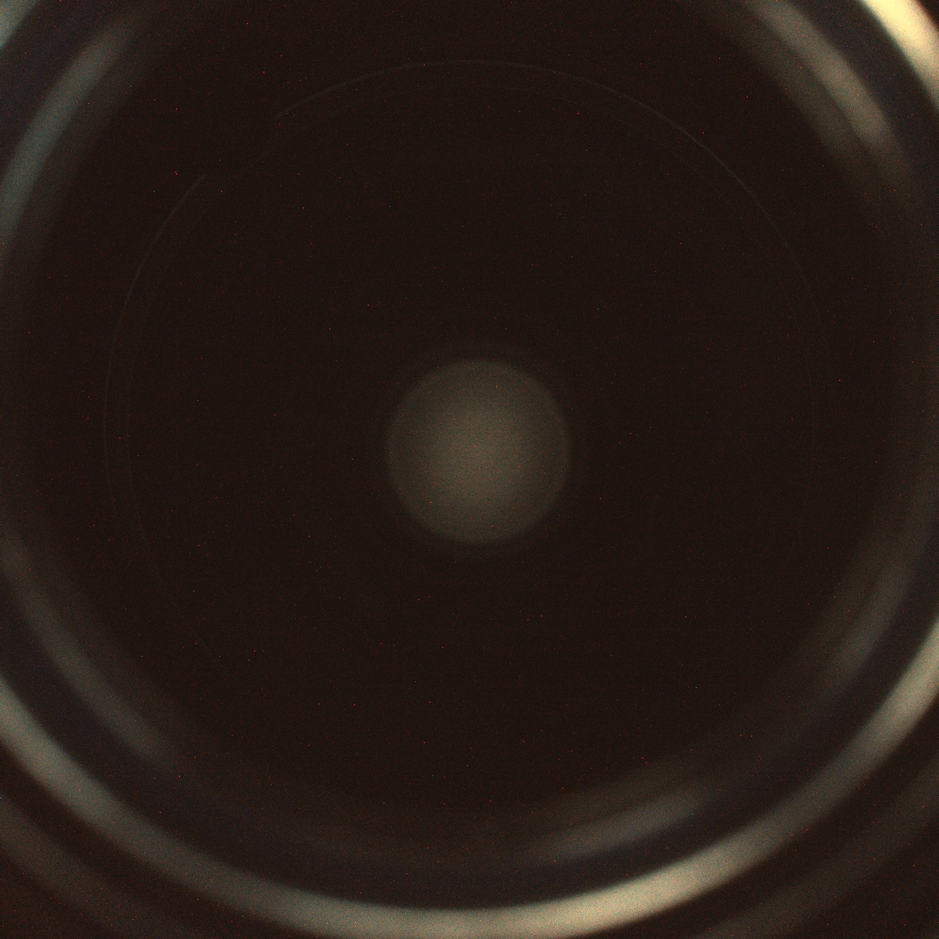
Plasma at Ignition vs Pressure
2% O₂ balance Helium
115 mTorr
136 mTorr
148 mTorr
210 mTorr
275 mTorr
388 mTorr
4.5% O₂ balance Helium
106 mTorr
110 mTorr
117 mTorr
172 mTorr
256 mTorr
316 mTorr
Work conducted at Fermilab in collaboration with Elisa Del Core and Bastiano Vitali (INFN LASA)

Slide 10
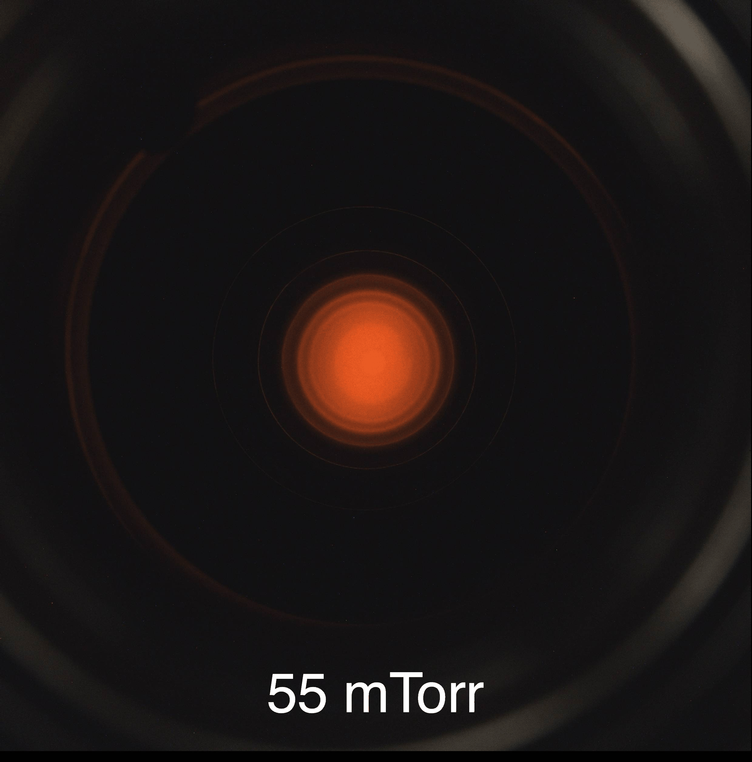
Plasma at Ignition vs Pressure
Measured on 9-cell 1.3GHz with LCLS-II HOM couplers, using standard 1.3GHz RF ignition procedure. Admin limit of P_{forward, max} = 125 W
20% O₂ balance Neon
Work conducted at Fermilab in collaboration with Elisa Del Core and Bastiano Vitali (INFN LASA)

Slide 11
Qualitative considerations on plasma behavior
At increasing O₂ fraction:
  We experience decreased plasma tunability by controlling the rf drive for fixed P_{forward} → decreased plasma density (not only at ignition)
  Plasma becomes more unpredictable, increasing from 2% to 4.5% causes plasma to jump to unexpected, non-adjacent cells, even worse with 20% O₂ (important to use 9-cell cavity vs single cell for this study!)
Relationship with removal rate? Unclear as RGA signals were absent/clean due to cavity being processed sequentially with different recipes without reintroducing contamination
Work conducted at Fermilab in collaboration with Elisa Del Core and Bastiano Vitali (INFN LASA)

Slide 12
Taking Into Account Cryomodule Constraints
03

Slide 13
Plasma behavior with Helium vs standard LCLS-II recipe
Tried to find a valid working point with Helium that gave similar parameter control to standard LCLS-II recipe with Neon
In LCLS-II → power limitation to ~10W due to HOM cables
Need to increase pressure to decrease power needed (not a great start)
Actually: at LCLS-II Ne pressure (~76mTorr) no He ignition (admin limit at 125W) → He ignition p_{min}=115mTorr with P_{forward}=120W( > P_{ignition,Ne})
With O₂ fraction > 2% : poor plasma control in multi-cell cavity

Slide 14
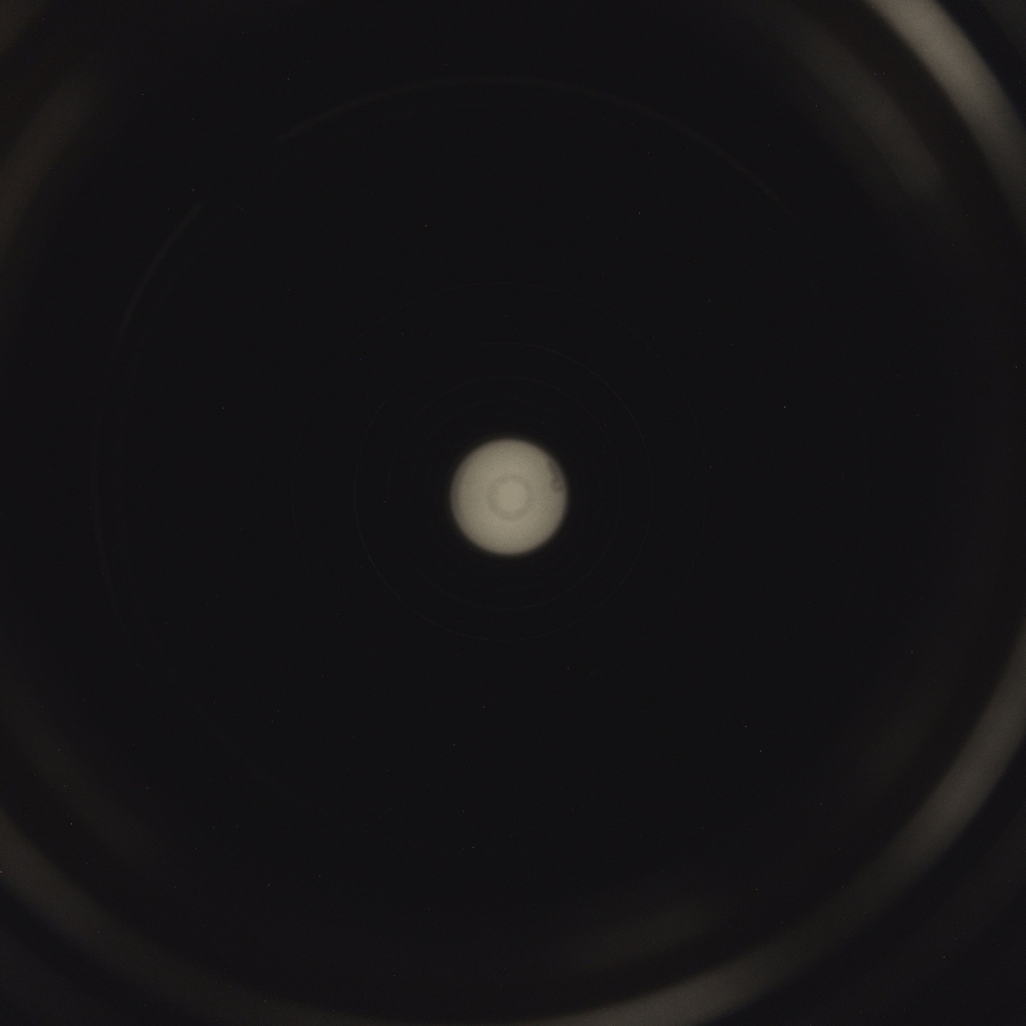
Plasma behavior with Helium vs standard LCLS-II recipe
Recipe: 115mTorr, 2% O₂ balance He
  During plasma transfer: if 2W < P_{forward} < 10W → plasma behavior unpredictable; if P_{forward} ~15W: good control of plasma transfer, no jumps. Exact LCLS-II modes combination for plasma transfer not always successful, used alternative combinations (from same dipole passbands)
  Plasma density: normally tune modes by 13-15MHz with Ne, with He limited to 10MHz with P_{forward}~15W, P_{diss}~5W
Alternative approach: ignite at 115mTorr, stabilize plasma in central cell (2-1 → 1-5), decrease pressure to 76mTorr with P_{forward}~15W: plasma transfers as predicted (no need for alternative modes), tunability limited to ~10MHz
2% O₂ balance Helium – 76mTorr

Slide 15
Conclusions
He preferred choice as inert gas for plasma? Unclear for these cavities yet if any compared to Ne recipe when considering limitations due to power constraints and necessity for predictable plasma control in multicell cavity in CM (no viewports, RF diagnostic only) or thinking about multi-pole modes in low beta cavities (SSR1, SSR2, …)
Need to conduct study with contaminated samples with the two working recipes and compare removal rates
  (how to make sure that the samples are really representative of the cavity surface?)
Could benefit from leveraging diagnostic techniques (such as spectrometer) to monitor electron temperature and density under different plasma conditions

