Slide 1
Field Emission Analysis in PIP-II SRF Cavities Using Geant4
June 11, 2026
Sajini Wijethunga
Engineering Physicist II

Slide 2
Field Emission
FE remains a significant hurdle for achieving high accelerating gradients and ensuring long-term reliability in modern SRF accelerators
FE is a quantum tunneling process triggered by surface contaminants such as dust, metallic flakes, adsorbed gases, or other impurities
Key Impacts:
  Radiation generation: Electron impacts on cavity walls produce Bremsstrahlung radiation, creating radiation hazards and complicating diagnostics, testing, and cavity qualification
  Performance degradation: Field-emitted electrons drain stored RF energy, lowering the intrinsic quality factor (Q₀) and limiting the achievable accelerating gradient
  Thermal and operational impact: Electron impacts cause localized heating and increase the cryogenic heat load, reducing overall system efficiency and operational stability
Because RF fields continuously redirect electron motion, the impact location may be far from the original emission site, making it difficult to pinpoint the source
External radiation detection is the standard diagnostic tool, but it provides only indirect information about the internal electron dynamics and emission mechanisms

Slide 3

Goals
Understand the characteristics of field-emission-induced radiation
Compare simulation results with experimental data to validate simulation predictions and optimize detector placement
Develop a cryomodule testing model to improve diagnostic accuracy
Use AI to correlate radiation maps with cavity locations

Slide 4






Simulation Framework
Geometry
construction
Primary particle
generation
Geant4
simulations
Analyze results
NXCAD
CST eigen mode solver
C++
ROOT file format
Python
(trimesh & gmsh libraries)
CST PIC solver
Python
The National Energy Research Scientific Computing Center –High-performance computing
Python

Slide 5
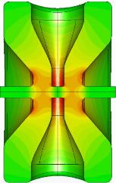
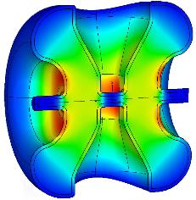
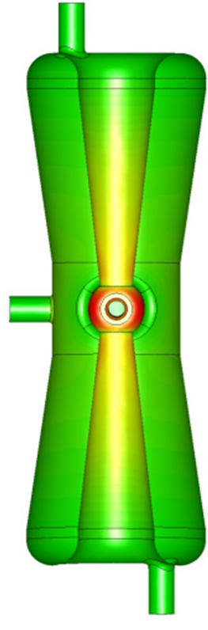


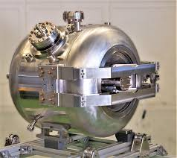
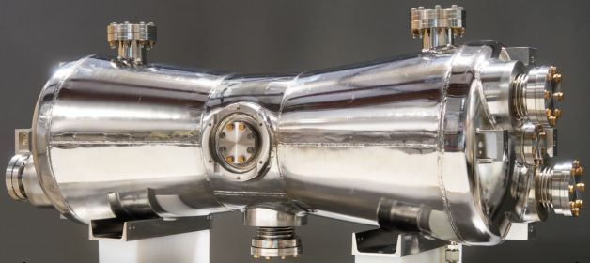
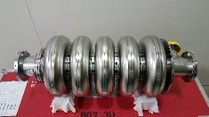
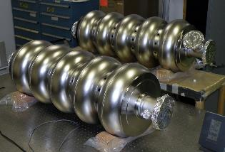
PIP-II Cavity Types
Parameter | HWR | SSR1 | SSR2 | LB650 | HB650
Frequency [MHz] | 162.5 | 325 | 325 | 650 | 650
Effective length, 𝐿_{𝑒𝑓𝑓} [m] | 0.207 | 0.205 | 0.436 | 0.704 | 1.061
β_{opt} | 0.11 | 0.22 | 0.47 | 0.65 | 0.97
Q₀ | 8.5E9 | 8.2E9 | 8.2E9 | 2.4E10 | 3.3E10
E_{acc} [MV/m] | 9.7 | 10.0 | 11.5 | 16.9 | 18.8
Fig. 1: PIP-II cavity types.

Slide 6
HB650 cavity

Slide 7
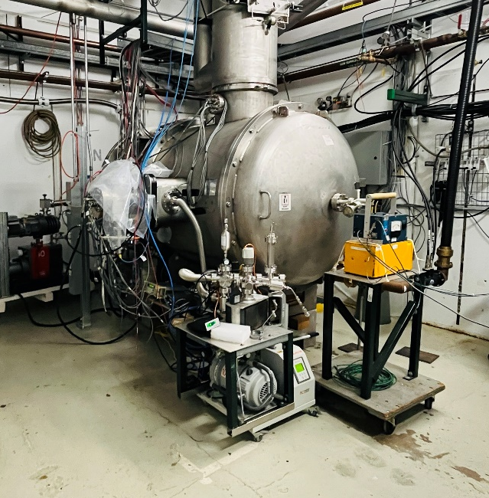
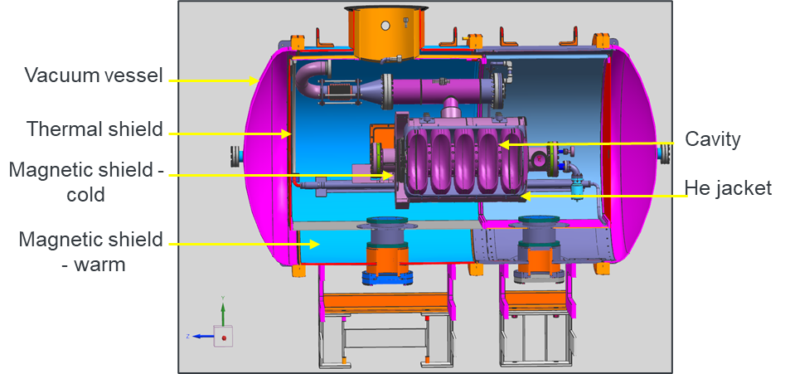
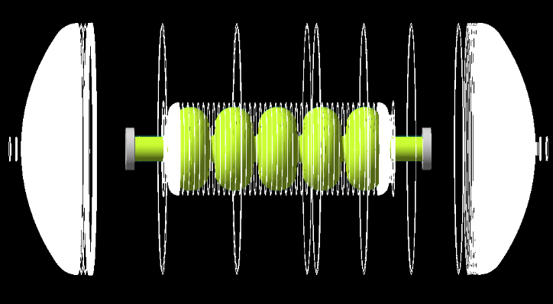
HB650 in STC - Geometry construction
The Fermilab Spoke Test Cryostat (STC) is used for testing SRF cavities for the PIP-II
The cryostat consists of several shielding layers of different materials and thicknesses
Fig. 04: Geant4 model of STC HB650 cavity assembly.
Fig. 02: STC test cave.
Fig. 03: CAD model of the STC HB650 cavity assembly.
Export geometry from Siemens NX, keeping shielding layers separate and fixing missing surfaces when possible.
Use Python + trimesh to slice the cleaned geometry and extract accurate z-r profiles.
Build the geometry in Geant4:
  G4Polycone for complex cylindrical-symmetric regions.
  G4Tubs for simple cylindrical sections.
 | Thickness [mm] | Material
Vacuum vessel | 12.7 | Stainless Steel
Magnetic shield | 1.6 | FeMnCrNi
Thermal shield | 4.8 | Al
Magnetic shield | 1.5 | FeMnCrNi
He jacket | 5.0 | Ti
Cavity | 4.0 | Nb
7

Slide 8
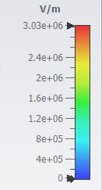
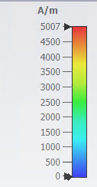
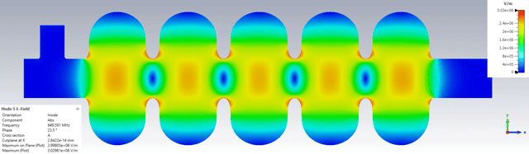
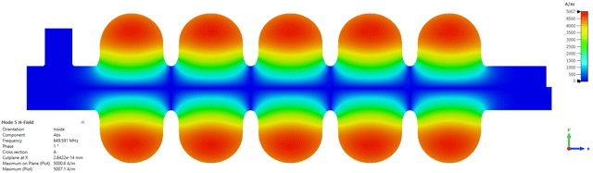
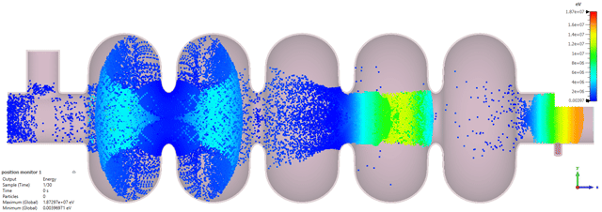
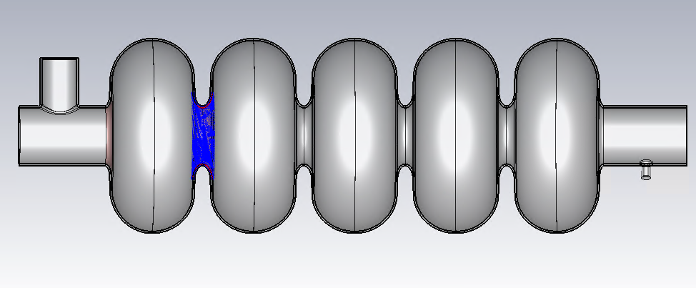
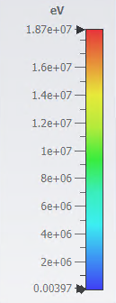



HB650 – Primary particle generation
1. Used CST eigenmode solver to simulate the electric and magnetic fields of the cavity
Fig. 5: Simulated electric and magnetic fields.
2. Used the CST PIC solver to simulate the field-emitted electron trajectories
1
2
3
4
5
6
Fig. 6: Particle source area - selected iris 2.
Fig. 7: Electron trajectories from the source particles in iris2.
The emission model chosen was field-induced emission; the coefficients of the following equation were determined by comparing with the Fowler-Nordheim equation
β_{FN} (field enhancement factor) = 100
ϕ (metal work function) = 4.3 eV for Nb
$$J=aE^{2}exp\left(\frac{−b}{E}\right)$$
$$a= 3.58×{10}^{−3}\frac{A}{V^{2}}$$
$$b=6.09×{10}^{8}\frac{V}{m}$$
Notes:
The PIC solver computes particle motion in self-consistent transient fields, making it more suitable for field-induced emission
Select 6 irises as below. Simulate each separately.
Import electromagnetic fields from the above eigen mode simulations and scale them to the operating Eacc = 18.8 MV/m

Slide 9
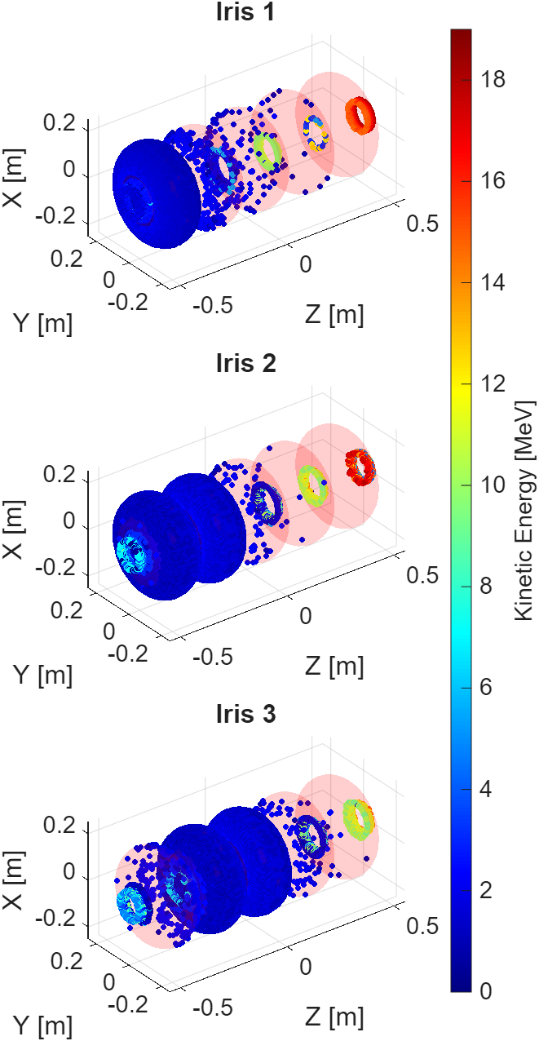
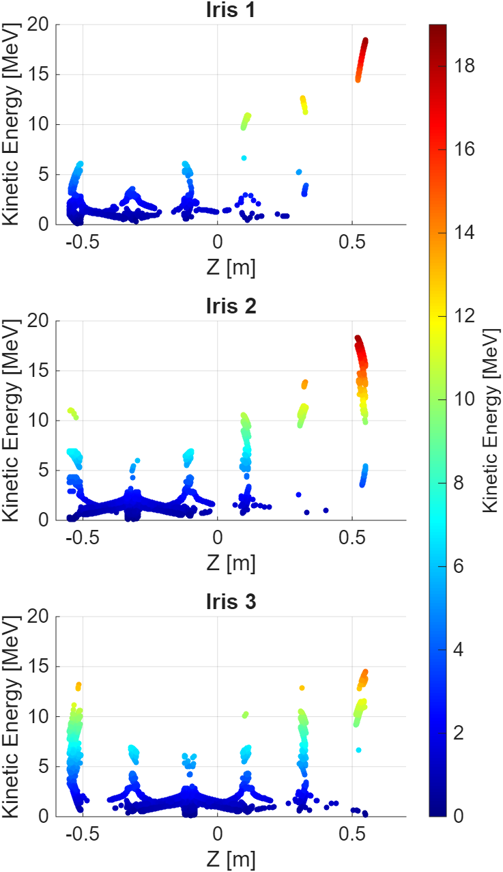
HB650 – Primary particle generation
3. Select particles impacting the cavity wall
Maximum energy reached by the impacted particles: ~ 19 MeV
Particles originating from irises 1-2 tend to reach their highest energy inside the cavity near irises 5-6
Particles from irises 5-6 reach their maximum energy in the opposite direction, peaking near the irises 1-2 region
Fig. 8: The position and energy distribution of electrons impacting the cavity surface.
Fig. 9: Particle energy along the cavity length.

Slide 10
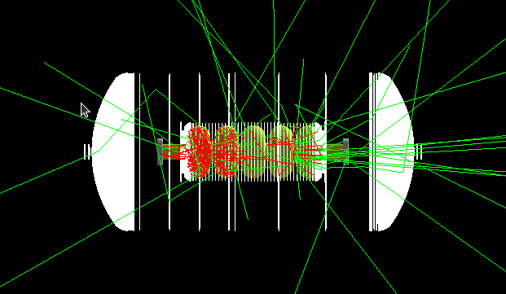
HB650 - Geant4 simulations
Geant4 is an open-source, Monte-Carlo-based toolkit used to simulate the transport and interaction of particles through matter
  Physics Processes: key physics processes of interest are bremsstrahlung, Compton scattering, and ionization
  Physics List: G4EmStandardPhysics_option4 used for high-accuracy modeling of low-energy EM interactions, including multiple scattering
  Tracking: continuously tracks both primary and secondary particles step-by-step until they are absorbed or escape into the world volume, recording all relevant information such as particle position, momentum, and energy
Electron trajectories
Gamma rays
Fig. 10: Particle shower generated by electrons impacting the cavity surface (from iris 2).
Notes:
Particles were tracked as they exited the cavity volume and reach 2 m

Slide 11
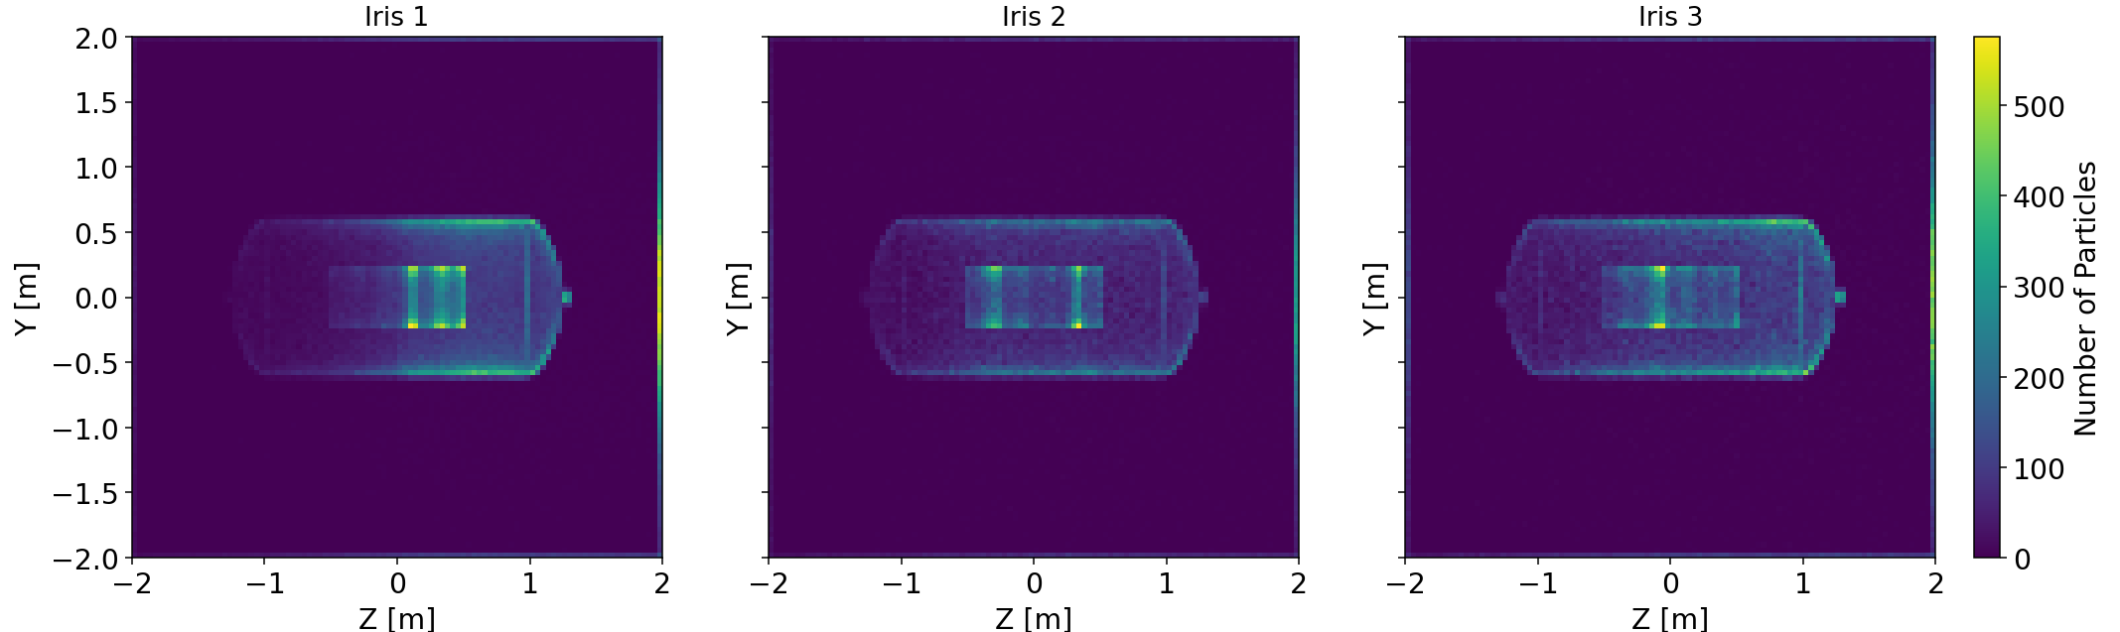
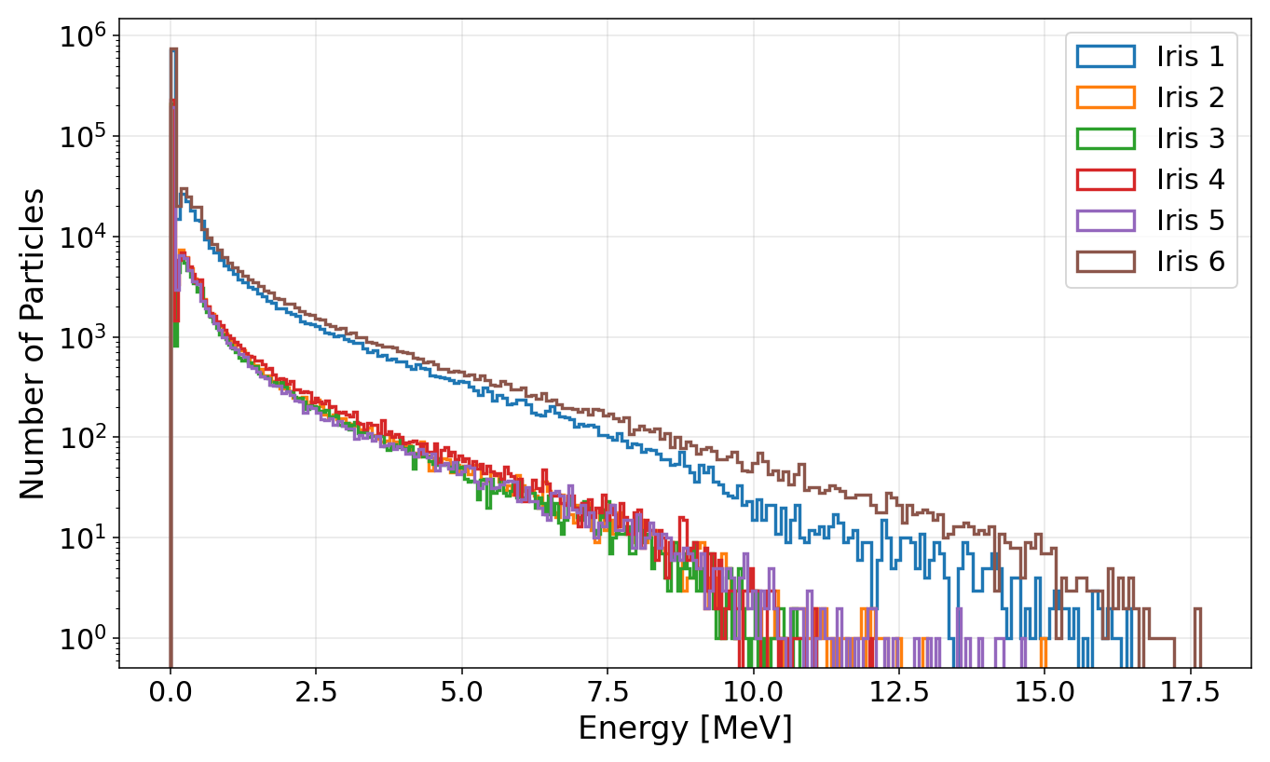
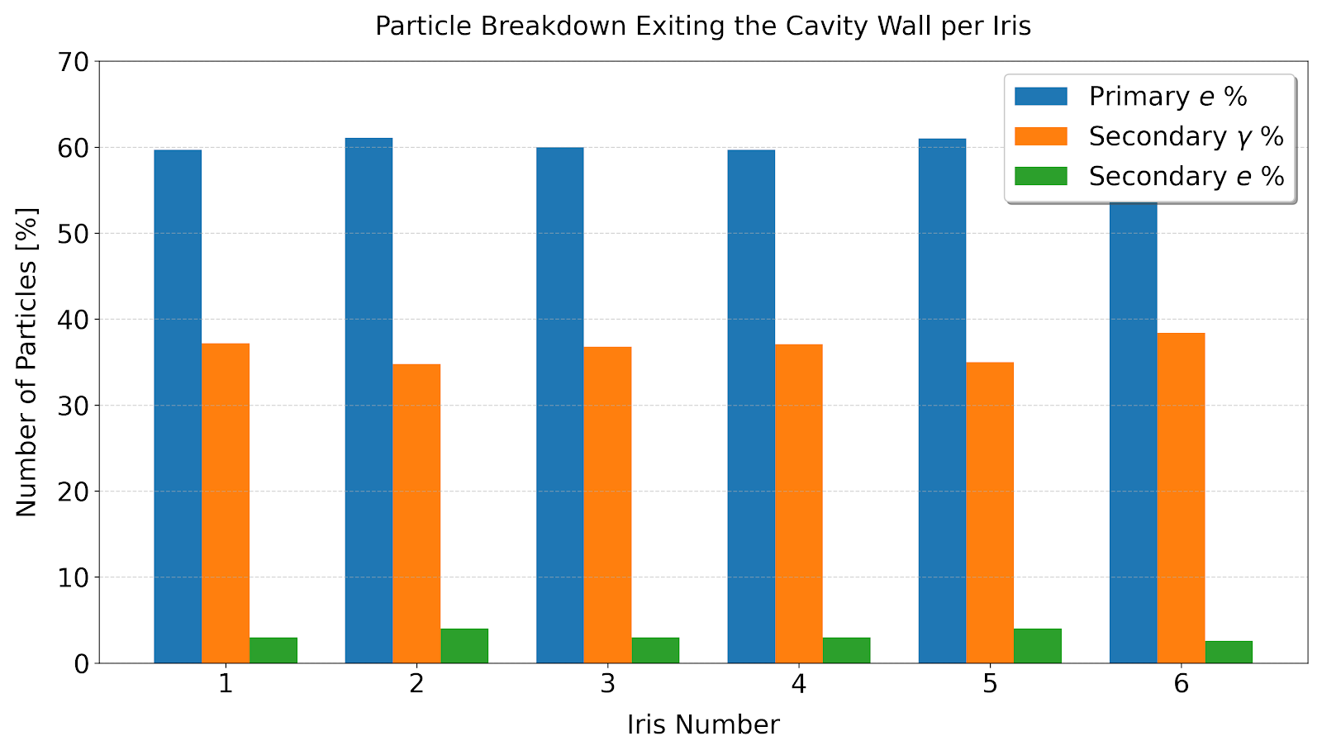
HB650 - Geant4 results analysis
Particles exiting the cavity wall
Fig. 11: Number of particles exiting the cavity wall visualization in the Y-Z plane.
Fig. 12: Energy distribution of the particles exiting the cavity wall.
The magnetic shield and vacuum vessel absorb most exiting particles, revealing the cavity cell structure in the particle distribution
Except for irises 1 and 6, most particles exit near their emission location before reaching maximum energy
Only a small fraction of exiting particles exceed 10 MeV, with most originating from irises 1 and 6
  Neutron production, if present, is therefore most likely associated with particle losses from irises 1 and 6
Fig. 13: Particle breakdown exiting the cavity volume.
Notes:
Most of the exiting particles are primary electrons, followed by primary gammas, and secondary electrons
We are interested particle energy higher than 10 MeV that will exit the vacuum

Slide 12
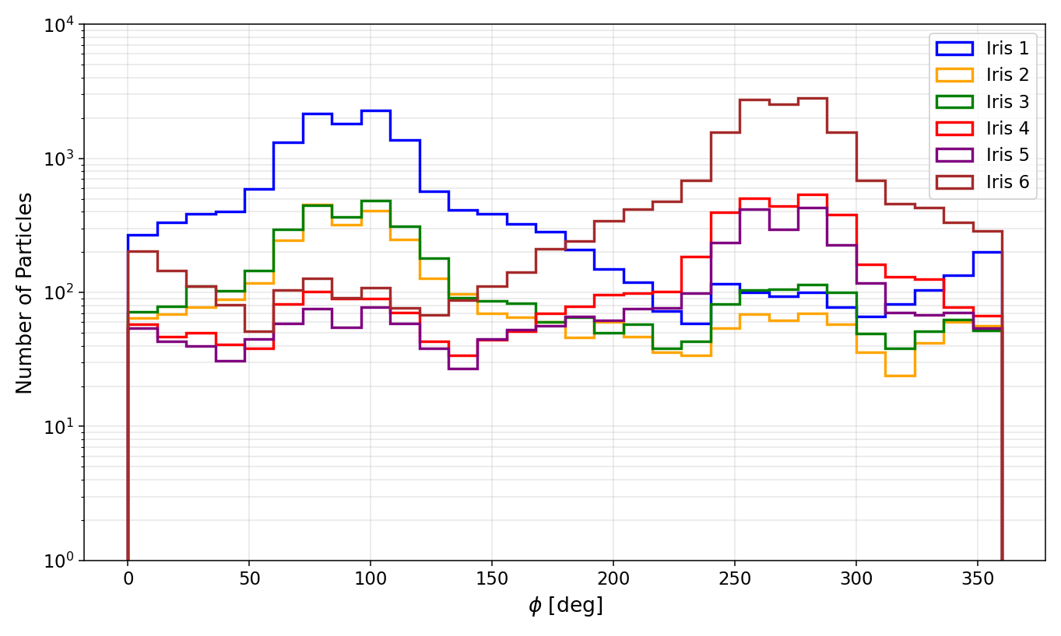
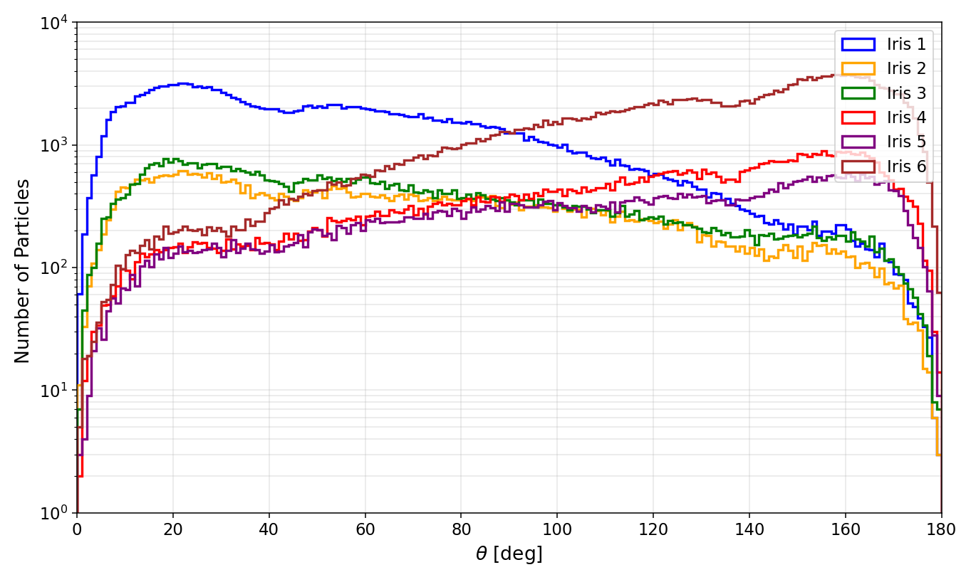
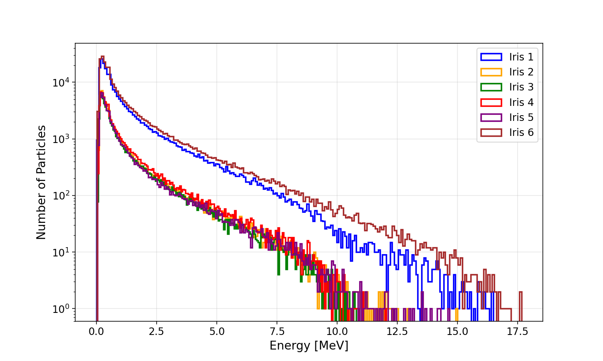
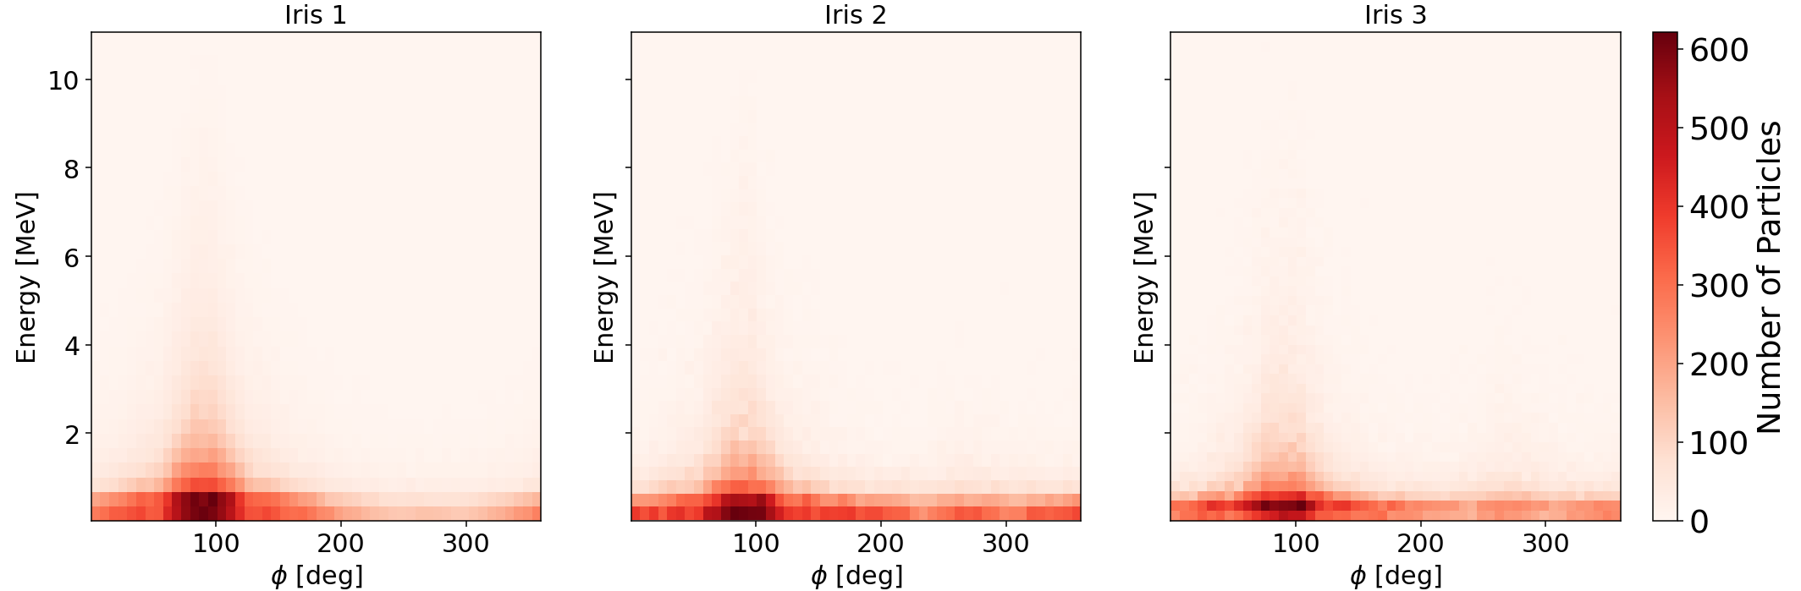

HB650 - Geant4 results analysis
Particles exiting the vacuum vessel
Φ = 90 ̊ = z+ direction
Φ = 270̊ = z- direction
y
θ = 0 ̊ = z+ direction
θ = 180̊ = z- direction
y
z
ρ $=\sqrt{x^{2}+y^{2}+z^{2}}$
θ
z
-x
φ
-x
Fig. 14: Particle distribution over phi angle (within y = ±10 cm).
Fig. 15: Particle distribution over theta angle.
Fig. 16: Energy distribution of particles over phi angle.
All particles escaping the vacuum vessel are gamma particles
Gamma particle trajectories exhibit a clear directional distribution
Fig. 17: Energy distribution of the particles exiting the vacuum vessel.
Notes:
With the overall higher energies of the escaping particles, a clear directional pattern appears in the gamma particles passing through the vacuum vessel
Consistent with the earlier arguments, particles originating from irises 1–3 show a strong peak in the +z direction, while those starting from irises 4–6 produce more particles traveling in the –z direction
The overall energy distributions reinforce this behavior

Slide 13
LB650 cavity

Slide 14
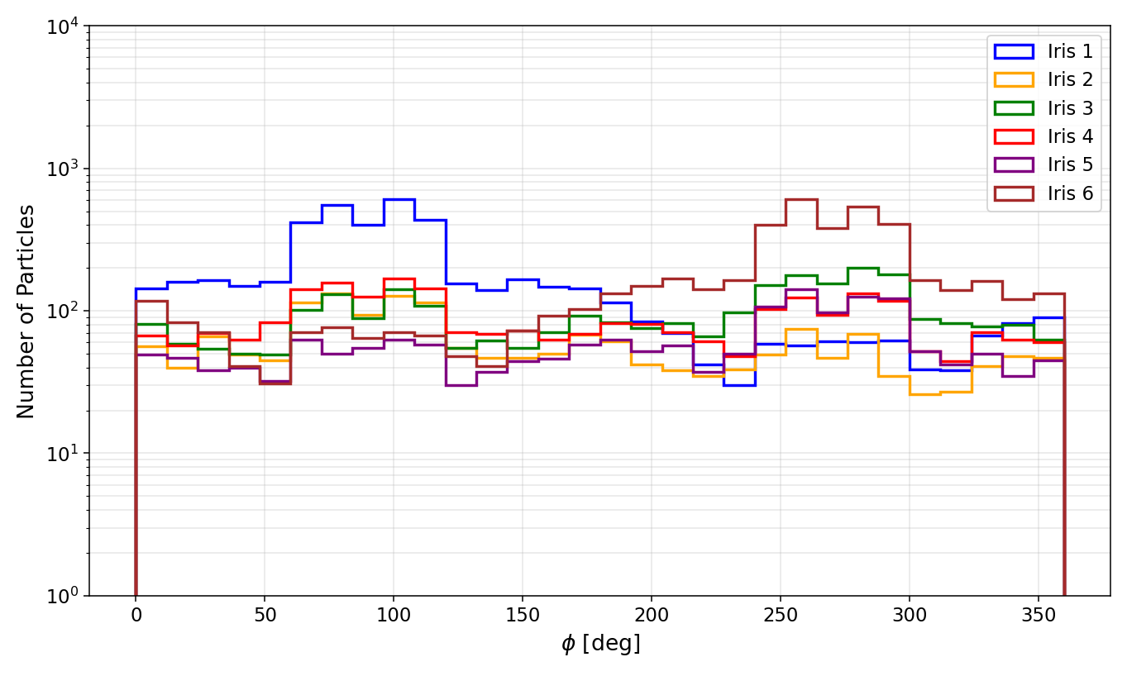
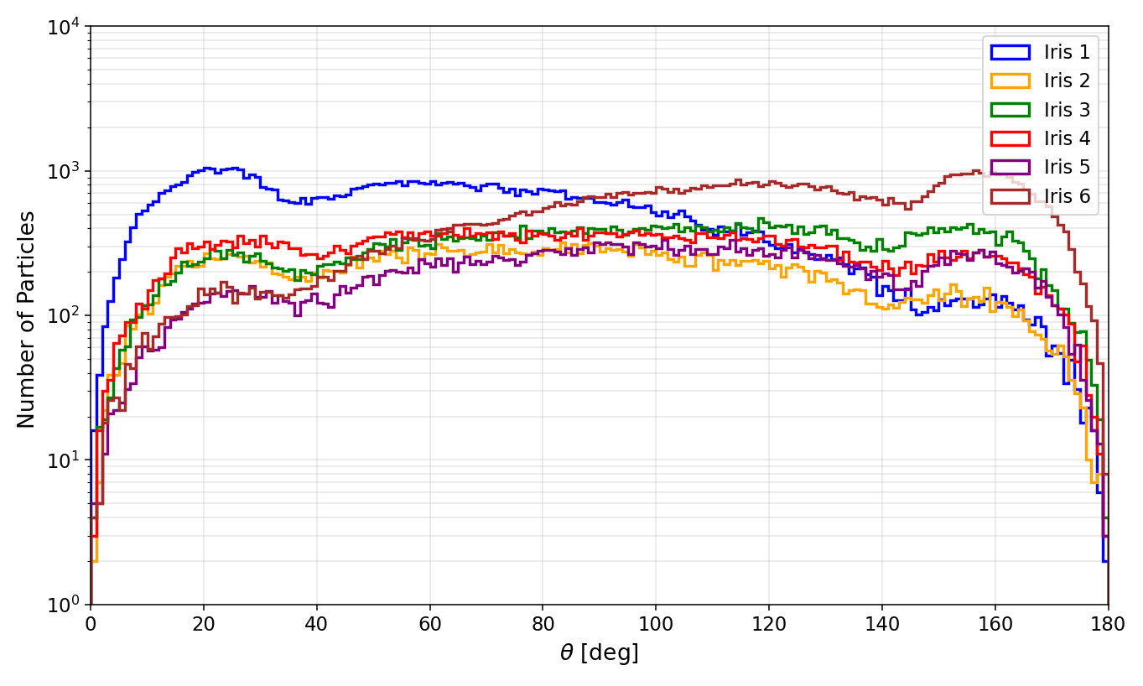
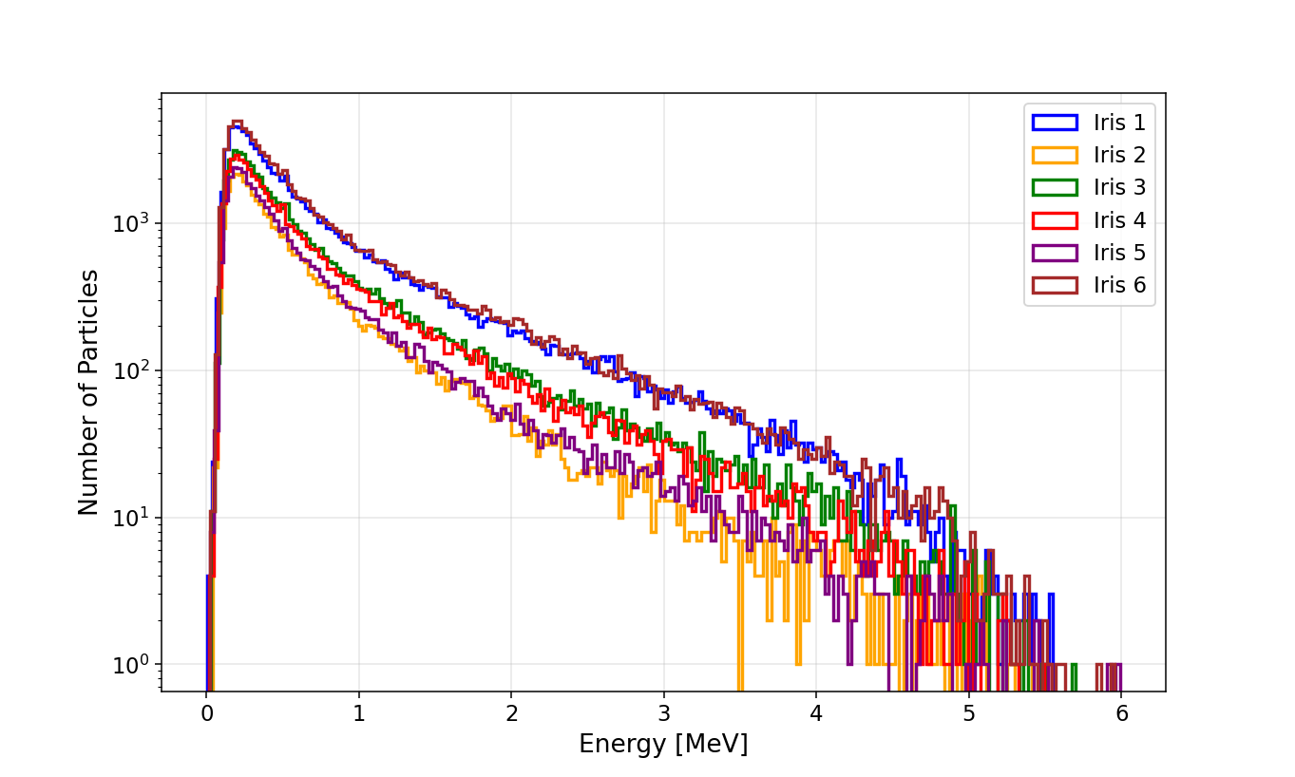
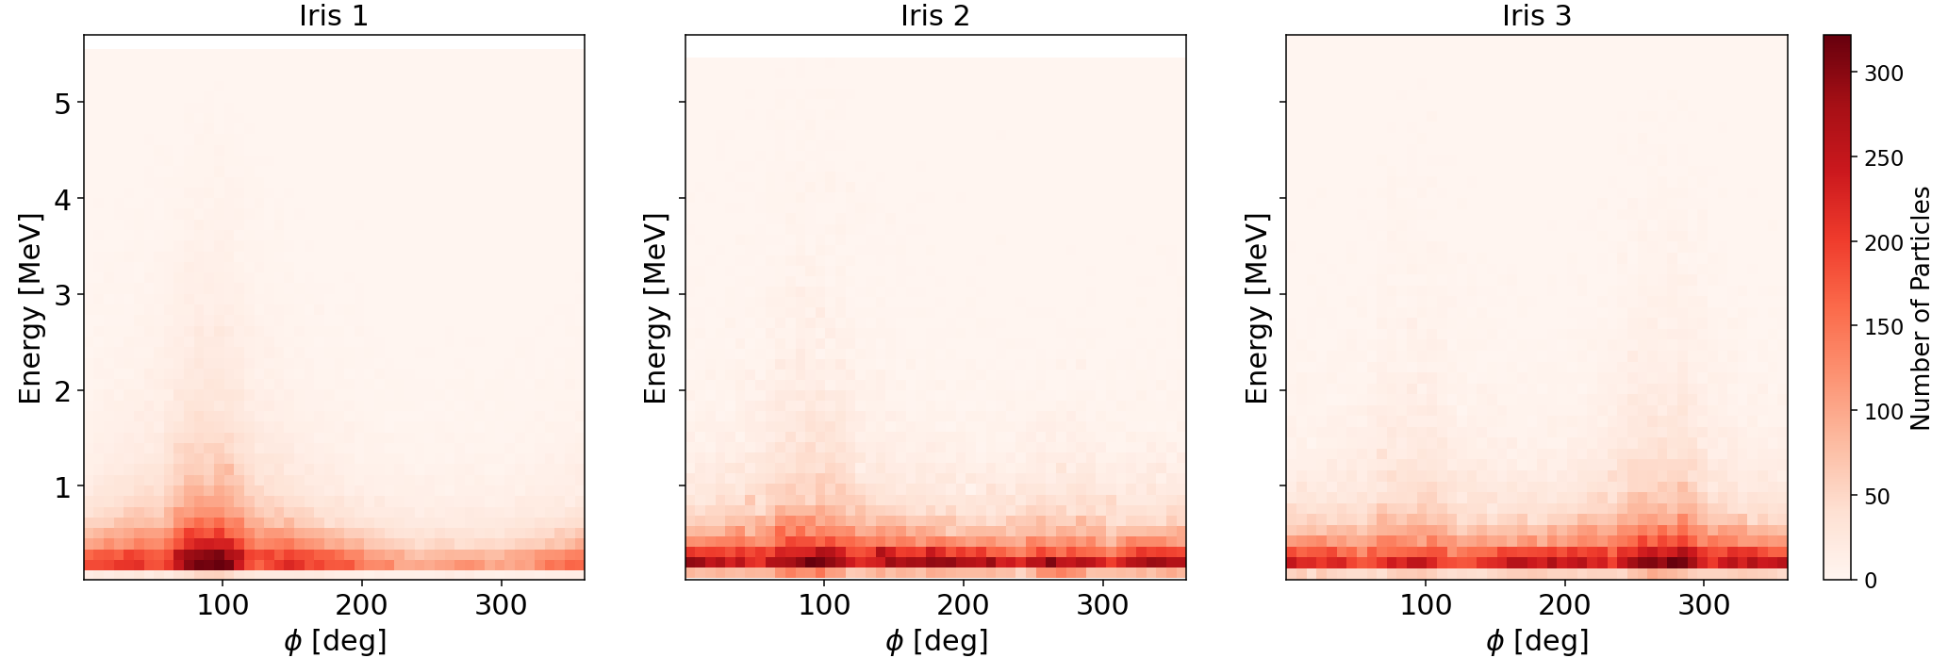
LB650 - Geant4 results analysis
Particles exiting the vacuum vessel
y
z
θ = 0 ̊ = z+ direction
θ = 180̊ = z- direction
y
Φ = 90 ̊ = z+ direction
Φ = 270̊ = z- direction
φ
-x
ρ $=\sqrt{x^{2}+y^{2}+z^{2}}$
θ
z
-x
Fig. 18: Particle distribution over phi angle (within y = ±10 cm).
Fig. 19: Particle distribution over theta angle.
Fig. 20: Energy distribution of particles over phi angle.
All particles escaping the vacuum vessel are gamma particles
Gamma particle trajectories exhibit a clear directional distribution
Fig. 21: Energy distribution of the particles exiting the vacuum vessel.

Slide 15
SSR2 cavity

Slide 16
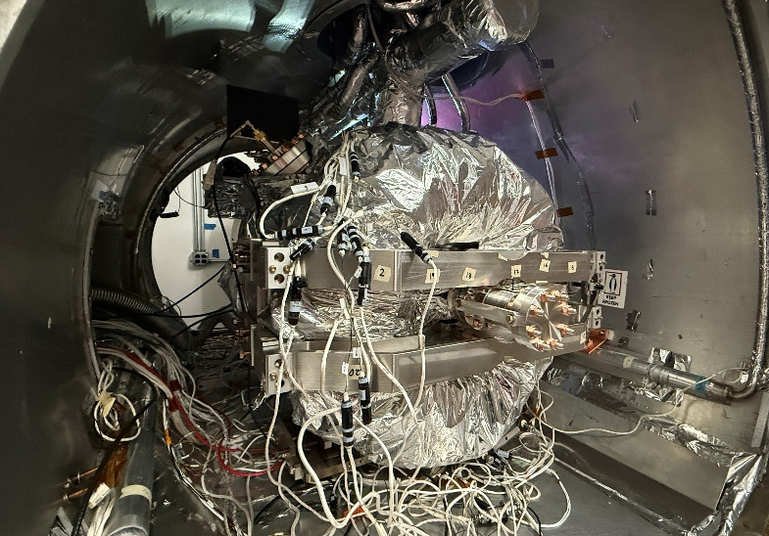
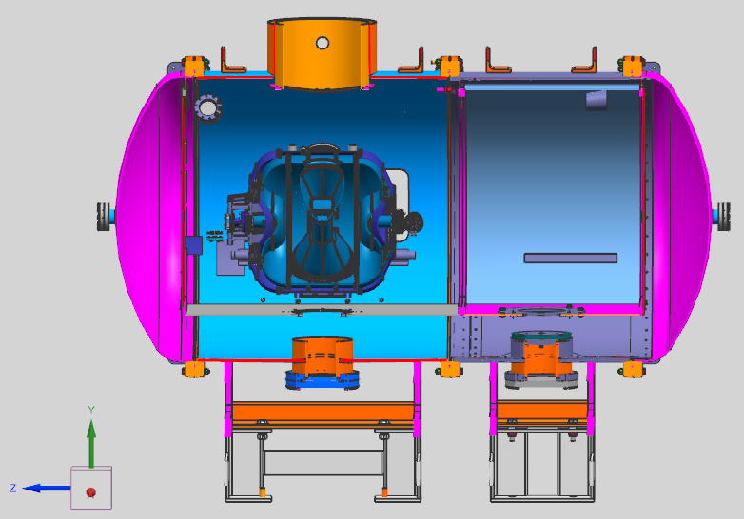
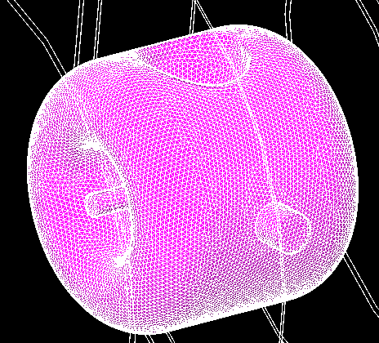
SSR2 in STC - Geometry construction
Vacuum vessel
Thermal shield
Cavity
He jacket
Magnetic shield
- warm
Fig. 22: STC SSR2 cavity assembly.
Fig. 23: CAD model of the STC SSR2 cavity assembly.
Fig. 24: Geant4 model of STC SSR2 cavity assembly.
Generate mesh files in STL format from STEP geometry files using Python with the gmsh library
Construct the geometry in Geant4 using CADMesh, which reads the STL file and represents the structure as a tessellated solid
 | Thickness [mm] | Material
Vacuum vessel | 12.7 | Stainless Steel
Magnetic shield | 1.6 | FeMnCrNi
Thermal shield | 4.8 | Al
He jacket | 4.0 | Ti
Cavity | 4.0 | Nb
Notes:
Assign outer wall materials and define inner vacuum regions for each layer.
Set the world volume as a 4 × 4 × 4 m³ cube.

Slide 17
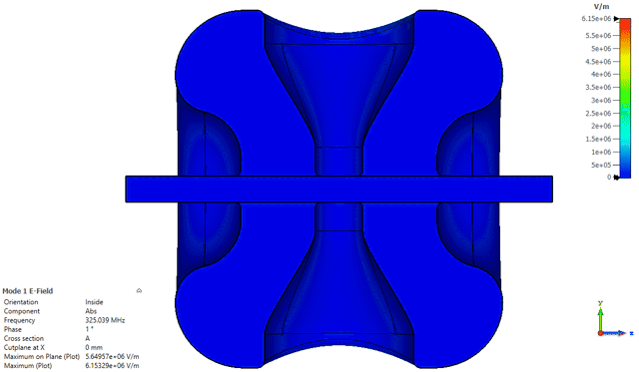
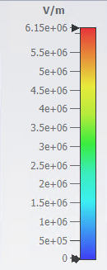
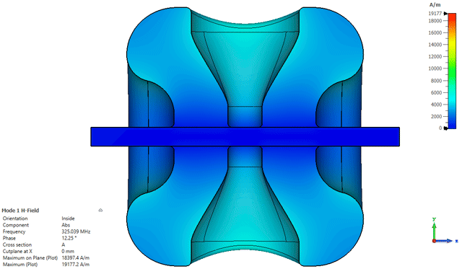
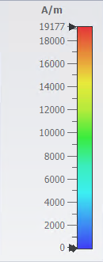
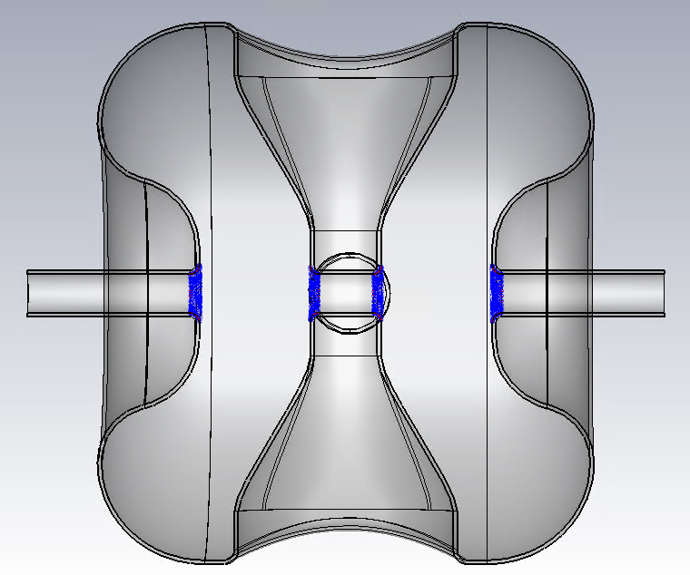
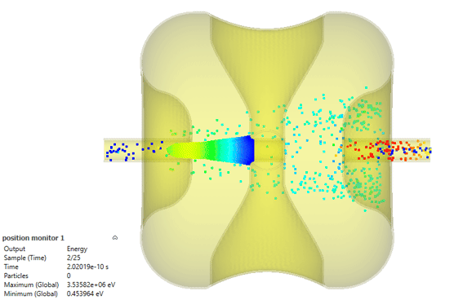
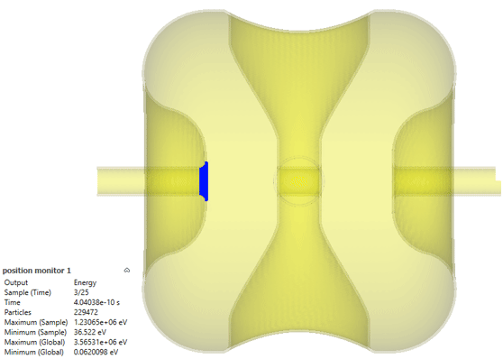
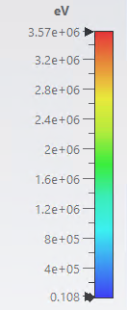
SSR2 - Primary particle generation
1. Used CST eigen mode solver to simulate the electric and magnetic fields of the cavity
Fig. 25: Simulated electric and magnetic fields.
2. Used the CST PIC solver to simulate the field-emitted electron trajectories
Iris 1
Iris 2
1
2
3
4
Fig. 26: Particle source area.
Fig. 27: Electron trajectories from the source particles.

Slide 18
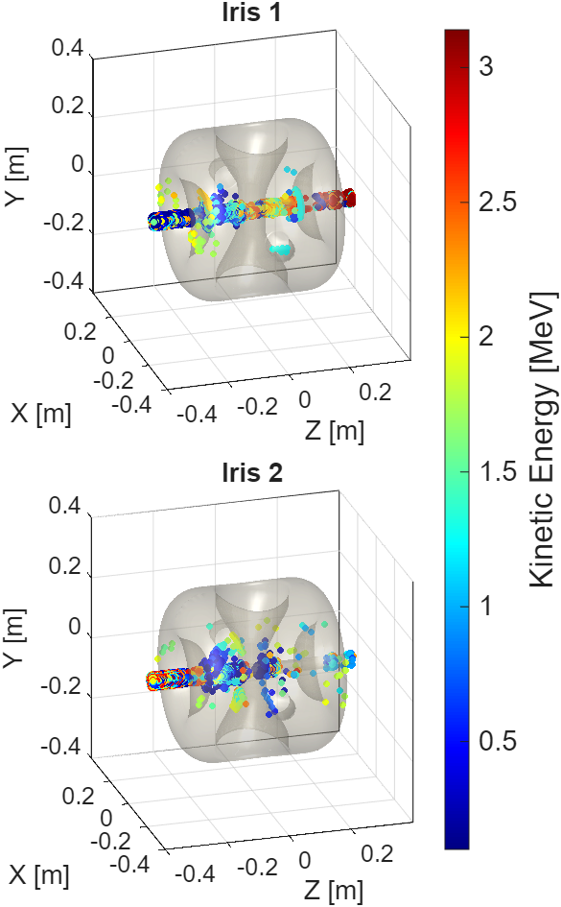
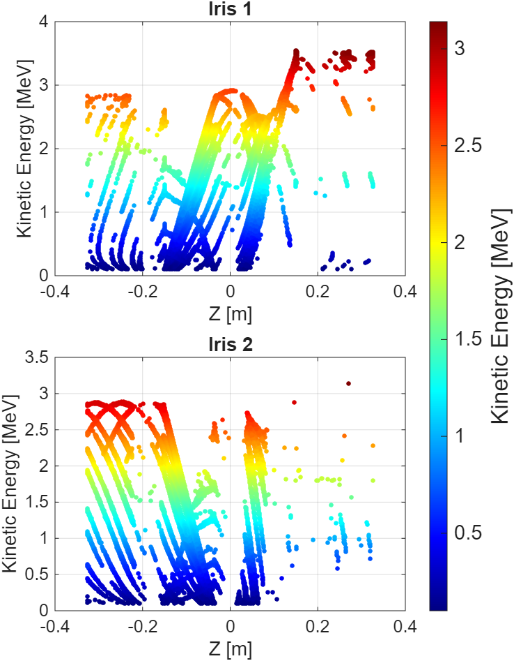
SSR2 - Primary particle generation
3. Select particles impacting the cavity wall
SSR2 cavity exhibits symmetry across the x-y plane (z=0)
The peak energy particles reach is ~3.6 MeV
Field-emitted particles originating from irises 1 and 3 are predominantly accelerated to higher energies toward the +z direction
Conversely, particles emitted from Irises 2 and 4 exhibit an opposite trend, gaining maximum kinetic energy toward the -z direction
Fig. 29: Particle energy along the cavity length.
Fig. 28: The position and energy distribution (in MeV) of electrons impacting the cavity surface.

Slide 19
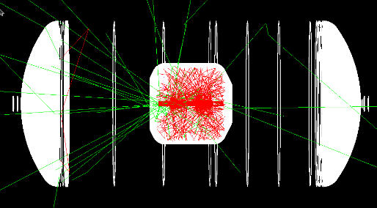
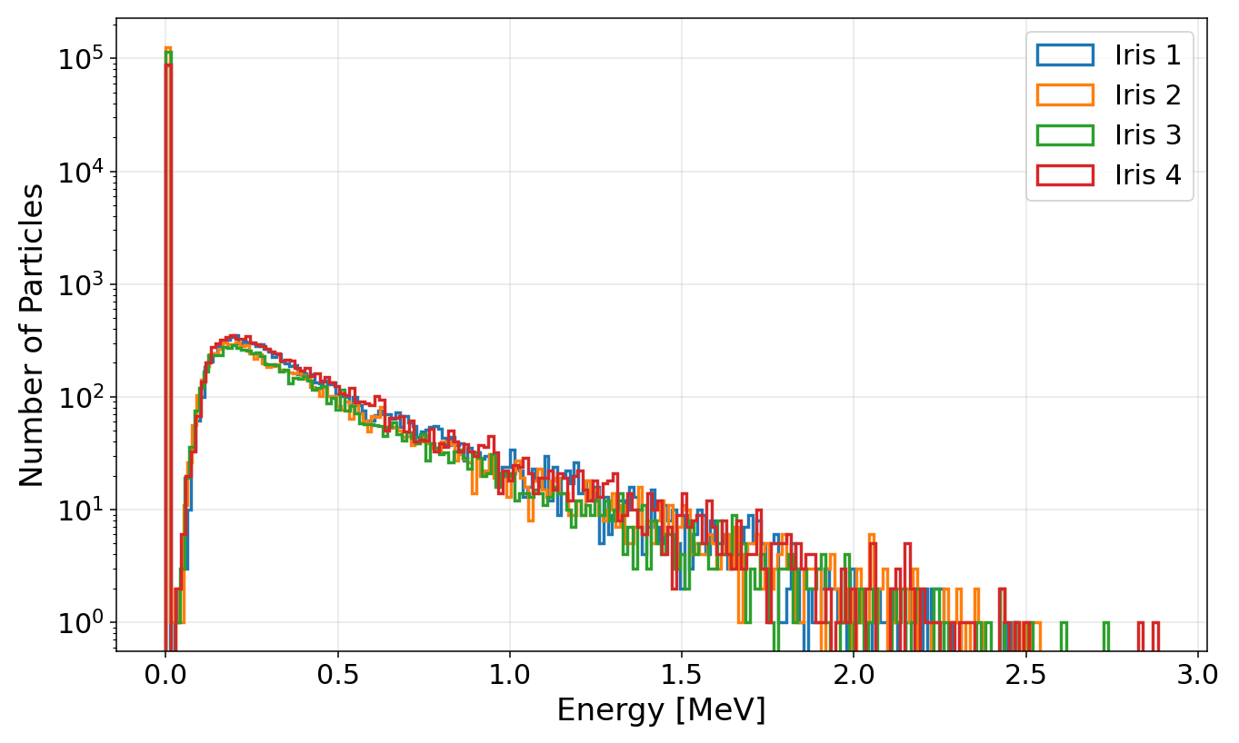
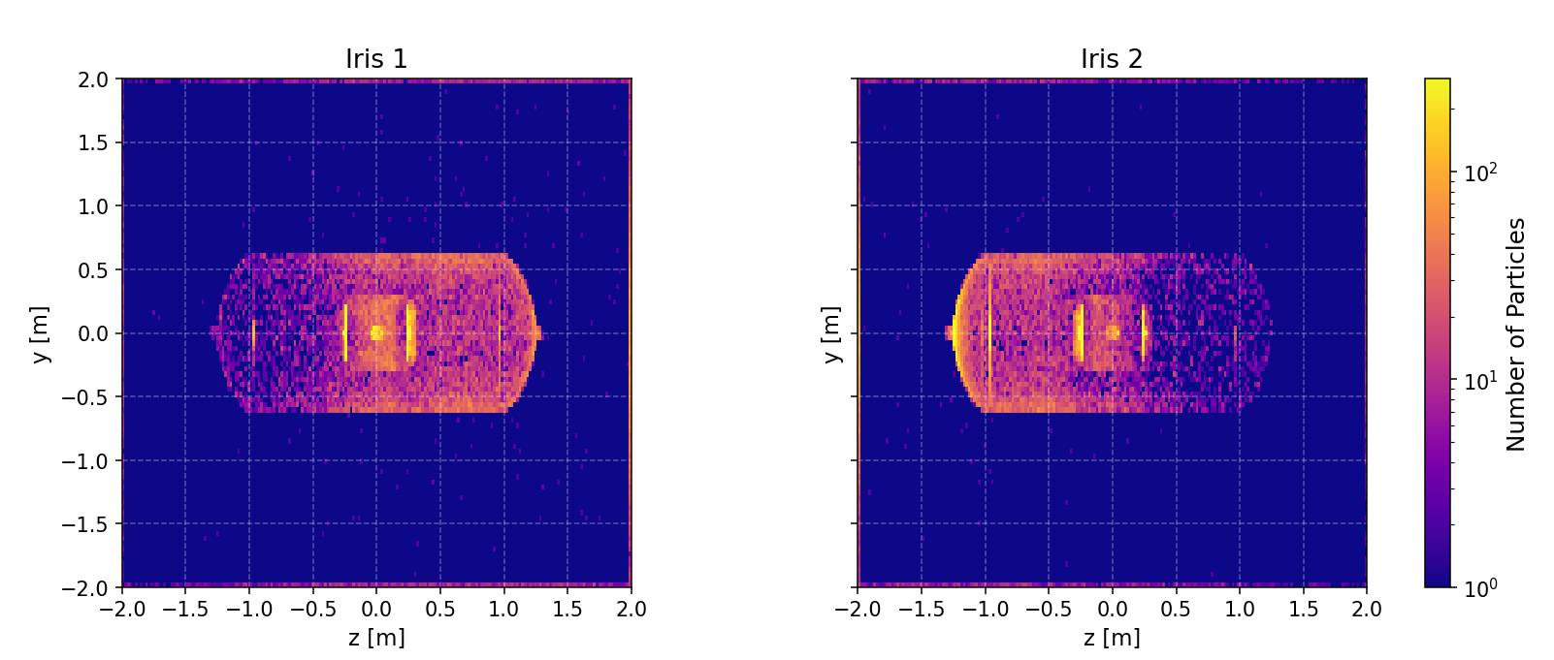
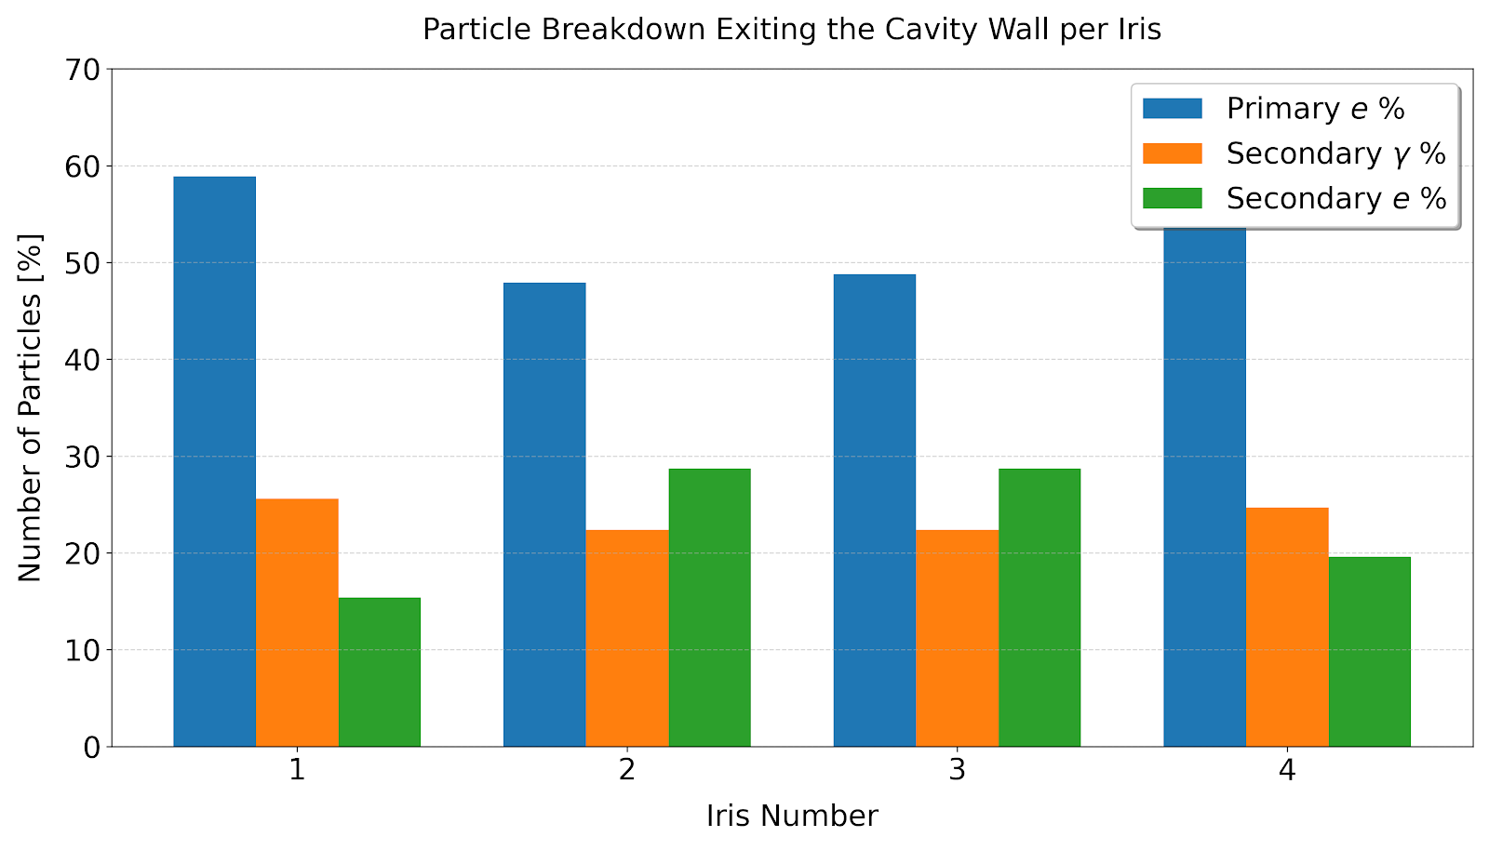
SSR2 - Geant4 results analysis
Particles exiting the cavity wall
Electron trajectories
Gamma rays
Fig. 30: Particle shower generated by electrons impacting the cavity surface (from iris 2).
Fig. 31: Energy distribution of the particles exiting the cavity wall.
Fig. 32: Number of particles exiting the cavity wall visualization in the Y-Z plane.
The He jacket and the surrounding vacuum vessel act as highly effective shields, absorbing most of the particles that escape the cavity
The energy distribution profile of the exiting particles remains consistent across all four irises.
Fig. 33: Particle breakdown exiting the cavity volume.
Notes:
Primary electrons constitute most of the particles exiting the cavity wall across all four irises, peaking at 58.9% for Iris 1. Secondary electrons and primary photons make up the remainder
The spectrum shows a sharp peak at very low energies < 0.1 MeV and gradually tapers off, with negligible particle counts extending up to ~ 2.5 to 3.0 MeV

Slide 20
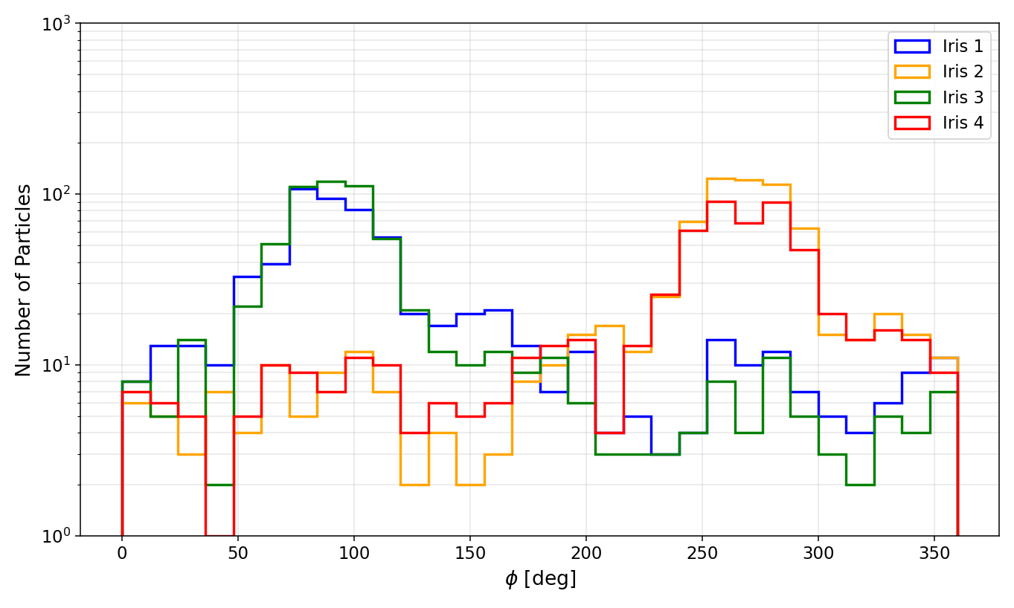
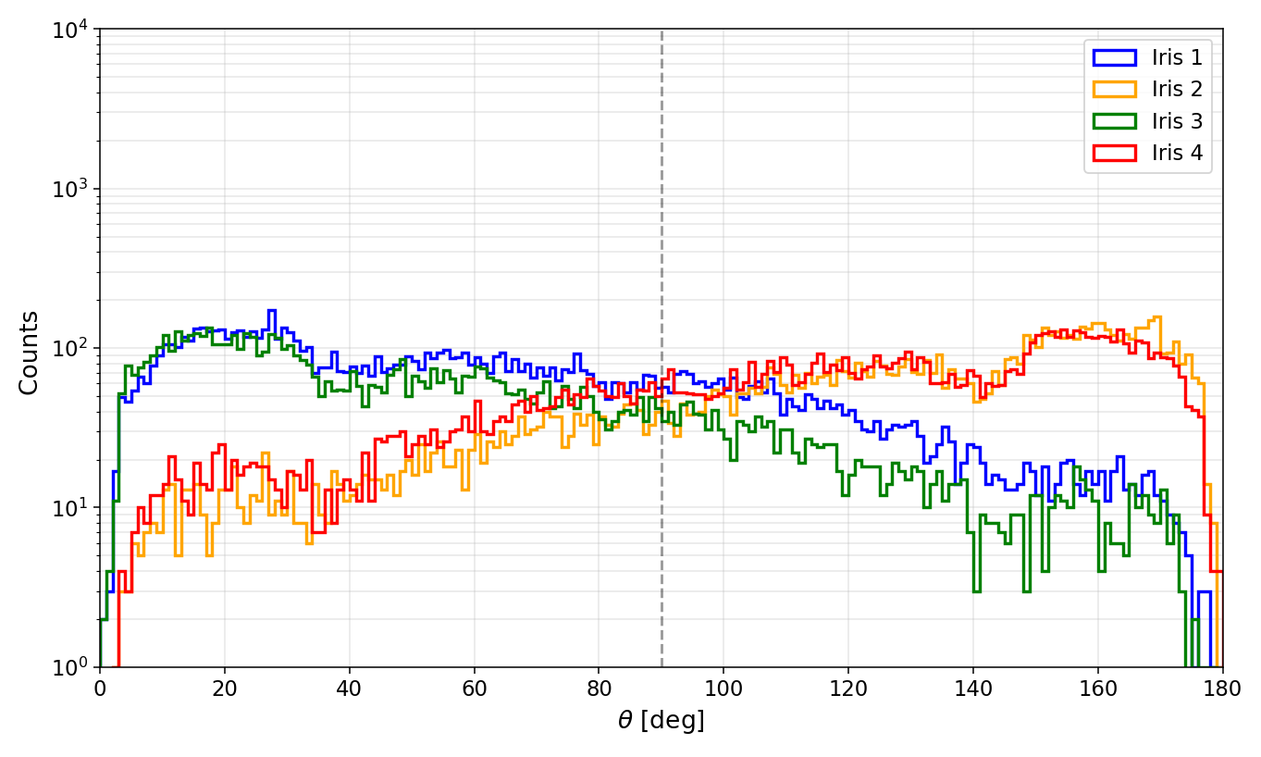


SSR2 - Geant4 results analysis
Particles exiting the vacuum vessel
Φ = 90 ̊ = z+ direction
Φ = 270̊ = z- direction
θ = 0 ̊ = z+ direction
θ = 180̊ = z- direction
y
z
y
ρ $=\sqrt{x^{2}+y^{2}+z^{2}}$
-x
φ
θ
z
-x
Fig. 34: Particle distribution over phi angle (within y = ±10 cm).
Fig. 35: Particle distribution over theta angle.
Fig. 36: Energy distribution of particles over phi angle.
All particles escaping the vacuum vessel are gamma particles
Gamma particle trajectories exhibit a clear directional distribution
Fig. 37: Energy distribution of the particles exiting the vacuum vessel.
Notes:
Particles originating from Irises 1 and 3 tend to reach their highest energy in the +z direction
Conversely, particles emitted from Irises 2 and 4 display the exact opposite kinematic behavior, reaching their maximum energy toward the –z direction
The overall energy distributions reinforce this behavior

Slide 21
SSR1 cavity

Slide 22



SSR1 - Geant4 results analysis
Particles exiting the vacuum vessel
Φ = 90 ̊ = z+ direction
Φ = 270̊ = z- direction
θ = 0 ̊ = z+ direction
θ = 180̊ = z- direction
y
y
z
ρ $=\sqrt{x^{2}+y^{2}+z^{2}}$
-x
φ
θ
z
-x
Fig. 38: Particle distribution over phi angle (within y = ±10 cm).
Fig. 39: Particle distribution over theta angle.
Fig. 40: Energy distribution of particles over phi angle.
All particles escaping the vacuum vessel are gamma particles
Gamma particle trajectories exhibit a clear directional distribution
Fig. 41: Energy distribution of the particles exiting the vacuum vessel.

Slide 23
Summary and Outlook
Summary
Developed a full CST - Geant4 simulation framework and performed systematic field emission studies across multiple iris locations, enabling analysis of radiation directionality across four PIP-II cavity types at STC.
Structural shielding absorbs most emitted particles, significantly limiting escape from the vacuum vessel.
Internal particle energy distributions strongly determine the observed radiation patterns.
  HB650 shows the highest particle energies, peaking near ~18 MeV. A non-negligible fraction of escaping particles exceeds 10 MeV, primarily originating from irises 1 and 6, making these locations the most likely contributors to neutron production. High-energy particles also exhibit clear directionality: irises 1-3 predominantly emit in +z, while irises 4-6 emit in −z.
  LB650 particle energy peaks near ~6 MeV, with no particles exceeding 10 MeV, indicating neutron production is unlikely. Irises 1-2 emit medium-energy particles toward +z, while irises 5-6 produce lower-energy particles toward −z.
  SSR2 and SSR1 particles reached energies up to ~3.5 MeV and ~1.5 MeV, respectively. In both cases, particles originating from irises 1 and 3 predominantly propagate in the +z direction, whereas those from irises 2 and 4 tend to accelerate toward the −z direction.
Outlook
Integrate radiation detectors into the Geant4 model and compare against STC measurements to improve diagnostics and optimize detector placement.
Notes:
Continue refining the simulation model by integrating the RF field into Geant4 and the analysis workflow.

Slide 24
Thank you!
Acknowledgment:
  Fermi Forward Discovery Group, LLC, under Contract No. 89243024CSC000002 with the U.S. Department of Energy, Office of Science, Office of High Energy Physics.

Slide 25
Backup

Slide 26


Radiation Monitors
Chipmunk detectors
Chipmunk radiation monitors at STC are used to measure radiation exiting the vacuum vessel
They are ion-chamber–based area monitors capable of detecting photons, charged particles, and non-thermal neutrons in both continuous and pulsed fields
Detection principle:
  Ionizing radiation creates charge in the ion chamber proportional to the absorbed dose.
  A zero-loss digitizing electrometer measures the charge and converts it to a signal.
Energy response:
  Low energies (<0.1 MeV): Reduced sensitivity; response is ~0.3 at 0.07 MeV.
  Intermediate energies (0.1–1 MeV): Response peaks around 0.1–0.2 MeV and stays close to the Co-60 reference (~1.0).
  High energies (>1 MeV): Response remains flat and slightly above the Co-60 reference.
Fig. 42: Chipmunk detector placed in front of the STC cave along the beam axis.
It would be more accurate to place radiation detectors inside the cryostat to better identify the source location, using scintillation detectors or cryogenic-compatible photodiodes.
Fig. 43: Photon energy vs response of chipmunk.
https://doi.org/10.1016/S0168-9002(02)01431-6.

Slide 27
Geant4
Geant4 is an open-source, Monte-Carlo–based toolkit used to simulate the transport and interaction of particles through matter
Geometry Construction: is hierarchically described through three base classes: solids (shape and dimensions), logical (material), and physical volumes (placement, orientation, and mother–daughter relationships)
  Geometry import options:
    CAD → GDML for direct geometry import
    CADMesh → loads triangular-mesh geometries (STL, PLY, OBJ)
    and converts them into G4TessellatedSolid objects
    G4Polycone → use for cylindrically symmetric models
Primary Particle: import position and energy distribution of field-emitted electrons impacting the cavity surface
Physics Processes: key physics processes of interest are bremsstrahlung, Compton scattering, and ionization
Physics List: G4EmStandardPhysics_option4 used for high-accuracy modeling of low-energy EM interactions, including multiple scattering
Tracking: continuously tracks both primary and secondary particles step-by-step until they are absorbed or escape into the world volume, recording all relevant information such as particle position, momentum, and energy
CAD models should be watertight, have correct facet orientation, no overlaps, etc.

Slide 28
HB650 – Geant4 results analysis
y
x
z
Particles exiting the vacuum vessel
Φ = 90 ̊ = z+ direction
Φ = 270̊ = z- direction
y
z
-x
φ
Fig. 14: Energy distribution of particles over phi angle.
Fig. 13: Particle distribution over phi angle (within y = ±10 cm).
With the overall higher energies of the escaping particles, a clear directional pattern appears in the gamma particles passing through the vacuum vessel
Consistent with the earlier arguments, particles originating from irises 1–3 show a strong peak in the +z direction, while those starting from irises 4–6 produce more particles traveling in the –z direction
The overall energy distributions reinforce this behavior
Fig. 15: Energy distribution of the particles exiting the vacuum vessel.

Slide 29


HB650 – Primary particle generation
3. Select particles impacting the cavity wall
Fig. 9: Particle energy along the cavity length.
Maximum energy reached by the impacted particles: ~ 19 MeV
Particles originating from irises 1–2 tend to reach their highest energy inside the cavity near irises 5–6
Likewise, particles from irises 5–6 reach their maximum energy in the opposite direction, peaking near the irises 1–2 region due to the same symmetry and phase behavior
Fig. 8: The position and energy distribution (in MeV) of electrons impacting the cavity surface.

Slide 30


LB650 – Primary particle generation
3. Select particles impacting the cavity wall
Maximum energy reached by the impacted particles: ~ 6 MeV
Fig. 17: Particle energy along the cavity length.
Because the cavity fields are symmetric, particles can accelerate in both the +z and –z directions depending on their emission phase
However, particles originating from irises 1–3 tend to reach their highest energy inside the cavity near irises 4–5
Likewise, particles from irises 5–6 reach their maximum energy in the opposite direction, peaking near the irises 2–3 region due to the same symmetry and phase behavior
Fig. 16: The position and energy distribution (in MeV) of electrons impacting the cavity surface.

Slide 31



LB650 – Geant4 results analysis
Particles exiting the cavity wall
Fig. 18: Number of particles exiting the cavity wall visualization in the Y-Z plane.
The cold magnetic shield and vacuum vessel absorb most particles exiting the cavity, making the cavity cell structure clearly visible
Except for irises 1 and 6, most exiting particles escape near their source as many low-energy particles leave the cavity before reaching maximum energy
A large fraction of particles have energies around 0.1 MeV, while only ~0.02% retain energy more than 5 MeV
Most exiting particles are primary electrons, followed by primary gammas and secondary electrons
Fig. 19: Energy distribution of the particles exiting the cavity wall.
Fig. 12: Particle breakdown exiting the cavity volume.

Slide 32










SSR1 – Primary particle generation
1. Used CST eigen mode solver to simulate the electric and magnetic fields of the cavity
Fig. 36: Simulated electric and magnetic fields.
2. Used the CST PIC solver to simulate the field-emitted electron trajectories
Iris 1
Iris 2
1
2
3
4
Iris 3
Iris 4
Fig. 37: Particle source area.
Fig. 38: Electron trajectories from the source particles.

Slide 33


SSR1 – Primary particle generation
3. Select particles impacting the cavity wall
SSR1 cavity also exhibits symmetry across the x-y plane (z=0)
The peak energy particles reach is ~1.5 MeV
Field-emitted particles originating from irises 1 and 3 are predominantly accelerated to higher energies toward the +z direction
Conversely, particles emitted from Irises 2 and 4 exhibit an opposite trend, gaining maximum kinetic energy toward the -z direction
Fig. 39: The position and energy distribution (in MeV) of electrons impacting the cavity surface.
Fig. 40: Particle energy along the cavity length.

Slide 34



SSR1 – Geant4 results analysis
Particles exiting the cavity wall
Fig. 41: Number of particles exiting the cavity wall visualization in the Y-Z plane and X-Y plane.
Fig. 42: Energy distribution of the particles exiting the cavity wall.
The He jacket and the surrounding vacuum vessel act as highly effective shields, absorbing most of the particles that manage to escape the cavity
The energy distribution profiles across all irises match closely, peaking sharply near 0.1 MeV and dropping off entirely past 1.2 MeV
Fig. 12: Particle breakdown exiting the cavity volume.

Slide 35

Neutron Production

Slide 36

Path to calculate radiation
$Rem= \frac{N.E.f.k}{m}$ . Q
Energy Total: Multiply photon count (N) by energy per photon (E) in MeV and conversion constant (k).
Absorbed Dose: Divide total energy by tissue mass (m) in kg to find the energy deposited per unit mass.
Biological Weighting: Multiply by Quality Factor (Q). For gamma rays, Q = 1, making 1 Rad = 1 Rem.
  N: Number of photons
  E: Energy (MeV)
  f: Absorption %
  m: Tissue Mass (kg)
  k: 1.602e-13 J/MeV
  Q: Quality Factor (1.0

