Slide 1
Now and future automatic clean assembly of SRF cavity
Hao Guo, Teng Tan, Wentao Ji (Institute of Modern Physics, CAS)
Shuai Wang (Dongguan University of Technology)
Chenzhang Yuan, Binbin Yong (Lanzhou University)
Xiaoyu Huang, Rihua Zheng (Advanced Energy Science and Technology Guangdong Laboratory)
June 9-12, 2026, France
Notes:
Good afternoon everyone.
My name is Hao Guo from the Institute of Modern Physics, Chinese Academy of Sciences.
It is a great pleasure to present our recent work on the automation of SRF cavity clean assembly, as well as our thoughts on future.
This work is the result of collaborations among several institutes and universities in China, and I would like to thank all of our collaborators for their support.
As we all know, SRF cavity assembly requires extremely high cleanliness standards. At the same time, many assembly procedures are repetitive, labor-intensive, and highly dependent on operator experience.
For this reason, we have been developed the heavy-load clean automatic technique.

Slide 2
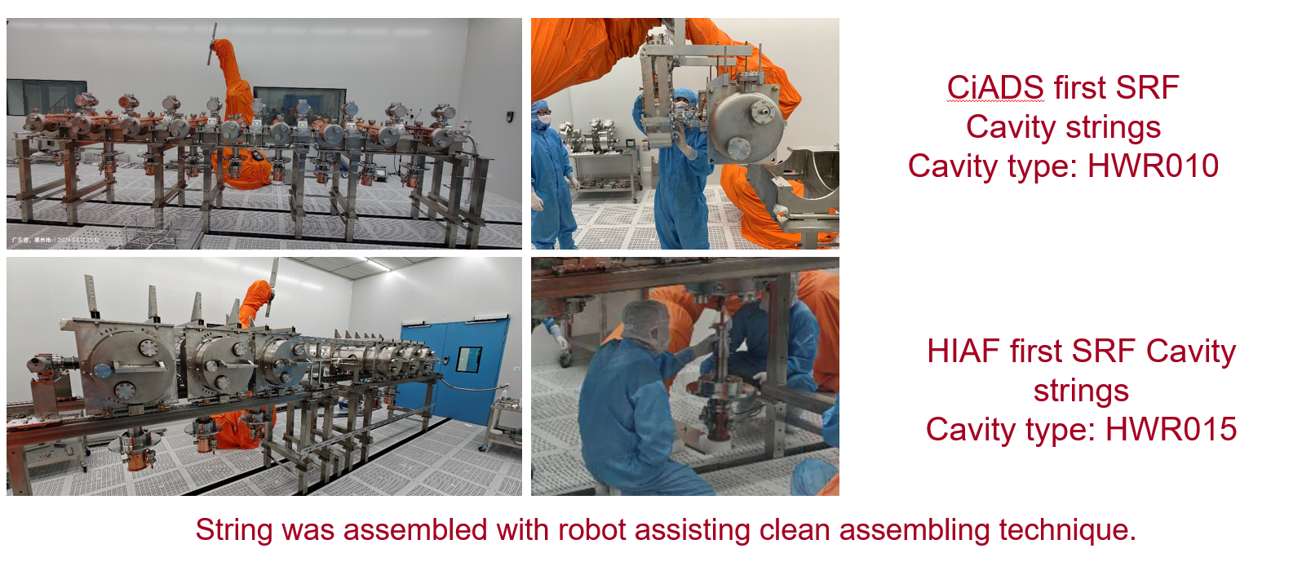
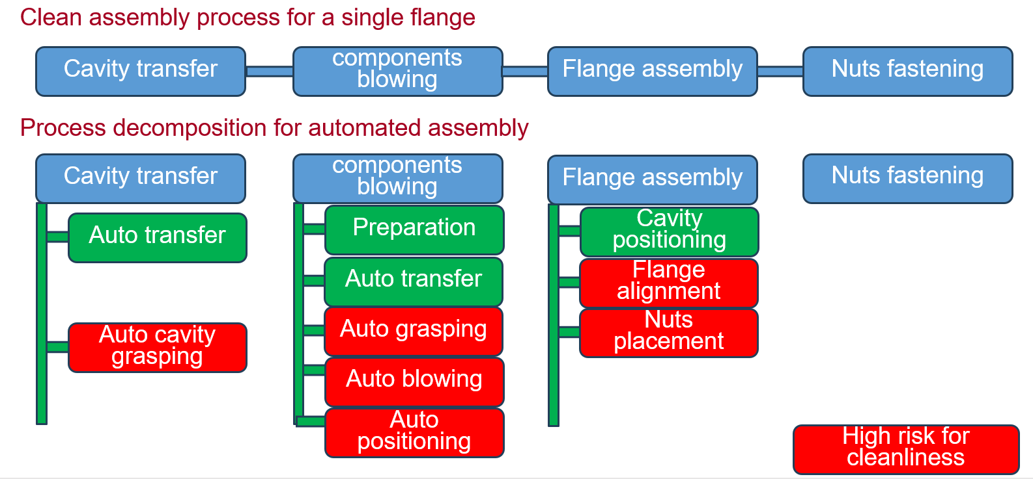
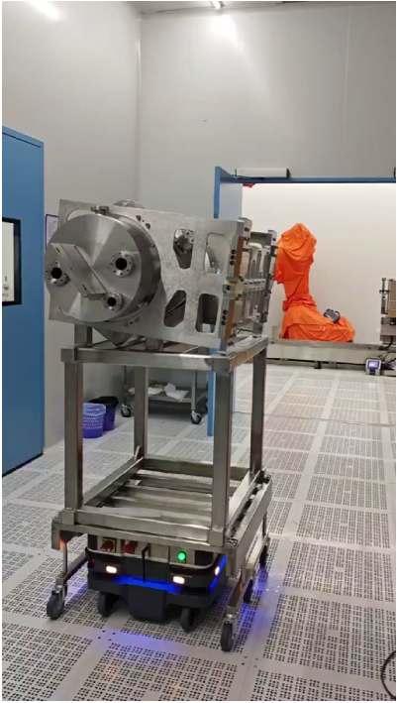
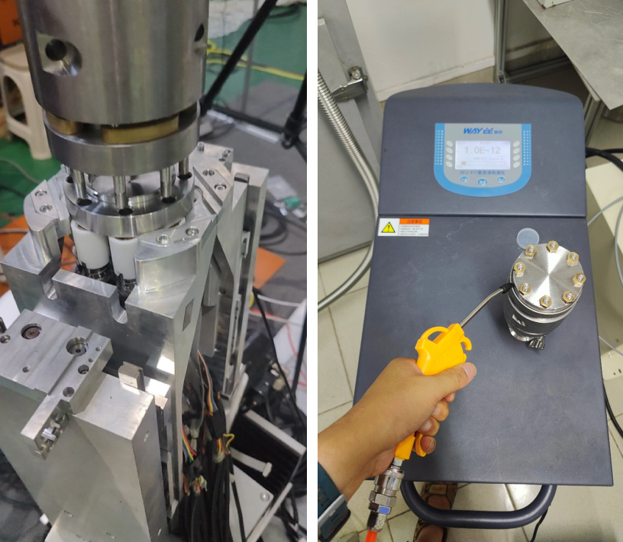
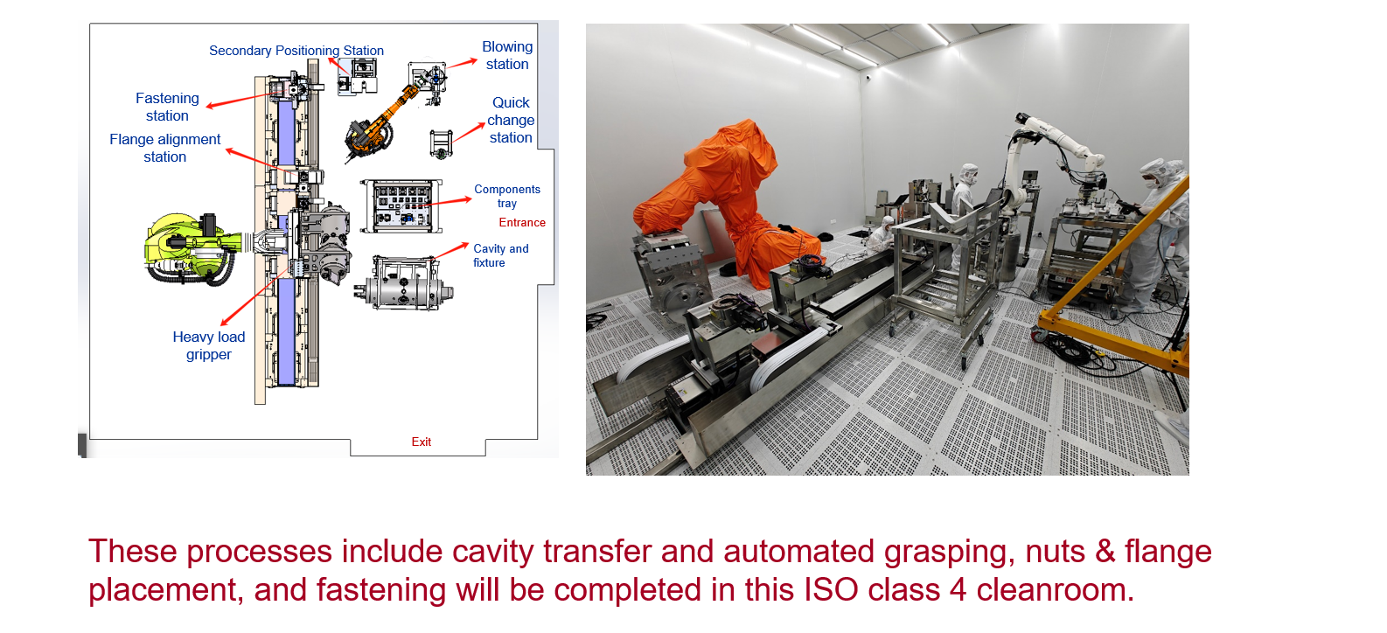
Previous works on automatic in cleanroom
Robot assisting clean assembly
Clean assembly process decomposition
Constructed an automated assembly test platform
Single-process automation test
Notes:
Let me begin with some background.
Our interest in automated clean assembly started several years ago.
At that time, our primary goal was not to automate the entire process immediately, but rather to understand the assembly workflow in detail.
We decomposed the clean assembly procedure into a series of individual operations and evaluated which tasks could potentially be performed by robotic systems.
Based on this work, we built an automated assembly test platform and carried out a number of single-process automation studies.
These early investigations provided valuable experience and laid the foundation for the integrated system that I will show next.

Slide 3
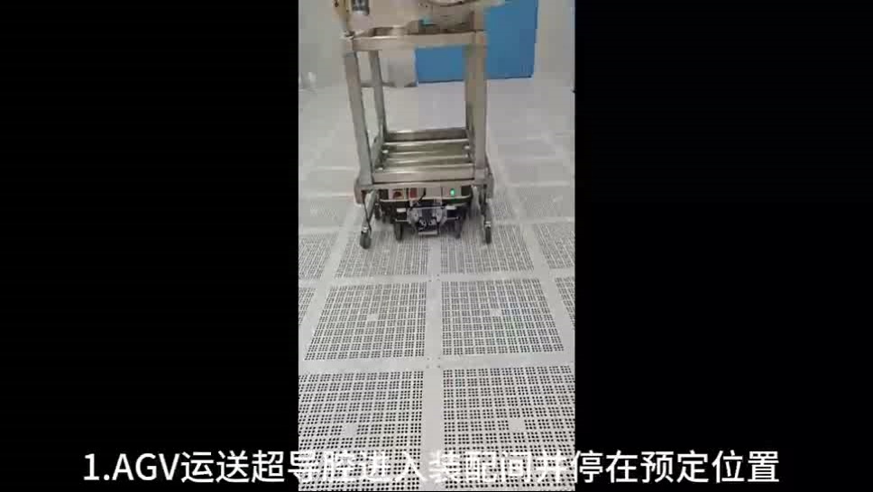
NOW works on automatic in cleanroom
Complete the automation operation on one flange.
Cavity transfer
Cavity grasping
Components blowing & positioning
Flange assembly
The full automated process runs for over one hour in total.
Notes:
Now we linked all the single-process into together, and one cavity flange can be assembly automatically in this video.
The system performs cavity transfer, cavity grasping, component handling, positioning, and flange assembly in this video.

Slide 4
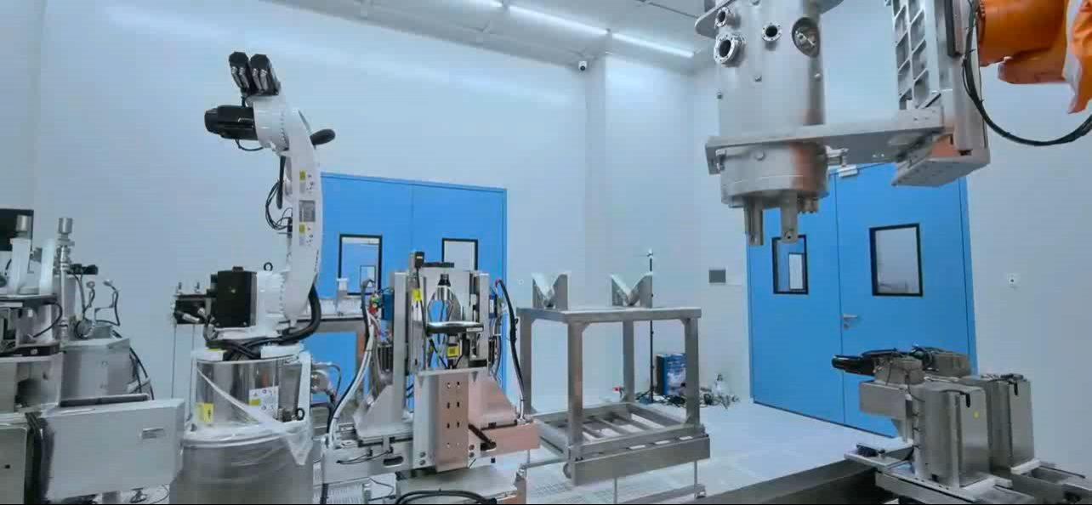
NOW works on automatic in cleanroom
Complete the automation operation on one flange.
Nuts fastening by two tightening spindles
The full automated process runs for over one hour in total.
Notes:
After flange assembly, the process continues with automatic nut fastening. And this video show how nuts could be fastening automatically.
Although fastening may appear straightforward, it actually requires precise positioning and consistent force control.
The successful completion of this step demonstrates that automation can cover not only handling operations but also precision assembly tasks.
Each video has been sped up by more than ten times
At present, the complete automated procedure takes slightly more than one hour to finish a flange assembly.

Slide 5
Considerations for Automated Processes
1. Which process is best suited for automation replacement and delivers the greatest benefits?
2. As AI technology evolves, what enhancements can it deliver to assembly operations within cleanrooms?
Notes:
After completing these demonstrations, we began asking ourselves two important questions.
The first question is:
Which process is best suited for automation replacement and delivers the greatest benefits?
The second question is:
As AI technology evolves, what enhancements can it deliver to assembly operations within cleanrooms?
The remainder of this presentation focuses on these two questions.

Slide 6
Considerations for Automated Processes
1. Which process is best suited for automation replacement and delivers the greatest benefits?
2. As AI technology evolves, what enhancements can it deliver to assembly operations within cleanrooms?
Notes:
Next we try to answer the first question.

Slide 7
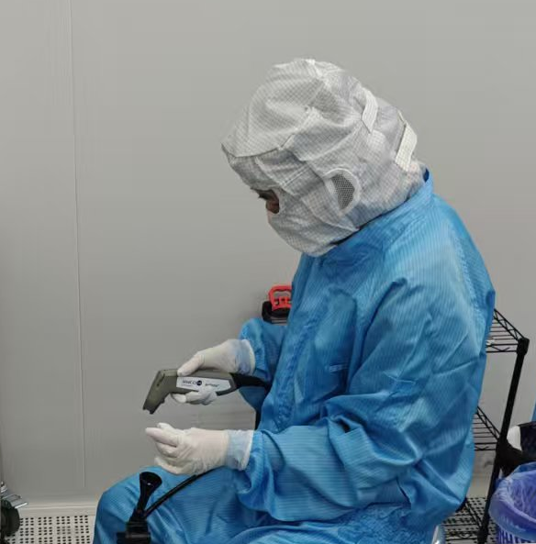
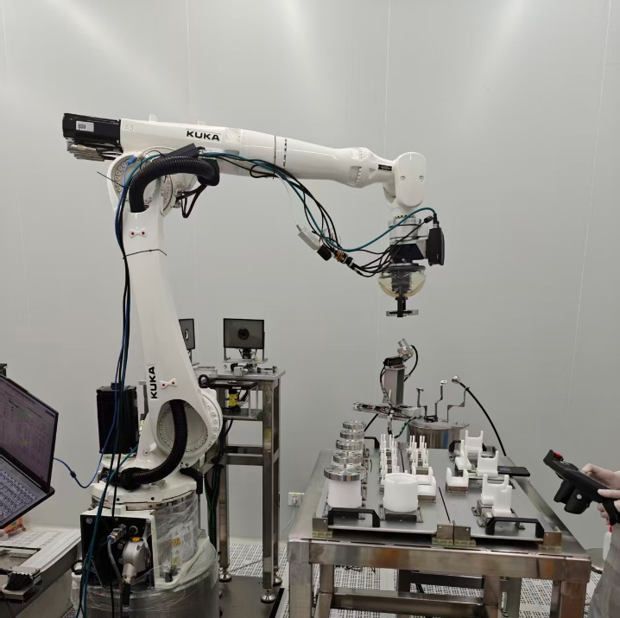
The first questions
Components blowing process
Saves over 2 labor hours per flange assembly.
Notes:
To answer the first question, we evaluated the labor requirements of different assembly procedures.
We found that the component blowing process consumes a significant amount of operator time.
For each flange assembly, this process alone can require more than two labor hours.
Therefore, from both efficiency and manpower perspectives, component blowing became our first priority for further automation.

Slide 8
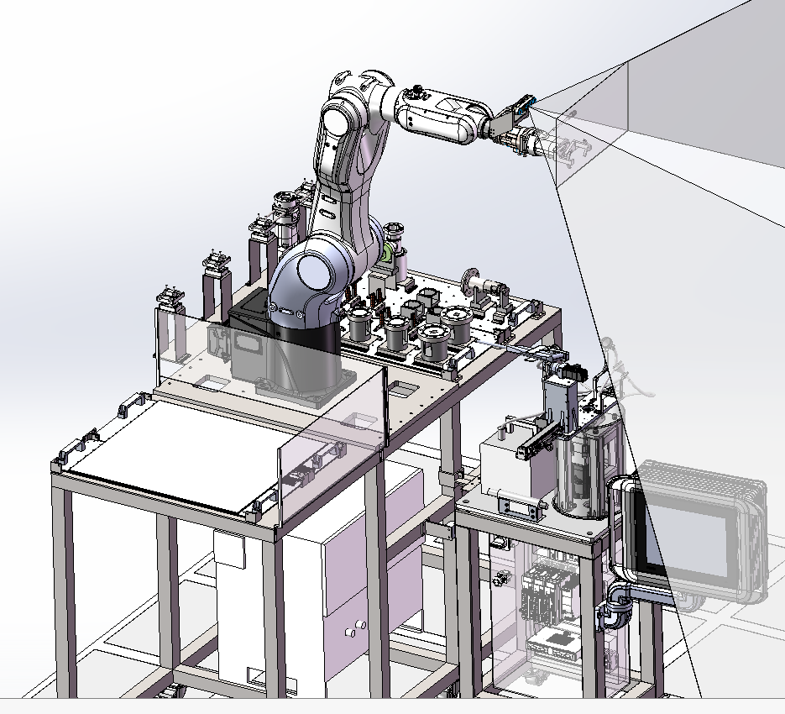
The first questions
An automatic components blowing system designed
Dirty Parts Placement Station
Clean Robot Arm
Blowing Platform
Clean Parts Placement Station
Goals: Independent operation; Adaptive gripping and blowing of components.
Notes:
So we separate the blowing system from our automatic test platform, and designed as an independent Automated System.
The system consists of:
a blowing platform,
a clean parts placement station,
a dirty parts placement station,
and a clean robotic arm.
The overall objective is to achieve independent operation without continuous human intervention.
More importantly, the system should be capable of adaptive gripping and adaptive blowing for components with different geometries and sizes.
This project is currently one of our major development directions.

Slide 9
Considerations for Automated Processes
1. Which process is best suited for automation replacement and delivers the greatest benefits?
2. As AI technology evolves, what enhancements can it deliver to assembly operations within cleanrooms?
Notes:
The second question concerns artificial intelligence.
Automation alone can replace manual operations, but AI has the potential to further improve assembly quality and reduce contamination risks.

Slide 10
The second questions
AI enables risk prediction and monitoring for clean assembly in cleanrooms.
E.g.
Moving quickly
Particles resuspended
SRF cavities contaminated
Hands contaminated
Parts contaminated
Reduce the incidence of risk events at the initial stage.
Monitor this stage
Prevent this phenomenon
Notes:
One possibly application is risk prediction and monitoring.
For example, during assembly:
operators may move too quickly,
particles may become resuspended,
contaminated hands may contact components,
or contaminated components may approach the cavity.
These events increase the probability of cavity contamination.
Our goal is to identify such risk conditions at an early stage, before contamination actually occurs.
In other words, we want to monitor mistake behaviors rather than only detect contamination after the fact.

Slide 11
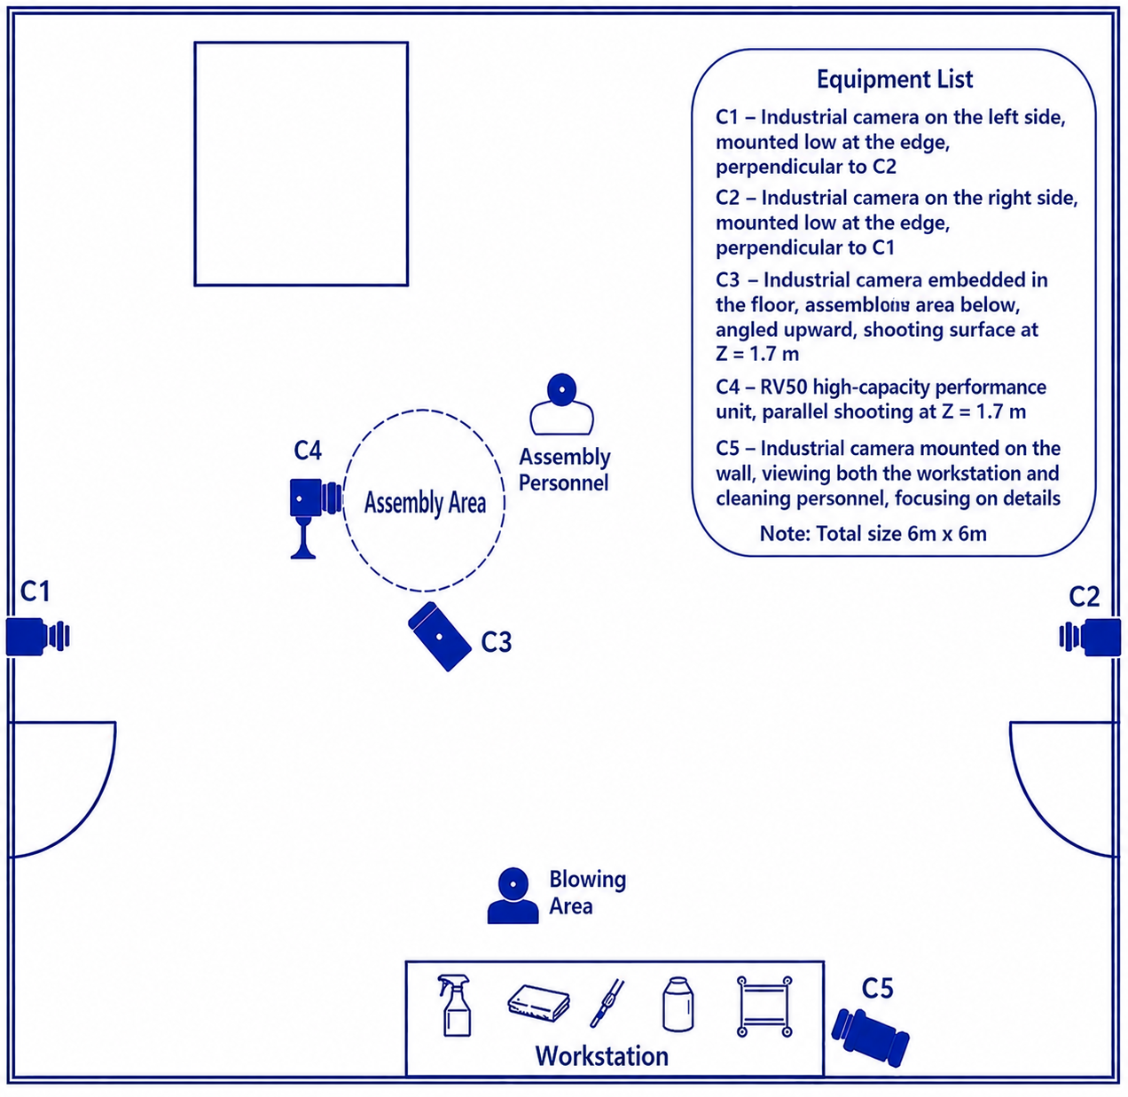
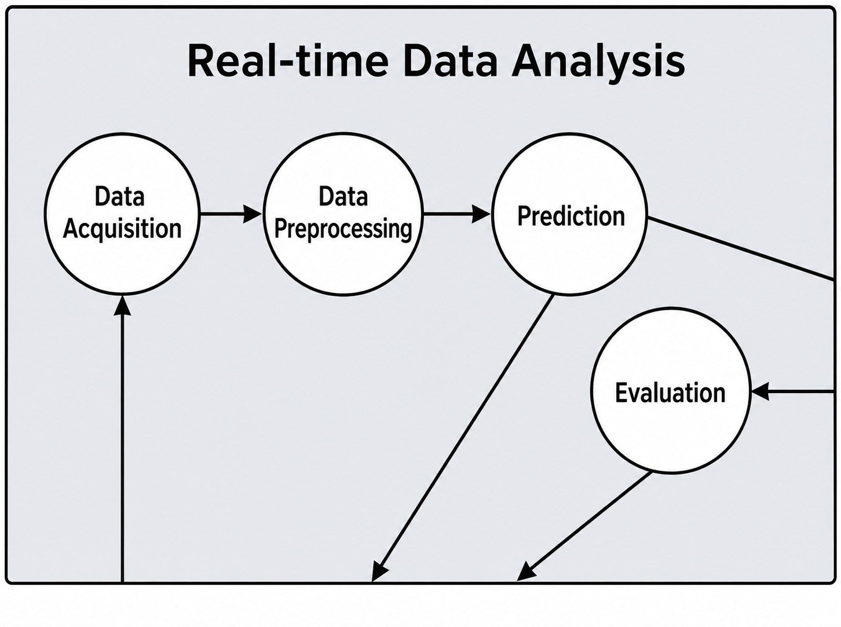
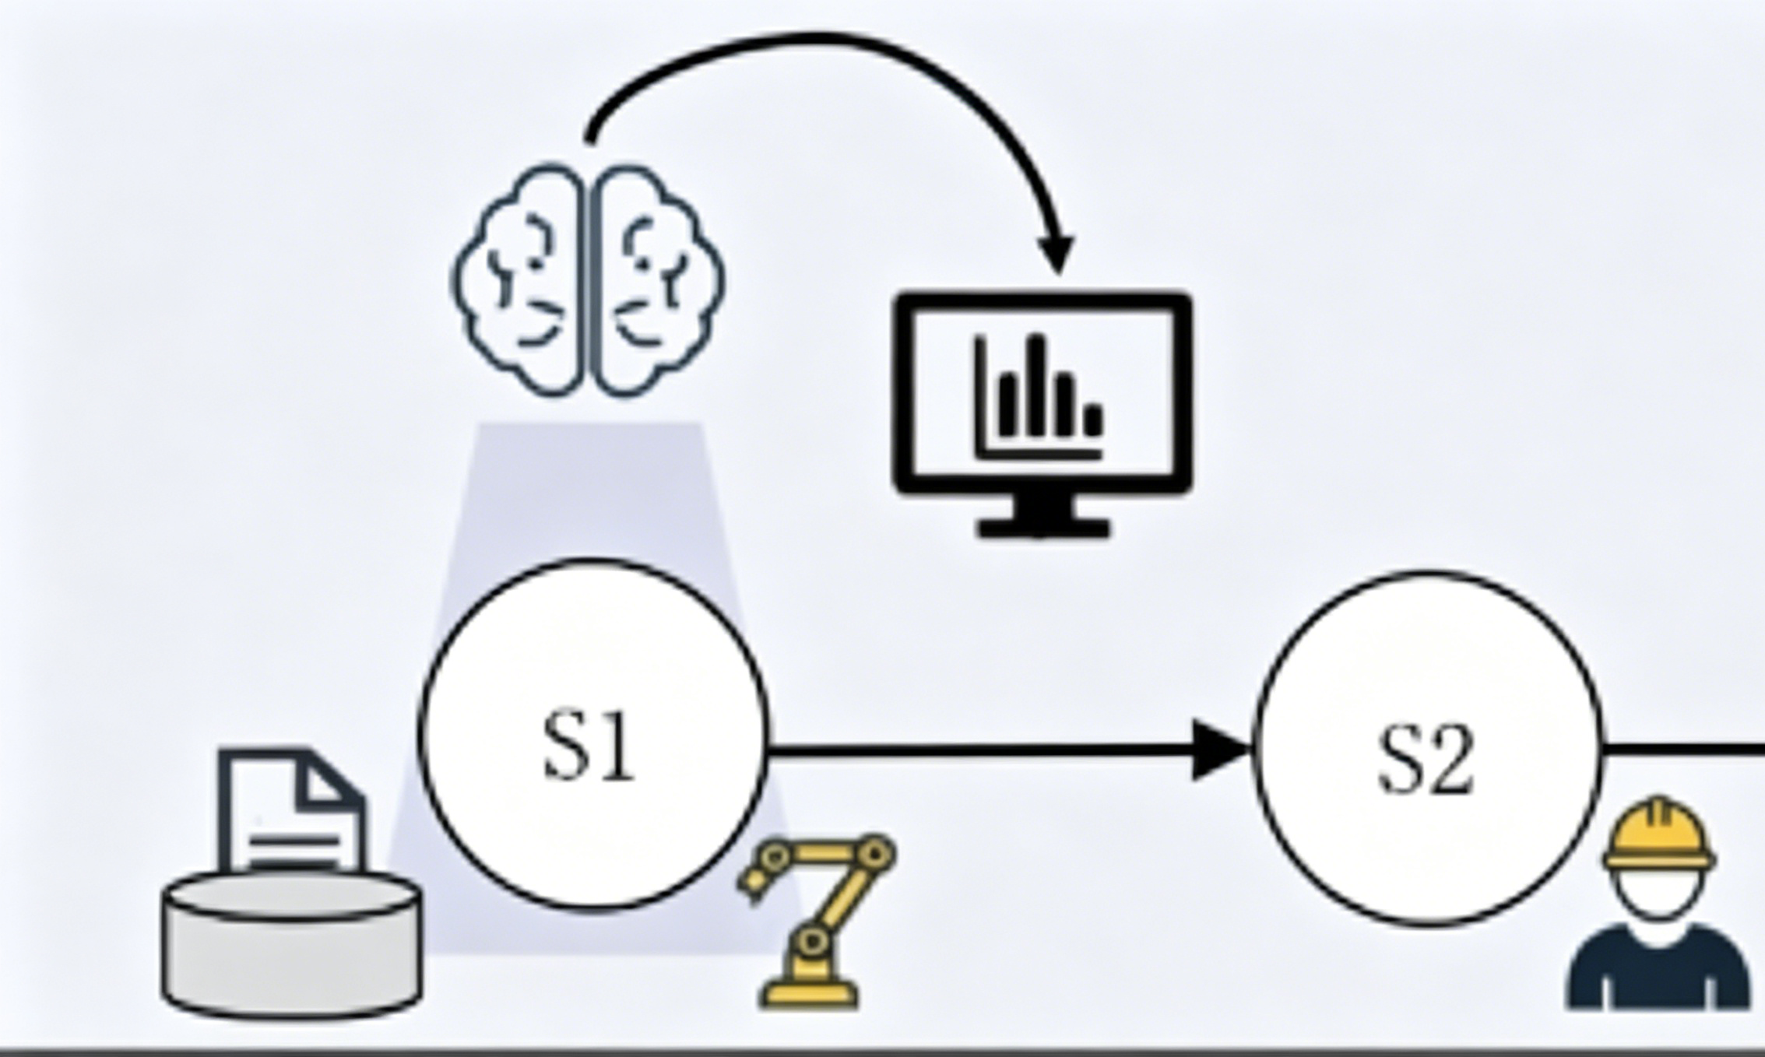
The second questions
Alerts
Monitor this stage via cameras
Real-time data analysis
Alerts or high-risk data logging
Passive inspection
Proactive risk prevention
Notes:
To achieve this goal, we propose a vision-based monitoring framework.
Multiple cameras continuously observe the assembly process.
The collected data are analyzed in real time using AI algorithms.
The system evaluates operator actions, component handling, and environmental conditions.
When abnormal behaviors or elevated risks are detected, alerts can be generated automatically.
At the same time, high-risk events can be logged for future analysis and process improvement.
Ultimately, this framework aims to transform clean assembly from passive inspection to proactive risk prevention.

Slide 12
Conclusion
Completed automated assembly test for SRF cavity flange, from cavity transferring to nuts fastening.
Two optimization focuses: automatic components blowing system and risk prediction and monitoring.
Question:
1. What else can AI do in cleanroom assembly?
Notes:
To summarize:
We have successfully completed automated assembly tests for SRF cavity flanges, covering the entire process from cavity transfer to nut fastening.
Based on our experience, we identified two major optimization directions:
First, the development of an automatic component blowing system.
Second, we use AI to predict the risk and try to prevented it. .
Looking ahead, we believe that artificial intelligence will become increasingly important in cleanroom assembly.
Therefore, I would like to leave one question for discussion:
What else can AI do in cleanroom assembly?
Thank you for your attention.

Slide 13



Special Thanks
Collaborators
Shuai Wang
Chenzhang Yuan & Binbin Yong
Xiaoyu Huang & Rihua Zeng
Institutions
Dongguan University of Technology
Lanzhou University
Advanced Energy Science and Technology Guangdong Laboratory
东莞理工学院
DONGGUAN UNIVERSITY OF TECHNOLOGY
Notes:
Before finishing, I would like to acknowledge all collaborators involved in this work again.

