Slide 1
Development of a cobot-assisted HPR system for complex geometries
N. Gandolfo et al.
TTC 2026 Meeting - 9-12 June 2026 - Gif-sur-Yvette, France
10th June 2026

Slide 2
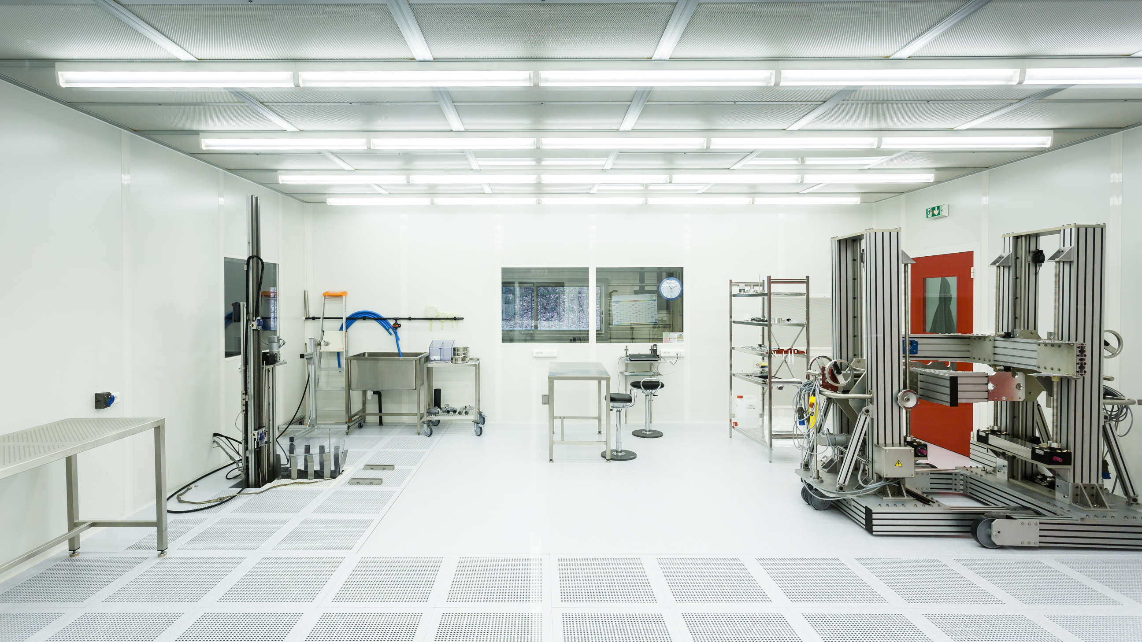
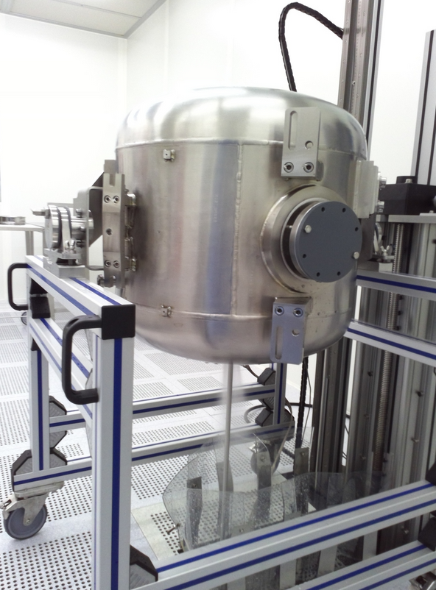
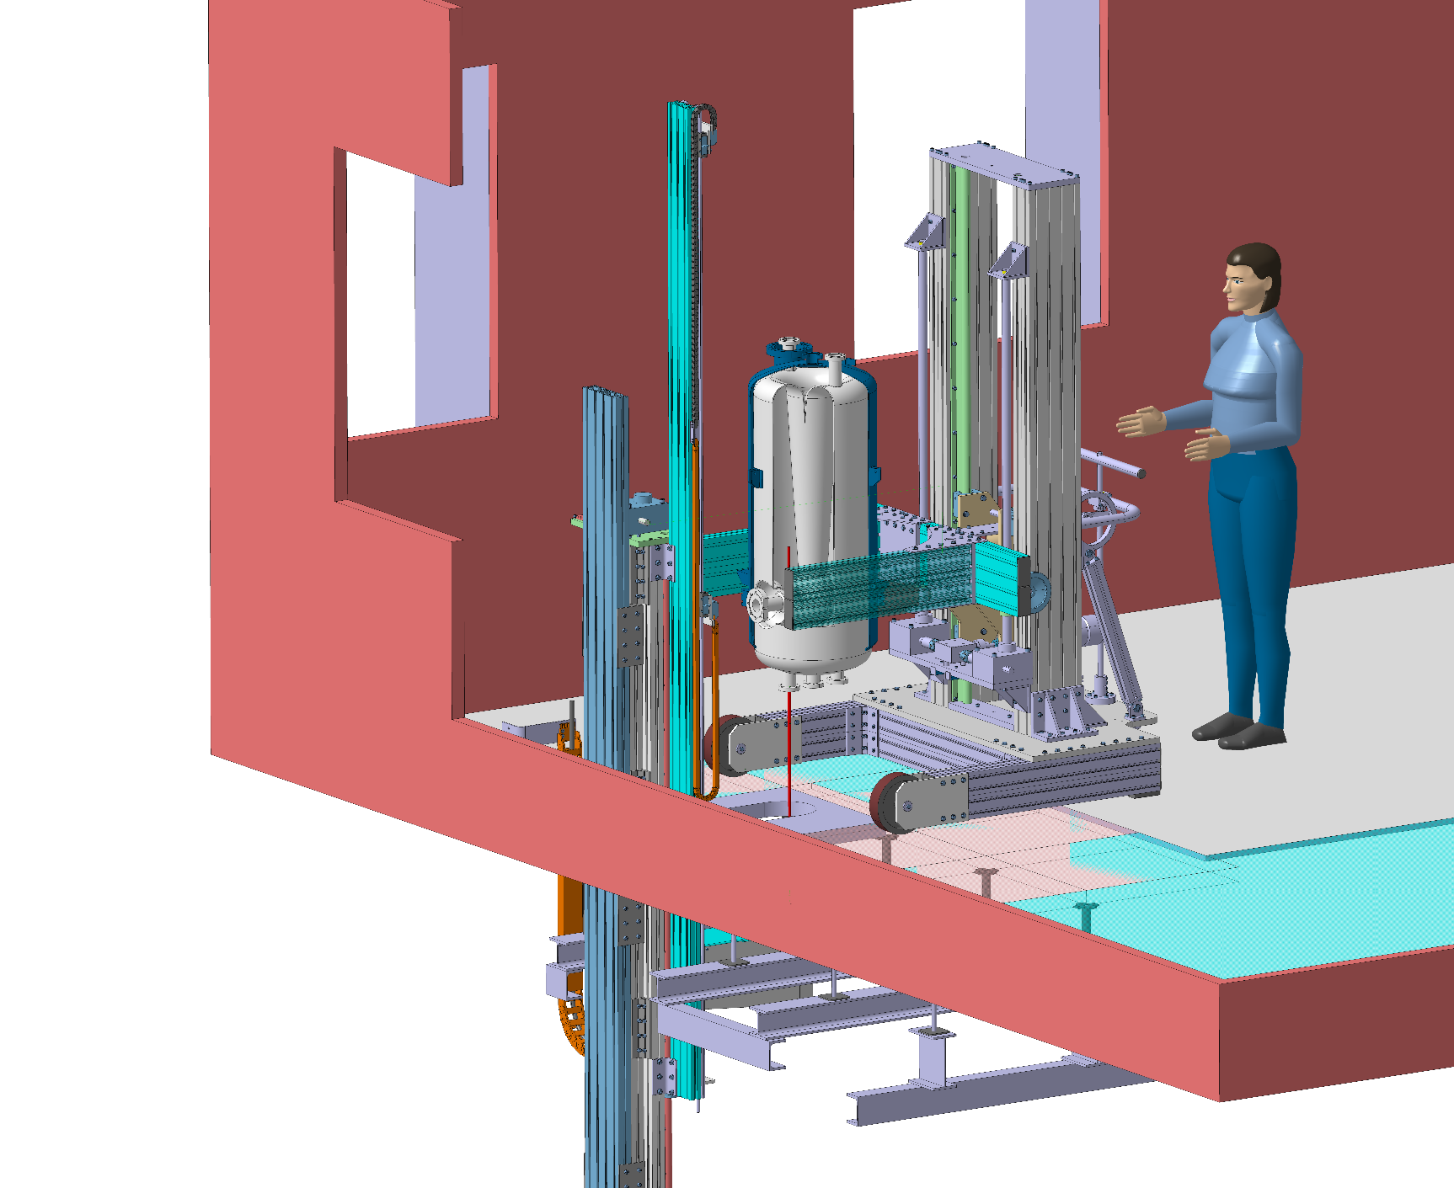
Legacy HPR system in SUPRATech facility at IJCLab
HPR installation of SUPRATech facility at IJCLab consist of :
  A mechanical system fixed on the ground gives mobility to the wand on the vertical axis and continuous rotation around it. (inside the ISO-4 cleanroom).
  Dedicated forklifts or trolley able to carry a cavity, and possibility to flip it around an horizontal axis (inside the ISO-4 cleanroom)
  A ultrapure water station coupled to a high pressure pump, outside of the cleanroom.
The system was reliable and successful for several projects (Spiral2, ESS, MYRRHA), but limitations appear were complex trajectories are required (PIP-II).
A
B
C
Spiral2 QWR β=0.12 during HPR

Slide 3
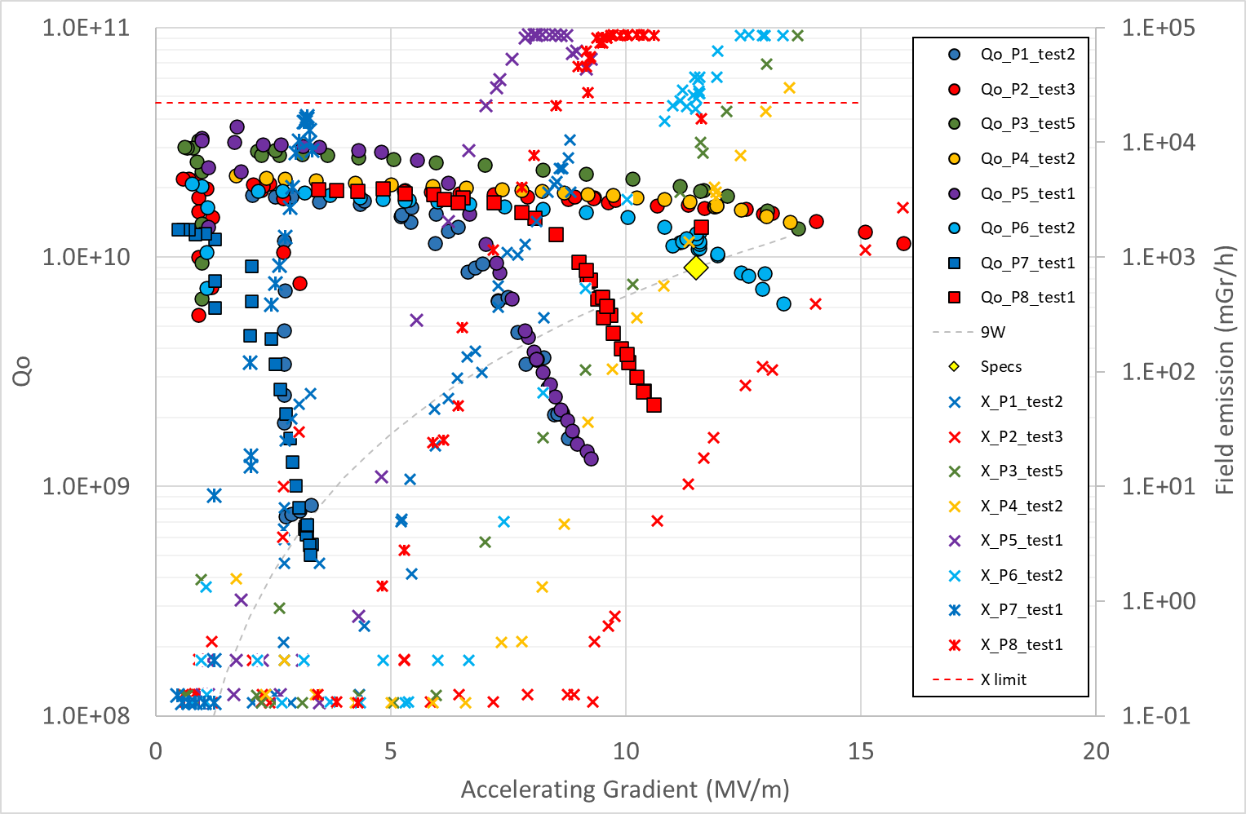
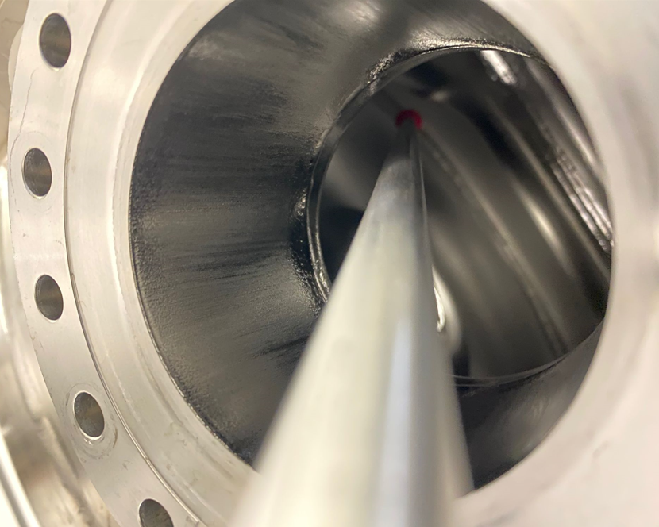
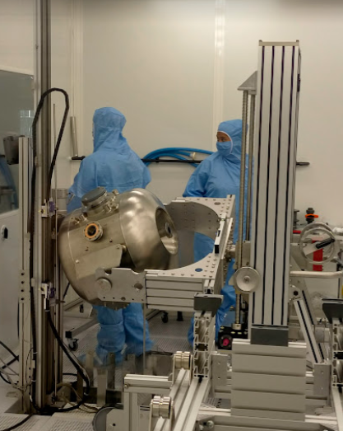
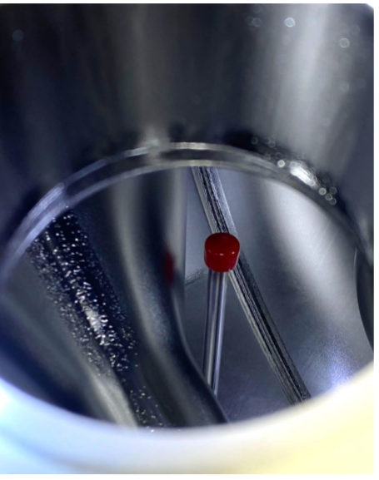
Limitations
One cavity qualified (P2) @IJCLab by applying a tilt to the wand to go beyond spoke bar (FE onset @ 9 MV/m).
Three cavities qualified (P3,P4,P6) @IJCLab by standard HPR with optimized nozzle angles (FE onset @ max 7 MV/m).
PIP-II SSR2 cavity prepared for tilted HPR
Moreover, in general :
  Low-beta cavities have geometries that make them particularly challenging to rinse effectively.
  In some projects, it is necessary to install dedicated HPR ports to ensure full coverage of the cavity surface, while in others, tilted wand trajectories are required.
  A major motivation for improving the control of the wand trajectory is to remove design constraints imposed by the need to make the RF geometry compatible with rinsing requirements.
Summary plot of last cryogenic tests performed at IJCLab.
D. Longuevergne et al., “CNRS contribution to PIP-II project: overview and lessons learned from SSR2 cavities prototyping”, presented at the SRF'25, Tokyo, Japan, Sep. 2025, paper MOP44

Slide 4
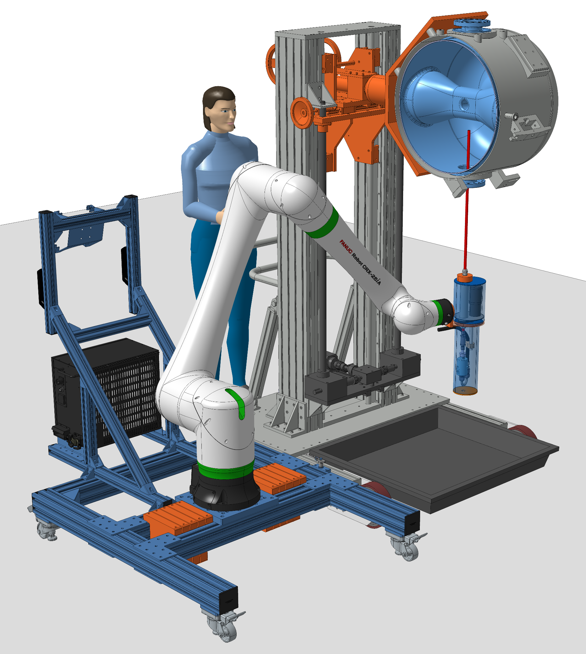
Cobot assisted tilted HPR operation
Robot specification
  FANUC CRX-25 Robot
  Collaborative robot (Cobot)
    CAN be safe to work close to someone
    Simple to program and to handle
  Weight : 127 kg
  Max. reach : 1889 mm
  Max. load capacity : 25 kg
  Repeatability : ± 0.05 mm
Robot cart specification
  Total weight (with cobot and dead weight) : 324 kg
  Footprint dimensions : 1100 x 1600 mm
  Ensure stable operation in any load case
  Can be rigidly attached to forklift
Forklift
  Refurbished in order to minimize cost
Lifter stage
Forklift
FANUC CRX-25 Cobot
SSR2 cavity
Robot cart
Water collector

Slide 5
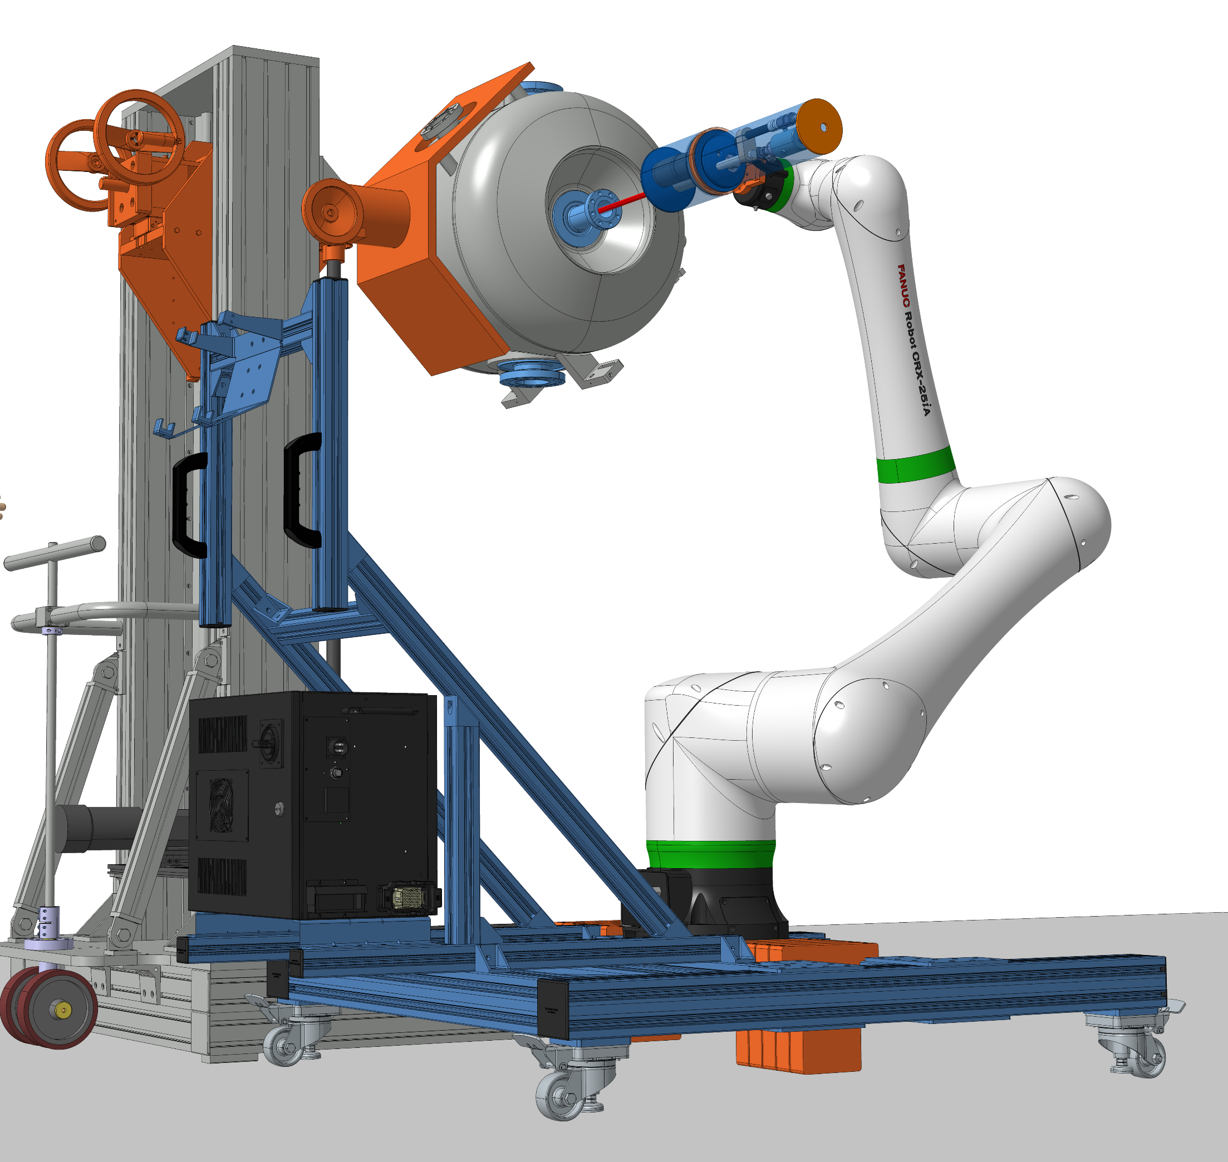
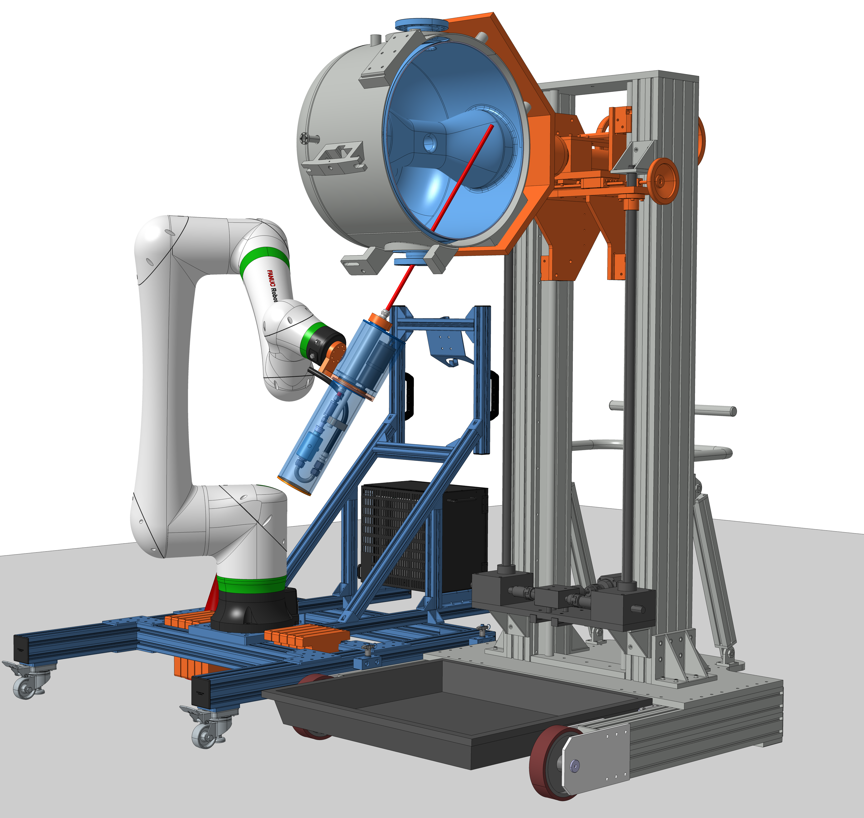
3 styles HPR
While the main challenge was to achieve tilted trajectories, vertical and horizontal trajectories were also studied to cover all possible configurations in order to minimize the need to move the cavity thereby reducing effort and the risk of contamination.
Vertical HPR through coupler port
Horizontal HPR through beam port
Diagonal HPR through coupler port

Slide 6
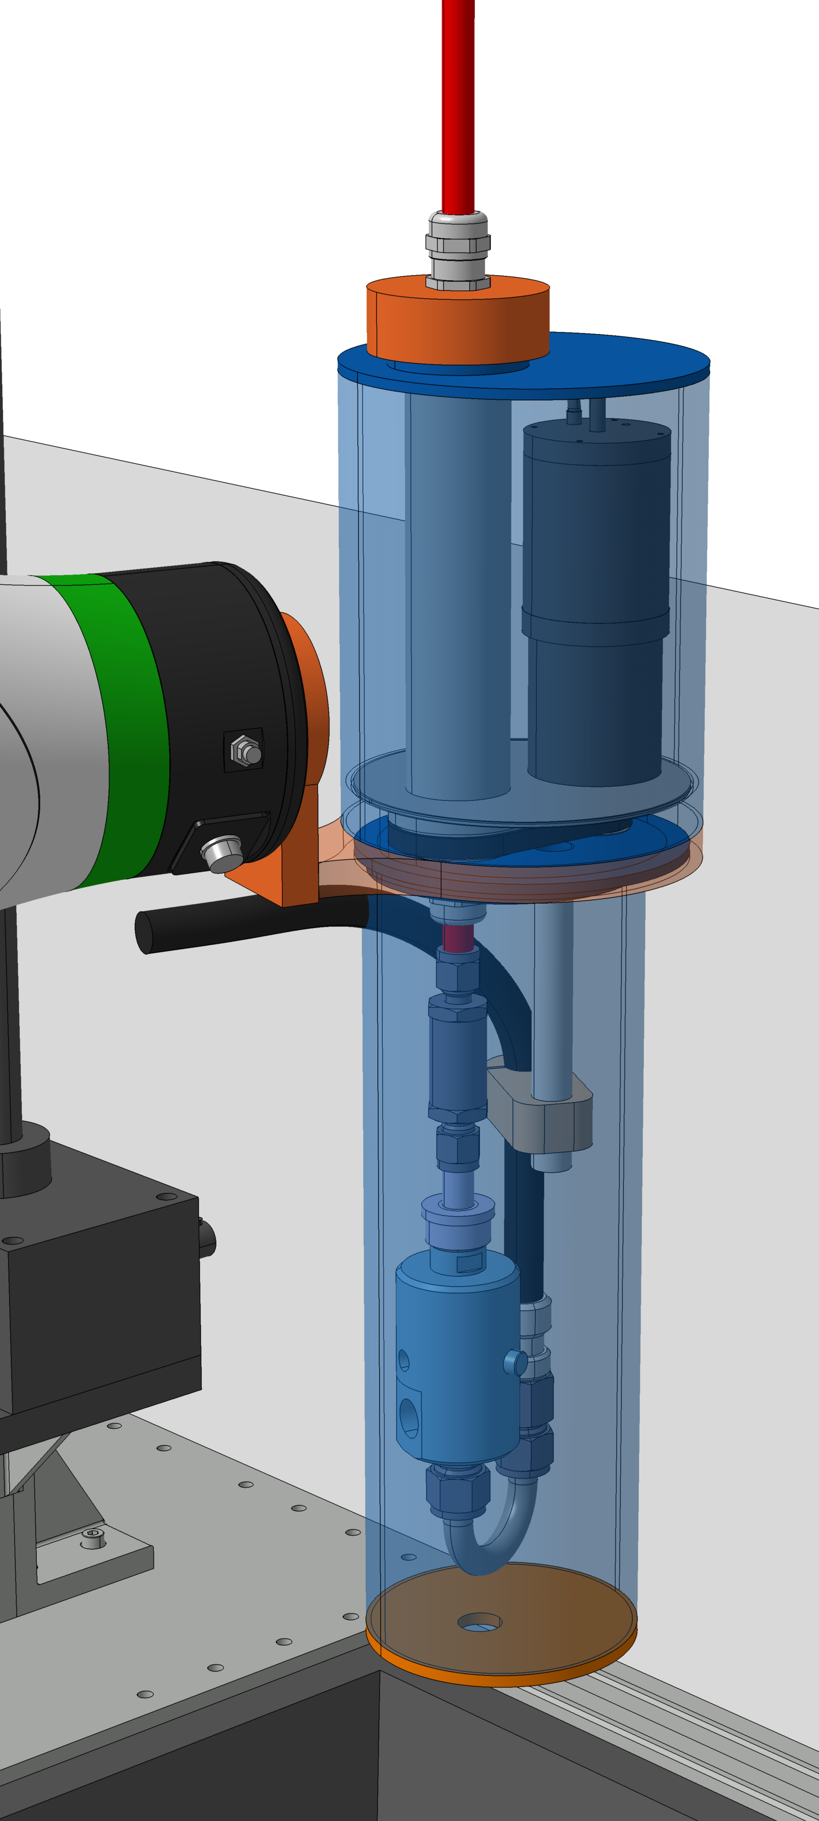
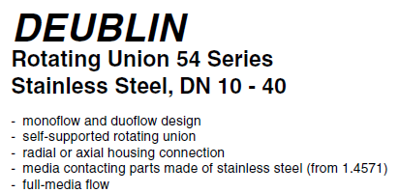
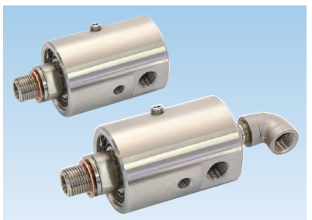
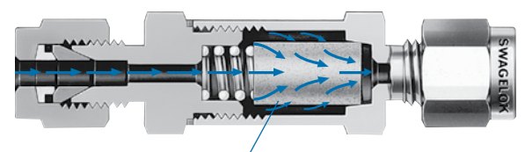
End effector
The end effector supports the wand, enabling controlled continuous rotation thanks to a motorized drive and rotary joint.
  Conservative rotation speed of the wand : 20 rev/min
It has to comply with the high pressure water system (18.2 MΩ.cm, 100 bar, 10 L/min) and ensure correct positioning of the wand with millimeter precision.
The integration of an inline filter after the rotary joint provides machine protection against contaminant in case of failure of the high pressure system.
Motor
Rotary bearing stage
High pressure hose
Inline filter
Rotary joint
Rotary joint
Inline filter 7µm pore

Slide 7
Toward fully automated routine
The cavity is first assembled and checked for proper alignment
  Second camera effector is being attached temporarily for precise relocation using Fanuc integrated vision routines
HPR cycles are then performed in horizontal, vertical, and tilted orientations to cover all surfaces
The cavity is then flipped in order to let the cobot reach the rest of the ports to be processed
  This will require an additional rotary actuator connected to the system with high repeatability
  At the moment, this flip is planned to be performed manually but automation is expected later on
Afterward, another sequence of HPR cycles and wait for drying
Horizontal HPR
Vertical HPR
Tilted HPR
(x4)
Cavity flip
Horizontal HPR
Vertical HPR
Tilted HPR
(x4)
Drying
Assembling
Verification
Automatic sequence : No human intervention

Slide 8
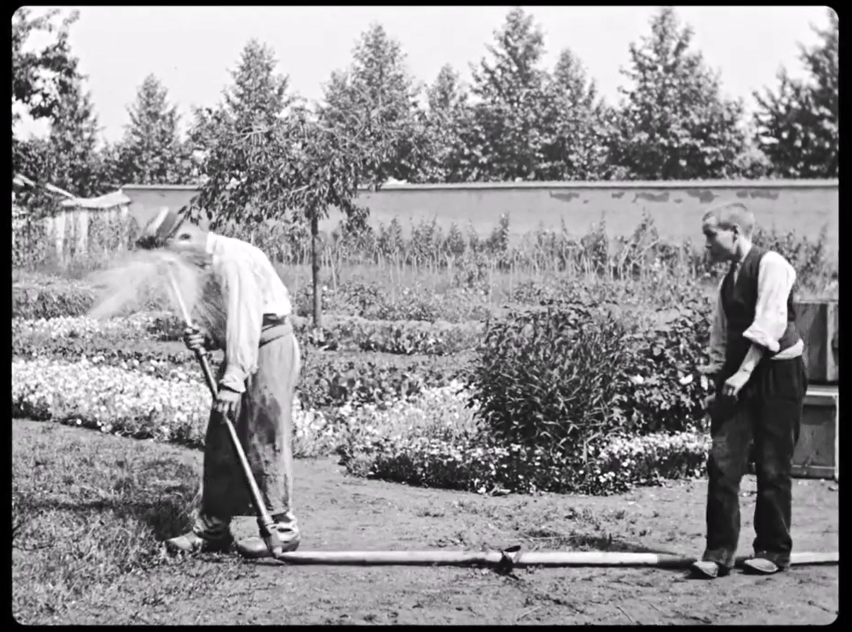
Highlights
Development is progressing but several issues still need to be addressed :
  High-pressure hose management (tension)
    In worst case the cable will trigger force alarm, pausing the operation and require operator intervention
    Maybe a dedicated tension system will prevent this to happen
  Camera locating
    Environment light, reproducibility, glitch, many aspects can conduct to misalignment
    To be mitigated by experiencing, also to be systematically checked with dummy wand
  Water rotary joint
    Check the residual contamination that could be generated during rotation
  Water flooding on wrist
    While the robot is specified IP67, special attention will be paid to avoid direct contact with ultra pure water
    A custom tailored sleeve will be designed to ensure protection
  Water flooding elsewhere
    Let’s try to not be “l’arroseur arrosé”
L'Arroseur arrosé
literally: "The Waterer Watered“
First movie in 1895 by Louis Lumière

Slide 9
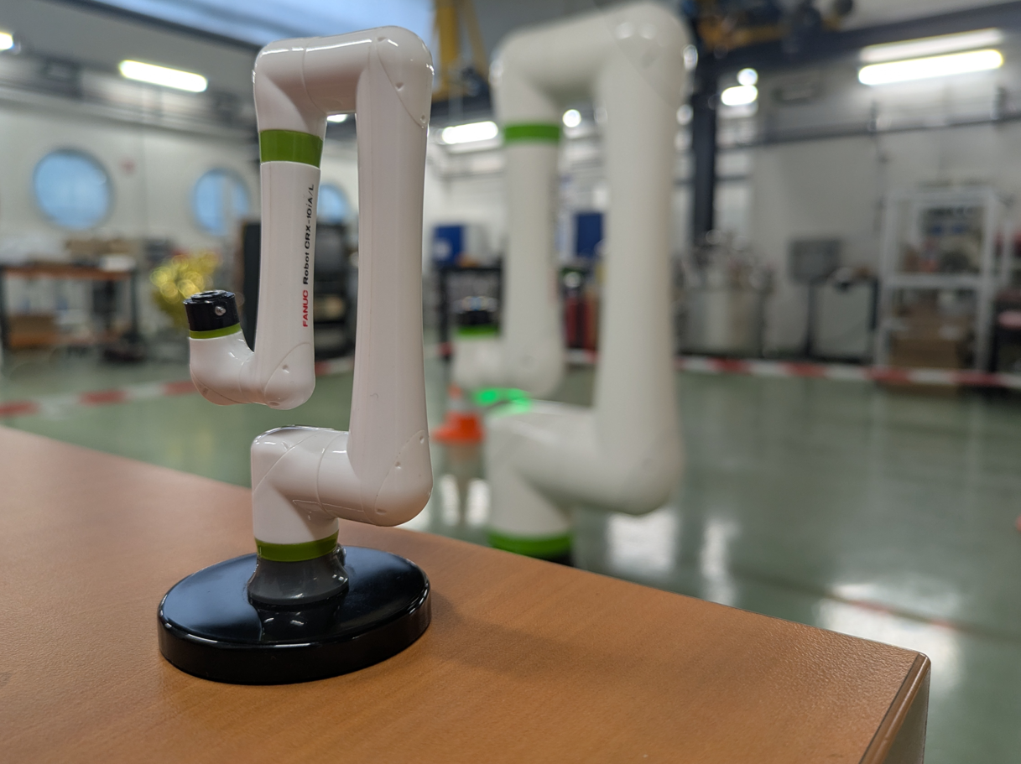
Thanks
Many thanks to IJCLab team: Sebastien Blivet, Bastien Delhaye, Patricia Duchesne, David Longuevergne, Mael Vannson, Lê My Vogt, Sandry Wallon
Also warmful thanks to : FNAL, CEA and FRIB experts for discussions that helped us to make significant progress

