Slide 1
Robotic assembly for field emission free systems
TTC 2026 Meeting,
CEA-CNRS-Université Paris, Saclay
Roger Ruber, Ian Conner,
Adam Duzik, Tali Harden

Slide 2
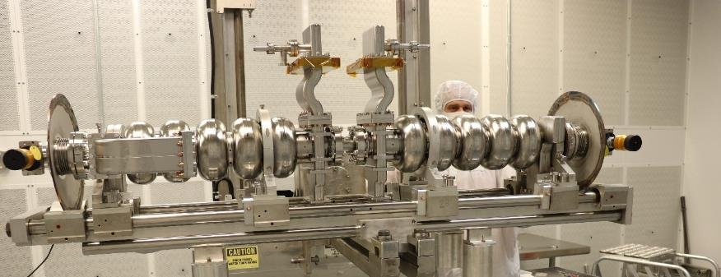
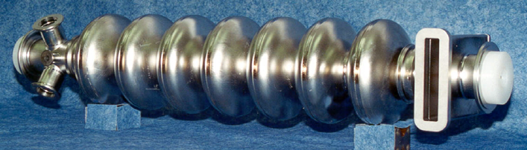
CEBAF – Continuous Electron Beam Facility
Construction start 1987; First beam 1 July 1994
Cryomodules connected by warm beamline sectors
Legacy cryomodules = 4 cryo-units with cavity pair
  1497 MHz 5-cell with waveguide couplers
  Liquid helium vessel incl. HOM load and tuner
  Flat flanges with indium seal
12 GeV upgrade C100 cryomodules
  Single 8 cavity string, 7-cell
  Aluminium seals with radial-wedge clamp
4 C100
1 F100 Cryomodules
10 C20,
6 C50,
3 C75,
1 P1R
Cryomodules
1 Booster
1 C20
1 R100
Cryomodules
124 MeV
Injector
Central Helium Liquefier
12 C20,
6 C50,
2 C75
Cryomodules
5 C100 Cryomodules
C75 5-cell SRF Cavity Pair
C100 7-cell SRF Cavity

Slide 3
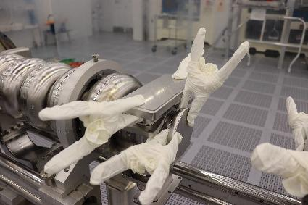
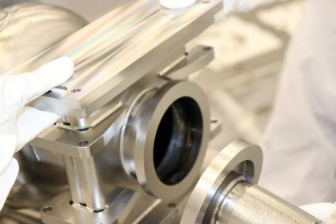
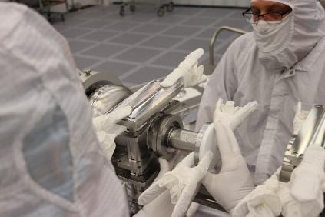
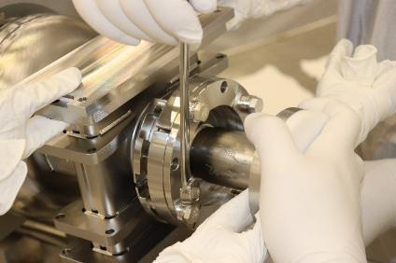
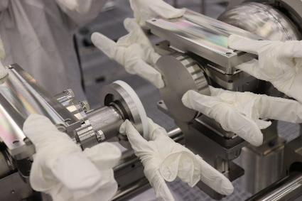
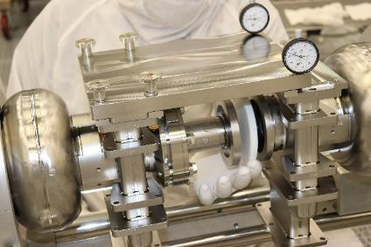
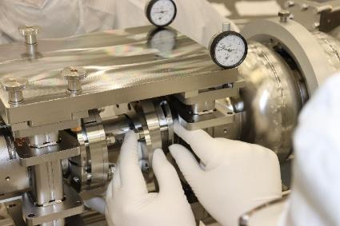
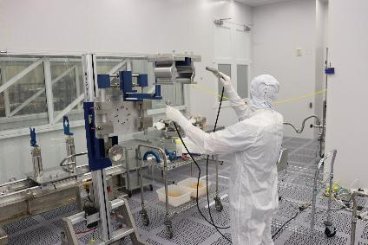
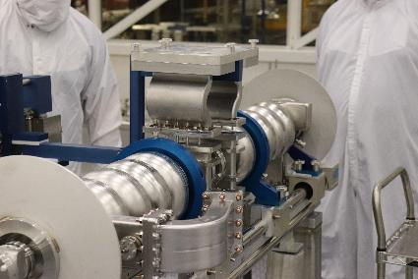
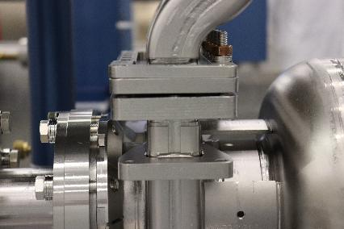
CEBAF Cavity Pair Manual Assembly Process

Slide 4
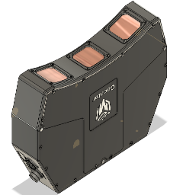
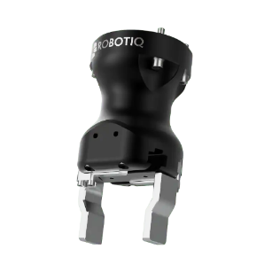
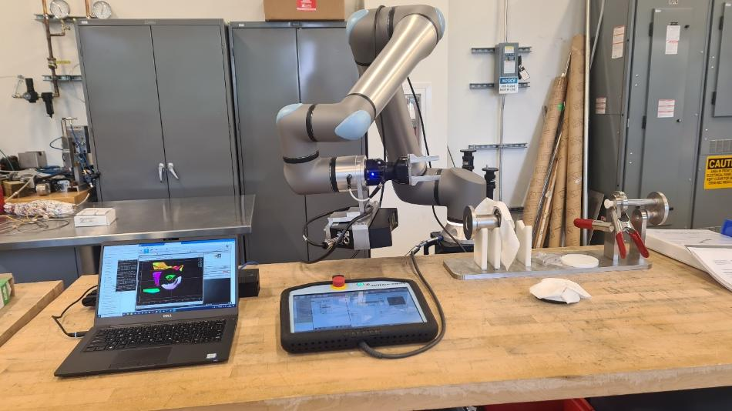
Robotic Assisted Assembly Process
Goal: Build field emission free cavities to improve SRF cryomodule performance.
Relevance: Robotic collaboration helps to improve quality, consistency, cost, and safety of SRF cavity and cryomodule production.
Universal Robots UR20 cobot
  20 kg load, 1’750 mm reach,
  5.5 N 0.2 Nm force/torque precision
Robotiq Hand-E gripper
  50 mm stroke, 185 N grip force
LMI Gocator 3520 snapshot camera
  353 mm clearance + measurement range,
  175 mm field of view
Intel RealSense D435i
  RGB and depth camera
Vention custom designed support base

Slide 5
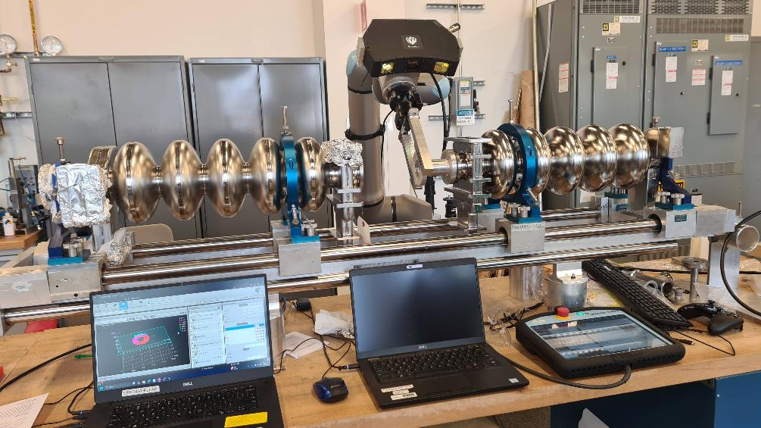
CEBAF Inner Adapter Assembly
Considered to be the most “tricky” and “dirty” assembly step
The first person,
  holds adapter in place with one hand,
  must use other hand to assist the second person mounting the clamp pieces.
Gocator camera
  locate cavity flange face
  locate inner adapter flange face
Gripper
  lift inner adapter
Cobot
  movement between positions
  “force mode” to press inner adapter

Slide 6
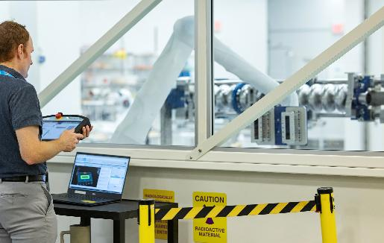
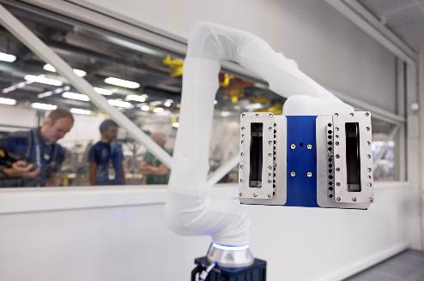
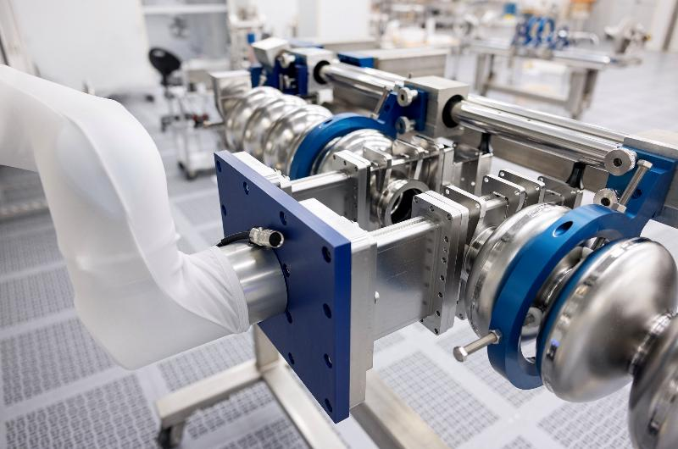
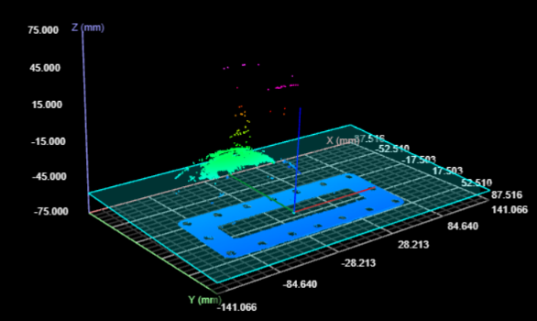
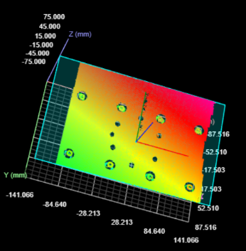
CEBAF Waveguide Pair Assembly
Scan and localize parts with Gocator
Remove Gocator (load limit 20 kg)
Attach waveguide plate
Calculate goal wrist position
Move to position
Manual fine-adjustment
  positioning offset within
  ±0.5 mm and ±0.2° incl. offset
  due to motion in present robot base

Slide 7
Limitations and Requirements
Vendor Native System
  Sequential structure
  Basic interaction with peripheral devices
  Basic logical and mathematical operations
  Understanding of the assembly process
Limitations
  Real-time operator decision and control
  Operator supervision and awareness
  Data persistence across runs
  Workspace modeling
  Path Planning
Conclusions
  Works well for static, repeatable tasks.
  Issues with deployment in changing environments and collaboration
Need
  Better operator situational awareness
  Collaborative autonomy with operator driven pacing and intermittent actions
  Human-robot teaming,
  not robots replacing humans
General Requirements
  Low-level system control
  Perception
  Workspace modeling
  High-level behaviour instructions
Collaborative Requirements
  Safety features for human interactions
  Real-time operator decisions and control
  Operator supervision and situational awareness
  Operator execution of concurrent and sequential tasks

Slide 8
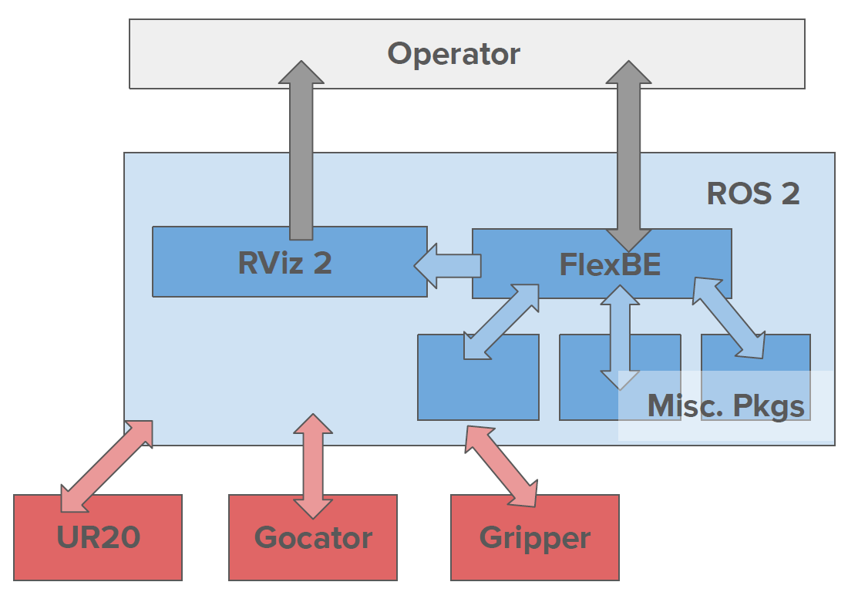
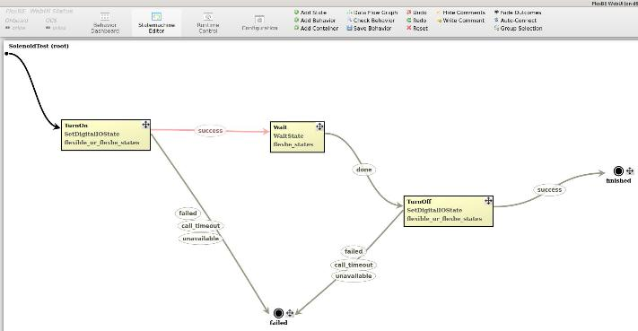
Robot Control using ROS2
Robot Operating System (ROS) 2
  open-source framework
  control and visualization
    increased operator supervision and awareness
  publisher/subscriber framework
    nodes composed of C++ and Phyton programs
  drivers for UR20 etc.
Support modules
  ROS2 Control for managing gripper etc.
  FlexBE workflow behaviour engine
  MoveIt path planning & workplace modeling
  RViz workplace visualization & simple digital twin

Slide 9
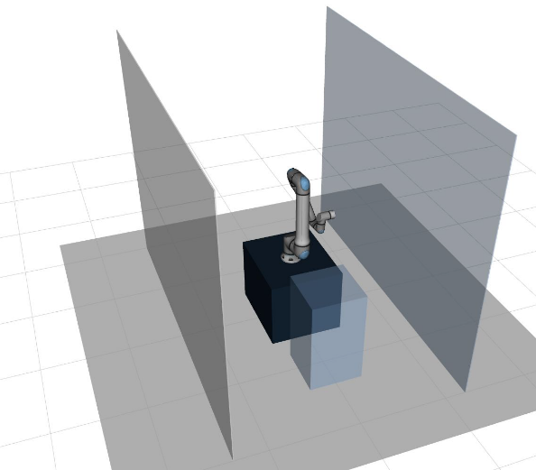
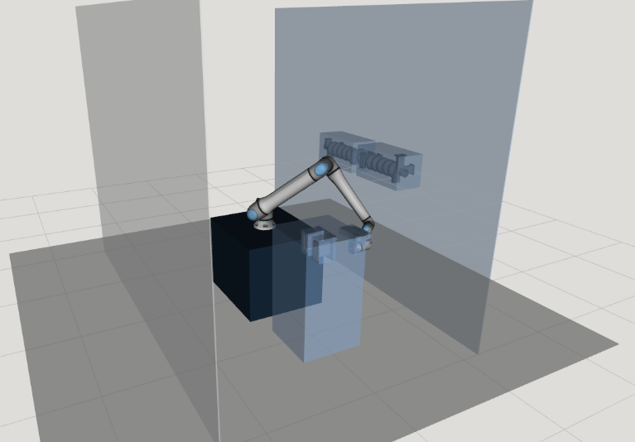
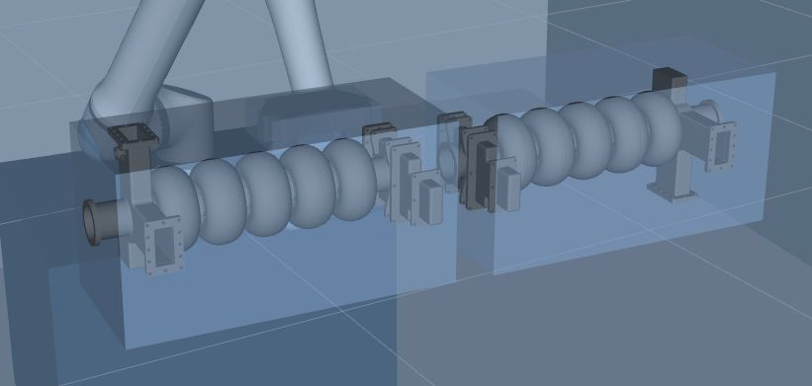
ROS2 Visualization and Planning
Mounted visuals
Dynamic collision objects
Planned path
Scanned visuals
Scanned Parts

Slide 10
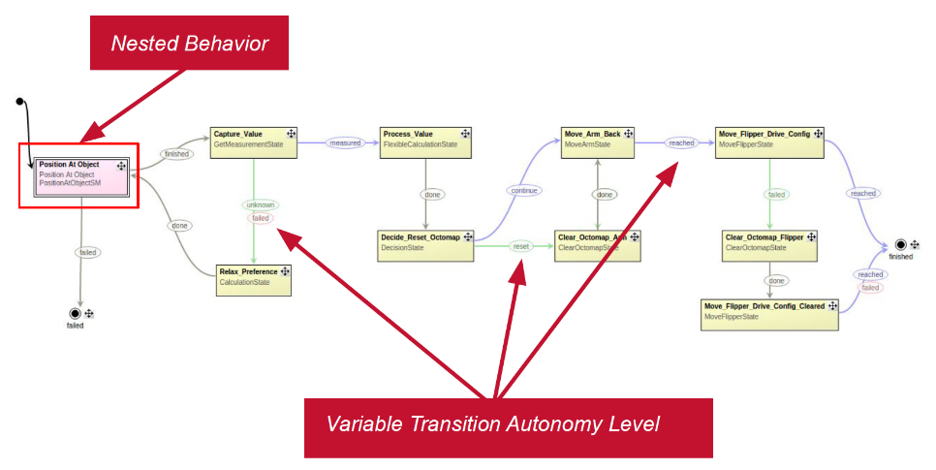
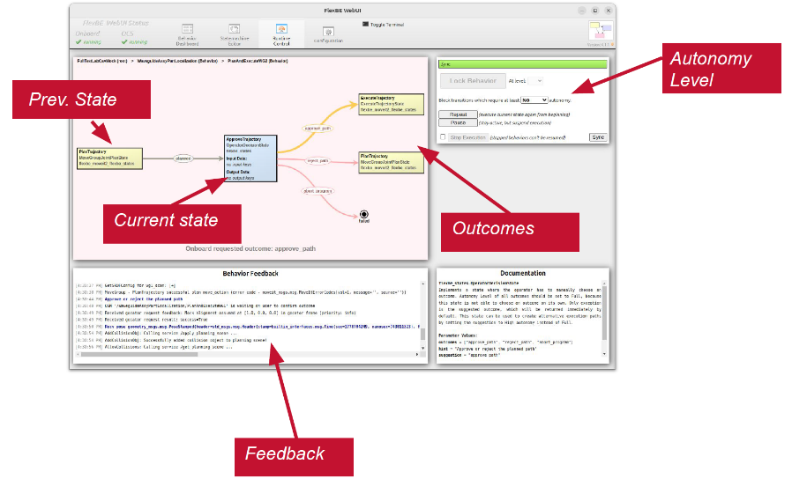
Collaborative Autonomy – FlexBE
FlexBE behaviour
Hierarchical finite state machines (HFSM)
  states, transitions, outcomes; modularity
Flexible behavior engine (FlexBE)
  develop, execute, supervise HFSMs
  developed during DARPA Robotics Challenge
  collaborative autonomy – Human-robot Teaming
Features
  real-time operator decision and control
  operator supervision and awareness
  high-level instructions
  execution of concurrent and sequential tasks
  perception (Gocator/ROS)
  workspace modelling (RViz + MoveIt)
  safety features for human interaction (UR)
  low-level system control (UR + ROS2)
Run-time control

Slide 11
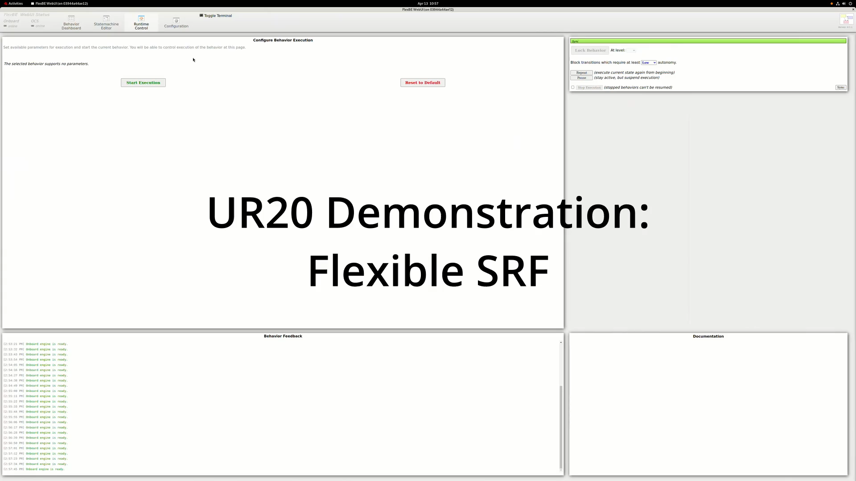
Assembly Demonstration

Slide 12
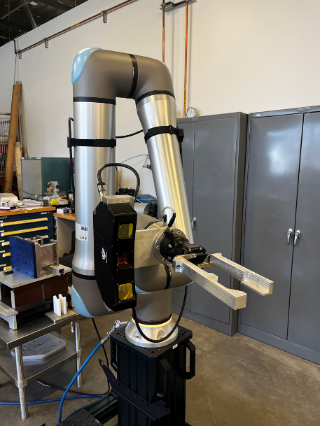
Conclusions
Developed assistive robotic system for cavity assembly
Established solid foundation for future work on
sensor-based control for closing the final millimeters
Acknowledgements
Jefferson Lab – SRF Operations Department and Engineering Division
  Greg Marble, Joshua Thomason, Tony Sessoms, Kirk David, Danny Forehand,
  Anthony Malave-Colon, Phil Denny, Chris Gould
Christopher Newport University – Capable Humanitarian Robotics and Intelligent Systems Lab (CHRISLab)
  David Conner
CIMTEC Automation
  Jonathan Cole, Brendan Suminski, John Lajoie
Supported by US Department of Energy, Office of Science, Nuclear Physics
under contract DE-AC05-06OR23177

