Slide 1
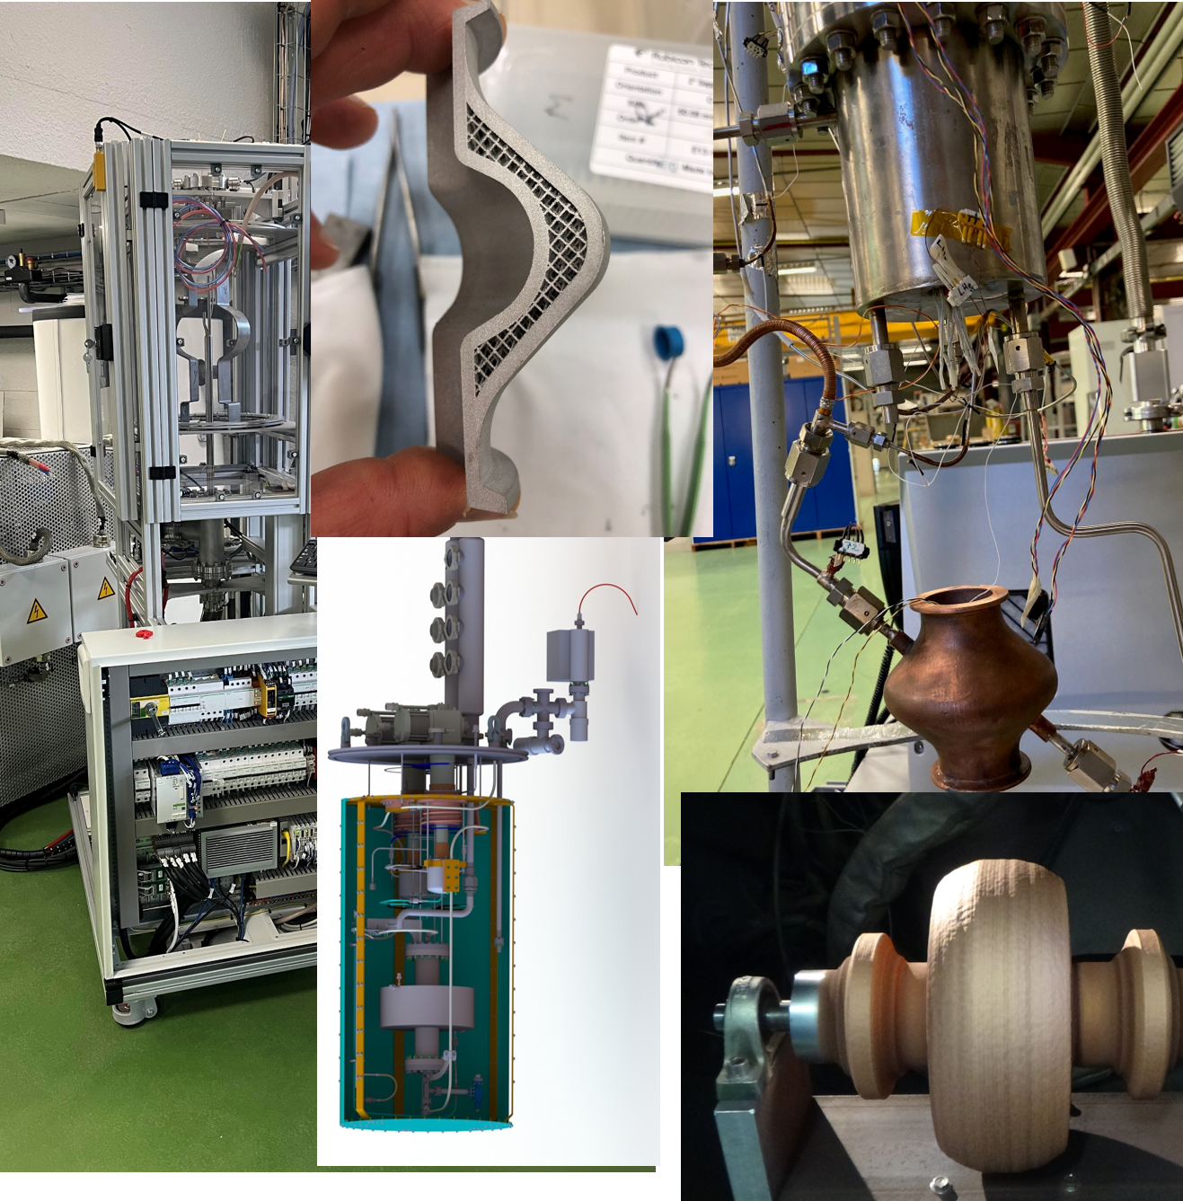


Additive manufacturing of Cu cavities
F. Eozénou¹, F. Motschmann¹, C. Verdy², Q. Ponchon¹, E. Sellin¹,
G. Perreu¹, J.M. Gheller¹, B. Baudouy¹, T. Proslier¹
CEA-Centre de Saclay, Université Paris Saclay, France
ICB , Université technologique de Belfort Montbéliard, France
TTC meeting 06-2026

Slide 2
Outline
Previous results on 3.9 GHz cavities – SLM
Scale up to 1.3 GHz cavities – Cold spray
  Electrical and thermal properties.
  Surface roughness and chemistry.
  Imbedded cooling channels.
  Leak tests.
  SS316 – Cu junctions.
Conclusion and Future directions
  Cryocoolers and deposition PACIFICS

Slide 3
Outline
Previous results on 3.9 GHz cavities – SLM
Scale up to 1.3 GHz cavities – Cold spray
  Electrical and thermal properties.
  Surface roughness and chemistry.
  Imbedded cooling channels.
  Leak tests.
  SS316 – Cu junctions.
Conclusion and Future directions
  Cryocoolers and deposition PACIFICS

Slide 4
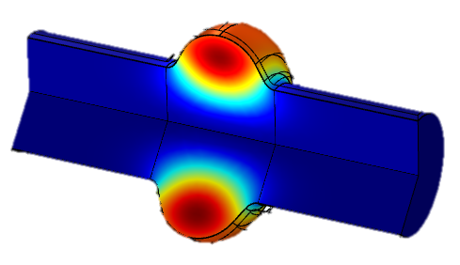
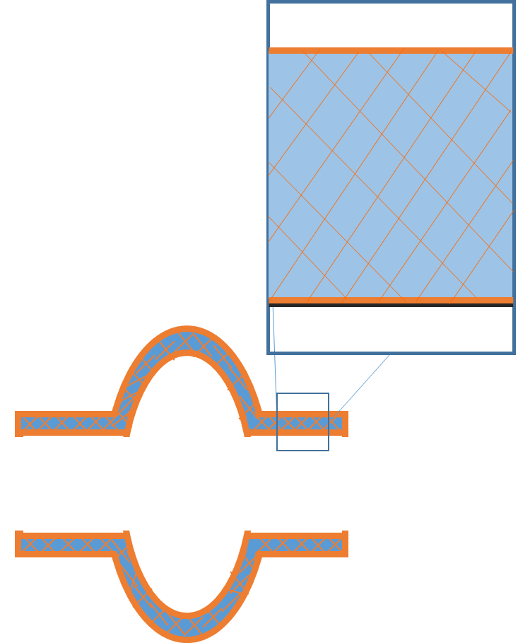
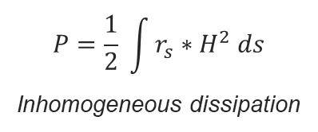
3D printing R&D of Cu SRF cavities
            Proposed approach:
$$P=\frac{1}{2} \int{r_{s}∗H^{2} ds}$$
Inhomogeneous dissipation
Cryogenic cost optimisation (vol of LHe divided by 10).
No welds.
Fabrication : additive manufacturing + coatings.
Materials : Cu + superconducting films (Nb, Nb₃Sn, MgB₂).
Cool down : In walls channels – closed loop LHe circuit. Cryocoolers.
Superconducting coatings
Requirements for Cu: roughness Ra << 1 µm, leak rate < 10⁻¹⁰ mbar.l.s⁻¹, RRR > 55 and k > 300W/(m.K).
Requirements for fabrication: fast (few hrs for a 1,3 Ghz cavity), control over shape -> cooling strategies.

Slide 5
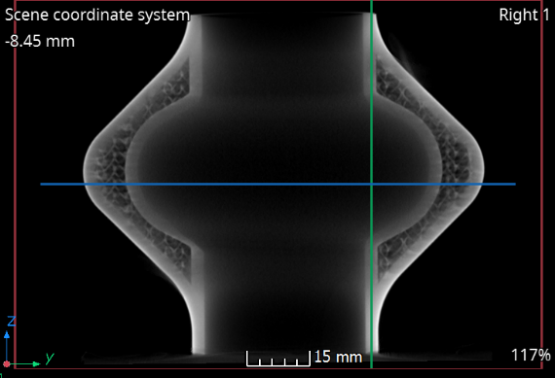
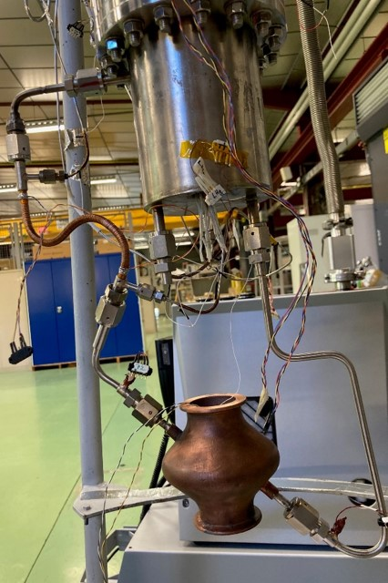
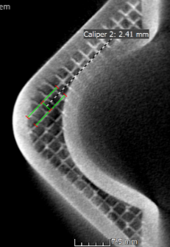
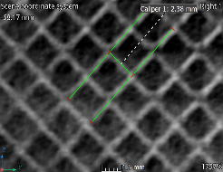
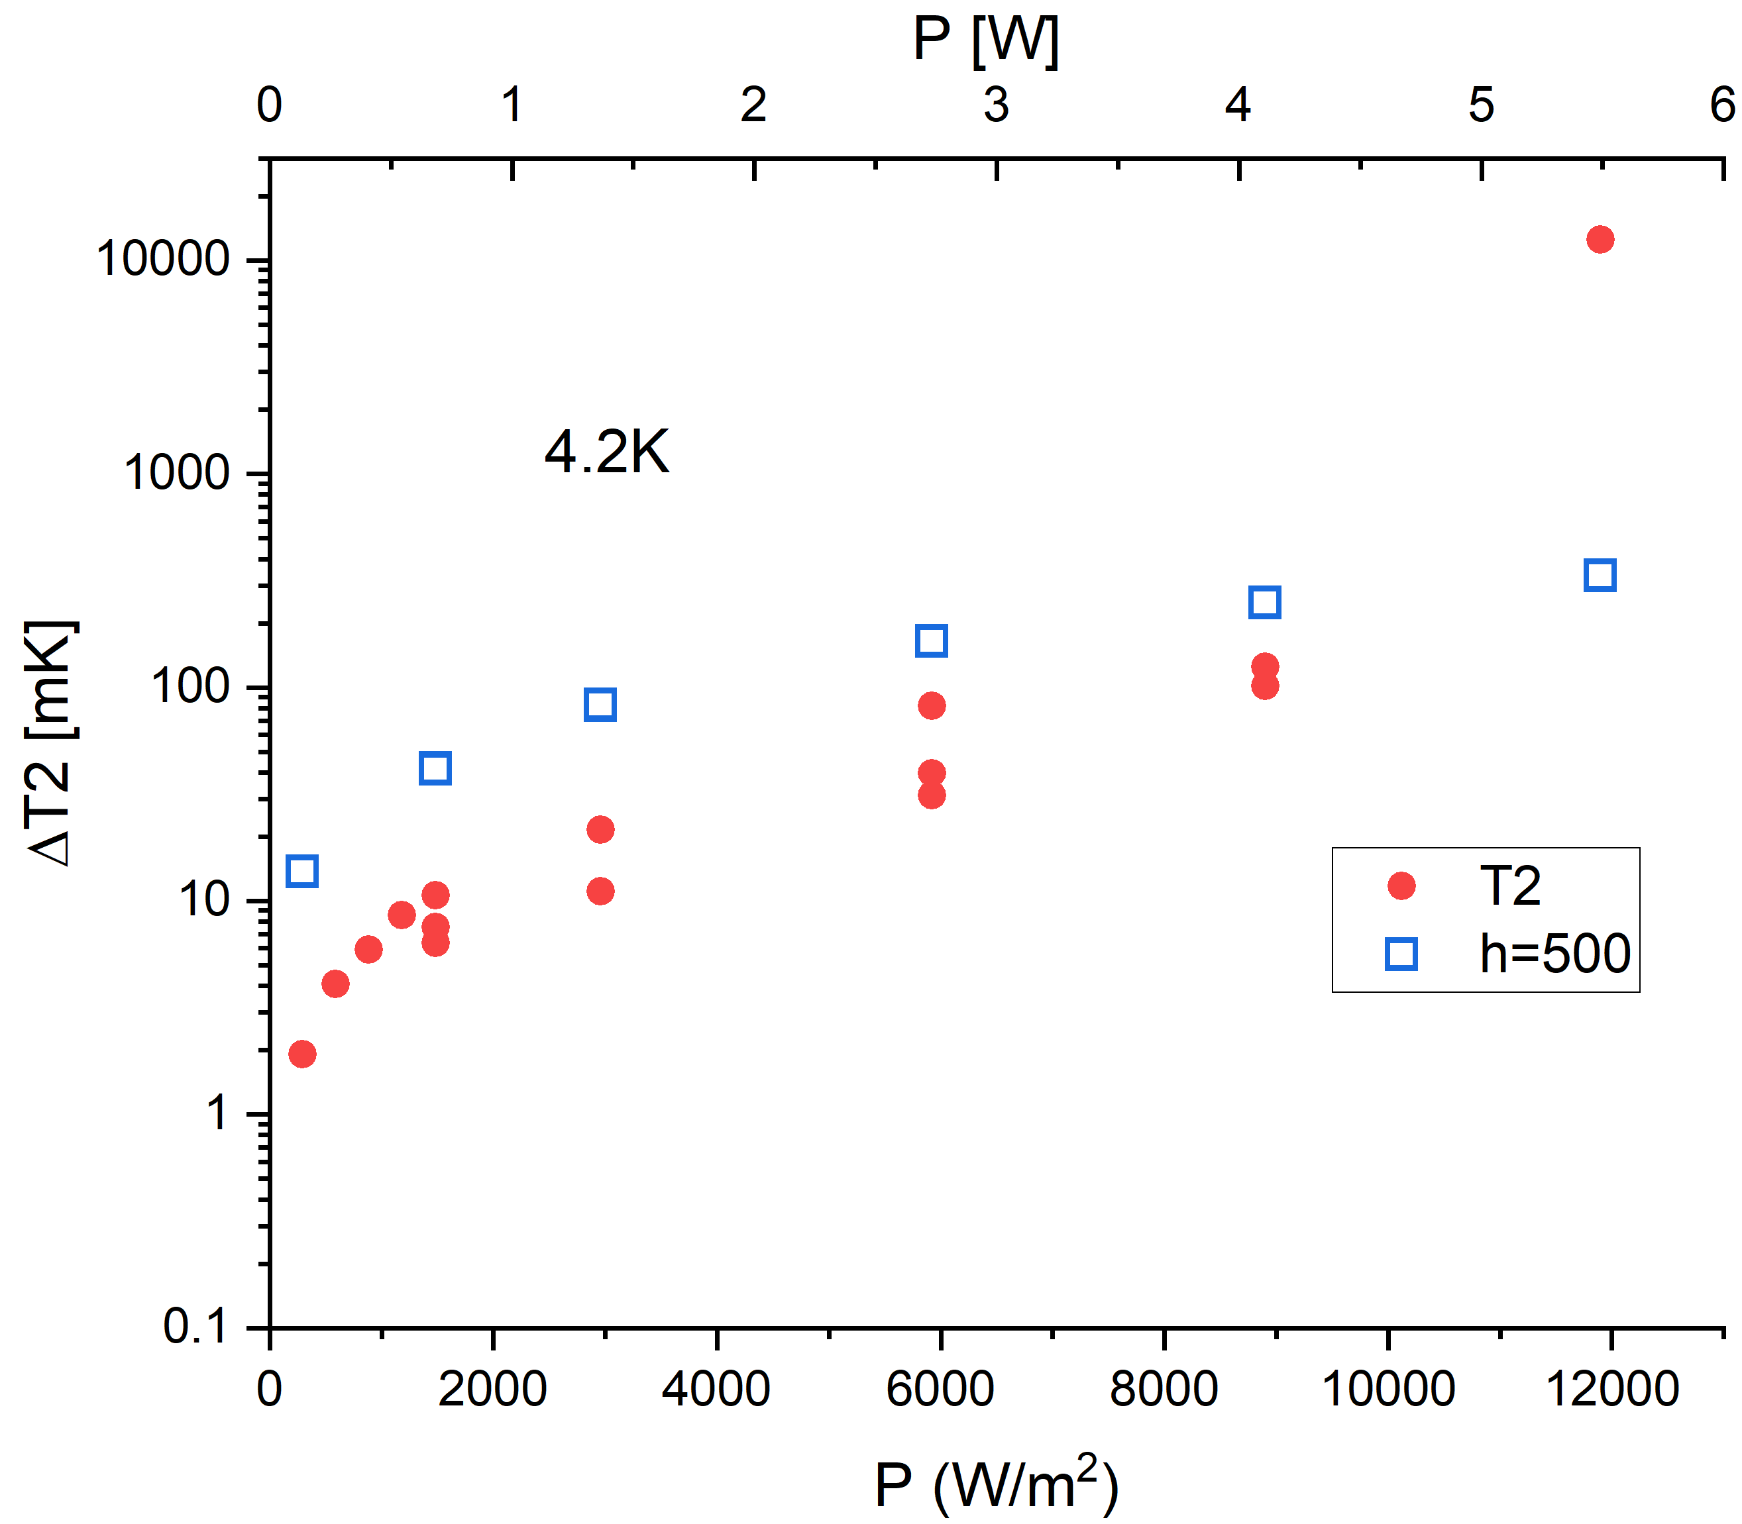
Cryogenic tests – proof of principle
Selected Laser Melting (SLM) of pur Cu.
First closed loop cryogenic test on a « lattice » 3,9 GHz cavity.
Tests at 4,2 and 4,5 K. Cryocooler power: 1,1 W and 1,5 W– cold head (reservoir).
P= 1 Bar at 4,2 K et 1,3 bar at 4,5 K.
Static vacuum (5.10⁻⁷ mbar).
Heater simulate the RF power.
Cernox: T1 et T3 before and after the cavity, T2 inside the cavity.
Cold head
He
T2
Tc Nb
continuous
Pulsed
He
T3
1st Successfull proof of principle.
SLM: excellent control over large variety of shapes for in walls cooling strategies.
But: too slow ( 3,9 GHz ~ 24 hrs).
Other technique is necessary for cost effective industrial scale production.
T1
Heater
h = heat transfer coefficient Cu-He.

Slide 6
Outline
Previous results on 3.9 GHz cavities – SLM
Scale up to 1.3 GHz cavities – Cold spray
  Electrical and thermal properties.
  Surface roughness and chemistry.
  Imbedded cooling channels.
  Leak tests.
  SS316 – Cu junctions.
Conclusion and Future directions
  Cryocoolers and deposition PACIFICS

Slide 7
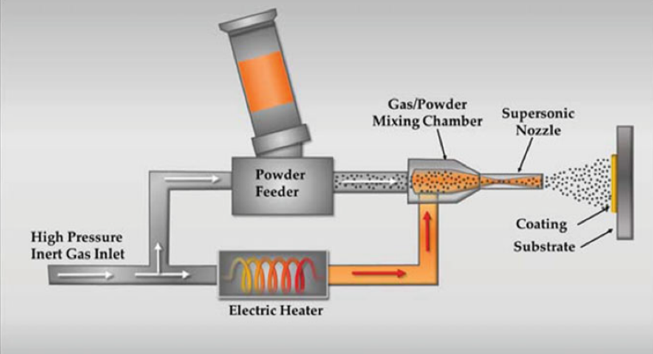
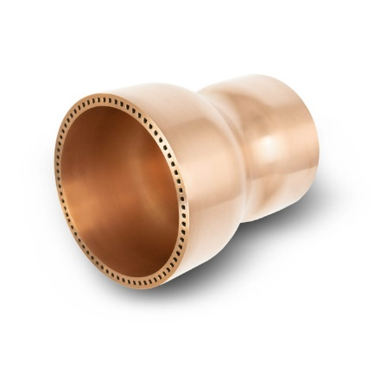
Cold spray of Copper SRF-Cavities
Exploration of Cold Spray Additive Manufacturing (CSAM) for copper cavities
Fast AM-method (deposition rate ~ 100 g/min).
Easy upscaling with available fabrication equipment.
Under recycled He or N₂ atmosphere (no difference for material properties).
Cu-alloy combustion chamber with integral cooling channels made via CSAM
Source: https://impact-innovations.com/en/applications/
Source: Practical Cold Spray, Springer
Powder: Cu 99.95% - (O ~ 200-300 ppm), d~ 31 µm.
Process: Pressure 21 bars / Temp = 500°C, speed: 400 m/s, scanning 200 mm/s.

Slide 8
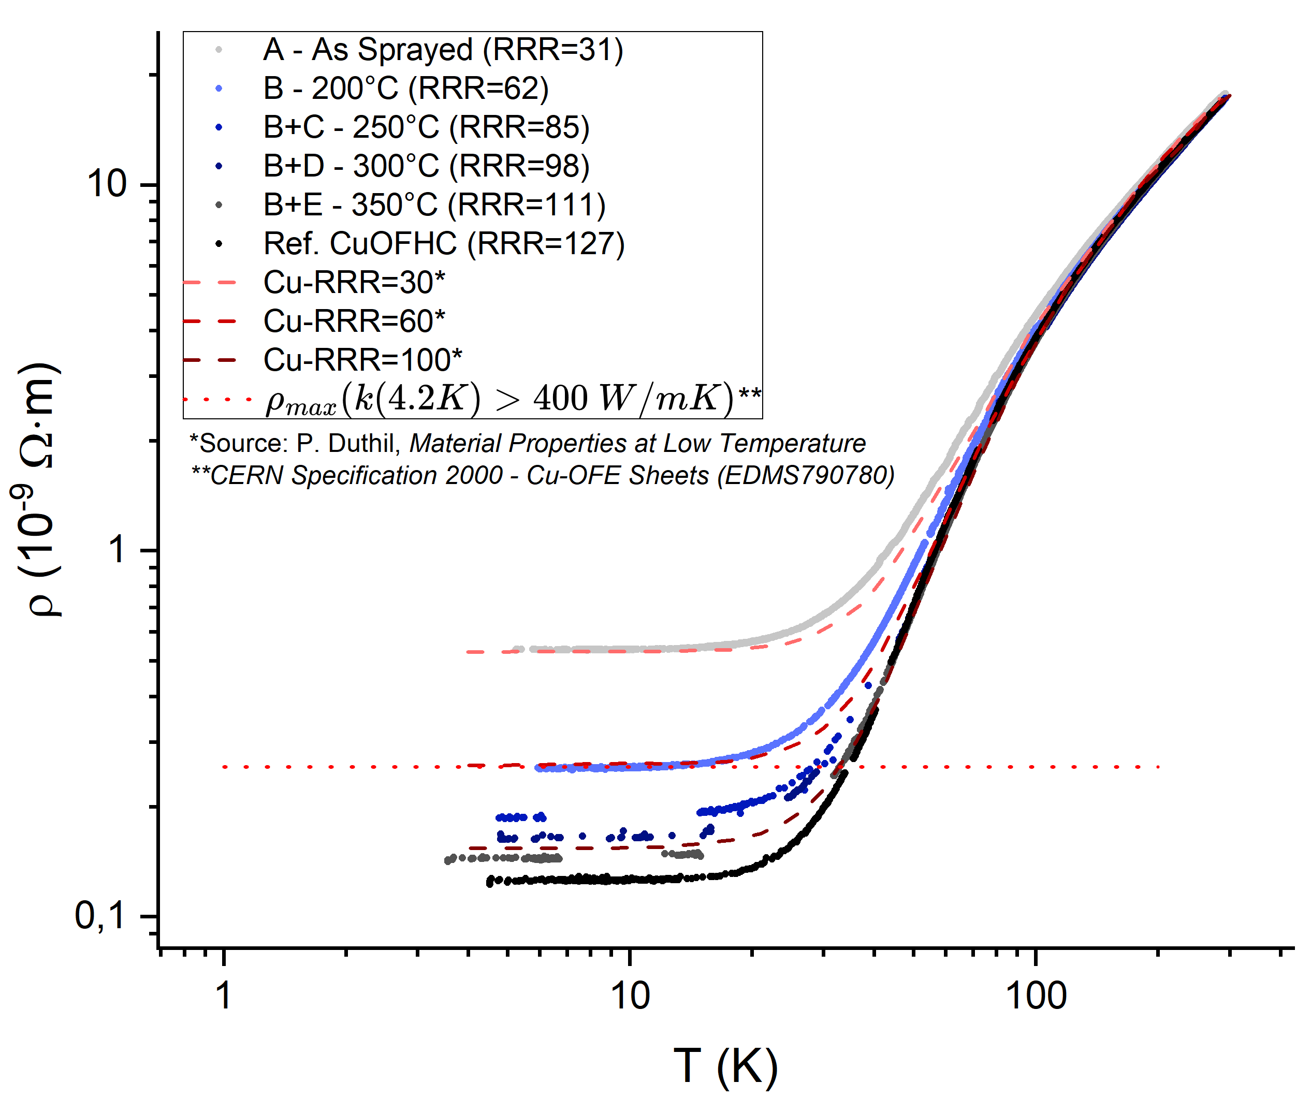
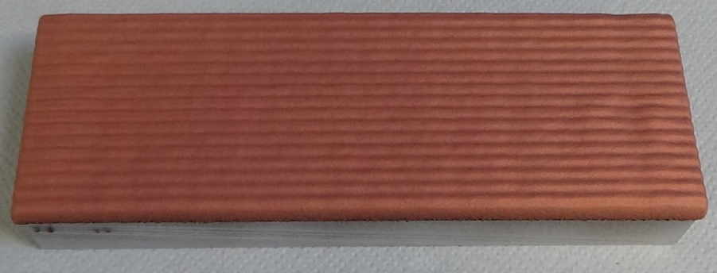
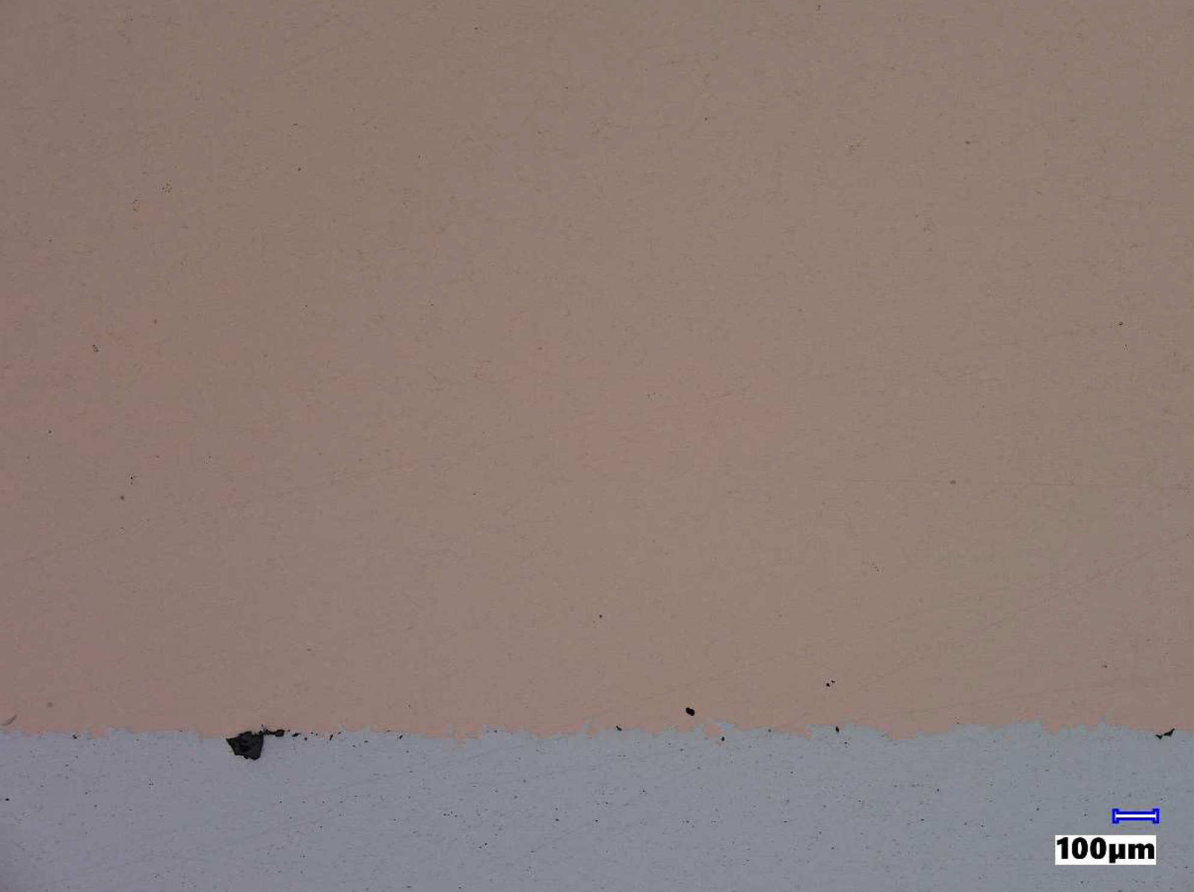

Cold spray – Material characteization
$$RRR=\frac{σ_{0 K}}{σ_{273 K}}=\frac{ρ_{273 K}}{ρ_{0 K}}≈\frac{ρ_{273 K}}{ρ_{4,2 K}}∝\frac{k_{e}}{T}$$
Exploration of Cold Spray Additive Manufacturing (CSAM) for copper cavities
RRR
Spec cavities = 55
Top: Sample of pure Cu deposition (th. ≈10 mm) on aluminium
Right: Cross section of Cu on Alu-substrate
Results on state of the art CSAM copper:
Dense deposition without porosities, electrical conductivity of > 58 MS/m after heat treatments at 200°C or higher.
RRR values after mild post-heat treatments (200°C) > 60, and k > 300 W/(m.K) at 4.2 K.
Slow decrease of hardness with increasing H.T.

Slide 9
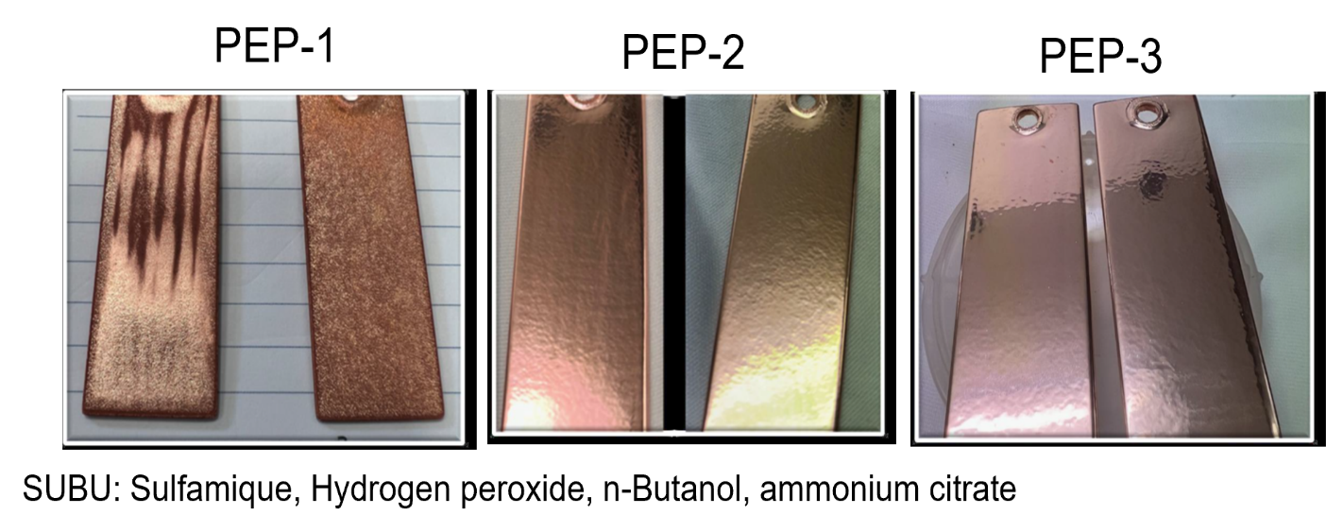
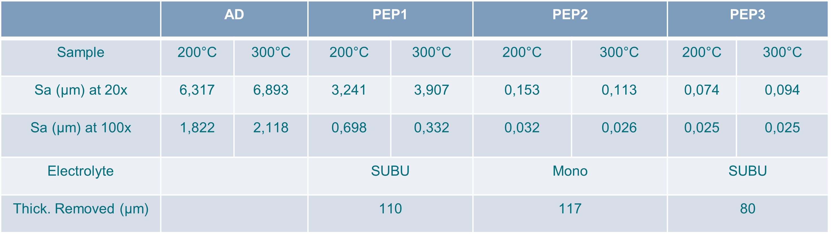
Cold spray – surface roughness
Electropolishing at CEA:
50% Phosphorique – 30% Butanol – 20% water (Internship K. Danfakha, E. Sellin)
Plasma Electropolishing at INFN:
Both techniques (EP and PEP) give Ra ~ 0.08 µm √
Effect on post annealing > 250°C: segregation of O impurities that creates holes/pits upon chemical etching.
Limit the post annealing to ≤ 250°C.

Slide 10
Cold spray – Multi metal junctions
Cold spray enable manufacturing 316L flanges + Cu cavity in one step.
350°C
700°C
As sprayed
+ 200°C in air
+ 350°C in HV
+700°C
No leaks (pure Cu or SS316-Cu) (< 10⁻¹⁰ mbar.l.s⁻¹) after 3 successive quenches L. N₂ tests. √
Interface Cu-316L withstand up to 350°C-12hr…but at 700°C cracks appear.
Permittivity 1.04 after 200°C (700°C transition -> austenitic non magnetic).

Slide 11
Cold spray – cooling channels
Cooling channels: In-wall liquid He flow tube.
Machining
Filling
Machining
Cu deposition
Air leak test 1.5 bars
Dissolution NaOH
Well defined continuous channels (NaOH dissolution of Al fillings) √
No air leak at 1.5 bar √ and He leak test successful (< 10⁻¹⁰ mbar.l.s⁻¹).
Well defined continuous channels (NaOH dissolution of Al fillings) √
No air leak at 1.5 bar √ -> future He leak test.

Slide 12
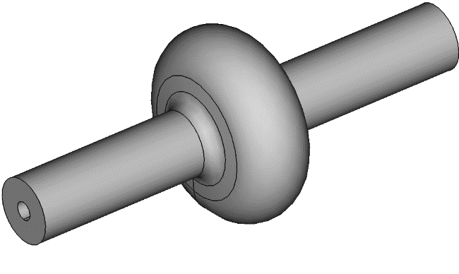
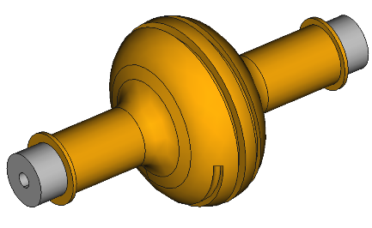
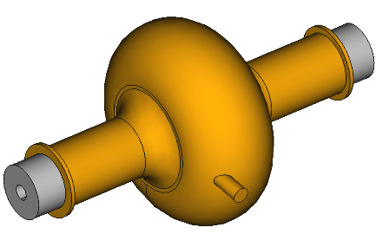
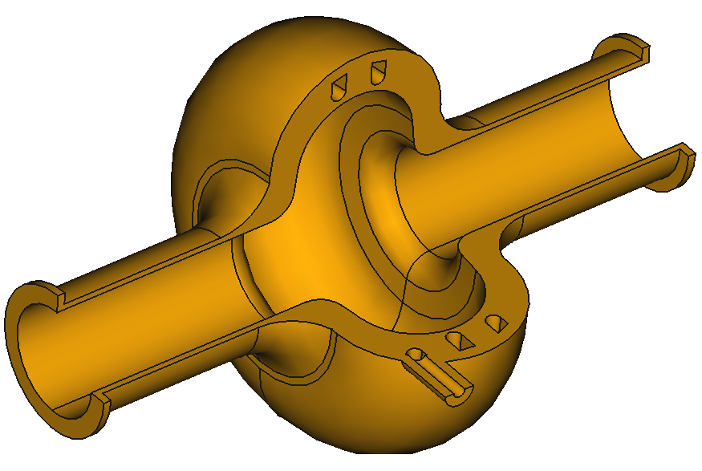
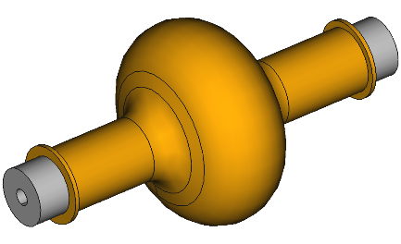
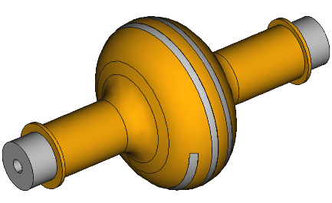
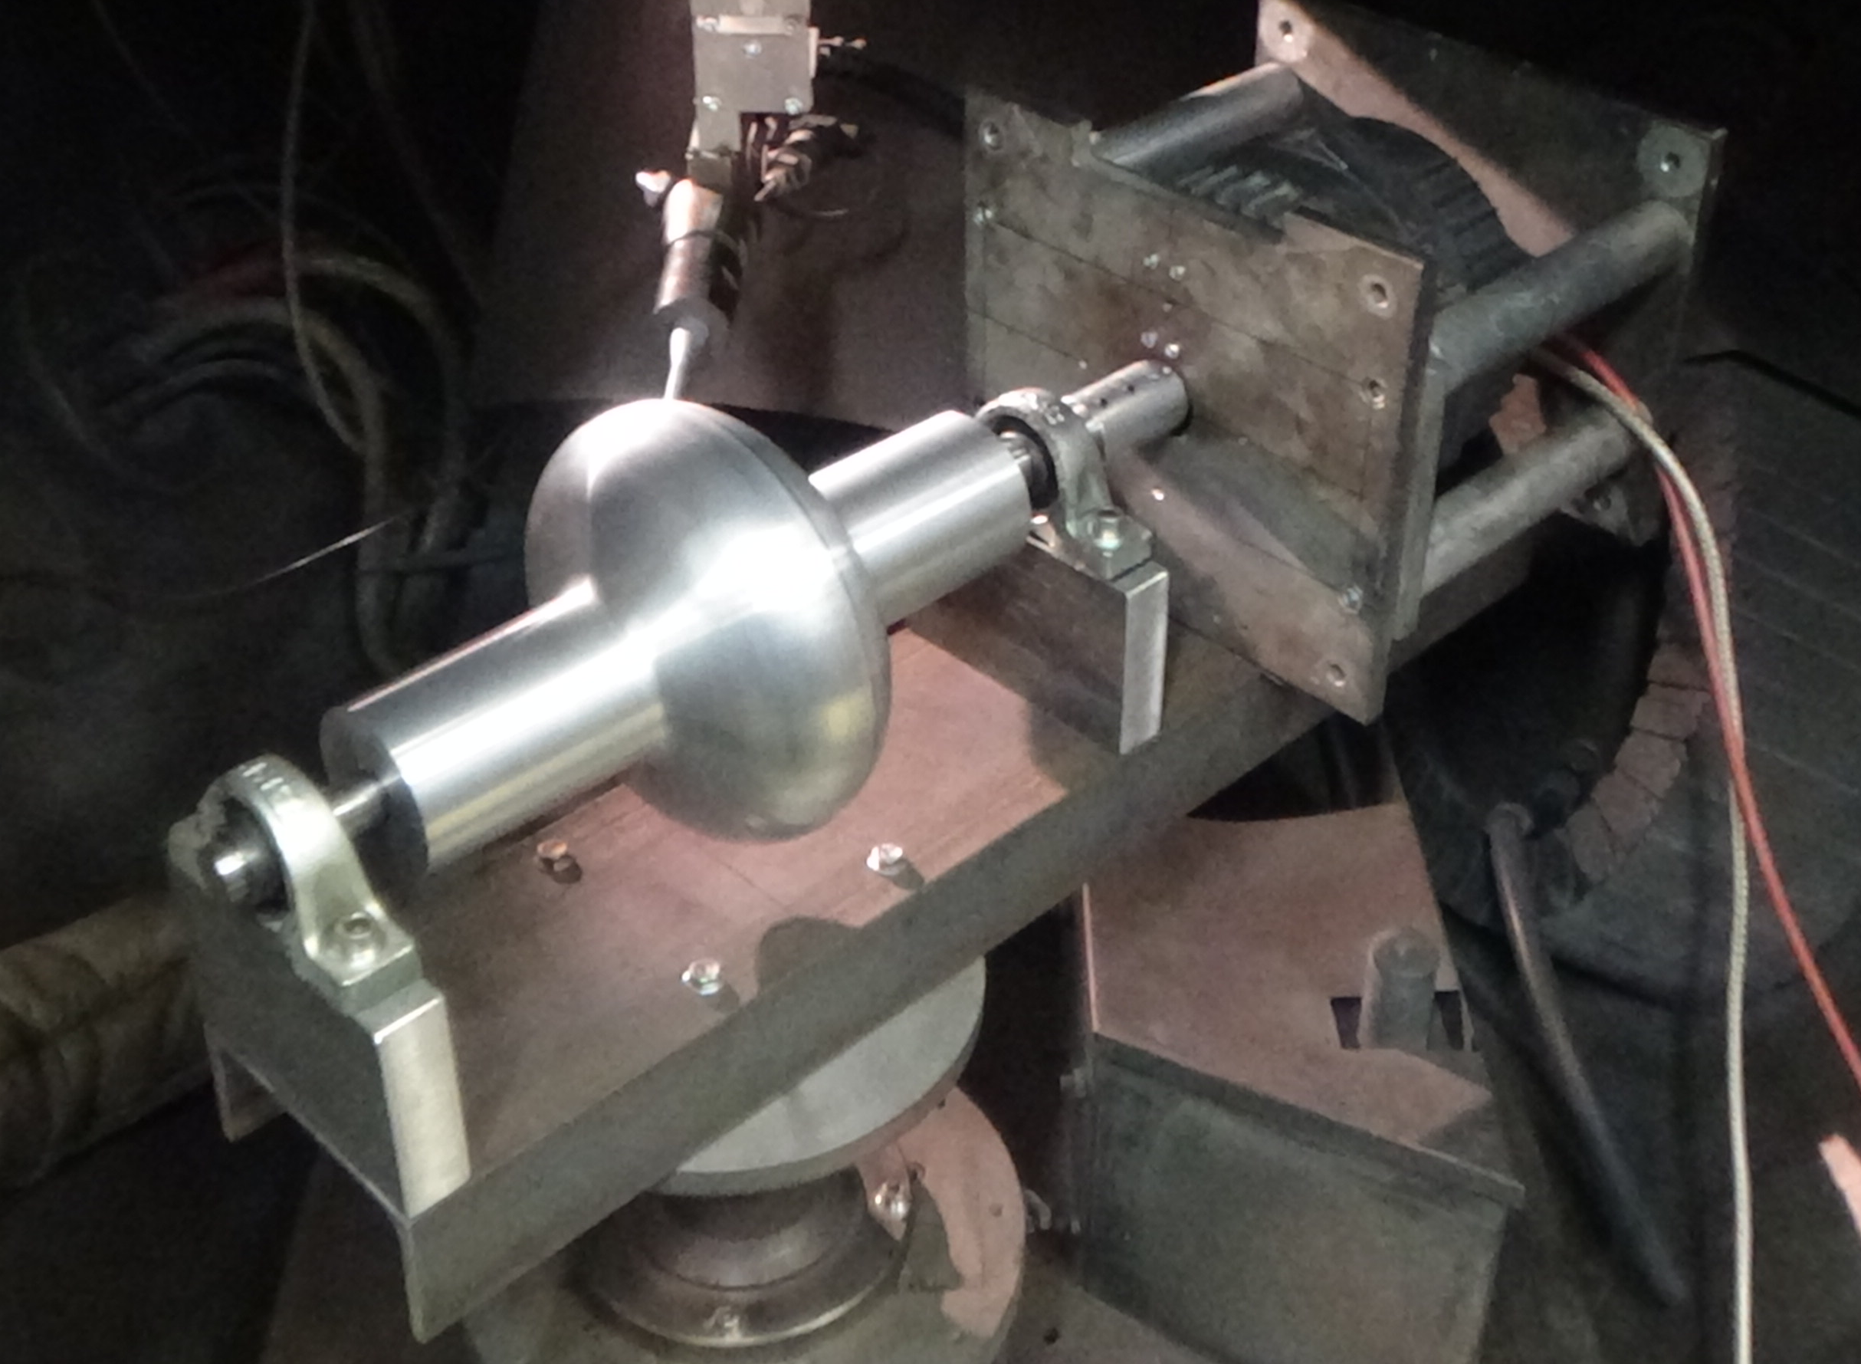
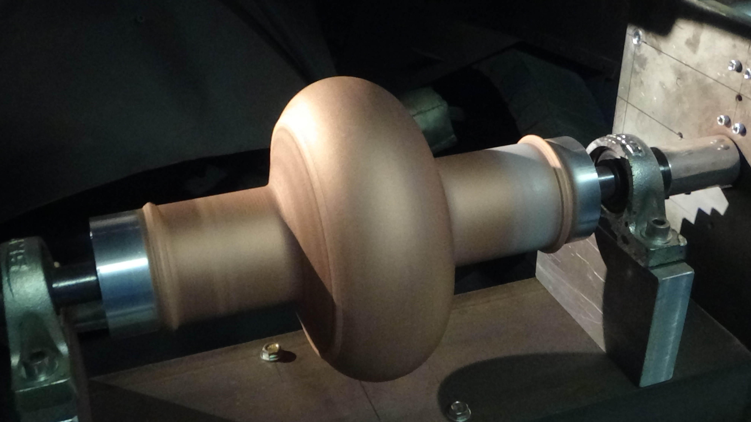
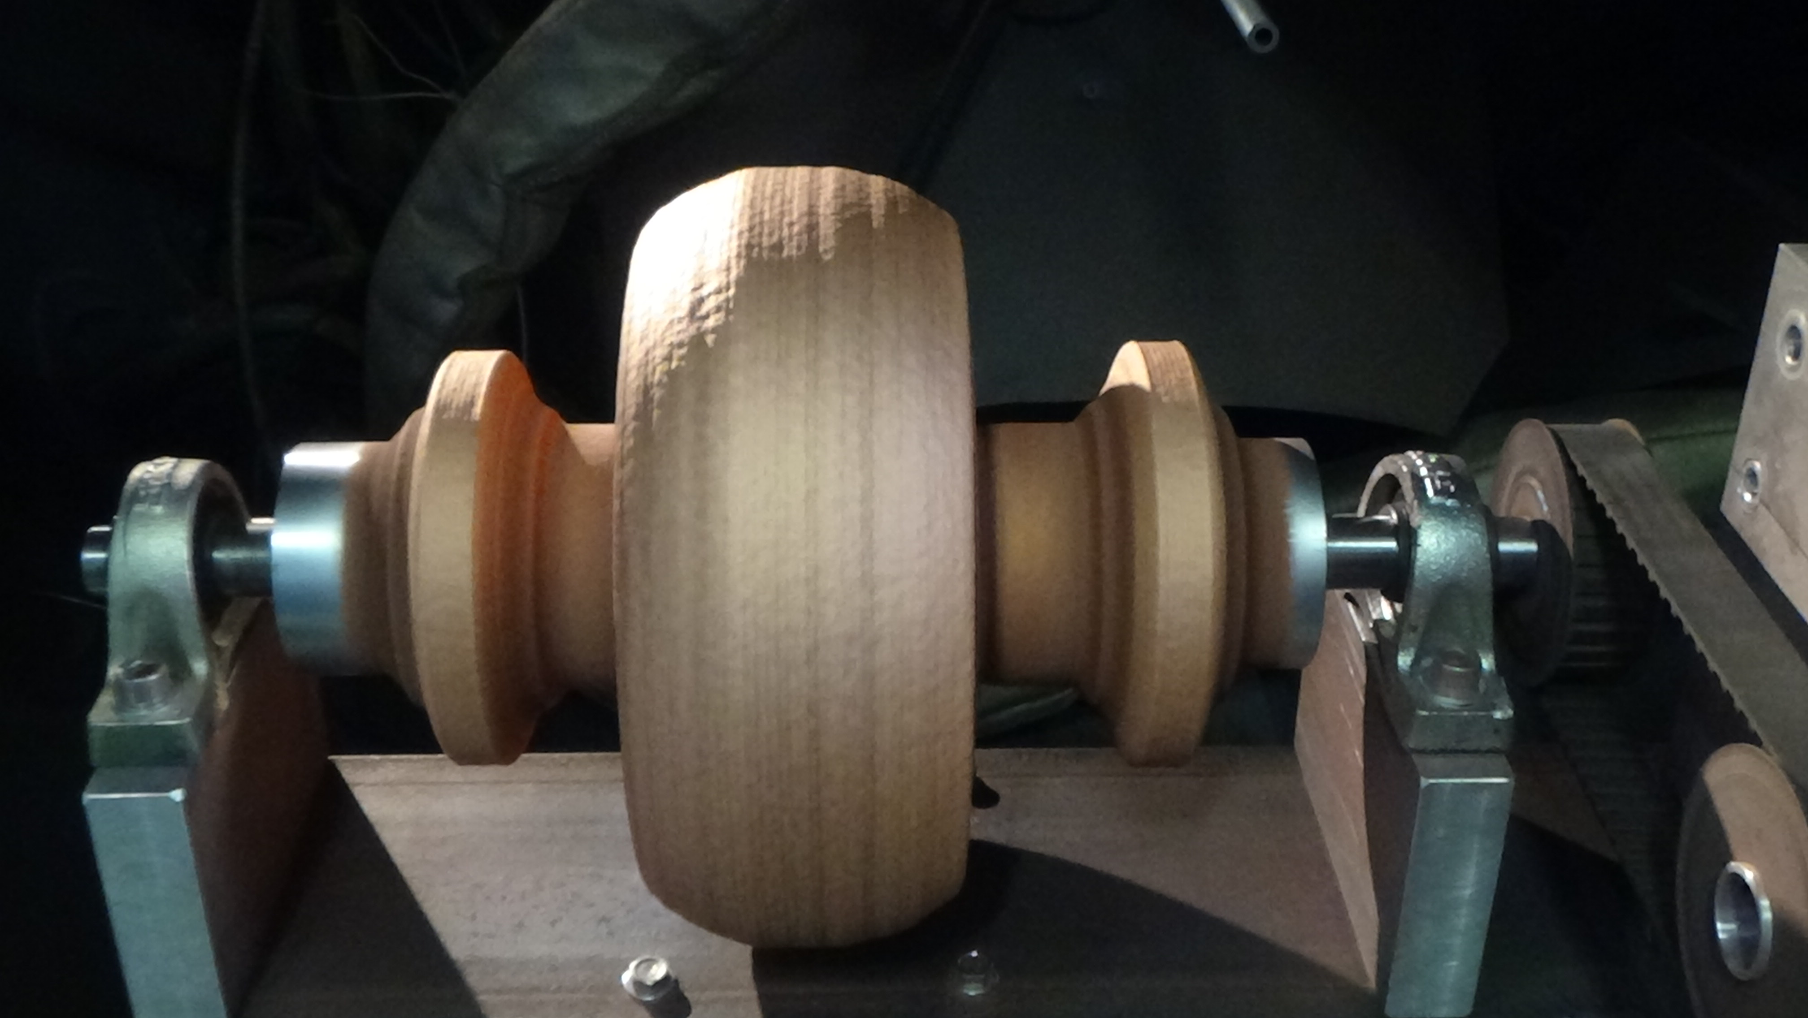
Cold spray – 1.3 GHz cavity
Alu mandrel
Machining
(e.g. channels)
Final Cu-depositon
1st Cu-deposition
Filling with alu
Final machining and chemical removal of aluminum
Machining
Al Mandrel
Cu CS
Cu CS
Under machining. Next step: inert Al fillings + CS of Cu + dissolution.
Al mandrel can be made from Al sheets (4 mm) at Piccoli instead of bulk.

Slide 13
Outline
Previous results on 3.9 GHz cavities – SLM
Scale up to 1.3 GHz cavities – Cold spray
  Electrical and thermal properties.
  Surface roughness and chemistry.
  Imbedded cooling channels.
  Leak tests.
  SS316 – Cu junctions.
Conclusion and Future directions
  Cryocoolers and deposition PACIFICS

Slide 14
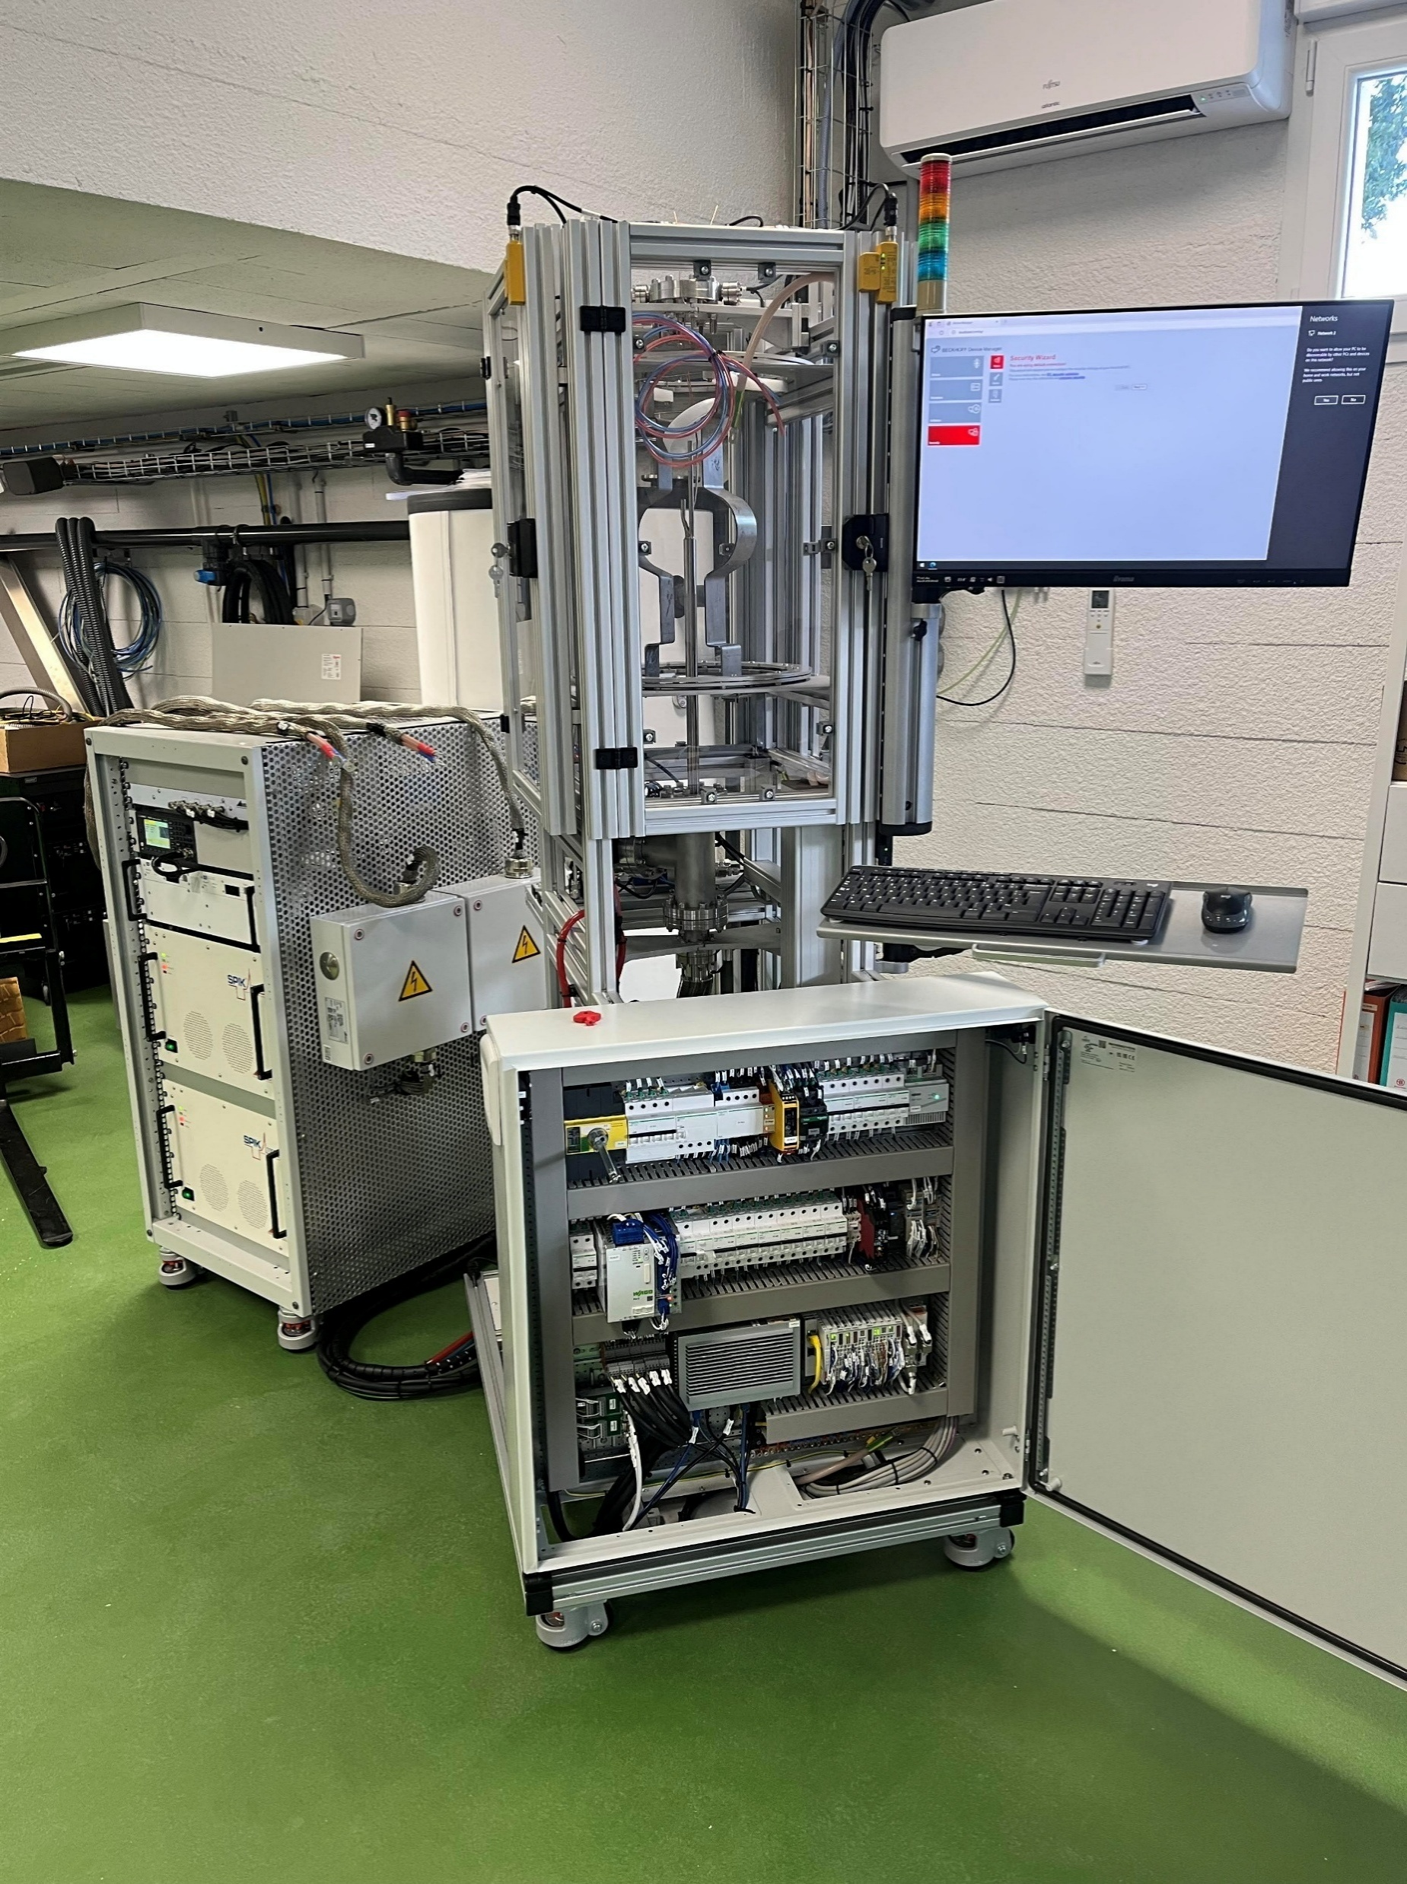
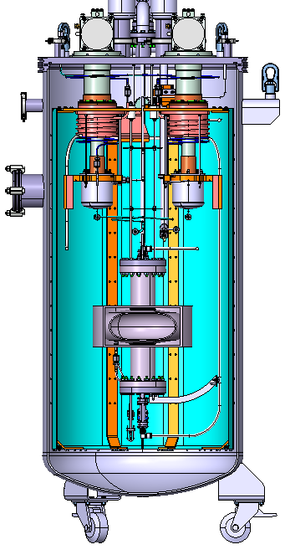
Future directions and conclusion
HiPIMS
Scarcity of ressources: higher operation temperature / reduce He volume/reduce materials .
Additive manufacturing to optimize He ressources and cooling process.
  Proof of principle demonstrated feasibility.
  Cu material meets required cavity criteria (RRR, roughness).
  Leak tests successfull.
  Cold Spray as scalable technique with multi metal manufacturing capability (Cu-SS/Cu-Ti).
Future Development of new facilities owing to ANR Equipex+ PACIFICS funding.
  New coating capability: HIPIMS for higher T_{C} material deposition.
  Cryocooler cryostat to test cool down performance of 3D printed 1.3 GHz cavity.
  Cryocooler cryostat to conduct RF tests 3D printed 1.3 GHz cavity coated with Nb .
Cryostat cryocooler

