Slide 1
High-power operation of the FPC for HEPS 166.6 MHz SRF cavities
Tongming Huang
IHEP

Slide 2
Outline
Introduction
High-power tests (on-stand, on-cavity)
On-line operation
Summary

Slide 3
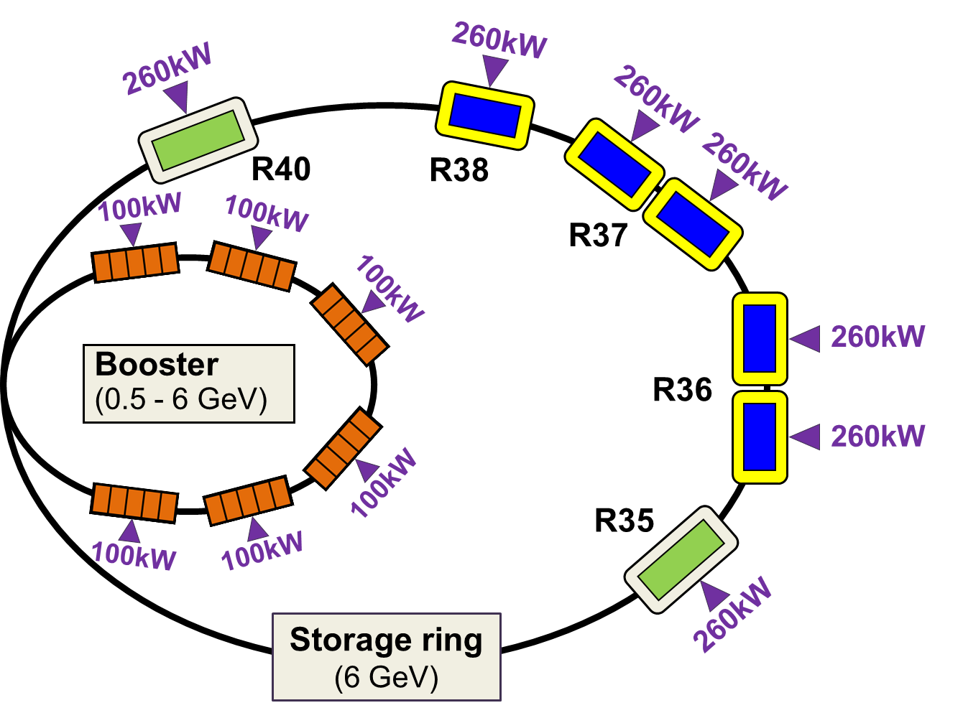
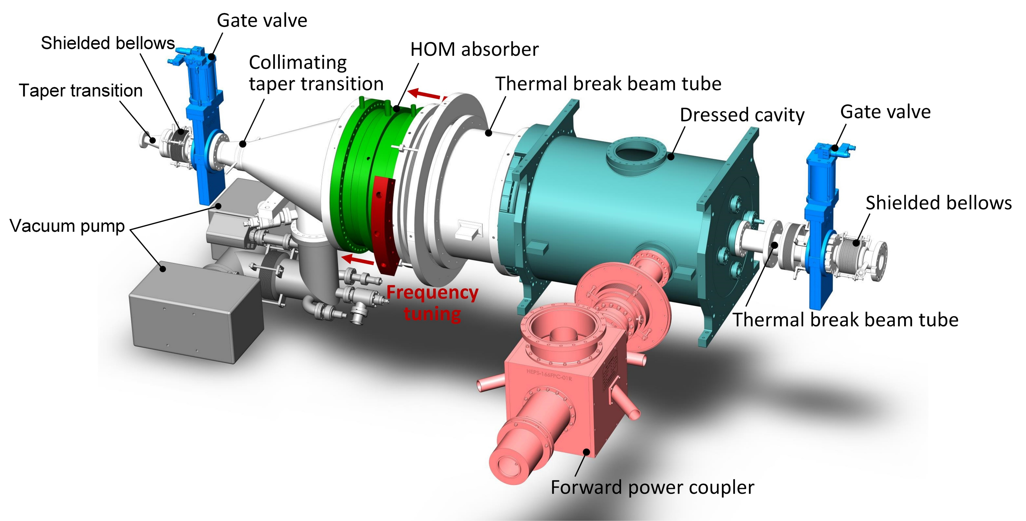
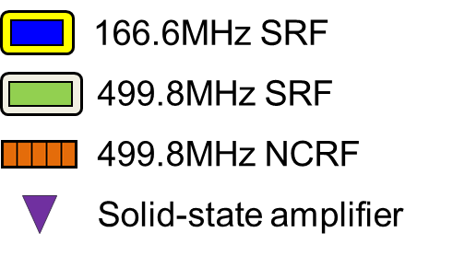
Introduction
Fundamental RF
RF frequency: 166.6 MHz
Total RF voltage: 5.14 MV
RF power per cavity: CW, 190 kW
Max. FPC power: CW, 250 kW (SSA limit)

Slide 4
Challenges (compromise)
Challenges: CW 250 kW + Cavity-wall location
Compromise and balance have been essential throughout the entire design process.
High power level
Minimum FE damage risk
Low cryogenic heat load
Cleanroom assembly
High RF loss → High dynamic heat load
Coupler location: close to cavity’s
H-end
Coupler location:
far away from cavity’s H-end
Short outer conductor and limited by cryostat size
Large magnetic field leakage → High dynamic heat load
Long outer conductor

Slide 5
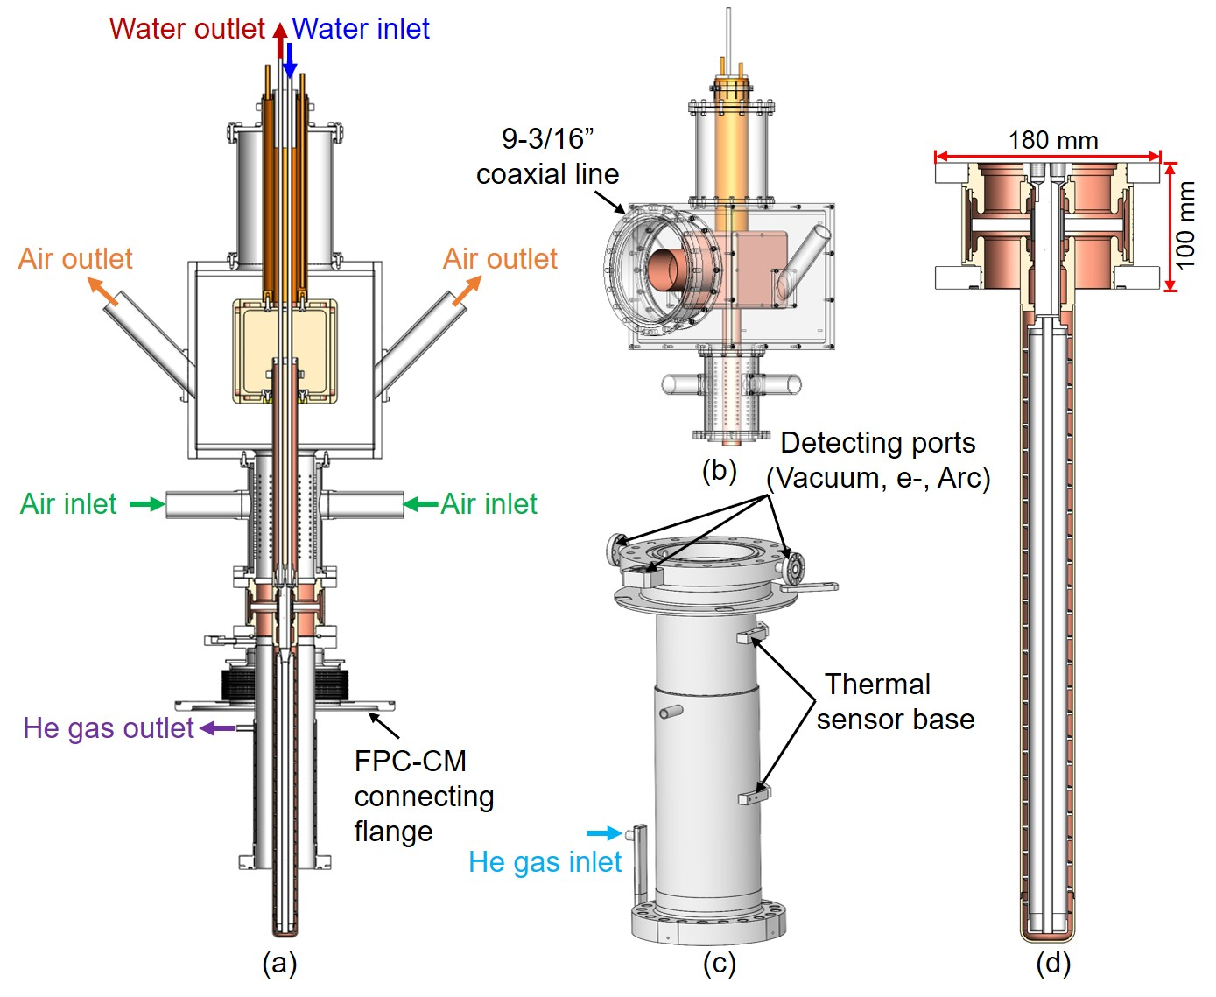
Main features (series design-B)
RF window
- Single window (Tristan-type)
- Ceramic size: 27.4*120*10 mm
- Ceramic material: 97.6% Al2O3 (Morgan AL-300)
Coaxial section
- OC: Double-wall structure
  Φ: 100mm, length: 402 mm, Zc: 50 Ω
  Thickness: 1mm SS + 20μm RRR30 copper plating
- IC: Made of copper (OFHC)
Transition component
- T-box structure
- Outer T-box dimension: 340*340*340 mm
- DC bias: ±2000V
Cooling
- Inner conductor (vacuum part): water
- Outer conductor (vacuum part): cold helium gas
- Inner conductor (air part): forced air
- Inner T-box (air part): forced air
Detector
- Vacuum, electron current, arc
Vacuum part
Vacuum part assembled with cavity in clean room

Slide 6
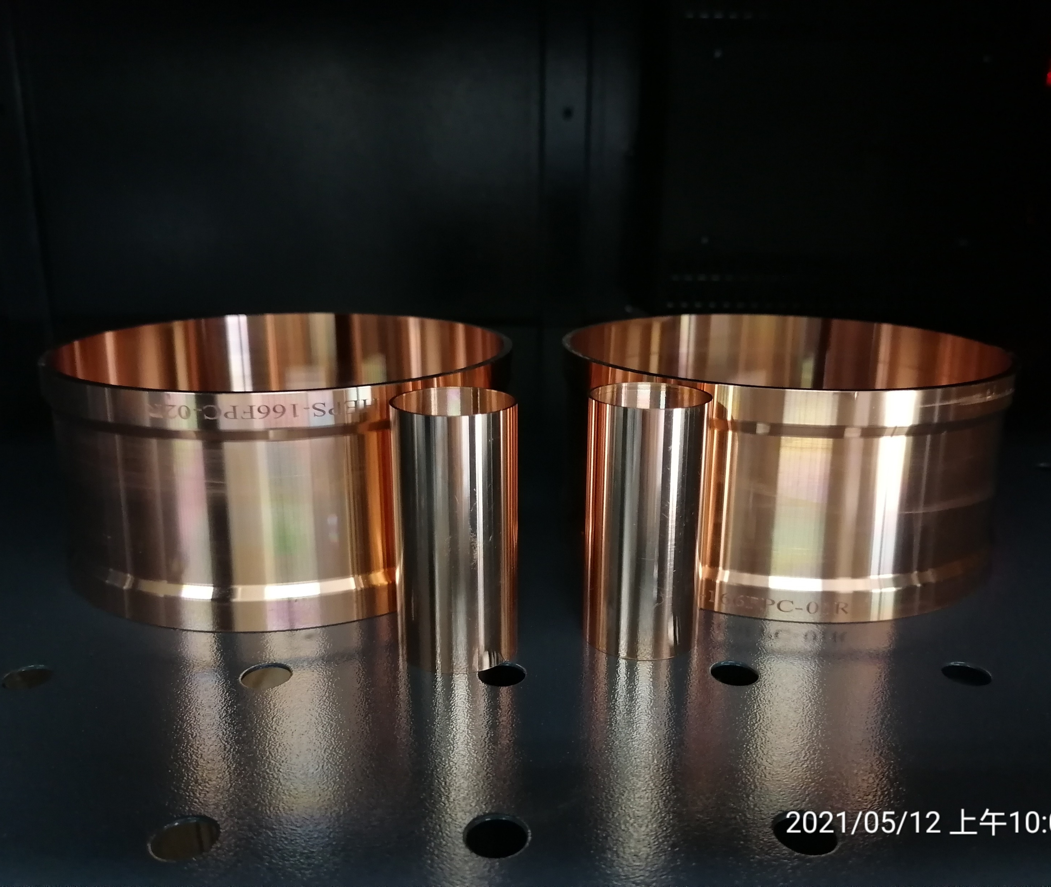
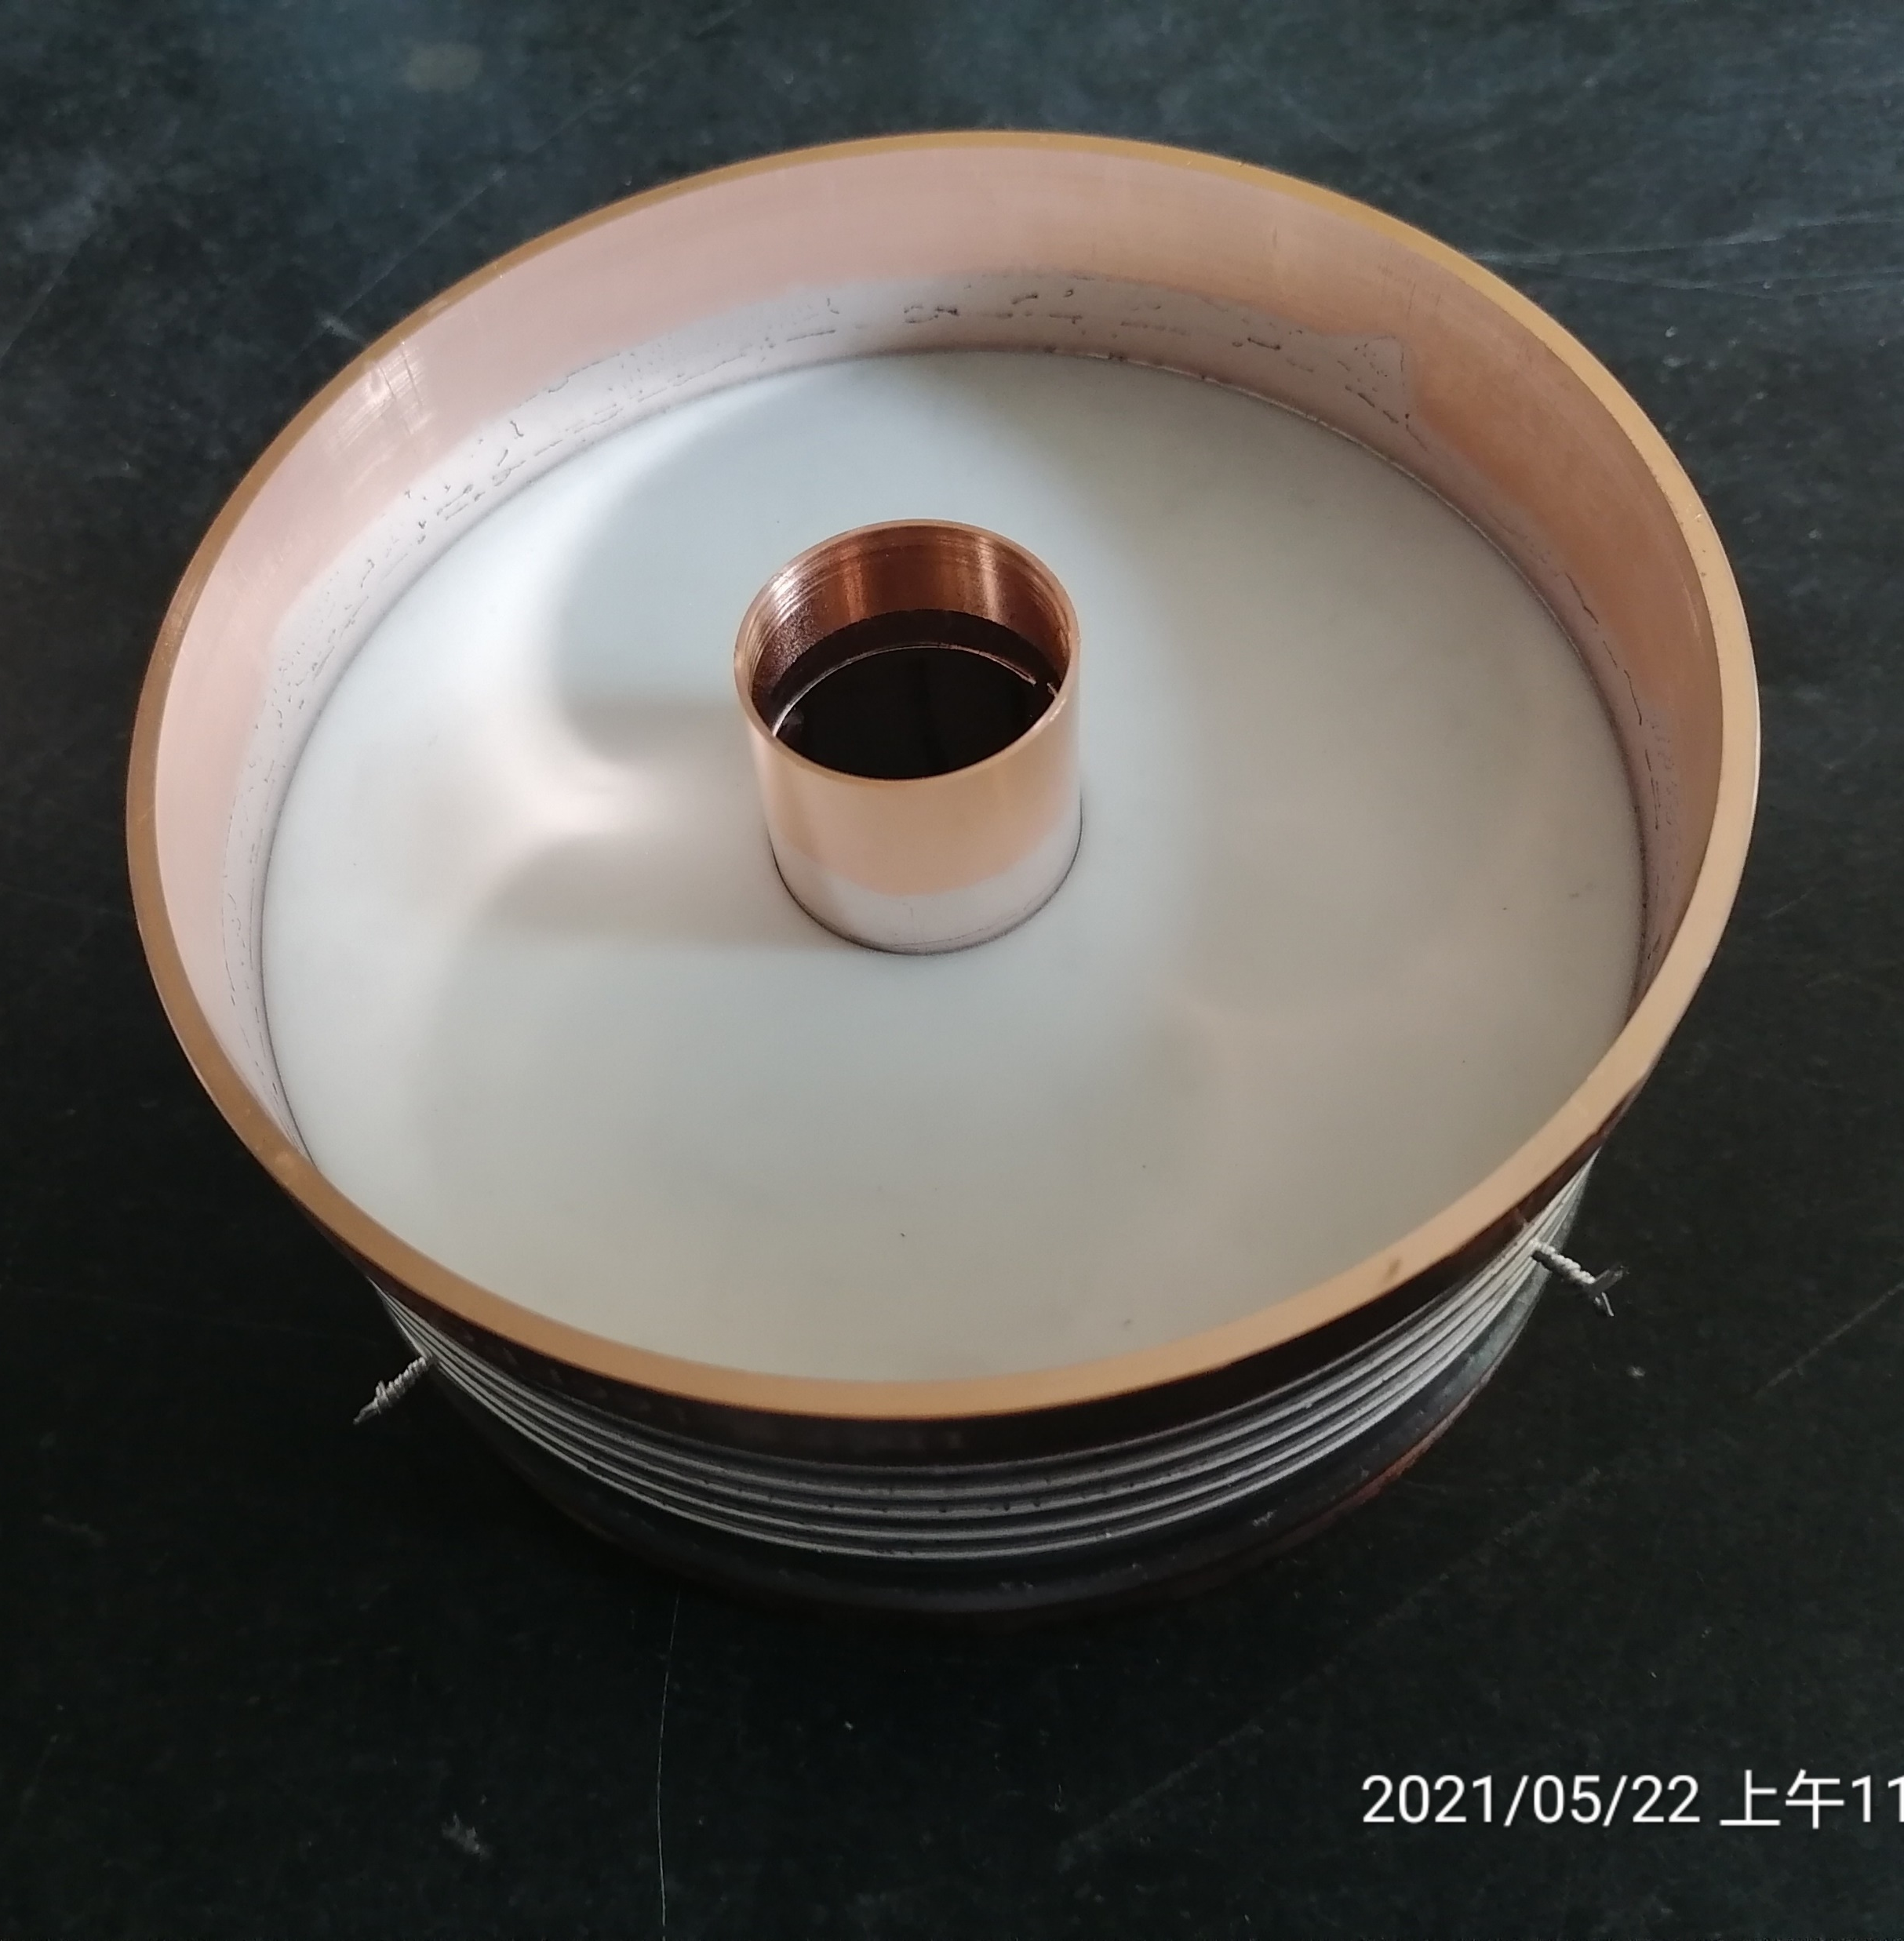
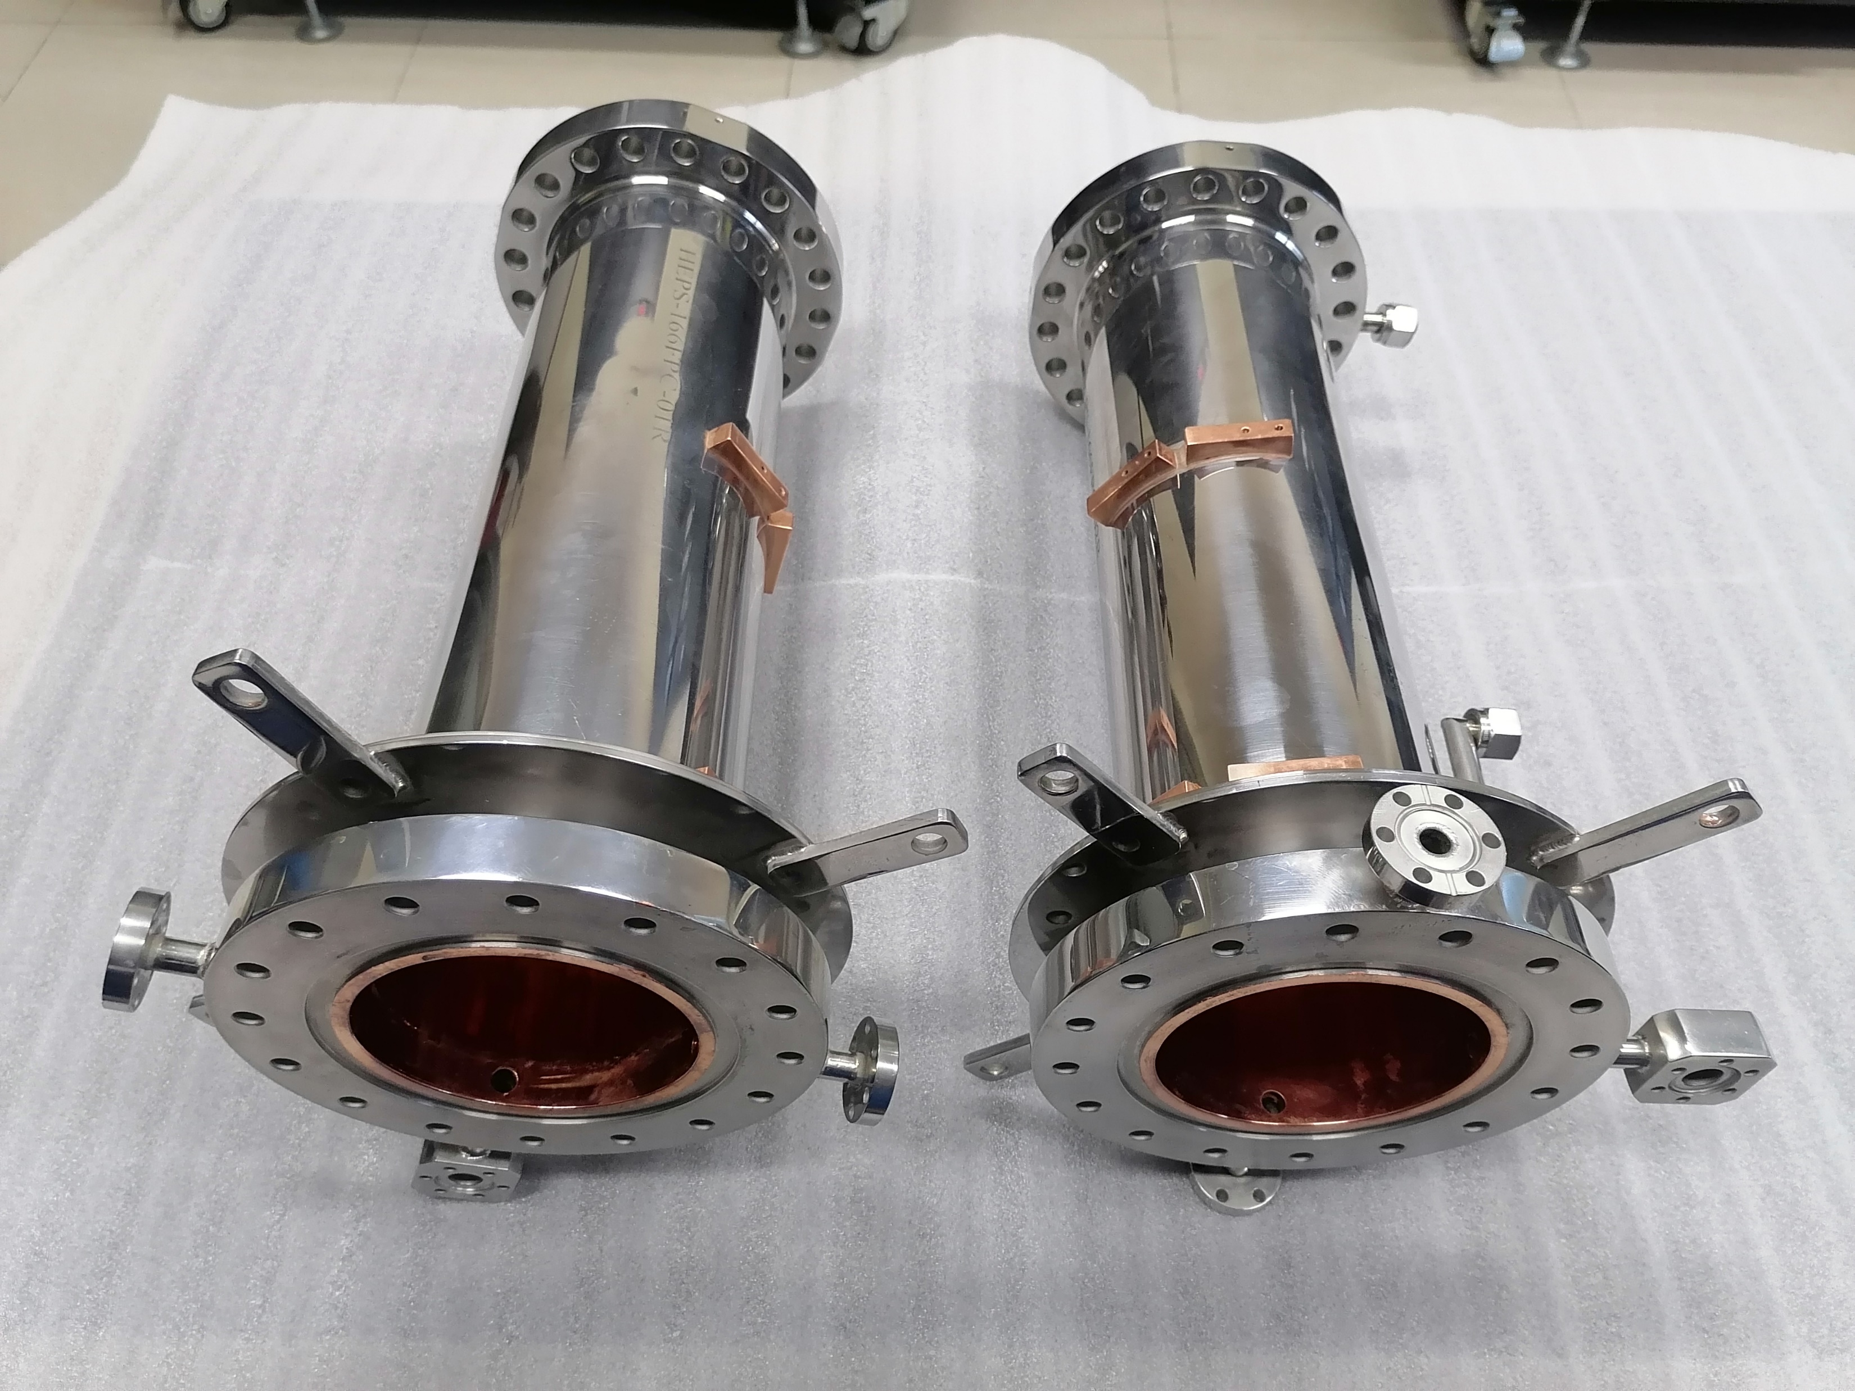
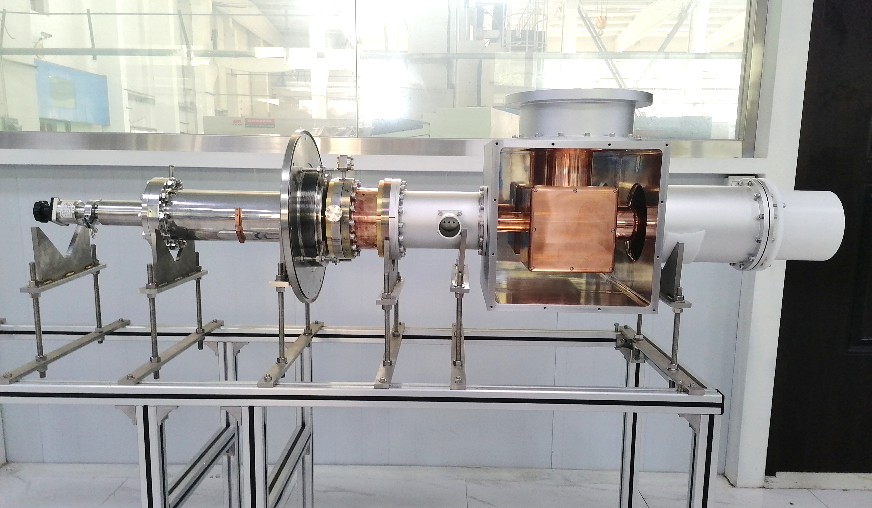
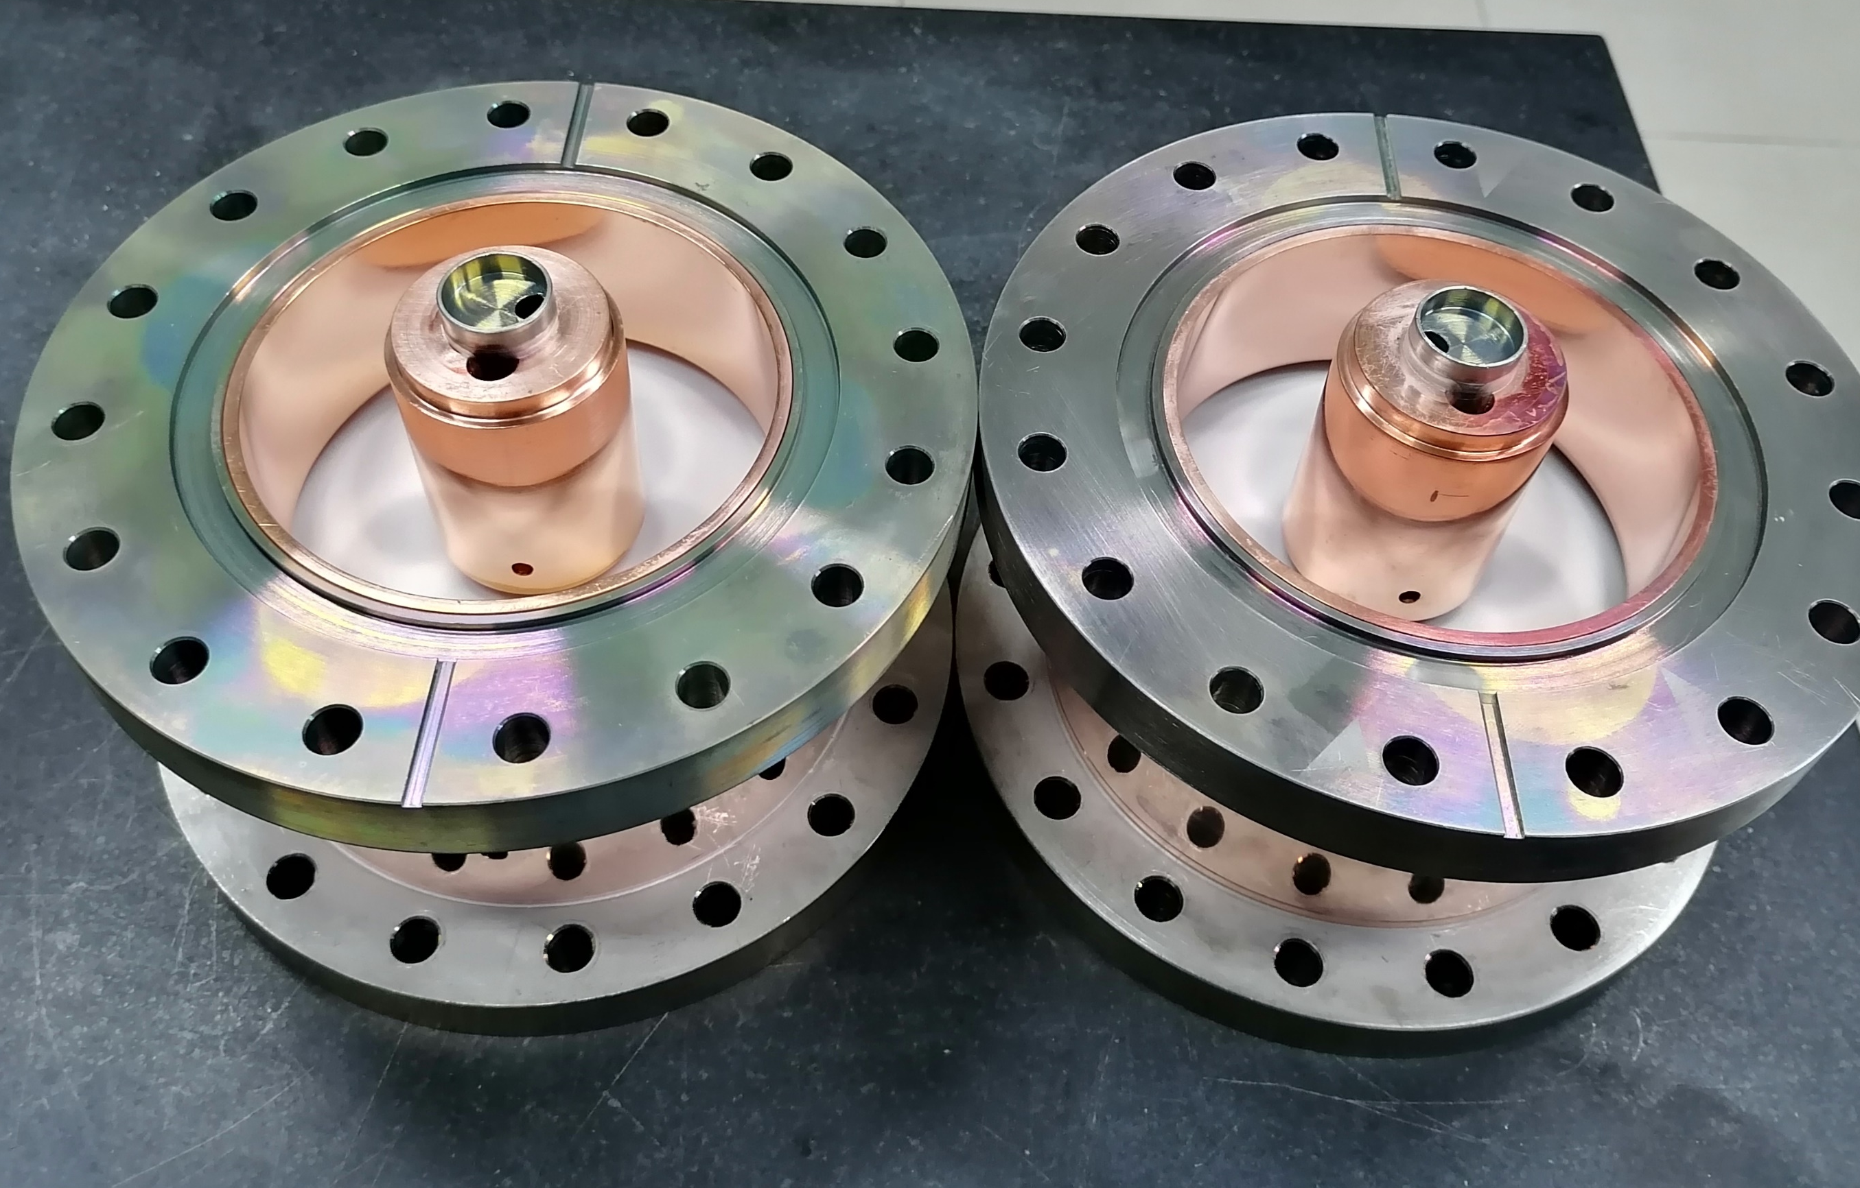
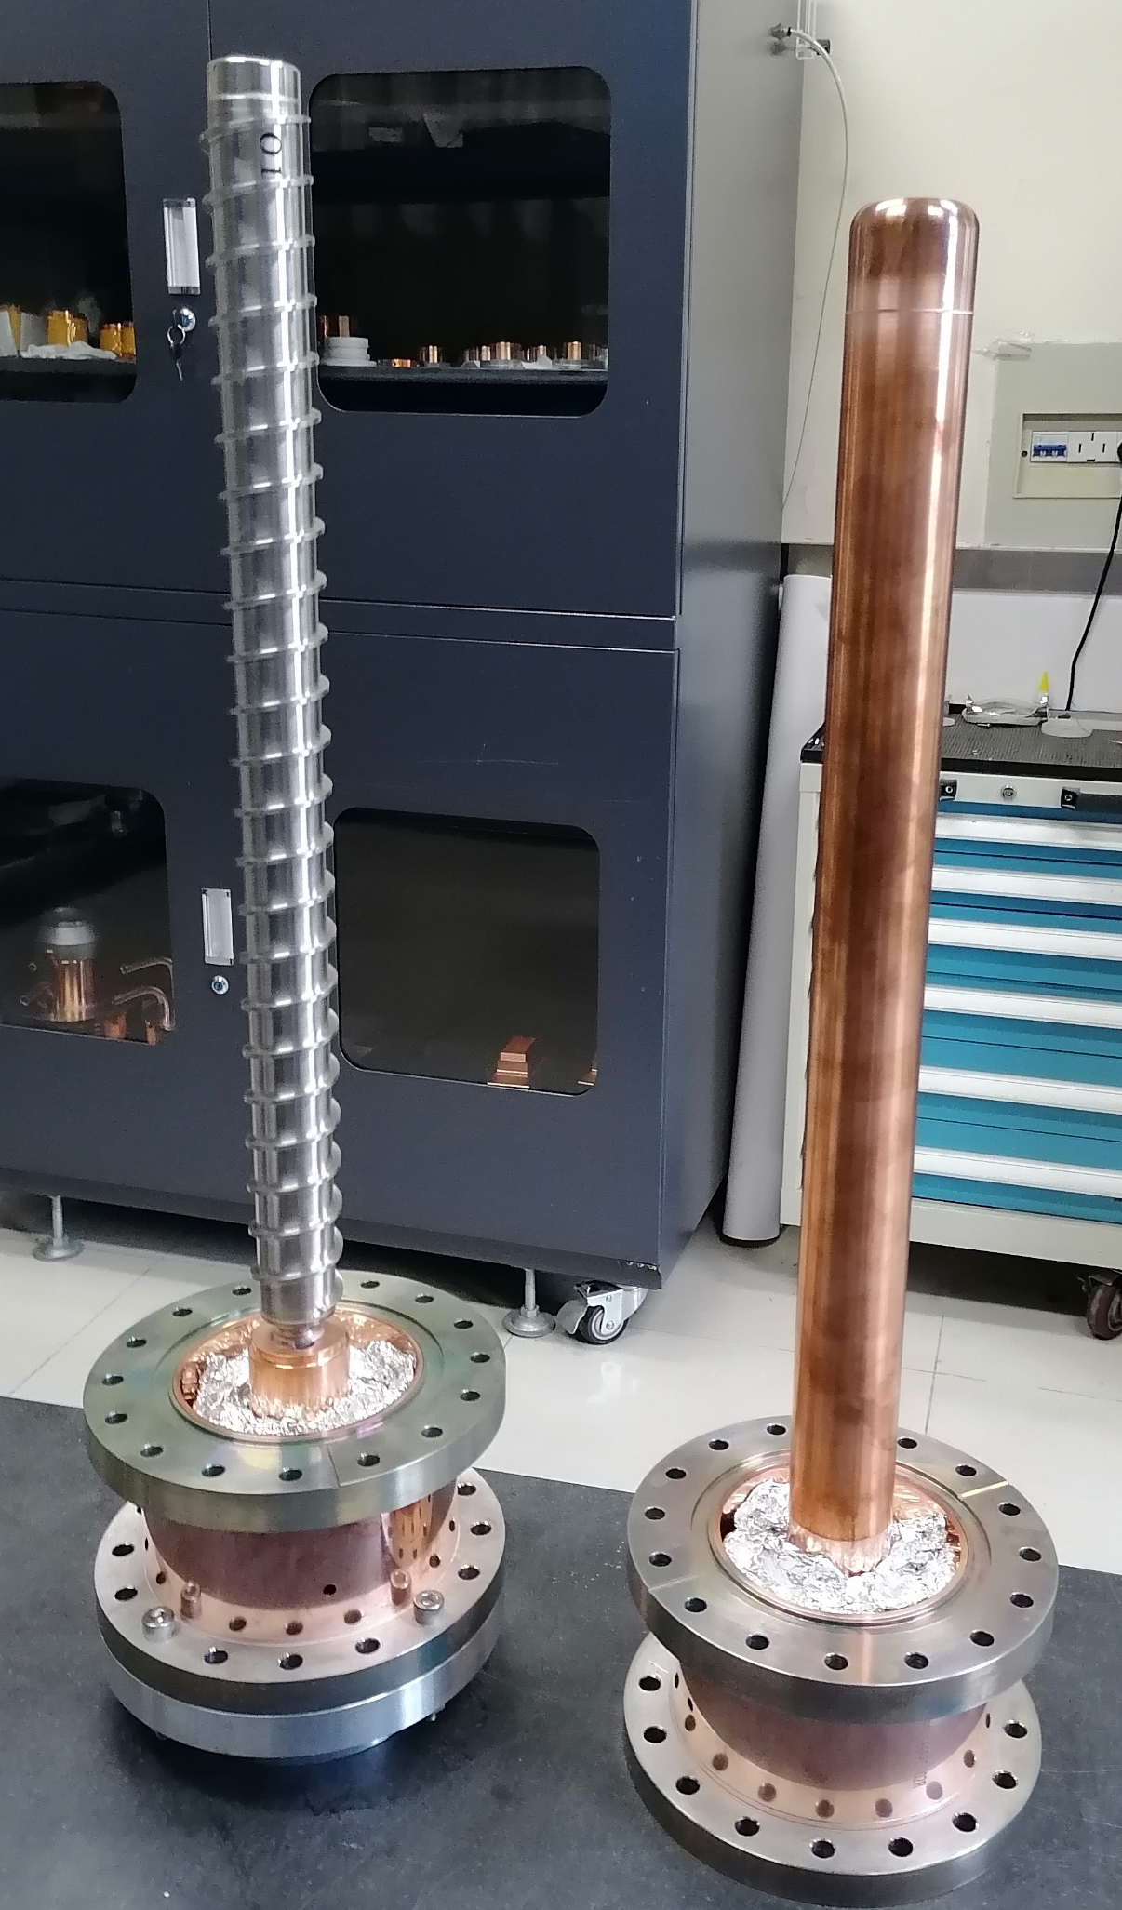
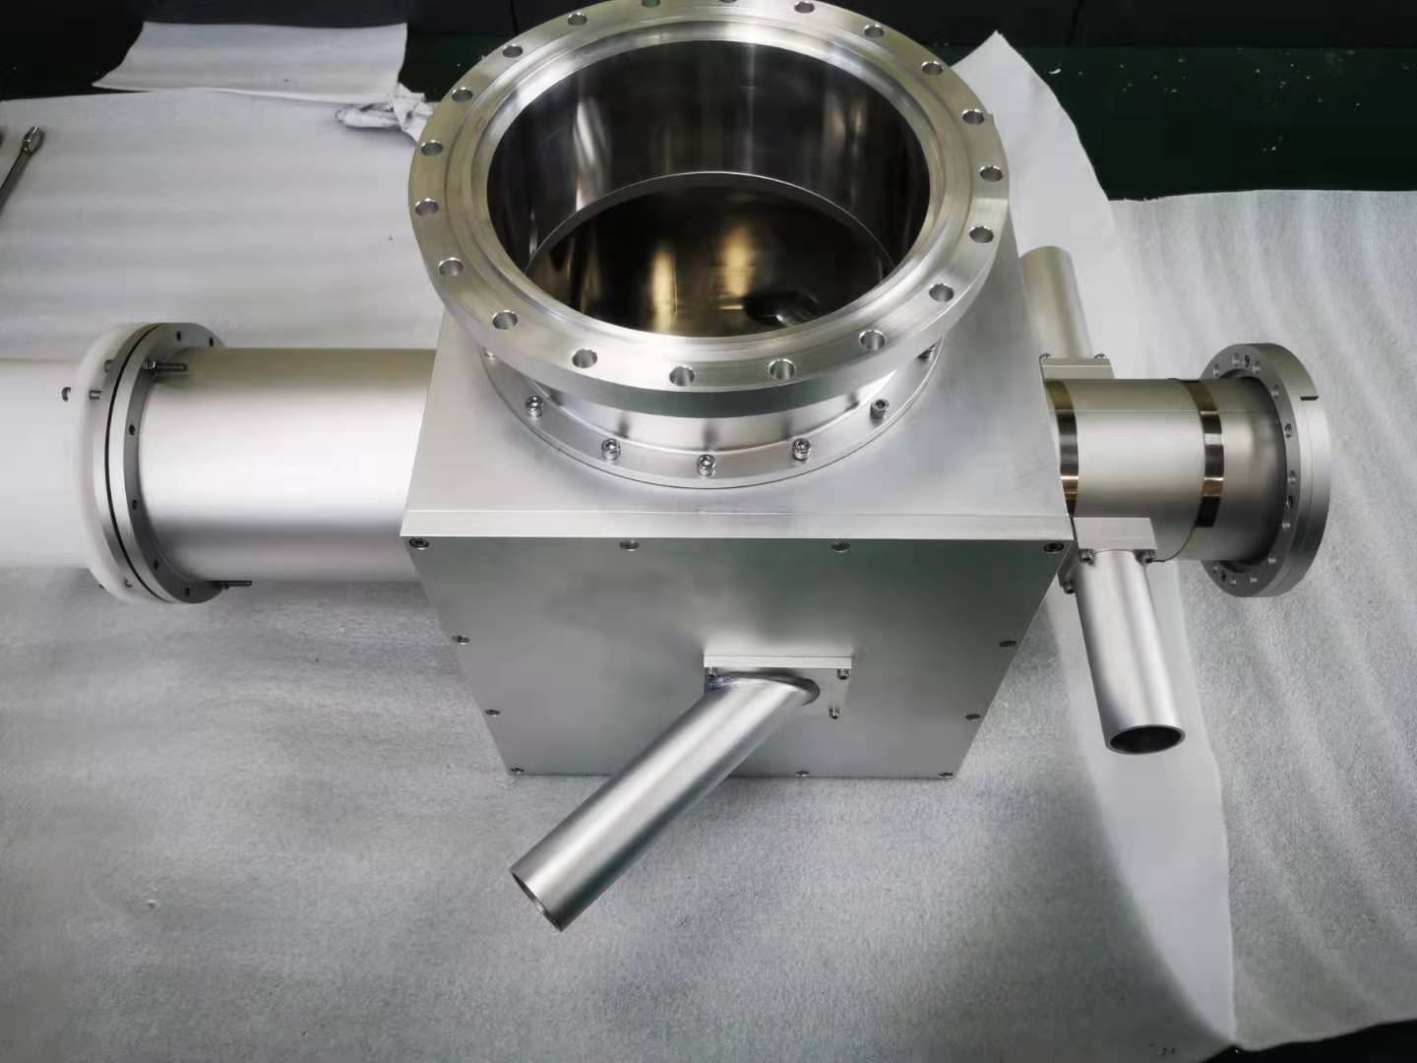
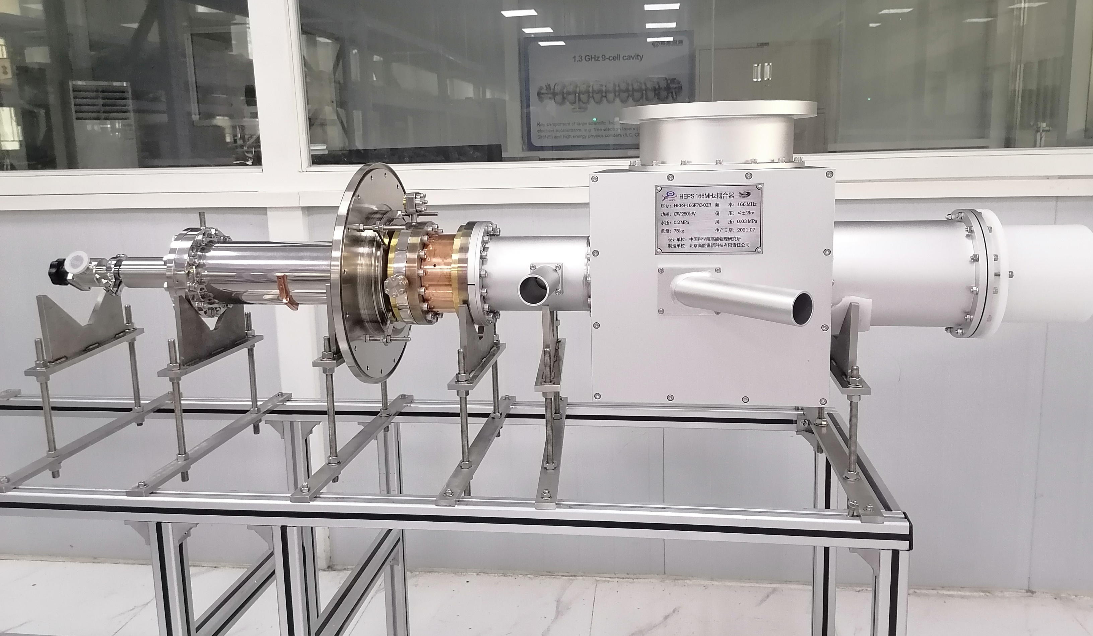
Fabrication
2 prototypes and 10 series FPCs were fabricated at Beijing HE-Racing Technology from 2017 to 2025.
Window frame
Window after 1st brazing
Outer conductor
Coupler during assembly
Window
Window-IC
T-box
Whole coupler

Slide 7
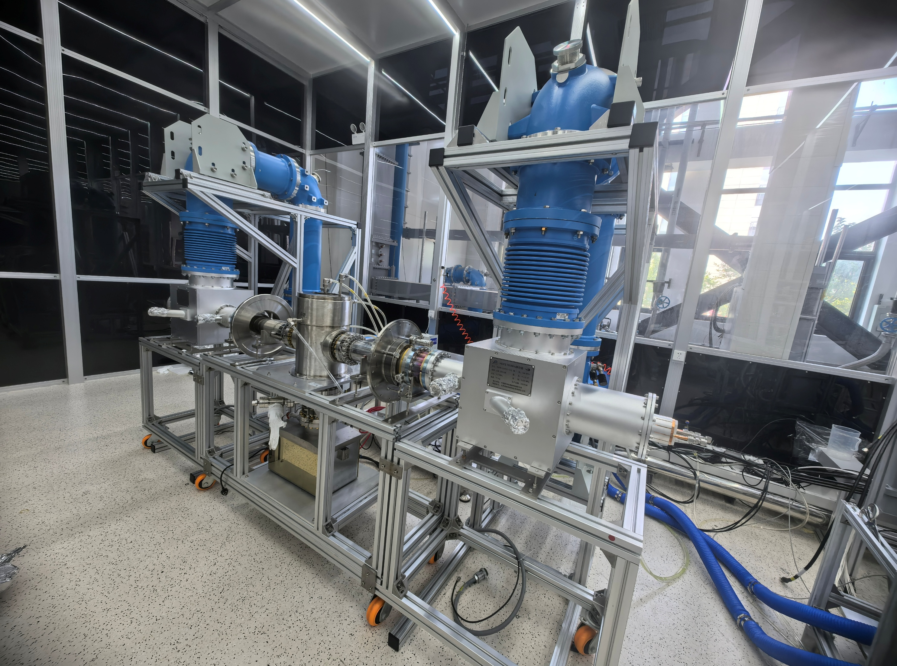
On- stand test: Timeline
Test Stand Validation: CW 250 kW (TW) ; CW 150 kW (SW)
Coupler | Time | Power source (SSA) | Mode | Max. power reached
PoP （HEPS-TF） | 2017.09 | 166.6MHz 50kW | TW & SW | CW, 50 kW
 | 2018.04 | 650MHz 150kW | TW | CW, 150 kW (Window)
Series design-A （1#, 2#） | 2022.02 | 166.6MHz 260kW | TW & SW | TW: CW 250 kW SW: CW 100 kW
Series design-B （6#, 7#） | 2024.9 | 166.6MHz 260kW | TW & SW | TW: CW 250 kW SW: CW 150 kW
Series design-B （8#, 9#） | 2024.11 | 166.6MHz 260kW | TW & SW | TW: CW 250 kW SW: CW 150 kW
Series design-B （4#, 5#） | 2025.4 | 166.6MHz 260kW | TW & SW | TW: CW 250 kW SW: CW 150 kW
Series design-B （3#, 10#） | 2025.5 | 166.6MHz 260kW | TW & SW | TW: CW 250 kW SW: CW 150 kW
On-stand high-power test
SW: standing wave, TW: travelling wave

Slide 8
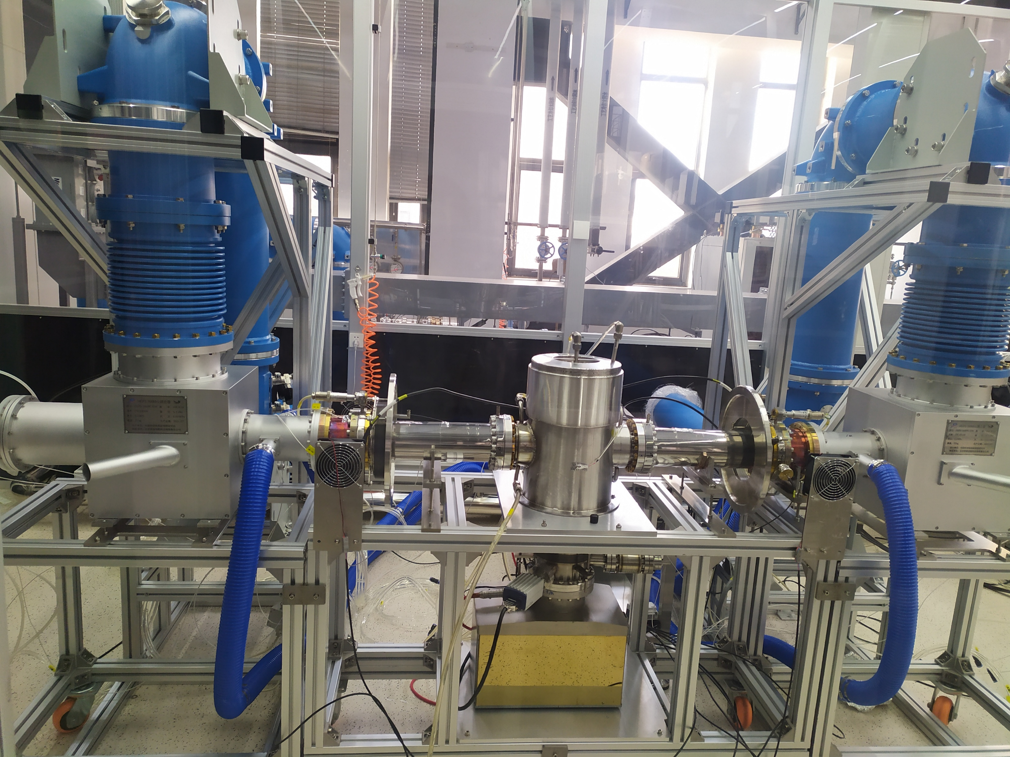
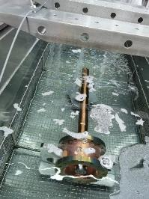
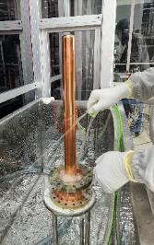
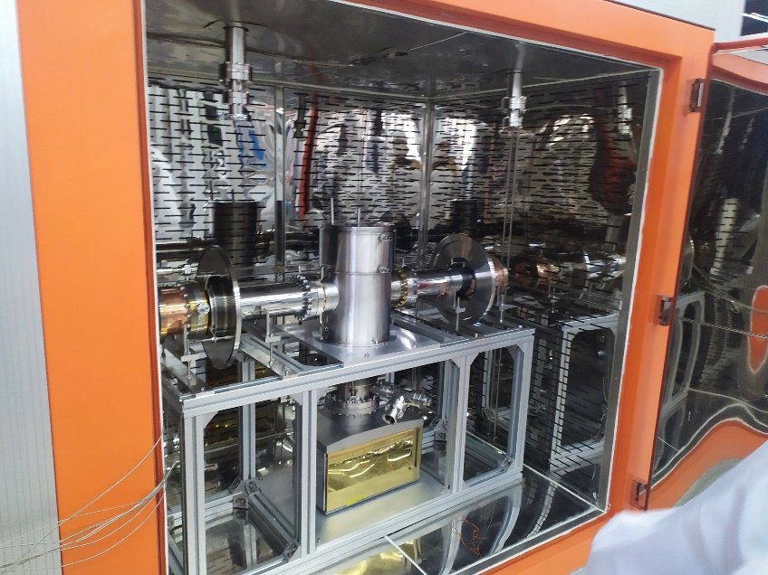
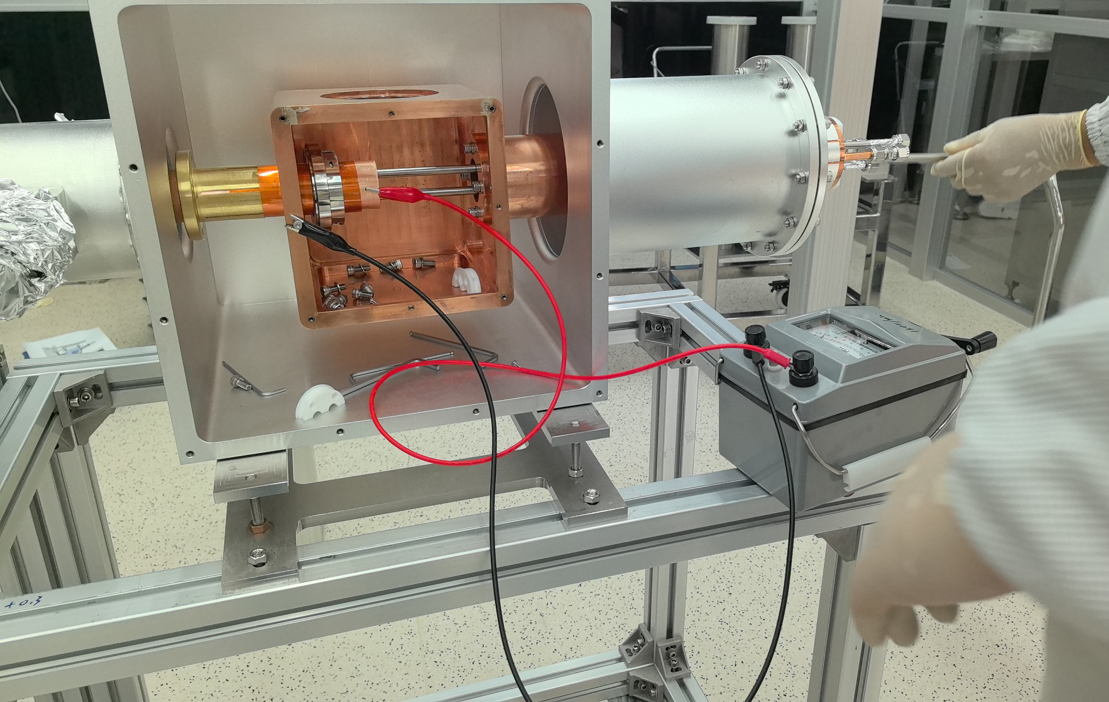
On-stand test: Procedure
The entire sequence of the on-stand tests was performed in cleanroom.
Reception
Ultrasonic clean
Ultra-pure water rinsing
Pure N2 gas drying
Assembly
(Vacuum part)
Storage
(N2 cabinet)
Disassembly
(Vacuum part)
High-power test
Assembly
(Air part)
Baking
(120°C, ≥48h)
Class 10000 (ISO 7)
Class 100 (ISO 5)
Class 10 (ISO 4)
Ultrasonic clean
Ultra-pure water rinsing
Custom-made baking oven (Located in ISO 5 cleanroom)
Air part assembly
(DC bias insulation test)
Test bench setup
(Located in ISO 5 clean room)

Slide 9
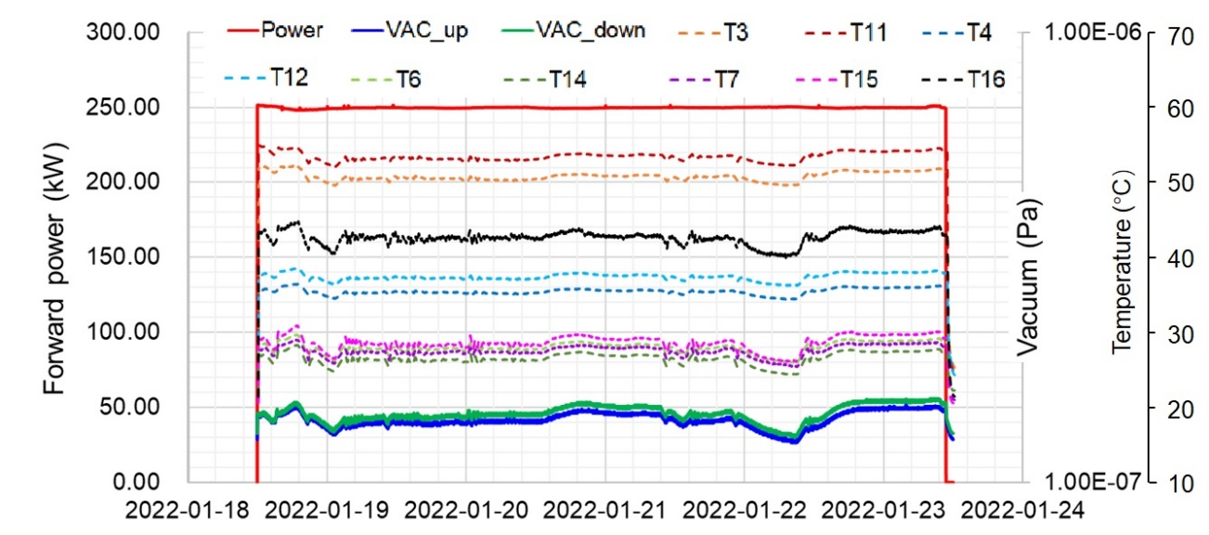
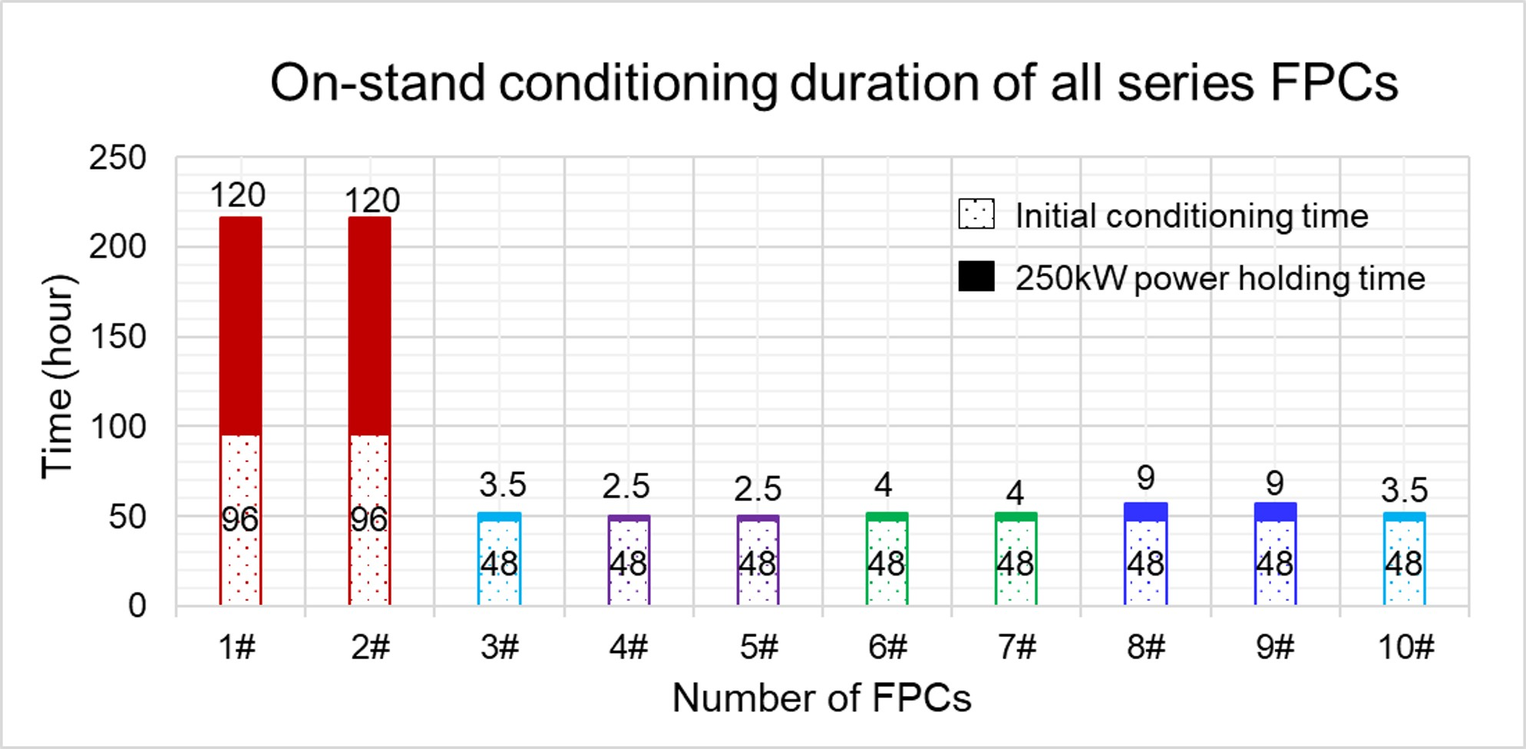
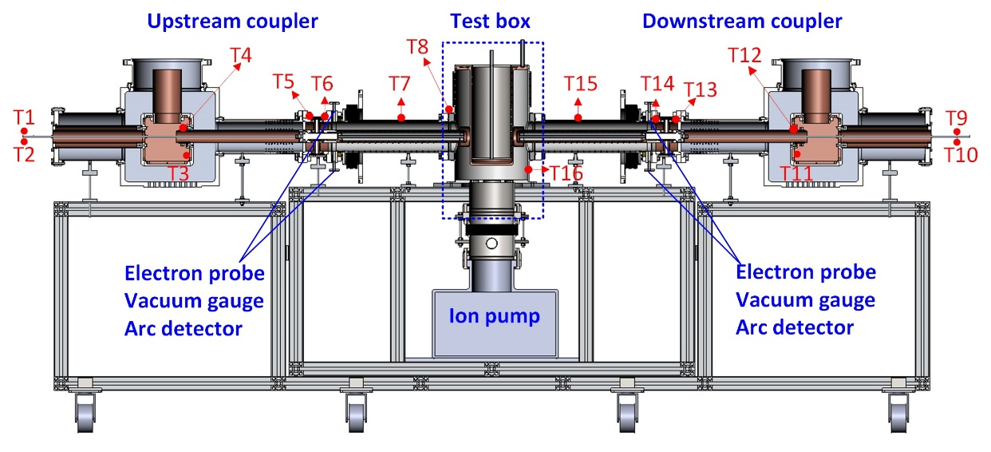
On-stand test: Results
TW mode
- Conditioned time: 96 h (design-A), 48 h (design-B)
- Power keeping: 120 h (design-A), 2.5~9 h (design-B)
- Max.T measured at outer window: 29 °C (Ambient T: 22 °C)
SW mode
- Phase shift: 1/16λ (step) * 8 positions (over 1/2λ range)
- Conditioned up to CW 100 kW (design-A), 150 kW (design-B)
- Power keeping for 1 hour at each phase
- Max.T measured at outer window: 35 °C (Ambient T: 17 °C)
Vacuum and temperatures during power keeping
at CW 250 kW in TW mode for 120 hours
Temperature sensor location
Duration of initial conditioning and power holding.

Slide 10
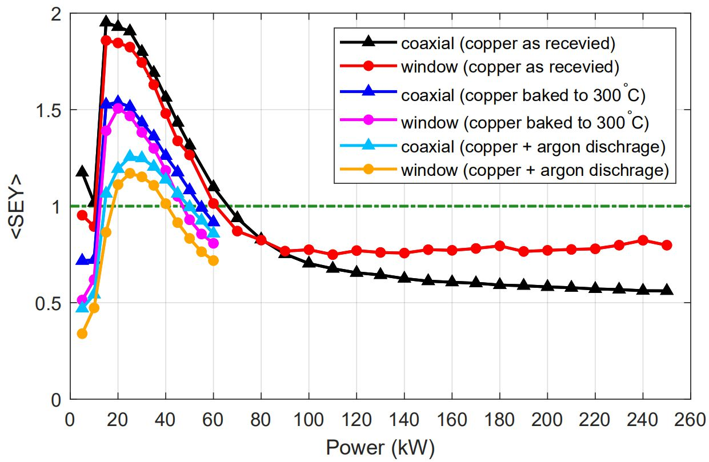
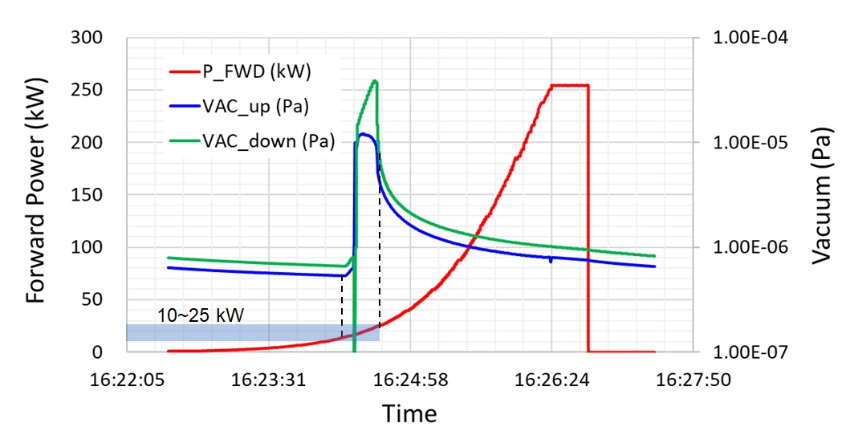
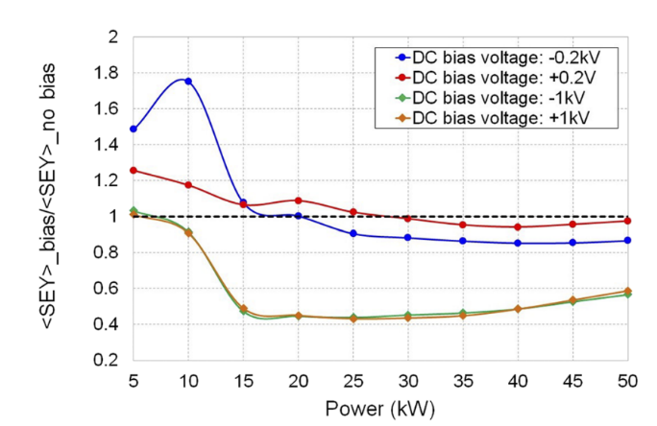
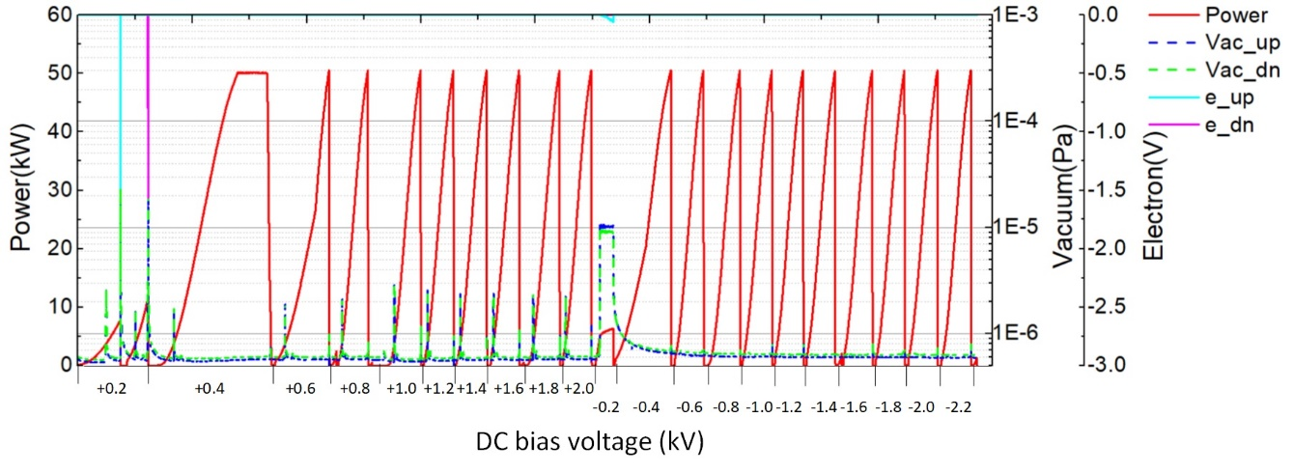
On-stand test: Multipacting validation
MP bands
- Simulation: 10-50 kW
- On-stand test: 10-25 kW
DC bias suppression
Simulation：
DC bias ±0.2kV → Exciting new MP
- On-stand test:
  +0.2kV → Fresh MP at 8kW,11kW
  -0.2 kV → New MP at 5.5 kW
Simulated hard MP band: 10 kW ~ 50 kW
Observed hard MP band : 10 kW~25 kW
Simu. & test: Agree well
DC bias of +0.8kV is suggested for on-line operation.
Simulated MP with DC bias
Observed MP with DC bias

Slide 11
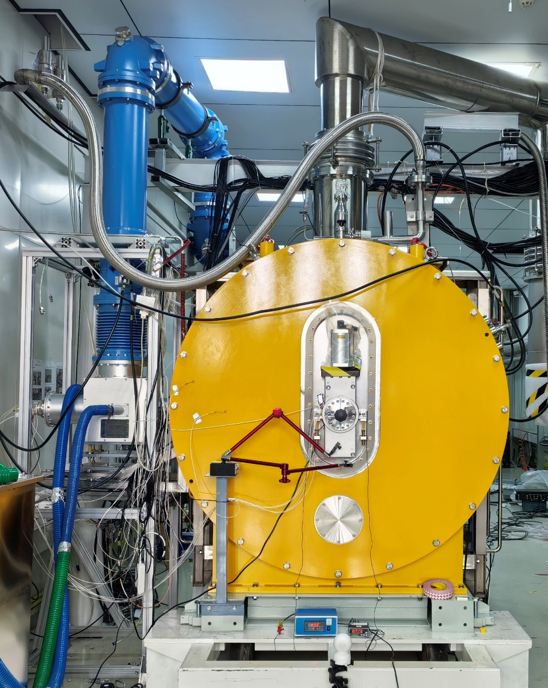
On- cavity test: Timeline
Coupler | Time | Power source (SSA) | Mode | Max. power reached | Description
PoP | 2018.12 | 166.6 MHz 50 kW | SW | CW 50 kW | PoP HT
Series_2# | 2023.11 | 166.6 MHz 260 kW | SW | CW 120 kW | CM1 HT
Series_6# | 2025.2 | 166 MHz 260 kW | SW | CW 120 kW | CM2 HT
Series_9# | 2025.3 | 166.6 MHz 260 kW | SW | CW 120 kW | CM3 HT
Series_7# | 2025.5 | 166.6MHz 260 kW | SW | CW 120 kW | CM5 HT
Series_8# | 2025.6 | 166.6 MHz 260 kW | SW | CW 120 kW | CM4 HT
SW: standing wave

Slide 12
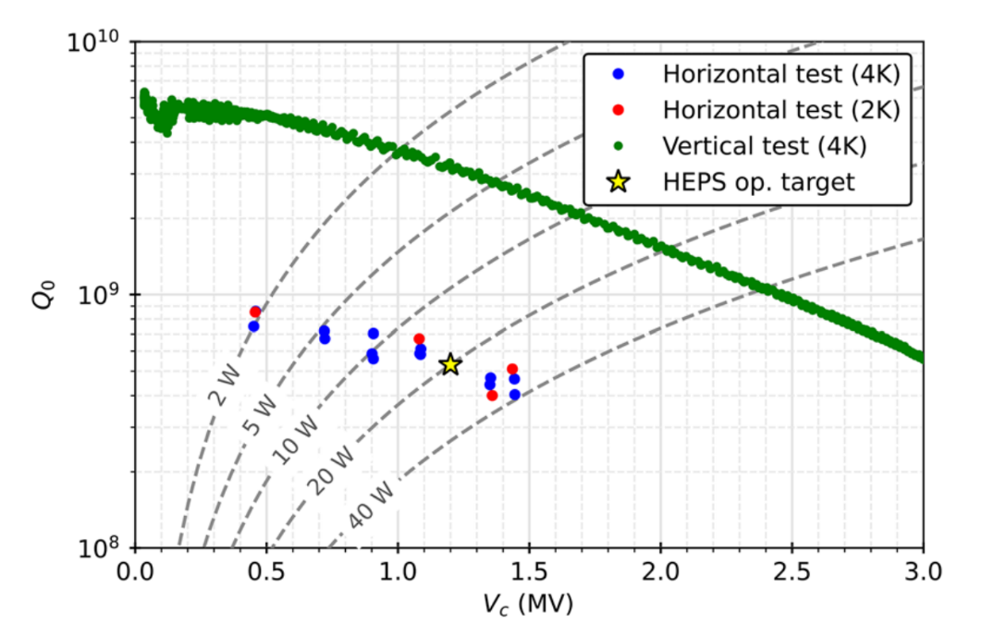
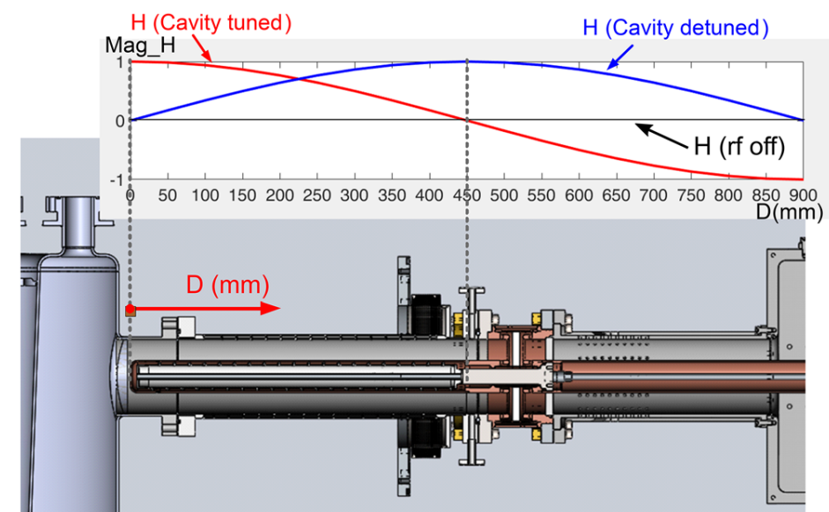
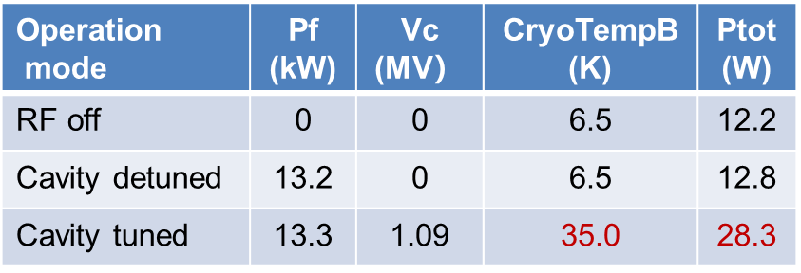
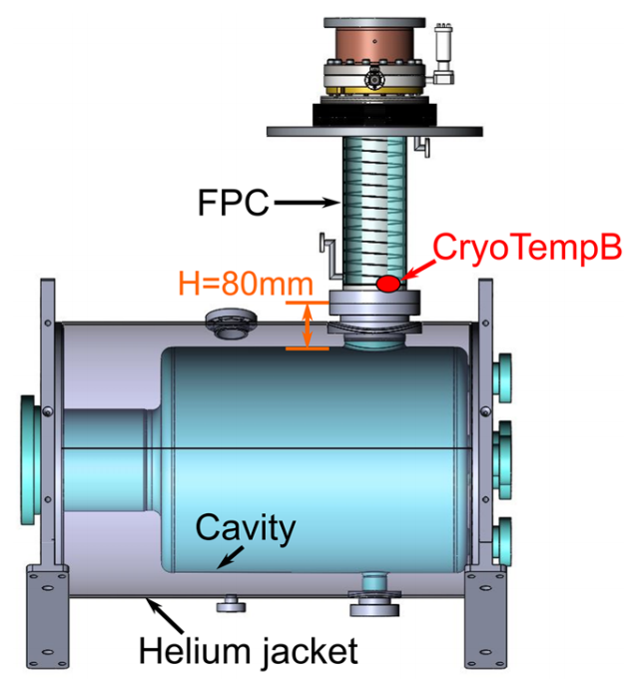
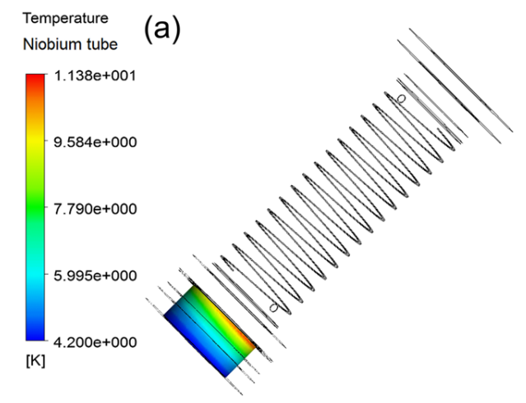
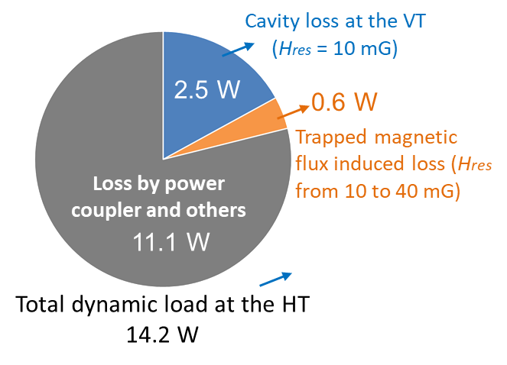
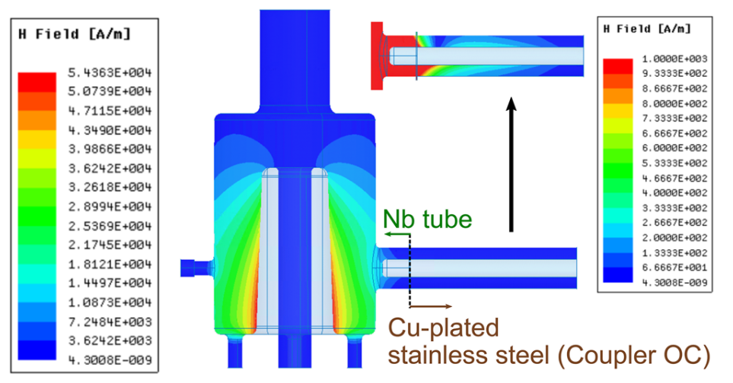
On-cavity test: Overheating issue (PoP: Prototype)
Observation: Detune → Tuned
- Temp at ‘CryoTempB’: 6.5 K → 35.0 K
- Total module heat load: 12 W → 28 W
Reason1: Field change (Detuned → Tuned)
Quench at 1.5 MV
Large performance degradation
11.4 K>9.3 K
Reason2: Field leakage (Cavity → FPC)
Simulation: T_max on the Nb extension tube 11.4 K (Vc=1.5MV, He flow:14.4 slm)
（PoP, HT, Vc=1.0MV）
Anomalous heat loss (11.1 W) → Likely mainly from FPC
Cavity–coupler interface overheating → Thermal runaway → Cavity quench
H-field > 1000 A/m in the cavity-coupler
interface region (at 1.5MV）

Slide 13
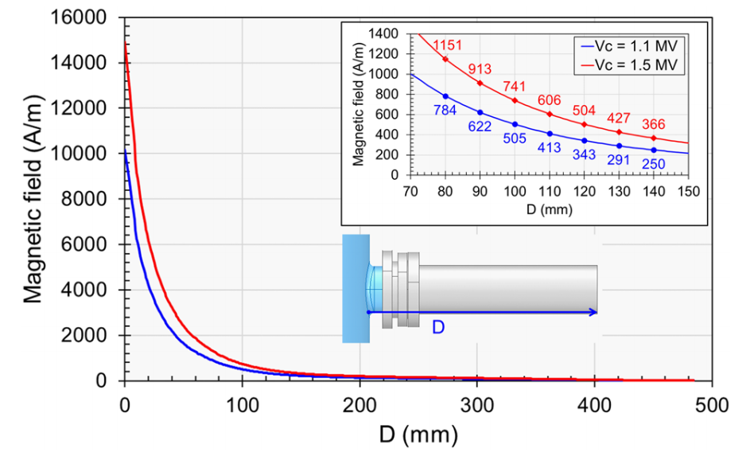
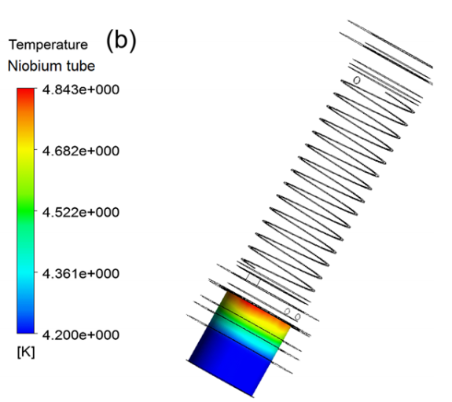
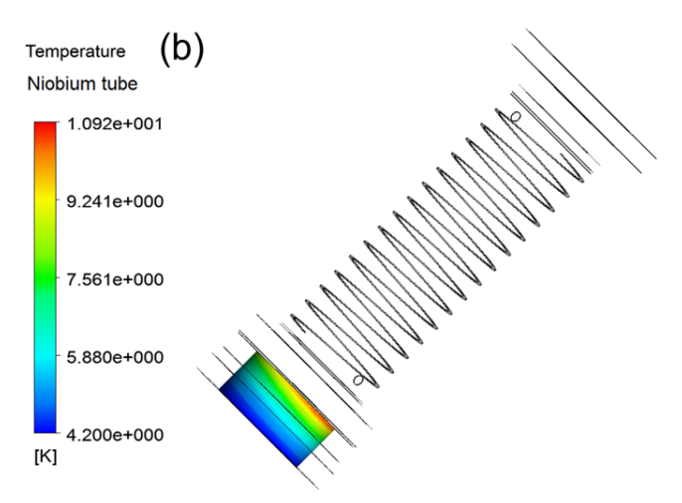
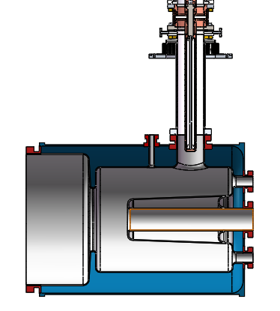
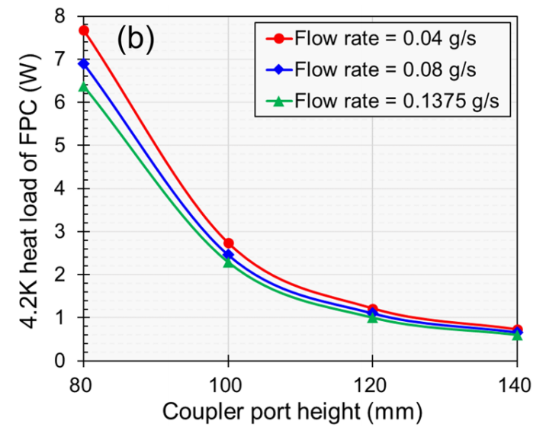
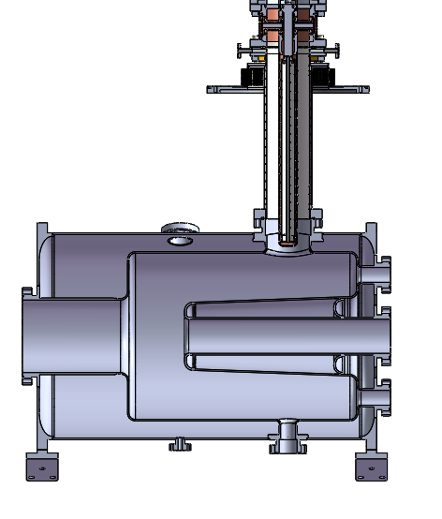
On-cavity test: Overheating solution (PoP→CM1)
Solution1: Increasing Helium gas flow rate yielded little improvement
4.8 K < 9.3 K
10.9 K>9.3 K
H-field along the FPC’s outer conductor
After 120 mm elongation:
Simulated T_max of the Nb tube 4.8 K
(Vc=1.5MV, He flow: 14.4 slm)
Simulated T_max on the Nb extension tube 10.9 K (Vc=1.5MV, He flow: 50 slm)
80 mm
40mm extension of Nb tube
120 mm
Solution 2: Elongate the Nb ext. tube at the coupler port from 80mm to 120mm
After mod. (1.5MV, 14.4 slm)
- 4K heat loss from coupler: 7.7W → 1.8W
- T_max of Nb: 11.4K → 4.8K
Simulated 4.2K heat loss from FPC
T. Huang et al., AIP Advances 11, 045024 (2021).

Slide 14
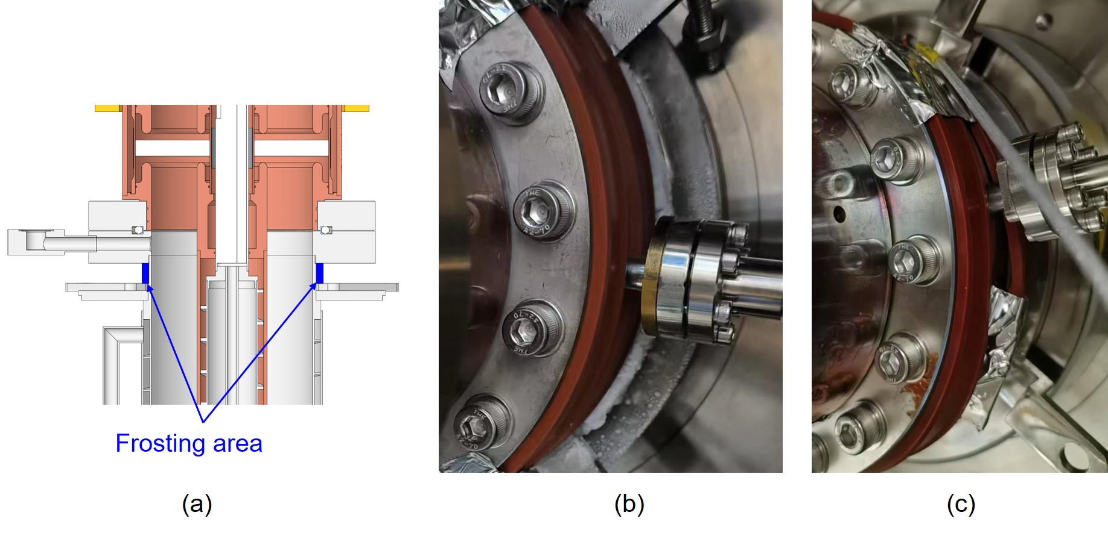
On-cavity test: Frosting issue (CM1: Series design-A)
As the gas helium flow rate increased up to 30 slm, serious frosting observed close to the coupler-cryostat connecting flange

Slide 15
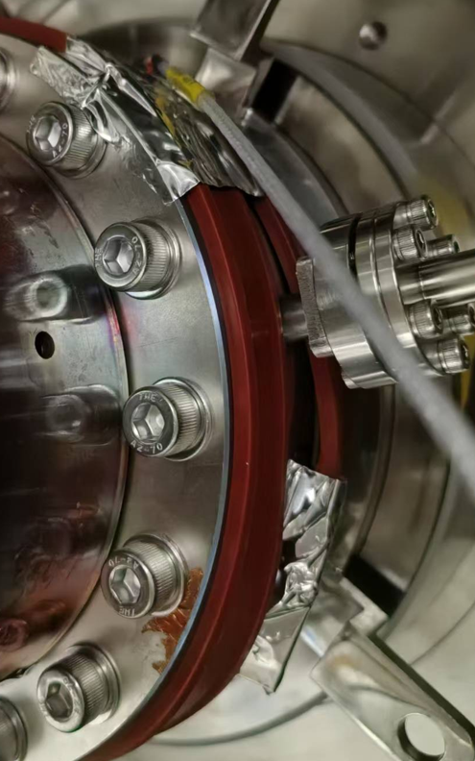
On-cavity test: Frosting solution (CM1→CM2~5)
Move the fin structure from the sidewall of the OC to the bottom of its warm flange
Move the outlet of the helium gas cooling pipe 113.5 mm away from the frosting area
CM2~CM5: NO frosting

Slide 16
On-cavity test: Overheating further alleviated (CM1→CM2~5)
Rotating the helium inlet pipe 90° sends cold gas to the hottest spot first, which further cools down the interface.
Helium inlet
Cavity H-end
Cavity H-end
Fixing block
Fixing block
Helium inlet
CM1
CM2~CM5
Interference → Bend pipe → Rotate inlet → Cold gas to hottest zone → Lower interface temperature

Slide 17
Modifications validation
Parameters | Prototype | Series design-A | Series design-B
Modules # | PoP | CM1 | CM2 | CM3 | CM4 | CM5
FPC structures related to main modifications | Nb port: 80mm He outlet: close to the OC warm end | Nb port: 120mm He outlet: close to the OC warm end He inlet: 12 o’clock Fin: on sidewall of the OC | Nb port: 120mm He outlet: in the middle of the OC He inlet: 3 o’clock Fin: on the bottom of OC warm flange
Cavity voltage | 1.0 MV | 1.2 MV | 1.2 MV
T_max on NbTi flange | Not measured | 15.4 K | 10.3 K | 9.8 K | 9.5 K | 10.8 K
T_max on OC cold end | 35.0 K | 14.2 K | 9.6 K | 8.4 K | 9.2 K | 8.9 K
4.2K heat load of FPC | 11.1 W | 3.0 W | 2.0 W | 2.0 W | 0.5 W | 1.4 W
Cavity quench | Quench at 1.5 MV | Not quench at 1.7 MV | Not quench at 1.5 MV
Icing and frosting near window | Icing | Frosting | No frosting

Slide 18
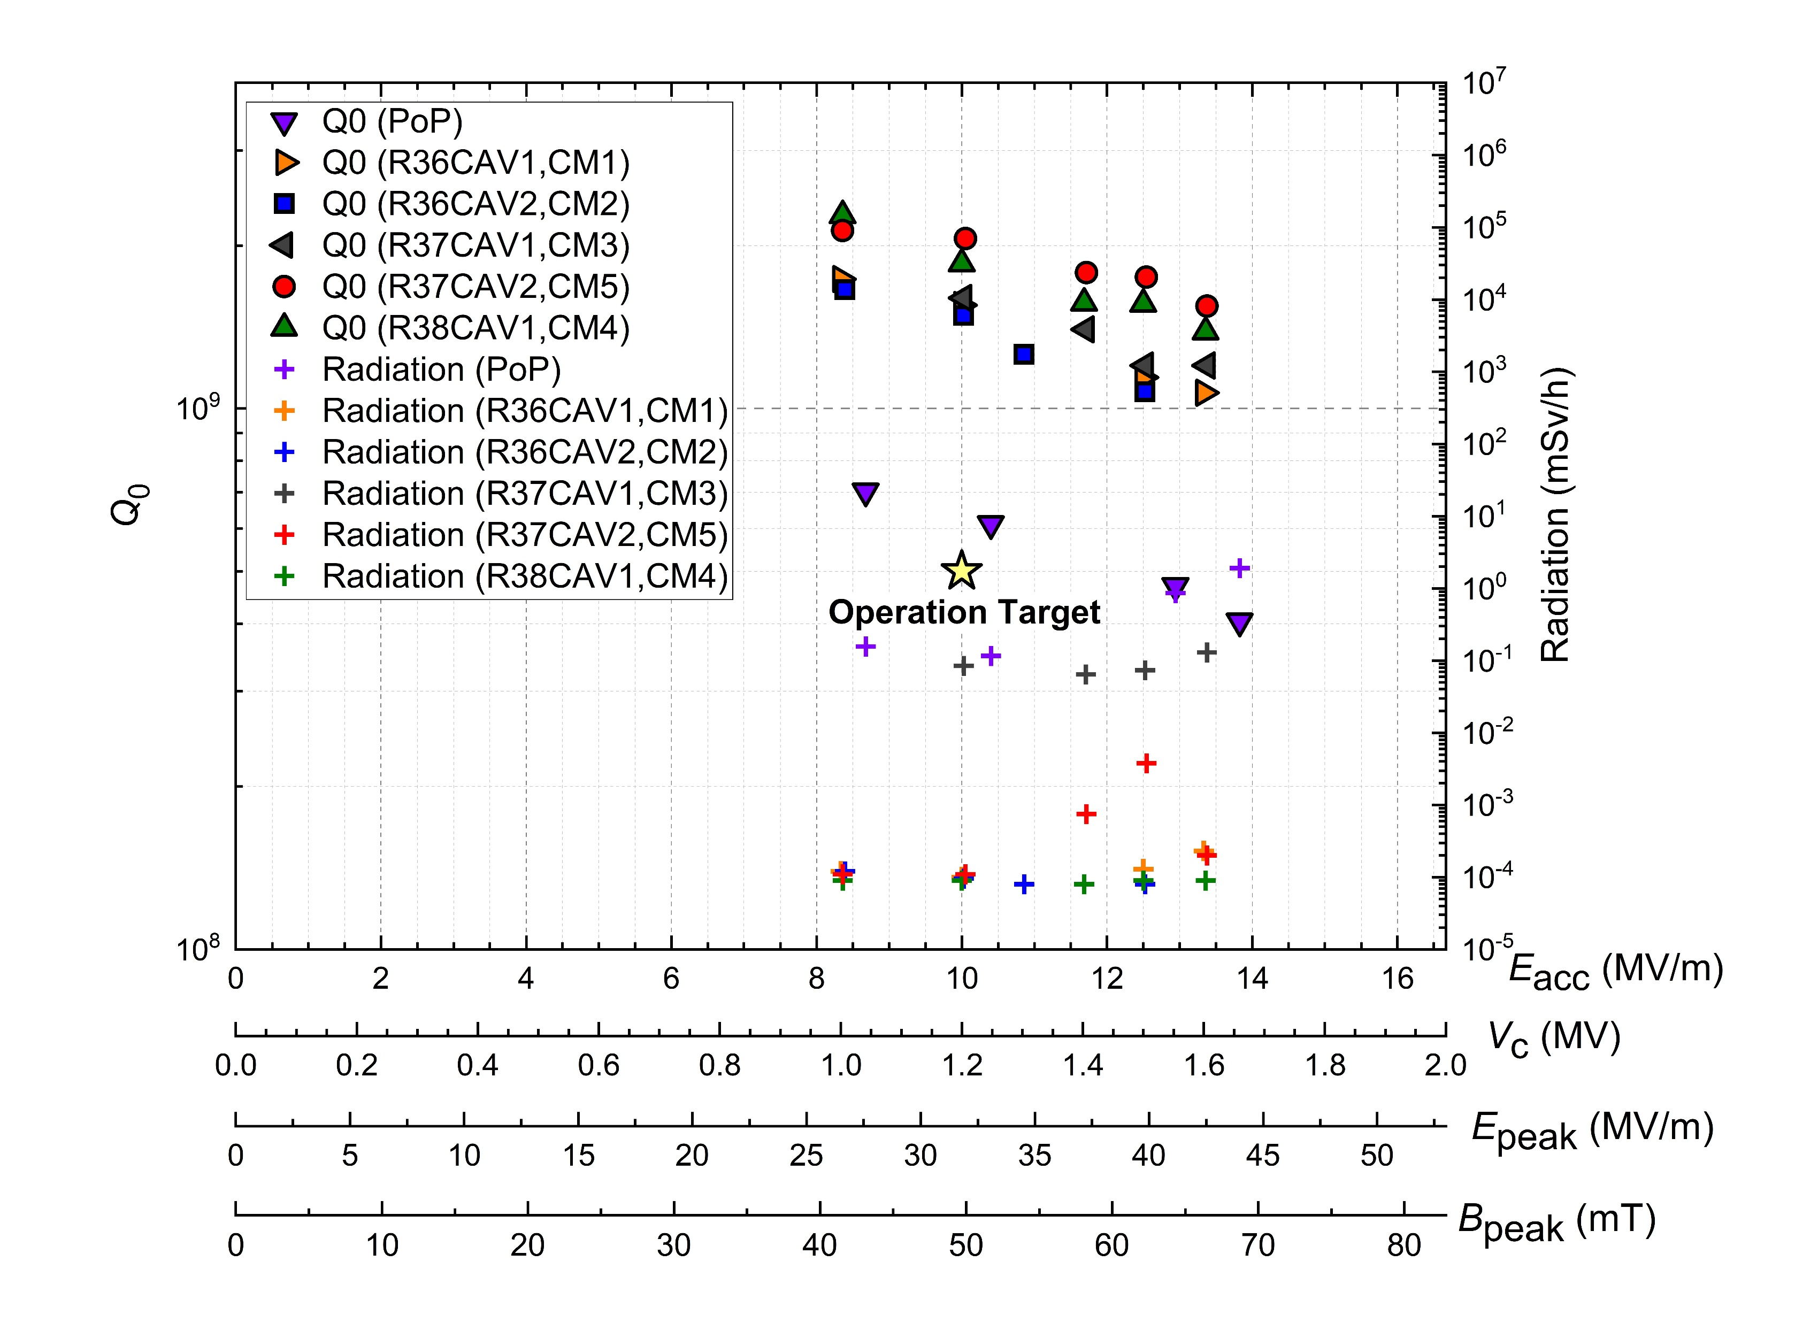
SRF modules performance improvements
The performance of the 166MHz SRF modules improved significantly benefiting the FPC related modifications.
  Overheating mitigation
  Q0 increased up to 2 times：
  - PoP: 4E8@1.45MV
  - Series: >1.0E9@1.5MV
  On-stand test processed in cleanroom
  Radiation dose decreased:
  - PoP: Several thousands uSv/h
  - Series: Less than 10 uSv/h

Slide 19
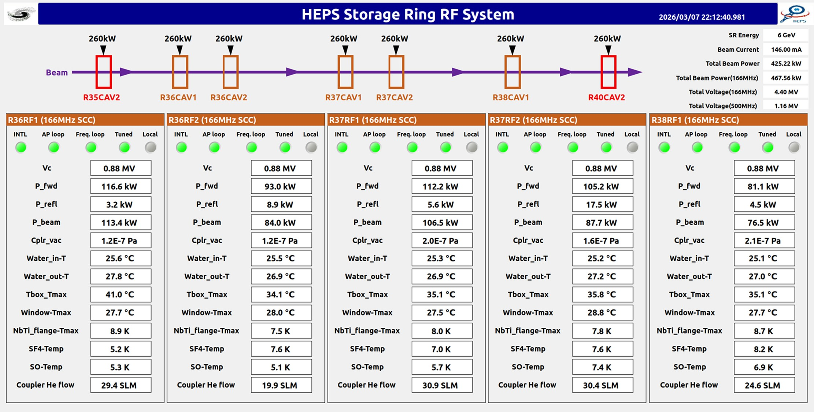
On-line operation: Performance
Five 166 MHz FPCs performed excellently during beam commissioning:
  ✔ ~150 mA beam current reached: 467 kW total RF power;116 kW max per FPC
  ✔ Vacuum <2.5×10⁻⁷ Pa; Temp: Window <29 °C , NbTi flange <9 K; ‘SO’ 5.3~7.4 K
  ✔ No overheating; Rare Multipacting & Genuine Arc

Slide 20
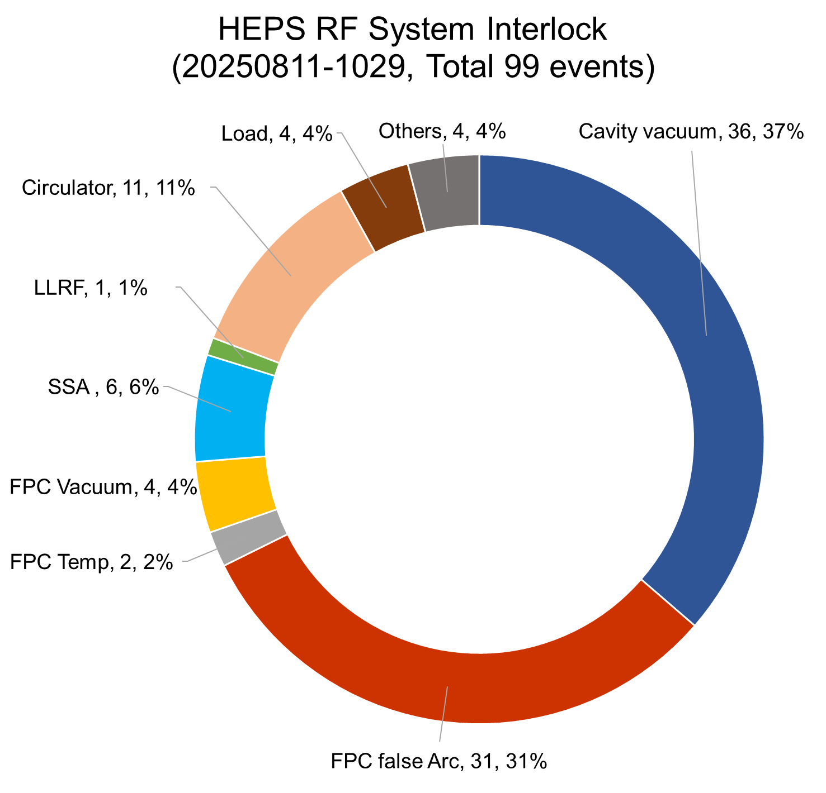
False Arc: Phenomena
Each 166 MHz FPC equipped with one AFT dual‑channel arc detector
Suspected False Arc
  Occurred frequently during HEPS commissioning
  Became the dominant interlock type (31/99=31%)
Characteristics of the ‘Suspected False Arc’ Events
✔Commonly Preceded by: Beam instability
✘Real Arc Signals NOT Observed:
Outgassing
Reflected power fluctuation
MP-induced e- current
Overheating
HEPS RF System Interlock
(202508-202510, 99 events)
Suspected ‘Arc’ events — likely not real FPC arcs.
False Arc: 31%

Slide 21
False Arc: Identification
Validation Experiment Setup
Added ‘Tunnel Arc’ system
Fiber path = ‘Coupler Arc’
Viewport not connected to window (5 cm away, shielded)
Fiber length: 30m
Experiment Results
‘Tunnel Arc’: triggered frequently
Coincided with:
  ‘Coupler Arc’
  Beam instability
False Arc Confirmed!
Cause: Beam‑loss‑induced X‑rays
Mechanism:
X-rays(beam loss) → Induce light in fiber
→ False Arc trigger

Slide 22
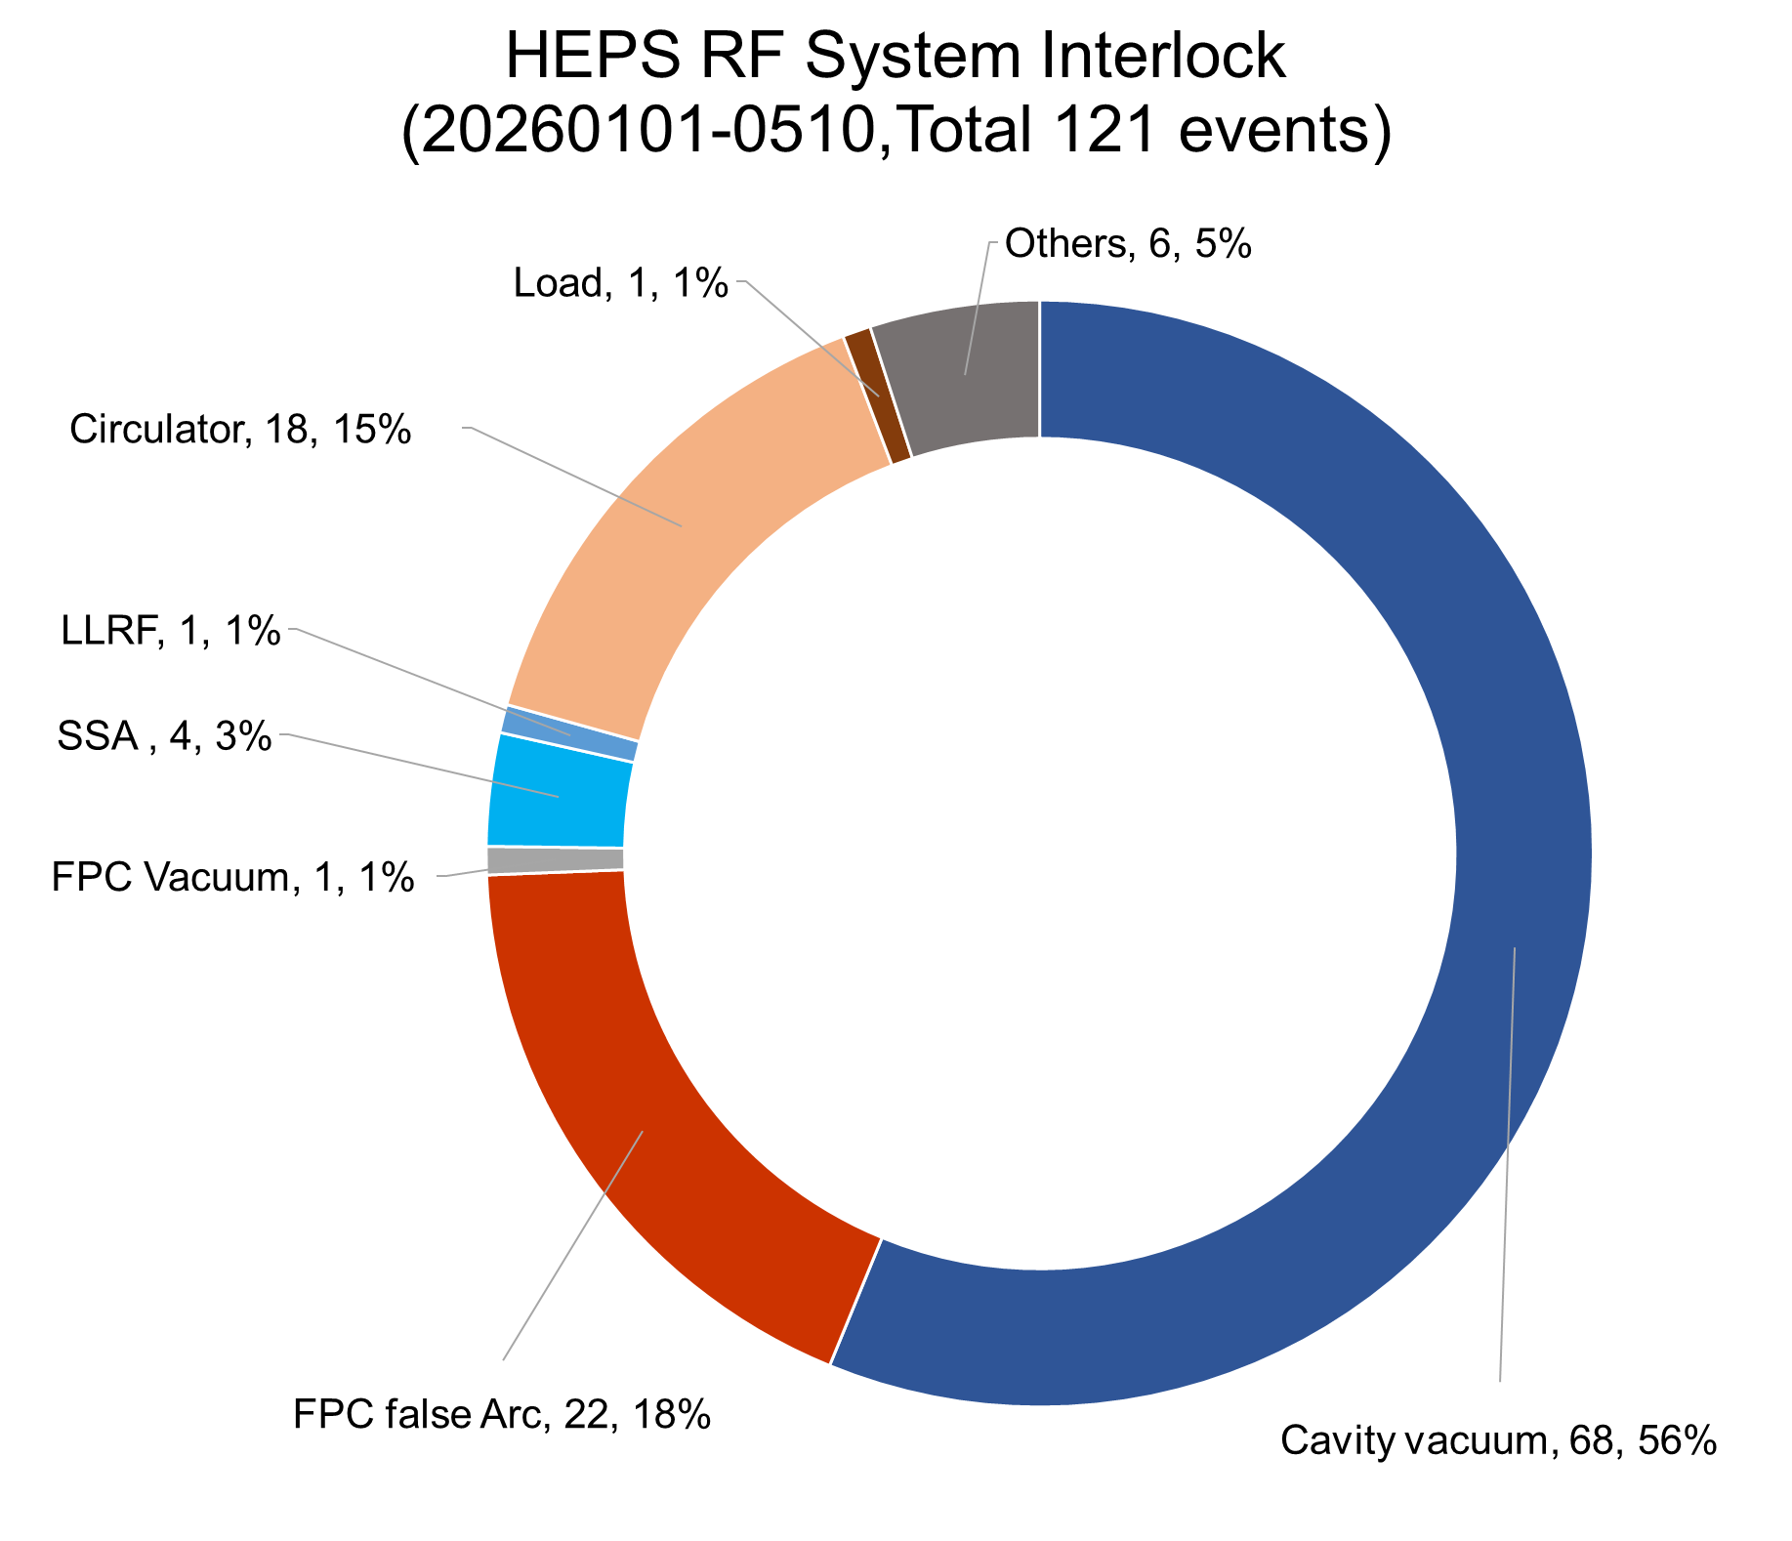
Solution: Logic-Based Discrimination
Impact of False Arc
✘ RF system trip rate ↑
✘ Optical fiber sensitivity ↓
✘ Fiber complete failure
Logic Discrimination → Reduce ‘Arc’ Frequency
Input signals: ‘Coupler arc’ + ‘Tunnel arc’ (X‑ray monitor)
Logic Rule: ‘Arc’ interlock ONLY triggered when:
‘Coupler arc’ = ‘Yes’ & ‘Tunnel arc’ = ‘No’
⚠️False arc decreased, but not eliminated
(31%→18%)
 | Before implementation (202508-202510) | After implementation (202601-202605)
Total interlock events (RF) | 99 | 121
Cavity vacuum | 36 (37%) | 68 (56%)
FPC false Arc | 31 (31%) | 22 (18%)
Circulator | 11 (11%) | 18 (15%)
Others | 21 (21%) | 13 (11)
False Arc: 18%

Slide 23
Summary
We developed the FPC over nine years, from prototype to series, fixing overheating and frosting issues step by step.
All series FPCs passed on‑stand testing up to 250 kW CW (TW) and 150 kW CW (SW). Five are now running stably in HEPS.
During beam operation, a false arc issue caused by X‑ray‑induced fiber light was identified and alleviated by logic‑based discrimination.

Slide 24
References of IHEP FPCs
http://dx.doi.org/10.1063/5.0001540
http://dx.doi.org/10.1063/5.0046377
http://dx.doi.org/10.1016/j.nima.2021.165649
http://dx.doi.org/10.1016/j.nima.2010.08.108
http://dx.doi.org/10.1088/1674-1137/32/11/017
http://dx.doi.org/10.1088/1674-1137/32/9/017
http://dx.doi.org/10.1088/1674-1137/36/4/011
http://dx.doi.org/10.1088/1674-1137/41/6/067001
http://dx.doi.org/10.1088/1674-1137/38/11/117002
http://dx.doi.org/10.1088/1674-1137/38/2/027001

