Slide 1
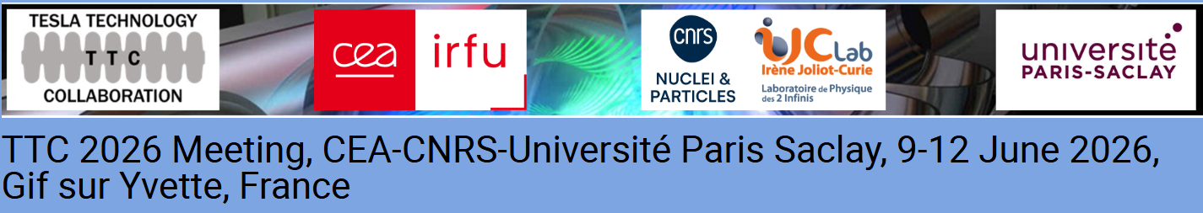
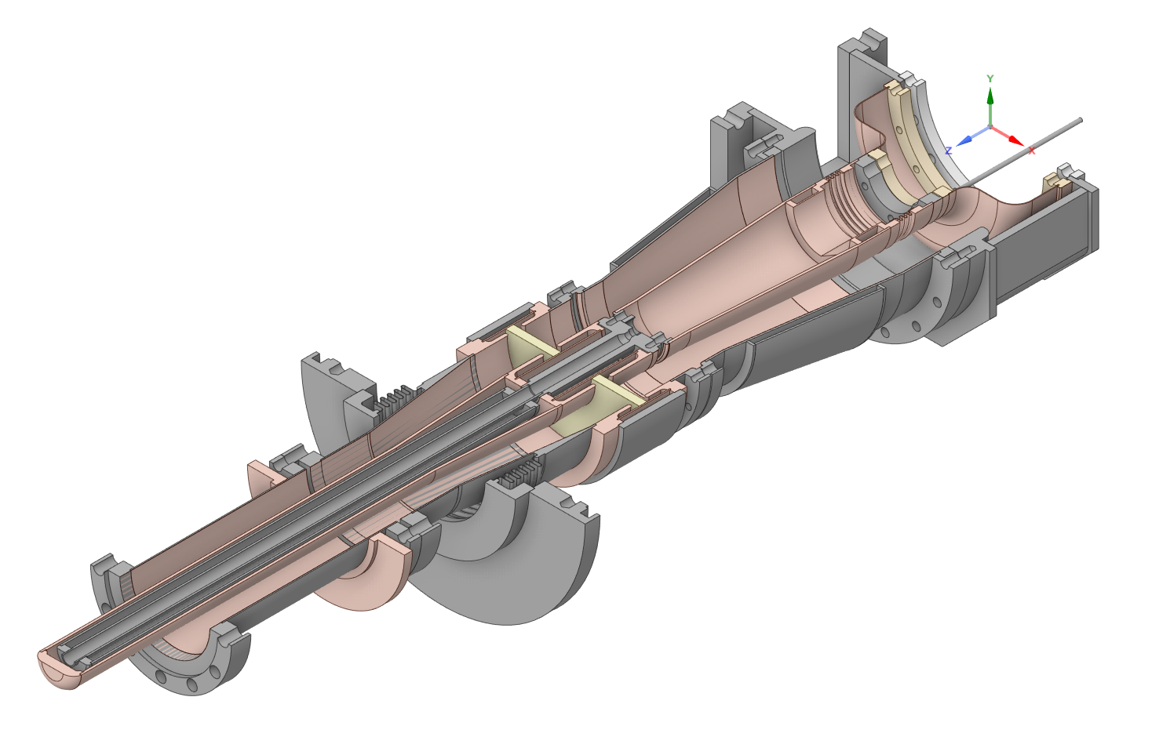
Achievement of CW 100 kW Class Power Transmission by an L-band High-Power Input Coupler for SRF Accelerators
Dr. Pragya Nama
Assistant Professor
KEK

Slide 2
Contents
CW 100 kW coupler design
Background
Experimental setup
RF conditioning
Summary
Discussion topics

Slide 3
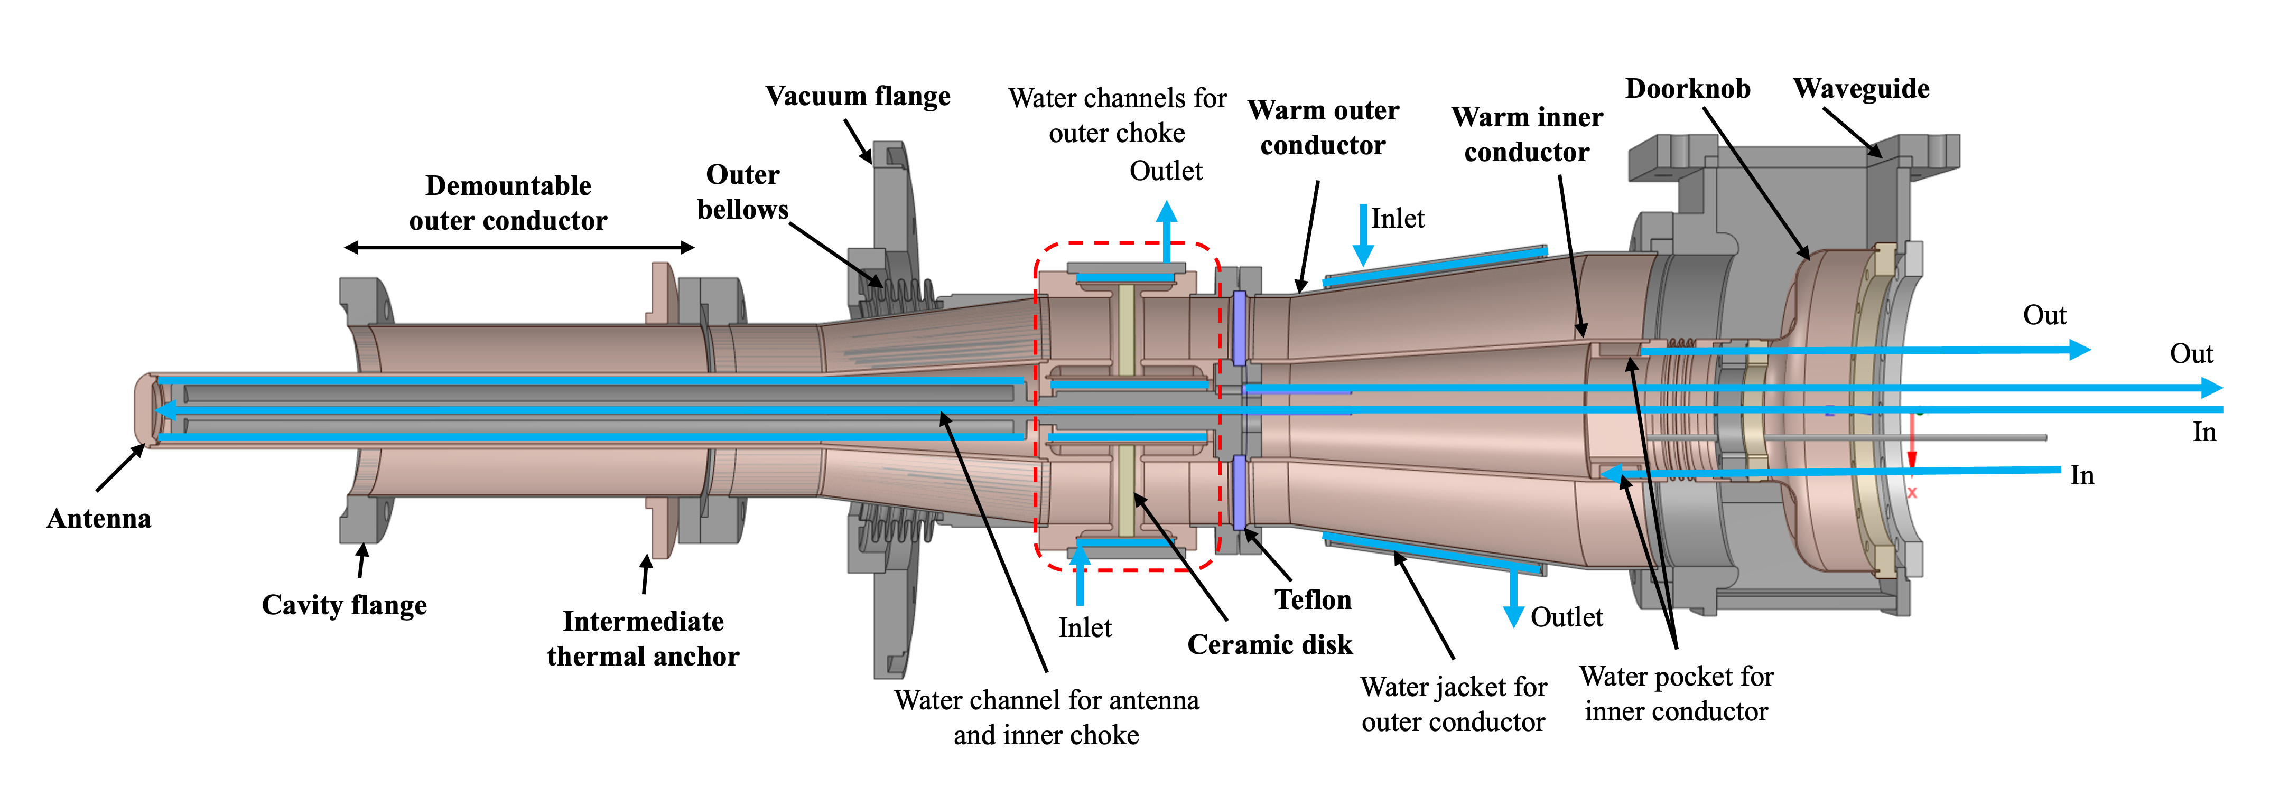
CW 100 kW coupler design
Thermal management strategy
Water cooling for the critical components -> Warm section, Antenna, RF window
Enlarged warm section
Low loss ceramic material
Conduction cooled by cryocooler

Slide 4
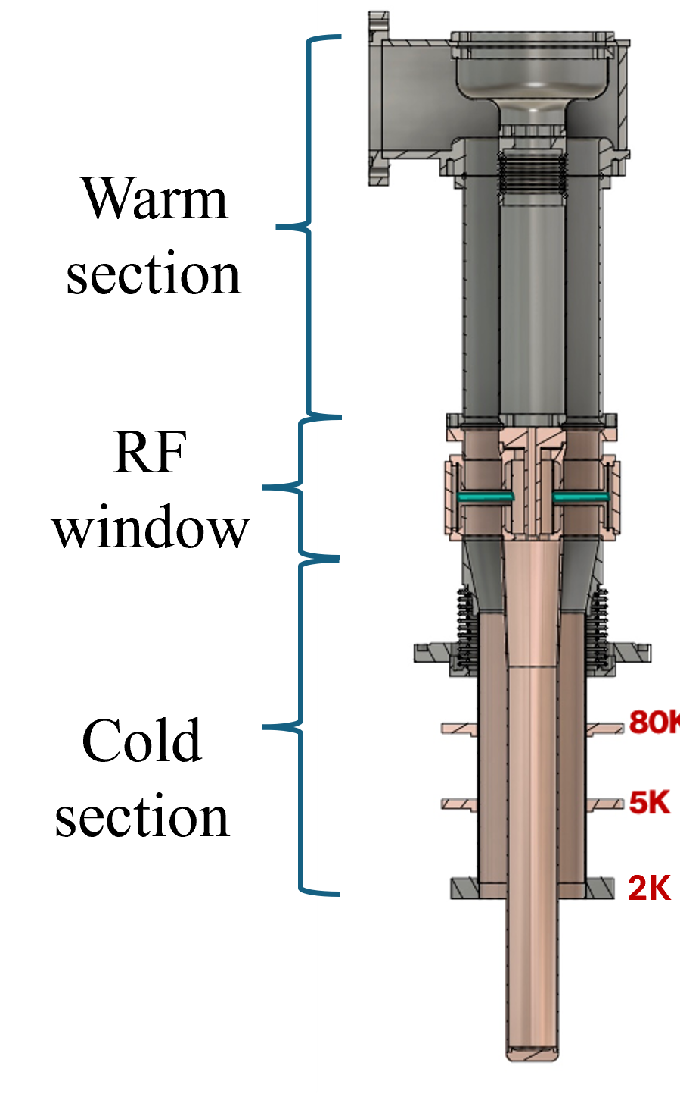
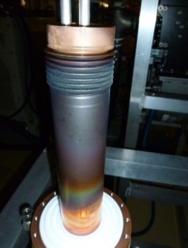
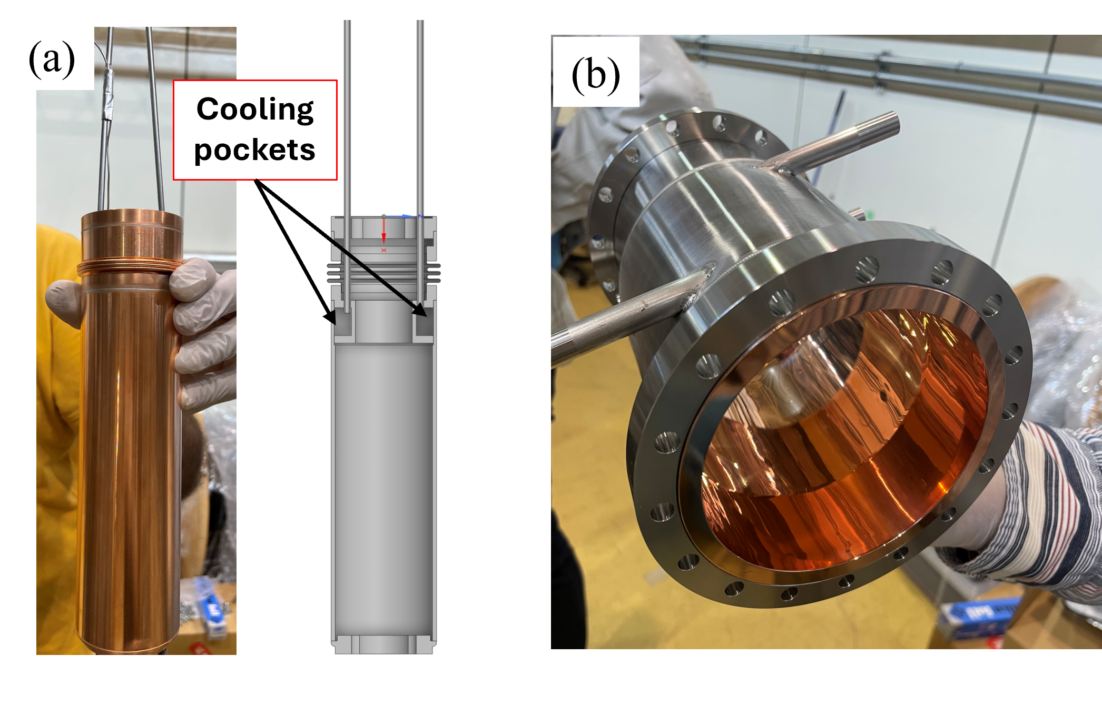
Background
cERL injector coupler (Prototype)
Modified cERL injector coupler
Modified warm inner conductor
Modified warm outer conductor
Water-cooling jacket
Pure Cu
Burned Inner conductor when 100 kW power in CW mode was applied for one minute
 | cERL injector coupler | Modifed cERL injector coupler
Material (IC) | Cu coated SUS | Pure Cu
Cooling | No cooling | Water cooling for inner and outer conductor
Temperature rise (IC) | 160 ºC at CW 20 kW | 4-5 ºC at CW 27 kW

Slide 5
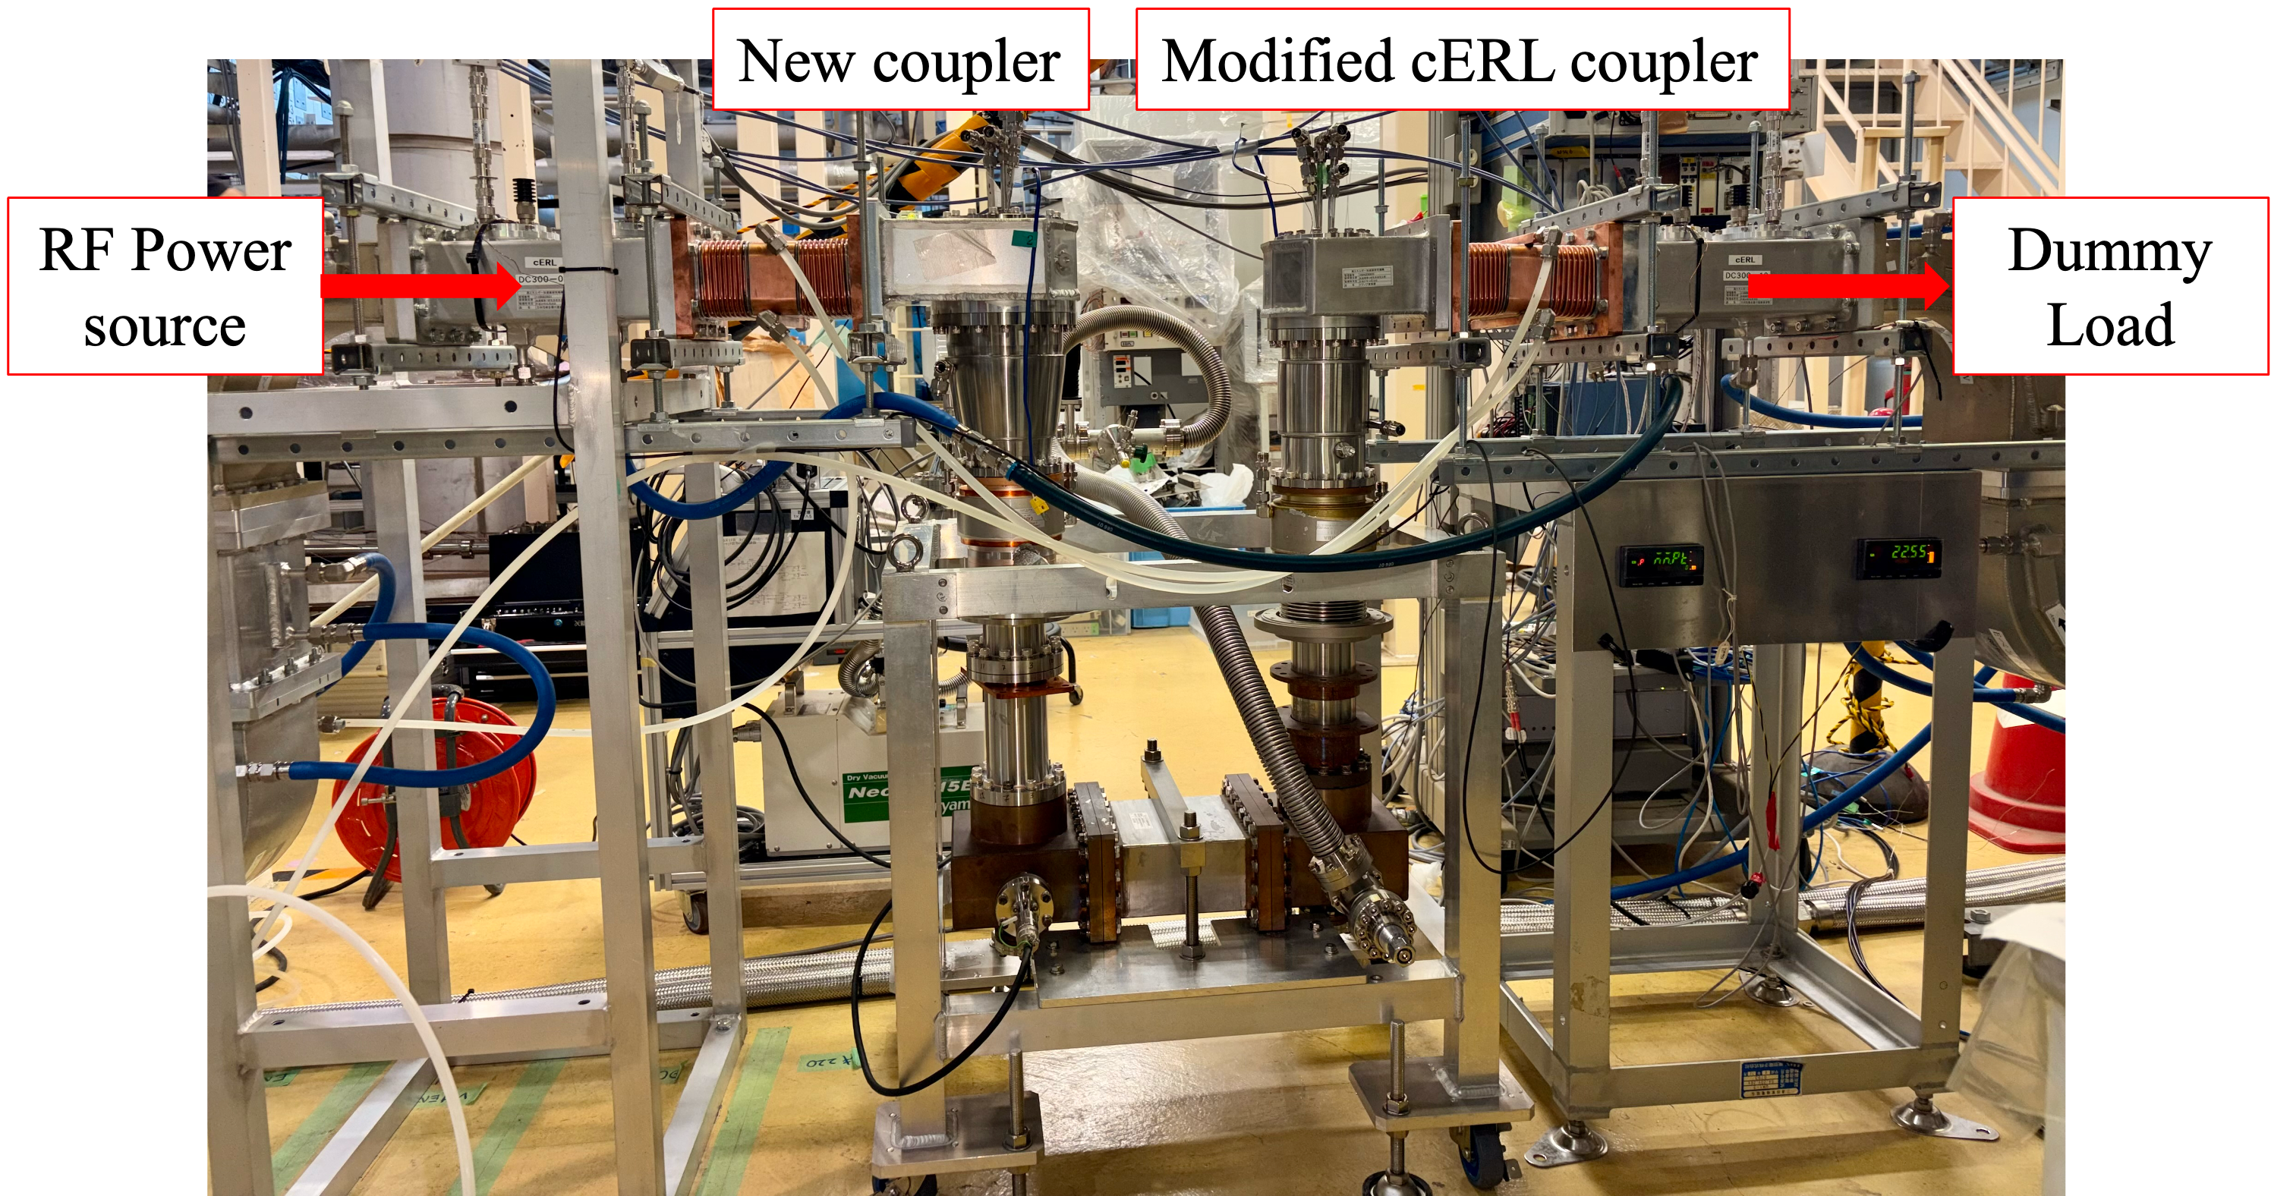
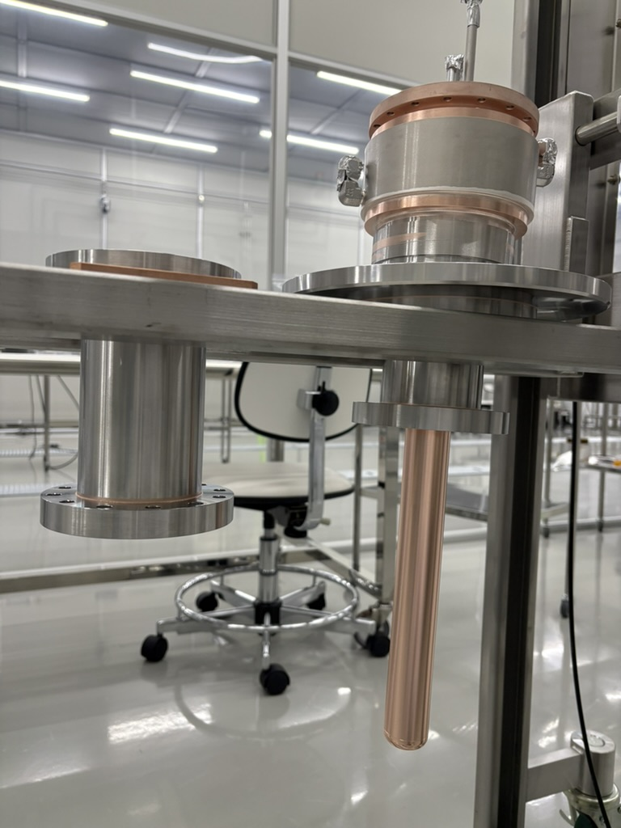
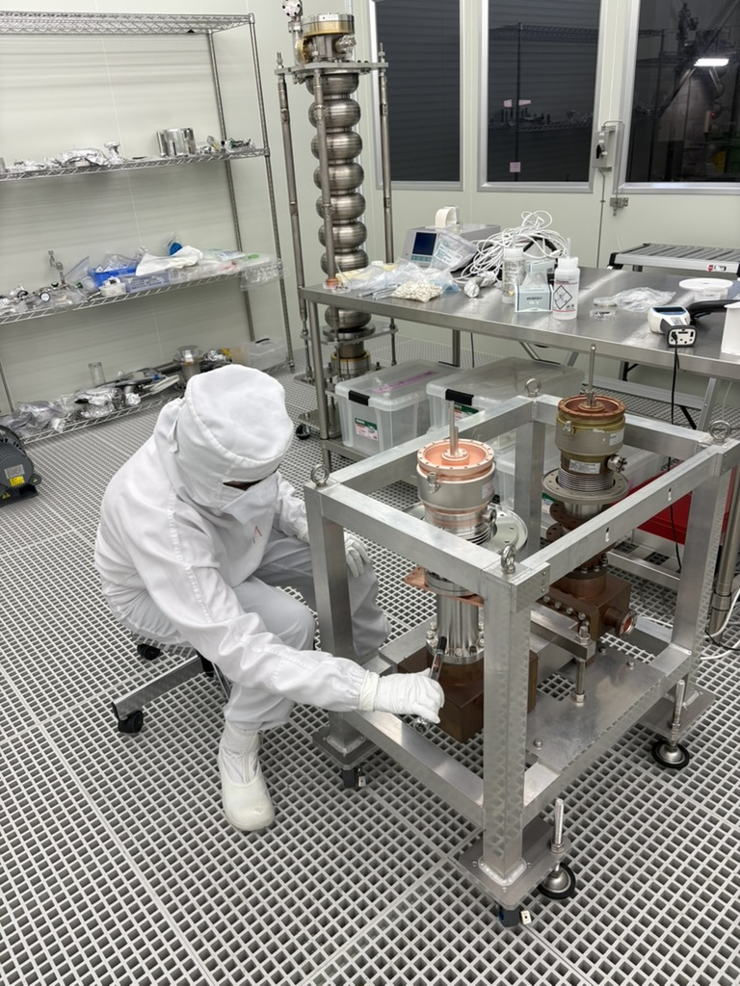
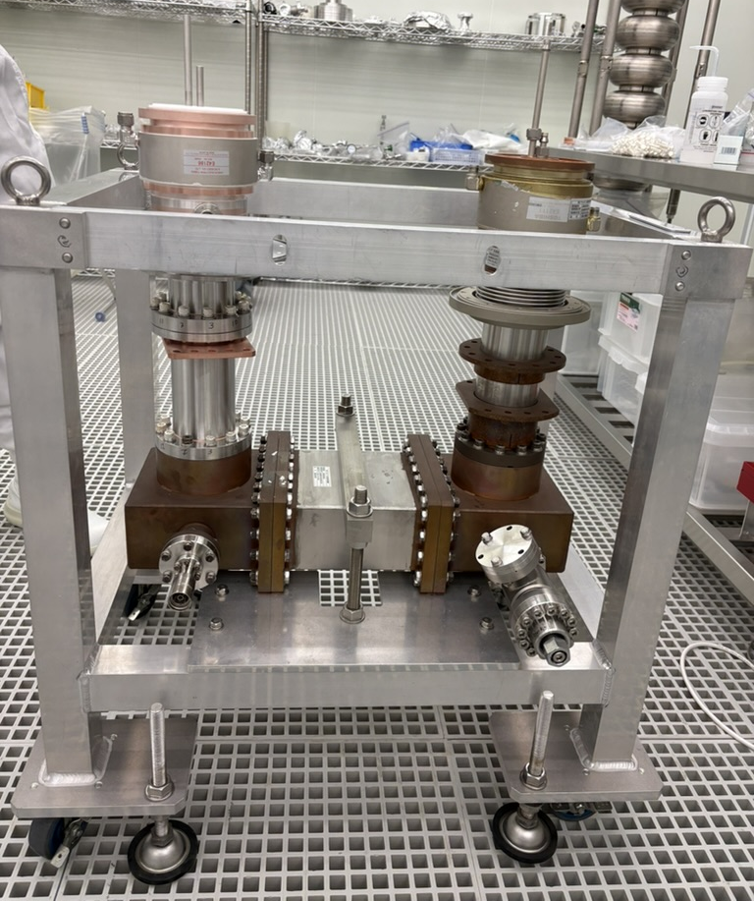
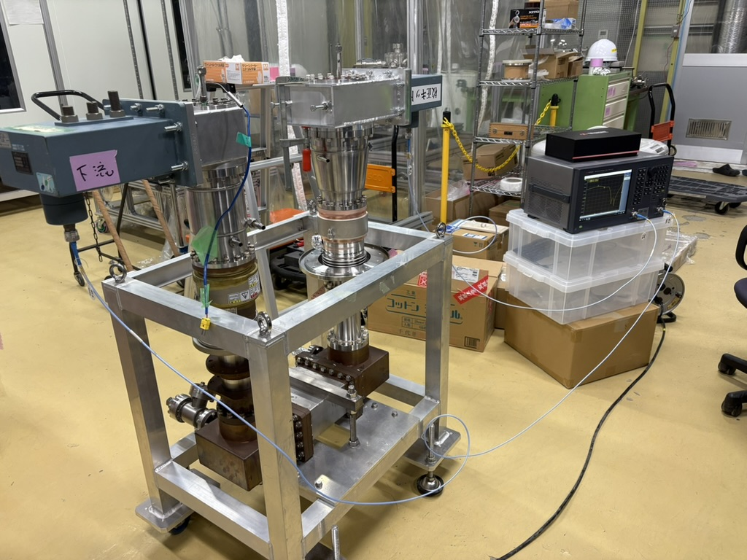
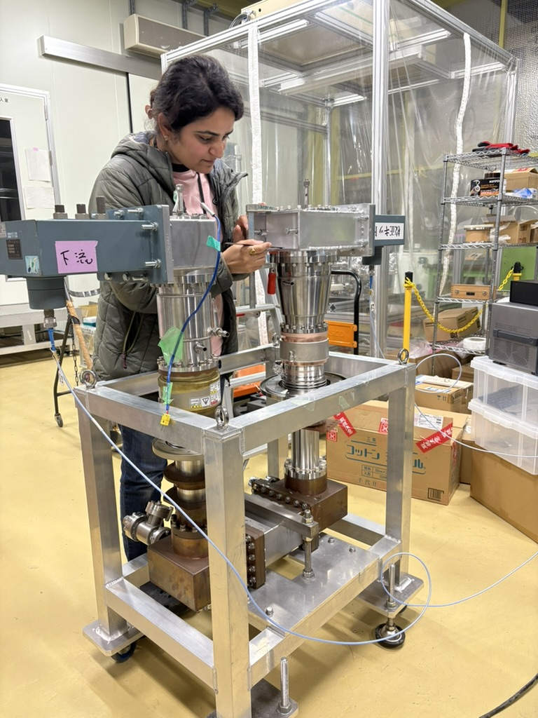
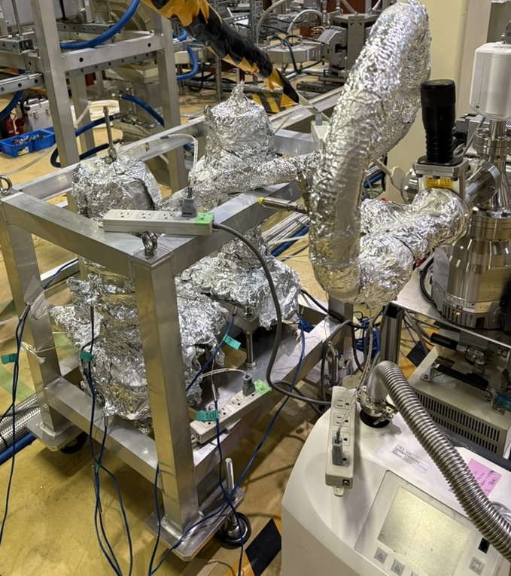
Test stand for high power test
Test stand was prepared with a new coupler and modified cERL injector coupler.
New coupler was cleaned in class 1000 CR. Drying and assembly in the class 10 CR. Baked for 48 hours at 120ºC.
Measured S1,1 @ 1.3 GHz = -21 dB
Assembled with power source and dummy load for high power test.
Coupler Cleaning in class 1000 clean room
Coupler test-stand assembly in class 10 clean room
Warm section assembly and Low power measurement
Adjustment of short plate
Coupler Baking Setup
RF window
Vacuum gauge
Modified warm section
Water cooled IC made of OFC
Water cooled OC
Demountable outer conductor
Antenna

Slide 6
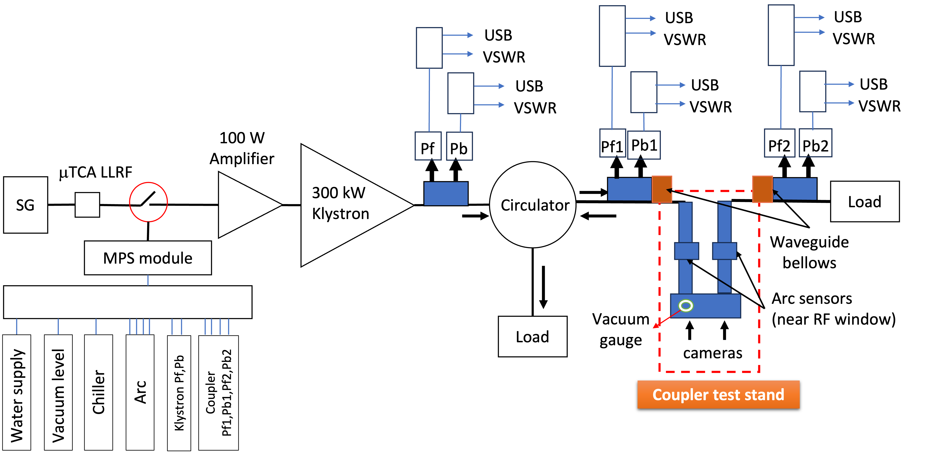
Experiment setup
Vacuum pump,
Chiller for water cooling and Fans for forced air cooling,
Temperature, Arc sensors and Cameras were installed.

Slide 7
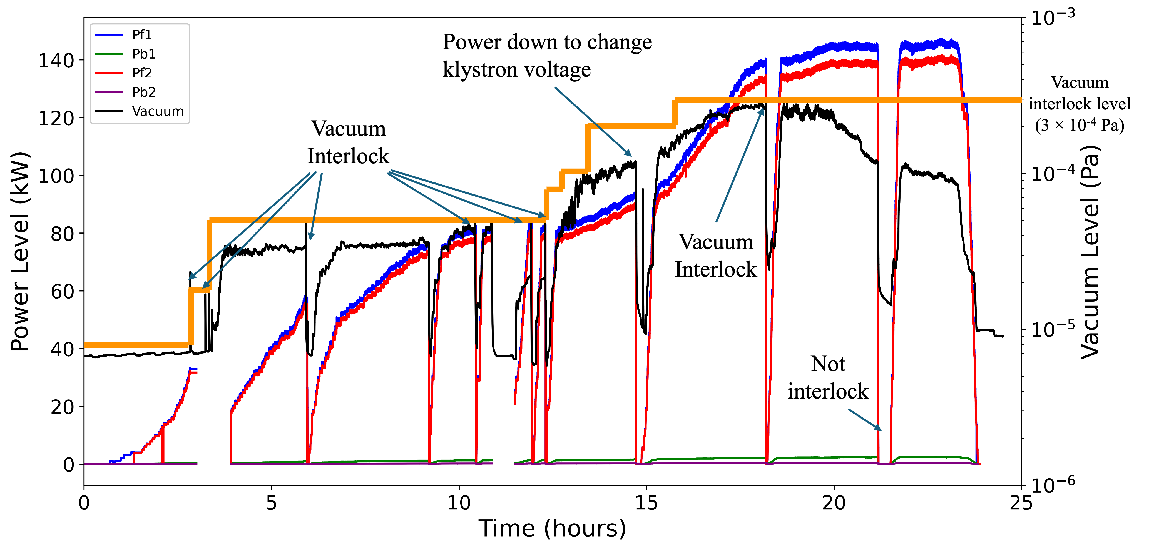
RF conditioning (pulse mode)
Starting RF conditioning in pulse mode (20μs pulse, 5 Hz)

Slide 8
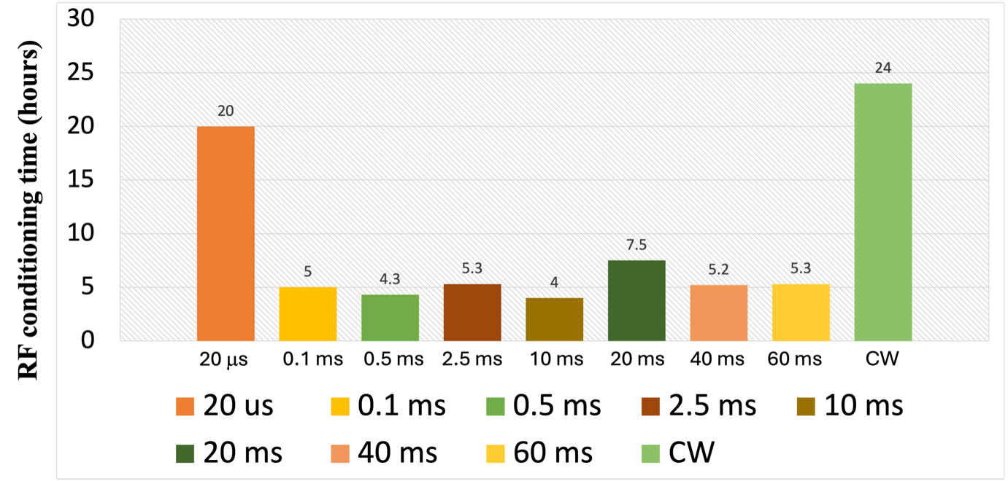
RF conditioning time
Number of days RF conditioning: 8 days
Total conditioning time: 84.6 hours (Pulse -> 60.6 hours and CW -> 24 hours)

Slide 9
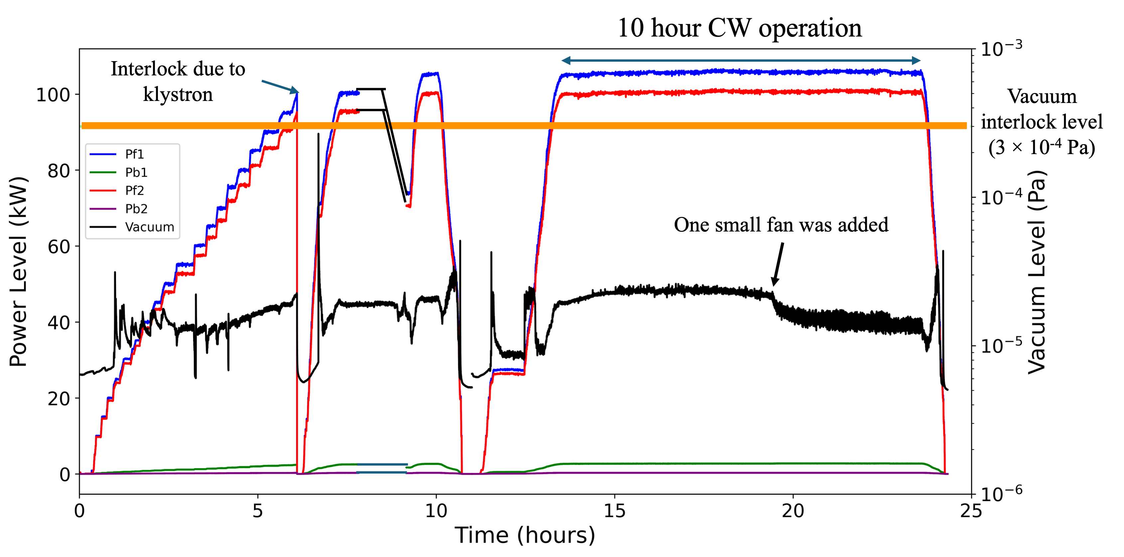
RF conditioning (CW mode)
Achieved record CW 100 kW RF transmission
No interlock related to the coupler.
Limited by the circulator.

Slide 10
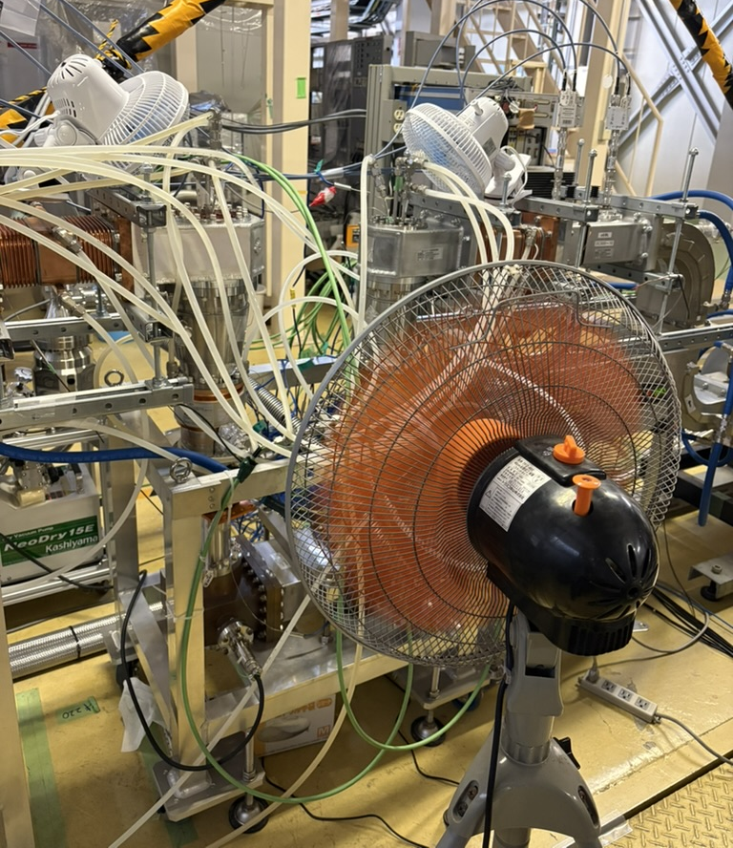
Suppression of temperature rise
Water cooling at
Warm inner conductor
Warm outer conductor
RF window
Antenna
Fan cooling at
Doorknob
Cold outer conductor
Whole test stand
Coupler test-stand during high power test
Water cooling pipes
Flow: 1L/min
Fan cooling
Modified warm section
Water cooled IC made of OFC
Water cooled OC
Vacuum gauge

Slide 11
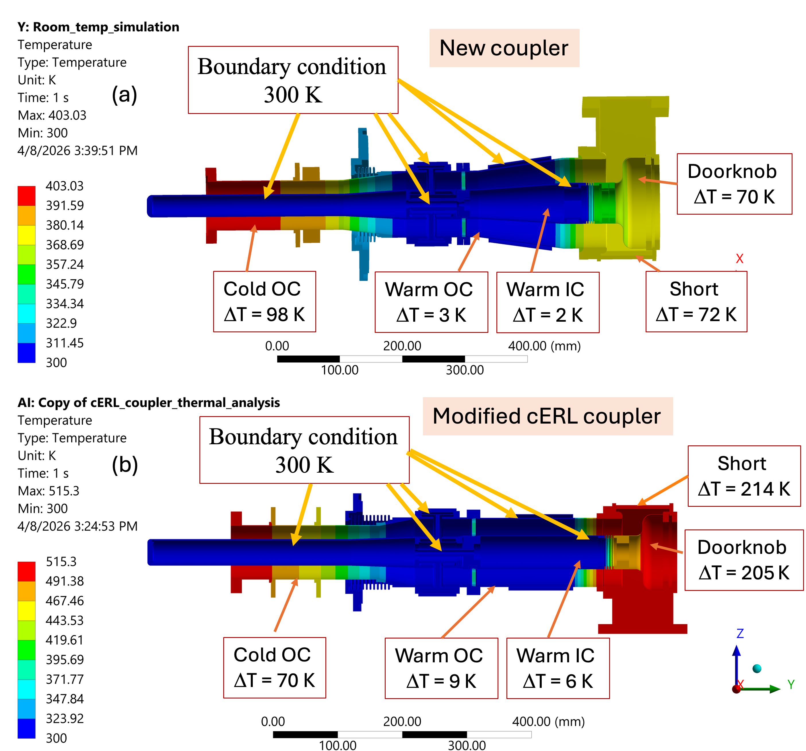
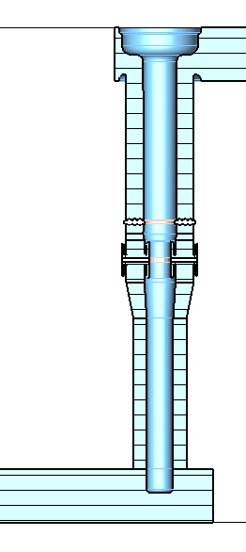
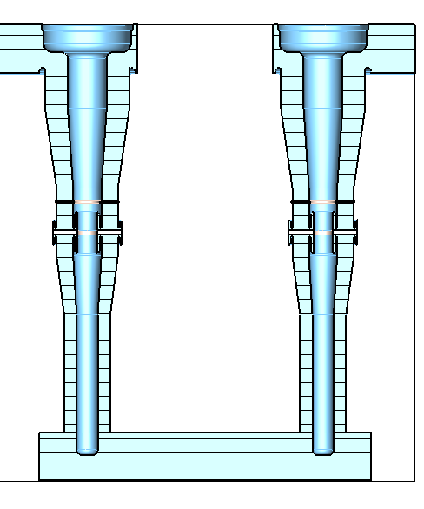
Temperature profile during high power test
Temperature Profile
Simulated temperature rise
(without convection )
New (upstream)
Modified cERL
(downstream)
DK up
(δT = 19ºC)
DK down
(δT = 55 ºC)
Short (δT = 18.5 ºC)
Short (δT = 51 ºC)
IC (δT = 14 ºC)
IC (δT = 18 ºC)
Warm OC jacket
(δT = -1 ºC)
Warm OC jacket
(δT = -1.5 ºC)
Warm OC (δT = 4 ºC)
Warm OC (δT = 7 ºC)
RF window
(δT = 0 ºC)
RF window
(δT = 9 ºC)
CB middle
(δT = 9 ºC)
Cold OC (δT = 8 ºC)
Cold OC (δT = 15 ºC)
CB up (δT = 19 ºC)
CB down (δT = 8 ºC)
Temperature rise at 100 kW CW power
Doorknob -> 19 ºC (max.), Inner conductor -> 14 ºC

Slide 12
Learning
Suppression of temperature rise using water cooling, and enlarged warm section
Water cooling together with the fan cooling was very efficient to suppress temperature rise during high power test in CW mode.
One warm window cooled by water is simple and best solution.
Both simulation and measurement confirmed that the increase in size significantly improve thermal performance.

Slide 13
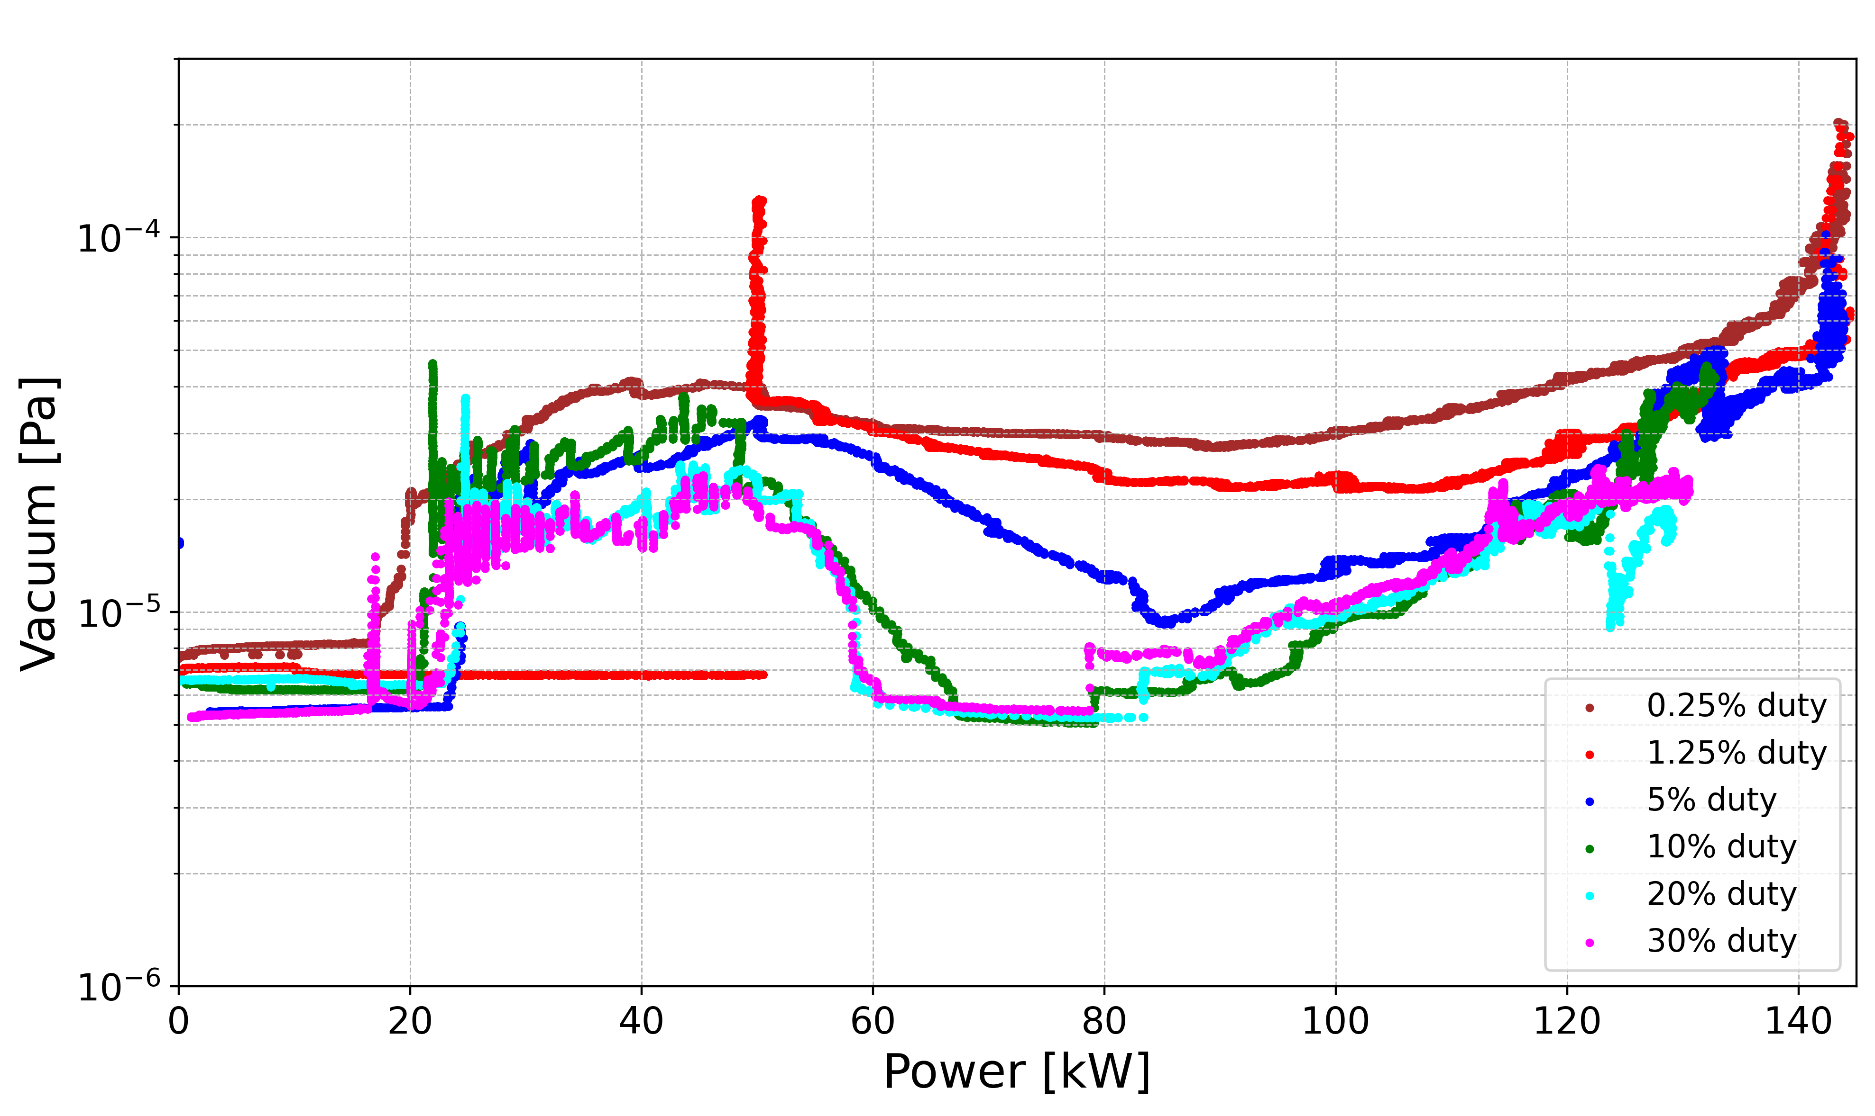
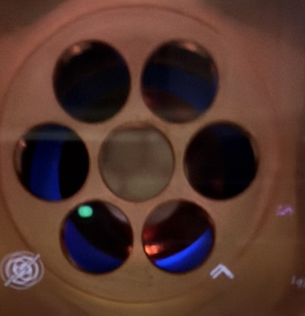
Vacuum during RF conditioning in pulse mode
Multipacting light was observed during pulse conditioning
0.25%
New coupler
5%
1.25%
30%
10%
20%
Light from camera
Blue light
Overall vacuum level decreases with the increase in duty cycle.
Vacuum activity remained power level between 20 kW to 55kW -> Multipacting
Note:
No such light was observed for the Modified cERL injector coupler.
RF conditioning for long time -> No multipacting!

Slide 14
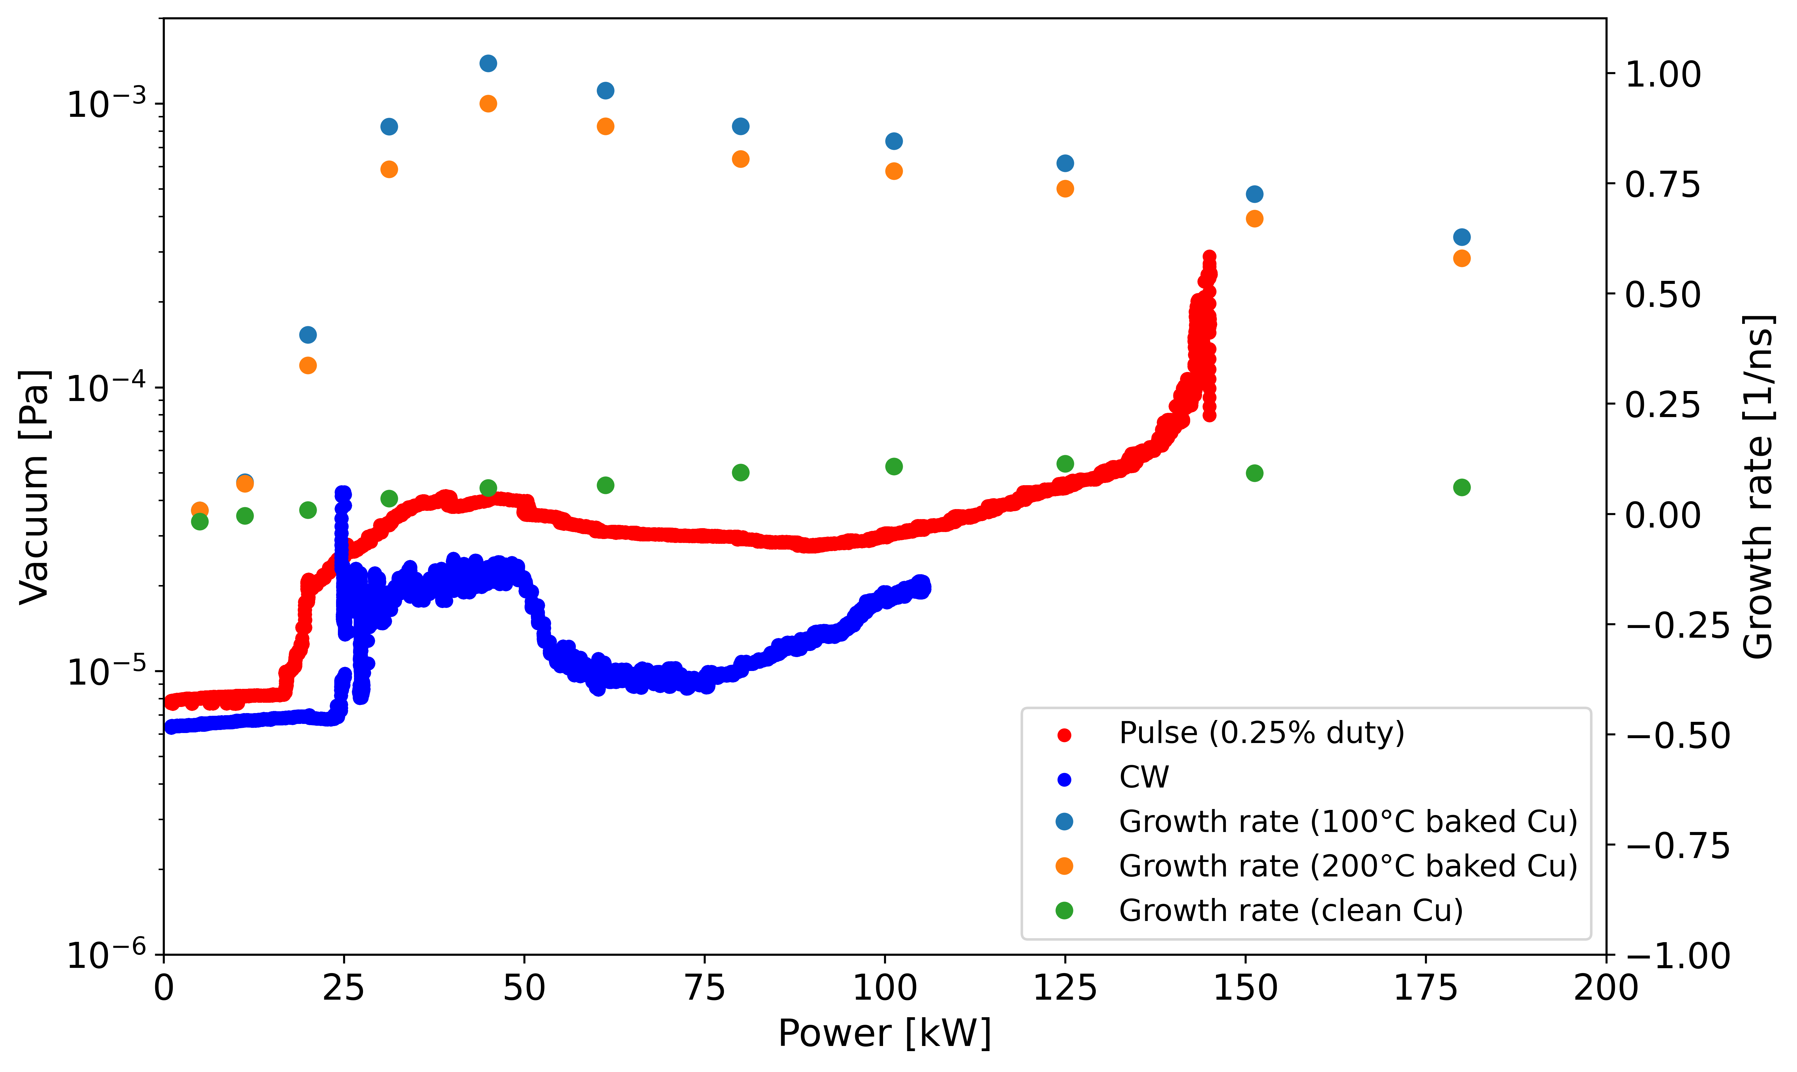
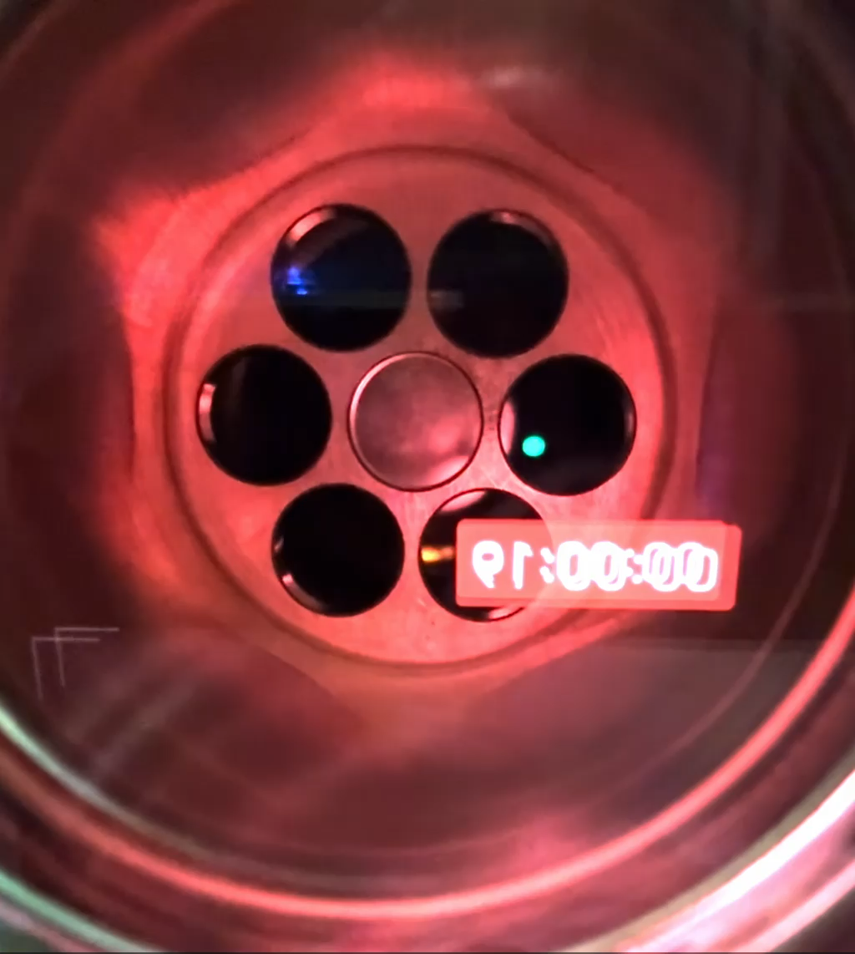
Observation and Simulation
Observed multipacting
Simulated multipacting growth rate along with the measured vacuum level
Power 130 kW, Pulse width 20 ms, Repetition rate 5 Hz
Growth rate (Cu 100ºC baked)
Growth rate (Cu 200ºC baked)
Start of conditioning
Growth rate (Clean Cu)
End of conditioning
Outgassing or multipacting!
Multipacting
In simulation, maximum growth rate was found at around 45 kW power -> consistent with the measured power range of vacuum activity.
Does your multipacting simulations are consistent with the measurement of not?

Slide 15
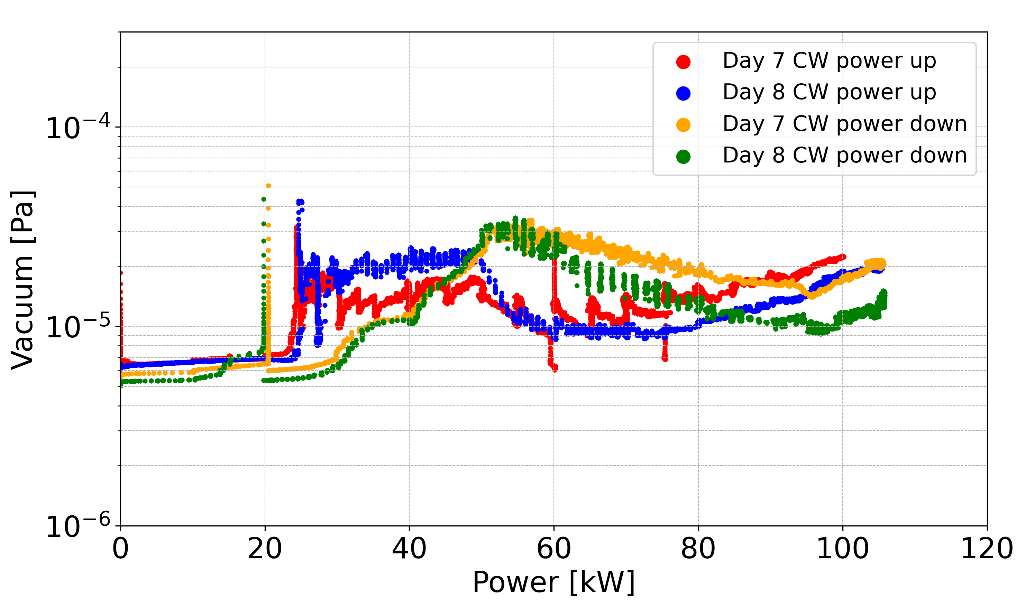
Hysteresis on Vacuum behavior
Day 7
Day 8
Power up
Power down
During power up, vacuum starts increasing around 23 - 55 kW.
Opposite vacuum behavior for power down.
Sharp increase in vacuum at 20 kW during power down.
Reproducible! Reason?
After conditioning, is it possible to completely remove?
During operation, did you observed multipacting? Is it a problem or not?
It is important to increase and decrease the power slowly to prevent the sharp increase in vacuum.
From 20 kW-55 kW, some vacuum activity happens (multipacting region!)

Slide 16
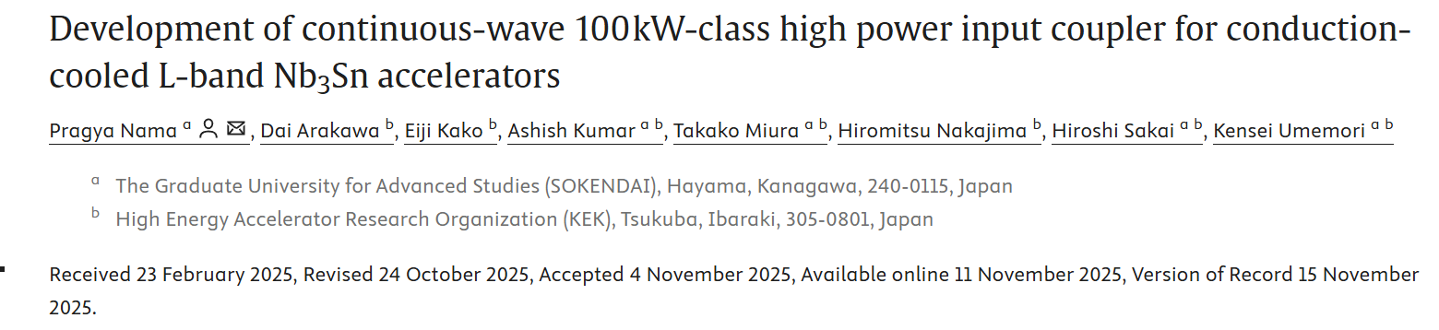
Summary
Developed CW 100 kW-class 1.3 GHz high power input coupler ->Achieved highest power transmission in CW mode.
In CW mode, 100 kW power transmission was maintained for continuously 10 hours without any interlock.
Published paper:
P. Nama, D. Arakawa, E. Kako, A. Kumar, T. Miura, H. Nakajima, H. Sakai, and K. Umemori, Development of continuous-wave 100 kW-class high power input coupler for conduction-cooled L-band Nb₃Sn accelerators, Nucl. Instrum. Methods Phys. Res. Sect. A 1083, 171155 (2025). https://doi.org/10.1016/j.nima.2025.171155

Slide 17
Discussion topics
1. Multipacting
Consistency of Multipacting simulation and experimental observation.
Complete elimination of multipacting is possible or not after conditioning?
Multipacting during the operation was observed or not? If yes, is it concerning or just avoid it?
2. Issues with higher (>100kW CW) power transmission.
What would be the limiting factor if we increase power level more than CW 100 kW? Multipacting! Or Temperature rise! Or what else?
3. Temperature rise
Consistency of temperature rise simulation and measurment.
How to simulate air cooling?

Slide 18
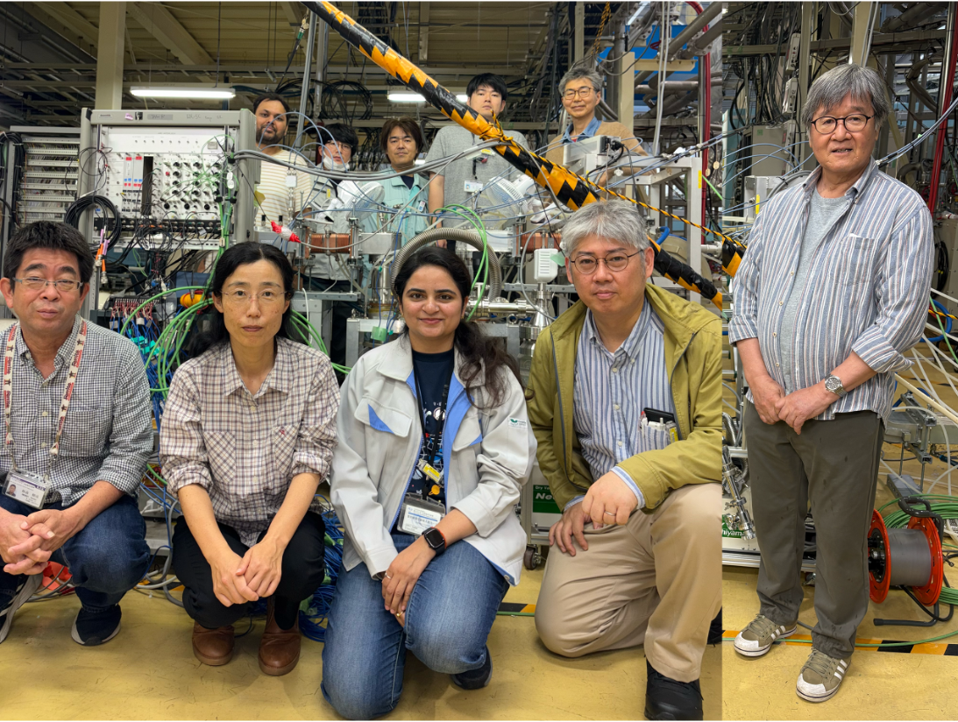
Coupler development team
This research was supported by the JST and the establishment of university fellowships for the creation of science and technology innovation (Grant Number JPMJFS2136) and partially supported by the US-Japan Science and Technology Cooperation Program in High Energy Physics and a JSPS Grant-in-Aid for Scientific Research (KAKENHI) Grant No. JP24K03208.

Slide 19
Thank you

