Slide 1

Compact on-axis Coaxial HOM Damper for SRF Cavities
June 9-12, 2026
A. LUNIN, S. BELOMESTNYKH, I. GONIN, T. KHABIBOULLINE and V. YAKOVLEV
FERMILAB-SLIDES-26-0081-SQMS-TD
This work has been authored by Fermi Forward Discovery Group, LLC under Contract No. 89243024CSC000002 with the U.S. Department of Energy, Office of Science, Office of High Energy Physics.

Slide 2
OUTLINE
HOM Damping in Low Frequency SRF Cavities
Motivation/Questions;
HOM specifics in oversized SRF cavities;
Ideas for an on-beamline-axis coaxial HOM coupler:
  Omnidirectional HOM coupling
  Half-septum coaxial coupler
  Rejection of the operating mode
Examples of coaxial HOM designs:
  53 MHz SRF alternative for the Fermilab Main Injector (MI) system
  394 MHz EIC Crab Cavity
Conclusions

Slide 3
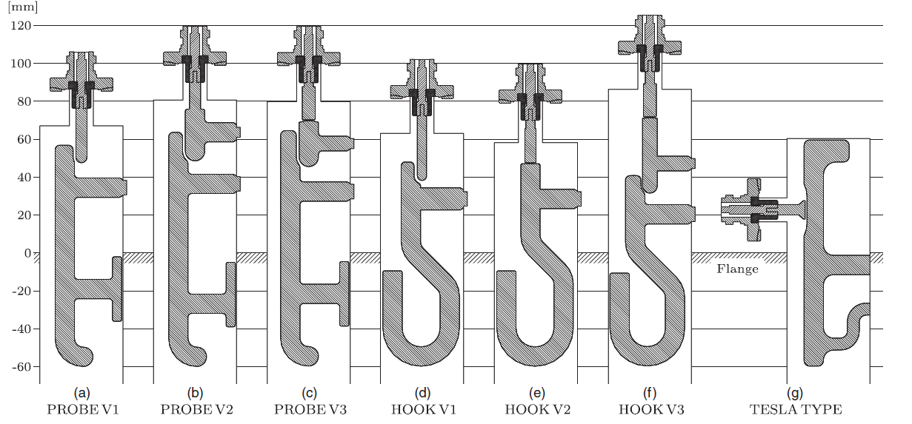
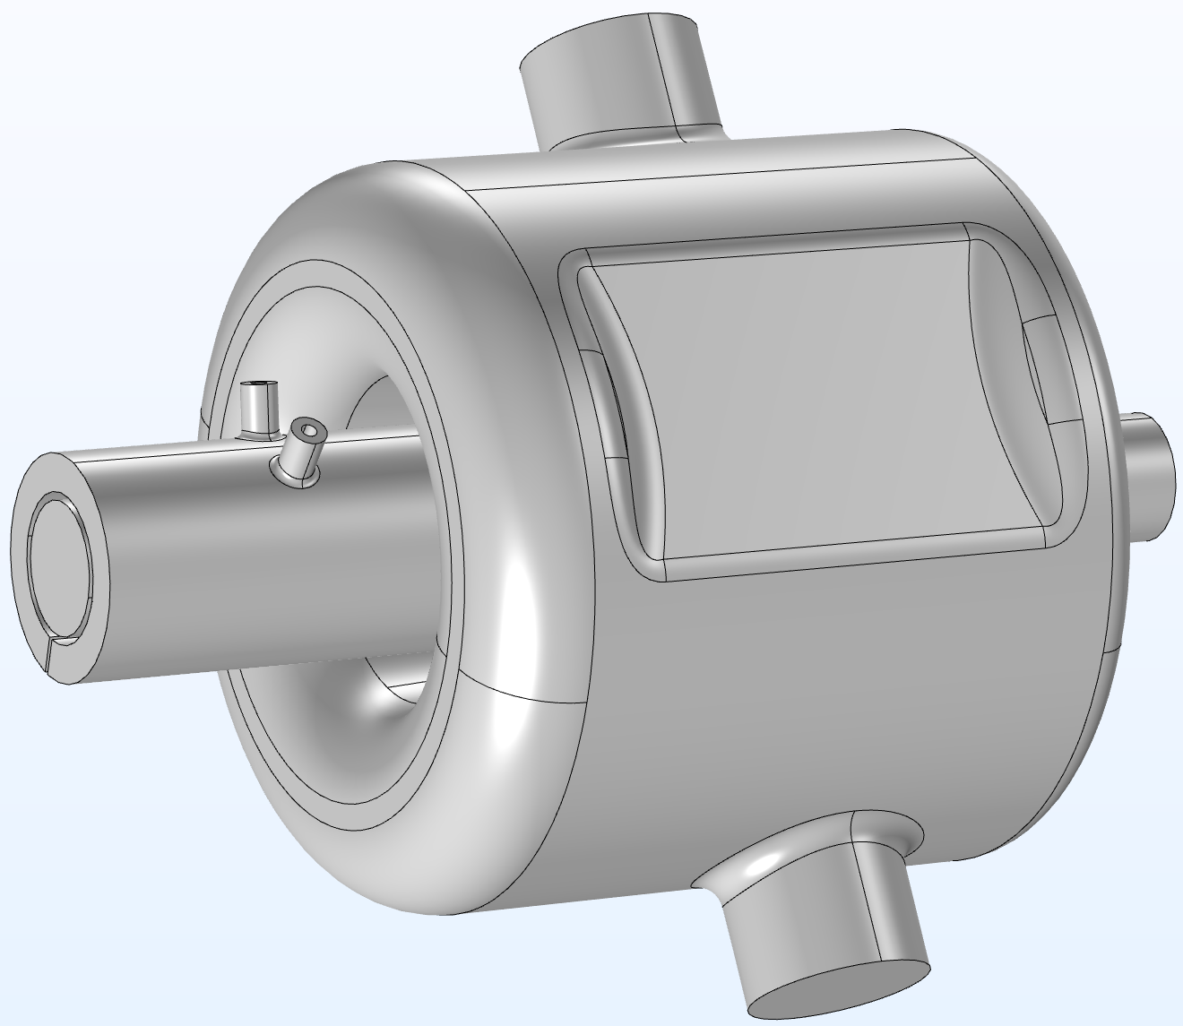
MOTIVATION AND QUESTIONS
Applications of Low Frequency SRF cavities
  Acceleration of low-beta particles in proton and ion linacs;
  Accelerating cavities for Storage Rings;
  Deflecting/crab cavities
Limitations of LF cavities with conventional HOM dampers
  Cavity space is limited in sizes (both transverse and longitudinal)
  Complexity of the HOM couplers and feedthroughs (loops & notch filter)
  Reliable HOM power extraction requires multiple HOM-coupler ports
  Difficult to operate the rejection scheme.
Compact coaxial HOM damper
  Coaxial coupler is a compact version of the folded Waveguide (WG) coupler;
  Coaxial gap provides good coupling with HOMs;
  Simple antenna feedthroughs;
  HOM absorber can be directly incorporated to the coupler;
Questions:
  Rejection of the operating mode;
  Multipacting in the coaxial line;
  Broadband wake-fields damping;
  Dipole HOM with arbitrary polarization;
  Mechanical design and fabrication;

Slide 4
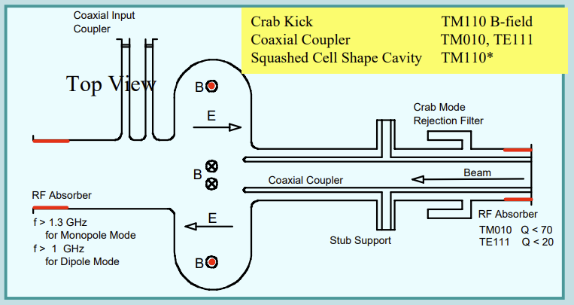
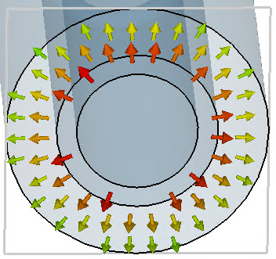
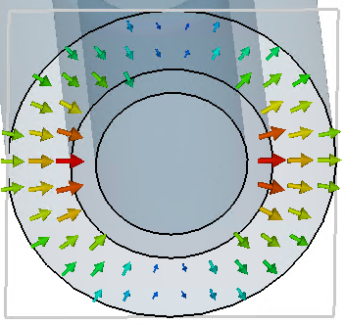
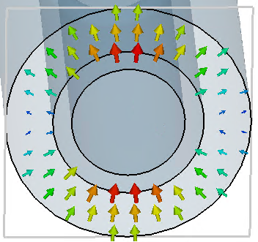
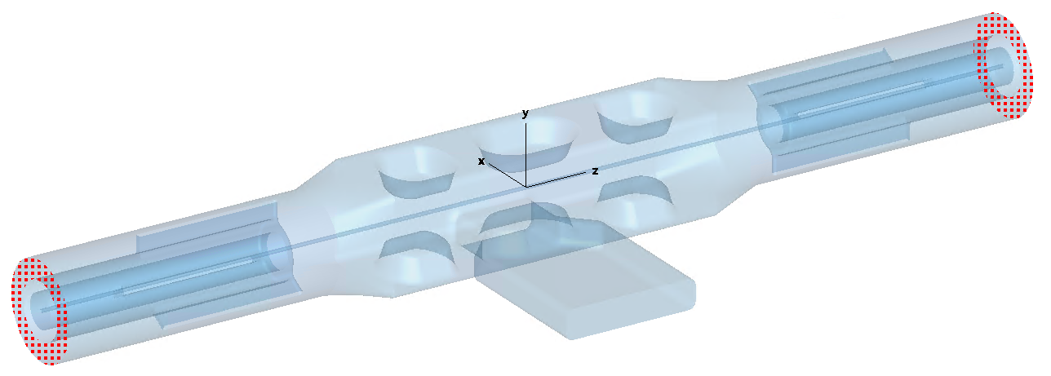
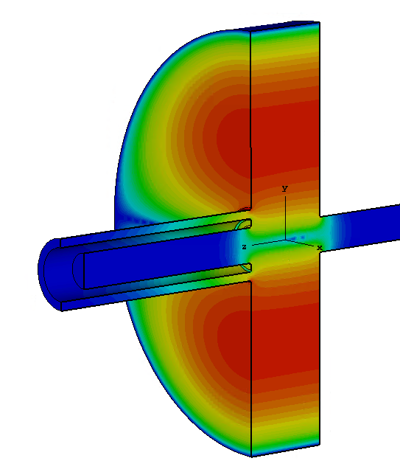
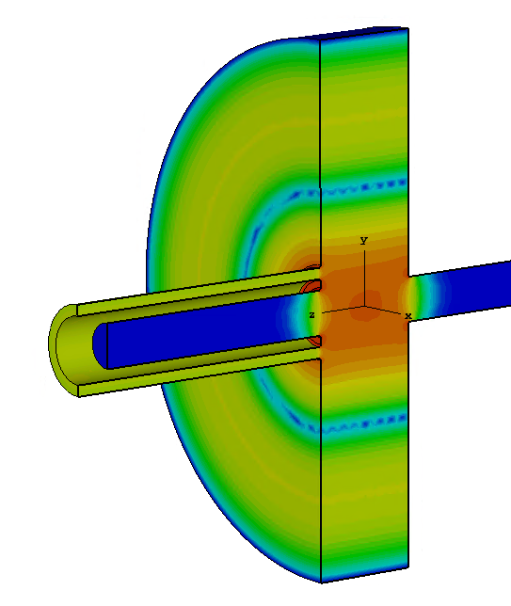
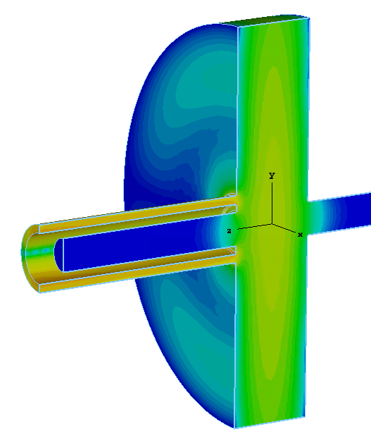
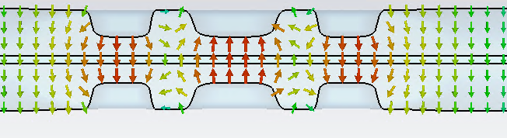
Basic Idea of the Coaxial Coupler (CC)
Oversized coaxial gap is a multimoded transmission line
  TEM mode: no cut off frequency; coupled with cavity monopole HOM modes
  TE₂₀ mode: λ_{c} ≈ π*(R₁+ R₂); coupled with cavity dipole HOMs (arb. polarization)
Selective coupling with the cavity modes
  By adjusting the coaxial radii, we can set all HOMs to be above the TE₂₀ cutoff;
  No coupling with the lower order and operating dipole TE modes;
CC can be used as a HOM damper for Crab Cavities
  In the 1990s, a CC-type HOM coupler was proposed for use in the KEKB crab cavities
KEKB Crab Cavity*
TEM-Mode
TE₂₀-Mode (Dipole)
H-sym
H-sym
E-sym
H-sym
E-sym
H-sym
[*] K. Hosoyama et al., “Development of the KEK-B Superconducting Crab Cavity”, EPAC08, THXM02, 2008
QMiR Crab Cavity operated by the TE-mode#
Operating Dipole Mode
HOMs above the TE₂₀ cutoff
[#] A. Lunin et al., “Design of a Quasi-waveguide Multi-cell Deflecting Cavity for the Advanced Photon Source,“ Physics Procedia, vol. 79, 2015

Slide 5
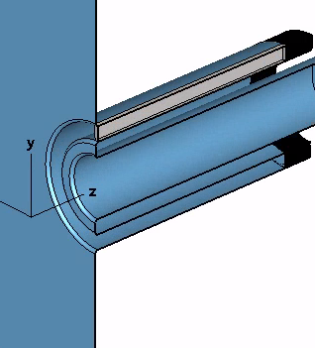
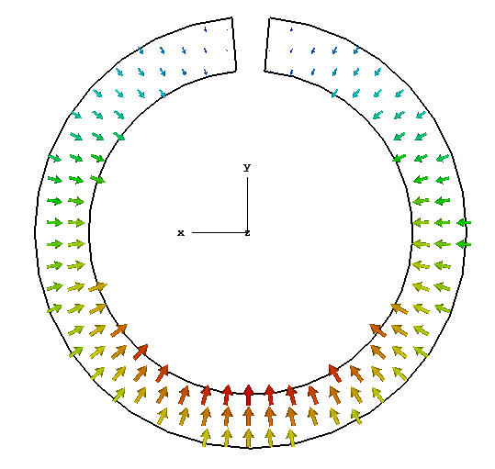
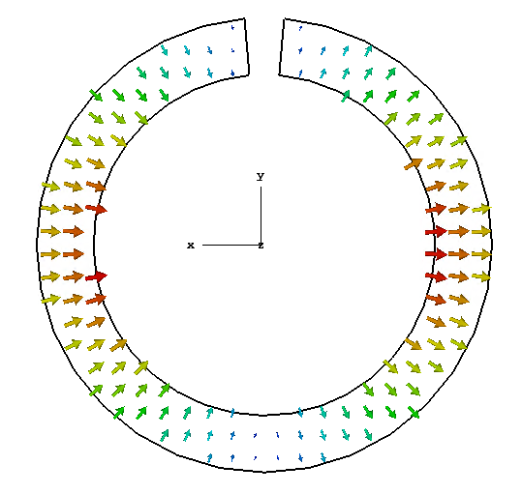
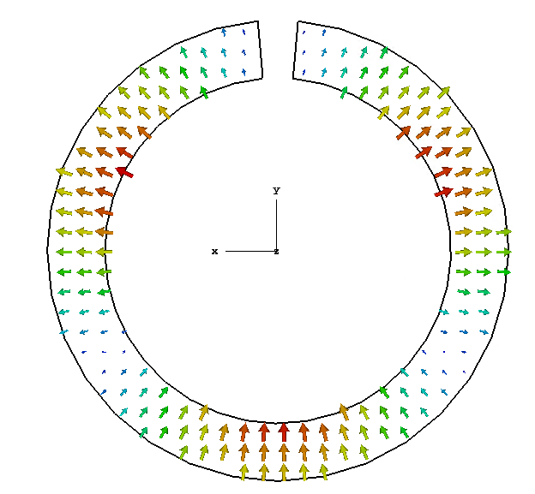
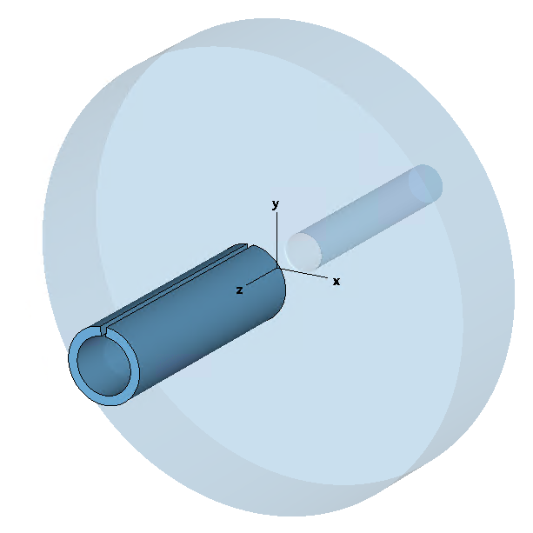
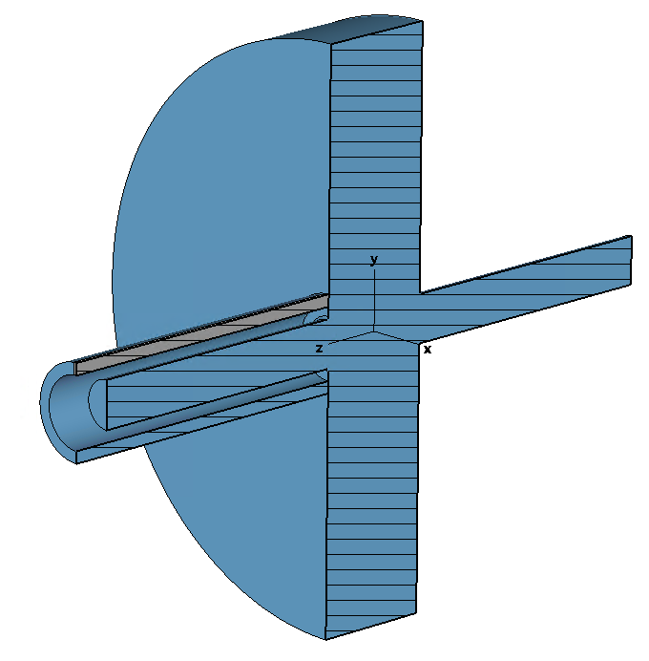
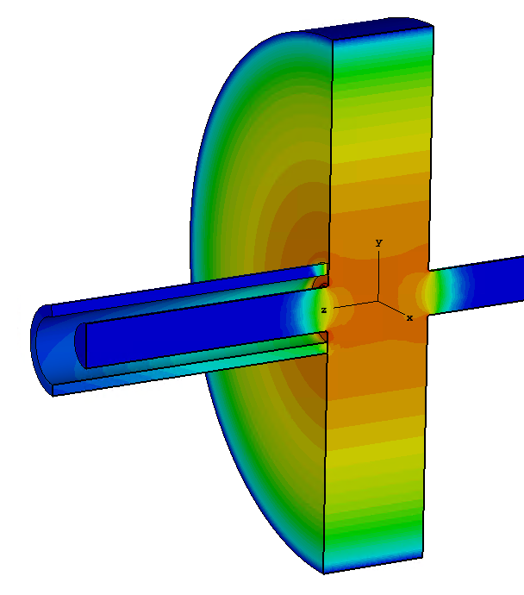
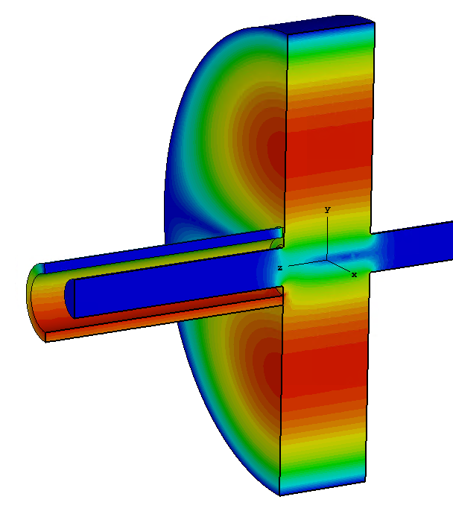
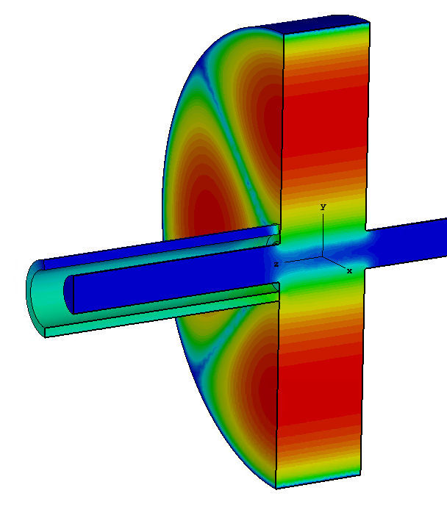
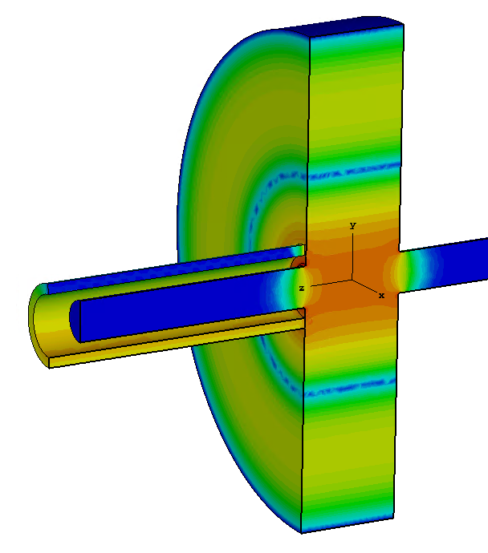
Basic Idea of the Coaxial Coupler (cont.)
Half-Septum Coaxial Line
  Folded Waveguide: No TEM mode(!);
  TE₁₀ mode: λ_{c} ≈ 2π*(R₁+ R₂) → the cutoff frequency is half of the TE₂₀ (!)
Selective coupling with the cavity modes
  Rejection of the TM operating mode (below the cutoff)
  Good coupling with HOMs above the cutoff frequency
HSCC can be used as a HOM damper for acc. cavity
C-shaped Side Coupler for ERL*
TE₁₀
TE₂₀
TE₃₀
[*] K. Sawamura et al., ERL2019, THCOXBS02, 2019
On-axis Half-Septum Coaxial Coupler
Operating TM Mode
HOMs above the TE₁₀ mode cutoff (fixed polarization)

Slide 6
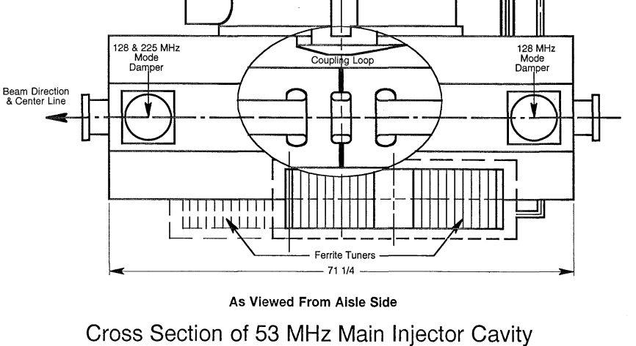
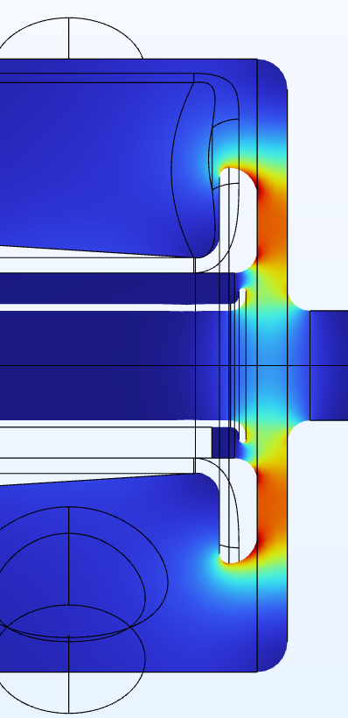
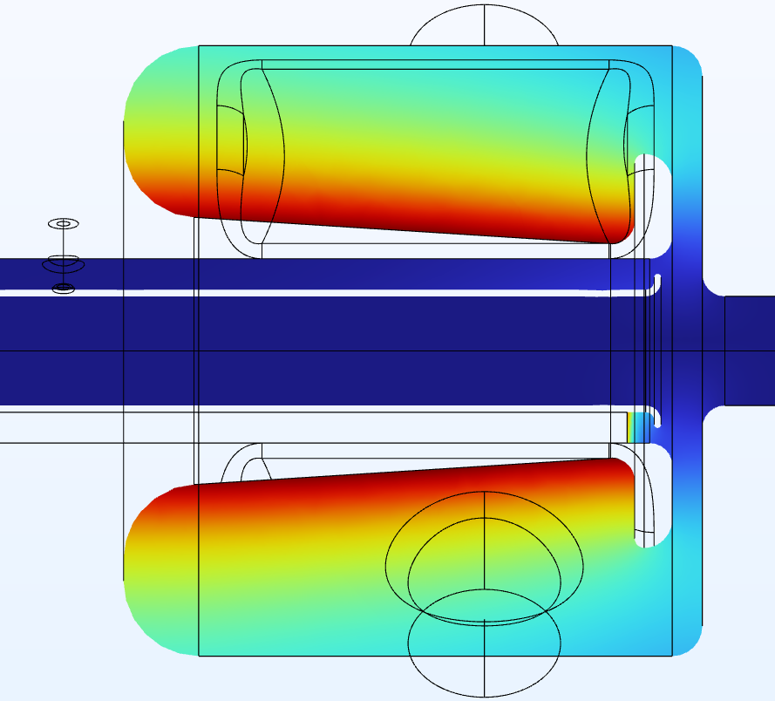
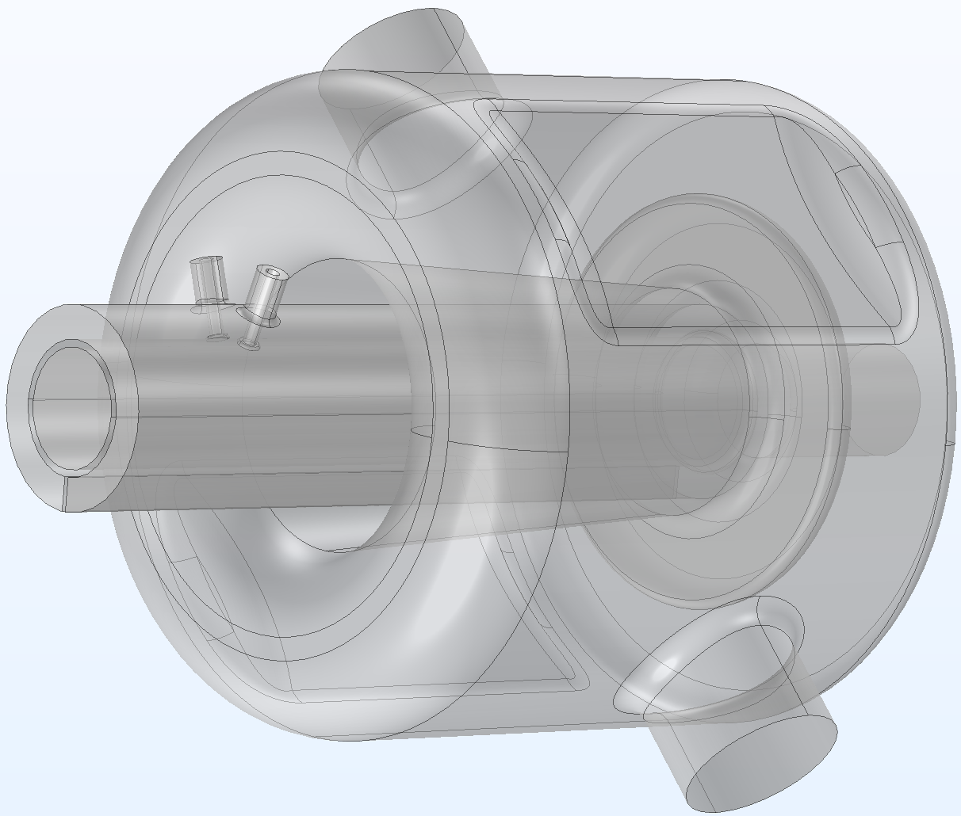
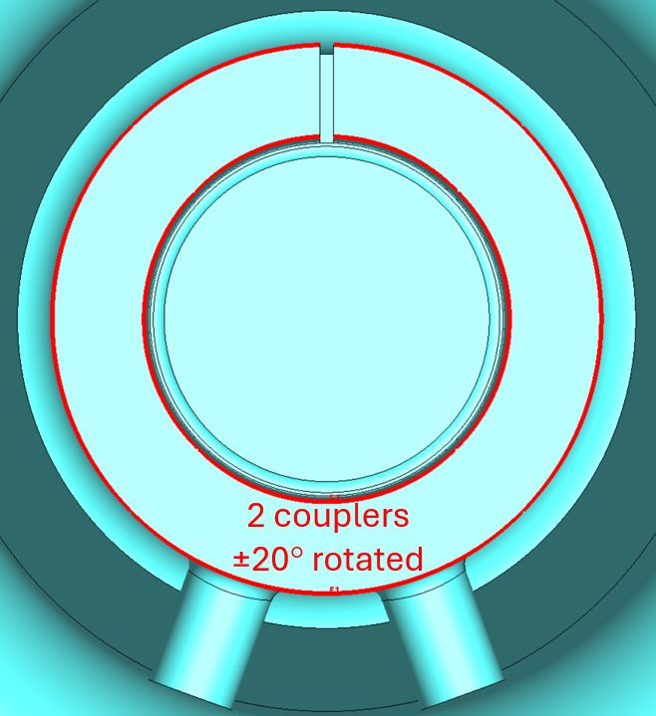
53 MHz SRF Cavity for the Fermilab Main Injector
SRF resonator proposed for alternative tunable 53-MHz MI cavity at Fermilab
  SRF cavity operate at higher acc. voltage (6 SRF replaced 40 NC RF cavities)
  Half-Septum CC is used for the HOM damping scheme;
CC rejection of the operating mode
Original MI cavity¹
QWR SRF cavity²
ø 812 mm
1800 mm
Tunable Membrane (green)
CC damping of Dipole HOMs
[1] The Fermilab Main Injector Technical Design Handbook, Fermilab, 1995
[2] K. McGee, A tunable superconducting rf cavity enabling next generation rapid-cycling synchrotrons, DOE ECRP, DE-FOA-0003450, Fermilab, 2025

Slide 7
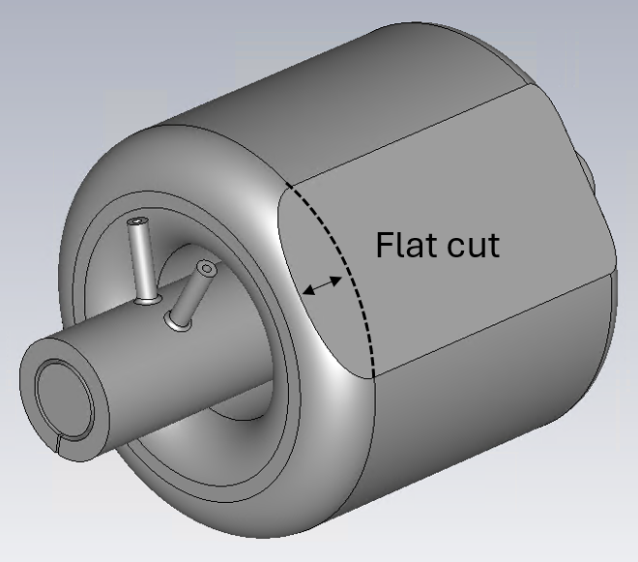
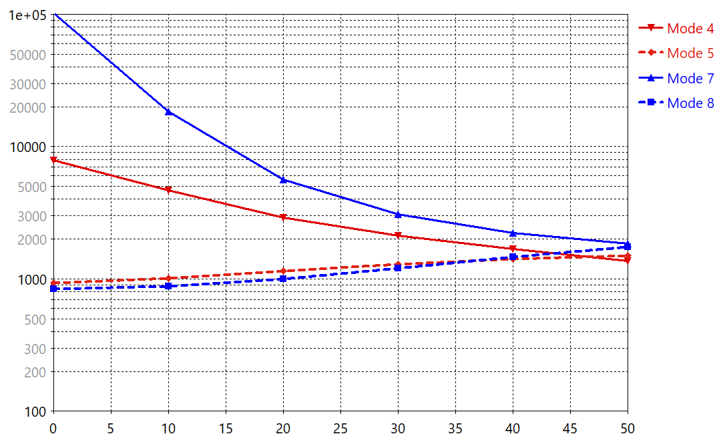
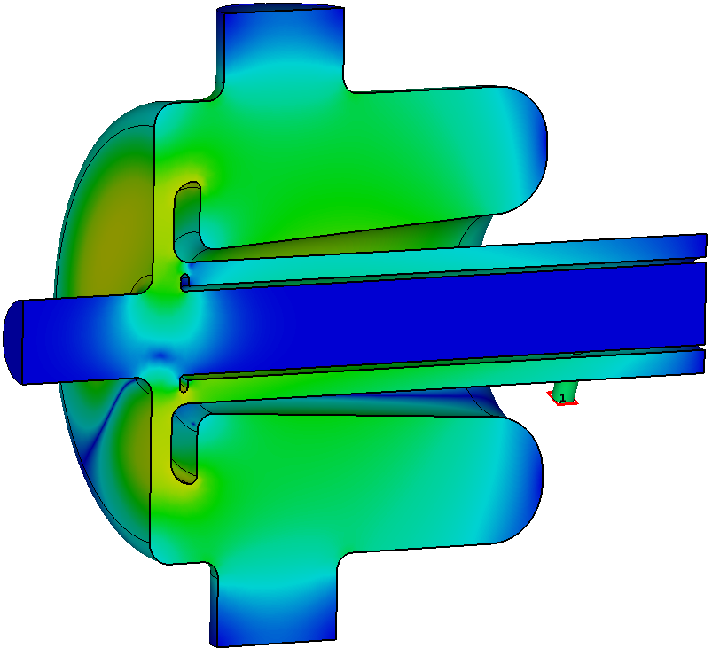
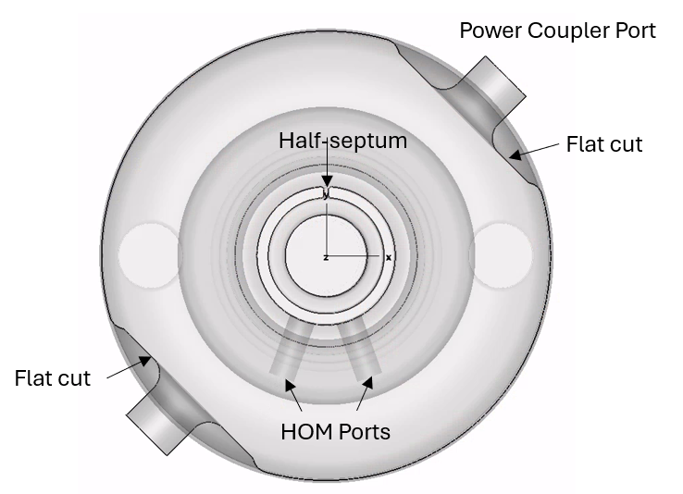
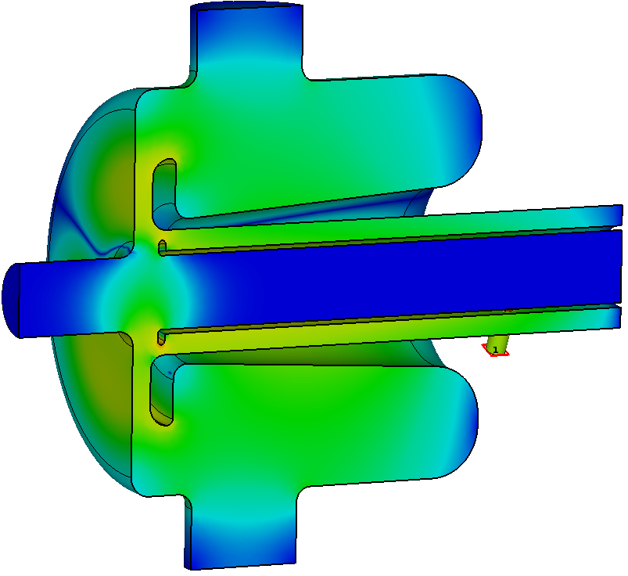
53 MHz SRF Cavity for the Fermilab Main Injector (cont.)
Damping dipole HOMs with arbitrary polarization
  The half-septum determines the polarization of propagating TE modes;
  The idea is to polarize the cavity HOMs by ±π/4 relative to the half-septum;
  Polarization splits the frequencies of degenerate dipole HOMs, which makes it possible to damp both and arbitrary combinations;
The proposed HOM damping scheme meets requirements of the MI
HOM polarization by two “flat cut” at +π/4 relative to the HSCC
HOM External Coupling vs the cut depth
D1_1, F = 236.2 MHz
D2
D1
HOM polarization by two FPC ports
D1_2, F = 241.5 MHz
Flat cut [mm]

Slide 8
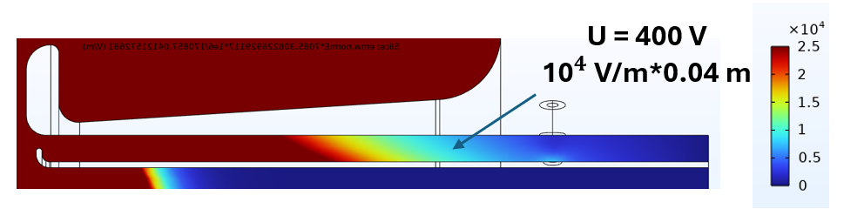
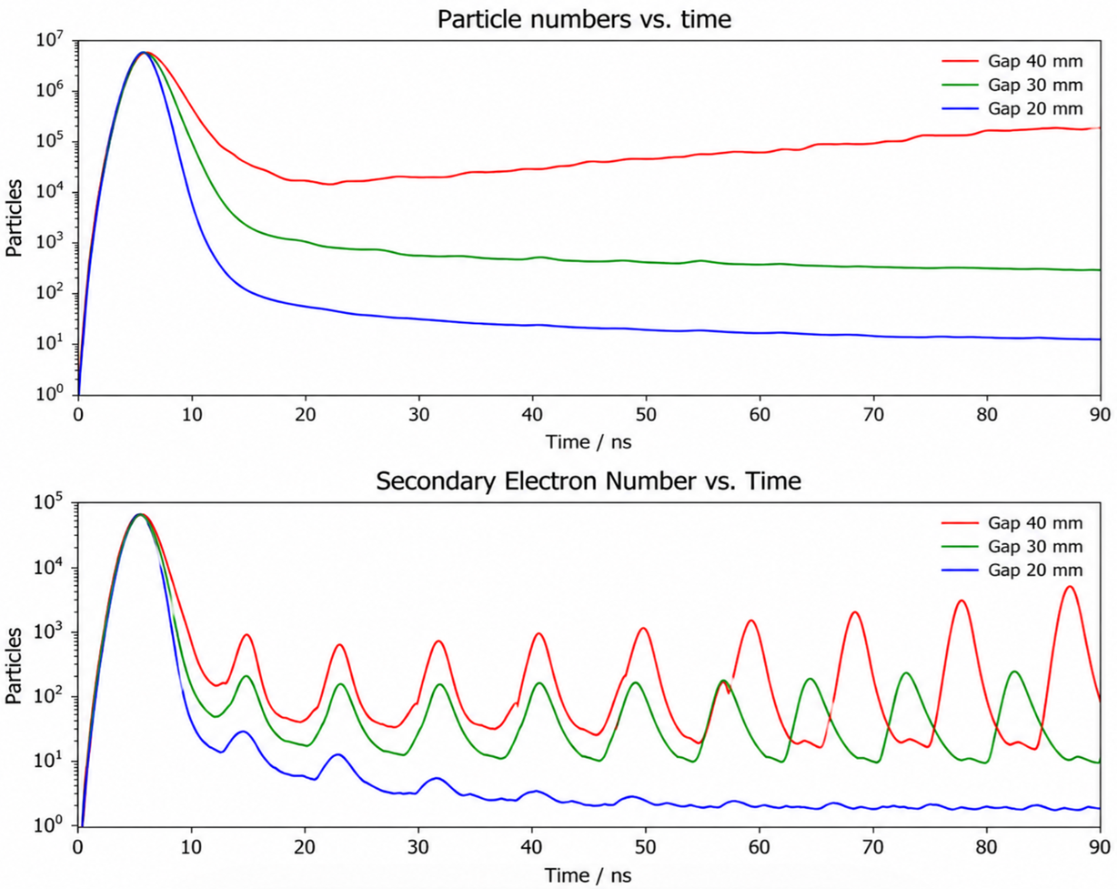
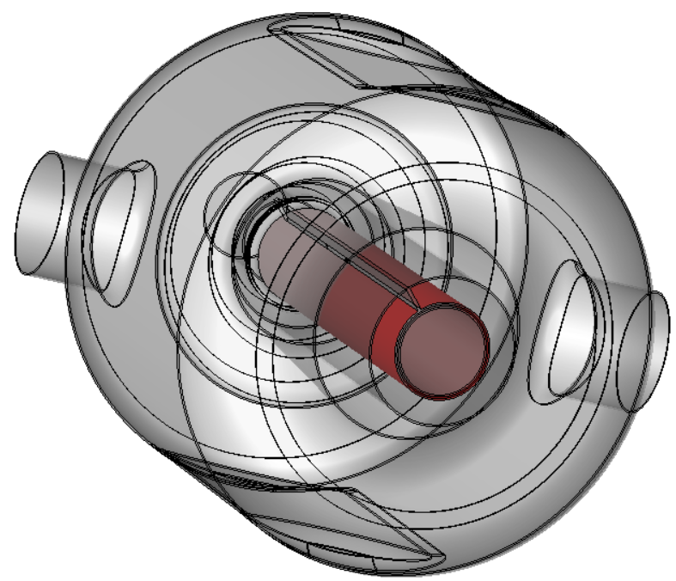
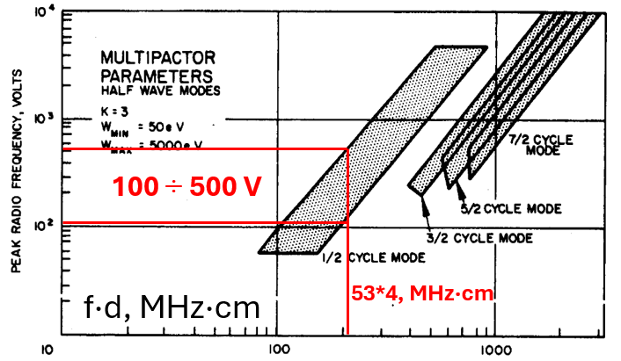
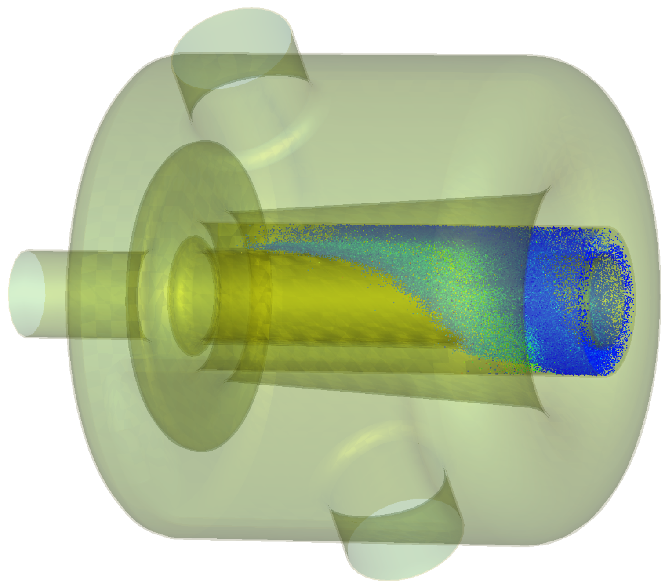
Coaxial Coupler Multipacting Studies
Initial CC design shown a presentence of a broadband MP
  MP was detected for a wide range of acc. voltage;
  Results confirmed by the theoretical 2D model of MP between two plates
The remedy is to reduce the CC gap (40 mm) and move to MP-free zone
Voltage in the Coaxial Gap
MP modeling in CST Particle Studio (red is emission surface)
MP between 2 plates*
V_{acc} = 1 MV
[*] The Study of multipactor breakdown in space electronic systems, NASA Contractor Report, NASA CR-448, Washington, D.C., 1966

Slide 9
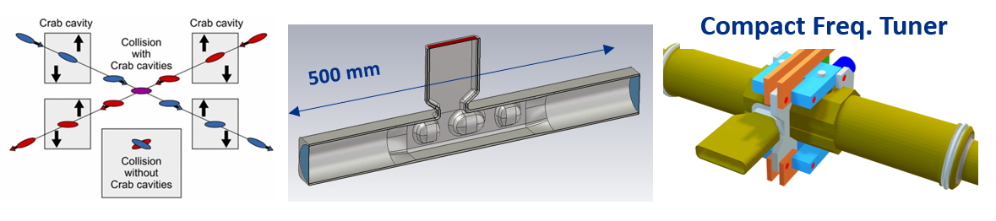
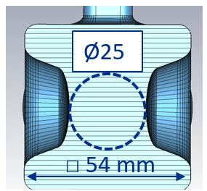
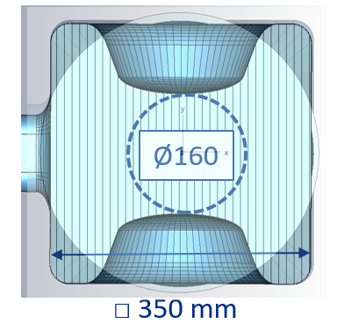
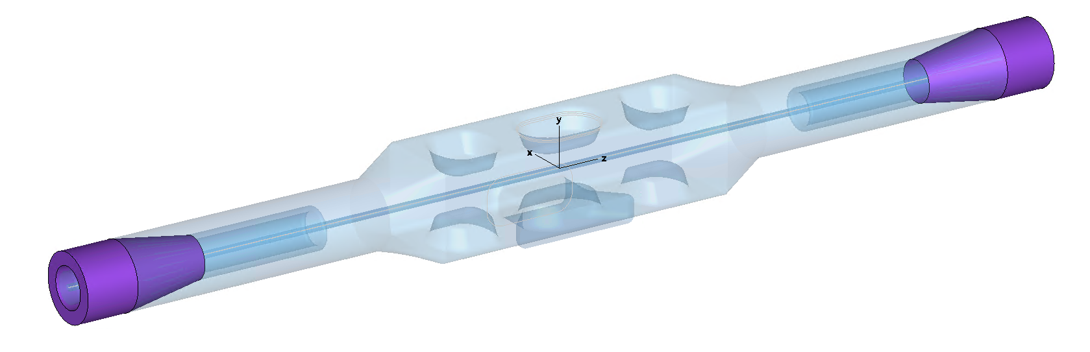
Proposed 394 MHz Crab Cavity for the EIC Project
2.6 GHz QMiR Crab Cavity for the ILC
  QMiR crab cavity selected to be a prototype for the ILC*
  HOMs are loaded to the beam pipe (HOM-couplers)
  Desing can be scaled to lower frequencies!
394 MHz EIC Crab Cavity with Coaxial Coupler for HOM damping
Scaled QMiR ( x 6.5 )
*A. Lunin et al., TUPTB044, SRF'23, Grand Rapids, MI, USA, 2023
BLA
BLA

Slide 10
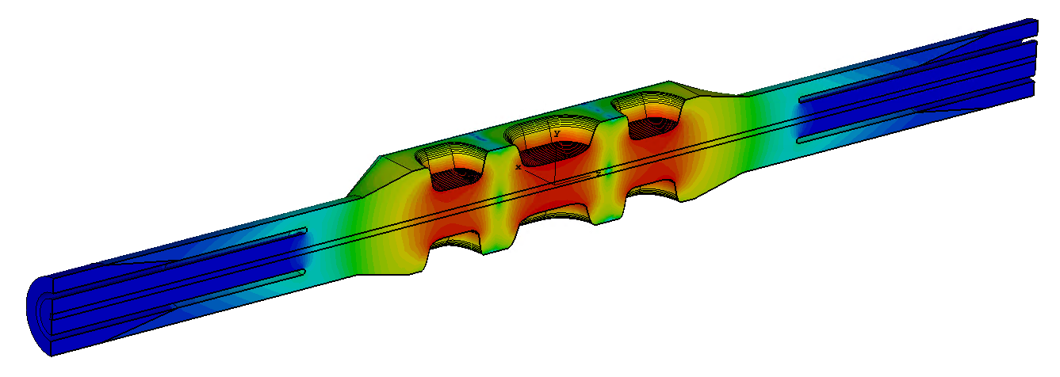
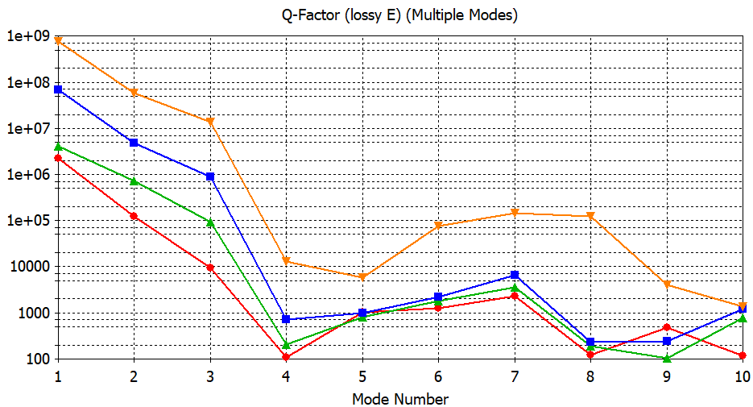
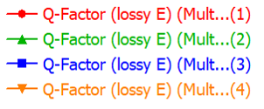
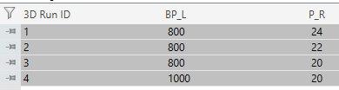
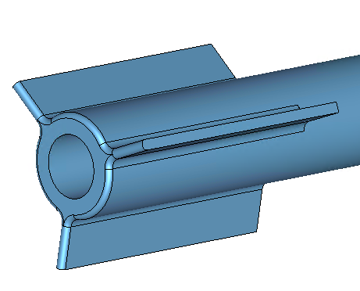
Proposed 394 MHz Crab Cavity for the EIC Project (cont.)
The operating TE-mode decays exponentially in CC
  The length required that Q_{ext} > 10⁷ exceeds the space limit (2500 mm)
Solution: radially sectioned coaxial as a filter for the SOM modes
  Filter is transparent for the HOMs above the cutoff
  The overall length can be reduced
Operating TE-mode rejection
Operating Mode
BP_L
4000 mm
SOM Filter

Slide 11
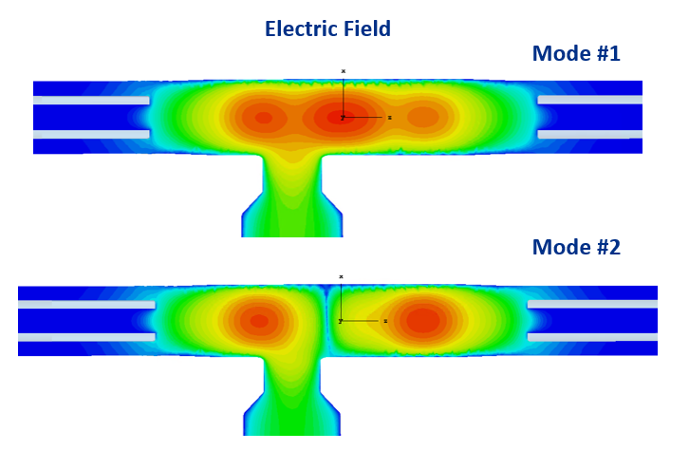
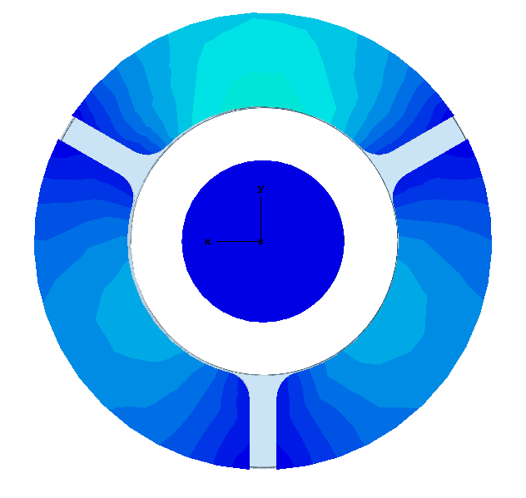
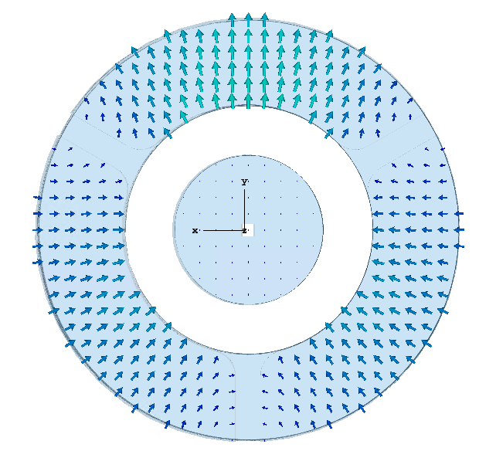
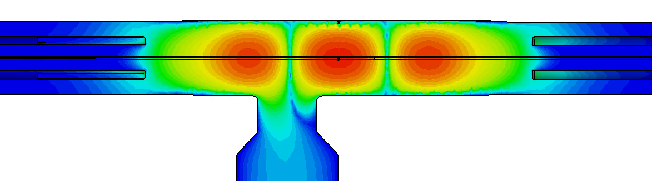
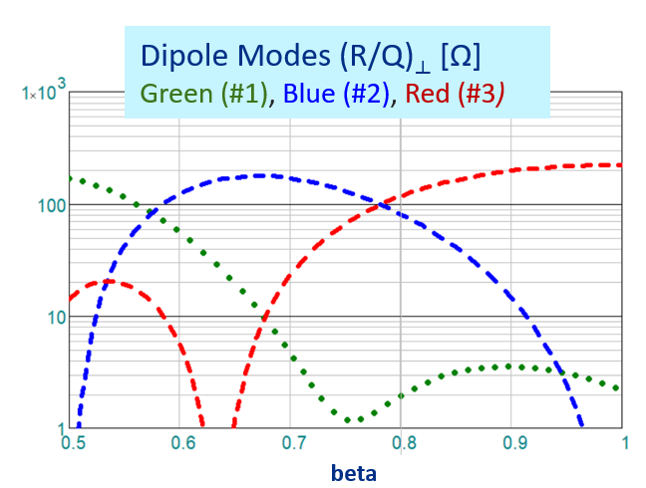


Proposed 394 MHz Crab Cavity for the EIC Project (cont.)
Coaxial Coupler with SOM high-pass filter
  SOM are coupled only to the input waveguide port
  The overall length reduced to be less that 3000 mm
Same Order Modes (SOM) Damping
QMiR Cavity with compact coaxial HOM loads
< 3000 mm

Slide 12




Proposed 394 MHz Crab Cavity for the EIC Project (cont.)
HOM Spectrum Summary
  Monopole HOMs are mostly loaded onto the CC
  Cavity is HOM free above 600 MHz (!)
HOM with Qext > 100
HOMs with highest (R/Q)*Q values
QMIR with a compact CC is suited for the EIC Crab Cavity
Cavity scaled and re-optimized for 394 MHz
Design is radially compact (<0.35 m) and simple;
Single QMiR can provide nominal 4.75 MV kick for EIC proton bunch;
SOM/HOM are damped below EIC specifications;

Slide 13
Conclusions
Coaxial couplers are a solution that can benefit many SRF applications
  CC provides strong omnidirectional coupling with cavity HOMs;
  Half-Septum is effectively a high-pass filter to reject the operating mode;
  CC simplifies mechanical design of HOM feedthroughs (notch filter);
  CC can be designed to be in MP free zone
Practical examples of CC HOM damping
  SRF resonator with CC designed as alternative tunable 53-MHz MI cavity;
  QMiR crab cavity with CC scaled to 394 MHz frequency for EIC project;
Coaxial Couper is a compact and effective solution for damping HOMs in Low Frequency SRF cavities

Slide 14
Acknowledgements
We extend our thanks to our colleagues at JLab and BNL for fruitful discussions on the design of the SRF cavities for the EIC project.

