Slide 1


Characterization of Cryogenic Beamline Absorber Materials for High-Current SRF Accelerators
Axel Perez Ruiz, Akira Miyazaki
TTC 2026. WG-4: R&D challenges for future advanced projects
Wednesday 10/06/2026

Slide 2
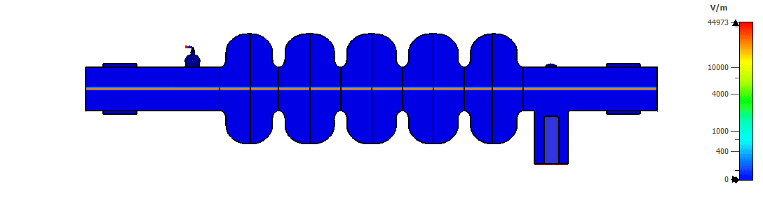
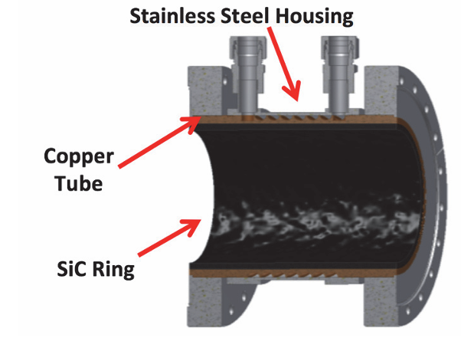
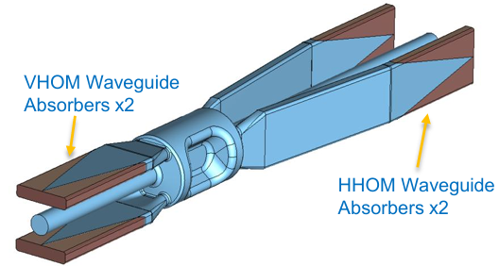
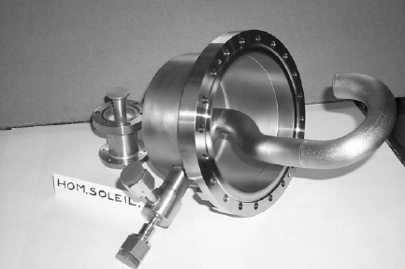
HOM Power in High-Current SRF Accelerators
Future Advanced Projects
  Storage rings
  Energy Recovery Linacs (ERLs)
  Free Electron Lasers (FELs)
  Future high-current colliders
HOM Damping
  High-current beams excite strong wake fields and Higher-Order Modes (HOMs)
  Undamped HOMs lead to: beam instabilities, increase cavity heat load, limit achievable beam current.
HOM Mitigation Techniques
  HOM couplers
  HOM waveguides
  Beam Line absorbers (BLAs)
Electron Beam Wakefield Simulation in CST
BLA for the APS upgrade (Argonne)
394 MHz Crab cavity HOM waveguides (EIC)
Hook HOM coupler (SOLEIL)

Slide 3
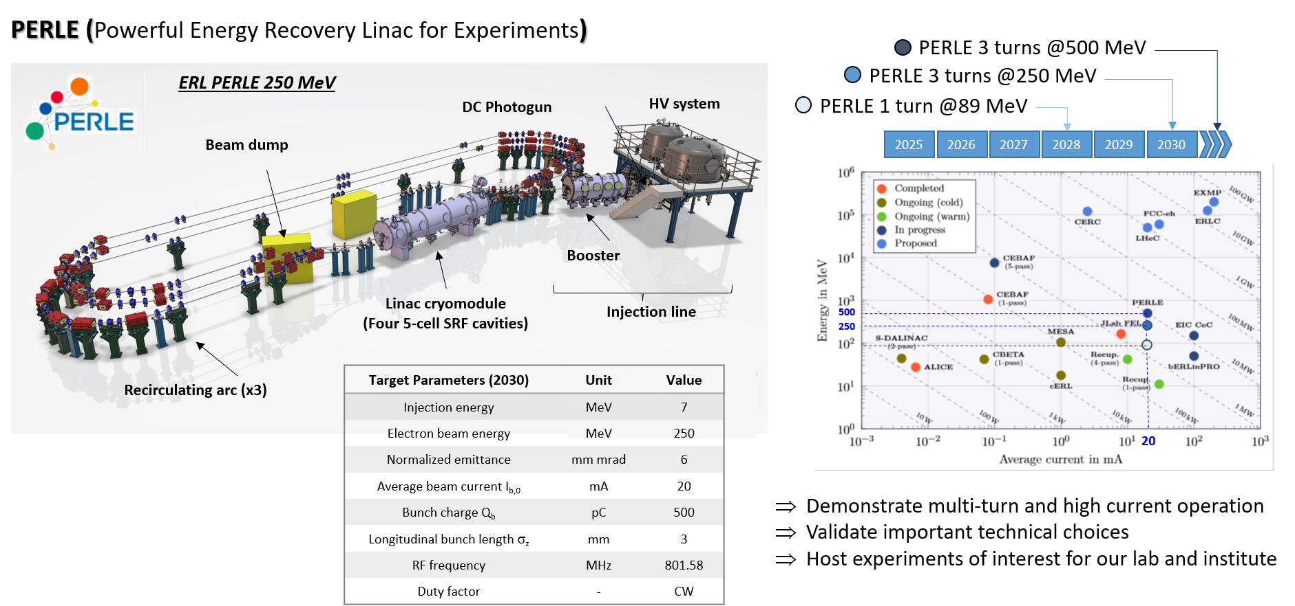
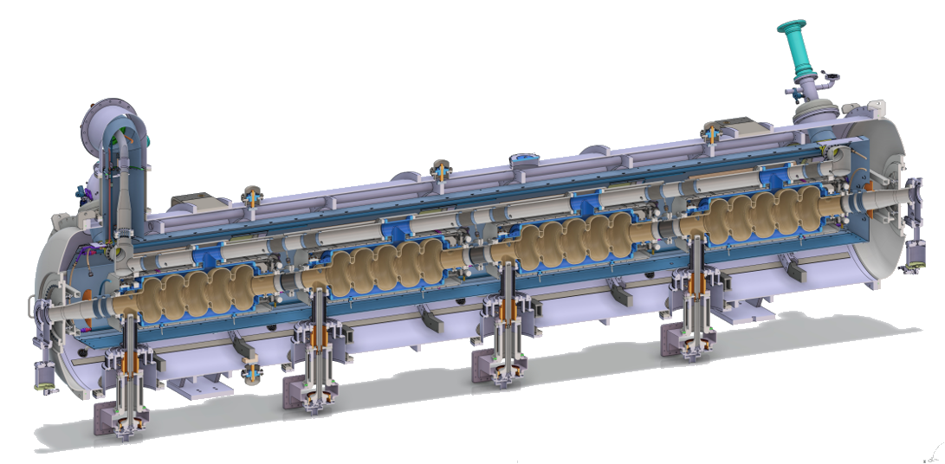
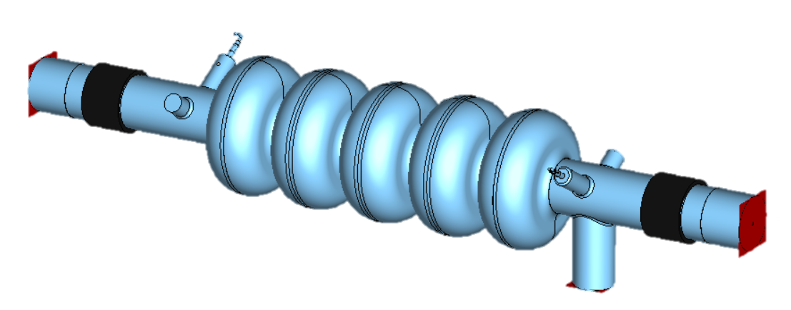
HOM power and BLAs for PERLE
PERLE Linac Cryomodule
HOM Couplers studies are completed
Cold Beam Line Absorbers, preliminary studies by C. Barbagallo (PhD Thesis):
  Estimate power absorption per BLA ~120 W
  He-cooling and thermal intercept (40K)
  Absorber parameters modeled using the Debye Model for CERASICB material.

Slide 4
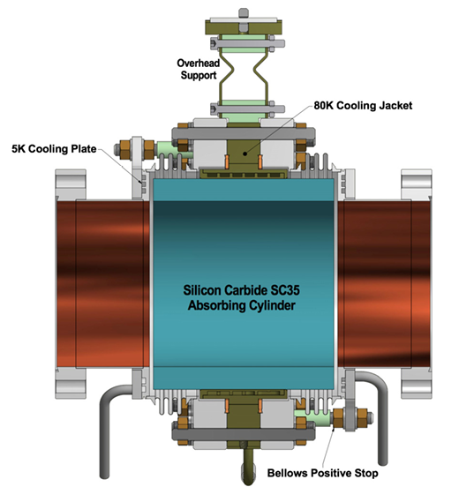
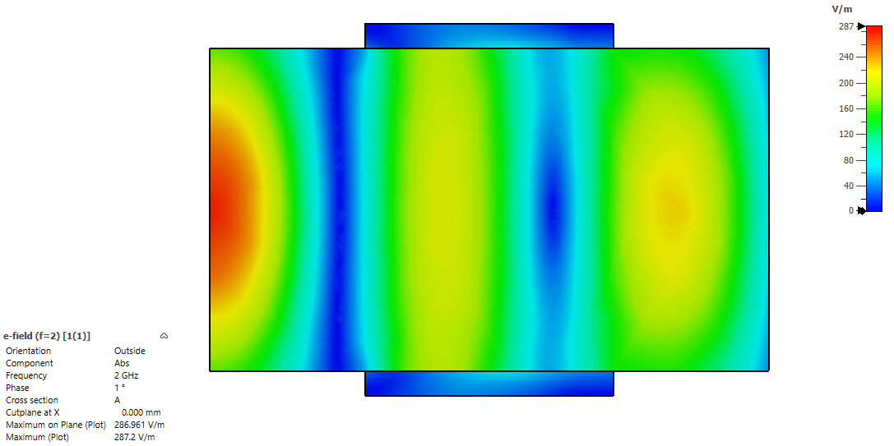

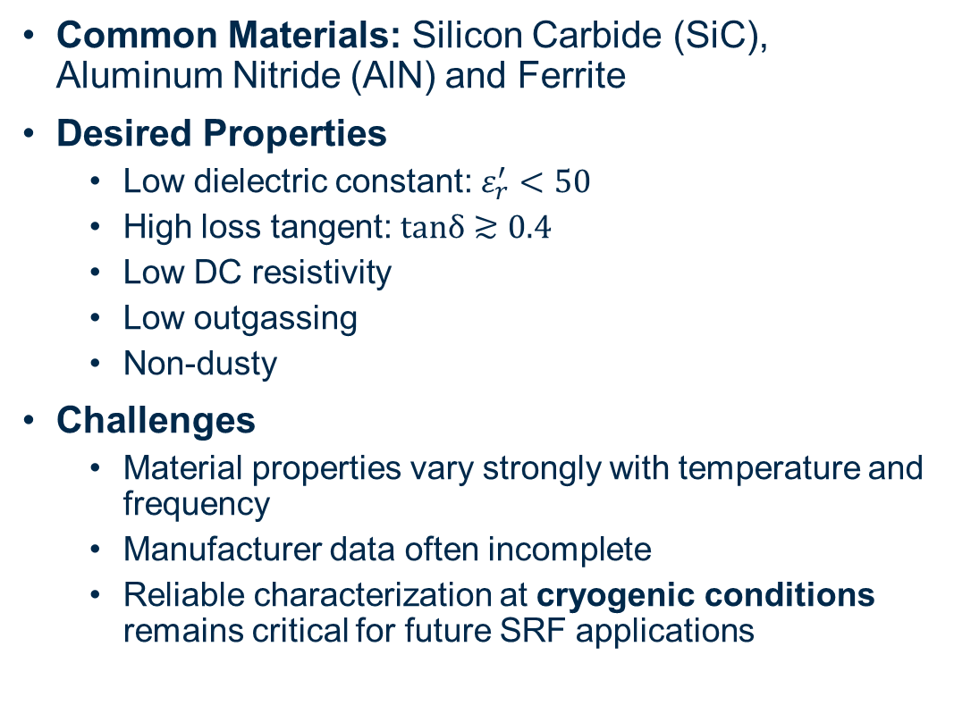

Cryogenic Beam Line Absorbers (BLAs)
Common Materials: Silicon Carbide (SiC), Aluminum Nitride (AlN) and Ferrite
Desired Properties
  Low dielectric constant: $ε_{r}^{′}<50$
  High loss tangent: $tanδ≳0.4$
  Low DC resistivity
  Low outgassing
  Non-dusty
Challenges
  Material properties vary strongly with temperature and frequency
  Manufacturer data often incomplete
  Reliable characterization at cryogenic conditions remains critical for future SRF applications
Cornell’s cryogenic BLA used in the Main Linac Cryomodule.
$$P_{in}$$
$$P_{out}$$
RF simulation (TE11 excitation at 2 GHz) in CST
Single pass BLA absorption ~90%

Slide 5
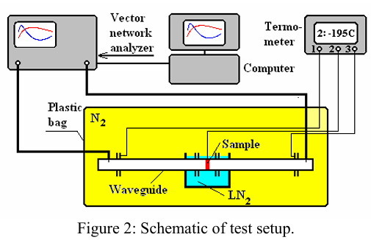
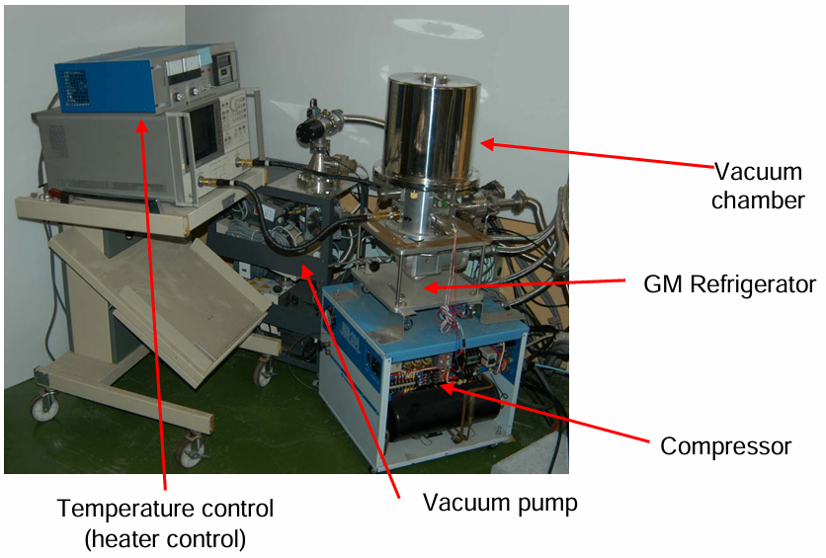
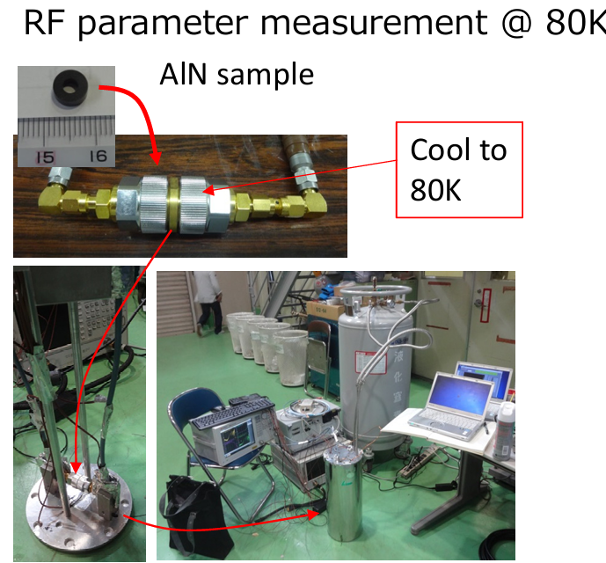
Characterization of Cryogenic Absorbers
Cryogenic dielectric measurements have been performed in the last two decades
  Major studies at Cornell, KEK, and other laboratories.
Persistent Challenges
  Material data remains: vendor and product batch dependent, project specific.
  Significant variability observed even for nominally identical materials.
Implication for Future SRF Accelerators
  Direct cryogenic measurements are still essential for absorber qualification
V. Shemelin et al., “Measurements of ε and μ of Lossy Materials for the Cryogenic HOM Load”. 10.1109/PAC.2005.1591505.
M. Sawamura et al. “RF absorber studies for cERL in Japan”, in HOM Workshop Oct. 12, 2010.
T. Ota et al., “Development of HOM dampers for superconducting cavities”, in Proc. PASJ’16, Aug. 2016, paper MOP022, pp. 377–379.

Slide 6
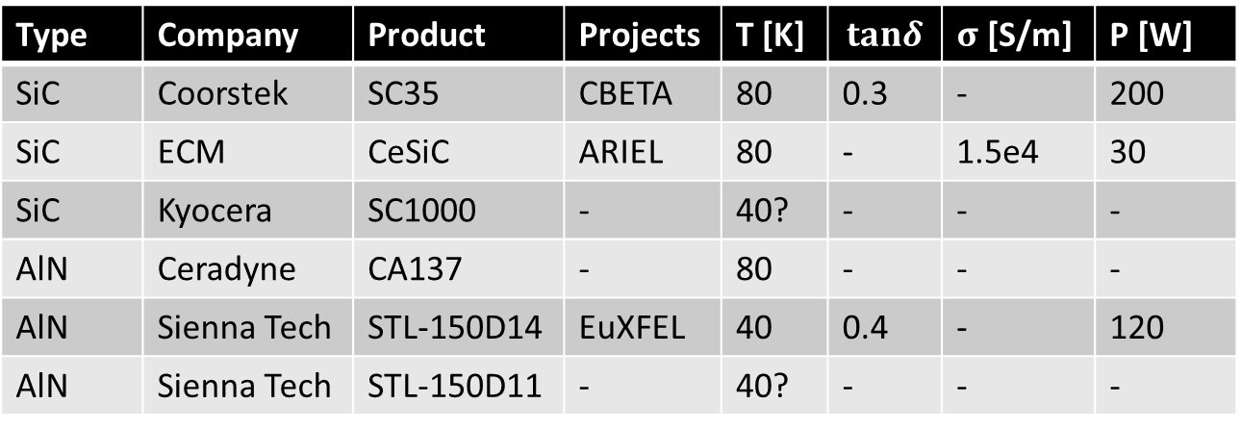
Candidate Materials for Cryogenic Absorbers
Commercially available cryogenic microwave absorber materials are limited.
For the PERLE (Powerful ERL for Experiments) at IJCLab, we have identified a set of candidate materials for detailed characterization.
Some materials are x10 more expensive than others
Type | Company | Product | Projects | T [K] | $$tanδ$$ | $σ$ [S/m] | P [W]
SiC | Coorstek | SC35 | CBETA | 80 | 0.3 | - | 200
SiC | ECM | CeSiC | ARIEL | 80 | - | 1.5e4 | 30
SiC | Kyocera | SC1000 | - | 40? | - | - | -
AlN | Ceradyne | CA137 | - | 80 | - | - | -
AlN | Sienna Tech | STL-150D14 | EuXFEL | 40 | 0.4 | - | 120
AlN | Sienna Tech | STL-150D11 | - | 40? | - | - | -
Samples
Procured
More information in:
R. Eichhorn et al. “Higher order mode absorbers for high current ERL applications”, in procc. SRF2015. Paper THBA05

Slide 7
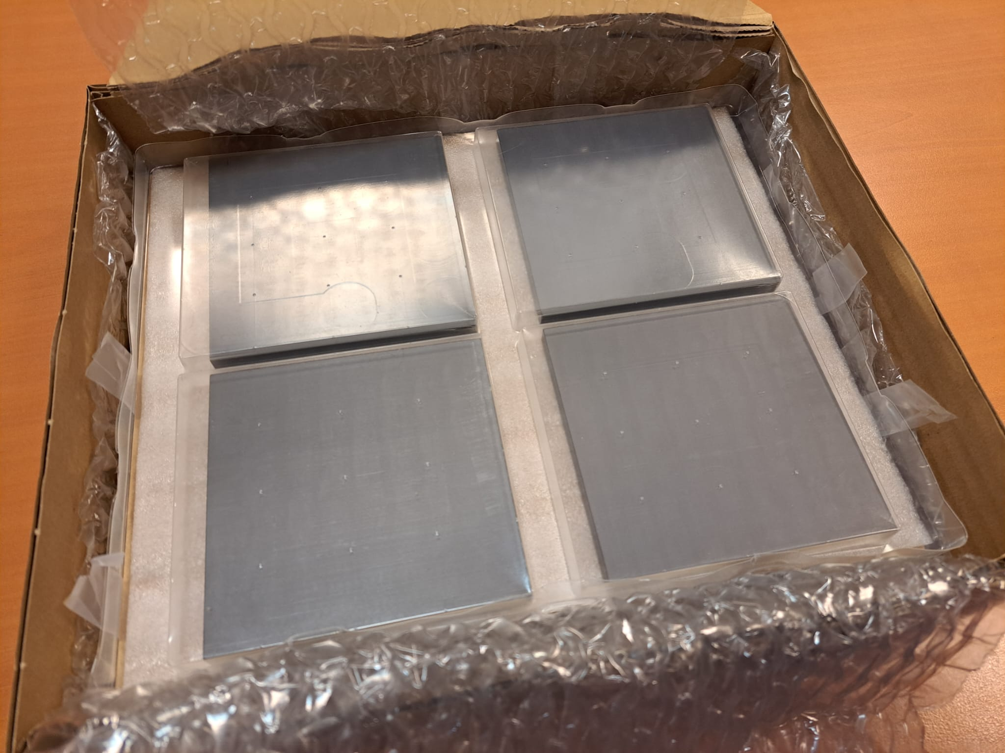
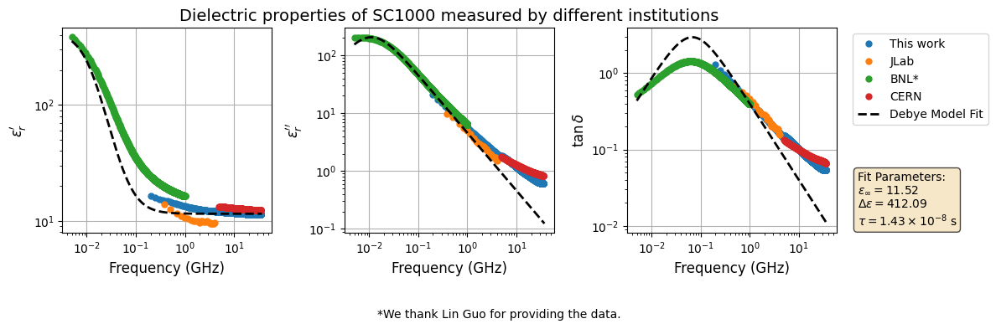
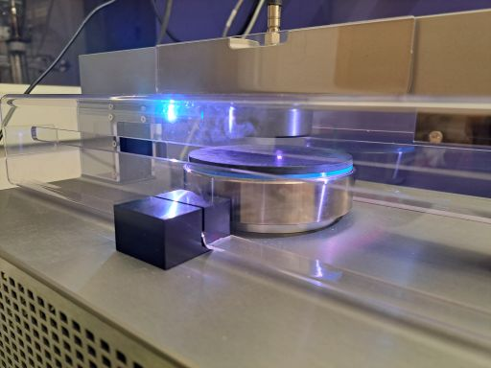
Benchmark at Room Temperature
We characterized four Kyocera SC1000 samples (100x100x8 mm), from 200 MHz to 35 GHZ, using a commercial device at CERN.
This measurements offer baseline for FCC-ee and EIC.
Samples provided by BNL
Consistency between different measurements
Reliable candidate material for RT BLA, then cold?
Measurement setup: DAK-TL2
A. Perez Ruiz et al. “Dielectric Characterization of Beam Line Absorber Samples for Next-Generation High Intensity Electron Beam SRF Accelerators”, in procc. IPAC26. Paper MOP7022

Slide 8
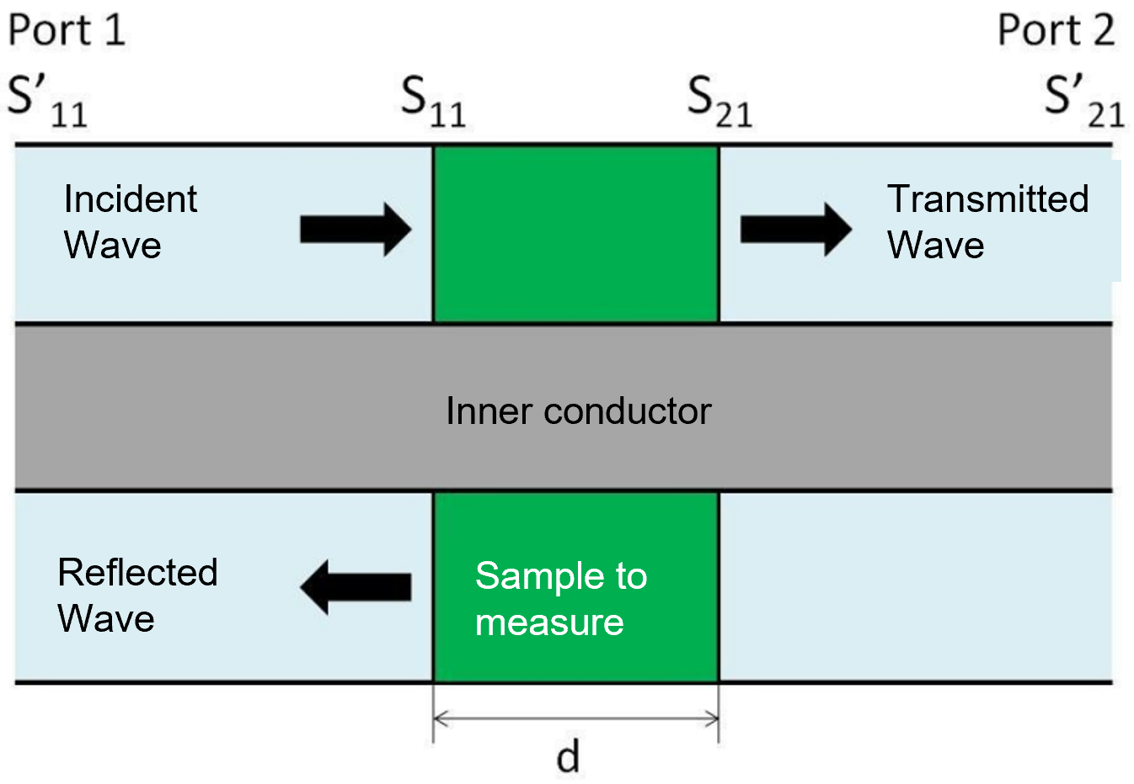
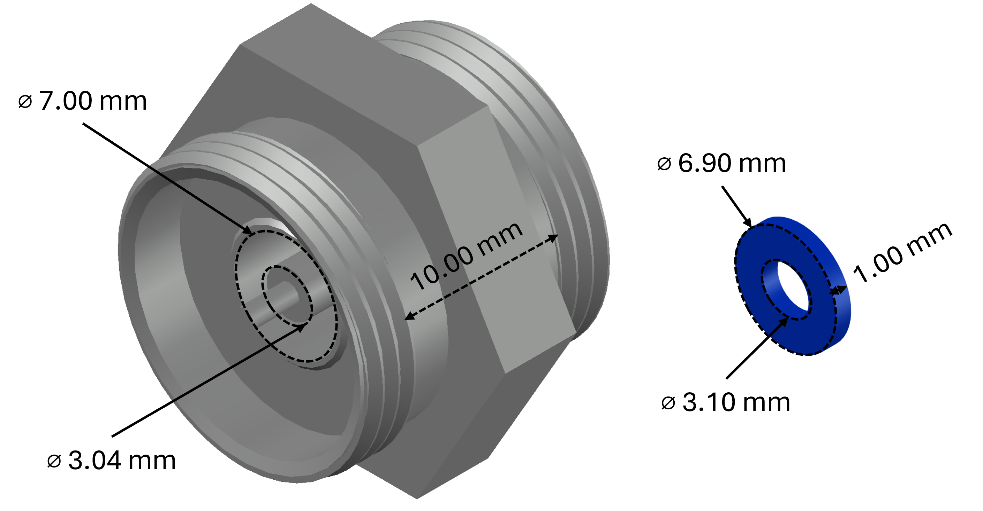
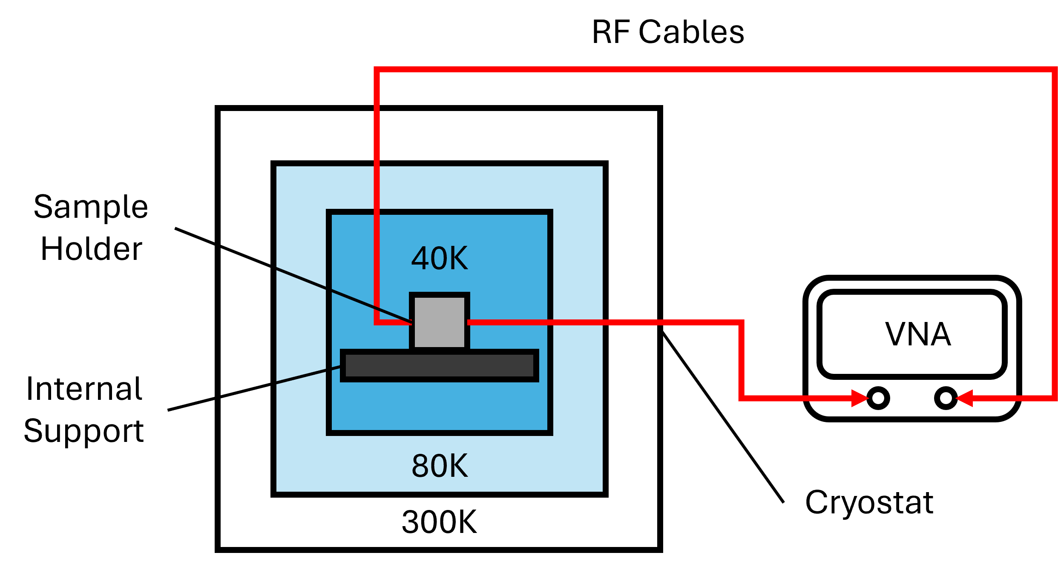
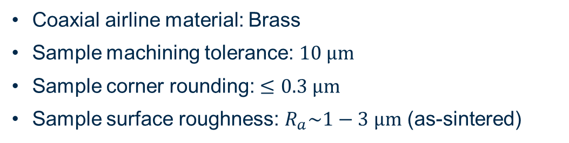
Design of a dedicated test-stand at IJCLab
Schematic of the setup
Left: APC7 connector coaxial airline (up to 18 GHz); Right: sample under test
Coaxial airline material: Brass
Sample machining tolerance: $10 μm$
Sample corner rounding: $≤0.3 μm$
Sample surface roughness: $R_{a}\sim 1−3 μm$ (as-sintered)
Simplified schematic of proposed cryogenic setup

Slide 9
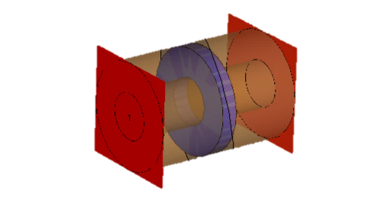
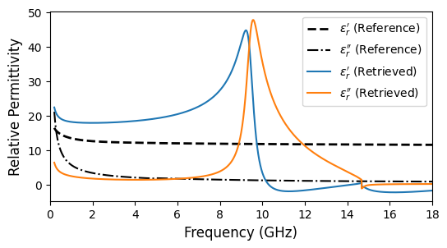
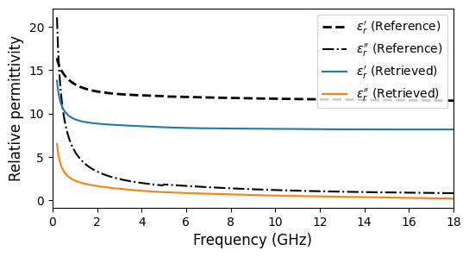
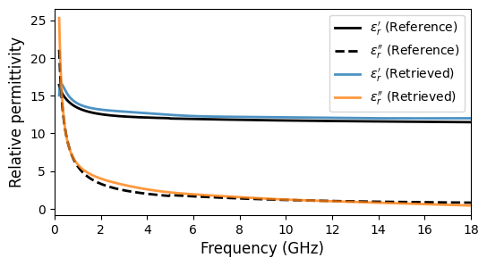
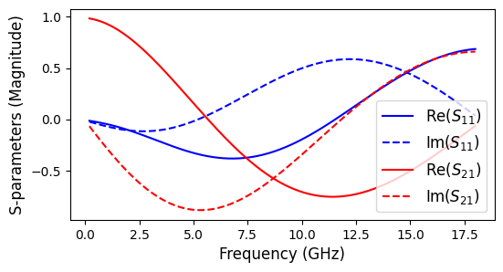
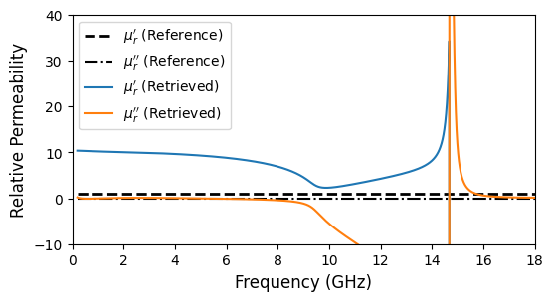
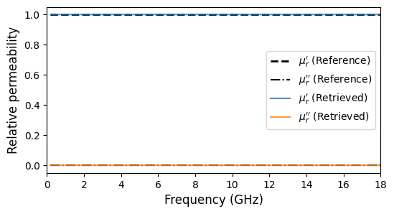
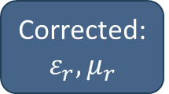
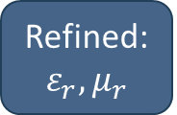
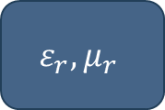
Retrieval Algorithm for $ε_{r}, μ_{r}$ extraction
S11, S21
*NRW Method
$$ε_{r}, μ_{r}$$
**NIST Method
Refined: $ε_{r}, μ_{r}$
Air-gap correction
Corrected: $ε_{r}, μ_{r}$
Reference Material:
SiC (SC1000) measured at RT.
Simplified CST Model
*E. J. Rothwell et al., “Analysis of the Nicolson-Ross-Weir method for characterizing the electromagnetic properties of engineered materials”, Prog. Electromagn. Res., vol. 157, pp. 31–47, 2016. doi:10.2528/PIER16071706
**Measurement of dielectric material properties, SIGLENT Technologies, 2024. https://www.siglenteu.com/application-note/measurement-of -dielectric-material-properties/

Slide 10
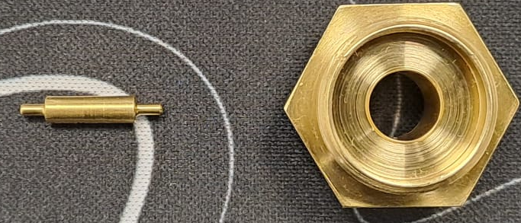
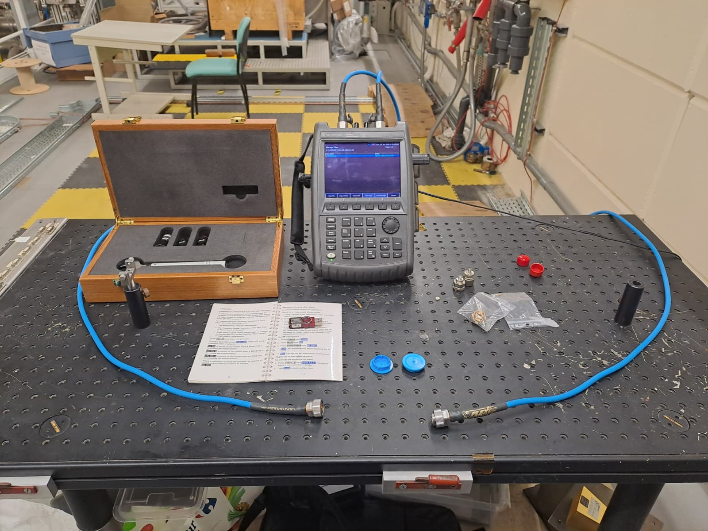
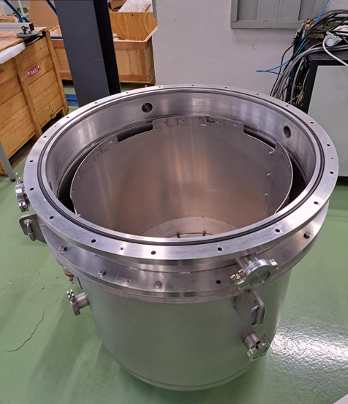
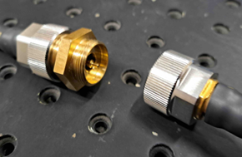
Test-stand today at IJClab
Sample holder just received some weeks ago.
APC7 Calibration.
LN2 Cryostat.

Slide 11

Conclusions
High-current SRF accelerators require efficient HOM damping to ensure beam stability and limit cryogenic losses.
Cryogenic Beam Line Absorbers remain a key technology for broadband HOM power extraction in future advanced projects.
Material qualification remains challenging due to the limited availability of cryogenic RF data and the significant variability observed between vendors and production batches.
A dedicated cryogenic test stand has been designed and procured at IJCLab to perform direct measurements of absorber materials.
First samples measurements will take place in the following months.
Outlook
Establish a consistent cryogenic material database for accelerator applications.
Support the development of HOM absorber solutions for future high-current SRF facilities, including PERLE and next-generation accelerator projects.
Work supported by funding from European Union‘s program EU HORIZON-INFRA-2023-TECH-01-01 under GA n°101131435
Notes:
As SRF accelerators move toward higher beam currents and industrial-scale deployment, the availability of reliable cryogenic material data will become increasingly important. Our goal is to contribute the measurement tools and data needed to make absorber selection a predictable engineering process rather than an empirical one

Slide 12
Backup Slides
Notes:
As SRF accelerators move toward higher beam currents and industrial-scale deployment, the availability of reliable cryogenic material data will become increasingly important. Our goal is to contribute the measurement tools and data needed to make absorber selection a predictable engineering process rather than an empirical one

Slide 13
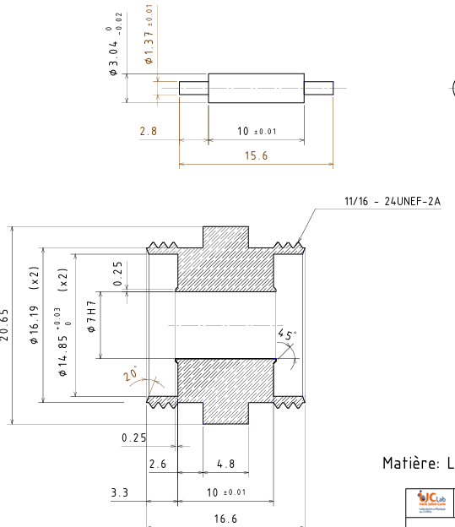
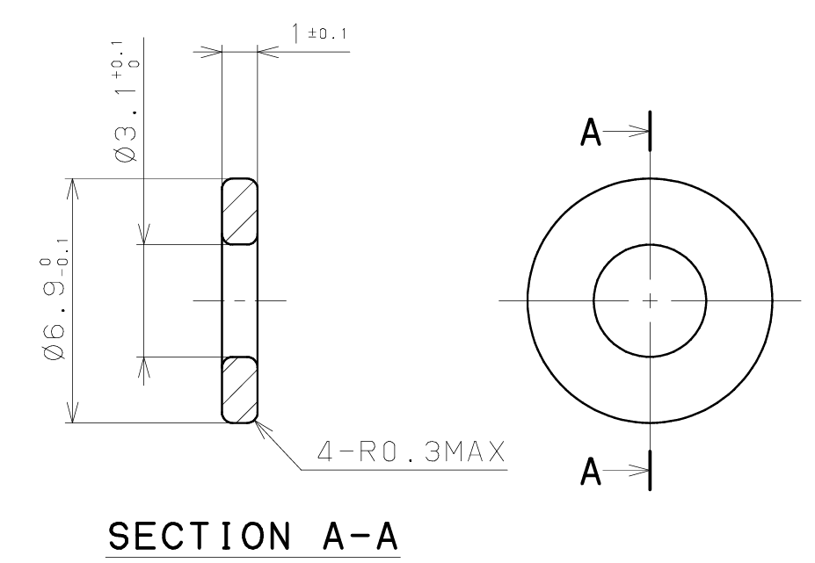
Detailed dimension for the APC7 connector

Slide 14
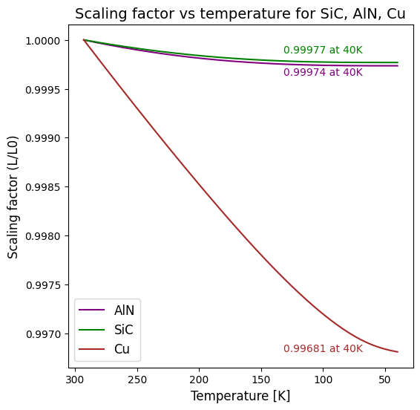
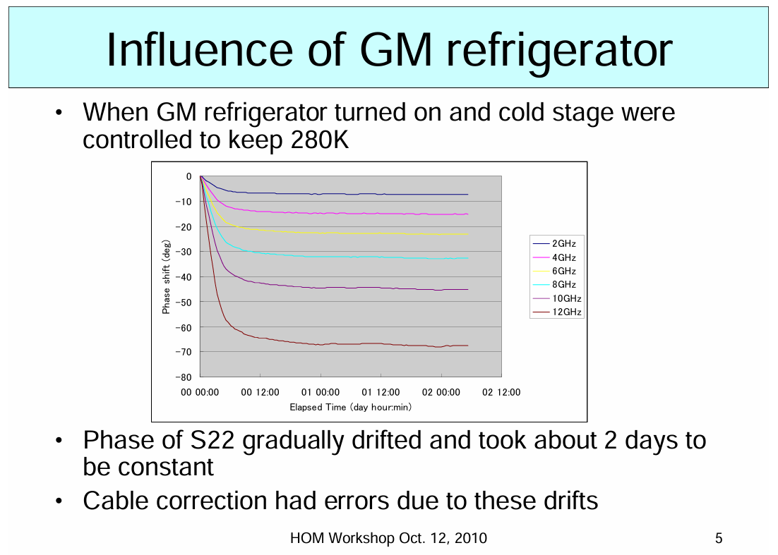
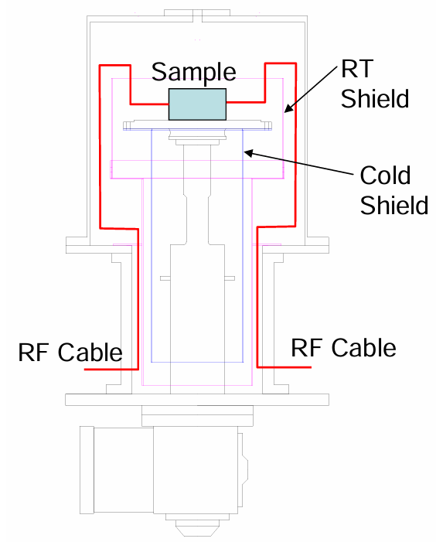
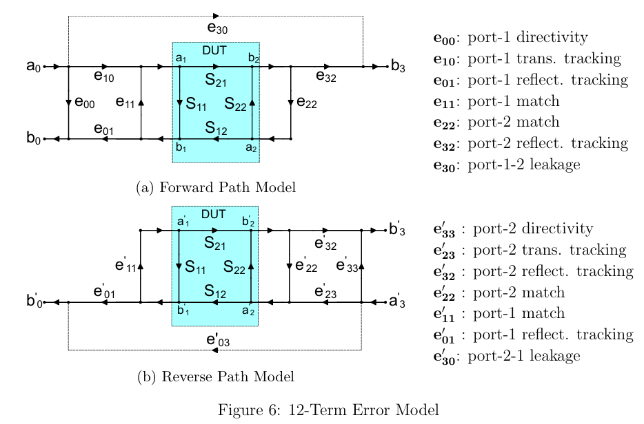
Challenges of cryogenic measurements
Expected phase shift during cooling down.
M. Sawamura et al. “RF absorber studies for cERL in Japan”, in HOM Workshop Oct. 12, 2010.
In general, the thermal expansion coefficient of metals is much larger than the one of ceramics.
We are considering offline SOLT calibration.
Mini-Circuits. UVNA-63 Application Note Error Correction

Slide 15
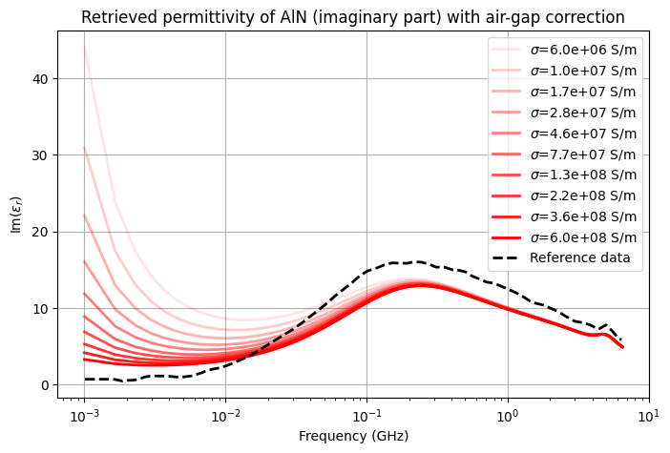
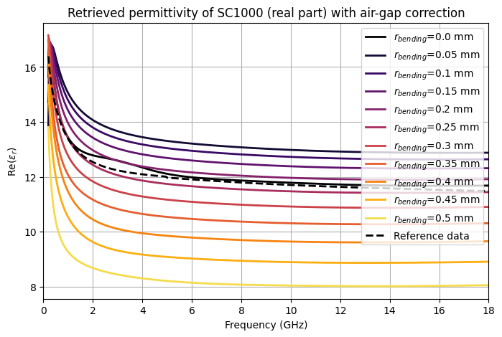
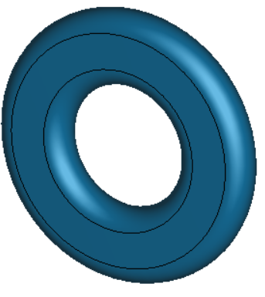
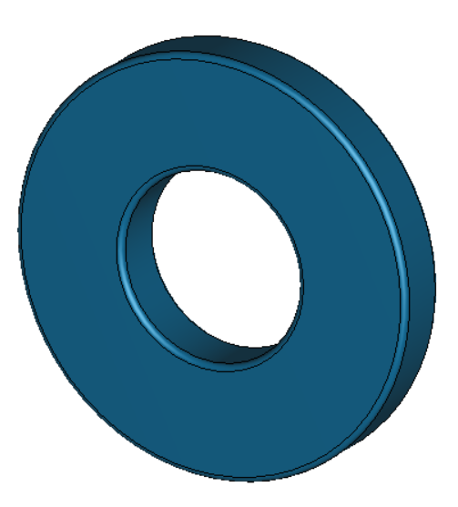
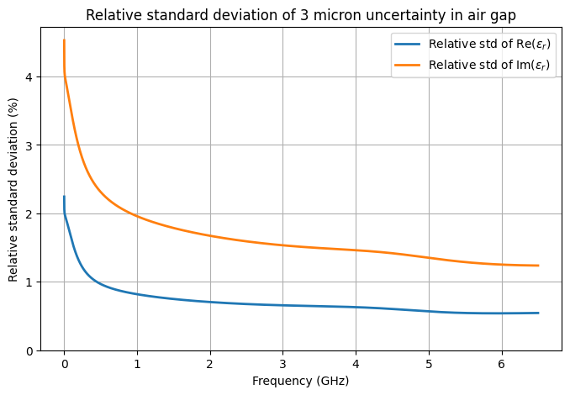
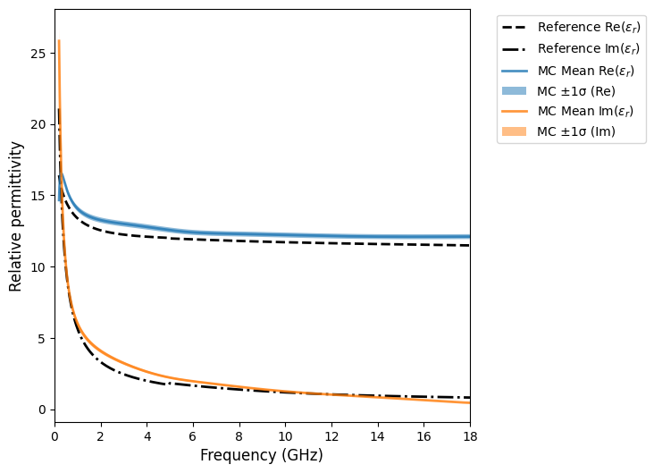

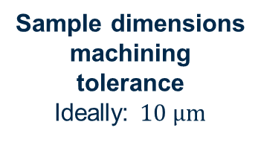
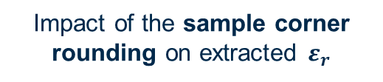
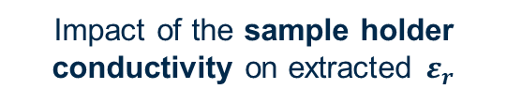


Simulation of the proposed setup
Impact of the sample holder conductivity on extracted $ε_{r}$
Impact of the sample corner rounding on extracted $ε_{r}$
From 100 MHz the effect is negligible.
Brass was selected from a mechanical perspective.
STL150D14
SC1000
A rounding of 0.3 mm was found acceptable
$$0.5 mm$$
$$0.1 mm$$
Impact of sample surface finish
As-sintered: $R_{a}\sim 1−3 μm$ OK!
SC1000
SC1000
Sample dimensions machining tolerance
Ideally: $10 μm$
Notes:
Originally considered material for the sample holder: OFE Copper C10100 $(σ\sim 6×10^{7} S/m)$. However, from a mechanical perspective, machining and elasticity at cryogenic are NOT optimal
Results: No significant impact on the retrieved εᵣ for frequencies above 100 MHz
Conclusion: Brass or bronze ($σ\sim 10^{7} S/m$) are viable alternatives

