Slide 1



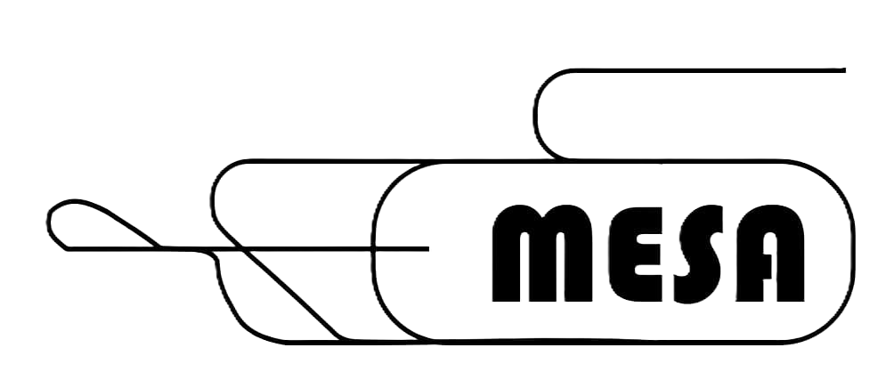
Improvement of CW ERL Performance of TESLA-type Cavities by Fast Reactive Tuners and Coated HOM-Antennas
F. Hug, R. Monroy Villa, P. Plattner, T.Stengler
Institut für Kernphysik
JGU Mainz
10.06.2026

Slide 2
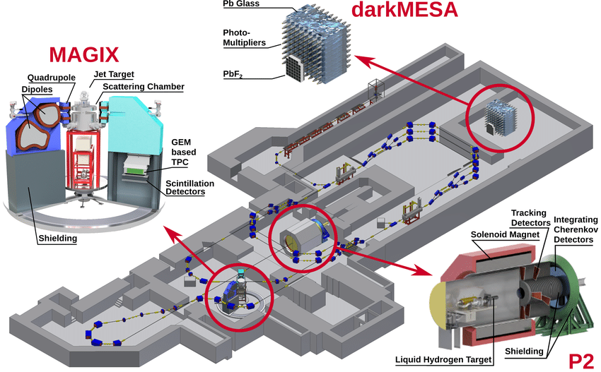
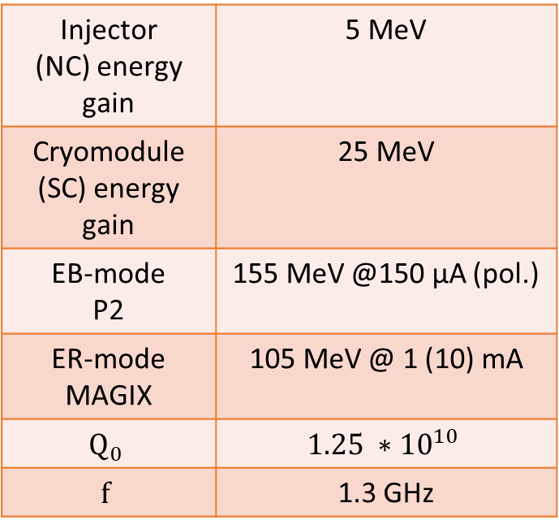
Mainz Energy recovering Superconducting Accelerator
Injector (NC) energy gain | 5 MeV
Cryomodule (SC) energy gain | 25 MeV
EB-mode P2 | 155 MeV @150 μA (pol.)
ER-mode MAGIX | 105 MeV @ 1 (10) mA
$$Q_{0}$$ | $$1.25 ∗{10}^{10}$$
$$f$$ | 1.3 GHz
3.5 m

Slide 3
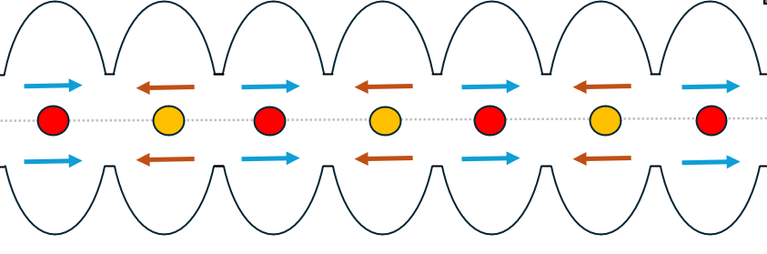
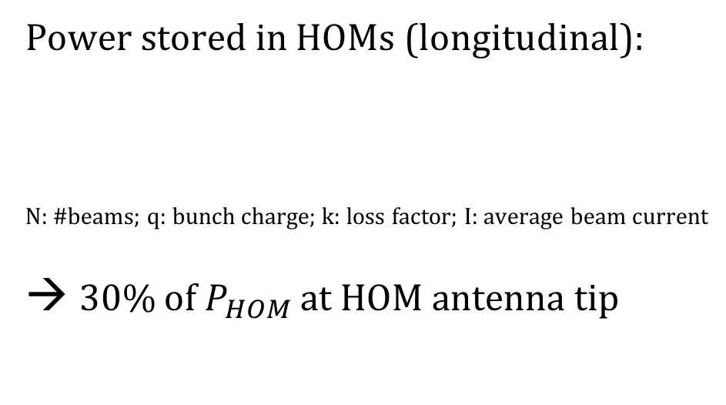
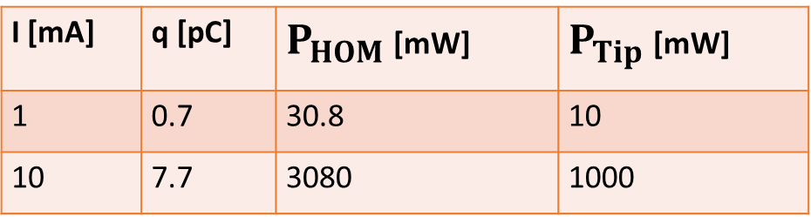

Higher Order Modes: Beam Induced HOMs
In ERL-mode: 4 e- beams simultaneous
(2x accelerating; 2x decelerating)
Power stored in HOMs (longitudinal):
N: #beams; q: bunch charge; k: loss factor; I: average beam current
30% of $P_{HOM}$ at HOM antenna tip
$$P_{HOM}=N∗q∗k∗I$$
L. Merminga, D.R. Douglas, and G.A. Krafft. High-current energy-recovering electron Linacs. Annual Review of Nuclear and Particle Science, 53(1):387–429, 2003.
= acc beams
= dec beams with 180° phase shift
Simulated Beam Blow Up limit: 12 mA (C. Stoll, Phd. Thesis, 2020 Mainz)
Calculated thermal power limit: 95 mW (~3.2 mA) (T. Stengler, Phd Thesis, 2020 Mainz)
I [mA] | q [pC] | $P_{HOM}$ [mW] | $P_{Tip}$ [mW]
1 | 0.7 | 30.8 | 10
10 | 7.7 | 3080 | 1000

Slide 4
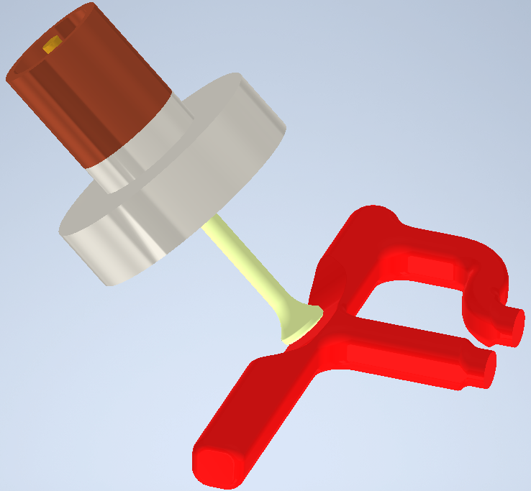
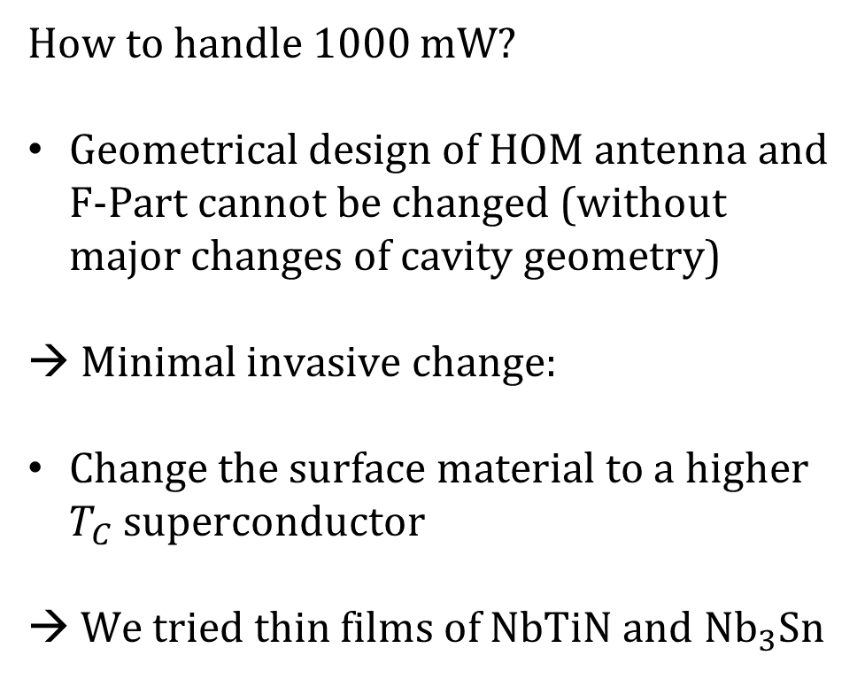
Higher Order Modes: Geometrical Boundaries
How to handle 1000 mW?
Geometrical design of HOM antenna and F-Part cannot be changed (without major changes of cavity geometry)
→ Minimal invasive change:
Change the surface material to a higher $T_{C}$ superconductor
→ We tried thin films of NbTiN and $Nb_{3}Sn$
F-Part
70mm
Feedthrough
Antenna

Slide 5
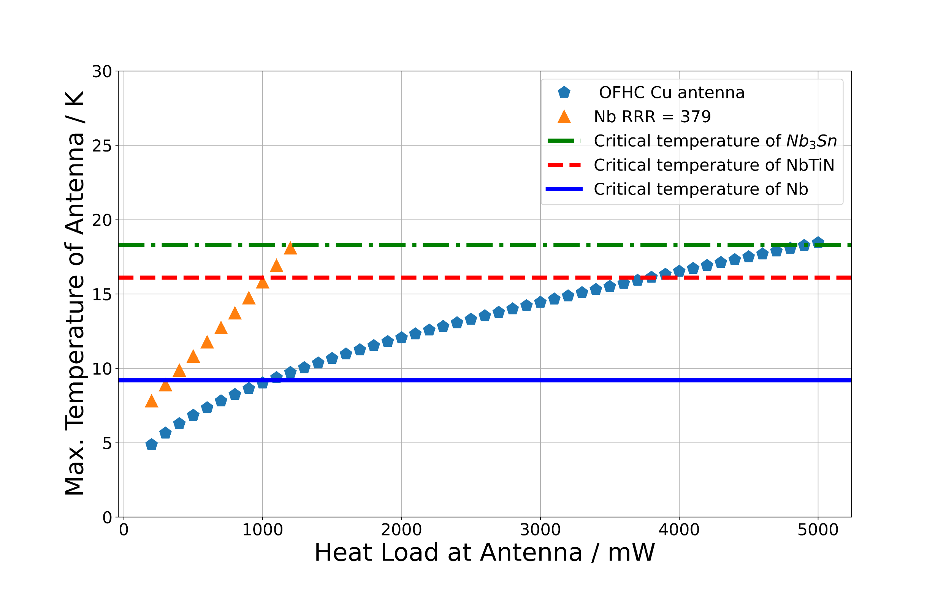
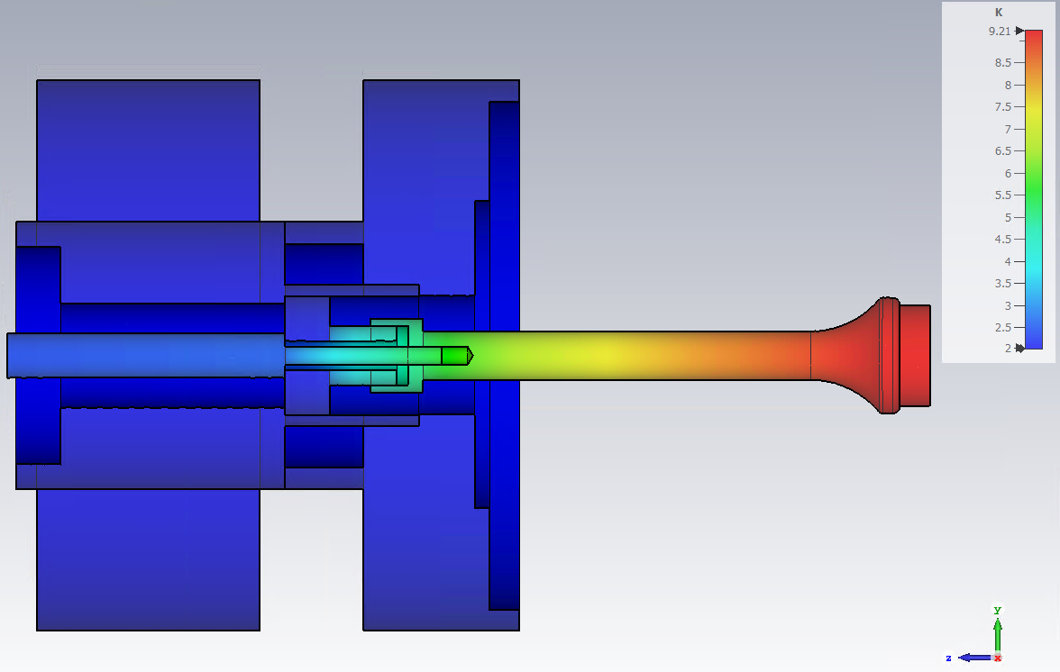
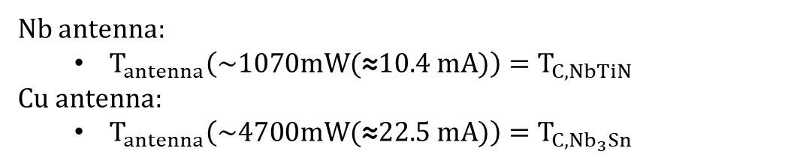
Thermal simulations
Flange (Ti)
Sleeve (OFHC Cu)
Ceramic (Sapphire)
Antenna (Nb)
Heat load
Pin (Mo)
Beam induced power
~70mm
Thermal properties are dominated by the bulk material (Nb, Cu)
Nb antenna:
  $T_{antenna}\left(\sim 1070mW(\text{≈}10.4 mA)\right)=T_{C,NbTiN}$
Cu antenna:
  $T_{antenna}\left(\sim 4700mW(\text{≈}22.5 mA)\right)=T_{{C,Nb}_{3}Sn}$

Slide 6
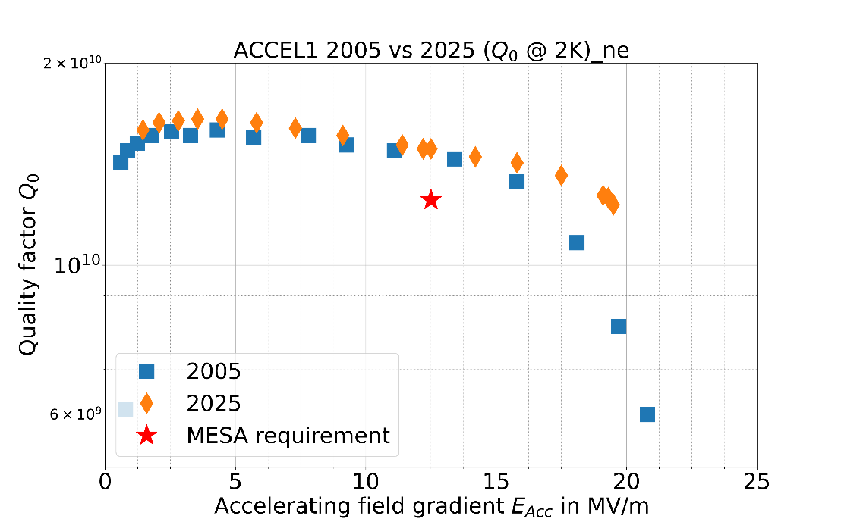
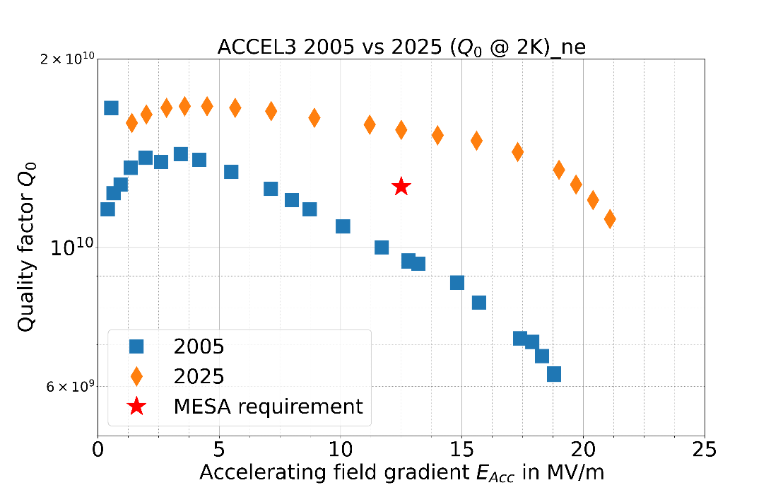
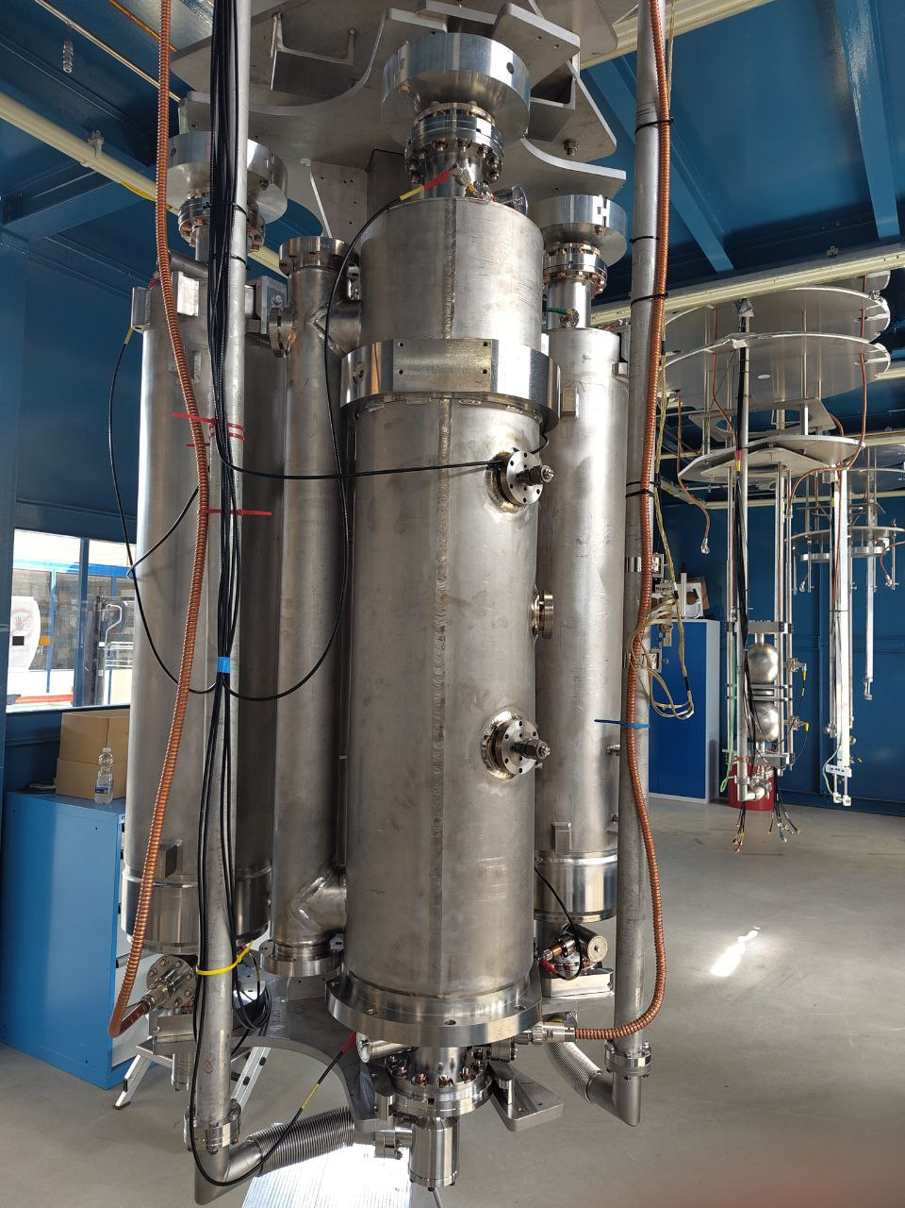
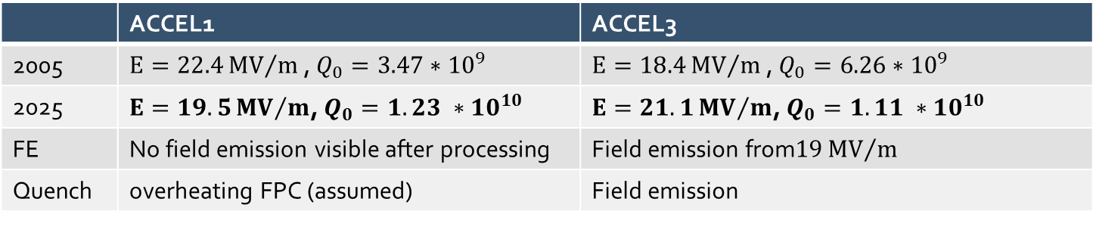
Refurbishment of an ELBE-type cryomodule
Module from decommissioned ALICE* facility at Mainz since 2019 :
→ Successful refurbishment of 2 cavities
→ Test platform for high beam current ERL upgrades
*We would like to thank STFC Daresbury for their generous gift.
 | ACCEL1 | ACCEL3
2005 | $E=22.4{MV}/m$, $Q_{0}=3.47∗{10}^{9}$ | $E=18.4{MV}/m$, $Q_{0}=6.26∗{10}^{9}$
2025 | $E=19.5{MV}/m$, $Q_{0}=1.23 ∗{10}^{10}$ | $E=21.1{MV}/m$, $Q_{0}=1.11 ∗10^{10}$
FE | No field emission visible after processing | Field emission from$19{MV}/m$
Quench | overheating FPC (assumed) | Field emission

Slide 7
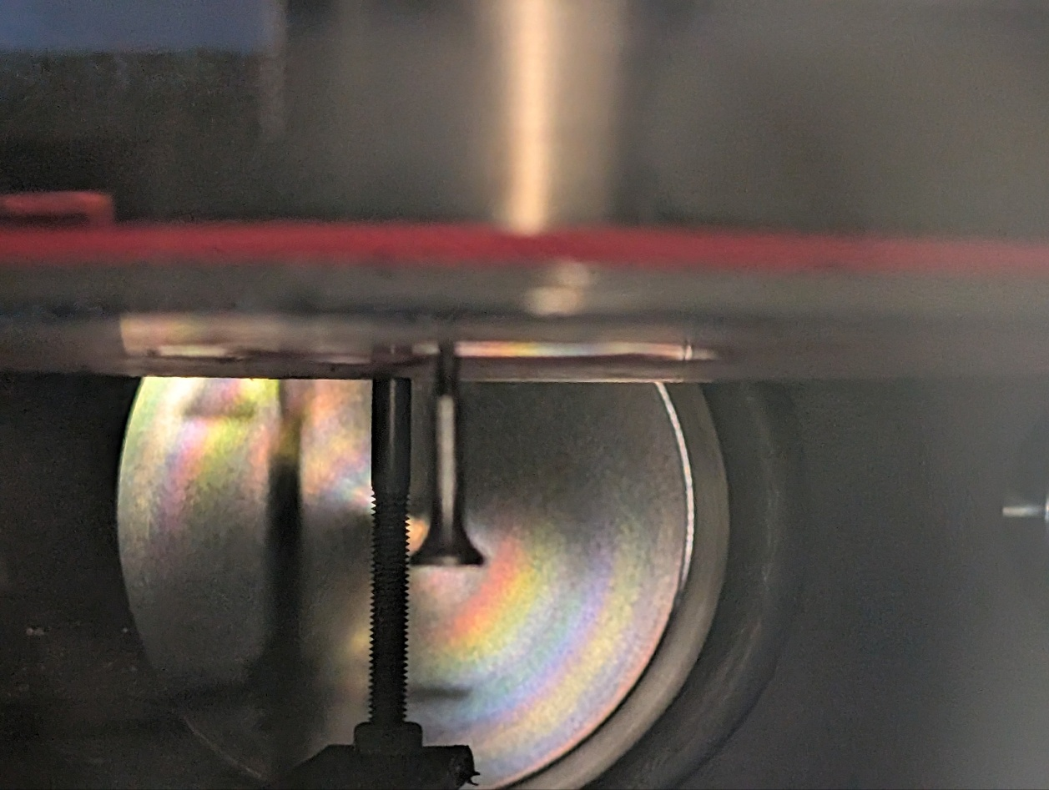
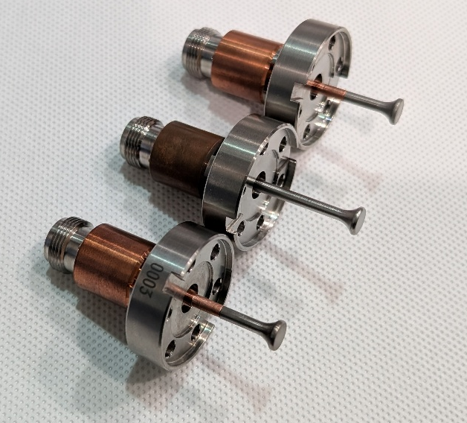
integration of coated Antennas: $Nb_{3}Sn$
Antennas have been installed to one resonator so far
Coatings provided by TU Darmstadt (Alff group) with Co-Sputtering method on copper

Slide 8
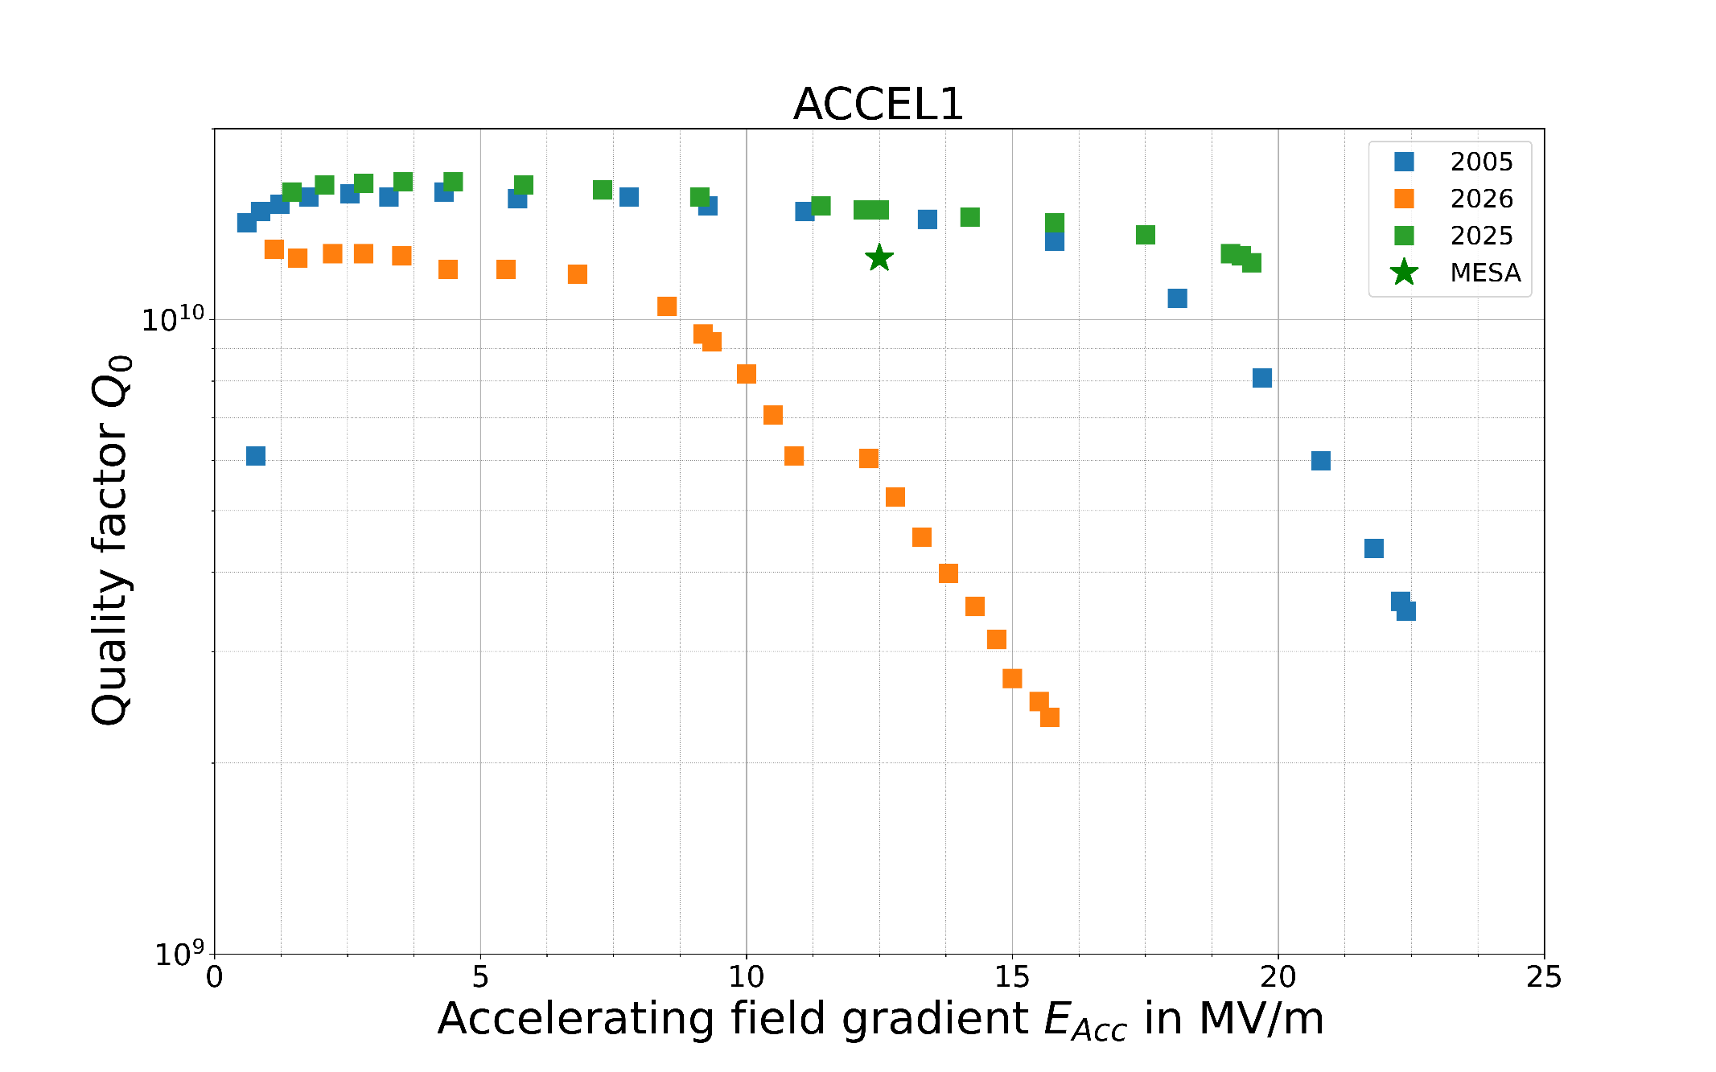
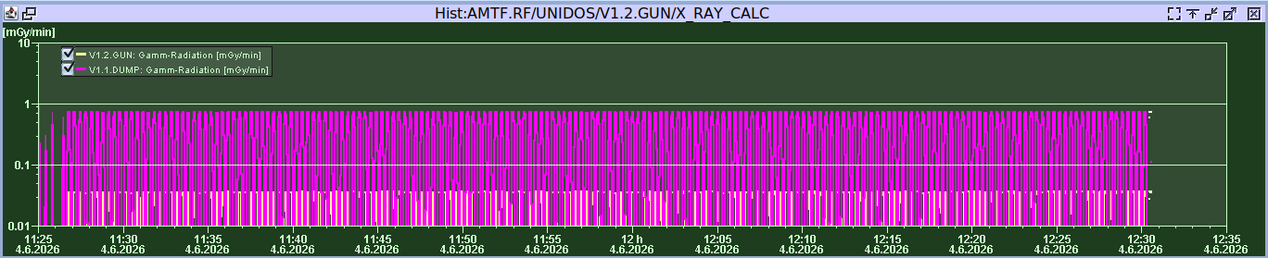
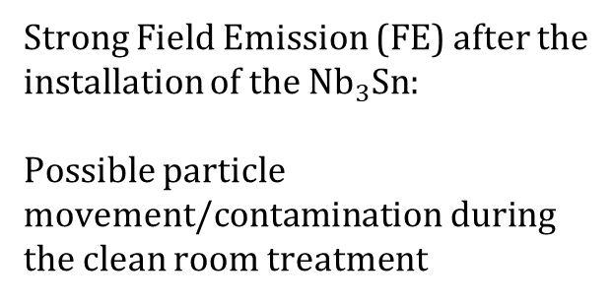
1st Vertical test with $Nb_{3}Sn$ antennas
1 hour of CW and pulsed processing could not remove the FE
Strong Field Emission (FE) after the installation of the $Nb_{3}Sn:$
Possible particle movement/contamination during the clean room treatment

Slide 9
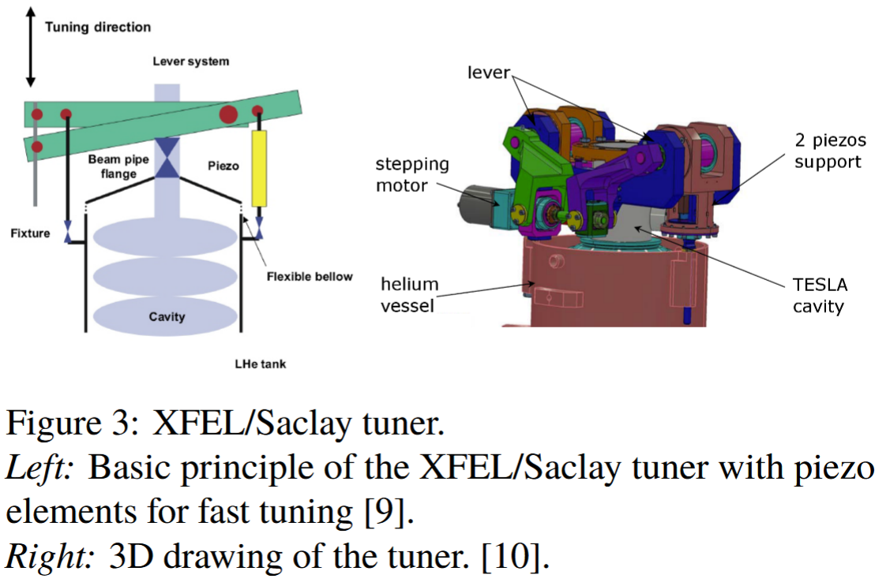
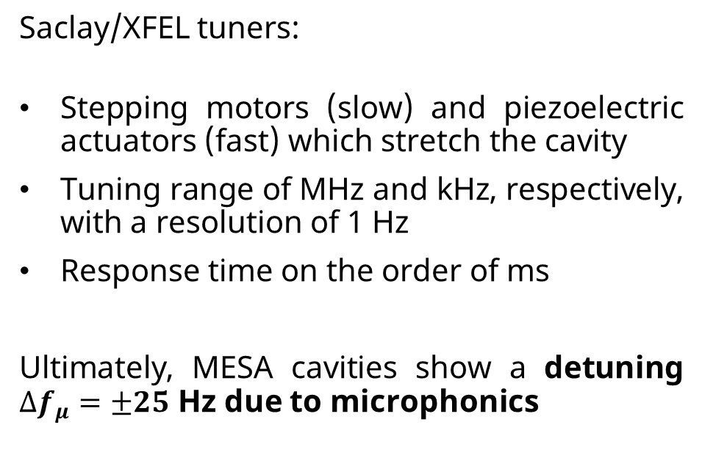
MESA uses Mechanical tuners for resonance control
Saclay/XFEL tuners:
Stepping motors (slow) and piezoelectric actuators (fast) which stretch the cavity
Tuning range of MHz and kHz, respectively, with a resolution of 1 Hz
Response time on the order of ms
Ultimately, MESA cavities show a detuning $∆f_{μ}=±25$ Hz due to microphonics
A. C. Pauline Kujawa, Bachelor‘s thesis, JGU Mainz, 2018
T. Stengler et. al., Process. Int. Conf. on RF Superconductivity, Whistler, Canada 2015

Slide 10
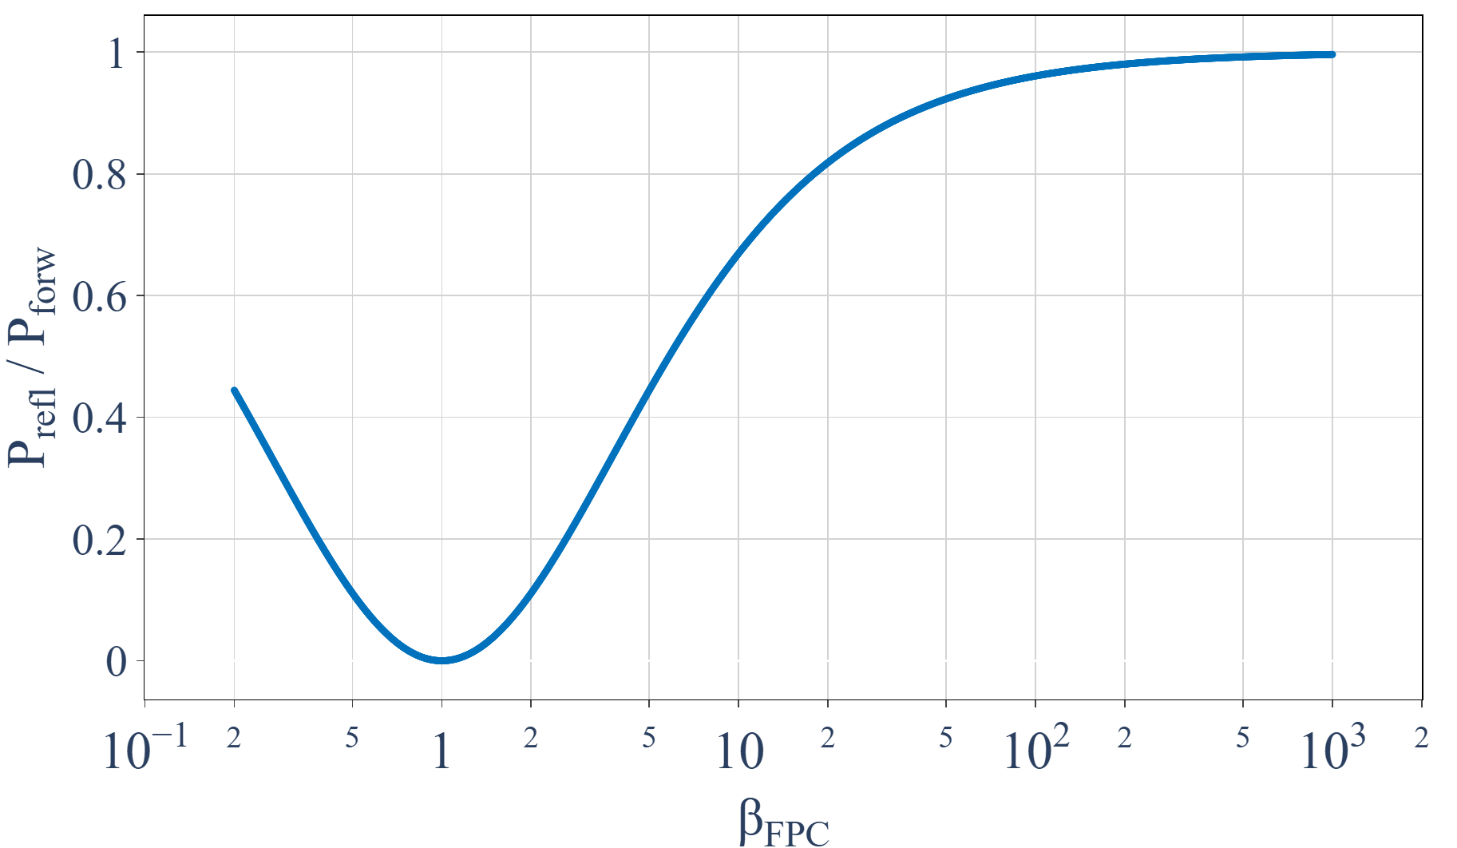
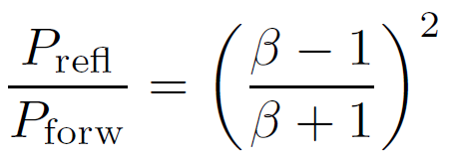
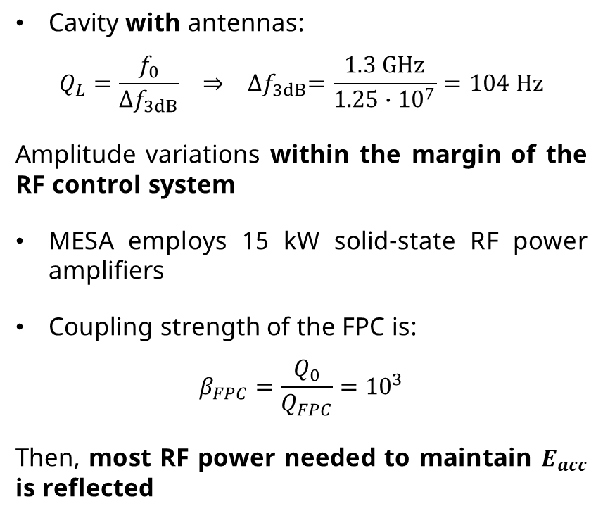
Broader cavity bandwidth reduces sensitivity to detuning
Cavity with antennas:
$$Q_{L}=\frac{f_{0}}{{∆f}_{3dB}} ⇒ {∆f}_{3dB}=\frac{1.3 GHz}{1.25∙{10}^{7}}=104 Hz$$
Amplitude variations within the margin of the RF control system
MESA employs 15 kW solid-state RF power amplifiers
Coupling strength of the FPC is:
$$β_{FPC}=\frac{Q_{0}}{Q_{FPC}}={10}^{3}$$
Then, most RF power needed to maintain $E_{acc}$ is reflected
Therefore, a faster tuning device is needed!
H. Padamsee, J. Knobloch, and T. Hays. RF Superconductivity for Accelerators. Wiley-VCH Verlag, Weinheim, 2008

Slide 11
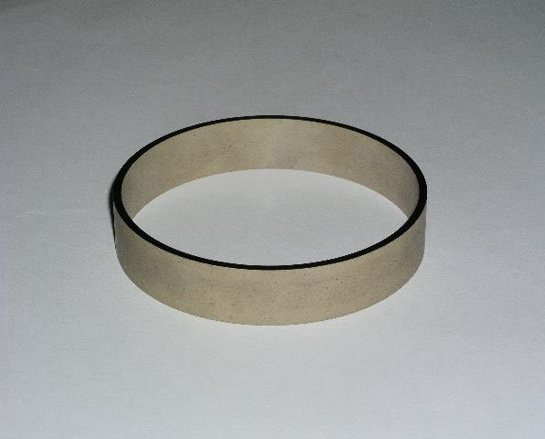
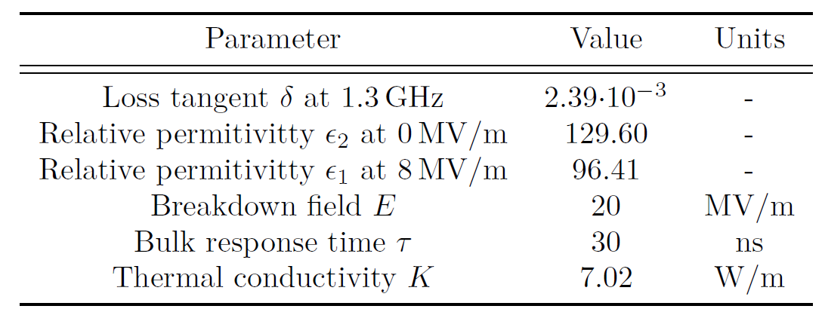





A new type of tuner thanks to Ferroelectrics
Recently developed low-loss FE ceramics, like BST-M (BaTiO₃/SrTiO₃-Mg), at Euclid Techlabs Inc allow for sub-μs response time tuners
$$V$$
$$w$$
$$b_{r}$$
$$a_{r}$$
$$g$$
Ferroelectric ring sample
FE material properties
A. Kanareykin t. al., Fast Switching Ferroelectric Materials for Accelerator Applications, AIP Conf. Proc. 877, 311–319 (2006)

Slide 12
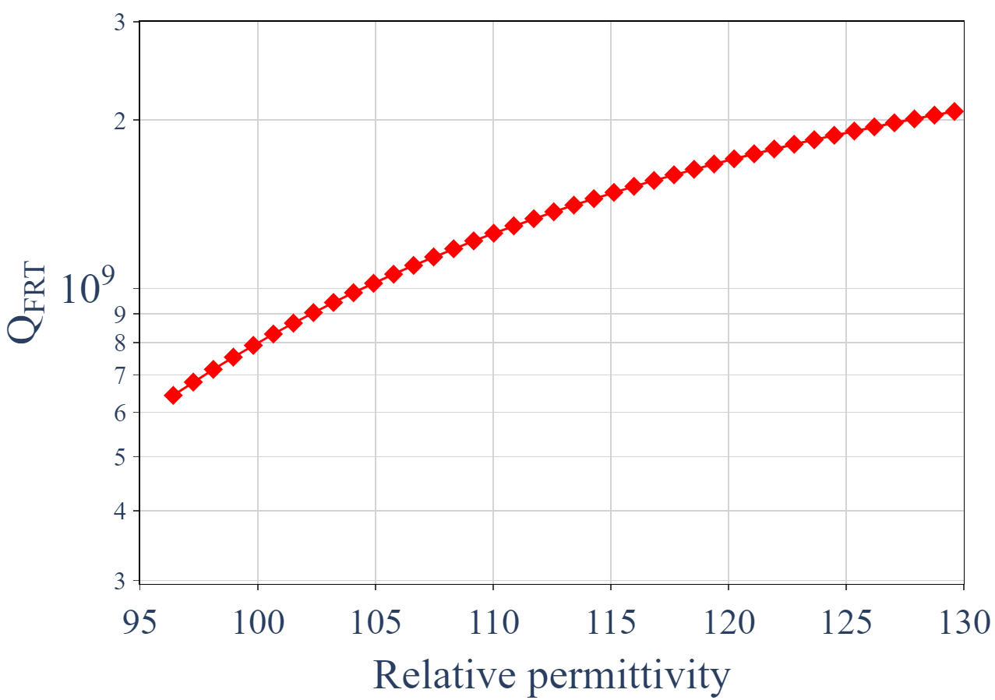

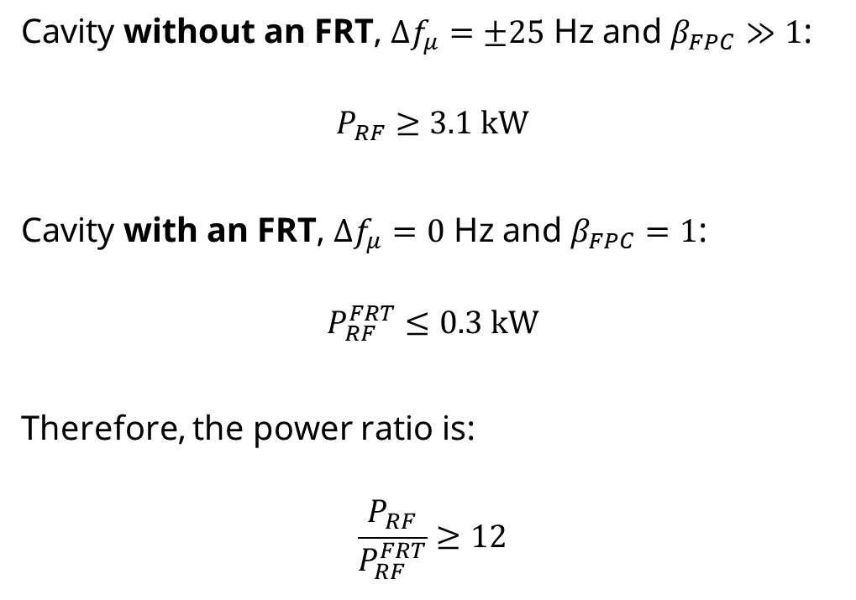

FE-FRT has an energy saving property for ERLs
Cavity without an FRT, $∆f_{μ}=±25$ Hz and $β_{FPC}≫1$:
$$P_{RF}≥3.1 kW$$
Cavity with an FRT, $∆f_{μ}=0$ Hz and $β_{FPC}=1$:
$$P_{RF}^{FRT}≤0.3 kW$$
Therefore, the power ratio is:
$$\frac{P_{RF}}{P_{RF}^{FRT}}≥12$$
$$ε_{2}$$
$$ε_{1}$$
Microphonics mitigated and forward RF power reduced by a factor of 12

Slide 13
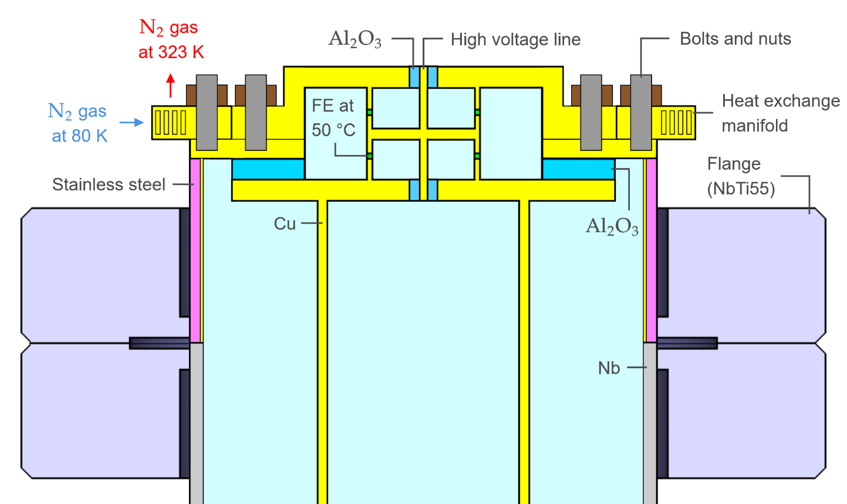
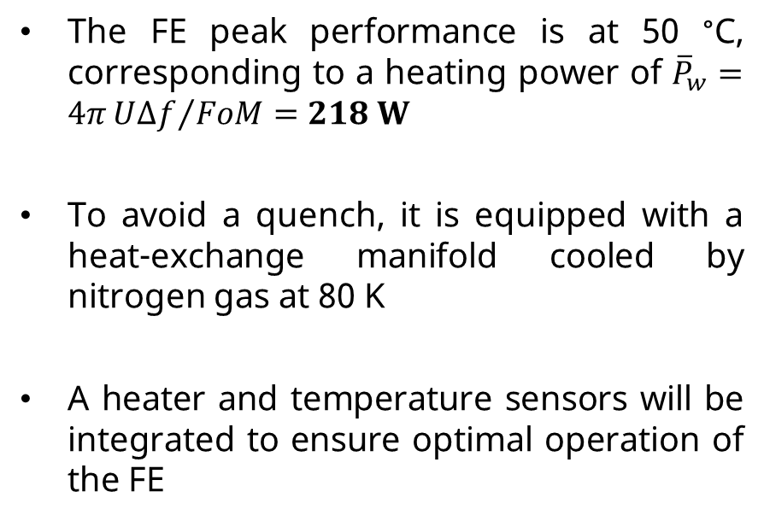
Thermal design
The FE peak performance is at 50 °C, corresponding to a heating power of ${\overline{P}}_{w}=4π{U∆f}/{FoM}=218 W$
To avoid a quench, it is equipped with a heat-exchange manifold cooled by nitrogen gas at 80 K
A heater and temperature sensors will be integrated to ensure optimal operation of the FE
Thermal tuner design in CST

Slide 14
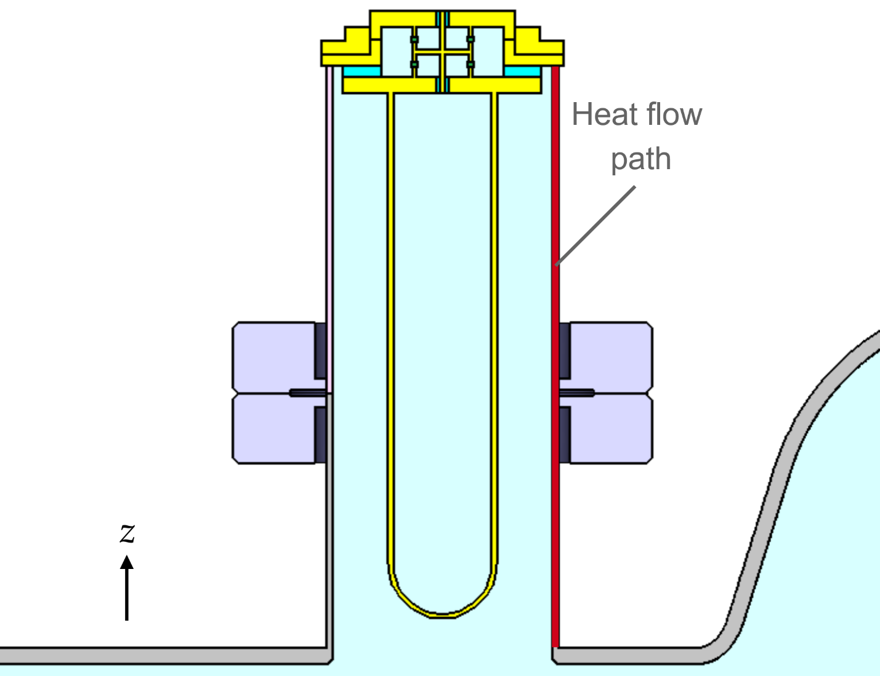
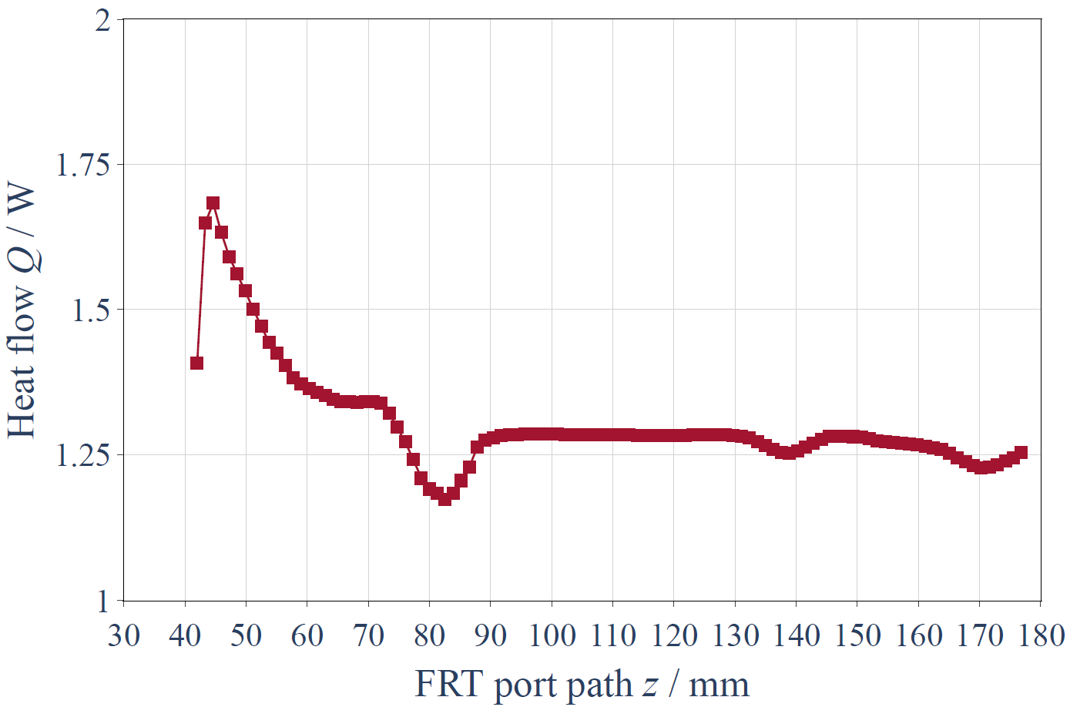
Design limits heat flow to the cavity
Port extension to 3λ/4 and wall thickness reduction to 1 mm were implemented to further reduce the heat reaching the cavity
Simulations show that the thermal load at the cavity beam pipe is limited to ~1 W, which can be handled by the cryogenic system
Cavity beam pipe
FRT
This preliminary design continues to be improved for fabrication

Slide 15
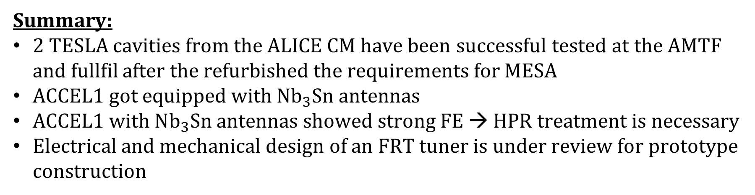
Summary & Outlook
Summary:
2 TESLA cavities from the ALICE CM have been successful tested at the AMTF and fullfil after the refurbished the requirements for MESA
ACCEL1 got equipped with $Nb_{3}Sn$ antennas
ACCEL1 with $Nb_{3}Sn$ antennas showed strong FE → HPR treatment is necessary
Electrical and mechanical design of an FRT tuner is under review for prototype construction
Outlook:
HPR treatment of ACCEL1 with a following VT is planned
Integration of coated antennas to ACCEL3
Building and testing of FRT prototypes

Slide 16
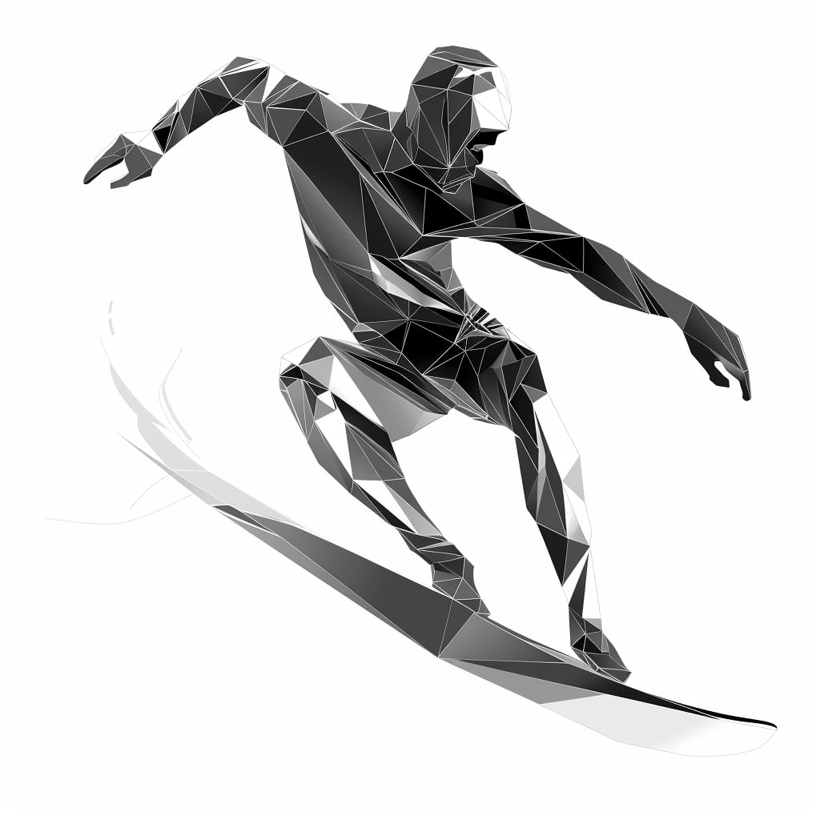
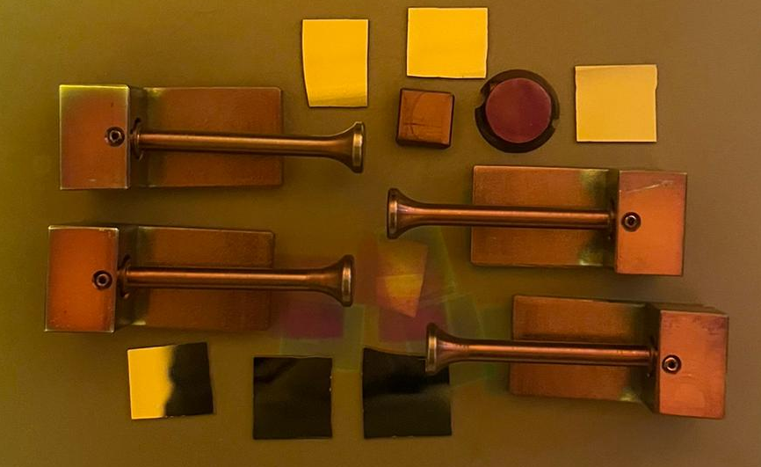
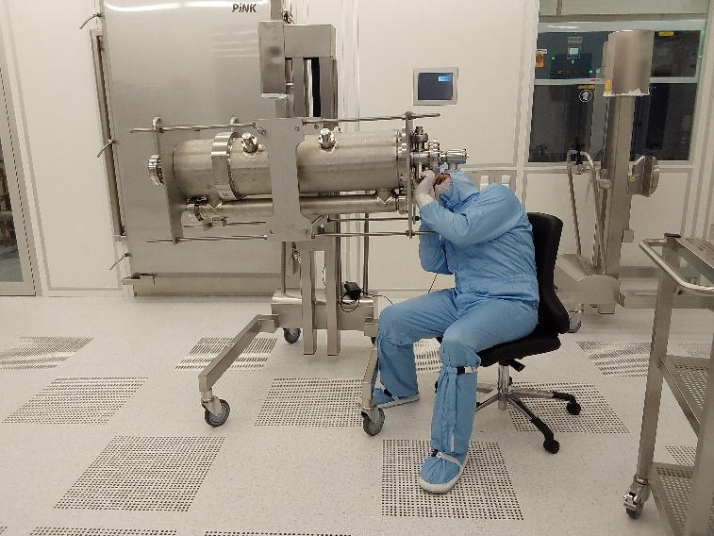
Thank you for your attention!
Work supported by BMFTR through 05H21UMRB1.

