Slide 1




ALD coating for multipacting mitigation in ICONE couplers
TTC meeting 2026 , Paris France 10-06-2026
Y kalboussi¹,G Ferrand¹, T Dejob ¹, J Leroy ², M François ² ,T Proslier ¹
¹DACM,CEA Saclay
²IRAMIS, CEA saclay
Notes:
Ajoute l’université paris saclay

Slide 2
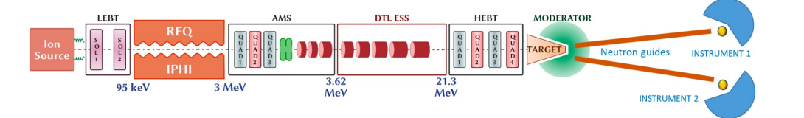
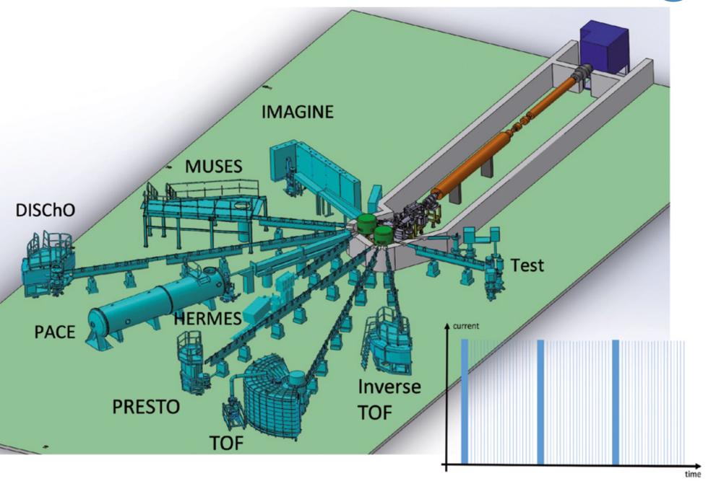
ICONE : New french neutrons source for Material sciences
Key Facility Components
Accelerator: 25 MeV, 80 mA at 6% duty cycles low-energy proton accelerator
Neutron Source: Cold and thermal neutron production using Be targets and moderator-reflector systems.
Instrument Suite: Diffraction, imaging, reflectometry, spectroscopy
Supporting Capabilities: Advanced sample environments, complementary characterization techniques, and AI-driven data analysis.
First beam is expected in 2033 and will installed at CEA saclay

Slide 3
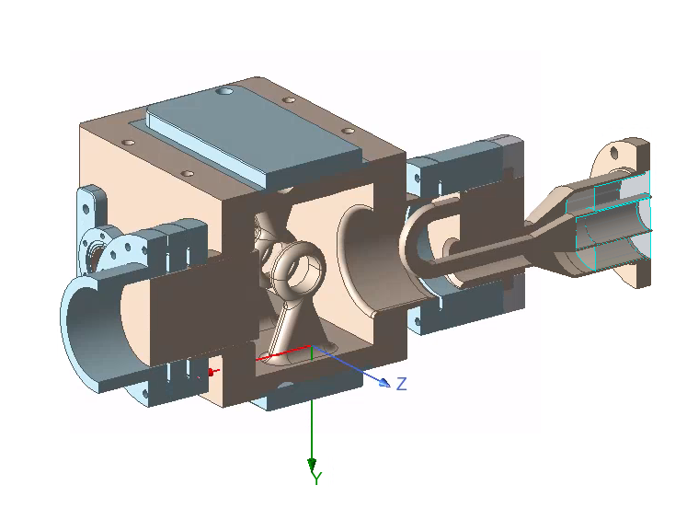
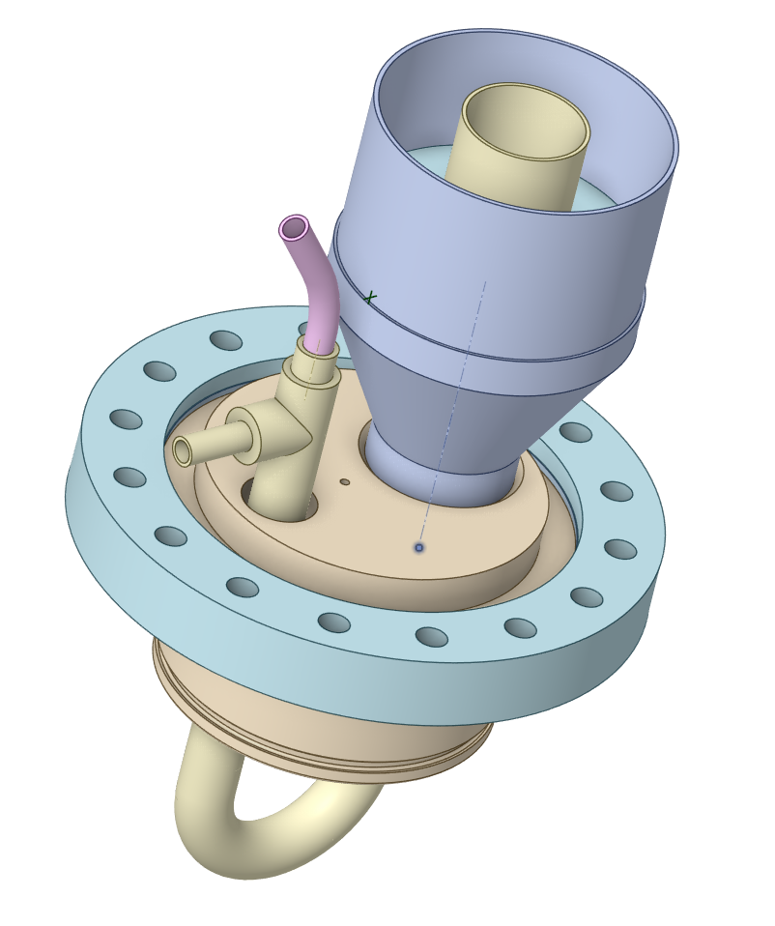
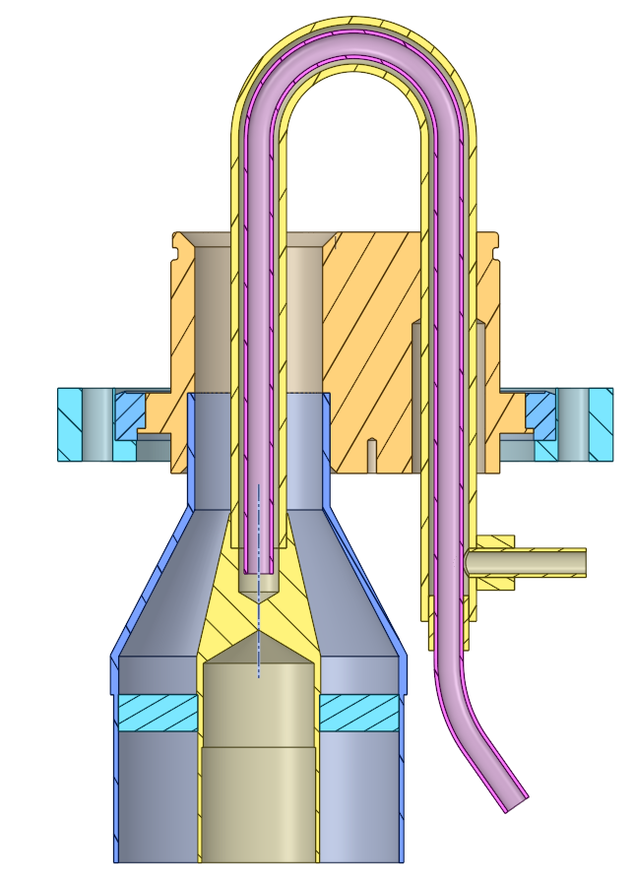
The LINAC designed by CEA
Ion source
LET
MET
DTL
HET
RFQ
Target
80 mA
75keV
3.62 MeV
25 MeV
DTL cavity + RF coupler at 352 MHz
RF coupler at 352 MHz
Notes:
DACM is responsible of the full linac from fion source to the target , including , low energy beam transport ot RF quadrupole, meadium enery beam transport, drift tube linac high energy beam transport
RF Q and DLT cavities will require RF power couplers at 352 MHz and we chose to use loop antenna couplers for all couplers ( 12 DTL cavities and 4 couplers for THE RFQ). Very similar to couplers used in ESS and spirale 2 RFQ couplers

Slide 4
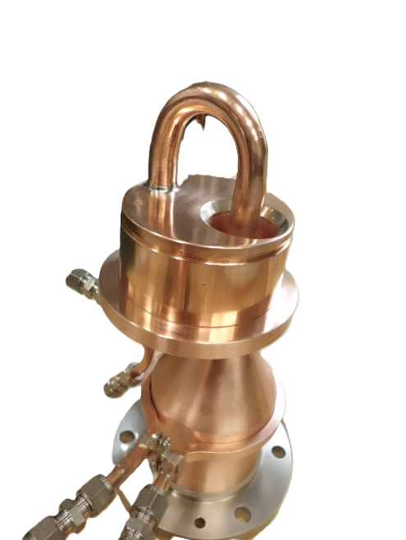
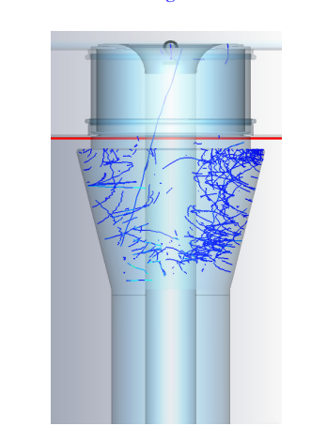
Multipacting in RF couplers
Multipacting is a very detrimental phenomena to RF systems.
Near the ceramic window, RF-accelerated electrons strike the Al₂O₃ surface, generating secondary electrons and sustaining multipacting as the SEY of Al₂O₃ is ~ 4.5.
Coating with low SEY film such as TiN is an established solution.
Al₂O₃ ceramic
Electron trajectoires Inside a power coupler [1]
TTC meeting 2026 10/06/2026
Notes:
> 100 MHZ ,
Freqence 352 Mhz ,
New gain ( RFQ) CEA projet au ganil , le meme design mais 88 MHz , ( un avec multipactor pas de multipactors
Based on CEA experiences with the same in ESS at 352 frequency , multipacting was a problem requirring conditionning time very long , So we decided to use TiN coating to reduce the secondary emission yield.
In RF couplers, multipacting is initiated by seed electrons emitted from the metal conductors or the ceramic window. Under the RF electric field, electrons resonate between the inner and outer conductors and/or impact the Al₂O₃ ceramic surface, generating secondary electrons and leading to an electron avalanche when the secondary electron yield exceeds unity.
12 cavité DTL ( design CEA) et donc 12 coupleurs
MULTIPACTOR SIMULATIONS OF THE SPL POWER COUPLER G. Burt, A. C. Dexter, P. K. Ambattu, Cockcroft Institute, Lancaster University, Lancaster, U.K. R. Calaga, BNL, Upton, Long Island, New York, U.S.A. E. Montesinos, CERN, Geneva, Switzerland

Slide 5
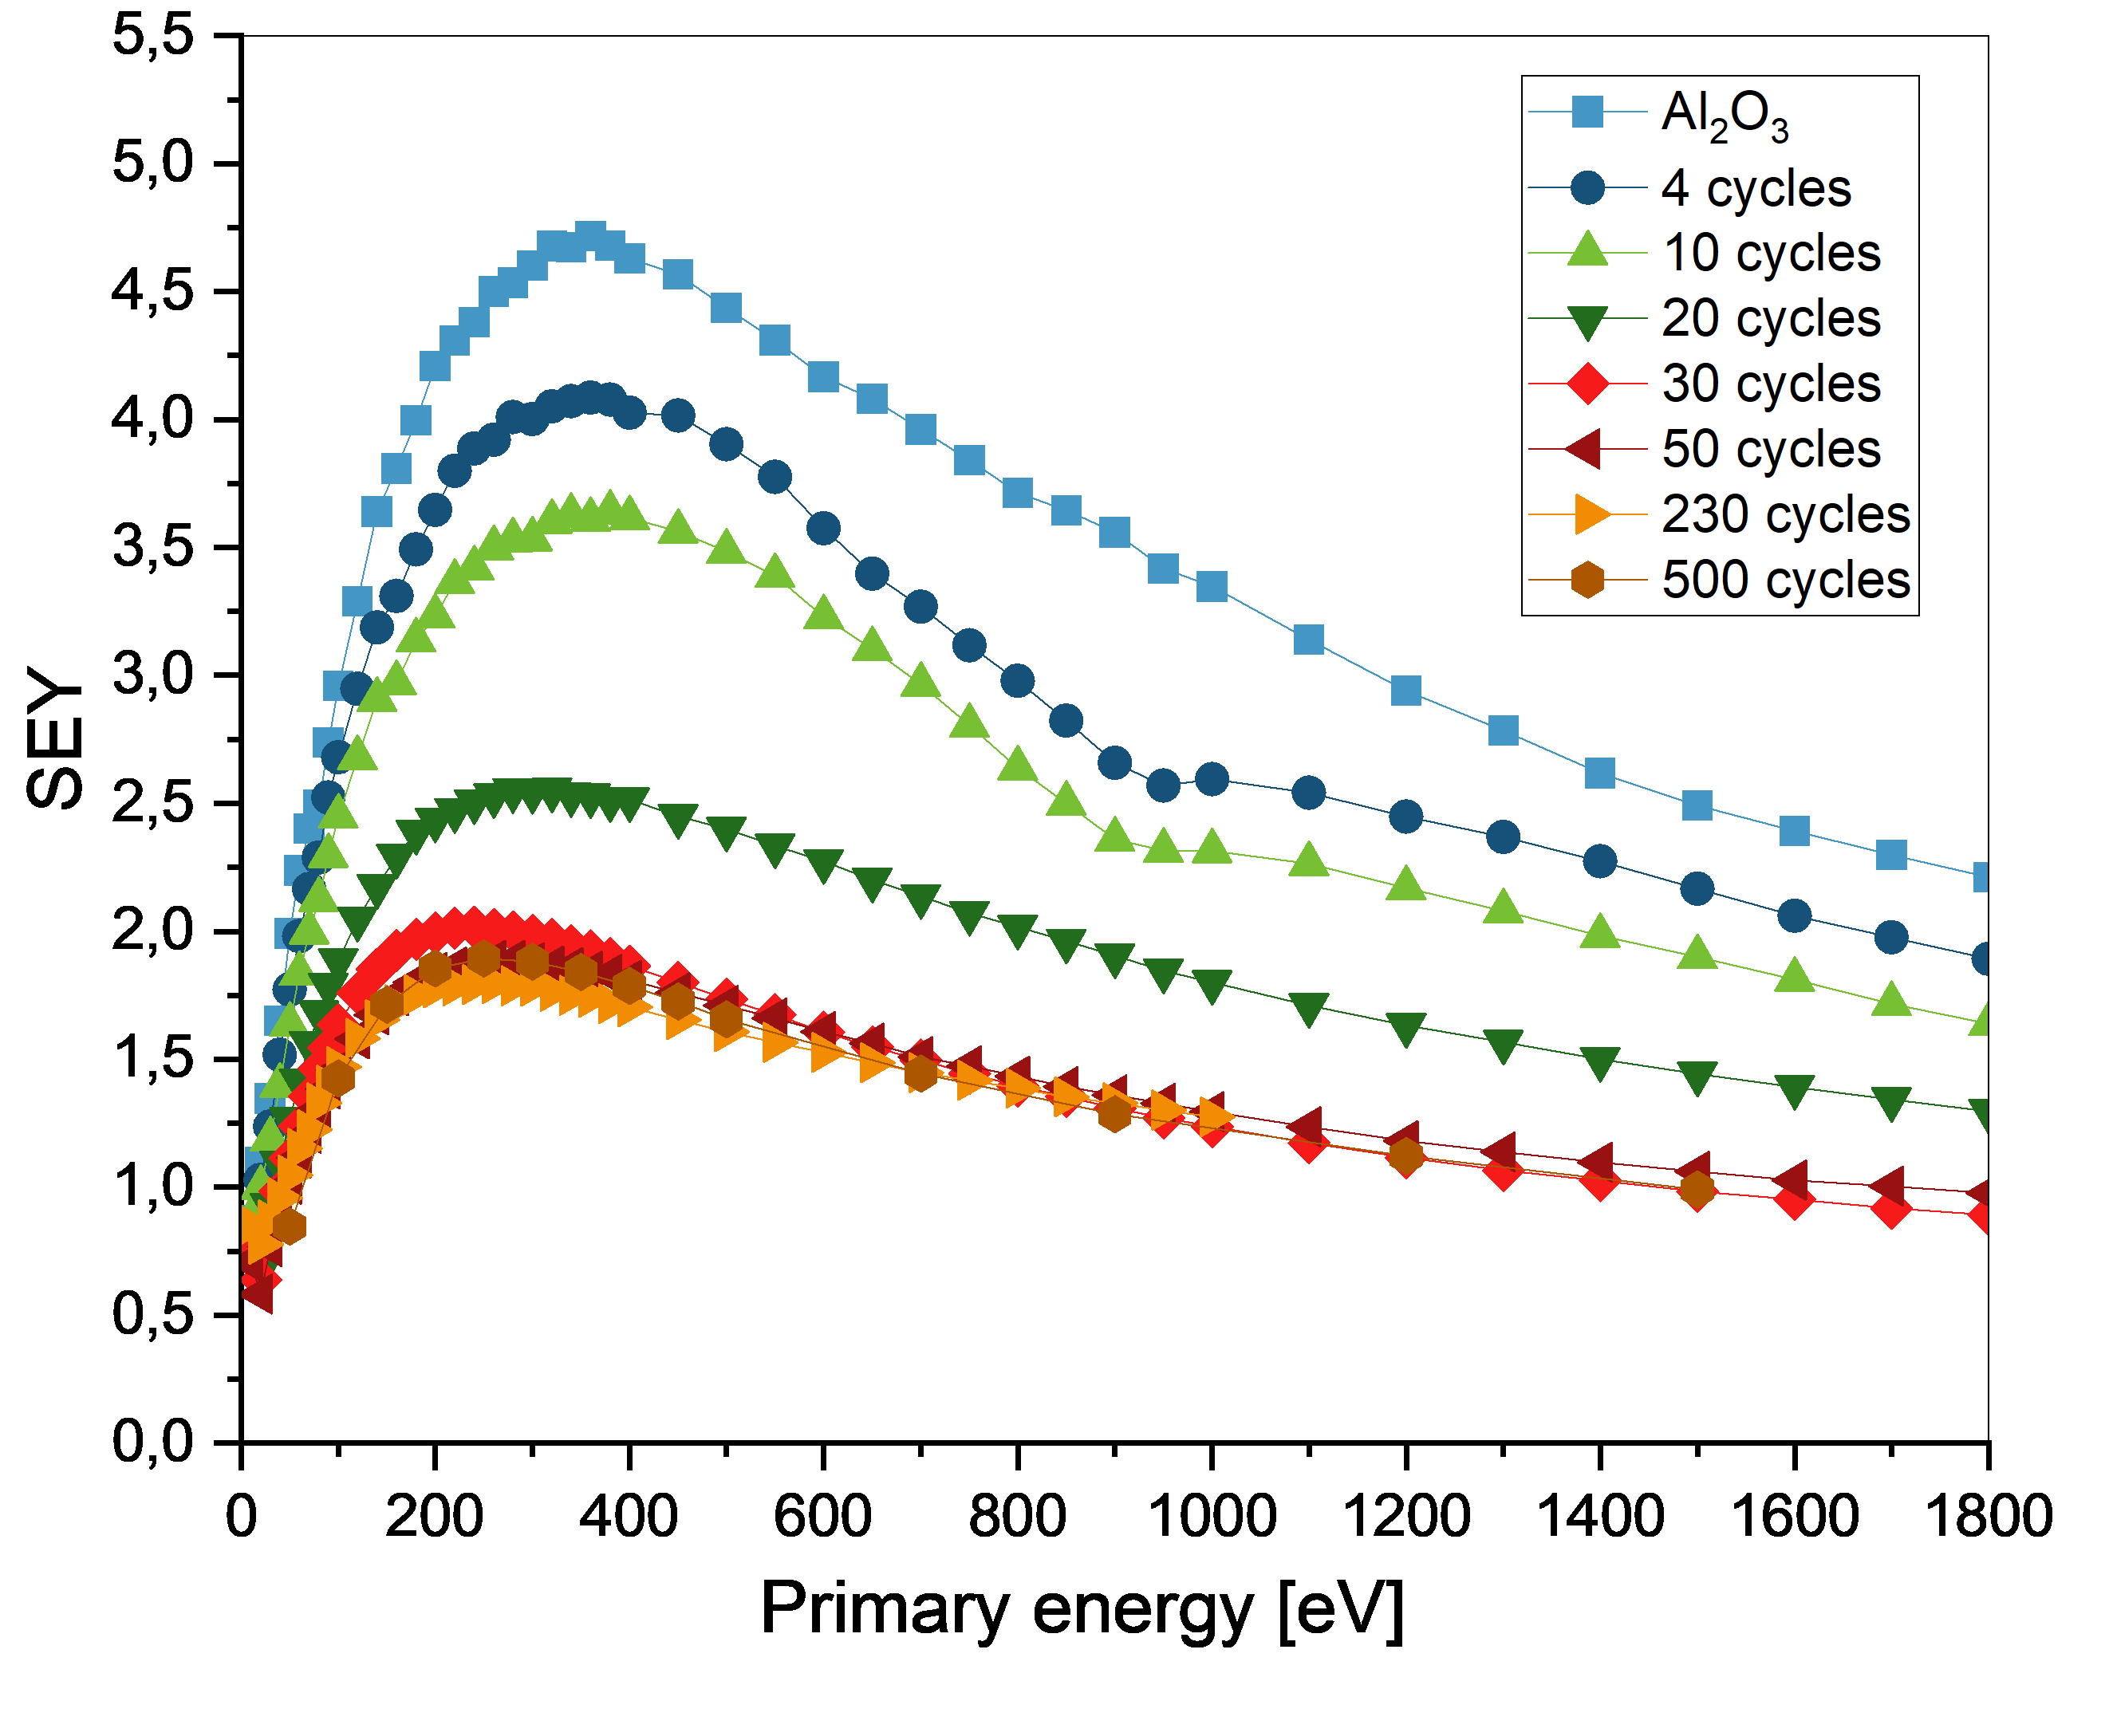
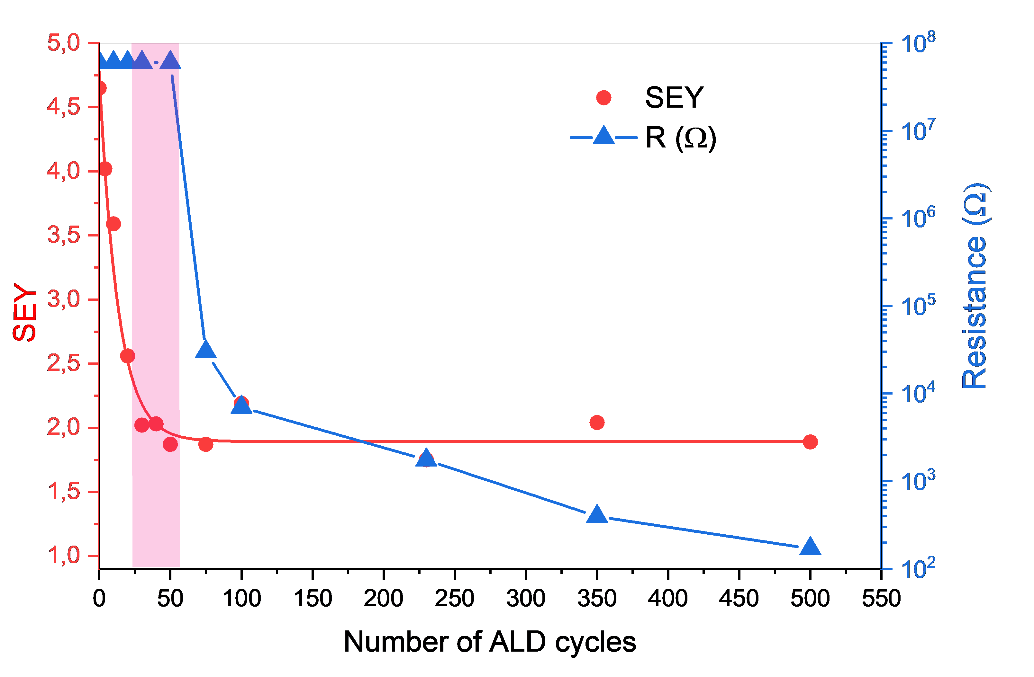
SEY measurements on the TiN – Al₂O₃ samples
TiN
We tested increasingly thicker TiN films ( by increasing the number of TiN ALD cycles ) deposited on 10 nm of Al₂O₃.
Al₂O₃
Si
There is a window of 30- 50 cycles where the SEY is low and the TiN film resistance is high [2].
TTC meeting 2026 10/06/2026
Notes:
Retire after conditionning
To that end, we tested diffrent TiN thckness of TiN coating by varriying the number of the ALD cycles used. Starting from the bare alumina , the SEY max of the surface dre
Fit = decroissance exponentiel en nombre de cycle

Slide 6

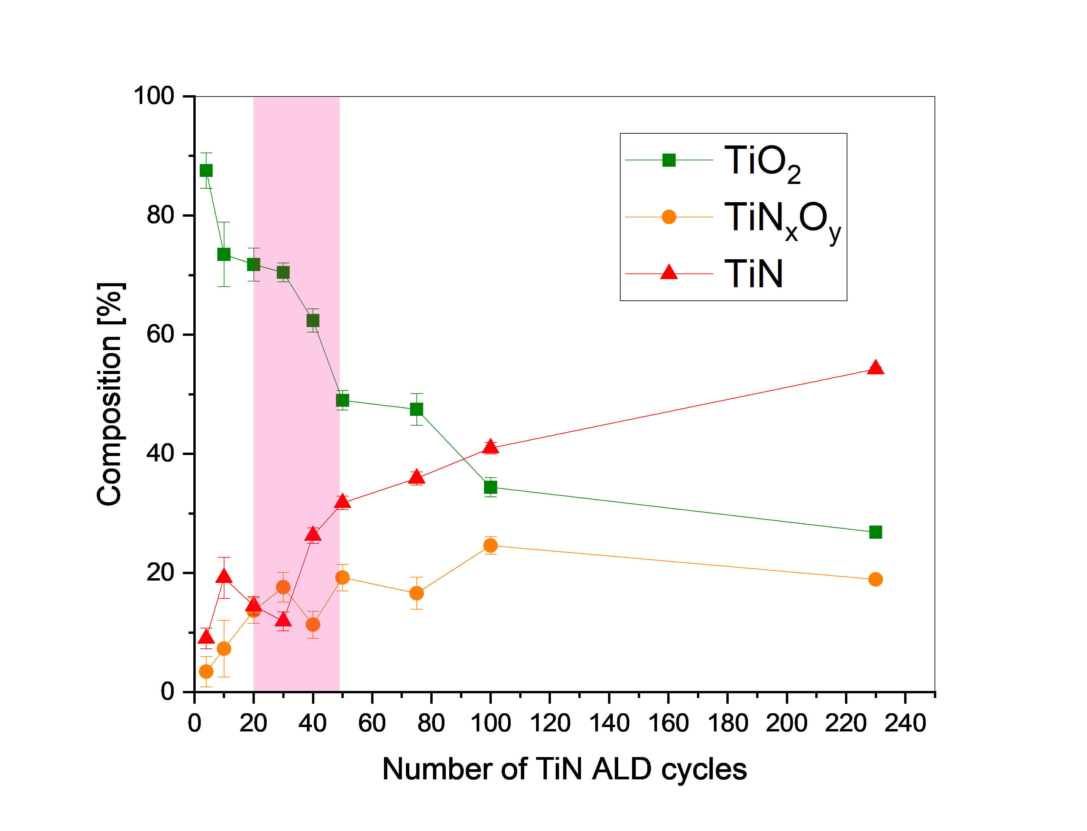
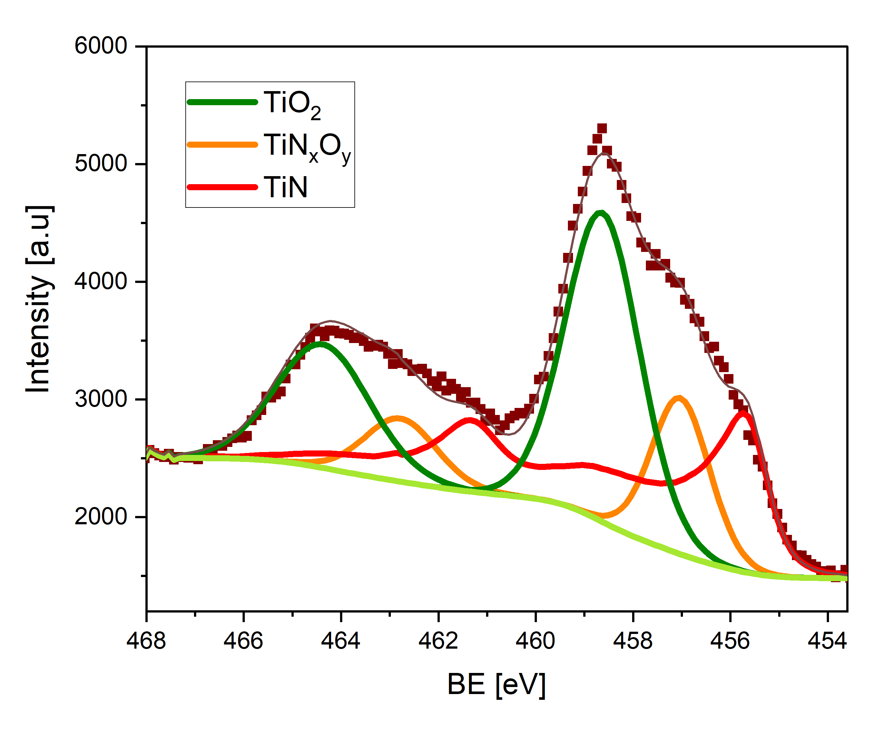
Chemical composition of TiN by XPS
Chemical composition of TiN films
XPS fitting of the Ti-2p core level spectra of the TiN film with 50 ALD cycles
Ultra thin TiN films are mainly composed of Ti oxides which is cohenrent with thier high resistance [2]
TTC meeting 2026 10/06/2026
6
Notes:
We found out that the ultra thin TiN films are mainly composed of Ti oxides which is cohenrent with thier high resistance.
Mettre echelle d’ epaisseur

Slide 7
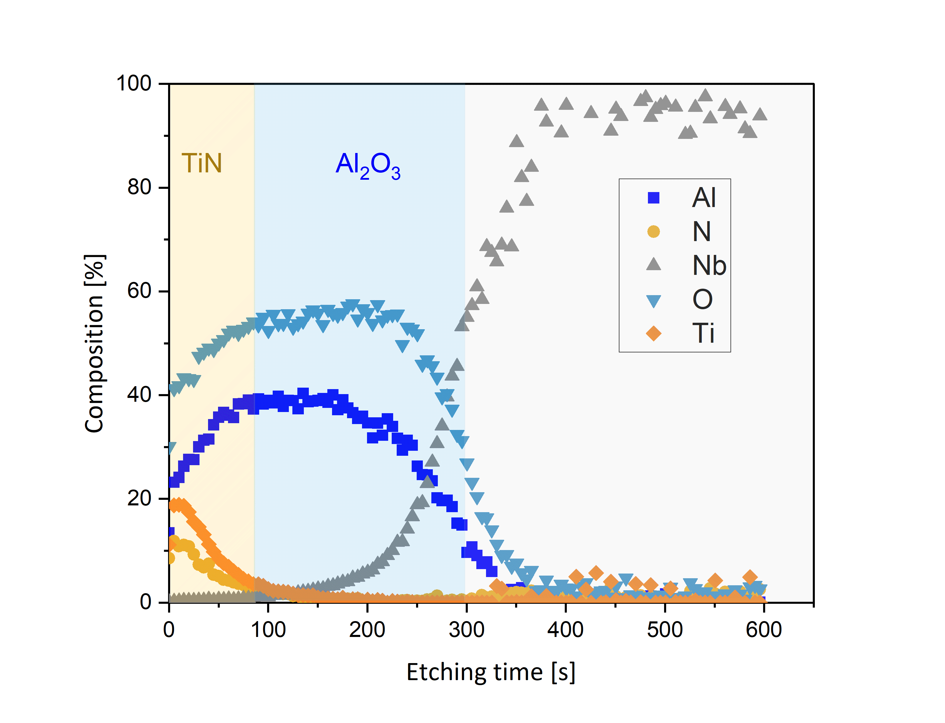
RF test of the TiN thin film on 1.3 Ghz cavity
XPS profile of TiN -Al₂O₃ on Nb
T= 1.4 K
The quality factor is slightly lowered but the 1.5 nm TiN film is effective as a multipacting mitigation layer [2].
TTC meeting 2026 10/06/2026
7
Notes:
Ajoute T= 1.4 K sur le graph
Fleche pour dire quel epaisseur on a choisi
Mettre le graph de themal stability TiN-Al2O3-Nb
Details sur annealings
Further test will be just one annealing

Slide 8
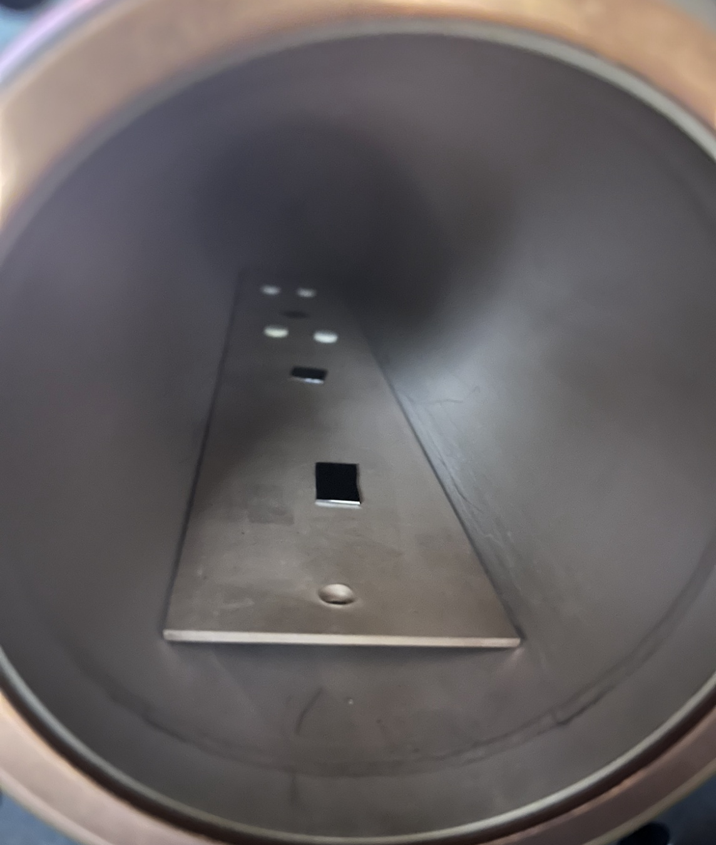
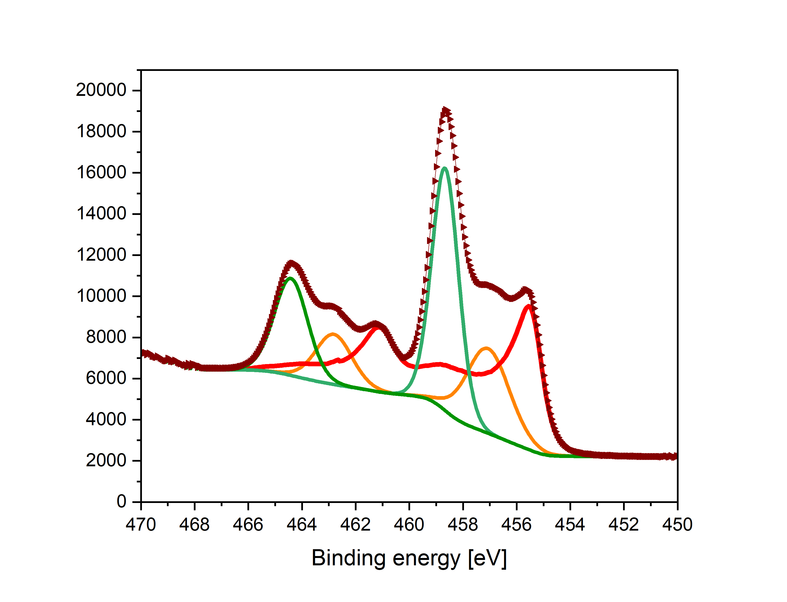
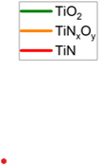
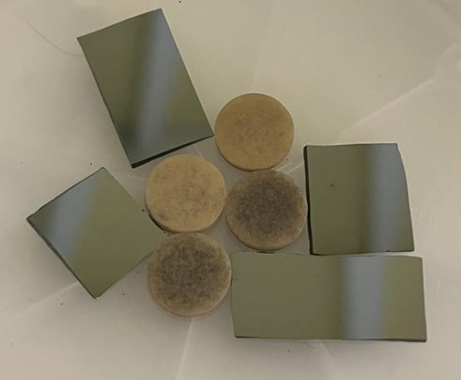
First tests on small alumina ceramics
Target : 5 nm of TiN. Typical thickness for TiN coating by sputtering.
240 cycles of TiN at 450°C using TiCl₄ + NH₃
TiN coating is confirmed by XPS on Si and Alumina ceramics
but the color of ceramics is grey and uneven …
Resistance is measured is around 10 kOhm
➔ Degazing of the ceramics can results in CVD like growth …
Microscopy of the ceramic surface
XPS analysis
TTC meeting 2026 10/06/2026
Notes:
Conclusion : c’est beaucoup trop… (on cherche > 10 MOhm.m)

Slide 9
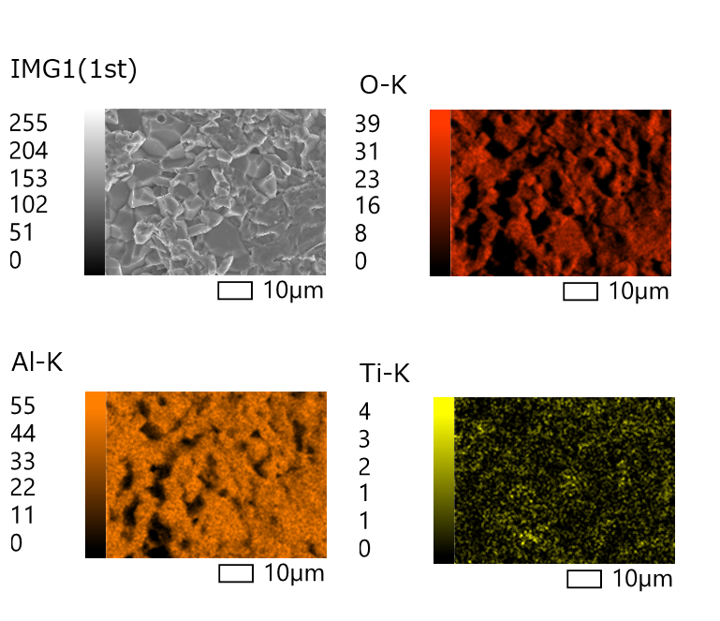
Second test on small alumina ceramics
5 nm TiN
New tests with a first Al₂O₃ coating by ALD typically 10 nm + 5 nm (240 cycles) of TiN
The ALD layer of Al₂O₃ is meant to reset the surface chemistry
New results : Better reproducibility and color, but resistance is still too low (typically around 10 kOhms)
We need to lower the thickness of TiN from 5nm (240 cycles) to 1,5 nm (40 cycles).
10 nm Al₂O₃
Al₂O₃ ceramics
TTC meeting 2026 10/06/2026

Slide 10
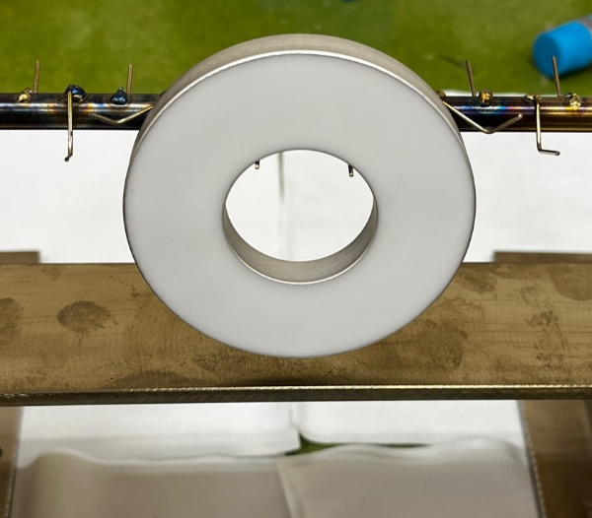
3rd test : 20 nm Al₂O₃ and 1.5 nm TiN
New tests 20 nm of Al₂O₃ coating by ALD typically + 1,5 nm (40 cycles) of TiN
The ALD layer of Al₂O₃ is meant to reset the surface chemistry
New results : Better reproducibility and color
Resistivity is > 10 MOhm.m
➔ Difficulties in brazing the ceramic into the copper parts of the coupler, probably due to wetting alteration caused by the 20 nm of Al₂O₃ .
1.5 nm TiN
20 nm Al₂O₃
Al₂O₃ ceramics
TTC meeting 2026 10/06/2026

Slide 11
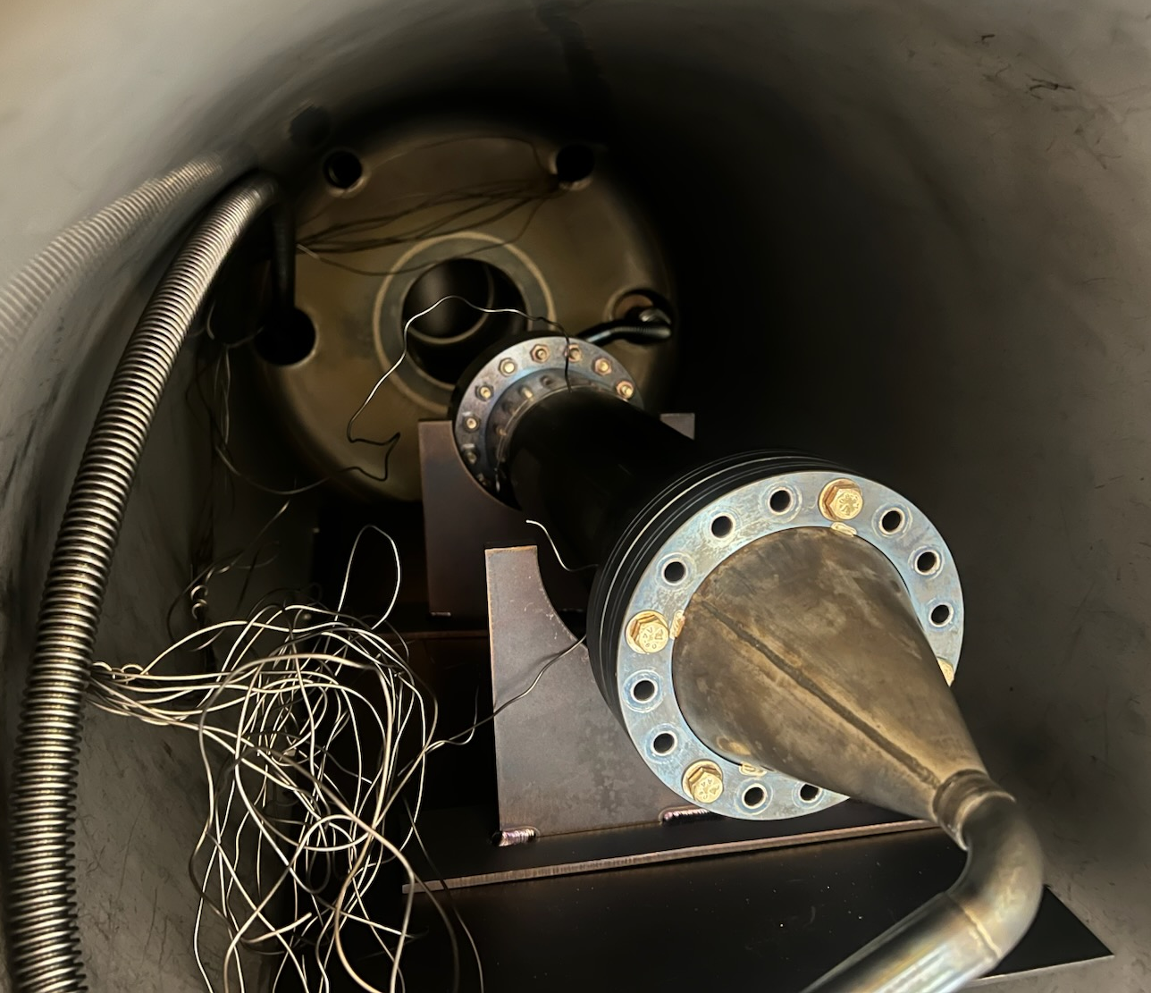
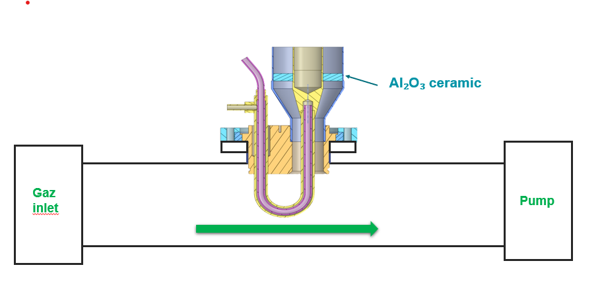
Next experiments
New tests with thinner Al₂O₃ + 1.5 nm of TiN
New tests of brazing after TiN Deposition.
Tests with a dummy coupler to enable TiN coating after the brazing.
Thank you for your attention !
TTC meeting 2026 10/06/2026

Slide 12
References
[1] MULTIPACTOR SIMULATIONS OF THE SPL POWER COUPLER G. Burt, A. C. Dexter, P. K. Ambattu, Cockcroft Institute, Lancaster University, Lancaster, U.K. R. Calaga, BNL, Upton, Long Island, New York, U.S.A. E. Montesinos, CERN, Geneva, Switzerland
[2] Y. Kalboussi et al. Multipacting mitigation by atomic layer deposition: The case study of titanium nitride. J. Appl. Phys. 28 August 2024; 136 (8): 085306. https://doi.org/10.1063/5.0221943
TTC meeting 2026 10/06/2026

