Slide 1
Latest findings on the development of the FE-FRT within the ISAS collaboration
Hongping Jiang
On the behalf of the ISAS collaboration
10 June 2026

Slide 2
Outlook
Introduction
  The project ISAS
  The FE-FRT concept
The equivalent circuit
The FE material characterization
The Transient Detuning Demonstrator (TDD)and Microphonics FE-FRT
  The TDD test results
  The FE-FRT for microphonics
  The discharge of the bias HV
    Some defective FE wafers
The novel FE-FRT RF design
  The Twin-axial type FE-FRT
  Integration of FE-FRT and HoM coupler

Slide 3
Introduction
The ISAS(Innovate for Sustainable Accelerating Systems)
  Energy savings from the RF power
    The objective is to significantly reduce the RF power sources and wall plug power for all SRF accelerators with ferro-electric fast reactive tuners (FE-FRTs) for control of transient beam loading and detuning by microphonics.
  Work package 1: FE-FRT
    optimal integration of Ferro-Electric Fast Reactive Tuners (FE-FRT) to deal with microphonics (1300 MHz) and transient detuning(400 and 800MHz).

Slide 4

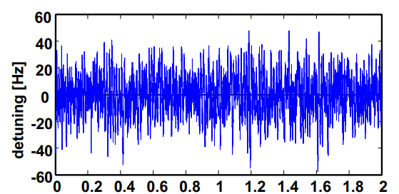
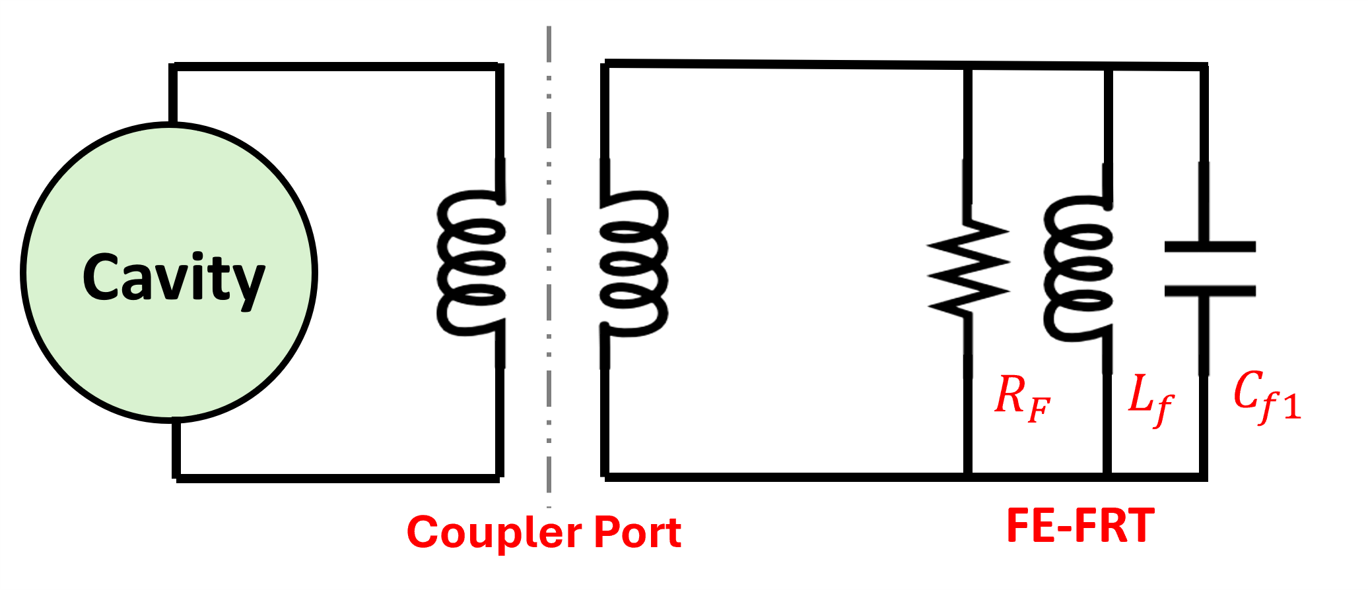
Microphonics and FE-FRT Concept
Microphonics: Mechanical vibrations in the environment cause rapid frequency deviations in SRF cavities (several Hz to tens of Hz, up to a few hundred Hz).
Mechanical tuners are slow and unsuitable for brittle thin-film cavities.
Fast reactive tuners (FRTs) enable swift frequency adjustments via variable reactance.
FRTs safely tune SRF cavities with fragile coatings like Nb₃Sn, avoiding structural damage.

Slide 5
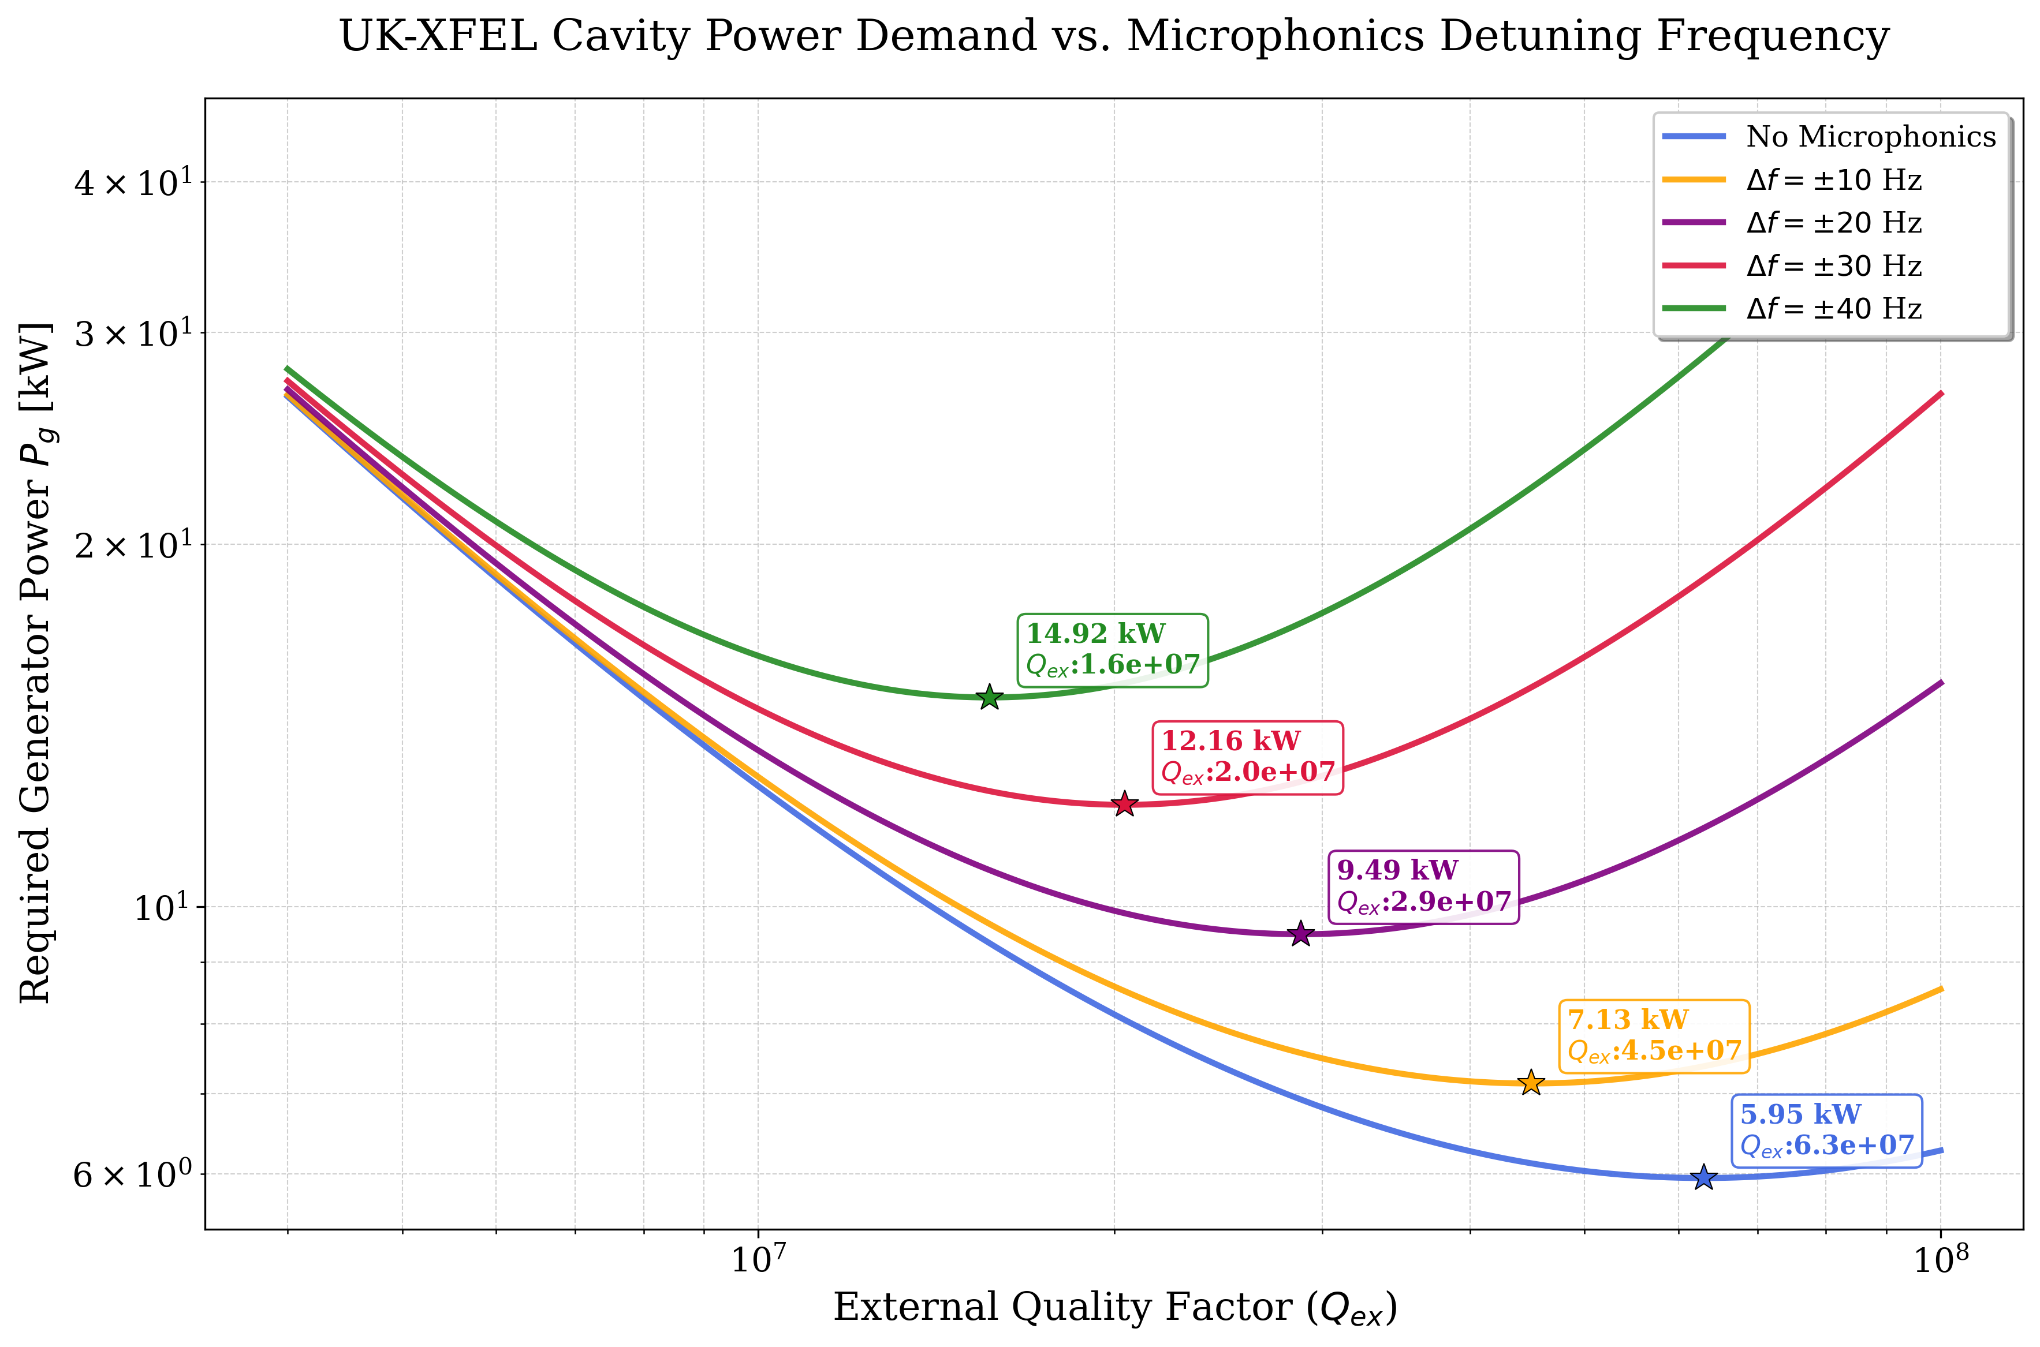
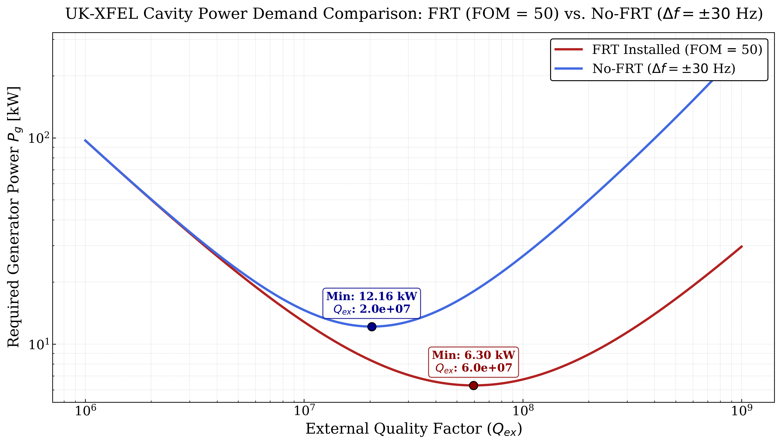
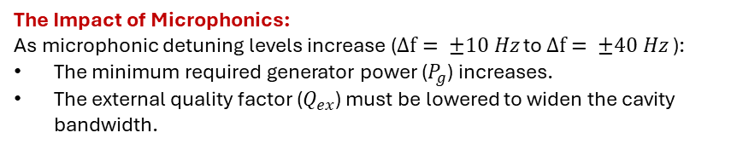
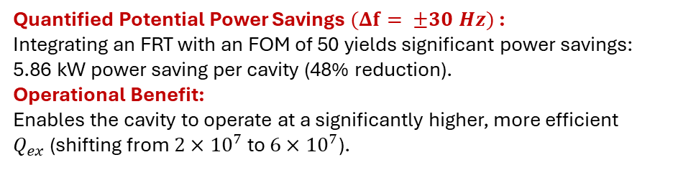
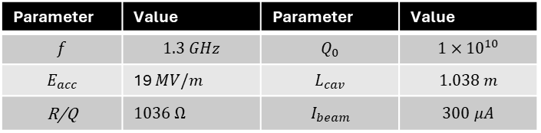
Potential Power Savings using FRTs (UK-XFEL Use-case)
The Impact of Microphonics:
As microphonic detuning levels increase ($Δf= ±10 Hz$to $Δf= ±40 Hz$):
The minimum required generator power ($P_{g}$) increases.
The external quality factor ($Q_{ex}$) must be lowered to widen the cavity bandwidth.
Best working point (without microphonics suppression) : 12.16 kW
Best working point (with microphonics suppression) : 6.30 kW
Quantified Potential Power Savings $(Δf= ±30 Hz)$:
Integrating an FRT with an FOM of 50 yields significant power savings:
5.86 kW power saving per cavity (48% reduction).
Operational Benefit:
Enables the cavity to operate at a significantly higher, more efficient $Q_{ex}$(shifting from $2×{10}^{7}$ to $6×{10}^{7}$).
Parameter | Value | Parameter | Value
$$f$$ | $$1.3 GHz$$ | $$Q_{0}$$ | $$1×{10}^{10}$$
$$E_{acc}$$ | 19 $MV/m$ | $$L_{cav}$$ | $$1.038 m$$
R/Q | $1036$ $Ω$ | $$I_{beam}$$ | $$300 μA$$
Cavity & Beam Parameters
Thanks and acknowledgments to Maleesh(Lancaster University)

Slide 6
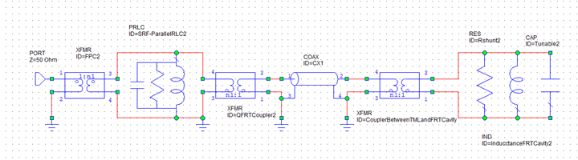
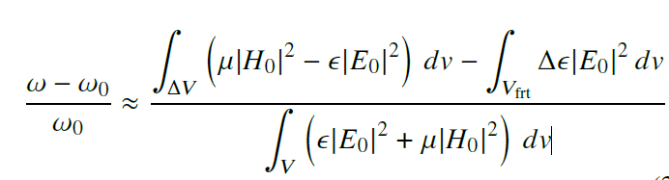
The equivalent circuit of the FRT system
The equivalent circuit and perturbation theory
ε Changing from the bias high voltage
Changing from Microphonics
FPC
SRF Cavity
Transmission line
FE-FRT
perturbation theory:

Slide 7
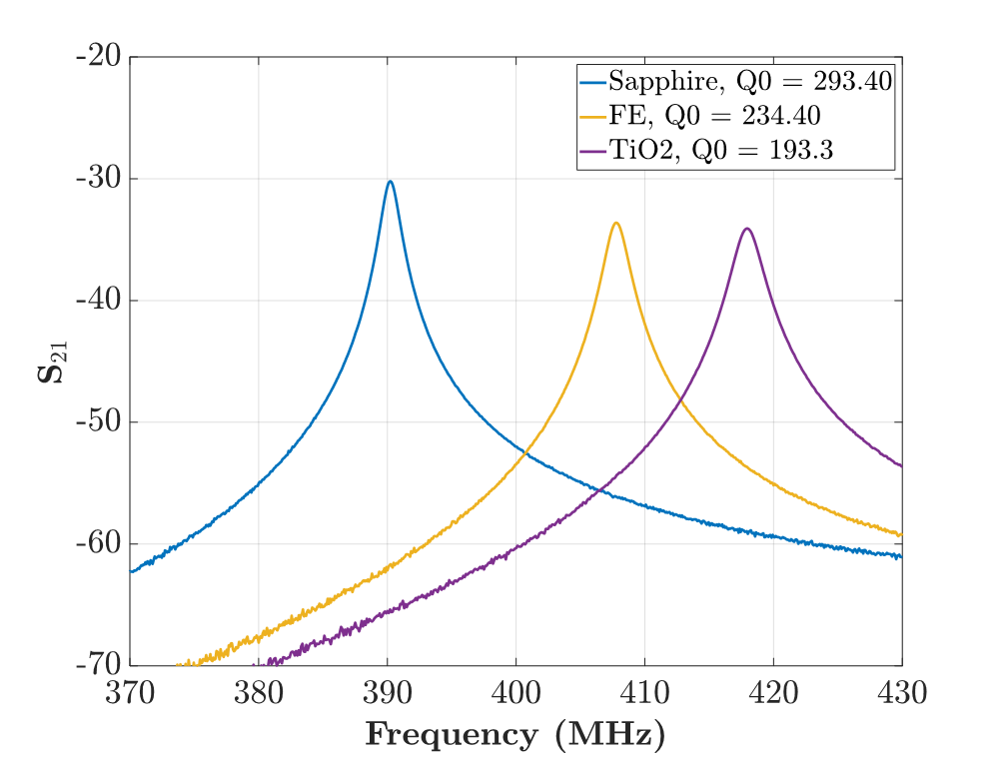
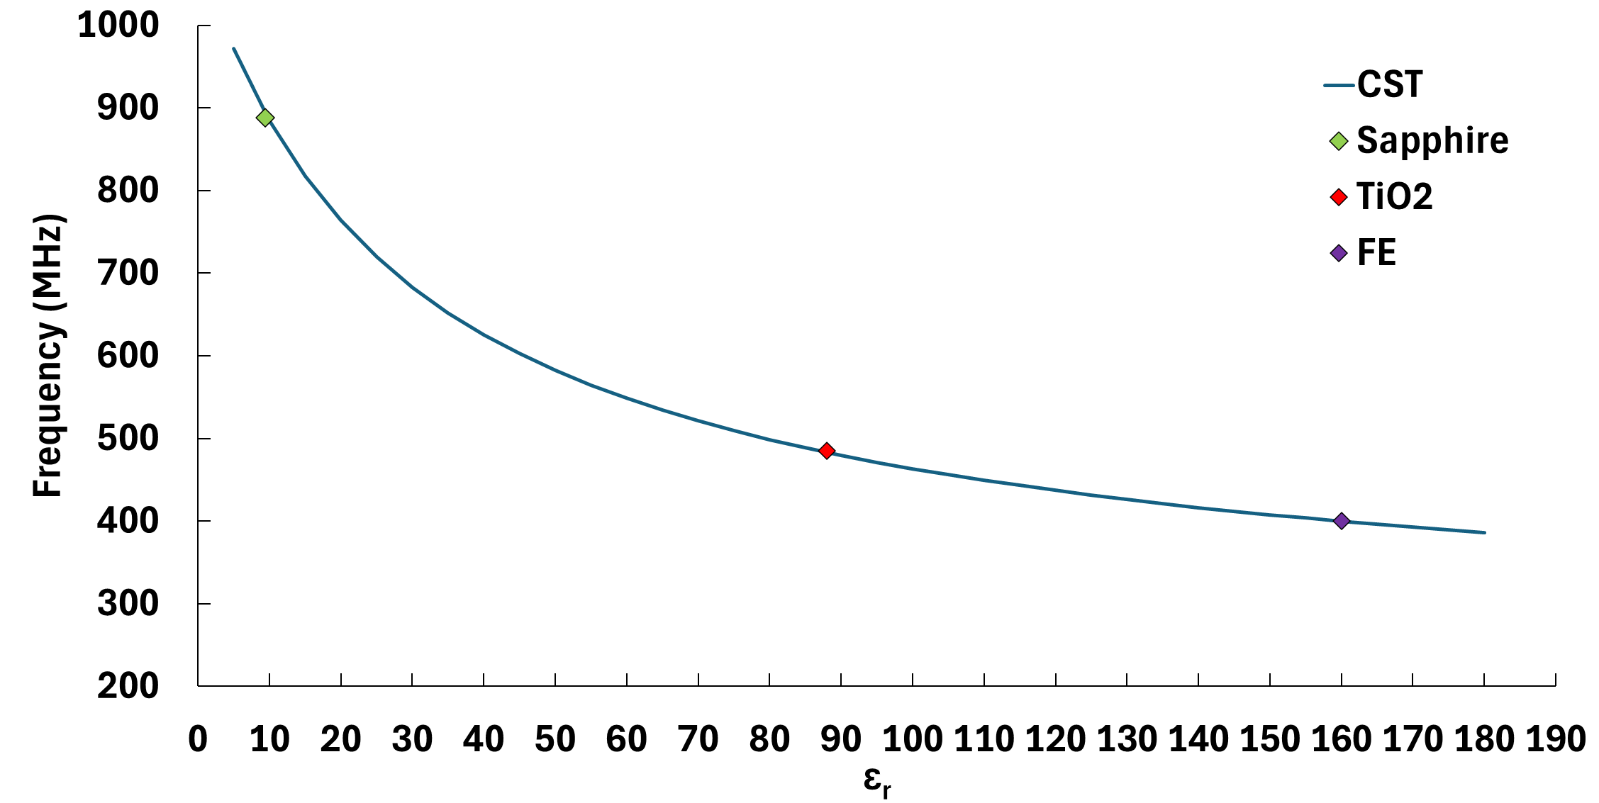
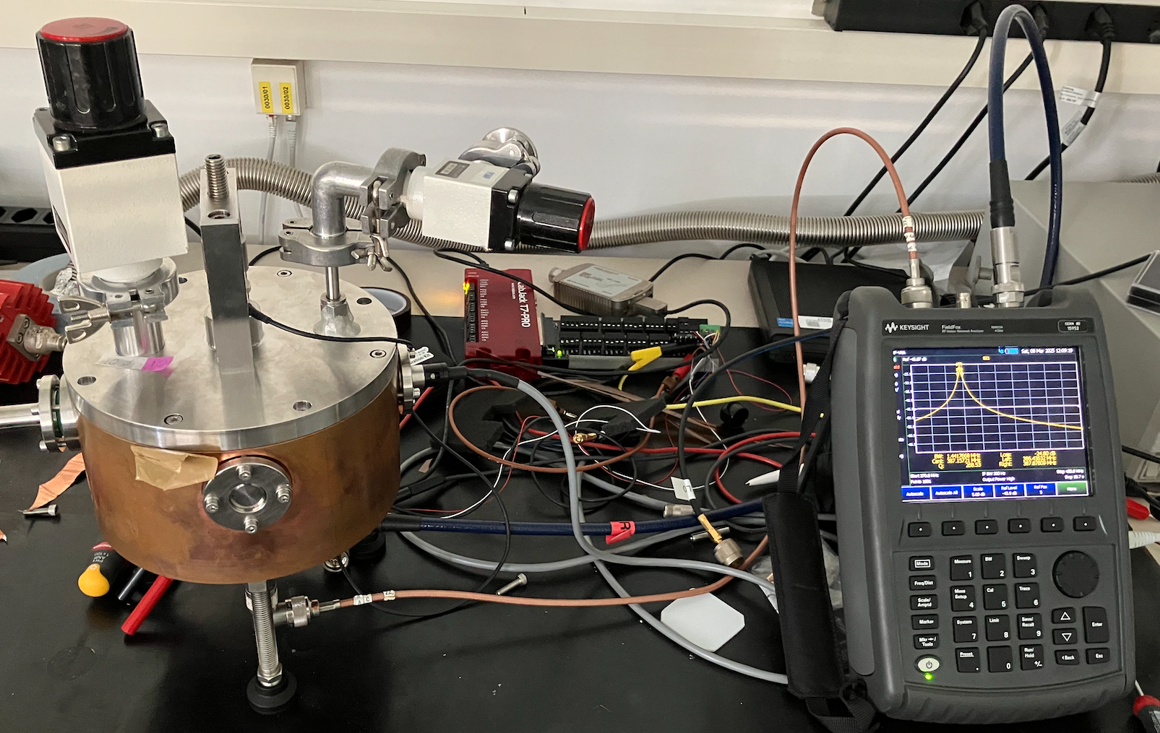
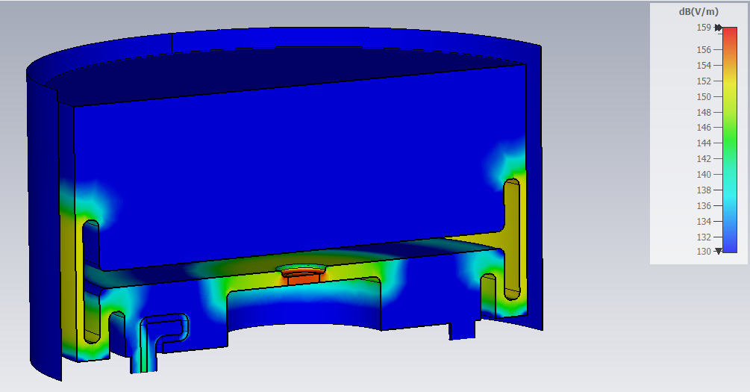
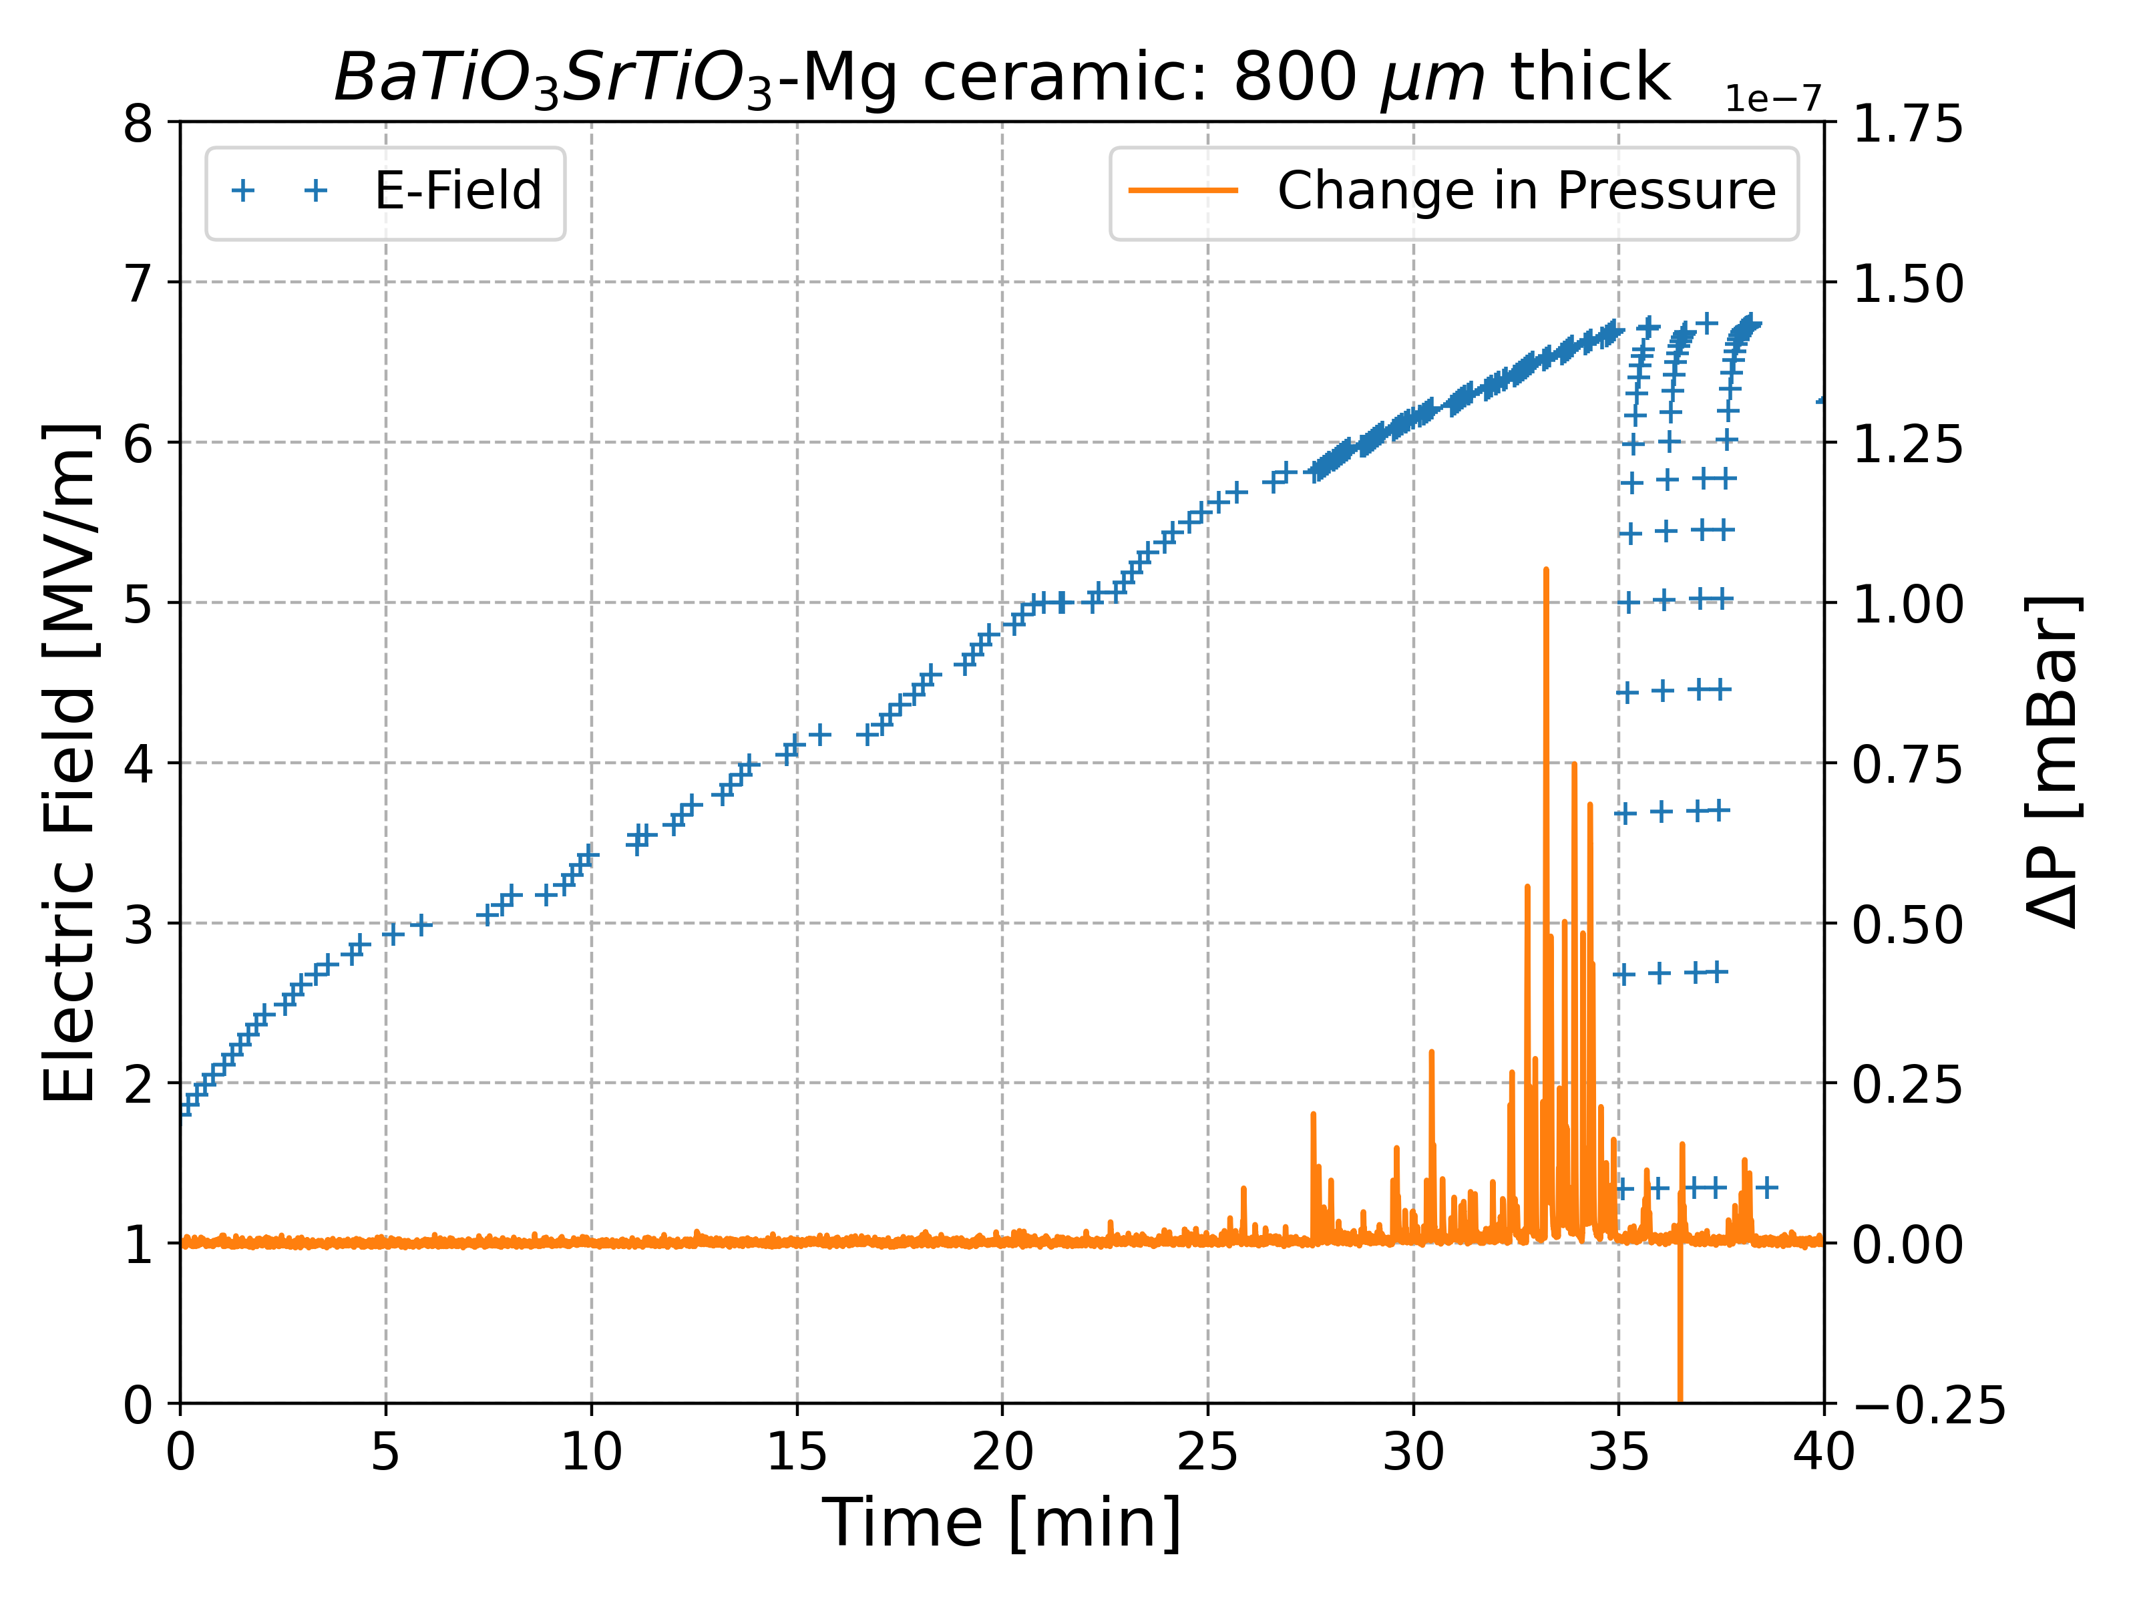
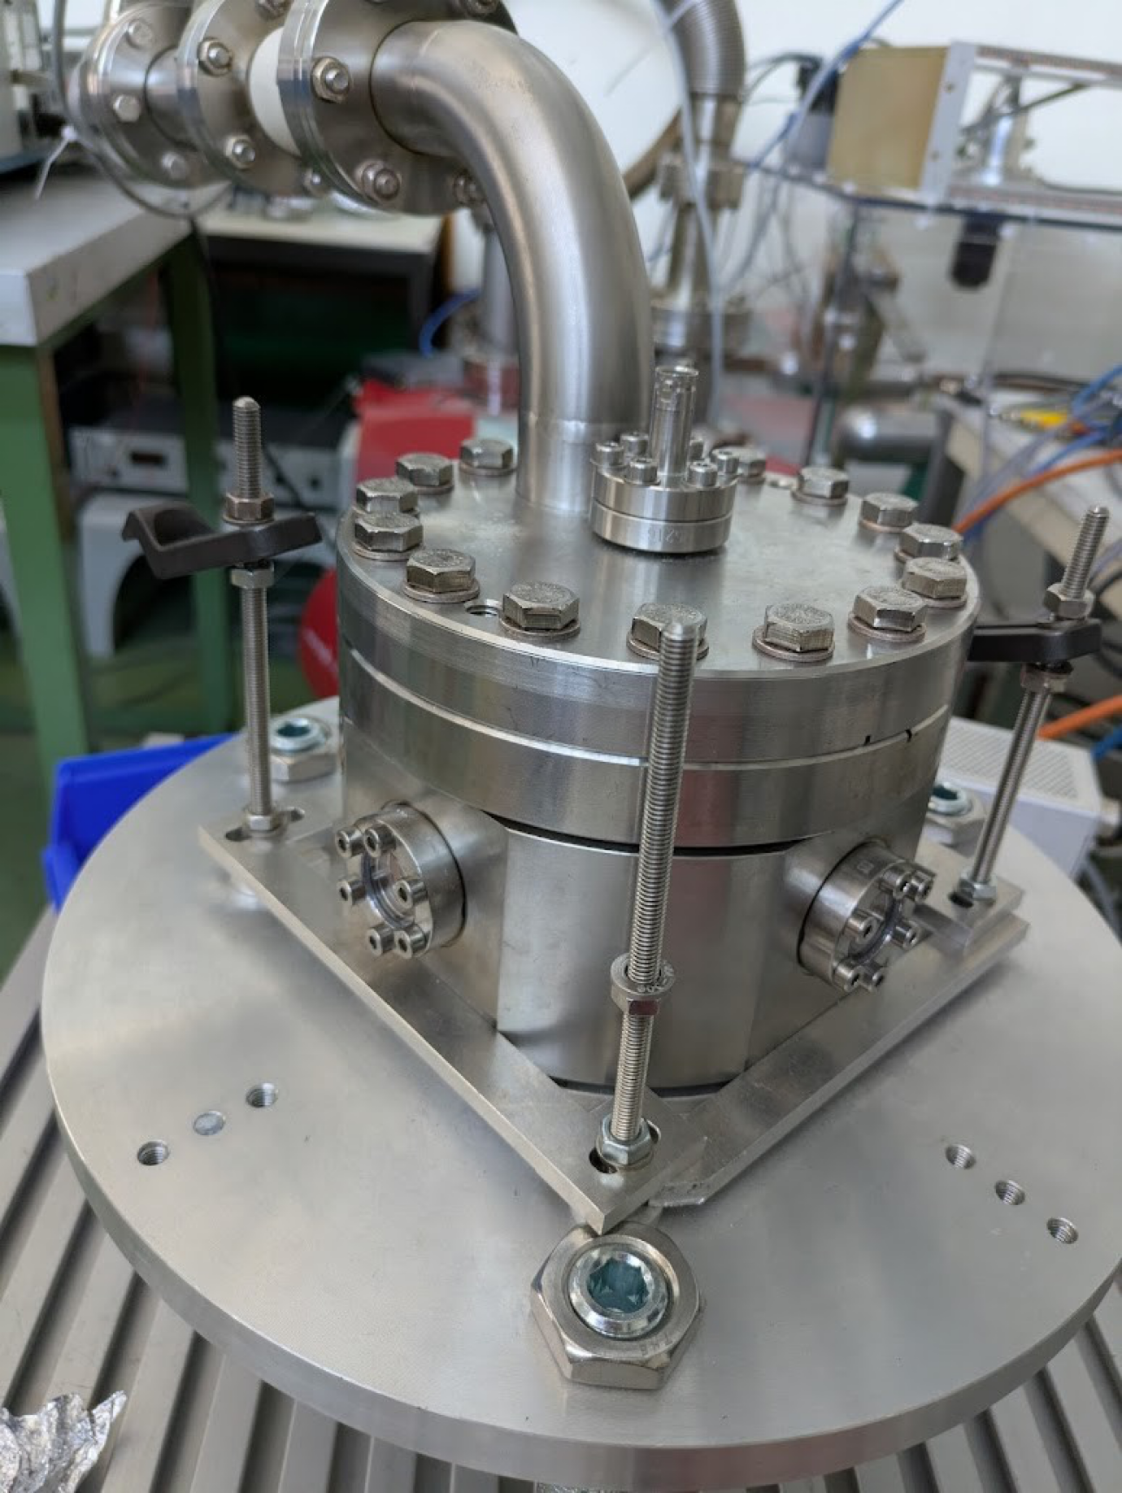
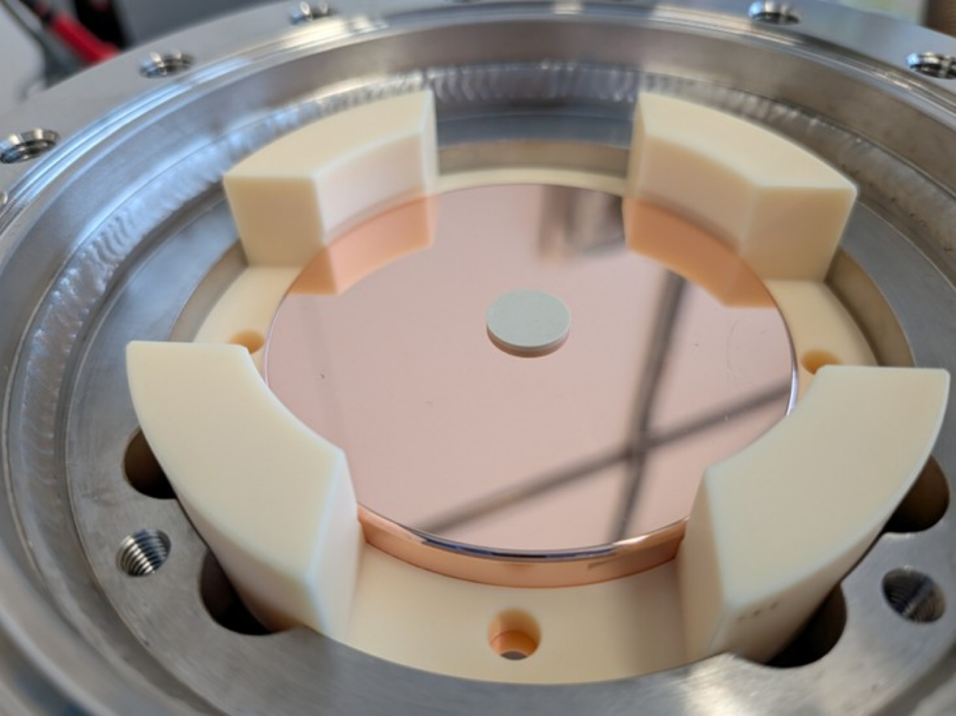
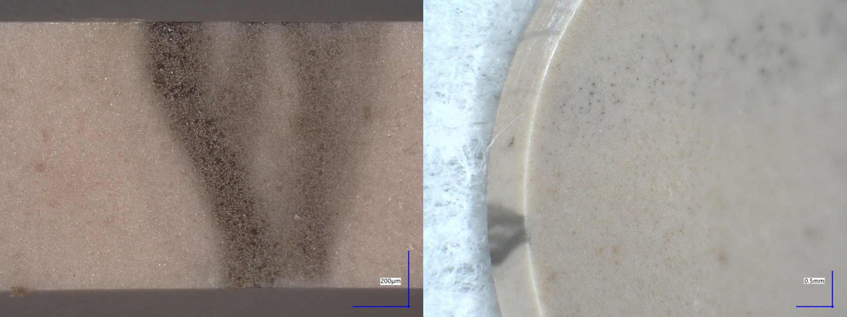
Ferroelectric Material: Characterisation
Material Characterisation in 400 MHz -900 MHz range Completed (1.3 GHz under test by Nick, HZB )
    Designed/fabricated RF structure for DC and RF measurement of complex permittivity
      Initial measurements on reference dielectrics and ferroelectric material: DONE
Cross calibration measurements in CERN’s Fixed-Gap biasing system
    DC & pulsed bias breakdown: ongoing triple-point breakdown geometry optimisation
      Detailed measurement campaign in Q3 2026
Fixed-Gap System
FE Triple point breakdown
Thanks and acknowledgments to Sam Smith(CERN)

Slide 8
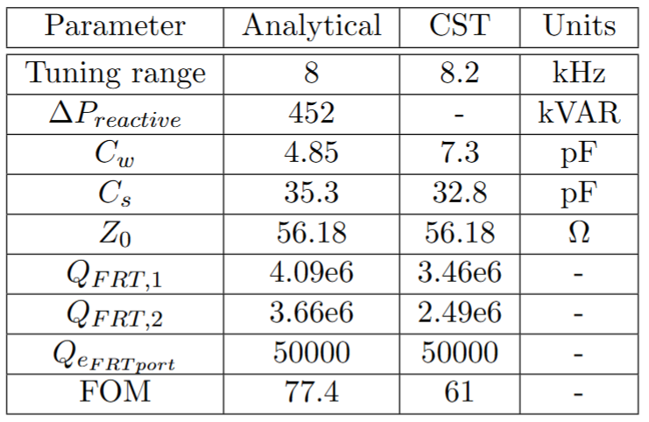
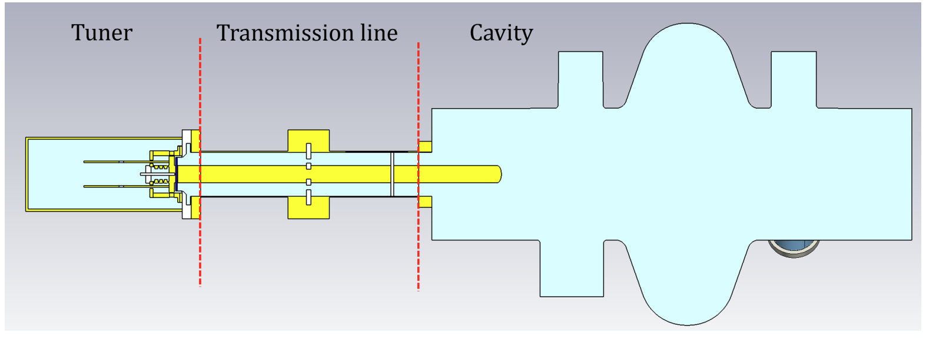
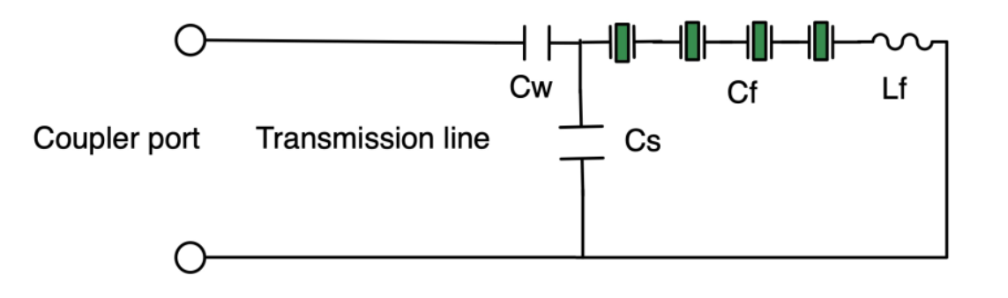
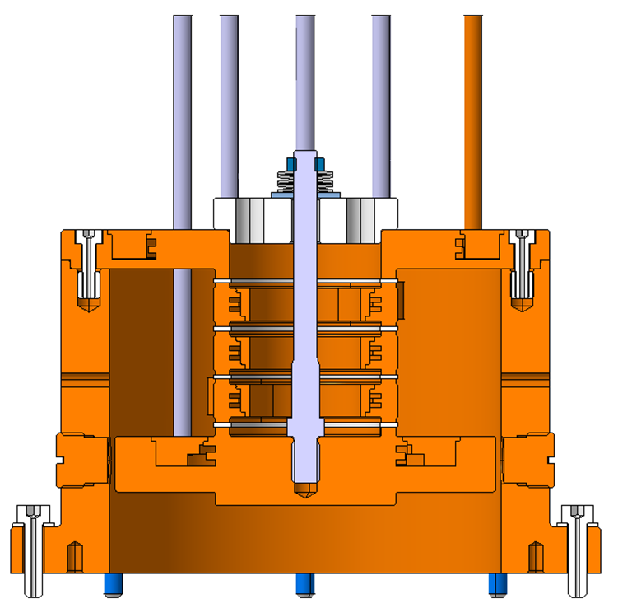
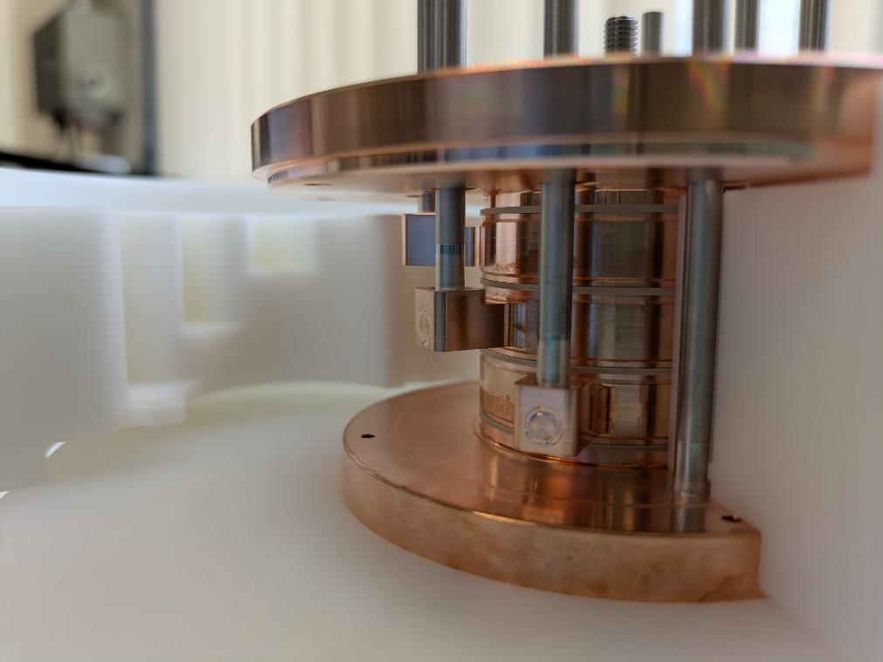
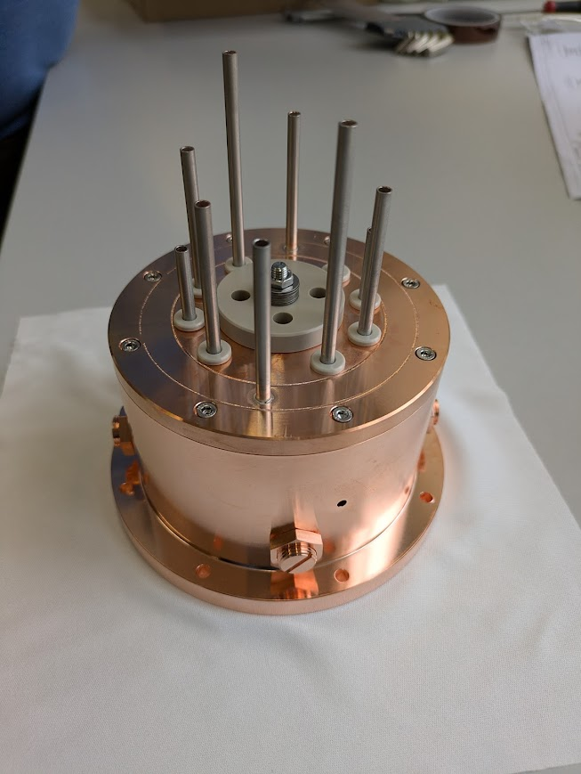
The Transient Detuning Demonstrator(TDD) tuner: RF Design
Discrete frequency switching on a 400 MHz cavity using an FE-FRT
Tuner Circuit
FE wafer stack
Overhang to mitigate breakdown
Integrated electrode cooling
controls dissipated power in FE
5 MPa Compression system
Un-brazed FE stack assembly
FE Wafers
Manual resonator tuning
Tuning screws to center tuner on f0
Thanks and acknowledgments to Sam Smith(CERN)

Slide 9
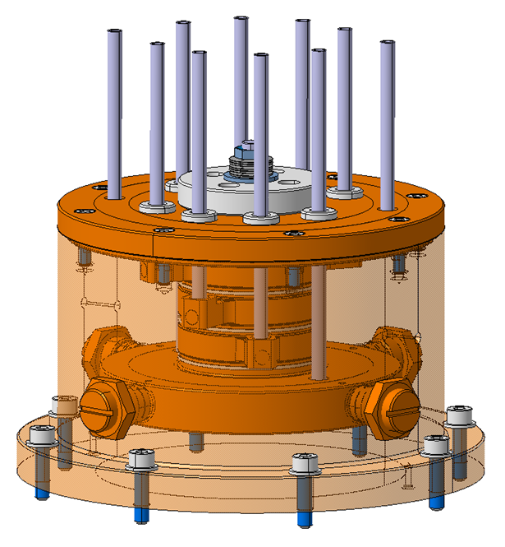
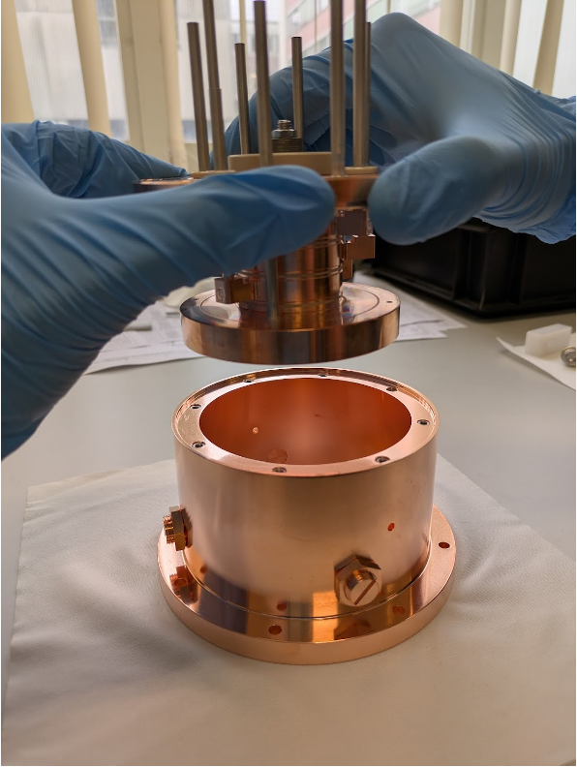
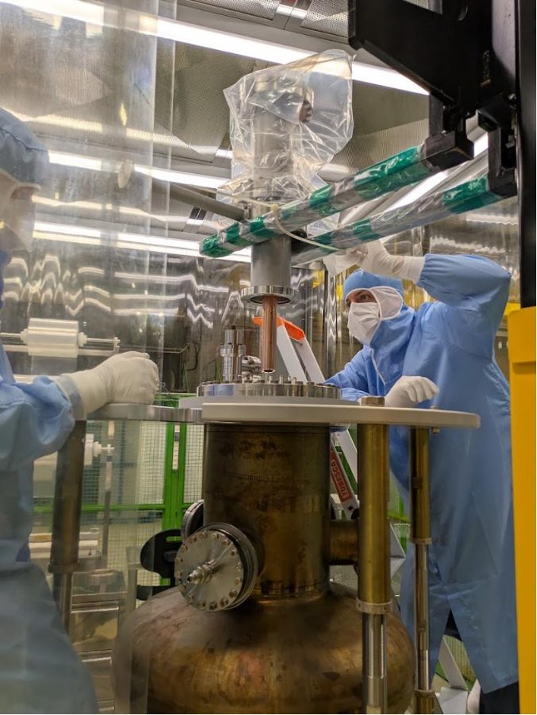
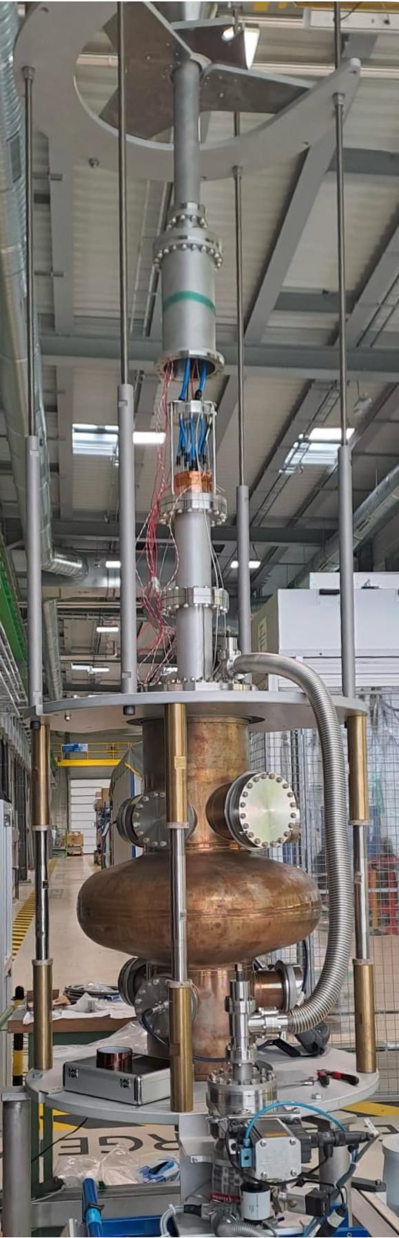
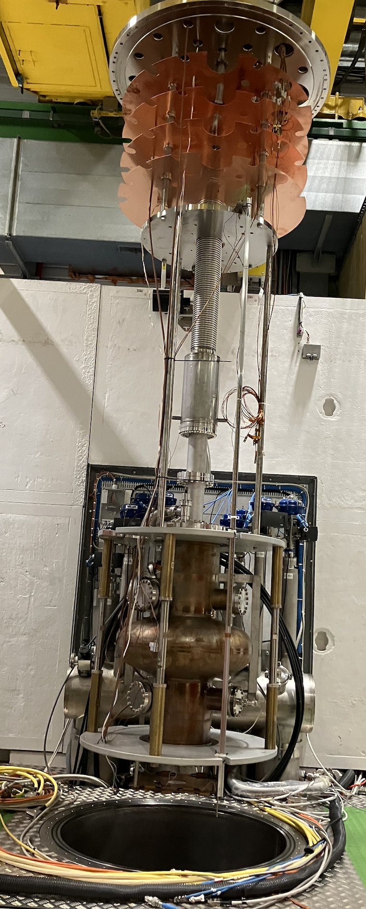
TDD : Initial warm and cold RF measurements
Assembly
Measure @ warm
Cold Test
Warm test: CST: Expect freq shift @300K from ε_{r} = 120 to 173 = 3.3 kHz
Cold test: Tuner @ 4.2 K: QFRT tuning
Sensitive to cryostat pressures
QFRT
3 kHz
Δf0
Thanks and acknowledgments to Sam Smith(CERN)

Slide 10
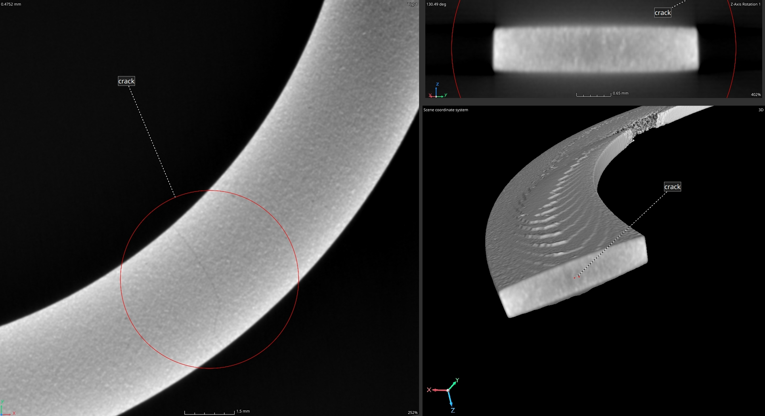
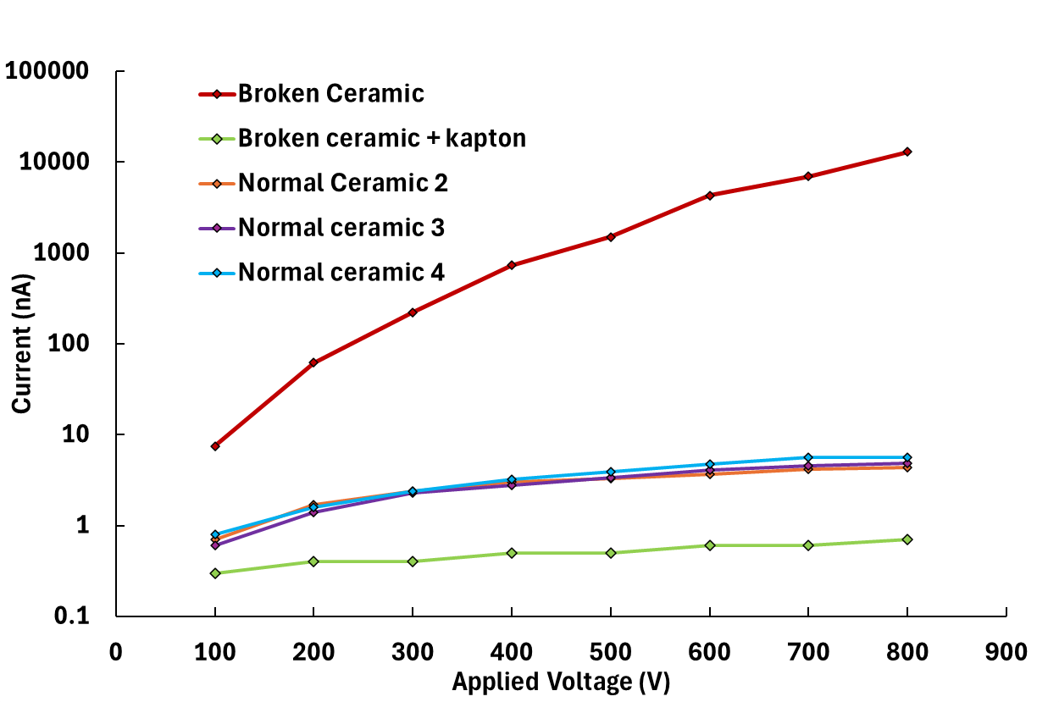
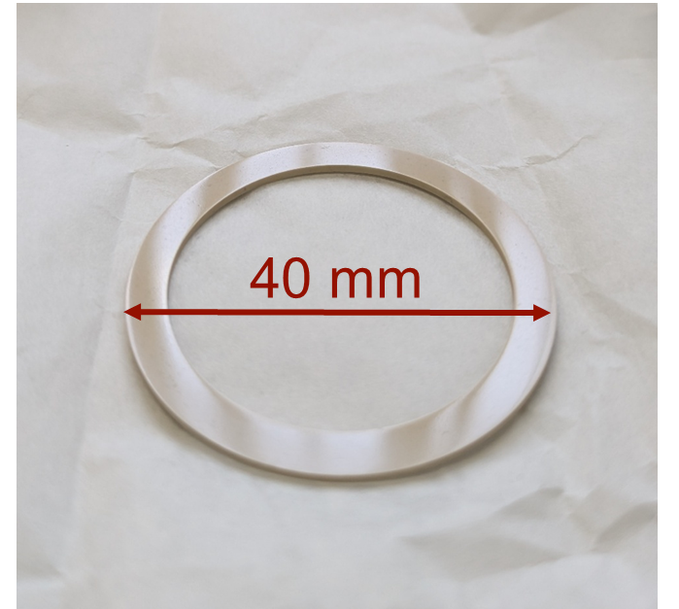
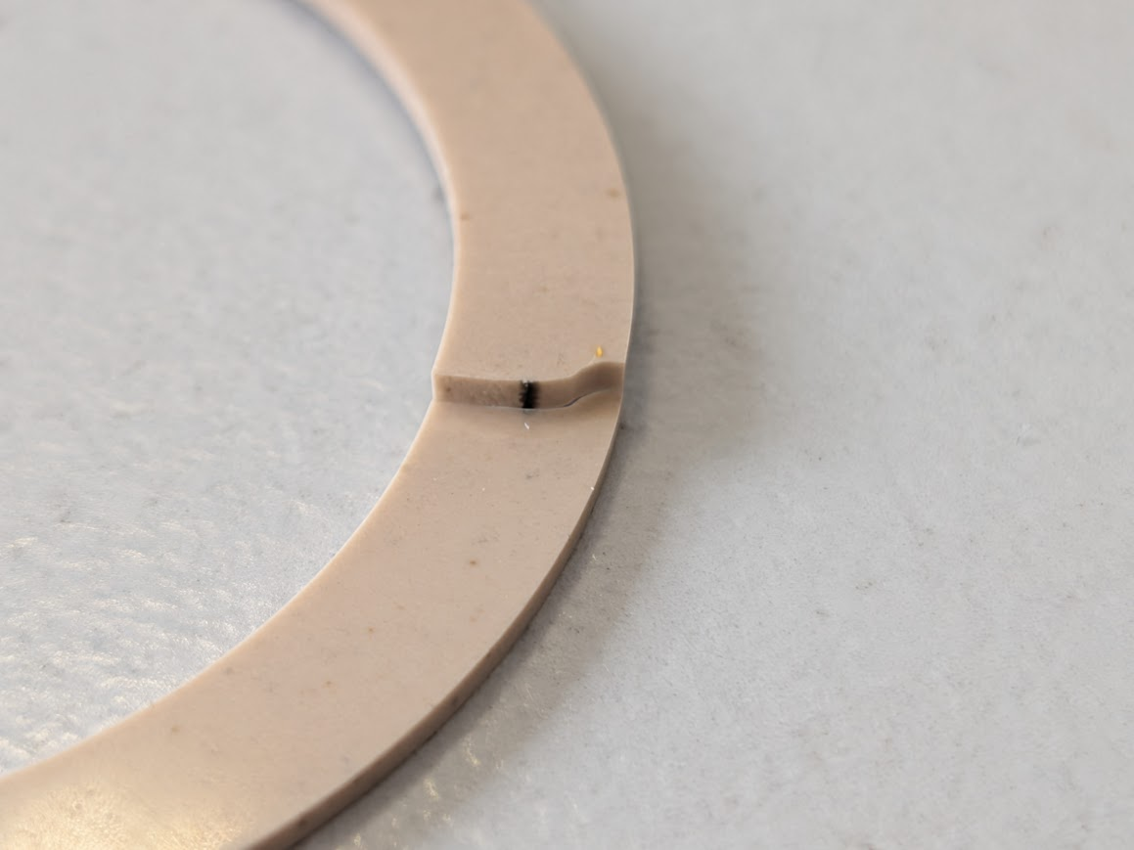
Ceramic issues
Bias voltage limited to 3kV during testing
CT scan revealed cracks in the ceramic which eventually led to breakdowns
The disk has been replaced and the others checked for cracks
Crack
Leakage current measured through ceramic
Breakdown path
Thanks and acknowledgments to Sam Smith(CERN)

Slide 11
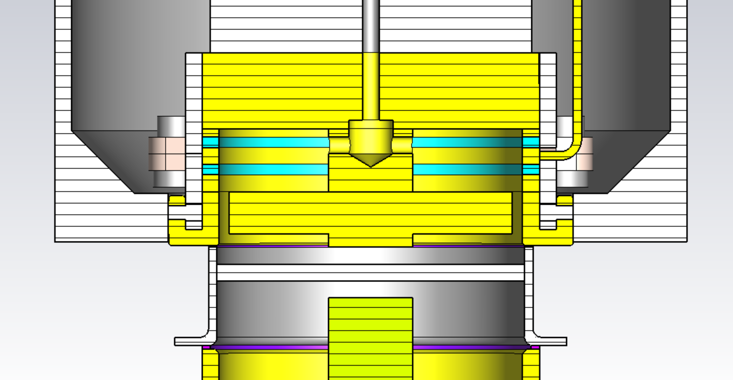
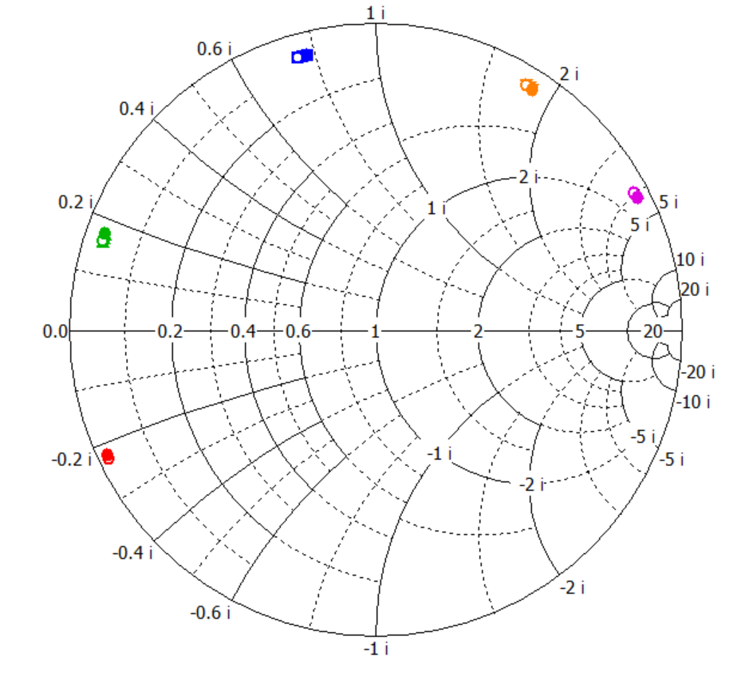
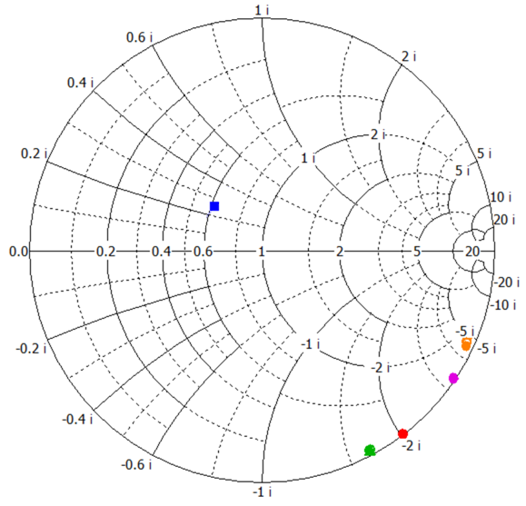
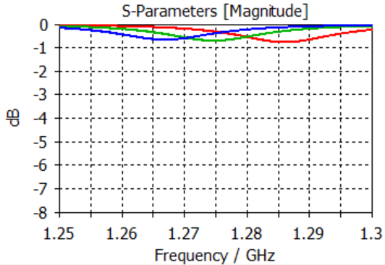
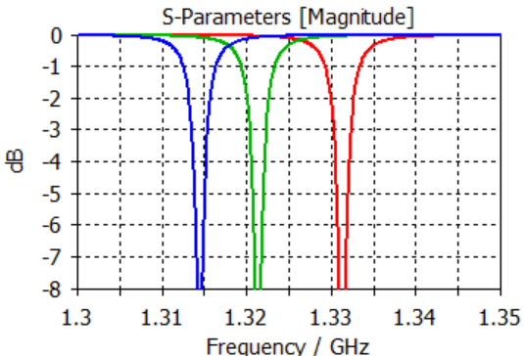

FRT – for Microphonics
Tuning capacitance/inductances/(FE wafer)
  Adjusted to give correct resonance
Window capacitance/phase change
Want highly over-couple
  Adjusted to give correct coupling
Everything effects everything else
Want good FoM and realistically buildable design
Strategy:
  Incorporate mechanical design elements early
  Change a parameter → reoptimize tuning cap → calculate FoM
  Simulate in f-domain without cavity
  Decouples antenna length and transmission line length
Tuning capacitance
Window capacitance
Thanks and acknowledgments to N. Shipman(HZB)
Window Cap Gap = 1mm
Window Cap Gap = 4mm
Effect of adjusting window capacitance. Direction of arrow direction of increasing permittivity.
Effect of adjusting window capacitance.

Slide 12
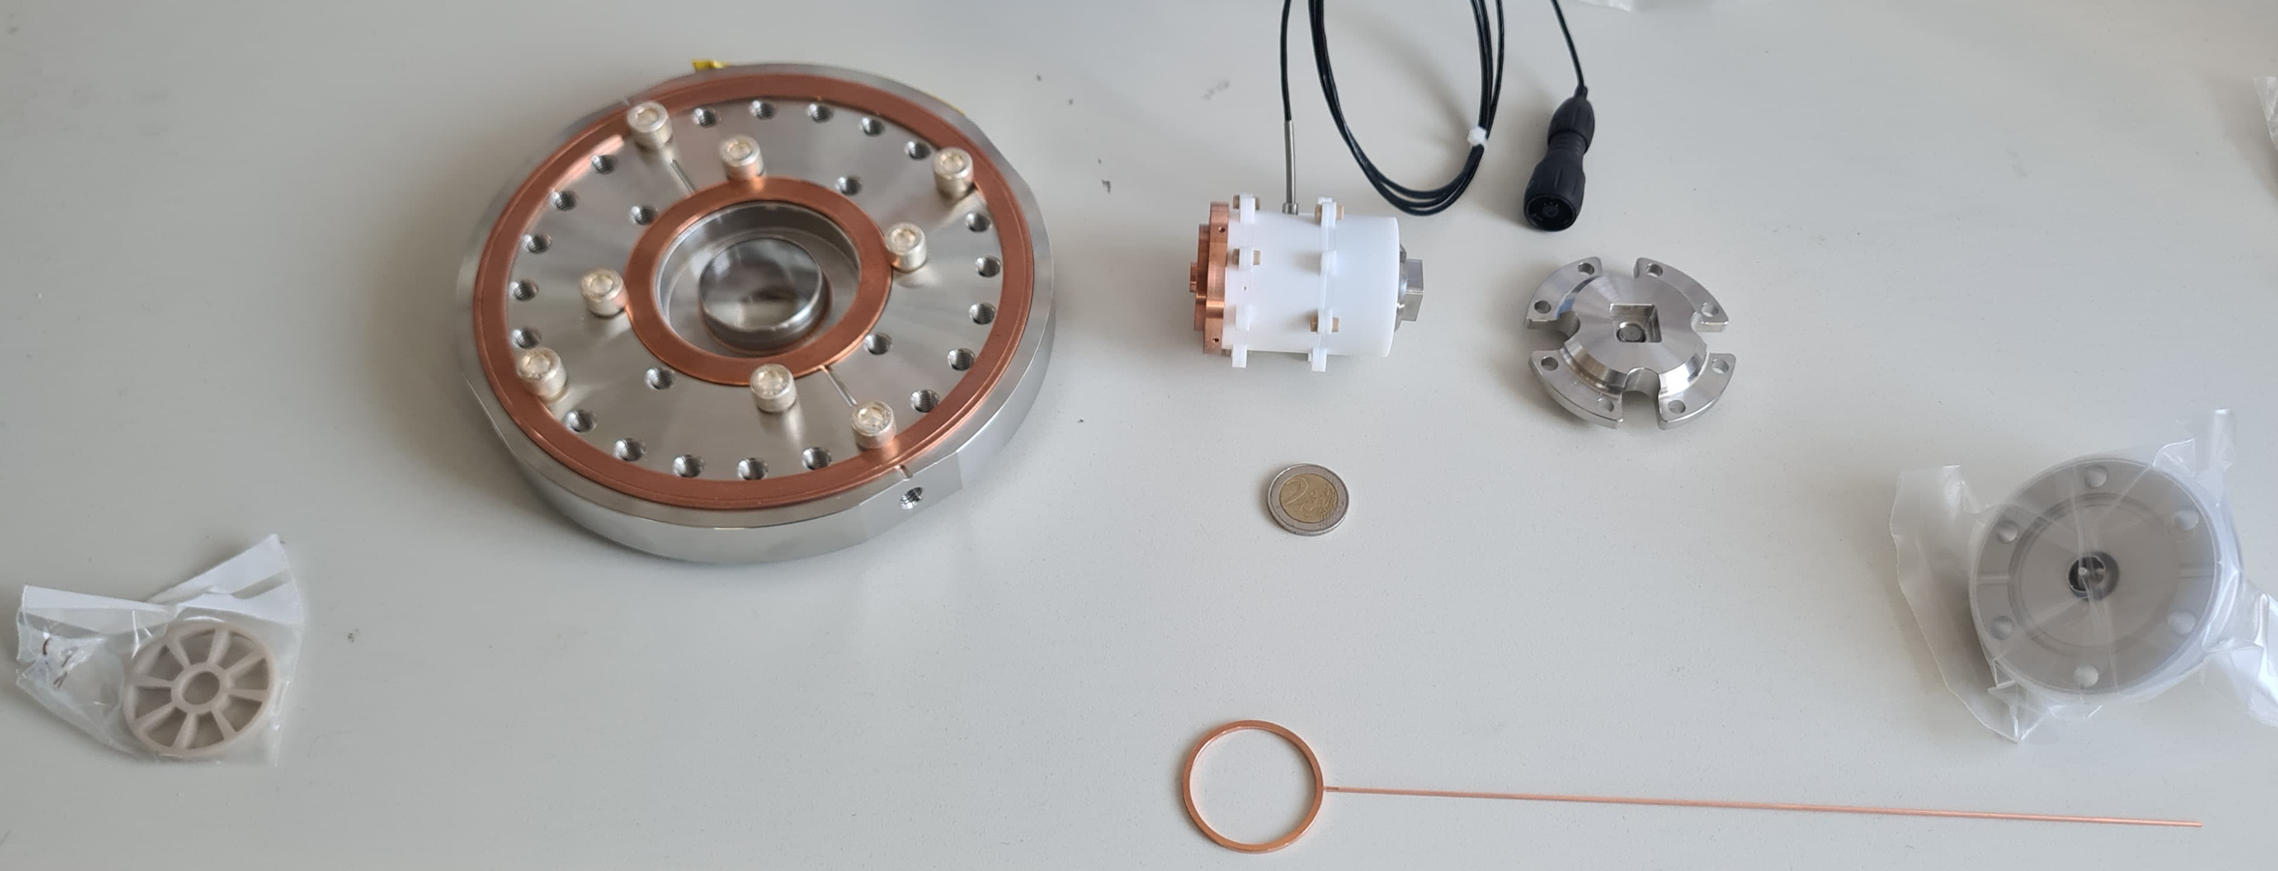
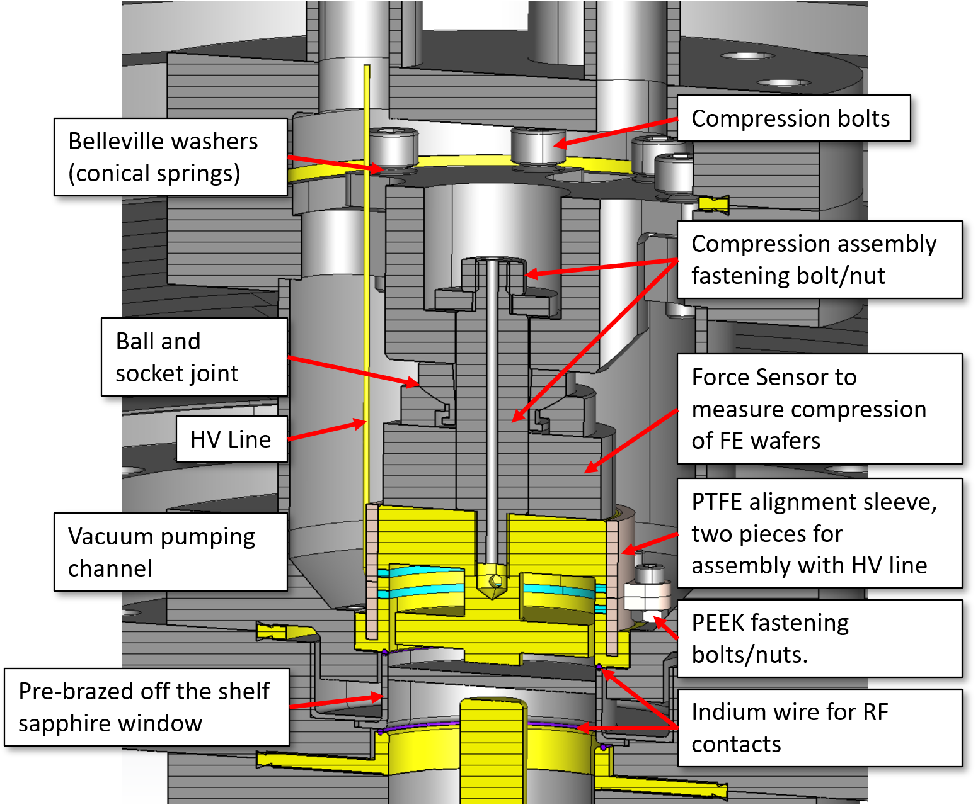
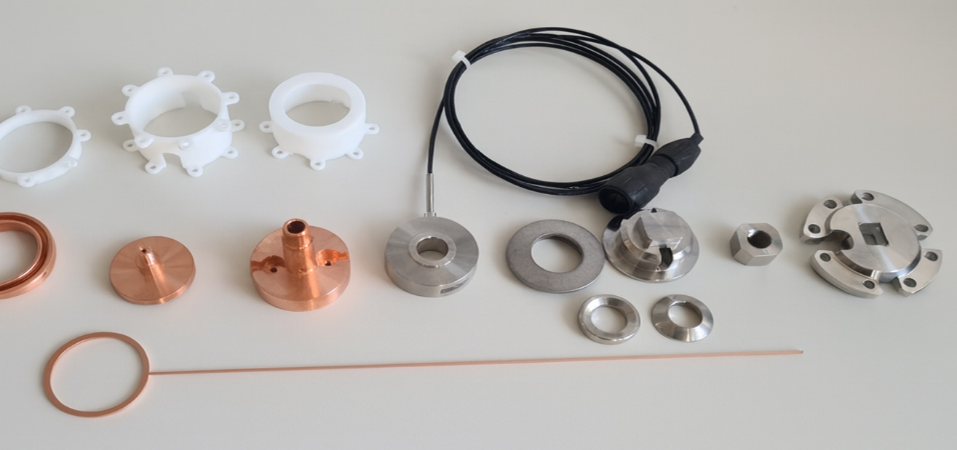
FRT – Mechanical design
2 euro coin
FE-FRT parts left to right: antenna holder, bottom flange with sapphire window, main stack, top of compression assembly, HV feedthrough. Bottom: HV electrode.
Slightly outdated cutaway view of mechanical design.
Thanks and acknowledgments to N. Shipman and A. Frahm(HZB).
Disassembled stack. Top: PTFE sleeve. Middle left to right: Lower electrode, inner conductor, top electrode, compression sensor, belleville washers, ball and socket joint, top parts of compression assembly. Bottom: HV electrode. Not shown: heater catridge, FE wafers.

Slide 13
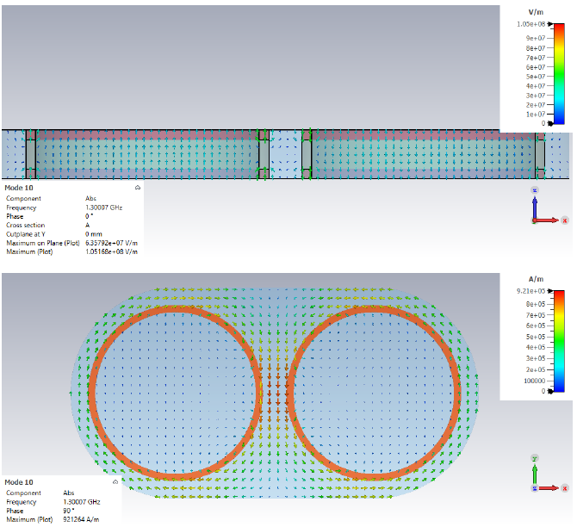
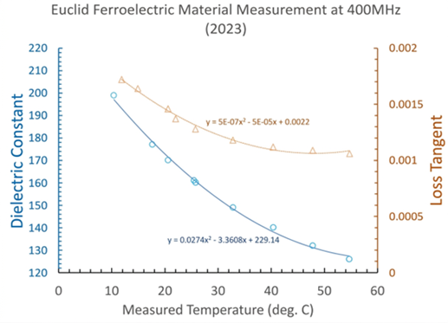
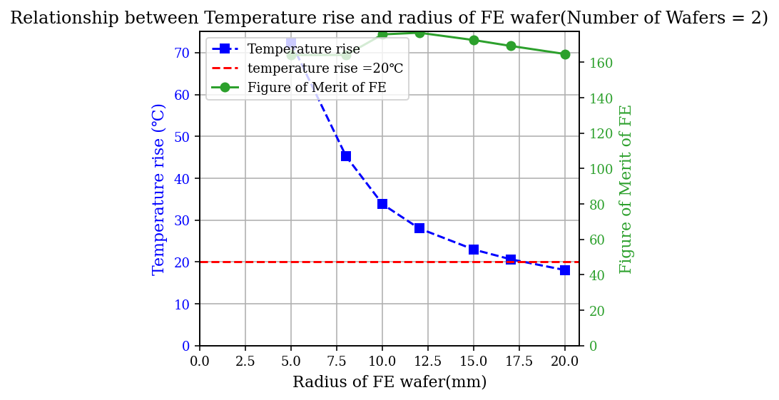
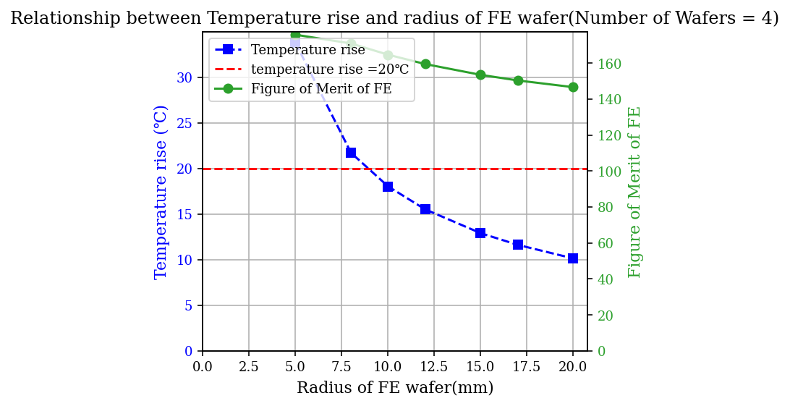
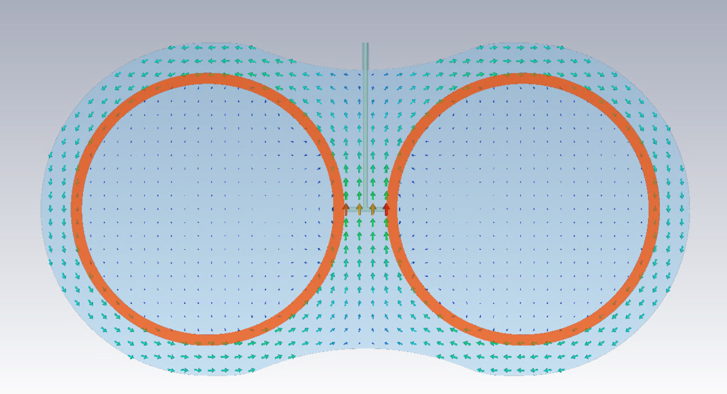
The novel FE-FRT RF design
The Twin-axial type FE-FRT
  The self-consistent temperature rise calculations
  The T shape bias High voltage without RF leakage
    Qe~10¹⁰

Slide 14
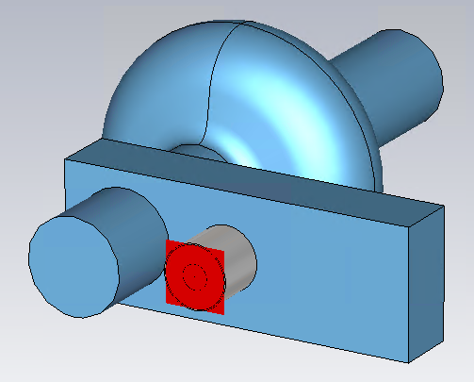
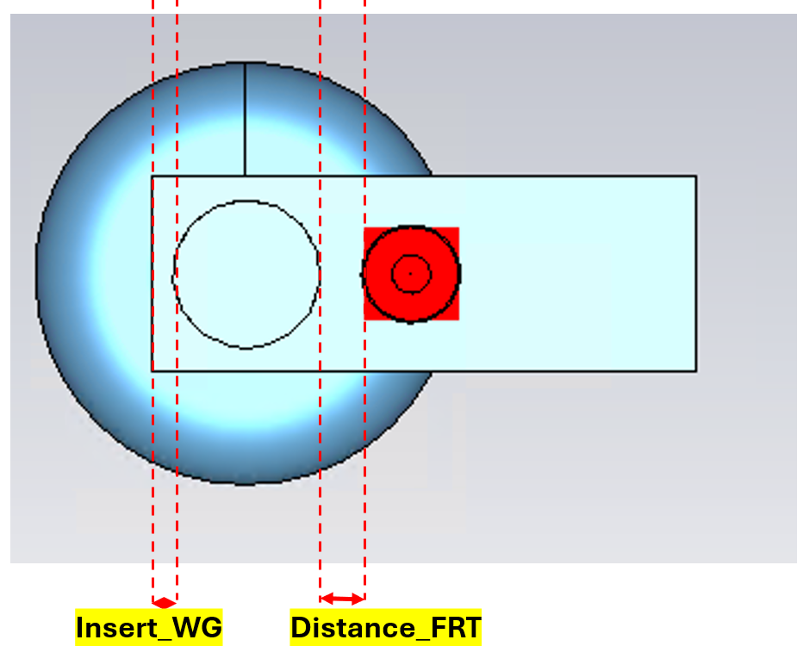
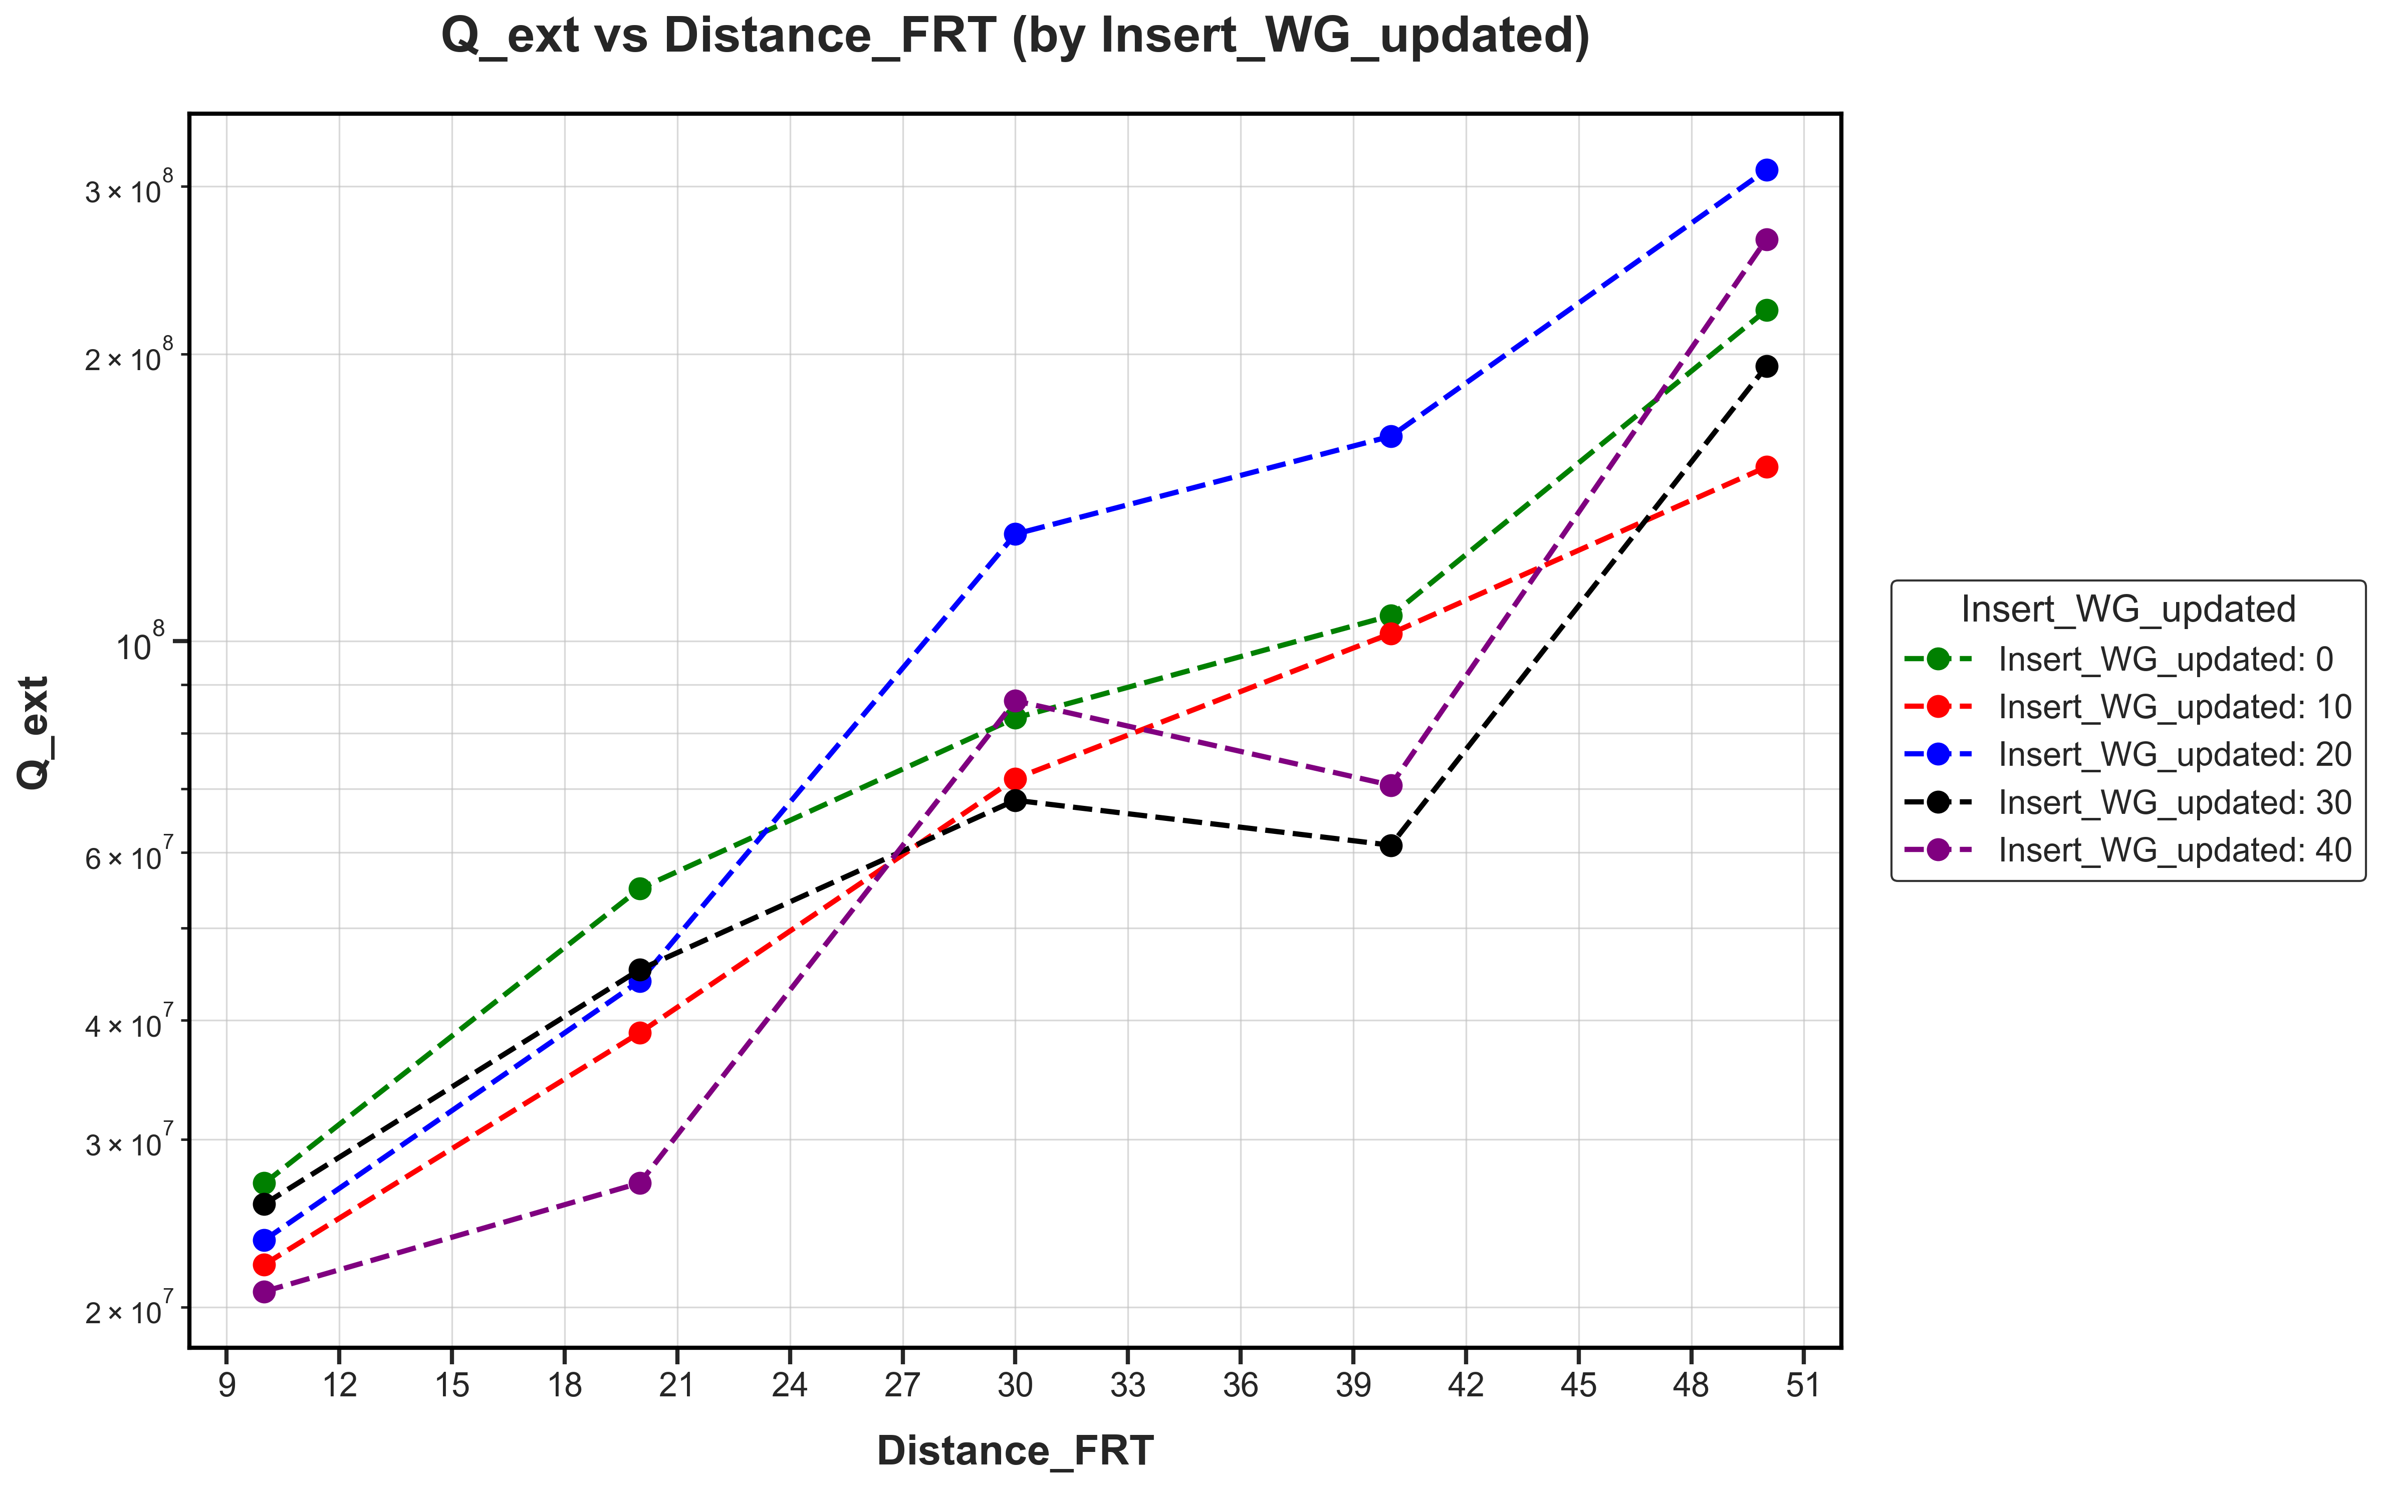
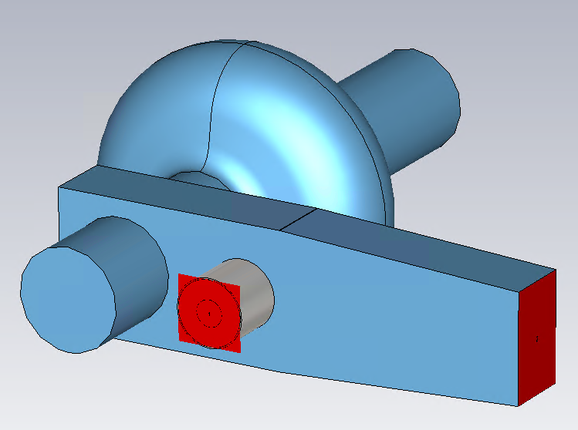
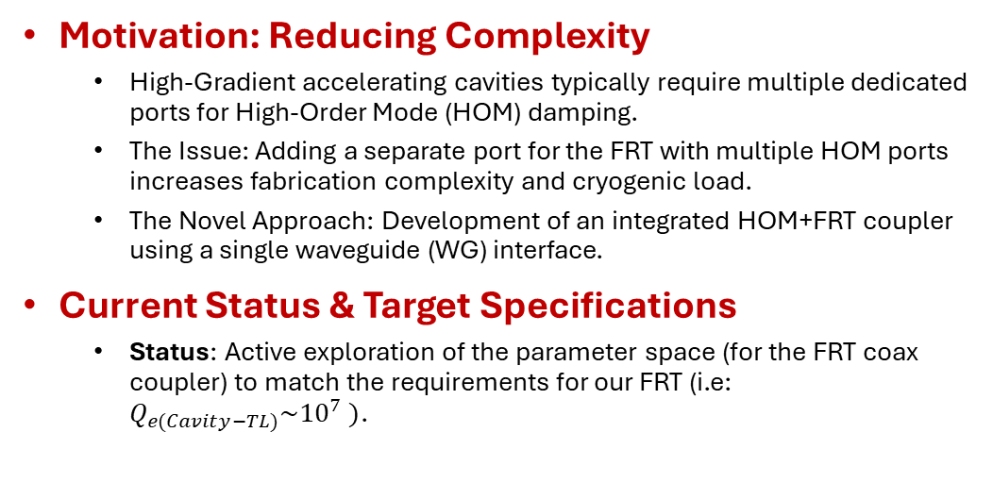
Integrated FRT+HOM Waveguide Coupler Design
Motivation: Reducing Complexity
  High-Gradient accelerating cavities typically require multiple dedicated ports for High-Order Mode (HOM) damping.
  The Issue: Adding a separate port for the FRT with multiple HOM ports increases fabrication complexity and cryogenic load.
  The Novel Approach: Development of an integrated HOM+FRT coupler using a single waveguide (WG) interface.
Current Status & Target Specifications
  Status: Active exploration of the parameter space (for the FRT coax coupler) to match the requirements for our FRT (i.e: ${Q_{e(Cavity−TL)}\sim 10}^{7} )$.
Active exploration of the parameter space
Thanks and acknowledgments to Maleesh(Lancaster University)

Slide 15





Next Steps: Move to RF power handling
Situation: Cold Cavity + tuner: too much infrastructure and logistics
Solution: Move to FE Phase shifter as test device
  FEPSID_1.0:Initial prototype made and tested. 2-wafer design
  FEPSID_1.2: Modified to 1-wafer design. Modification going to central workshop
  FEPSID_2.0: High power design: Single wafer deign targeting 100kW
RF
Circulator
FEPSID
Load
Scope

Slide 16
Thank you for your attention
Any questions?

