Slide 1


Reduced BCS Resistance and Stable Medium- Field Operation from Nb₃Al-Nb S'S Multilayer
June 9th, 2026
TTC 2026 Meeting, CEA-CNRS-Université Paris Saclay
Nathan Sitaraman, Zhaslan Baraissov, Alexis Grassl, David A. Muller, and Matthias Liepe

Slide 2
Outline
Background
  Review of Nb₃Al
  Review of test setup for flat sample plates
Results
  Overview of RF data
  Overview of temperature-mapping data
Sample analysis
  Big defects
  Small defects
Next steps

Slide 3
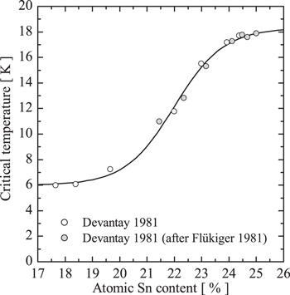
Nb₃Al for SRF
Minimum A15-phase Tc 10-11K, vs. 5-6K for tin-depleted Nb₃Sn
Moehlecke et. al. Nb₃Al
Nb₃Sn

Slide 4
Nb₃Al for SRF
Minimum A15-phase Tc 10-11K, vs. 5-6K for tin-depleted Nb₃Sn

Slide 5
Nb₃Al for SRF
Minimum A15-phase Tc 10-11K, vs. 5-6K for tin-depleted Nb₃Sn

Slide 6
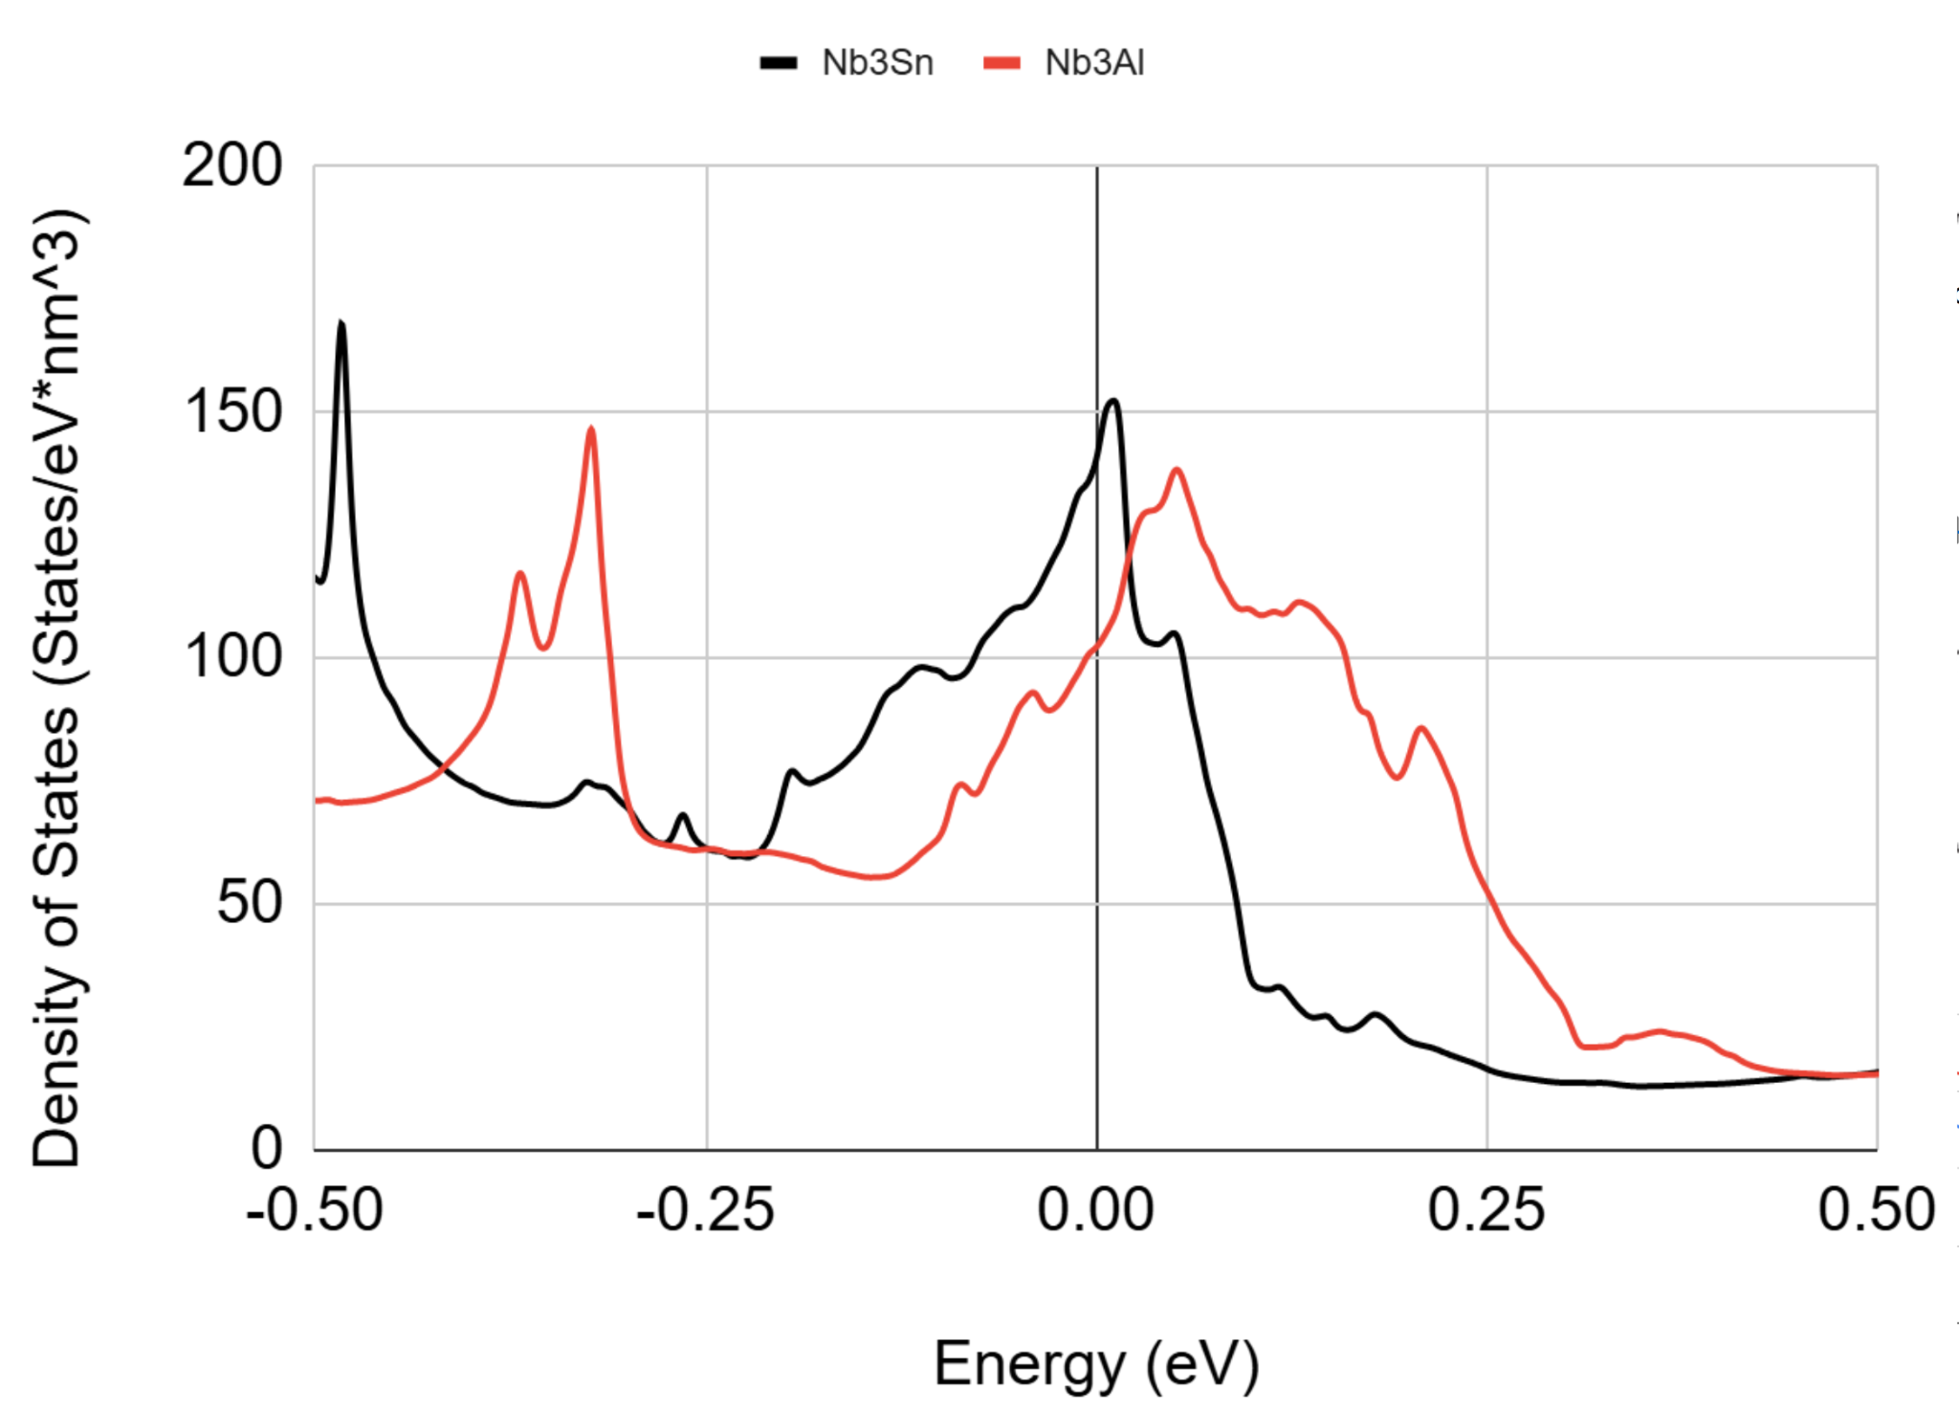
Nb₃Al for SRF
Minimum A15-phase Tc 10-11K, vs. 5-6K for tin-depleted Nb₃Sn
Why?

Slide 7
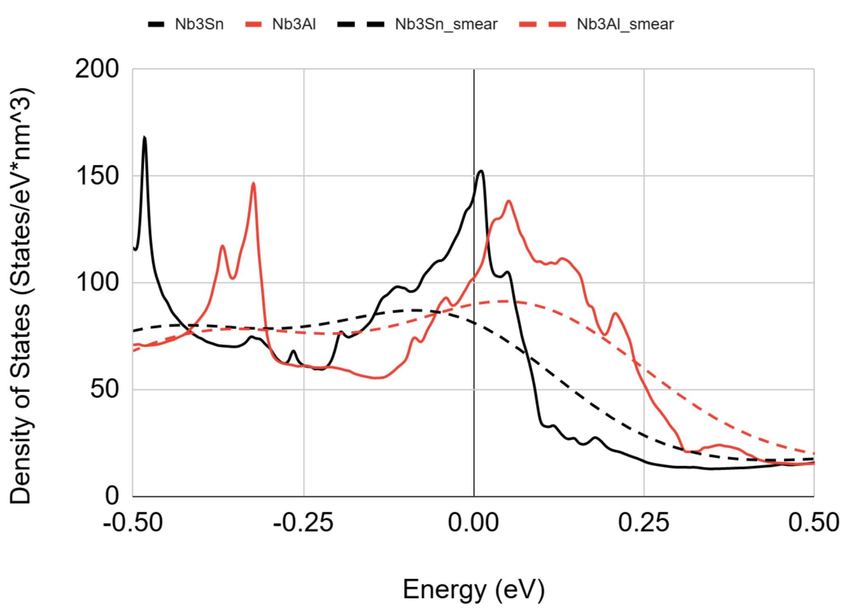
Nb₃Al for SRF
Minimum A15-phase Tc 10-11K, vs. 5-6K for tin-depleted Nb₃Sn
Why?
Slight difference in electronic structure makes Nb₃Al Tc less sensitive to disorder

Slide 8
Nb₃Al for SRF
Minimum A15-phase Tc 10-11K, vs. 5-6K for tin-depleted Nb₃Sn
Why?
Slight difference in electronic structure makes Nb₃Al Tc less sensitive to disorder
Disorder effect on Fermi-level density of states 3x smaller for Nb₃Al

Slide 9
Nb₃Al for SRF
Minimum A15-phase Tc 10-11K, vs. 5-6K for tin-depleted Nb₃Sn
Why?
Slight difference in electronic structure makes Nb₃Al Tc less sensitive to disorder
Ok, but why multilayer?

Slide 10
Nb₃Al for SRF
Minimum A15-phase Tc 10-11K, vs. 5-6K for tin-depleted Nb₃Sn
Why?
Slight difference in electronic structure makes Nb₃Al Tc less sensitive to disorder
Ok, but why multilayer?
  Al depletion at interface not a big concern, so high performance with ultra-thin layer possible!

Slide 11
Nb₃Al for SRF
Minimum A15-phase Tc 10-11K, vs. 5-6K for tin-depleted Nb₃Sn
Why?
Slight difference in electronic structure makes Nb₃Al Tc less sensitive to disorder
Ok, but why multilayer?
  Al depletion at interface not a big concern, so high performance with ultra-thin layer possible!
  Thin layer improves thermal stability, less roughness/defect prone than thick layers?

Slide 12
Nb₃Al for SRF
Minimum A15-phase Tc 10-11K, vs. 5-6K for tin-depleted Nb₃Sn
Why?
Slight difference in electronic structure makes Nb₃Al Tc less sensitive to disorder
Ok, but why multilayer?
  Al depletion at interface not a big concern, so high performance with ultra-thin layer possible!
  Thin layer improves thermal stability, less roughness/defect prone than thick layers?
  S’S physics is cool??

Slide 13
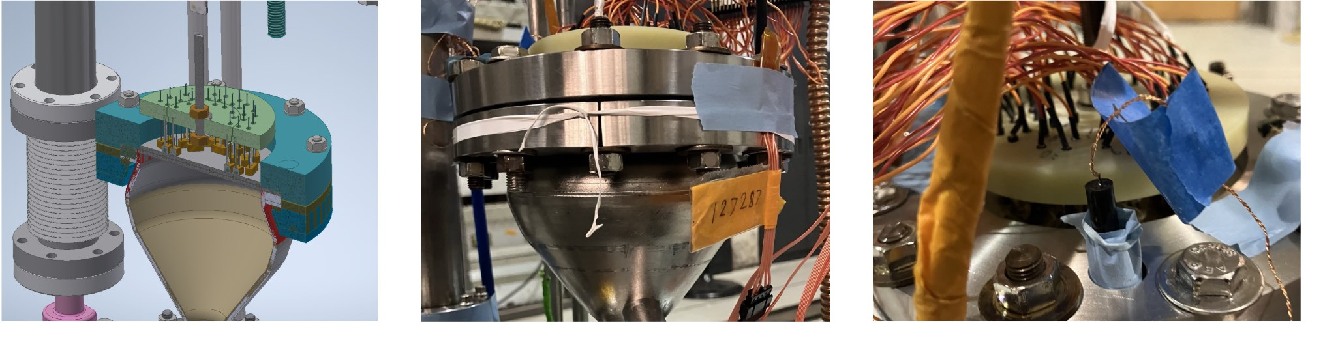
Sample host cavity (~4GHz, TE011 mode, G = 802Ω)
Host (120C baked) has very low R at low T

Slide 14
Sample host cavity (~4GHz, TE011 mode, G = 802Ω)
Host (120C baked) has very low R at low T
Can extract residual resistance of plate from low-T data

Slide 15
Sample host cavity (~4GHz, TE011 mode, G = 802Ω)
Host (120C baked) has very low R at low T
Can extract residual resistance of plate from low-T data
Host has similar/higher R to plate at 4.2K

Slide 16
Sample host cavity (~4GHz, TE011 mode, G = 802Ω)
Host (120C baked) has very low R at low T
Can extract residual resistance of plate from low-T data
Host has similar/higher R to plate at 4.2K
Need to use T-map to extract BCS resistance of sample plate

Slide 17
Results
note: RF penetration depth expected to be at least 100nm
Sample | Quench field | Estimated residual | Estimated 4.2K BCS
~200nm Nb₃Al
~400nm Nb₃Al
~400nm Nb₃Al + chemistry

Slide 18
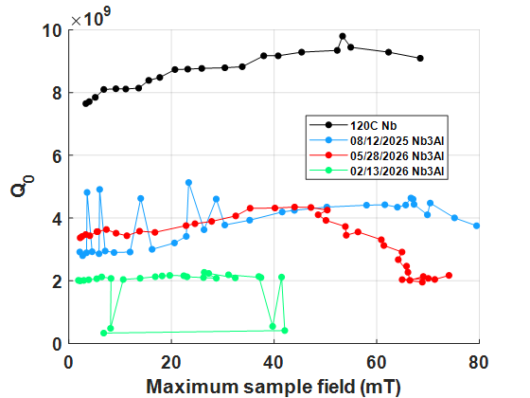
Results
note: RF penetration depth expected to be at least 100nm
Sample | Quench field | Estimated residual | Estimated 4.2K BCS
~200nm Nb₃Al | >80mT (quench on host)
~400nm Nb₃Al | 41mT (quench on defect)
~400nm Nb₃Al + chemistry | 74mT (limited by Q-slope)

Slide 19
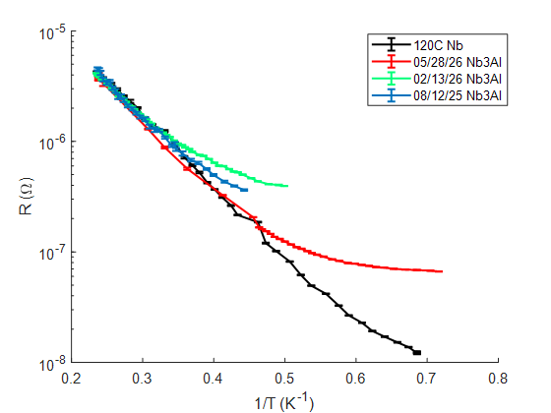
Results
note: RF penetration depth expected to be at least 100nm
Sample | Quench field | Estimated residual | Estimated 4.2K BCS
~200nm Nb₃Al | >80mT (quench on host) | ~1.0µΩ (preliminary)
~400nm Nb₃Al | 41mT (quench on defect) | ~2.0µΩ (preliminary)
~400nm Nb₃Al + chemistry | 74mT (limited by Q-slope) | ~0.4µΩ (preliminary)
Note: low-field R decreased after taking high-field data. Trapped flux moved around…?

Slide 20
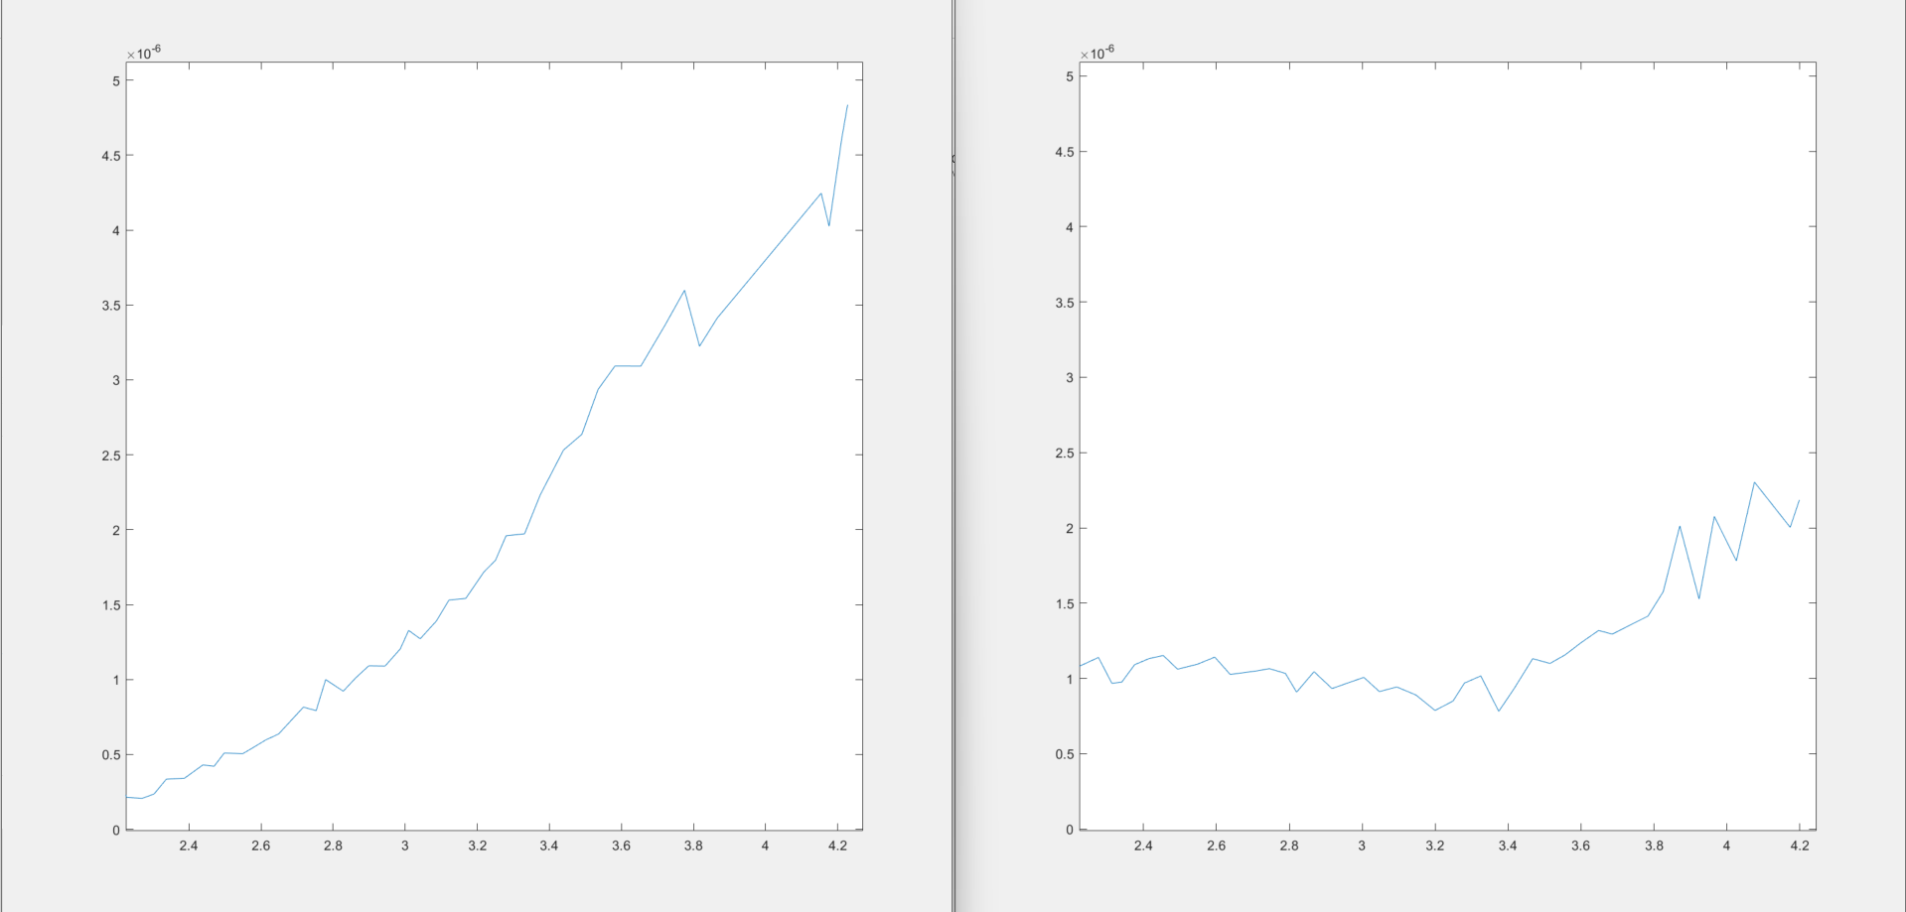
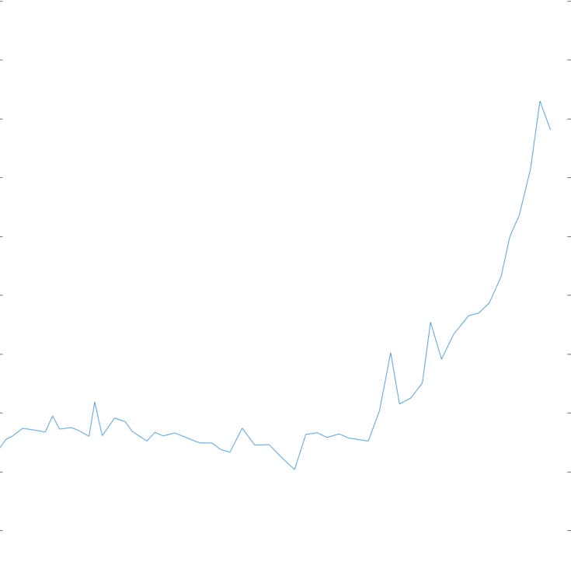
Results
Baseline Nb
Change in normalized T-map heating from 4.2K to 2.2K corresponds to BCS resistance
400nm Nb₃Al + chemistry
400nm Nb₃Al
Normalized T-map heating
2.2 3.2 4.2
2.2 3.2 4.2
2.2 3.2 4.2
note: RF penetration depth expected to be at least 100nm
Temperature (K)
Temperature (K)
Temperature (K)
Sample | Quench field | Estimated residual | Estimated 4.2K BCS
~200nm Nb₃Al | >80mT (quench on host) | ~1.5µΩ (preliminary) | not measured
~400nm Nb₃Al | 41mT (quench on defect) | ~2.0µΩ (preliminary) | ~1.0µΩ (very preliminary)
~400nm Nb₃Al + chemistry | 74mT (limited by Q-slope) | ~0.4µΩ (preliminary) | ~2.7µΩ (very preliminary)

Slide 21
Results
Baseline Nb
Change in normalized T-map heating from 4.2K to 2.2K corresponds to BCS resistance
400nm Nb₃Al + chemistry
400nm Nb₃Al
Normalized T-map heating
2.2 3.2 4.2
2.2 3.2 4.2
2.2 3.2 4.2
note: RF penetration depth expected to be at least 100nm
Temperature (K)
Temperature (K)
Temperature (K)
Sample | Quench field | Estimated residual | Estimated 4.2K BCS
~200nm Nb₃Al | >80mT (quench on host) | ~1.5µΩ (preliminary) | not measured
~400nm Nb₃Al | 41mT (quench on defect) | ~2.0µΩ (preliminary) | ~1.0µΩ (very preliminary)
~400nm Nb₃Al + chemistry | 74mT (limited by Q-slope) | ~0.4µΩ (preliminary) | ~2.7µΩ (very preliminary)
Clean Nb baseline at 4GHz, 4.2K: ~5µΩ

Slide 22
Results
Baseline Nb
Change in normalized T-map heating from 4.2K to 2.2K corresponds to BCS resistance
400nm Nb₃Al + chemistry
400nm Nb₃Al
Normalized T-map heating
Sample | Quench field | Estimated residual | Estimated 4.2K BCS
~200nm Nb₃Al | >80mT (quench on host) | ~1.5µΩ (preliminary) | not measured
~400nm Nb₃Al | 41mT (quench on defect) | ~2.0µΩ (preliminary) | ~1.0µΩ (very preliminary)
~400nm Nb₃Al + chemistry | 74mT (limited by Q-slope) | ~0.4µΩ (preliminary) | ~2.7µΩ (very preliminary)
Short-term goal | >80mT | <0.4µΩ | <1.0µΩ
Clean Nb baseline at 4GHz, 4.2K: ~5µΩ

Slide 23
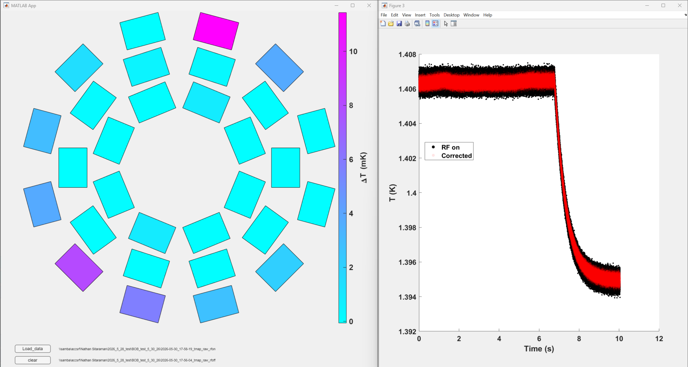
Big defects (400nm plate with chemistry)
At low T, heating concentrated on *outside* of plate, where fields should be lower…

Slide 24
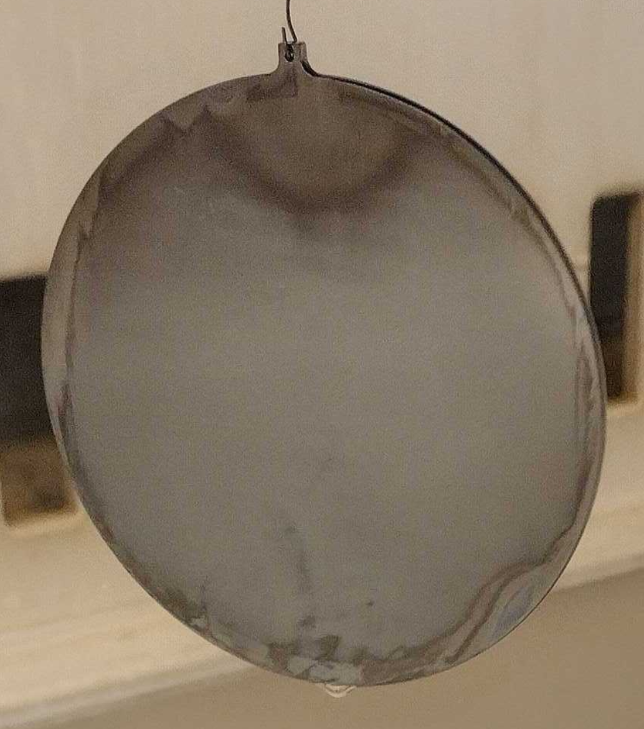
Big defects (400nm plate with chemistry)
At low T, heating concentrated on *outside* of plate, where fields should be lower…
Maybe it has to do with that brown-ish color around the perimeter?

Slide 25
Big defects (400nm plate with chemistry)
At low T, heating concentrated on *outside* of plate, where fields should be lower…
Maybe it has to do with that brown-ish color around the perimeter?
This plate still reached 74mT and Q over 10¹⁰. Potential to do much better!

Slide 26
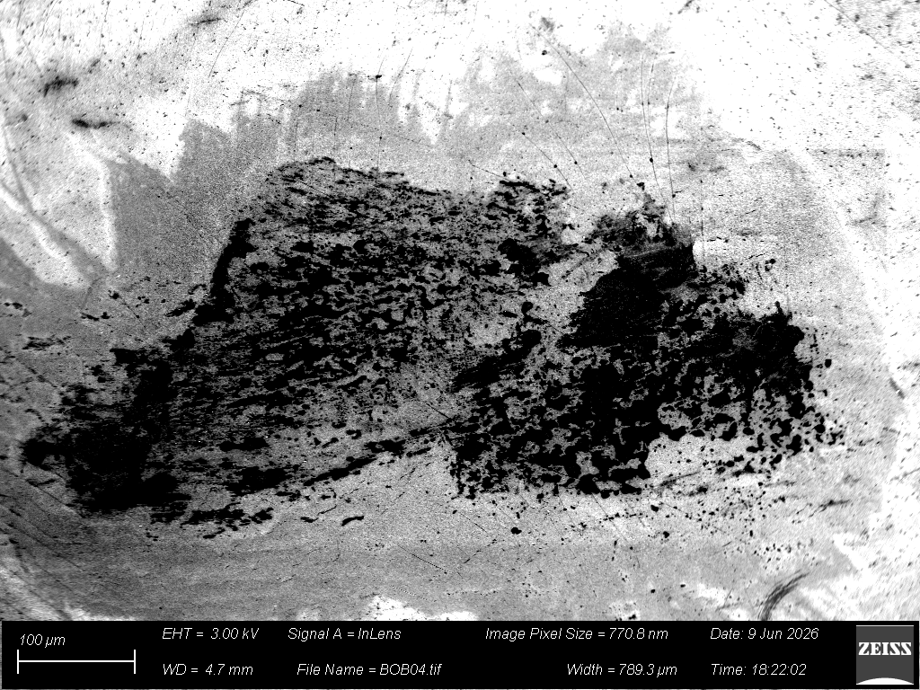
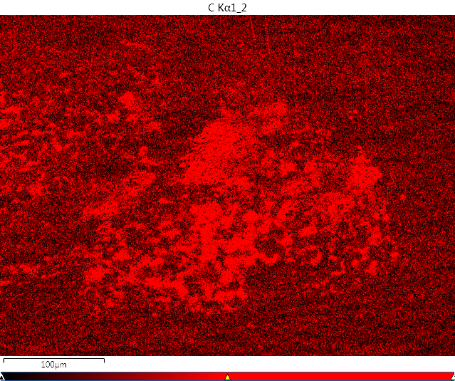
Defect near quench spot (400nm plate without chemistry)
0.78mm
EDS Carbon map

Slide 27
Defect near quench spot (400nm plate without chemistry)
0.78mm
EDS Carbon map

Slide 28
Defect near quench spot (400nm plate without chemistry)
0.78mm
Likely a dust particle that got baked into the sample plate?

Slide 29
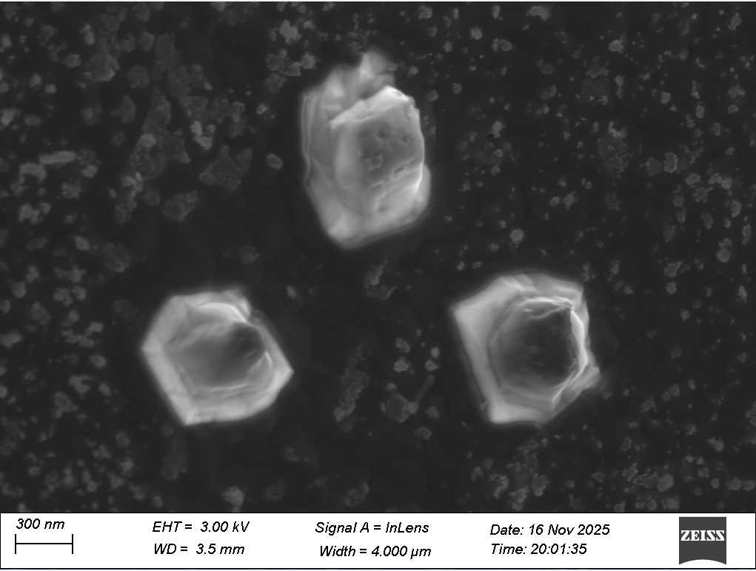
Smaller defects (seen on all samples)

Slide 30
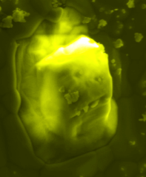
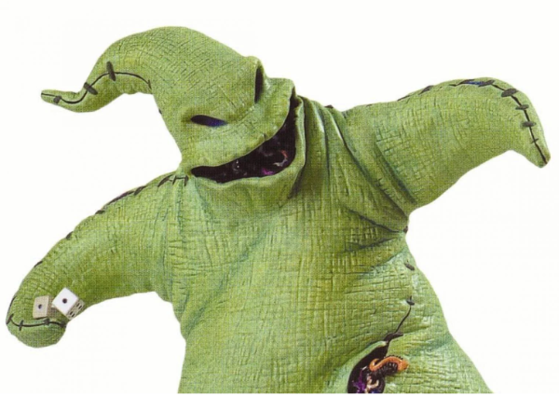
Smaller defects (seen on all samples)
Oogie Boogie
(Al₂O₃?)
Oogie Boogie
(baseline from The Nightmare Before Christmas)

Slide 31
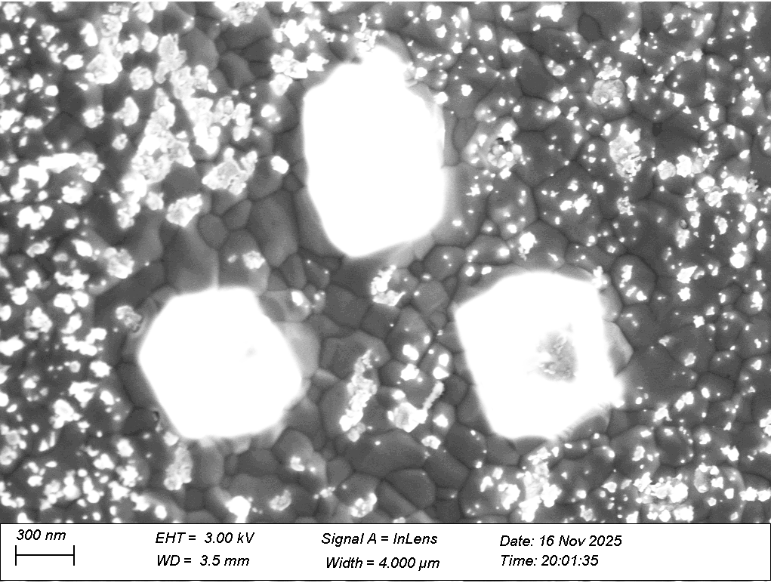
Smaller defects (seen on all samples)

Slide 32
Smaller defects (seen on all samples)
Big oxide blobs
Tiny oxide particles
Nb₃Al grains in background

Slide 33
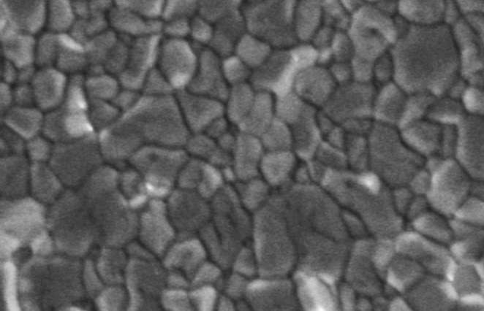
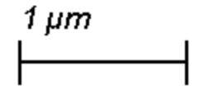
Smaller defects (seen on all samples)
Big oxide blobs
Tiny oxide particles
Nb₃Al grains in background
Other regions look pristine,
totally free of oxides…why?

Slide 34
Smaller defects (seen on all samples)
Big oxide blobs
Tiny oxide particles
Nb₃Al grains in background
Other regions look pristine,
totally free of oxides…why?
Change prep/furnace conditions?
Keep working on chemical oxide removal?
Al₂O₃ resists most chemicals;
H₂O₂ + NH₃ most promising so far…

Slide 35
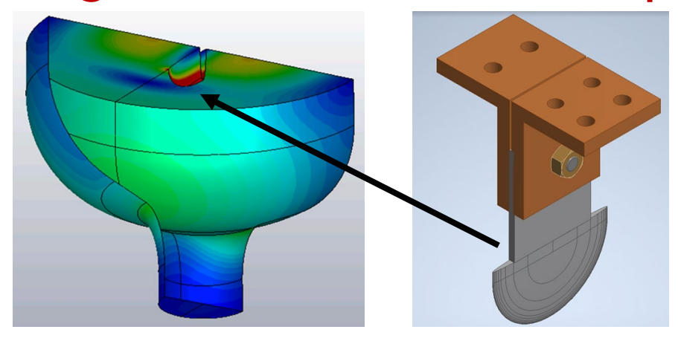
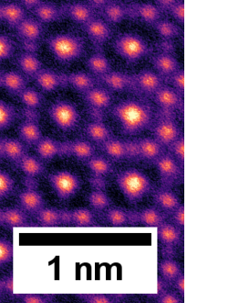
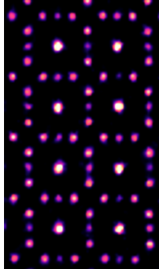
Conclusions
Despite significant imperfections, 3/3 tests so far have set benchmarks for quench field, BCS resistance, and residual resistance
  Reflects “forgiving” nature of ultra-thin Nb₃Al
If major defects can be eliminated, ~5x improvement over
Nb at 4.2K seems possible
Next steps
  Superheating field measurements in C-SHRP cavity
    First such measurement for S’S (200nm sample)!
  Cross section analysis and defect studies!
  More creative chemistry and furnace recipes!
Novel Multislice Electron Ptychography
Conventional HAADF STEM

