Slide 1
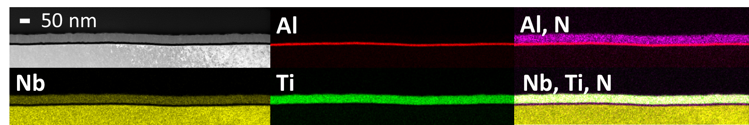
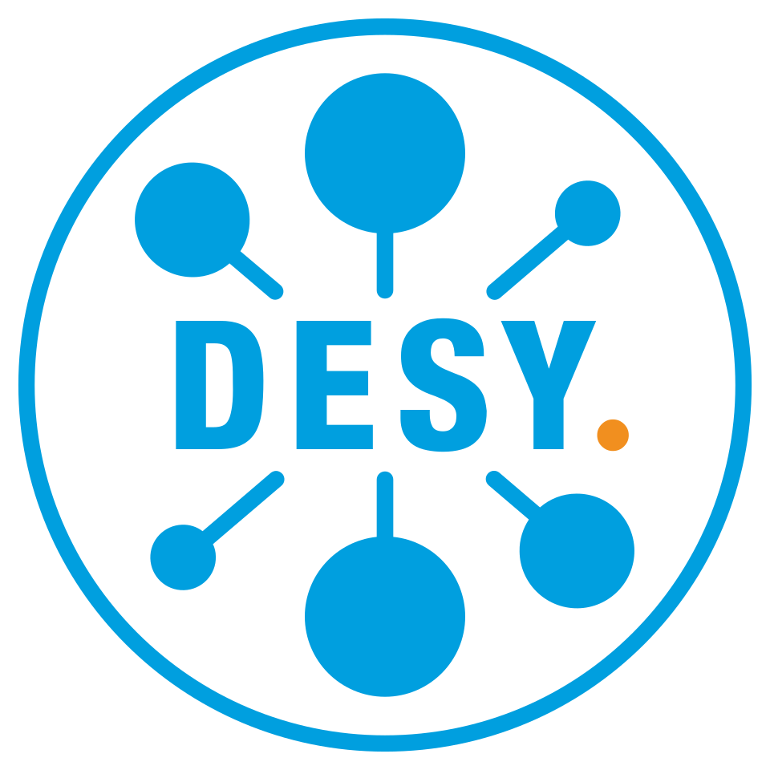
Status of the
Thin Film R&D at U Hamburg
Marc Wenskat – on behalf of the SRF R&D Team
TTC Meeting 2026 @ CEA-CNRS-Université Paris Saclay

Slide 2
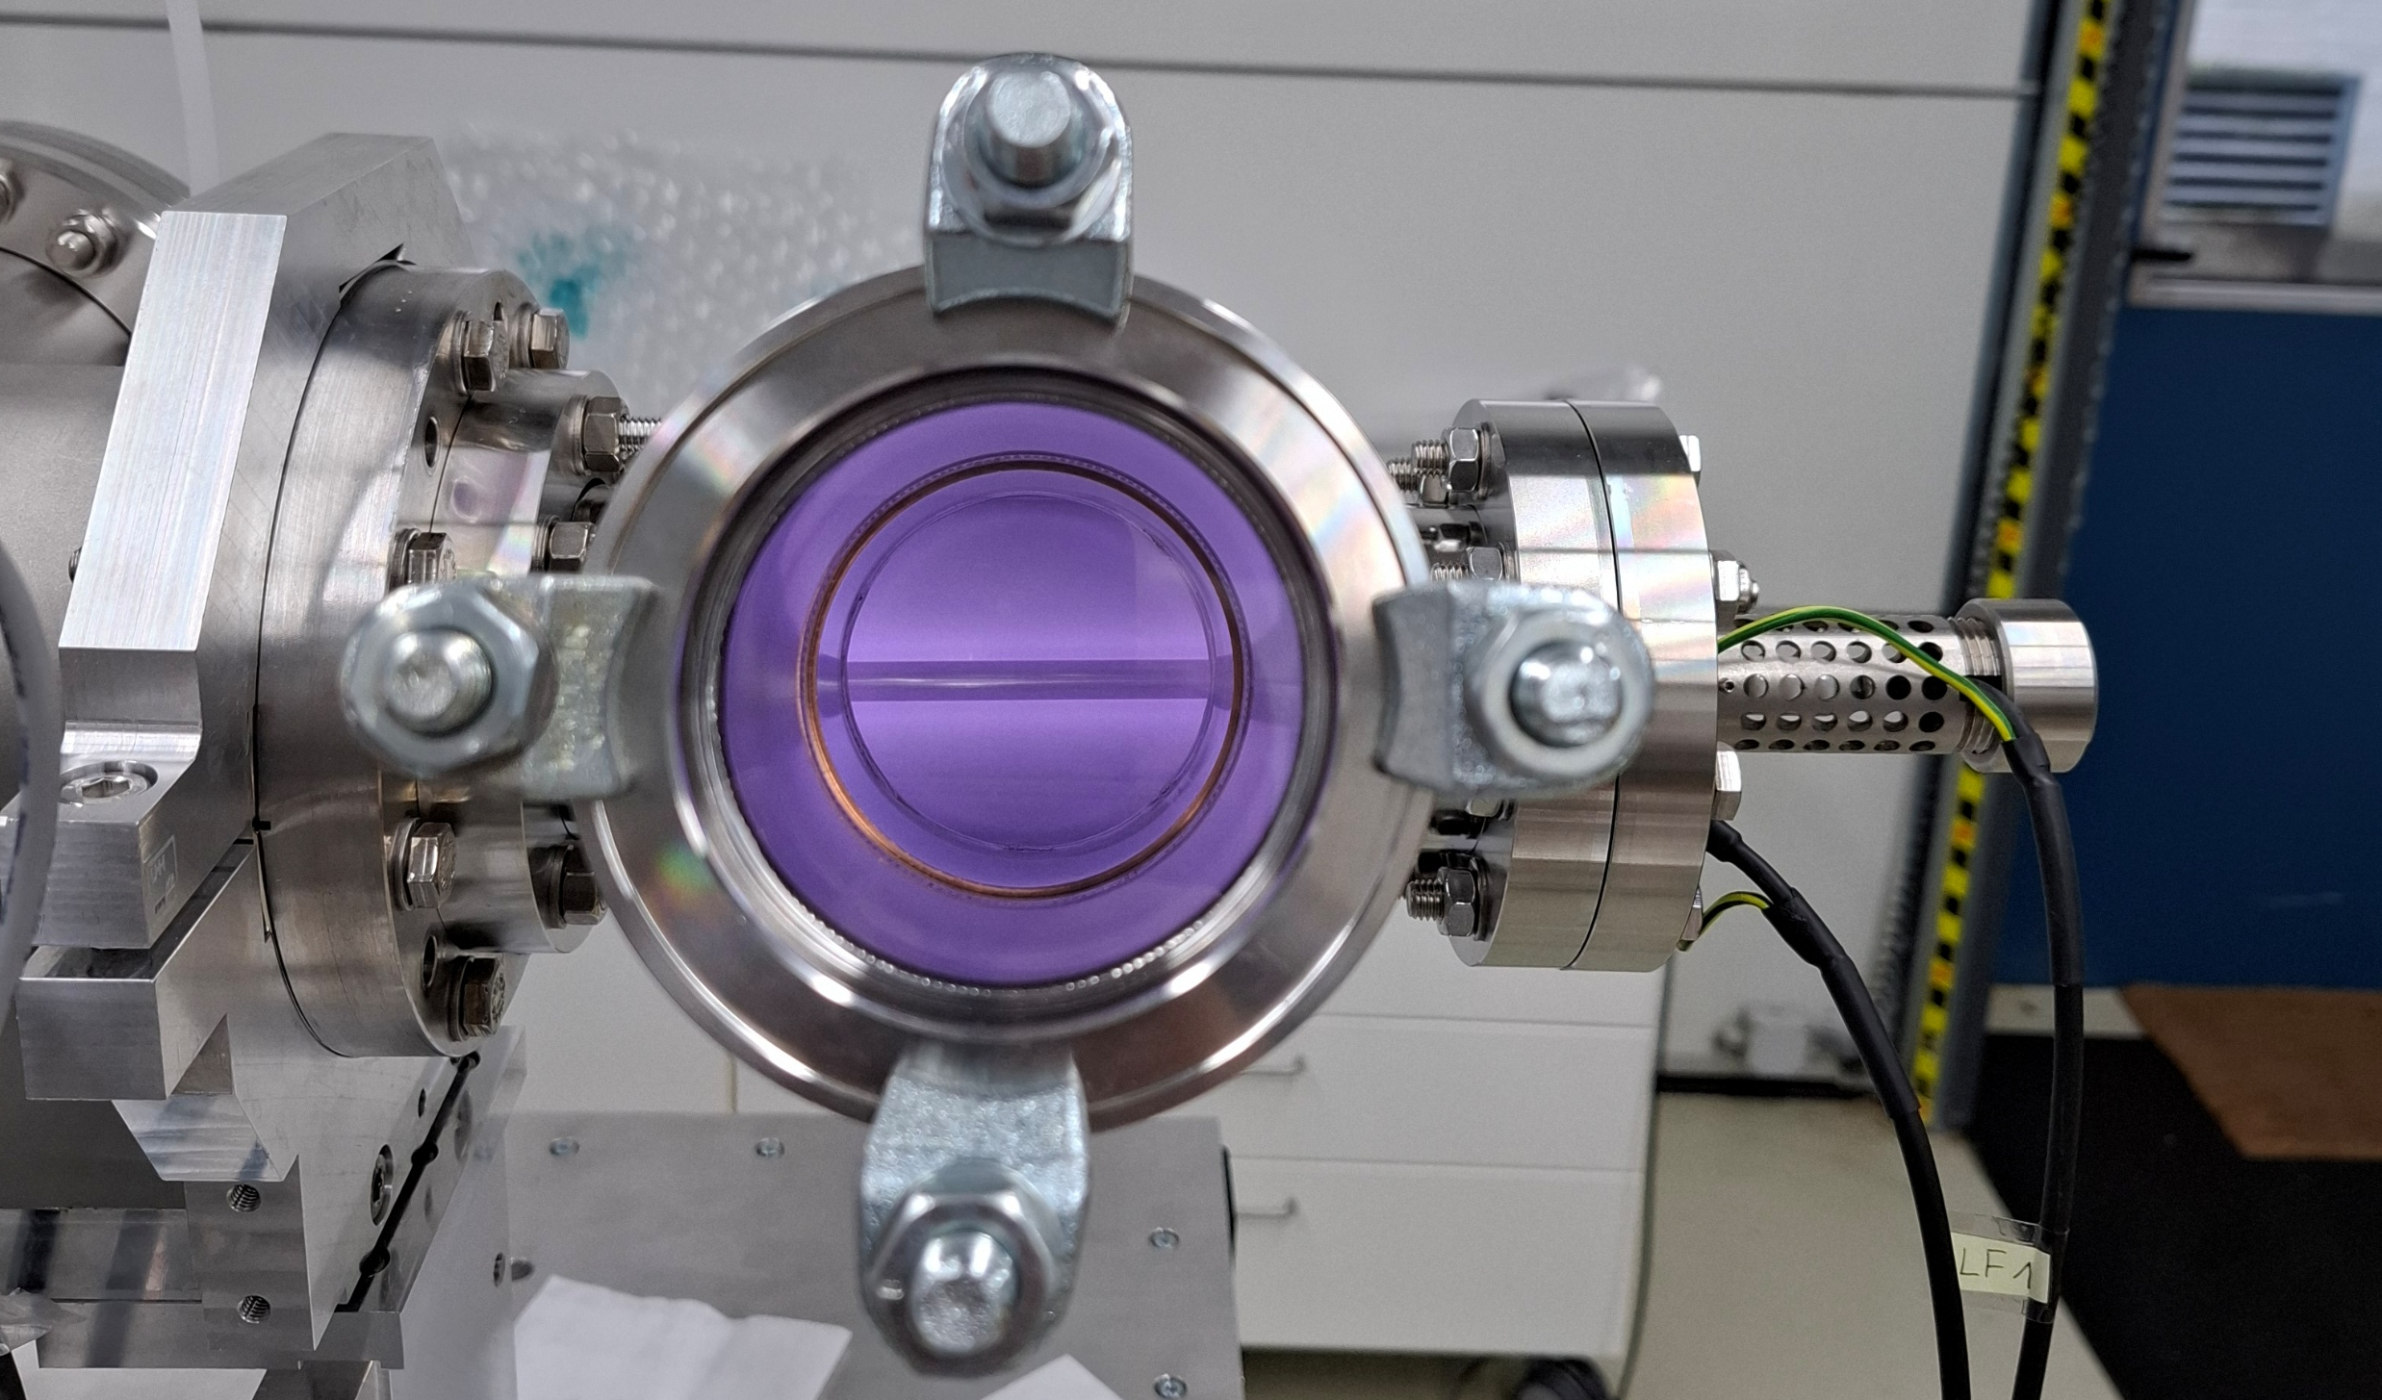
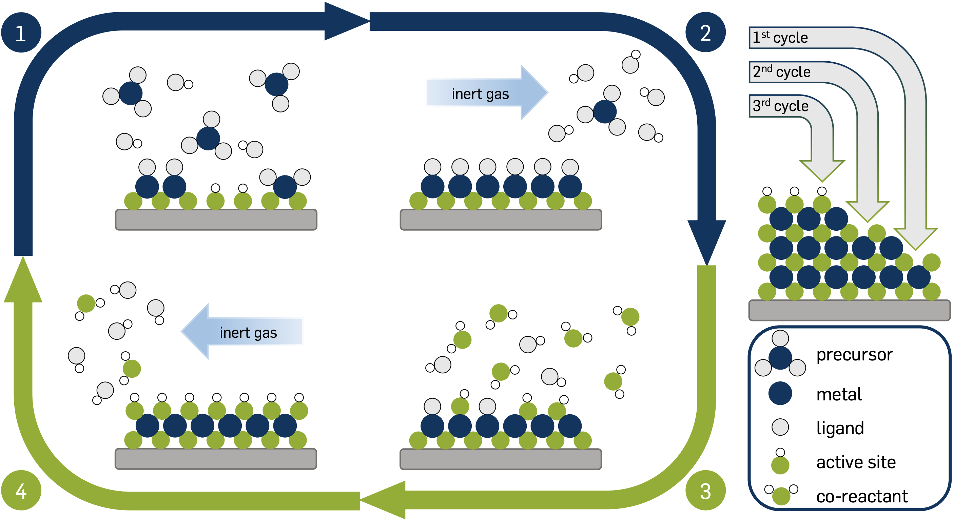
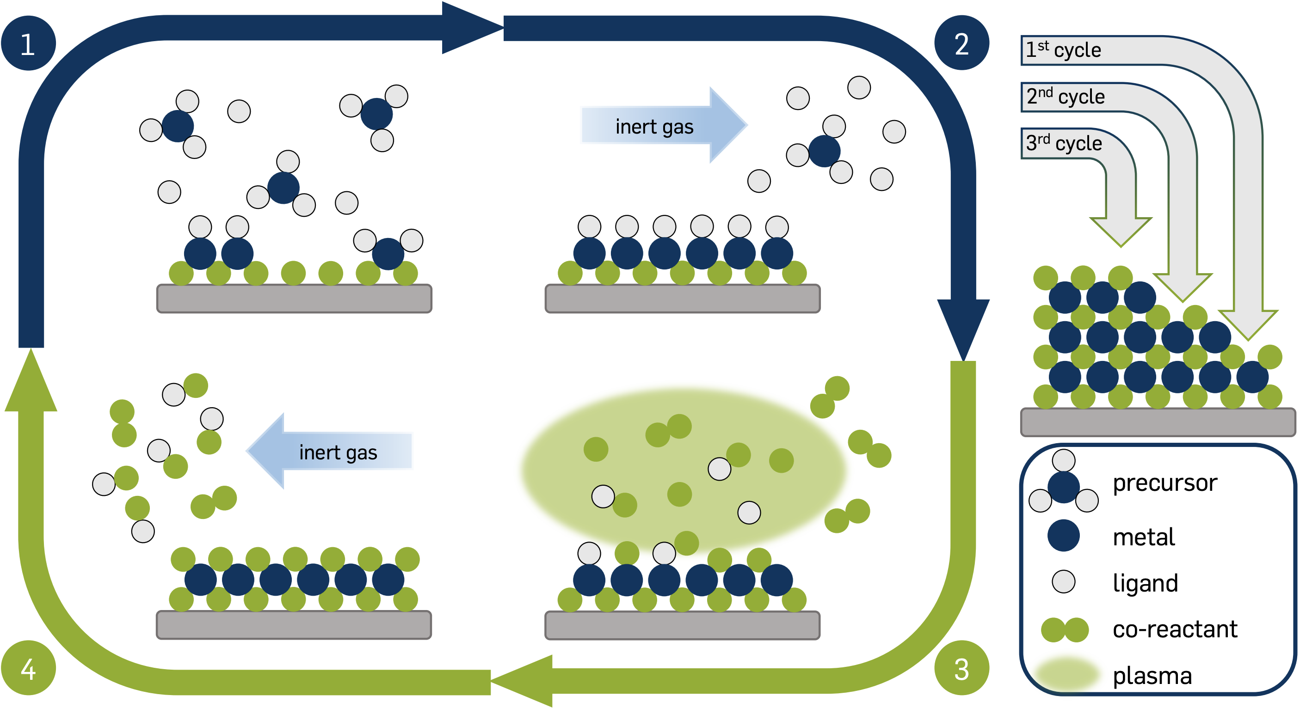
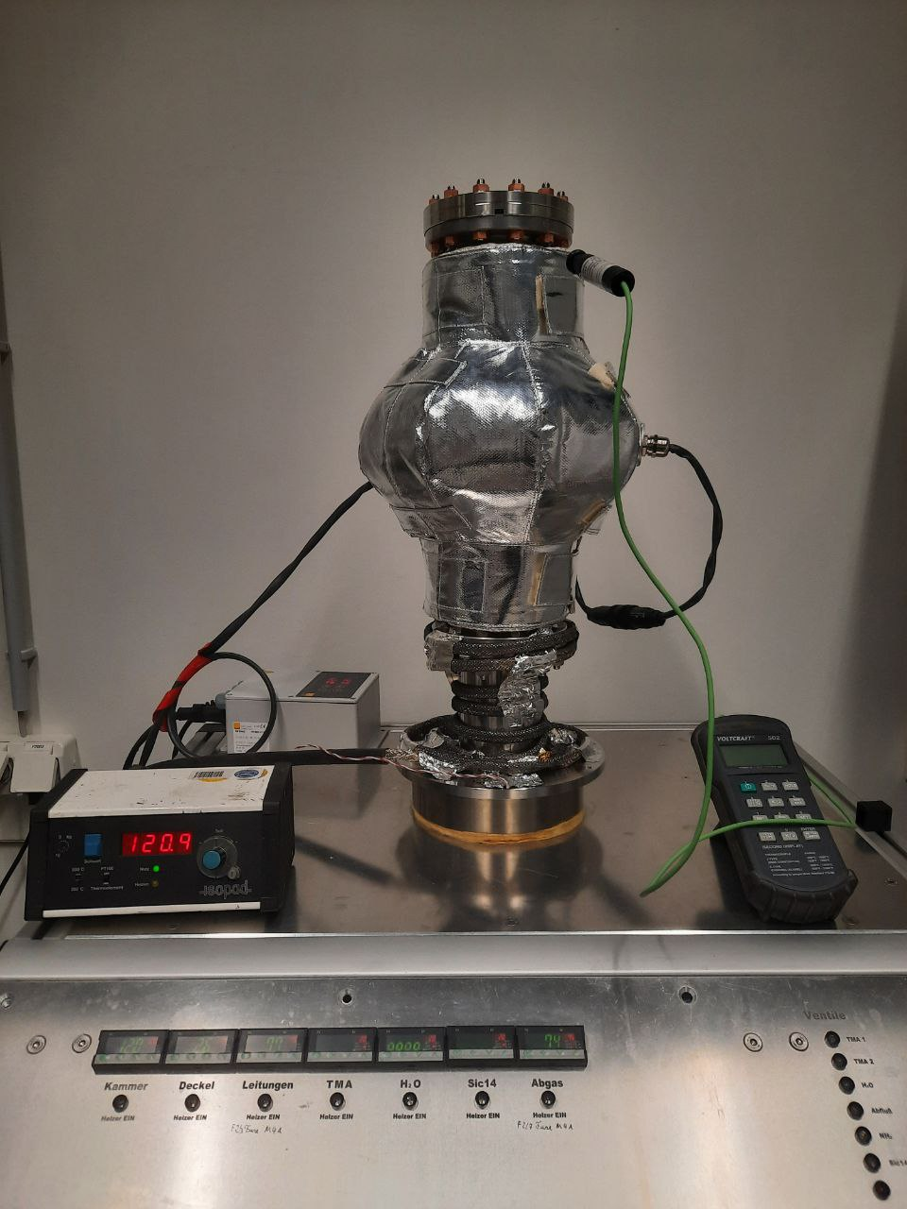
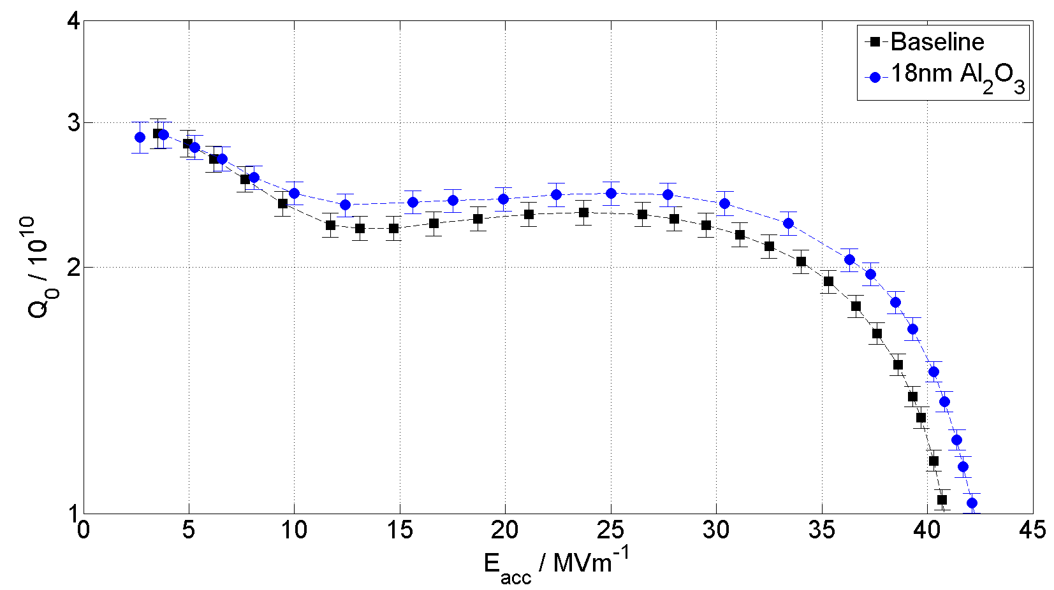
Method of choice: Atomic Layer Deposition
Self-limited growth process with high conformity & thickness control “independent” of geometry
At a price of slow growth rate and not all materials possible (e.g. no Nb₃Sn)
Al Precursor
Al, Nb, Ti Precursor
Thermal ALD System at University of Hamburg
Thermal ALD
Plasma-enhanced ALD
120 °C
250 °C
[G.K. Deyu et al., Chem. Mater. 2024, 36, 6, 2846–2856 (2024)]
[M. Wenskat et al., Supercond. Sci. Technol. 36 015010 (2023)]
H₂O
[L. Mai, DOI: 10.13154/294-7658 (2020)]
N₂ Plasma
[L. Mai, DOI: 10.13154/294-7658 (2020)]
[G.K. Deyu et al., Mater. Horiz. 12, 5594-5626 (2025)]
[I. Gonzalez Diaz-Palacio et al., J. Appl. Phys. 134, 035301 (2023)]

Slide 3
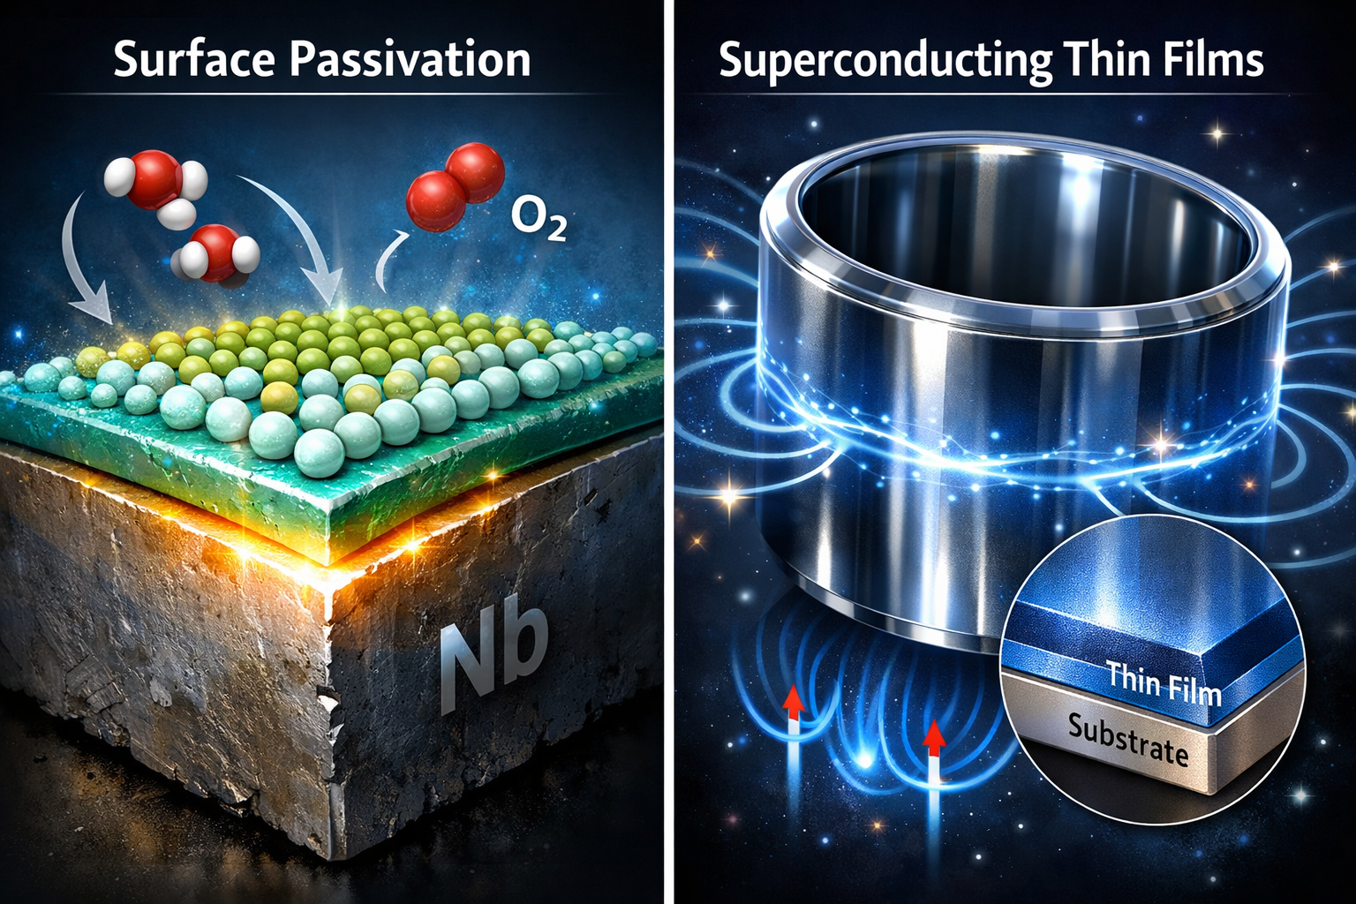
Thermal ALD
Plasma-enhanced ALD

Slide 4
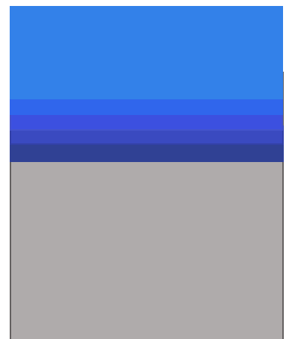
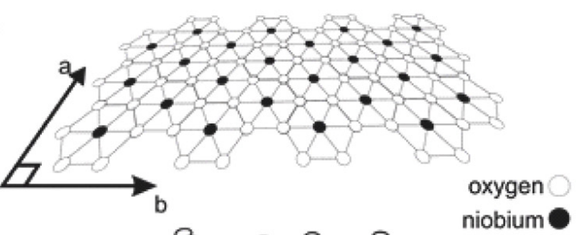
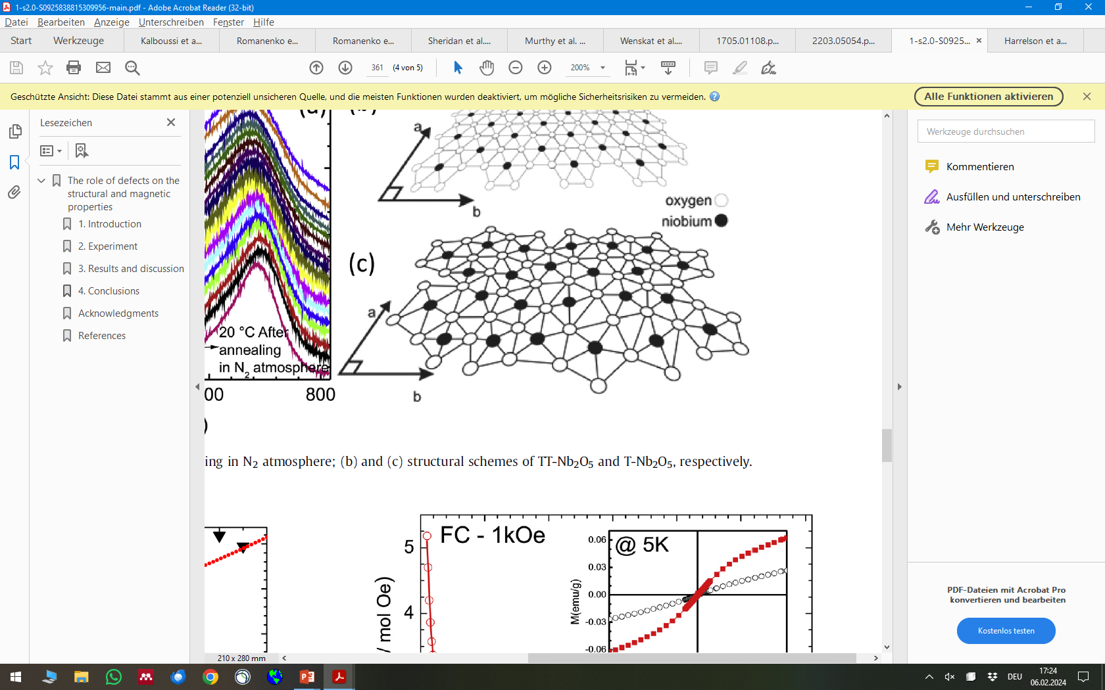
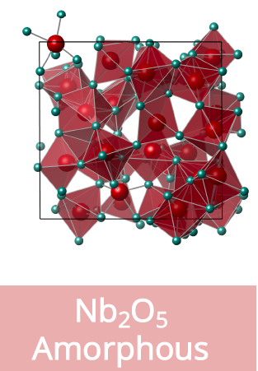



What do we know about Nb-oxides? It‘s complicated!
$${Nb}_{2}O_{5}$$
~5 nm
Periodic Lattice?
$$NbO2, NbO,NbOx$$
$$Nb$$
Reality: Energetically not favored at RT, not “our” Nb₂O₅
Amorphous = defective
[Sheridan, Evan, et al., arXiv preprint arXiv:2111.11684 (2021)]
[Harrelson, Thomas, et al., arXiv preprint arXiv:2111.11590 (2021)]
[Murthy, Akshay A., et al. ACS nano 16.10 (2022): 17257-17262.]
[Herval, Leonilson KS, et al. Journal of Alloys and Compounds 653 (2015): 358-362.]

Slide 5
Why does it matter if Nb-oxide is defective?
Creates losses! How? → Unbound valence electrons
Dominant mechanism depends on the amplitude of the applied field
As both regimes are linked by the same microscopic origin:
Study one regime, learn about the other
E_{acc} (number of photons)
low
high
Electron spins alignment can be in two different configuration → Two-Level System
Application: Quantum computing
Magnetic moment of unbound spin act as magnetic scattering site, causes pair breaking → Magnetic impurities
Application: Accelerators
[A. Romanenko et al., Phys. Rev. Lett., vol. 119, no. 26, p. 264801 (2017)]
[Y. Kalboussi et al., Appl. Phys. Lett., vol. 124, no. 13 (2024)]
[L. Grasselino et al., THA04, SRF2025]
[R. Venugopal et al., TUP16, SRF2025]
[T. Proslier et al. IEEE Trans. Appl. Supercond 21.3: 2619-2622 (2011)]
[N. Groll et al., arXiv preprint arXiv:1805.06359 (2018)]

Slide 6
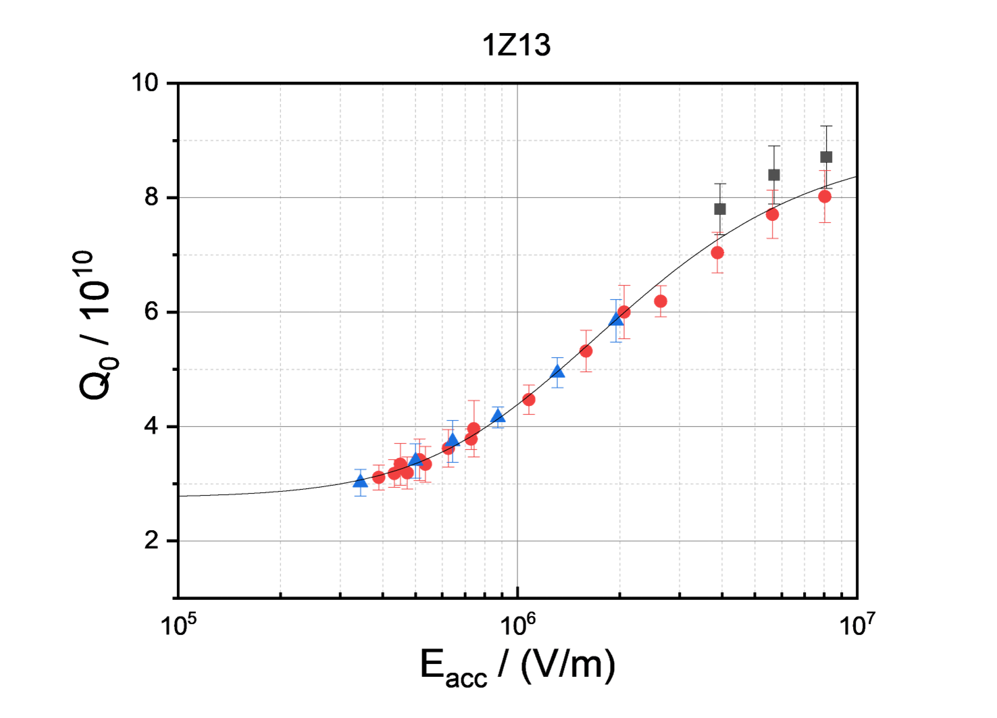
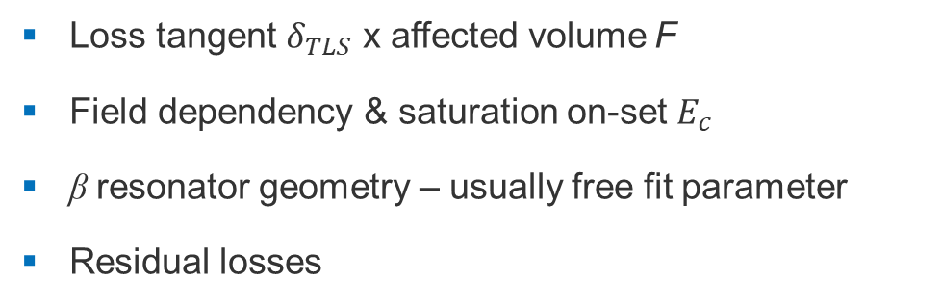
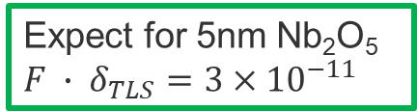

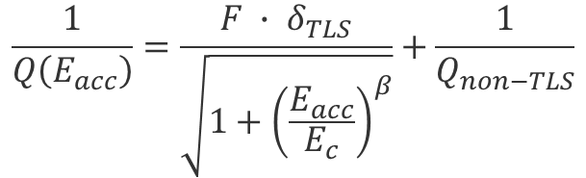
Established low E_{acc} measurement (at 1.5K) at DESY
[M. Wiencek et al., THP40, SRF2025]
[R. Venugopal et al., TUP16, SRF2025]
$$\frac{1}{Q\left(E_{acc}\right)}=\frac{F ∙ δ_{TLS}}{\sqrt{1+{\left(\frac{E_{acc}}{E_{c}}\right)}^{β}}}+\frac{1}{Q_{non−TLS}}$$
$F ∙ δ_{TLS}=\left(2.8±0.3\right)×{10}^{−11}$
Loss tangent $δ_{TLS}$ x affected volume F
Field dependency & saturation on-set $E_{c}$
β resonator geometry – usually free fit parameter
Residual losses
Colors: Measurements with different VT configurations
1.5K
Expect for 5nm Nb₂O₅
$F ∙ δ_{TLS}=3×{10}^{−11}$
[A. Romanenko et al., Phys. Rev. Lett., vol. 119, no. 26, p. 264801 (2017)]

Slide 7
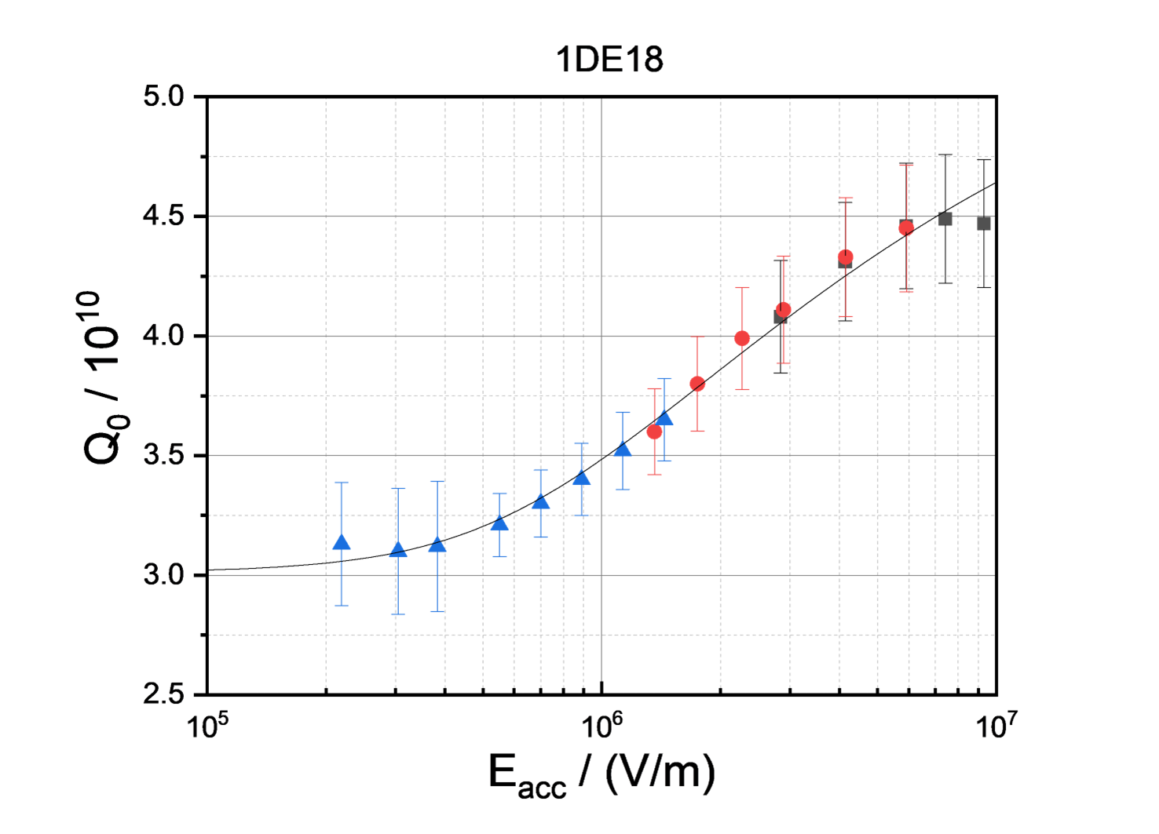
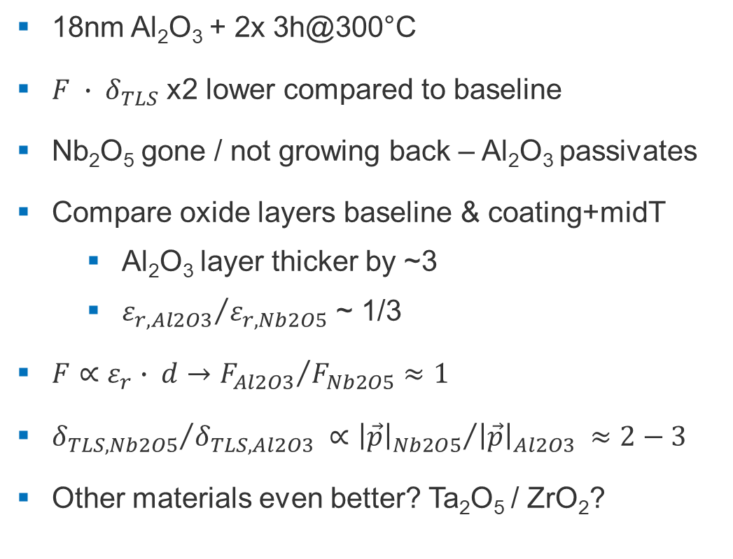

Al₂O₃ passivation works & the physics checks out
[R. Venugopal et al., TUP16, SRF2025]
[A. Zaidman et al., Phys. Rev. Materials 9, 094806 (2025)]
18nm Al₂O₃ + 2x 3h@300°C
$F ∙ δ_{TLS}$ x2 lower compared to baseline
Nb₂O₅ gone / not growing back – Al₂O₃ passivates
Compare oxide layers baseline & coating+midT
  Al₂O₃ layer thicker by ~3
  ${ε_{r,Al2O3}}/{ε_{r,Nb2O5}}$ ~ 1/3
$F∝ε_{r}∙ d→{F_{Al2O3}}/{F_{Nb2O5}}≈1$
${δ_{TLS, Nb2O5}}/{δ_{TLS, Al2O3}} ∝{{\left|\vec{p}\right|}_{Nb2O5}}/{{\left|\vec{p}\right|}_{Al2O3}} ≈2−3$
Other materials even better? Ta₂O₅ / ZrO₂?
$F ∙ δ_{TLS}=\left(1.5±0.9\right)×{10}^{−11}$
Colors: Measurements with different VT configurations
1.5K

Slide 9
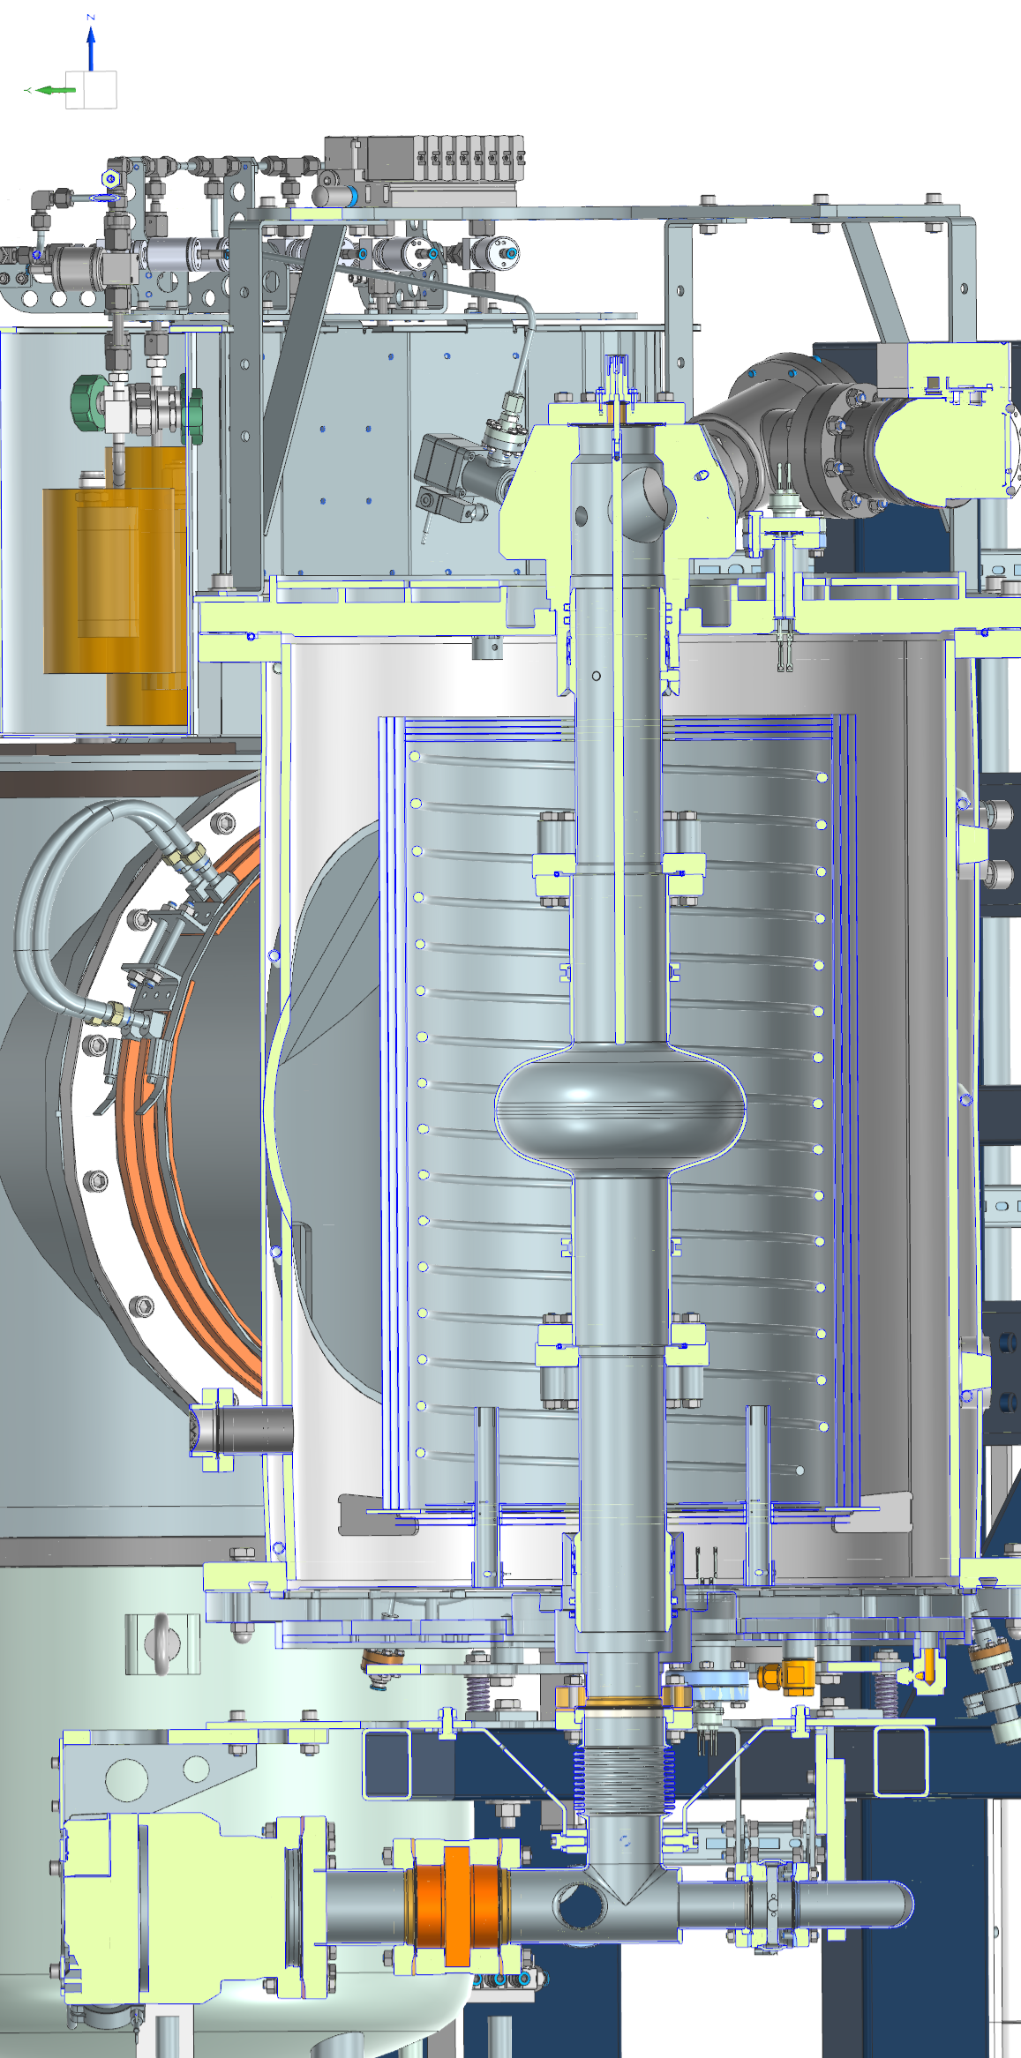
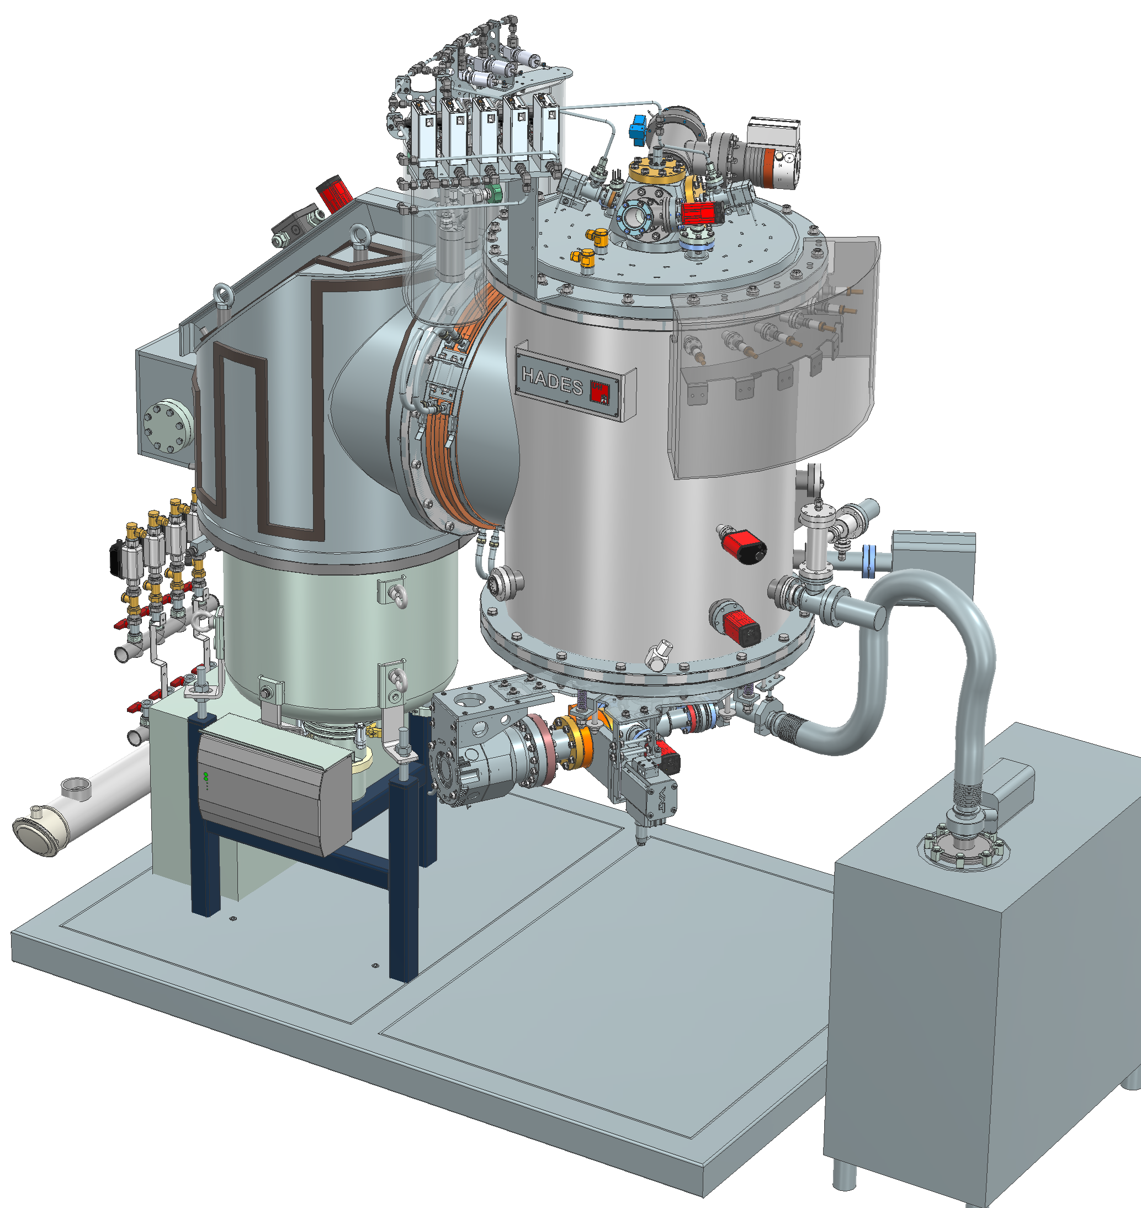
Dream: unique & versatile cavity coating system
High versatility in one system:
PEALD and thermal ALD
Planned materials:
  NbTiN / NbN
  AlN
  Al₂O₃
  Ta₂O₅
In-situ annealing due to better p_{base}
  dissolve oxide layers before coating
  after coating to activate films
11.6.2026 | TTC2026 | M. Wenskat | ThinFilm R&D @ UHH

Slide 10
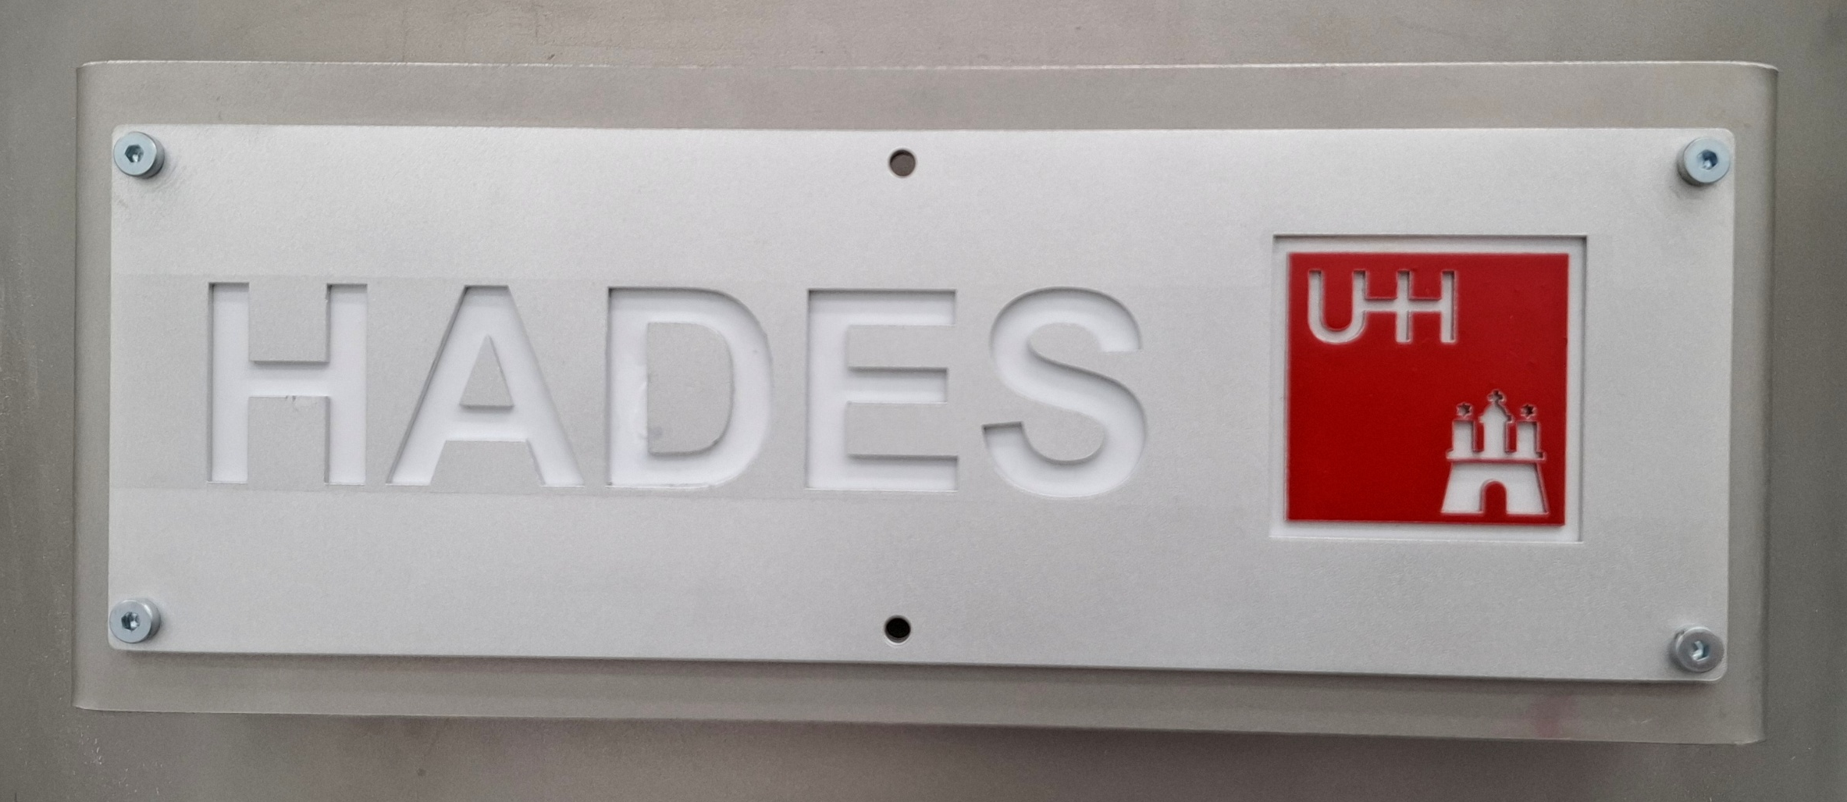
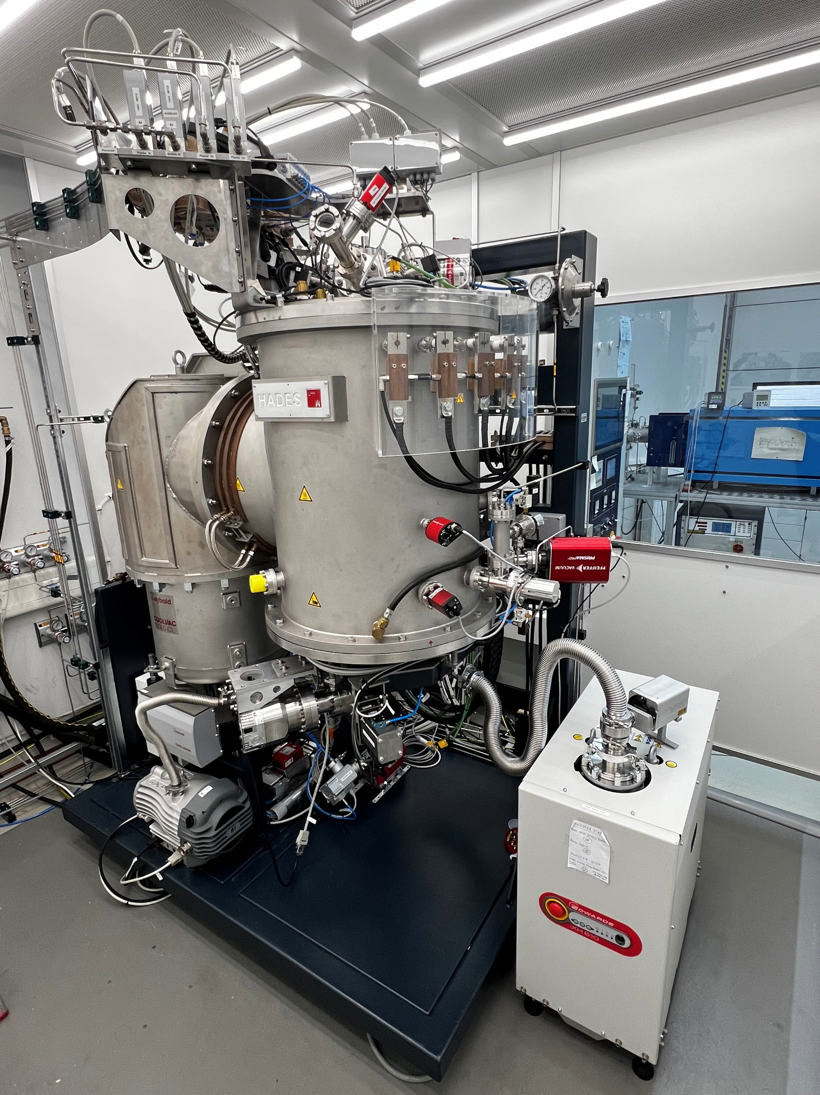
Dream + Team + Hard Work = Reality
Hamburgs Atomic Layer Deposition Instrument
for Enhanced Superconductors
Hades was not only the god of the underworld (not evil), but also the keeper of hidden treasures buried deep beneath the surface
11.6.2026 | TTC2026 | M. Wenskat | ThinFilm R&D @ UHH

Slide 11
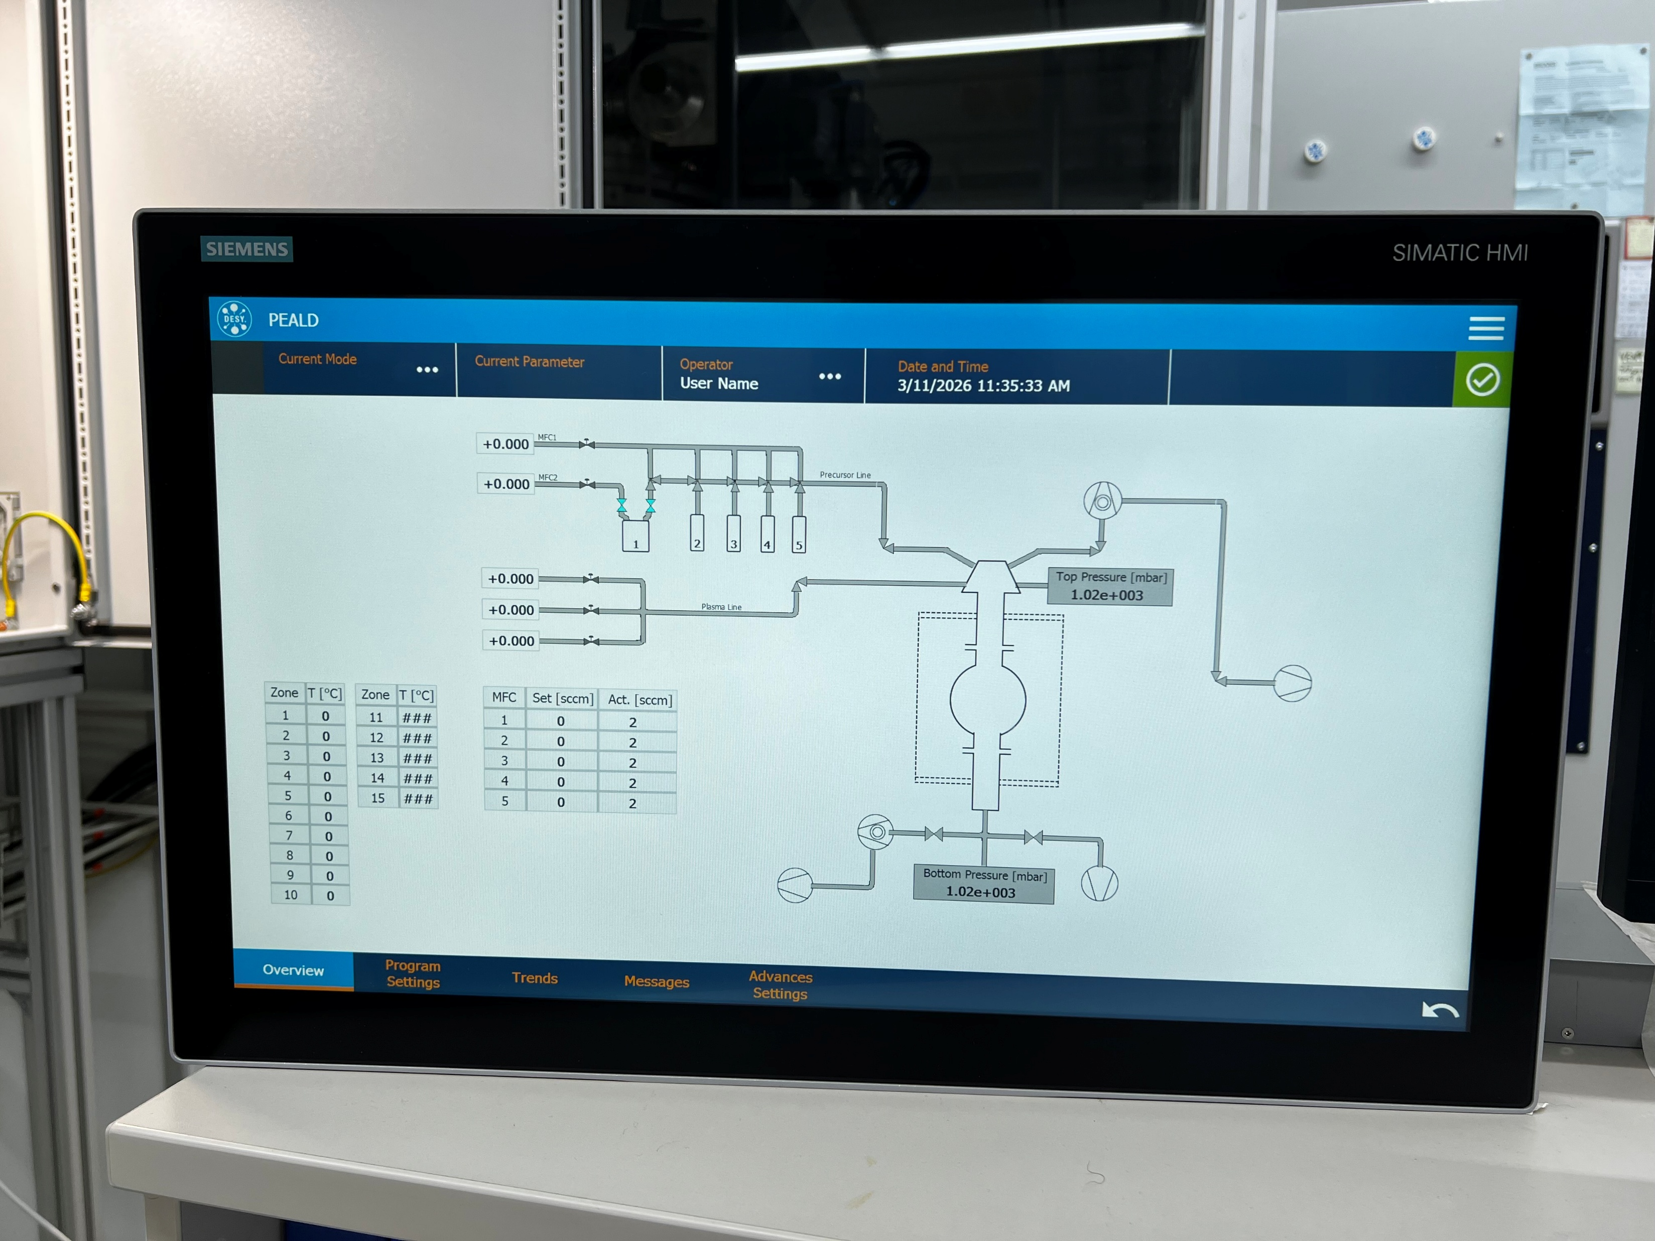
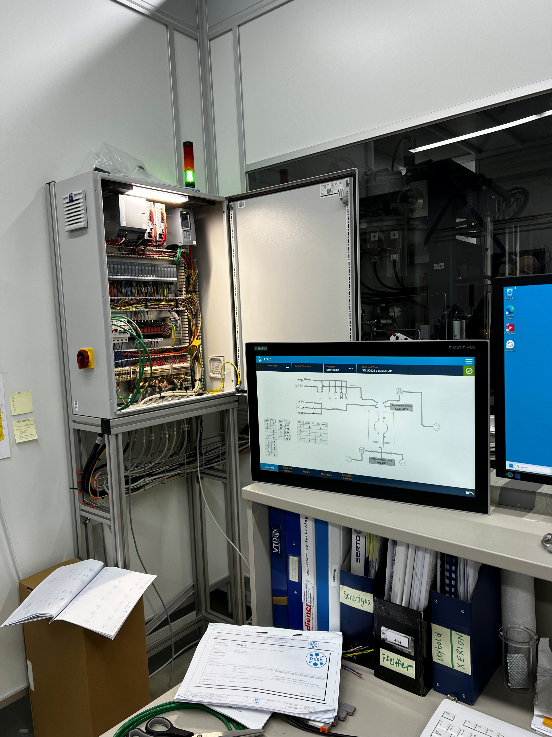
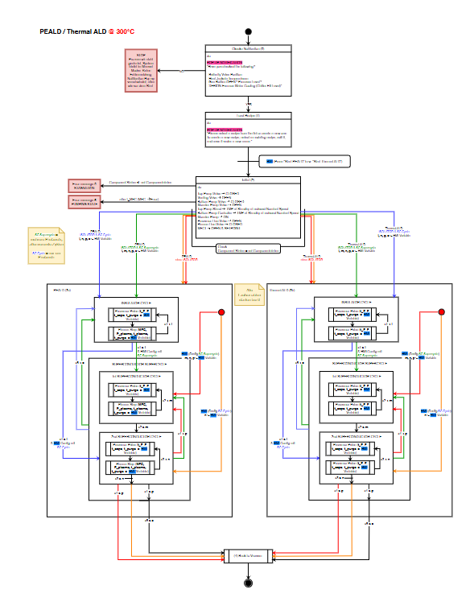
All components are ready and PLC is working
Next step: Check processes

Slide 12
Conclusion
Surface Passivation
Superconducting Film
New tool to tailor SRF performance
Optimizing recipes (materials/coating/annealing)
Optimizing for what: High or low fields? Or is it the same?
→ Studying how regimes are linked (RF & material)
New & unique HADES system → coat cavities with superconducting films
Final steps are underway …
… first coating results with HADES at thin film workshop
11.6.2026 | TTC2026 | M. Wenskat | ThinFilm R&D @ UHH

Slide 13
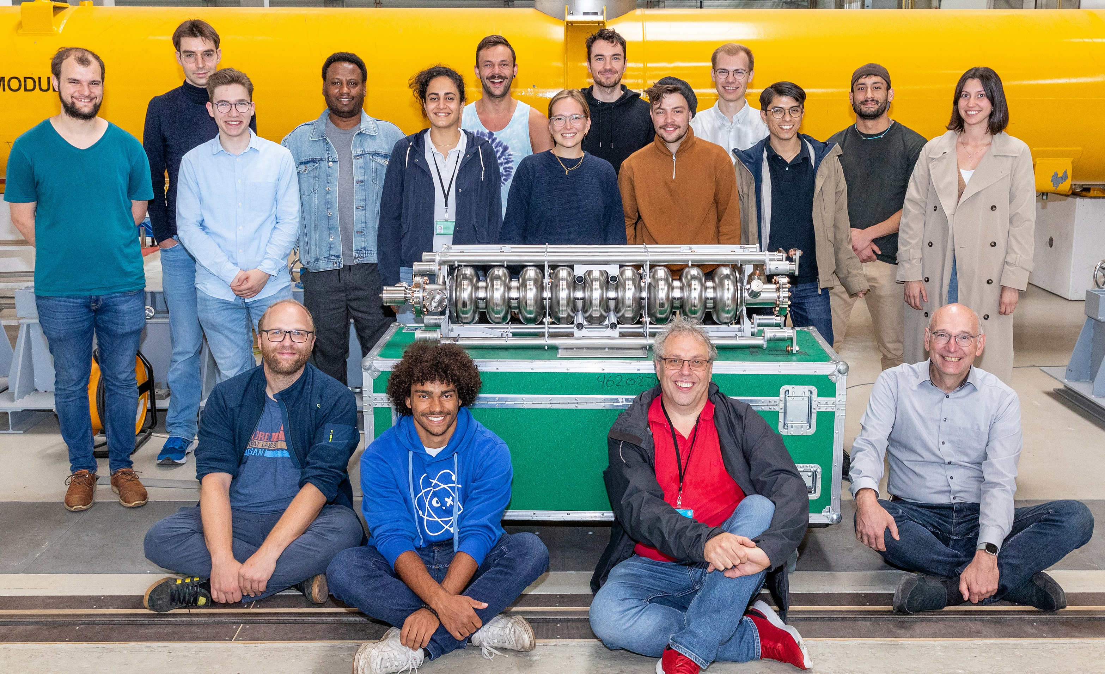
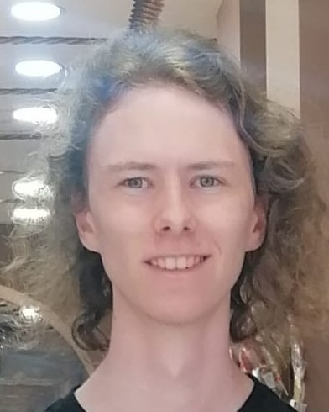

A great team to make it all work
Getnet Deyu
moved to industry
Isabel Gonzalez Diaz-Palacio
moved to industry
Lea Preece
PhD Student
Lasse Koch
MSc Student
Wolfgang Hillert
Professor
Cornelius Martens
Engineer
Rakshith Venugopal
PhD Student

Slide 14

▪ to you for listening / your patience
▪ to the conveners to invite me
▪ to BMFTR for funding
▪ to the team
Thanks…
Questions?
Marc Wenskat / MSL
marc.wenskat@desy.de

Slide 16
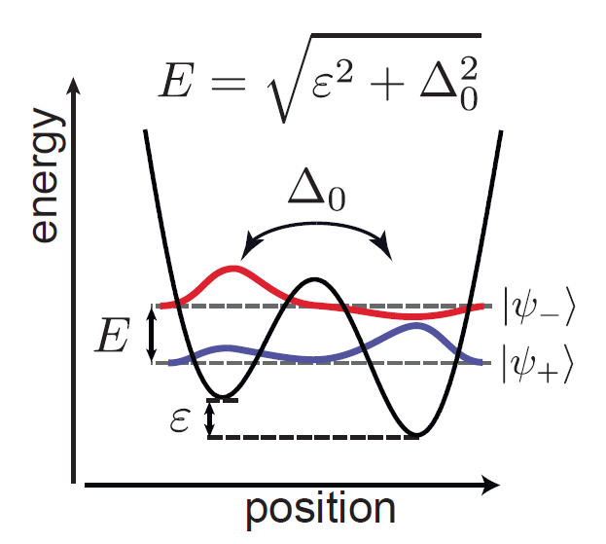
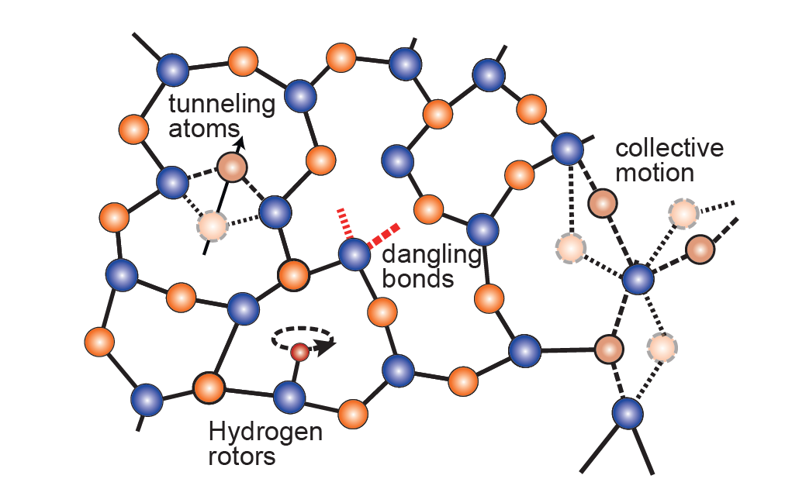
Two-Level System: Assumptions
The TLS can exist in one of two energetically similar configurations.
These configurations are modelled as two minima in a double-well potential which are separated by a barrier.
At sufficiently low temperatures, thermal activation over the barrier is suppressed and the dynamics are governed by quantum tunneling through the barrier.
In general, the system couples to applied electric fields in such a way that transitions can be driven between the states.
Due to the multiple/random arrangements, an ensemble of TLS is characterized by a wide distribution of potential barrier heights and thus spans a large range of switching rates and eigenenergies.
[Müller, Clemens, Jared H. Cole, and Jürgen Lisenfeld. Reports on Progress in Physics 82.12 (2019): 124501.]

Slide 17
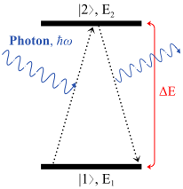
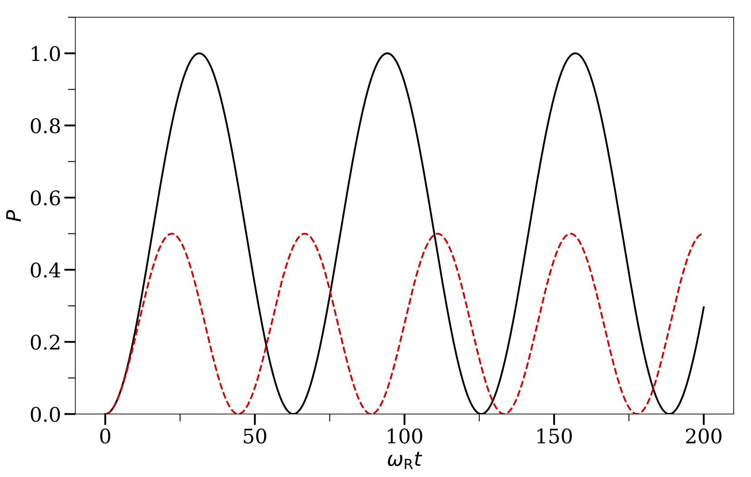

Rabi-Oscillation
When TLS couple through an electric dipole moment d to oscillating electric fields, they can resonantly absorb energy (and give rise to dielectric loss).
Probability P to find TLS in excited state is proportional to sin²(Ω_{Rabi}t/2)
$$Ω_{Rabi}=\frac{{\vec{d}}_{1,2}∙{\vec{E}}_{0}}{ℏ}$$

Slide 18
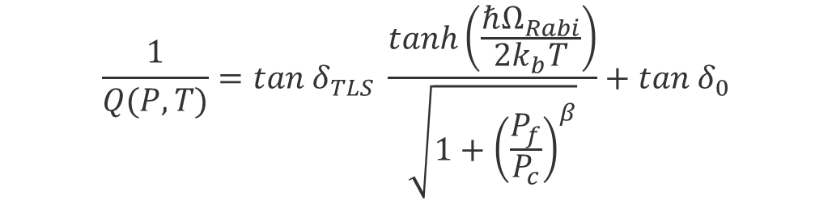
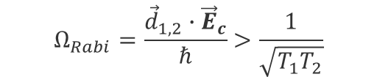
Power dependent losses
In order to get into excited state, the TLS needs to be in its ground state. If all TLS are in the excited state, no absorption and hence no losses.
When a TLS is driven above a certain critical power P_{c} , Ω_{Rabi} will be larger than the TLS loss rates
If the excitation happens faster than the decay (P_{f}>P_{c}), we saturate the losses
$$Ω_{Rabi}=\frac{{\vec{d}}_{1,2}∙{\vec{E}}_{c}}{ℏ}>\frac{1}{\sqrt{T_{1}T_{2}}}$$
$$\frac{1}{Q(P,T)}=tan{ δ}_{TLS} \frac{tanh\left(\frac{ℏΩ_{Rabi}}{2k_{b}T}\right)}{\sqrt{1+{\left(\frac{P_{f}}{P_{c}}\right)}^{β}}}+tan{ δ}_{0}$$
Single species, non-interacting TLS
[Müller, Clemens, Jared H. Cole, and Jürgen Lisenfeld. Reports on Progress in Physics 82.12 (2019): 124501.]

