Slide 1
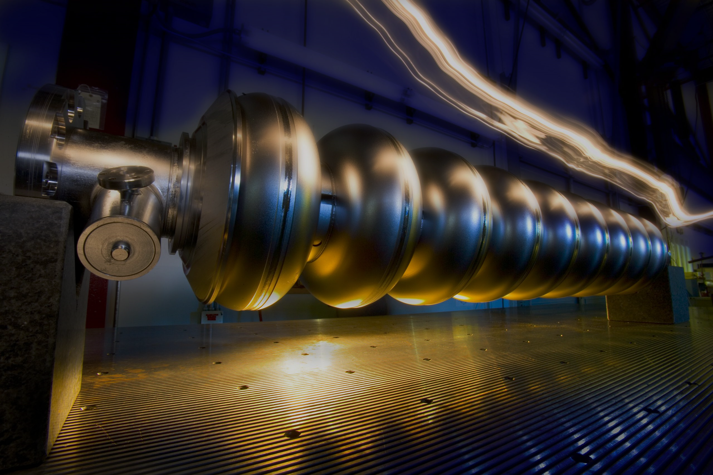

Development of next-generation superconducting thin-film accelerator cavities
Peng Dong
ShanghaiTech University
June 11th, 2026
TTC meeting(2026), Gif sur Yvette, France
Notes:
下一代超导薄膜加速腔

Slide 2
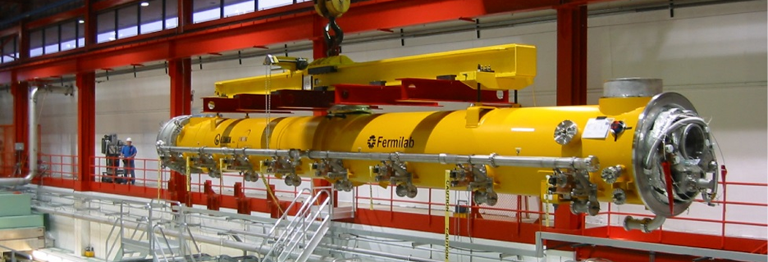
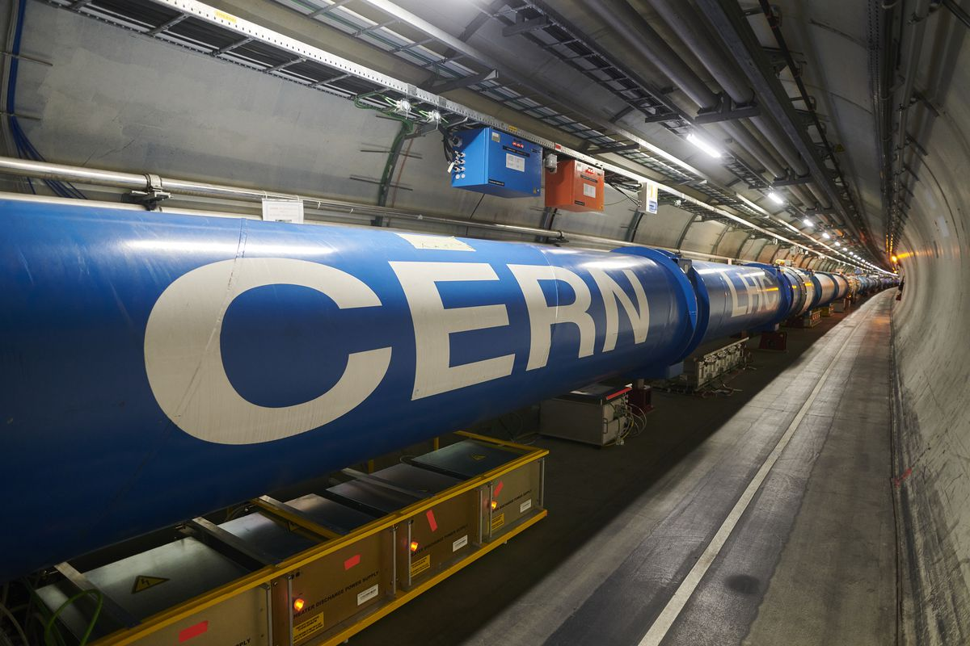
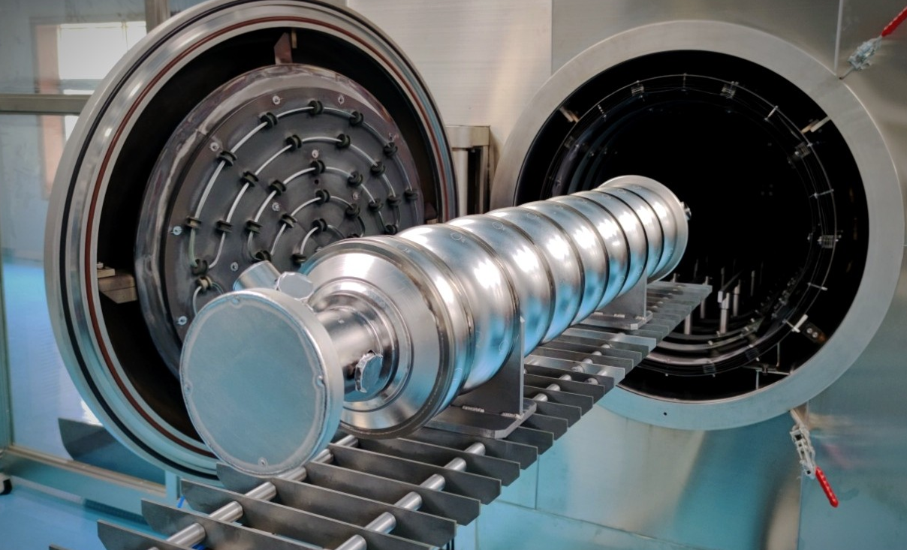
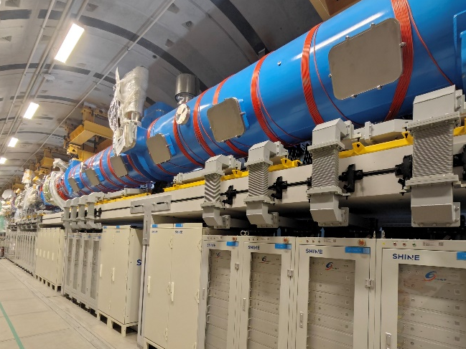
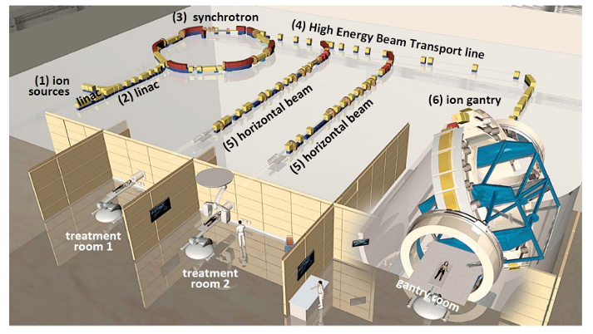
SRF cavity
@Fermilab
@CERN
@Fermilab, US
@SARI
@SHINE
SRF cavity matters.
TTC meeting(2026), Gif sur Yvette, France
Notes:
An SRF cavity uses microwave injection to create a standing-wave field, accelerating electron or proton beams.
The pure Nb cavity have been used widely such as not only were used in large dscientic facilituy，but also beed used in theropotic apparatus。
CERN’s particle accelerator
The Hard X-ray Free Electron Laser Facility @ShanghaiTech University
heavy-ion therapeutic apparatus

Slide 3
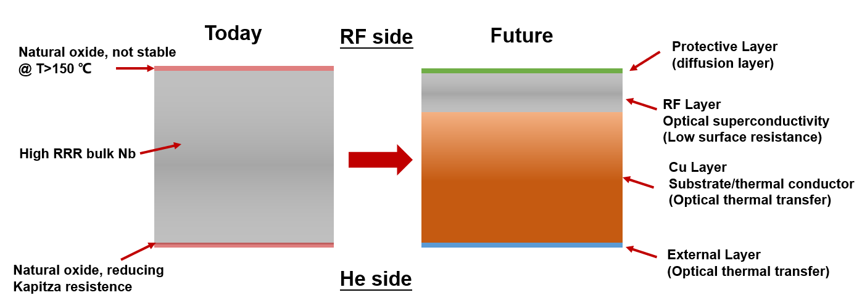
Superconducting niobium film accelerating cavity
Developing of next-generation niobium-film cavity technology
Nb film
Nb
Cu
Challenges
Advantages
Poor Thermal Stability
Superior Thermal Stability
Stringent Processing Requirements
Higher Operating Temperature
Exceptionally High Operational Costs
Significant Cost Efficiency
TTC meeting(2026), Gif sur Yvette, France
A.-.M. Valente Feliciano et al . arXiv:2204.02536
Notes:
However, due to the expensive Nb material and high cooling and grid power cost, developing the next generation "Nb-Cu" composite cavity has become an important direction.
A common method is depositing a superconducting film on a copper substrate, combining good thermal conductivity and SRF cavity performance. It can effectively reduce costs.

Slide 4
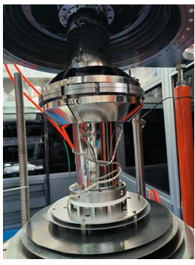
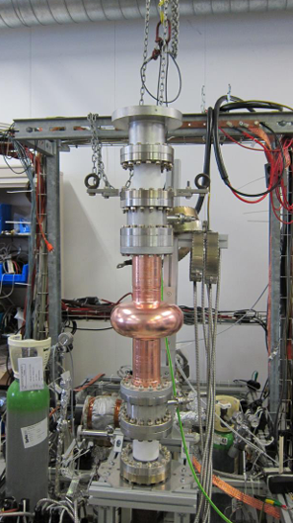
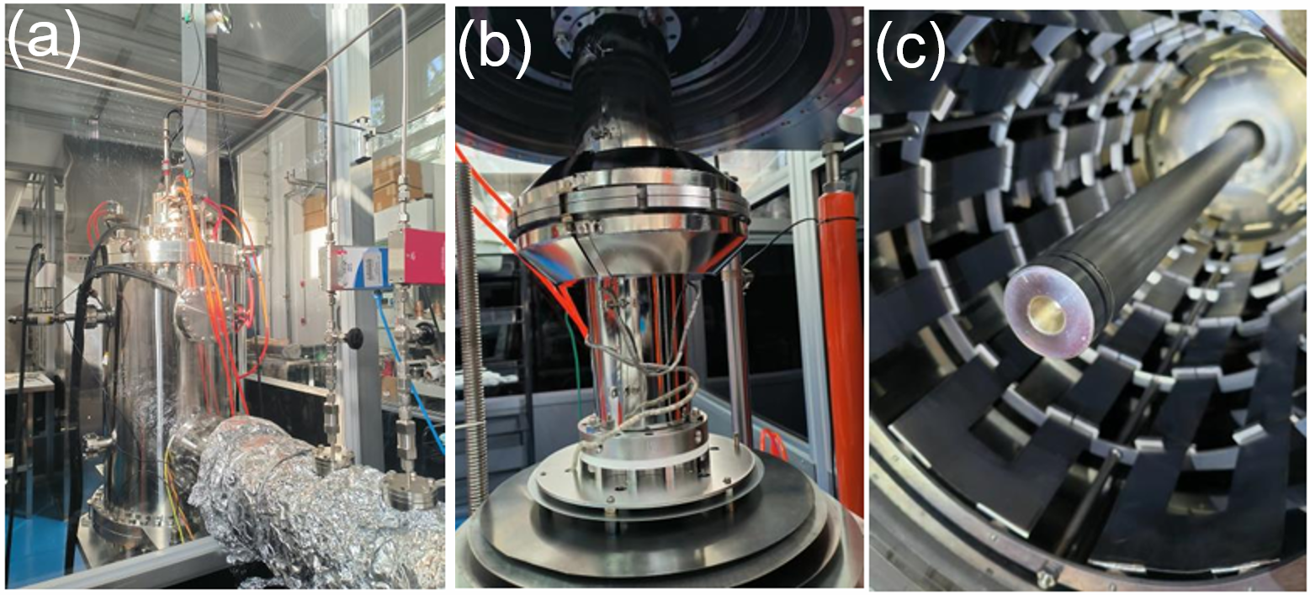
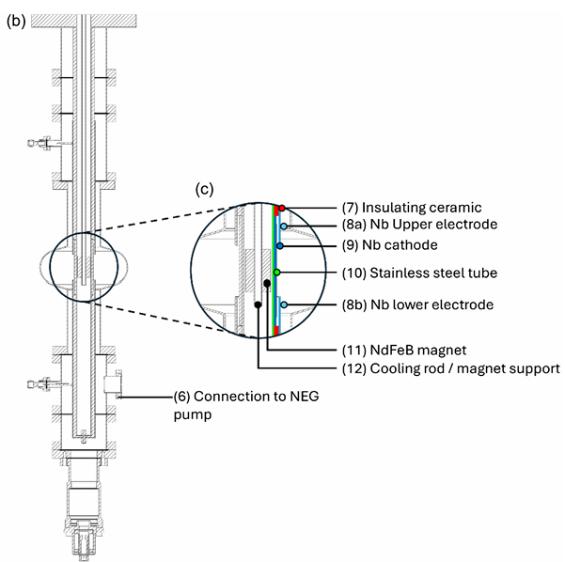
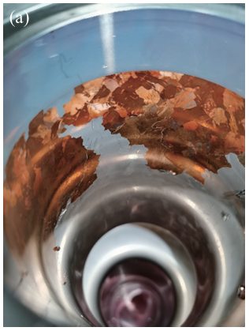
Research Developments thin-film technique
High-energy pulsed magnetron sputtering technique (HiPIMS)
@CERN
@IHEP (2023)
Uniform film thickness and delamination are challenging.
TTC meeting(2026), Gif sur Yvette, France
真空科学与技术学报, 2023, 43(1): 29-35
Notes:
Depending on the high plsma density , it is a important method to spttering Nb-Cu cavity.
Nb-Cu cavities have developed like CERN and IHEP . However, uniform thickness and strong adhesion remain challenging.

Slide 5

Development of Nb-Cu cavity in ShanghaiTech:
High-energy Pulsed Magnetron Re-sputtering/Sputtering technique (HiPIMRS)
Peng Dong et al., Review of Scientific Instruments 96, 103901 (2025)
Notes:
Therefore，We developed a novel “High-energy Pulsed Magnetron Re-sputtering/Sputtering” (HiPIMRS) technique.

Slide 6
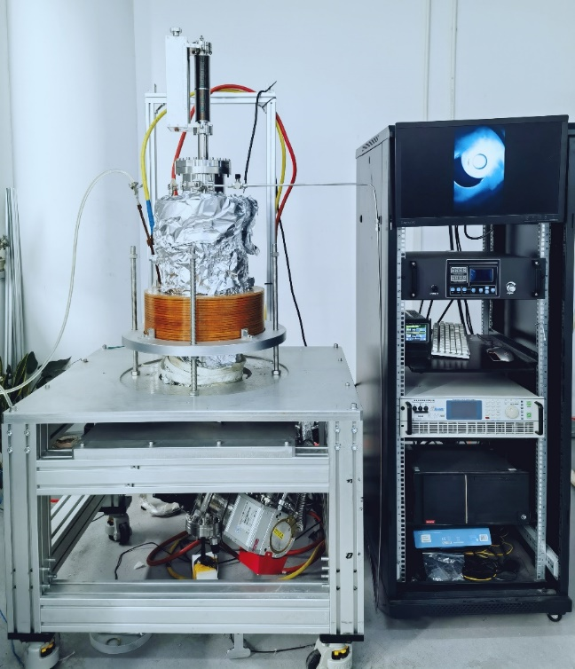
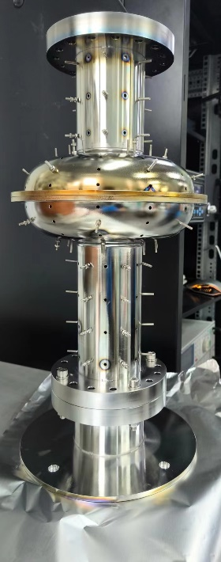
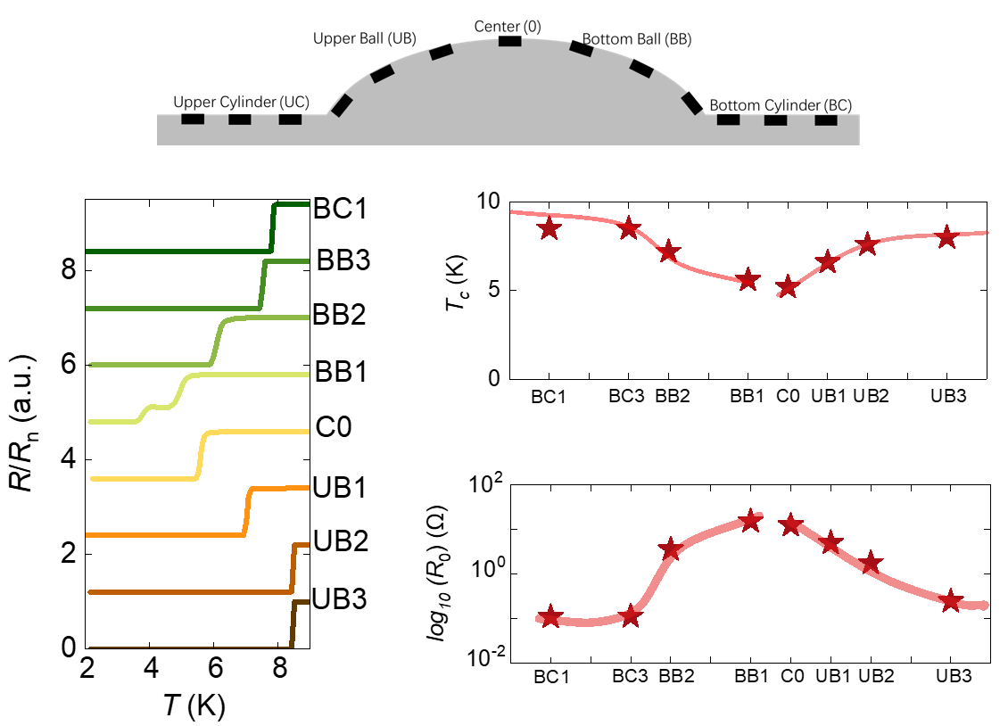
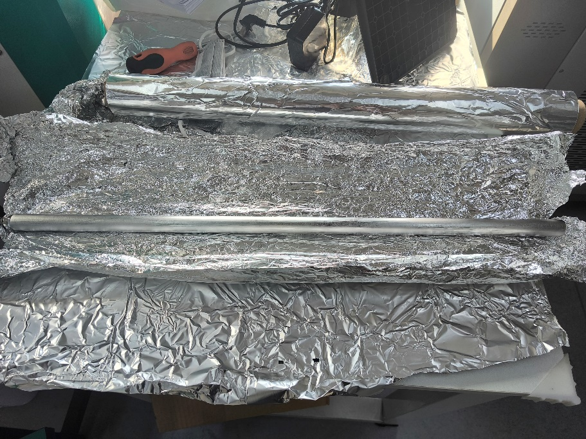
1st generation HiPIMRS (2021-2024)
Nb target
Thin-film on Si substrate
@ShanghaiTech
Success in a DEMO system and fabricated superconducting Nb thin films.
TTC meeting(2026), Gif sur Yvette, France
Notes:
For the first generation of the target system, we used long cylindrical target materials and equal-sized stainless steel cavities. Small-scale tests were conducted on the inner walls of the cavities, and superconducting films were successfully grown, However, the superconducting films were clearly non-uniform.

Slide 7
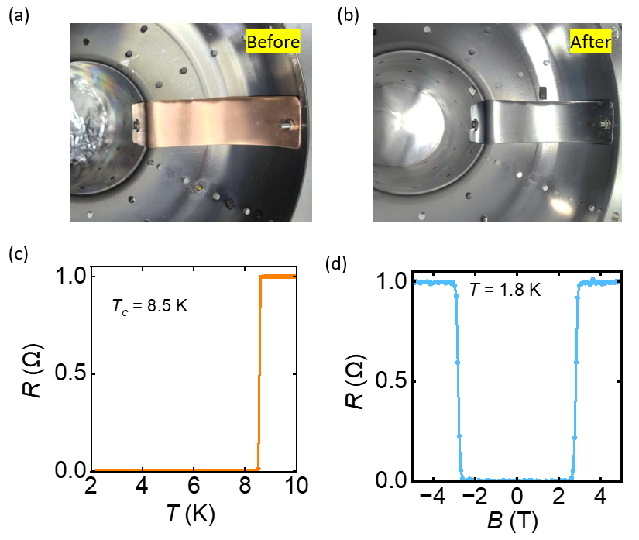
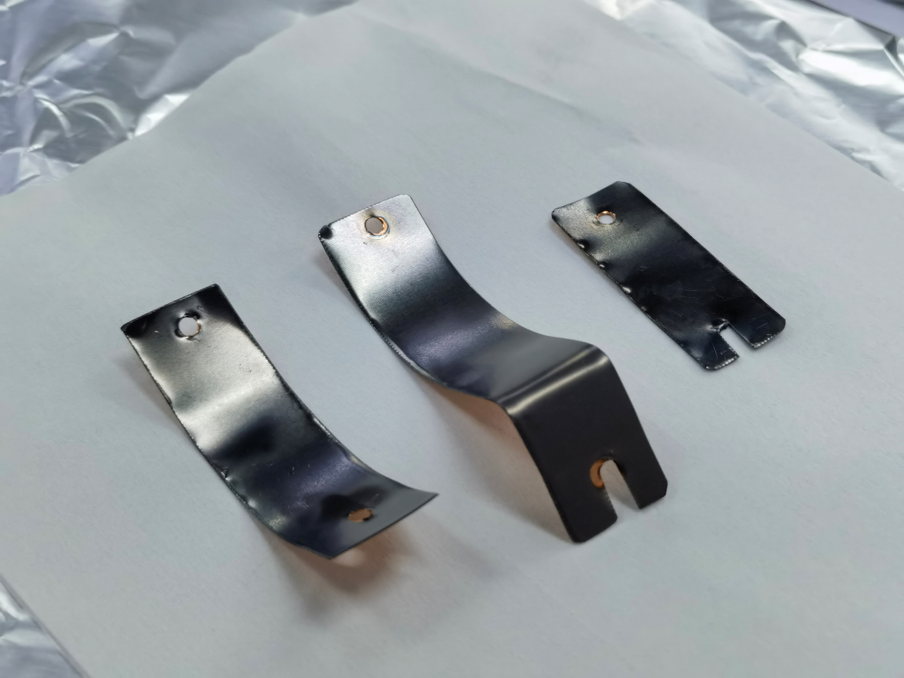

1st generation HiPIMRS (2021-2024)
Thin films on Cu substrate
isopropanol, acetone, and DI water cleaning
②
①
③
③
②
①
TTC meeting(2026), Gif sur Yvette, France
Notes:
Furthermore, we also attempted to sputter superconducting films on copper substrates. Similarly, we achieved superconductivity, with the critical temperature reaching 8.5 K.

Slide 8
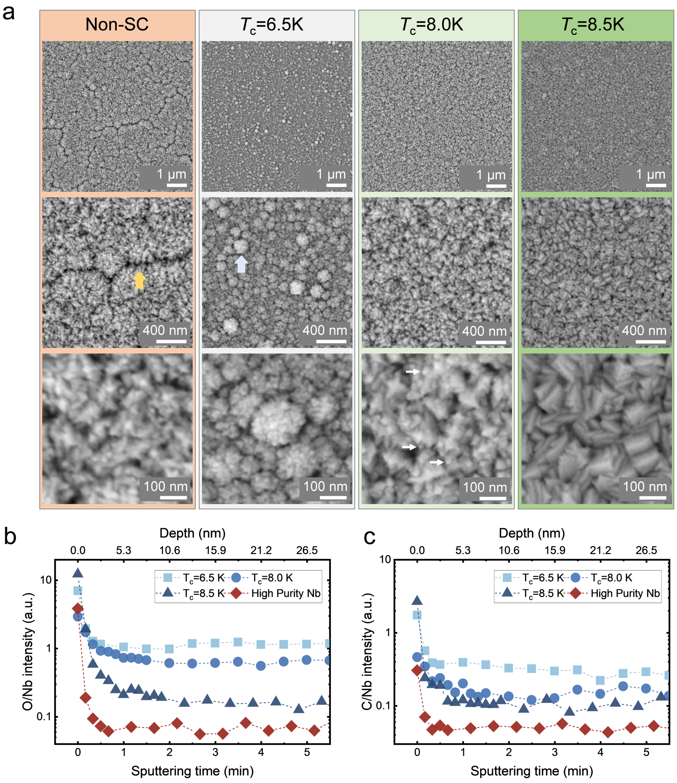
1st generation HiPIMRS (2021-2024)
Structure and morphology analysis
0.2 A
0.5 A
0.75 A
1 A
5
4
μm
3
5
Characteristic peaks of the Nb film —— (110) ; Average surface roughness ~ 15 nm; Particulate size ~ 100 nm;
With increasing impulse current (0.2→1 Å), Nb film grain size increases, defects reduce.
2
3
4
μm
1
1
2
0
1 μm
TTC meeting(2026), Gif sur Yvette, France
Notes:
XRD shows a preferred (110) orientation. Average surface roughness ~15 nm, grain size ~100 nm. the changes in the sample morphology under different currentsDense

Slide 9
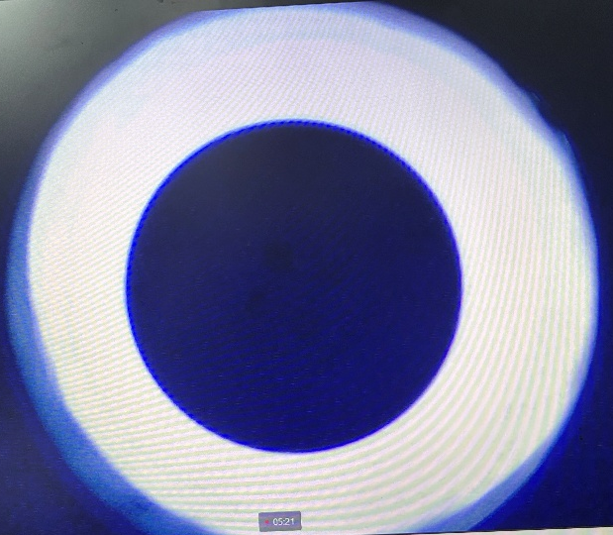
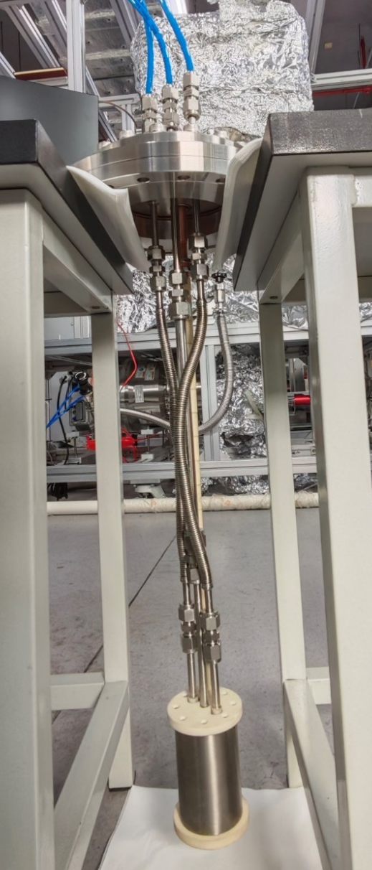
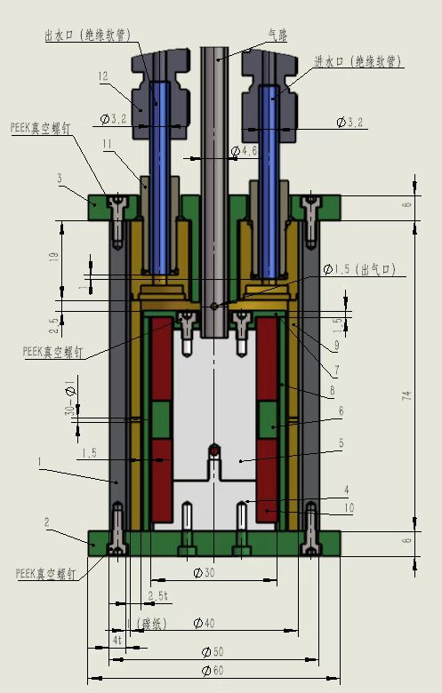
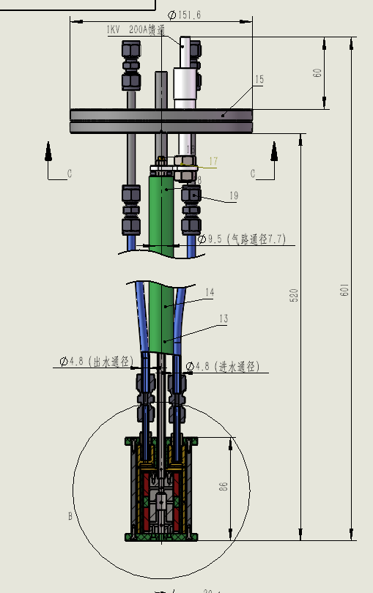
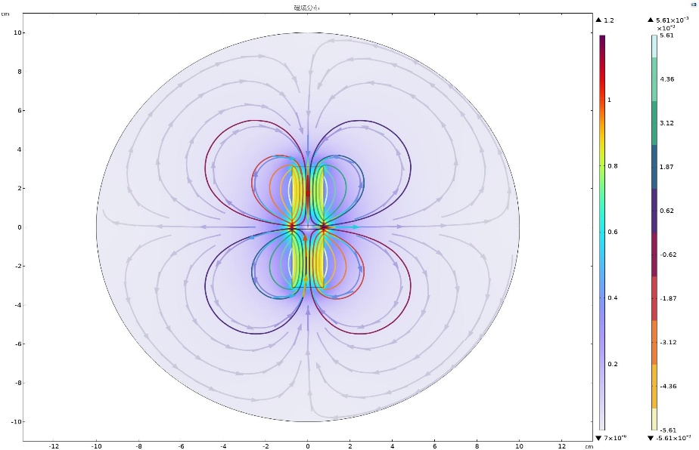
2nd generation HiPIMRS (2024-)
Target system
Intrinsic architecture of target
Plasma
Nb Target
South pole
North pole
North pole
1
South pole
Insulating ceramic
Target specimen
Target system
Notes:
Due to the uniform film of the first-generation target, we designed the second-generation target system.
We reduced the surface area of the target and integrated the magnet into the interior of the target.
We simulated the distribution of the surface magnetic field. This is the plasma during the sputtering process. This is the target specimen.

Slide 10
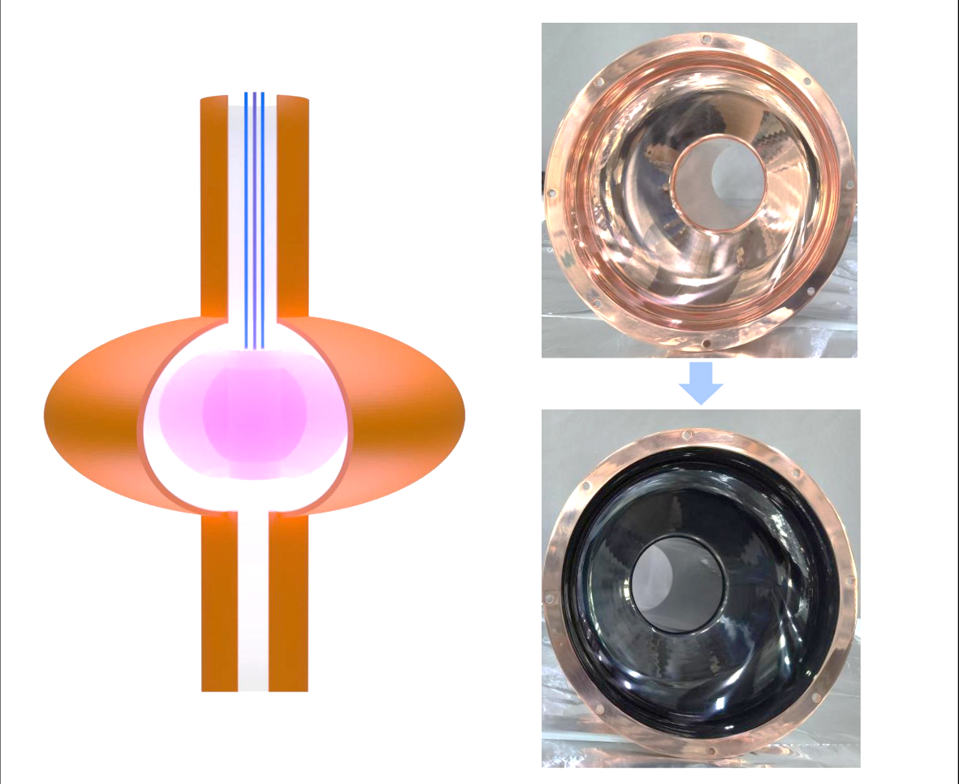
2nd generation HiPIMRS (2024-)
Significantly enhanced the film’s homogeneity
UB5
UB4
UB3
UB2
UB1
BB1
BB2
BB3
BB4
BB5
TTC meeting(2026), Gif sur Yvette, France
Notes:
Similarly, the results of the sample testing demonstrated a significant improvement in uniformity, and the superconducting transition temperature reached 9.2 K.

Slide 11
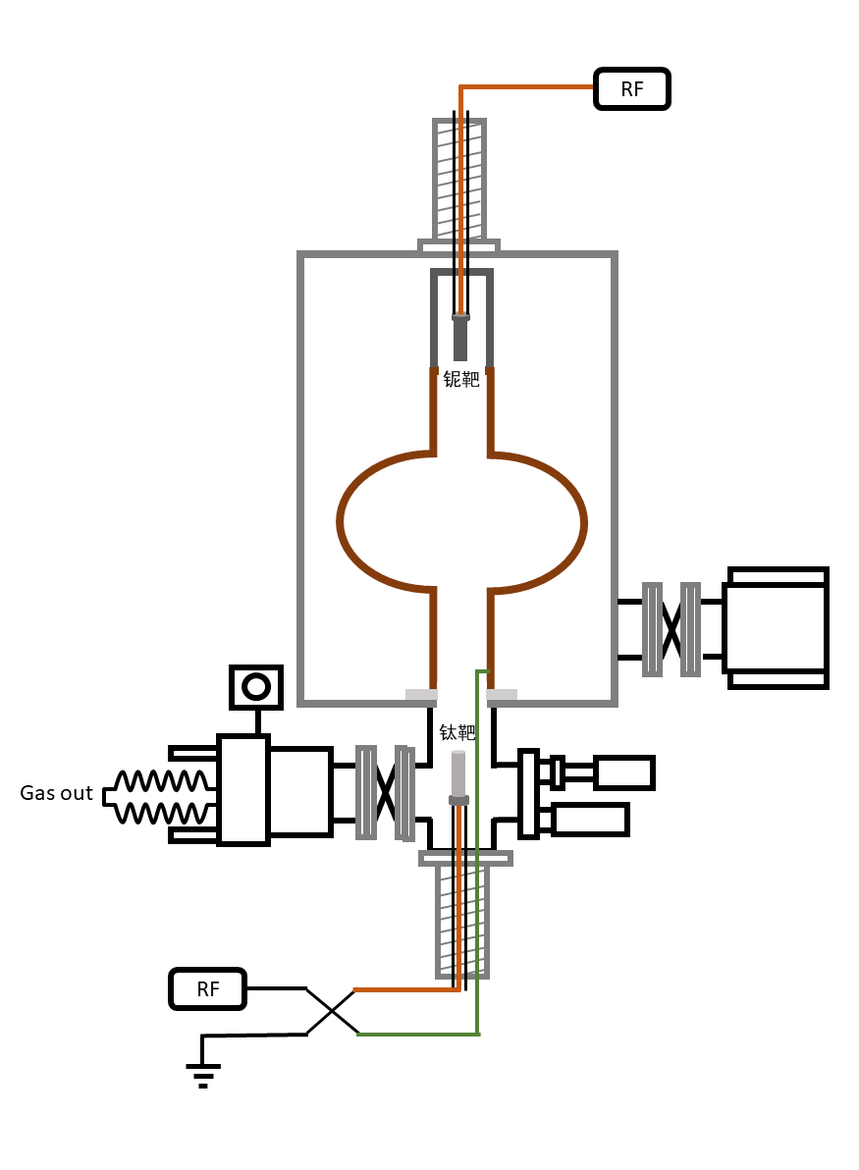
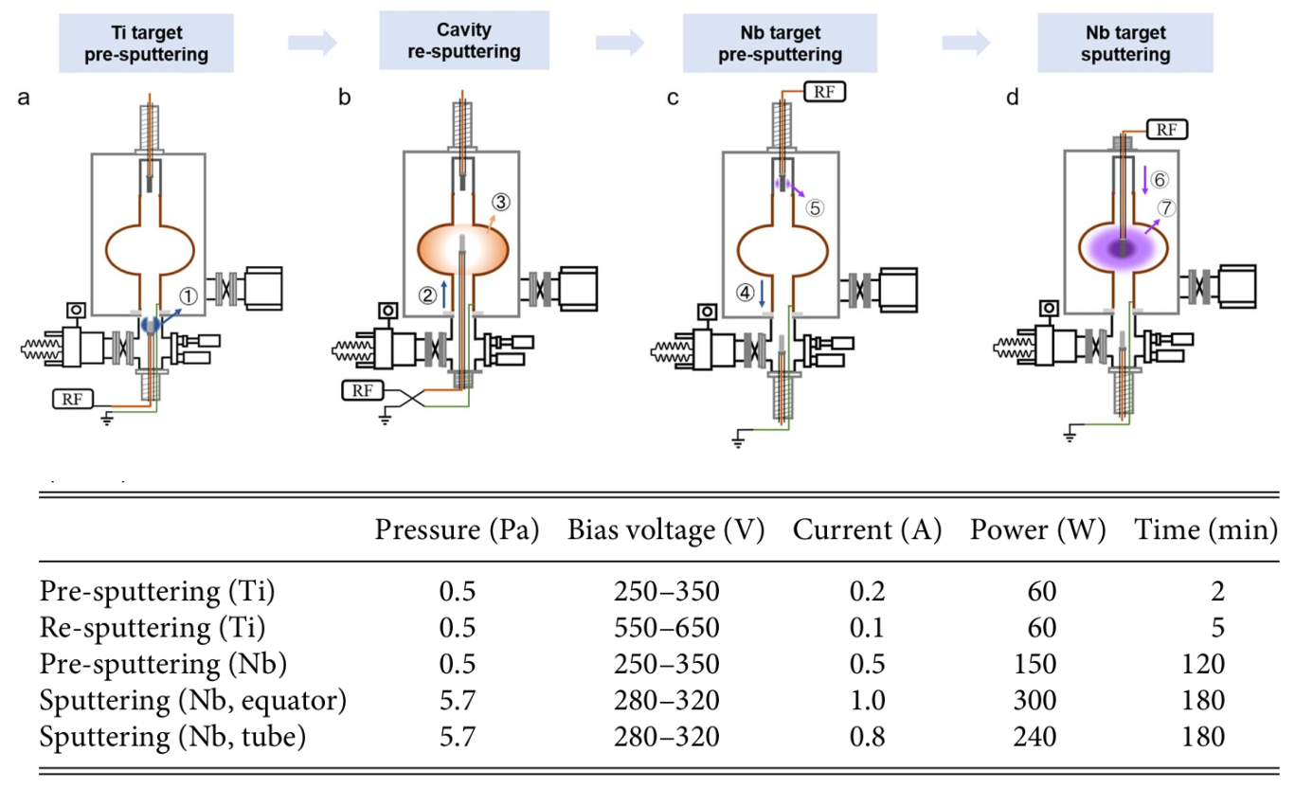
2nd generation HiPIMRS (2024-)
Re-sputtering/Sputtering progress
TTC meeting(2026), Gif sur Yvette, France
Notes:
Inportantly,our process includes an in-situ plasma cleaning step. The cross-sectional diagram clearly shows that there are numerous voids at the interface in the case of no reverse sputtering, but after reverse sputtering, the interface becomes very smooth. The process significantly enhances adhesion between the Nb film and the Cu substrate. At the same time, it can be observed that the Non resputting samples showed obvious delamination, but the resputtering samples had excellent adhesion.

Slide 12
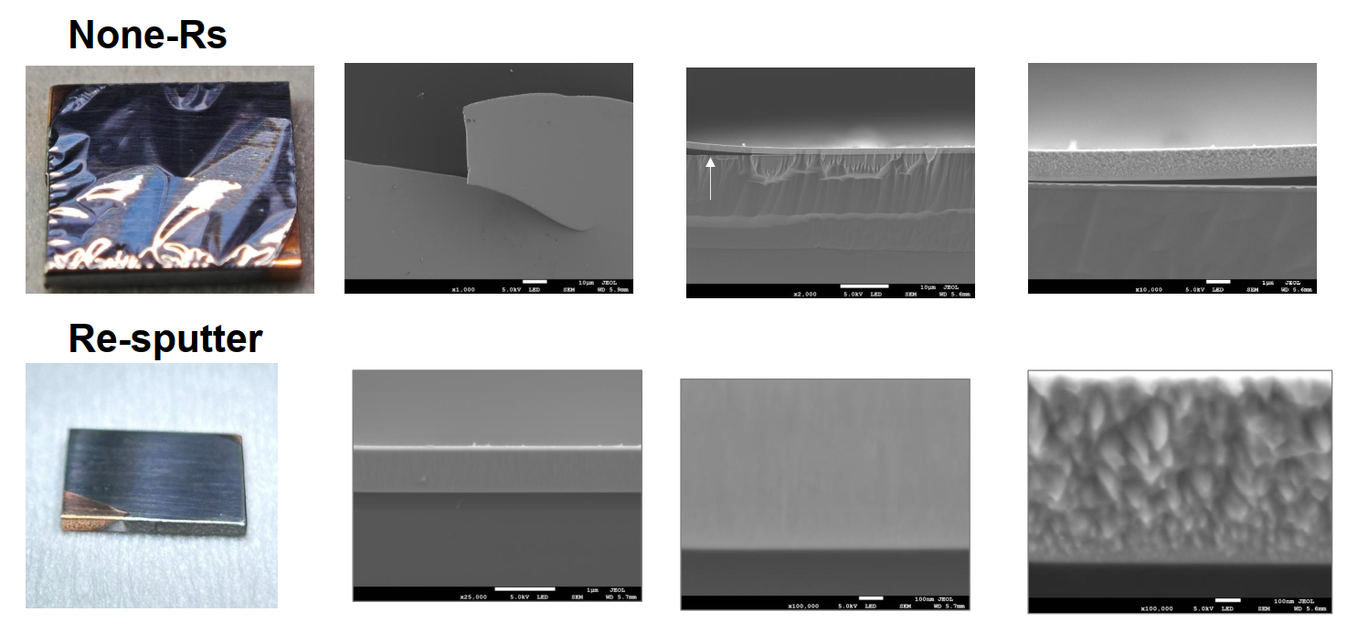
2nd generation HiPIMRS (2024-)
In-situ plasma cleaning, for enhanced adhesion efficacy
TTC meeting(2026), Gif sur Yvette, France
Notes:
The film is clearly separated from the substrate.

Slide 13
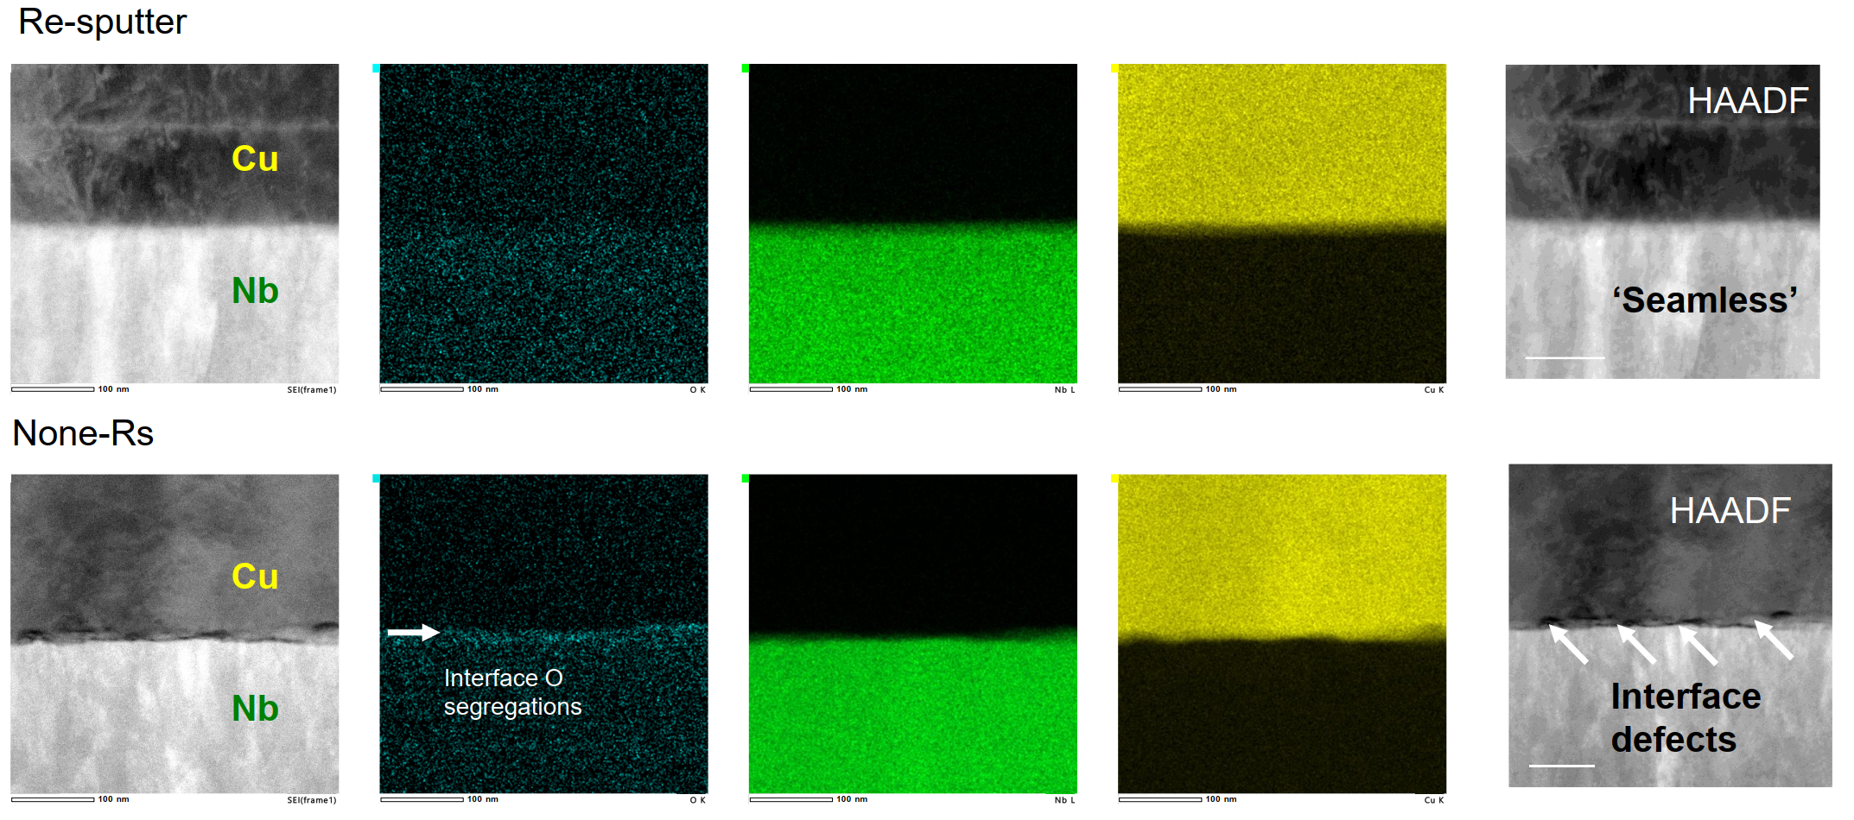
2nd generation HiPIMRS (2024-)
Removing oxygen and void.
TTC meeting(2026), Gif sur Yvette, France

Slide 14
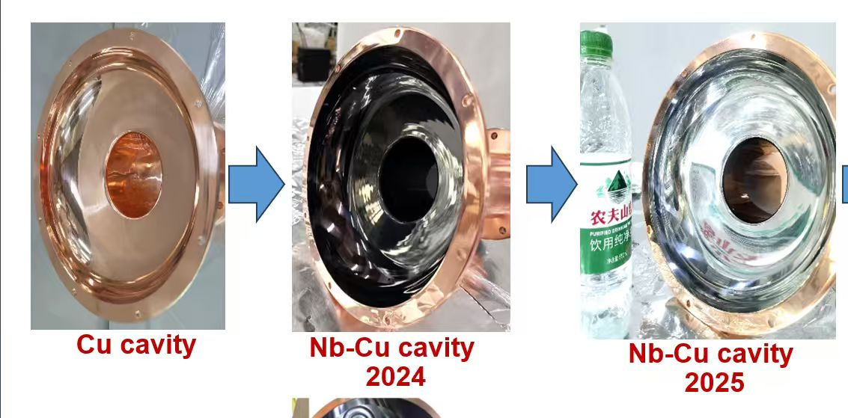
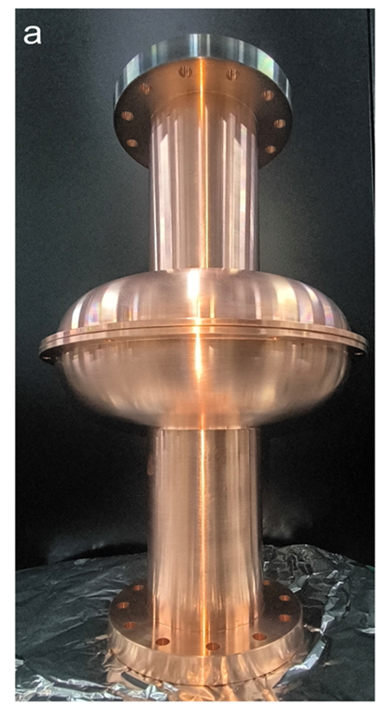
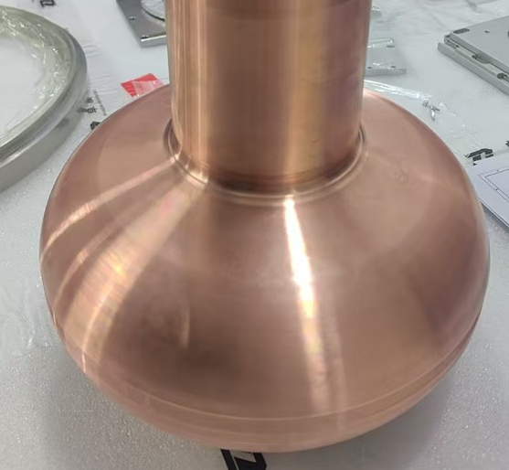
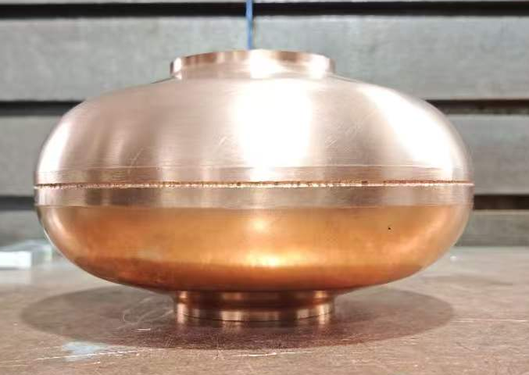
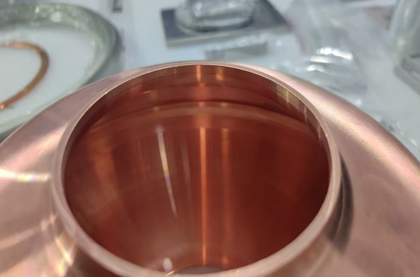
Progress of Nb-Cu cavity
Sputtering in hemi-spherical cavity
1.3 GHz copper cavity and vertical measurement
TTC meeting(2026), Gif sur Yvette, France
Notes:
Based on the above results and methods, we carried out sputtering coating on the semi-copper cavity. Through the second-generation target system, we have already achieved the sputtering of a film with obvious metallic luster on the copper cavity. Subsequently, we will conduct sputtering coating on the inner wall of the complete copper cavity and perform low-temperature vertical testing.

Slide 15
Summary and Outlook
Developed a high-energy pulsed magnetron sputtering apparats for high-quality superconducting Nb films on Cu cavity.
The Nb thin films on Cu cavities demonstrate T_{c} of 9.2 K, homogenously thickness distribution, and strong adhesion with Cu substrate.
It is impressive to develop Nb₃Sn-Cu cavities technique.
Notes:
We developed a novel HiPIMRS apparatus for high-quality Nb films on complex SRF Cu cavities. The Nb films show Tc of 9 K, uniform thickness, and strong adhesion. We are now moving towards Nb₃Sn-Cu cavity technology.

Slide 16


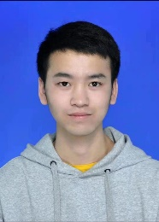
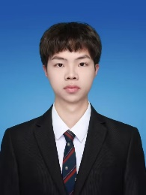
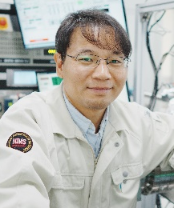


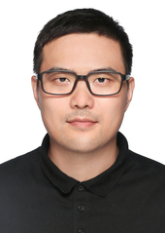


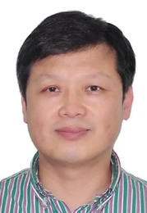
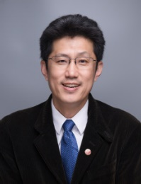

Acknowledgements
Dr. Peng Dong
Yanjiang Wang
Jianjun Xiao
Prof. Jun Li
Prof. Jun Li
Prof. Yulin Chen
Dr. Zhaoxi Chen
Prof. Xuerong Liu
Prof. Jinfang Chen
Prof. Dong Wang
Prof. Zhi Liu
Notes:
Finally , I would like to thank my collaborators for their help and support.

Slide 17
Thanks for your attention！

