Slide 1
From 1.3 GHz to 400 MHz Nb/Cu Cavities: Challenges and Optimisation Strategies
presenter: Caroline Hain
G. Rosaz, C. Pereira, S. Forel, L. Ferreira, D. Doretto, A. Guyot, A. Vassallo, K. Brunner, G. Pechaud, D. Smekens, B. Dubois, S. Bizzaglia, S. Zadeh, F. Pelloux
(and many others from TE, SY, EN)
TTC meeting
9-12 June 2026

Slide 2

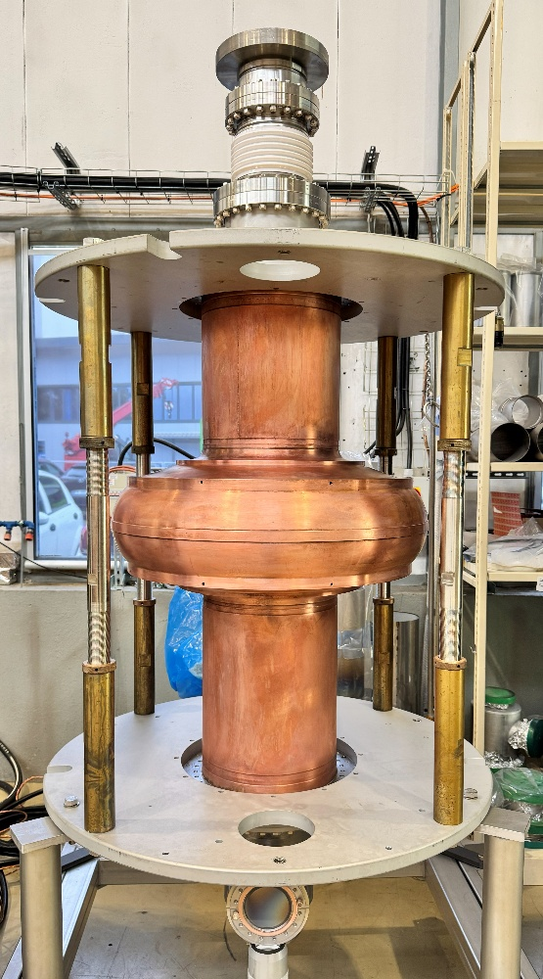
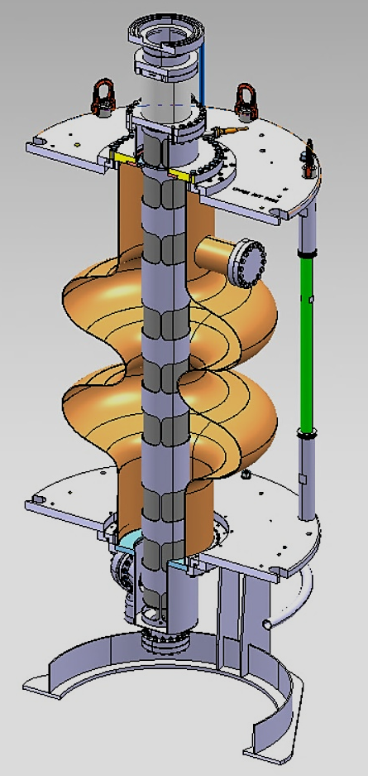
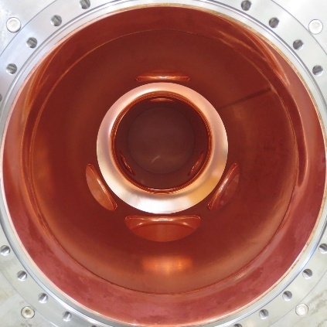
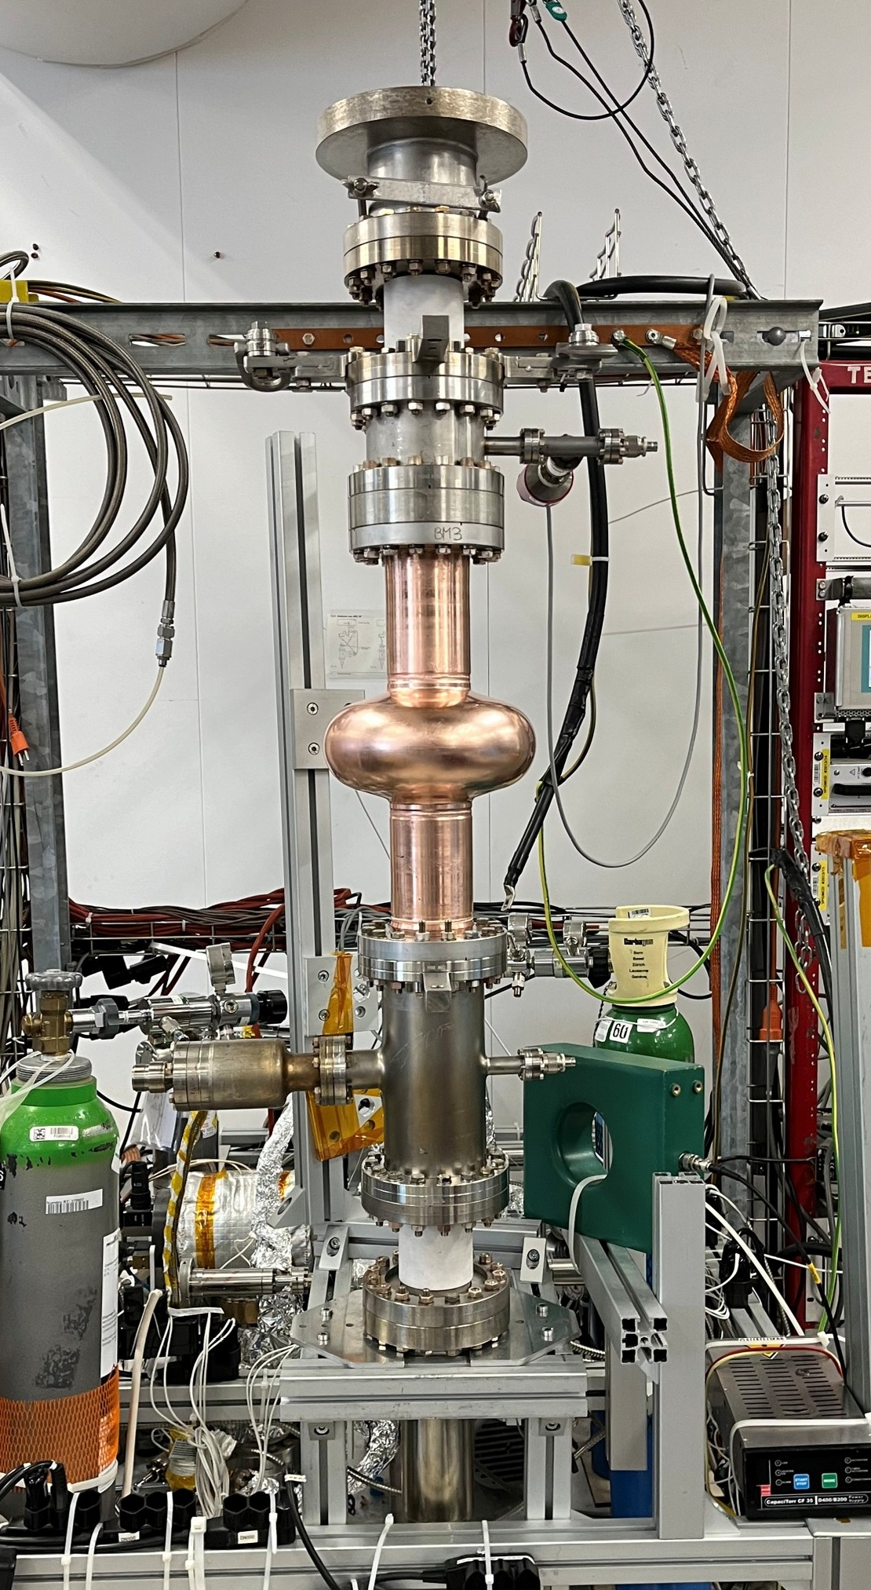
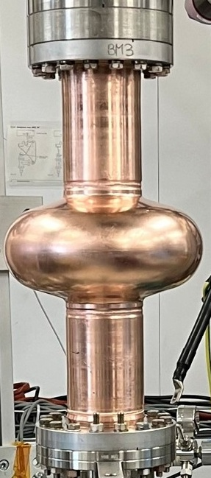
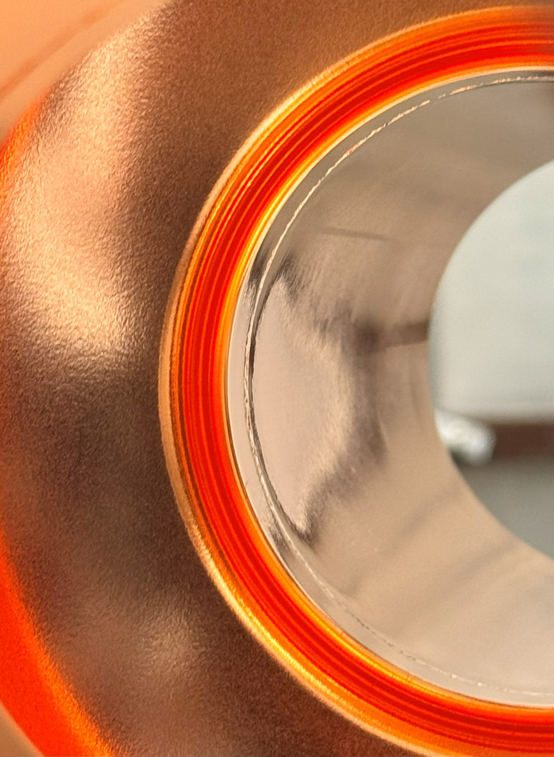
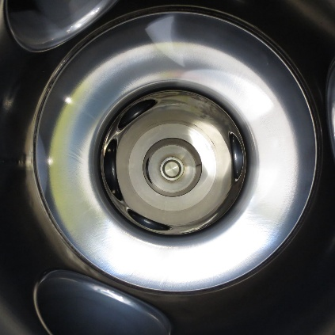
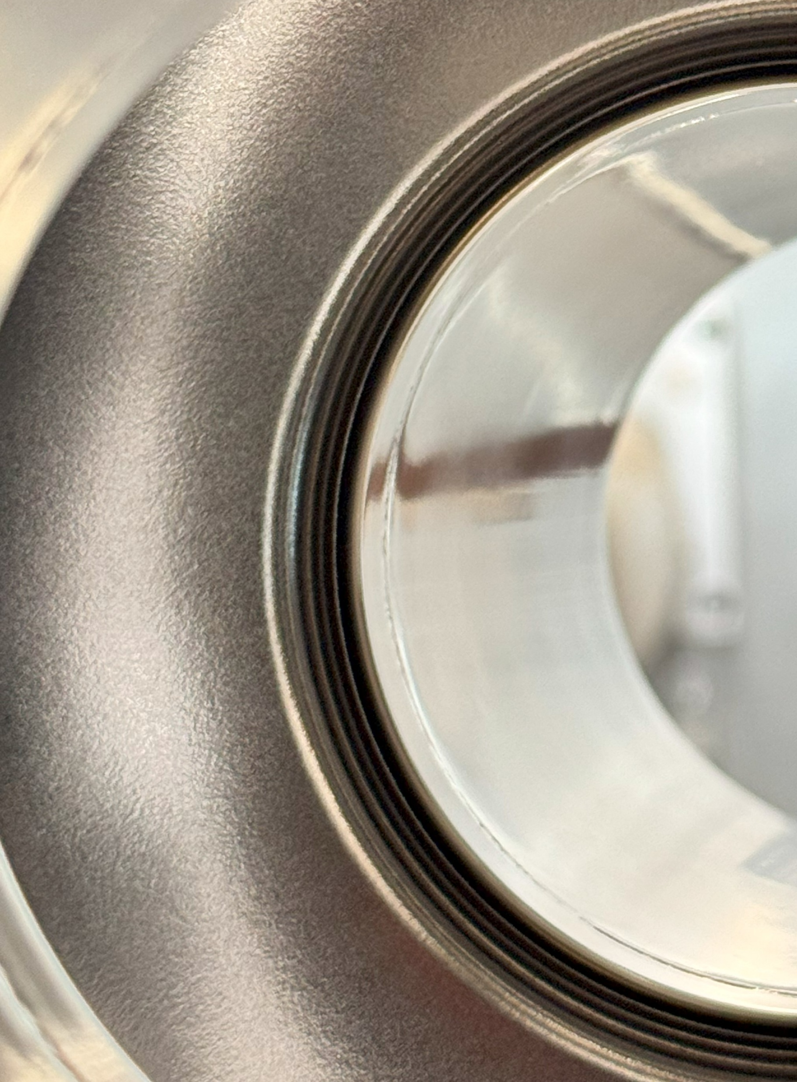
Quantitative objectives
1.3 GHz
400 MHz
4×10⁸ @ 12 MV/m, 4.2 K (scaled 400 MHz FCC specs)
1×10¹⁰ @ 20 MV/m, 2 K (R&D goal)
1×10¹⁰ @ 25 MV/m, 2 K (R&D goal)
2-cell, 3.3×10⁹ @ 12.2 MV/m, 4.5 K (FCC specs, bare)
What is the current status?

Slide 3
1.3 GHz R&D progress

Slide 4
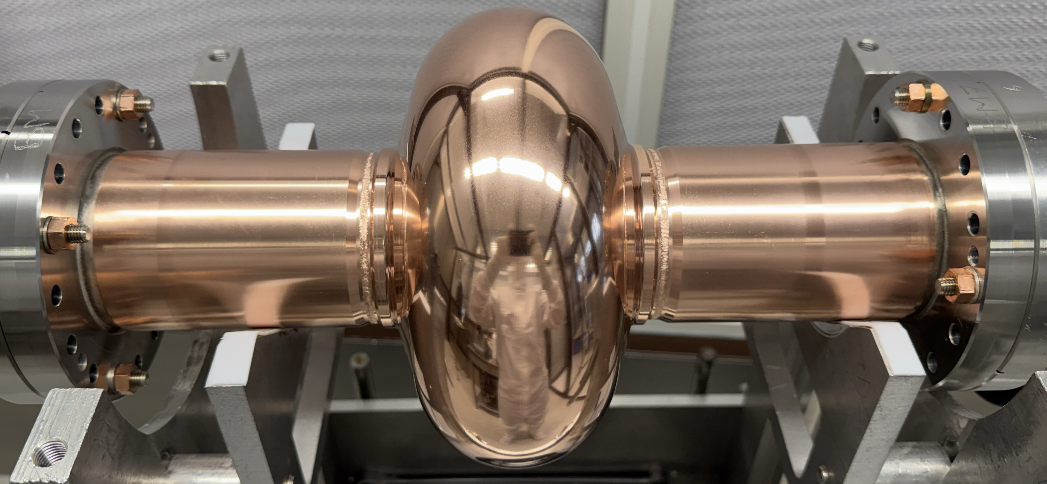
Advancements in 1.3 GHz R&D
important factors:
surface state/treatment of Cu (polishing + passivation)
compact, high purity Nb coatings, i.e. strict control over level of impurities (e.g. oxygen, hydrogen, particulates)
example 1.3 GHz cavity

Slide 5
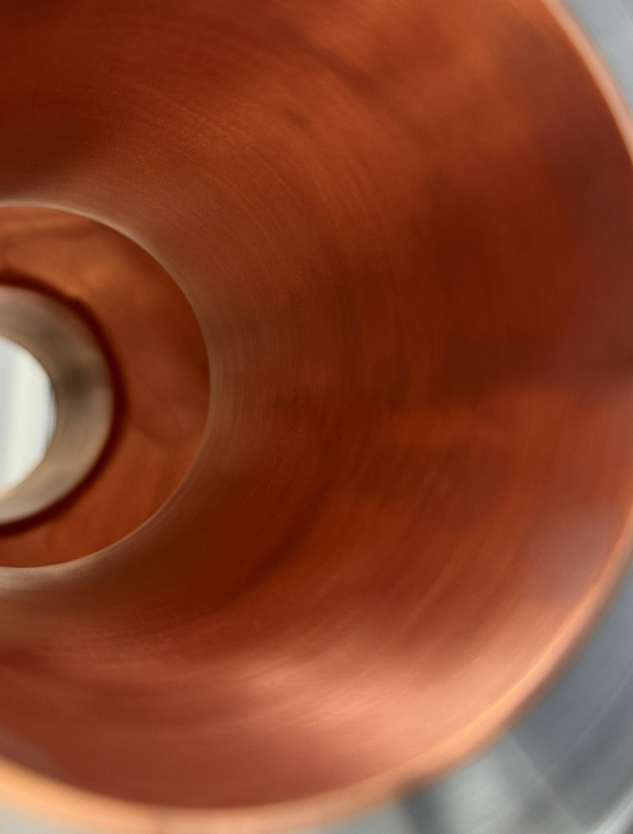
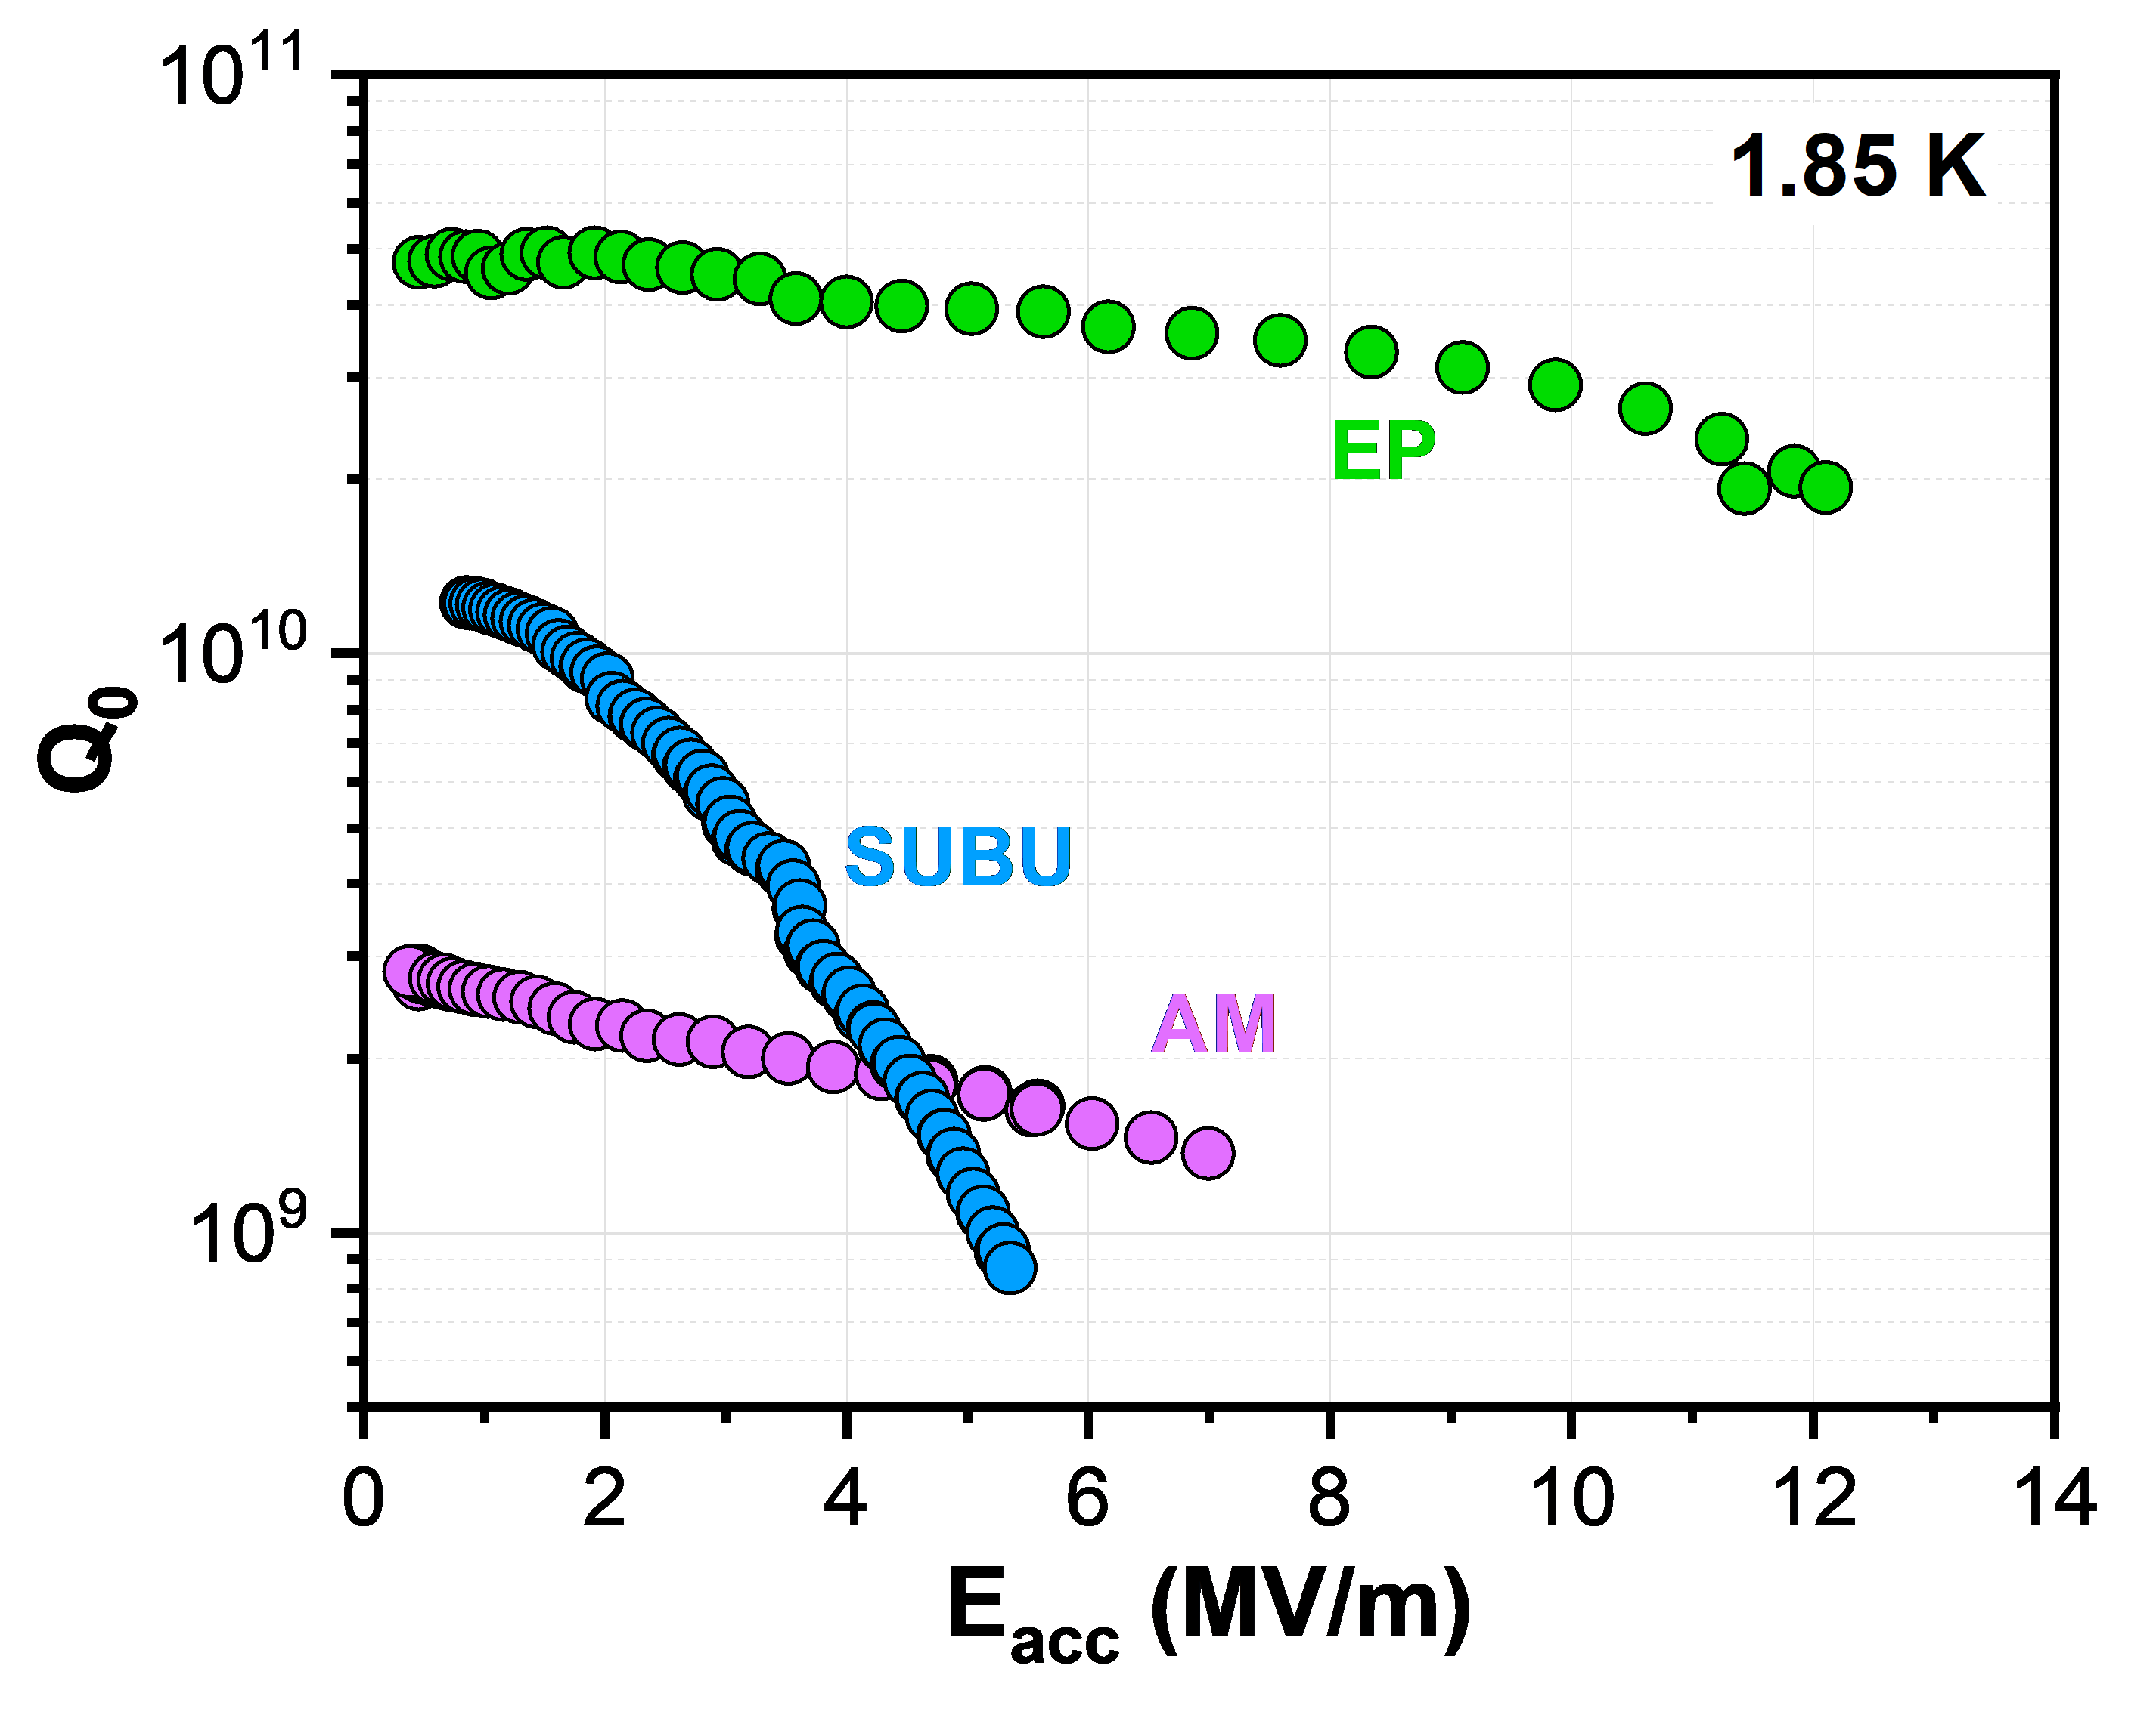
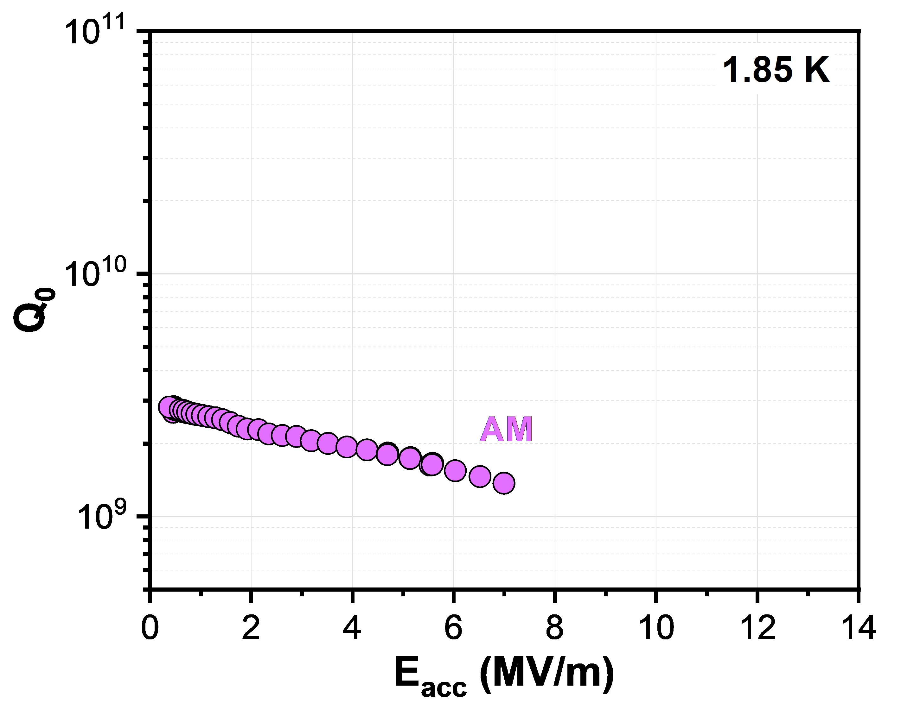
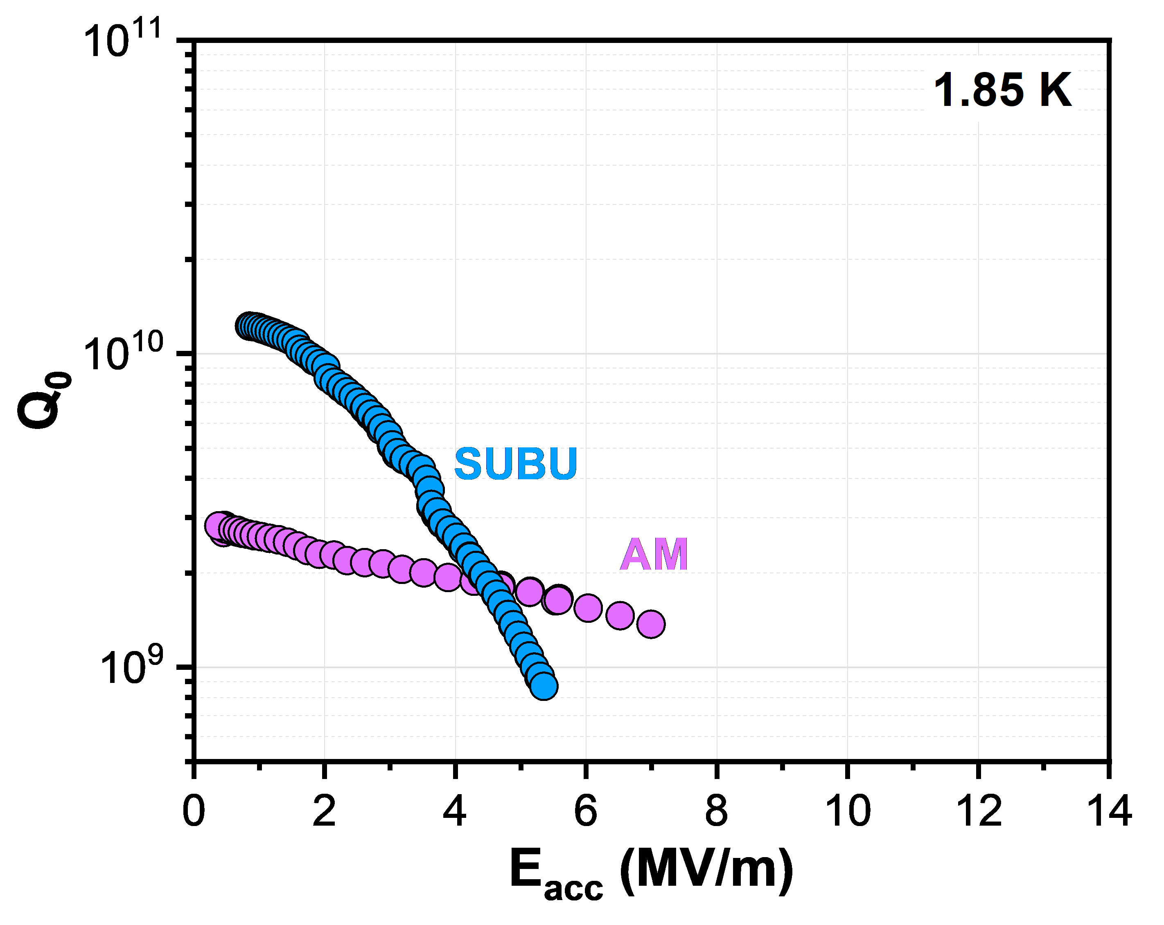
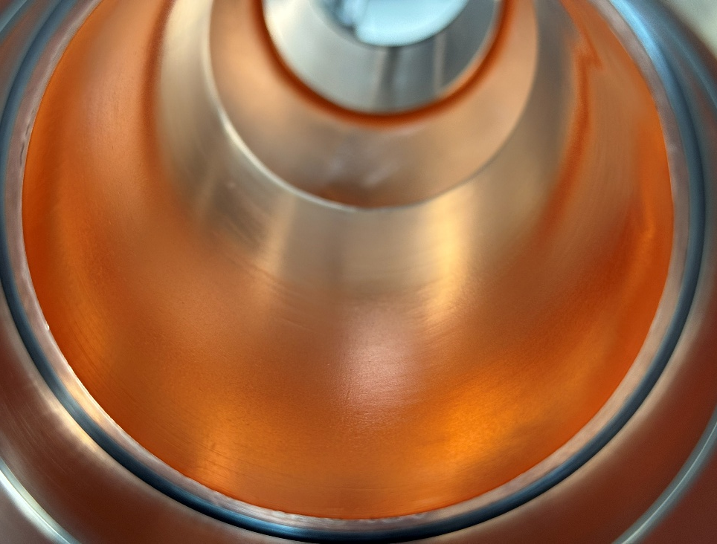
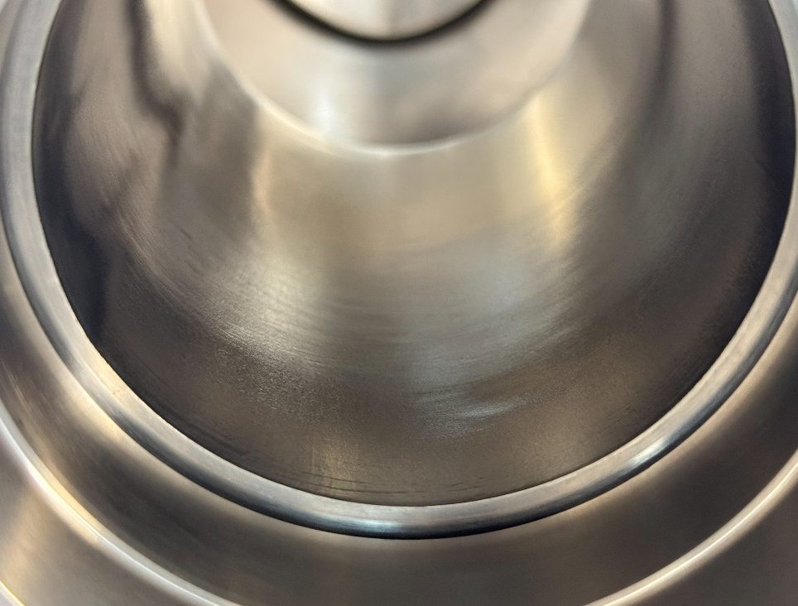
Advancements in 1.3 GHz R&D
important factors:
surface state/treatment of Cu (polishing + passivation)
compact, high purity Nb coatings, i.e. strict control over level of impurities (e.g. oxygen, hydrogen, particulates)
example 1.3 GHz cavity
as-machined (AM)
machining marks, high roughness, mechanically damaged near-surface layer
chemical polishing (with SUBU)
mixture of sulfamic acid, hydrogen peroxide,
n-butanol and ammonium citrate
removes damaged layer, reduces roughness BUT differentially etches crystallographic orientations, can induce micropitting
electropolishing (EP)
mixture of phosphoric acid and n-butanol
reduces microroughness, more uniformly polished surfaces
as-machined, cleaned
electropolished
EP, Nb-coated

Slide 6
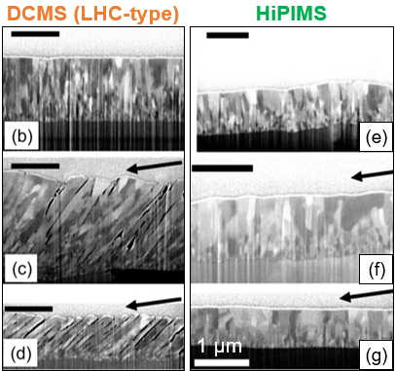
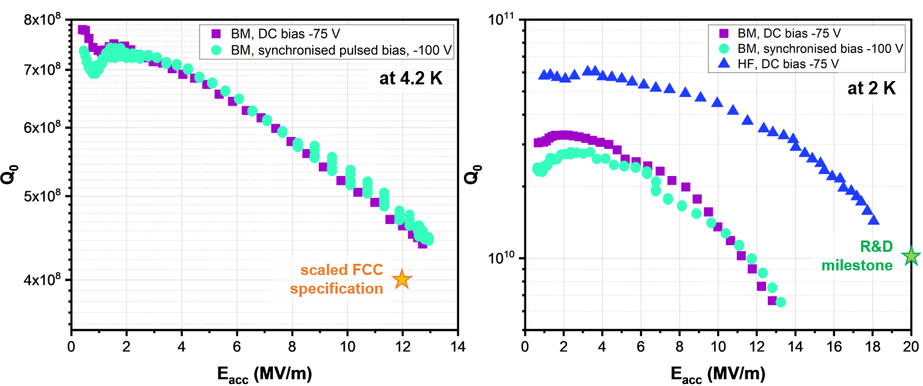

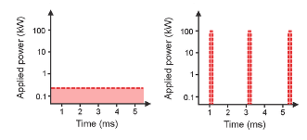
Advancements in 1.3 GHz R&D
important factors:
surface state/treatment of Cu (polishing + passivation)
compact, high purity Nb coatings, i.e. strict control over level of impurities (e.g. oxygen, hydrogen, particulates)
EP + HiPIMS
example 1.3 GHz cavity
HiPIMS vs DCMS
high plasma density (approx. 10¹⁹ m⁻³) compared to DCMS (approx. 10¹⁶ m⁻³)
increased probability for ionising collisions
high degree of ionisation of sputtered material
PhD work of C. Pereira
T. Mieno Plasma Science and Technology
M. Ghaemi et al. Surface & Coatings Technology 476 (2024) 130199
11th TFSRF Workshop (2024)

Slide 7
How to transfer this approach to 400 MHz cavities?

Slide 8
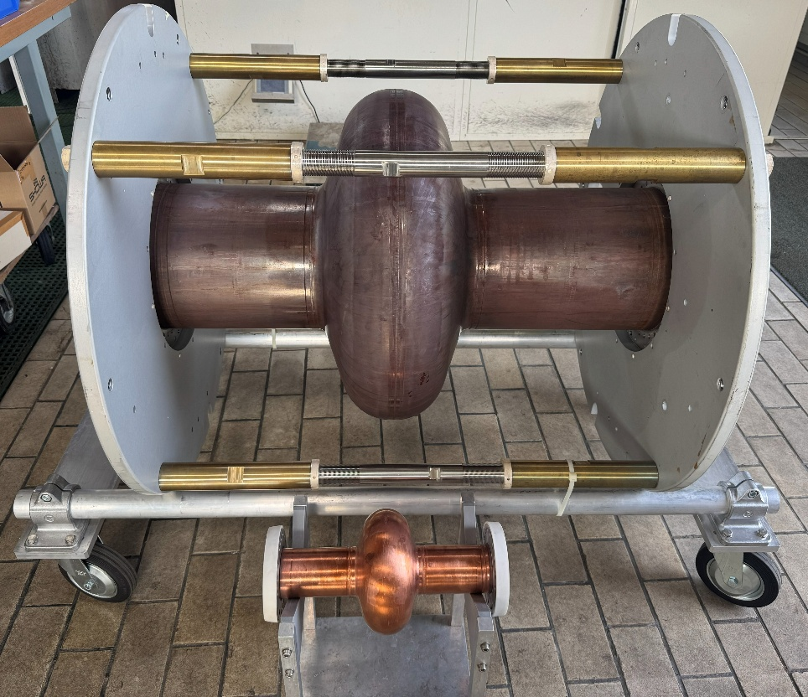
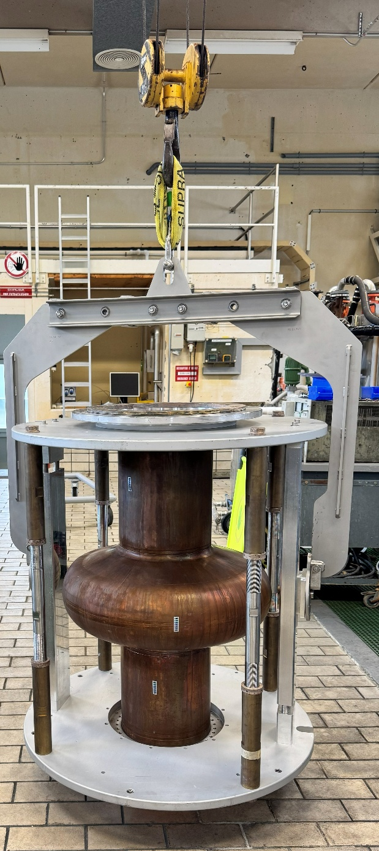
Upscaling to 400 MHz
example 1.3 GHz cavity
moving from 1.3 GHz to 400 MHz cavities can present a challenge
much larger surface area needs to be treated
object handling becomes significantly more difficult, requiring crane support
switching between process steps is time-consuming
400 MHz
1.3 GHz

Slide 9
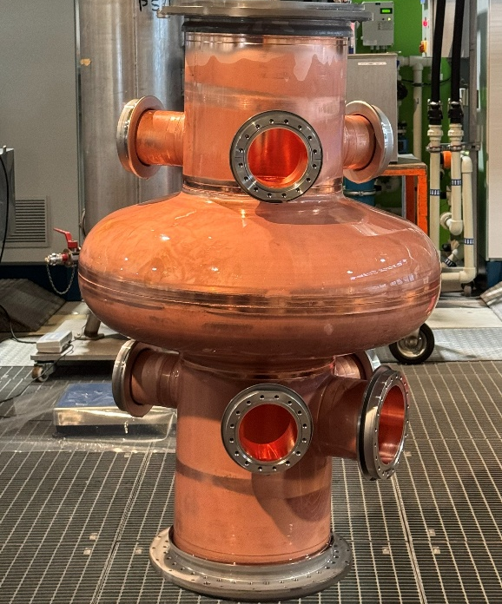
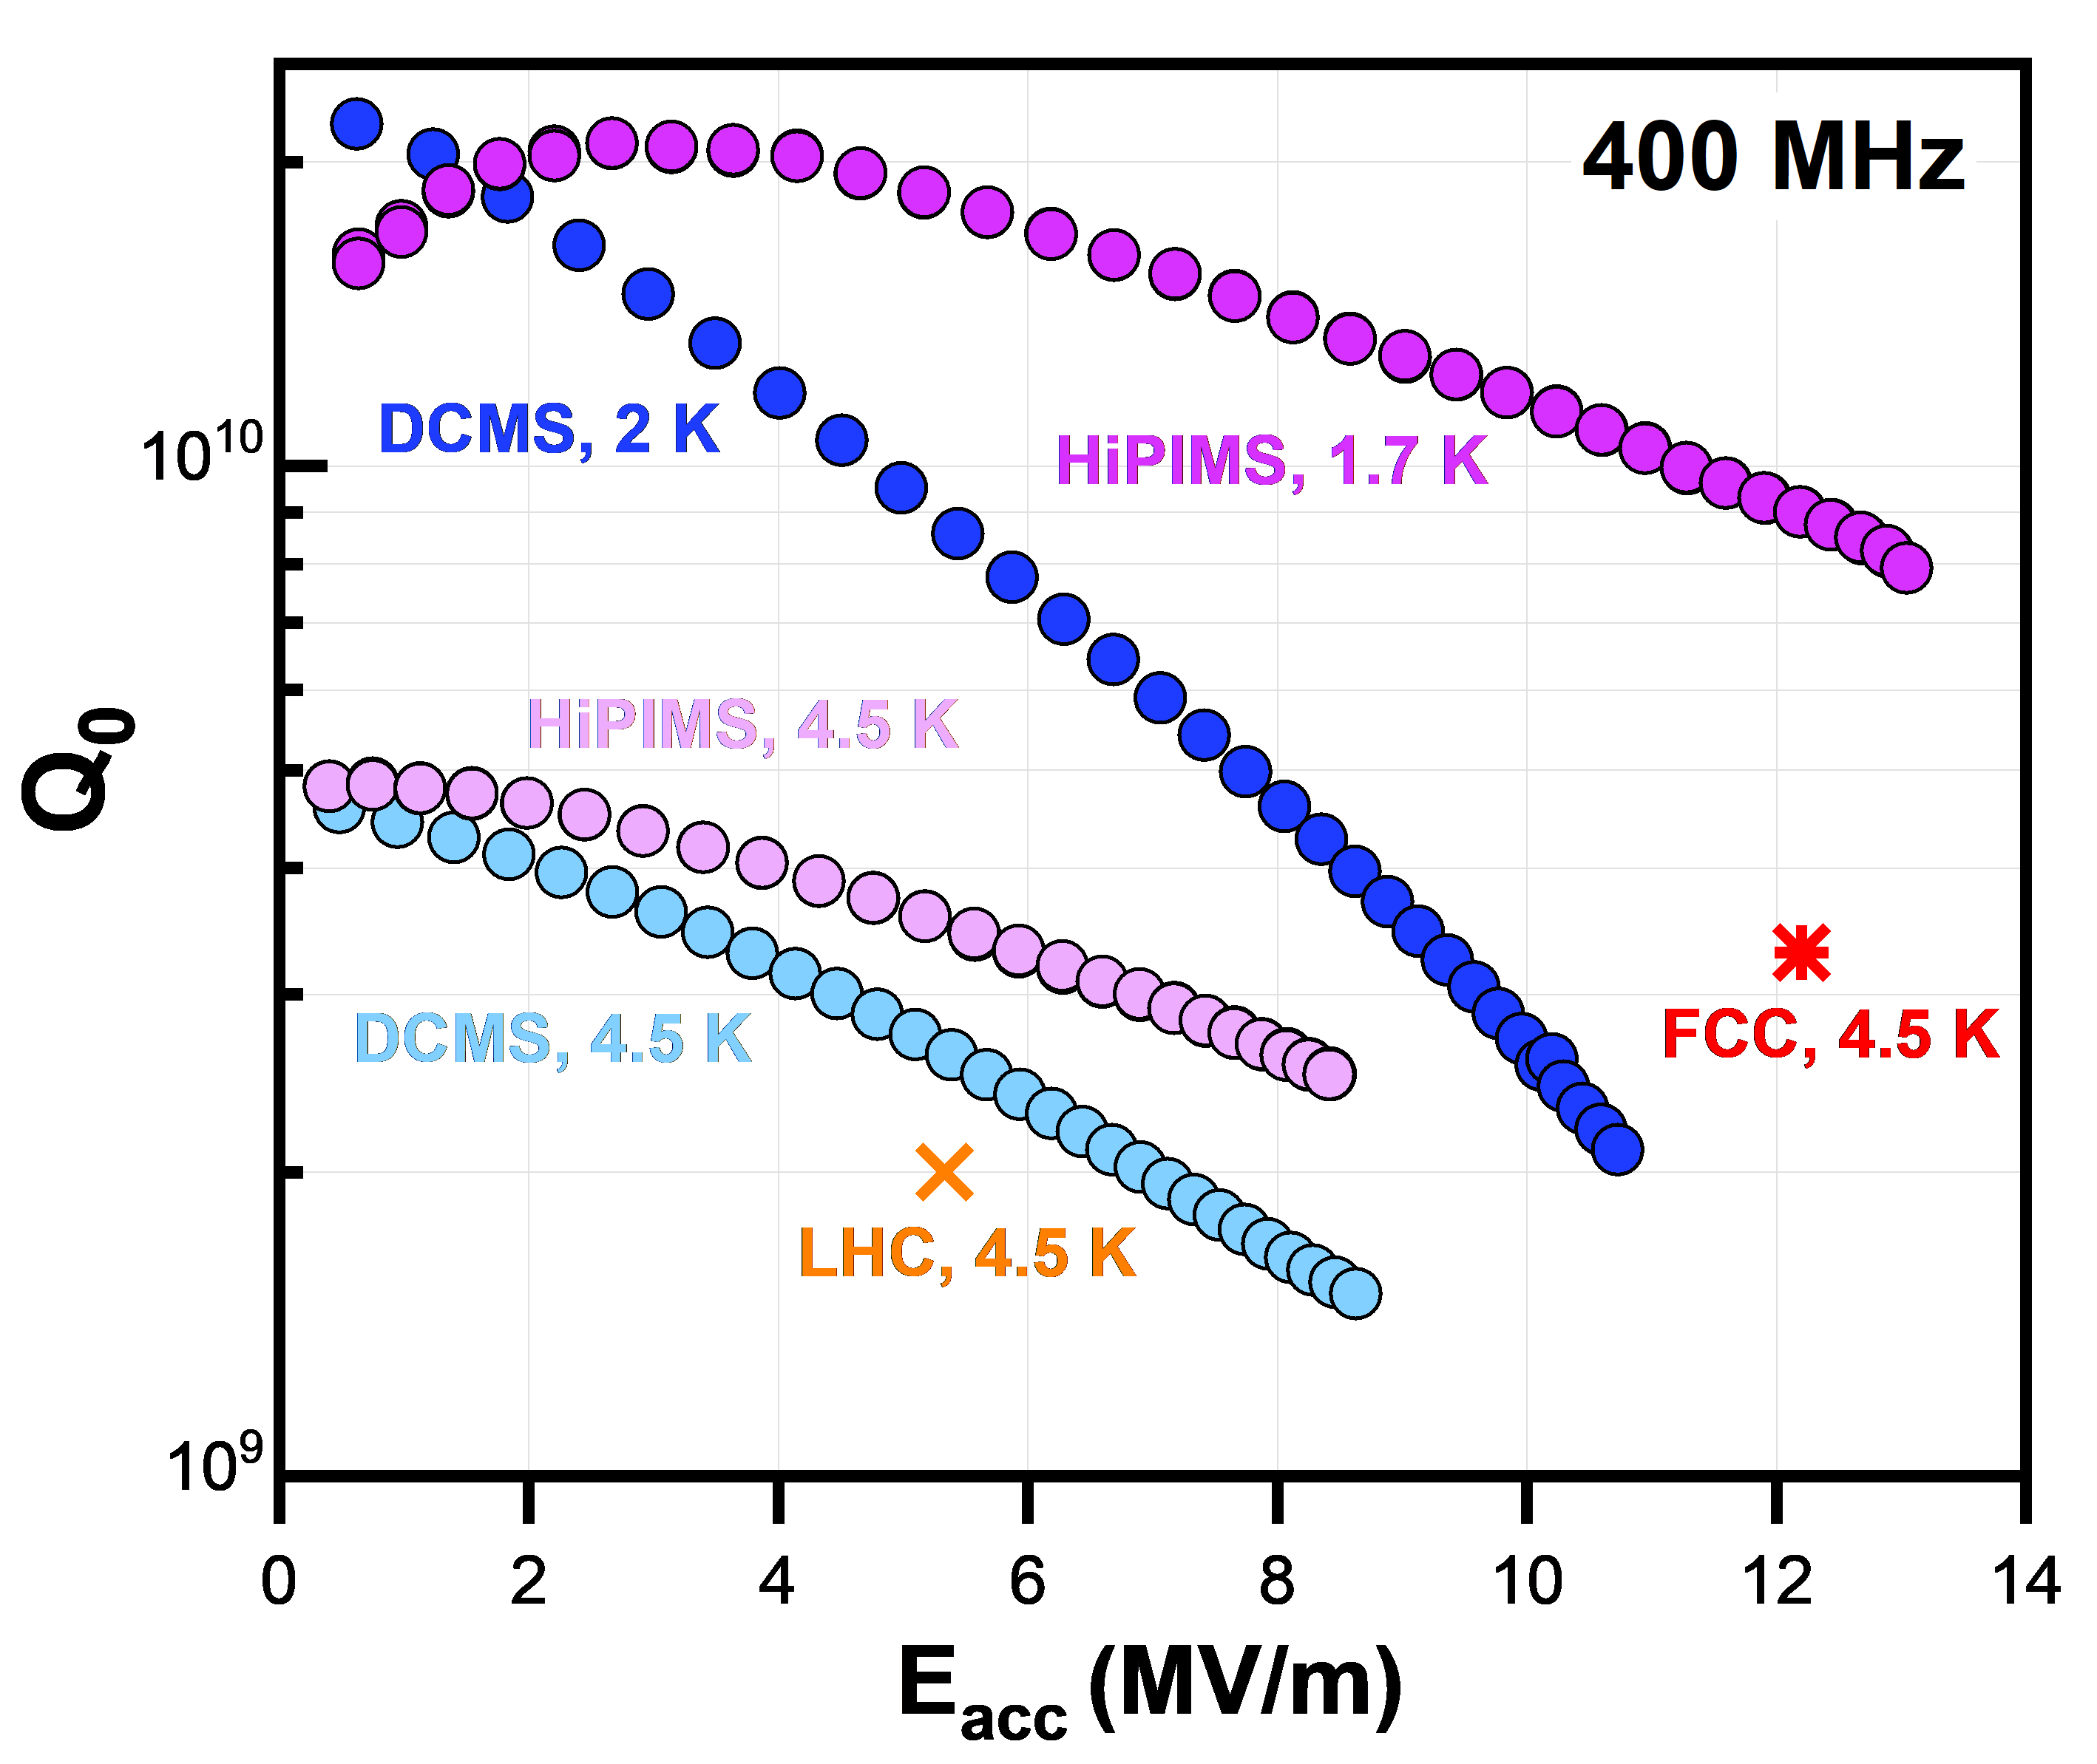
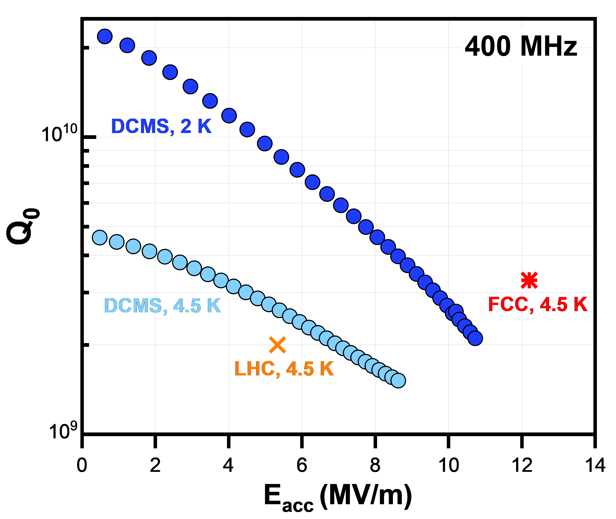
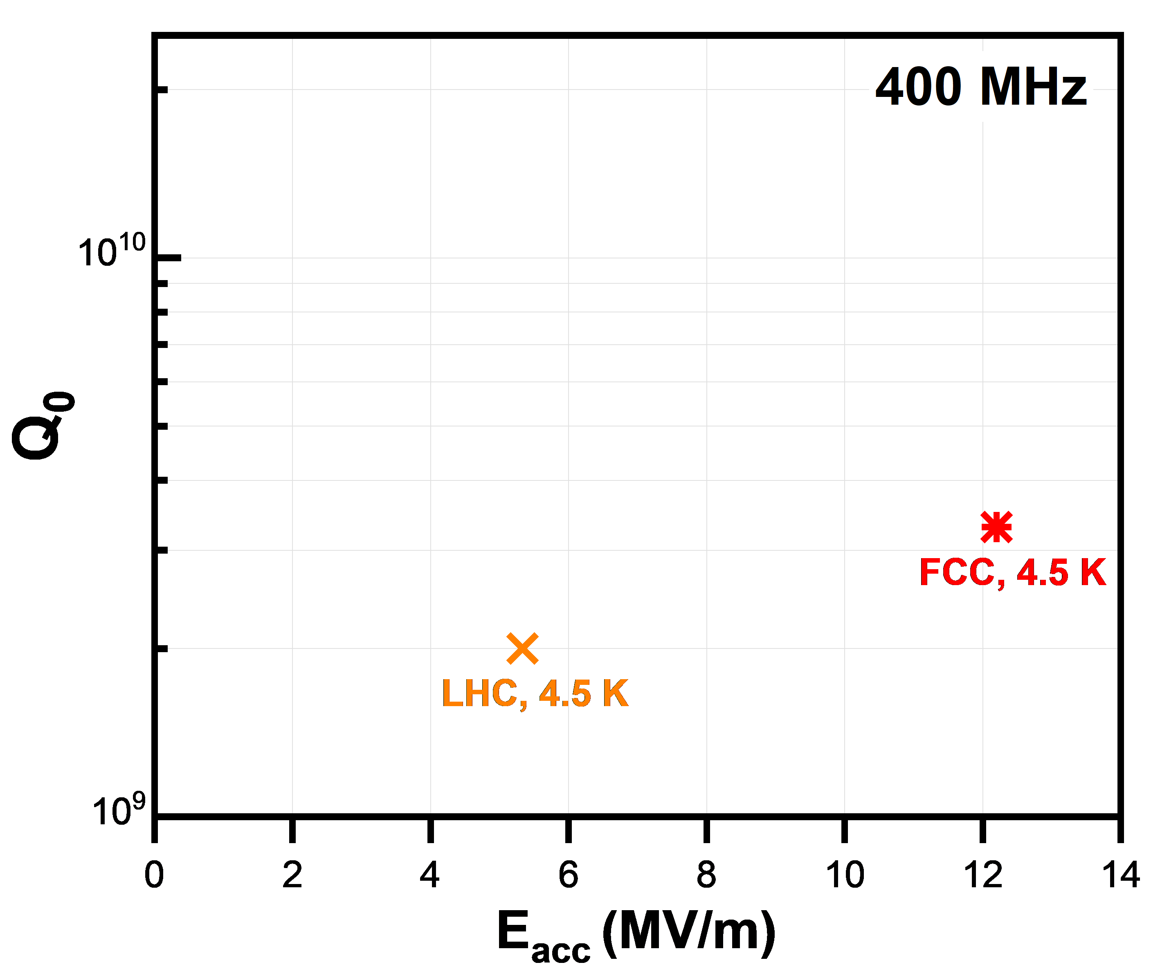
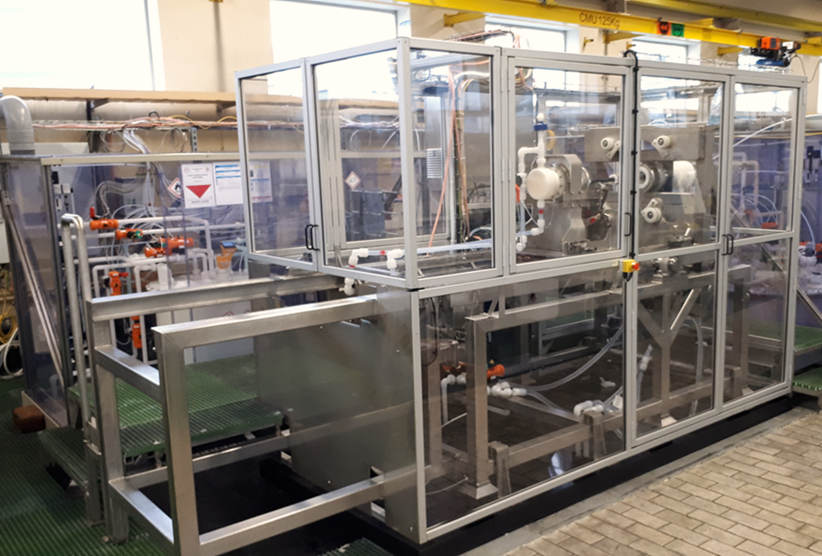
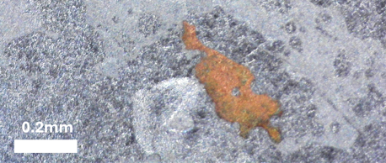
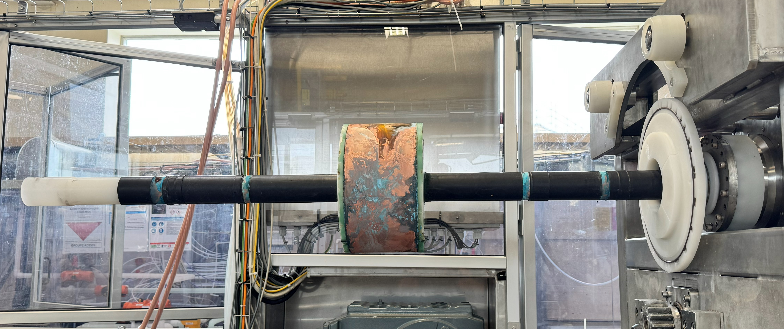
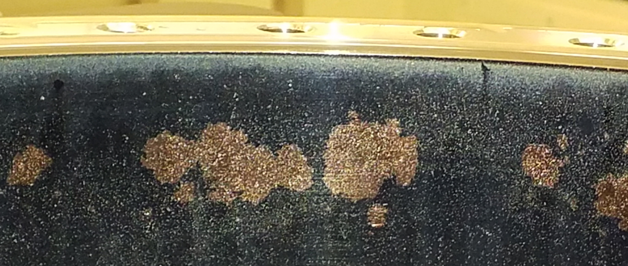
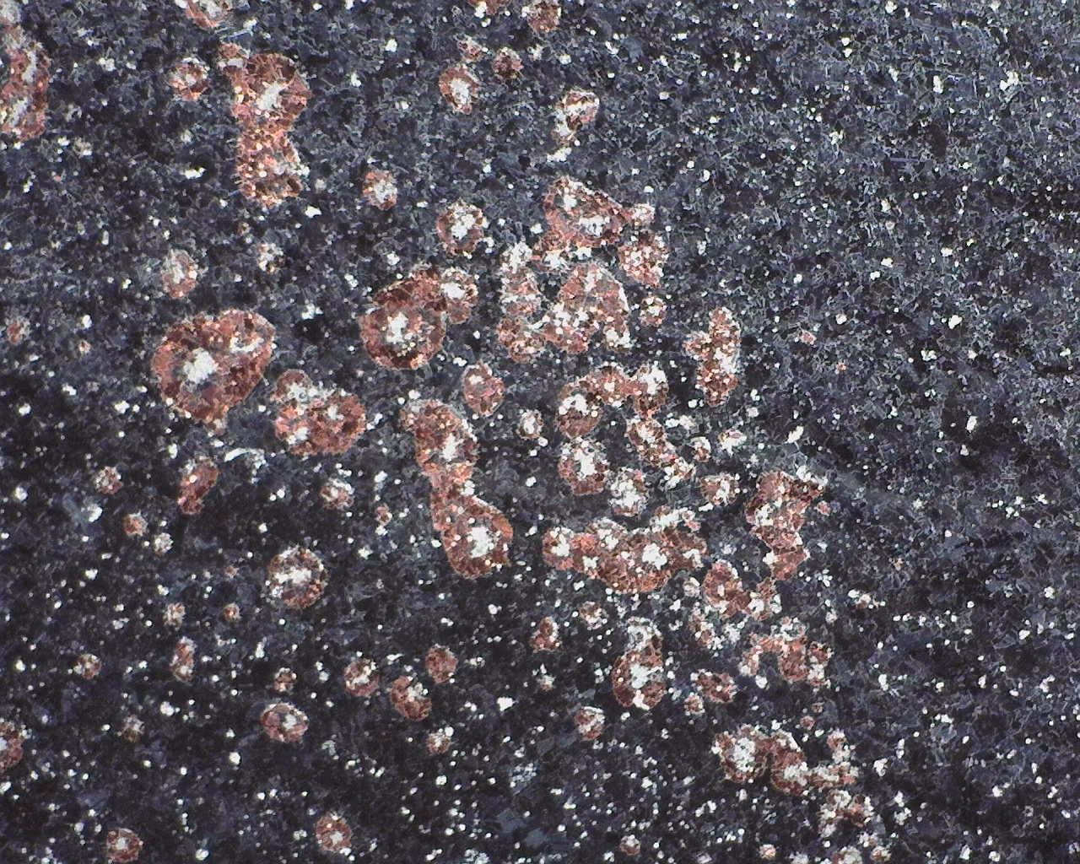
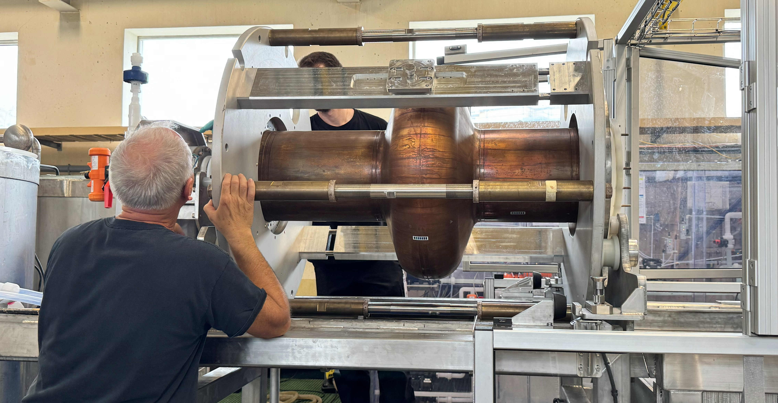
Upscaling to 400 MHz
SUBU + DCMS
moving to EP
SUBU + HiPIMS
so far ALL attempts of EP of 400 MHz cavities have resulted in peel-off
example 400 MHz cavity
20 mm
important factors:
surface state/treatment of Cu (polishing + passivation)
compact, high purity Nb coatings, i.e. strict control over level of impurities (e.g. oxygen, hydrogen, particulates)
SUBU surface treatment, DCMS coating → LHC specs met at 4.5 K
SUBU surface treatment, high power impulse magnetron sputtering (HiPIMS) → improvement in Q₀, BUT FCC specifications not met yet
10 mm

Slide 10
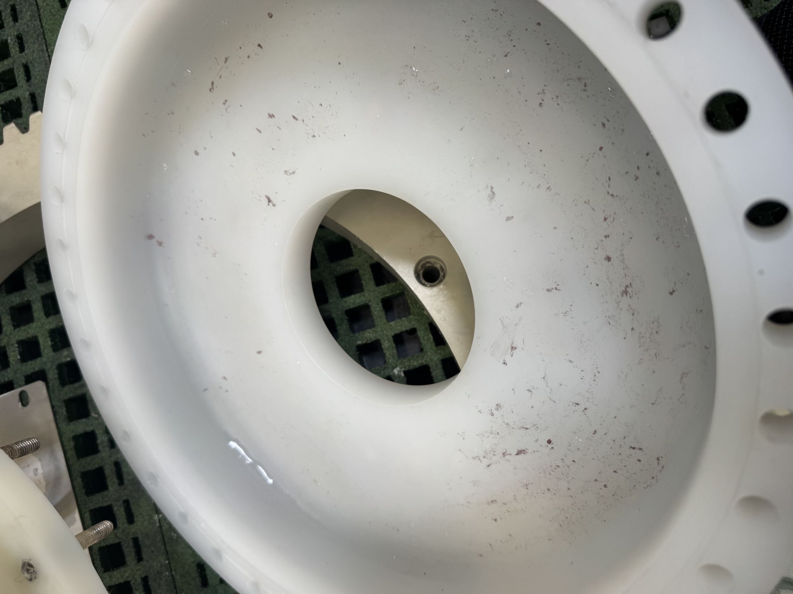
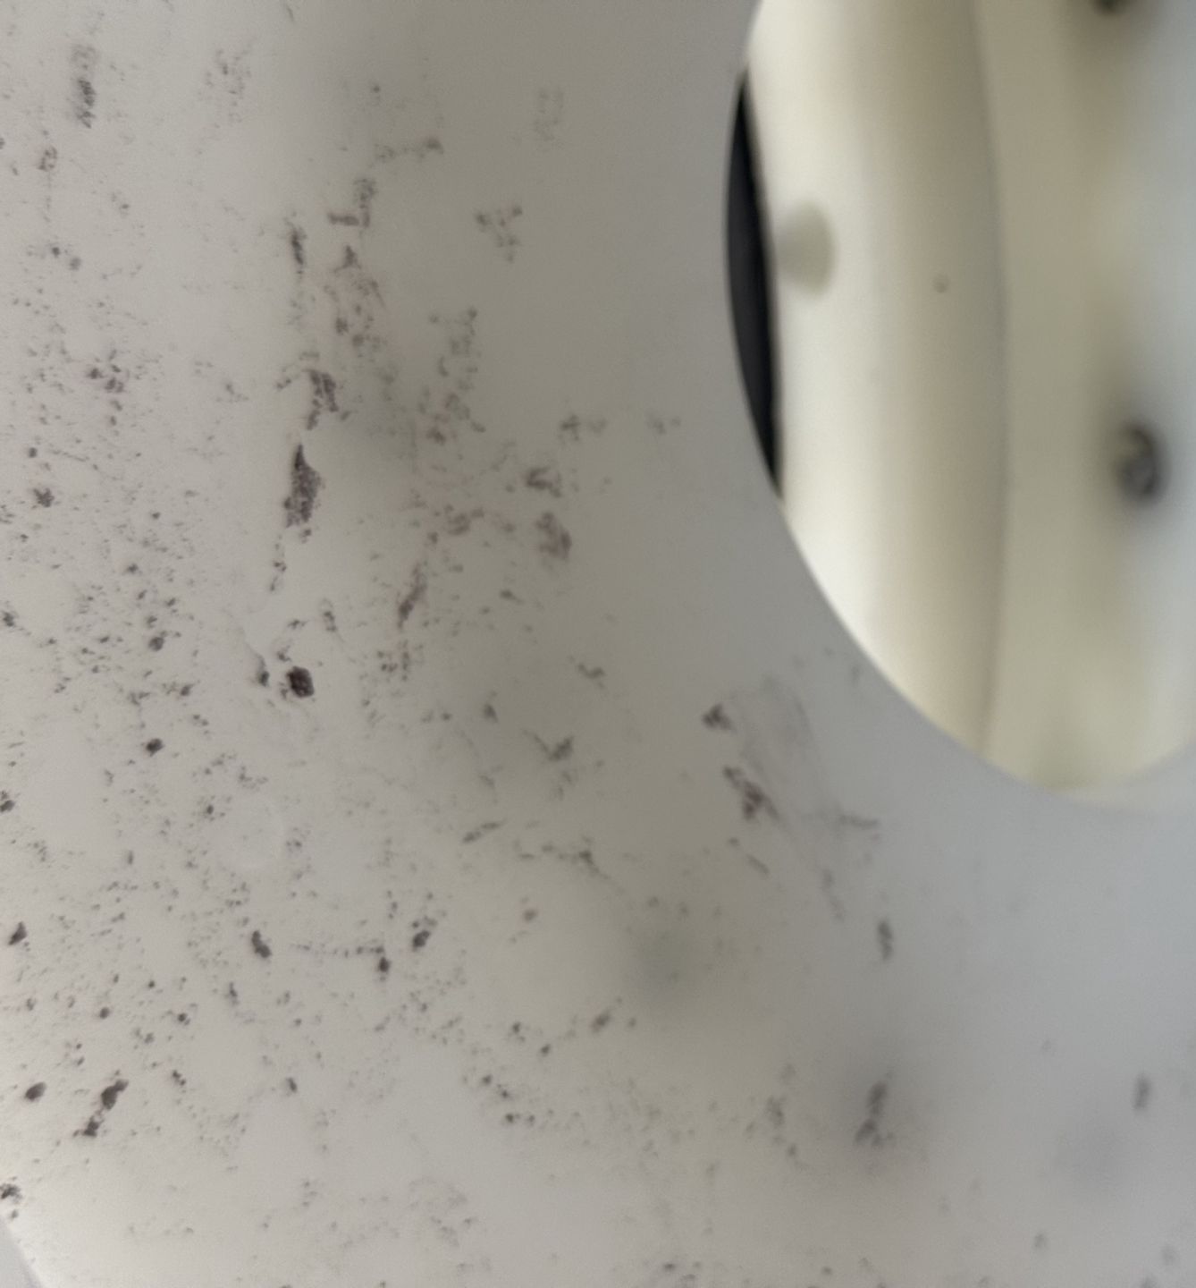
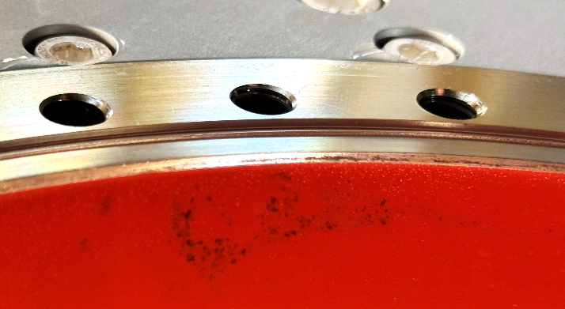
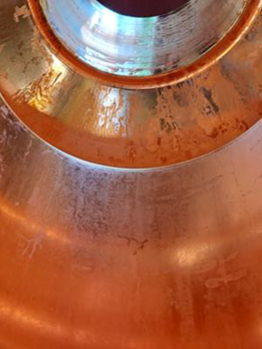
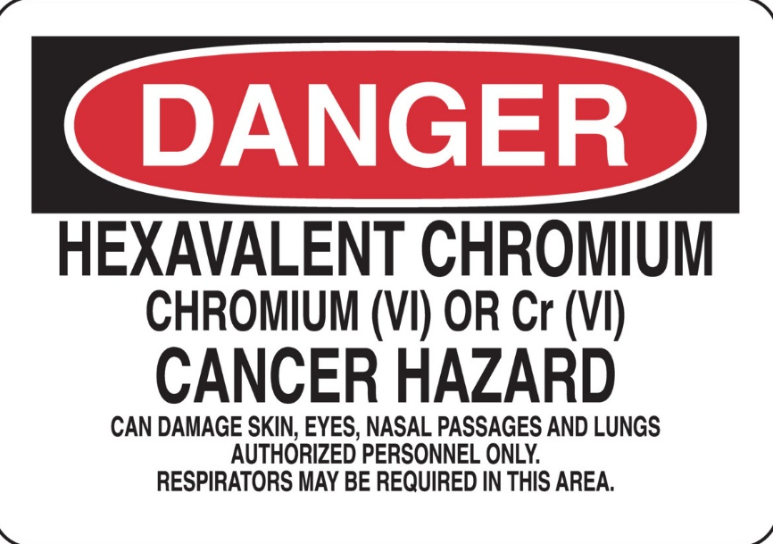
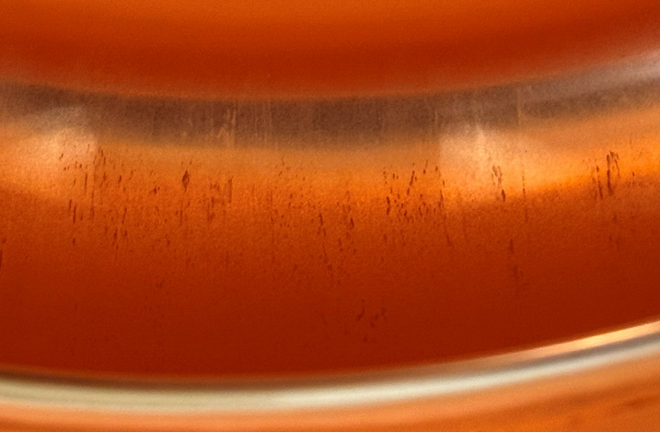
Upscaling to 400 MHz
same setup for both 1.3 GHz and 400 MHz cavities
larger volume needs to be treated
insufficient and inhomogeneous rinsing
fine Cu powder collected on the outflow side
oxidation stains
takes time to mount/dismount the cavity
preventing oxidation is critical
availability of safe passivation solutions is limited
example 400 MHz cavity
important factors:
surface state/treatment of Cu (polishing + passivation)
compact, high purity Nb coatings, i.e. strict control over level of impurities (e.g. oxygen, hydrogen, particulates)
effective
long-lasting protection
highly toxic

Slide 11
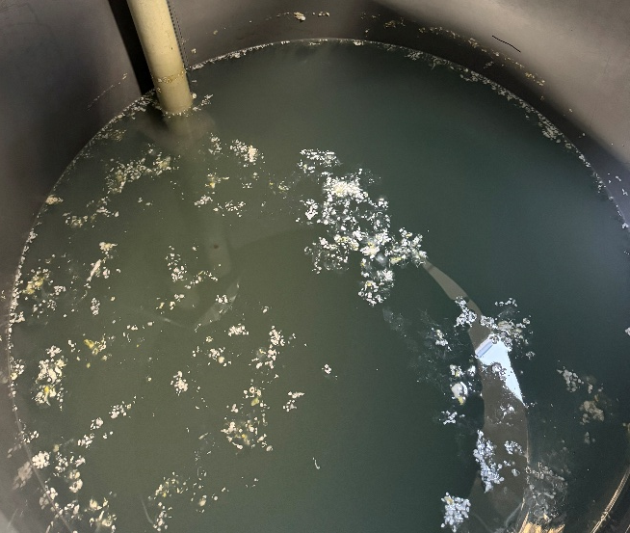
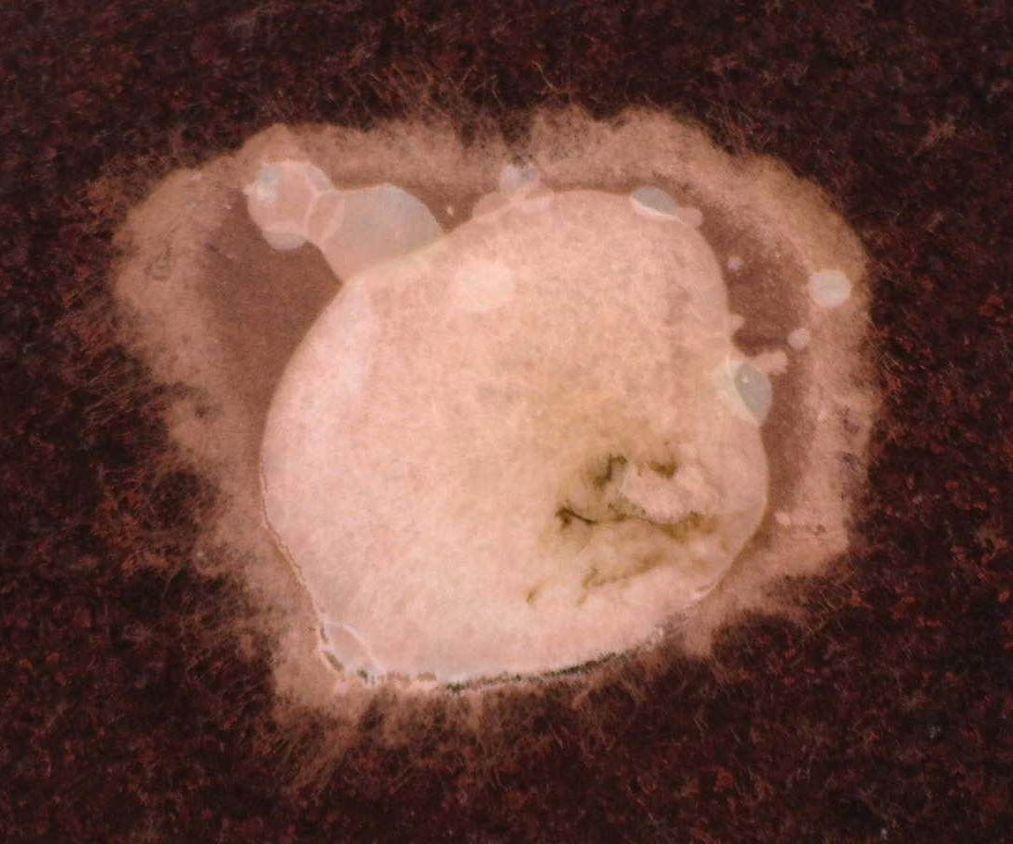
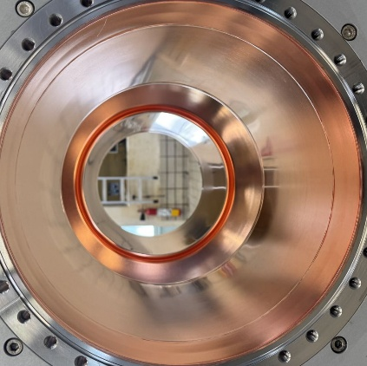
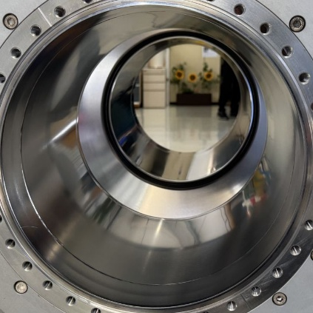
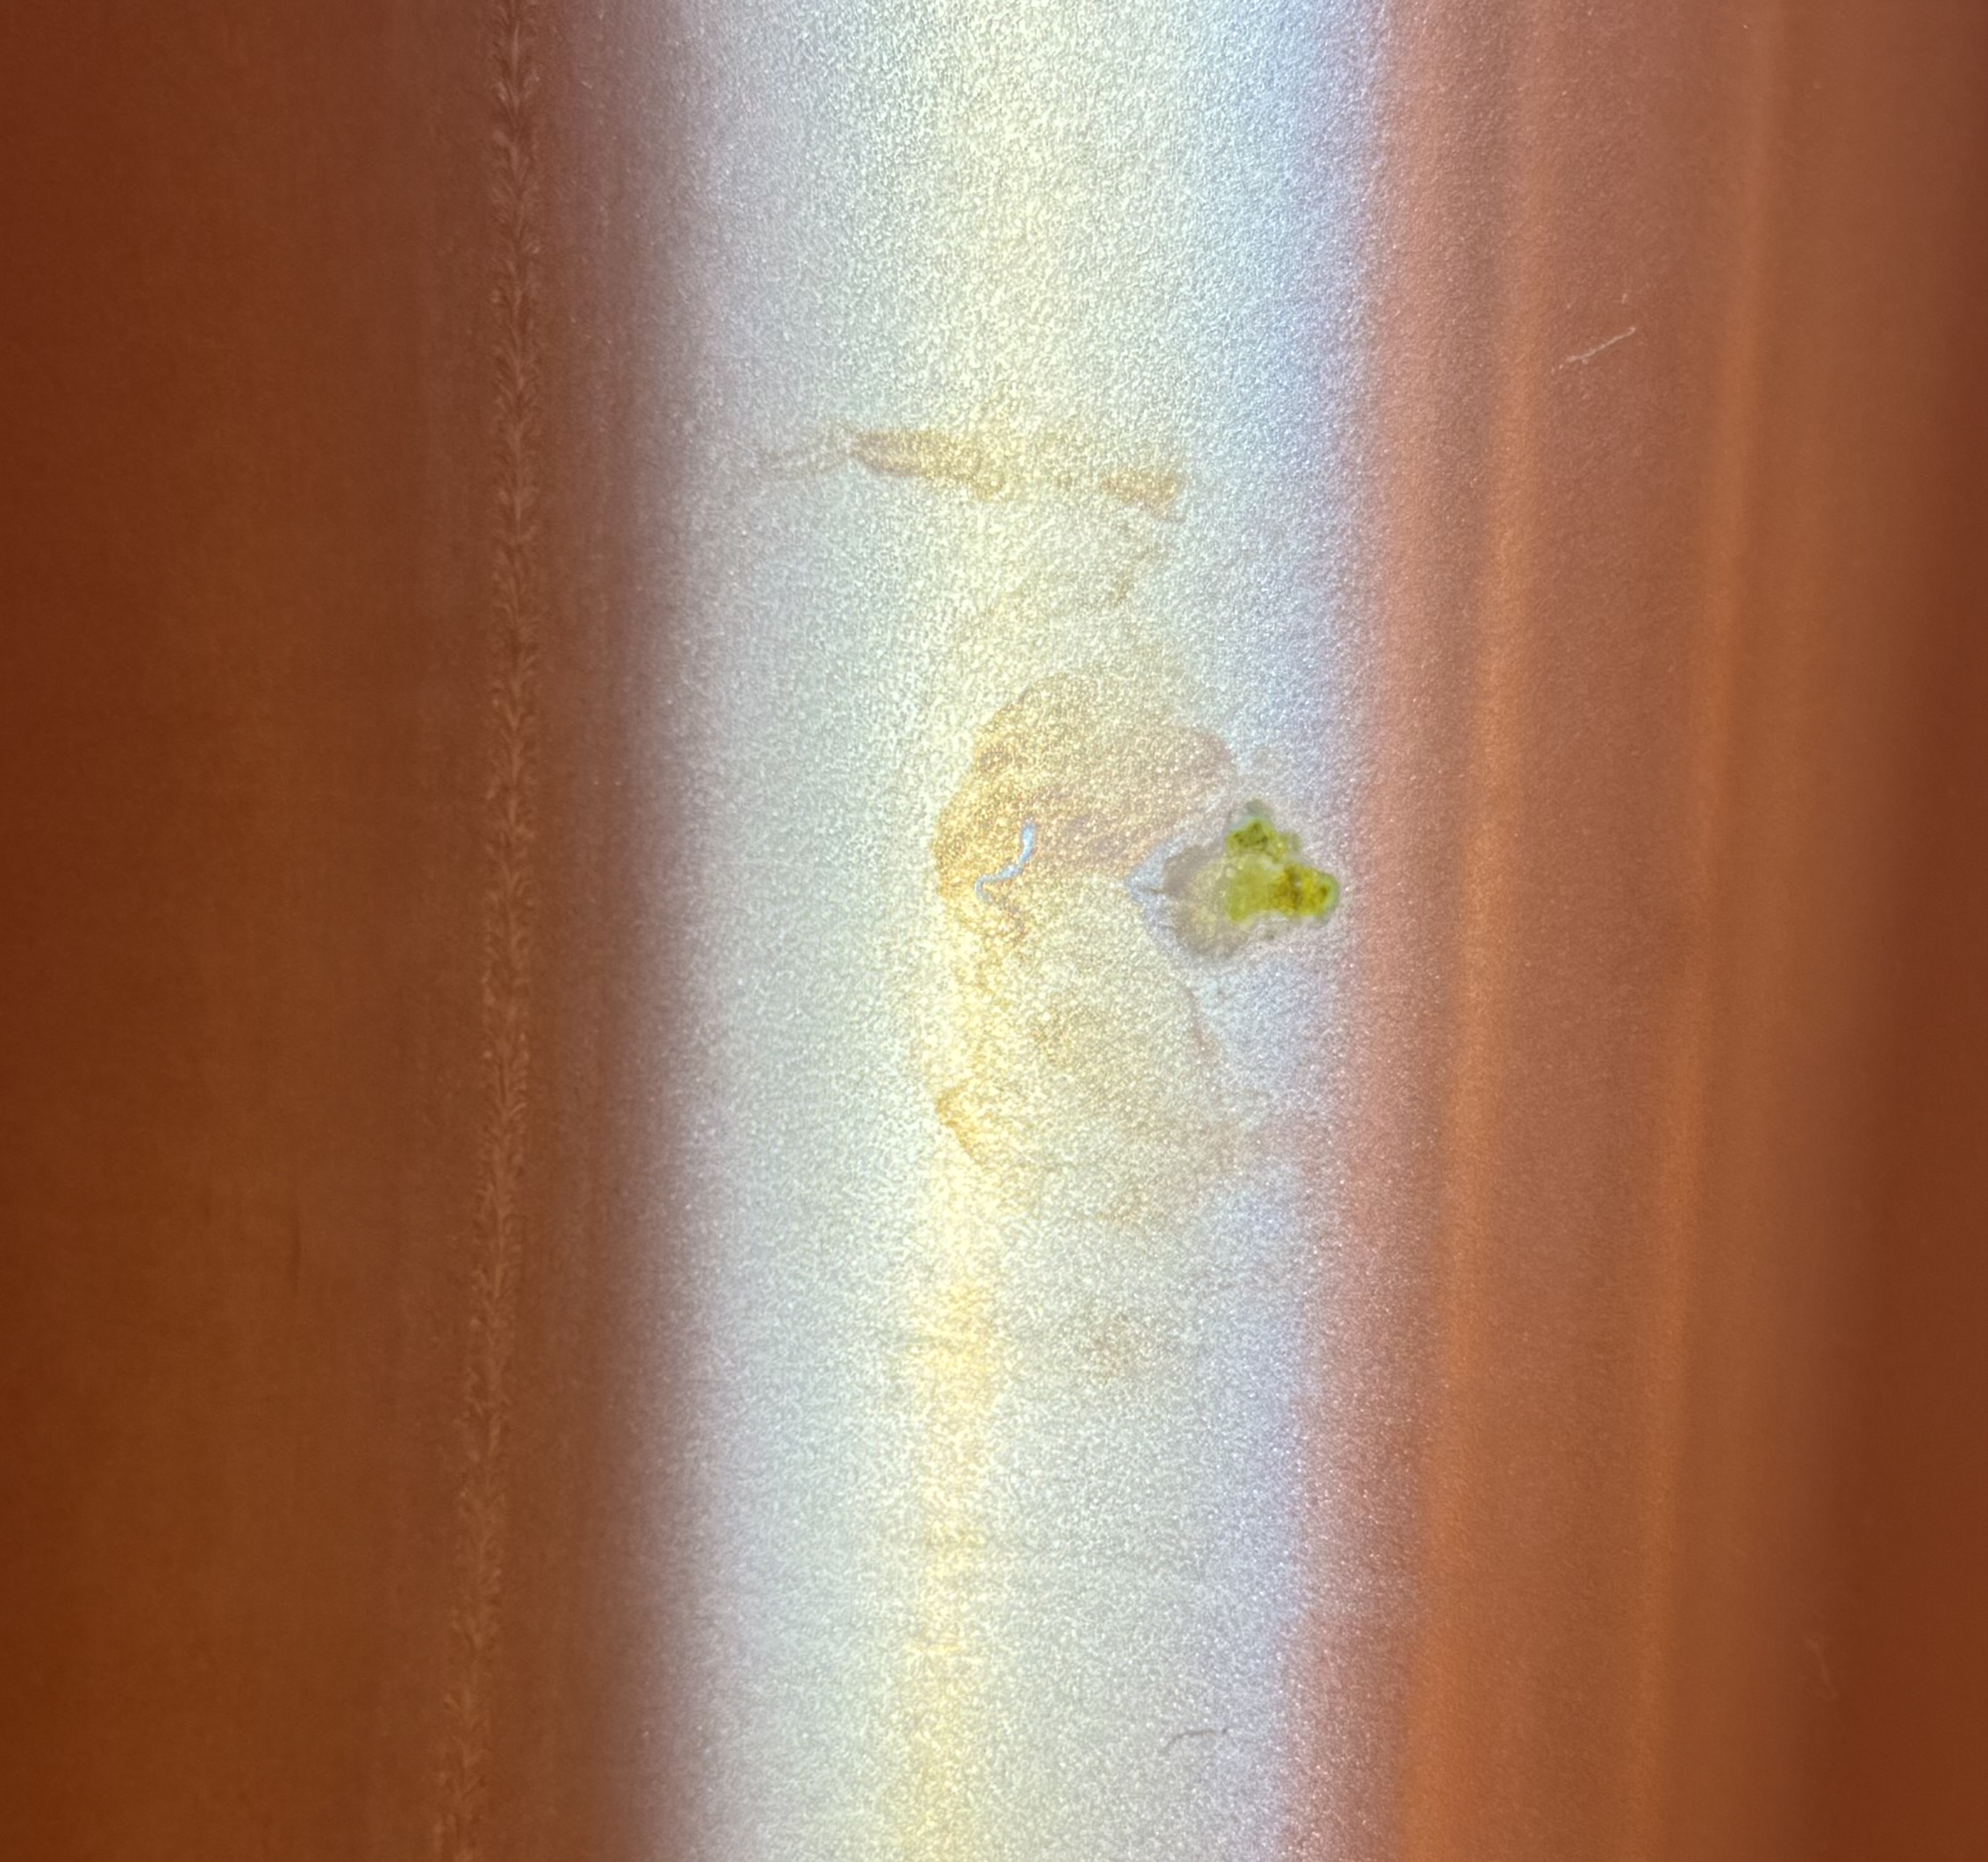
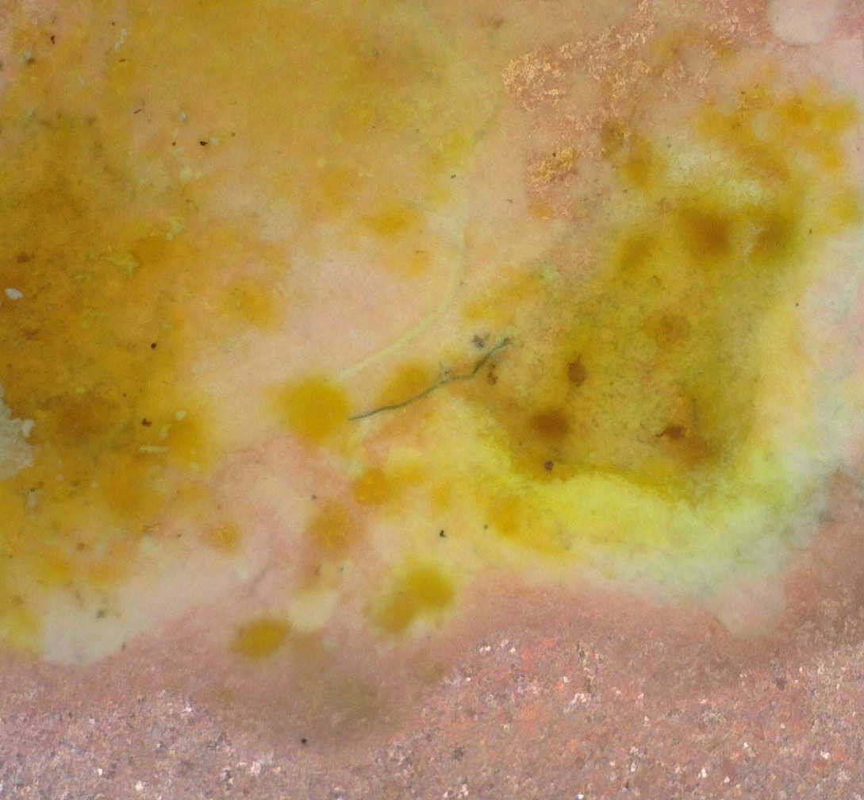
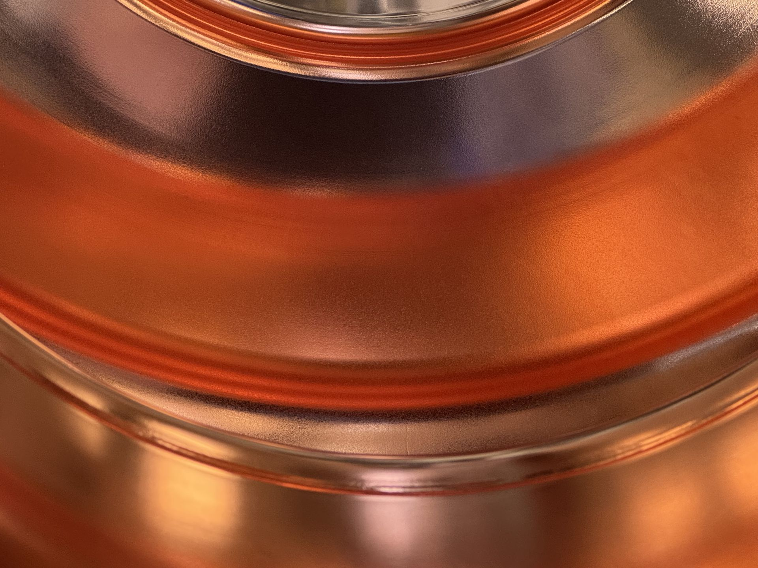
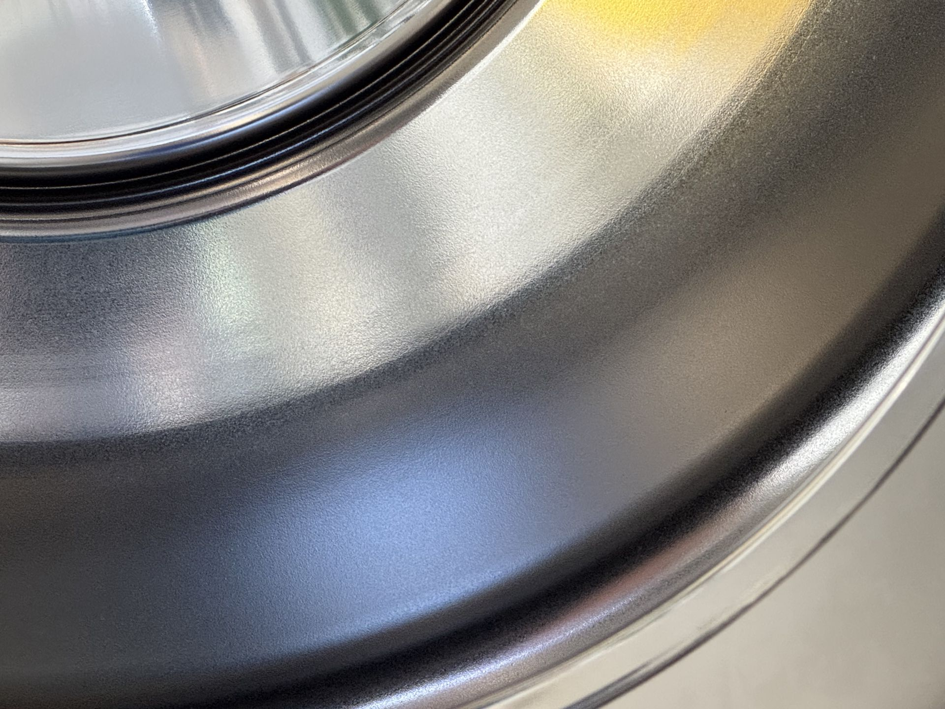
Upscaling to 400 MHz
ammonium citrate
(same as for 1.3 GHz)
much safer
not as robust as Cr (VI)
helps control surface chemistry
improvements in monitoring EP bath, passivation solution and environmental conditions
additional high-pressure rinsing
…and biocompatible!
example 400 MHz cavity
0.2 mm
important factors:
surface state/treatment of Cu (polishing + passivation)
compact, high purity Nb coatings, i.e. strict control over level of impurities (e.g. oxygen, hydrogen, particulates)
10 mm
0.2 mm

Slide 12
summarising

Slide 13
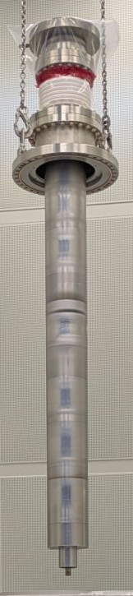
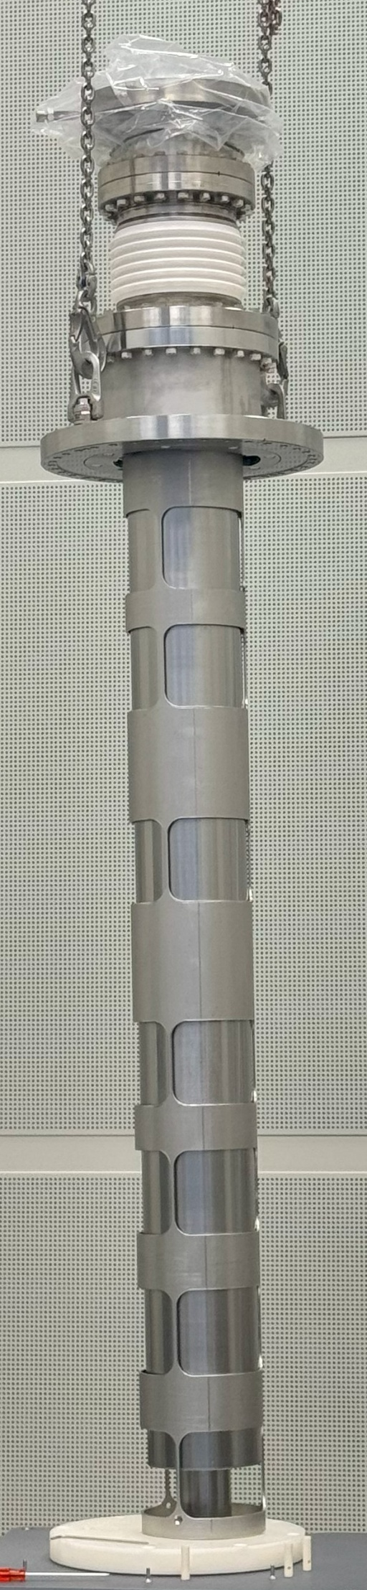
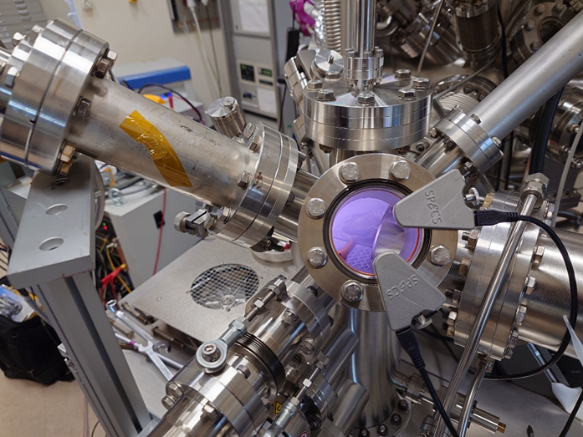
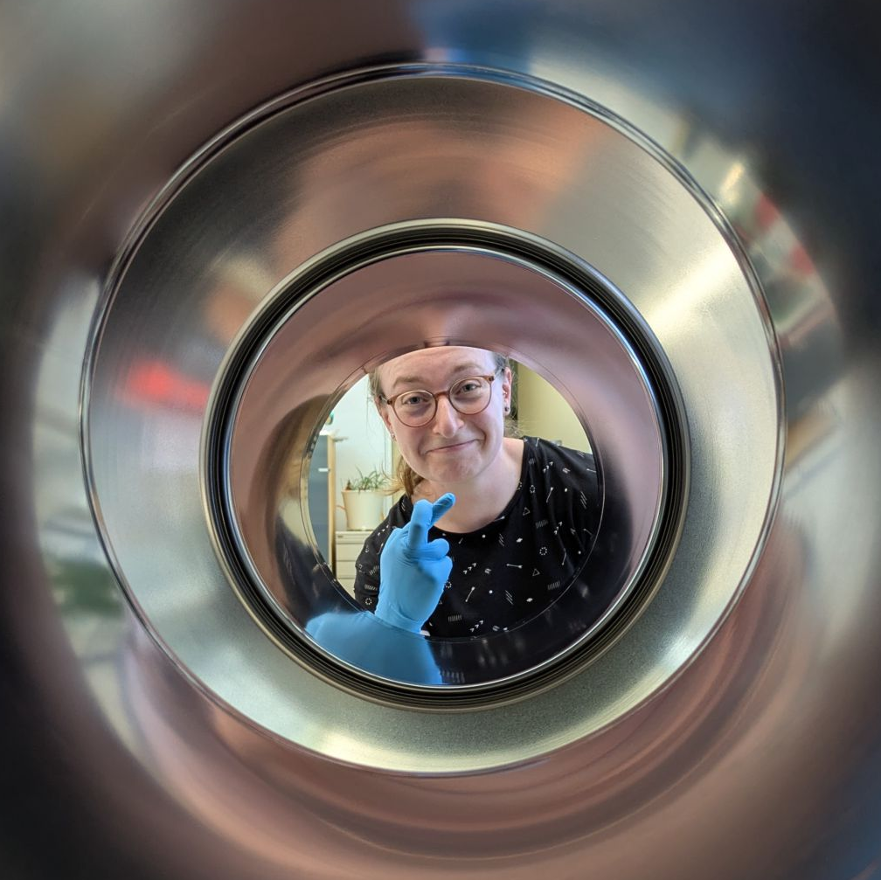
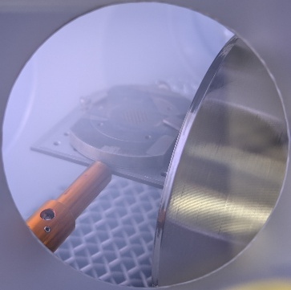
Summary and ongoing activities
So far…
possible to reach the FCC specifications demonstrated on 1.3 GHz cavities
HiPIMS improves the Q₀ of the Nb coatings
biggest challenge related to electropolishing, improvements ongoing
latest processed cavity to be RF tested mid-June
ongoing activities and next steps
improving cavity-EP system interface
studies related to optimising anode design
HiPIMS + cavity biasing (DC and synchronised)
plasma surface treatment: surface cleaning and passivation
courtesy of: C. Kouzios, M. Himmerlich

Slide 14
From 1.3 GHz to 400 MHz Nb/Cu Cavities: Challenges and Optimisation Strategies
presenter: Caroline Hain
G. Rosaz, C. Pereira, S. Forel, L. Ferreira, D. Doretto, A. Guyot, A. Vassallo, K. Brunner, G. Pechaud, D. Smekens, B. Dubois, S. Bizzaglia, S. Zadeh, F. Pelloux
(and many others from TE, SY, EN)
TTC meeting
9-12 June 2026

