Slide 1
Recent Results of
Nb/Cu Coated Cavities under KEK/CERN Collaboration
TTC Meeting, 11 June 2025
W. Venturini Delsolaro, S. Atieh, K. Brunner, C. P. A. Carlos, M. Garlaschè,
C. Hain, C. Pereira, G. J. Rosaz, J. S. Swieszek, A. G. Terricabras (CERN)
H. Araki, A. Yamamoto, M. Yamanaka (KEK)

Slide 2


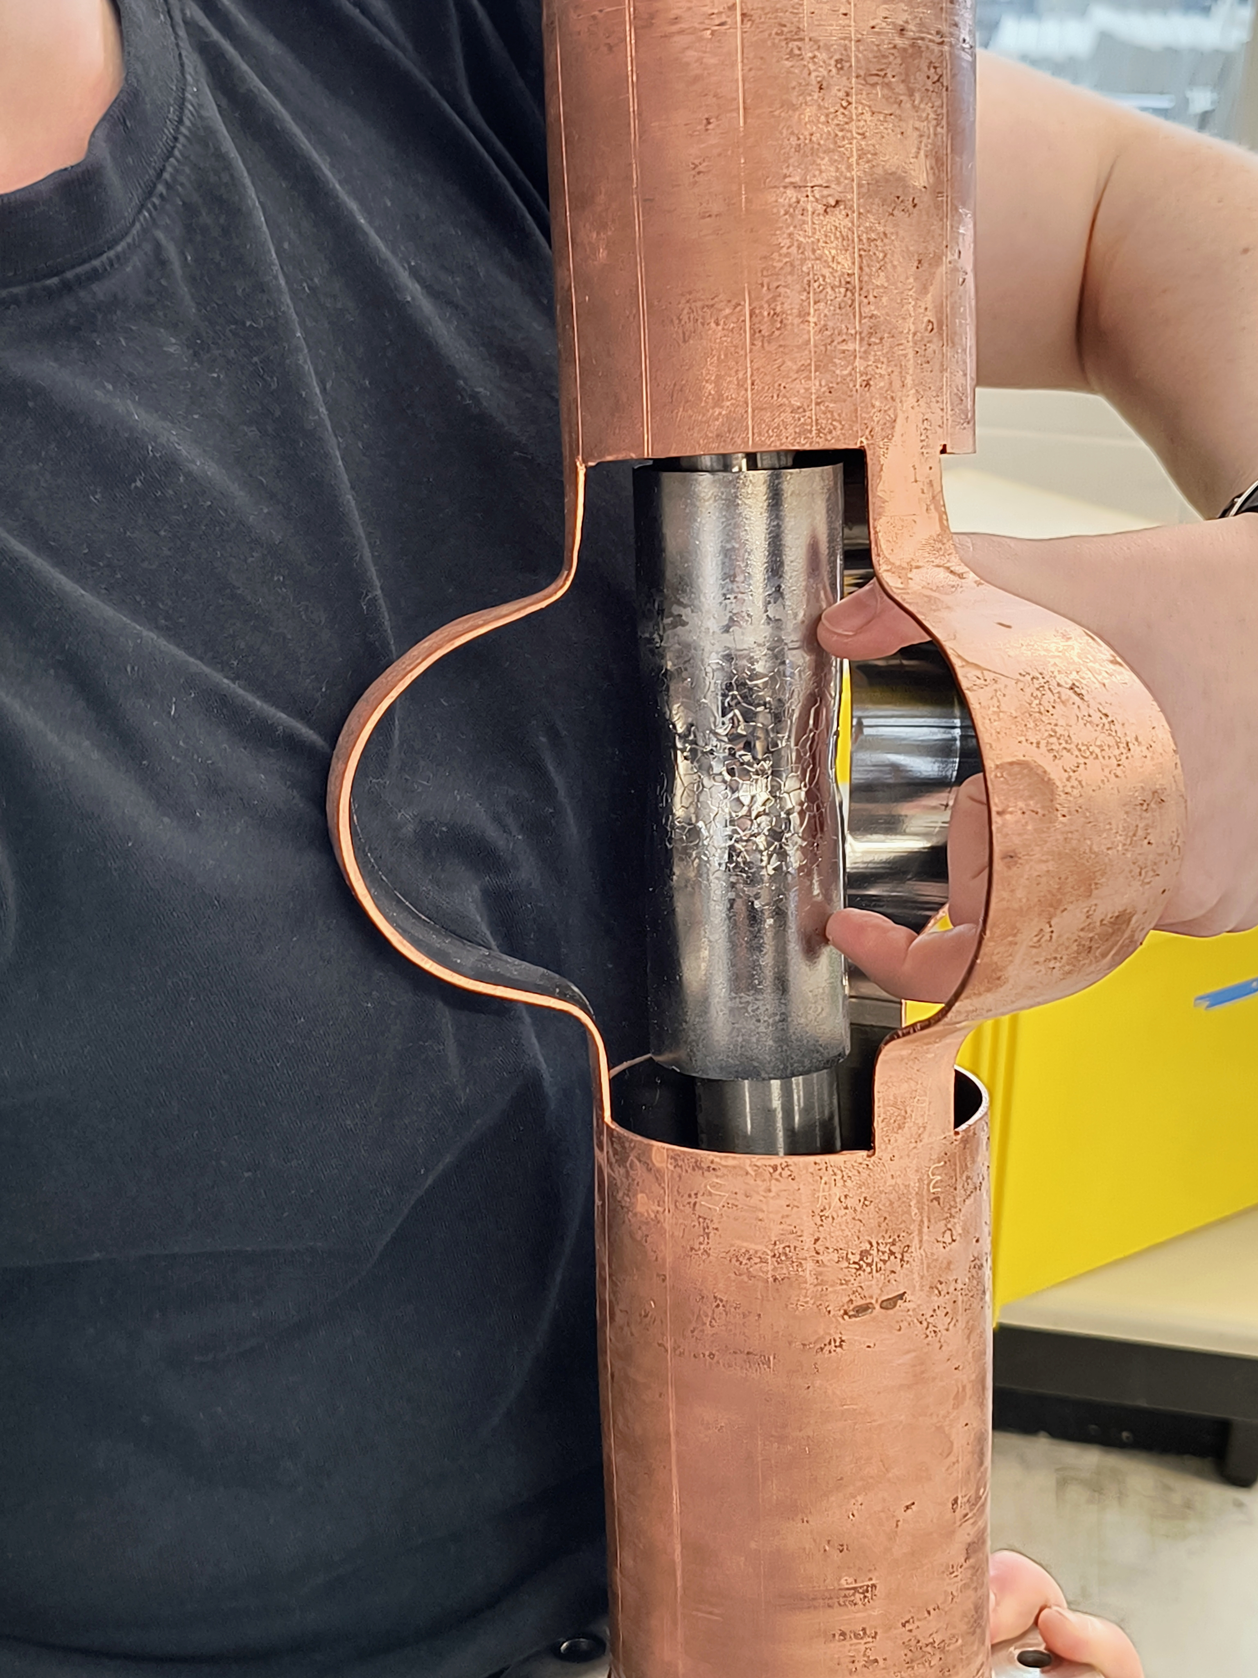
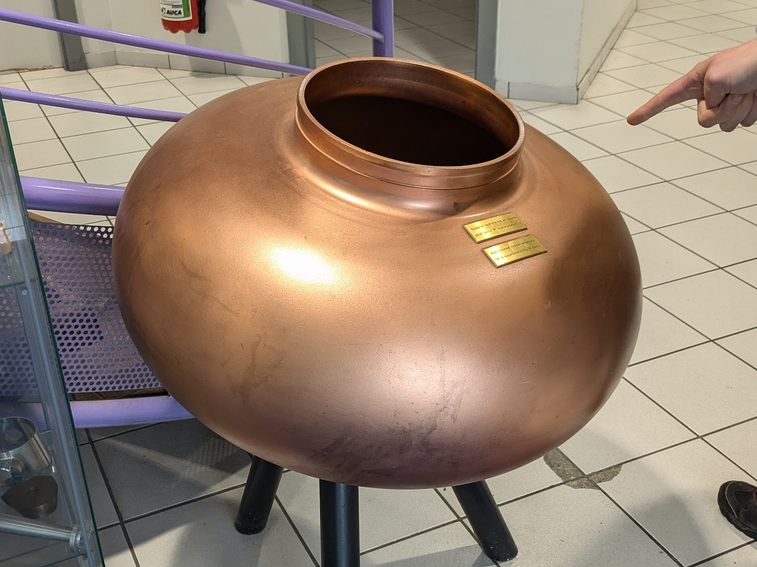
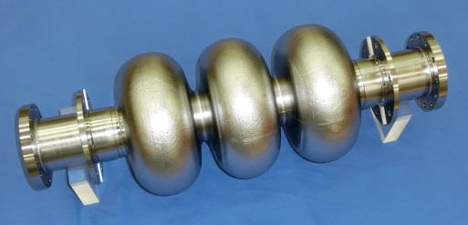
KEK/CERN Collaboration on hydroforming for Nb/Cu cavities
CERN
KEK
  Nb/Cu development since the time of LEP, LHC etc.
  Copper tube hydroforming
  R&D for FCC on HiPIMS Nb coatings
  Bulk Nb cavity development from TRISTAN
  1.3 GHz processing facility
  Bulk Nb hydroforming
  ILC

Slide 3
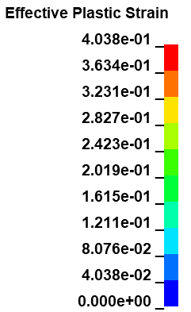
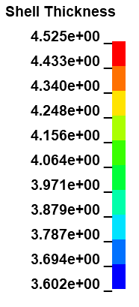
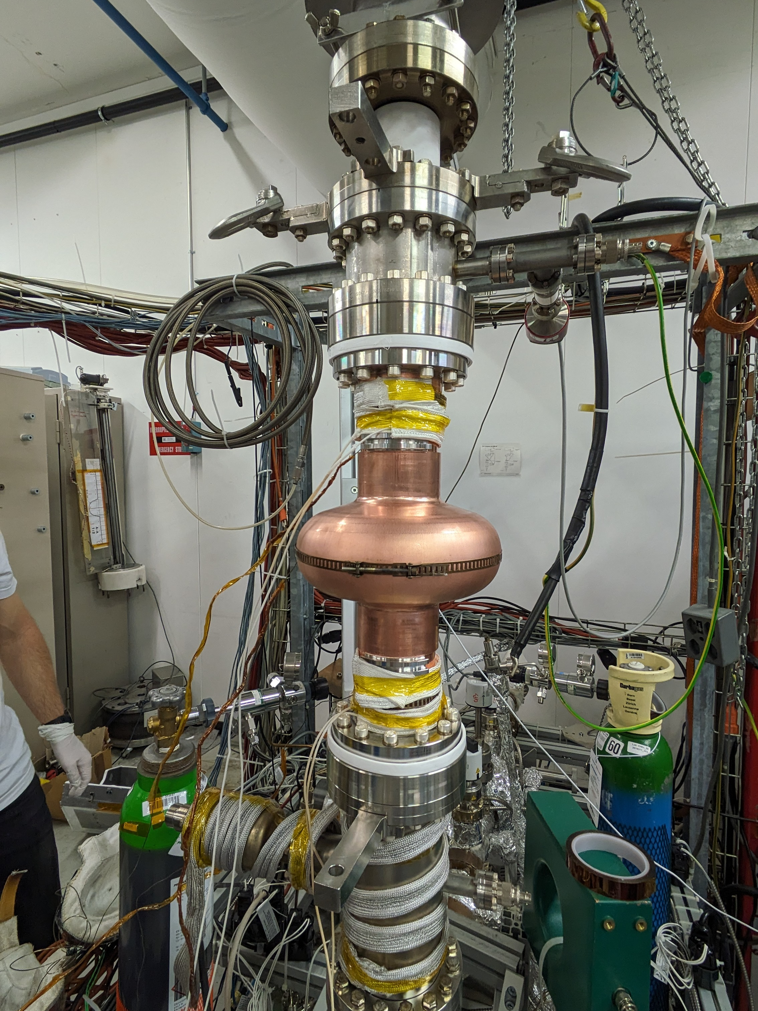
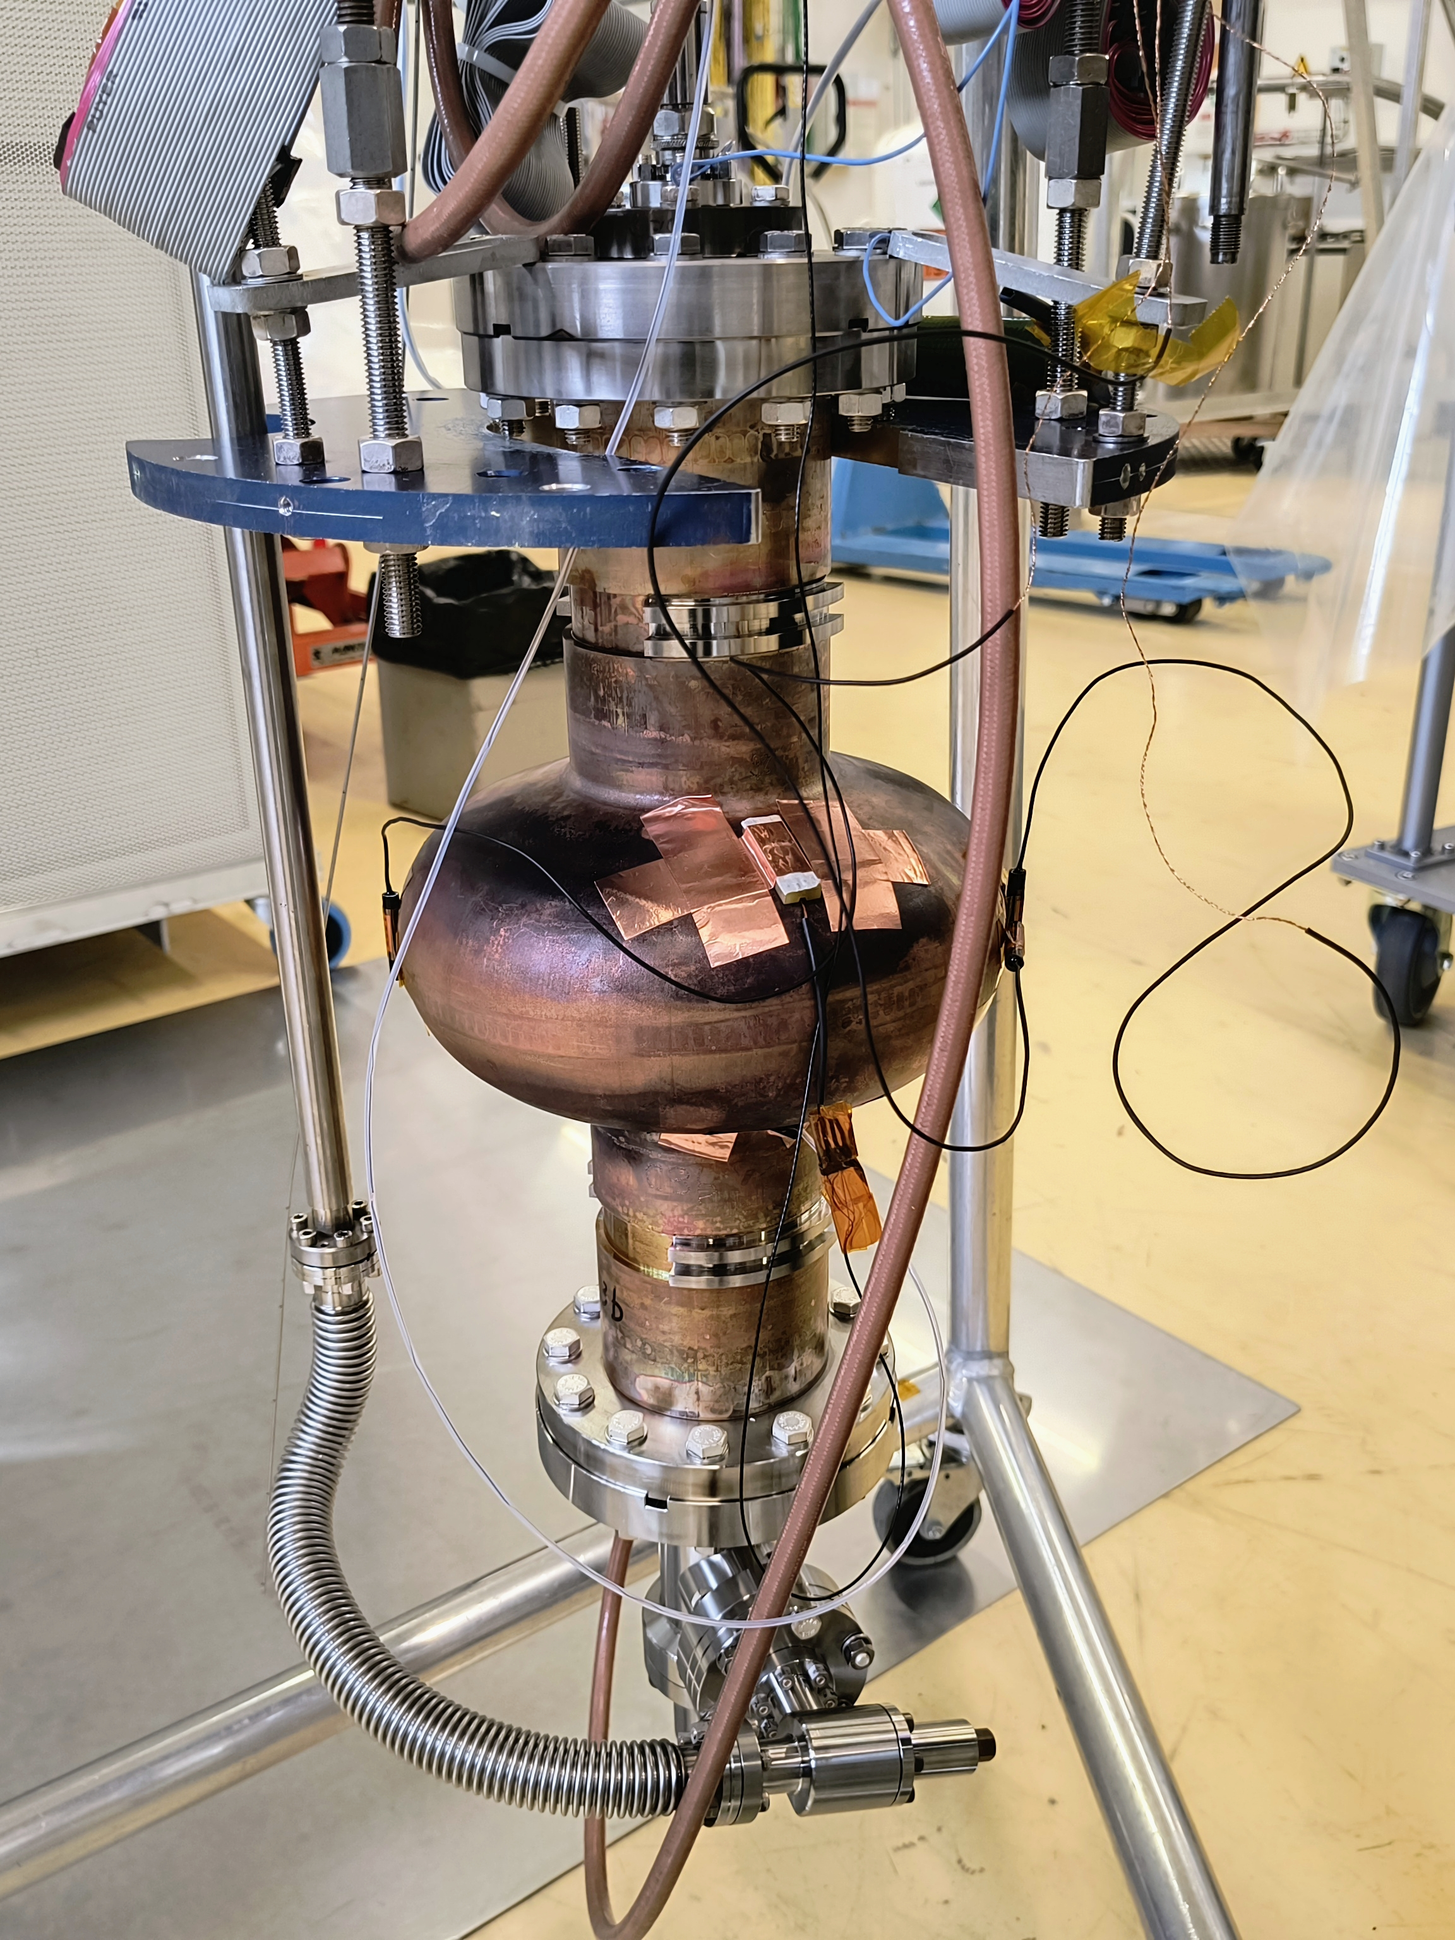
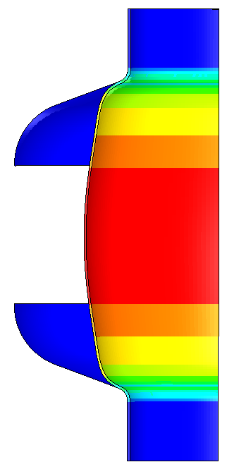
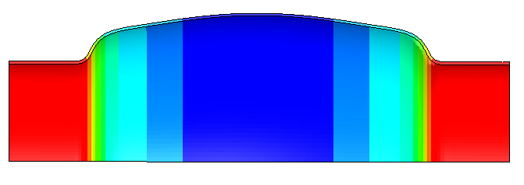
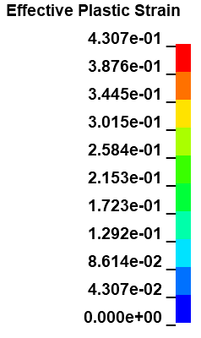
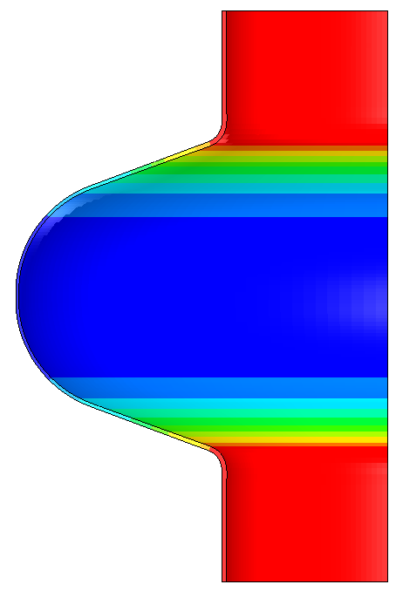
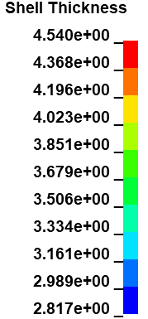
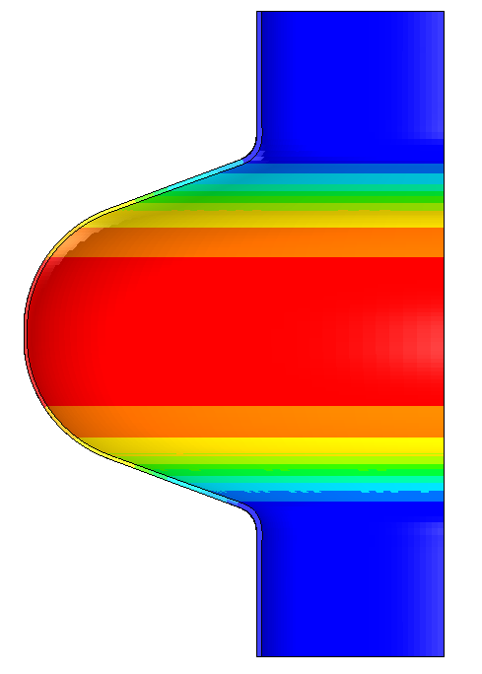
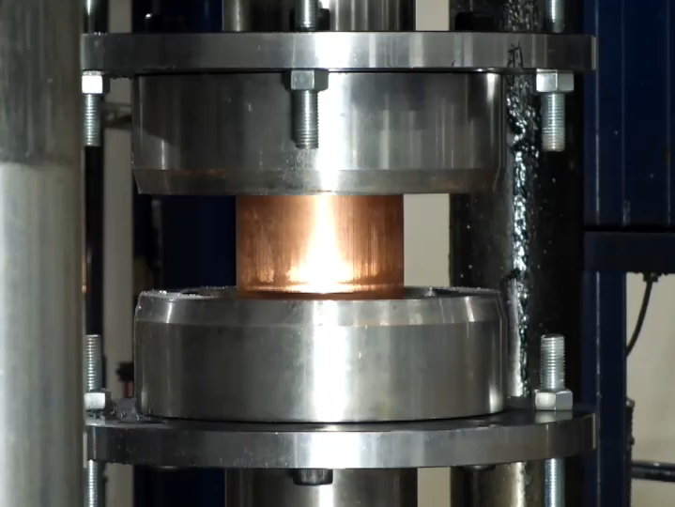
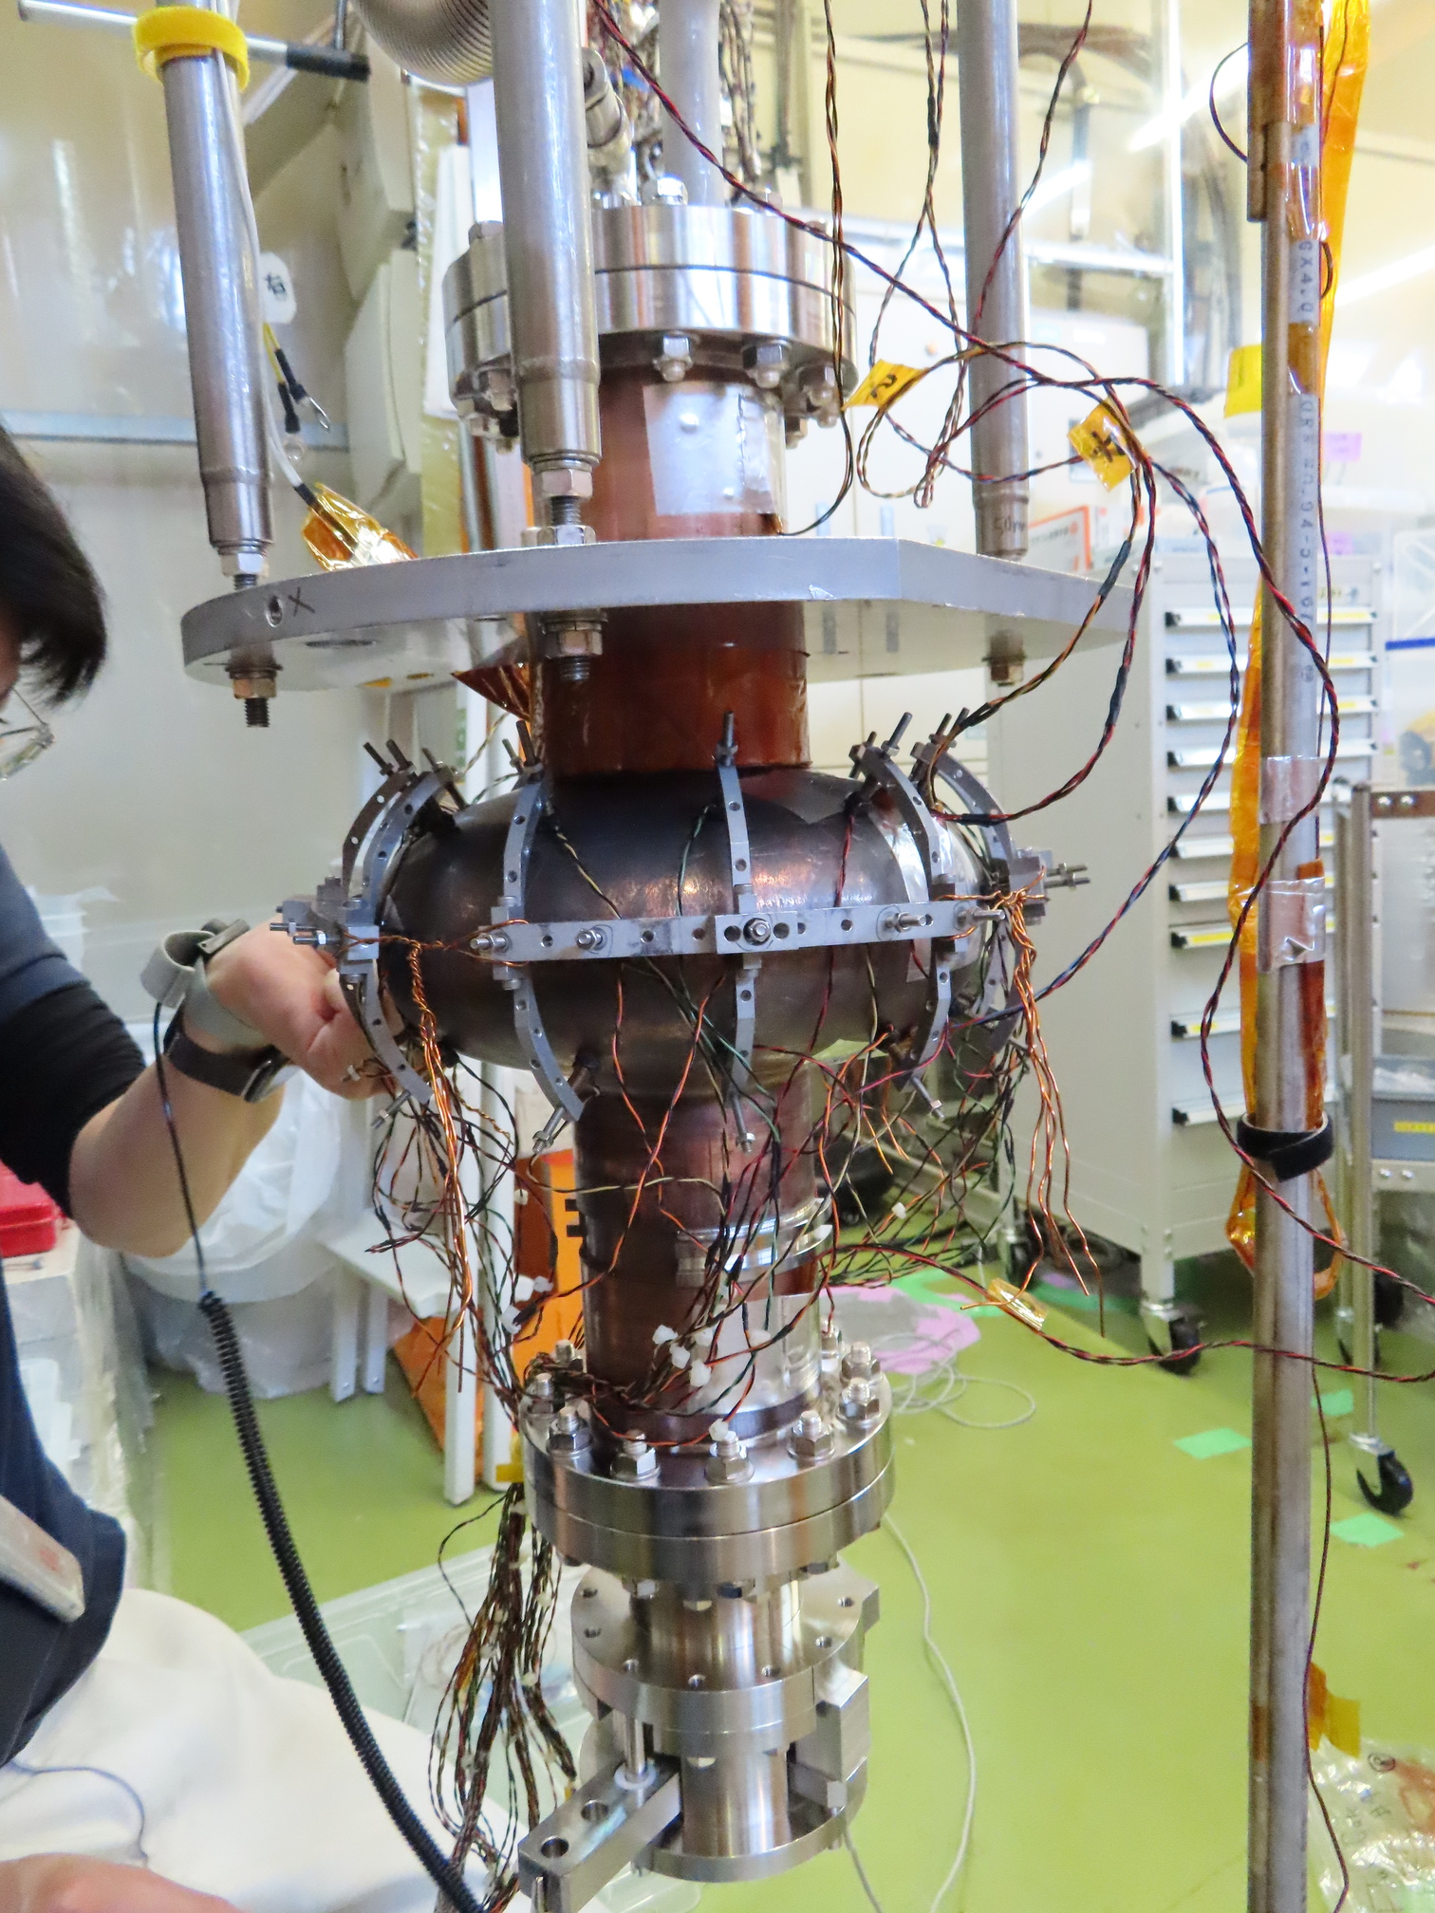
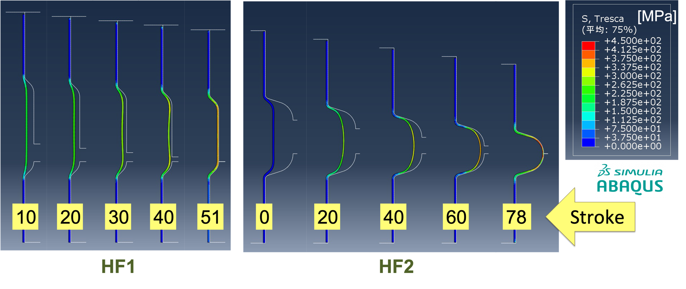
1.3 GHz copper cavity fabrication
Hydroforming
Simulation
Coating
Measurement

Slide 4
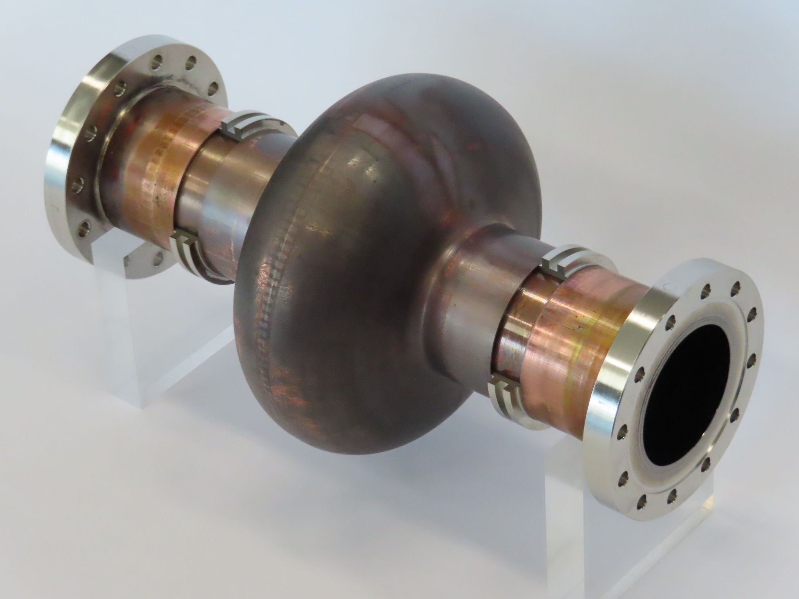
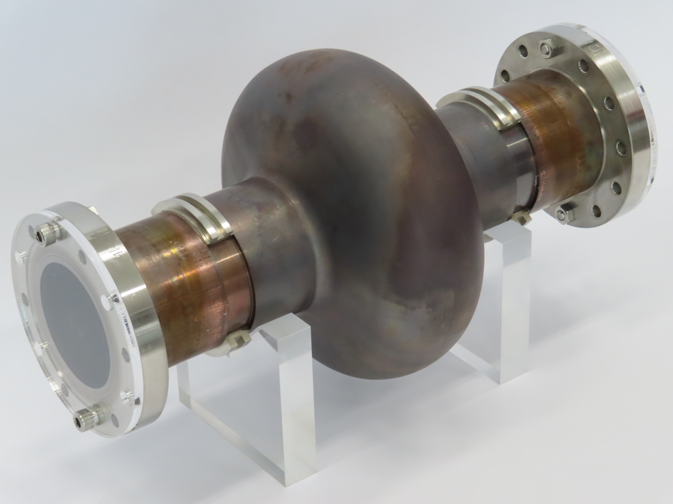
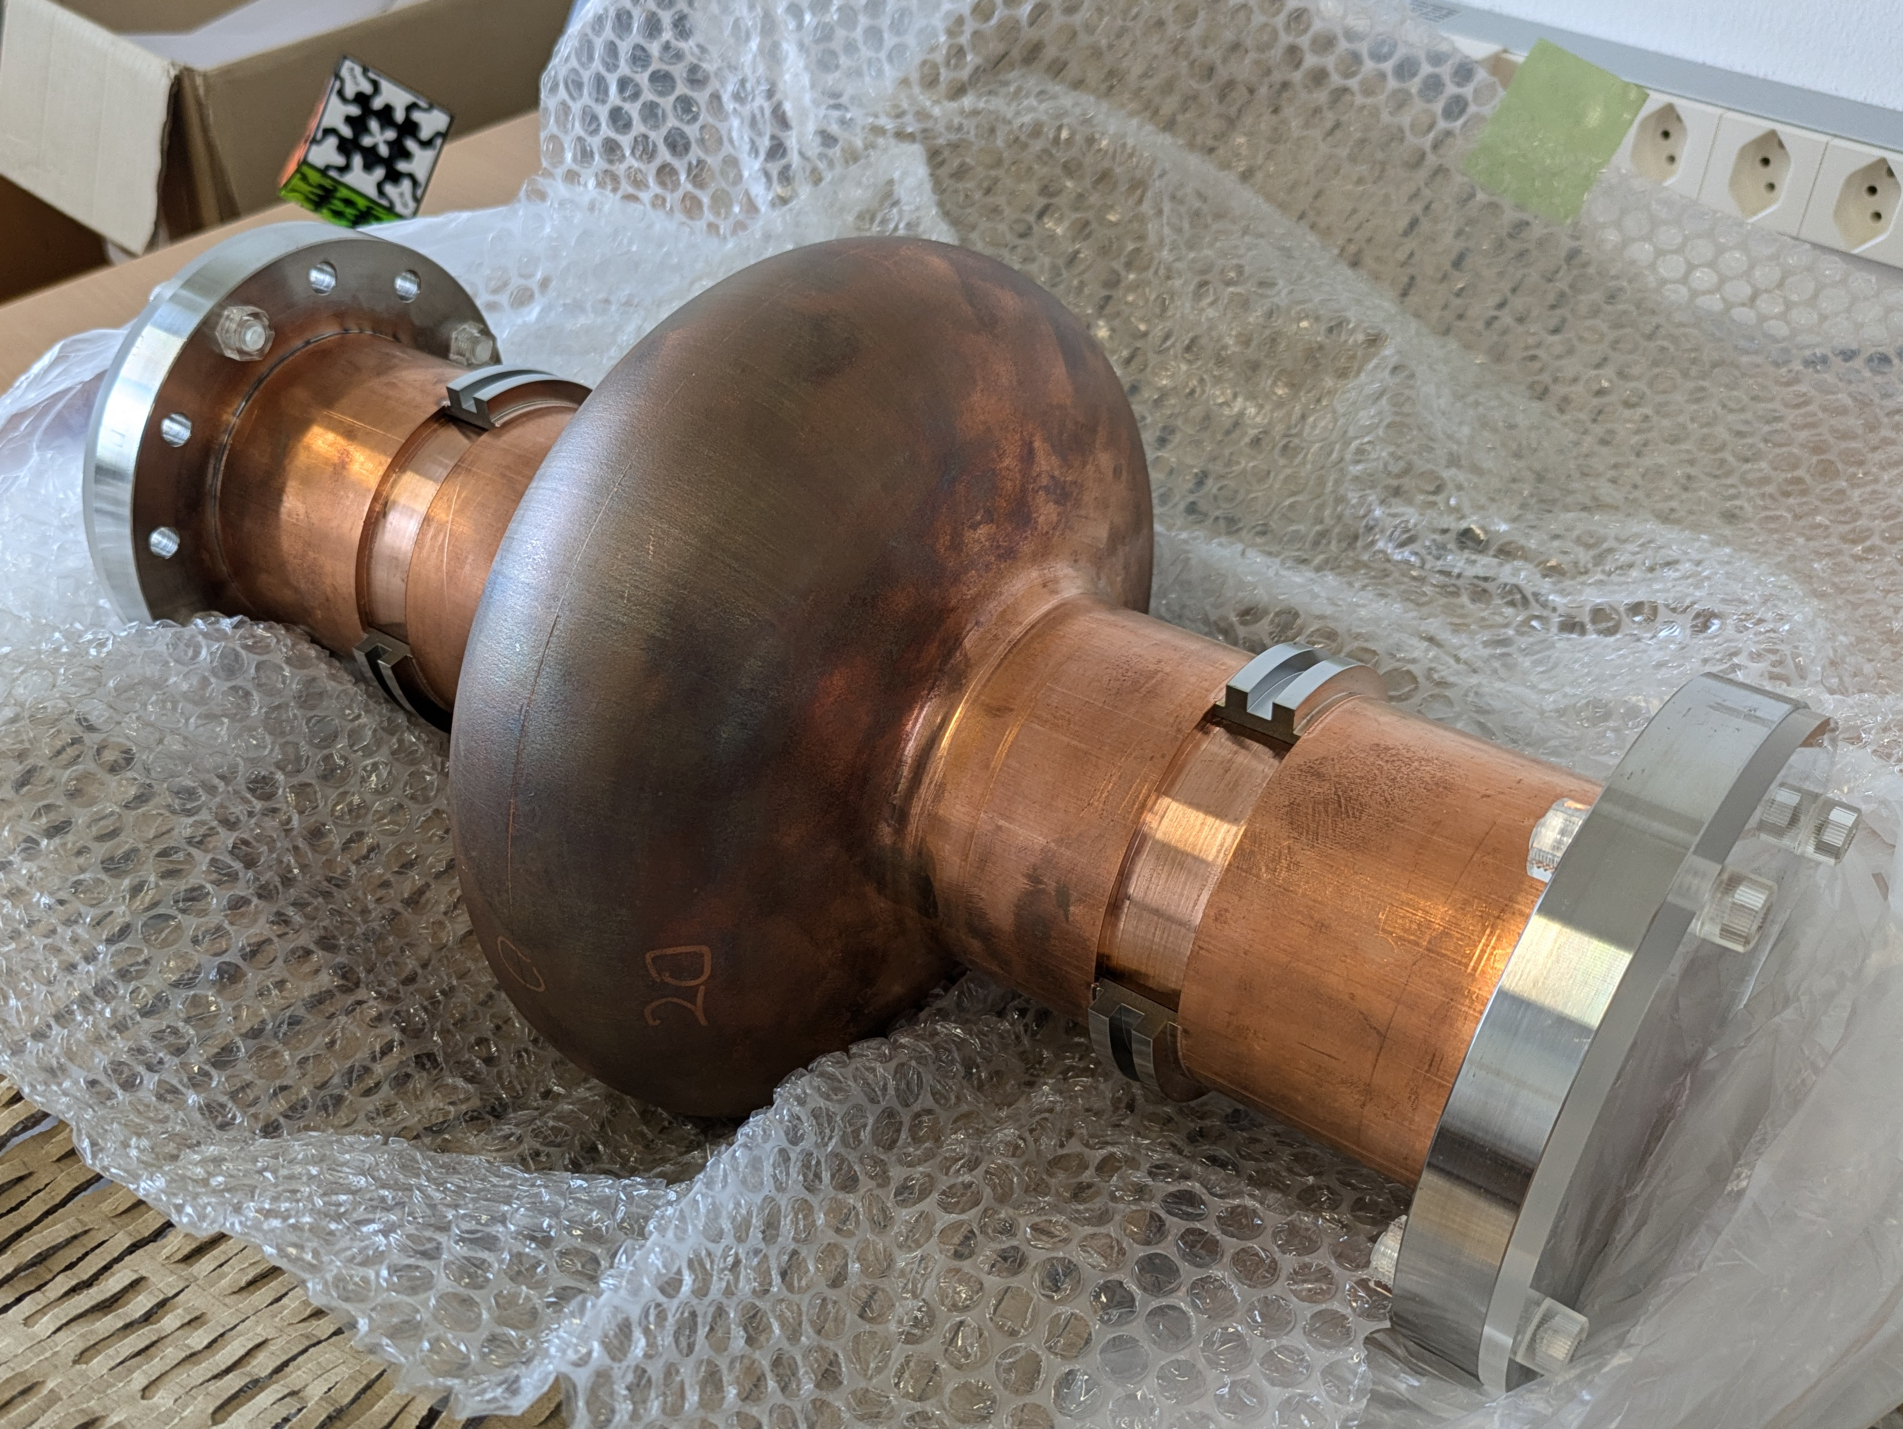
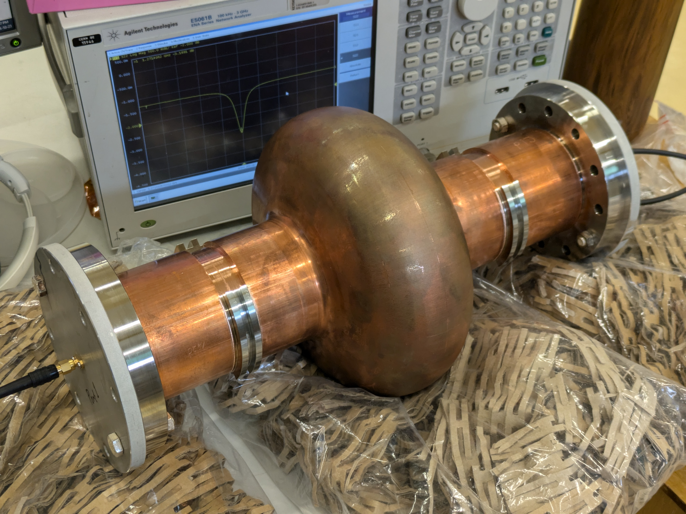

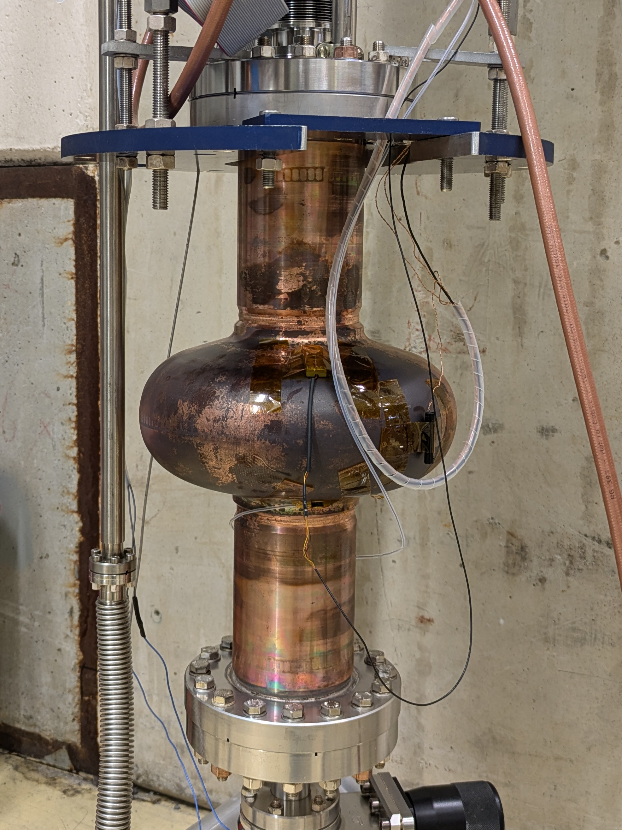
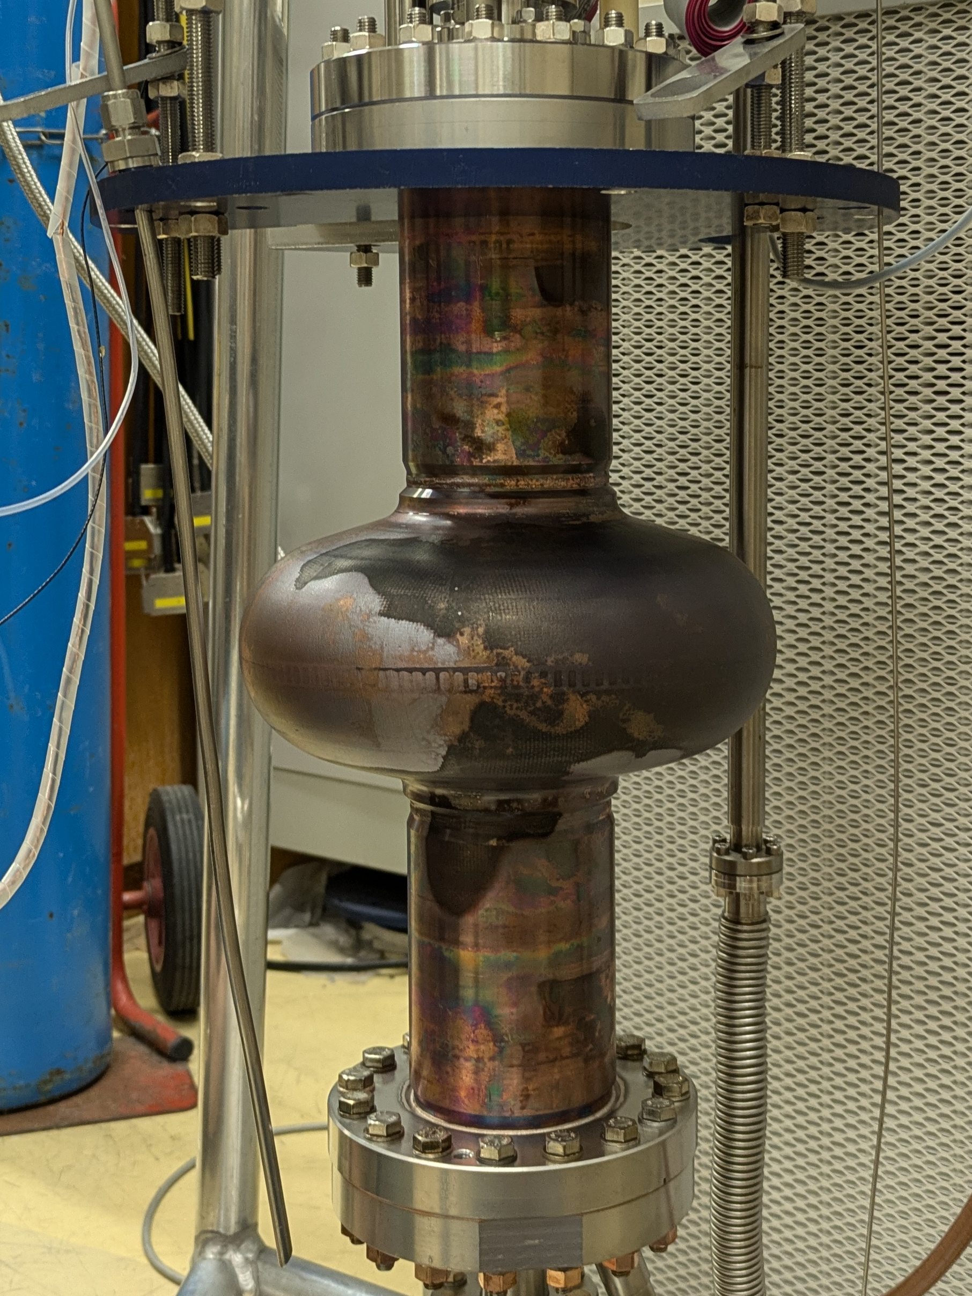
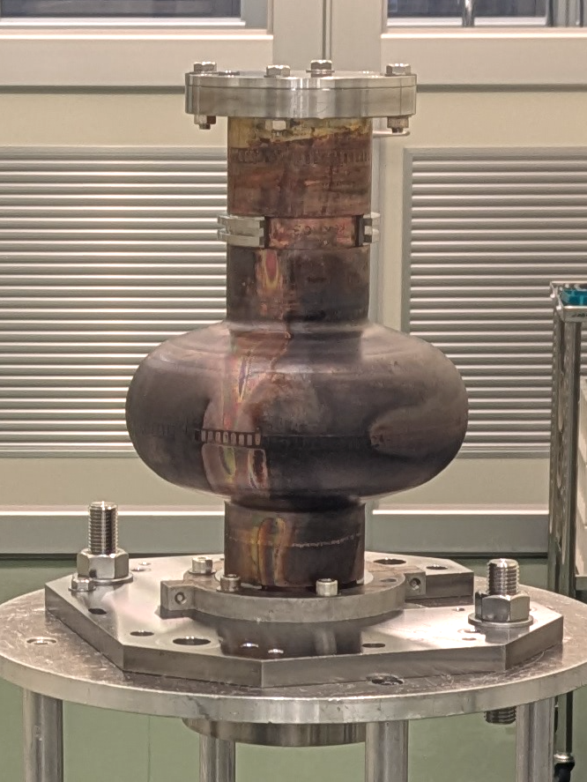
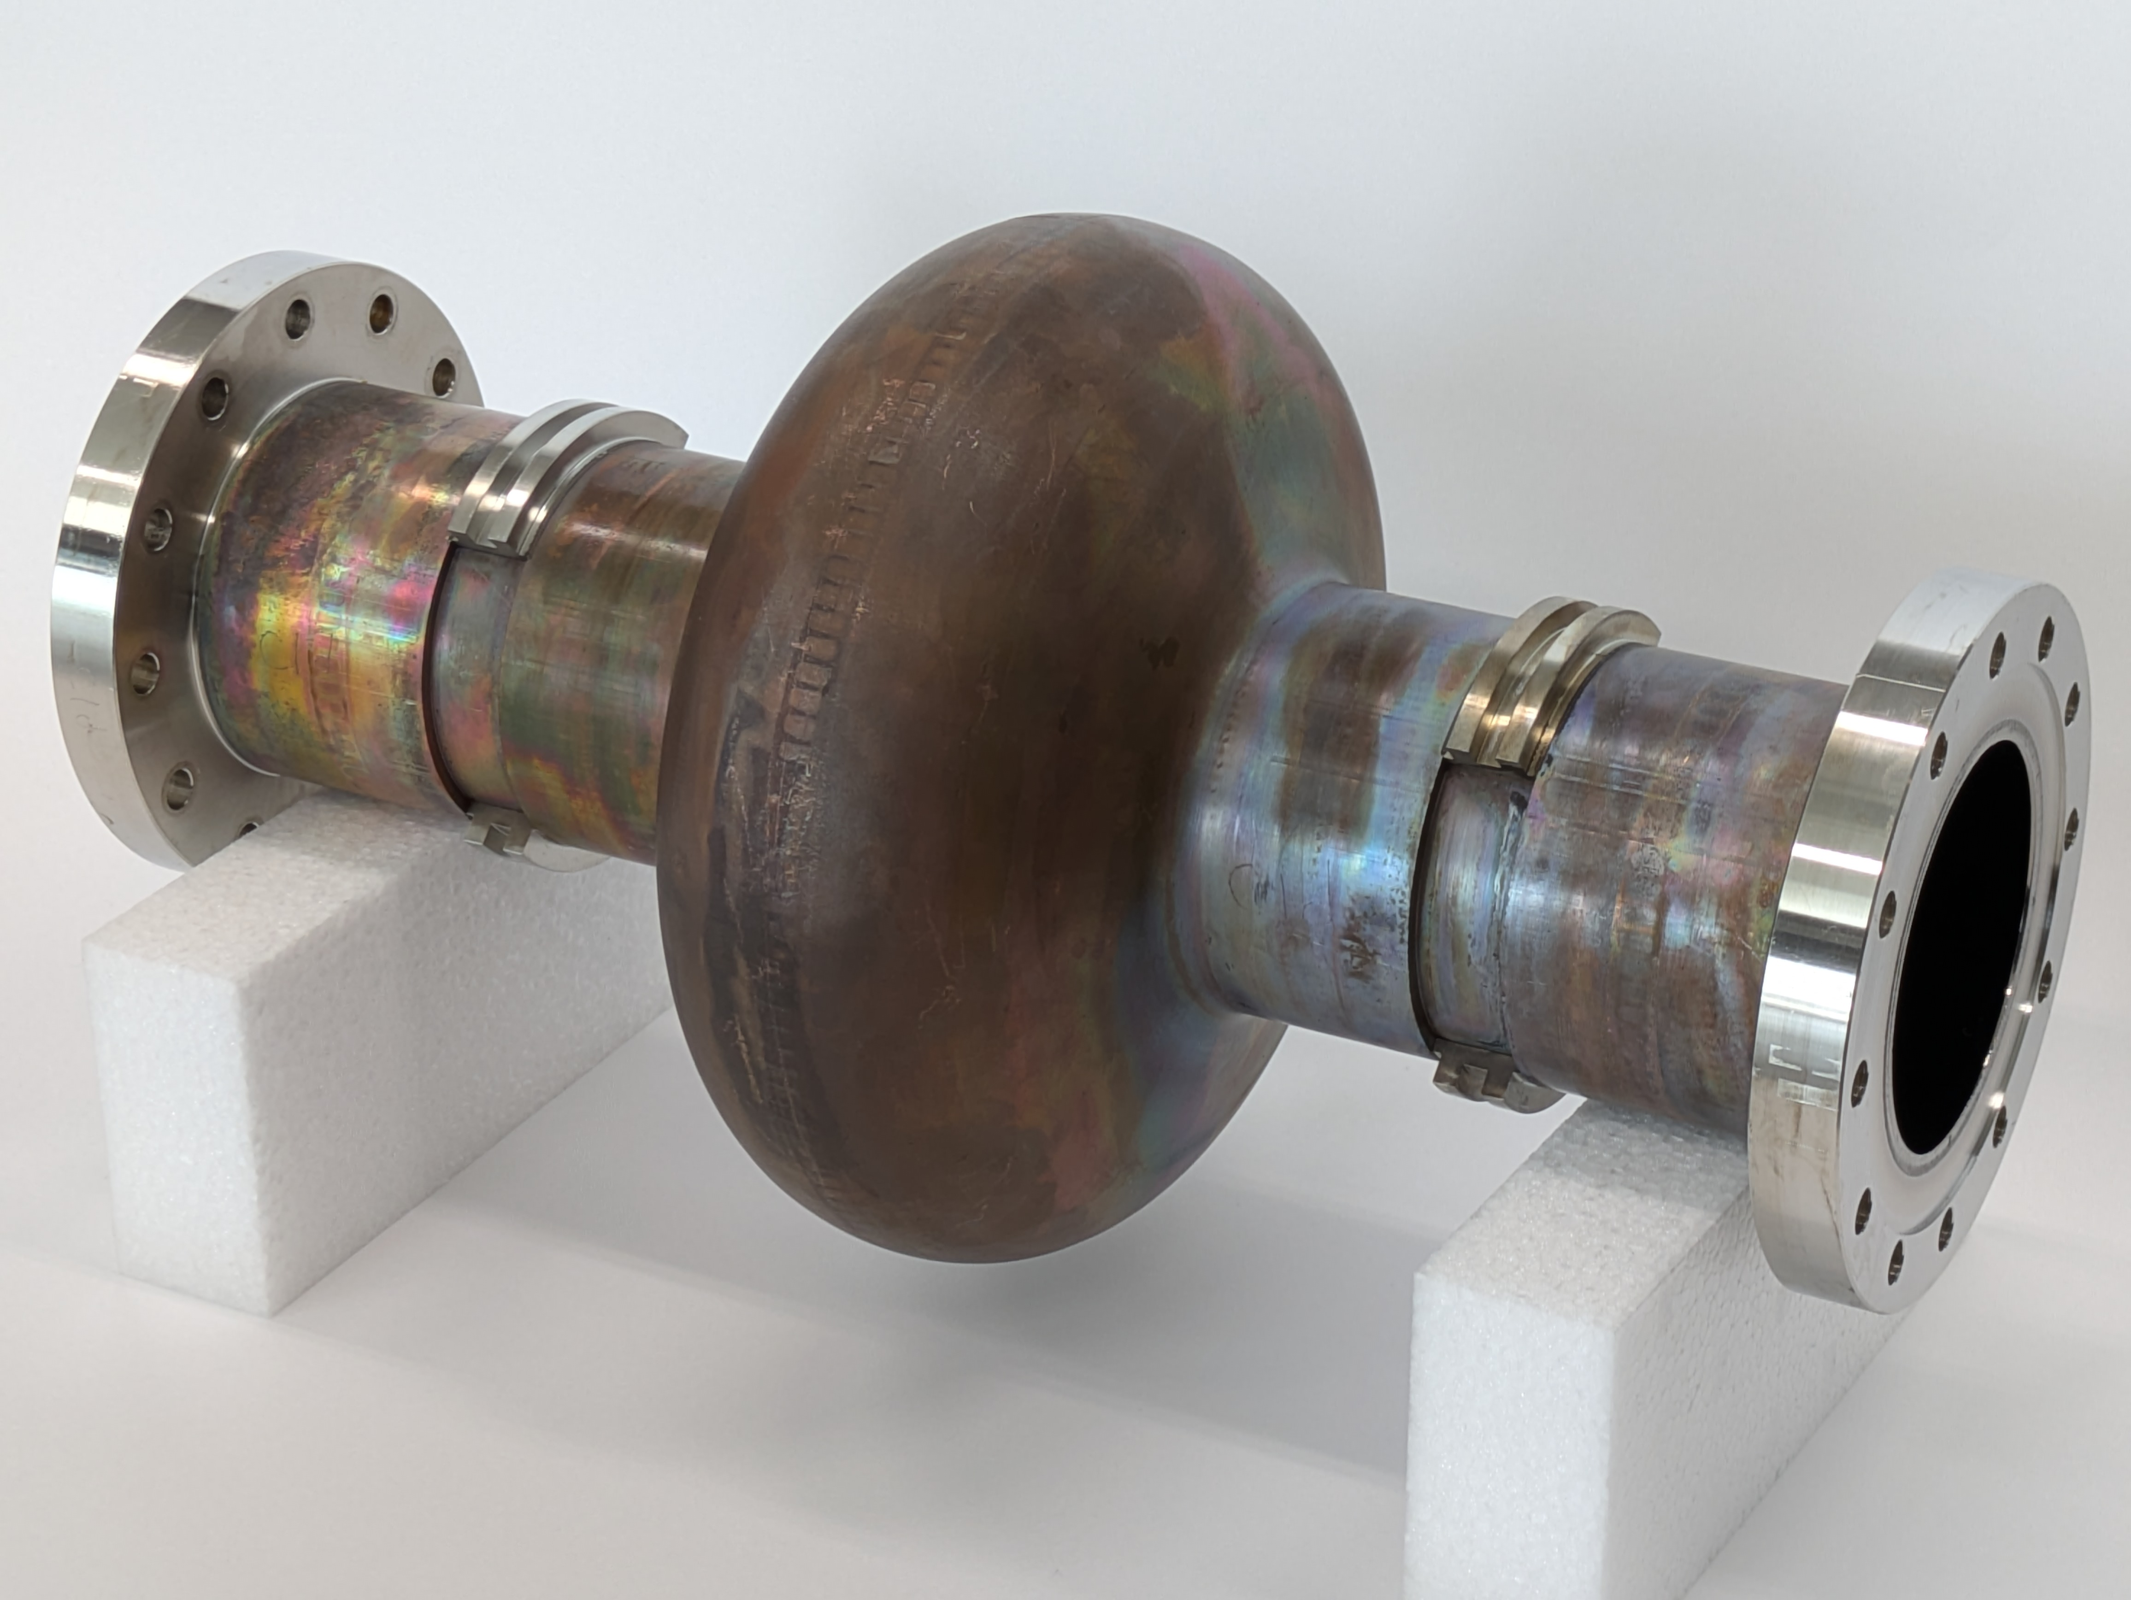
Cavities overview
C1, C1b
The first series of full-seamless
C1c, C1d
Hydroforming + Plasma EP
KEK14, KEK15
Brazed and welded
with CF flanges
C3, C3b
Mechanical polishing + light EP
+ Hydroforming

Slide 5
Results: Q vs E at 1.85 K
Low field (~1 MV/m)
  Q₀ ~ 2-5 ×10¹⁰ :
  Comparable to standard bulk Nb cavities (EP + 120℃ baking)
  Exception: KEK14
Mid field (~10 MV/m)
  Q-drops to < 1×10¹⁰
  Exception: C3b
Max E_{acc}
  12-20 MV/m
  Not as high as standard bulk Nb, but comparable to previous Nb/Cu films on bulk machined substrates.

Slide 6
Attempts to reduce surface roughness
C3 and C3b
  Mechanical polishing and light EP was applied before hydroforming
  No significant improvement on roughness
C1d
  Plasma EP was applied by INFN Legnaro on copper surface after hydroforming
  Surface roughness was reduced
  Macro-structure (orange-peel) remained
C3b
C1d
C3

Slide 7
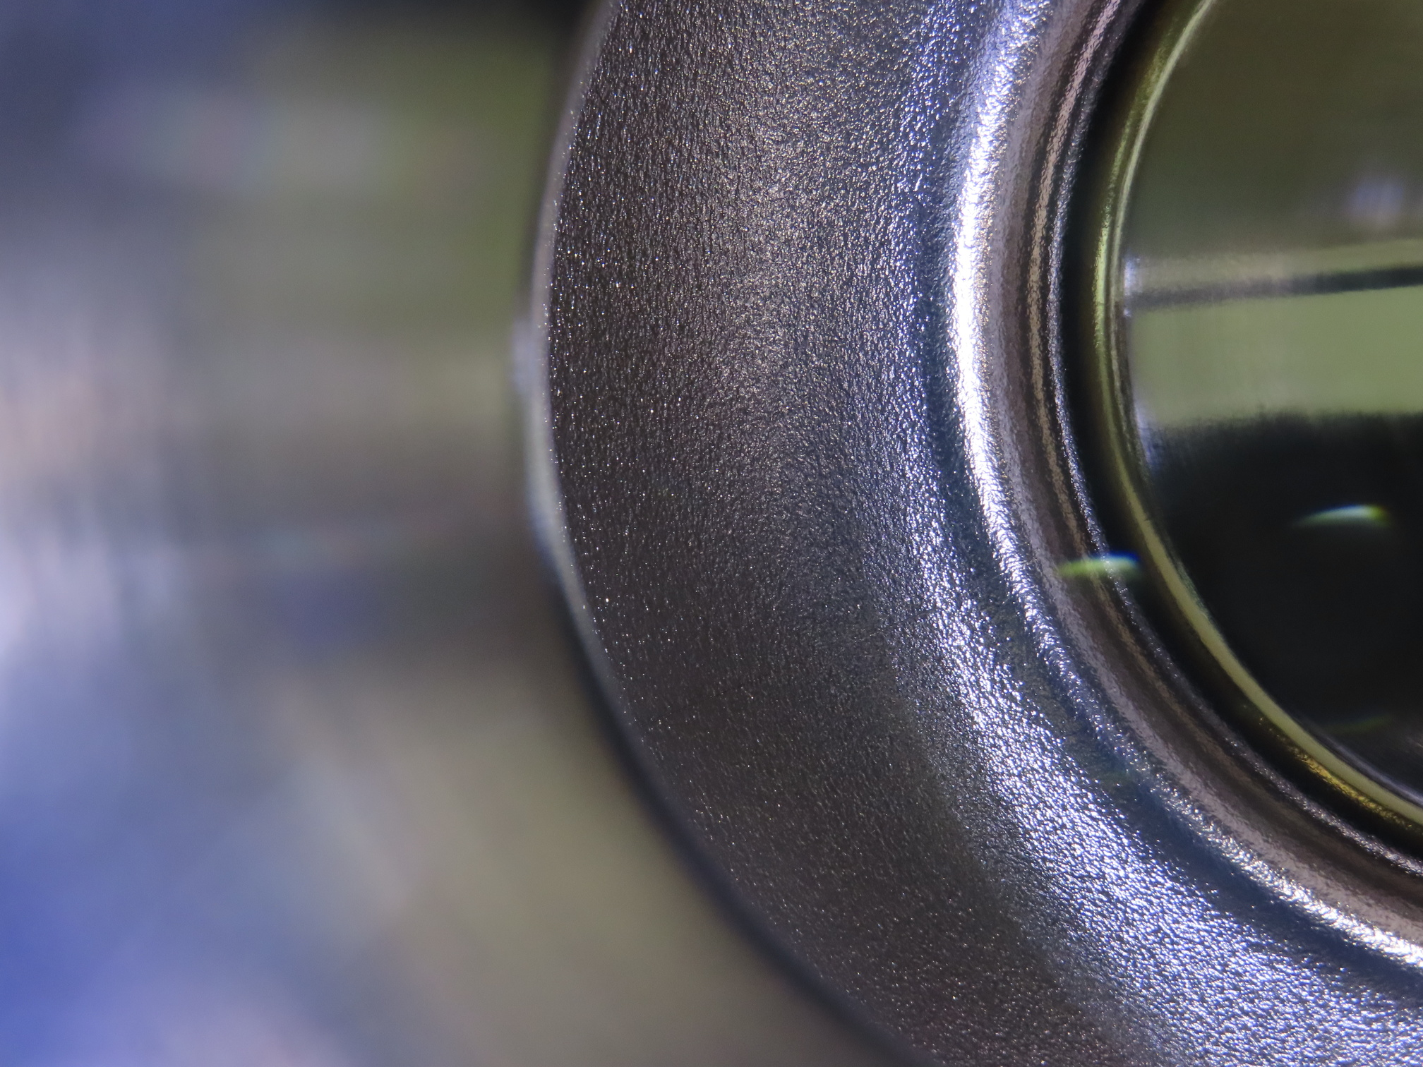
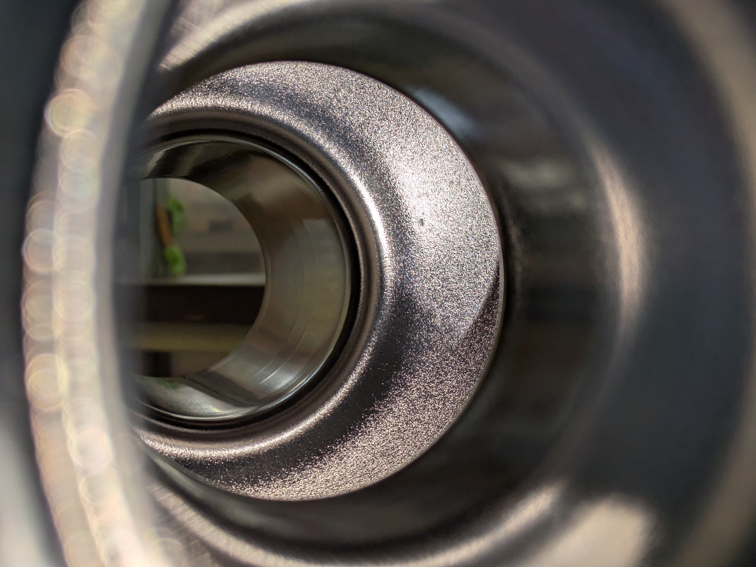
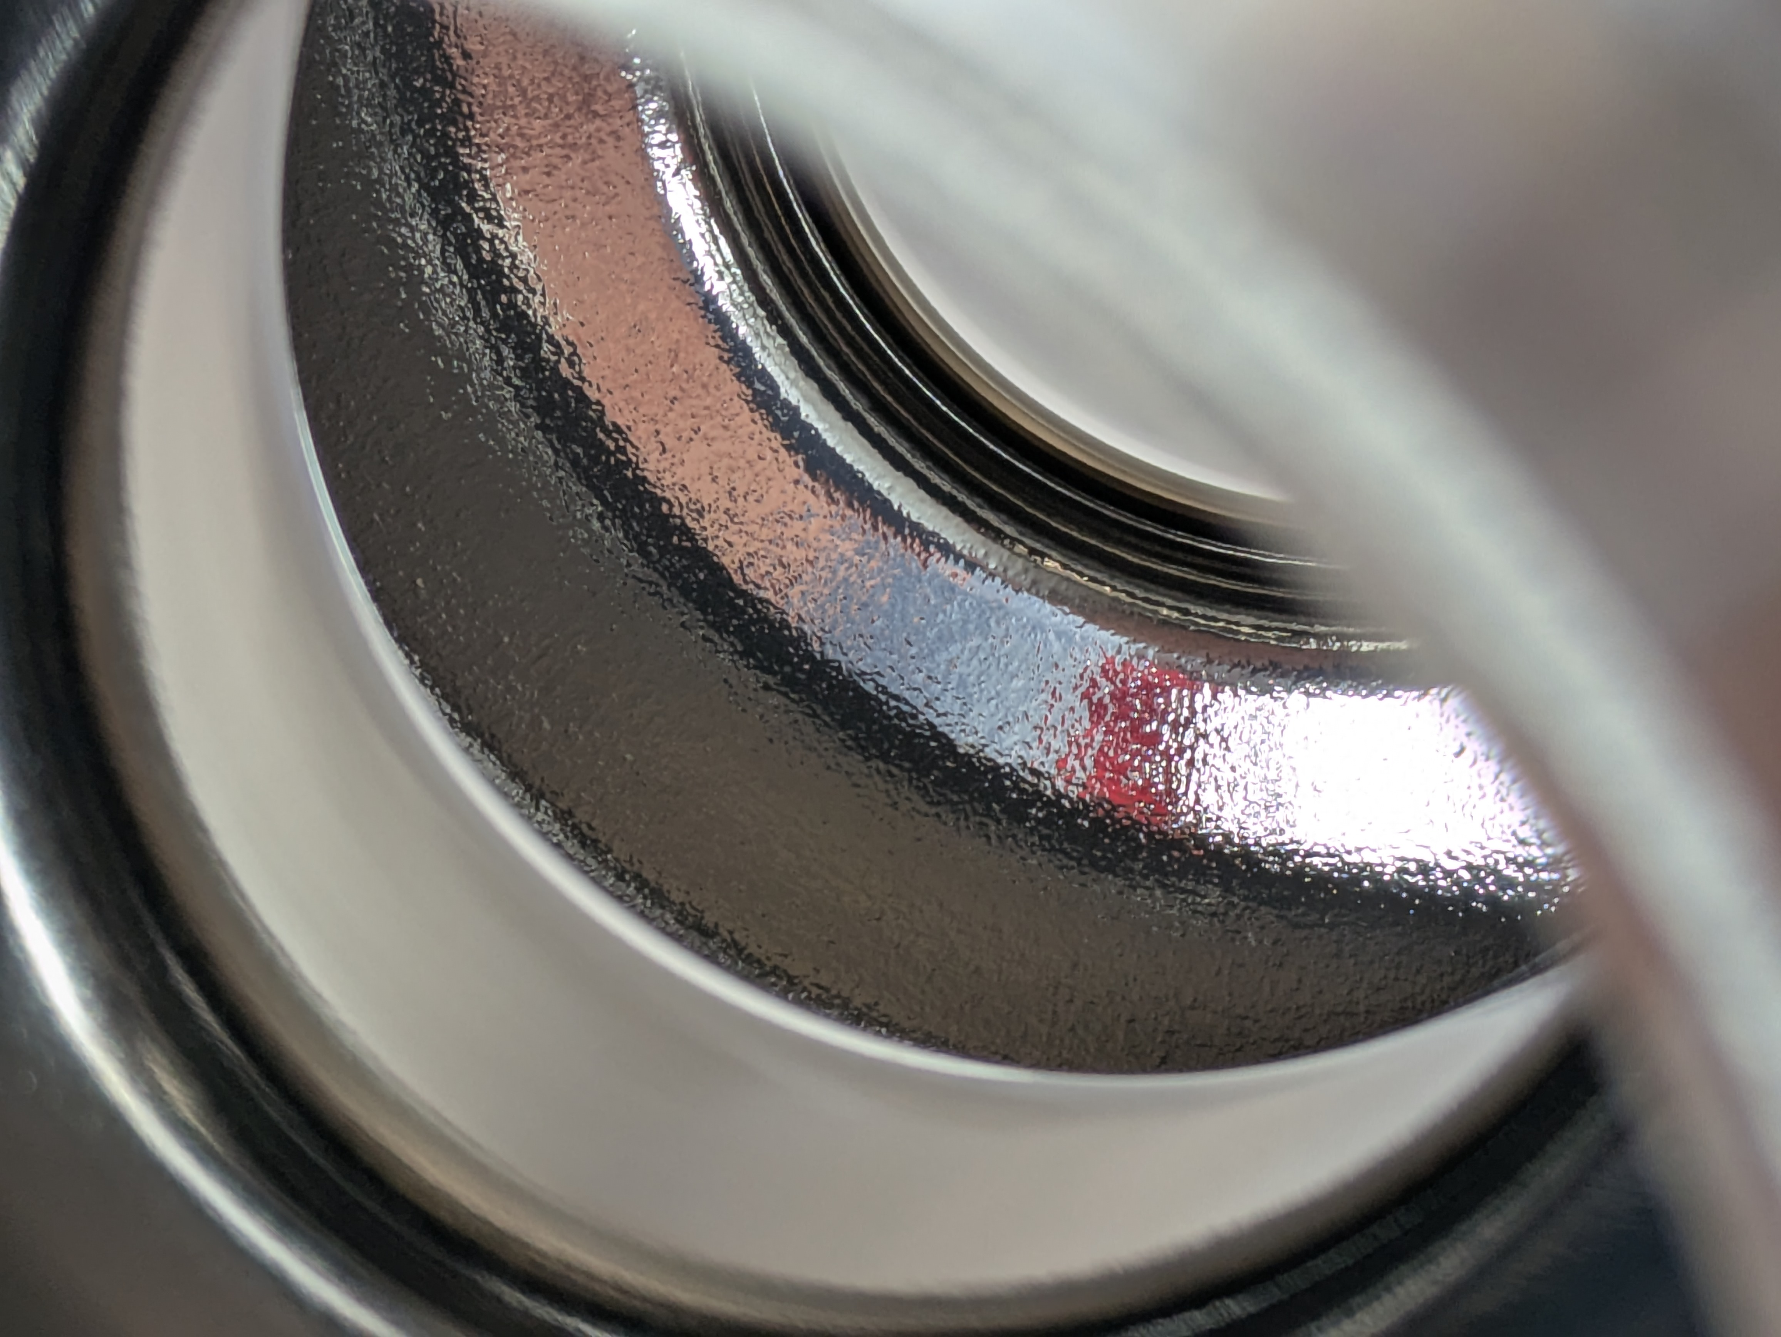
Surface roughness
 | C1, C1b | C3, C3b | C1d
Treatment | Standard | Mechanical polishing before hydroforming | Plasma EP ~200 um after hydroforming
Surface
Roughness (Ra) | 3.3 μm | 2.7 μm | 0.69 μm
Q₀ at 10 MV/m | C1: 3 ×10⁹ C1b: 3 ×10⁹ | C3: 1 ×10⁹ C3b: 3 ×10¹⁰ | C1d: 4 ×10⁹
No clear correlation of surface roughness with RF performance on this small data set

Slide 8
Origin of Q-drop
C3 and C3b:
  Produced with the same procedure
  Huge difference in RF performance
Slight decrease of T-dependent Rs with H_{rf}
First signs of anti-Q slope in Nb films?
Q-drop is caused by residual resistance

Slide 9
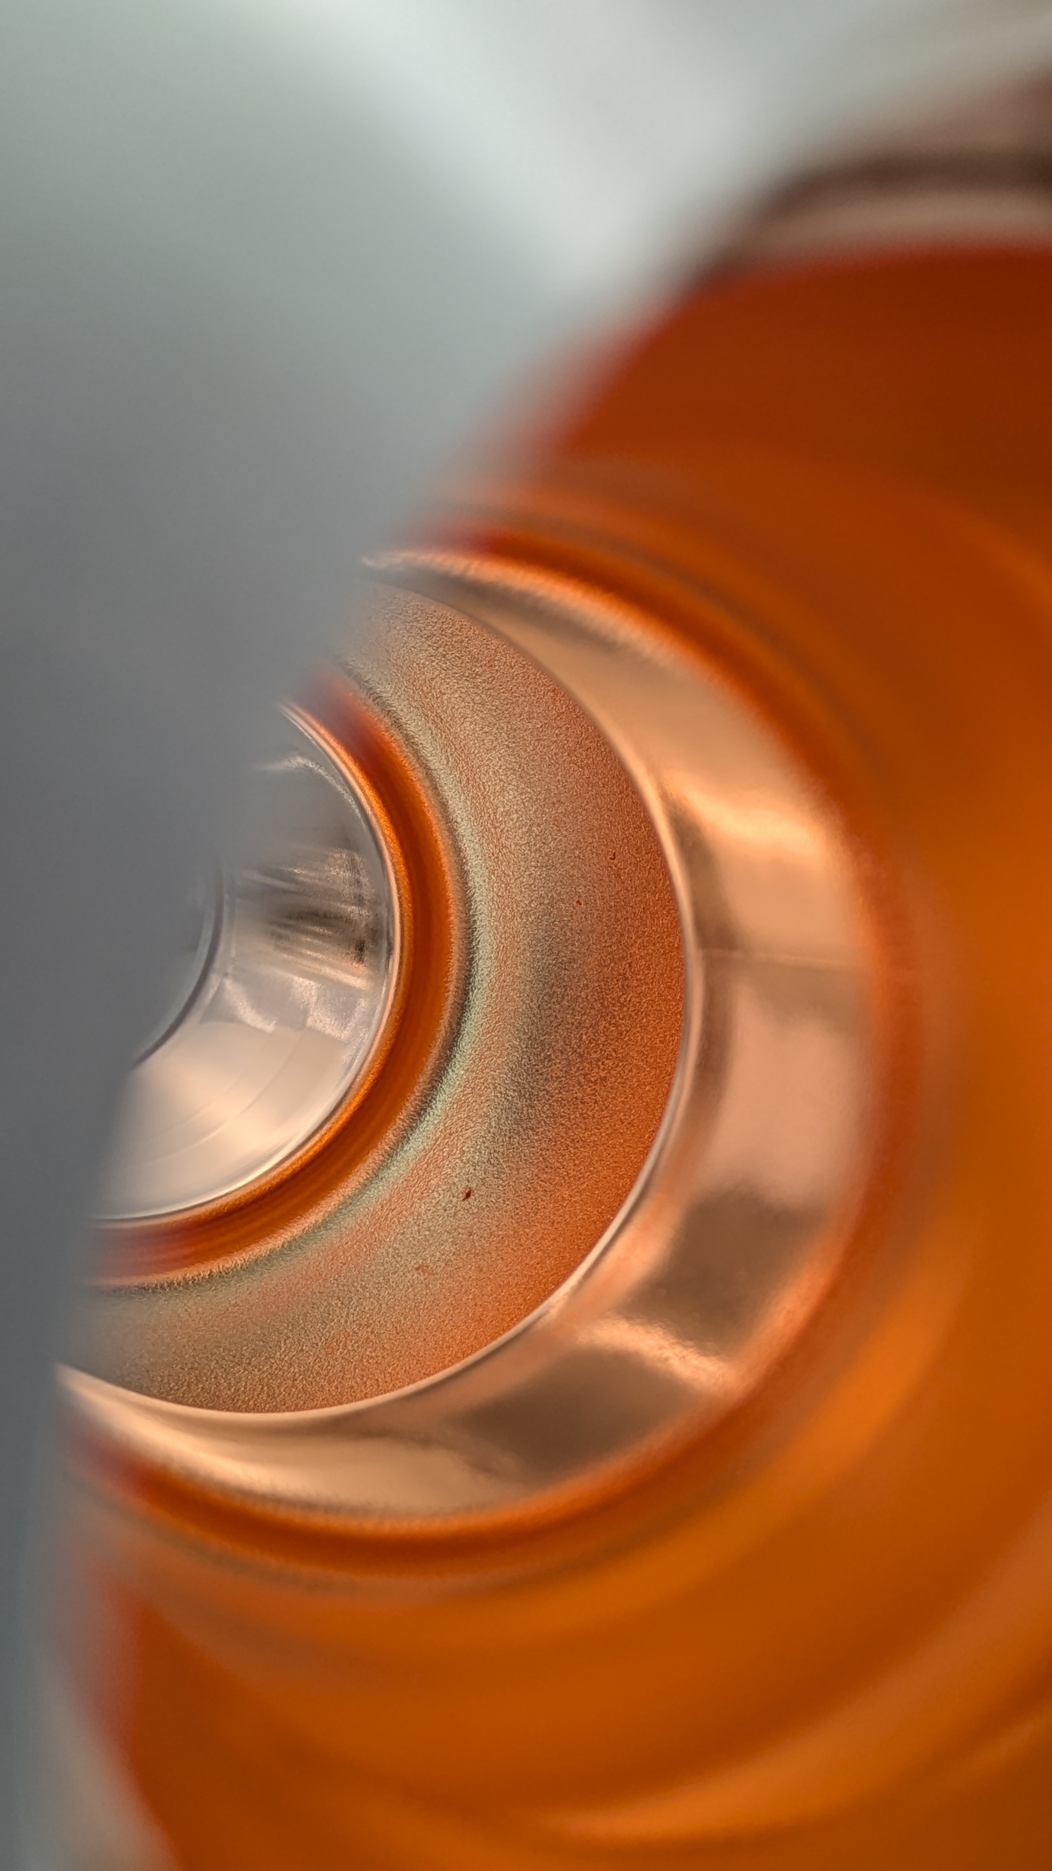
What spoiled C3?
C3: one oxidized spot on the copper surface
Black spot appeared on niobium surface
Possible (likely) explanation: local contamination of Nb layer from the substrate defects

Slide 10
Effect of cool down gradients (thermoelectric currents)
ΔT at T_{c}:
    Spatial temperature difference causes magnetic flux trapping induced by thermoelectric current.
Residual resistance becomes larger
in large ΔT cooling condition
Strong increase of R_{res} with Hrf

Slide 11
R_{res} / ΔT correlation
Large ΔT cooling (without shield)
Small ΔT cooling is essential for bilayer structure cavities.
A simple “shield” is effective for vertical cryostat measurement.
Small ΔT cooling (with shield)

Slide 12
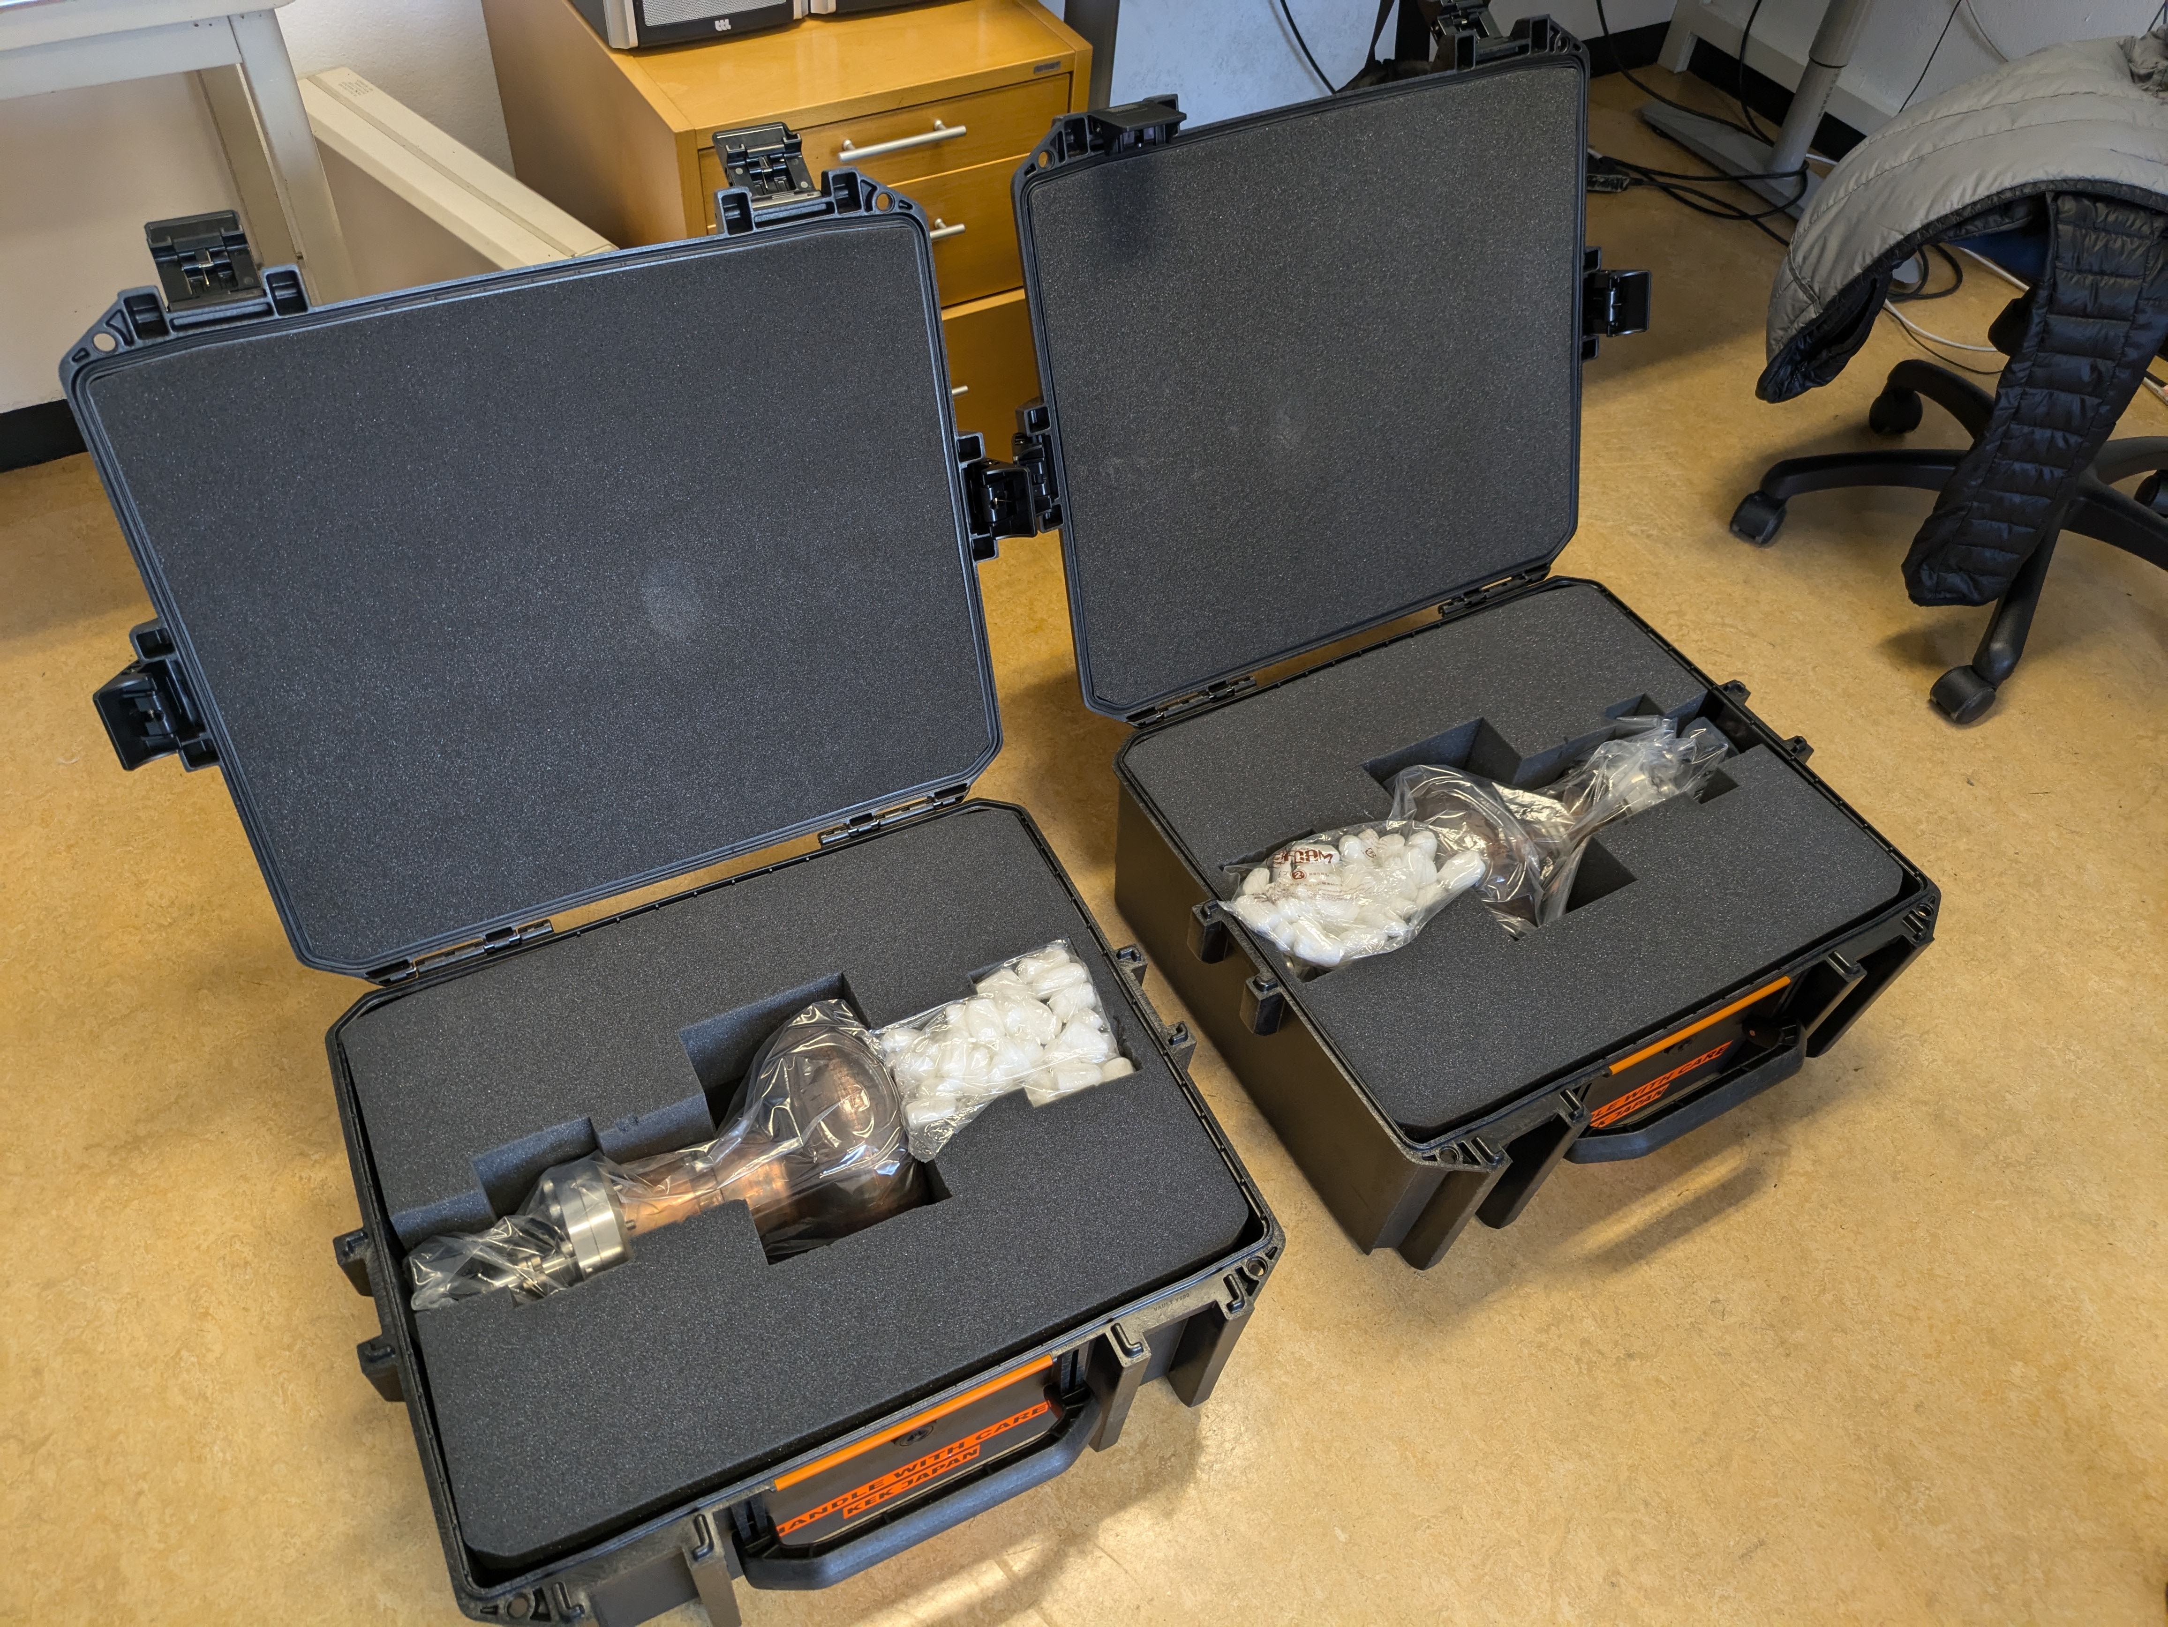
Transportation, measurement cross checks
C1, C1b and C3b
  Nb coating at CERN
  First RF test at KEK
  Second RF test at CERN
  No degradation after long-distance transportation
  Consistent measurement results

Slide 13
Summary
  CERN and KEK started a collaboration to explore hydroforming as a possible substrate manufacturing method for Nb/Cu thin film cavities
  The cavities can be fully-seamless: no welding seams on equator, iris and beam-tube.
  Single-cell 1.3 GHz cavities were successfully produced, and RF performances measured both at CERN and KEK.
  In low-field (~1 MV/m), the quality factor is comparable to standard bulk Nb cavities:
  At mid-field (~10 MV/m), most cavities had Q-drop below 1×10¹⁰.
  The reason for Q drops are localized defects (same as in previous experience with other manufacturing methods)
  However, one cavity maintained Q₀ > 1×10¹⁰ up to 17.5 MV/m.
  The surface roughness is degraded by the hydroforming process due to the huge plastic deformations. The well known orange-peel was maintained even after electropolishing and niobium coating.
  However, this has been observed also in the best performing cavity, so its effect on RF performance is unclear.
  The T-dependent Rs is constant or slightly decreases with field, the Q slope comes from the residual resistance
  An important source of residual resistance is magnetic flux trapping caused by thermoelectric current
  In the measurements using a vertical cryostat, this effect can be eliminated by covering the cavity to ensure that cold helium gas does not blow onto only a part of the cavity, and by cooling it slowly.
  The measurement results from CERN and KEK on the same cavities were consistent. Long-distance transport had no effect on the cavity performance.

