Slide 1

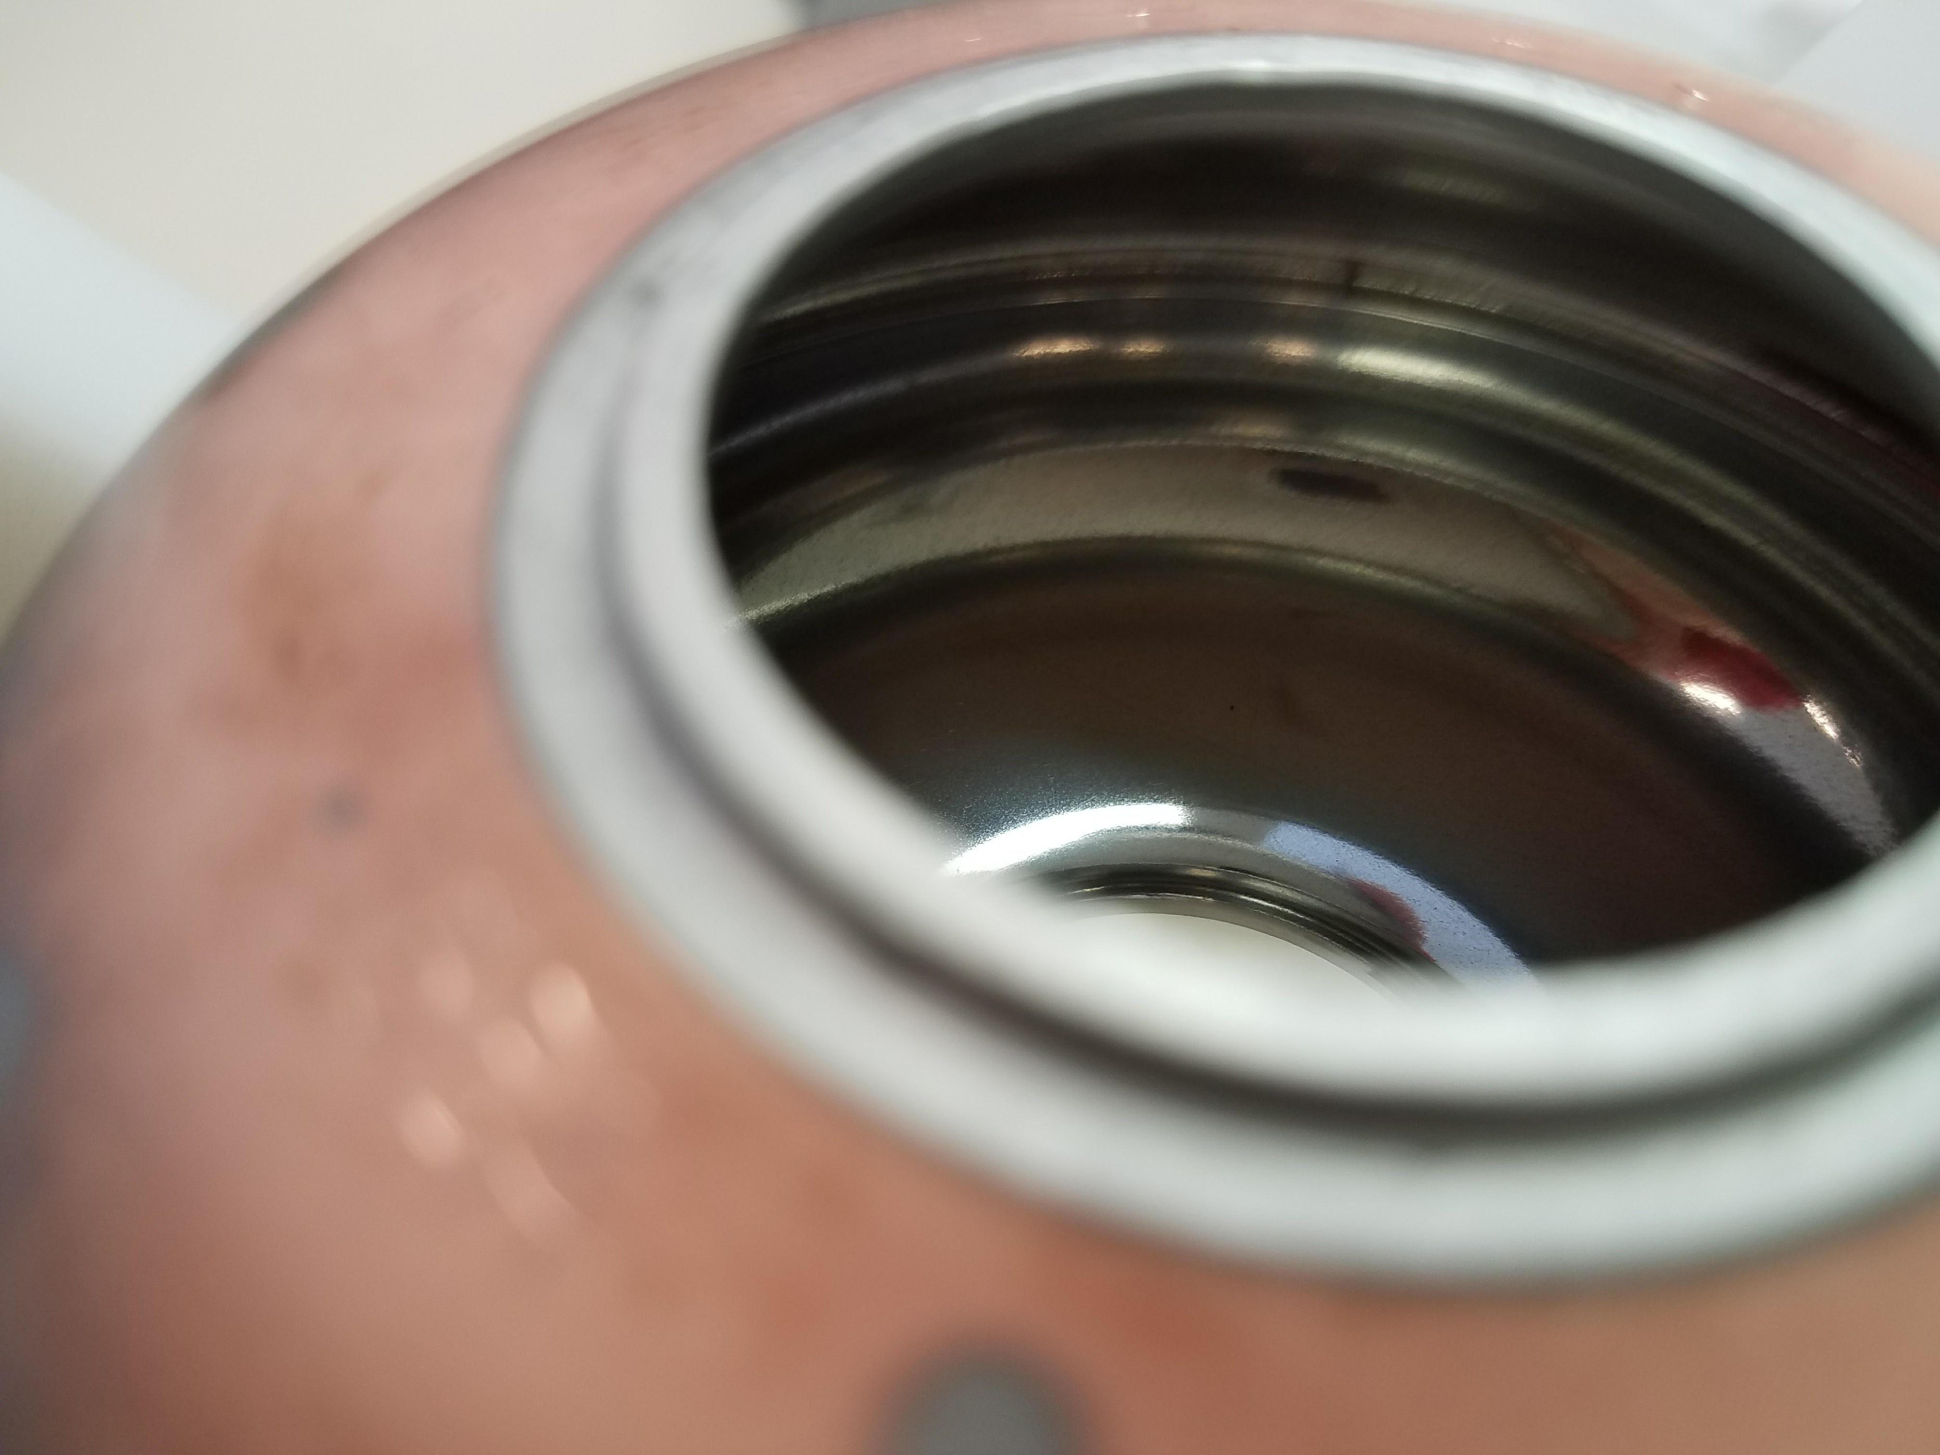
Update on Nb & Nb₃Sn on Cu
Developments at JLab
6/11/26
A.-M Valente-Feliciano, U. Pudasaini, O. Hryhorenko, S. Bira, Minqgi Ge, Eric Lechner, Brandi Redman, Theo Cahall​
​​

Slide 2
Outline
Update on 1.3 GHz Nb/Cu development
Development of Nb₃Sn on Cu and other substrates
Supporting Developments
Summary

Slide 3
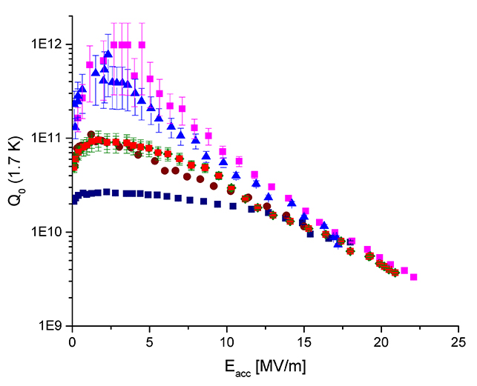
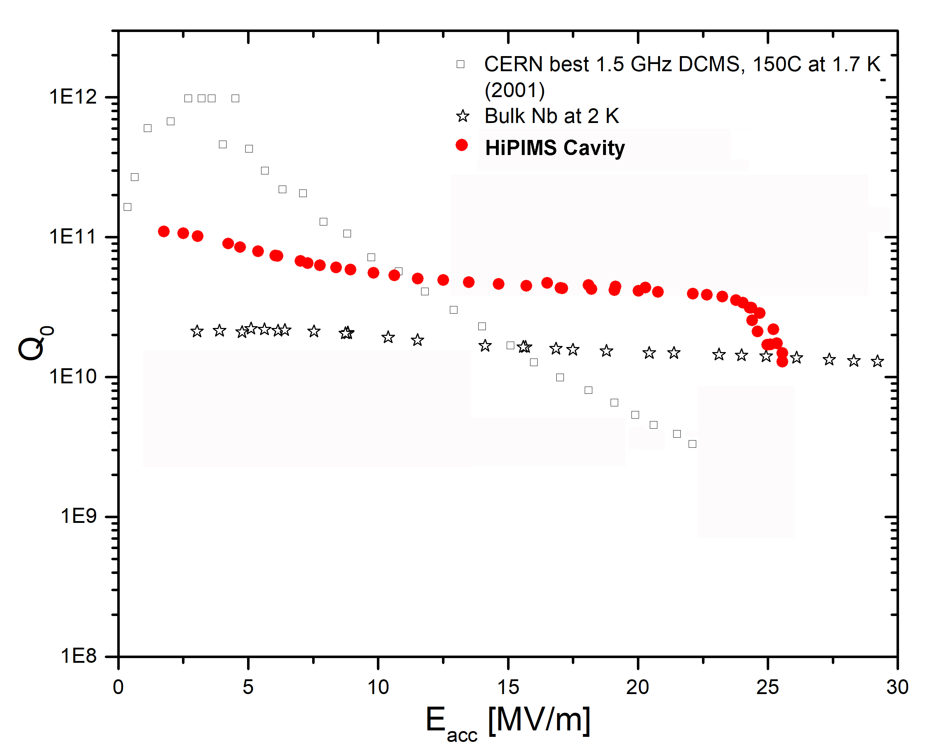
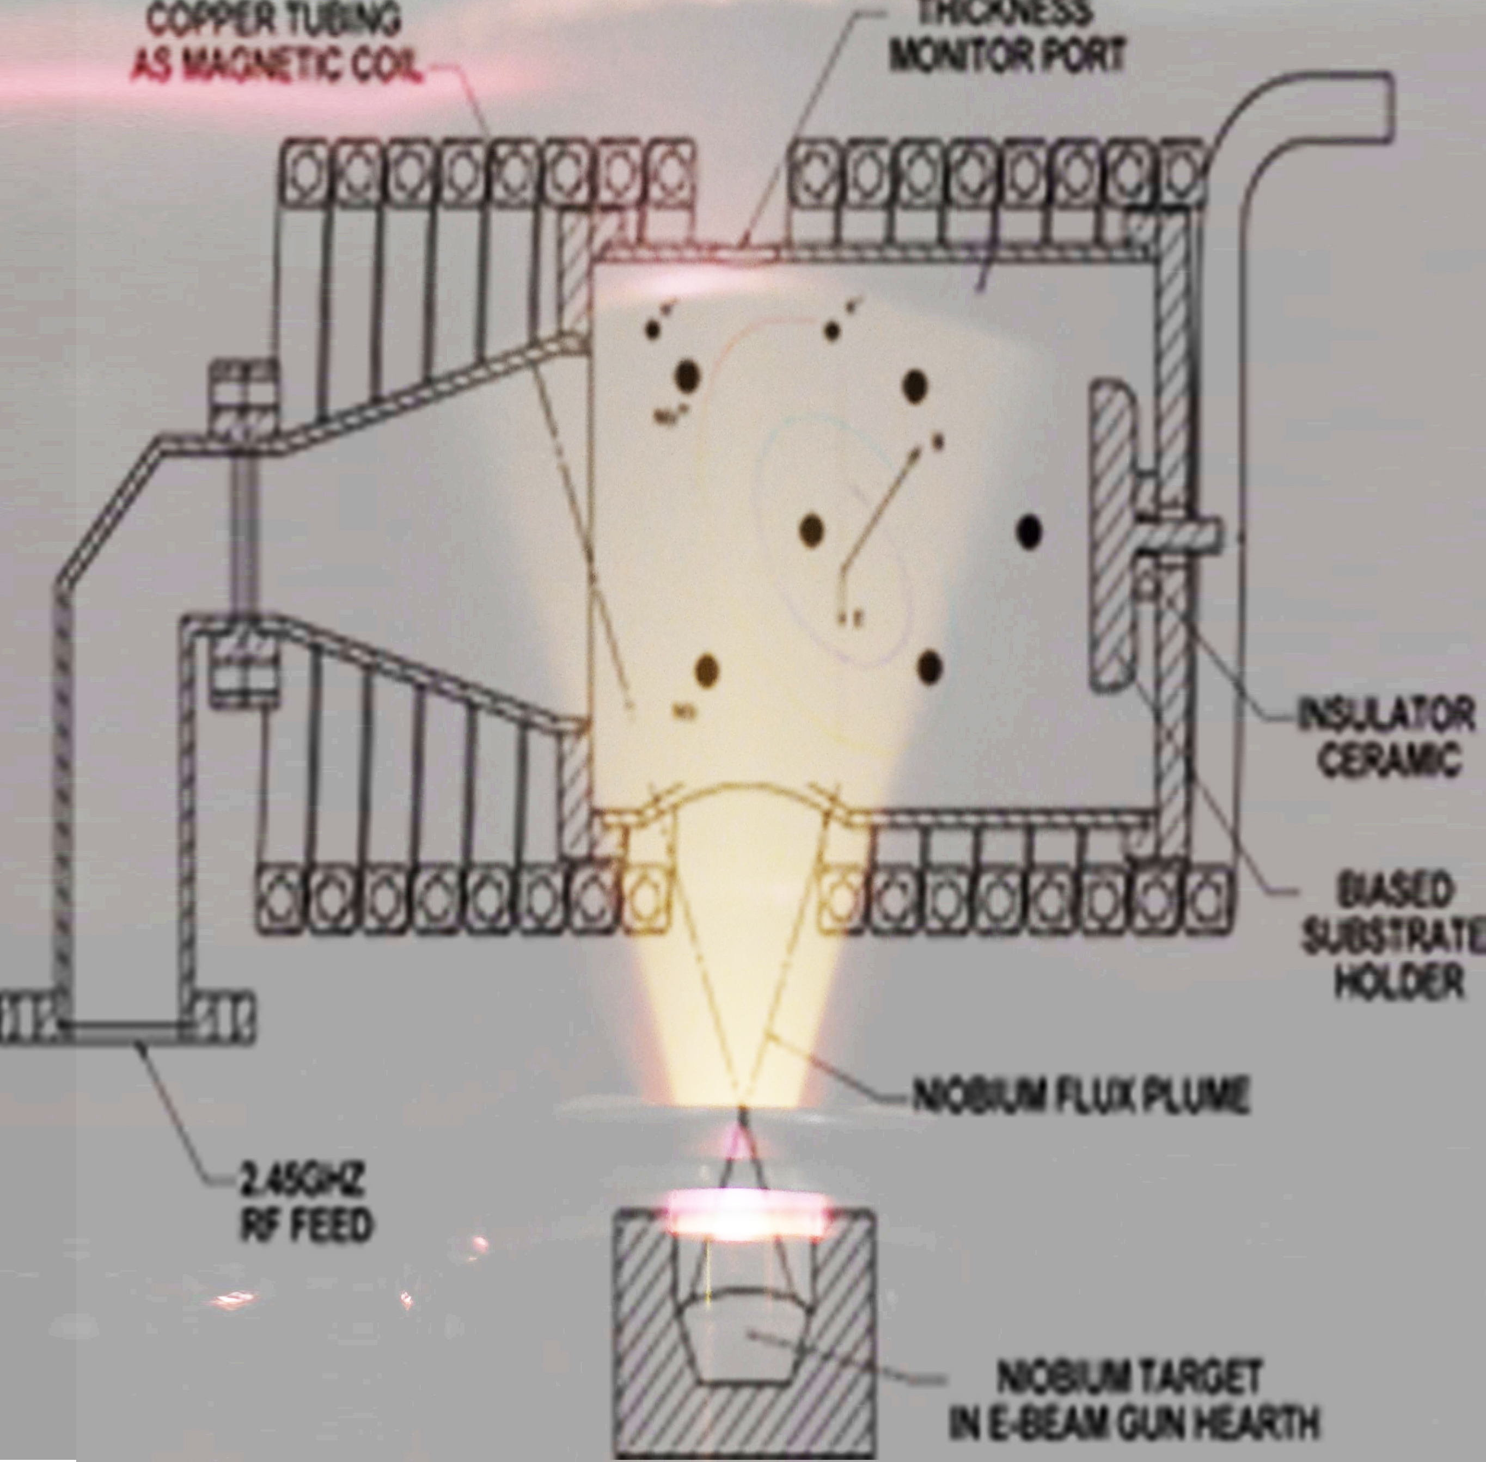
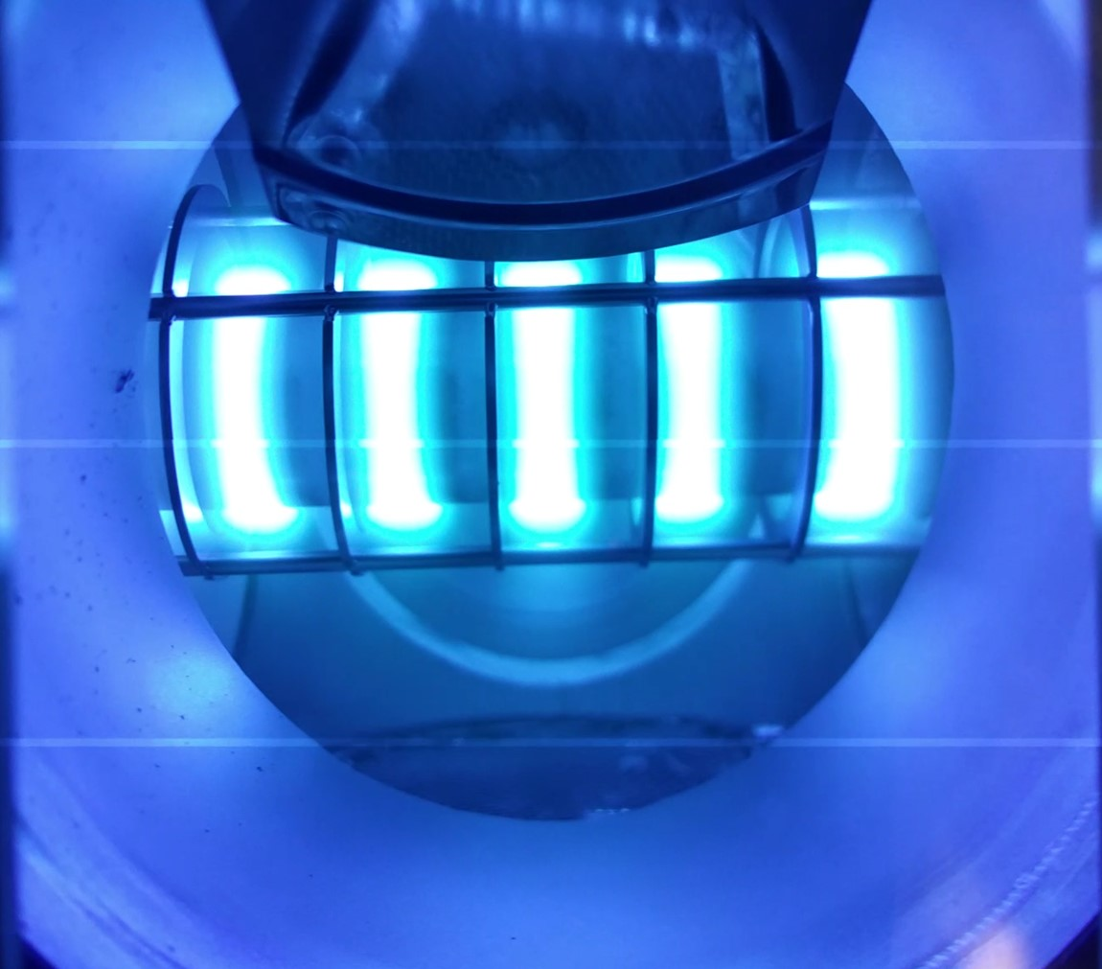
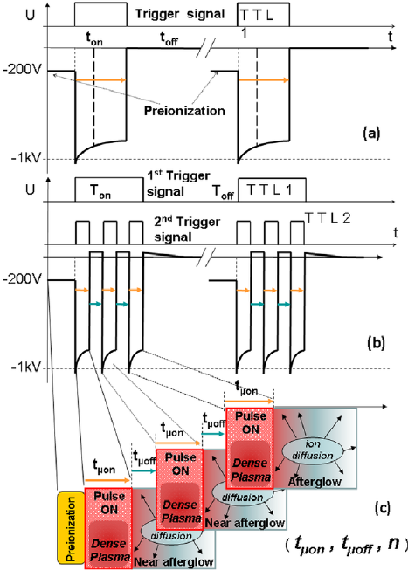
Produce Nb/Cu cavities with HiPIMS at 1.3 GHz and lower frequencies with at least Q~ 2x 10¹⁰ at 2K, 15 MV/m
Overcome Q-slope plaguing Nb/Cu cavities by producing high quality Nb films with hyperthermal ions
The development of SRF surfaces with other forms of Nb and other superconducting materials have the potential to further improve SRF cavity performance beyond the Nb material intrinsic limit. This combined with higher efficiency and quality control are most relevant for structures required for large instruments and for industrial accelerators
Energetic Condensation
Energetic Condensation implemented with 2 techniques
Goal
ECR
Cylindrical HiPIMS

Slide 4
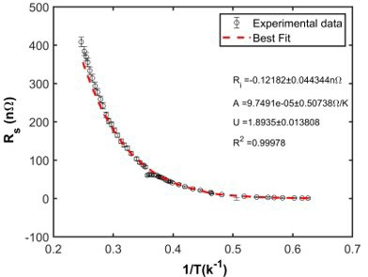
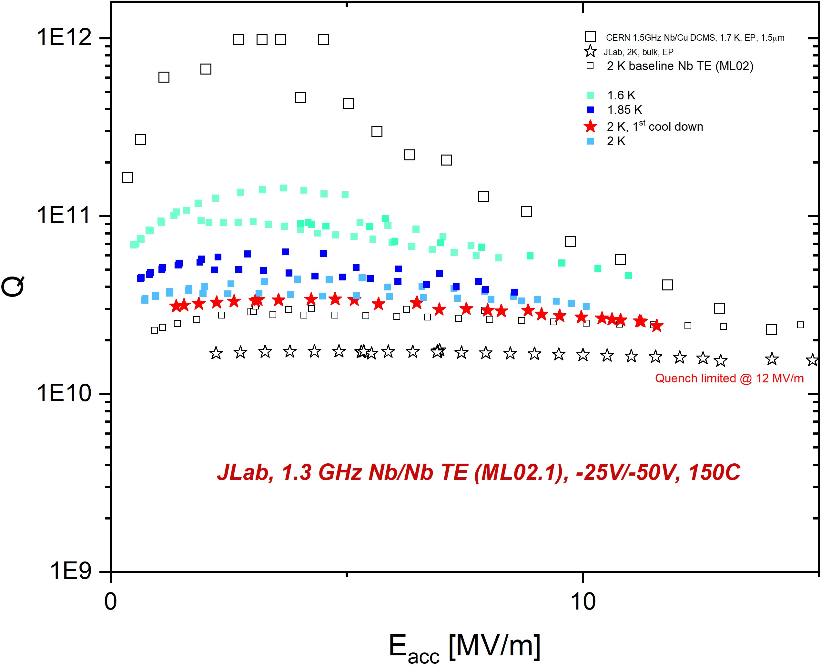
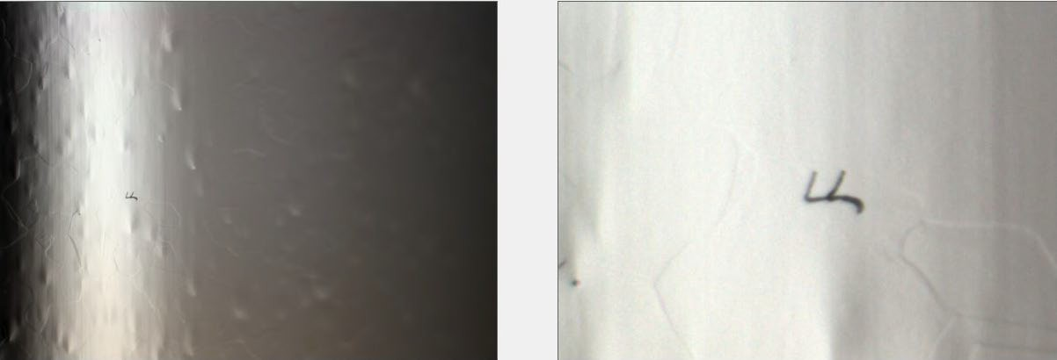
Q-slope mitigation with HiPIMS Nb films
Coating Temperature: 150 ºC
Nucleation at -25 V, subsequent growth -50 V
HiPIMS Nb film/Nb results
Δ=1.8935,
R_{res}=0.1 nΩ
mfp=57.2 nm
No degradation in Q compared to bulk substrate though quench limitation early at 12 MV/m
No intrinsic limitation for Nb films

Slide 5
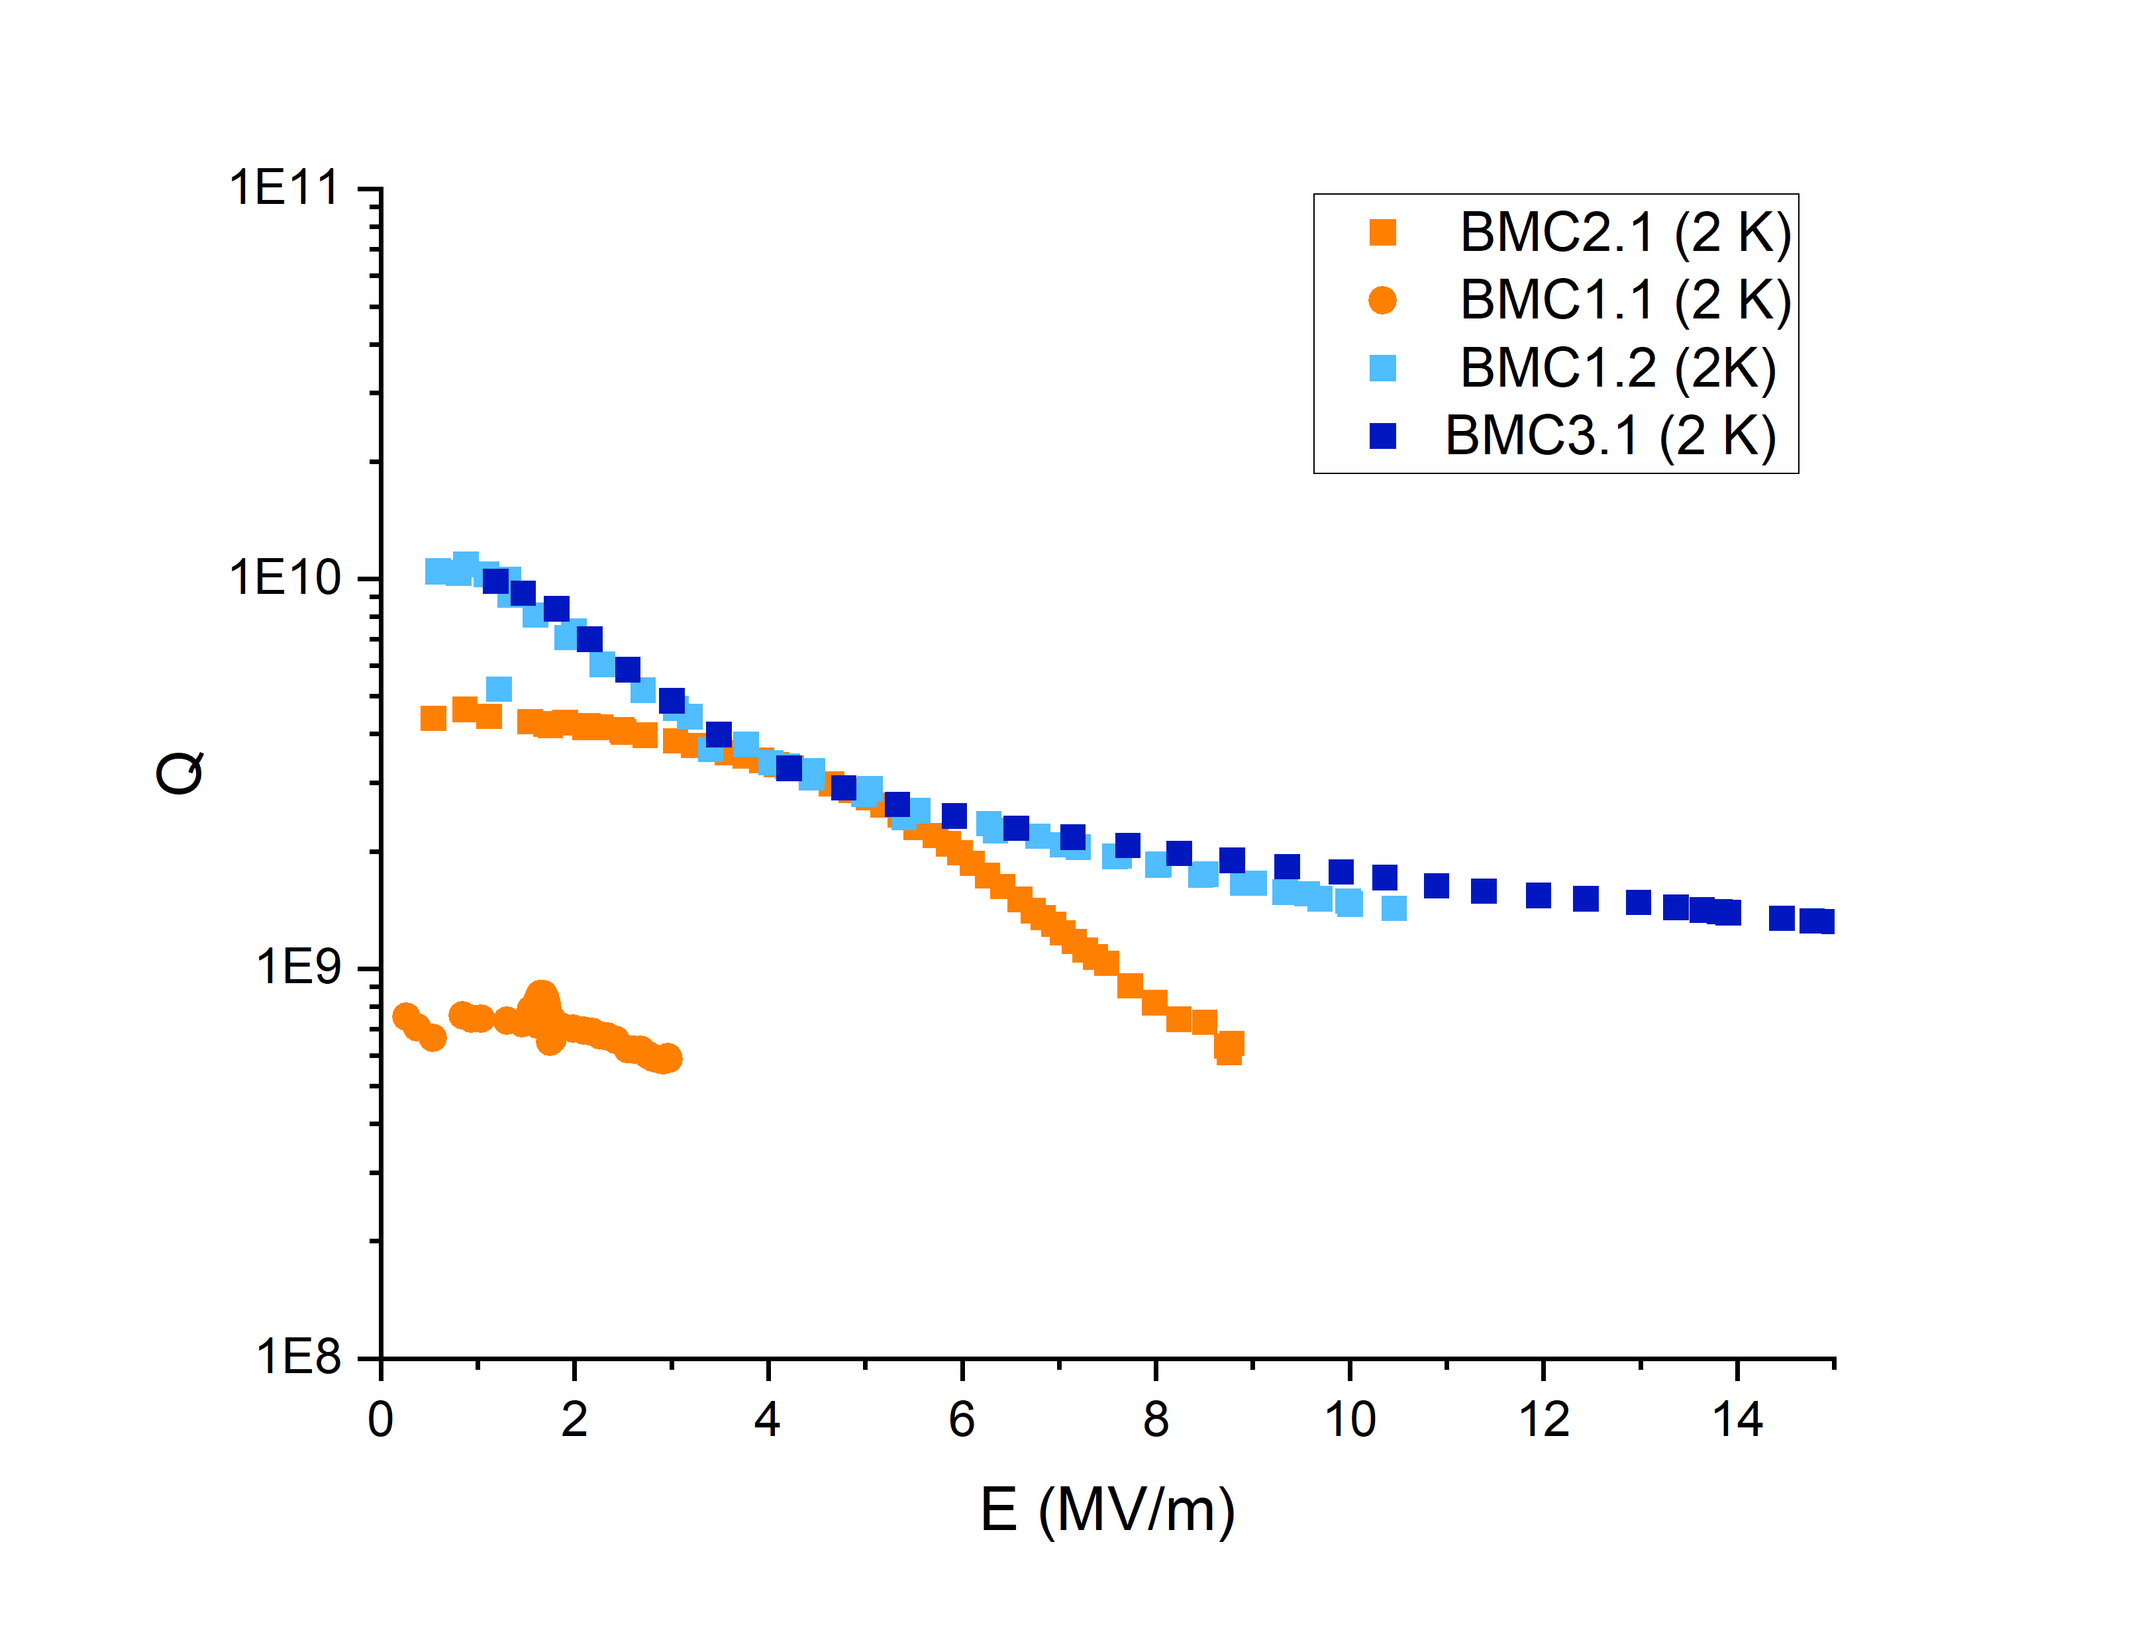
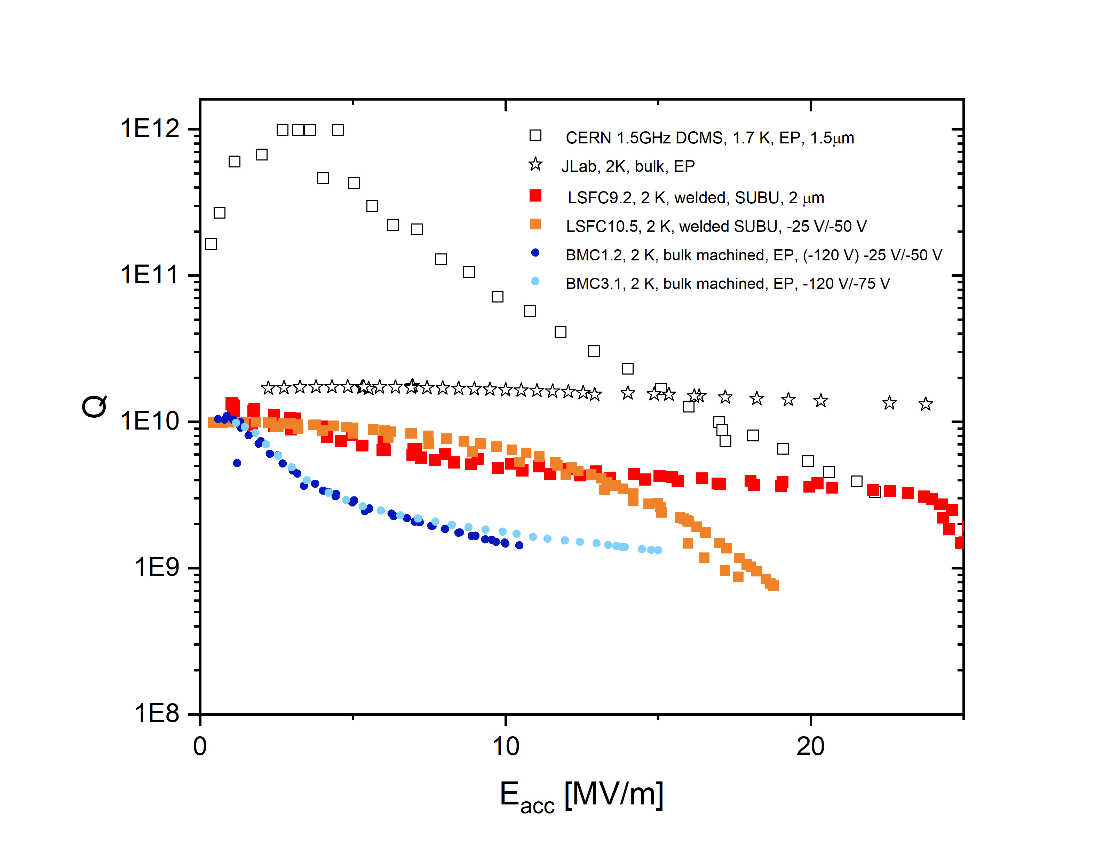
1.3 GHz Nb/Cu (bulk machined) cavities
Q on bulk machined Cu cavities still low. T_{c} ~ 9.1 K, low for Nb/Cu films ( T_{c} expected > 9.35 K)
Origin: film poisoned with N due to leak on Kr injection line - validated with samples
Issue fixed, BUT progress further hindered due to facilities problem: PCW conductivity > 3000 uS/cm due to bacteria contamination, which induce damage with the pulser (currently under repair)

Slide 6
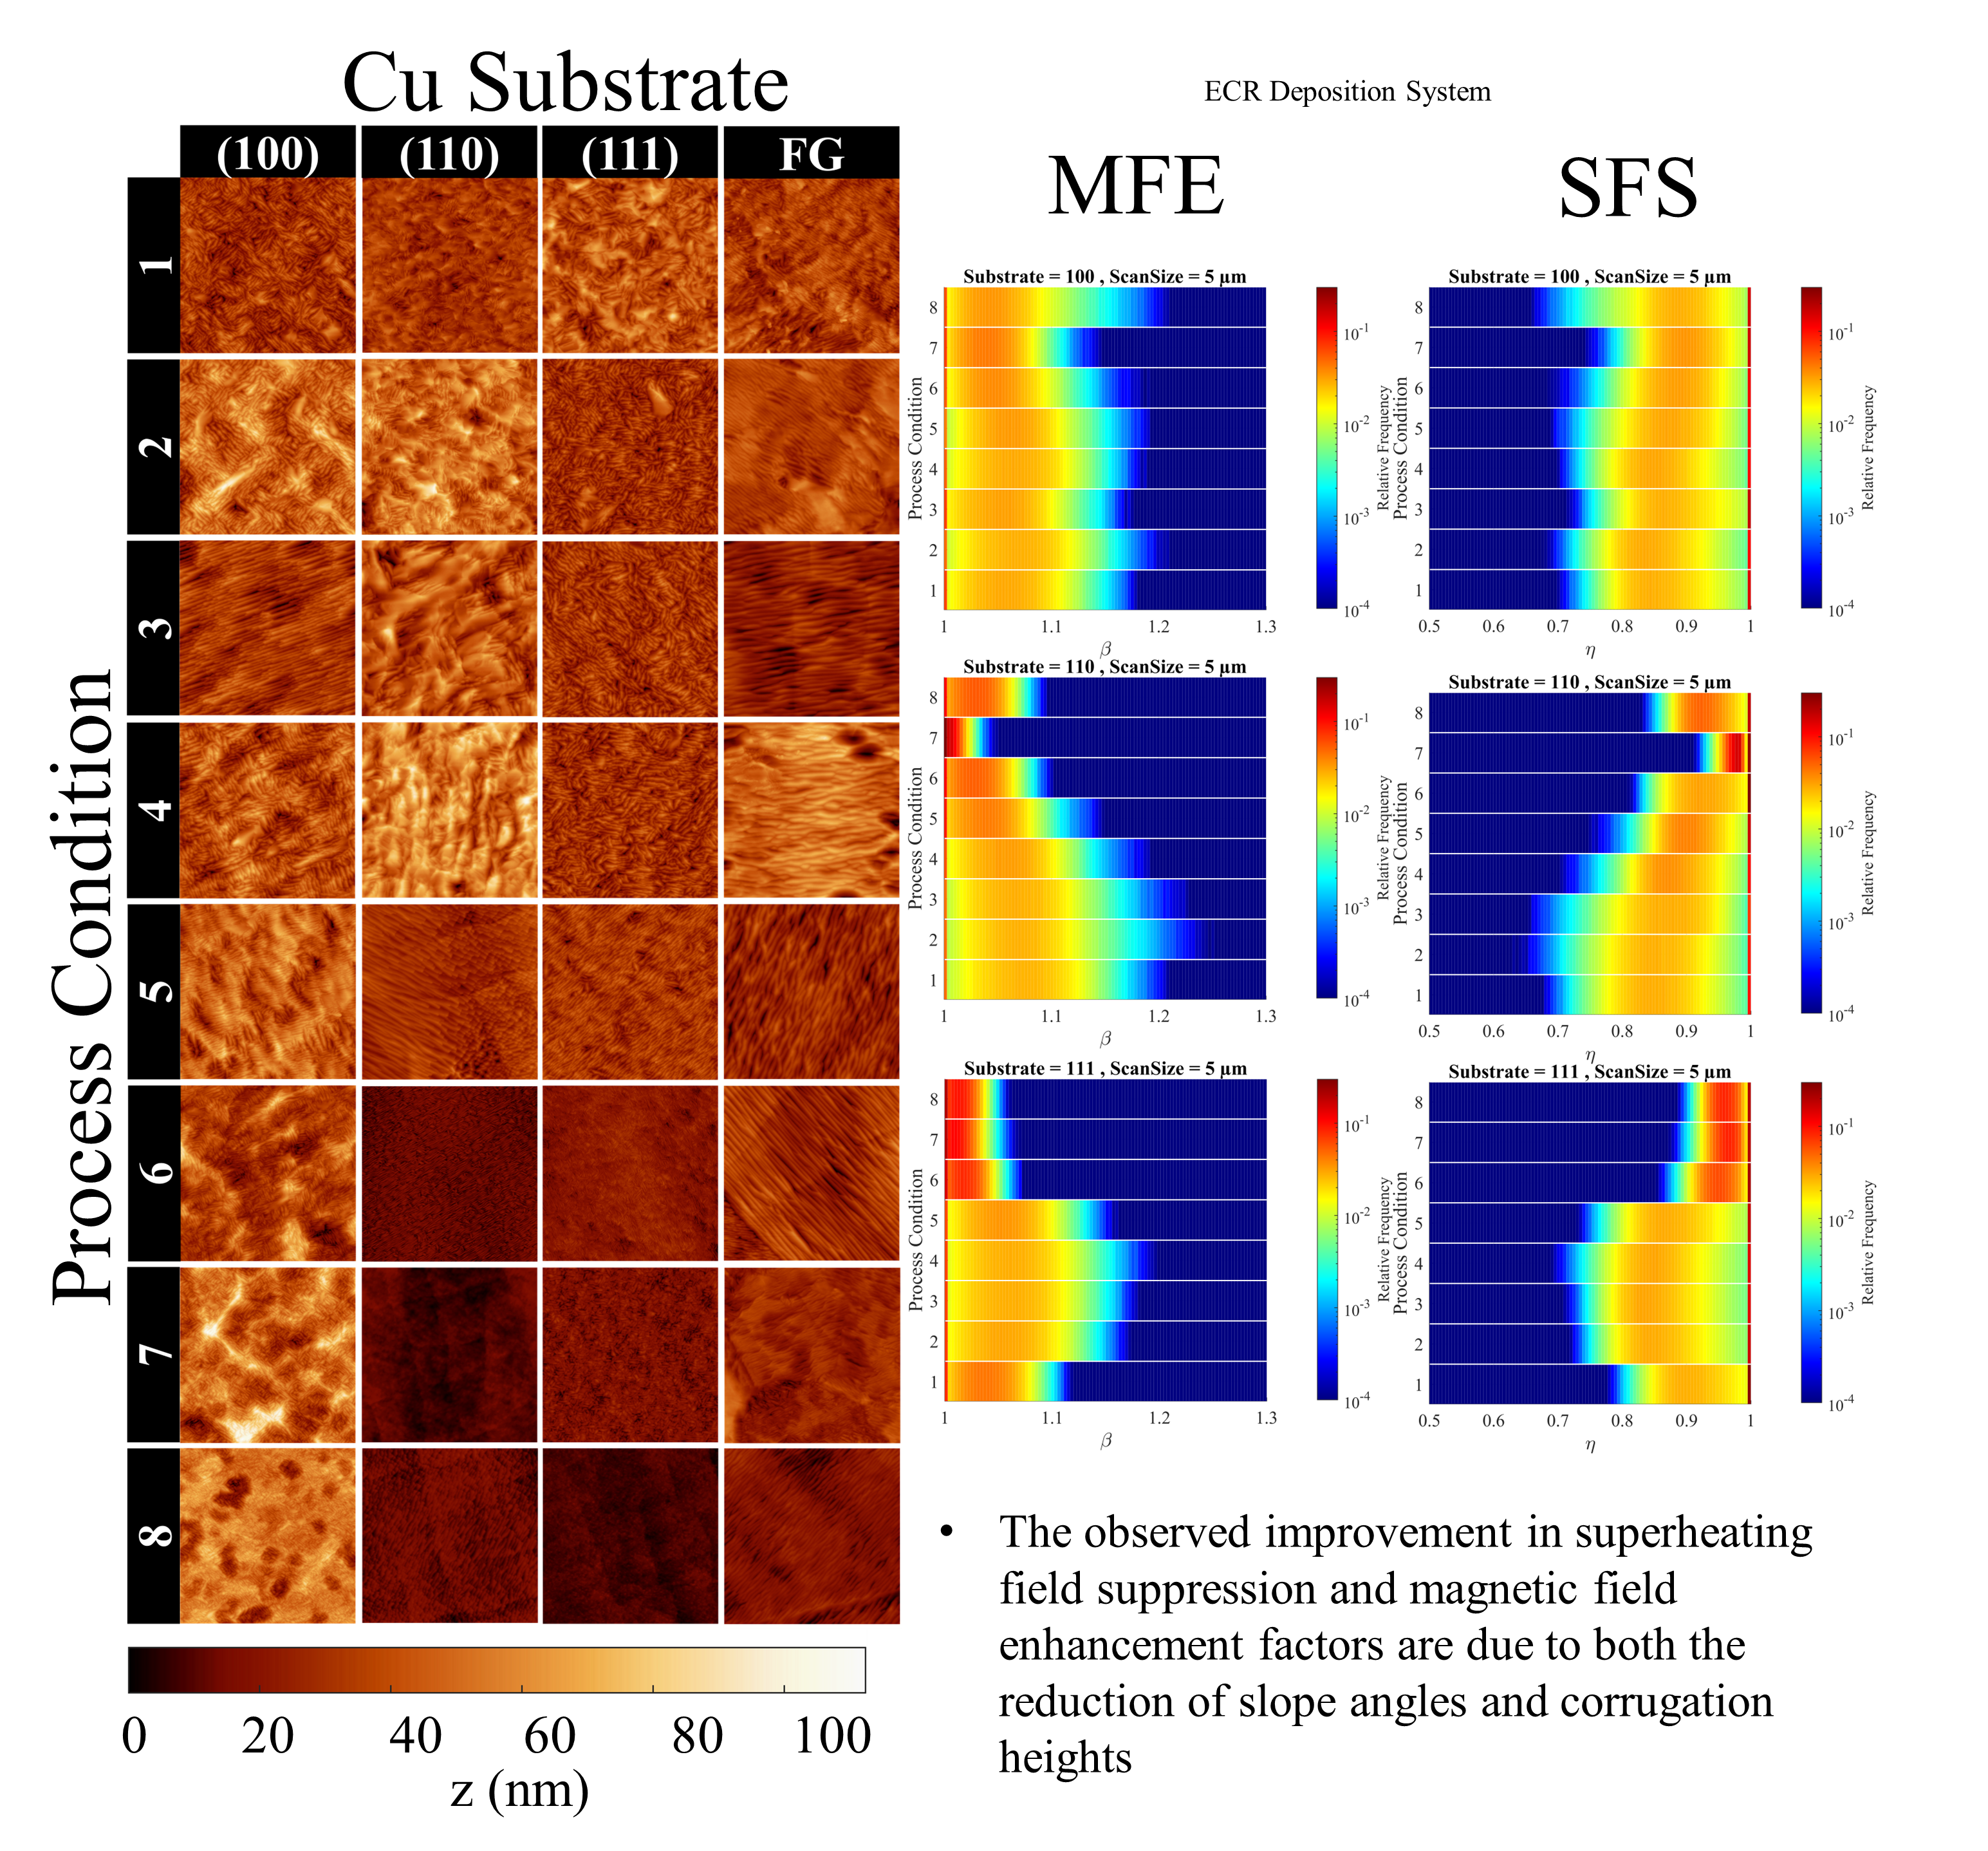
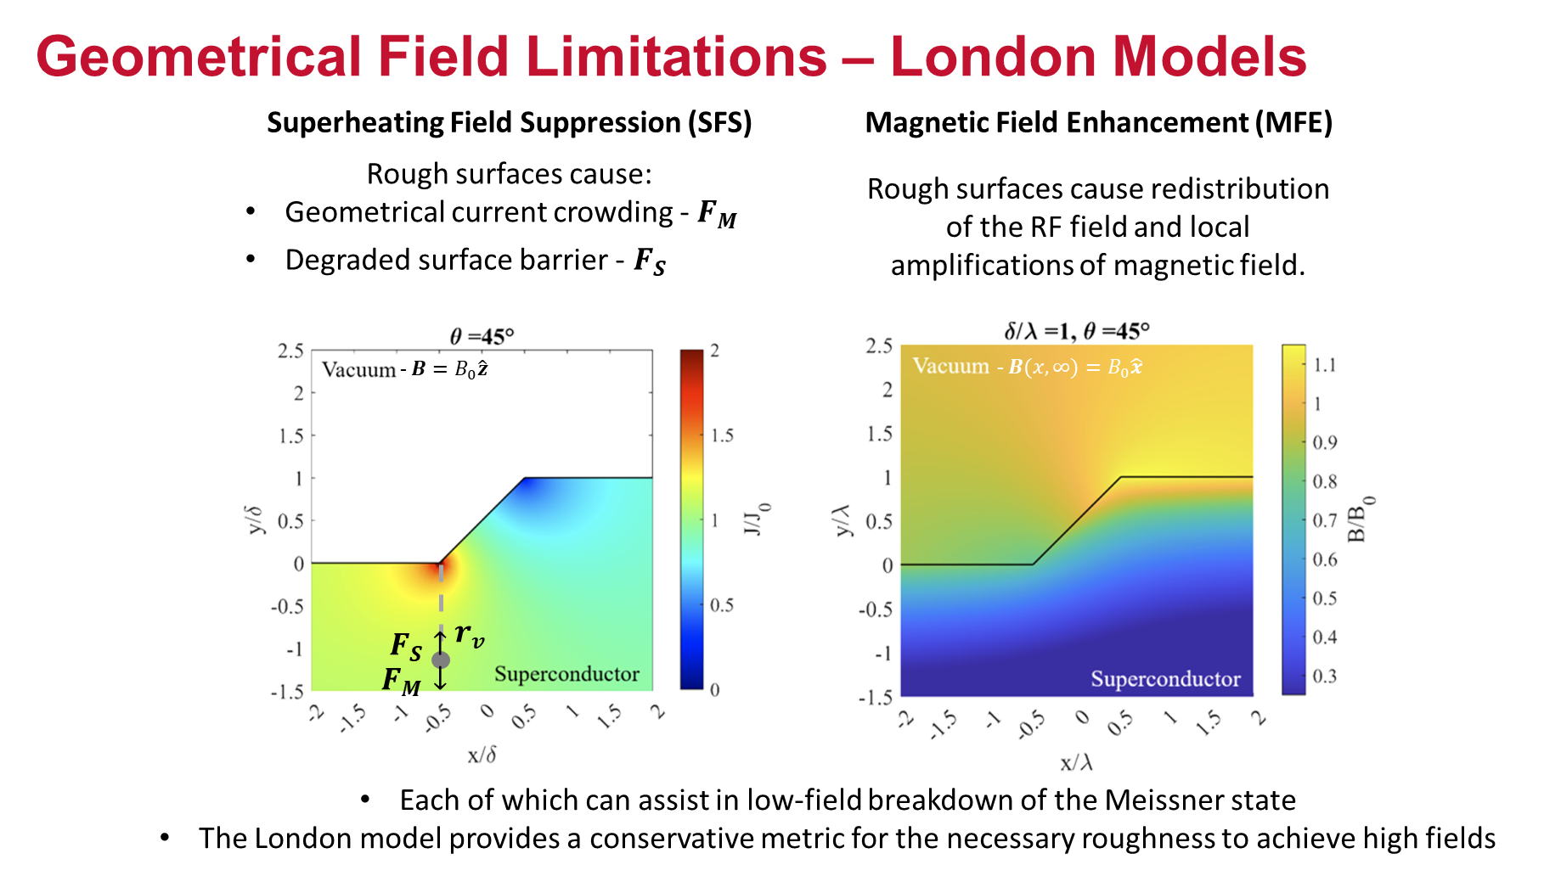
Nb on Cu optimization: Mitigating Geometrical Field Limitations via Nucleation Energy
ECR Nb on Cu
Increasing nucleation energy
Courtesy B. Redman, E. Lechner
See E. Lechner presentation on Tuesday afternoon
Ongoing complementary studies: j_{c} and H_{c1} as function of nucleation energy
PRELIMINARY
[1] Lechner, Eric M., et al. Physical Review Accelerators and Beams 26.10 (2023): 103101.
[2] Hryhorenko, O., A-M. Valente-Feliciano, and E.M. Lechner. Superconductor Science and Technology 39.2 (2026): 025014.

Slide 7
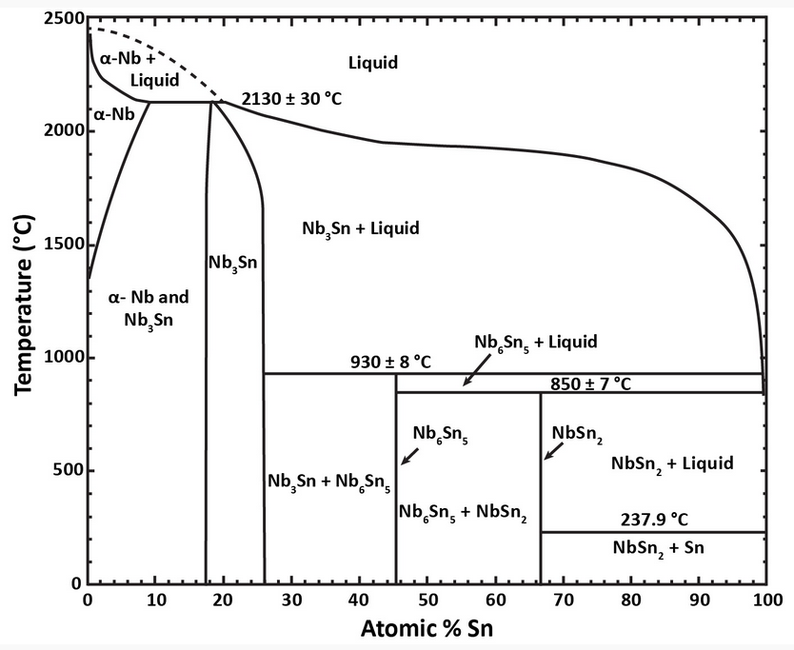
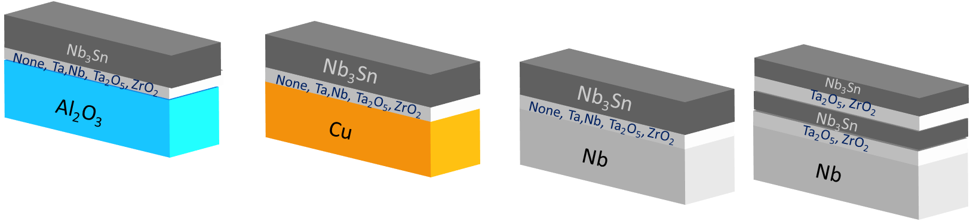
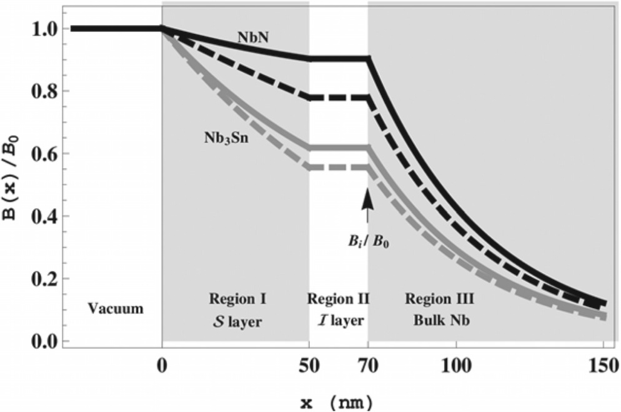
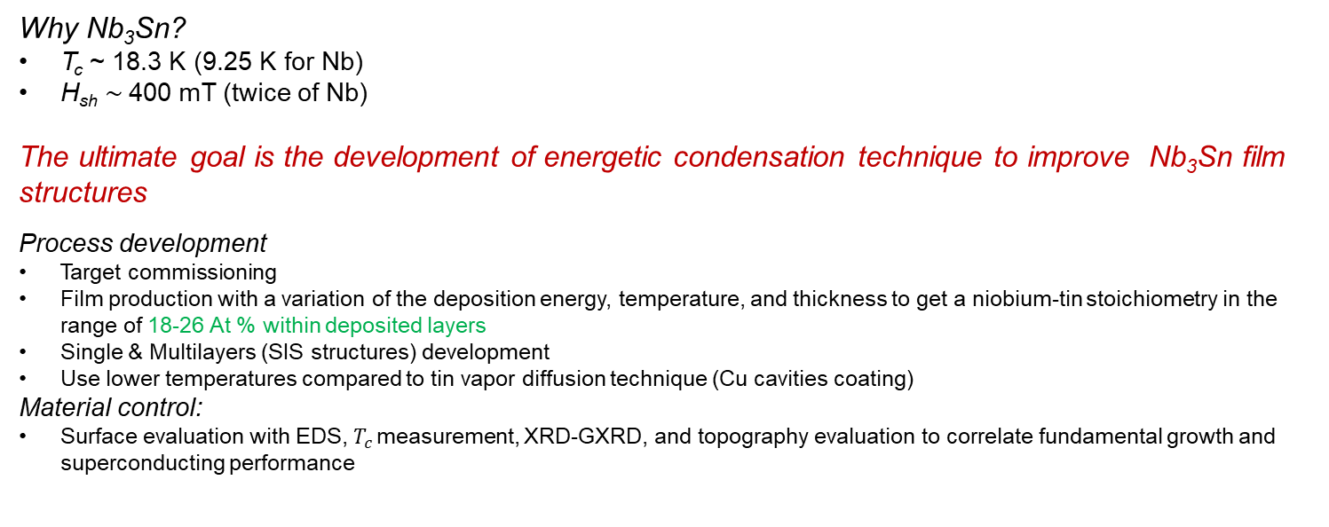
Single & multilayers structures
Nb₃Sn Development – Goals
Why Nb₃Sn?
T_{c} ~ 18.3 K (9.25 K for Nb)
H_{sh} $\sim$400 mT (twice of Nb)
The ultimate goal is the development of energetic condensation technique to improve Nb₃Sn film structures
Process development
Target commissioning
Film production with a variation of the deposition energy, temperature, and thickness to get a niobium-tin stoichiometry in the range of 18-26 At % within deposited layers
Single & Multilayers (SIS structures) development
Use lower temperatures compared to tin vapor diffusion technique (Cu cavities coating)
Material control:
Surface evaluation with EDS, $T_{c }$measurement, XRD-GXRD, and topography evaluation to correlate fundamental growth and superconducting performance
Film structure [1]
Binary phase diagram of the Nb-Sn system [2]
Multilayer coating[3]
[1] André Anders, A structure zone diagram including plasma-based deposition and ion etching, Thin Solid Films, Volume 518, Issue 15, 2010, Pages 4087-4090, ISSN 0040-6090, https://doi.org/10.1016/j.tsf.2009.10.145.
[2] Charlesworth JP, Macphail I, Madsen PE. Experimental work on the niobium-tin constitution diagram and related studies. Journal of Materials Science. 1970 Jul 1;5(7):580-603.
[3] Takayuki Kubo, Yoshihisa Iwashita, Takayuki Saeki; Radio-frequency electromagnetic field and vortex penetration in multilayered superconductors. Appl. Phys. Lett. 20 January 2014; 104 (3): 032603. https://doi.org/10.1063/1.4862892

Slide 8
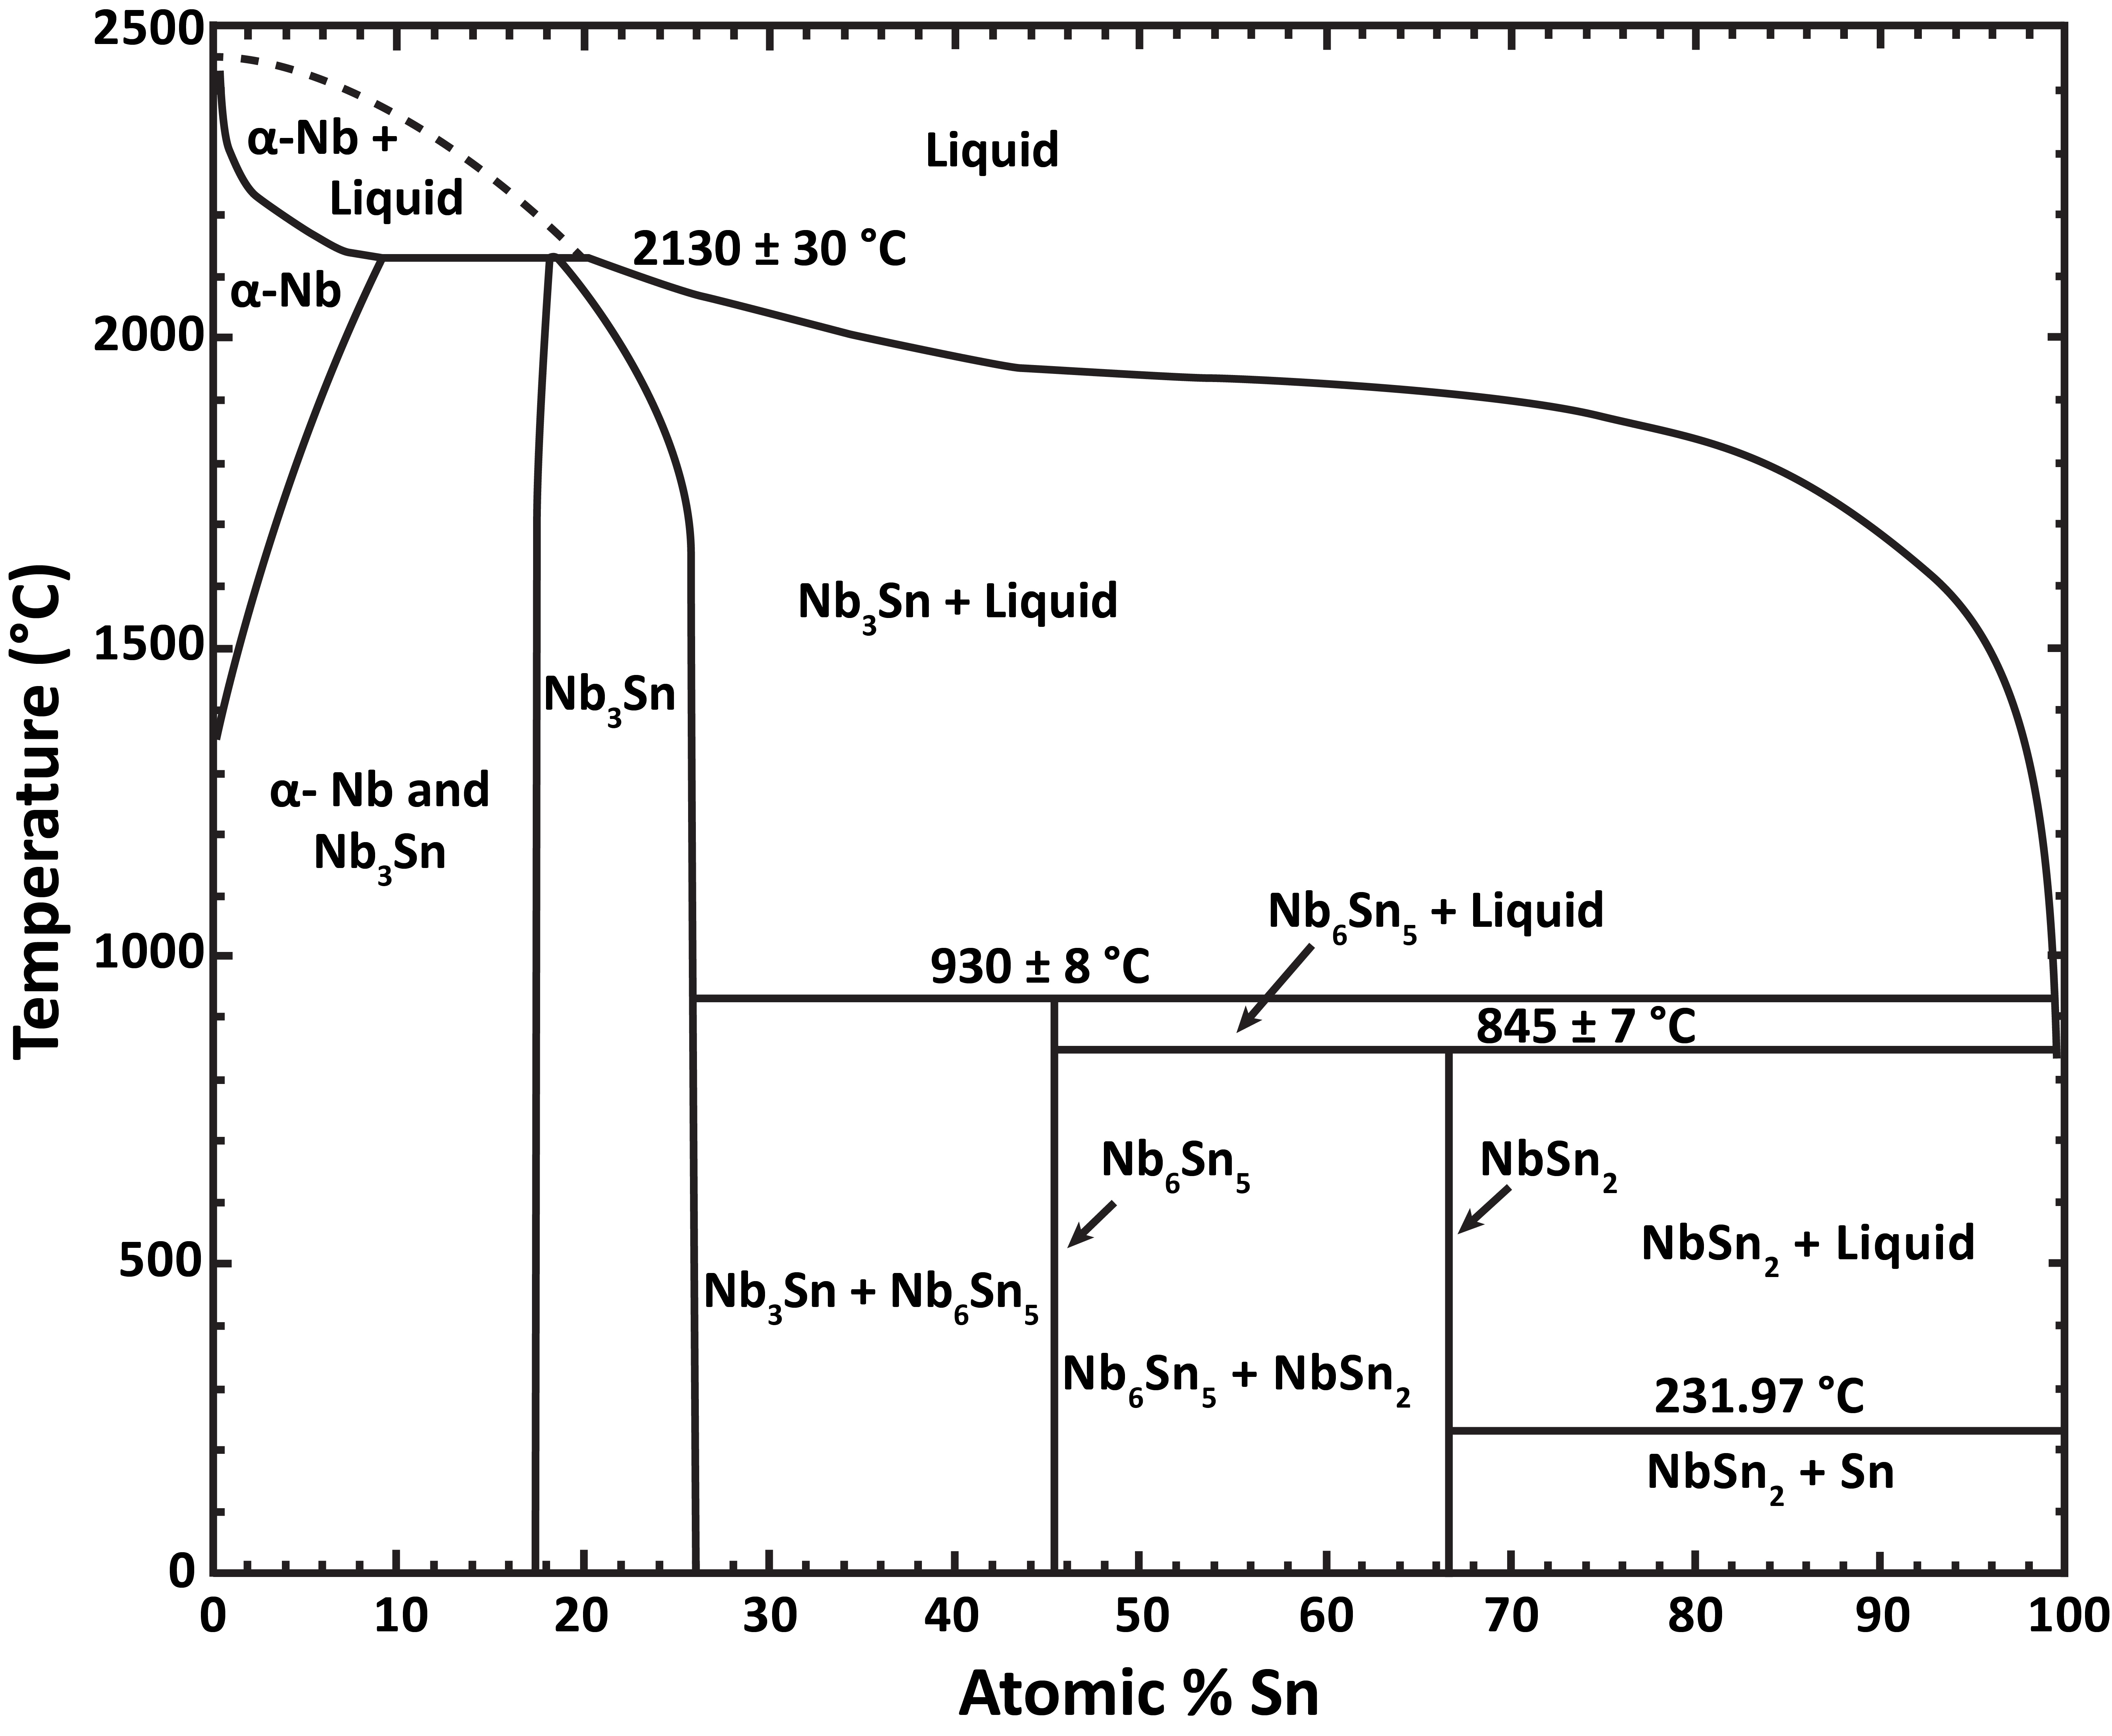
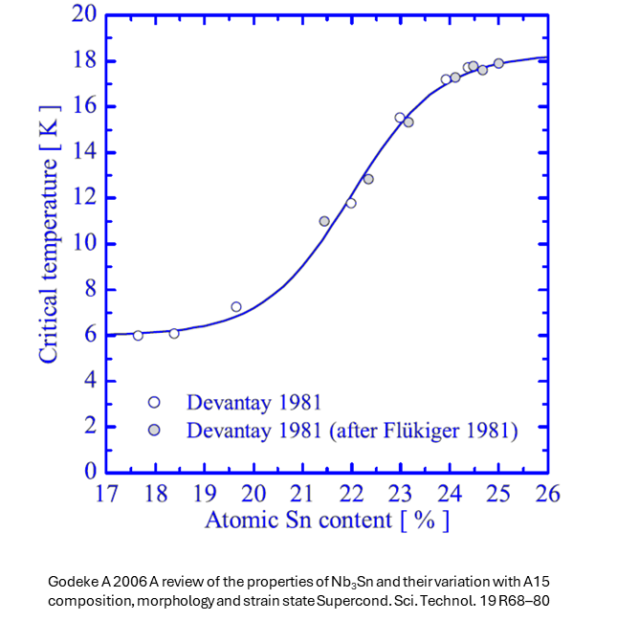
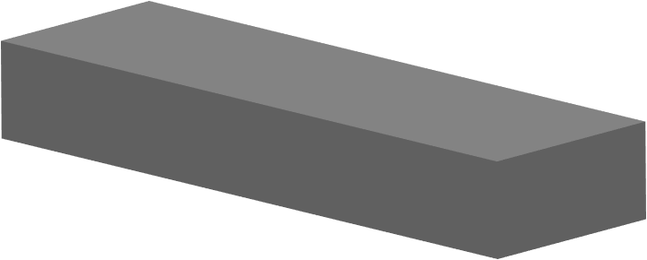
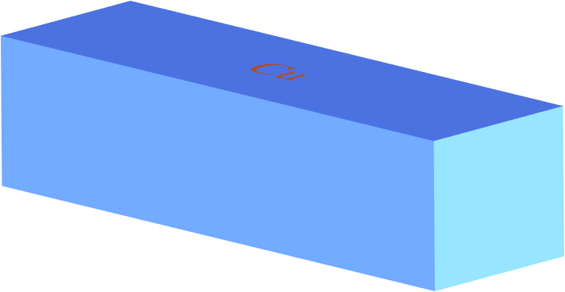



Nb₃Sn film deposition
A15 phase
narrow window
Nb₃Sn on Cu at the beginning of the road.
1) Thermal budget is limited due to Cu substrate, Nb₃Sn requires high energetic budget : need to compensate with ion energy
2) Need for an interlayer : Cu affinity with Sn and Cu high mobility above 600 °C make a barrier layer (Ta, Nb…) a must.
3) Pay attention to materials used for sample holder ( need to switch from Cu to Mo)
4) Use same setup geometry as HiPIMS deposition for cavities (need for cylindrical target)
Good T_{c} on ideal substrate required : Nb₃Sn/Al₂O₃
Reacted during coating
Required Sn % = 24 to 25 at. %
Adequate coating temperature needed to provide energetics necessary to form A15 phase

Slide 9
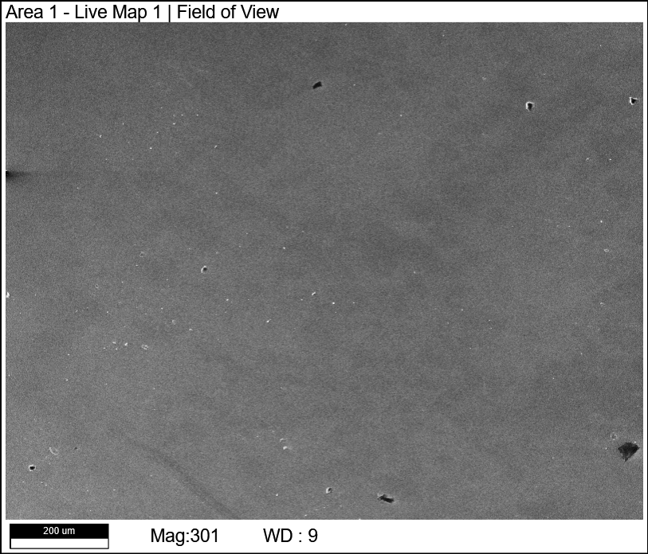
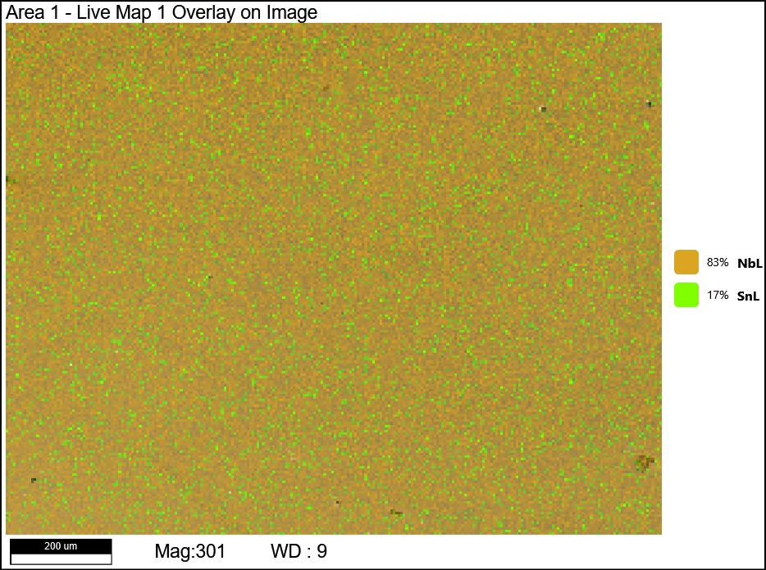
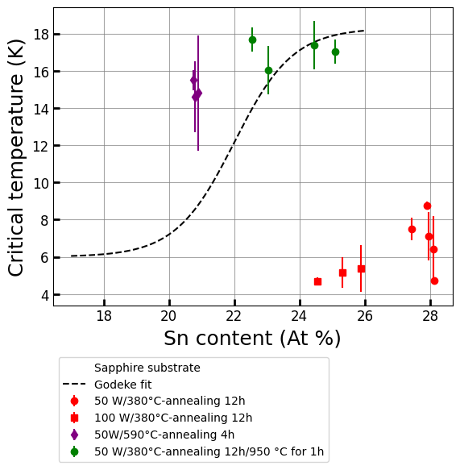
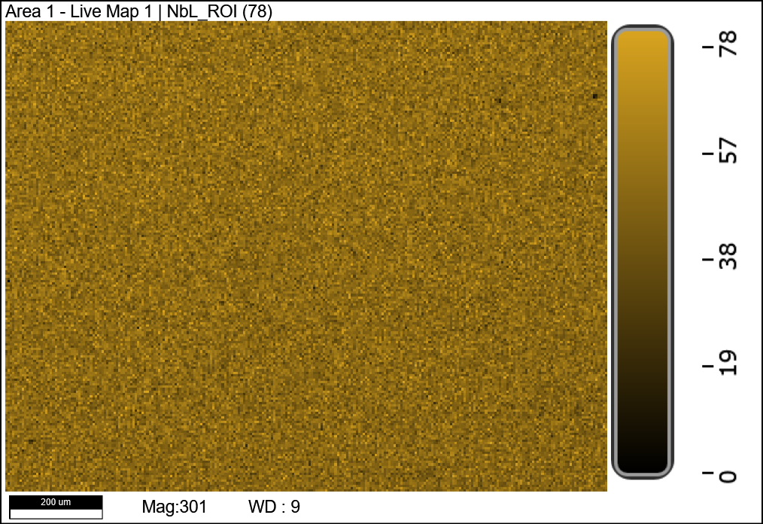
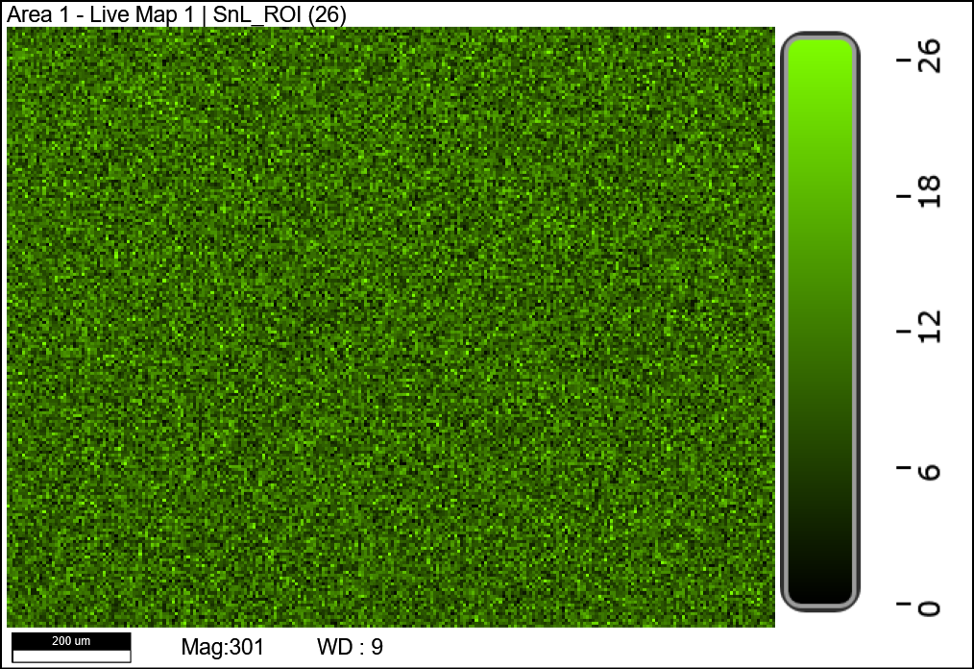
Nb₃Sn film deposition
Nb₃Sn/a-Al₂O₃
ECR Nb/Al₂O₃
Ta/Al₂O₃
a-Al₂O₃
Nb₃Sn/ECR Nb/Al₂O₃
c-Al₂O₃
Post-annealing @ 950°C
T_{c}
SEM
EDS
Alloyed NbSn target
Power increase leads to reducing Sn content at the same annealing conditions, but also reduces T_{c}
Additional ex-situ annealing at 950 °C for 1h resulted in Sn content drop, also improves T_{c} (17.7K).
Coating @ 620 °C yields T_{c}~15-16 K without ex-situ annealing
Increase of Ar working pressure yields further improved stoichiometry and T_{c}>16 K without ex-situ annealing on Al₂O₃, Ta/ Al₂O₃, ECR Nb/ Al₂O₃
50 W/620°C -1e⁻²mbar
Nb₃Sn on Cu (with Nb & Ta interlayers) and bulk Nb under characterization

Slide 10
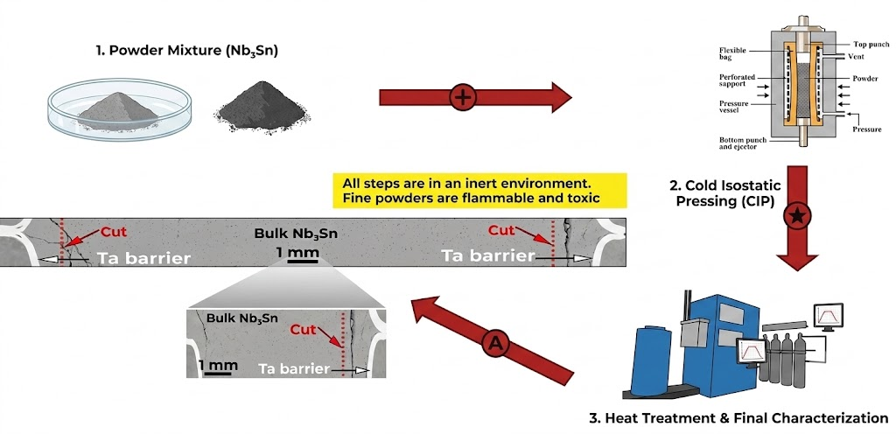
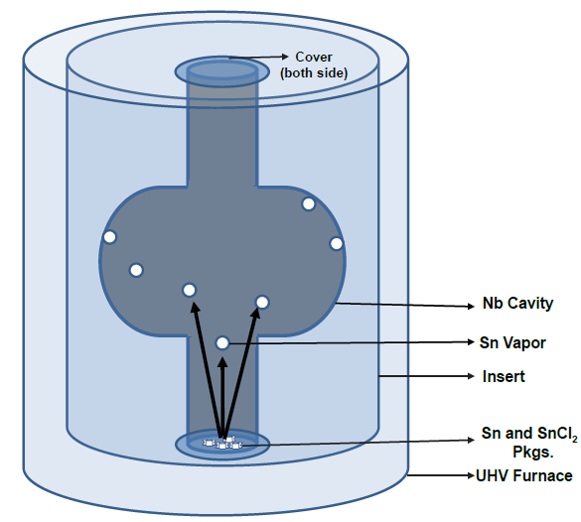
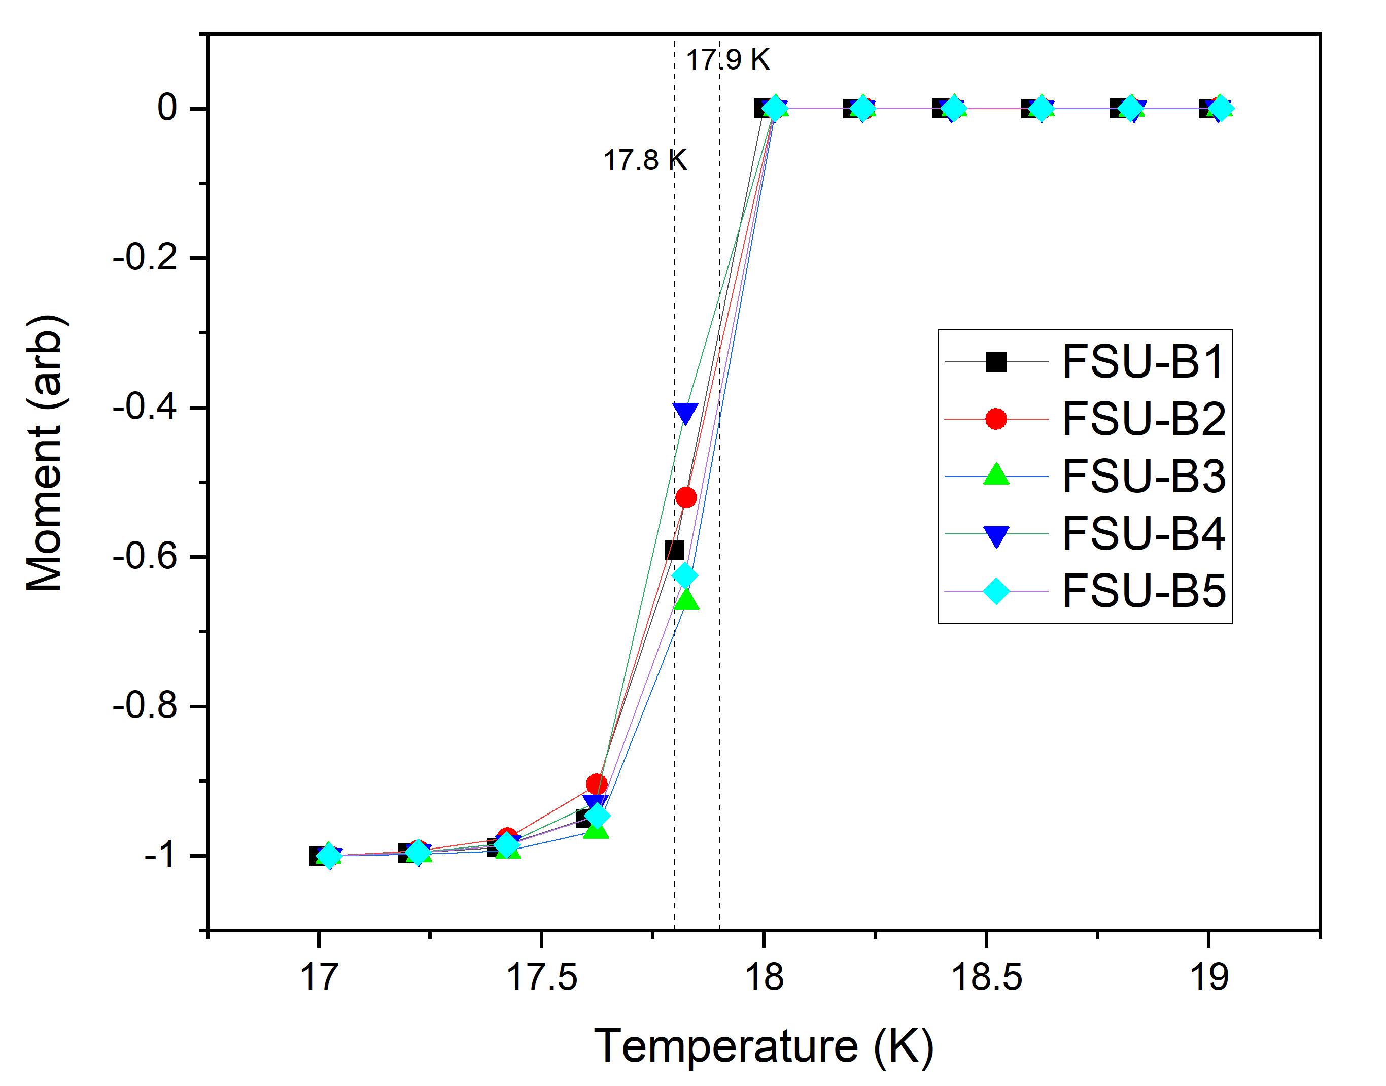
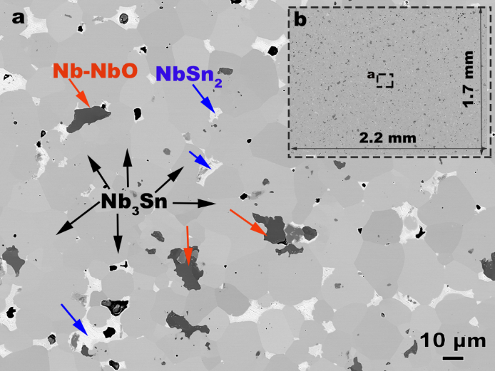
Nb₃Sn Cylindrical Cathode Development
Development required for implementation of PVD for cavity geometries
2 approaches in parallel for cylindrical stoichiometric targets
Alloyed Target starting from powders mix
Sn diffusion into Nb cathode tubes
JLab/FSU/Ames Lab

Slide 11
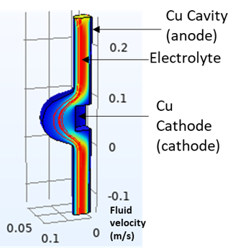
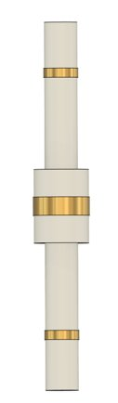
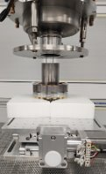
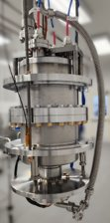
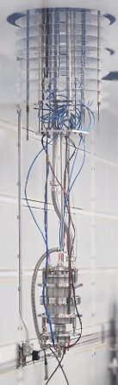
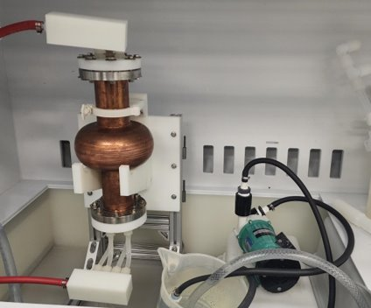

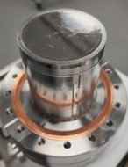
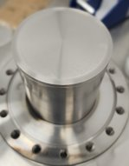
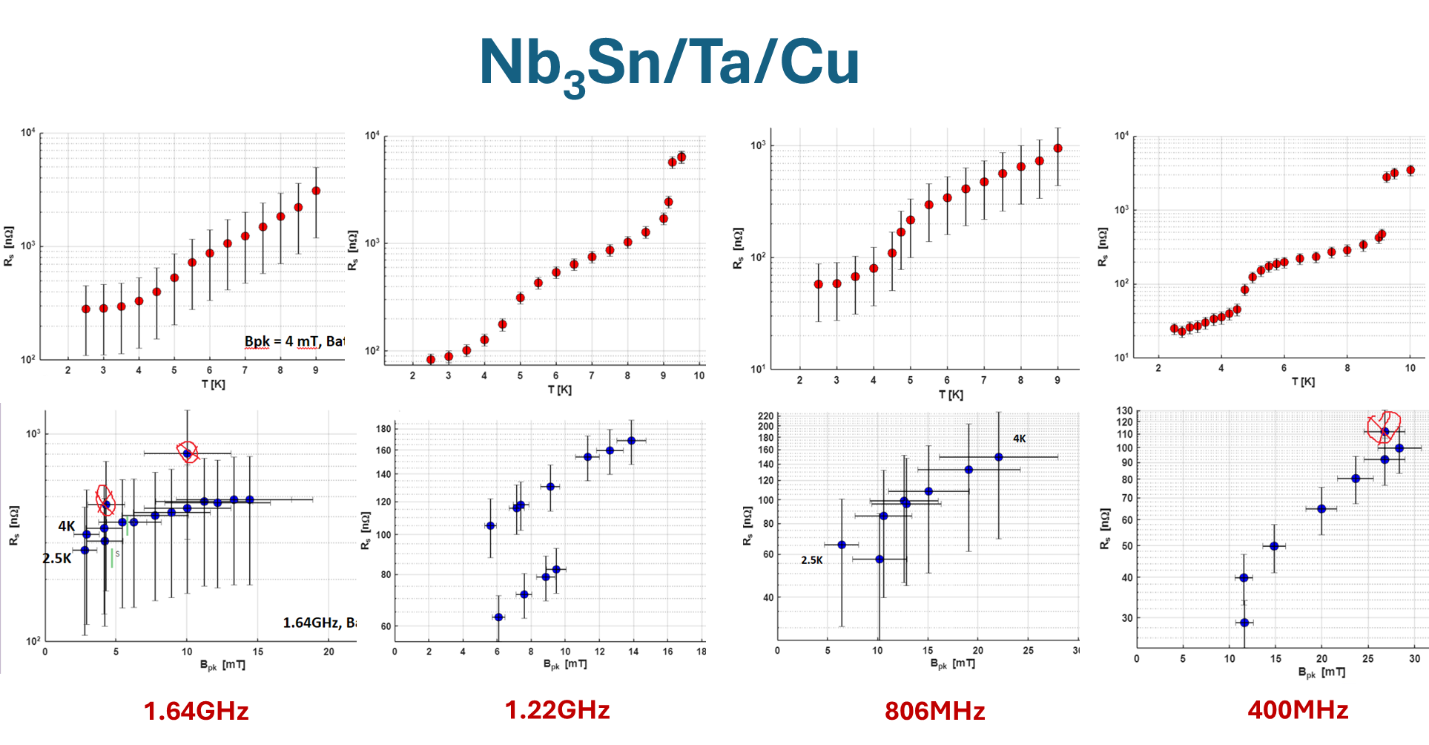
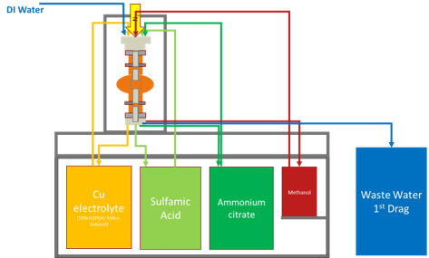
Supporting Developments
Cu Cavity Electropolishing
QPR Facility for sample RF measurements
M. Ge et al.
S. Bira, N. Gale
  Design cavity support structures
  Design cathode handling system
  Design electrical safety system
  Electrical Safety Review
  Fabricate proof of concept system
  Water test system
  Incorporate power supply
  Final electrical safety check
  Electropolish cavity
Other limiting mechanisms likely concurrent:
Non-stoichiometry
Tin droplets
Patchy regions
Demonstrated Key RF performances by Rs vs Bpk and Rs vs T at multiple temperatures (up to Tc) for 4 modes
Achieved 1 nΩ resolution at 10 mT for bulk Nb at 2.5 K;
Achieved ~20 nΩ for the regular bulk Nb sample;
Achieved 60 mT for the bulk Nb sample without quenching;
Extended QPR frequency range to 1.6 GHz, near the CEBAF frequency;
Completed comprehensive error analysis and resolution estimation;
The measured frequencies of all quadruple modes are consistence with CST simulation.
Design & Fabrication of a cavity electropolishing system integrating all the steps required for Cu substrate preparation for cavity deposition​

Slide 12
Summary & Next Steps
No intrinsic limit for the mitigation of Nb thing film Q-slope
The devil is in the details. Constant attention is necessary to maintain adequate deposition conditions
Nb₃Sn DC sputtering with alloyed stoichiometric target requires substrate temperature above 600 °C, high Ar pressure (1e⁻² mbar), low current density
Nb₃Sn on Cu (with Nb & Ta interlayers) and bulk Nb under characterization
Refine deposition process for denser, more uniform and relaxed material for thick and thin layers, switch from Ar to Kr
RF measurements with QPR samples
Implement Nb₃Sn cavity deposition with cylindrical cathode developed

Slide 13
Merci
Thank You

