Slide 1











Matteo Lazzari
INFN – Legnaro National Laboratories · Università degli Studi di Padova
on behalf of the LNL Surface Treatments & Superconductivity Team
◆ PhD scholarship fully funded by Zanon Research & Innovation
Nb₃Sn-coated copper cavities
from an optimized film to a 1.3 GHz coating system
TTC 2026 · TESLA TECHNOLOGY COLLABORATION · GIF-SUR-YVETTE, 9–12 JUNE 2026
SUPPORTED BY
EU Horizon — iSAS (GA 101131435) & I.FAST (GA 101004730). INFN CSN5 SuperMAD · CSN1 SRF, RD_FCC.
HOSTED BY · PROJECTS & COLLABORATIONS

Slide 2
ACKNOWLEDGEMENTS
LNL SRF R&D — a collaborative effort
EU HORIZON PROGRAMMES
INFN ACCELERATOR R&D
INTERNATIONAL PARTNERS
INFN–LNL
C. Pira, O. Azzolini, E. Chyhyrynets, E. Cremonesi, T. M. Ezeaba, D. Fonnesu, D. Ford, G. Keppel, M. Lazzari, F. Stivanello
HZDR
S. Prucnal, S. Zhou
INFN PD · RM3 · TO · LNF
A. Pepato, P. Rebesan · N. Pompeo, E. Silva · G. Ghigo · C. Gatti, G. Maccarrone, D. Di Gioacchino
Jefferson Lab
A. M. Valente Feliciano
CEA
C. Z. Antoine, I. Curci, Y. Kalboussi, T. Proslier
IEE SAS
E. Seiler, R. Ries
CERN
G. Rosaz, W. Venturini
STFC / UKRI
O. B. Malyshev, R. Valizadeh, C. Benjamin, T. Sian, L. Smith
DESY
M. Wenskat
Lancaster · Liverpool · Siegen
G. Burt, N. Leicester, S. Marks, D. Seal · W. Bradley, S. Simon · X. Jiang, T. Staedler, A. Zubtsovskii
HZB
S. Keckert, O. Kugeler, J. Knobloch
Riga Tech. Univ. · Piccoli
A. Medvids · R. Berton, D. Piccoli, F. Piccoli, G. Squizzato, F. Telatin
TTC 2026 · M. Lazzari, INFN–LNL, malazzar@lnl.infn.it
02 / 17

Slide 3
TECHNOLOGY READINESS LEVEL
Each EU project, a step up in TRL
Nb₃Sn-on-Cu has climbed the TRL ladder through successive European programmes.
TRL 6
Demonstrated in operation
TRL 4–5
Validated in relevant env.
Conduction-cooling cryomodule
TRL 3–4
Validated in the laboratory
Flux trapping & tunability
Study on planar samples + first RF test on QPR
TRL SCALE
1
2
3
4
5
6
7
8
9
Basic principles
Concept
Proof of concept
Lab validated
Relevant env.
Demonstrated
Operational prototype
Qualified
Proven in operation
TTC 2026 · M. Lazzari, INFN–LNL, malazzar@lnl.infn.it
03 / 17

Slide 4
01
PART 01
Film & technical solutions
Film stoichiometry & Tᴄ, the copper substrate and Nb buffer layer — and the measurements that validate the recipe.
TTC 2026 · M. Lazzari, INFN–LNL, malazzar@lnl.infn.it
04 / 17

Slide 5
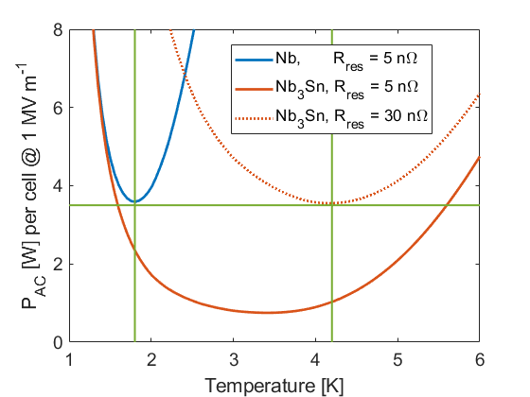
WHY Nb₃Sn ON COPPER
01 · Film & technical solutions
A route to efficient, 4.5 K SRF accelerators
4.5 K
Target operating temperature
÷ 3
Cryo grid power vs Nb @ 2 K
The copper substrate — coated by PVD
Thermal stability — excellent heat evacuation → conduction-cooling ready
Low cost — OFE Cu is 20–100× cheaper than RRR-300 bulk Nb
Nb @ 2 K → Nb₃Sn @ 4.5 K cuts cryogenic power ×3 (Thin-Film SRF Roadmap, I.FAST D9.1)
Mature PVD heritage — Nb/Cu by sputtering proven on LEP2, LHC, HIE-ISOLDE → FCC-ee
TTC 2026 · M. Lazzari, INFN–LNL, malazzar@lnl.infn.it
05 / 17

Slide 6
THE PROBLEM
01 · Film & technical solutions
Nb₃Sn on Cu: four coupled challenges
1 Brittle A15 phase
Tᴄ follows Sn% (18–26 at%); A15 is brittle → thin film only
2 Low-melting substrate
Cu weakens above ~400 °C → hard limit T ≤ 600–650 °C
3 Tight geometry
Small aperture of 1.3 GHz cavities makes uniform coating hard
4 Sn–Cu interdiffusion
Sn and Cu are miscible → an intermediate buffer layer is mandatory
A15 forms as a single phase only above ~930 °C — well beyond the copper limit: the coating strategy must work around it.
TTC 2026 · M. Lazzari, INFN–LNL, malazzar@lnl.infn.it
06 / 17

Slide 7
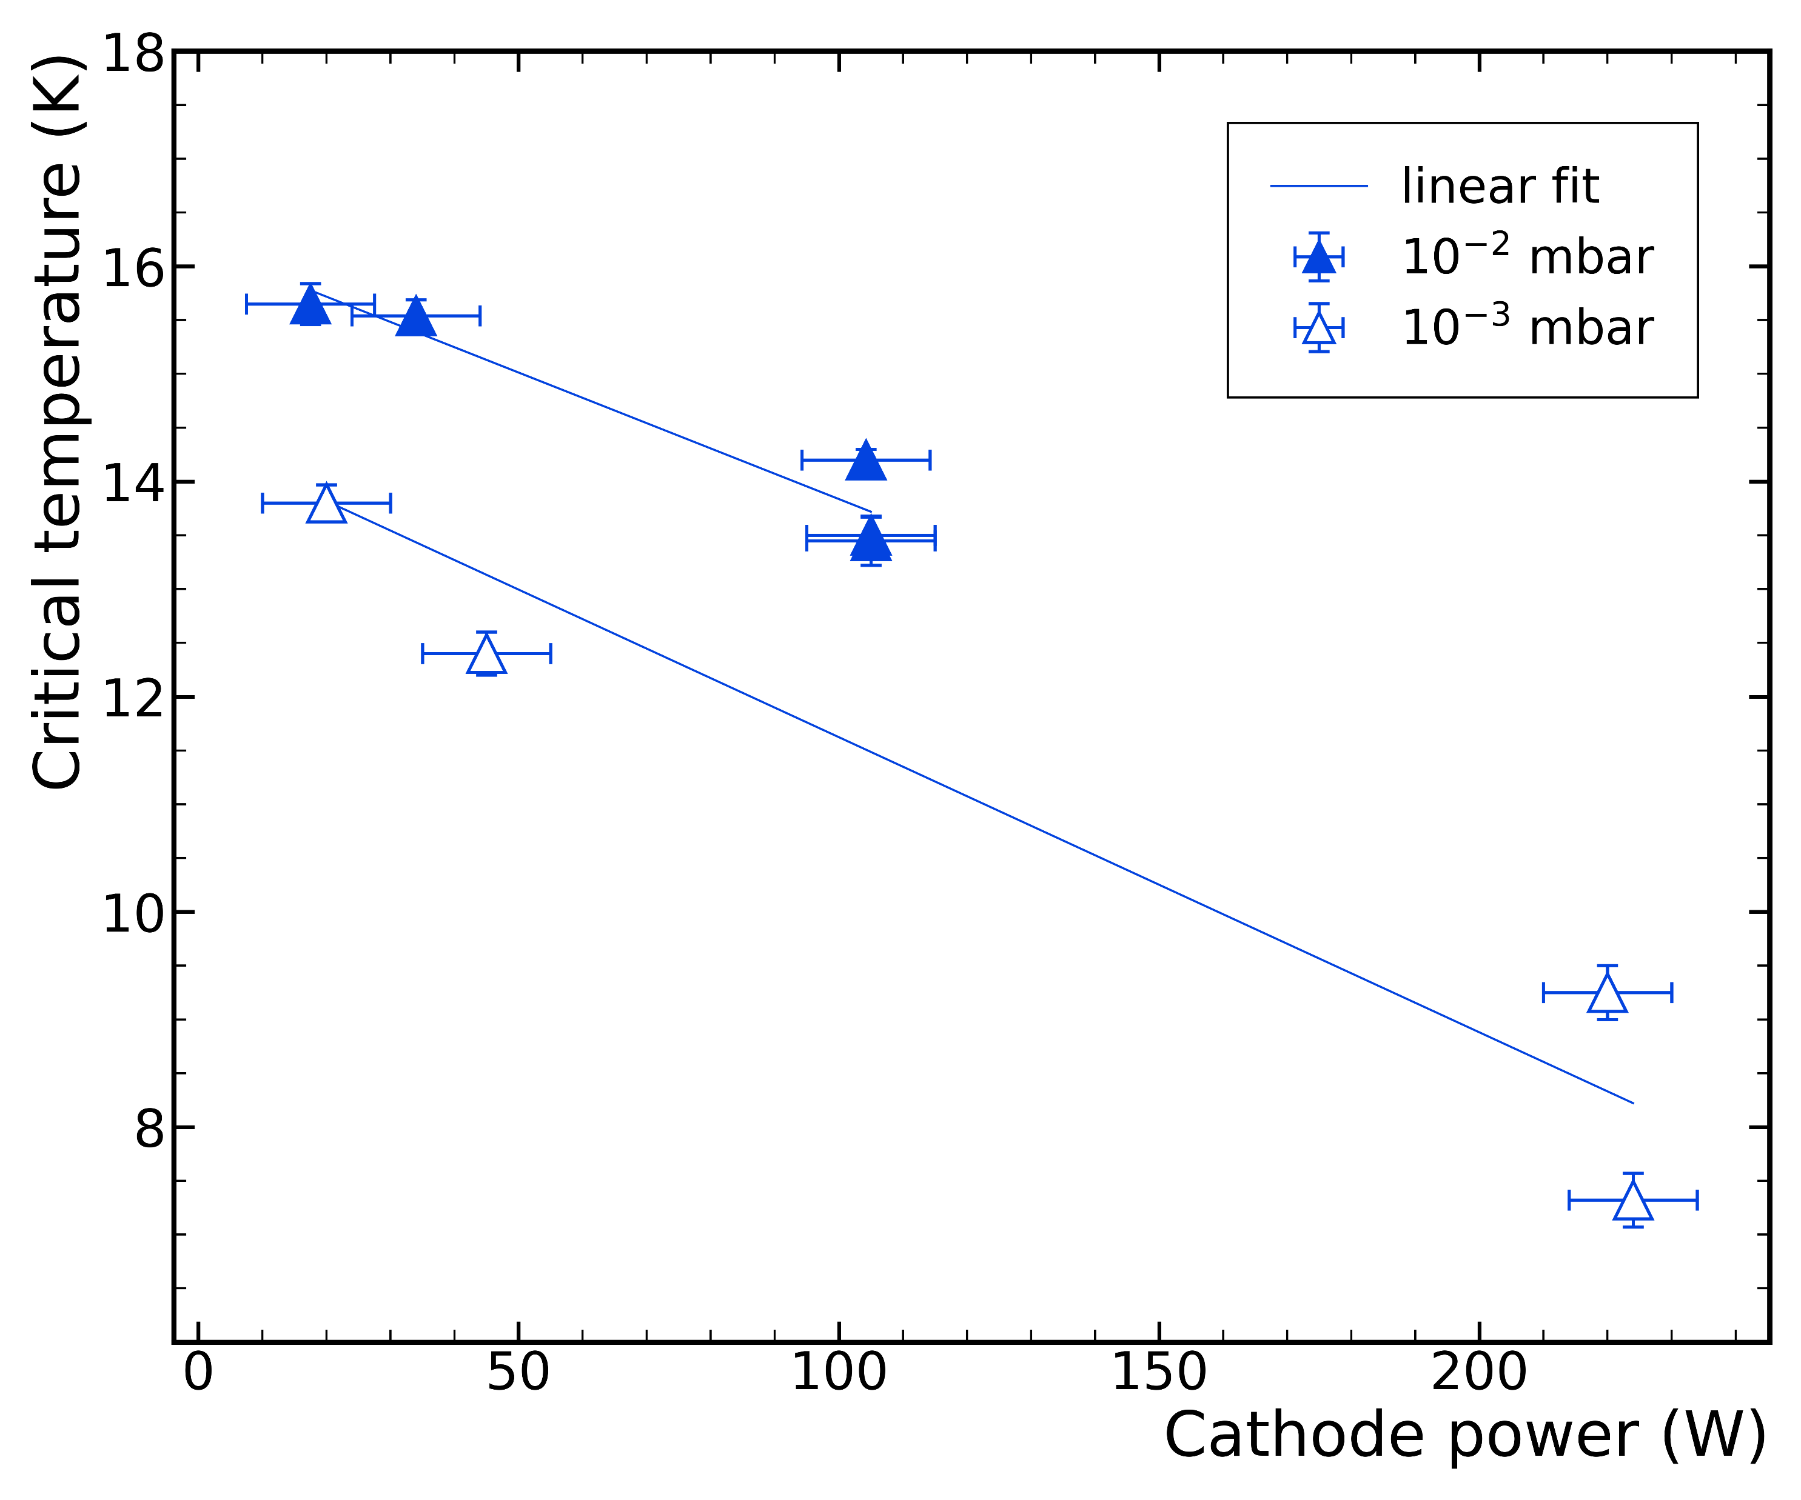
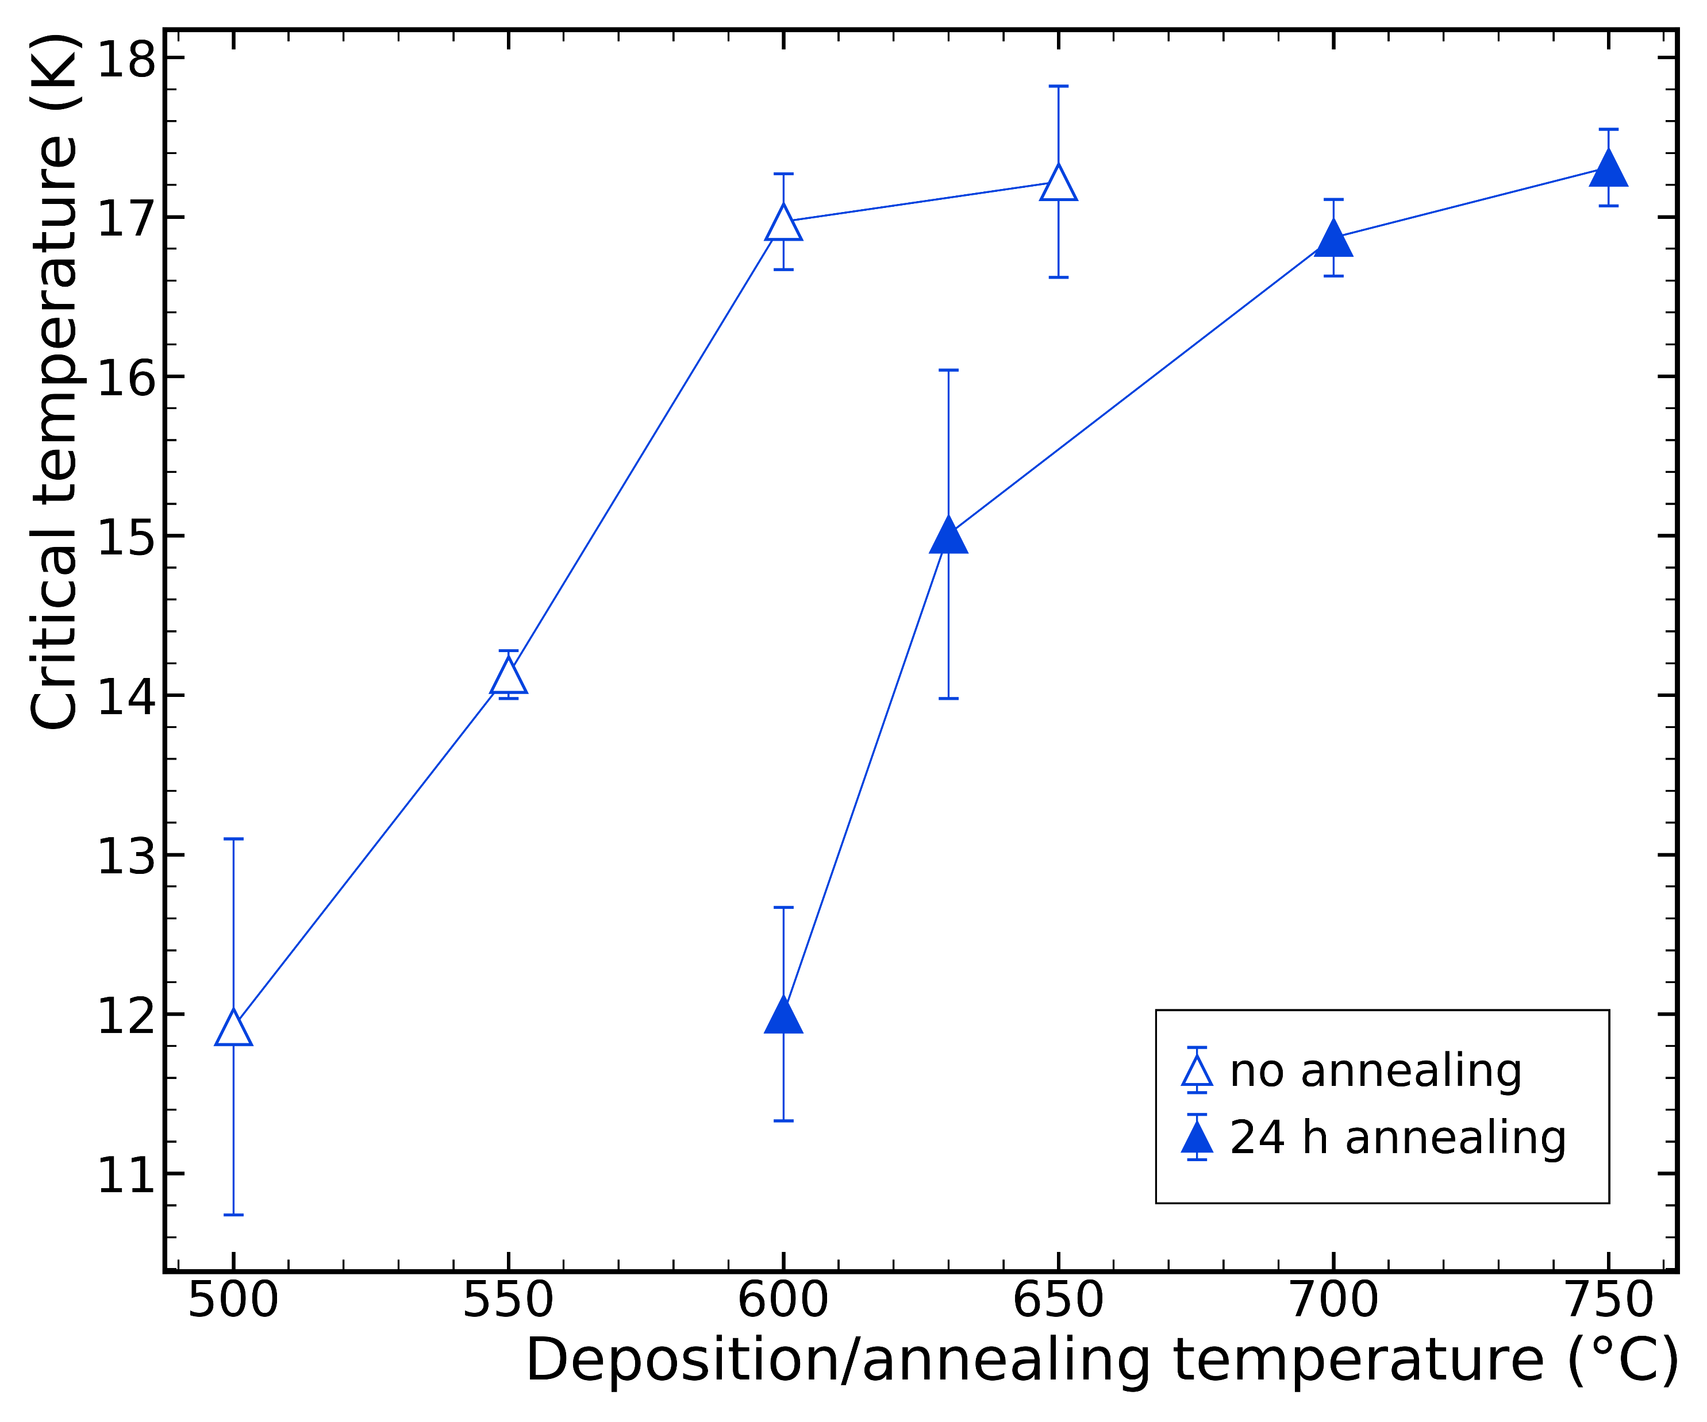
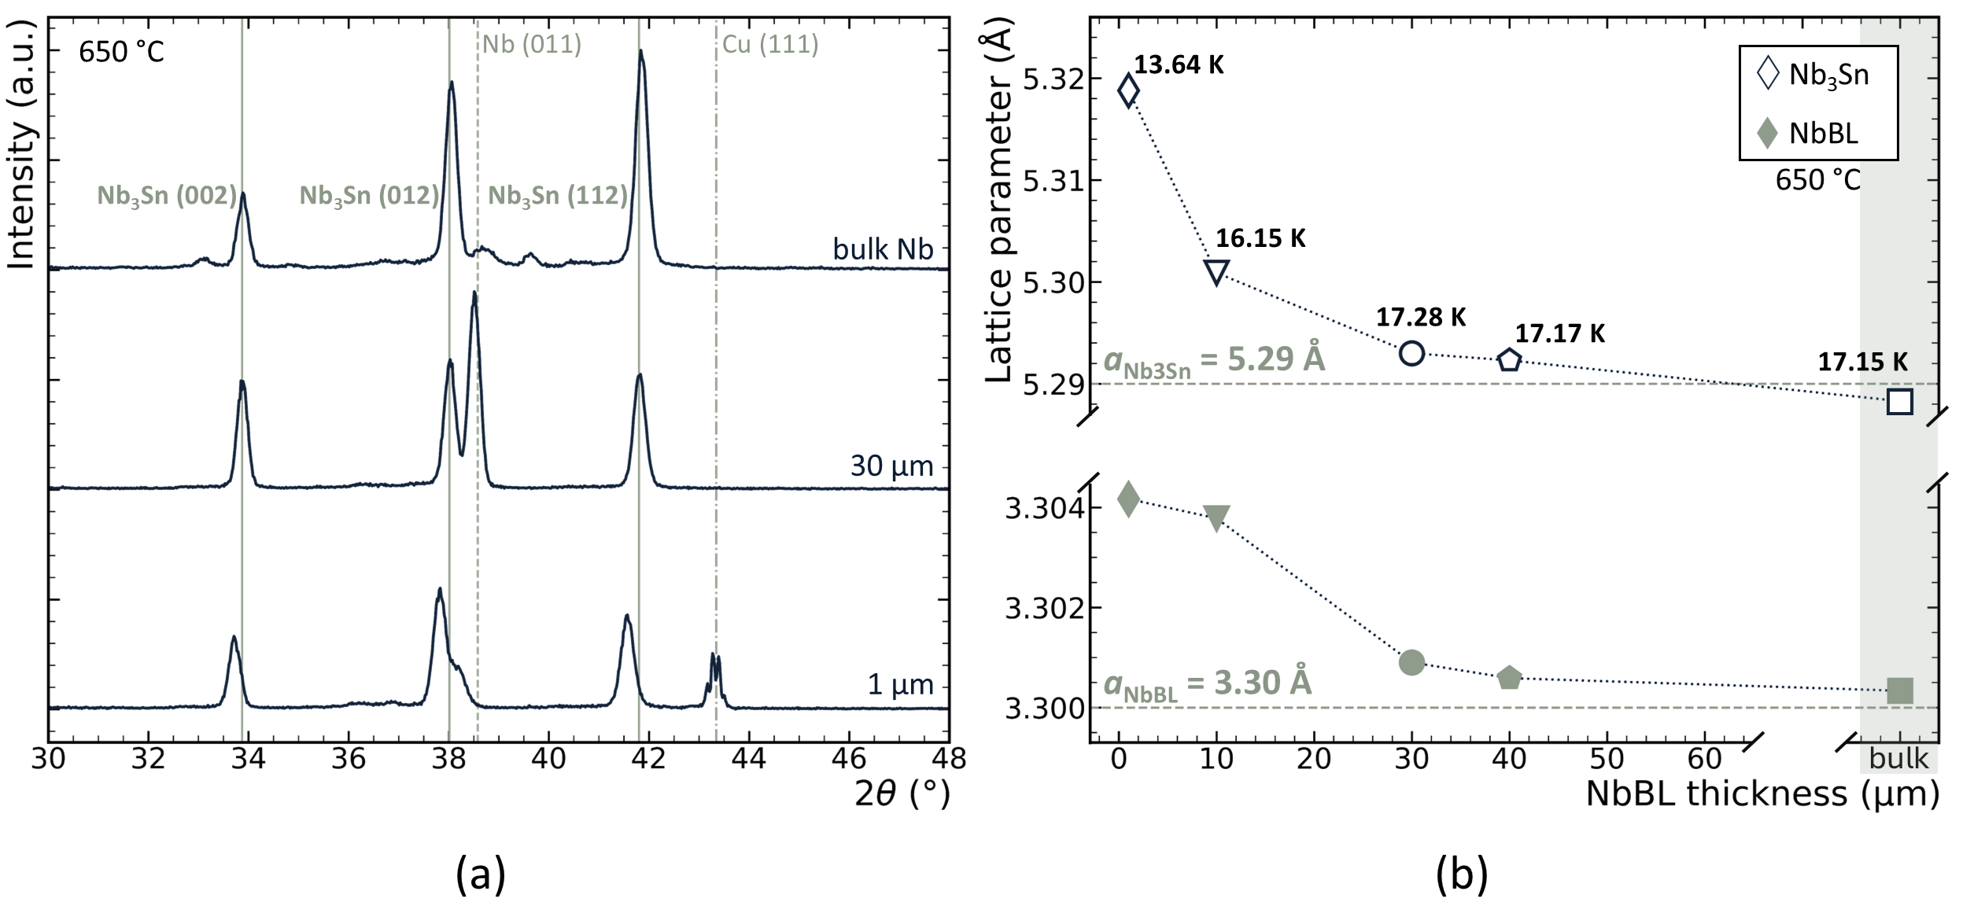

INFN LNL SOLUTION
01 · Film & technical solutions
DC magnetron sputtering — a $T_{C}$ -driven recipe
DCMS from a single stoichiometric Nb₃Sn target *
Simple set-up · full parameter control · coating and interface decoupled · Tsubstrate ≤ 650 °C
1
Low cathode power ~250 mW/cm²
2
High deposition pressure 2×10⁻² mbar
3
Deposition temperature 600–650 °C
4
No post-annealing
5
Nb buffer layer ~30 µm — thermal stress mitigation+ accommodation layer
$T_{C}$ > 17 K on Cu
$T_{C}$ vs cathode power · vs deposition/annealing T · XRD and lattice/Tᴄ vs Nb-buffer thickness
* D. Fonnesu et al., Recipe optimization and SRF test of Cu-compatible Nb₃Sn films by DCMS, Sci. Rep. 16, 3539 (2026).
TTC 2026 · M. Lazzari, INFN–LNL, malazzar@lnl.infn.it
07 / 17

Slide 8
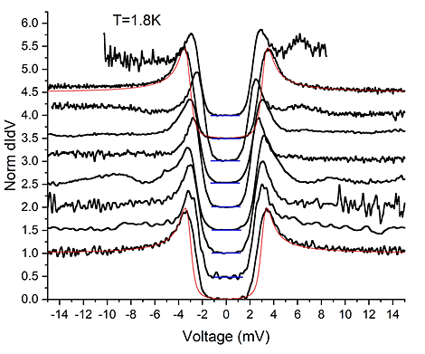
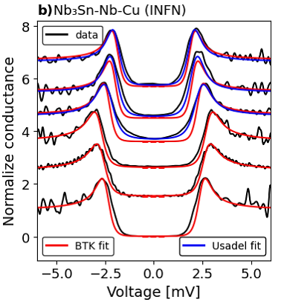
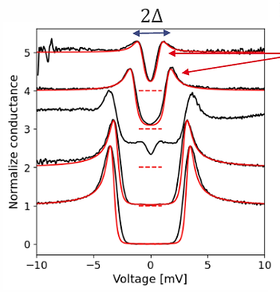
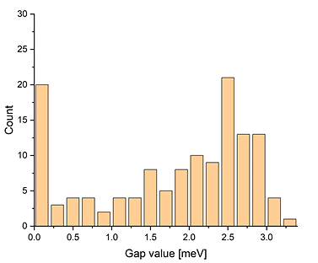
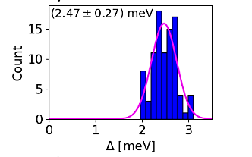
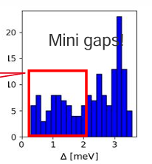
CHARACTERIZATION
01 · Film & technical solutions
SC energy gap — tunneling spectroscopy across deposition methods
HiPIMS
DCMS · INFN LNL recipe
VTD
Broad gap distribution
inhomogeneous, many low-gap states
Δ = 2.47 ± 0.27 meV
single clean gap · BTK / Usadel fits
Sub-gap “mini-gaps”
residual states below the gap
Courtesy of T. Proslier, I. Curci
TTC 2026 · M. Lazzari, INFN–LNL, malazzar@lnl.infn.it
08 / 17

Slide 9
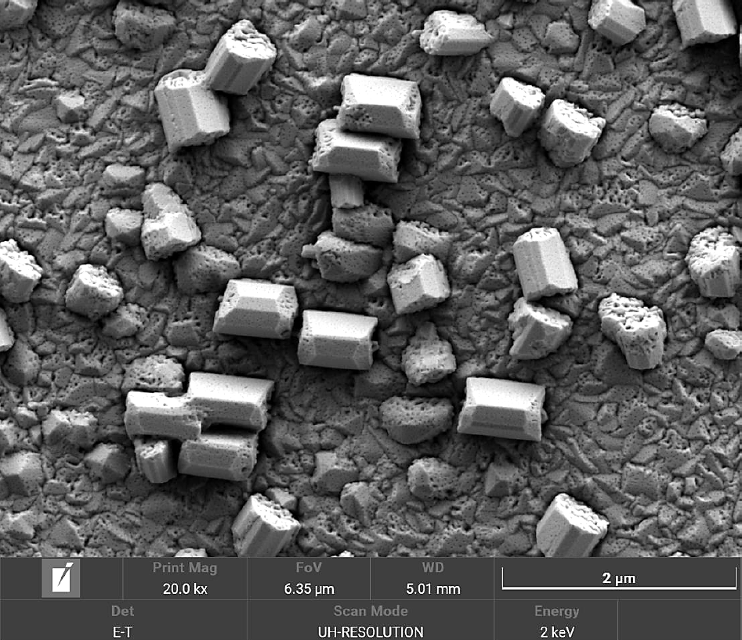
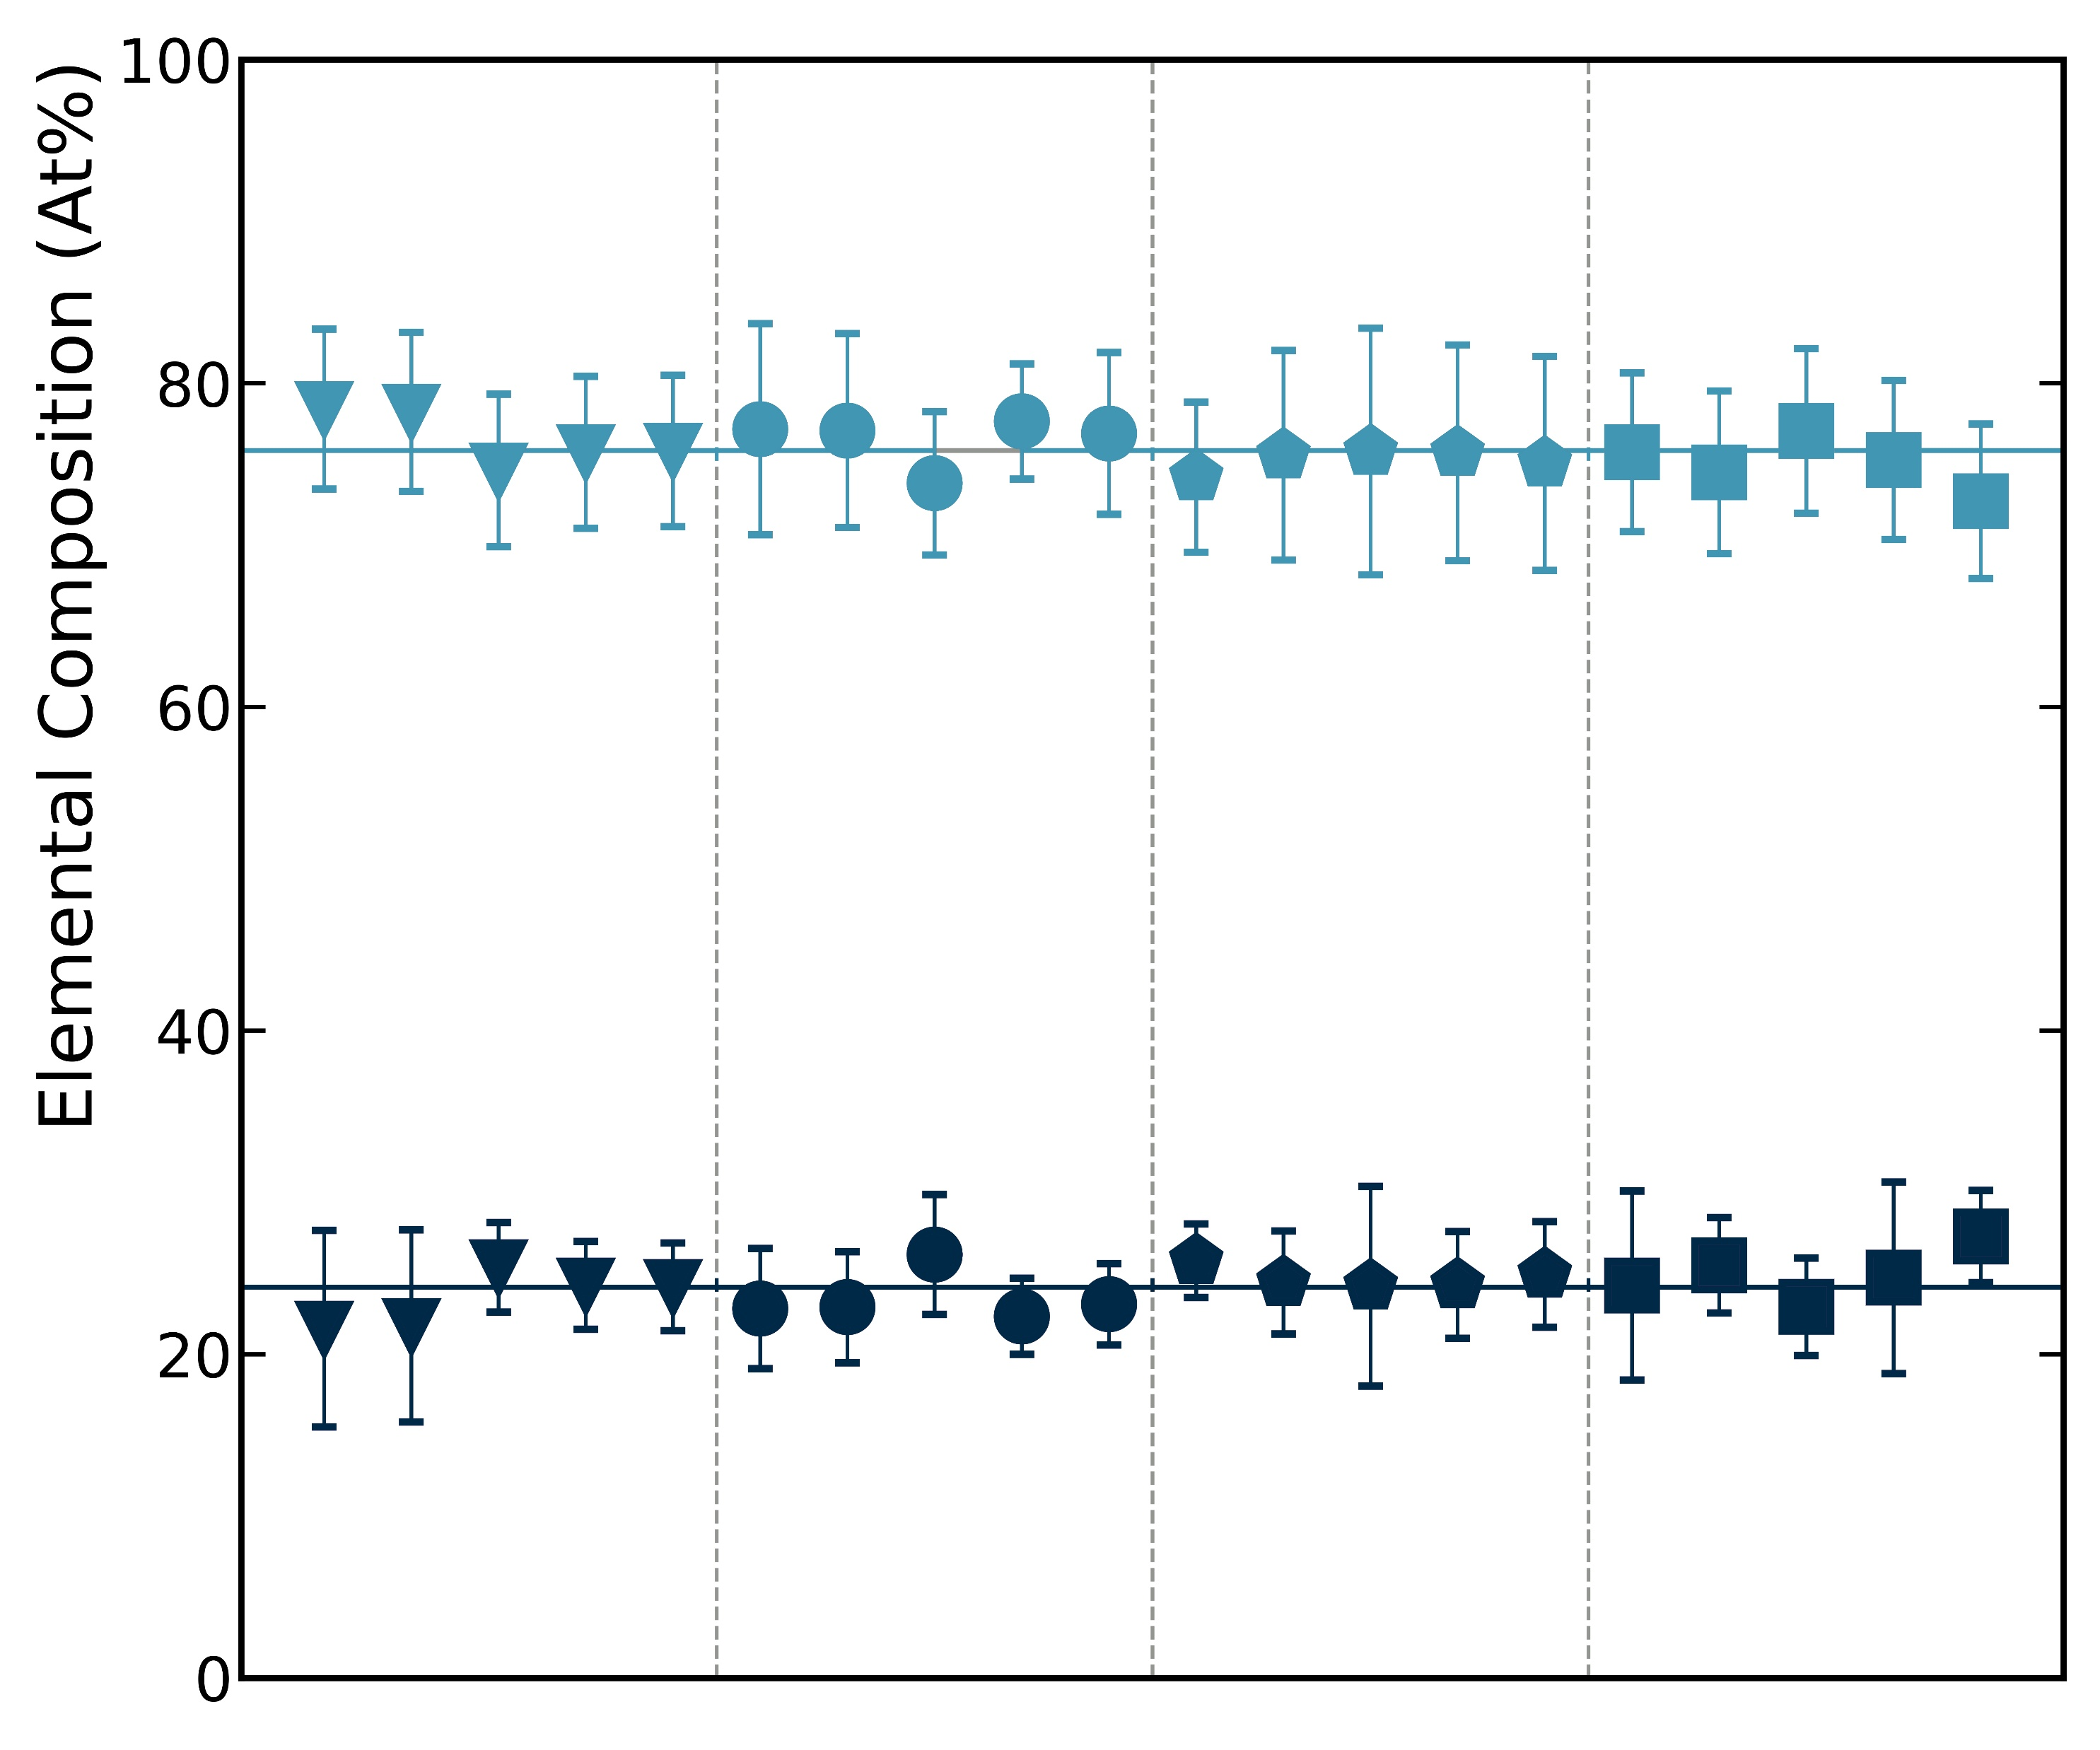
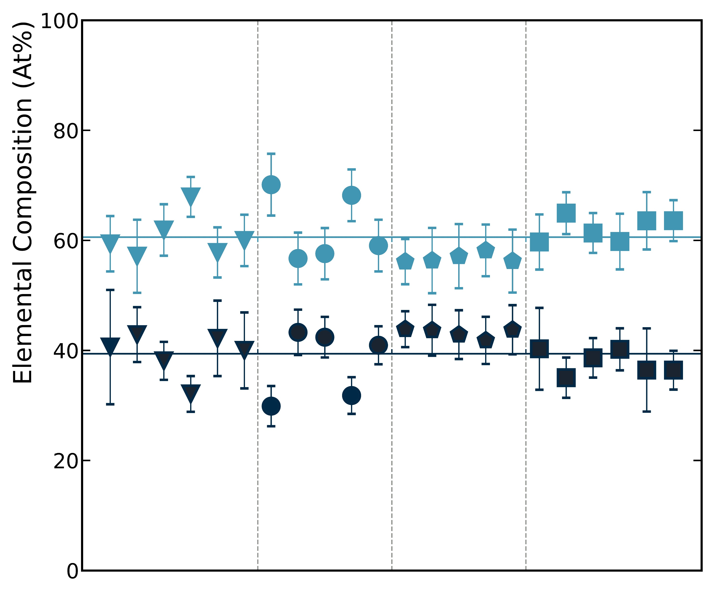
CHARACTERIZATION
01 · Film & technical solutions
The optimized film holds up to scrutiny
Base film · stoichiometric matrix
Islands · Sn-rich phase
Nb 61%
Nb 76%
Nb₃Sn islands on bulk Nb (SEM)
Sn 24%
Sn 39%
# islands by substrate
most
Sapphire
Bulk Nb
NbBL-10
NbBL-30
NbBL-40
Bulk Nb
NbBL-10
NbBL-30
NbBL-40
Bulk Nb
Nb buffer
Cu
Courtesy of A. Zubtsovskii
fewest — good for Cu cavities
TTC 2026 · M. Lazzari, INFN–LNL, malazzar@lnl.infn.it
09 / 17

Slide 10
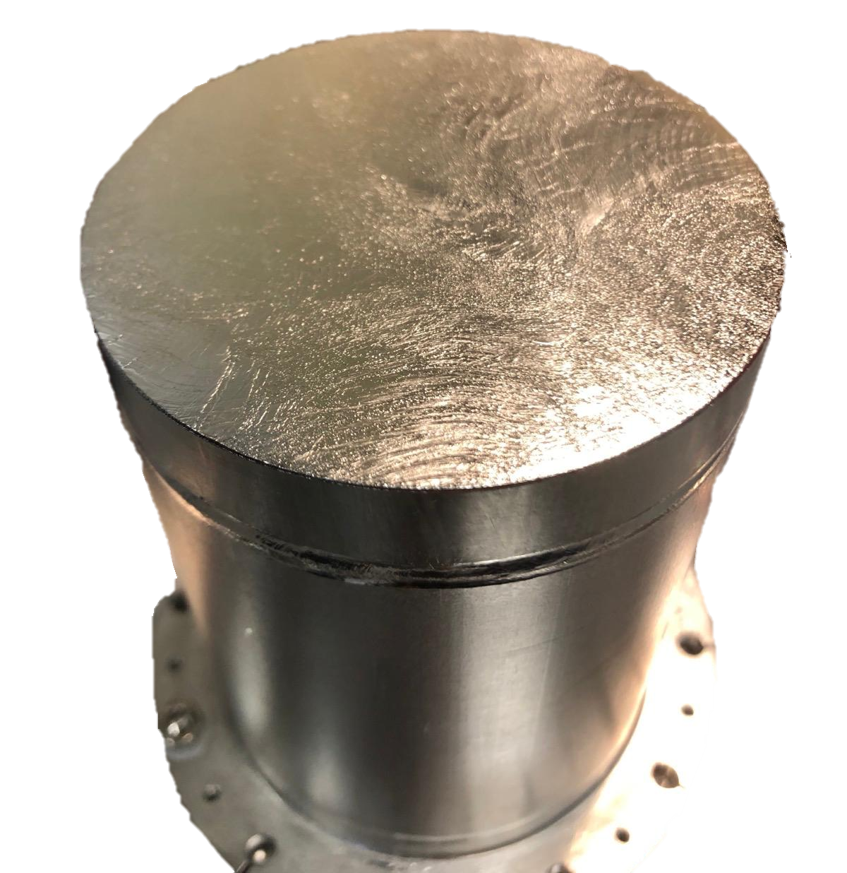
RF VALIDATION
01 · Film & technical solutions
A specific RF Measured on tailored samples
COOL-DOWN BEHAVIOUR
→ Slow cool-down data suggest flux trapping
→ Steep rise > 40 mT → likely thermal dissipation
Same sample, two cool-downs
Slow vs fast cool-down on one QPR sample isolates trapped-flux losses from the intrinsic surface resistance.
10 cm
QPR sample · ⌀ ≈ 10 cm
Surface resistance vs peak RF field · 4 K, 400 MHz (courtesy O. Kugeler, S. Keckert, HZB)
TTC 2026 · M. Lazzari, INFN–LNL, malazzar@lnl.infn.it
10 / 17

Slide 11
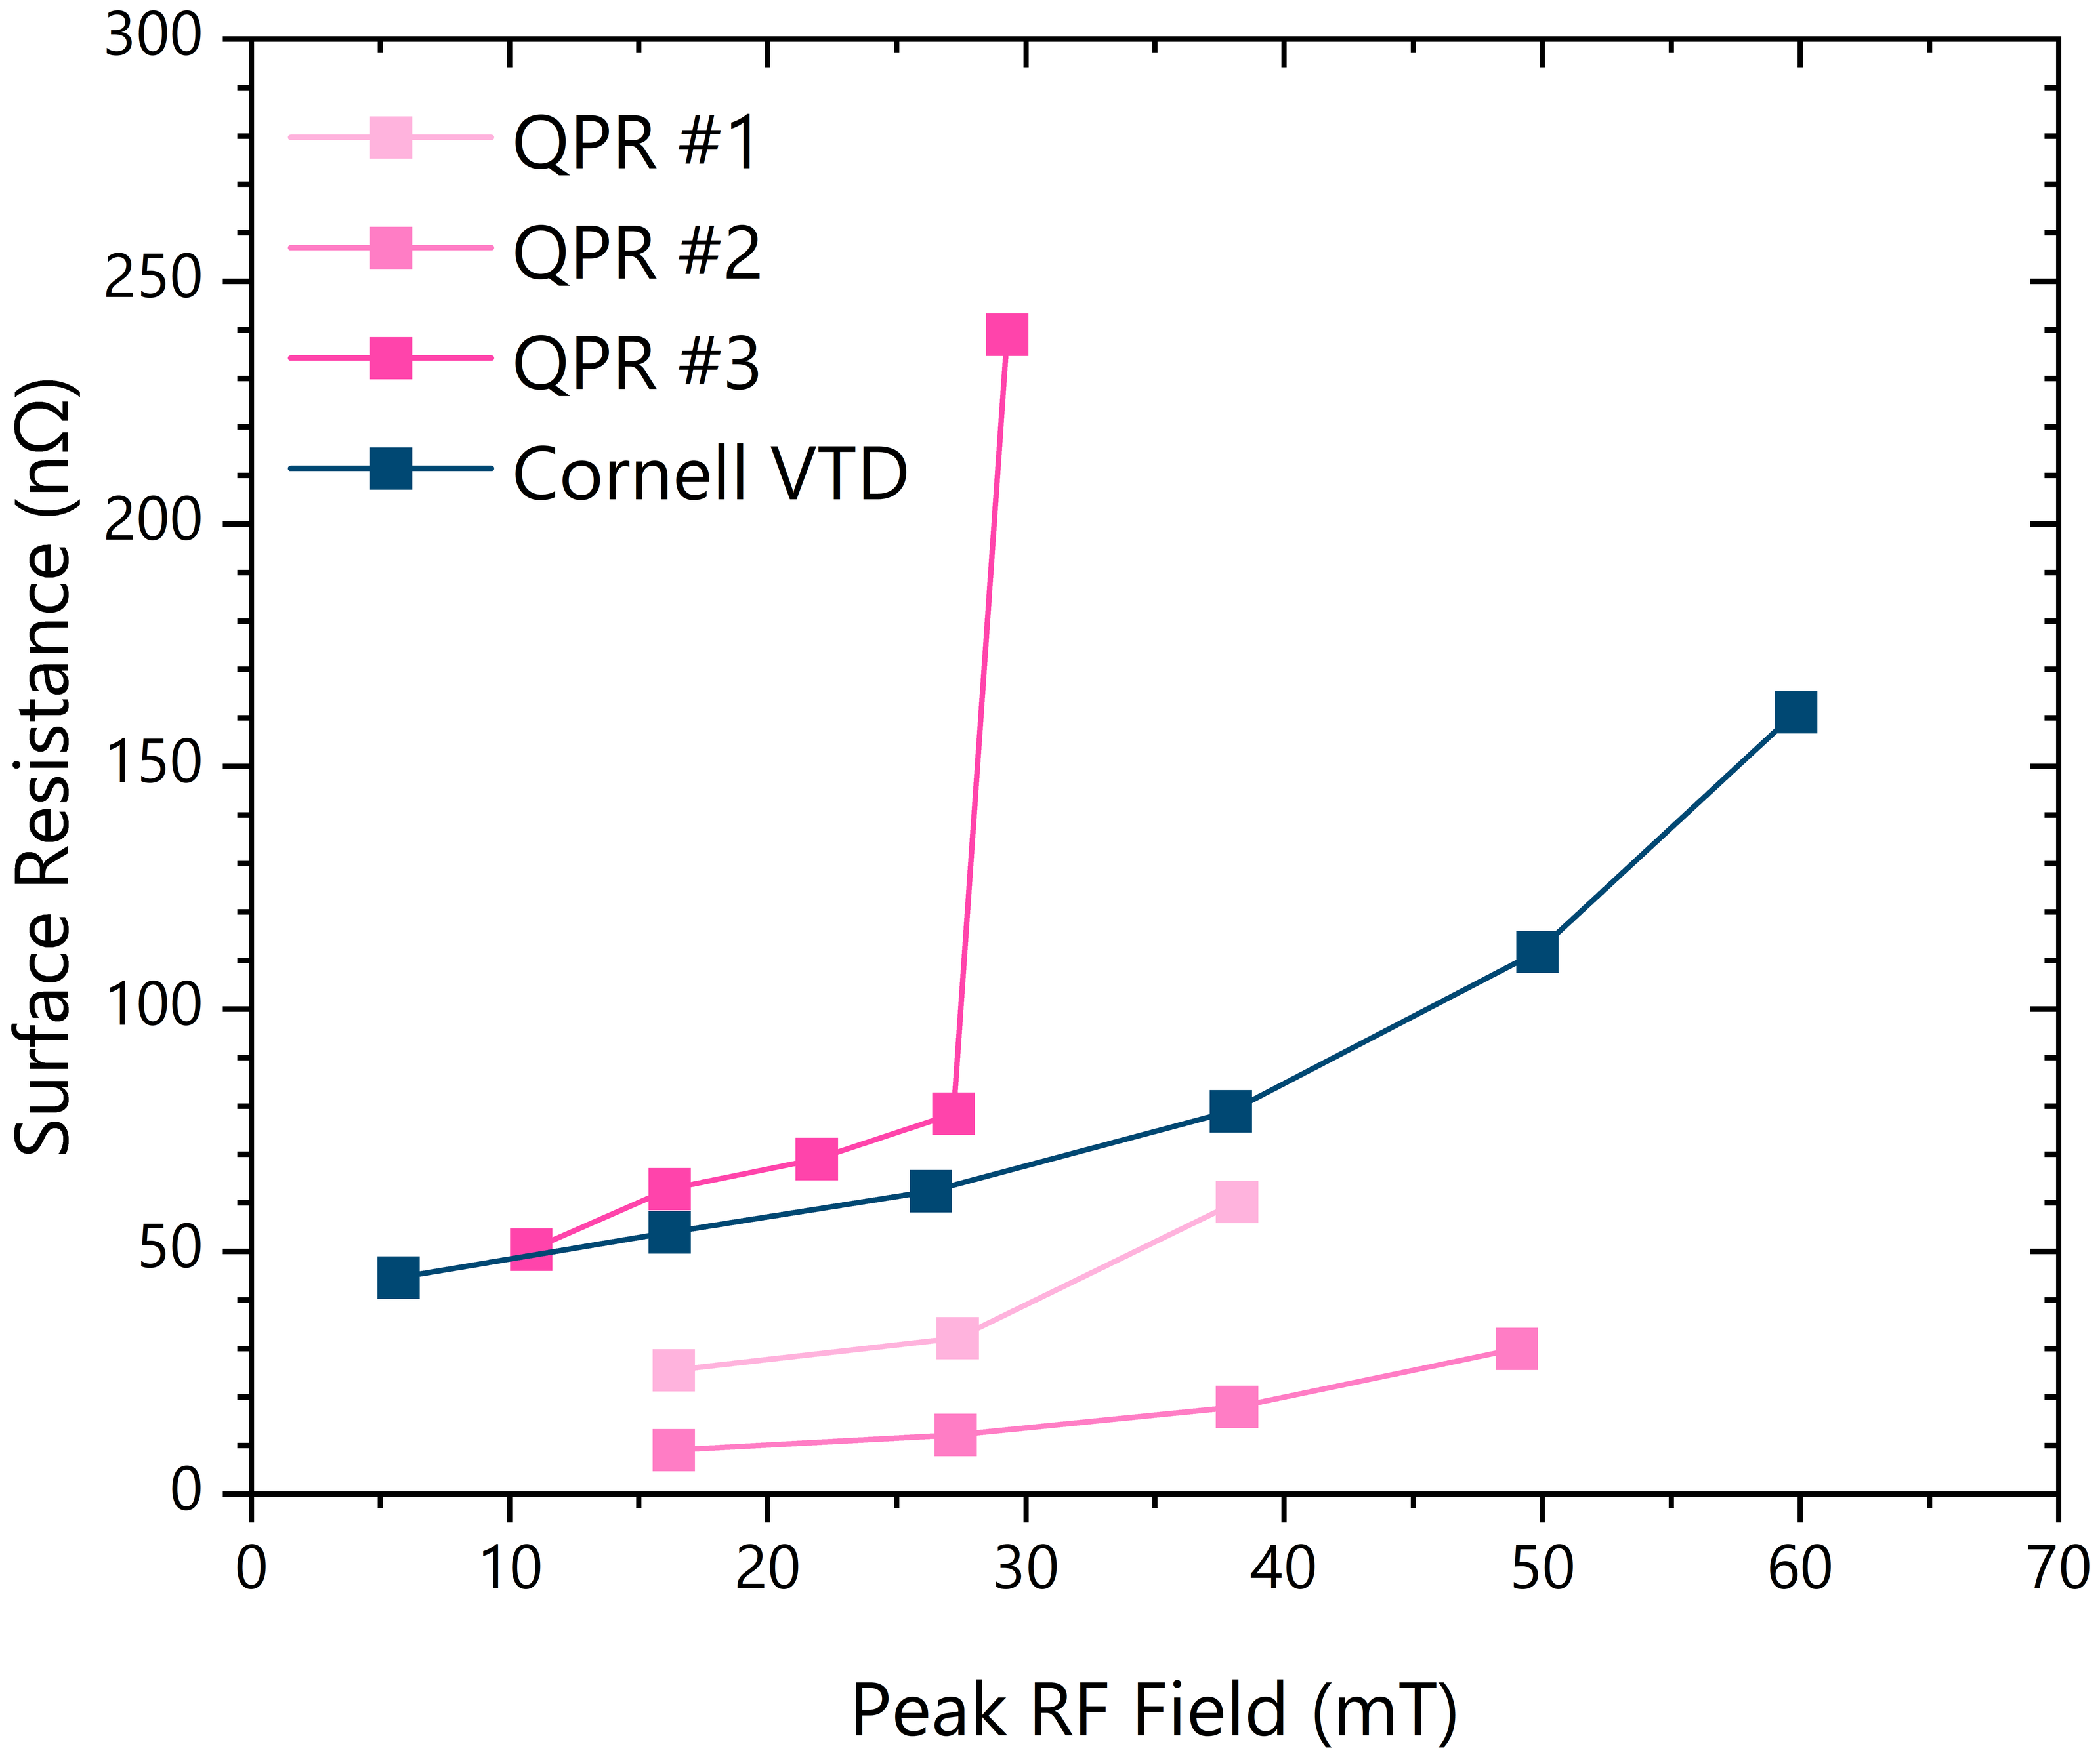
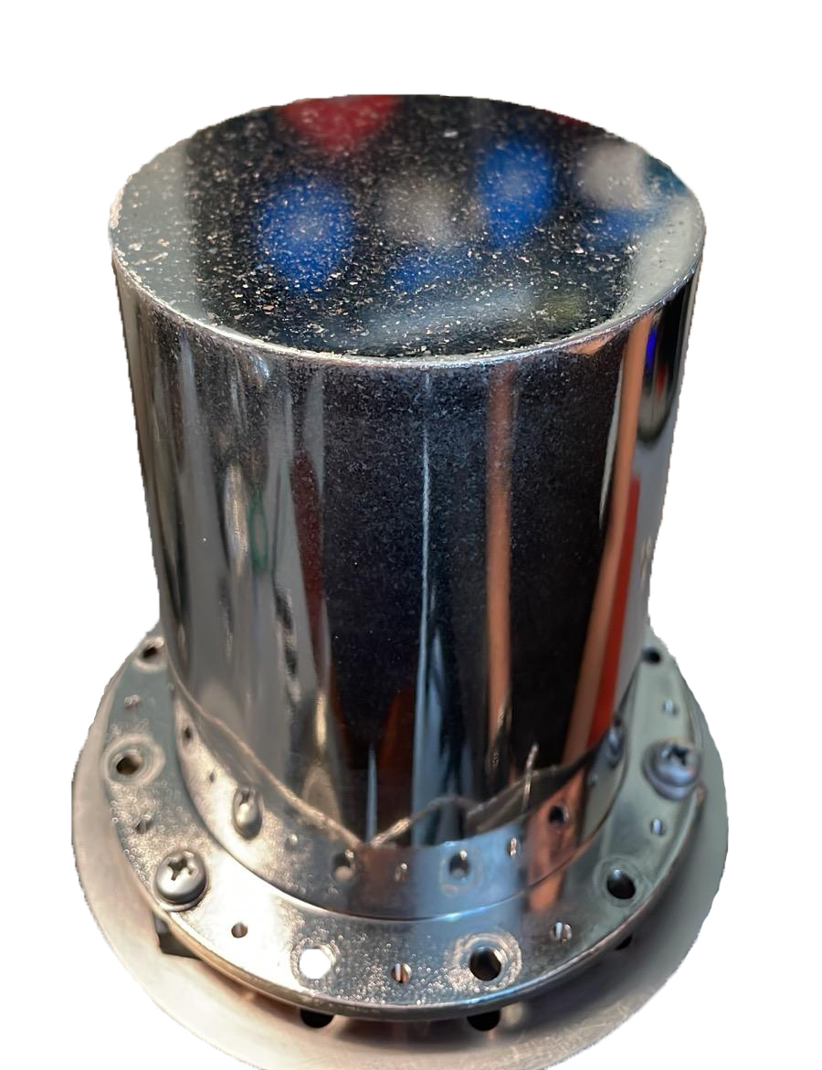
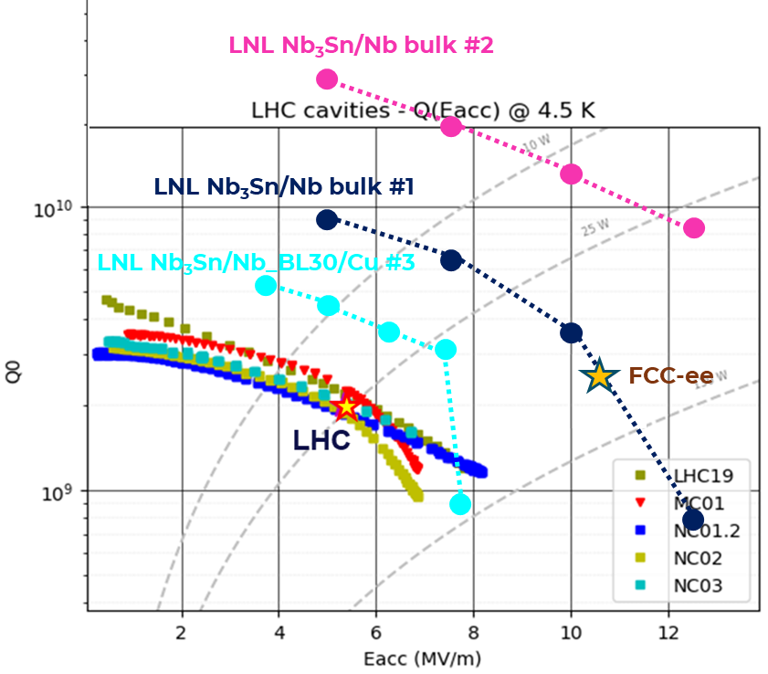
RF VALIDATION
01 · Film & technical solutions
Recipe confirmed on QPR samples
Rₛ vs peak RF field
Defects during NbBL deposition
Q vs Eacc · reaching the FCC-ee target
Sample
Tᴄ
Quench
Rs @ 4K
vs VTD
Surface preparation matters
Sample #1 · bulk Nb · BCP
17.2 K
> 70 mT
~ 25 nΩ
≈ to 40 mT
EP (#2) cuts low-field Rₛ >2× and lifts quench vs BCP (#1); Q ≈ 10× LHC.
#3 — first full-Cu QPR coating: very preliminary.
Sample #2 · bulk Nb · EP + pol.
17.45 K
> 85 mT
< 9 nΩ
better, ≤ 50 mT
Sample #3 · full Cu · NbBL30
prelim.
—
—
first on Cu
4 K · 400 MHz · courtesy O. Kugeler, S. Keckert (HZB)
TTC 2026 · M. Lazzari, INFN–LNL, malazzar@lnl.infn.it
11 / 17

Slide 12
02
PART 02
Upscaling to 1.3 GHz
From flat samples to a real TESLA-shaped cavity: building the deposition system that makes it possible.
TTC 2026 · M. Lazzari, INFN–LNL, malazzar@lnl.infn.it
12 / 17

Slide 13
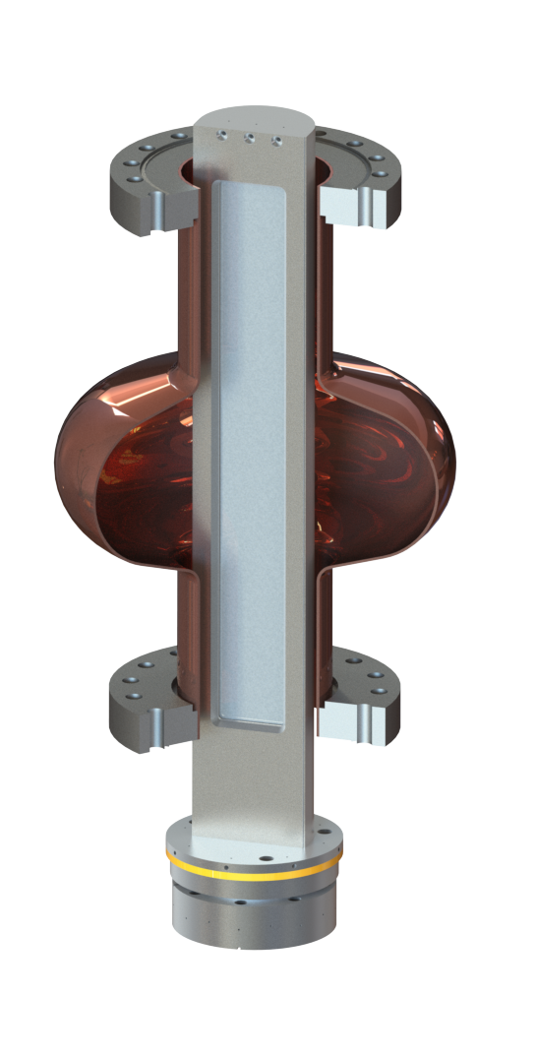
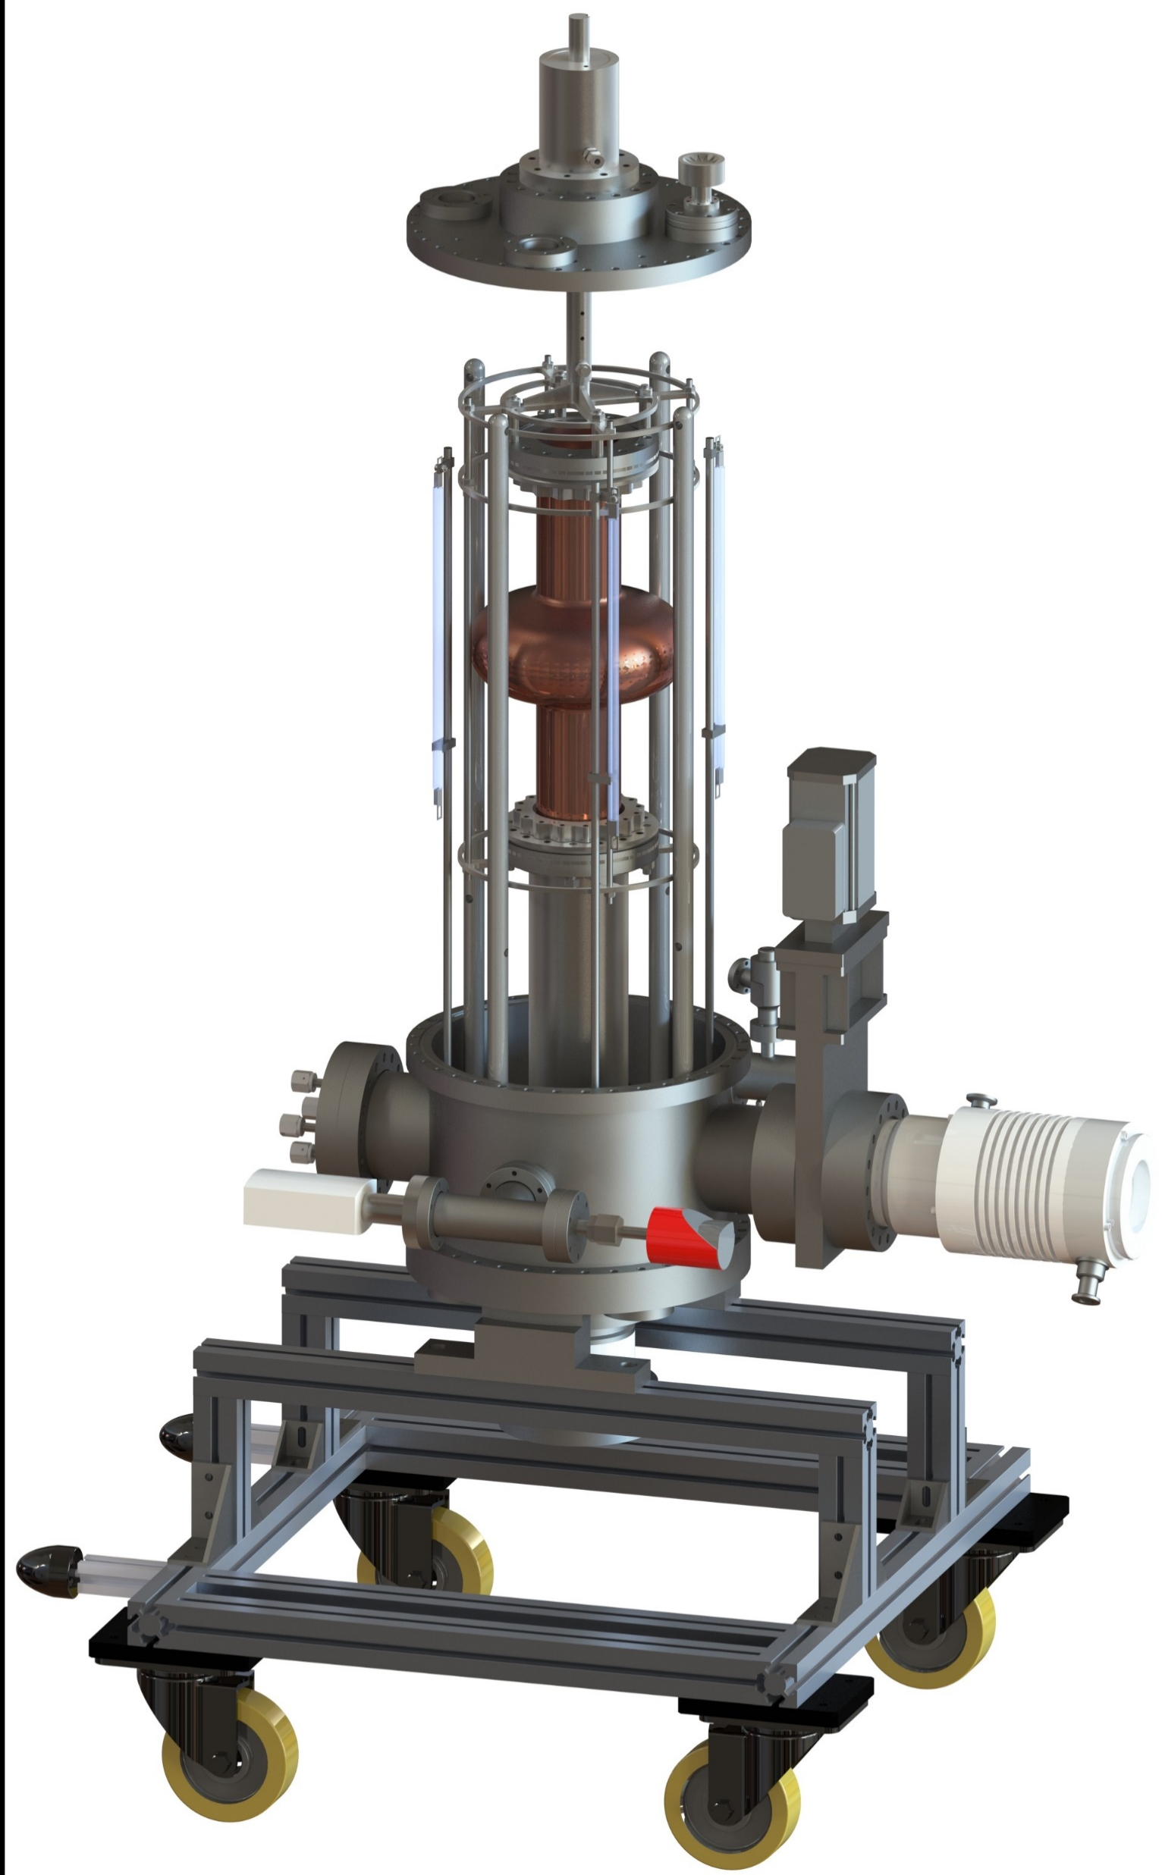
THE 1.3 GHZ COATING SYSTEM @ LNL
02 · Upscaling to 1.3 GHz
Fixed rectangular magnetron, rotating cavity
A geometry built for uniformity
Fixed planar magnetron — a rectangular cathode runs along the cavity axis
Rotating cavity — the 1.3 GHz cavity turns around it for an even coating
Stoichiometric target — same Nb₃Sn recipe validated on QPR, now in 3D
Design reference
M. Lazzari et al., “A new system for Nb₃Sn thin-film deposition on 1.3 GHz cavities”, SRF2025, TUP31
Coating chamber · rotating 1.3 GHz cavity
TTC 2026 · M. Lazzari, INFN–LNL, malazzar@lnl.infn.it
13 / 17

Slide 14
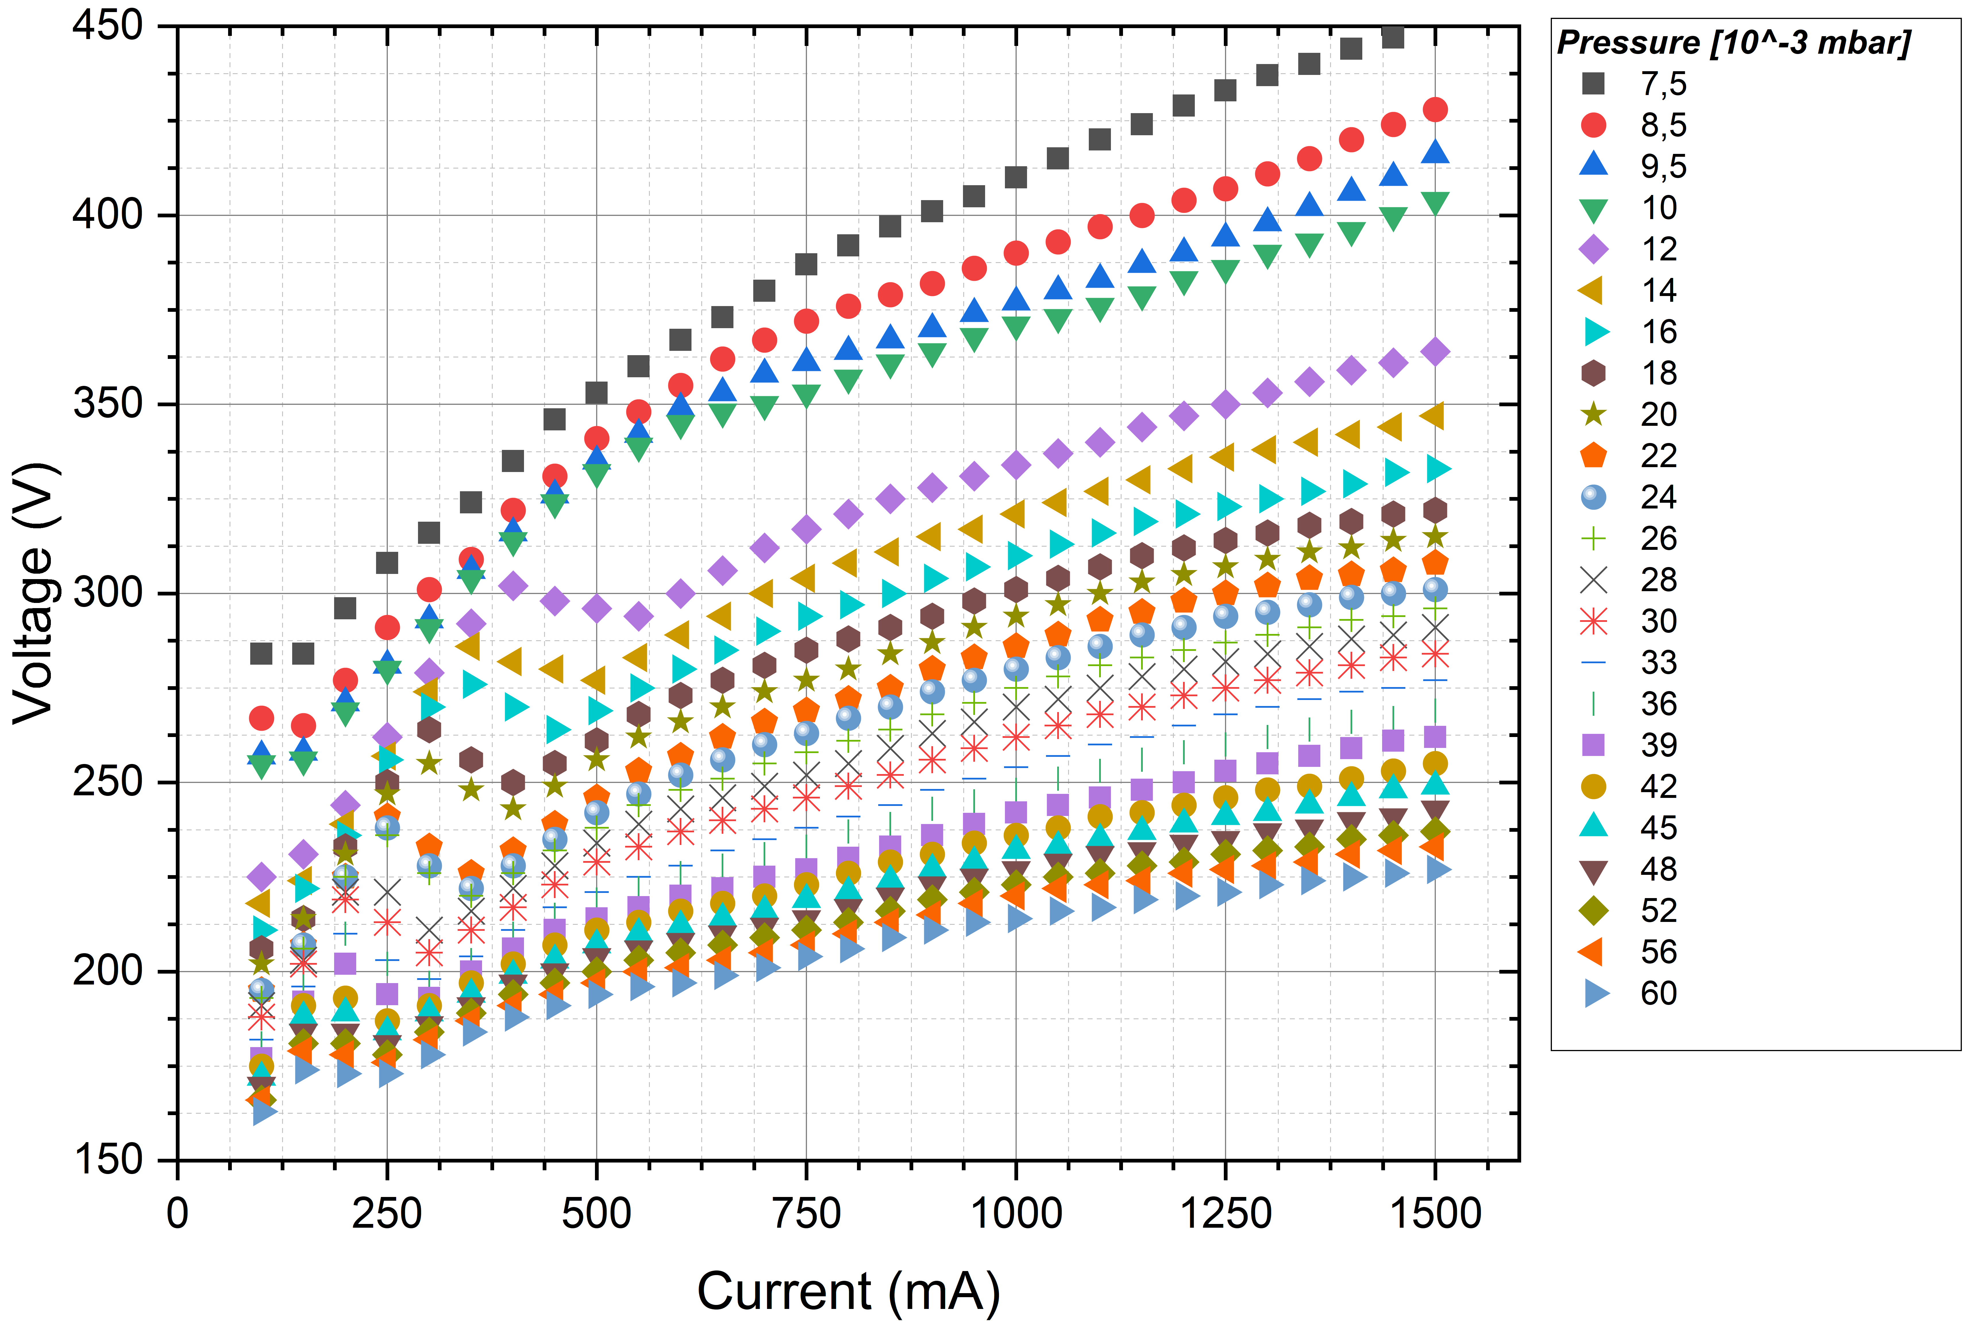
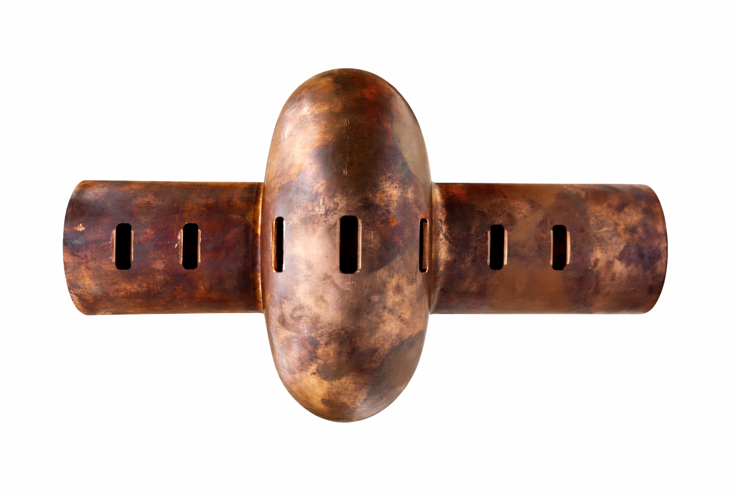
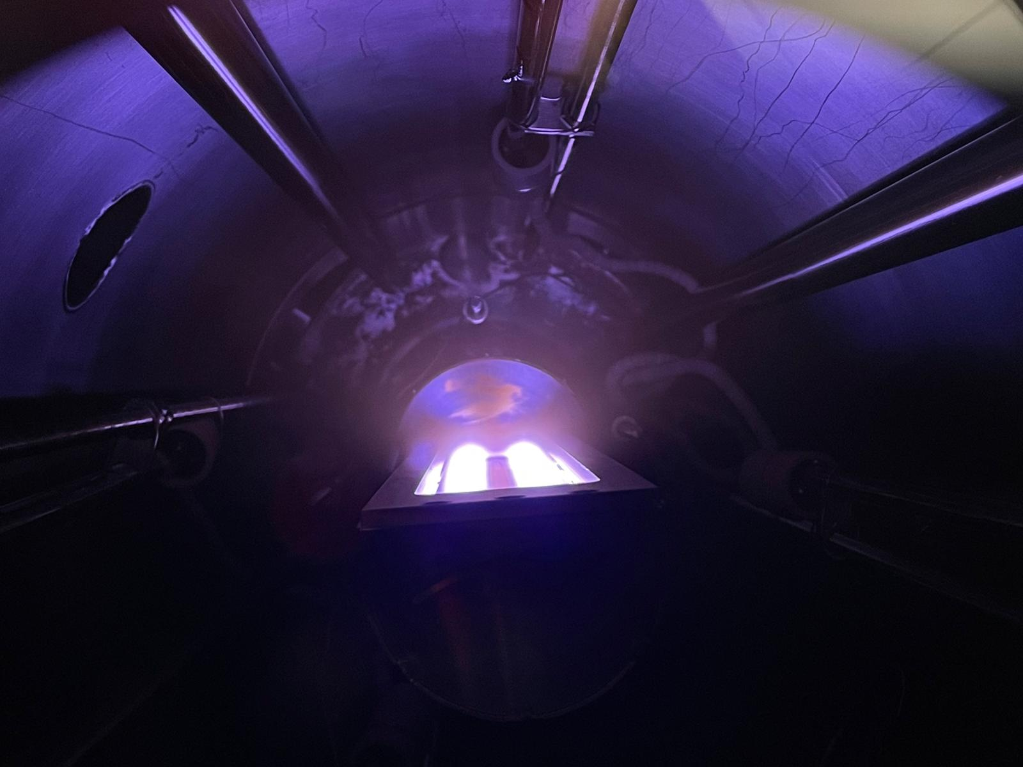
COMMISSIONING
02 · Upscaling to 1.3 GHz
System assembled — magnetron characterized
CURRENT STATUS
✓
Vacuum system — assembled & tested
✓
Heating system — completed & tested
✓
Magnetron — first Nb-target ignition
Rotating-cavity system — design phase
Discharge power law (V–I)
MAGNETRON CHARACTERIZATION
1
2
3
4
5
6
7
Three magnet sets — 0.68 / 0.92 / 1.02 T tested
Up to 1 A — classical power-law discharge confirmed
Rate mapping — DR₂(equator) ≈ 4× DR₁ · Med vs straight magnets compared
Ignited Nb plasma
Deposition rate DR₁ / DR₂ along the cavity
TTC 2026 · M. Lazzari, INFN–LNL, malazzar@lnl.infn.it
14 / 17

Slide 15
ROADMAP
Next steps
Follow the beam: where the particle sits is today; its path traces the road to a working 4.2 K cavity.
1° semester 2026
2° semester 2026
End of
2026
Full
2027
◆ we are here
working cavity
First Nb coating on a dummy cavity
Coating of Nb3Sn on a dummy cavity
Coating of Nb3Sn on a Nb bulk cavity
Coating of Nb3Sn on a Cu cavity
TTC 2026 · M. Lazzari, INFN–LNL, malazzar@lnl.infn.it
15 / 17

Slide 16
SUMMARY
Where we stand on Nb₃Sn on Cu @ 1.3 GHz
1
Optimized recipe
DCMS from a stoichiometric target — Tᴄ > 17 K on copper, validated.
2
RF-proven film
Rs < 9 nΩ @ 4 K and quench > 85 mT on QPR — beats the VTD reference.
3
1.3 GHz system built
LNL rotating-cavity magnetron commissioned; first cavities being coated.
4
Clear path ahead
Nb (2026) → Cu prototype (2027) → 4.2 K vertical test.
TTC 2026 · M. Lazzari, INFN–LNL, malazzar@lnl.infn.it
16 / 17

Slide 17



Thank you
Matteo Lazzari · malazzar@lnl.infn.it
LNL Surface Treatments & Superconductivity Team · INFN-LNL · PhD funded by Zanon Research & Innovation
KEY REFERENCES
D. Fonnesu et al., “Recipe optimization and SRF test of Cu-compatible Nb₃Sn films by DCMS”, Sci. Rep. 16, 3539 (2026).
M. Lazzari et al., “A new system for Nb₃Sn thin-film deposition on 1.3 GHz cavities”, SRF2025, TUP31.
SUPPORTED BY
iSAS (GA 101131435) · I.FAST (GA 101004730) · INFN CSN5 SuperMAD / CSN1 SRF, RD_FCC · Zanon R&I

Slide 18
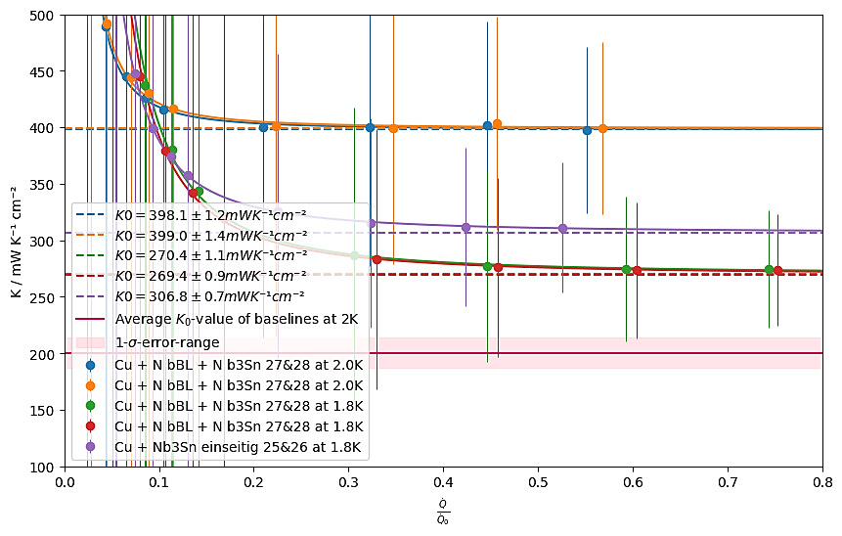
BACKUP
Thermal transmittance
Nb₃Sn/30 μm Nb BL/Cu and Nb₃Sn/Cu
30 μm Nb BL/Cu
proved better than bulk Nb
From measurement at 1.8 K:
Limited reduction of thermal transmittance of Nb BL compared to Cu
TTC 2026 · M. Lazzari, INFN–LNL, malazzar@lnl.infn.it

Slide 19
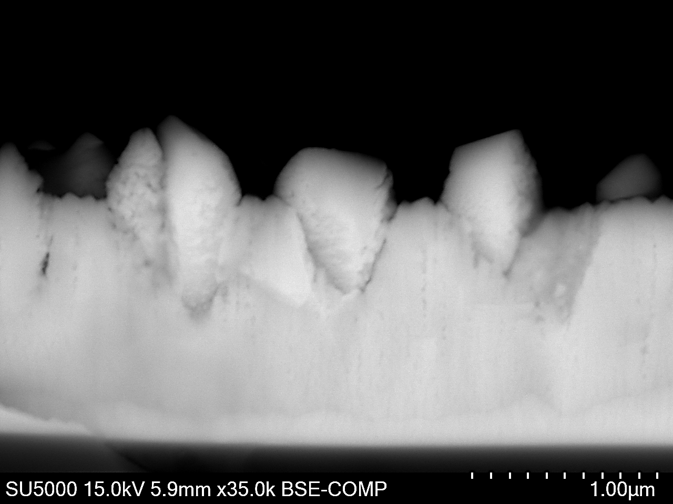
BACKUP
Morphology — Nb₃Sn on bulk Nb
TTC 2026 · M. Lazzari, INFN–LNL, malazzar@lnl.infn.it

Slide 20
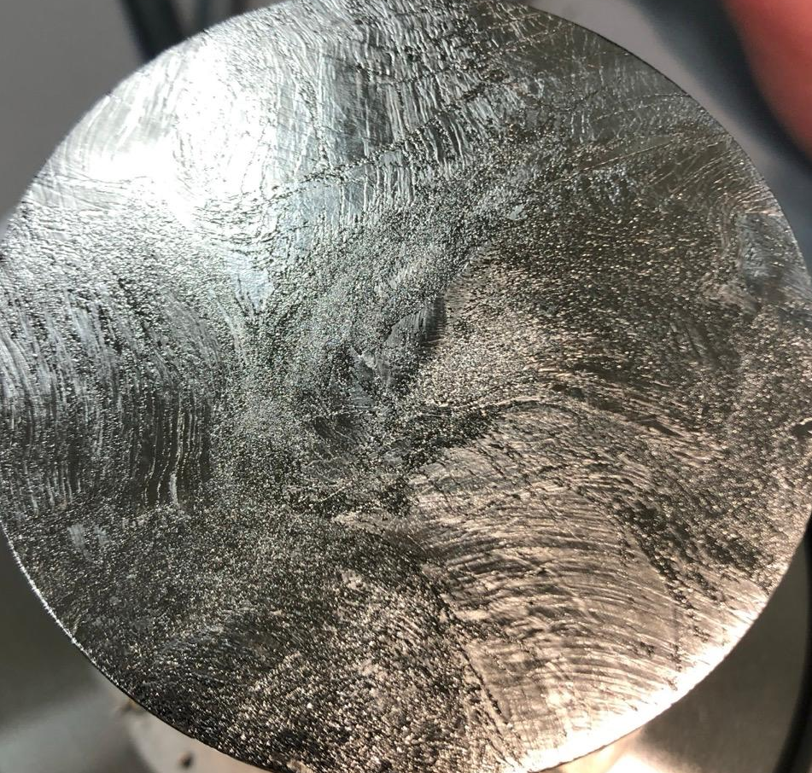
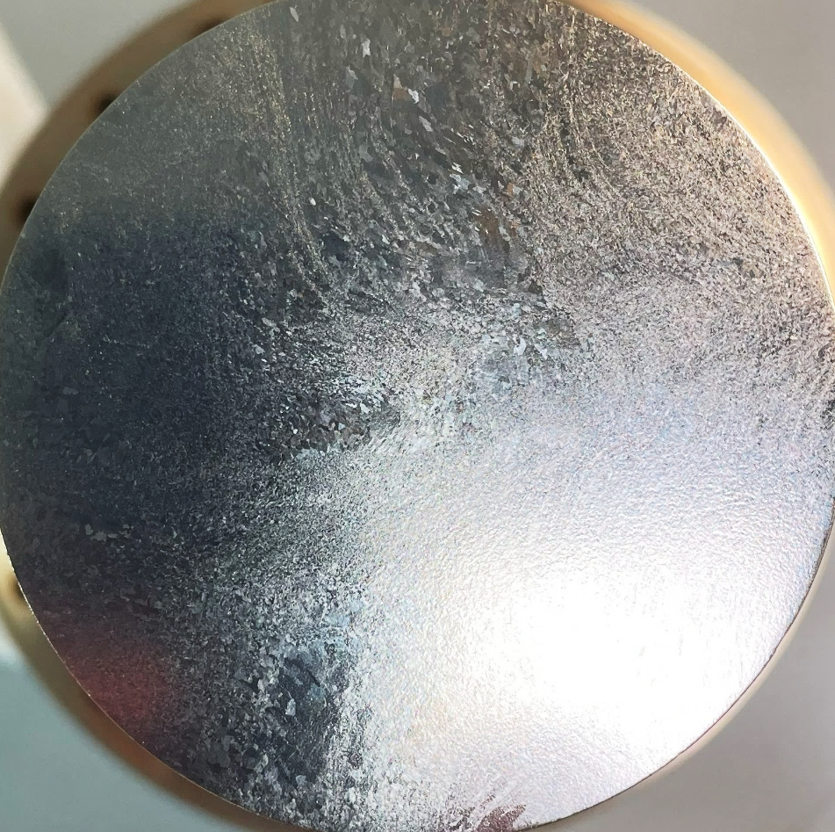
BACKUP
QPR sample comparison
Nb₃Sn/bulk Nb
Sample #1 (just seen)
Nb₃Sn/bulk Nb
Sample #2
Surface preparation:
Metallographic polishing
+
EP
Surface preparation:
BCP
TTC 2026 · M. Lazzari, INFN–LNL, malazzar@lnl.infn.it

Slide 21
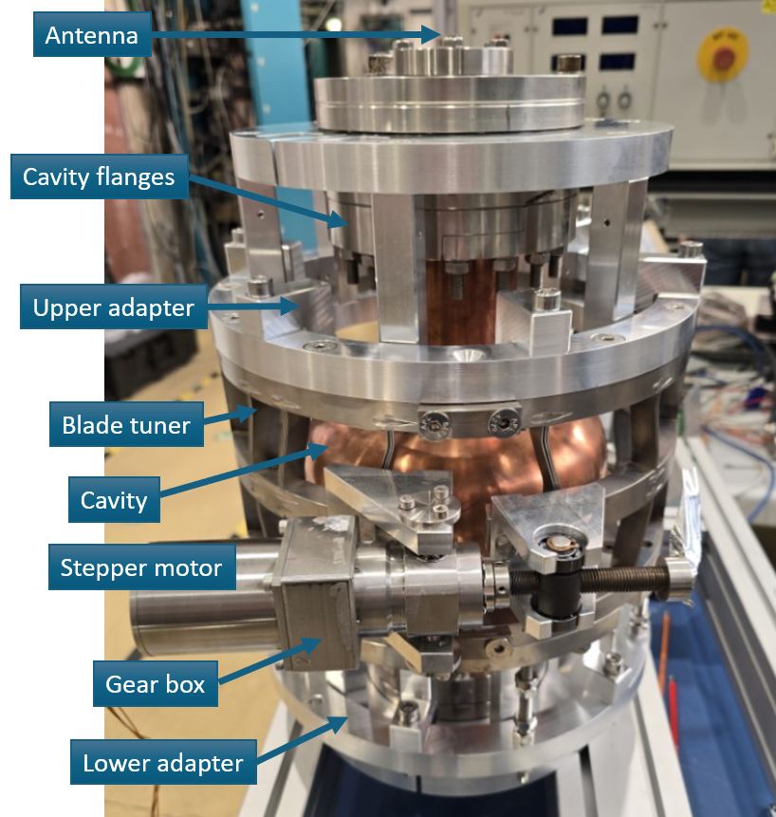
BACKUP
1.3 GHz cavity assembly
TTC 2026 · M. Lazzari, INFN–LNL, malazzar@lnl.infn.it

