Slide 1


Recent Progress in Nb3Sn for SRF cavities at UKRI
Reza Valizadeh, Oleg Malyshev, Christopher Benjamin, Dan Seal, James Conlon,
Andrew Vick, Alan Wheelhouse (STFC),
Graeme Burt (Lancaster University)

Slide 2
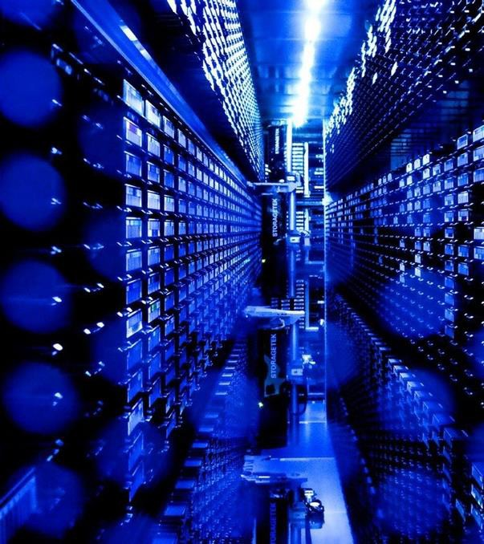
Outline
Objectives & Strategy
Thin Film Testing & Validation
Cavity Deposition
Summary

Slide 3


SRF Thin Film Objectives

Slide 4
Aims & Objectives
  To develop and validate a novel class of SRF cavities based on Nb₃Sn and NbTiN thin films: improve accelerator performance and efficiency through higher accelerating fields,
            better stability,
          reduced material costs,
  lower operational costs compared to traditional bulk niobium cavities
Development of in-house skills and capabilities to deposit, measure and test thin film cavities
Thin film cavity of high T_{c} tested in cryomodule with beam

Slide 5
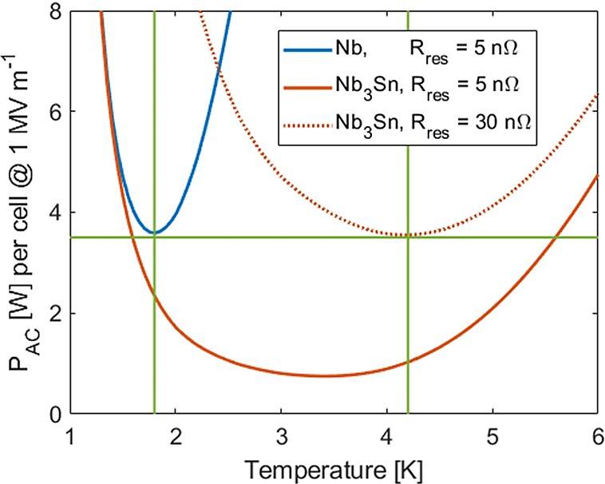
Nb₃Sn for SRF – Potential
T_{c} (Nb) = 9.2 K ➔ T_{c} (Nb₃Sn) = 18.3 K
results in lower R_{BCS} at a given temperature
  operation at 4.5 K
  reduce grid power to run cryo plant by factor of 3
[1]
potential demonstrated by VTD cavities (state of the art):
Q₀ ~ 2 x 10¹⁰ at 20 MV/m (4.4 K, 1.3 GHz) [2]

Slide 6
Thin Film Testing & Validation

Slide 7
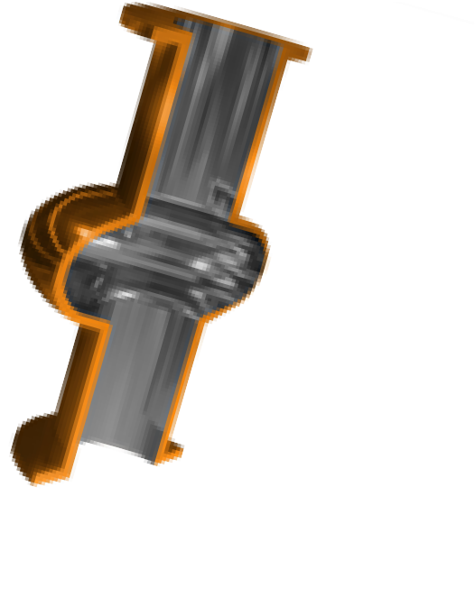
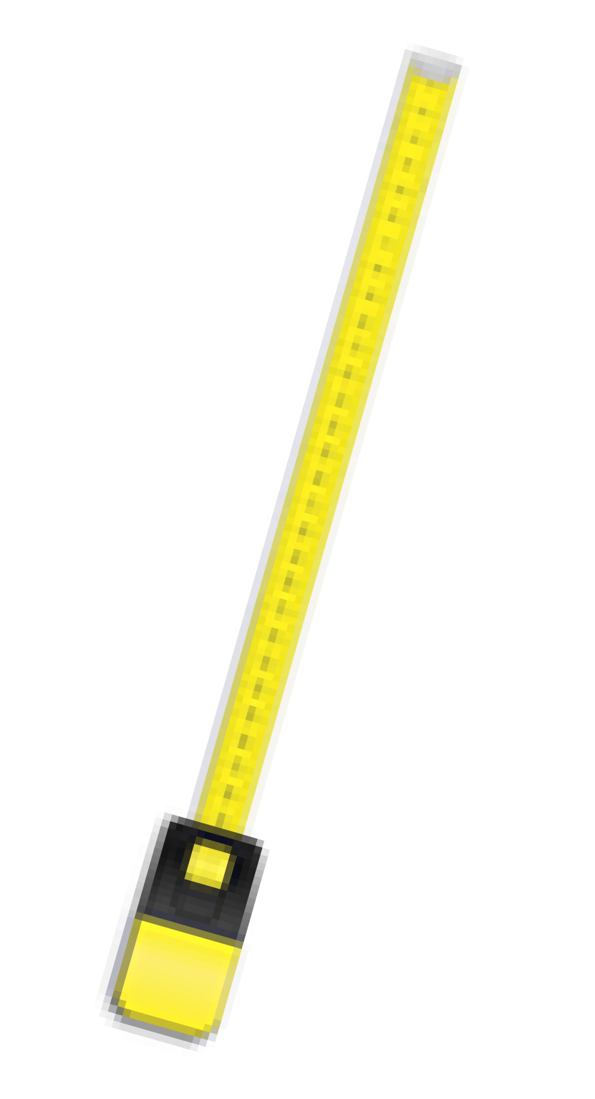

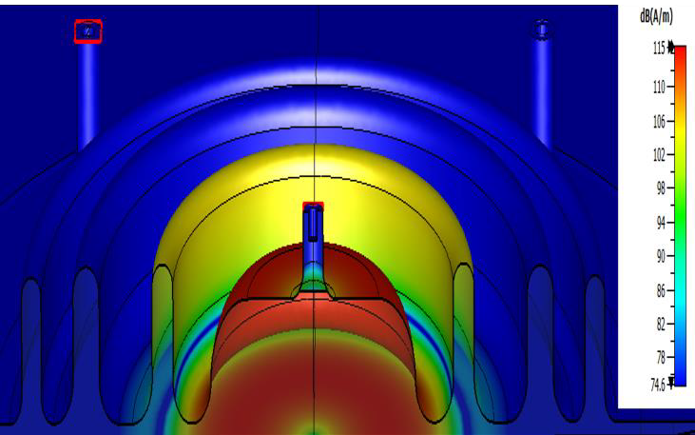

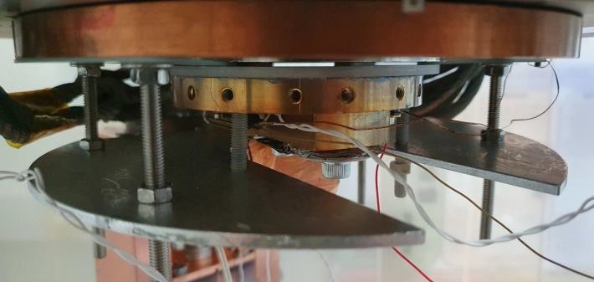
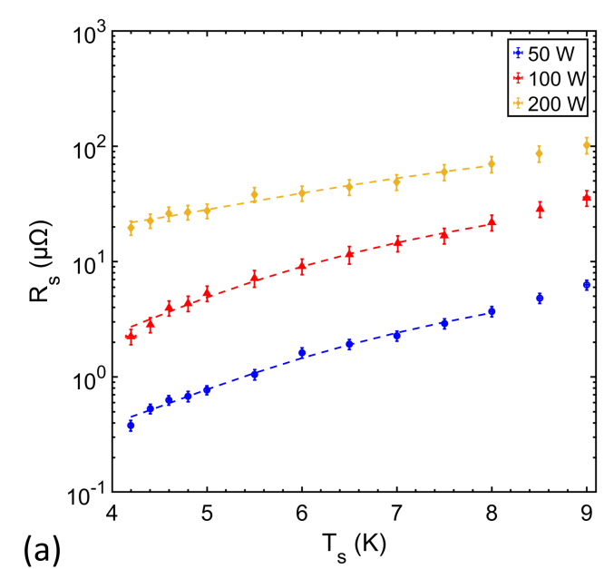
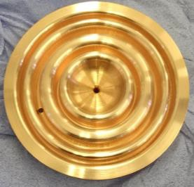
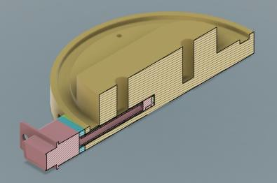
RF Test With Choke Cavity
Effect of deposition temperature on Nb/Cu
3 tests per
week!
100
90
80
70
60
50
40
30
20
10
0
Target 1 (4 hr)
Target 2 (4 hr) BCS
Most importantly, how does the thin film perform under RF conditions?
R_{s}, 4.2 K (µΩ)
7.8 GHz Choke Cavity
Low field measurements:
R_{s} vs B_{s, pk}
R_{s} vs T_{s}
Penetration depth vs T_{s}
0 100 200 300 400 500 600 700
Mass parameter optimisation prior to:
Deposition Temperature (°C)
Effect of magnetron power on Nb₃Sn/Cu
High field/low frequency tests with QPR
Cavity tests
Upgrades to increase B_{s, pk}:
Hall sensors for residual magnetisation
studies
Magnetic shields
TF coated Cu cavities
CI bunker
Courtesy of P. McGuinness (ASTeC)
9th September 2025
STFC Thin Films Programme – CERN Visit
D. Seal (ASTeC)
29

Slide 8
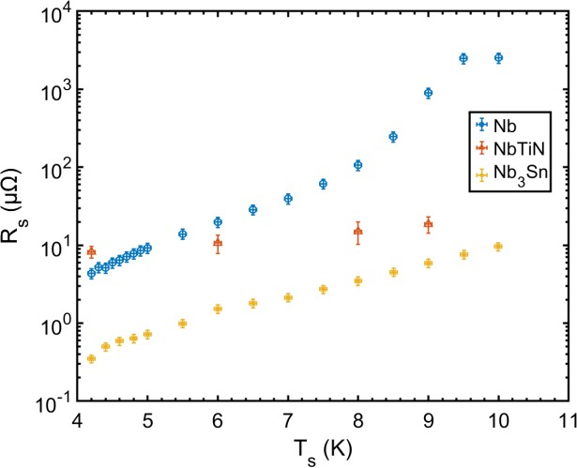
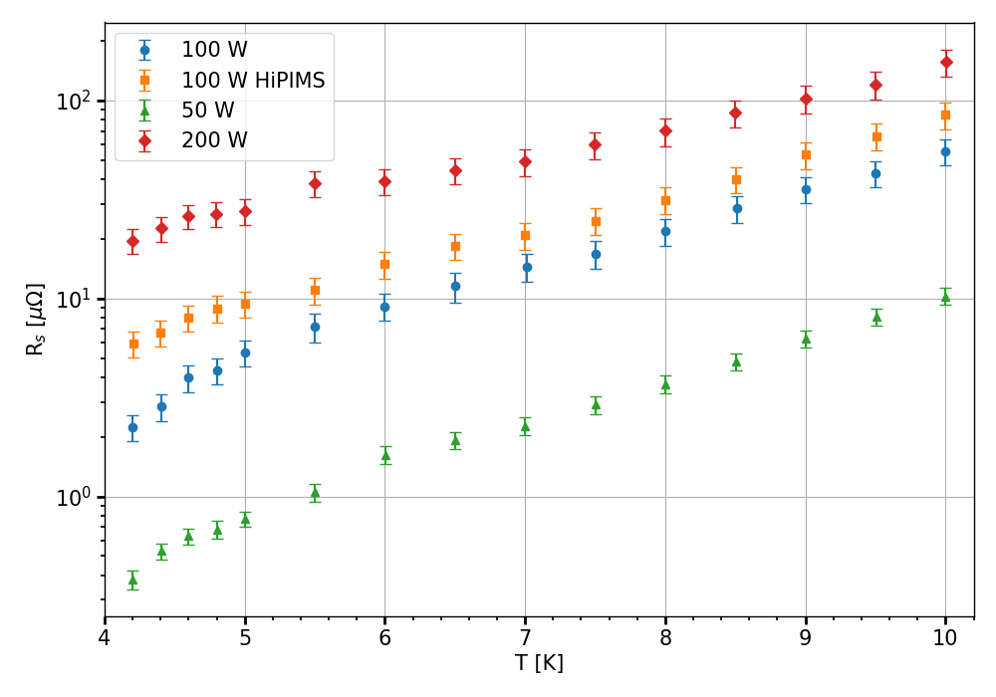
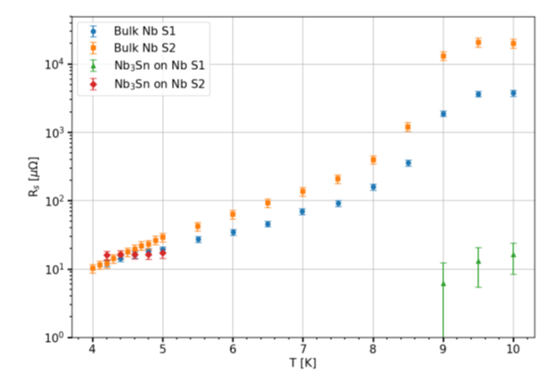
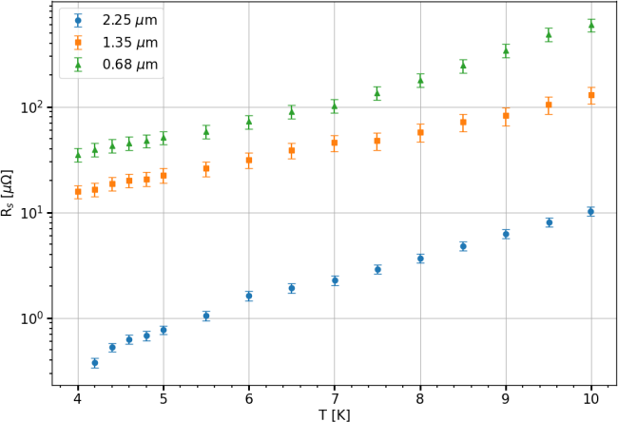
Optimisation of deposition parameters using choke cavity
Surface resistance of different SC thin film on Cu
Surface resistance on Nb with different surface roughness surface preparation
Optimisation of deposition power for Nb₃Sn on Cu
Optimum deposition power for Nb₃Sn is stablished at 50 W DC power
Film Thickness dependence of Nb₃Sn on Cu
Best surface resistance so far is achieved on Nb substrate
For high T_{c}, Nb₃Sn seems to be more suitable candidate for 4 K operation having lower R_{s} than NbTiN.
Surface resistance of different thickness on Cu

Slide 9

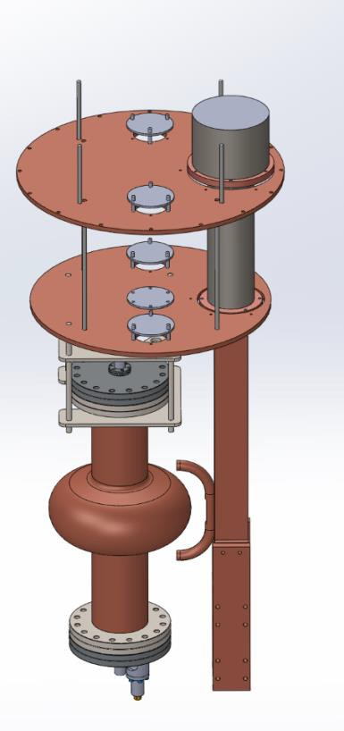

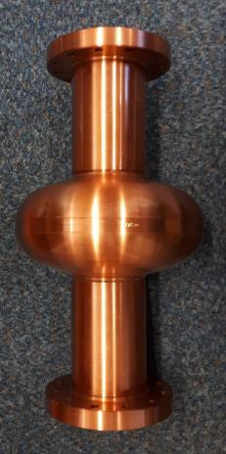
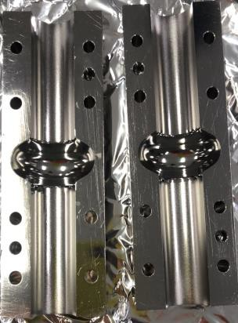

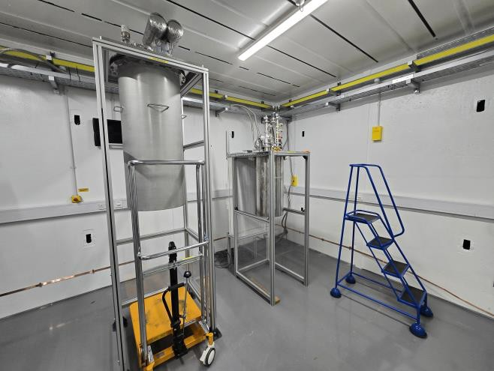
Low Power Cavity Test Facility
First tests in 2025!
Cryocooler based facility
P < 2.5 W, T > 4 K (est.)
Quick first cavity test
Good cavities will have high power test in LHe
Cold head
Feedthroughs for RF, wiring etc
4 types of cavity
1.3 GHz cavity
1.3 GHz closed
1.3 GHz split
6 GHz closed
6 GHz split
Adapter for heat links
6 GHz split cavity
Cavity facility alongside Choke Cavity facility
Courtesy of O. Poynton & J. Rigby

Slide 10
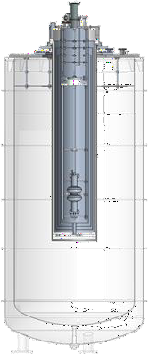
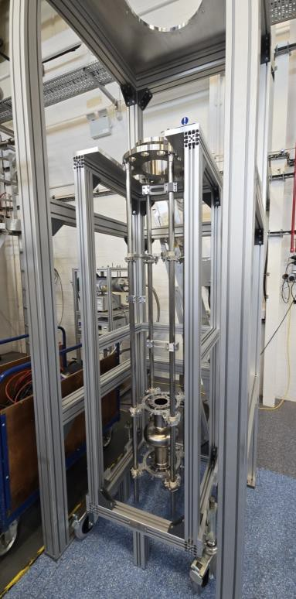
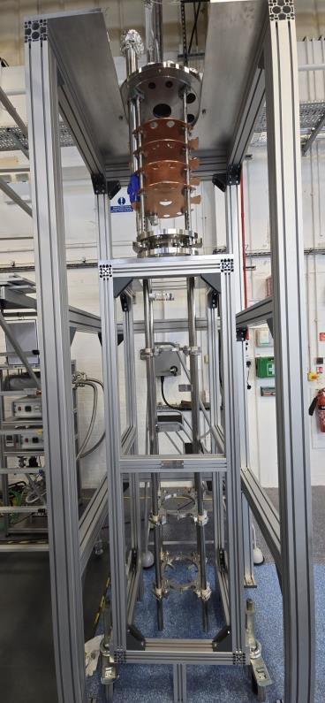


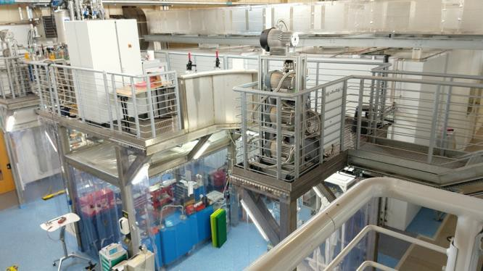
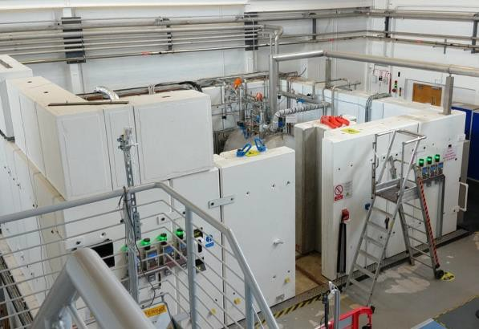
High Power Cavity Testing
Commissioning in 2025!
Full Q₀ vs E_{acc} test with LHe
Testing with existing STFC/DL LHe infrastructure
mainly used for ESS & PIP-II cavity tests
Upgrades now allow for:
  For thin film SRF programme
  A RF single system for 650 and 700 MHz,
and 1.3 GHz
  P ≤ 200 W, T = 2 & 4.2 K
  Capability for 9-cell tests
Courtesy of T. Sian & C. Hill
However, very limited number and durations for free timeslots, i.e. only good cavities should be characterised
Existing SRF Test Facilities in SuRF Lab at Daresbury Laboratory
Coordinated by T. Sian (ASTeC)

Slide 11
1.3 GHz Cavity Deposition

Slide 12
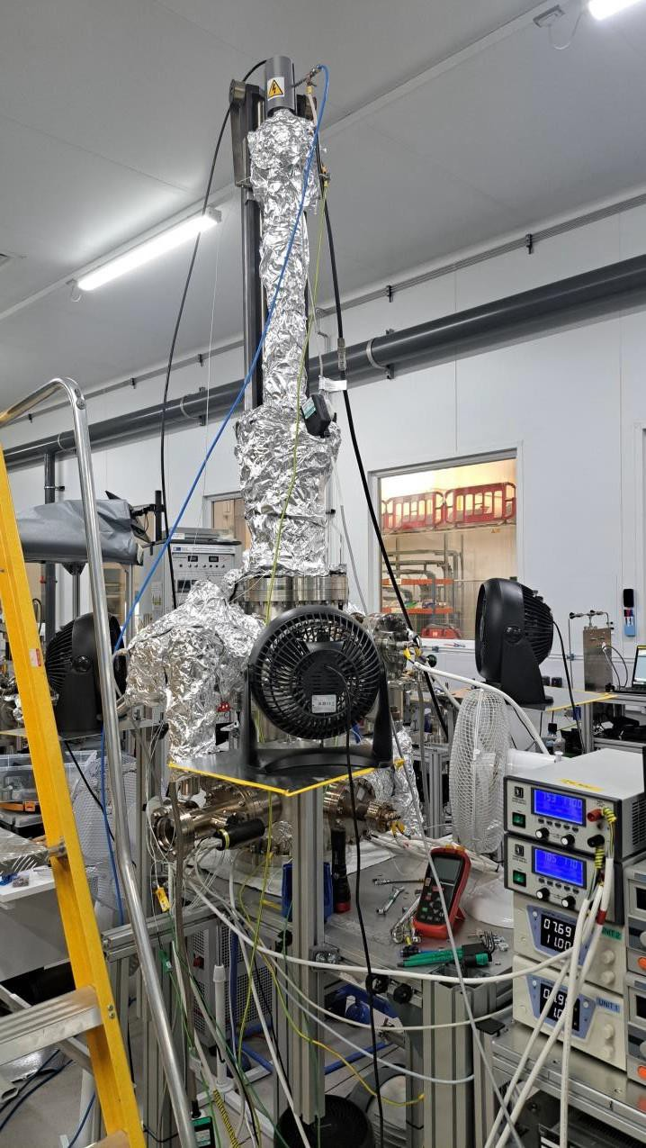
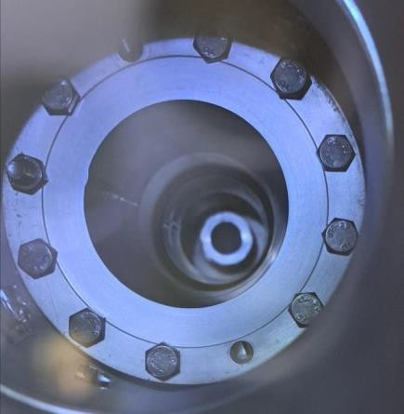
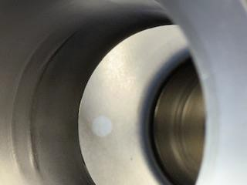
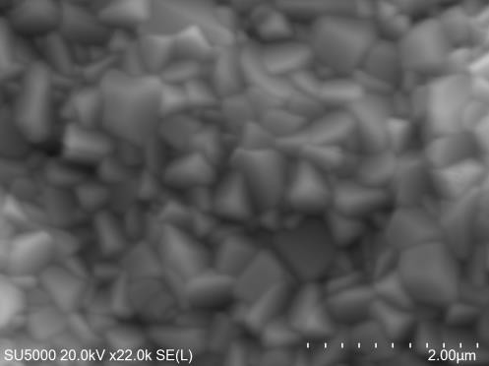
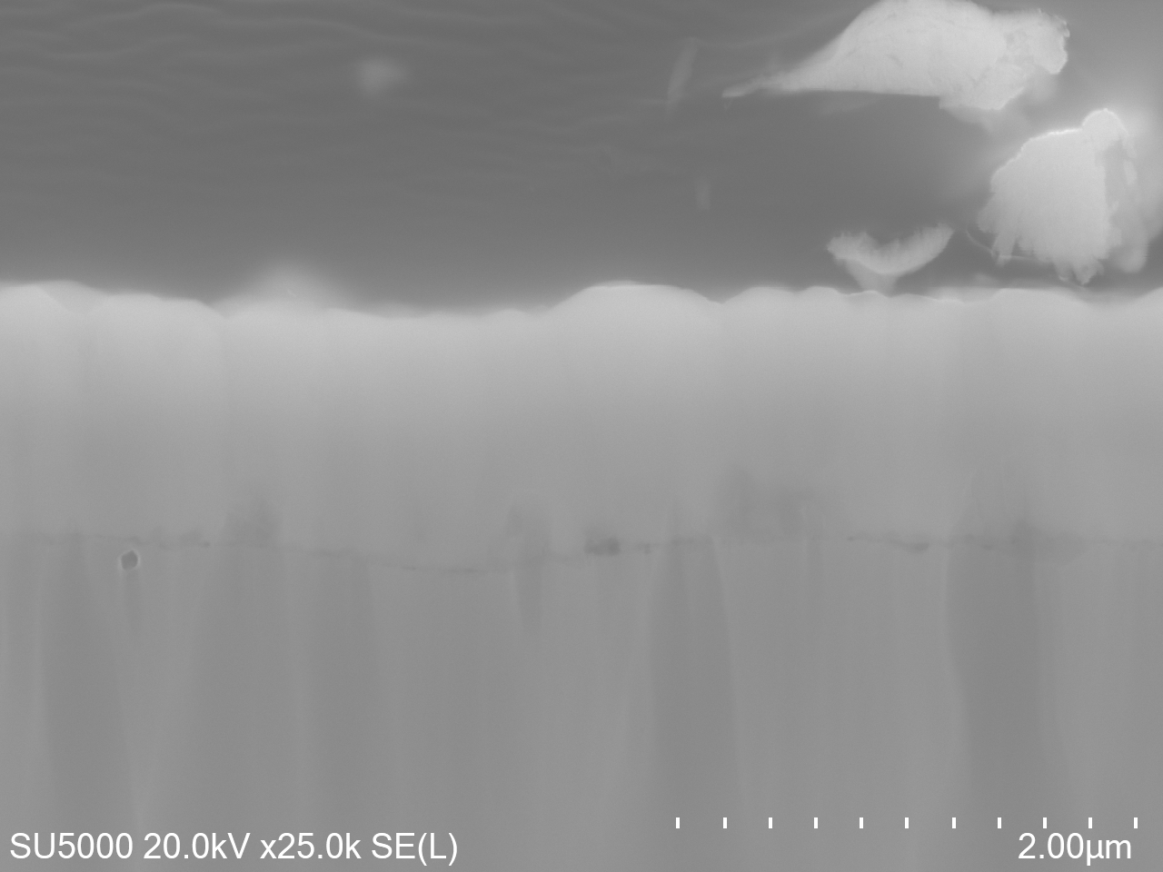
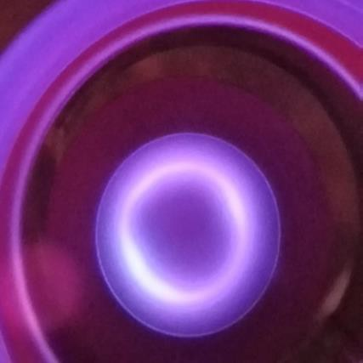
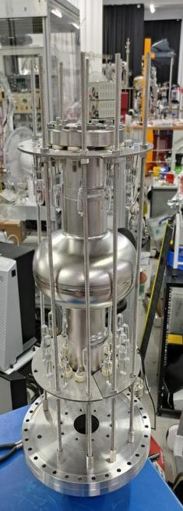
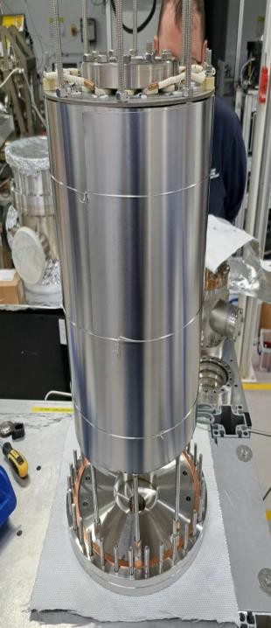
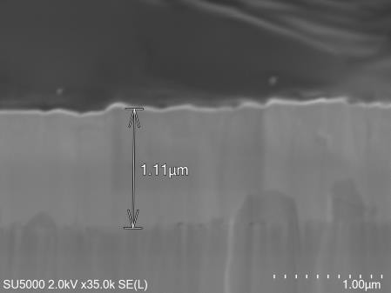

First Nb₃Sn calibration on 1.3 GHz Nb Cavity
First trial run of Nb₃Sn deposition of
1.3 GHz Nb cavity with deposition parameters established on planar samples.
The trial run proved to be successful. T_{c} of 17.5 K
View after deposition of Nb₃Sn and
Nb3Sn on Nb Witness sample
View from bottom flange
uncoated area under witness sample
Nb3Sn
Nb
Nb3Sn
View during deposition at 650° C
Cu

Slide 13
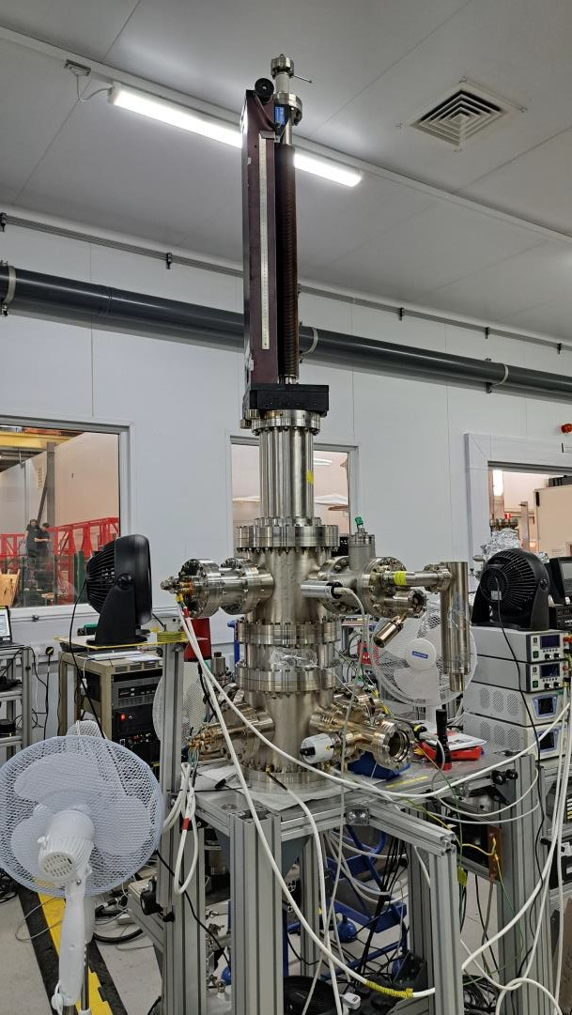
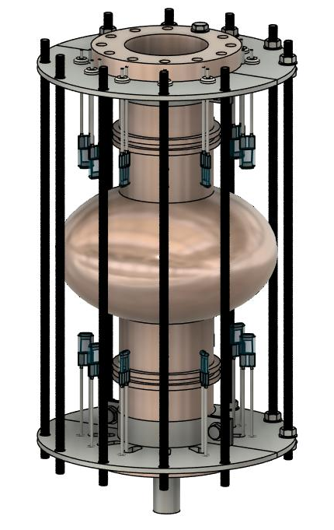
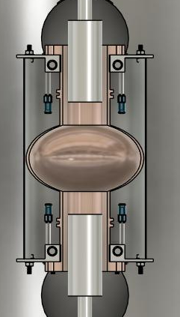
First 1.3 GHz Nb cavity deposited with Nb3Sn
Cavity heating stage
Cavity is deposited using magnetron sputtering (PVD).
Deposition inside a UHV system.
Deposition at 600 ºC
Custom in-house magnetron designed and tested can be positioned inside the cavity.
Two magnetron opposite each other was moved in and out during deposition total 30 hours.
Sputtered material (Plasma)
Magnetron

Slide 14
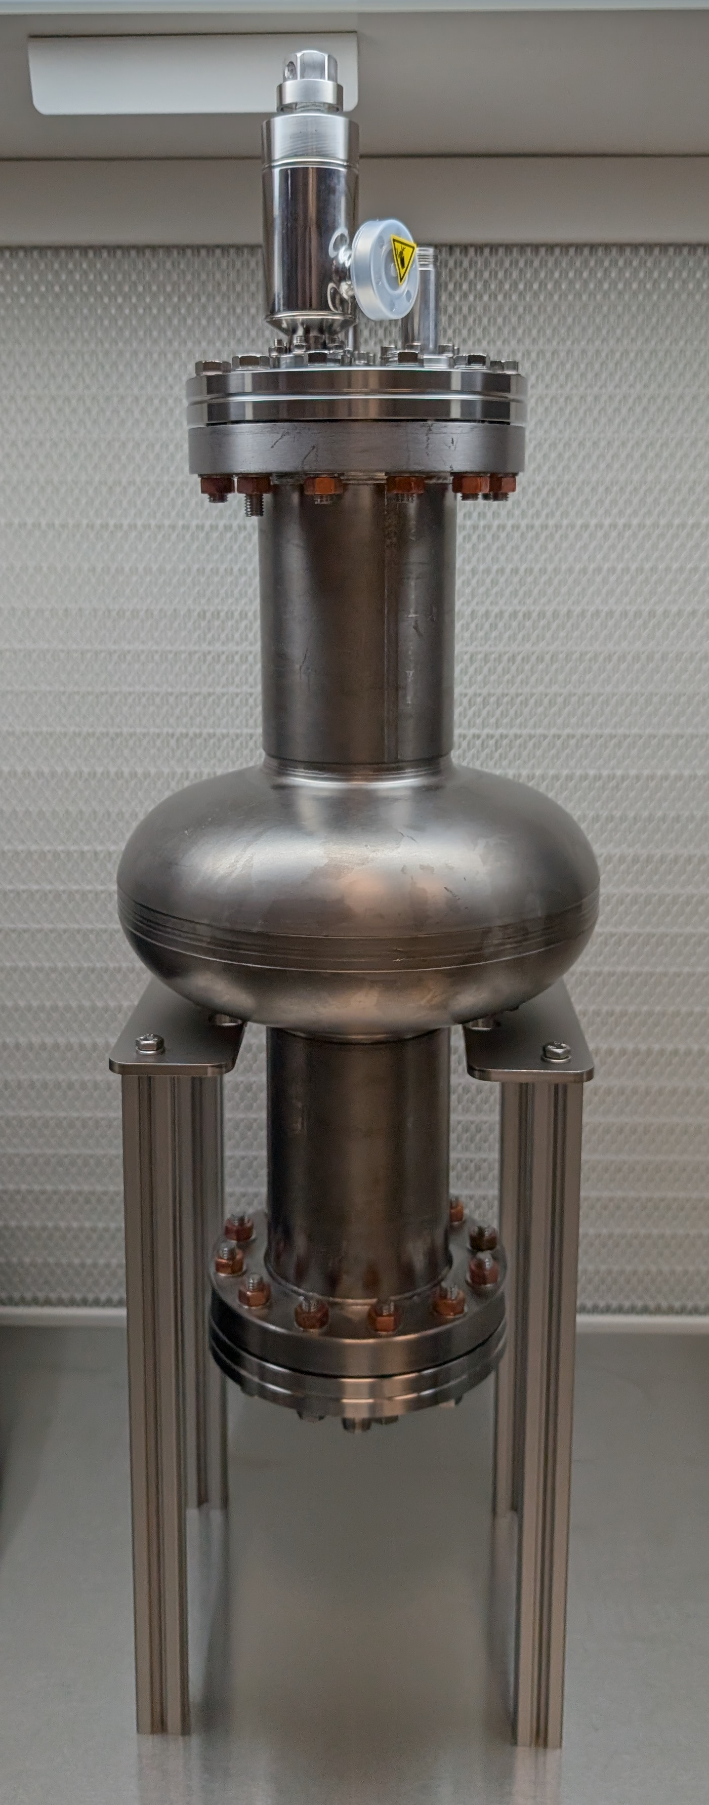
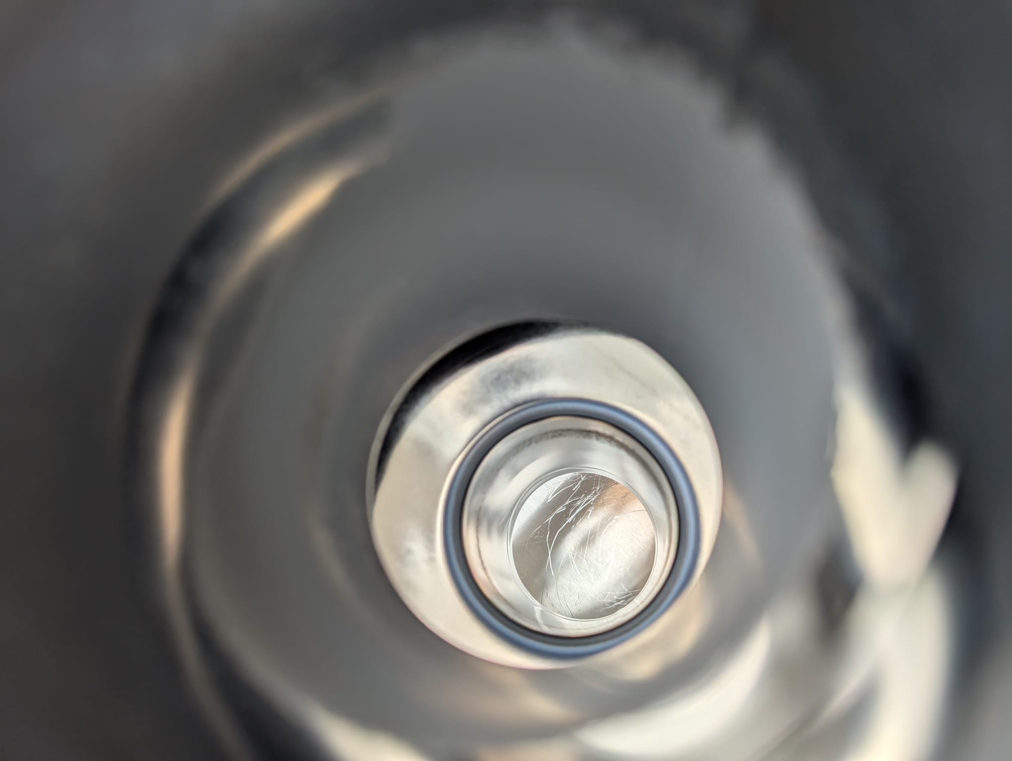
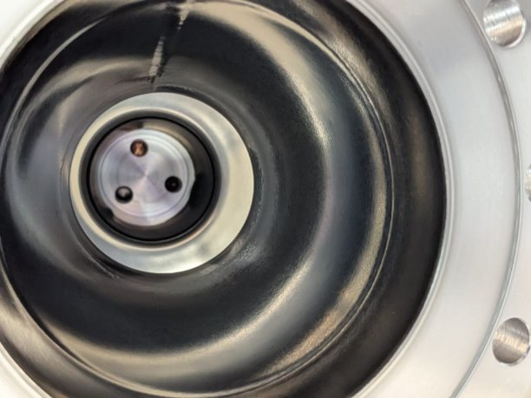
First Nb₃Sn on Nb cavity at STFC.
Inside the cavity after deposition
After some test depositions the first 1.3 GHz Nb has been coated with Nb₃Sn.
After visual inspection, the cavity was prepared for testing in an ISO 4 cleanroom environment.
The cavity transported to HZB for testing.

Slide 15
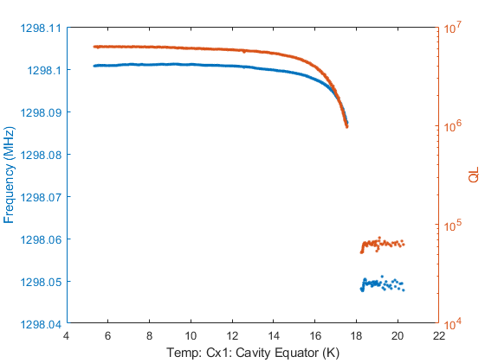
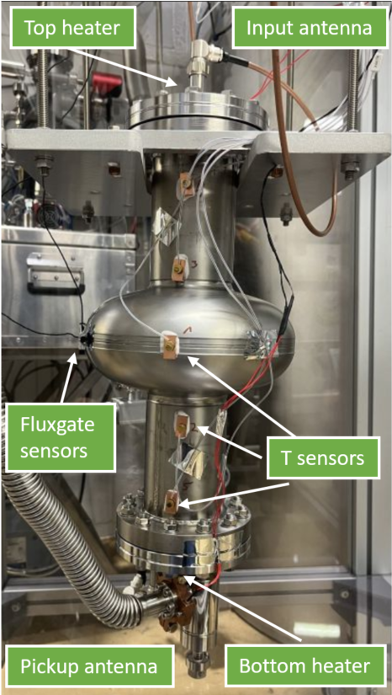
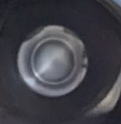
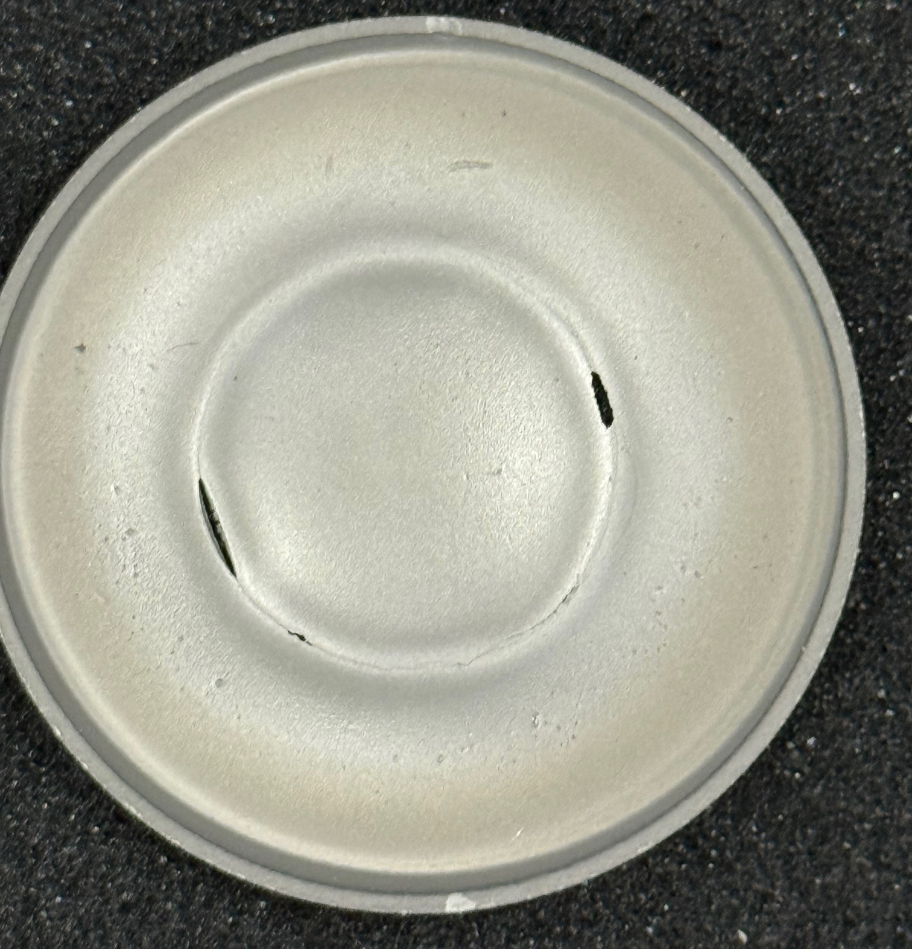
RF Test At HZB
No thermo-currents were recorded with the azimuthally placed sensors.
While the Tc was at 18.1 K it only achieved a Q₀ of 8 x 10⁶
No Tc of Nb was detected: Possibly cavity fully coated.
Poor Q factor:
  Cu contamination at surface layer due to diminishing target
  Present of other normal conducting material due to poor cavity handling.
  Or other reasons to be determined.
  No HPR after Deposition
Q₀ of 8 x 10⁶
R_{s} (5.3 K) ~ 43 μΩ, T_{c} ~ 18 K
Frequency and loaded quality factor vs temperature
Just after venting chamber
After target removed

Slide 16
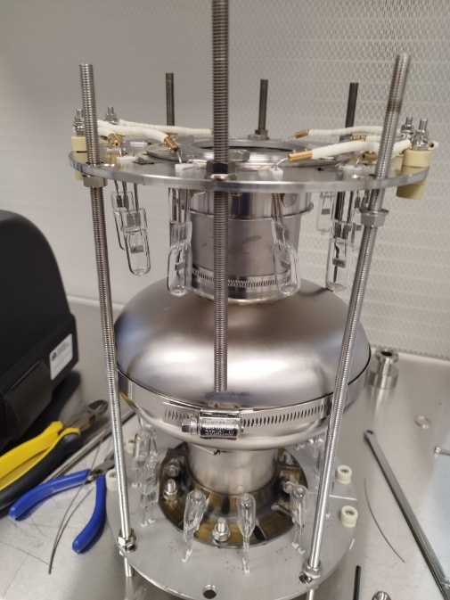
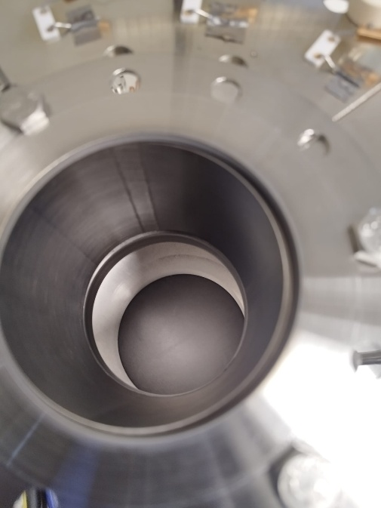
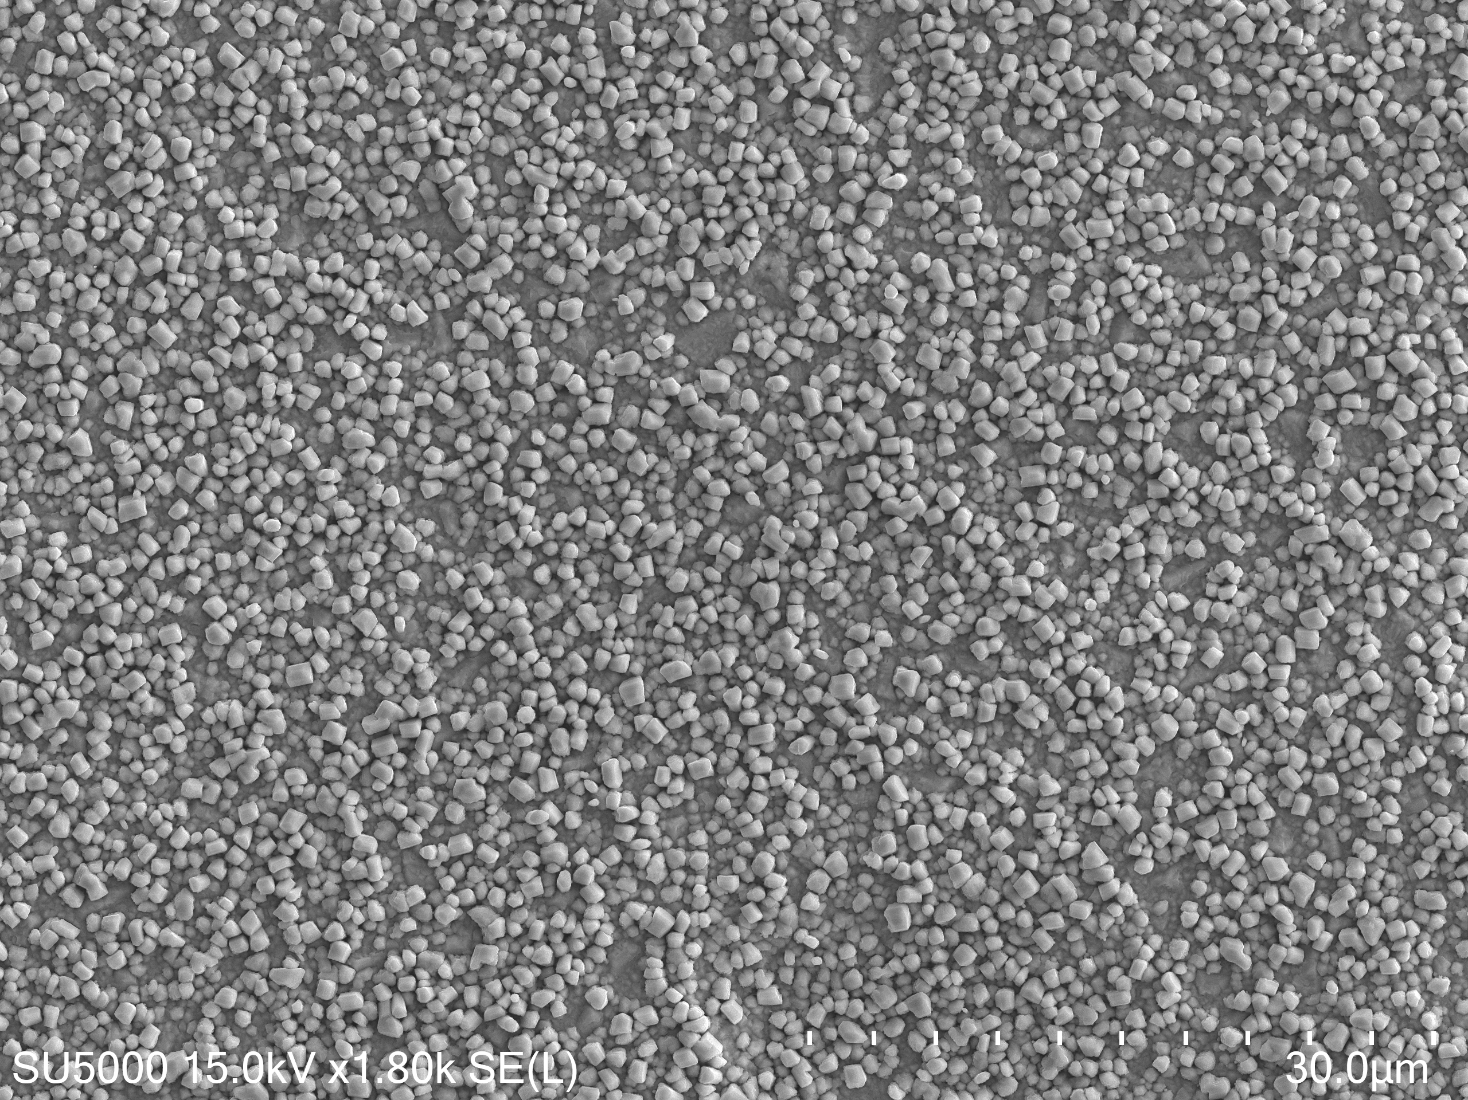
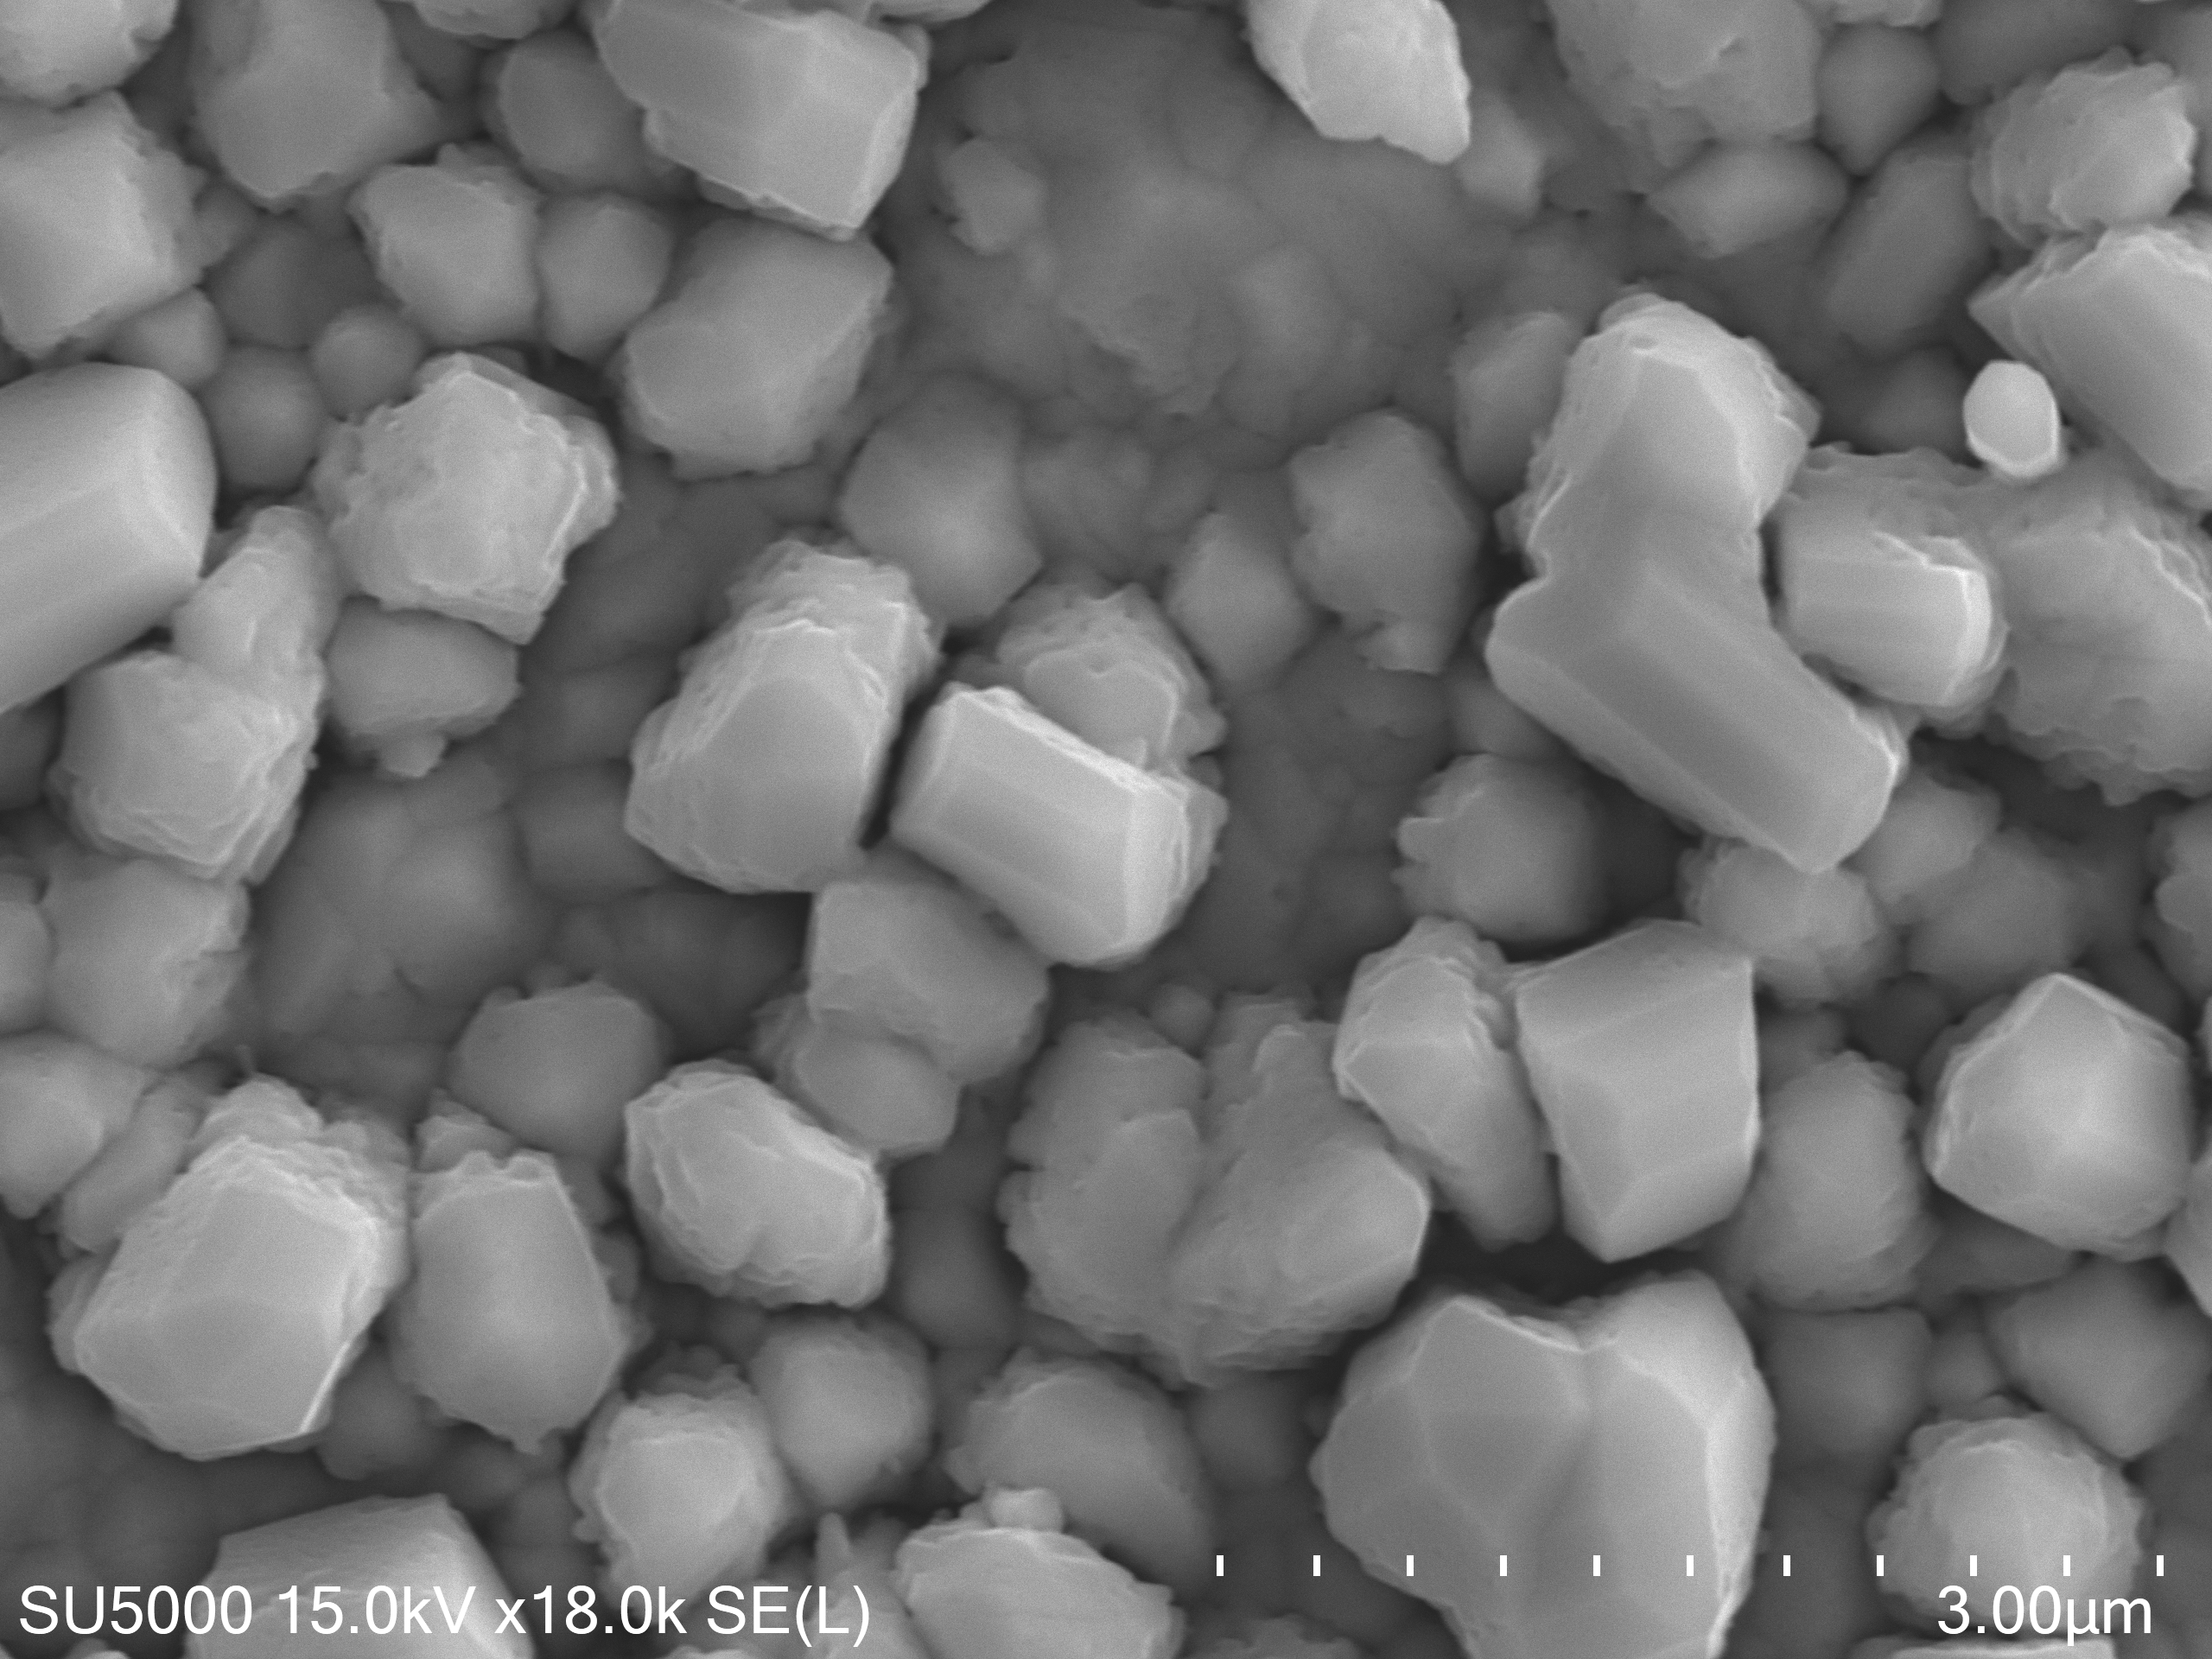
Nb Disk deposition inside segmented Nb Cavity C
Unfortunately, this resulted in mixed composition and non superconducting phase (high Sn content) gave
May be caused:
        By low temperature deposition below 600 C
Or target non homogeneity
R_{s} (5 K) ~ 1500 μΩ,
T_{c} ~ 18 K

Slide 17
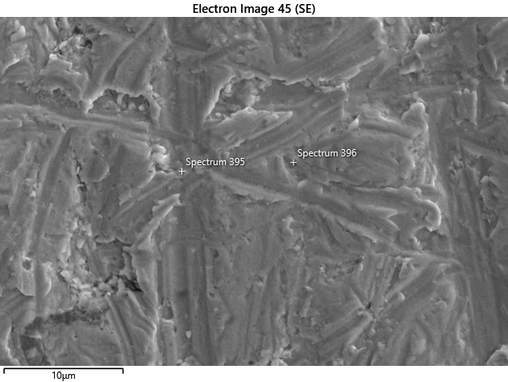
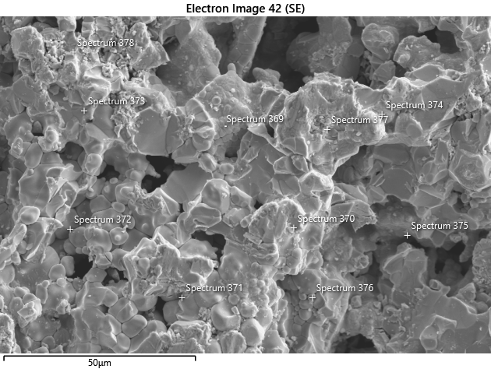
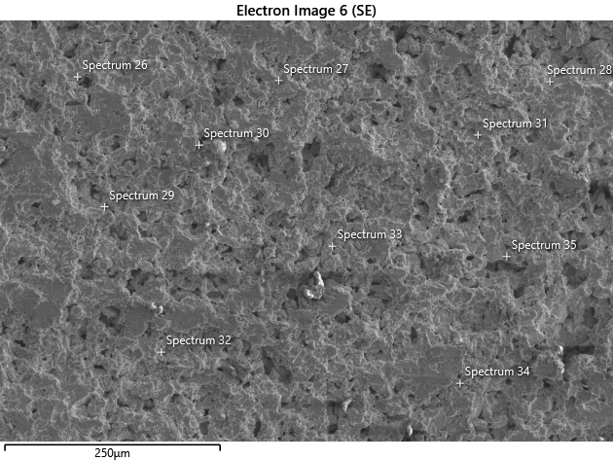
Pre and post Annealed targets
Pre annealed (Name) | Average Nb At% | Average Sn At % | No. of spectra
Site 4 | 70.13 | 29.87 | 10
Site 9 | 70.38 | 29.62 | 9
Post Annealed
Site 1 | 68.98 | 30.02 | 10
Site 2 | 66.82 | 33.18 | 9
Site 3 | 63.61 | 36.39 | 7
Nb 100 mm Holder
Center (Light spot) | 95.88 | 4.12 | 2
Edge (Dark) | 99.85 | 0.15 | 2

Slide 18
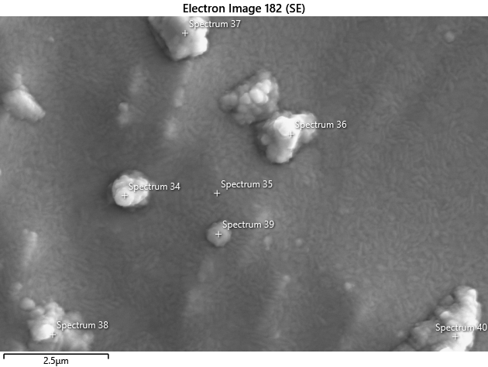
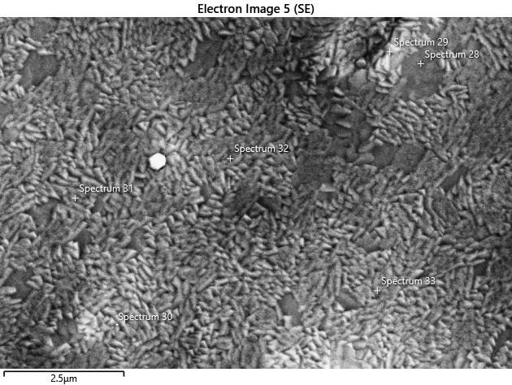


Comparison of Nb3Sn deposition from two different targets two different magnetron outside cavity
New target/HM magnetron
Old target/Com magnetron
Statistic Nb Sn
Max 76.43 26.83
Min 73.17 23.57
Average 75.38 24.62
Standard Deviation 0.76 0.76
Statistic Nb Sn
Max 78.05 24.11
Min 75.89 21.95
Average 76.93 23.07
Standard Deviation 0.72 0.72

Slide 19



Copper Cavity deposition facility
The new deposition facility currently being commissioned at Daresbury Laboratory. It will be a dedicated facility for the deposition of 1.3 GHz cavities (Both single and two-cell).
The facility will be situated in an ISO 6 cleanroom environment.
Initial deposition tests are being conducted using a Nb cylindrical target and mock Cu cavity components. Integrating the heating stage.
Cu mock cavity segments
Nb Cylindrical Magnetron

Slide 20
Summary
First 1.3 GHz Nb cavity was produced by magnetron sputtering, the major deliverable for IFAST and progression of ISAS.
Although full coverage and high T_{c} was achieved, it resulted in low Q₀ of 8x10⁶ and R_{s} (5.3 K) ~ 43 μΩ, T_{c} ~ 18 K
After optimising deposition parameters on flat samples further optimization is needed for cavity deposition
Additional processing may be needed to remove non-superconducting phase growth to achieve low surface resistance:
    Post thermal annealing
    Mechanical or chemical polishing
    Laser or plasma processing
The ultimate goal is to deposit Nb₃Sn on copper cavity:
    Do we need suitable buffer layer
    Do we need further optimisation from Nb to Cu cavity?
    Lack of cylindrical target further complicates the process.

