Slide 1
Towards Nb₃Sn coated copper cavities for energy efficient SRF application
Márton Major, Alexey Arzumanov, Amir Farhood, Dorothea Fonnesu,
Michaela Arnold, Norbert Pietralla, and Lambert Alff
Technical University of Darmstadt, Darmstadt, Germany
TTC 2026 Meeting, CEA-CNRS-Université Paris Saclay 2026, France
11. June 2026

Slide 2
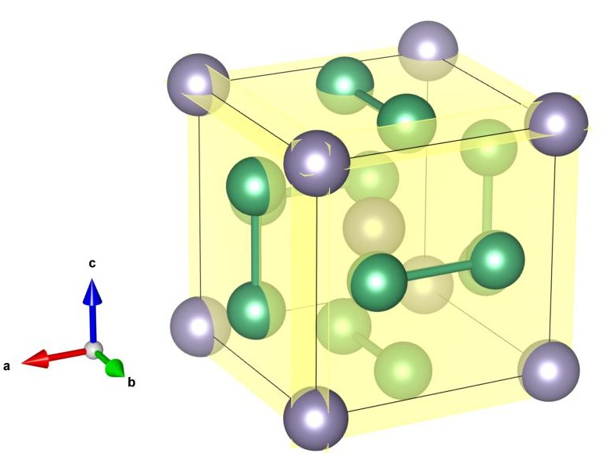
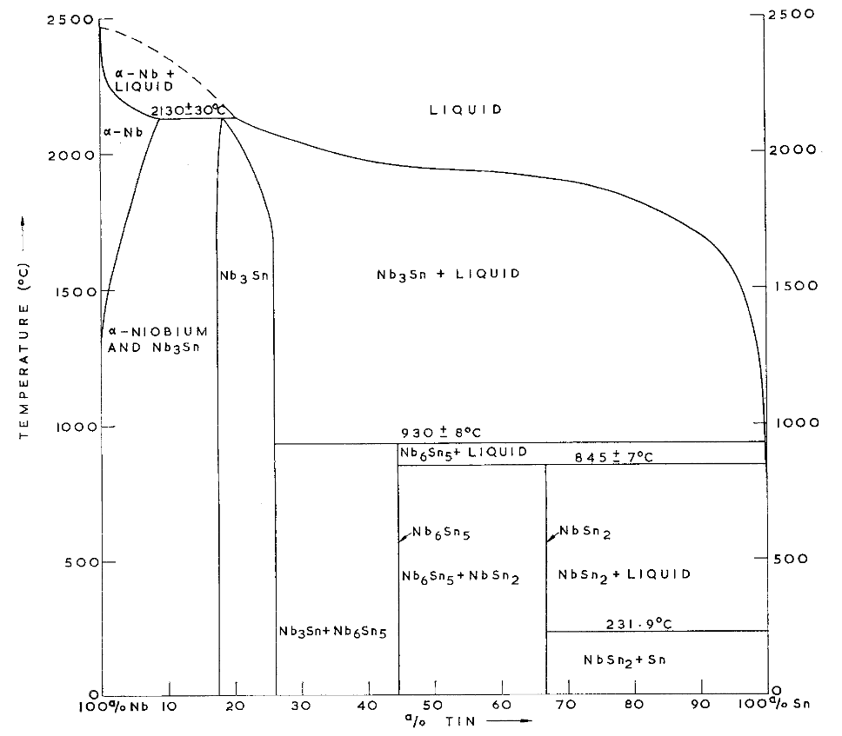
Introduction
Sn
Nb
Cubic A15 phase
T_{c} ~ 18.3K, brittle
Charlesworth, Macphail, Madsen, J Mat. Sci. 5 580 (1970) DOI: 10.1007/BF00554367

Slide 3
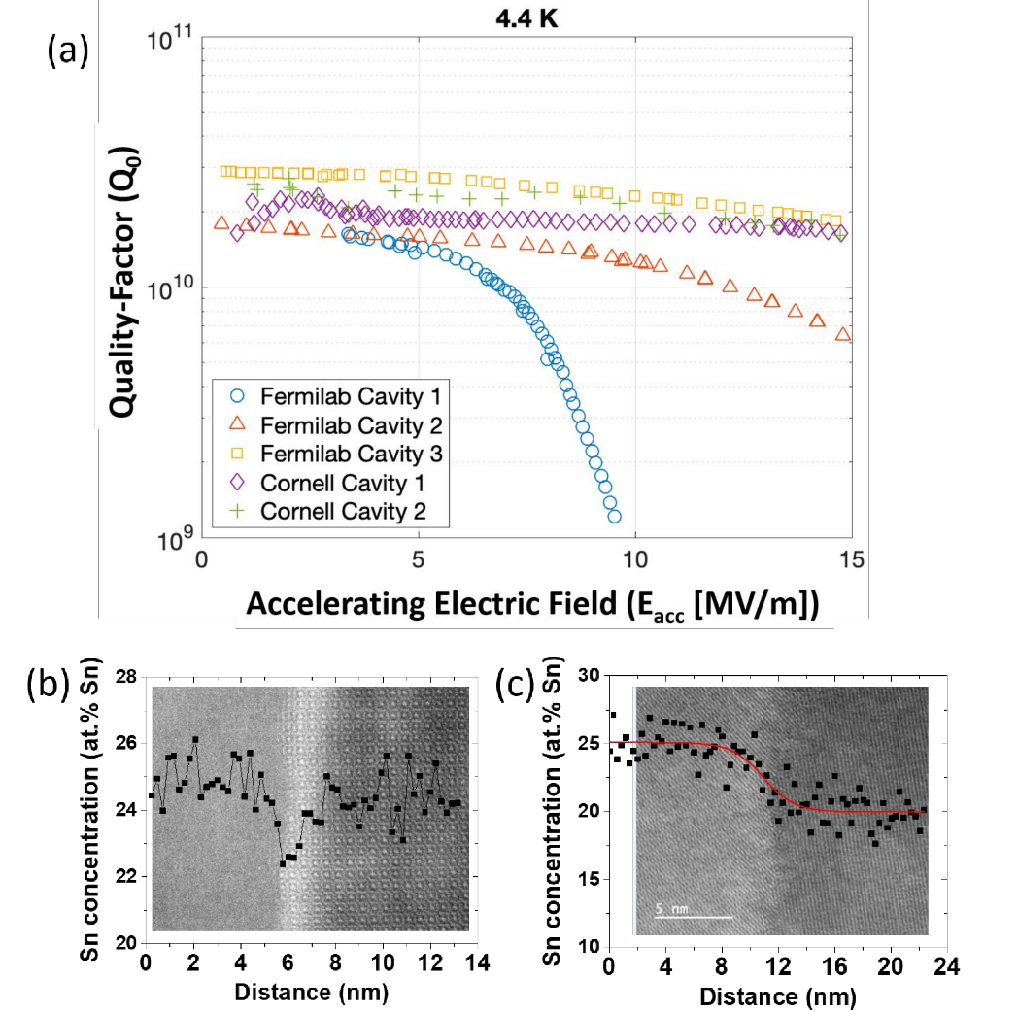
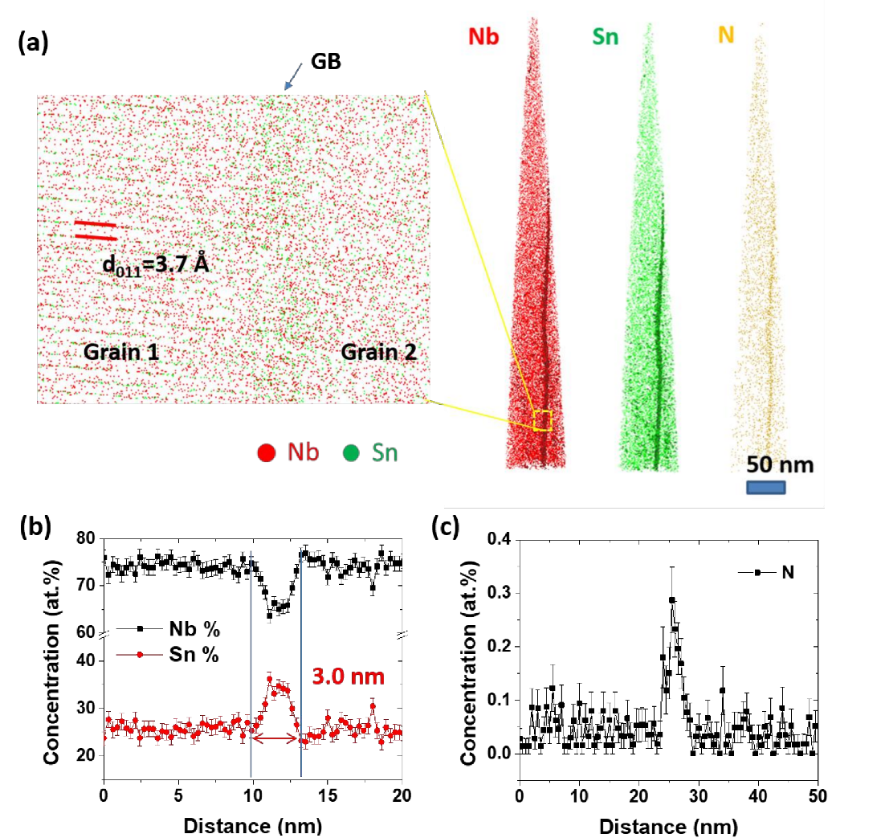
Motivation
Early quenching of Nb₃Sn coated cavities
Lee et al., Acta Materialia 188 155 (2020) DOI: 10.1016/j.actamat.2020.01.055

Slide 4
MEthod
Nb₃Sn co-sputtering
Nb₃Sn co-sputtering = same time deposition of two materials (here the elements Nb and Sn) from two independent sources (targets)
Heater
Nb₃Sn
Substrate
Nb
MFC
Butterfly valve
Argon
Exhaust
Nb Target
Sn Target
Schäfer et al., J. Appl. Phys. 128 133902 (2020) DOI: 10.1063/5.0015376

Slide 5
MEthod
Nb₃Sn co-sputtering at low substrate temperature (starting at 500 °C)
Heater
Nb₃Sn
Substrate
Nb
MFC
Butterfly valve
Argon
Direct synthesis of Nb₃Sn without annealing
Control of stoichiometry by sputtering rate and energy
Independence from substrate
Fast film growth by high sputtering rates
High kinetic energies form phase pure film at low deposition temperature (500 °C), compatible with Cu substrate
No tin segregation
Exhaust
Nb Target
Sn Target
Schäfer et al., J. Appl. Phys. 128 133902 (2020) DOI: 10.1063/5.0015376

Slide 6
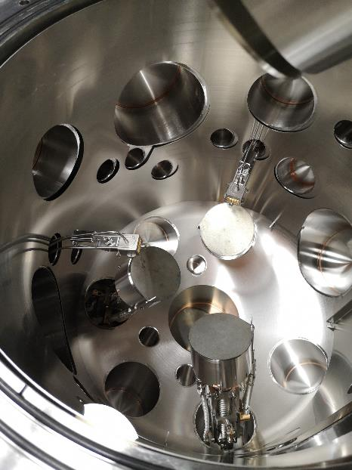
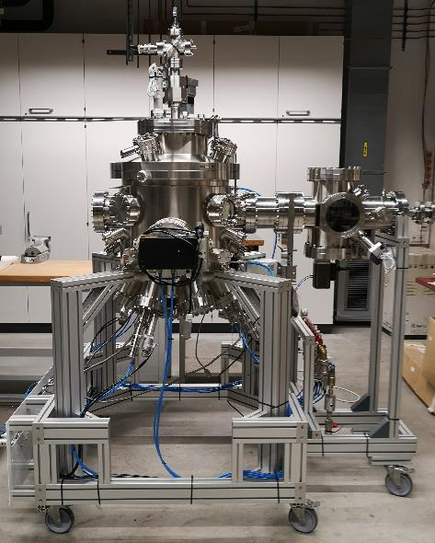
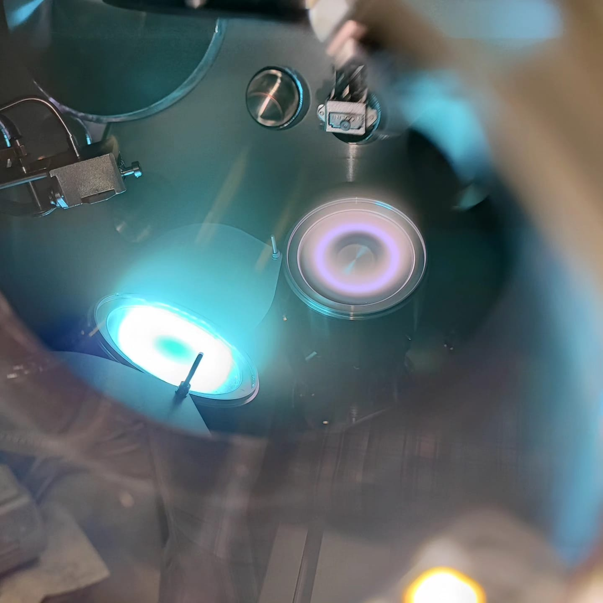
Equipment
Sputter chamber with up to three targets
Exchangeable sample holder for i) small flat samples, ii) smaller objects up to QPR cups and possible upgrade to iii) inner coating of complete 1.3 GHz single cell cavities
Sn
Nb

Slide 7
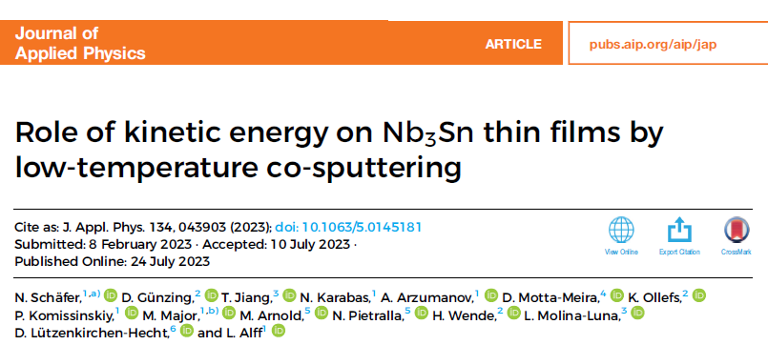
Results I
Grazing incidence (ω = 5°) XRD patterns of Nb₃Sn films grown on fused silica substrate. The sputtering power ratio (of Nb/Sn) was set to 5.25. Substrate temperature during growth was 320 °C.
Schäfer et al., J. Appl. Phys. 128 133902 (2020) DOI: 10.1063/5.0015376

Slide 8
Results II
Comparison of two Nb₃Sn films grown at 320 °C, measured at 4 K. The sample grown at high sputtering energies (30 W Sn/158 W Nb) shows almost no variation in critical current vs H, while the sample grown at low sputtering energies show a variation in critical current, typical for weak-link superconducting behavior.
Normalized resistance of Nb₃Sn films grown with different source power. Substrate temperature was 320 °C.
Schäfer et al., J. Appl. Phys. 134 043903 (2023) DOI: 10.1063/5.0145181

Slide 9
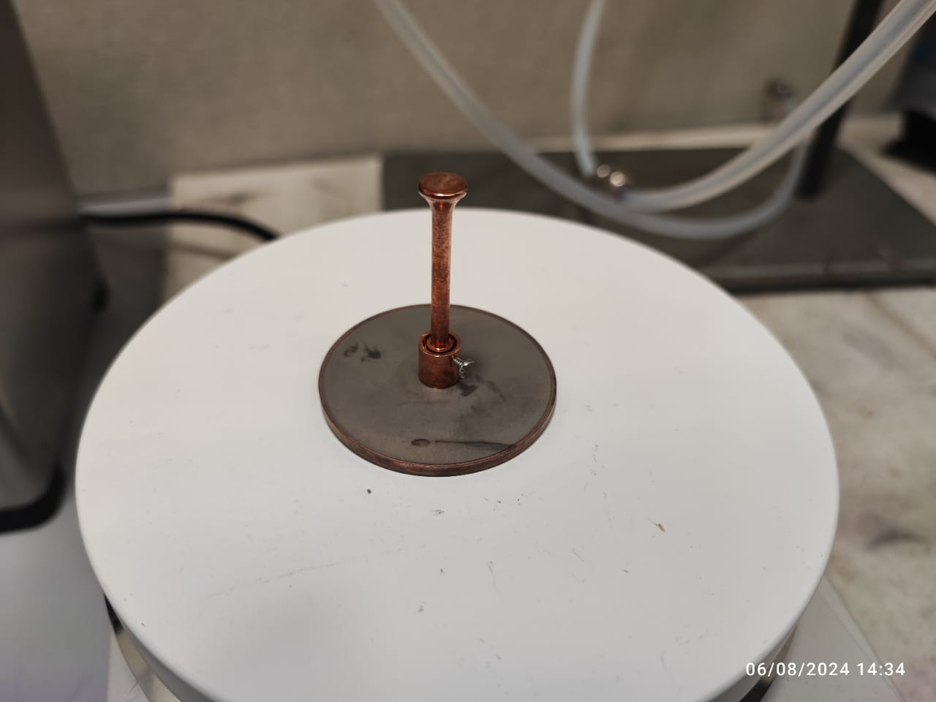
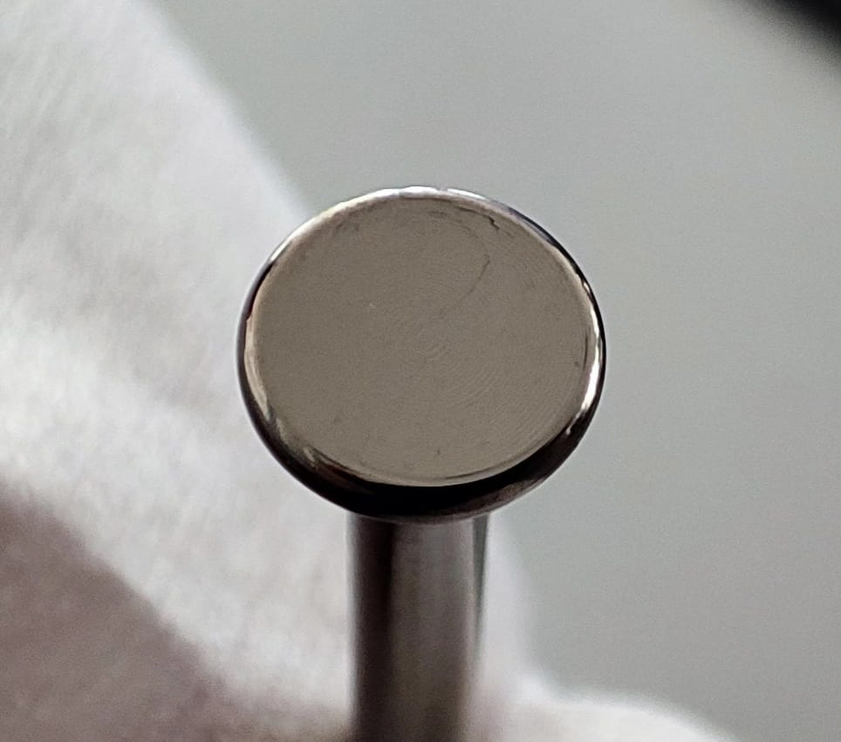
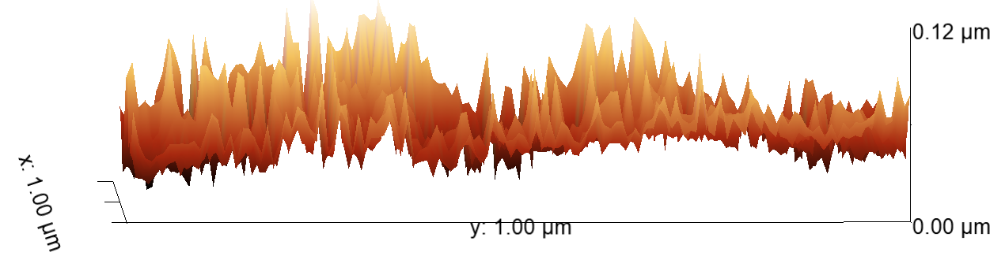
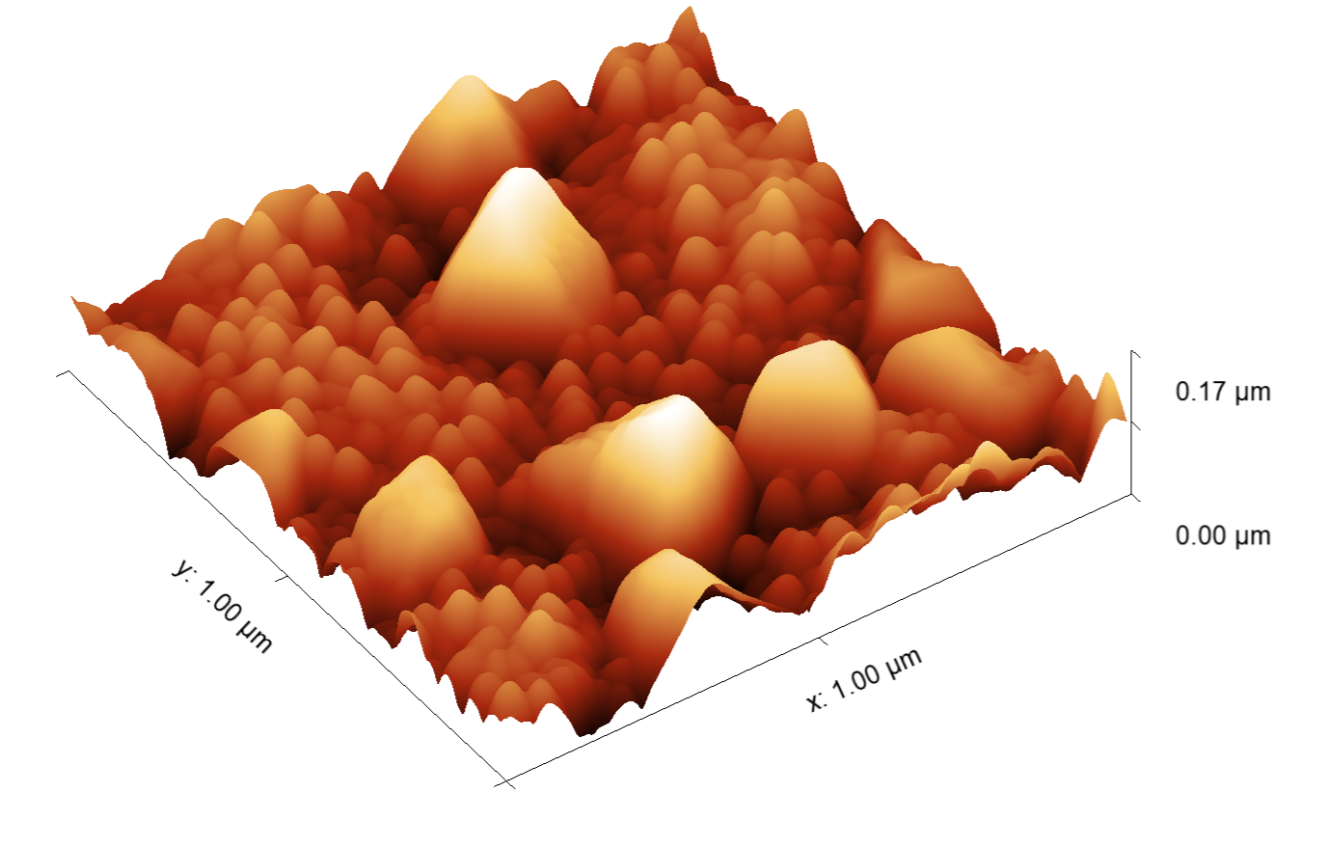
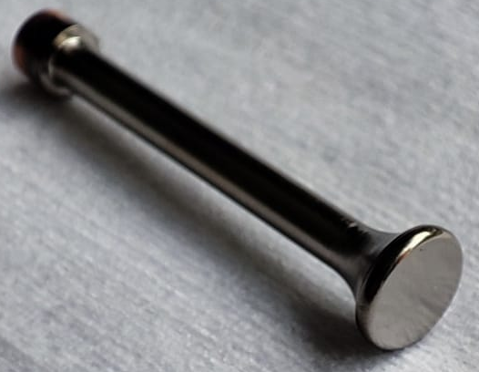
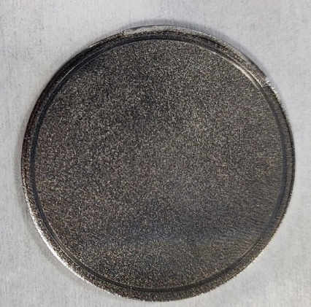
Nb₃Sn Coating
On copper HOM antenna
In cooperation with Johannes Gutenberg University of Mainz, Florian Hug’s group
Coating of Nb disc
In cooperation with University of Hamburg, Marc Wenskat
Roughness
before coating
(AFM)
Roughness
after coating
(AFM)
Plattner et al. IPAC ‘24 Nashville 2760 DOI: 10.18429/JACOW-IPAC2024-WEPS32
Wenskat et al., Physica C 632 1354694 (2025) DOI: 10.1016/j.physc.2025.1354694

Slide 10
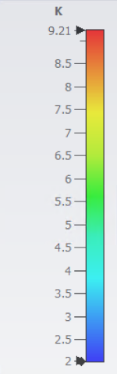
Nb₃Sn Coating
On copper HOM antenna
In cooperation with Johannes Gutenberg University of Mainz, Florian Hug group
On top T_{c,0} ≈ 14.5 K
At side T_{c,0} ≈ 14.0 K
Normalized voltage (shielding effect) on a coated Cu foil at the top of a dummy antenna
Thermal simulation with a static load of 330mW at the antenna tip. The temperature at the tip is with 9.21K, which is close to the critical temperature of Nb [1].
At bottom T_{c,0} ≈ 13.0 K
Conclusion: T_{C,0} > 13 K at every region of the surface
Plattner et al., IPAC’23 Venice 3029 DOI:10.18429/JACOW-IPAC2023-WEPA164
[1] Plattner et al., IPAC ‘24 Nashville 2760 DOI: 10.18429/JACOW-IPAC2024-WEPS32

Slide 11
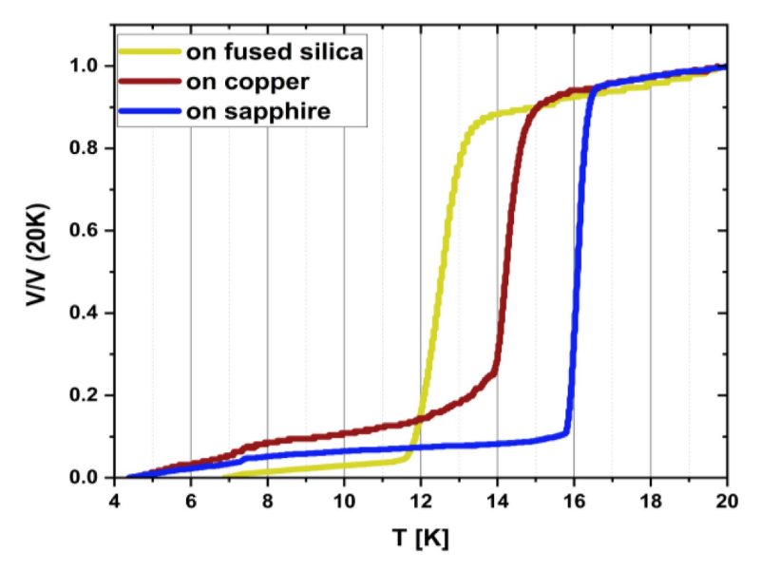
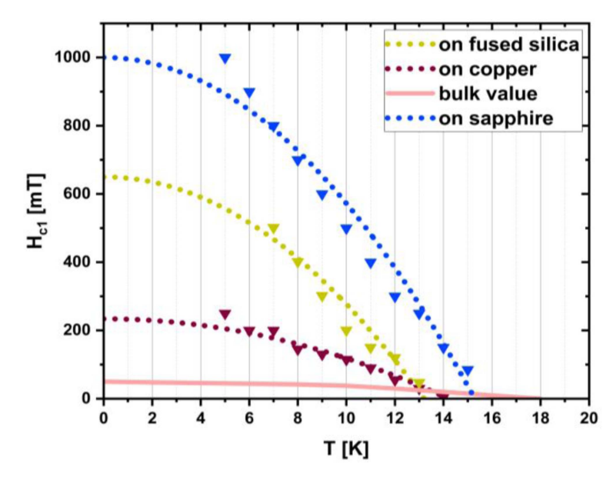
role of substrate
Critical temperature as shown by the shielding effect of thin films deposited on different substrates at a substrate temperature of 500 °C
Critical field H_{c1} determined from the lowest magnetization in magnetization versus external field measurements as a function of temperature
Farhood, Arzumanov, Major, Arnold, Pietralla, and Alff, IEEE Trans. Appl. Supercond. 36 7500607 (2026) DOI: 10.1109/TASC.2026.3662680

Slide 12
X-ray diffraction measurement
Critical temperature as shown by the shielding effect of thin films deposited on different substrates at a substrate temperature of 500 °C
XRD patterns of deposited Nb₃Sn films at 500 °C on different substrates
Farhood et al., IEEE Trans. Appl. Supercond. 36 7500607 (2026) DOI: 10.1109/TASC.2026.3662680

Slide 13
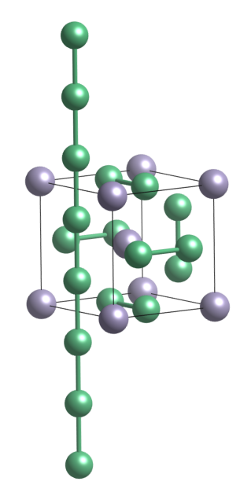
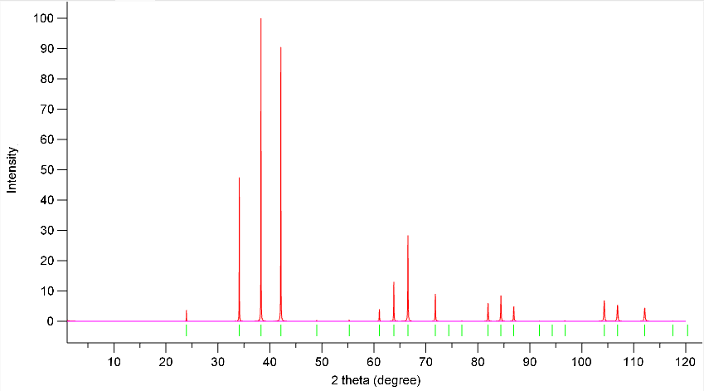

Nb₃Sn unit cell, powder XRD
210
Pm$\overline{\text{3}}$n (#223)
211
Nb: 6c
Sn: 2a
200
110
220
Calculated powder XRD pattern of Nb₃Sn (by VESTA)

Slide 14
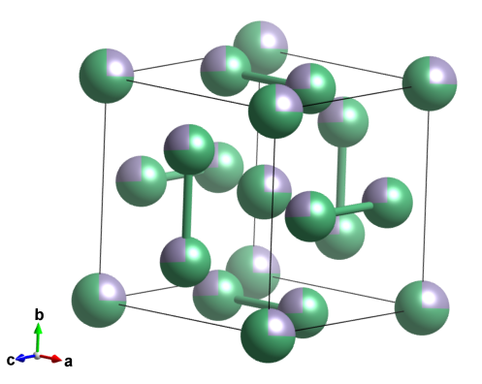
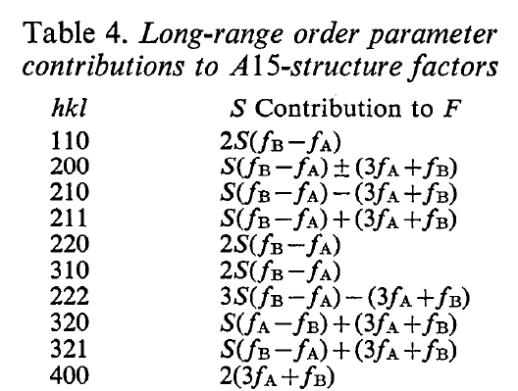
Long Range Order (LRO)
S: Bragg Williams long range order parameter. For complete order S = 1, all Nb atoms are on Nb position, all Sn on Sn position, no vacancy.
Complete disorder: S = 0.
Complete disorder (S = 0)
Complete order (S = 1)
Van Reuth and Waterstrat, Acta Cryst. B 24 186 (1968) DOI: 10.1107/S0567740868001937

Slide 15
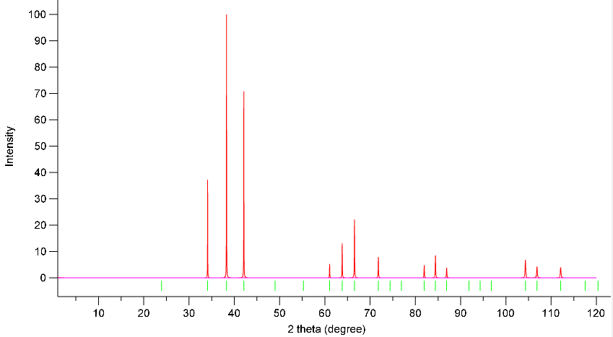
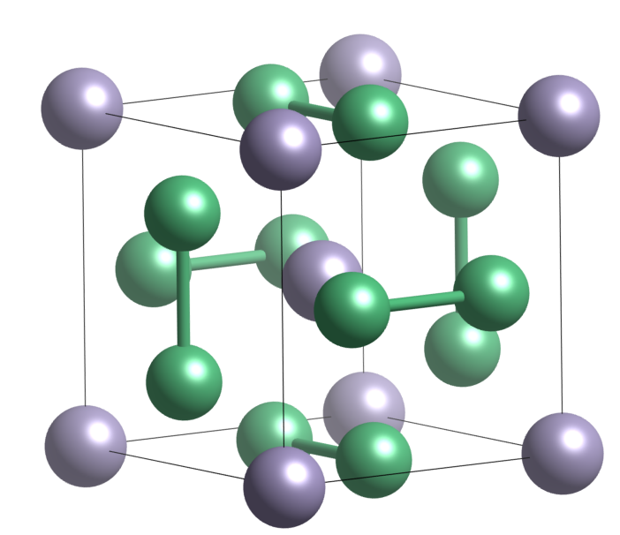
Long Range Order (LRO)
S: Bragg Williams long range order parameter. For complete order S=1, all Nb atoms are on Nb position, all Sn on Sn position, no vacancy.
Complete disorder: S=0.
disordered
ordered
210
211
200
110
220
Complete disorder (S = 0)

Slide 16
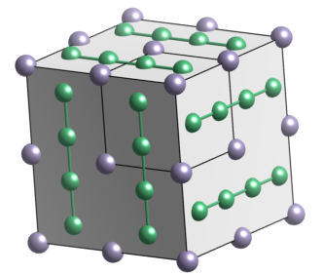
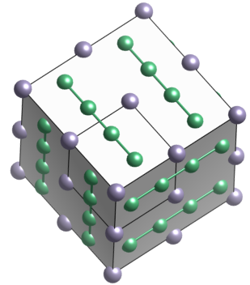
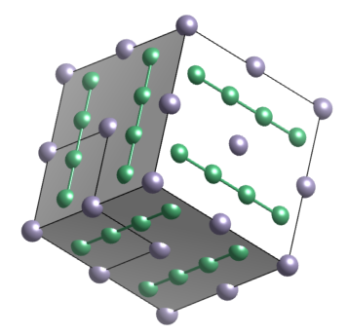
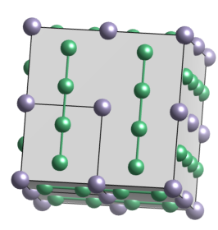
Preferred orientation (texture)
Texture
XRD peak intensities depend on
Structure factor (long range order)
Preferred orientation (texture)
Order

Slide 17
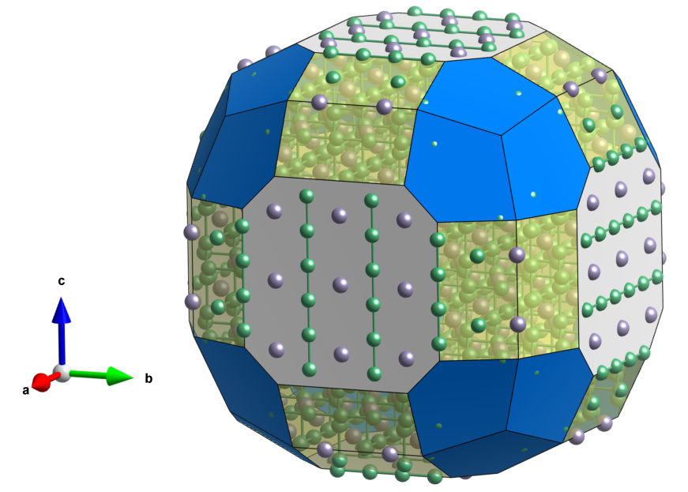
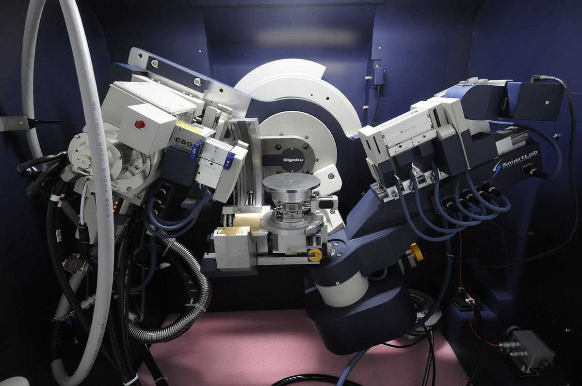
Peak – Plane
200 – (100)
210 – (210)
211 – (211)
Texture measurement
Peak | Plane | 2θ (deg)
200 | (100) | 33.89
210 | (210) | 38.06
211 | (211) | 41.85
210
211
200
Picture: Gabi Haindl
110
220

Slide 18
Peak – Plane
200 – (100)
210 – (210)
211 – (211)
Texture measurement
Peak | Plane | 2θ (deg)
200 | (100) | 33.89
210 | (210) | 38.06
211 | (211) | 41.85
210
211
200
110
220
XRD patterns of deposited Nb₃Sn films at 500 °C on different substrates
Powder XRD pattern of Nb₃Sn
Farhood et al., IEEE Trans. Appl. Supercond. 36 7500607 (2026) DOI: 10.1109/TASC.2026.3662680

Slide 19
Texture measurement on r-cut sapphire

Slide 20
Texture measurement on copper

Slide 21
Texture measurement on fused silica

Slide 22
ψ-scans (XRD on tilted sample)
Angle between (100) and (211) is 35.3°
On glass: strong (100) texture
On copper: no texture (polycristalline)

Slide 23
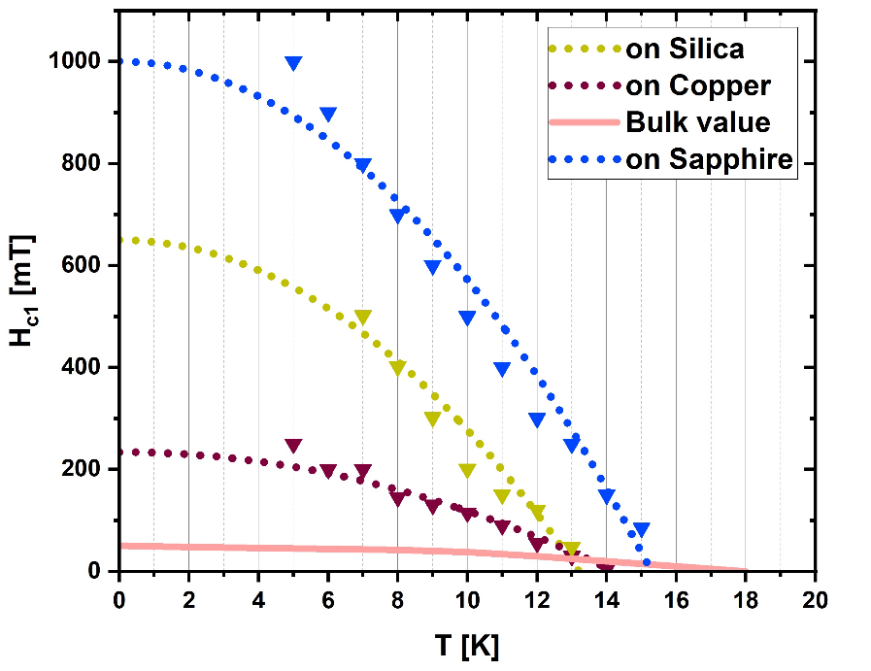
Conclusion
Critical temperature (shielding)
Critical field H_{c1}
XRD patterns of Nb₃Sn films
Conclusion: superconducting properties (T_{c} and H_{c1}) depend on microstructure of the deposited film, which is inherited from the substrate. Unexpected: on amorphous substrate (fused silica) strong (100) texture.
Next steps: check long range order for other substrates (single crystalline MgO), micro and macro strain (peak shift and broadening) as seen by XRD.
Final goal: Nb₃Sn coating on Cu with close-to-bulk superconducting properties by low-temperature co-sputtering.
A. Farhood, A. Arzumanov, M. Major, M. Arnold, N. Pietralla, and L. Alff, IEEE Trans. Appl. Supercond. 36 (2026) 7500607

Slide 24



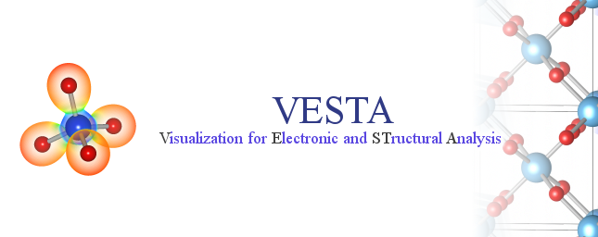


Acknowledgement
Thank you for your attention!
Funded by BMBF Project 05H21RDRB1 and the German Research Foundation (DFG) through grant GRK2128 (AccelencE)

