Slide 1
Optimization of Bronze-Route Nb₃Sn Films on Cu Substrates for Quadrupole Resonator (QPR) Testing
Ming Lu
11.06.2026
TTC2026 Meeting, France

Slide 2
Outline
1. Introduction of Nb₃Sn coatings via bronze route
2. Nb₃Sn QPR sample Fabrication and RF test
3. Small Sample Characterization and Analysis
4. Summary and Future work

Slide 3
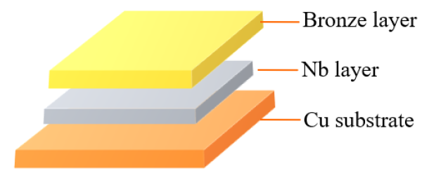
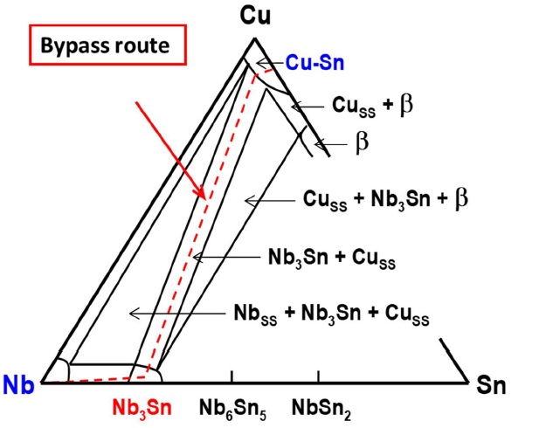
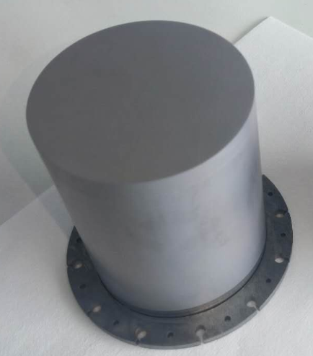
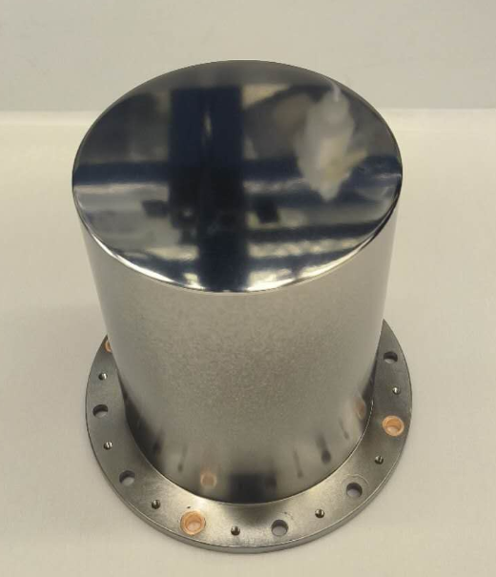
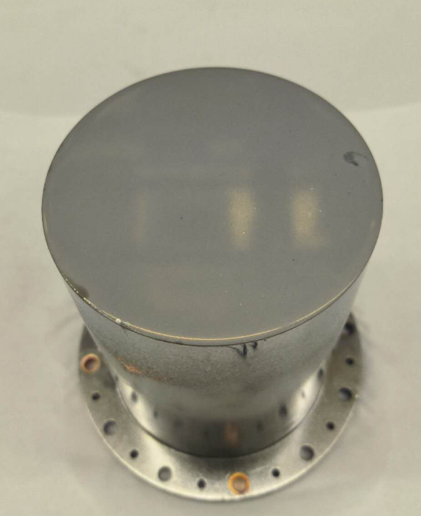
Introduction of Nb₃Sn/Cu by bronze route
Nb₃Sn film on Cu by bronze route
The optimization of Cu-based Nb₃Sn coating involves combining two key aspects: Nb₃Sn/Nb and Nb/Cu.
Precursor structure for bronze route
Nb₃Sn layer
Nb₃Sn layer
Nb layer
Nb layer
Nb substrate
Cu substrate
Cu substrate
Cu-based Nb₃Sn QPR sample preparation at HZB
Phase diagram of Nb-Cu-Sn ternary system at 700℃
bronze route
HiPIMS+baking
Nb₃Sn on Cu
Nb₃Sn on Nb
Nb on Cu
Cu-based Nb₃Sn: A suitable Nb barrier layer (>10 μm) is required to prevent Cu diffusion into Nb₃Sn, Sn diffusion into Cu, and Cu/Nb₃Sn lattice mismatch (low T_{c}).

Slide 4
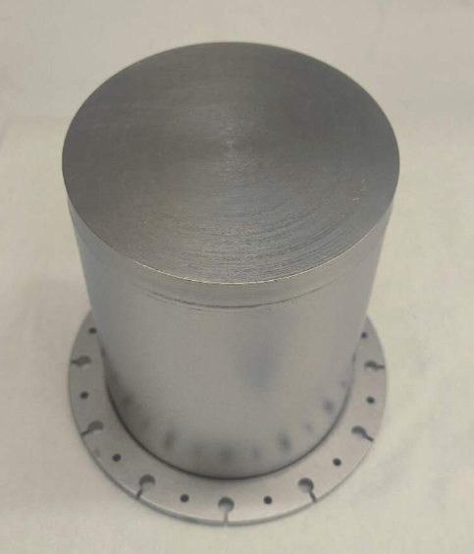
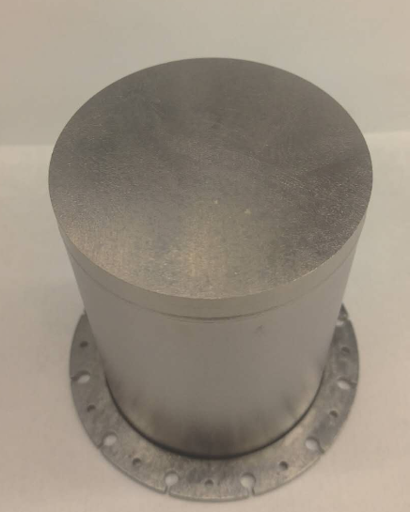
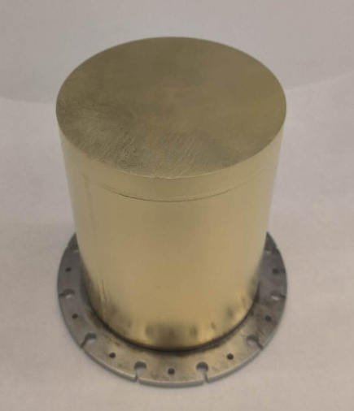
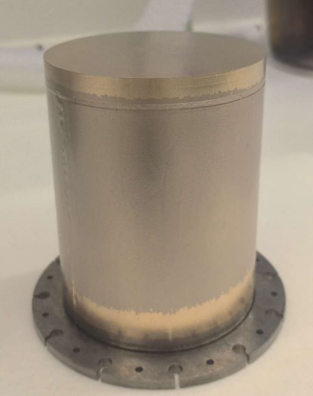
Nb₃Sn/Nb QPR sample fabrication process
Bronze layer
Nb₃Sn layer
Nb substrate
Nb₃Sn layer
Nb substrate
Nb substrate
Nb QPR sample
BCP 120μm + baking
Coating bronze
Synthesized Nb₃Sn
Removing bronze
Nb₃Sn/Nb preparation via bronze route
120 μm BCP + 700 °C (20h) baking to remove hydrogen and release stress;
Before bronze electroplating, the sample need activation and tilting to avoid trapped bubbles.
Increasing annealing temperature from 700 °C to 750 °C, enlarged Nb₃Sn grain size and reduced surface impurities.

Slide 5
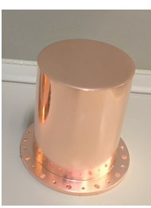
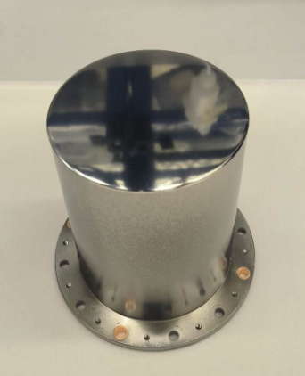
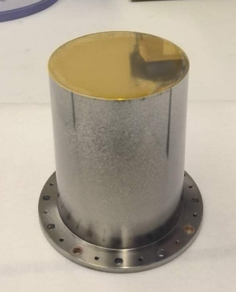
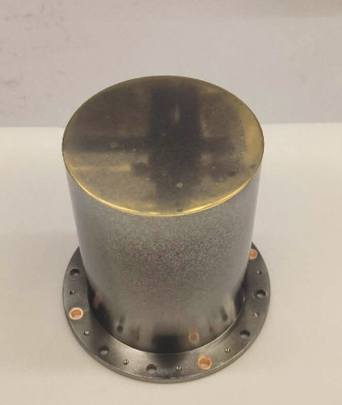
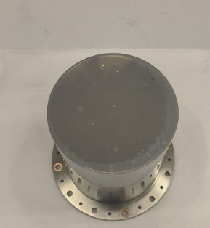
Nb₃Sn/Cu QPR sample fabrication process
Bronze layer
Nb layer
Nb₃Sn layer
Nb₃Sn layer
Cu substrate
Cu substrate
Cu substrate
Electropolishing Cu
Sputtering Nb
Coating bronze
700℃ Heat treatment
Removing bronze
Nb₃Sn/Cu preparation via bronze route
30 μm EP + 700 °C (20h) baking to increase the Nb layer density and release stress;
Due to the thin Nb film at the bottom (<1 μm), the bronze layer was deposited only on the top surface.
The sample still need activation and tilting to avoid surface trapped bubbles.

Slide 6

Nb₃Sn QPR sample R_{s}-T test comparison
Sebastian Keckert
Nb₃Sn on Nb
Nb₃Sn on Cu
Corresponds to $Q_{0}={10}^{10}$
R_{s}=17.1 nΩ @4 K, 20 mT, 417 MHz
R_{s}=46.0 nΩ @4 K, 20 mT, 413 MHz
At 4 K, the Cu-substrate Nb₃Sn sample exhibit an R_{s} value 29 nΩ higher than that of the Nb-substrate Nb₃Sn sample. Both samples show severe Q-slope, and simplified BCS model fitting was performed.

Slide 7

Nb₃Sn QPR sample R_{res} fitting comparison
Nb₃Sn on Nb
Nb₃Sn on Cu
R_{res}=16.04 nΩ @ 20 mT, 417 MHz
R_{res}=36.37 nΩ @ 20 mT, 413 MHz
Compared with the Nb-substrate sample, the Cu-substrate Nb₃Sn shows ~20 nΩ higher R_{res} at 20 mT, a lower Δ across all fields, and a smaller A parameter with weaker field dependence.

Slide 8
Nb₃Sn QPR sample thermal cycle comparison
Nb₃Sn on Nb
Nb₃Sn on Cu
ΔR_{s}=1.5 nΩ @ 4K, 20 mT, 417 MHz
ΔR_{s}=0.8 nΩ @ 4K, 20 mT, 413 MHz
The both R_{s}​ shows only a minor dependence on the cooling rate, indicating that R_{s}​ via bronze route is not sensitive to the thermal cycling conditions.

Slide 9
Nb₃Sn QPR sample penetration depth comparison
Nb₃Sn on Nb
Nb₃Sn on Cu
λ(0) = 166.78 ± 3.91 nm
T_{c} = 18.026 ± 0.025 K
λ(0) = 123.6± 5.4nm
T_{c} = 14.71± 0.06 K
Compared with the Nb-substrate Nb₃Sn (18.0 K), the Cu-substrate sample shows a lower λ(0) and lower T_{c} (14.7 K).

Slide 10
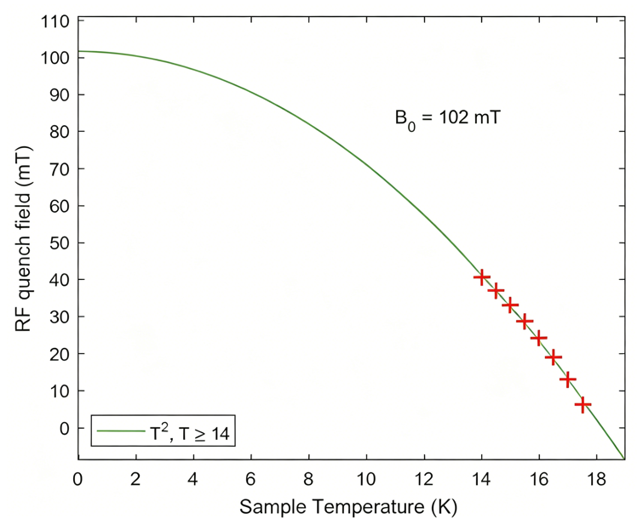
Nb₃Sn QPR sample critical field comparison
B₀=56.3mT
Nb₃Sn on Nb
Nb₃Sn on Cu
Sebastian Keckert
The temperature-dependent quench field data near T_{c} was described by a T² fit.
The Cu-substrate Nb₃Sn exhibits a lower B_{c}(0) (56.3 mT) compared with Nb-substrate Nb₃Sn (102 mT).

Slide 11
Outlines
1. Introduction of Nb₃Sn coatings via bronze route
2. Nb₃Sn QPR sample Fabrication and RF test
3. Small Sample Characterization and Analysis
4. Summary and Future work

Slide 12
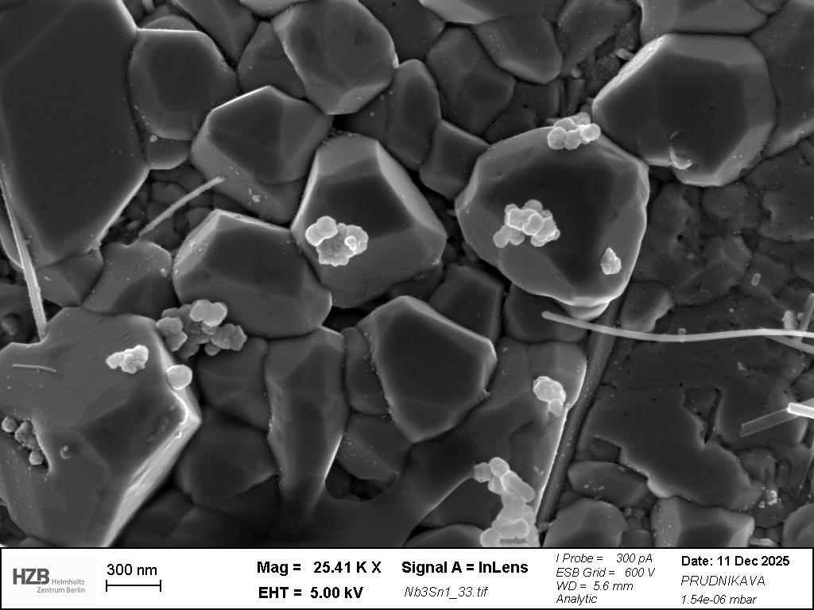
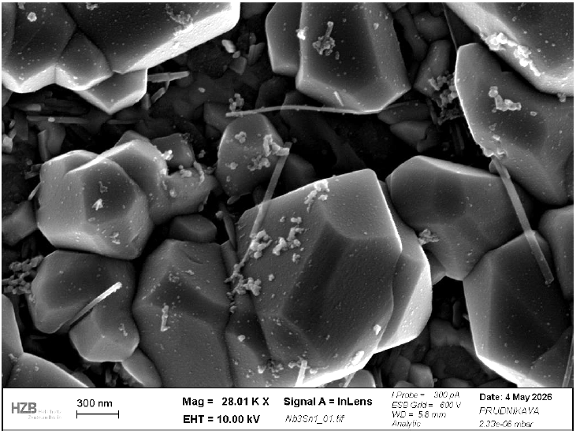
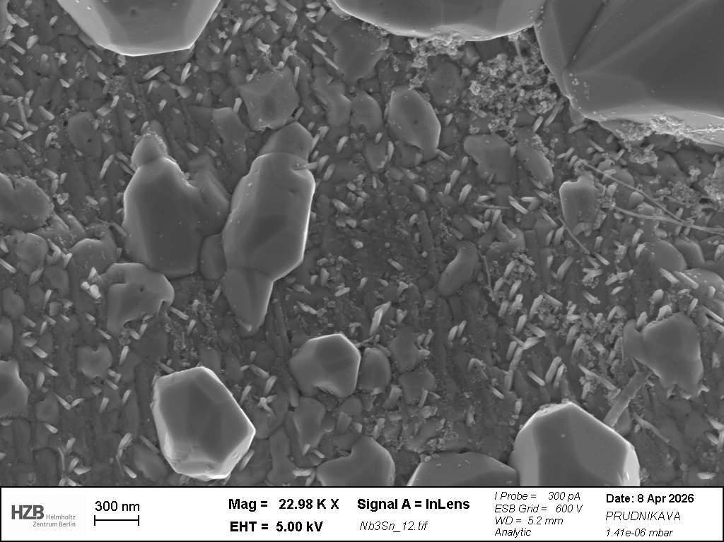
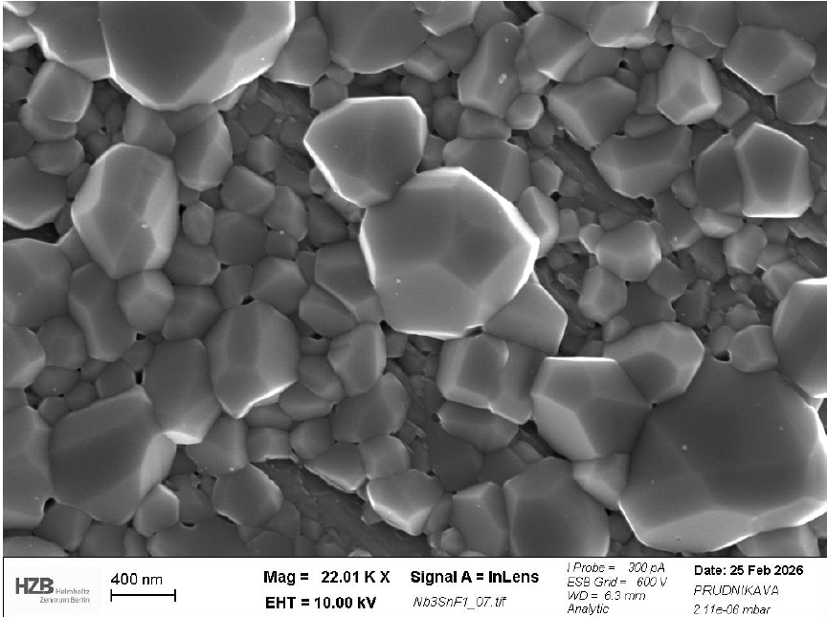
SEM characterization of Cu-based Nb₃Sn
Nb₃Sn on Cu
Nb₃Sn on Cu
Several problems on Nb₃Sn/Cu:
Copper particle contamination – removable by aqua regia.
Nanofiber contamination – likely from O (Nb layer) and P (bronze layer) impurity precipitation after heat treatment; not observed on Nb substrate samples; under investigation.
Nb oxide contamination – removable by 4% HF + H₂SO₄ solution.
Nb₃Sn on Cu
Nb₃Sn on Nb
Alena Prudnikava

Slide 13
Upgrade of Cu-based Nb₃Sn coating recipes
Step | Process | Original Parameters | Upgrade Parameters
1 | Mechanical polishing | Up to 100 µm removal | Up to 100 µm removal
2 | Degreasing | 1% Citranox®, 1 h | 1% Citranox®, 1 h
3 | Cu Electropolishing (EP) | ≈30 µm | ≈30 µm
4 | HiPIMS Nb (sputtering) | Tsub ≈ 180 °C, Ar = 2 Pa, Power = 600 W, Thickness ≈ 10 µm | Tsub ≈ 180 °C, Ar = 0.8 Pa, Power = 400 W, Thickness ≈ 10 µm
5 | High-temperature baking | 700 °C, 20 h | 700 °C, 20 h
6 | Bronze electroplating | ≈10 µm bronze | ≈10 µm bronze
7 | Vacuum Heat treatment | 700 °C, 30 h | 750 °C, 30 h
8 | Surface bronze removal | Aqua regia about 5 min | Aqua regia about 10 min
Optimized steps 4 (denser Nb barrier layer), 7 (large grain size) and 8 (fewer impurities):
Sample 1: baseline process, Nb₃Sn/Nb/Cu ≈ 1.0 µm / 10 µm / 3 mm
Sample 2: optimized steps 4+7+8, Nb₃Sn/Nb/Cu ≈ 1.0 µm / 10 µm / 3 mm

Slide 14
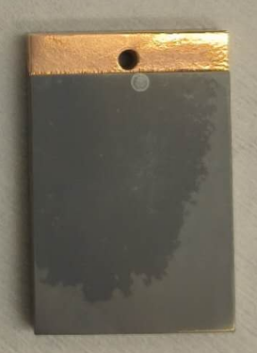
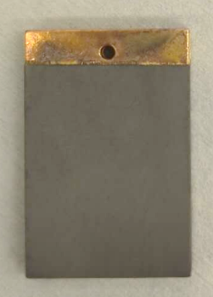
PPMS characterization of Cu-based Nb₃Sn
Origin Nb₃Sn on Cu substrate
New Nb₃Sn on Cu substrate
Baking the Nb film (HiPIMS) at 700℃(20h) and then increase heat treatment of bronze route at 750℃ can increase the T_{c} (15.0 K->16.1 K).

Slide 15
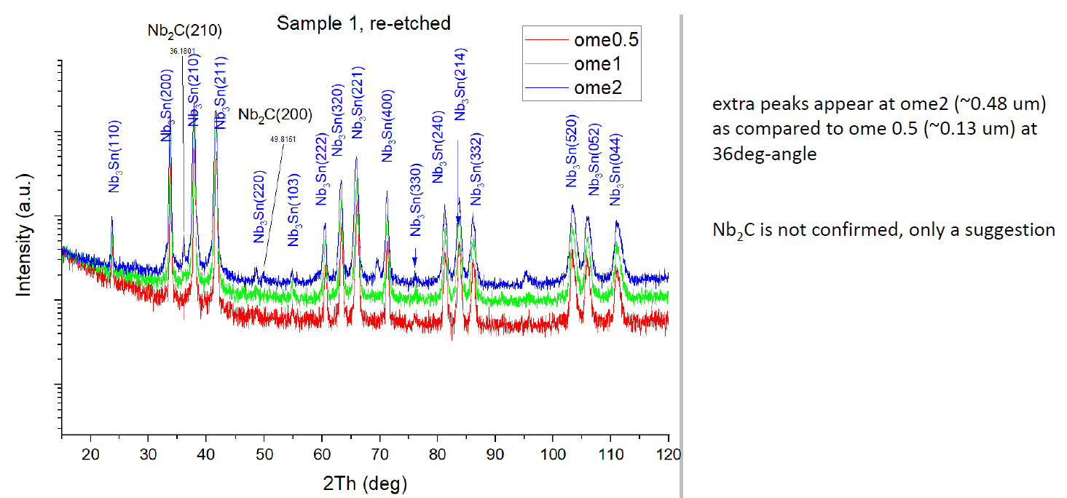
GIXRD characterization of Cu-based Nb₃Sn
GIXRD only detects Nb₃Sn phase.
Other impurities are below the detection limit or amorphous.
New Nb₃Sn on Cu substrate
Cu,CuO_{x}
NbO_{x},SnO_{x},C-H
Nb₃Sn layer
NbSn₂
Nb barrier layer
GIXRD
Alena Prudnikava
Cu substrate

Slide 16
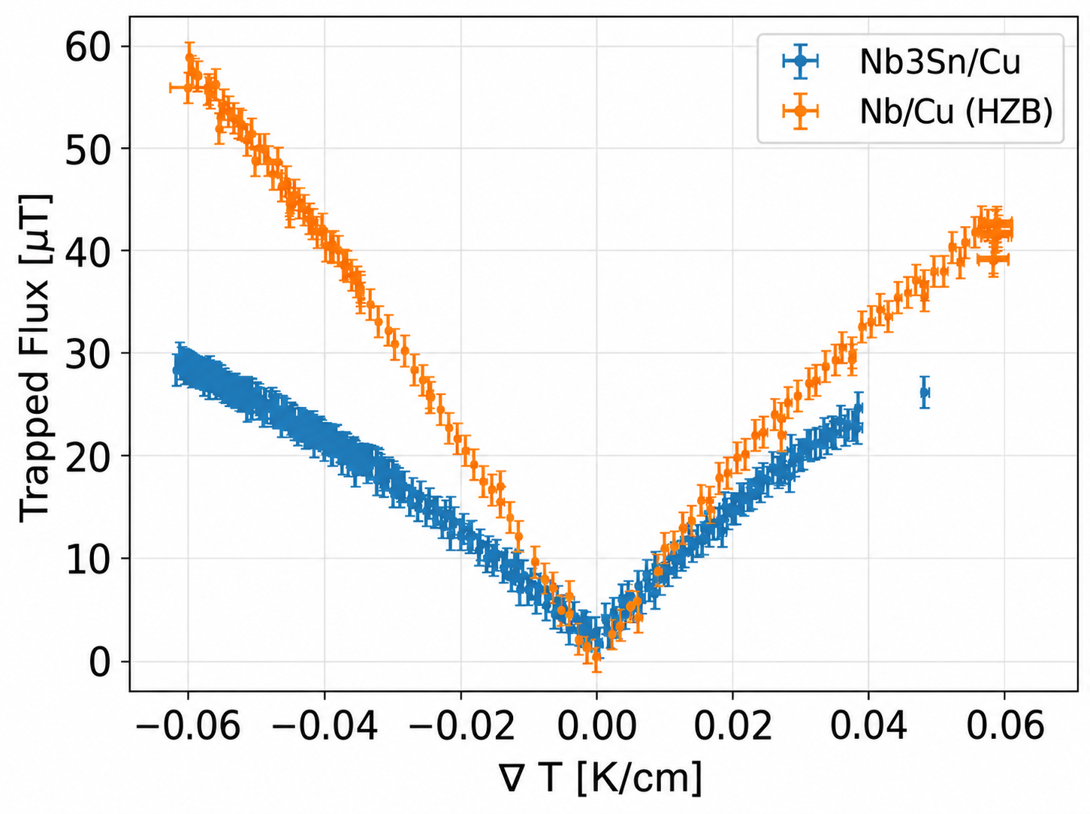
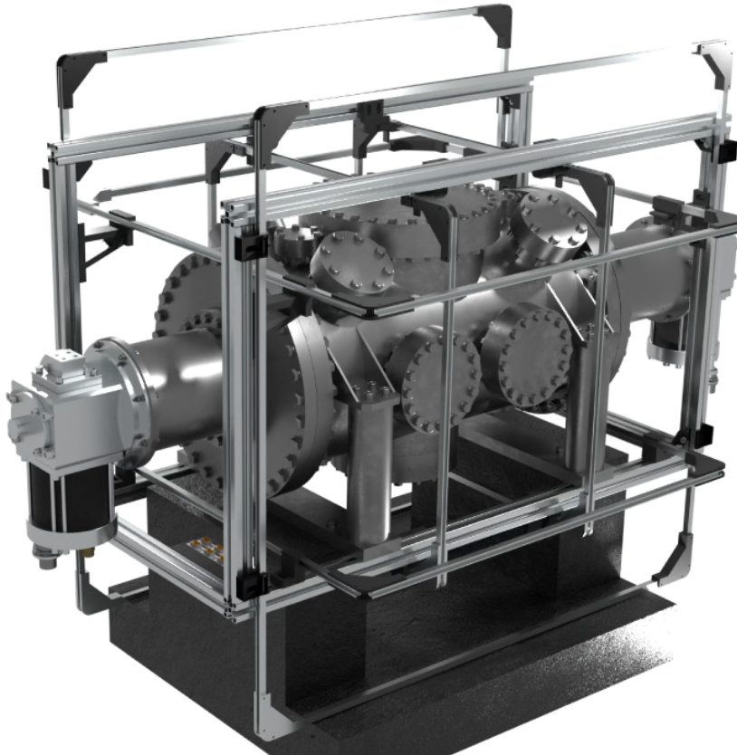
Thermal current test of Cu-based Nb₃Sn surface
Comparison with previous results
New Nb₃Sn on Cu substrate
F. Kramer,
SRF2025
Felix Kramer
CRAFT Test conditions: Zero field cooled, Plot trapped flux magnitude of center sensor versus temperature gradient during cooldown (CRAFT details: Alex Cierpka, TTC2026 WG1 S4).
Under the 0.05 K/cm temperature gradient, flux trapping in the new sample decreased from 200 μT to 25 μT, even below Nb films (35 μT), indicating suppressed thermoelectric currents due to improved coating homogeneity and weaker flux pinning.

Slide 17
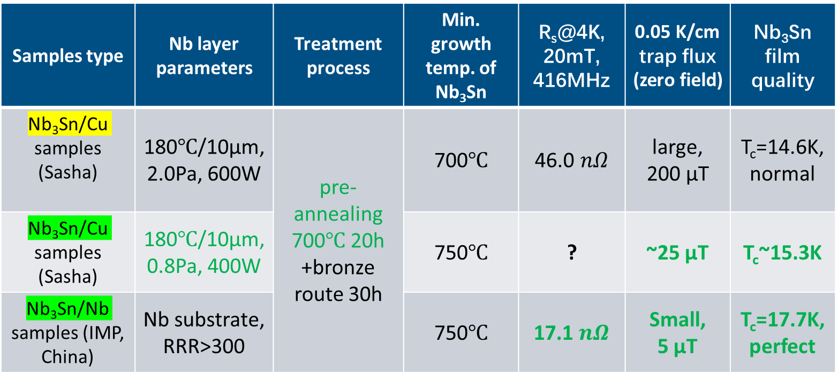
Analysis of Cu-based Nb₃Sn coating recipes
Increasing the niobium barrier layer’s density or thickness improved the Nb₃Sn film quality on copper, approaching the quality of Nb₃Sn on high-purity Nb.
Samples type | Nb layer parameters | Treatment process | Min. growth temp. of Nb₃Sn | R_{s}@4K, 20mT, 416MHz | 0.05 K/cm trap flux (zero field) | Nb₃Sn film quality
Nb₃Sn/Cu samples (Sasha) | 180℃/10μm, 2.0Pa, 600W | pre-annealing 700℃ 20h +bronze route 30h | 700℃ | 46.0 $nΩ$ | large, 200 μT | T_{c}=14.6K,normal
Nb₃Sn/Cu samples (Sasha) | 180℃/10μm, 0.8Pa, 400W |  | 750℃ | ? | ~25 μT | T_{c}~15.3K
Nb₃Sn/Nb samples (IMP, China) | Nb substrate, RRR>300 |  | 750℃ | 17.1 $nΩ$ | Small, 5 μT | T_{c}=17.7K,perfect
SUST, DOI: 10.1088/1361-6668/ae496a
Origin Sample 1
Upgrade Sample 2

Slide 18
Work summary and future work plan
Work summary:
  The fabrication process, RF performance, and material characteristics of Nb₃Sn samples prepared on Cu and Nb substrates were compared, and possible optimization strategies for further improvement were proposed.
Future work plan:
  Prepare two new Cu-based Nb₃Sn QPR samples (RF test) and two 100 × 60 × 3 mm³ flat samples (trapped flux test).
  Optimize the Nb layer thickness and density to reduce strain in Nb₃Sn and thereby further enhance T_{c}.
  Use higher Sn content (10→15 at%) bronze, and longer annealing (750 °C, 30→50 h).
  Use EP-treated Nb substrate and Nb₃Sn, and optimize bronze etching recipe.
  Develop laser treatment, PEP, FE treatment, high-T baking, plasma cleaning to improve the surface quality of Nb₃Sn.

Slide 19
Thanks for your attention.

