Slide 1
Challenges to the vapor diffusion Nb₃Sn coatings: A Materials Analysis
Month Day, Year
Nikki Tagdulang
Title

Slide 2
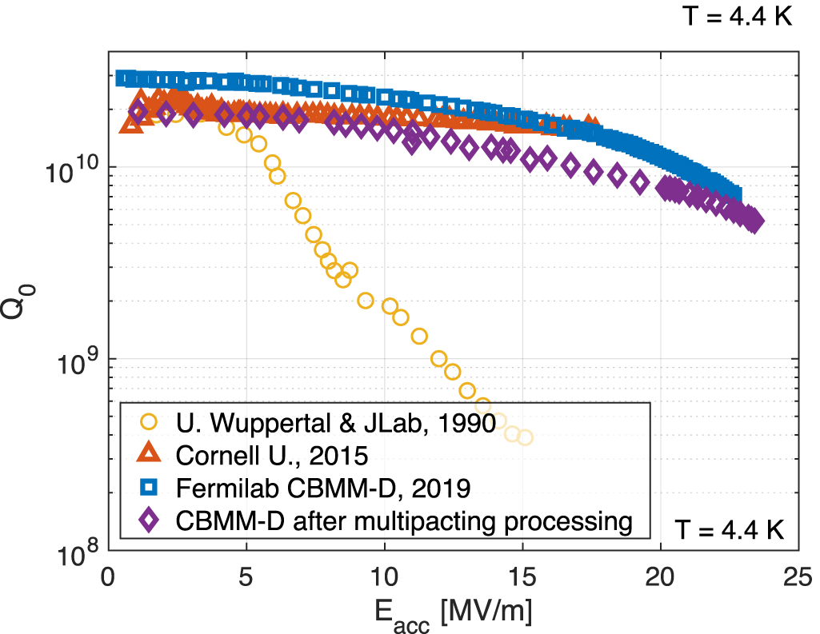
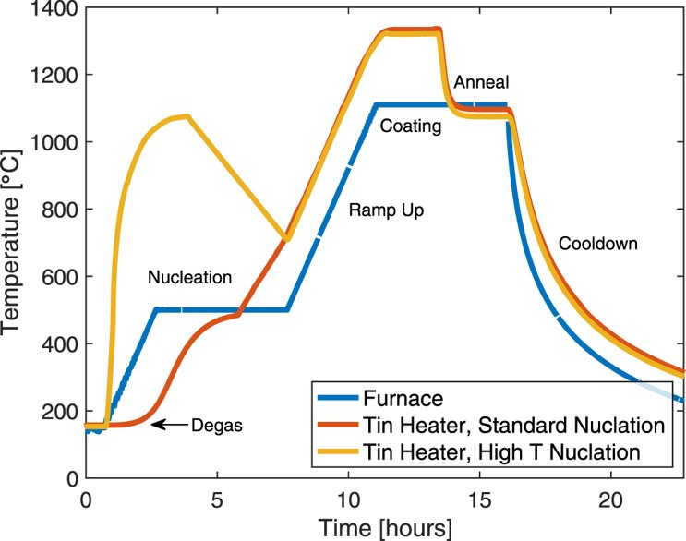

The case of vapor diffusion Nb₃Sn coatings
Nb₃Sn promises high-Q and high-field gradient for future high-energy colliders.
High T Nucleation promotes shiny, thinner films
Highest $E_{acc}$ is above 20 MV/m
Limited RF performance yet in Nb₃Sn-coated cavities and reproducibility remains a concern.

Slide 3
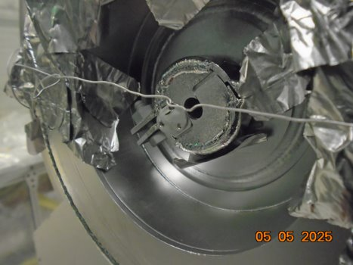
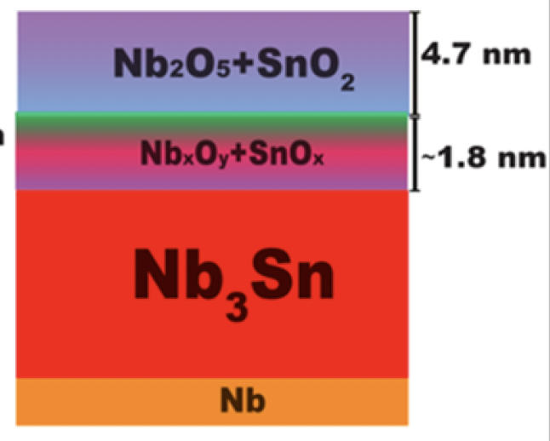
Towards understanding the potential factors affecting Nb₃Sn-coated cavities
What is the effect of Ti to Nb₃Sn coatings?
What is the effect of native oxides to Nb₃Sn coatings?
We closely monitor the impurities in our Nb₃Sn coatings through materials analysis, in particular, Ti levels which is assumed to be one of the factors degrading cavity performance.
We first identify the temperature to which oxide fully dissolved through successive heat treatment and in-situ time-of-flight secondary ion mass spectroscopy to a representative Nb₃Sn. Apply potential heat-treatment to Nb₃Sn-coated cavity.
Witness sample
Flange cover

Slide 4
Towards understanding the potential factors affecting Nb₃Sn-coated cavities
What is the effect of Ti to Nb₃Sn coatings?
We closely monitor the impurities in our Nb₃Sn coatings through materials analysis, in particular, Ti levels which is assumed to be one of the factors degrading cavity performance.
Witness sample
Flange cover

Slide 5
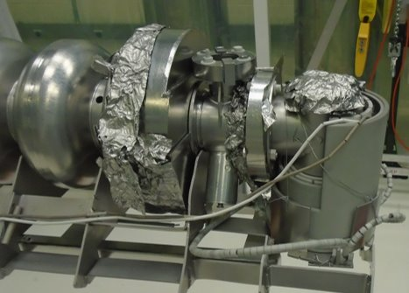
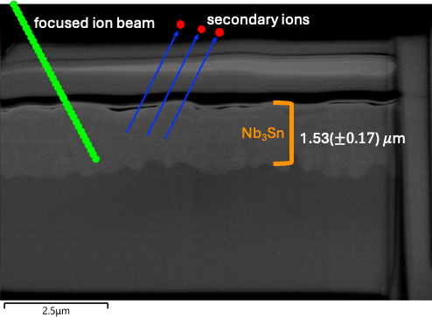
Ti level analysis approach
Witness sample
Flange covers
Flange covers and foils are used to minimize as much as possible Ti diffusion into the inner surface of the cavity. Ti impurities still persist and needs to be quantified.
Witness samples are placed inside the source tube and at the end of the cavity.
Time-of-flight secondary ion mass spectrometry is used to monitor Ti levels
Sputter rate estimated from the thickness of the Nb₃Sn, about ~0.3 nm/s.
O2+ sputter source with 2keV energy in a 200 x 200 um analysis area.

Slide 6
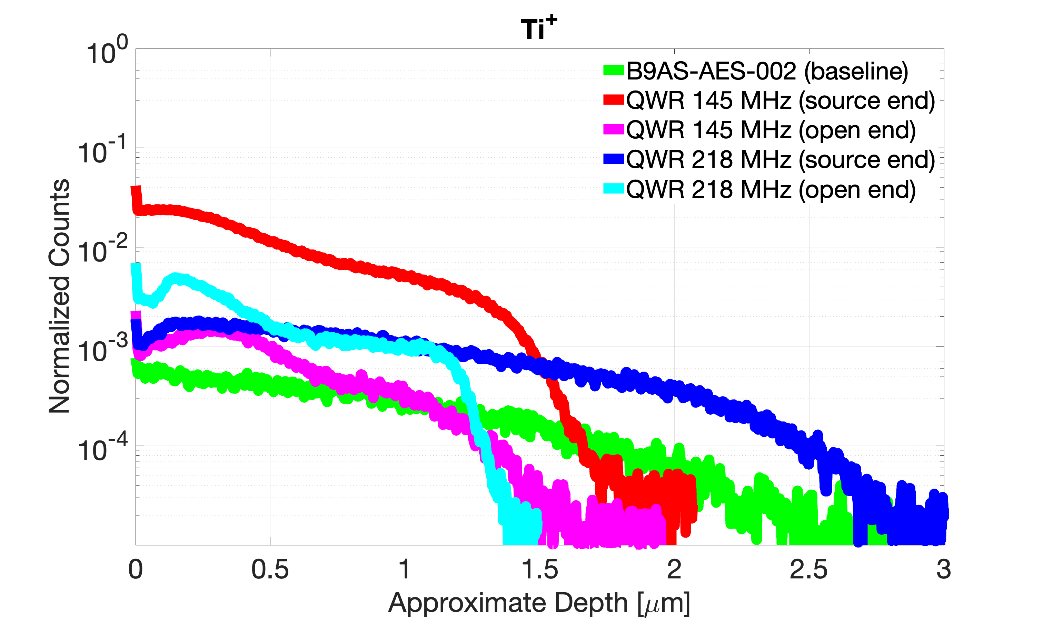
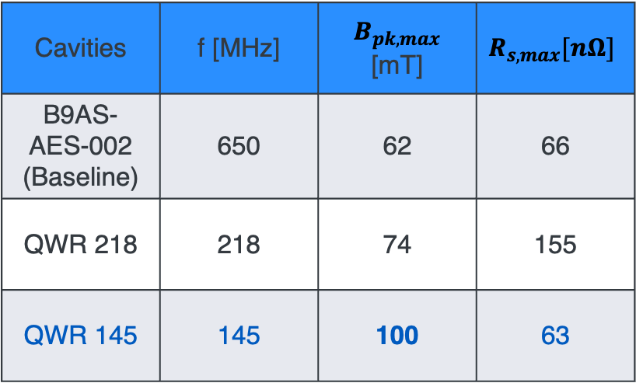
Comparative analysis of Ti levels in witness samples
Cavities | f [MHz] | $B_{pk,max}$ [mT] | $$R_{s,max}[nΩ]$$
B9AS-AES-002 (Baseline) | 650 | 62 | 66
QWR 218 | 218 | 74 | 155
QWR 145 | 145 | 100 | 63
QWR 145 achieved the best ever B_{pk,max} in Nb₃Sn coated cavities
No correlation between current titanium levels and RF performance

Slide 7
Summary and Outlook
We show initial results of the Ti levels and understand how it affects RF performance of the Nb₃Sn-coated cavities. We don’t see a correlation of the Ti-levels with the RF performance of the Nb₃Sn-coated cavities.
Understand if we do really need to use flange covers.
Flange covers

Slide 8
Towards understanding the potential factors affecting Nb₃Sn-coated cavities
What is the effect of native oxides to Nb₃Sn coatings?
We first identify the temperature to which oxide fully dissolved through successive heat treatment and in-situ time-of-flight secondary ion mass spectroscopy to a representative Nb₃Sn. Apply potential heat-treatment to Nb₃Sn-coated cavity.
Cano et al., J. Phys. Chem. C 2023, 127, 19705−19716

Slide 9
Native oxide dissolution analysis approach
Nb₃Sn sample as-received.
TOF-SIMS analysis
Baked at 325 ºC/1h
Time-of-flight secondary ion mass spectrometry is used.
Cs- sputter source with 1keV energy in a 200 x 200 um analysis area.
TOF-SIMS analysis without breaking vacuum.
Baked at 500 ºC/1h
.
.
.

Slide 10
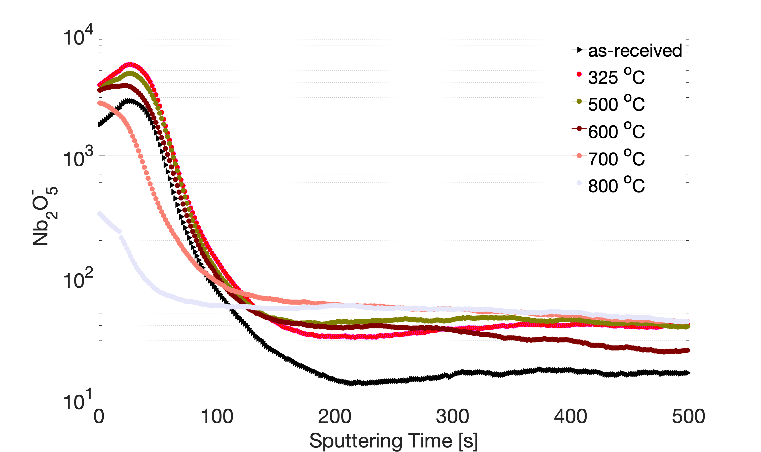
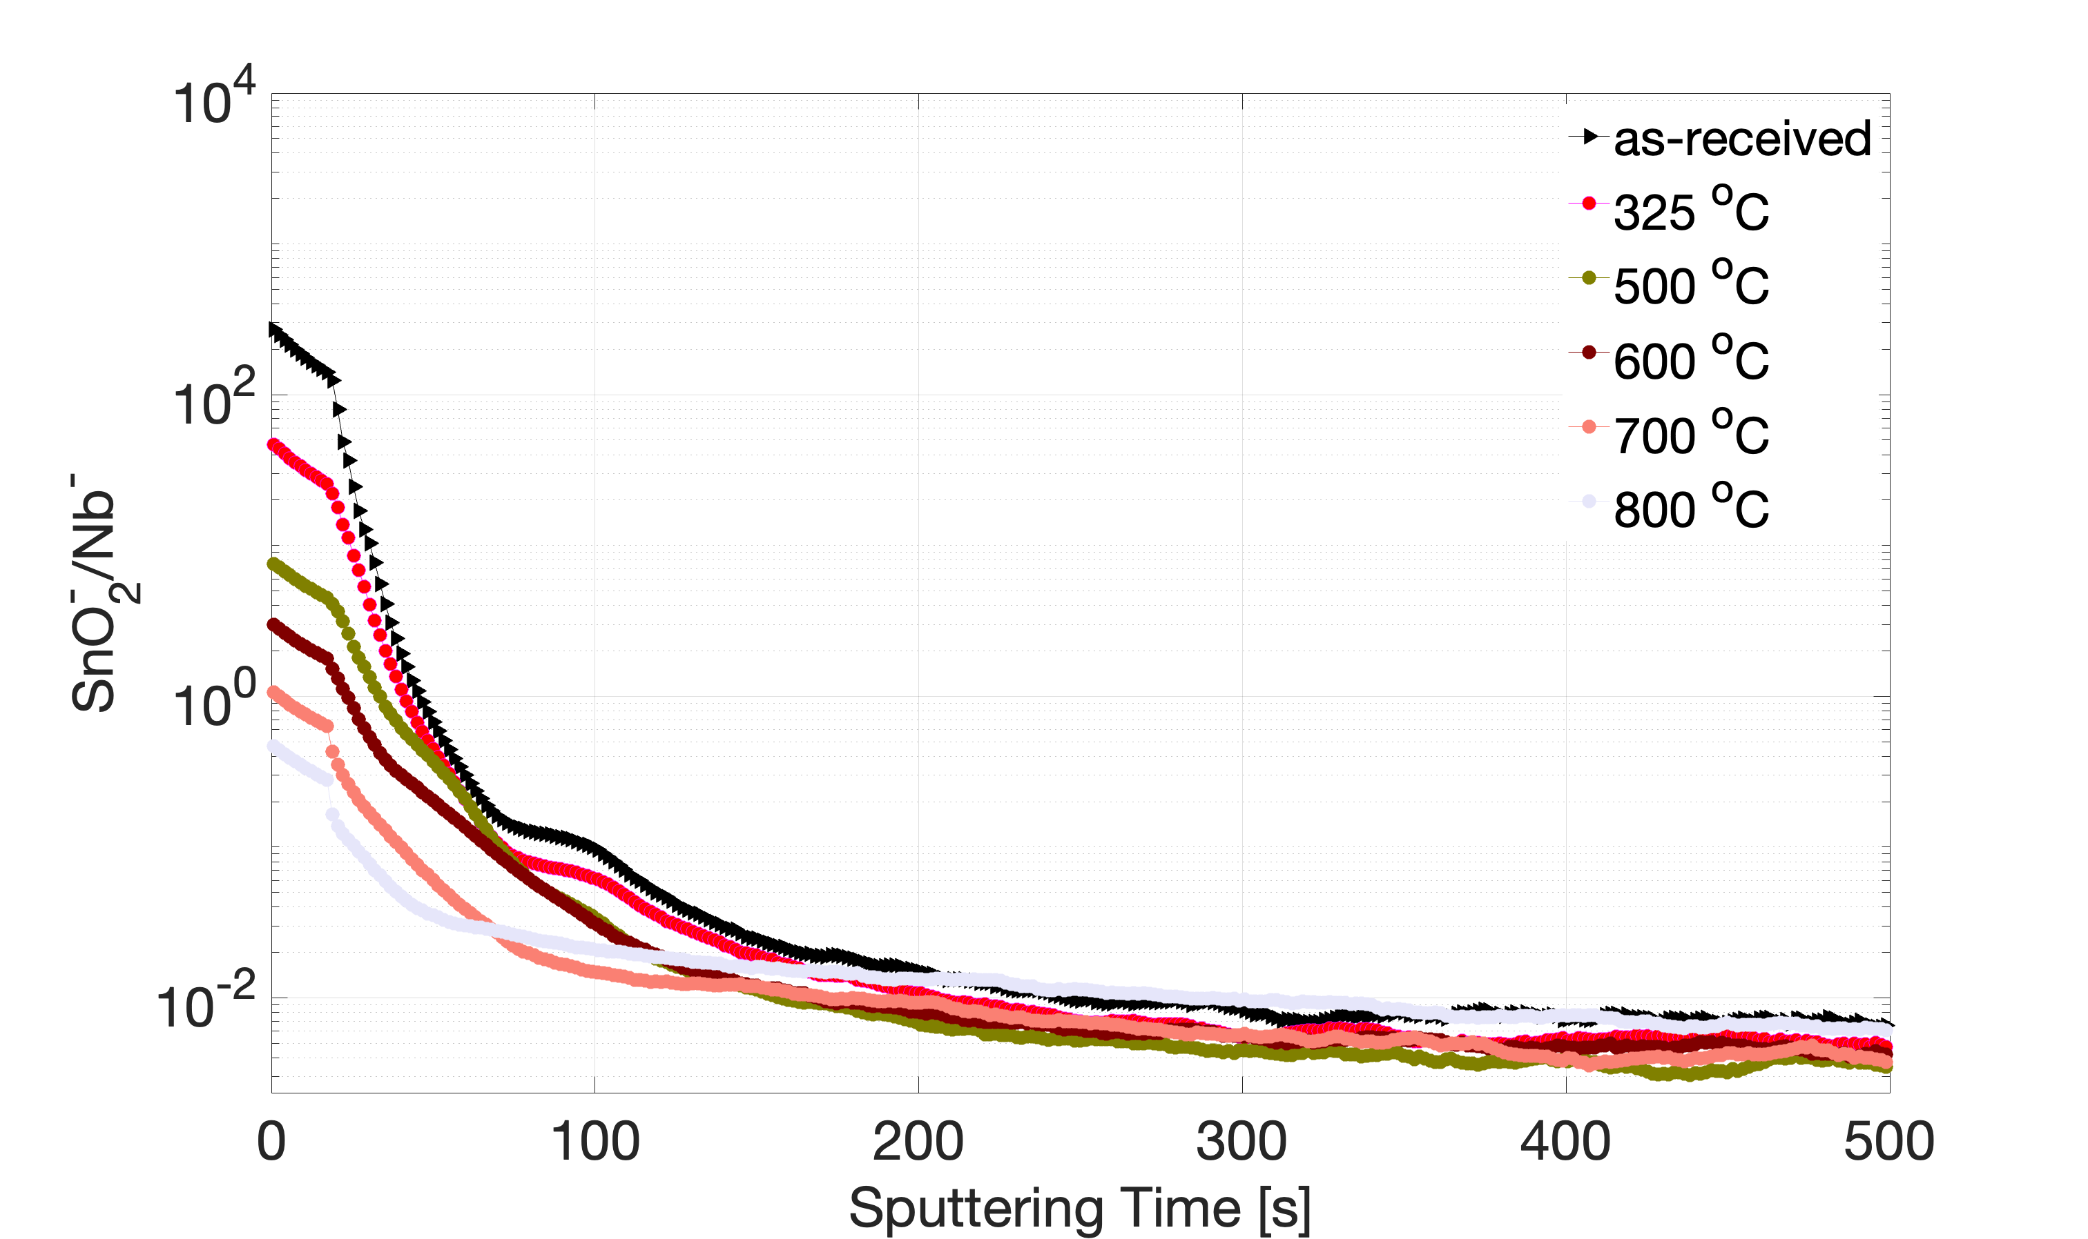
Native oxides depth profile
A Nb₃Sn sample is baked at each temperature for 1 h and measured using TOF-SIMS without breaking vacuum.
Native oxides dissolve at 800 ºC/1h.
Cano et al., J. Phys. Chem. C 2023, 127, 19705−19716

Slide 11
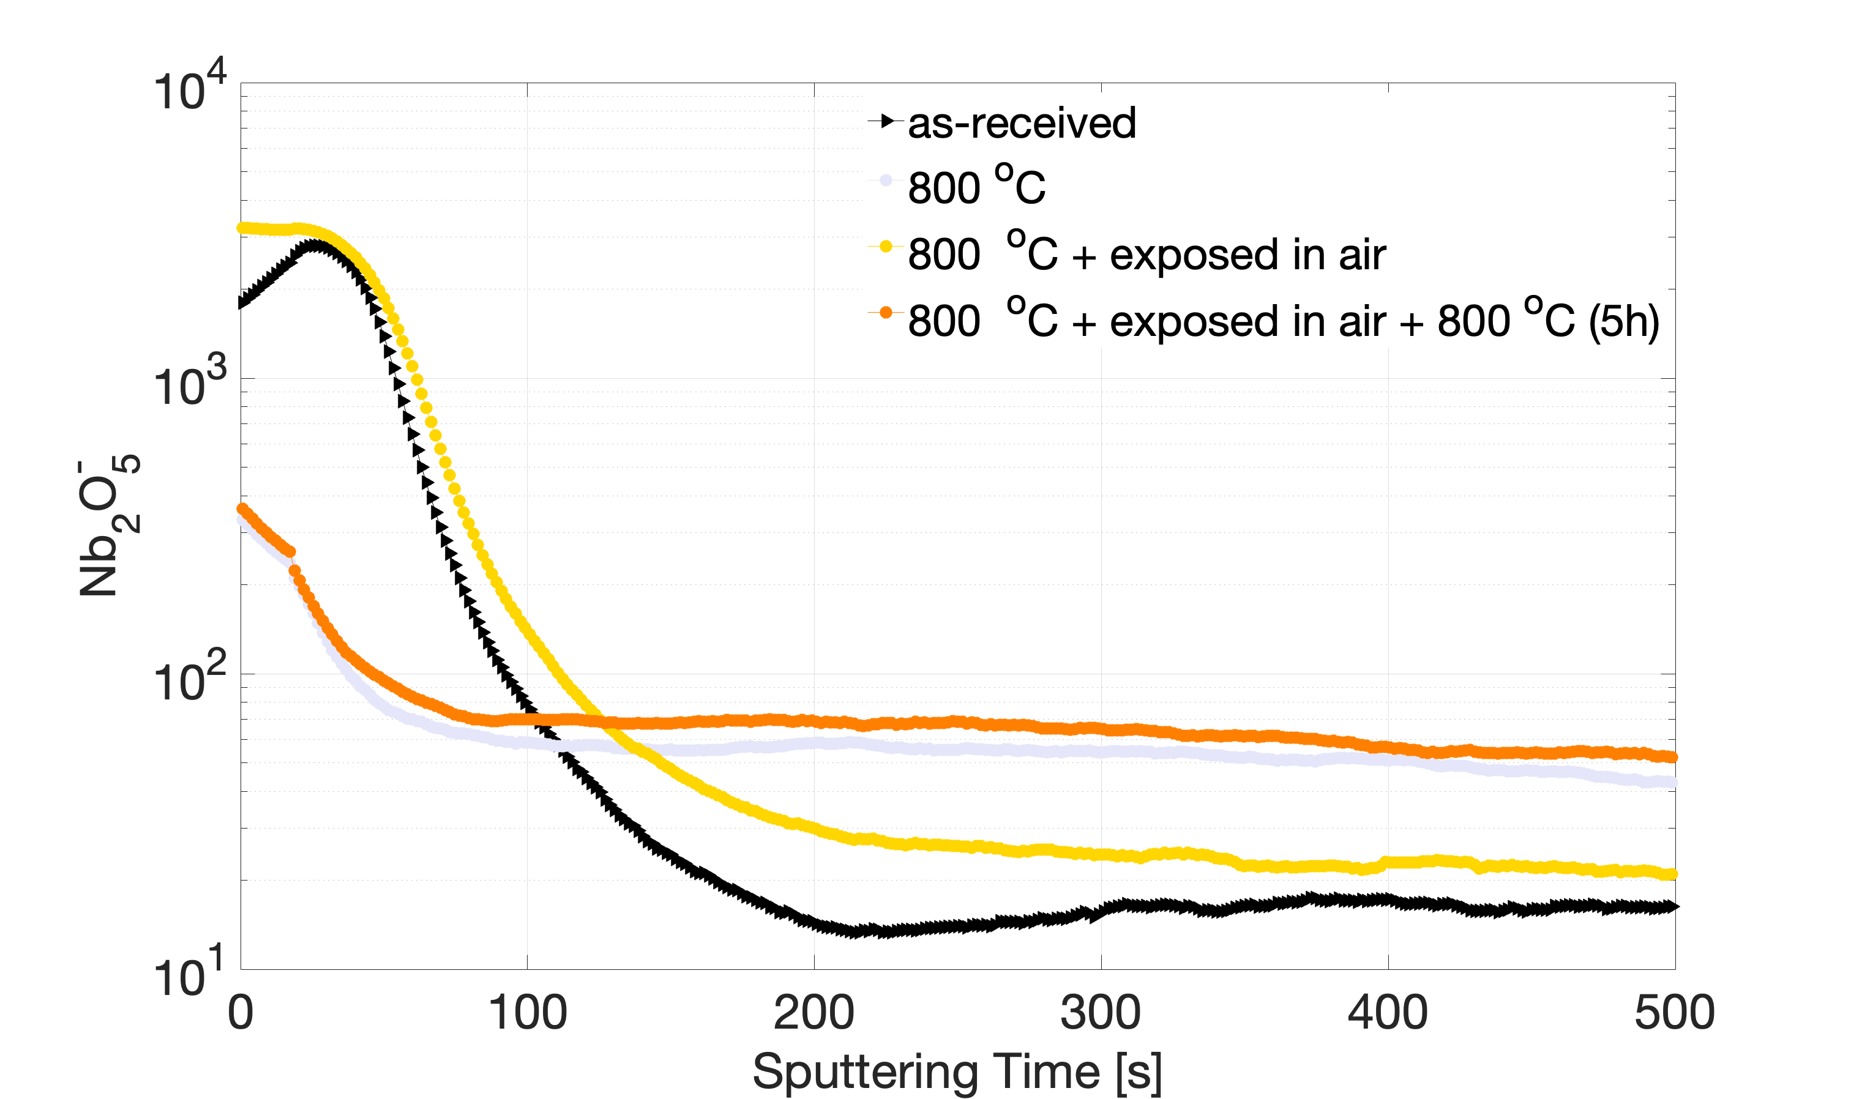
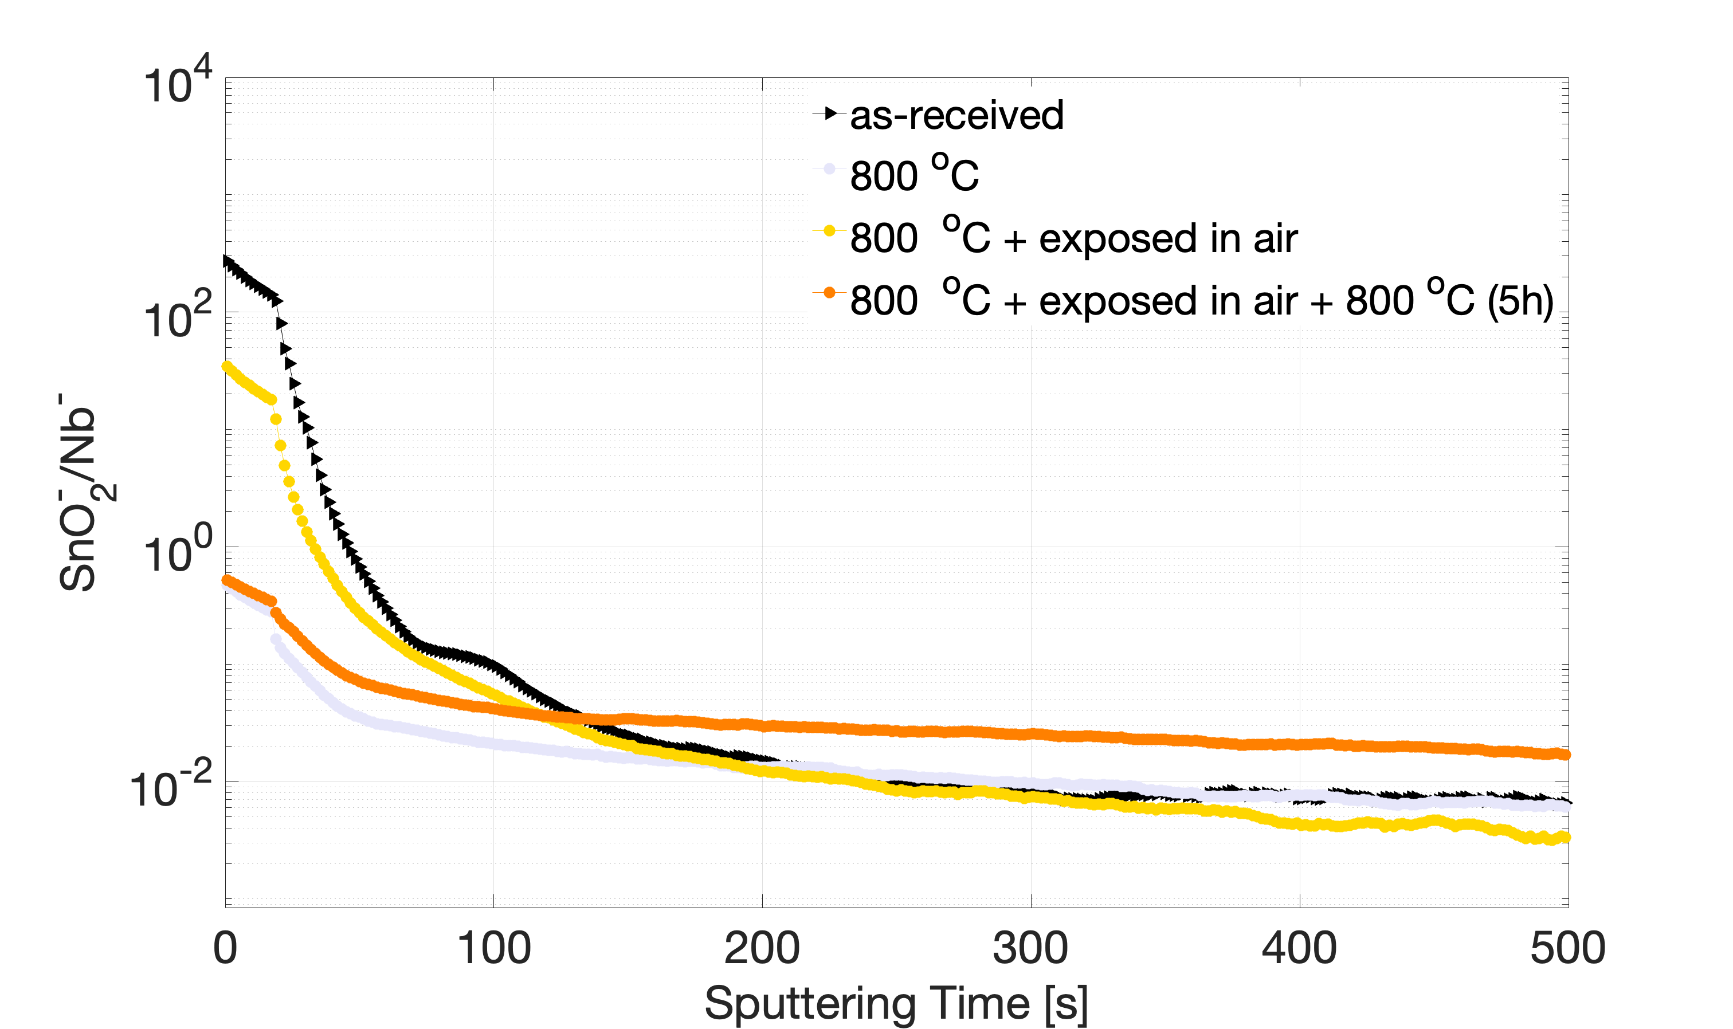
After exposing to atmosphere..
Native oxides regrows after exposing to atmosphere. We confirmed by baking longer at 800 ºC the background level of the oxides.

Slide 12
After exposing to atmosphere..
Is the Sn concentration retained after 800 ºC/1h baking?
Native oxides regrows after exposing to atmosphere. We confirmed by baking longer at 800 ºC the background level of the oxides.

Slide 13
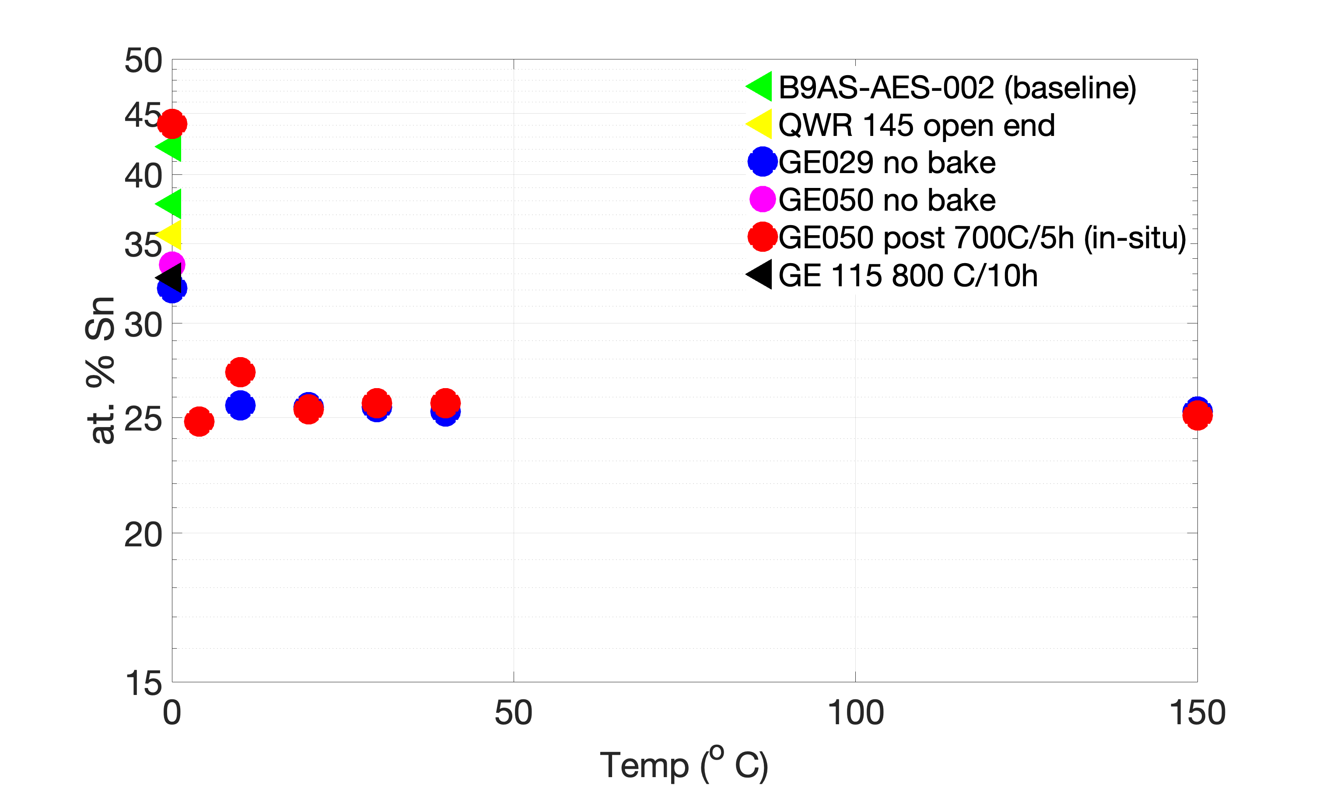
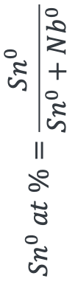
Sn concentration analysis
X-ray photoelectron spectroscopy (XPS) was used.
Sputtered using a 5 kV mono-chromatic Argon
In-situ baking was performed at 700 ºC/5h only instead of 800 ºC/1h, limited by the instrument.
$$Sn^{0} at \%=\frac{Sn^{0}}{Sn^{0}+Nb^{0}}$$
Stoichiometric Nb₃Sn layer
The Sn concentration after 800 ºC heat treatment is within an acceptable level.

Slide 14
Outlook
We performed successive baking of a Nb₃Sn sample up to 800 ºC to confirm up to which temperature the native oxides (Nb₂O₅ and SnO₂) dissolve. We found 800 ºC/1h enough to dissolve oxide. Moreover, Sn concentration level remains within acceptable range.
In-situ heat treatment set-up is ongoing for this level of temperature.
Perform oxide dissolution on Nb₃Sn-coated cavities

Slide 15
Acknowledgements
Brad Tennis, Damon Bice, Daniel Bafia, Grigory Eremeev, Sam Posen
Jae-yel Lee, Zu-hawn Sung, Akshay Murthy, Weislawa Diedzic-Misiewicz, Adam Clairmont
FNAL technical staff
Troy Peterson and Mike Kelly (ANL)

Slide 16
Thank you for listening!

Slide 18
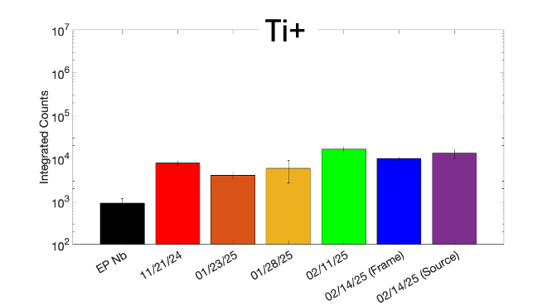
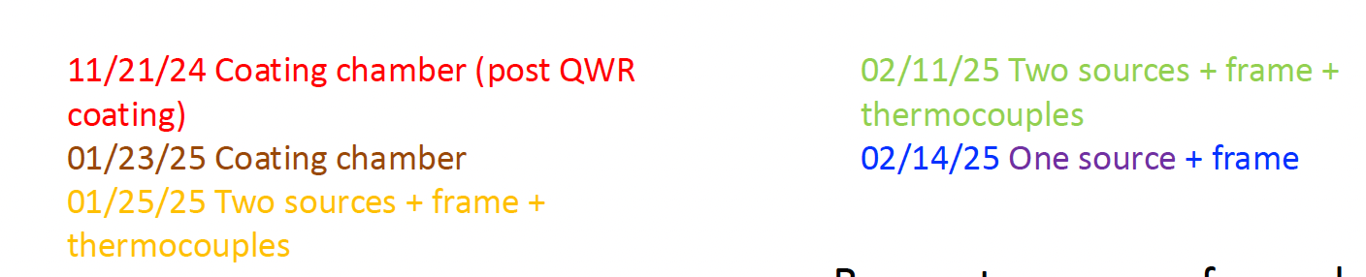
How to de-contaminate coating chamber from Ti?
Integrated counts of Ti was calculated until it reaches background.
Heat-treatment at 1200 ºC/3h of the coating set-up was performed.
Burn-out alone will not remove the Ti impurities in the set-up. Instead, we routinely perform BCP.

