Slide 1
WG-1 Summary: High Q₀/High Gradient
Daniel Bafia, Jinfang Chen, Lea Steder

Slide 2
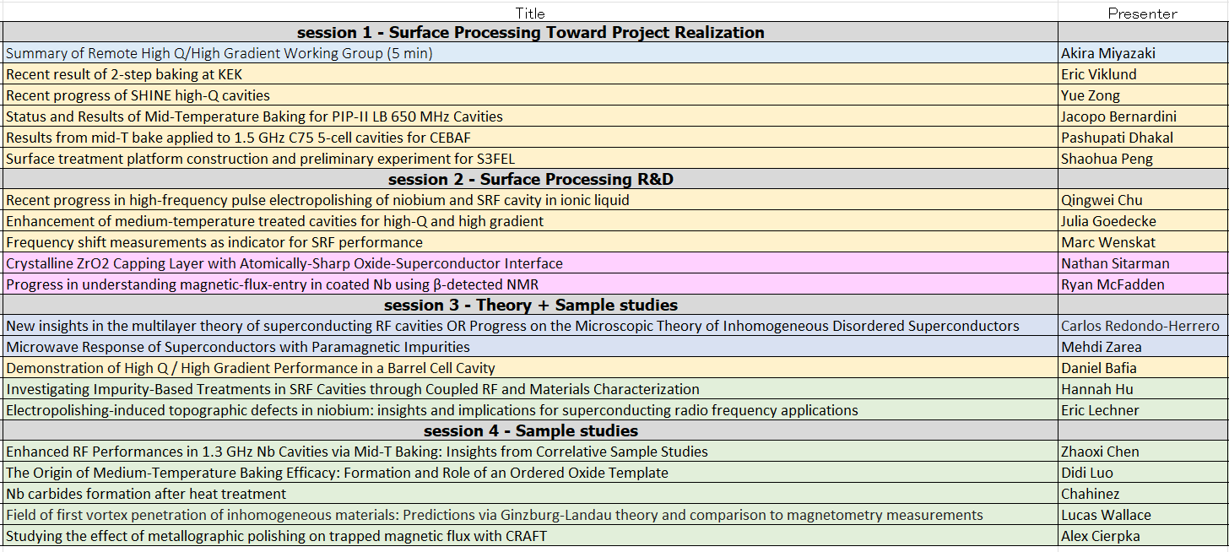
WG-1 Timetable

Slide 3
Takeaways From Presentations and Discussions
Main Themes:
Mid-T baking is transitioning from laboratory demonstrations to deployment.
Impurity engineering and co-doping are enabling predictive optimization of SRF materials.
Interface chemistry is emerging as a key control parameter alongside impurity concentration.
New diagnostics are improving our understanding of flux entry and performance limits.
Surface engineering continues to enable high performance across frequencies and cavity geometries.

Slide 4
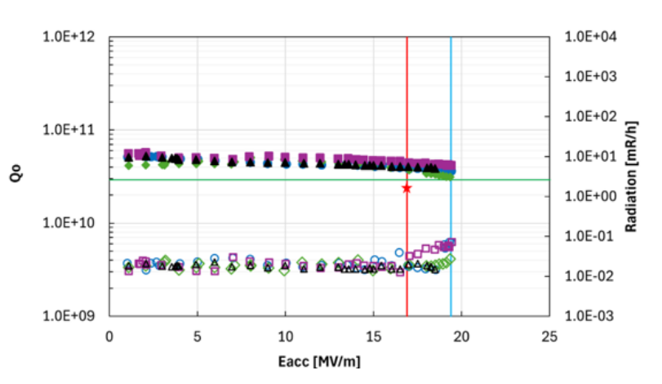
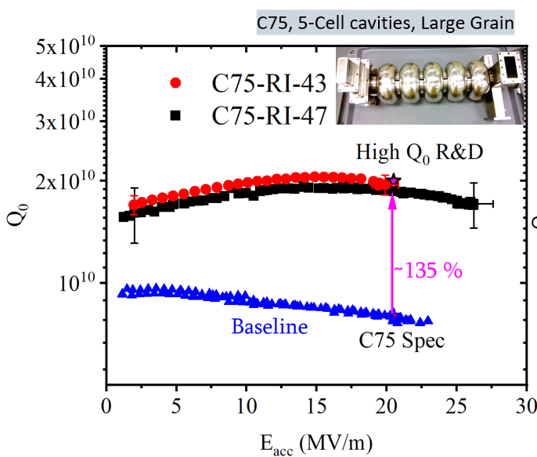
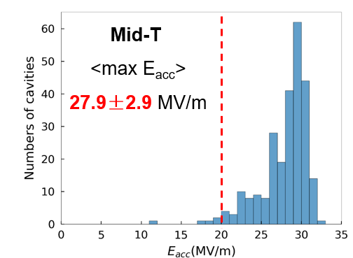
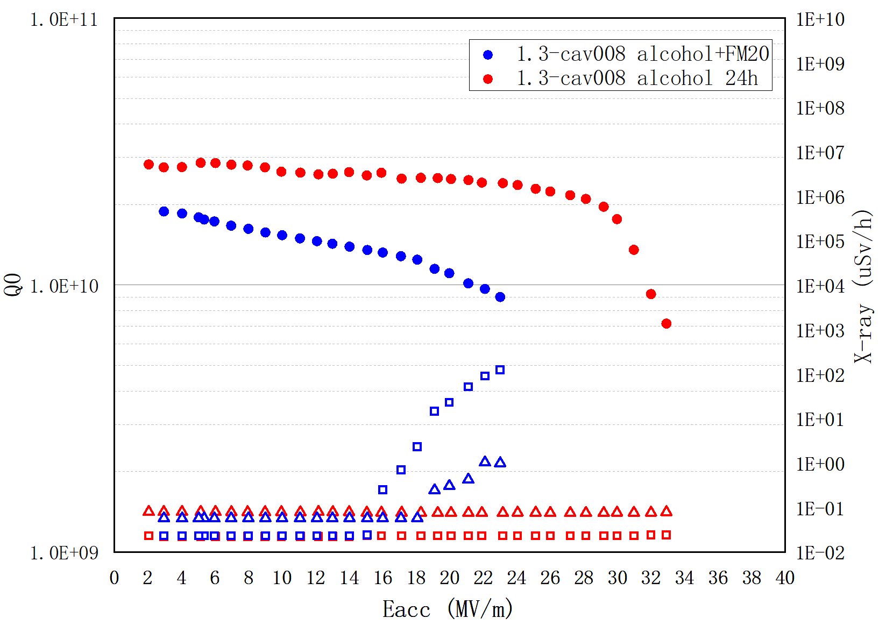
Application of Mid-T Baking Treatment to Projects
PIP-II
Jacopo Bernardini
CEBAF
Pashupati Dhakal
S³FEL
Shaohua Peng
SHINE
Yue Zong
SHINE fabricating CM with either mid-T baked or N-doped cavities
250 dressed mid-T cavities tested, 81% test rate, 3 CM per month
4 LB650 MHz successfully qualified for PIP-II post mid-T baking
Treatment is being industrialized at vendor
New cavity processing platform available to S3FEL; exploring mid-T baking
Refurbishing C75 cavities;
Using mid-T baking shows 135% improvement in Q₀
Mid-T baking is transitioning from a laboratory treatment to a deployable technology, with successful qualification, industrialization, and implementation across multiple accelerator projects

Slide 5
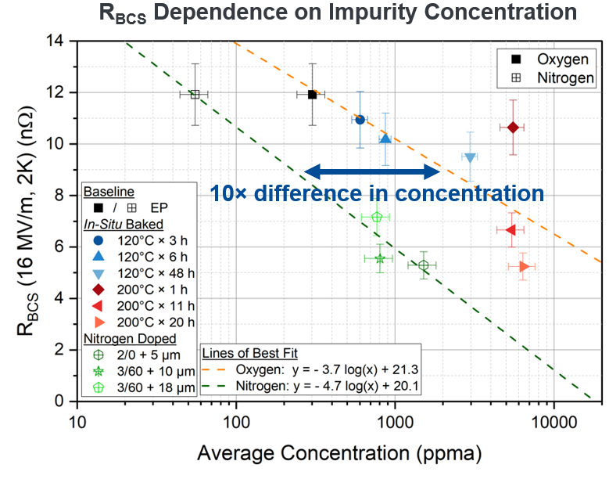
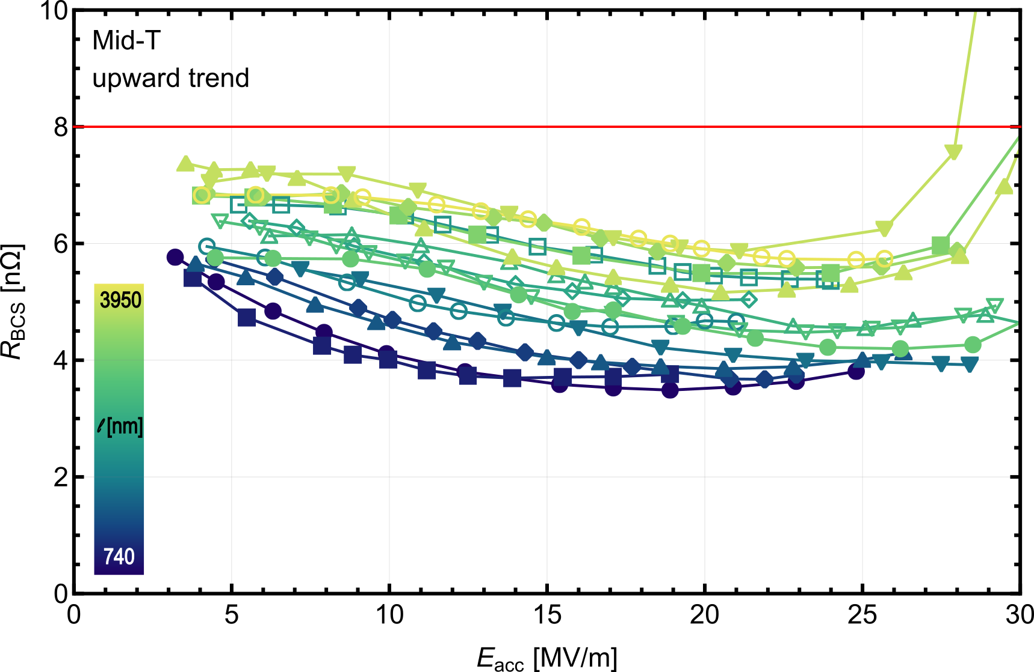
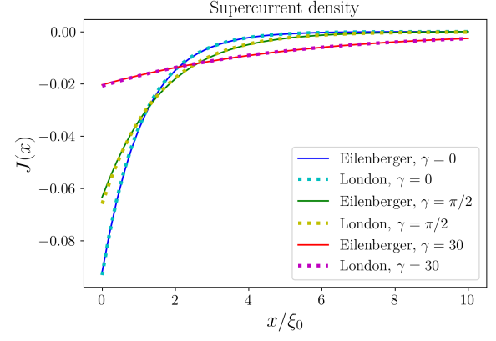

O Impurities as a Central Variable in Predicting Cavity Performance Post Baking
Julia Goedecke
Carlos Redondo-Herrero
Incorporating Impurity Profile to Model Current Density
Hannah Hu
Enhancement of 1.3 GHz performance with mid-T Baking
O and N both reduce the BCS resistance, similar effect in cavity performance for either high Q or high gradient
Confirm that diffusion depth is a key parameter in determining the predicted BCS; Identified 900 C treatment as a “soft” reset
Developed theory that considers inhomogeneous disorder
Useful tool for modeling field penetration in SRF cavities
Advances in experiment and theory are enabling impurity-engineered optimization of both Q₀ and G.
Notes:
Hannah
Carlos
Offers experimental implemention

Slide 6
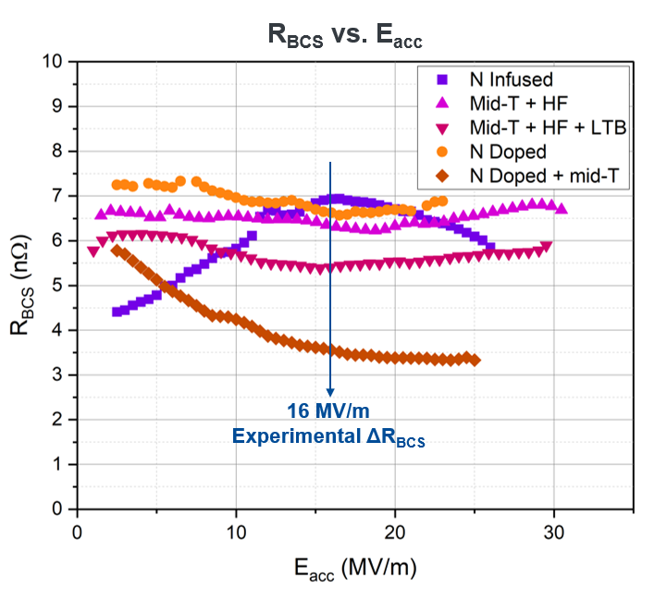
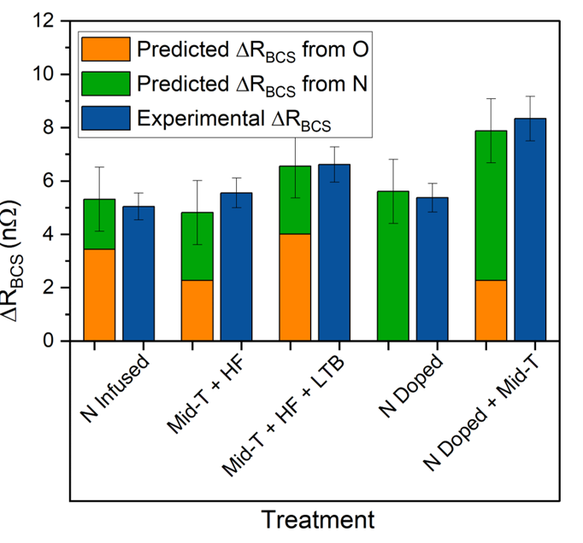
Toward Predictive Impurity Engineering: Co-Doping
Hannah Hu
Combines oxygen- and nitrogen-based treatments to independently tune impurity profiles
Independent control of O and N contribution to R_{BCS}
Additive reduction in R_{BCS}
Demonstrated predictive optimization of SRF performance
Co-doping demonstrates that SRF performance can be engineered through deliberate control of impurity profiles rather than discovered through empirical processing recipes.

Slide 7
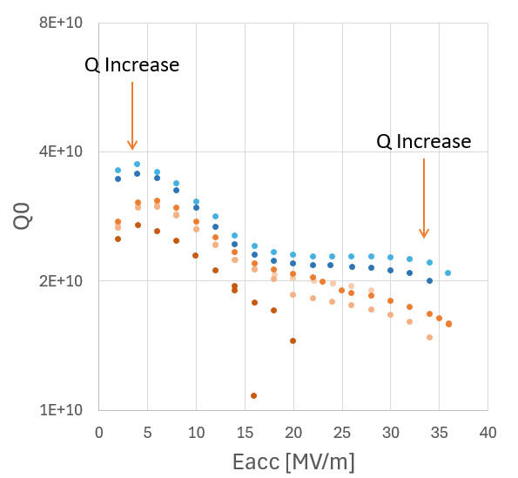
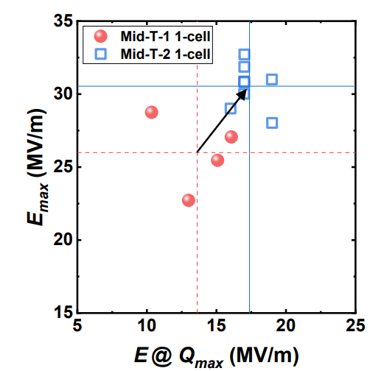
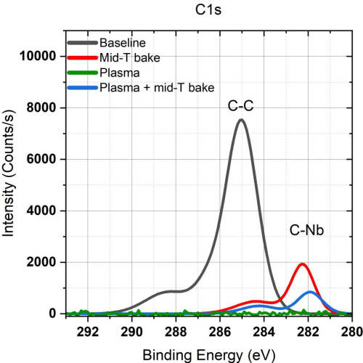
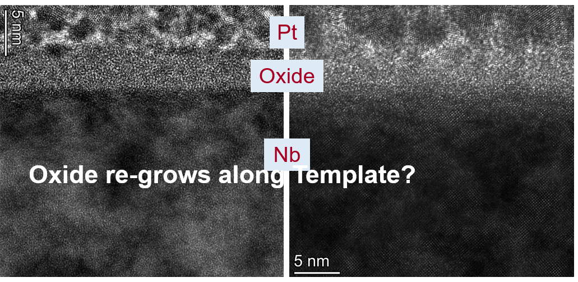
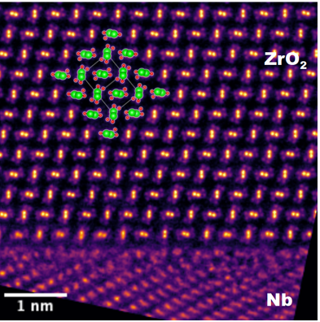
Beyond Mid-T Baking & Oxygen Doping: The Role of Interfaces
Chahinez Boutelaa
Exposure to air
Eric Viklund
Didi Luo
EP
Zhaoxi Chen
Plasma treatment shifts carbide formation from Nb₂C to NbC → highlights importance of baking configuration for surface chemistry
Mid-T baking modifies both O profiles and Nb/oxide interface structure, highlighting the role of oxide chemistry in SRF performance.
HPR post 75/120 C baking increases Q₀ at high fields → regrows oxide and reduces R_{res}
Nathan Sitaraman
Interface chemistry is emerging as a key lever for simultaneously optimizing Q₀ and accelerating gradient
Nearly complete removal of NbO with ZrO₂ capping → Demonstrated crystallinity
Notes:
Zhaoxi Chen
Didi Luo
Chahinez Boutelaa
Nathan Sitarman
The community is increasingly shifting from viewing mid-T baking solely as oxygen doping toward a broader picture where oxide structure, carbide formation, and interface chemistry may all influence SRF performance.

Slide 8
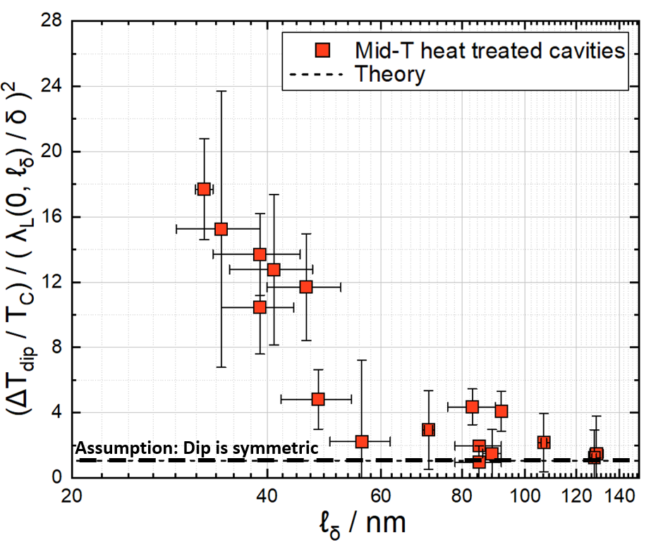
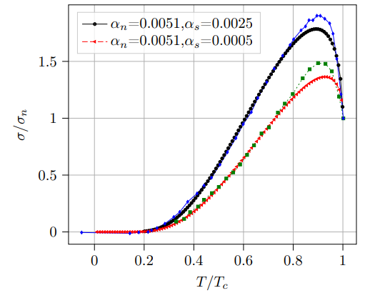
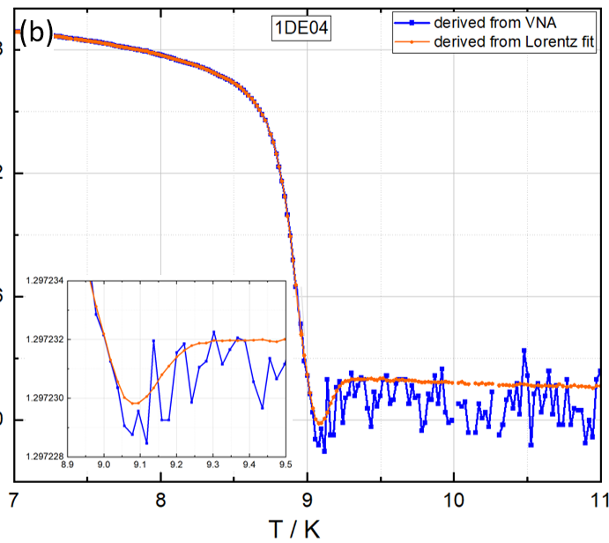
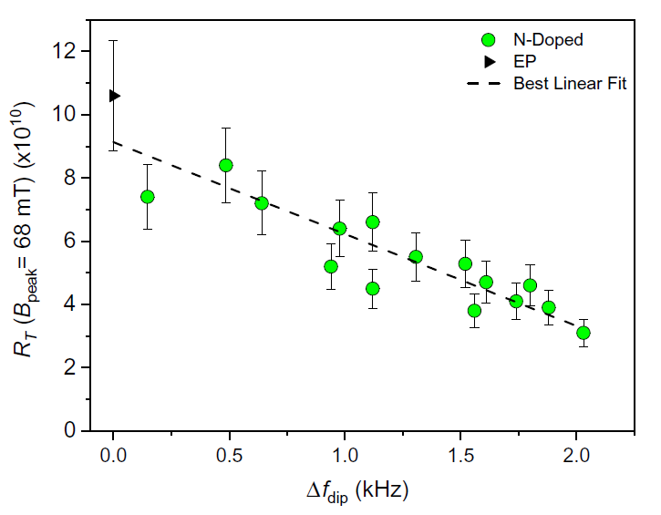
Frequency Shift as a Predictor of Cavity Performance
The f₀ vs T dip as a predictor of performance
Marc Wenskat
Microwave Response of Superconductors with Paramagnetic Impurities
Mehdi Zarea
R_{BCS} vs F₀ dip Magnitude
D. Bafia PRApplied 23, 054052 (2025)
Developed theory including magnetic impurity pair breaking
Offers a possible origin for the observed frequency dip
Frequency dip correlates with cavity performance metrics
Agrees with previously published data
The frequency-shift dip is emerging as a diagnostic of superconducting properties, while new theoretical models are beginning to connect this behavior to microscopic material parameters.

Slide 9
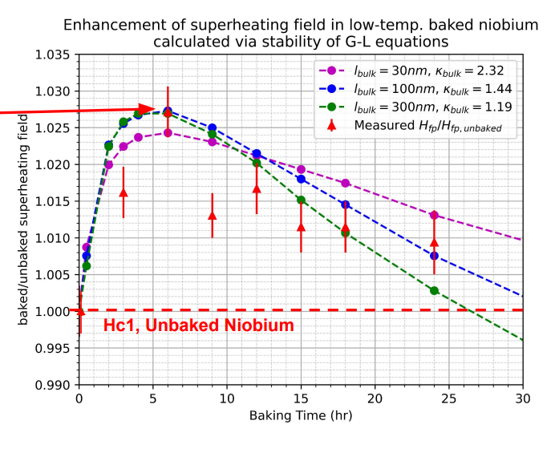
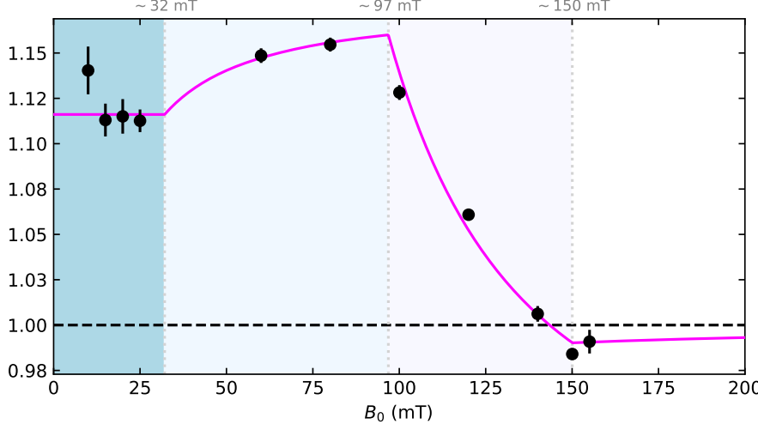
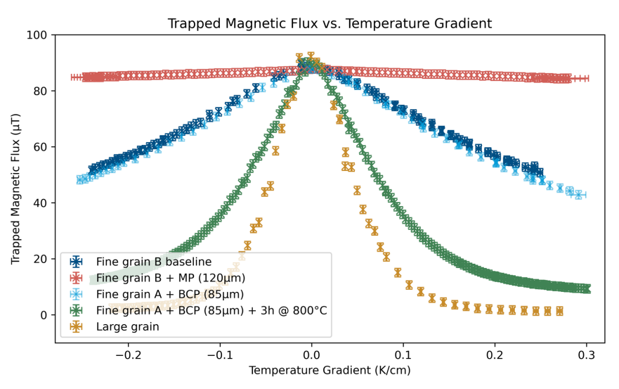
Flux Entry and Flux Trapping
Ryan McFadden
Lucas Wallace
Alexander Cierpka
Demonstrated CRAFT tool for high throughput flux trapping experiments
Demonstrated variations in flux expulsion/pinning of variously processed samples
β-NMR directly resolved layer-by-layer flux penetration in NbTiN/AlN/Nb, providing a powerful new probe of vortex entry and magnetic screening in SRF materials.
Magnetization measurement of LTB ellipsoidal Nb samples demonstrate an enhanced surface barrier, delaying field penetration
The community is developing both theory and diagnostics to directly study vortices in superconductors, adding a new dimension to our basic physics understanding
Notes:
Ryan McFadden Lucas Wallace Alex Cierpka

Slide 10
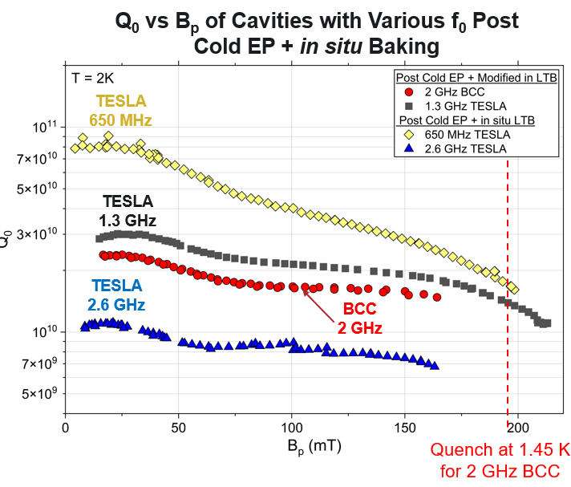
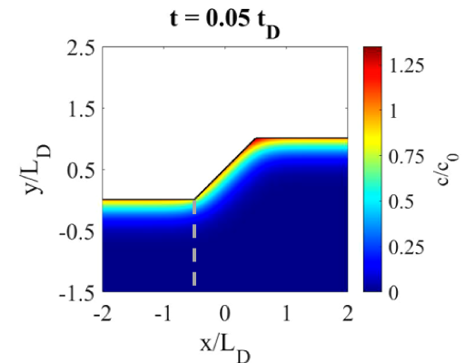
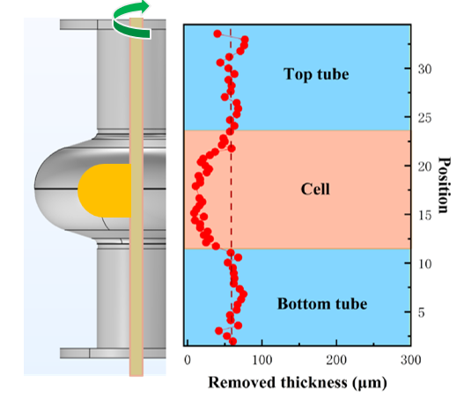
Surface Quality Remains a Major Factor for High Q/High G Performance
Daniel Bafia
Eric Lechner
Qingwei Chu
Nanoscale topography may significantly reduce the superheating field
Highlights the importance of precise surface preparation.
HF-free ionic liquid EP offers an alternative processing route.
Conventional SRF processing with optimized EP produced expected high-Q/high-gradient behavior in a low-R/Q barrel-cell cavity
Demonstrated ~200 mT in novel barrel cell cavity
Optimized surface preparation remains the key enabler of high-Q/high-gradient performance, regardless of cavity frequency or geometry.

Slide 11
Conclusions
Mid-T Baking is Maturing
  Successful deployment and qualification efforts at SHINE, PIP-II, CEBAF, and S3FEL demonstrate increasing readiness for project-scale implementation.
Toward Predictive Materials Engineering
  Impurity concentration, diffusion depth, and co-doping are emerging as controllable parameters for optimizing cavity performance.
Beyond Oxygen Doping: The Role of Interfaces
  Oxide structure, oxide regrowth, carbide formation, and interface chemistry are increasingly recognized as contributors to SRF performance.
Understanding Performance Limits
  New diagnostics and modeling are improving our understanding of flux penetration, trapped flux losses, and superheating field limitations.
Expanding the High-Q / High-Gradient Toolbox
  Advances in processing and cavity design continue to demonstrate excellent performance across frequencies, facilities, and cavity geometries.
Takeaway: The field is transitioning from empirical surface treatments toward predictive engineering of superconducting materials, interfaces, and cavity surfaces for next-generation SRF applications.

