Slide 1
WG2 Summary
On behalf of all WG2 speakers
and conveners
Enrico Cenni (CEA), Tiancai Jiang (IMP), Zhongyuan Yao (TRIUMF)

Slide 2
WG2: Effective operation of aging machines for performance and reliability
THE CHARGE
For operating SRF accelerators the initial performance may have degraded due to gradual decay (field emission, magnetic pollution, poor vacuum, …) or singular perturbations (component failure, vacuum/cryo accidents). Maintaining performance to meet science needs may involve upgrading protocols or developing new mitigation methods but also could dictate upgrades in equipment to retain or boost performance. This working group should concentrate on methods and techniques used in operating SRF accelerators to retain or boost performance through various means such as HPP processing, helium processing, plasma processing and Ozone-gas processing, thermal cycling, reconfiguration, reprocessing. The working group should also include the developments towards the understanding and suppression of sources of degradation.
Keywords: operating accelerators, performance degradation, in-situ processing techniques, sources of degradation

Slide 3
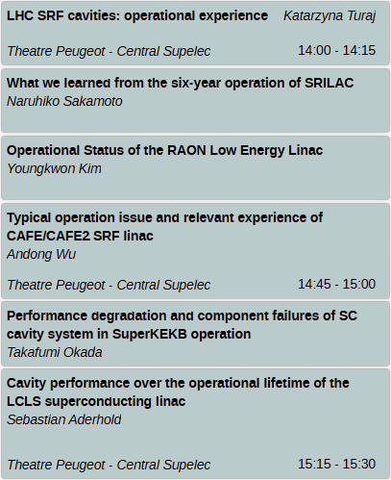
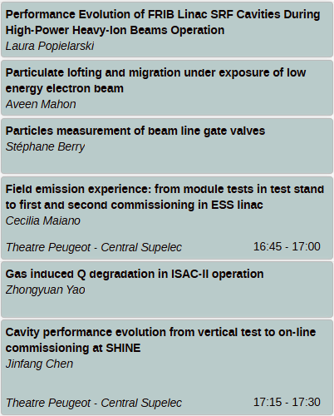
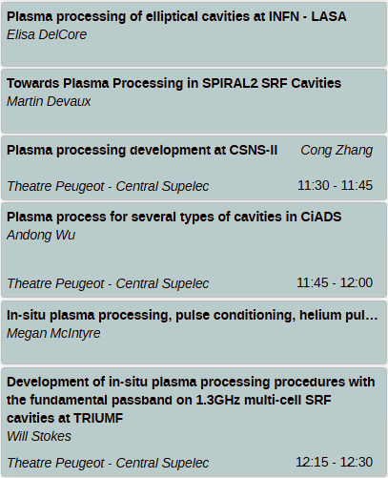
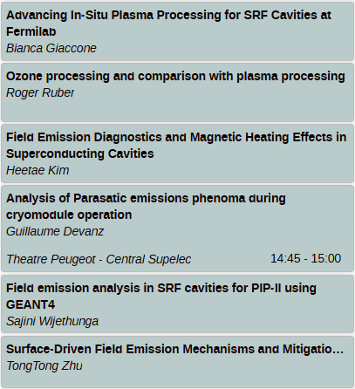
24 Talks (AS 9/EU 6/NA 9) from 17 Labs
Performance degradation and component failures in operation
FE mitigation and plasma processing
FE diagnose, activation and root causes

Slide 4
Causes of performance or cavity loss
23 causes reported from 10 facilities
  LHC, ESS, SIRLAC, SuperKEKB, ROAN, CAFE, SHINE, LCLS-SC, FRIB, ISAC-II
Cavity vacuum
2 cases restored by
‘in-situ’ methods
Ancillaries
Couplers, tuner, cable
Vacuum
Cavity, CM,FPC, beamline, instrumentations
FE
Cavity
FE, quench, MP

Slide 5
Causes of performance or cavity loss
Facility | Cause#1 | Mitigation#1 | Cause#2 | Cause#3 | Cause#4 | Cause#5 | Note
LHC | HOM overheating & cavity quench (no evident related to beam) | 1. Reduce operating voltage 2. Replace CM | Rupture disk | Accidental venting (restored with helium processing) | Voltage limit | Internal RF cable / cracks on electric dome
ESS | FE (cavity emitter, beam loss, coupler electron) | Not affect RF control and cryo, may mask arcing signal 1. Short high-power pulse with recipe 0.3~0.5ms/full power 2. Coupler conditioning with nominal pulse |  |  |  |  | FE instrumentations provide detailed information, in-depth studies reveal potential root causes of FE
SIRLAC | FE (indication of beam induced, no correlation with cavity position) | 1. High power pulse with recipe 0.5Hz/20ms | FPC leak (Extra warm window with active pumping ) |  |  |  | onset field is about half of peak field in pulse conditioning
SuperKEKB | Cavity vacuum leak | Horizontal HPR | Multipacting/cavity breakdown | Peizo breakdown |  |  | Automation of performance measurement and RF conditioning Operating data acquisition
ROAN | FE | 1. High power pulse with recipe 1~5Hz/20~25ms 2. Plasma processing in plan

Slide 6
Causes of performance or cavity loss
Facility | Cause#1 | Mitigation#1 | Cause#2 | Cause#3 | Cause#4 | Cause#5 | Note
CAFE | FE | 1. coupler discharge and window damage -> protection algorithm in LLRF 2. Pulse conditioning -> not effective 1Hz/10ms 3. Helium conditioning -> effective with limitation 4. O plasma -> more effective 5. Combine helium conditioning and O plasma | Cavity vacuum vent (NeO plasma restored performance) | Single coupler window leakage | Particle migration from warm section | Gas deposition from coupler
SHINE | Vacuum leak | 1.Refurbish CM, HPR + light BCP | Vacuum vessel degaussing
LCLS-SC | FE | 1. pulse processing has improvement with limitations and risks 3Hz/increase pulse width from 1ms/full power 2. replace CM34 | Tuner issues (stepper, Piezo, control) | FPC heating | Rf issues
FRIB | FE (correlated with beam loss) | 1. stop the beam quickly (chopper) after observing beam losses due to Li film thickness change 2. Pulse conditioning 3. Plasma processing 4. Performance tracking |  |  |  |  | Cavity performance tracking automation tools
ISAC-II | Beamline vacuum | Improve vacuum or partial thermal cycle

Slide 7
Shared interests on FE
No clear correlation with cavity position in CM – SIRLAC, LCLS-SC, FRIB
Some correlation with CM position in linac – ESS, SIRLAC, FRIB
Indications of beam loss induced – ESS, SIRLAC, FRIB
Track FE activation and development
  Routine performance tracking – SuperKEKB
  Automation of performance measurement, conditioning – SuperKEKB, FRIB
  Diagnostics – more later

Slide 8
FE mitigation
Off-line refurbishment (HPR or light BCP +HPR)
Horizontal HPR
Replace CM
In-situ conditioning/processing
  High power pulse conditioning is generally applied to operating system
    0.5~5Hz repetition rate / 0.3~25ms pulse width – ESS, SIRLAC, ROAN, CAFE, LCLS-SC
    Generally, helps to mitigate FE, but limitations and negative example also reported
    Recipe and effectiveness may vary due to configurations of RF system and FPC
  More later
  …...

Slide 9
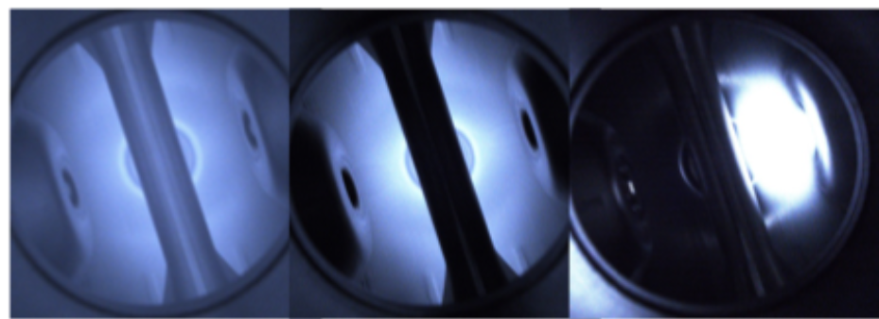
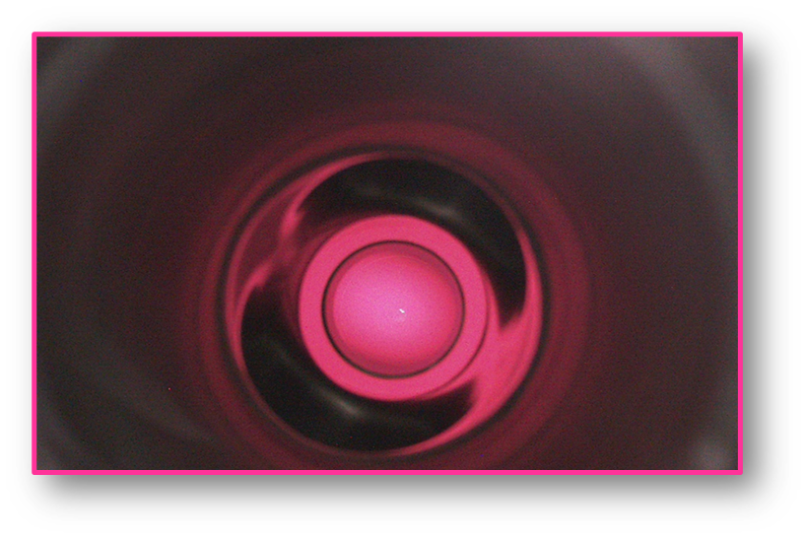
Plasma processing
Lab | Gas mixture | Working Pressure [mbar] | Diagnostics | Cavity geometry
INFN-LASA | Nitrogen and Helium | 0.25-0.35 | Spectrometer, Optical | Elliptical
GANIL | Nitrogen/Oxygen | 0.02-0.04 | RGA, Optical | QWR
CSNS – IHEP | Argon/Oxygen and Helium/Oxygen | 0.5-1 | RGA | Spokes, Elliptical
IMP | Neon, Argon, Helium, Oxygen | - | - | QWR, HWR, Elliptical
ANL | Argon/Oxygen | 0.07-0.13 | Cold test (radiation) | QWR
TRIUMF | Helium/Oxygen | 0.17-0.24 | RGA, Optical | Elliptical
FNAL | Neon/Oxygen and Helium/Oxygen | 0.07-0.5 | Optical | Spokes, Elliptical
JLab | Helium/Oxygen | 0.4 | Cold test (radiation), RGA | Elliptical

Slide 10
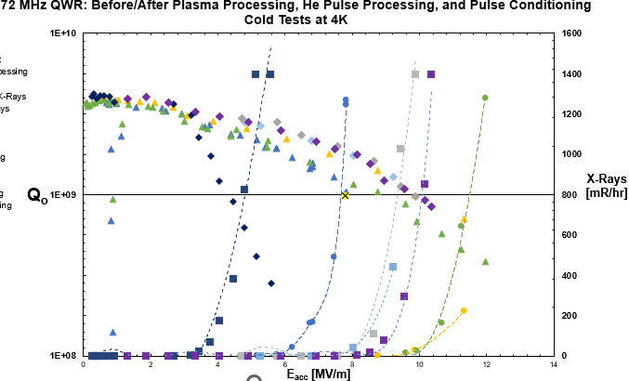
Comparison of in-situ processing
  Ar/Oxygen plasma > He processing > RF pulse conditioning – ANL
  Oxygen plasma > He processing > RF pulse conditioning – IMP
  Ozone processing ≈ He/Oxygen Plasma – JLAB
  Change chemistry of upper surface layer
  Oxidize surface layer to Nb2O5
  Increase work function value
  Immunize the surface layer
  against adsorption of
  contaminants

Slide 11
Particulates generation and migration
Actuation of all-metal gate valve generates ~100 particulates with size >0.3micron – CEA
  Influence of pneumatic actuator’s pressure is not significant for particle generation point of view
  Advise to limit the number of closing/opening cycles
Demonstrate particulates lofting and migration by electron charges – TRIUMF
  More analysis on energy and angular distributions to understand lofting criteria and impacted range
Causes of FE activation – CEA/ESS
  Cavity, coupler, and beam induced

Slide 12
FE diagnose, activation and root causes
Detectors
  Fast scintillator detectors – CEA/ESS
    ~10µs down to ~10ns time resolution
    Time resolved gamma detection enable discrimination of radiation caused by cavities and/or by FPC
  Pandora – DESY, ESS
    Pulse mode operation
    Gamma and Neutron detection
Simulation – CEA, FNAL
  Particle tracking (CST, Geant4)
  Particle/Matter interaction (Geant4)
  Detail geometry enable activation studies and parasitic effect on accelerator components
FE analytical model to describe cavity performance – IBS
Residual gas adsorption caused FE enhancement – IMP

Slide 13
Many thanks to all WG2 speakers and audiences
“Time was too short”
Less talks or roundtable discussion
Led discussion to answer specific questions shared in advance among speakers/conveners (like WG3 and Hot topic)

