Slide 1
WG4 Summary:
R&D Challenges for Future Advanced Projects
Conveners : Cristian Pira (INFN), Teng Tan (IMP), Laura Popielarski (FRIB)
Théâtre Joël Rousseau, Wednesday and Thursday
Keywords: Field emission prevention, producing field emission free systems, robotics development, Nb/Cu performance, Nb/Cu industrialization, Nb3Sn production, Nb3Sn operation, thin film R&D, muon colliders, advanced FPC HOM couplers, advanced tuners

Slide 2
WG Overview
WG4 focuses on the key technical challenges of future advanced SRF projects, covering four topics:
Field Emission Suppression and Additive Manufacturing (Session 1, 7 talks)
Couplers and tuners (Session 2, 5+1 talks)
Material 1: Surface Engineering, Nb/Cu Coating (Session 3, 7 talks)
Material 2: Nb₃Sn thin film (Session 4, 6 talks)
26 talks in total, 16 EU, 6NA, 4 Asia,
6 Female speakers
All presentations follow the “10+2” rule.

Slide 3
WG-Overview
This time WG4 R&D focuses on field emission prevention, additive manufacturing, advanced couplers/tuners, and novel materials (Nb/Cu, Nb₃Sn). Current progress includes robotic assembly, ALD coatings, and high-power couplers.
Future SRF challenges demand industrial scalability, defect-free surfaces, higher efficiency, and turn-key systems for next-generation accelerators. It’s good to see all the emerging efforts throughout the world.

Slide 4
WG4 Session 1: Toward Automated, Clean, and Scalable SRF Cavity Production
Advancing SRF cavity fabrication through:
  Robot-assisted clean assembly
  Additive manufacturing approaches for seamless cavity structures
Common objective: improve cavity performance, reproducibility, and manufacturability
Key drivers identified across presentations
  Reduce particle contamination and field emission risks
  Improve assembly precision and process repeatability
  Reduce manual, time-intensive operations
  Enable future large-scale SRF production through automation and digital manufacturing
Overall message:
Automation is transitioning from a research activity toward integration into SRF production workflows.

Slide 5
Technical Highlights: Robotics and Additive Manufacturing Progress
Progress demonstrated across multiple laboratories
  Automated cavity handling, flange assembly, fastening, and cleanroom operations successfully demonstrated
  Cobot integration is improving:
    cleanliness control
    assembly consistency
    operator safety
    process efficiency
Examples of advances
  Automated SRF cavity assembly test completed (transfer → positioning → nut fastening)
  Cobot-assisted HPR systems developed for complex geometries
  Robotic systems supporting cavity string assembly activities
Remaining challenges
  Robust operation in complex cleanroom environments:
    hose/cable management
    camera-based positioning reliability
    contamination control
  Long-term system maintainability
Additive Manufacturing for SRF Cavities
  Emerging opportunity
    New fabrication routes to reduce material use and enable seamless cavity concepts
Demonstrated progress
  Cu additive manufacturing substrates achieving required:
  RRR performance
  surface quality
  leak-tightness
Cold spray and wire additive manufacturing approaches progressing toward cavity fabrication
Future directions
  Hybrid additive + subtractive manufacturing for improved RF surfaces
  Nb coating development
  RF and cryogenic testing of printed cavities

Slide 6
Key Takeaways & Outlook
Key Takeaways
  Robotics is demonstrating clear value for SRF assembly:
    Improved reproducibility
    Reduced exposure time of RF surfaces
    Improved use of skilled workforce
  Additive manufacturing offers a potential paradigm shift:
    Seamless cavity production
    Optimized material usage
    New design possibilities
  Both approaches require continued integration of:
    Automation
    Sensing and feedback control
    Process monitoring
    SRF performance validation
Looking Forward
  Move from technology demonstration toward qualified production processes
  Leverage AI/data-driver monitoring for clean assembly optimization
  Continue international collaboration to mature these technologies
Closing:
  The future of SRF cavity production will combine precision robotics, advanced manufacturing and intelligent process control.

Slide 7
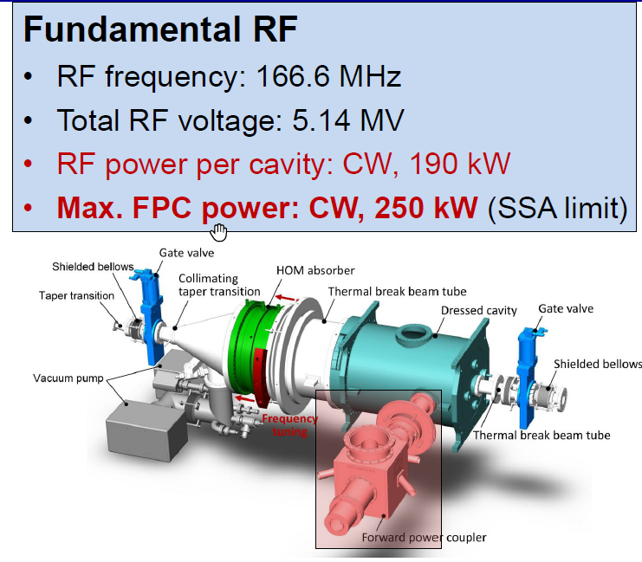
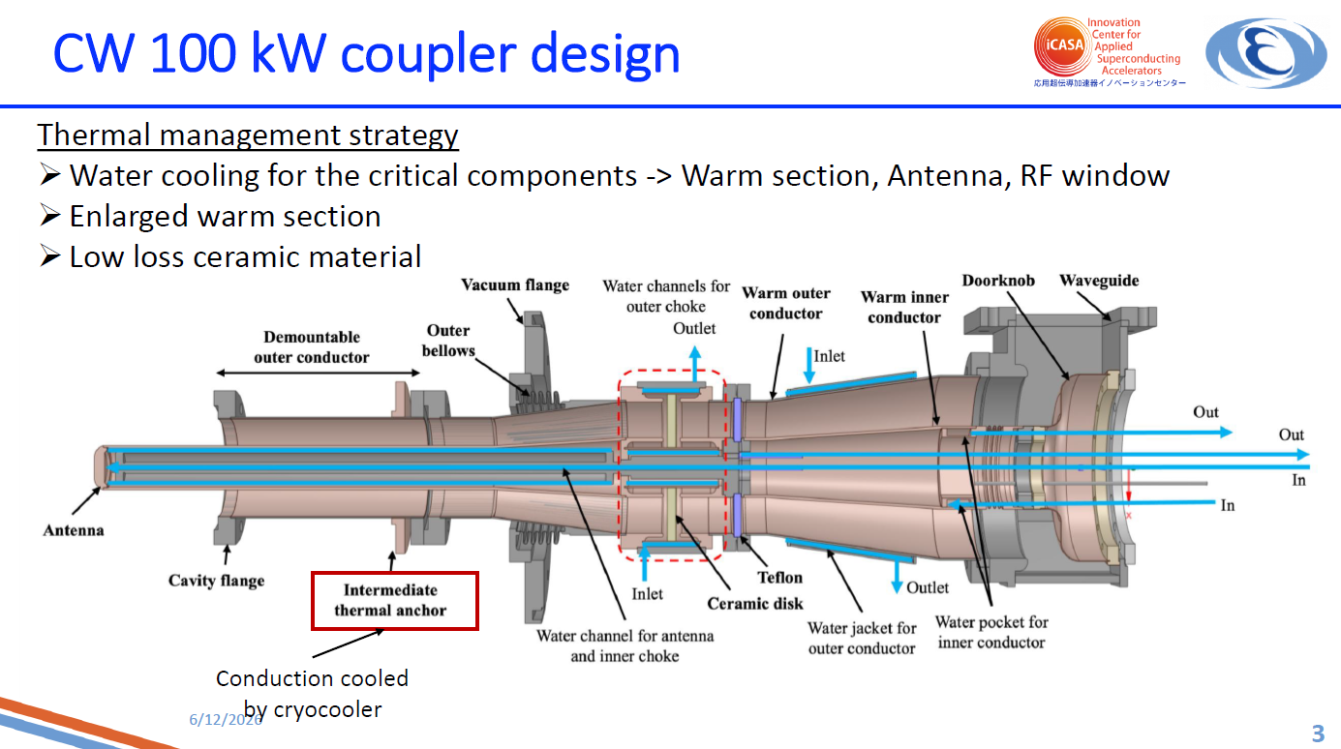
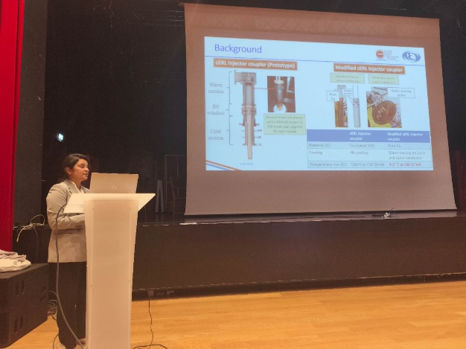
Session 2 Summary: High Power FPC
Tongming Huang (IHEP) – 166.6 MHz FPC for HEPS
Pragya Nama (KEK) – 1.3 GHz CW 100 kW coupler
Demonstrate record CW operation up to 250 kW at 166 MHz with effective overheating and false‑arc mitigation, and the first 100 kW CW at 1.3 GHz with validated thermal management and multipacting conditioning, advancing the state of the art for high‑current SRF accelerators.
Notes:
Tongming Huang (IHEP) – 166.6 MHz FPC for HEPS
Demonstrated CW operation up to 250 kW (traveling wave) and 150 kW (standing wave) after systematic prototyping.
Solved overheating at the cavity‑coupler interface by elongating the Nb extension tube (80 → 120 mm) and optimizing helium gas cooling, raising $Q_{0}$ from 4×10⁸ to >1×10⁹ at 1.5 MV.
Identified and mitigated false arc triggers caused by beam‑loss‑induced X‑rays using logic‑based discrimination, reducing interlocks from 31 % to 18 %.
These solutions provide a design roadmap for high‑power, CW‑capable fundamental power couplers for low‑frequency SRF cavities.
Pragya Nama (KEK) – 1.3 GHz CW 100 kW coupler
Achieved world‑first CW 100 kW power transmission for 10 hours without interlock, using water‑cooled inner/outer conductors, an enlarged warm section, and fan cooling.
Identified a multipacting band (20–55 kW) that matched simulations and was conditioned away.
The work establishes a practical thermal management strategy and conditioning procedure for multi‑100 kW CW couplers, essential for future high‑current ERLs and colliders.

Slide 8
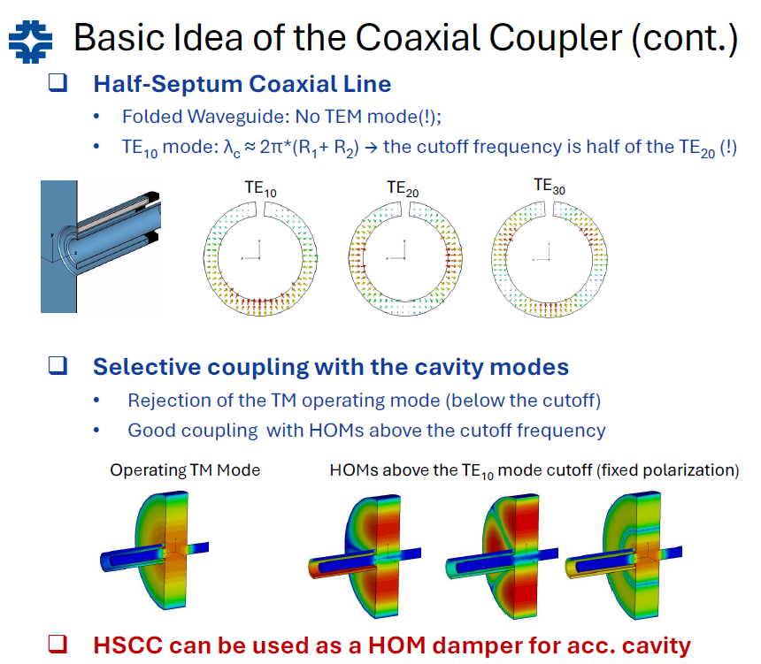
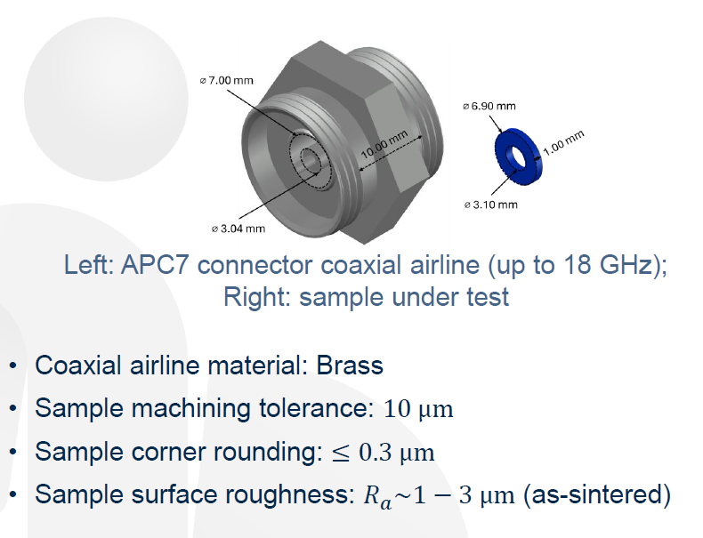
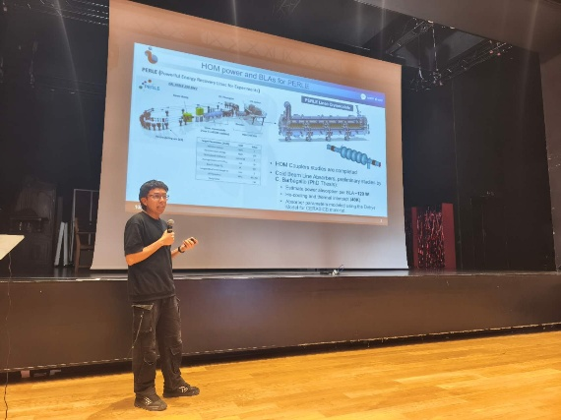
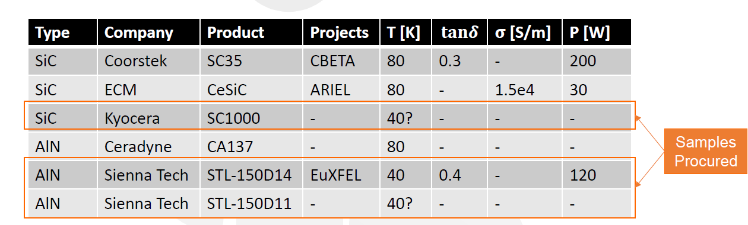
Session 2 Summary: HOM damper
A. Lunin (Fermilab) – Coaxial HOM damper
Axel Perez Ruiz (IJCLab) – Cryogenic beamline absorber materials
Advancing future HOM couplers toward higher reliability and broadband performance for high-current SRF cavities.
Notes:
A. Lunin (Fermilab) – Coaxial HOM damper
Proposed a compact on‑axis coaxial coupler / half‑septum design that provides omnidirectional HOM coupling while rejecting the operating mode via a high‑pass filter effect.
Demonstrated practical implementations: a 53 MHz SRF cavity for Fermilab’s Main Injector and a 394 MHz crab cavity for the EIC, showing effective damping of dipole and monopole HOMs with external $Q$ below 2×10⁴.
Addressed multipacting by reducing the coaxial gap to move into a MP‑free zone.
This offers a compact, mechanically simple alternative to bulky waveguide HOM dampers for low‑frequency SRF cavities.
Axel Perez Ruiz (IJCLab) – Cryogenic beamline absorber materials
Surveyed candidate materials (SiC, AlN, ferrites) and identified strong vendor‑ and batch‑dependent variability, highlighting the need for direct cryogenic RF characterization.
Designed and procured a dedicated test stand (APC7 coaxial airline, LN2 cryostat) at IJCLab to measure permittivity and loss tangent down to cryogenic temperatures.
Benchmark room‑temperature data on Kyocera SC1000 (200 MHz–35 GHz) provide a reference for FCC‑ee and EIC.
The work supports reliable HOM absorber selection for high‑current SRF facilities (PERLE, EIC, future colliders) where uncontrolled HOM power leads to beam instability and cryogenic load.

Slide 9
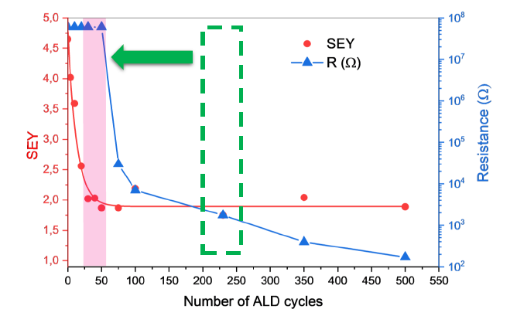
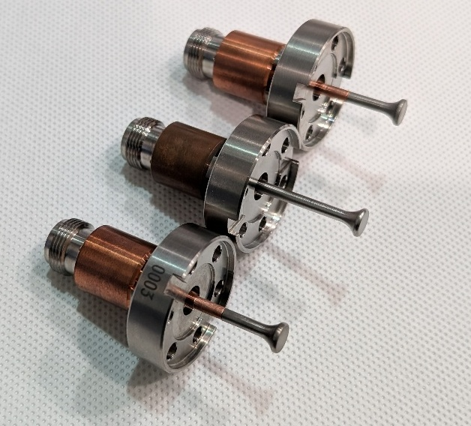
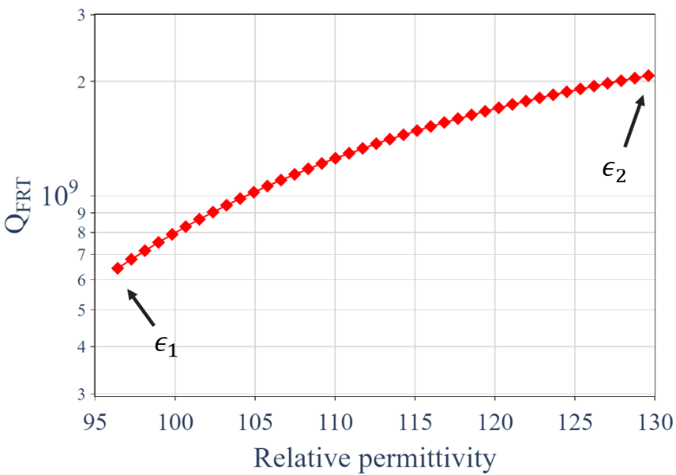
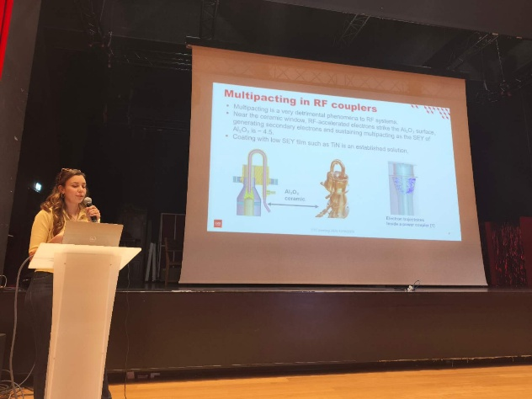
Session 2 Summary: Coupler & Tuner
Y. Kalboussi (CEA) – ALD TiN coating for ICONE couplers
F. Hug (JGU Mainz) – Fast ferroelectric tuner & Nb₃Sn‑coated HOM antennas
Designed a thermal management system (80 K N₂ gas cooling) to keep the ferroelectric at 50 °C while limiting heat leak to the cavity to ~1 W.
Explored Nb₃Sn‑coated HOM antennas to increase the thermal margin for high‑current operation
This ALD approach enables precise, conformal low‑SEY coatings on complex coupler ceramics, offering an alternative to sputtered TiN with better control and less risk of shorting.
Notes:
Y. Kalboussi (CEA) – ALD TiN coating for ICONE couplers
Showed that 1.5 nm TiN deposited by atomic layer deposition (ALD) on Al₂O₃ windows reduces secondary electron yield (SEY) effectively, while thicker films (5 nm) become too conductive.
Solved reproducibility issues by first coating a 10–20 nm Al₂O₃ buffer layer to reset surface chemistry, achieving resistivity >10 MΩ·m.
This ALD approach enables precise, conformal low‑SEY coatings on complex coupler ceramics, offering an alternative to sputtered TiN with better control and less risk of shorting.
The technique is directly applicable to mitigating multipacting in RF couplers for high‑power SRF linacs.
F. Hug (JGU Mainz) – Fast ferroelectric tuner & Nb₃Sn‑coated HOM antennas
Developed a ferroelectric‑based fast reactive tuner (FRT) using BST‑M ceramics (τ < 30 ns) to actively cancel microphonics (±25 Hz). Simulations show it can reduce required forward RF power by a factor of 12 (from >3 kW to <0.3 kW) for an ERL cavity.
Designed a thermal management system (80 K N₂ gas cooling) to keep the ferroelectric at 50 °C while limiting heat leak to the cavity to ~1 W.
Explored Nb₃Sn‑coated HOM antennas to increase the thermal margin for high‑current operation (10 mA class). Although initial tests showed field emission, the approach opens a path to handle >1 W per HOM antenna without quenching.
These innovations enable higher beam current and lower RF power consumption in CW ERLs (e.g., MESA), directly addressing the limits posed by HOM heating and microphonics.

Slide 10
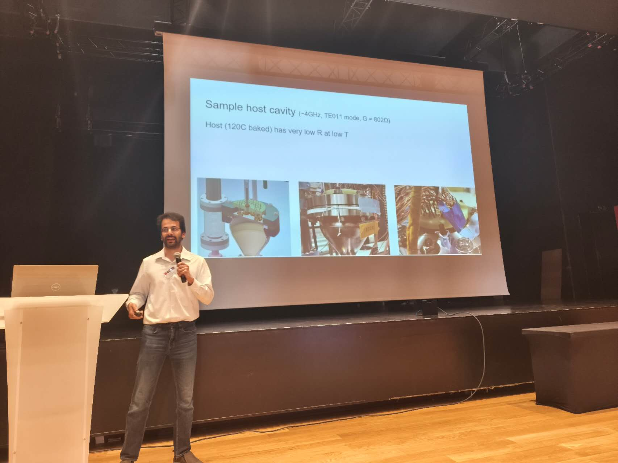
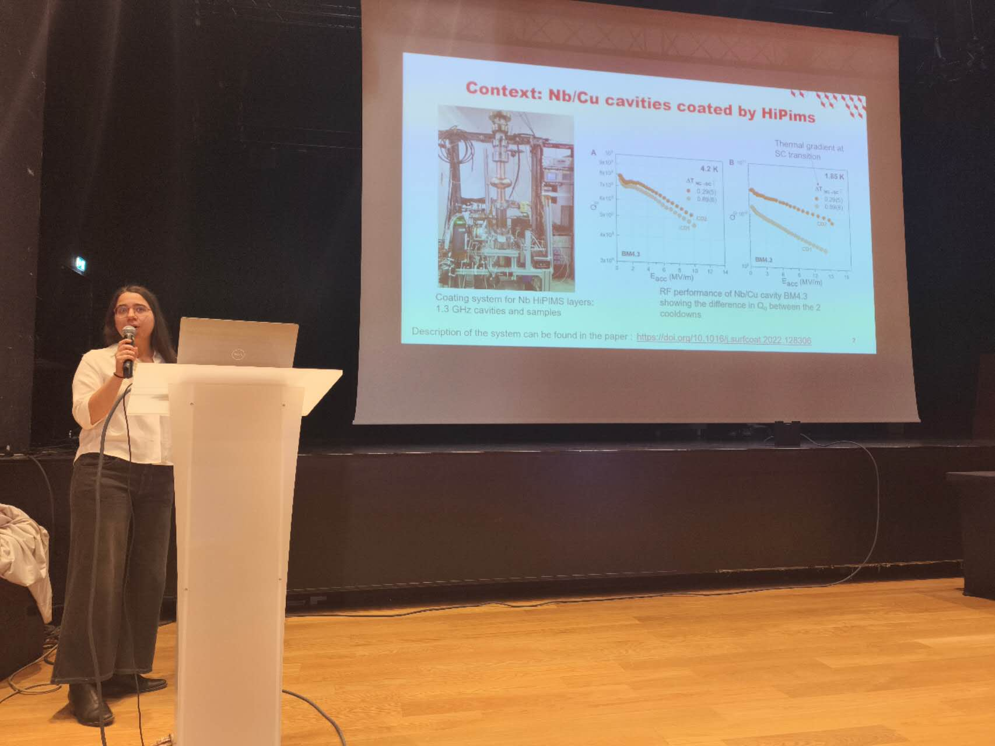
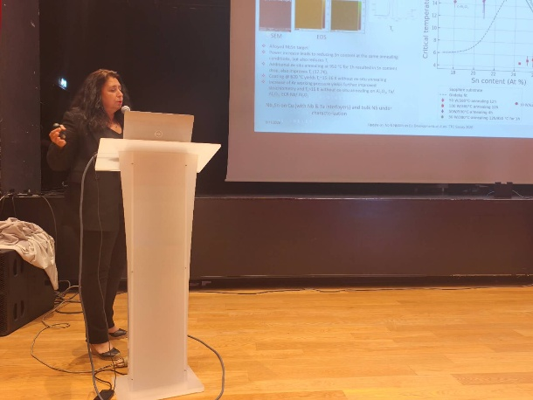
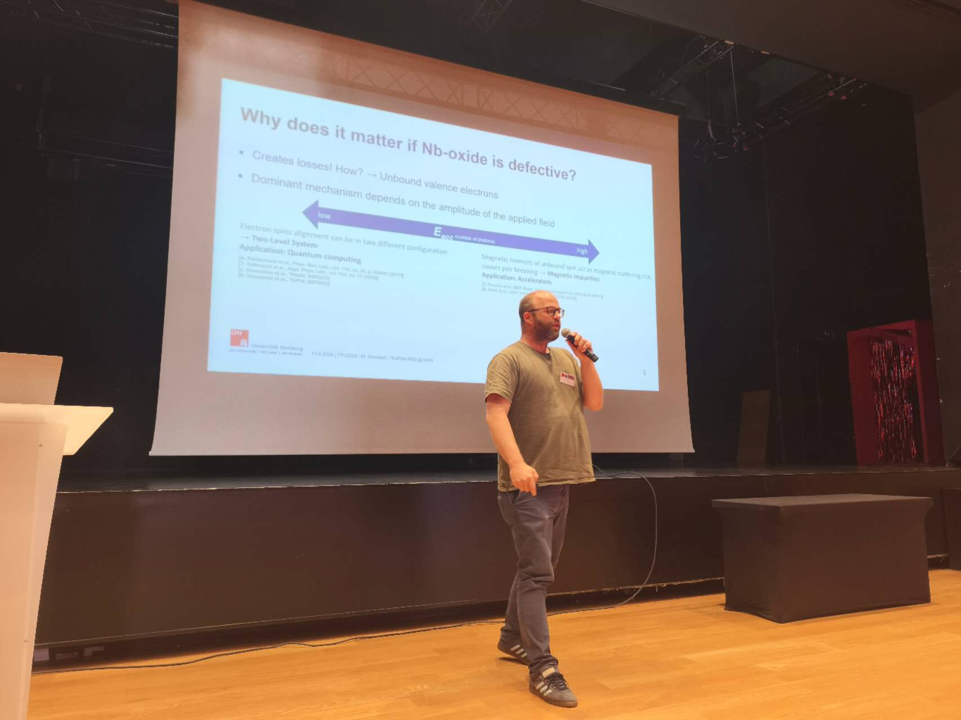
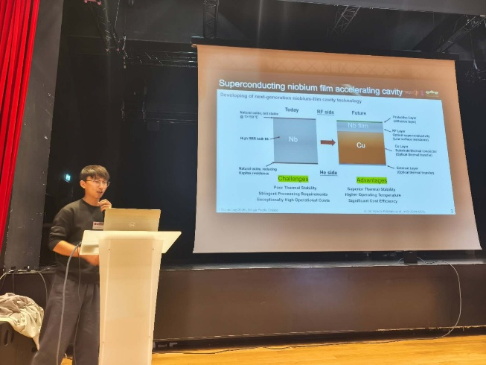
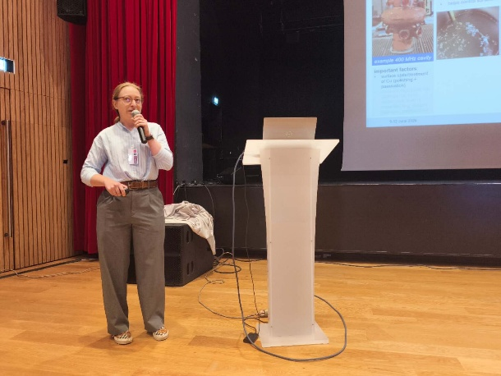
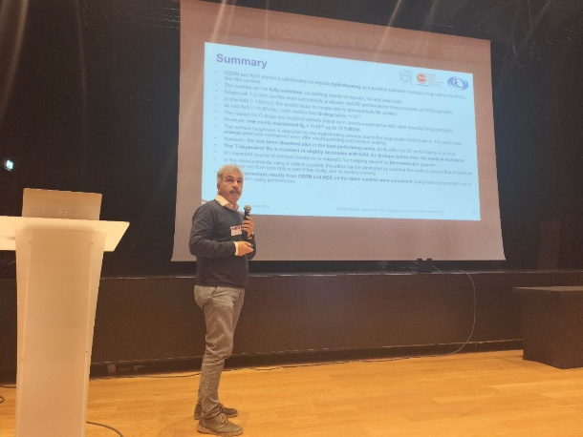
WG3 Summary: Material 1
Keywords | Presentations
Nb/Cu thin-film cavities (HiPIMS, substrates, upscaling) | Peng Dong (ShanghaiTech) Caroline Hain (CERN) W. Venturini Delsolaro (CERN/KEK) A.-M. Valente-Feliciano (JLab)
Alternative materials & multilayers (Nb₃Al, Nb₃Sn) | Nathan Sitaraman (Cornell) A.-M. Valente-Feliciano (JLab)
Surface passivation & interlayers (ALD) | Marc Wenskat (Hamburg) Ivana Curci (CEA/CERN)

Slide 11
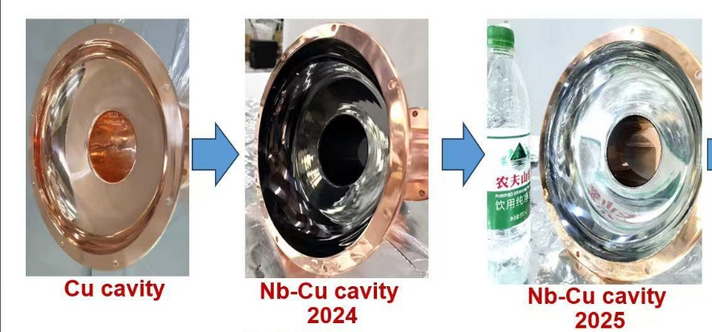
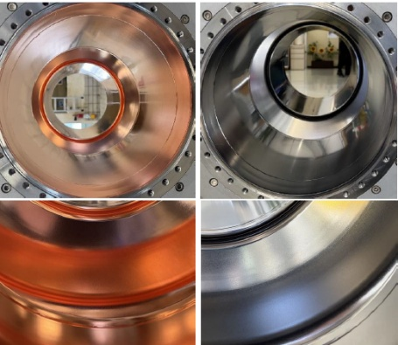
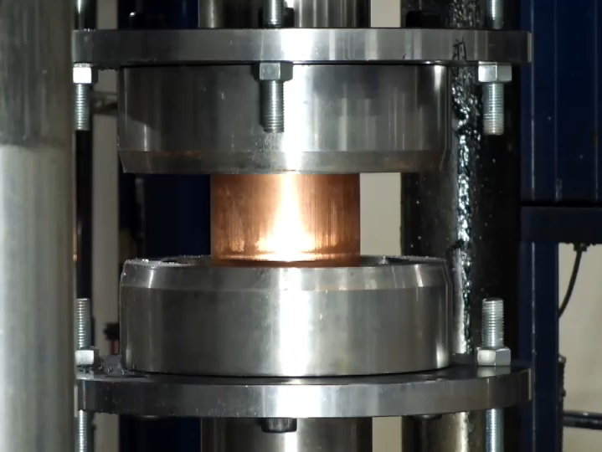
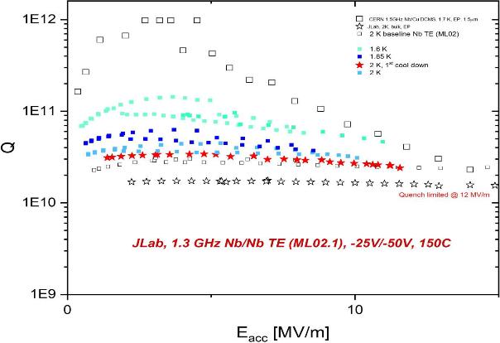
Session 3 Summary: Nb/Cu thin-film cavities
HiPIMS is now the dominant deposition technique for Nb/Cu cavities, delivering higher plasma density (~10¹⁹ m⁻³) vs. DCMS, leading to denser films and improved Q₀.
ShanghaiTech (Peng Dong) developed a second-generation high-energy pulsed magnetron sputtering (HiPIMRS) system with significantly enhanced film homogeneity, in-situ plasma cleaning for adhesion, and successful Nb films on Cu with T_{c} = 9.2 K.
CERN (Caroline Hain) demonstrated that 1.3 GHz cavities can meet FCC specifications (Q₀ > 1×10¹⁰ at 20 MV/m). Upscaling to 400 MHz faces challenges: larger surface area, handling, oxidation prevention, and limited safe passivation solutions. HiPIMS improves Q₀ but FCC specs not yet met at 400 MHz.
KEK/CERN collaboration (Venturini Delsolaro) produced fully seamless hydroformed 1.3 GHz Cu cavities. One cavity (C3b) maintained Q₀ > 1×10¹⁰ up to 17.5 MV/m. Key findings: Q-drop originates from residual resistance due to magnetic flux trapping from thermoelectric currents – mitigated by slow cooling and thermal shielding. Surface roughness (orange-peel) after hydroforming did not clearly correlate with RF performance.
JLab (Valente-Feliciano) confirmed no intrinsic Q-slope limitation for Nb films using energetic condensation (HiPIMS). However, film poisoning (N₂ leak) and facility issues (bacteria in cooling water) hindered progress – highlighting the importance of process control.

Slide 12
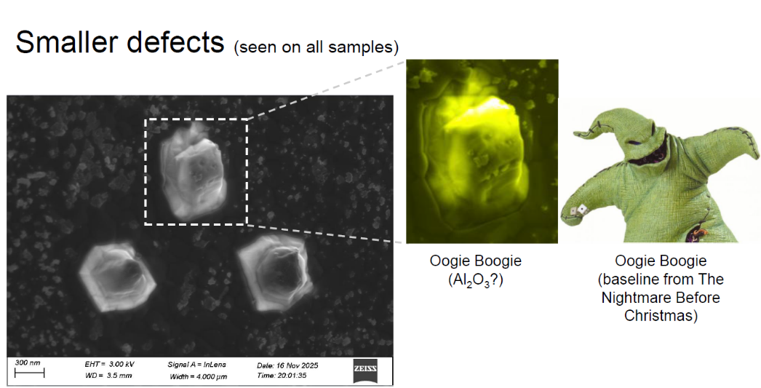
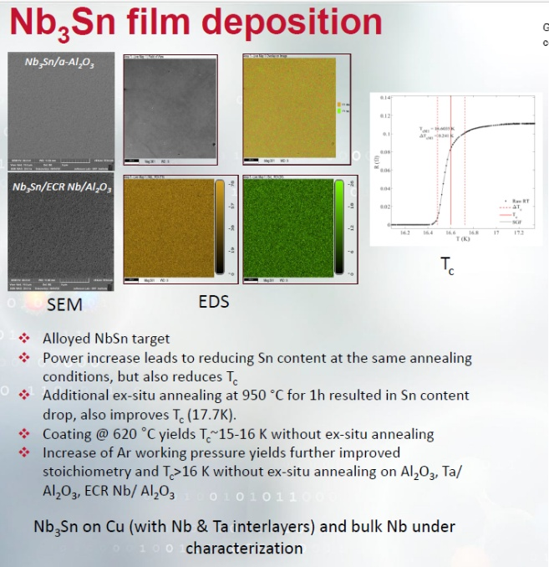
Session 3 Summary: Nb₃Al & Nb₃Sn
Nathan Sitaraman (Cornell) presented ultra-thin Nb₃Al-Nb multilayers (~200–400 nm) with remarkable tolerance to disorder – minimum A15 T_{c} remains 10–11 K (vs. 5–6 K for Sn-depleted Nb₃Sn). Best results: 400 nm Nb₃Al + chemistry achieved 74 mT (limited by Q-slope, not quench) with estimated residual resistance ~0.4 μΩ and Q > 1×10¹⁰ at 4.2 K. Defects (oxide blobs, dust particles) were identified but did not completely kill performance – reflecting the “forgiving” nature of Nb₃Al. Next: superheating field measurements.
Valente-Feliciano (JLab) on Nb₃Sn: DC sputtering from alloyed Nb₃Sn targets requires substrate T > 600 °C, high Ar pressure (1e-2 mbar), and low current density. T_{c} > 16 K achieved on Al₂O₃, Ta/Al₂O₃, and ECR Nb/Al₂O₃. On Cu, interlayers (Nb, Ta) are mandatory to prevent Sn diffusion. Work is ongoing to refine deposition and move to cavity coating.

Slide 13
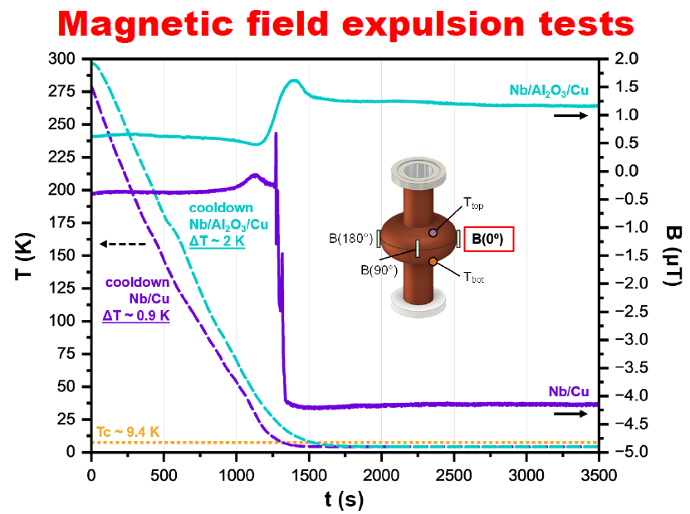
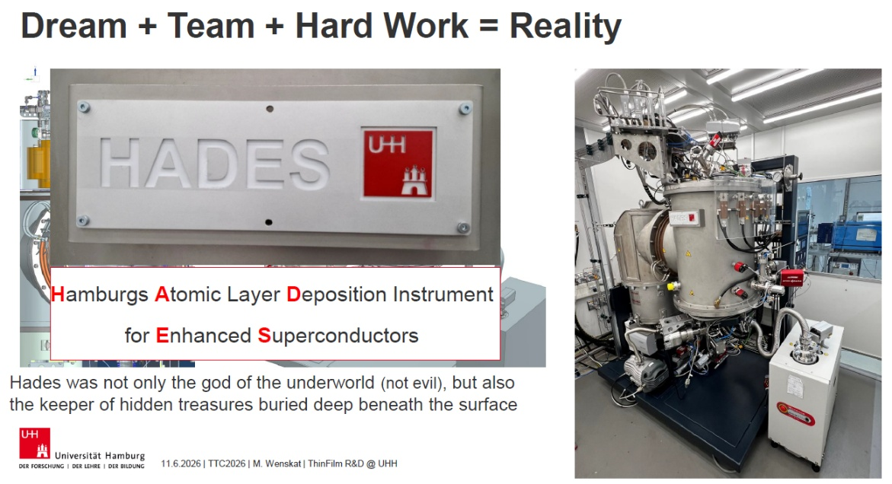
Session 3 Summary: ALD Applications
Thermoelectric Current Suppression via ALD Interlayers
Ivana Curci (CEA/CERN) demonstrated that an Al₂O₃ interlayer (by ALD) between Cu and Nb reduces trapped magnetic flux from ~4 μT to ~1 μT during cooldown, effectively suppressing thermoelectric currents. The Nb/Al₂O₃/Cu cavity showed less cooling-rate dependence, though the Q-slope was more pronounced – possibly due to the interlayer or external factors. Superconducting properties (PcTS, XRD) remained unchanged from bulk Nb. Next steps: optimize thickness and materials for electrical insulation + thermal conductivity.
Surface Passivation & Oxide Engineering
Marc Wenskat (Hamburg) reported that 18 nm Al₂O₃ by thermal ALD on Nb reduces the TLS loss tangent (F·δ_TLS) by a factor of 2 compared to native Nb₂O₅, due to passivation preventing Nb-oxide regrowth. The group is commissioning HADES – a versatile cavity coating system (PEALD + thermal ALD) for NbTiN, AlN, Ta₂O₅, etc., with in-situ annealing.

Slide 14
WG4 – Session 4 - Nb₃Sn
6 talks
4 different coating technologies
DC Magnetron Sputtering
Co-Sputtering
Bronze Route
Vapor Tin Diffusion

Slide 15


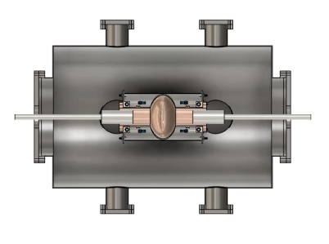
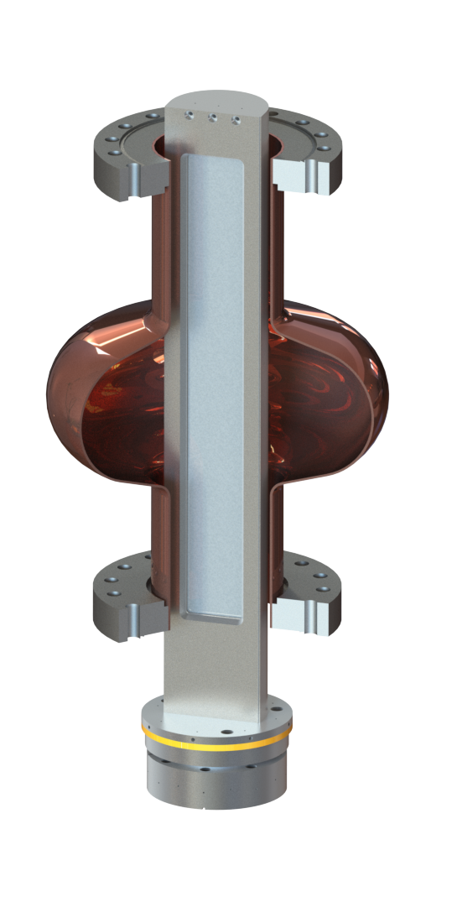
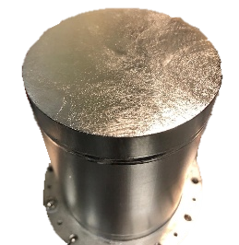
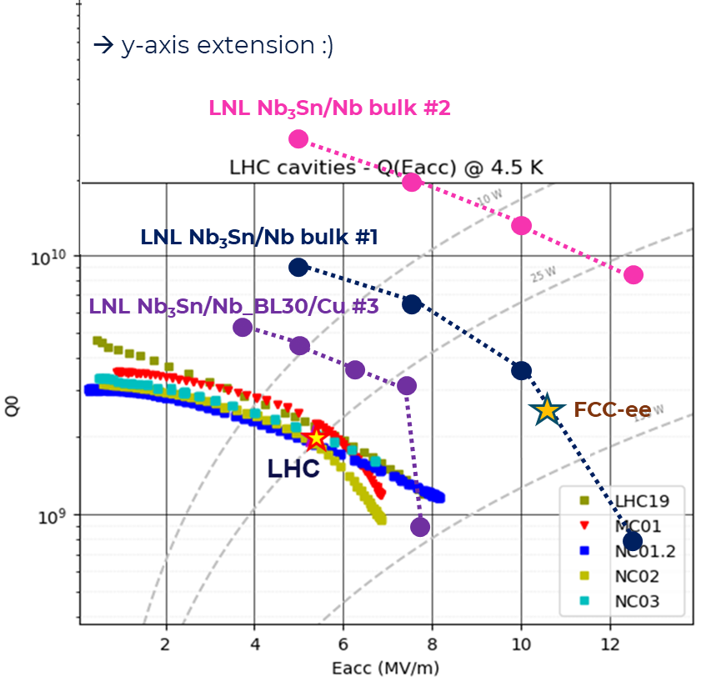
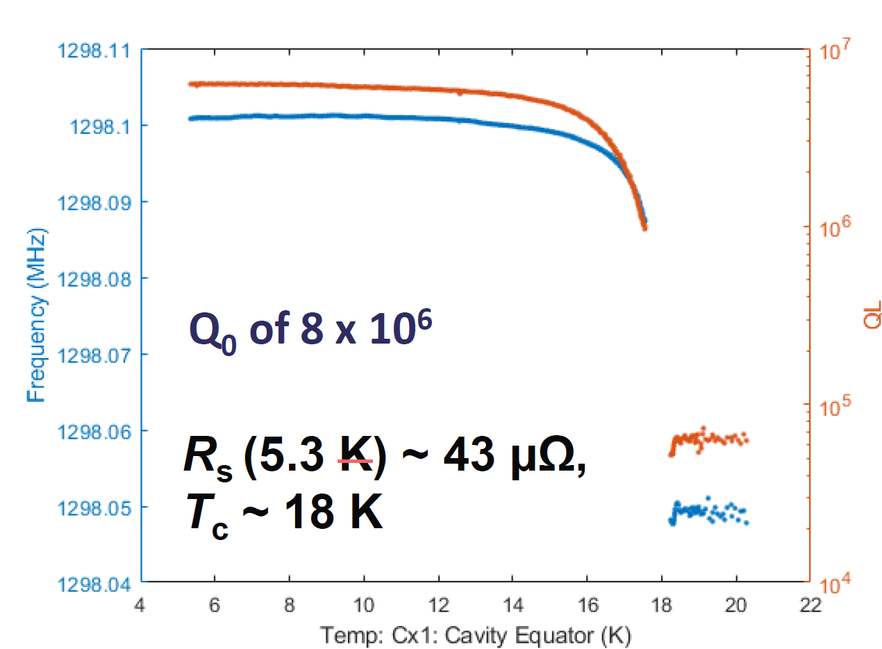
DC Magnetron Sputtering
Matteo Lazzari
Reza Valizadeh
Double movable magnetrons
Fixed cavity
Rectangular magnetron
Rotating Cavity
First test on 1.3 GHz Nb3Sn on Nb
Cu contamination kill the performance
State of the art RF performances on QPR

Slide 16

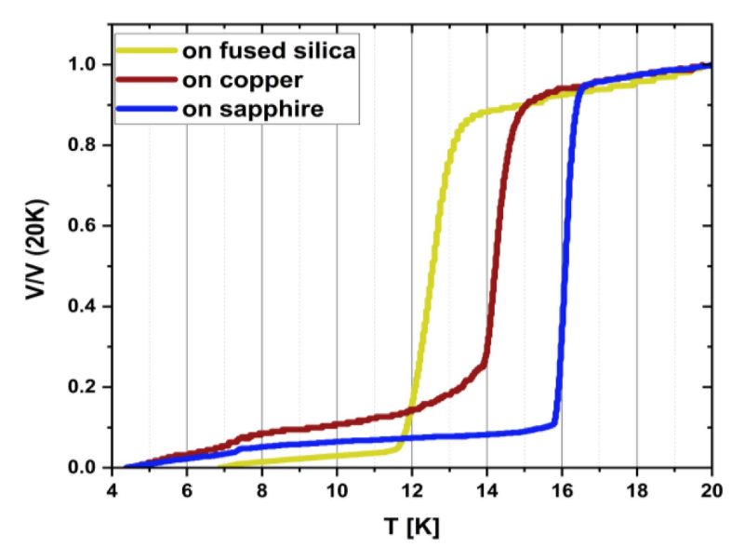
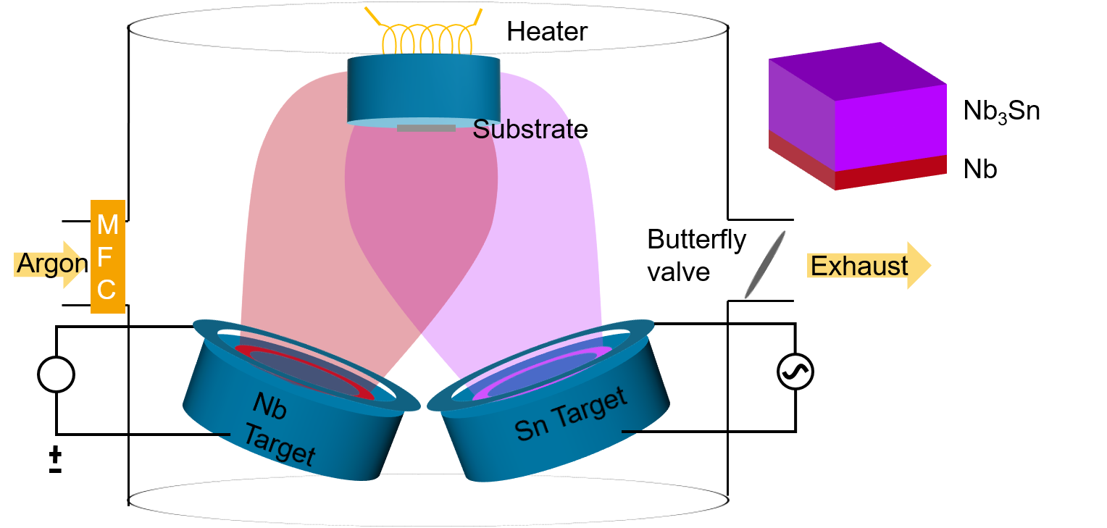
Nb-Sn Co-sputtering
Marton Major
Substrate strongly influence Nb3Sn microstructure and SC properties (similar to DC-MS)
Critical temperature as shown by the shielding effect of thin films deposited on different substrates at a substrate temperature of 500 °C

Slide 17


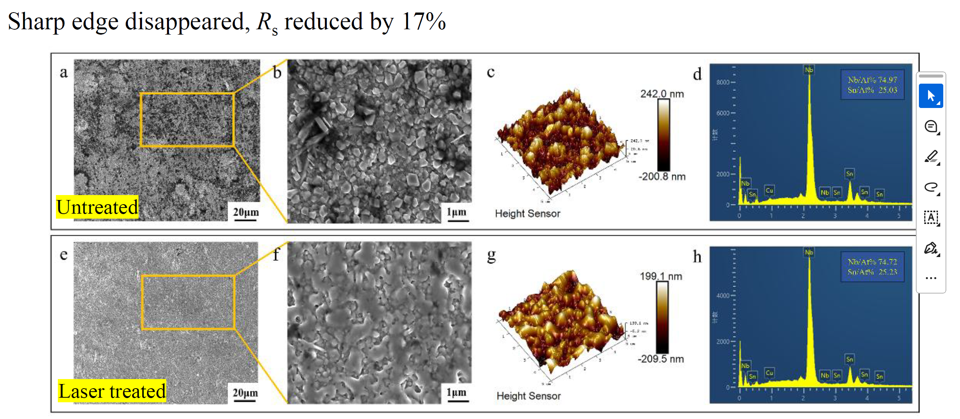
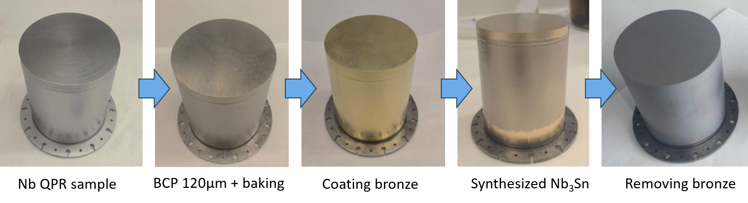
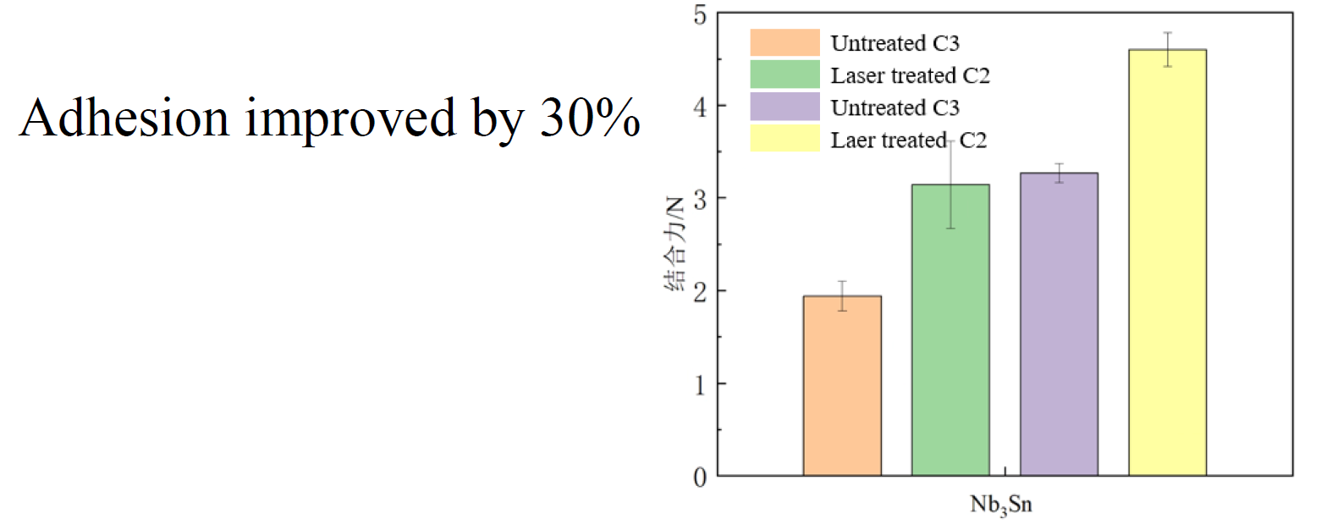
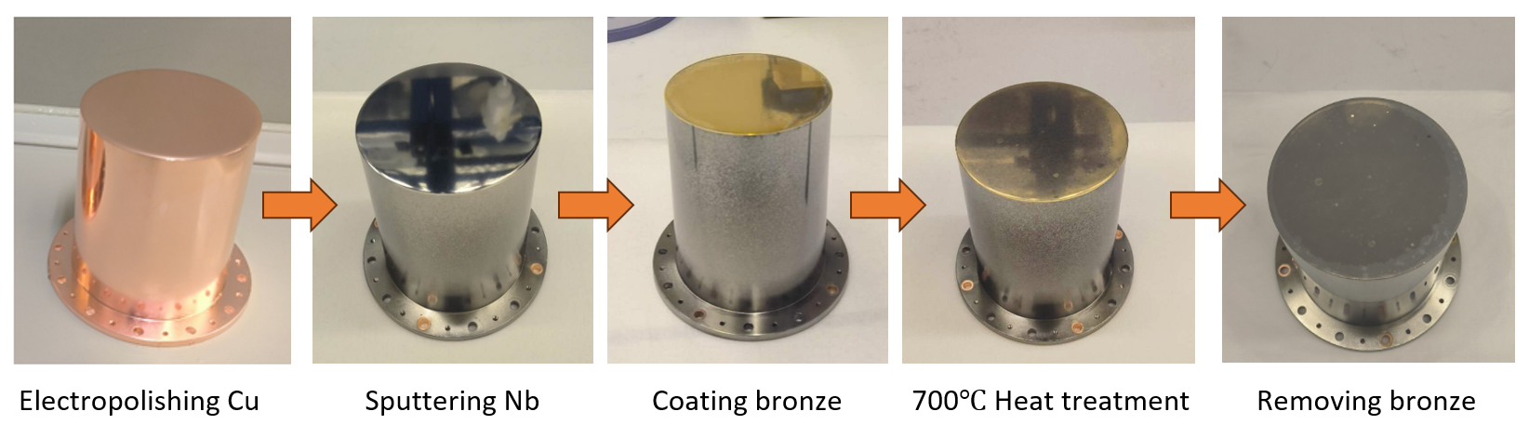
Bronze Route
Teng Tan
Ming Lu
BRONZE ROUTE + LASER TREATMENT
Nb BULK SUBSTRATE - R_{s}=17.1 nΩ @4 K, 20 mT, 417 MHz
Cu SUBSTRATE - R_{s}=46.0 nΩ @4 K, 20 mT, 413 MHz

Slide 18

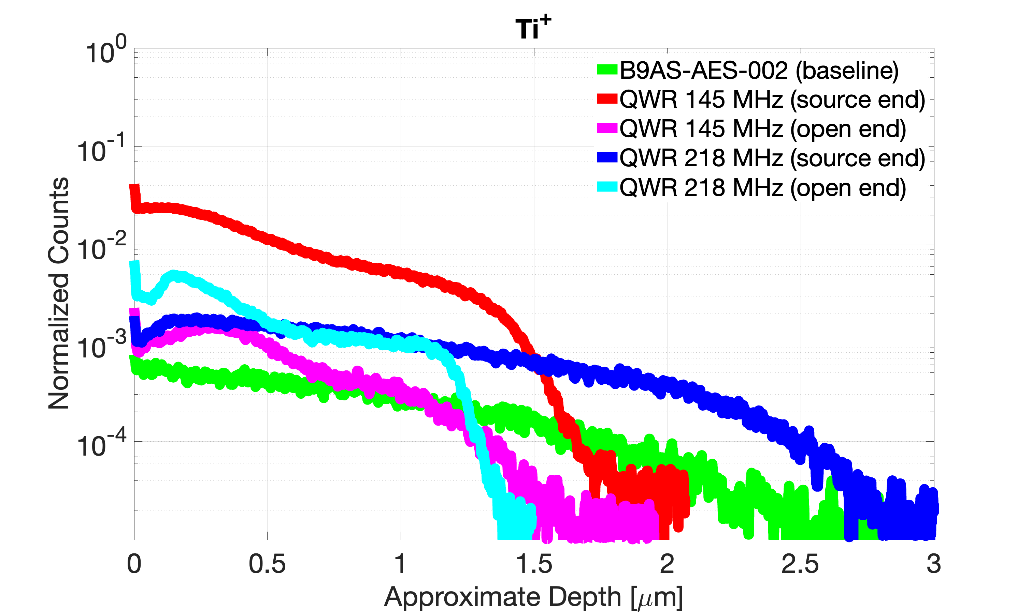
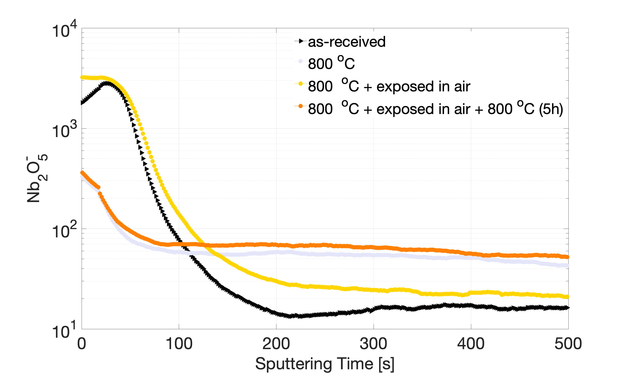
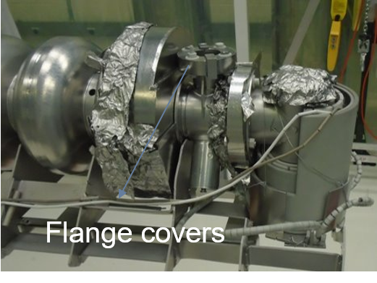
Vapor Diffusion
Nikki Tagdulang
Titanium Contamination by the flanges
Oxide Dissolution
No correlation between current titanium levels and RF performance
800 ºC/1h enough to dissolve oxide
→ Sn concentration level remains within acceptable range
We really need flange covers?

Slide 19
Take home message
Substrate matter!
→ Best SC properties on Nb rather than Cu
Laser treatment is a prominsing post-treatment route to explore
Room for improving and simplify VTD coating set-up and procedure
First results on alternative Nb₃Sn coating techniques very promising:
stay tuned!
→ Discussion will continue at SRF Thin Film Workshop in Chester (UK),
21-25 September 2026 (abstract submission open)

