Slide 1

Report of TTC-TB meeting
at CEA – CNRS – Universite Paris Saclay
2026, Jun 10
Co-chairs
Hiroshi Sakai (KEK)
Detlef Reschke (DESY)
Decisions/discussions of the discussion during the meeting marked in this color.

Slide 2
Outline
Renewal, present member list + attendance
SPC meetings
Discussions
Proposal of WG-organization at the next TTC
Topics for in-depth discussion at the next TTC
Others

Slide 3

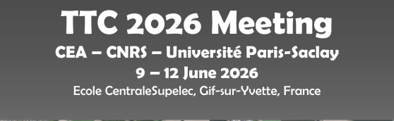
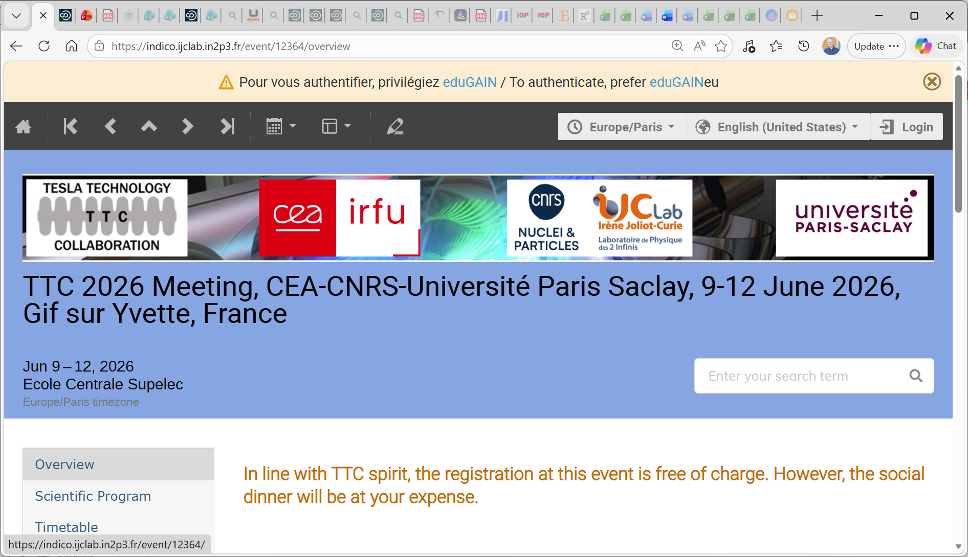
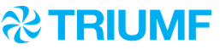
TTC-Technical Board renewed (by Bob)
The TTC Technical Board is made up of community experts who advise the TTC-EC about focus topics for the next TTC meeting and provide WG coordination – they are not lab representatives
The TTC-TB inputs are used to set the Working Group topics and inform the scientific program.
The TTC-TB has been renewed over the last six months with 13 new members with a focus to balance the regions and improve the gender balance.
27 Members (EU=9, NA=9, Asia=9)
Improved gender equity: now 9/27 (33% women from 22%)
Co-chairs
H. Sakai (KEK) and D. Reschke (DESY)
Cavity and couplers (13)
R.L. Geng (JLAB)
J. Hao (PKU)
K. Umemori (KEK)
J.Y. Zhai (IHEP)
D. Longuevergne (IJCLab)
N. Sakamoto (RIKEN)
L. Monaco (INFN Milano)
P. Dhakal (JLab)
Sang-Ho Kim (SNS)
Franck Peauger (CERN)
Suba de Silva (ODU)
Kellen McGee (FNAL)
Yasmine Kalboussi (Saclay)
RF and tuning (3)
Guillaume Devanz (Saclay)
Crispin Contreras-Martinez (FNAL)
Jinfang Chen (SARI)
Cryomodule and cryogenics (6)
S. Barbanotti (DESY)
Han Li (IASF)
L. Popielarski (FRIB)
Yongkwon Kim (RAON)
Teng Tan (IMP)
Cecilia Maiano (ESS)
Integration and operation (3)
J. Branlard (DESY)
Silvia Verdu Andres (BNL)
Zhongyuan Yao (TRIUMF)
 | Europe | NA | Asia | Total
Male | 5 | 5 | 8 | 18
Female | 4 | 4 | 1 | 9
Totals | 9 | 9 | 9 | 27
* observer status for full TTC-EC plus honoris causa
TTC-2026 June 9, 2026 Bob Laxdal

Slide 4
TTC-TB members
Number of TB members fixed to 27
Thanks to - Michiru, Sebastian & Alan -> changed to the EC & CB
- Sergio, Tug, John, Axel, Matthias, Frank, Martina, Alexander, Curt & Zac
Welcome to all new members!
Reminder:
Technical Board is a board of individual experts based on their expertise in the respective field.
It is not a representation of all or a subgroup of the TTC labs.

Slide 5
Attendees TTC-TB (2026, Jun 09)
Co-chairs
H. Sakai (KEK)
D. Reschke (DESY)
Total TB members= 27
(EU=9, NA=9, Asia=9)
gender balance: 8/27
TTC 2026
participation = 18 of 27
+ EC / chairs
gender balance: 5/18
Cavity and couplers
Rongli Geng (JLAB)
Jiankui Hao (PKU)
Kensei Umemori (KEK)
Jiyuan Zhai (IHEP)
David Longuevergne (IJCLab)
Naruhiko Sakamoto (RIKEN)
Laura Monaco (INFN Milano)
Pashupati Dhakal (JLab)
Franck Peauger (CERN)
Subashini da Silva (ODU)
Kellen Mc Ghee (FNAL)
Yasmine Kalboussy (CEA)
Sang-Ho Kim (ORNL)
RF and tuning
Crispin Contreras-Martinez (FNAL)
Jinfang Chen (SARI)
Guillaume Devanz (CEA)
Cryomodule and cryogenics
Laura Popielarski (FRIB)
Serena Barbanotti (DESY)
Youngkwan Kim (RAON)
Han Li (IASF)
Teng Tan (IMP)
Cecilia Maiano (ESS)
Integration and operation
Sylvia Verdu Andres (BNL)
Julien Branlard (DESY)
Zhongyuan Yao (TRIUMF)
Honoris causa (observer)
C. Pagani (INFN)
M. Ross (SLAC)
H. Padamsee (Cornell)
W.-D. Moeller (DESY)
P. Pierini (ESS)
E. Kako (KEK)
Regional representatives (observer)
Catherine Madec (CEA Saclay)
Hans Weise (DESY)
Akira Yamamoto (KEK)
Gao Jie (IHEP)
Sergey Belomestnykh (FNAL)
Michiru Nishiwaki (KEK)
Sebastian Aderhold (SLAC)
TTC Chair (Observer)
Bob Laxdal, Anne-Marie Valente

Slide 6
SPC meetings + organization
Scientific Program Committee meeting by remote
(SPC members: David, Juliette, Anne-Marie, Catherine, Michiru, Eiji, Hans, Bob, Jie, Sergey, Akira, Sebastian, Hiroshi, Detlef)
16 SPC meetings held: well-organized by LOC chairs
Beginning with 7th meeting we added participation of WG conveners
Smooth and effective organization of scientific program incl. convenors activities
Few Visa issues; effective handling of invitation letters
The indico site was prepared quickly for ensuring important and effective information.
=> thanks to David, Juliette and all LOC members
Thanks to all the WG and Hot Topic convenors!

Slide 7
Participants
Location | Date | Participants | Parallel | WGs
CEA-CNRS-Univ. Saclay Paris | 2026, June | ~195 | 2-para | 4 WG’s
IBS | 2025, Apr. | ~180 | 2-para | 4 WG’s
ESS | 2024, Nov. | ~180 | 2-para | 4 WG’s
Fermilab | 2023, Dec. | ~190 | 2-para | 4 WG’s
QST | 2022, Oct. | ~120 | 2-para | 4 WG’s
QST/KEK (remote) | 2022, Jan. | 304 | 2-para | 2 WGs
DESY (remote) | 2021, Jan. | 260 | 2-para | 2 WGs
CERN | 2020, Feb. | 187 | 2-para | 4 WGs
TRIUMF | 2019, Feb. | 108 | 2-para | 4 WGs
RIKEN | 2018, June | 140 | 2-para | 4 WGs
INFN-Milano | 2018, Feb. | 178 | 2-para | 4 WGs
MSU | 2017, Feb. | 123 | 2-para. | 4 WGs
CEA-Saclay | 2016, July | 127 | 2-para. | 4 WGs
SLAC | 2015, Dec. | 130 | 2-para. | 4 WGs
We kept two parallel sessions and 4 WG’s except for remote meeting.

Slide 8
Outline
Updated member list
Report from SPC meetings + scientific program
Discussions
Proposal of WG-organization ad topics at the next TTC
Plenary talks
Hot topic
Others

Slide 9
WG-organization for next TTC
Parallel sessions => Two
How many WG’s? => Four?
To be discussed at first SPC meetings depending on decision of WG’s:
Reduce to 3 WG’s with 1 WG in plenary (interesting for all/most) + 2 WG in parallel
First SPC meeting for the next TTC → start in August 2026
(Final decision on WG’s & invited talks, invitation of plenary speakers, visa situation, ….)
Convenors to be encouraged to guide the session by list of “provocative” questions: stimulate discussion;
avoid conference style with a series of talks
Addendum Social Event:
Proposal to ask all speakers to bring up their open topics, questions, challenges to the audience
In case of overlapping topics: Joining of WG’s can be considered + helpful.
History of WG topics to assist the definition of the program of future meetings is prepared
Probably we keep the scheme of the last meetings

Slide 10
WG topics for next meeting
  This meeting
  WG1: Latest Activities on High-G and High-Q performances
  WG2: Effective operation of aging machines for performance and reliability
  WG3: R&D for Mass production and Quality assurance for accelerator modules
  WG4: R&D challenges for future advanced projects
  Discussed
  “WG High Q/High G” not as a full WG
  => to be discussed in SPC
  WG: “Effective operation of aging machines for performance and reliability”
  -> decided: keep for the next meeting

Slide 11
WG topics for next meeting II
  Machine Learning and Artificial Intelligence for SRF applications
  various examples for accelerator operation e.g. performance tuning, set-up to meet operation points, rf conditioning routines, general rf measurement tasks; cryo operations; AI assisted rf design of cavities
  Q: What do we do "by hand" and where do we use programs? Does it make a difference? Is it worth it for a procedure that we do very rarely? ... “
  -> What are applications for AI / machine learning at SRF?
  -> no final conclusion for WG; possibly special seminars / invited talks about dedicated topics: operation, inspections (pattern recognition)
  Problems/challenges with cryoplants
  invite especially cryo people;
  What about the 4kW limit for cryoplants?
  Special types of cavities (WG at TTC2023)
  Superconducting injectors with cathodes & crab cavities

Slide 12
WG topics for next meeting III
Standardization of VT results (cavity performances)
We had this topic and discussions in the past; important for esp. in-kind contributed projects
definition of key parameters for VT + CM test:
rf calibration techniques
important diagnostics
fast cool down protocols
active cancellation & passive shielding of magnetic fields
strategy to measure radiation; what is FE-free?
standardization of protocols
=> looks good as WG topic
Conduction cooling based accelerator
becoming increasingly interesting in the community; fast progress
related to cryo cooler progress: only 2 main vendors?
=> possibly as invited talk for cryo cooler applications
=> decision in first SPC meeting (after this Hot Topic session)

Slide 13
WG topics for next meeting IV
  Nb material: new vendors
  Controversial discussion: all vendors have been at Riken, also at Lund, special session at Aomori
  => probably shifted to future meeting
  Future of ERL’s & experiences up to now
  Controversial discussion: What to study wrt SRF for ERL? What are the remaining questions?
  ERL workshop in Sep 2026 => plenary talk by Hiroshi at next TTC (as minimum)
  High power couplers
  What are the goals and required frequencies? Strongly related to roadmaps (Europe in this meeting; NA in next meeting)
  => Positive response as WG in next meeting

Slide 14
WG topics for next meeting V
  Operation with high Qext couplers
  most facilities actually operate at moderate Qext values (i.e. 1e7 or below).
  Future: experience from SHINE and LCLS-II HE, which had a target Qext of 4e7, but pushed to Qext to 6e7. Q: How does this change in Qext affects operation (sensitivity to microphonics, impact on RF overhead, impact onmachine availability, ie. more trips etc..)
  How the couplers heat-up during operation is also interesting....
  => next meeting maybe too early for LCLS2-HE; includes high Qext couplers => for 2028
  Origin of field emission activation during cryomodule operation
  collect possible sources, experimental effects during/after activation of field emission in
  a) cryomodule operation
  b) after shutdown (warm-up / cool-down)
  What remedies and strategies in various labs exist? Risks for deteriotion by processing
  => Decided as WG topic

Slide 15
Plenary talks: List of this meeting
This meeting:
SRF activities at CEA
SRF phase transition at IJCLab: from TEM to elliptical cavities
European Strategy for SRF development
SRF Systems for the EIC Project
Development, commissioning and high-current CW operation of 166.6 MHz HOM-damped SRF modules at HEPS
Commissioning and current Status of HELIAC Project at GSI
LCLS-II-HE upgrade status/Recent Status of LCLS-II operation experience
RF commissioning of HIAF's iLINAC
Experience with recommissioning of the European XFEL after Long Installation and Maintenance Period
Typically 8-9 slots available.

Slide 16
Candidates for next plenary talks
Decided talks:
Report on SRF activities at organizing institute
North American Roadmap/strategy for SRF development
Report from ERL Workshop, Sep2026 (possibly part of WG, instead)
Proposals (decided at SPC meeting):
SNS: 20y of operation
Commissioning of SHINE linac (RF commission; experience on cryomodule production)
High Power Proton Linac at IMP
Summary on rf sources: (pros and cons of various sources)
Development and first results of a MW-class power coupler => probably as WG
Machine Learning for complex-topology RF cavity optimization: application to crab cavities => see WG discussion
Review of heavily damped cavity solutions
NMR results of superconductor behavior dependence on niobium surface treatment
PIP-II first results (cavities, modules) => string assembly procedures in WG3, this meeting
Status of PolFEL => invited talk at SRF25
New cavity design for fundamental physics (Non-accelerator fundamental physics with SRF cavity)
Experience from ESS commissioning => cryo experience in WG3, this meeting

Slide 17
“Old” candidates forplenary talks
“old” Proposals
SRF system of MYRRHA project
=> after discussion the project => still in phase 1 MINERVA => to be revisited for next meetings
Commissioning of DALS injector => to be revisited for next meetings

Slide 18
Hot Topic Session
This TTC: Developing SRF towards Turn-Key Industrial Systems
1. Conduction cooling 2. Nb3Sn on Copper
Proposals:
- Fabrication of SRF cavities with limited supply vendors (interested parties: FCC, EIC, …)
- SRF cavities in real environment conditions
(high-gradient operation of SRF cavities in the surroundings of coated beam pipes, e.g. SPS, EIC; use of cold traps to mitigate migration of particles and physisorbed gases into the SRF cavities)
=> to be decided in first SPC meeting

Slide 19
Special Seminars
Proposal by local host of next TTC meeting (as usual)

Slide 20
Any other comments for the next TTC??
Pre-meeting of TB by Zoom ~1 week before TTC?
=> this meeting: not initiated by Detlef => for next TB meeting
For next meeting(s):
- if possible: separate large room for plenary talks
- two smaller rooms for discussion of WG’s would be good => no microphone necessary
Your Questions and Comments?

Slide 21
Thank you for your attention.

