Slide 1
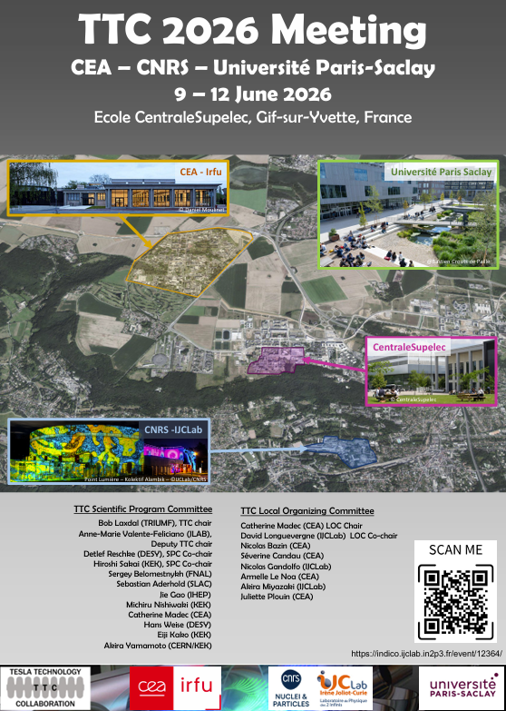
CLOSING of TTC2026

Slide 2
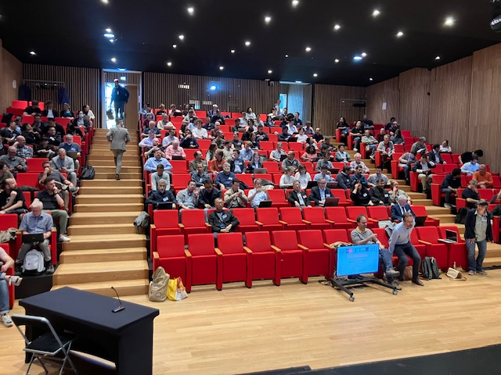
Attendance
197 participants

Slide 3
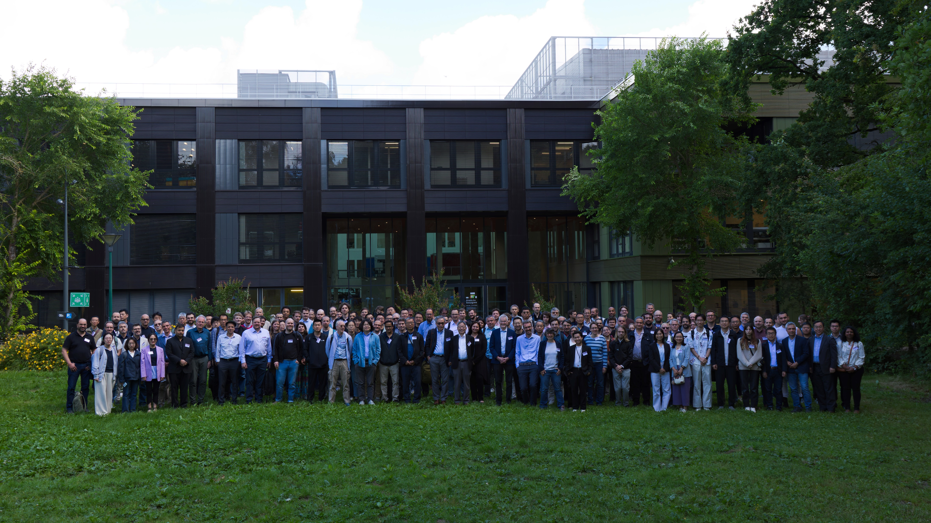

Slide 4
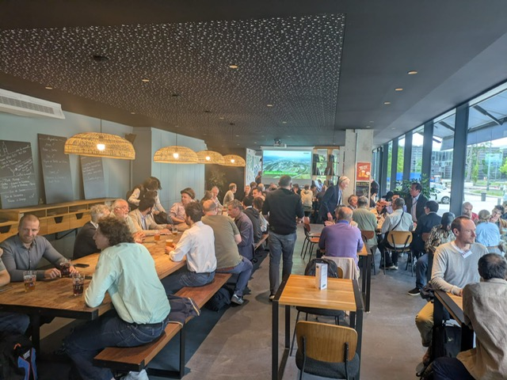
Social event

Slide 5
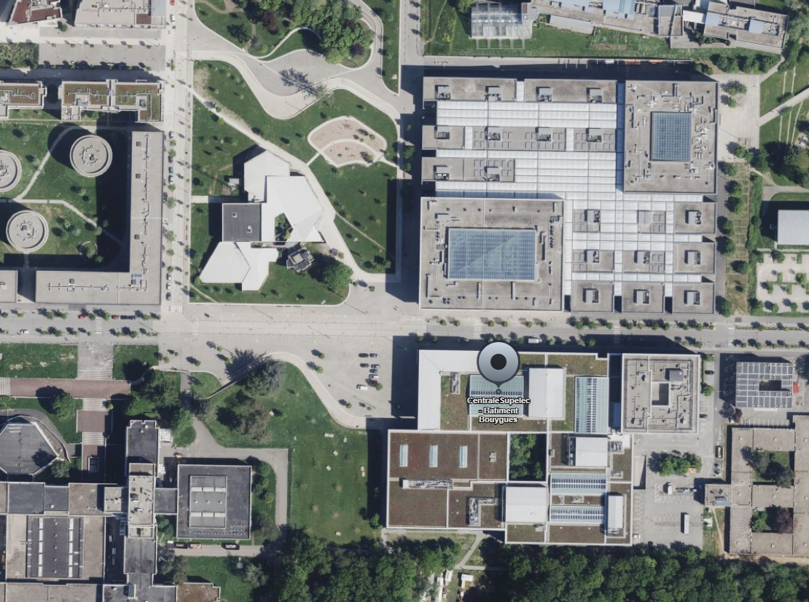
DEPARTURE for CEA visit : 1:30PM
In front of Centrale Supélec Bouygues Building
Meeting point

Slide 6
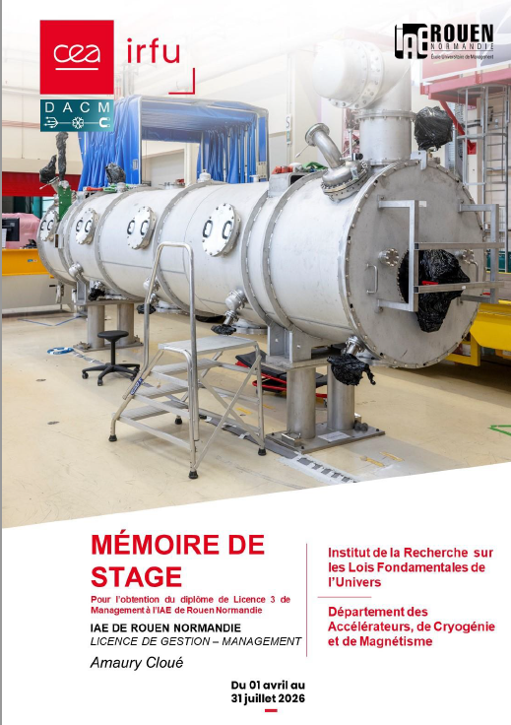
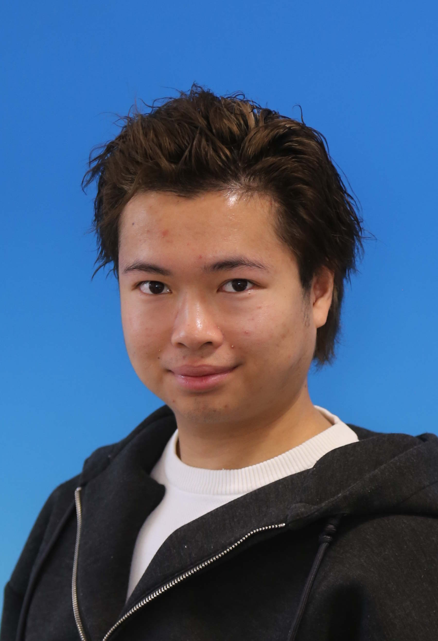
Special thanks to Amaury Cloue
He realized a 3 months internship for his undergraduate degree in management
He was a key member of the Local Organizing Committee
He wrote a detail internship report where he tried to answer this question:
How does the organization of international physics conferences lead project leaders to adapt their management tools in response to institutional, human, and geopolitical constraints?

Slide 7
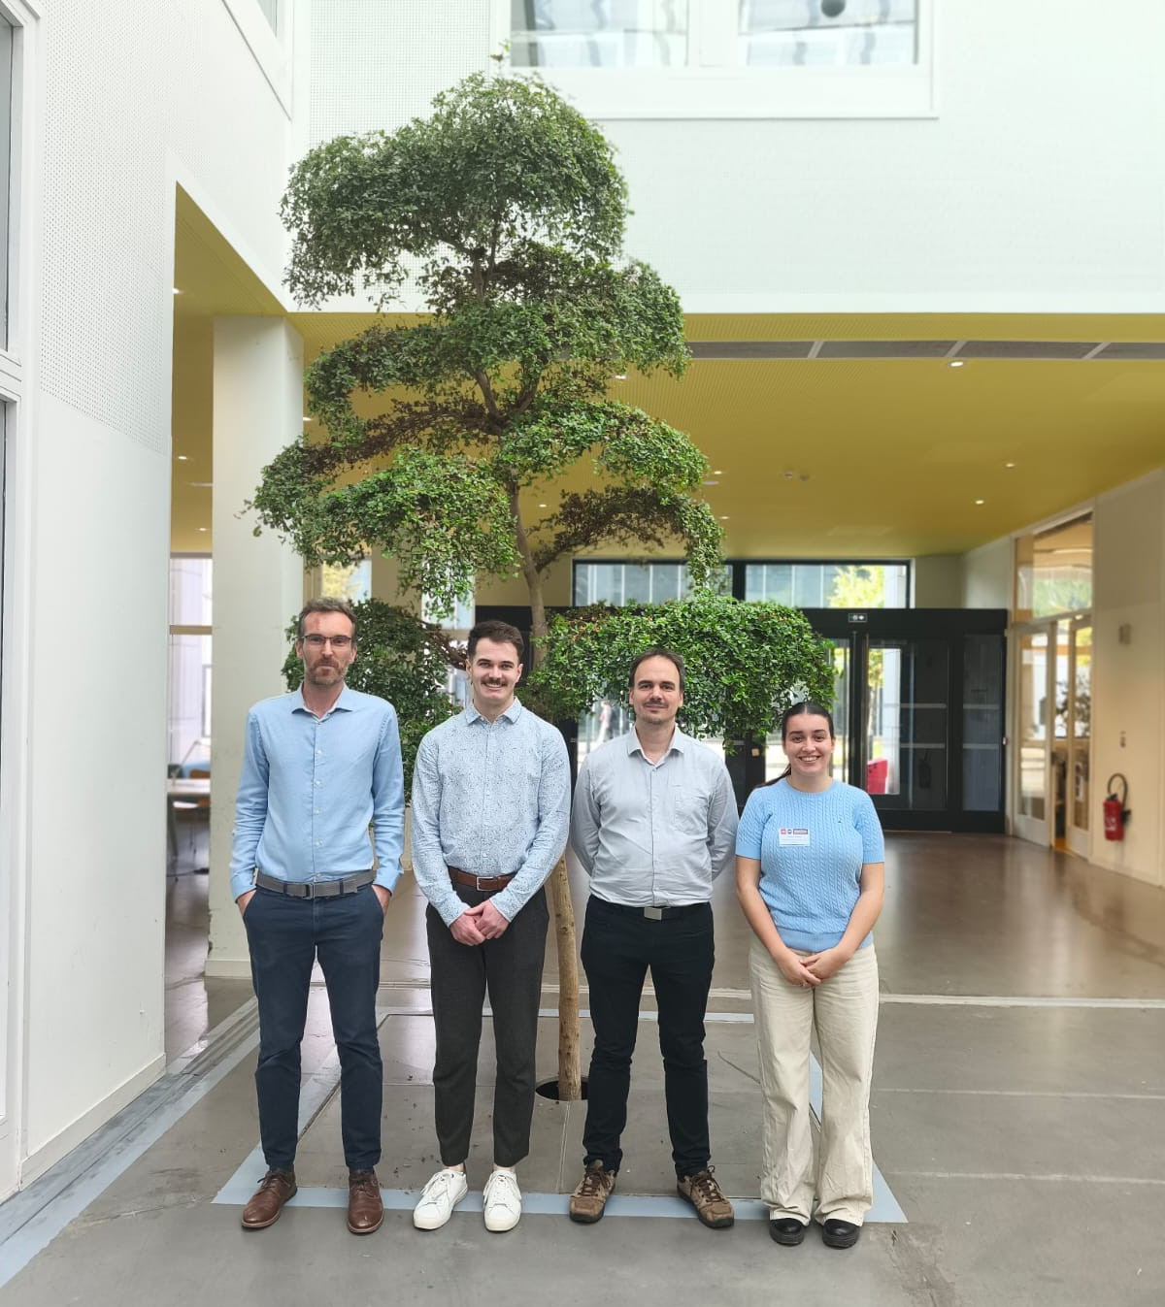
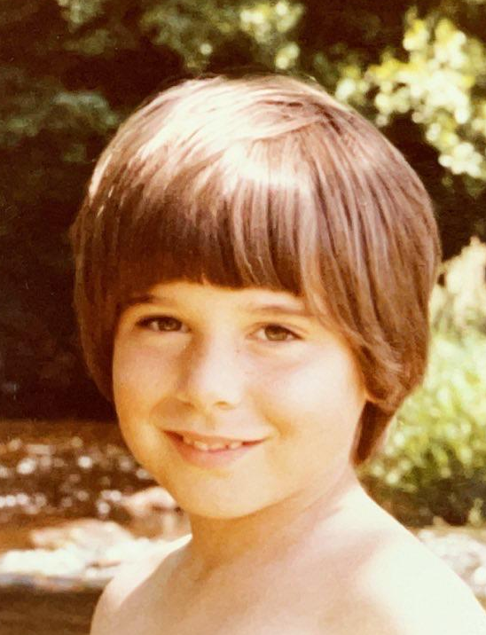
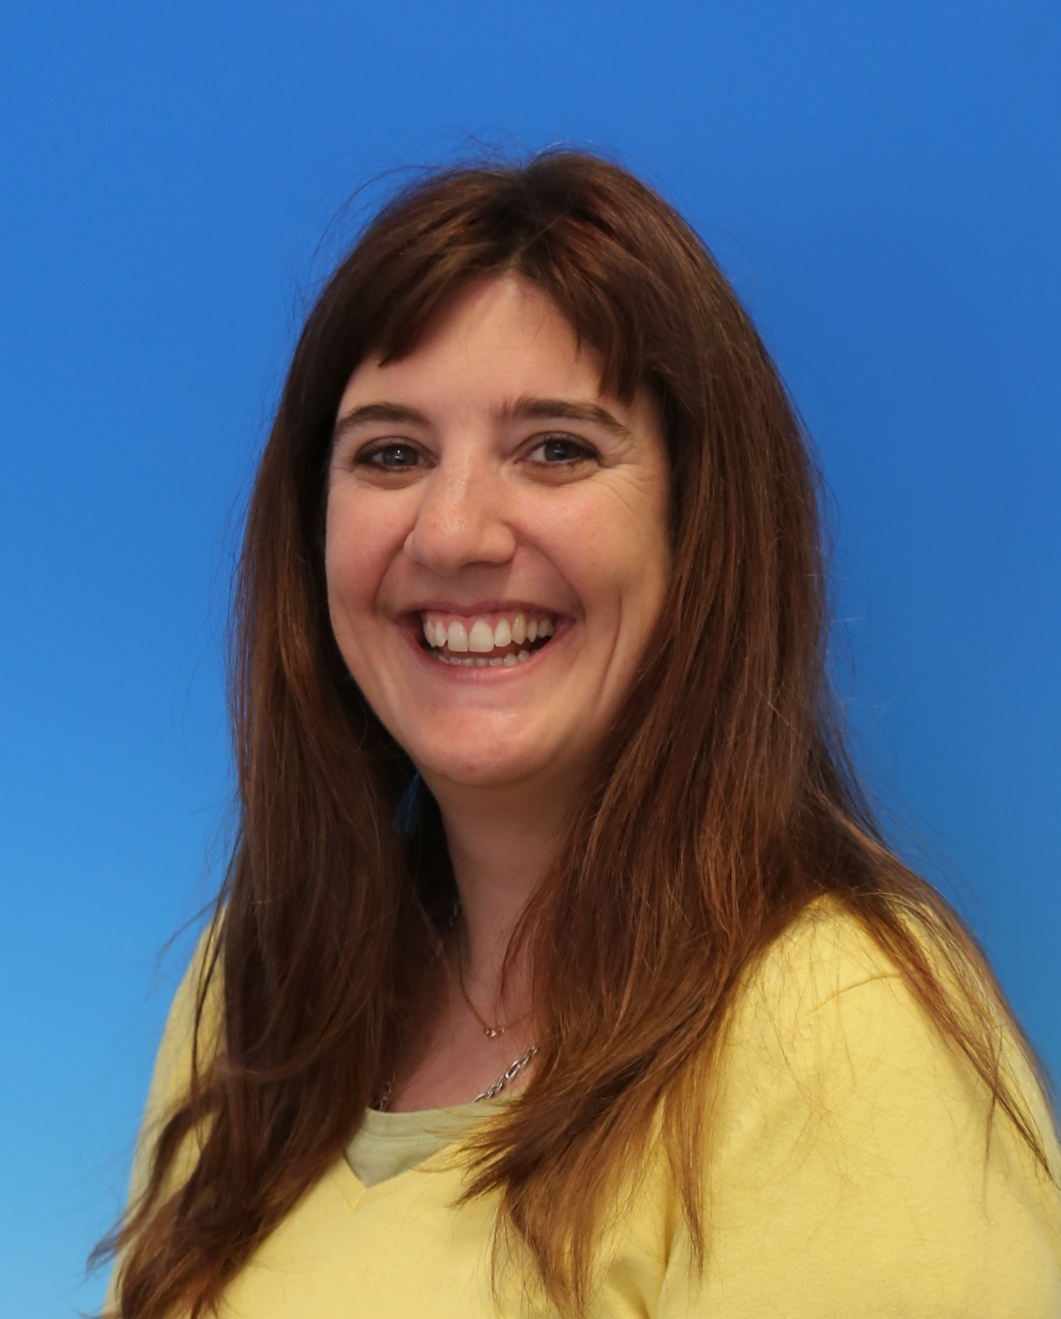
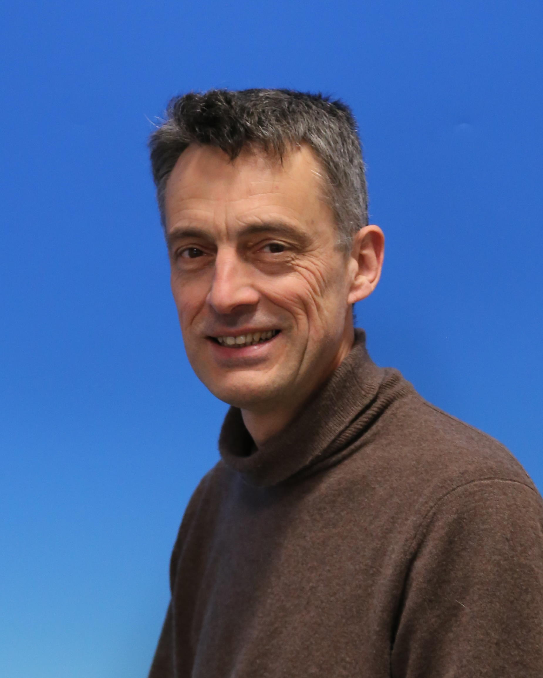
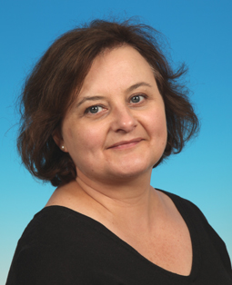
Special thanks
to our LOC

Slide 8
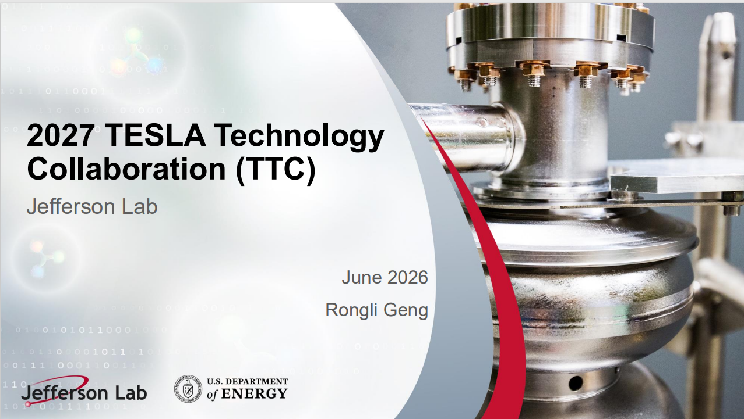

Next meetings

