Slide 1
Particulate lofting & migration under exposure to low energy electron beam
Aveen Mahon (she/her)
Accelerator Division
TRIUMF | UVic

Slide 2
TRIUMF is located on the traditional, ancestral, and unceded territory of the xʷməθkʷəy̓əm (Musqueam) People

Slide 3
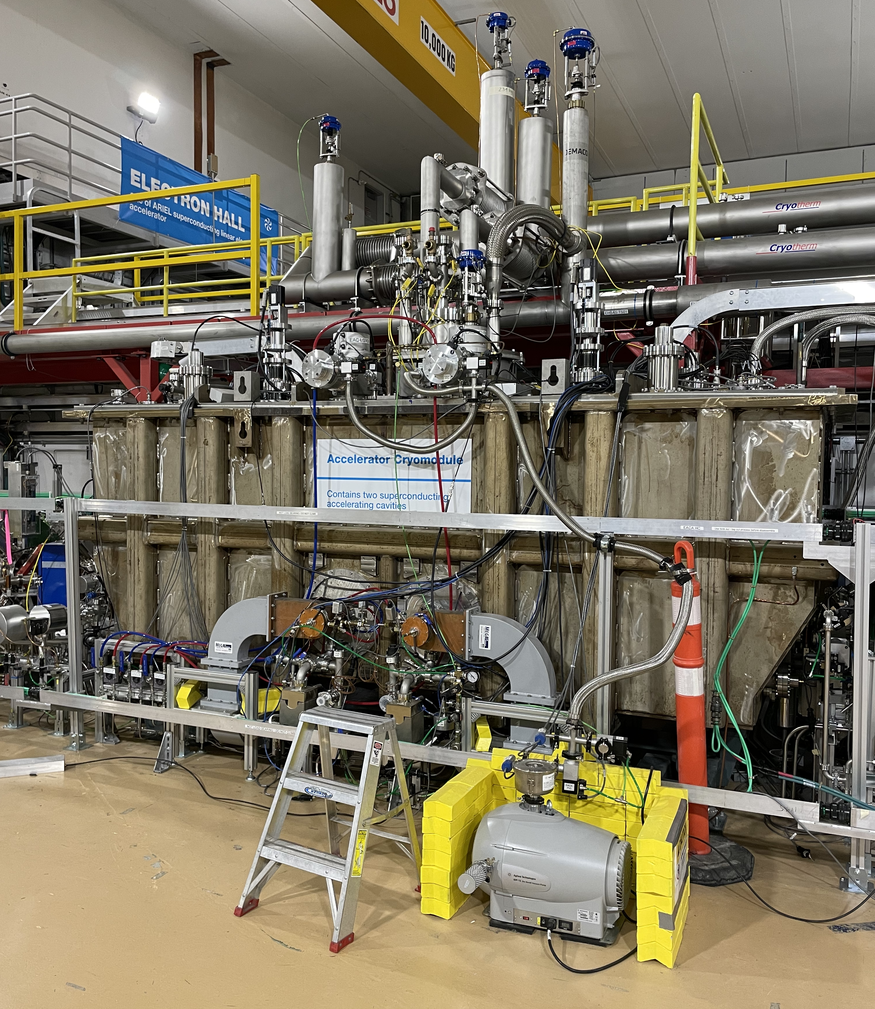
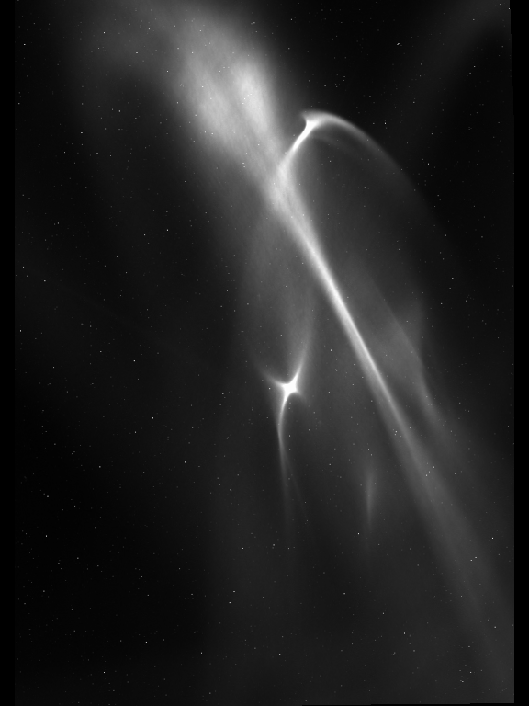
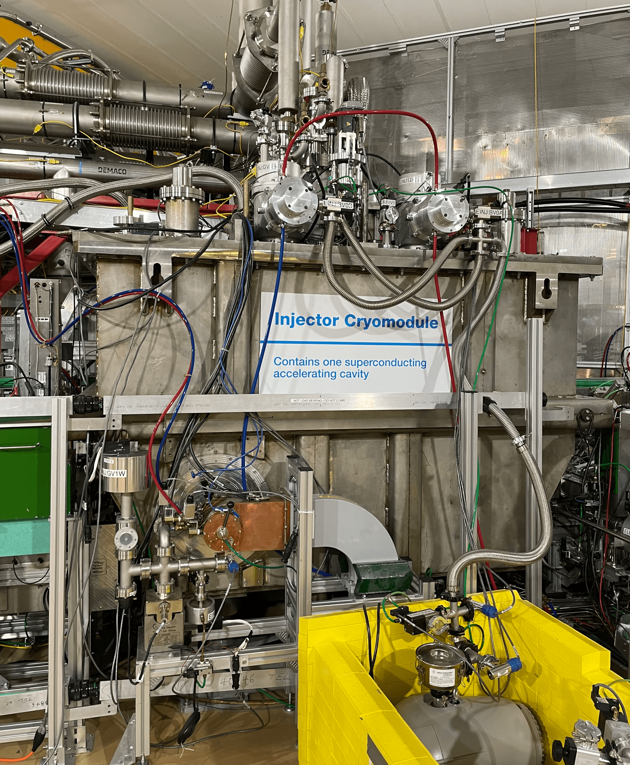
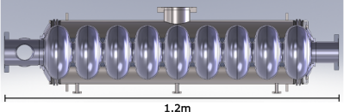
Field Emission (FE) at the TRIUMF e-Linac
Superconducting electron linear accelerator
Beam Energy | 30 MeV
Nominal Beam Current | 10 mA
RF frequency | 1.3 GHz
Cavity Type | Elliptical (9-cell)
Cavity Material | Bulk Niobium
Cavity Temp | 2K
5 mm
FE root cause – particulate contamination
Degradation over time → migration?
EABT:VS1
May 7 2026
A. Mahon TTC 2026 June 10

Slide 4
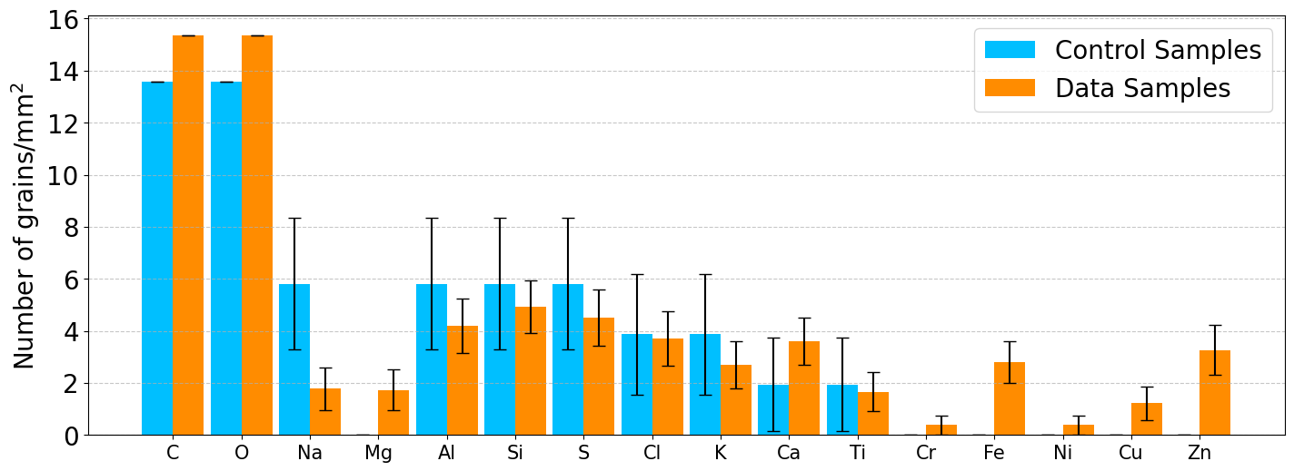
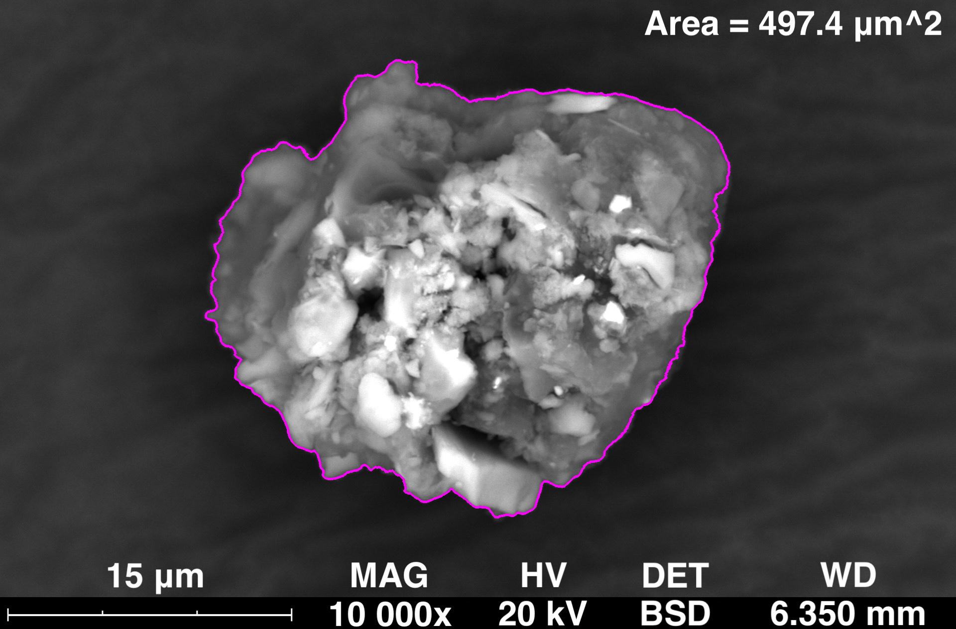
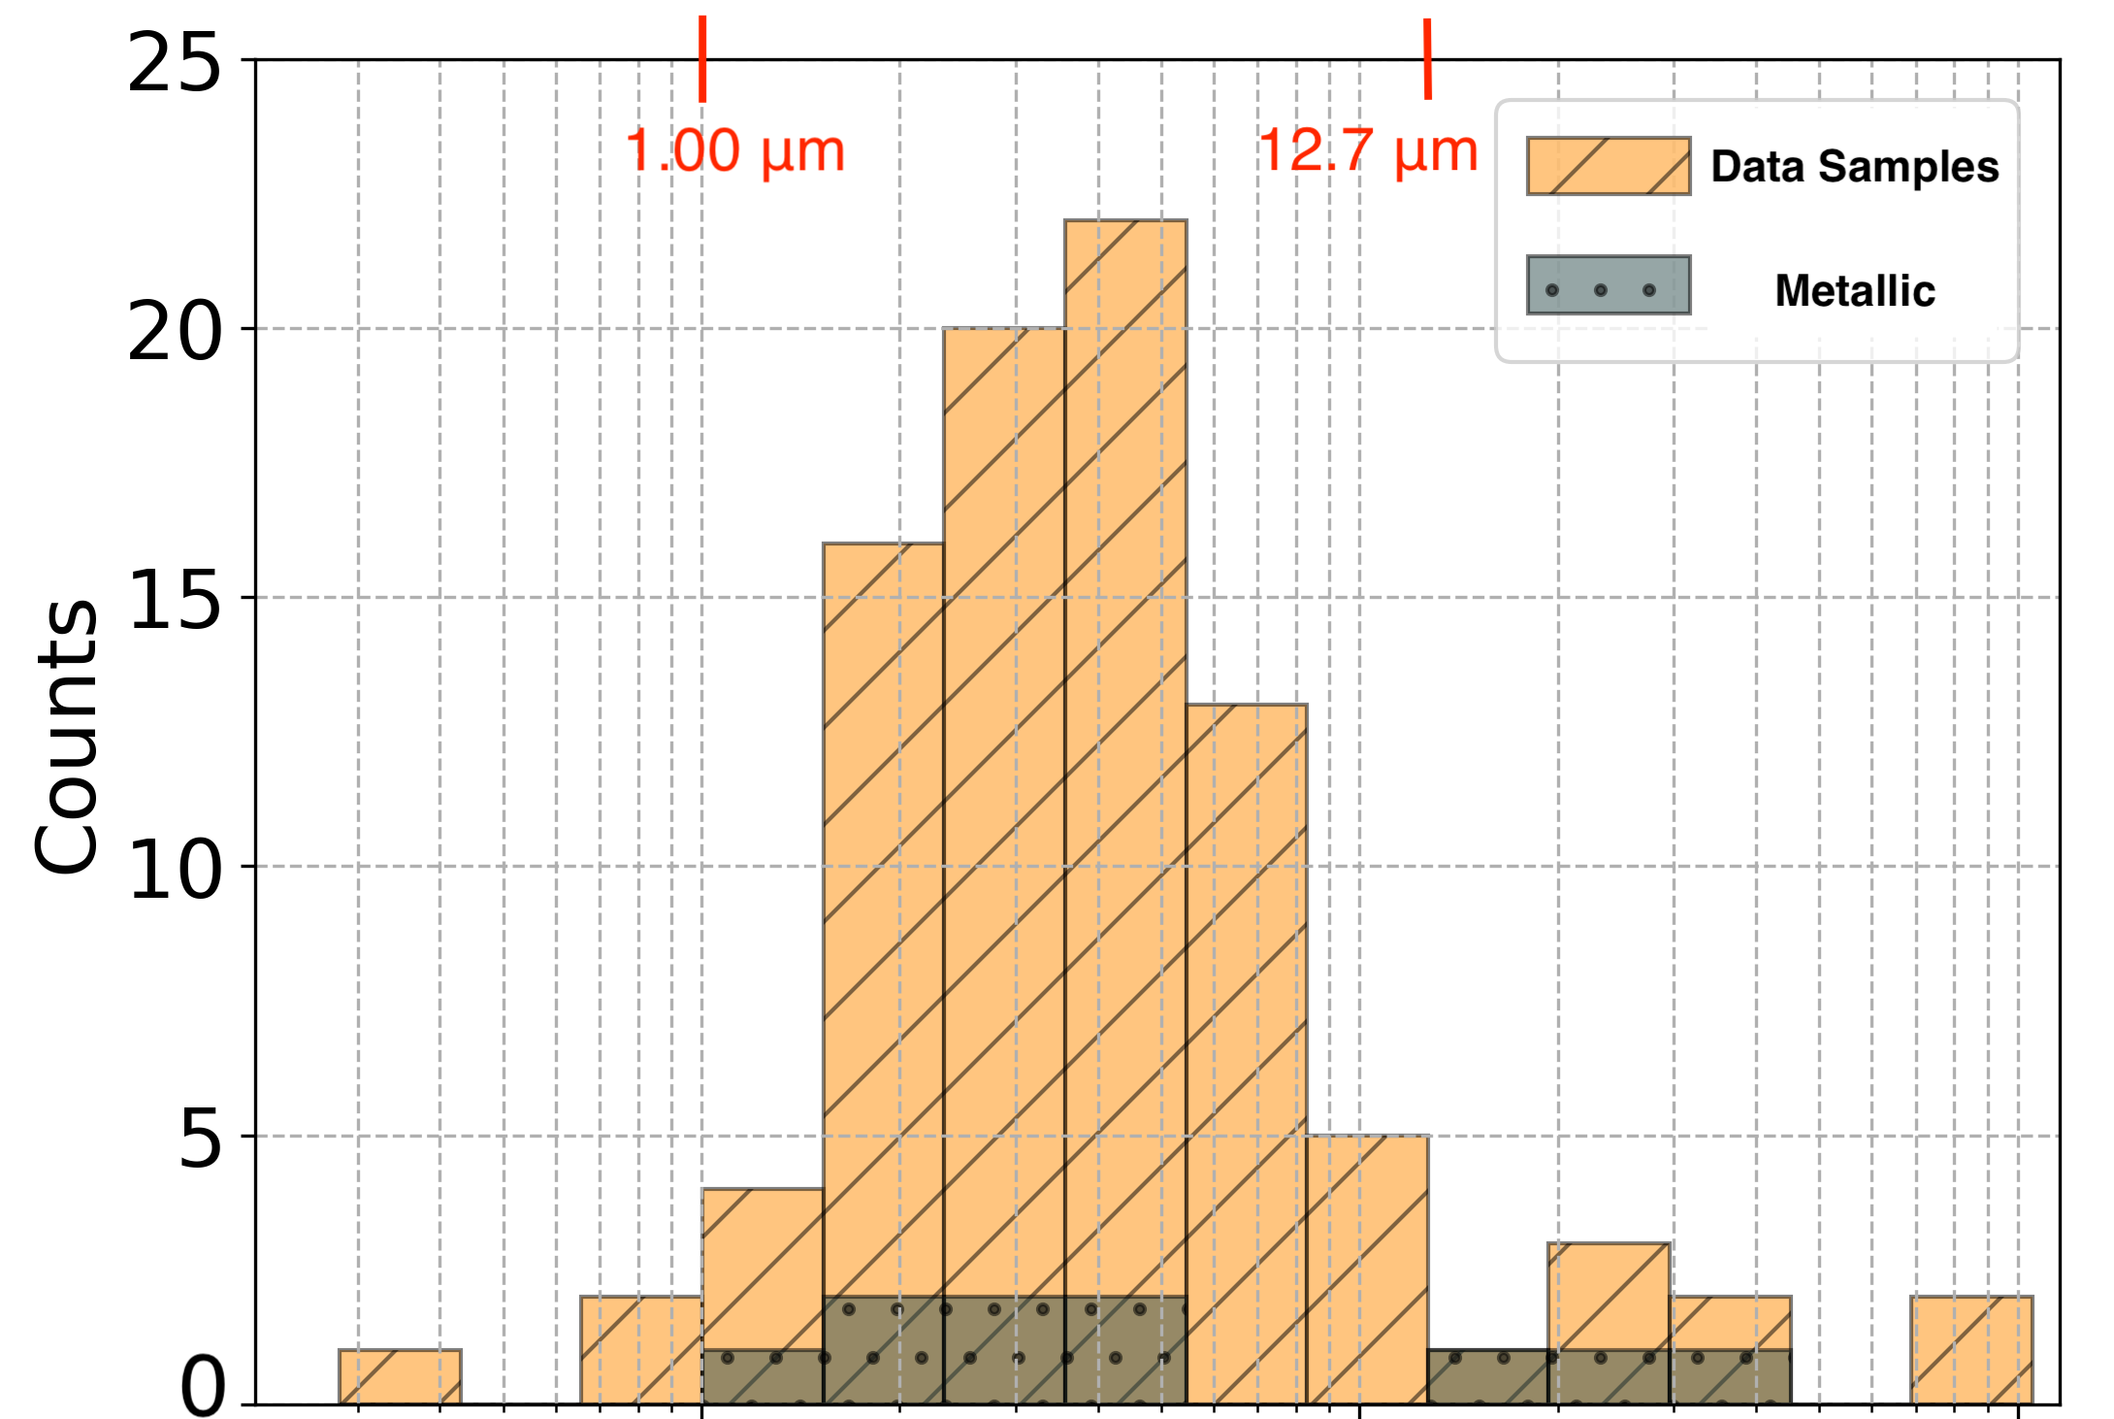
Nature of Contamination
Composition:
MOTIVATION:
Are there ways we can design our systems to prevent particulate migration during operation?
Necessary to understand the conditions of the dust particles (composition, velocity, charge…)
Size:
PREVIOUS STUDIES:
Scanning electron microscopy (SEM) studies of particulates in TRIUMF e-Linac
  LINAC 24 Proceedings (THAA010)
  TTC 2025 Talk (Link to indico)
  SRF 25 Proceedings (TUP64)
Influenced choice of particulates to study!
A. Mahon TTC 2026 June 10

Slide 5
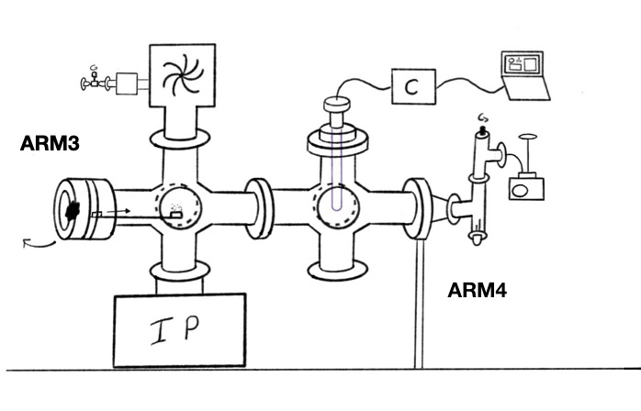
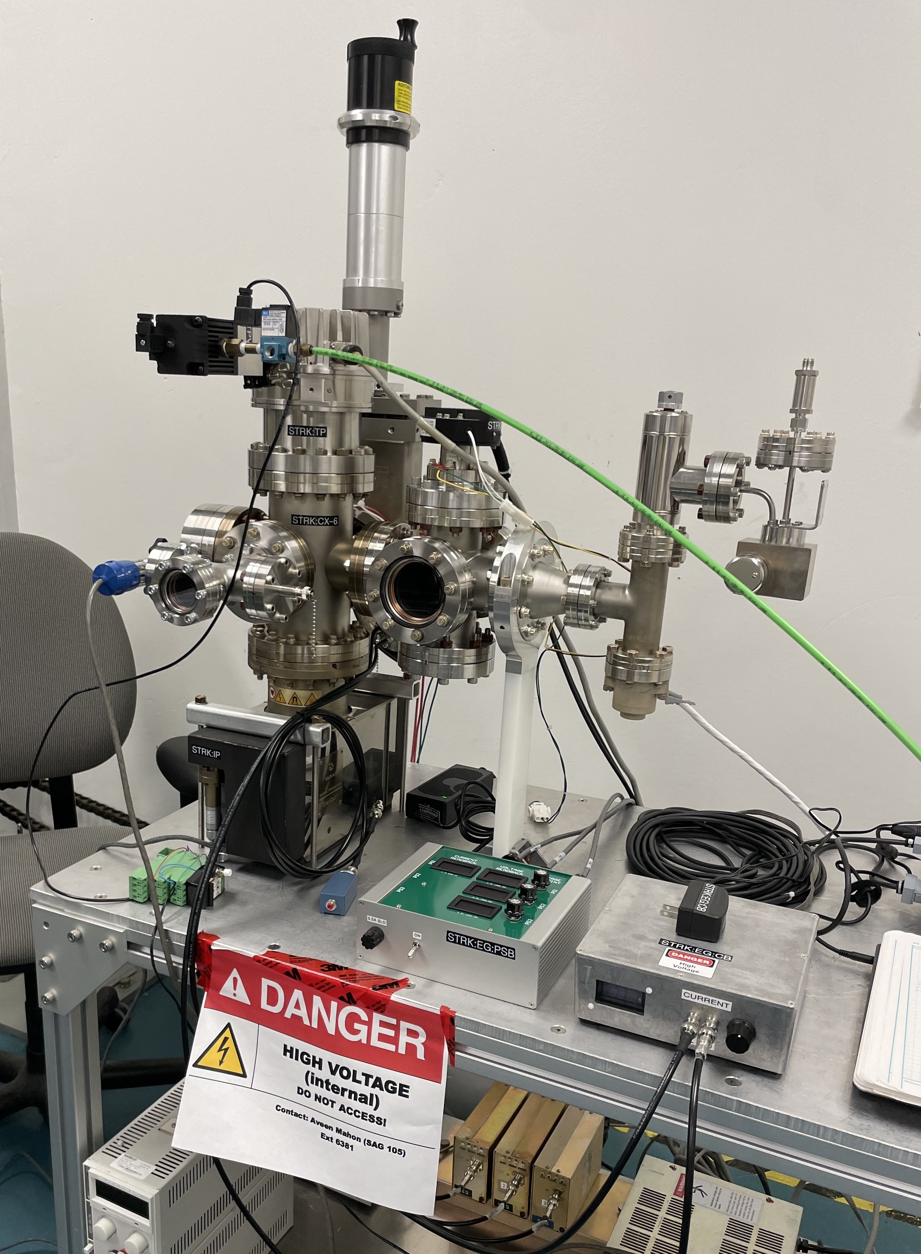
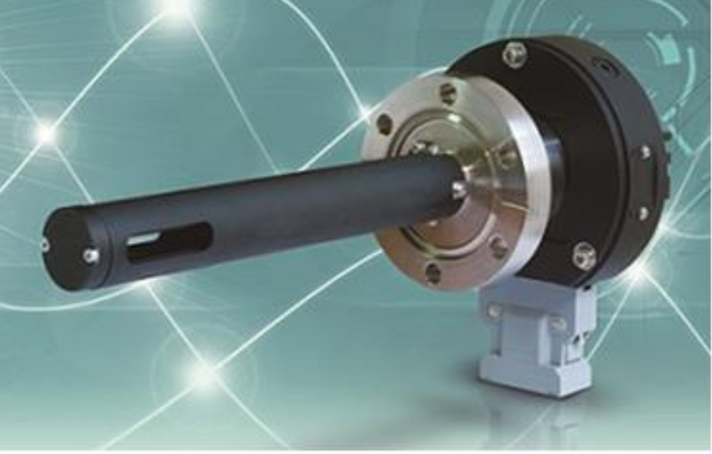
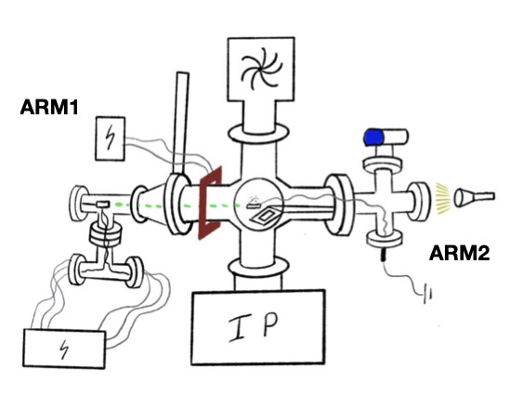
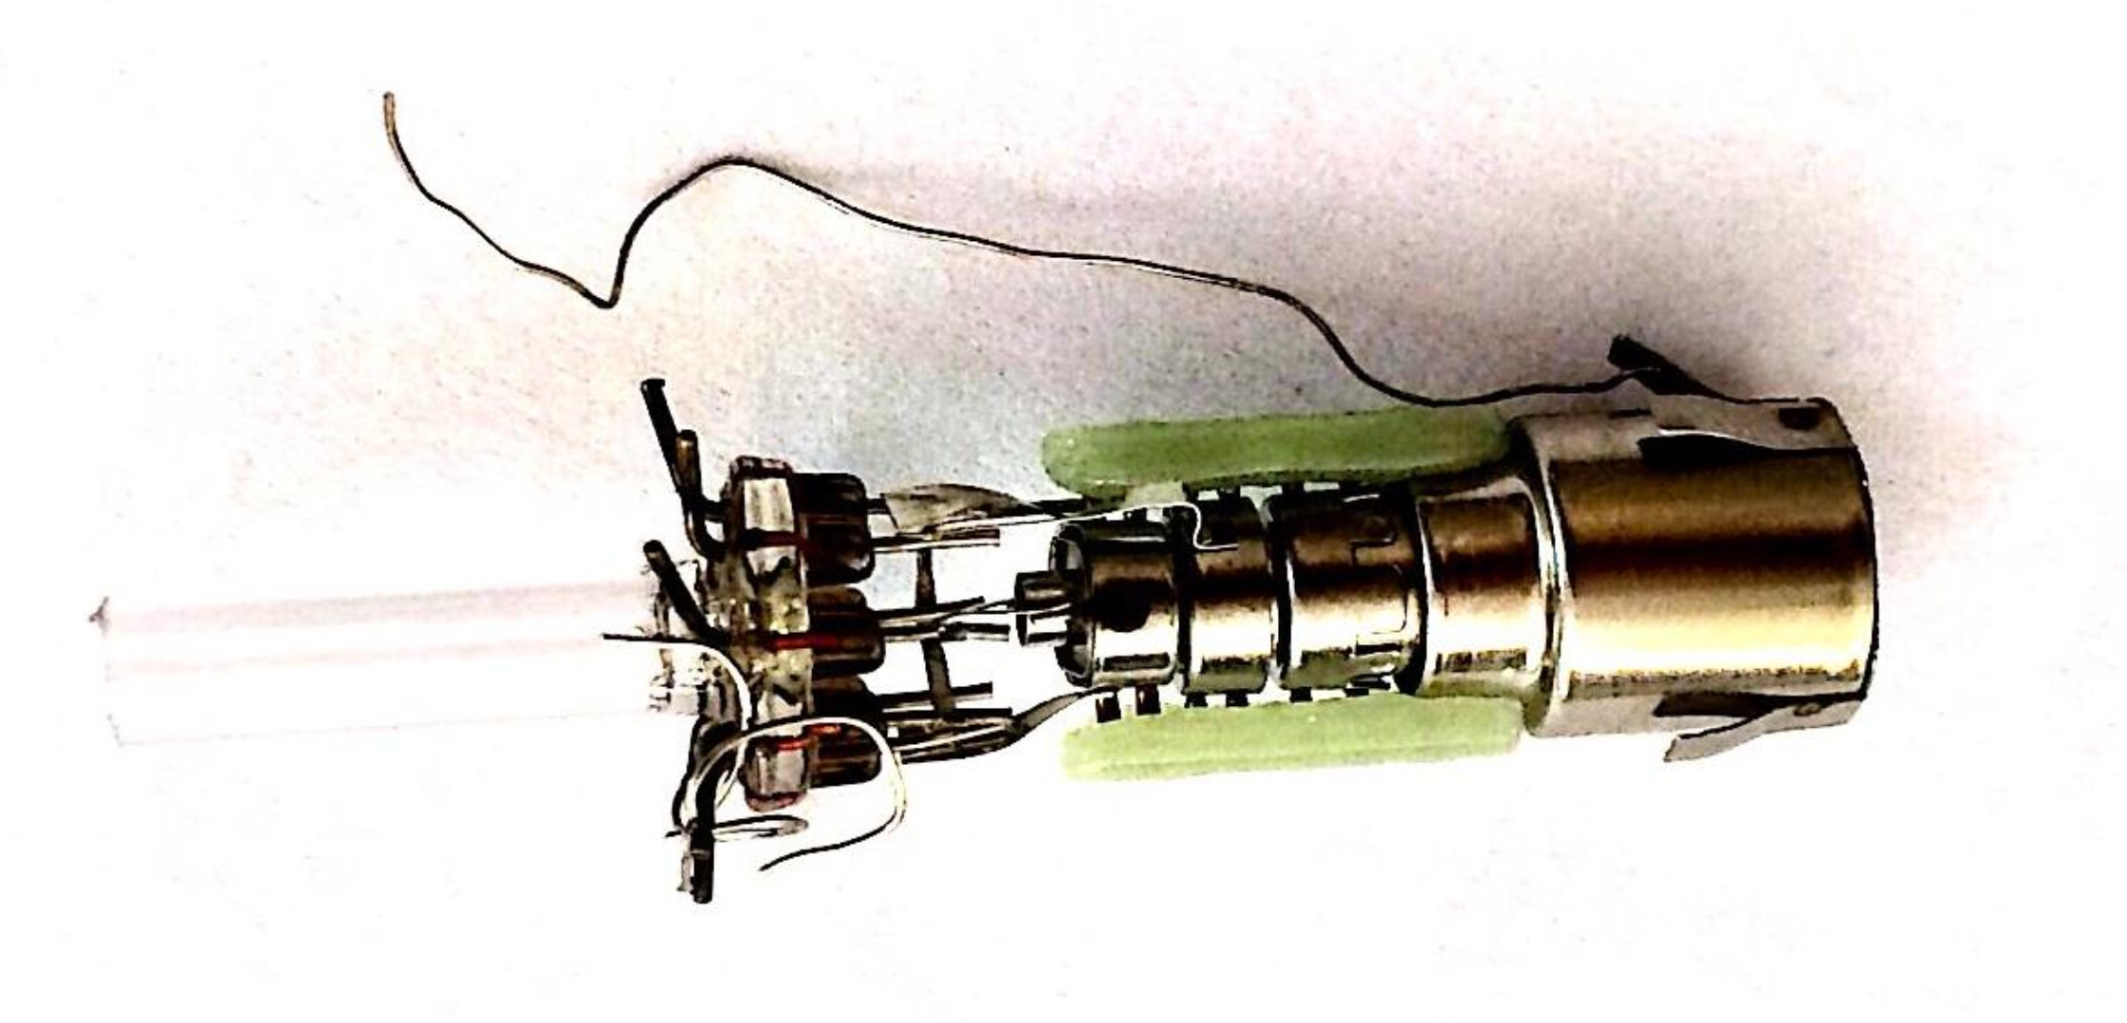
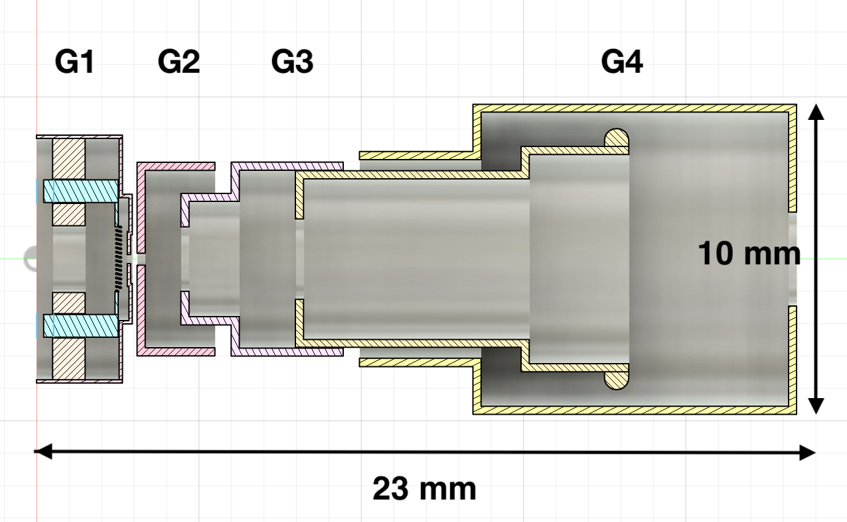
Lofting and Migration Test Setup
Front View
Vacuum ~10⁻⁷ Torr
Low energy electron gun (up to 1.5 keV)
In Vacuum Particle Counter (WEXX)
Particulate Samples:
  SiO2
  Fe based Stainless Steel (SS)
  AlSi10Mg
  CuSn10
}
1-45um diameter
Side View
}
15-45um diameter
Electron Gun:
Components:
A. Mahon TTC 2026 June 10

Slide 6
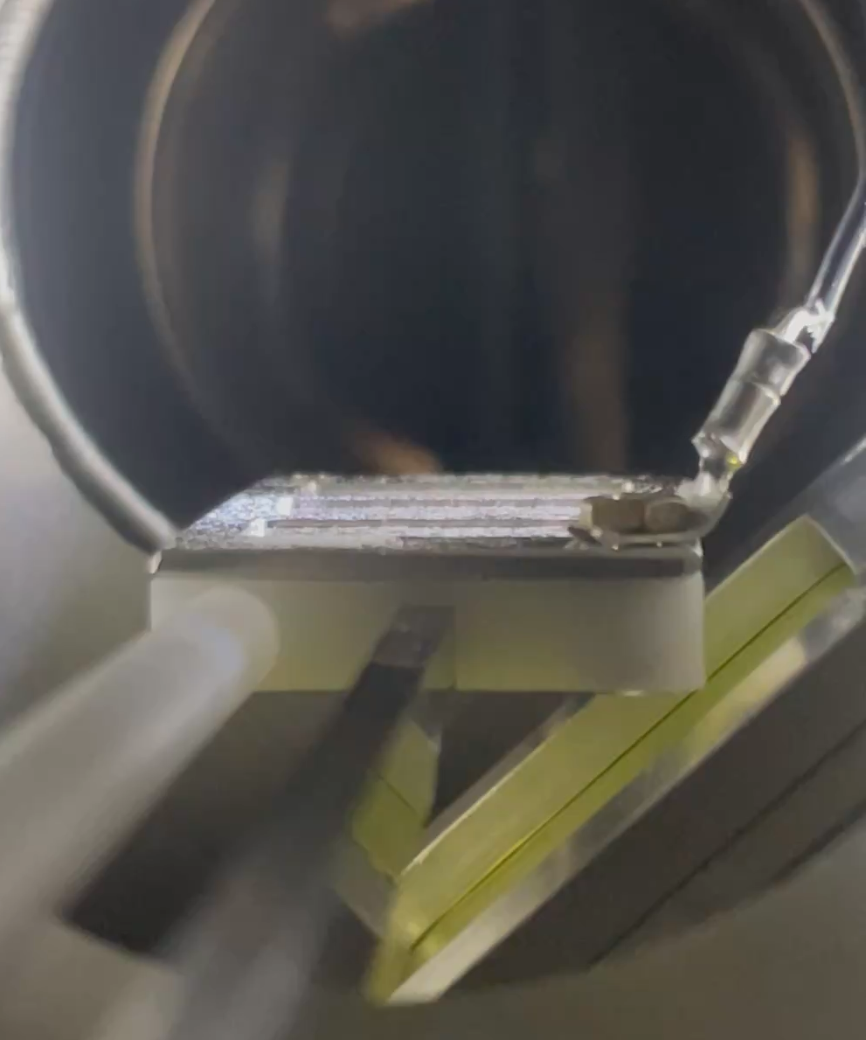
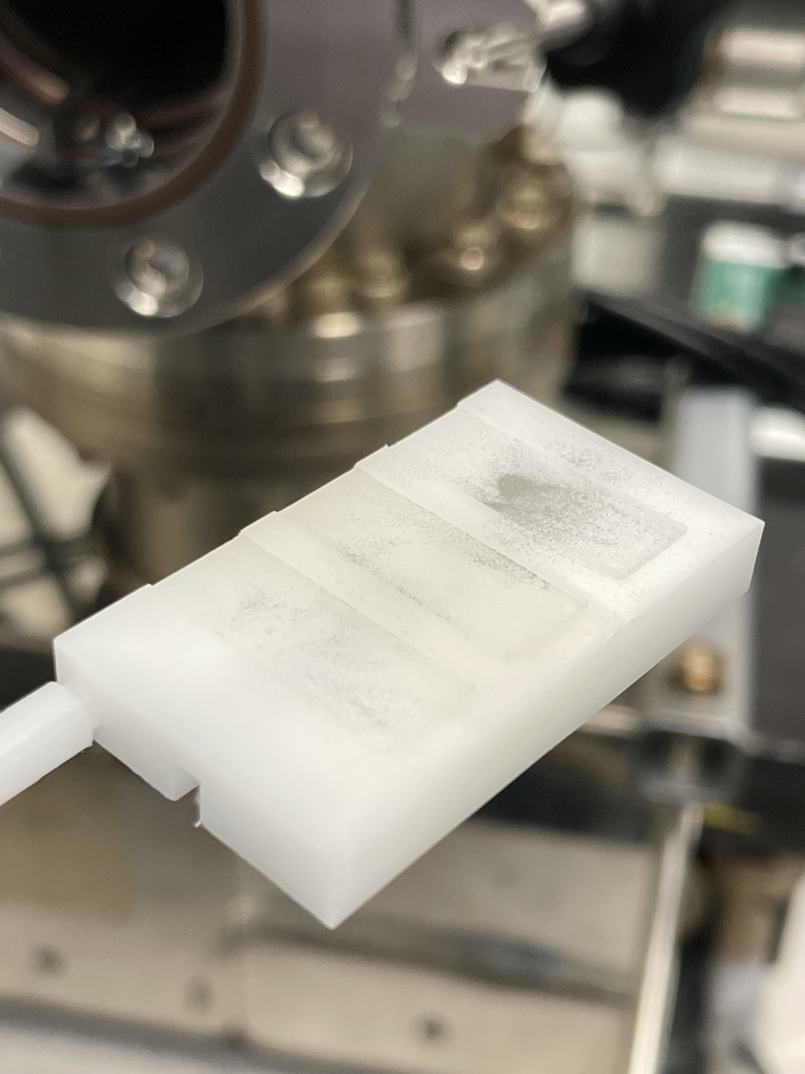
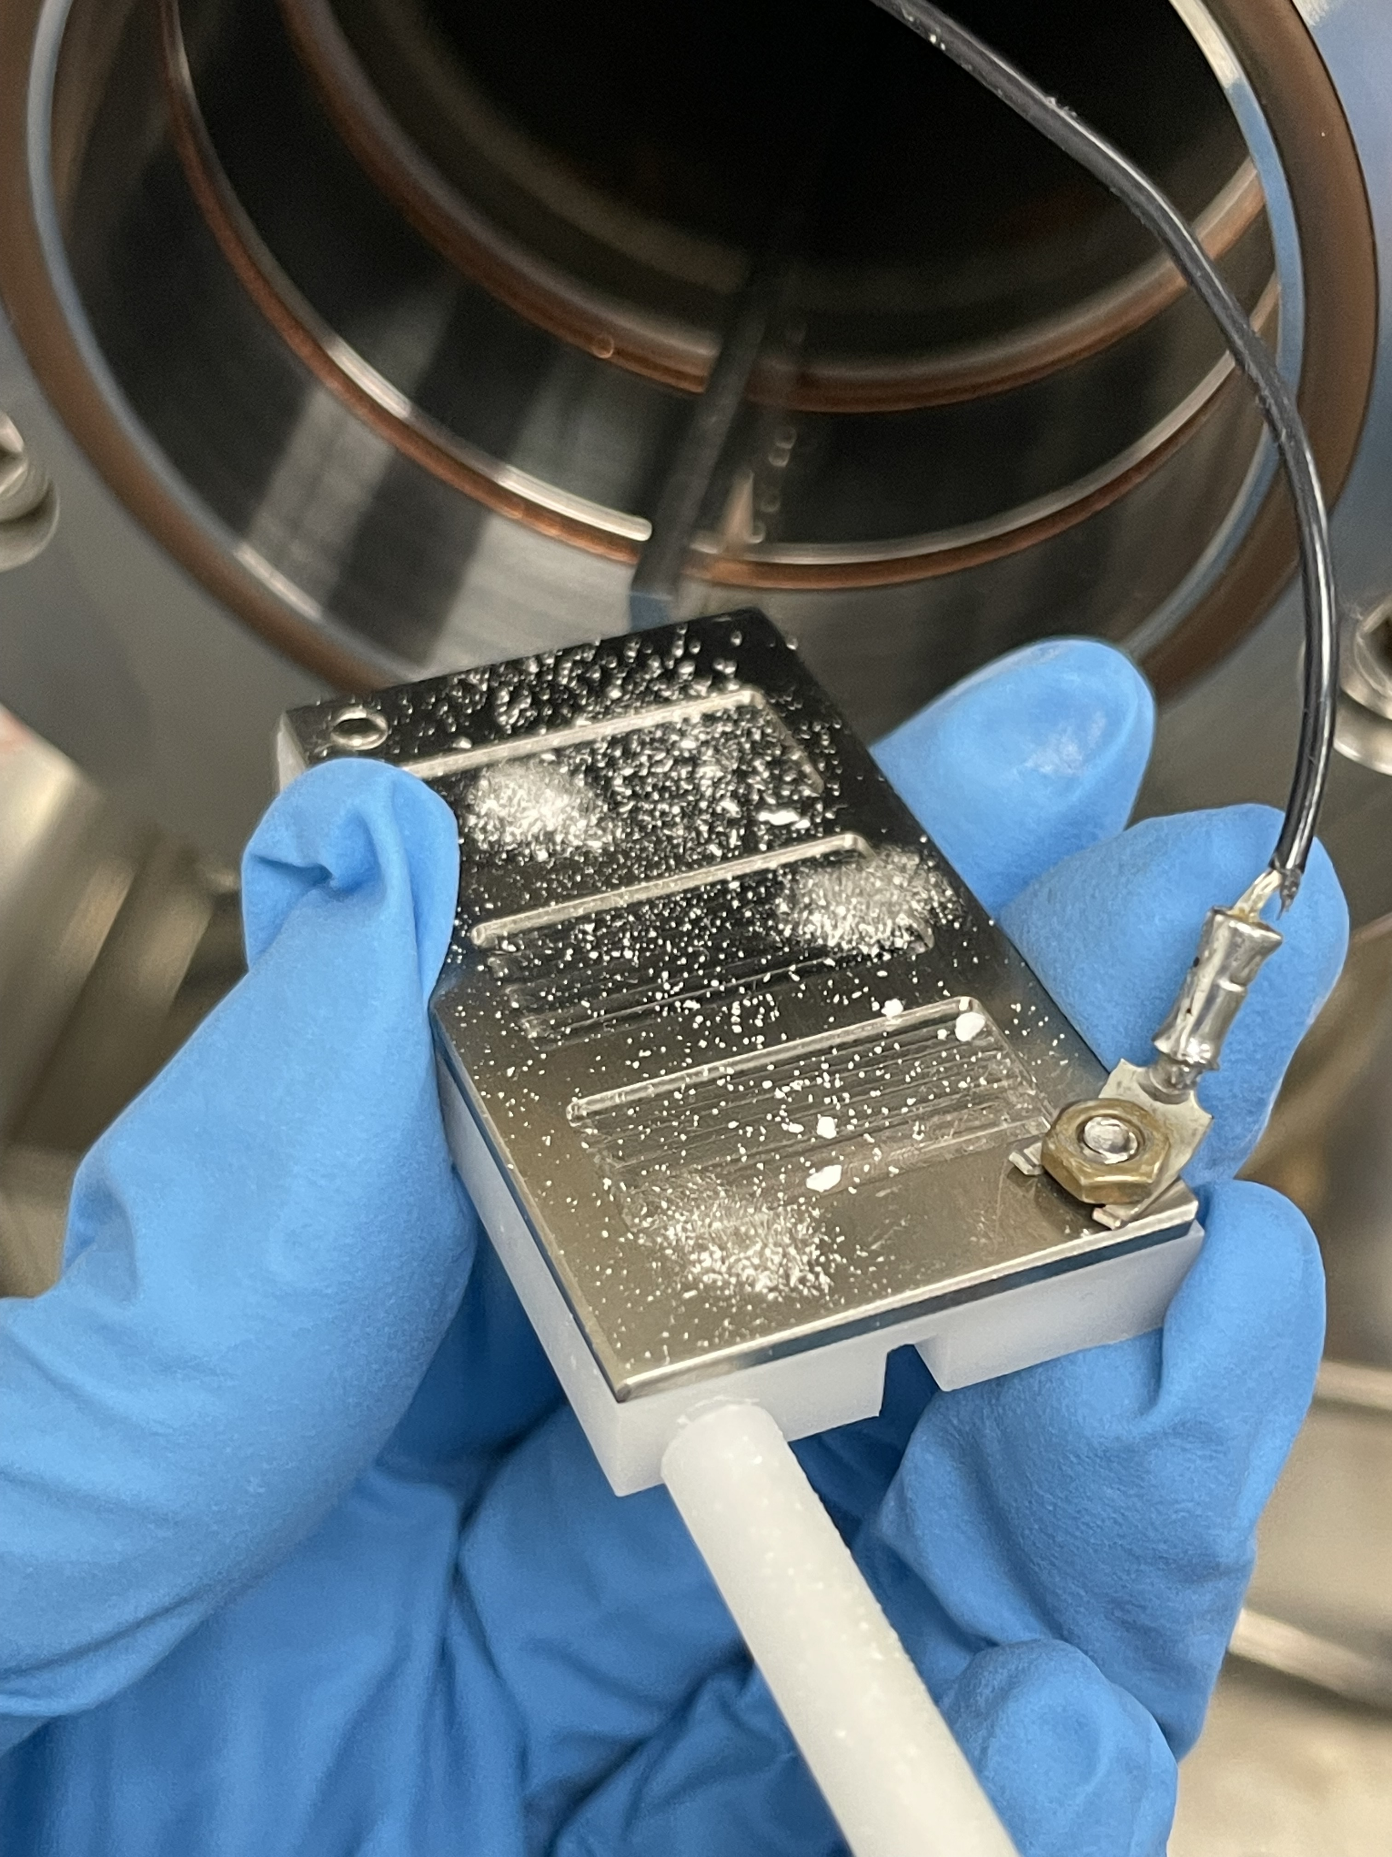
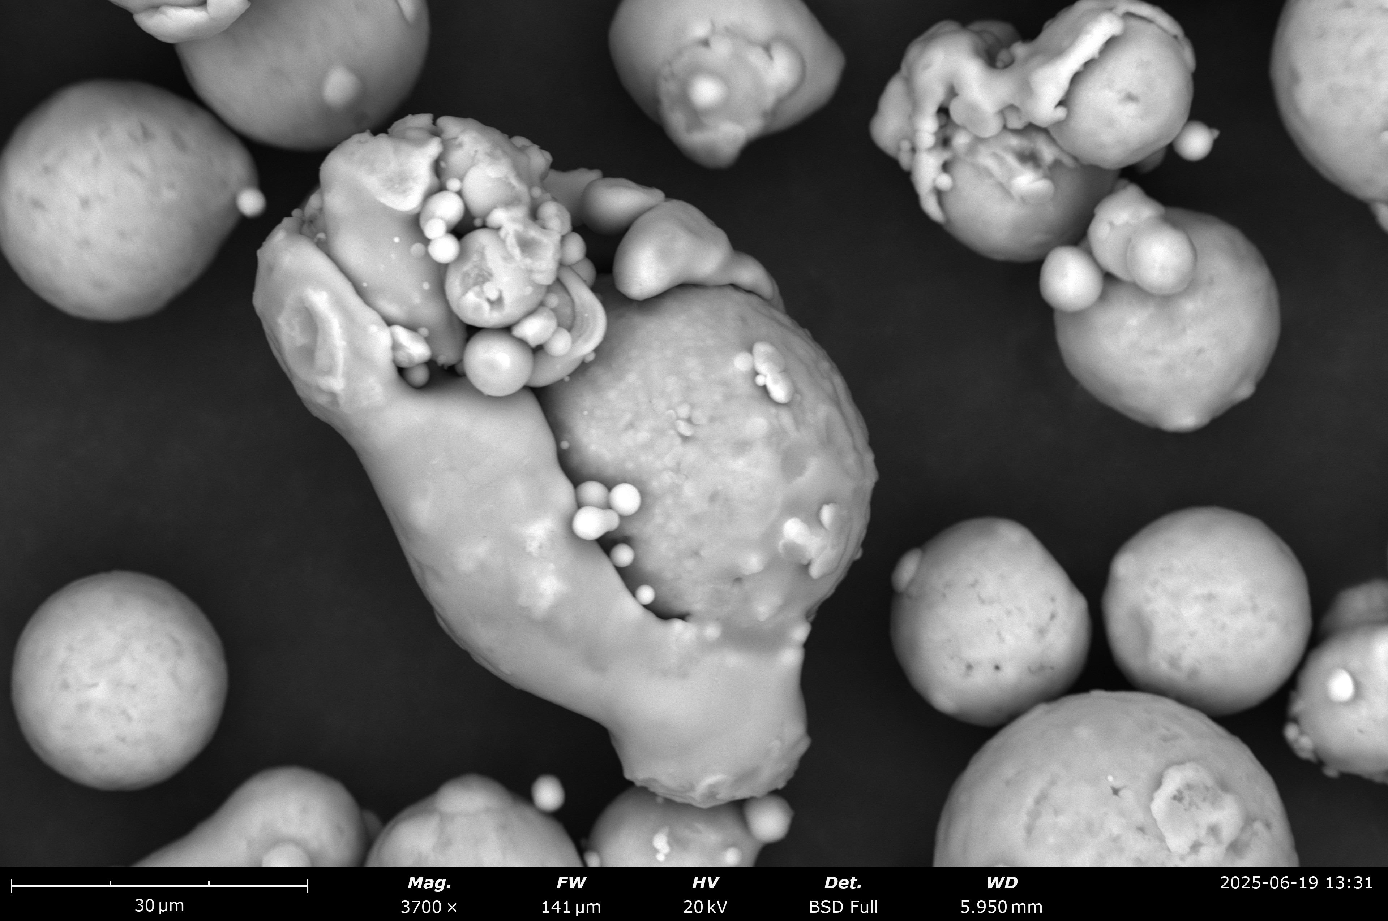
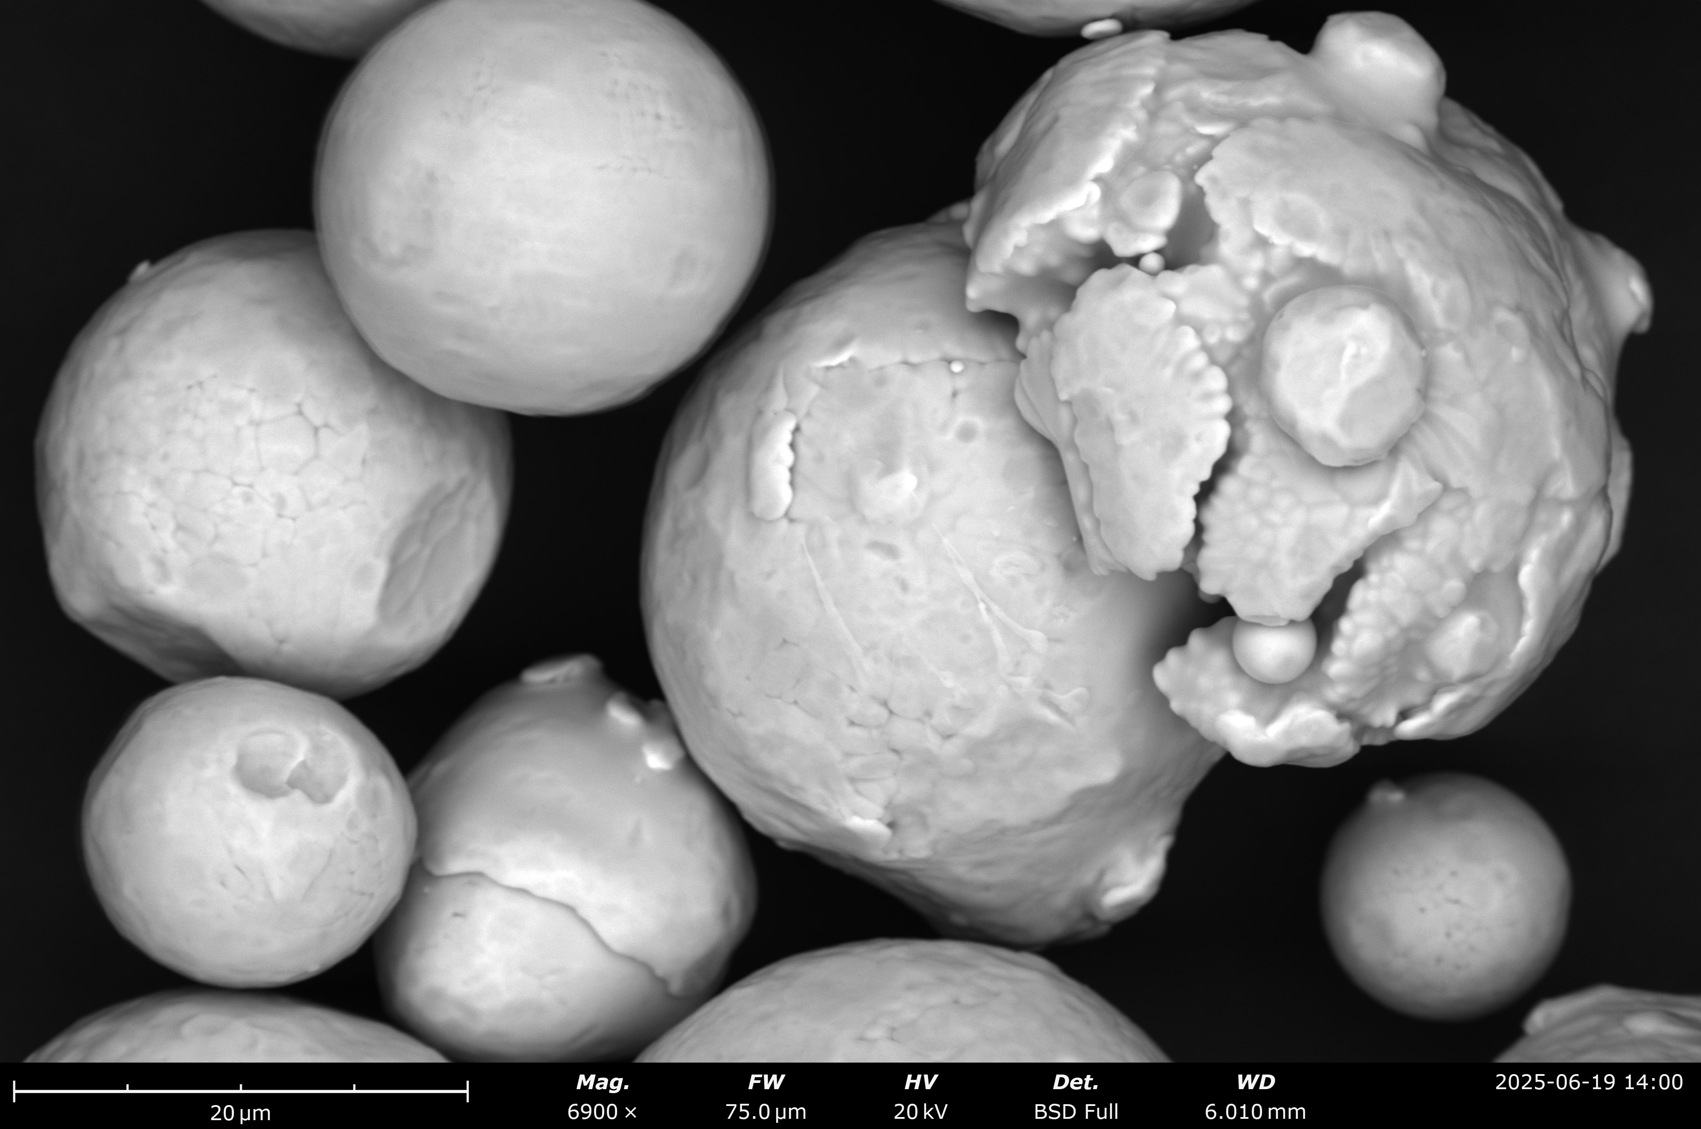
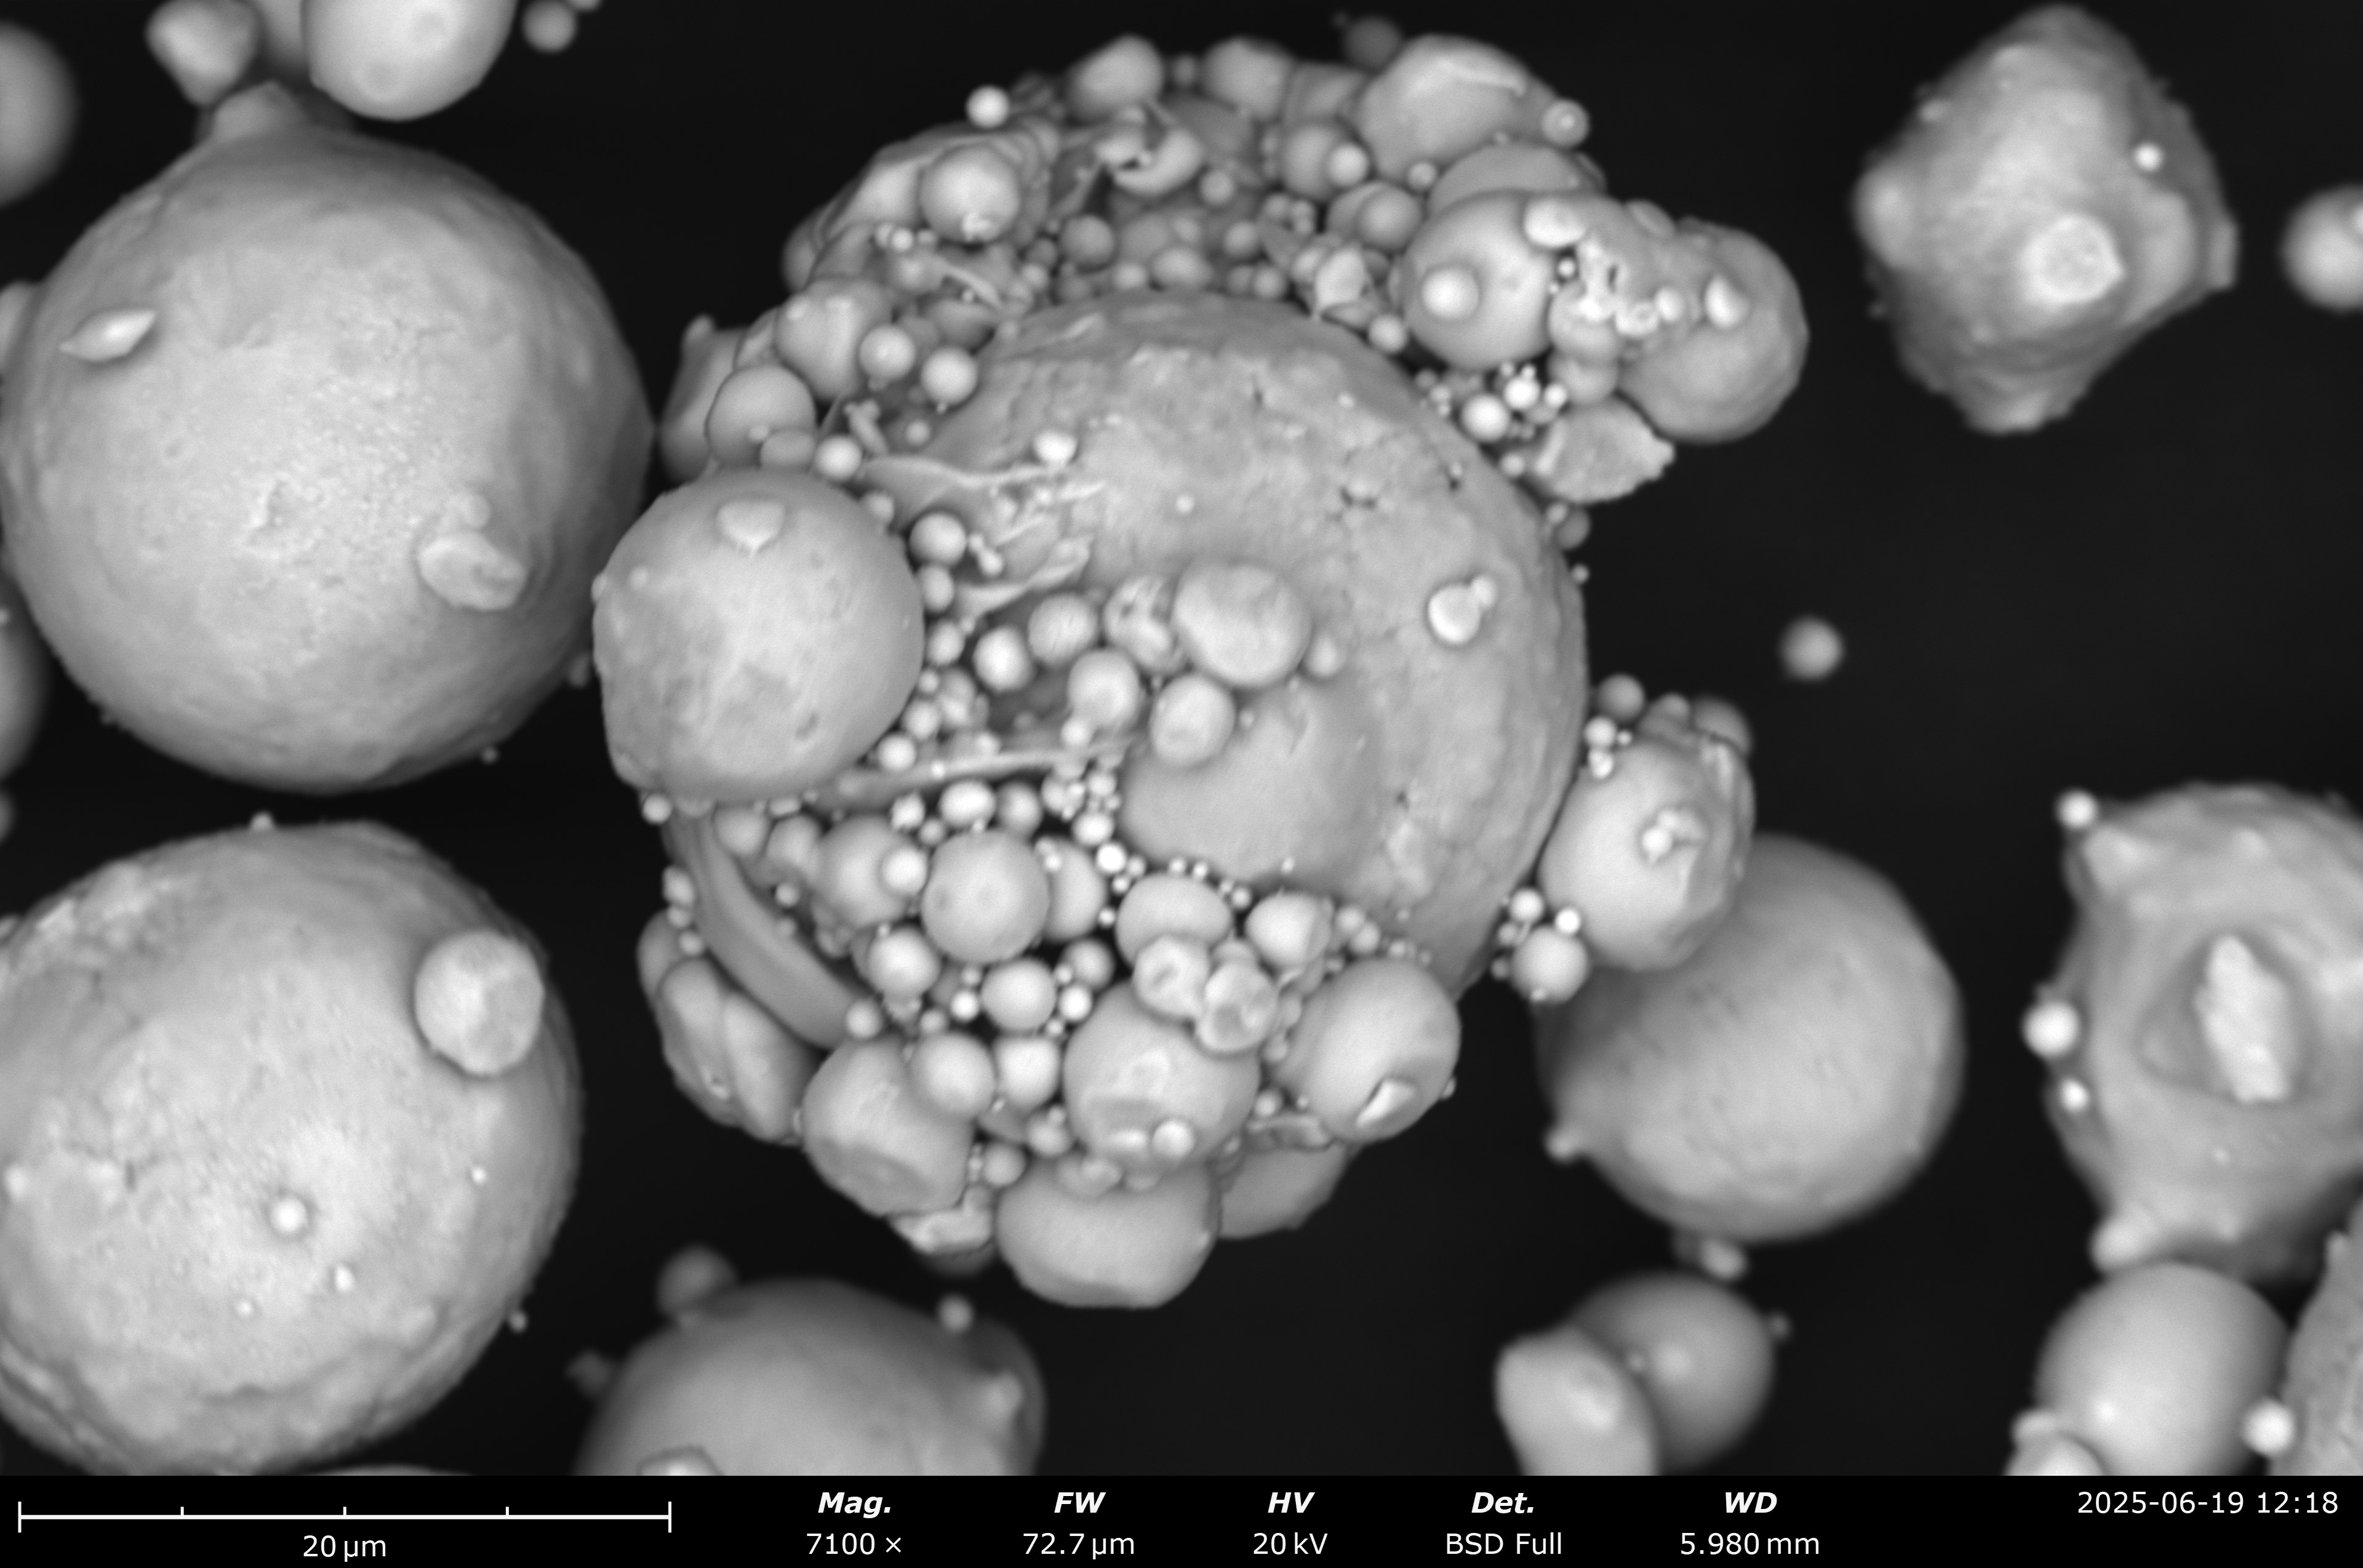
Lofting Results
Incident electron energies where lofting observed:
  Between 50-200eV depending on dust/substrate combination
Combinations tested thus far
  ✅ SiO2 on Delrin
  ✅ SS on Delrin
  ✅ SiO2 on SS (grounded)
  ✅ SS on SS (grounded)
  ✅ AlSi10Mg on SS (grounded)
  ❌ CuSn10 on SS (grounded)
e⁻
A. Mahon TTC 2026 June 10
AlSi10Mg
Fe
CuSn10

Slide 7
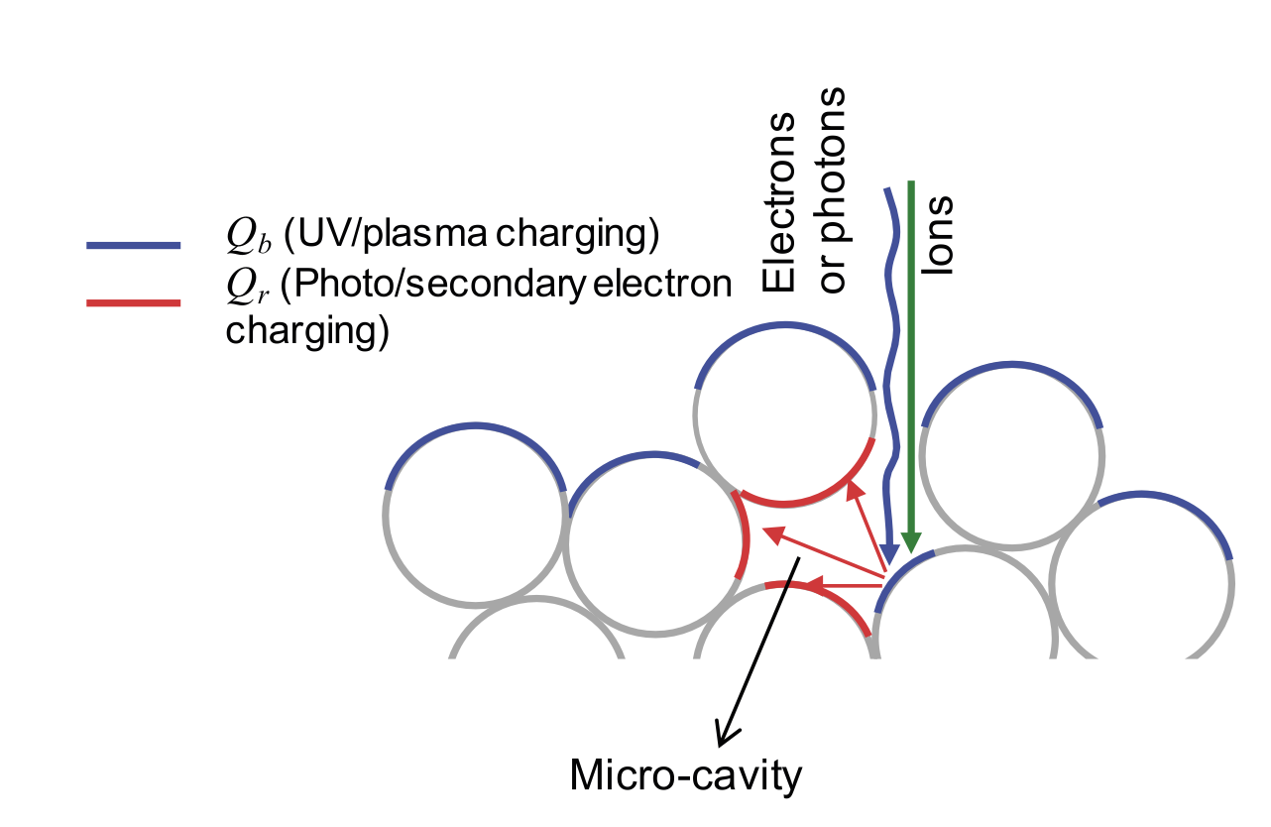
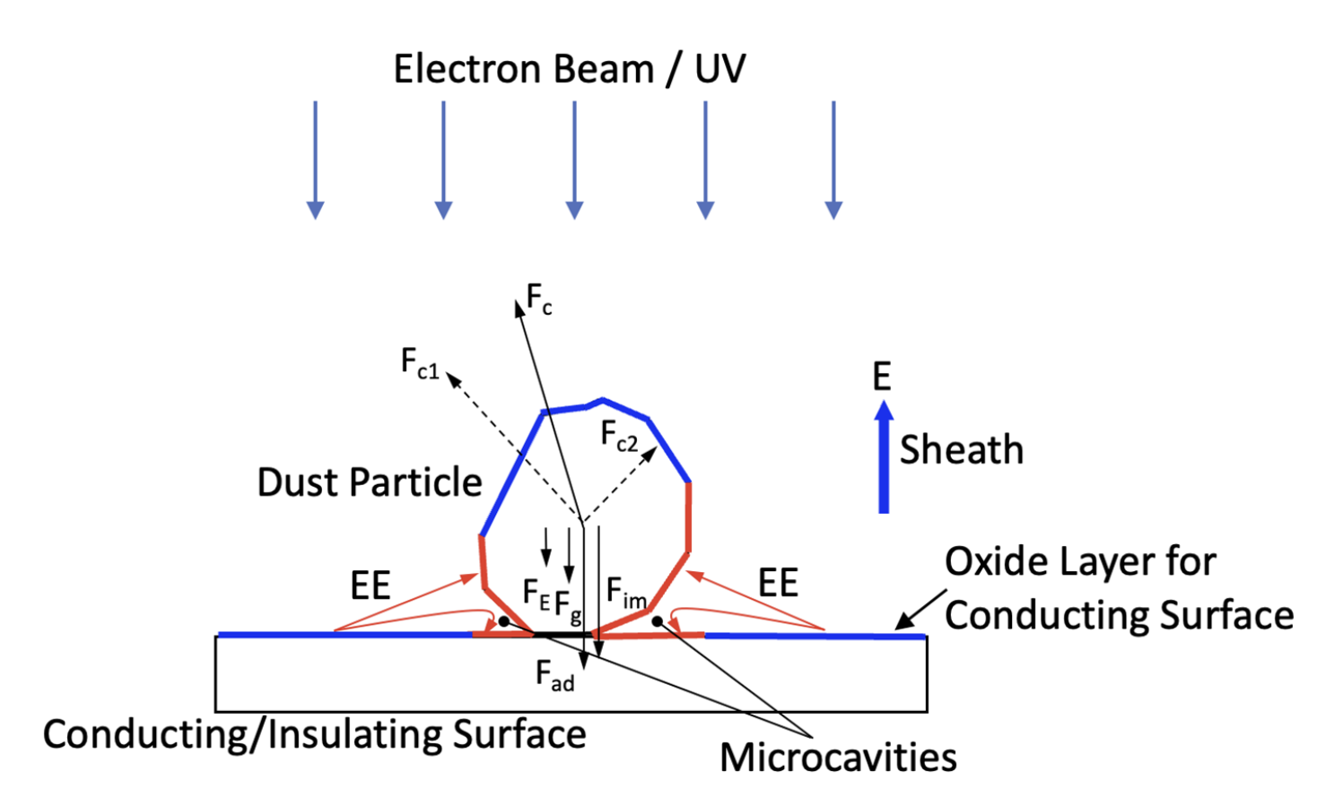
Lofting Theory
Patched Charge Model
Mono-layer:
Multilayer:
Dynamics of particulates (dust) in vacuum influenced by charge
  Evidence from CERN UFO events [1]
  Studies at U. Colorado on dust in space [2,3]
Principle:
  Emission of secondary electrons from primary electron impact
  Re-absorbed into microcavities → negative charge buildup
  Repulsive forces > adhesive forces → LIFTOFF
[3]
[2]
Adhesive Forces | Repulsive Forces
Gravity | Coulomb repulsion (microcavities)
Surface Adhesion
Sheath electric field
Image force (conducting)
A. Mahon TTC 2026 June 10

Slide 8
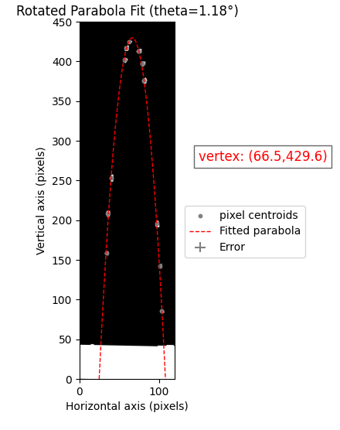
Launch Velocities
Can inform strength of potential barrier needed to halt migration
Kinetic Energy: K = ½ mv²
In combination with charge gives electric potential: E = K/q
Dust type | Launch Speed and Angle | Dust Type | Launch Speed and Angle | Dust Type | Launch Speed and Angle
AlSi10Mg on SS: | 0.56 m/s at 86º | SiO2 on SS: | 0.35 m/s at 80º | SS on SS: | 0.31 m/s at 73º
 | 0.34 m/s at 58º |  | 0.31 m/s at 73º |  | 0.34 m/s at 76º
 | 0.27 m/s at 60º |  | 0.44 m/s at 67º |  | 0.32 m/s at 89º
 | 0.69 m/s at 89º |  | 0.34 m/s at 73º |  | 0.30 m/s at 64º
 | 0.47 m/s at 83º |  | 0.31 m/s at 79º |  | 0.25 m/s at 51º
A. Mahon TTC 2026 June 10
E-Gun Energy
60 eV
50 eV
50 eV
160 eV
160eV
170 eV
120 eV
120 eV
200eV
200eV
110eV (?)
110 eV
110 eV
110 eV
110eV
Errors:
Statistical – run code bunch of times and see by how much values change
Systematic – assuming bottom of stage is zero for each event even though it could be anywhere on the stage - unknown

Slide 9
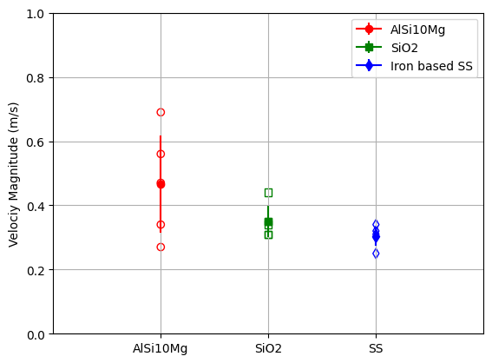
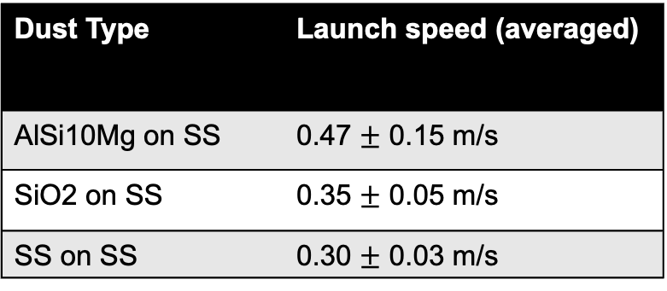
Launch Velocities
Can inform strength of potential barrier needed to halt migration
Kinetic Energy: K = ½ mv²
In combination with charge gives electric potential: E = K/q
Dust Type | Launch speed (averaged)
AlSi10Mg on SS | 0.47 $±$ 0.15 m/s
SiO2 on SS | 0.35 $±$ 0.05 m/s
SS on SS | 0.30 $±$ 0.03 m/s
A. Mahon TTC 2026 June 10

Slide 10
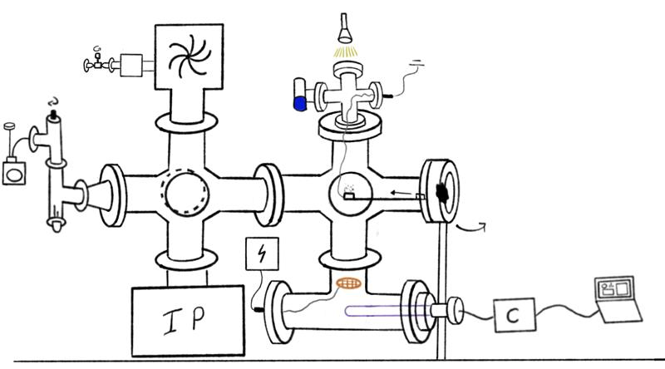
Next step...charge!
Millikan oil drop-type experiment
Can estimate charge of particulates from magnitude of voltage on grid required to halt them
In combination with velocity results will provide estimate (polarity, order of magnitude) of potential barrier needed stop passage of charged dust into cavities
Upgrade underway with expected results by end of Summer 2026
Grid
A. Mahon TTC 2026 June 10

Slide 11
References
[1] Goddard, B., et al. "Transient beam losses in the LHC injection kickers from micron scale dust particles." Conf. Proc.. Vol. 1205201. No. CERN-ATS-2012-219. 2012.
[2] Wang, X., et al. "Dust charging and transport on airless planetary bodies." Geophysical Research Letters 43.12 (2016): 6103-6110.
[3] Taylor, Kelyan, et al. "Charging and lofting of dust particles on surfaces exposed to a pulsed electron beam." Physics of Plasmas 32.11 (2025).

Slide 12




Thank you
Merci
www.triumf.ca
Follow us @TRIUMFLab

Slide 13
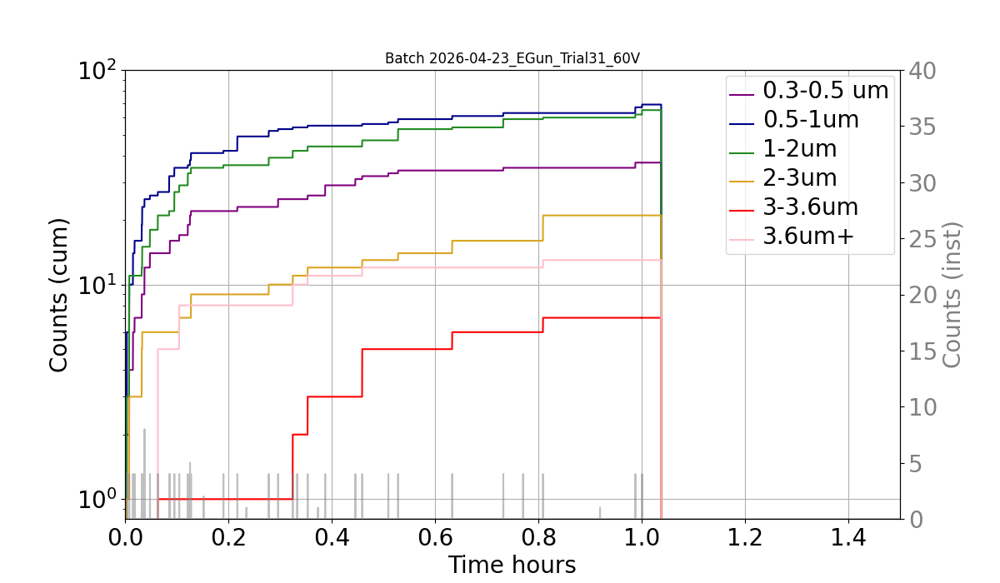
Front View
Backup slides
Particle Counter (PC):
~ 20 cm from sample stage
Only dust sample to register counts → SiO2!!
Also classifies
based on size
20cm

Slide 14
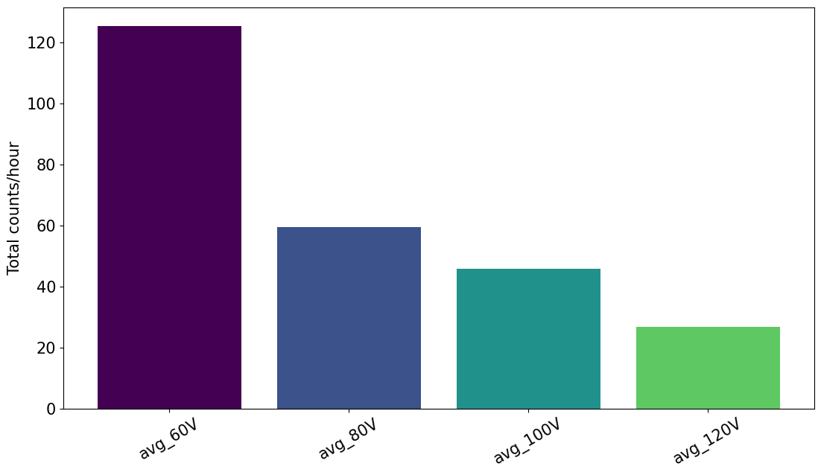
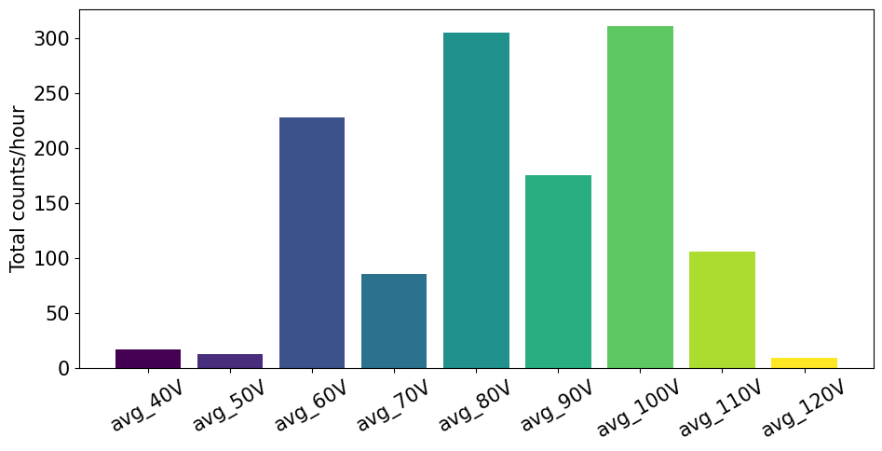
SiO2 on SS Case study: Particle Counter (PC)
Sample 1
ADA*
PRELIMINARY
Counts/time rate extrapolated from PC measurements
Trials at set electron beam energies (40-120eV)
SEY for this material type should peak ~100 eV [3]
Ascending vs descending order can impact SEY yields and thus lofting
The more the surface has been exposed to the electron beam, the more it has processed and the lower the SEY
Sample 2
DDA*
PRELIMINARY
With further trials range of relevant electron beam energies can be established
* A: ascending, B: descending
A. Mahon TTC 2026 June 10

Slide 15
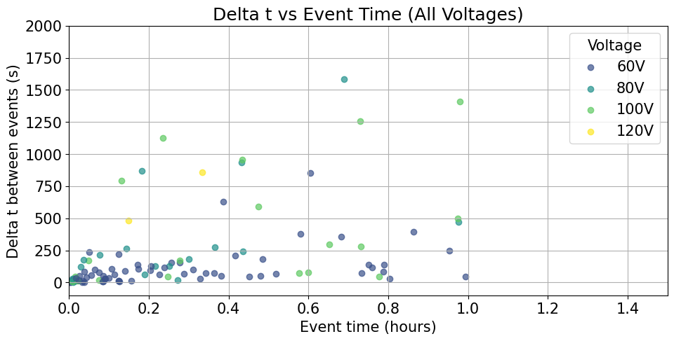
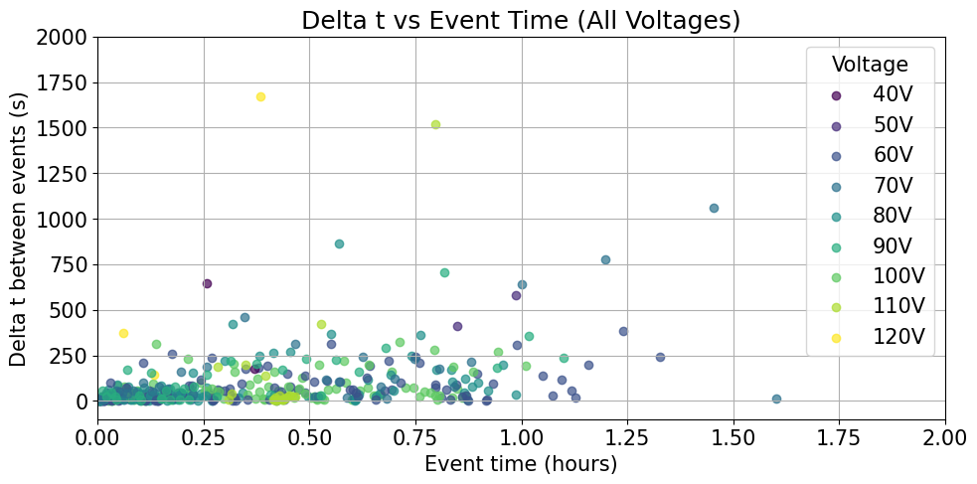
SiO2 Case study: PC event time intervals
Sample 1
ADA
PRELIMINARY
How frequently we record events per energy trial
Counts less consistent as time progresses
Also could be attributed to change in SEY of surface with prolonged exposure to e- beam
Sample 2
DDA
PRELIMINARY
A. Mahon TTC 2026 June 10

