Slide 1

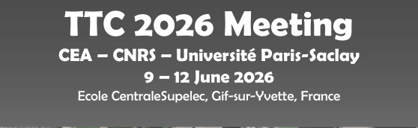
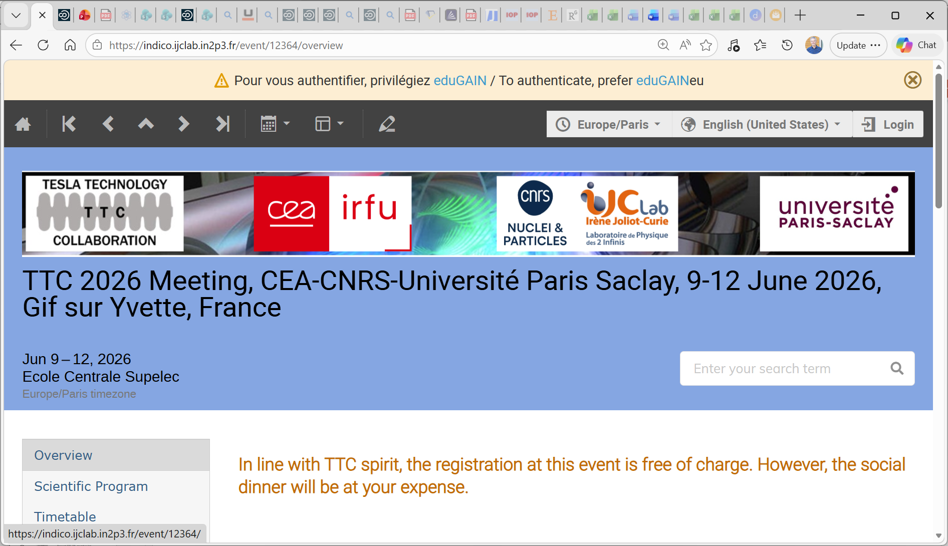
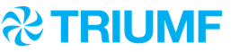
Report from TTC Collaboration Board Meeting
TTC-CB Report
Bob Laxdal (TRIUMF) – TTC Chair
Anne-Marie Valente-Feliciano (JLAB) – TTC Deputy Chair
June 9, 2026
In Person
TTC-2026 June 9, 2026 Bob Laxdal

Slide 2
Attendance
TTC Collaboration Board Meeting – 06/09/2026
Attendees (29) : Bob Laxdal (TRIUMF) [chair], Anne Marie Valente-Feliciano (JLab)[notes], Sergey Belomestnikh (FNAL), Sebastian Aderhold (SLAC), Cecilia Maiano (ESS), Catherine Madec (CEA), Akira Miyazaki (IJCLab), Jinfang Chen (SARI), Carlo Pagani (INFN Milan-LASA) [emeritus], Qiong Wu (BNL), Han Li (IASF), Rocio Santiago Kern (UU), Anna Shabalina (STFC), Jie Gao (IHEP, CAS), Rongli Geng (JLab), Massamba Diap (SOLEIL), Daniele Sartore (INFN Milano, LASA), Cristian Pira (INFN LNL), Walter Venturini Delsolaro (CERN), Hans Weise (DESY), Laura Popierlaski (MSU/FRIB), Dariusz Bocian (IFJ PAN), Youngkwon Kim (RAON IBS), Marc Wenskat (U. Hamburg ), Teng Tan (IMP, CAS), Detlef Reschke (DESY, TTC-TB), Naruhiko Sakamoto (RIKEN), Hiroshi Sakai (KEK), Akira Yamamoto (KEK) [emeritus].
29 Attendees – 23 Members + 6 Proxies
TTC-2026 June 9, 2026 Bob Laxdal

Slide 3
Agenda
Updates on the Collaboration
Technical Board Renewal
Site for TTC-2027
Proposals for TTC2028
AOB
TTC-2026 June 9, 2026 Bob Laxdal

Slide 4
Agenda
Updates on the Collaboration
Technical Board Renewal
Site for TTC-2027
Proposals for TTC2028
AOB
TTC-2026 June 9, 2026 Bob Laxdal

Slide 5
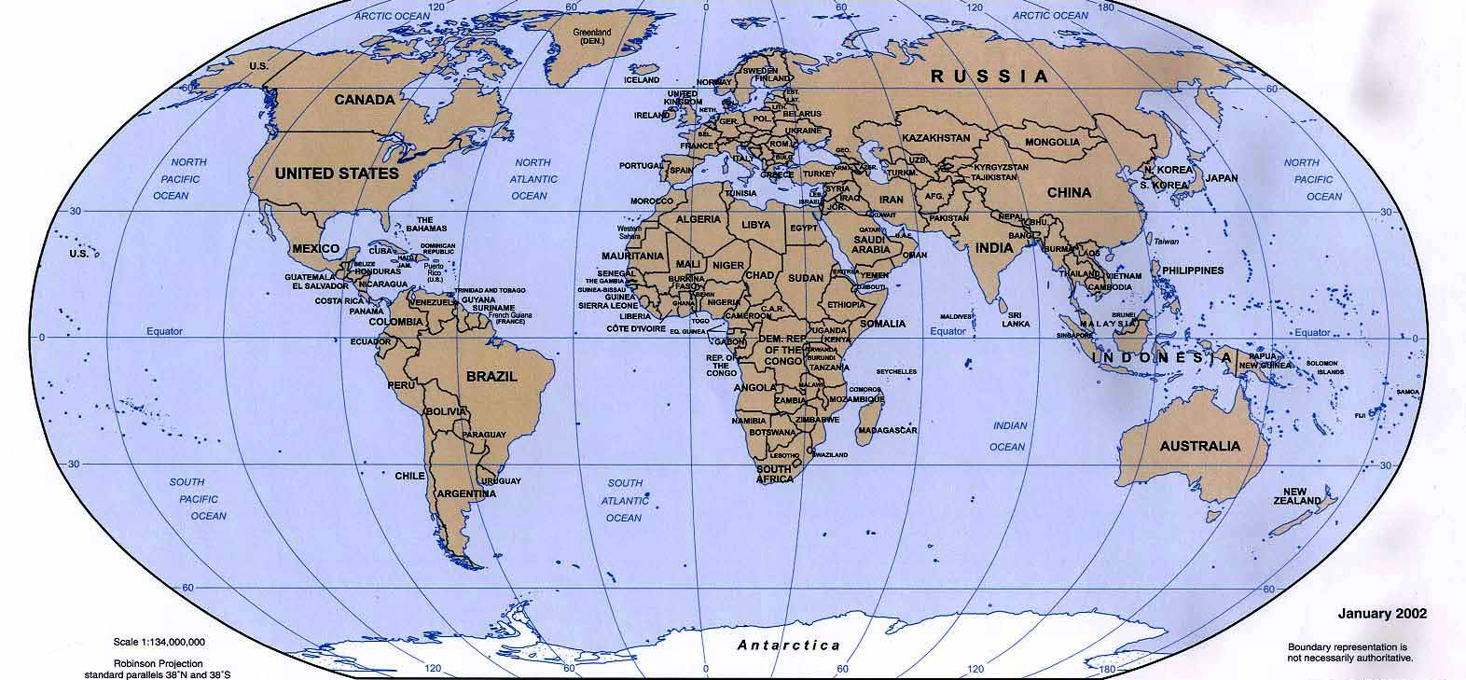
Updates on the collaboration
Upp.U
ESS
BUW
TRIUMF
DESY
TUD
HZB
IFJPAN
FNAL
FRIB
STFC
HZDR
HZH
IHEP
ANL
Cornell
JAI
CANDLE
IMP
PKU
QST
JAEA
LBNL
IPN
CEA
CERN
IUAC
TU
KEK
SLAC
CNRS
IJCLab
Elettra
LNL
LNF
RIKEN
ORNL
BNL
IASF
JLab
LASA
RRCAT
SARI
IBS
NSRRC
BARC
VECC
TTC - 64 Institutes across 16 countries
Collaboration Members
TTC-2026 June 9, 2026 Bob Laxdal

Slide 6
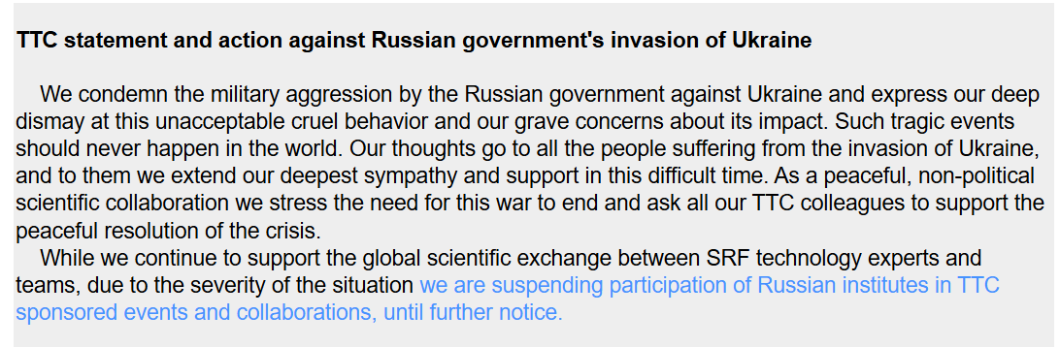
Status of Russia Members
Reconfirmation vote - reconfirmed
March 11th, 2022
Eiji Kako, Bob Laxdal, Hans Weise, Paolo Pierini, Sergey Belomestnykh
And Akira Yamamoto (TTC Chairs and Executive Committee members)
November 11th, 2024
Reconfirmation and approval of the Collaboration Board
June 9th, 2026
Reconfirmation and approval of the Collaboration Board
TTC-2026 June 9, 2026 Bob Laxdal

Slide 7
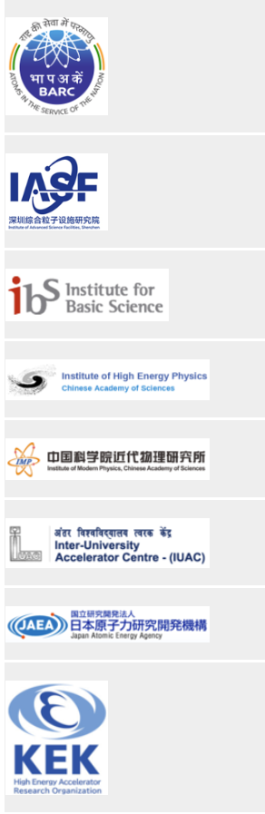
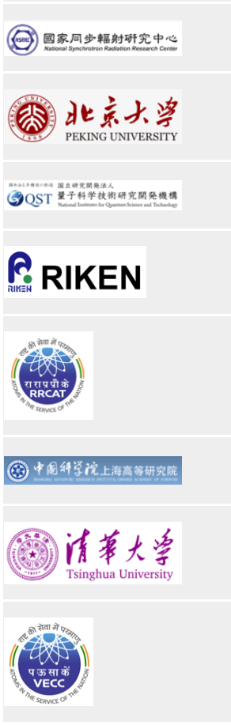
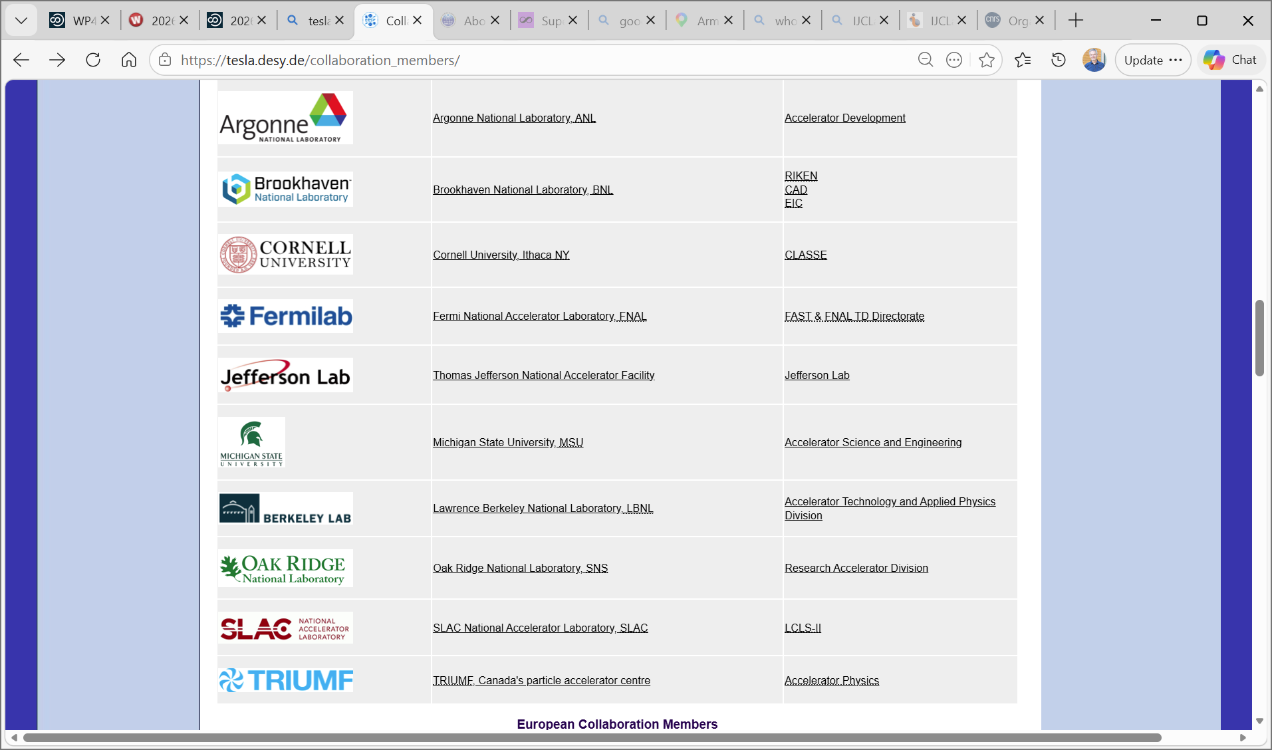
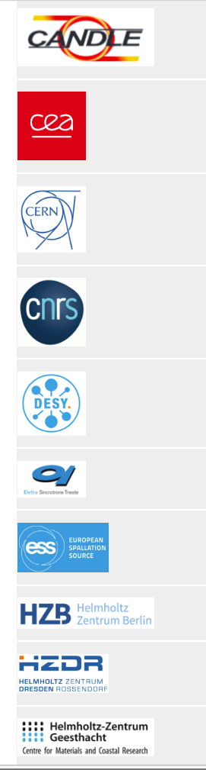
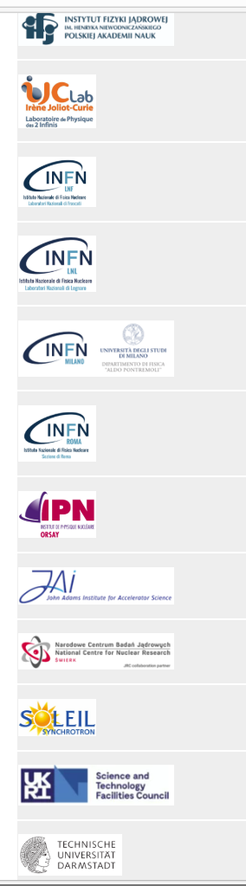
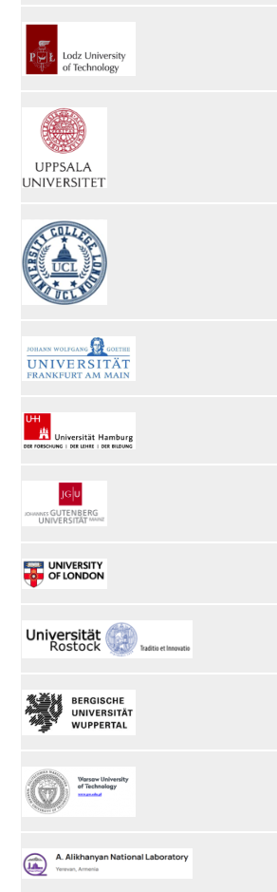
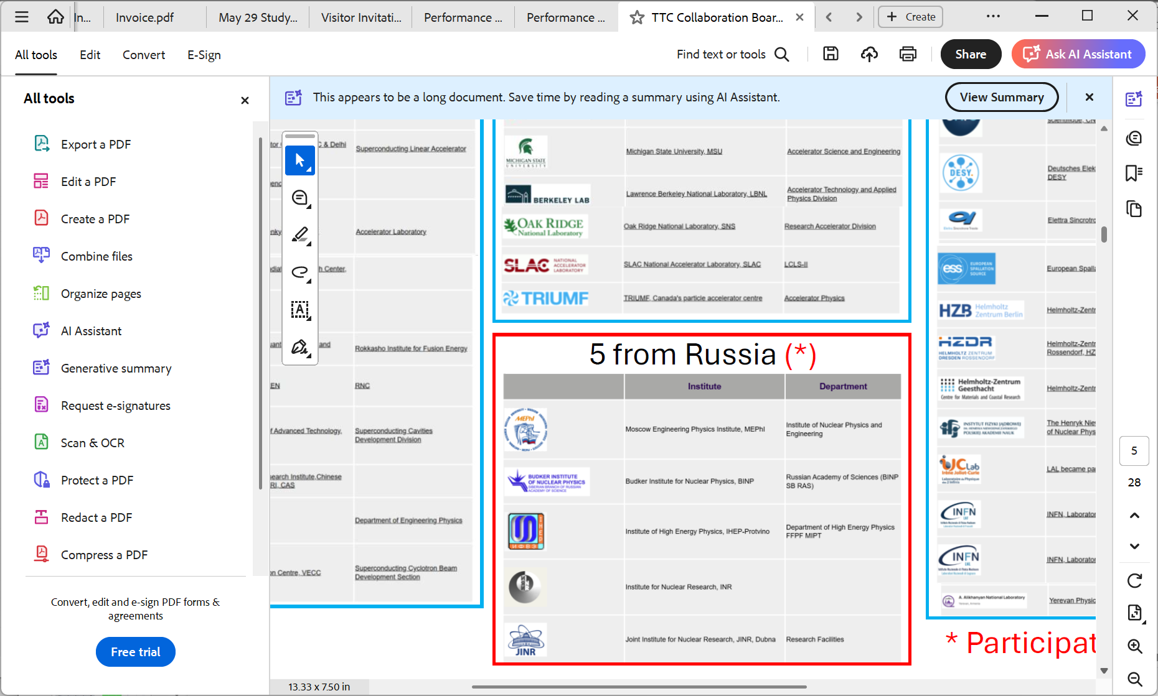
TTC by Region
Asia Region (16)
North America Region (10)
European Region (33)
Russia (5) *
* Presently suspended
TTC-2026 June 9, 2026 Bob Laxdal

Slide 8
New CB members
Simon B. Adrian replaces Ursula van Rienen as the University of Rostock representative on the CB
Hiroshi Sakai replaces Shin Michizono as the KEK representative on the CB
Yeonsei Chung replaces Myeun Kwon as the IRIS representative on the CB
Alan Wheelhouse replaces Peter McIntosh as the STFC representative on the CB
Welcome to the new members!
TTC-2026 June 9, 2026 Bob Laxdal

Slide 9
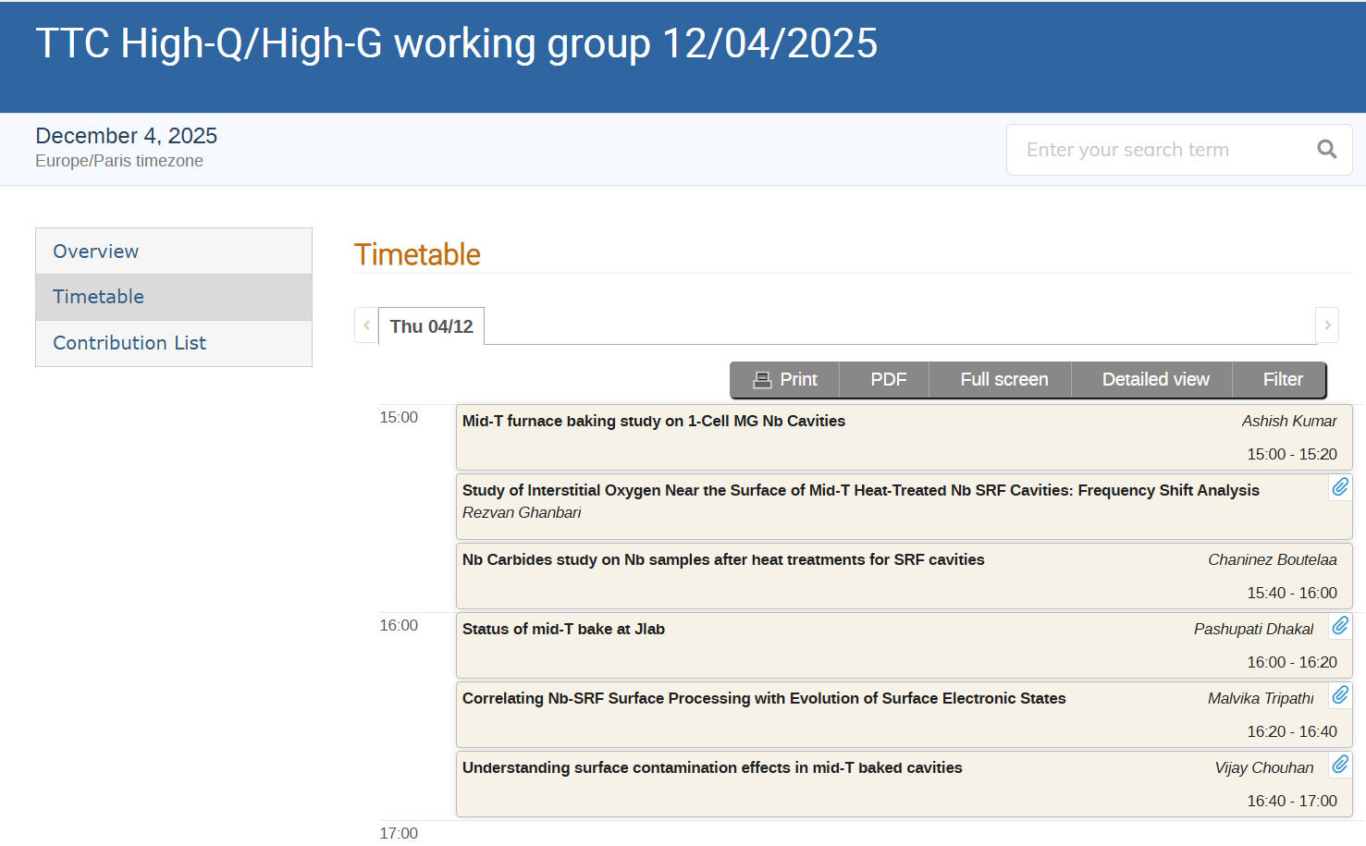
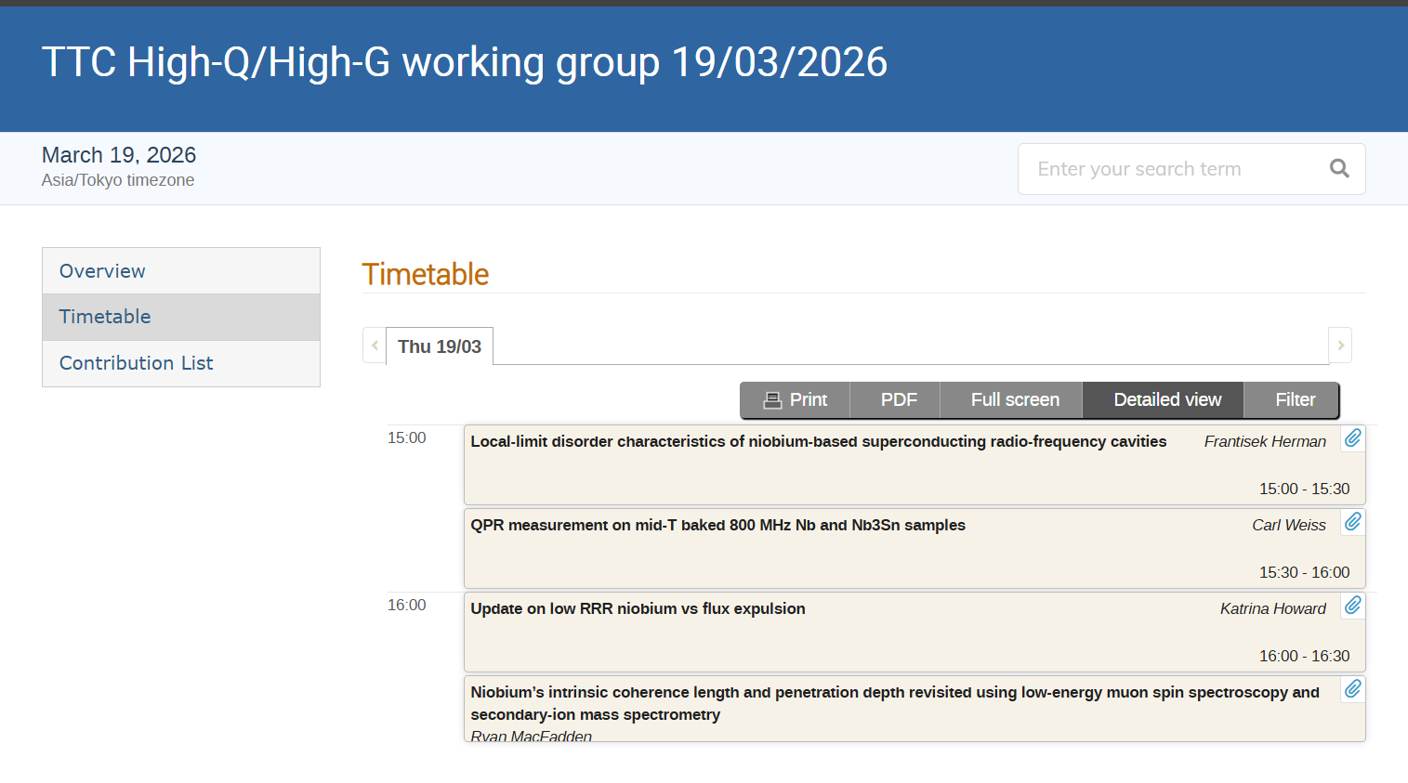
High Q/High G Working Group
Two remote sessions coordinated by the High Q/High G working group – Dec. 5, 2025 and March 19, 2026
Both events well attended – thanks to Akira, Martina and Kensei for coordination
TTC-2026 June 9, 2026 Bob Laxdal

Slide 10
TTC Executive Committee
Executive committee during 2025-2028
Chair – Bob Laxdal
Deputy Chair – Anne-Marie Valente-Feliciano
North America
Sergey Belomestnikh
Sebastian Aderhold
Europe
Catherine Madec
Hans Weise
Asia
Jie Gao
Michiru Nishiwaki
We are the executive committee of TTC so please reach out with suggestions and comments!
Thanks to the committee for their support of TTC2026!
Observers:
Akira Yamamoto
Eiji Kako
TTC-2026 June 9, 2026 Bob Laxdal

Slide 11
Agenda
Updates on the Collaboration
Technical Board Renewal
Site for TTC-2027
Proposals for TTC2028
AOB
TTC-2026 June 9, 2026 Bob Laxdal

Slide 12
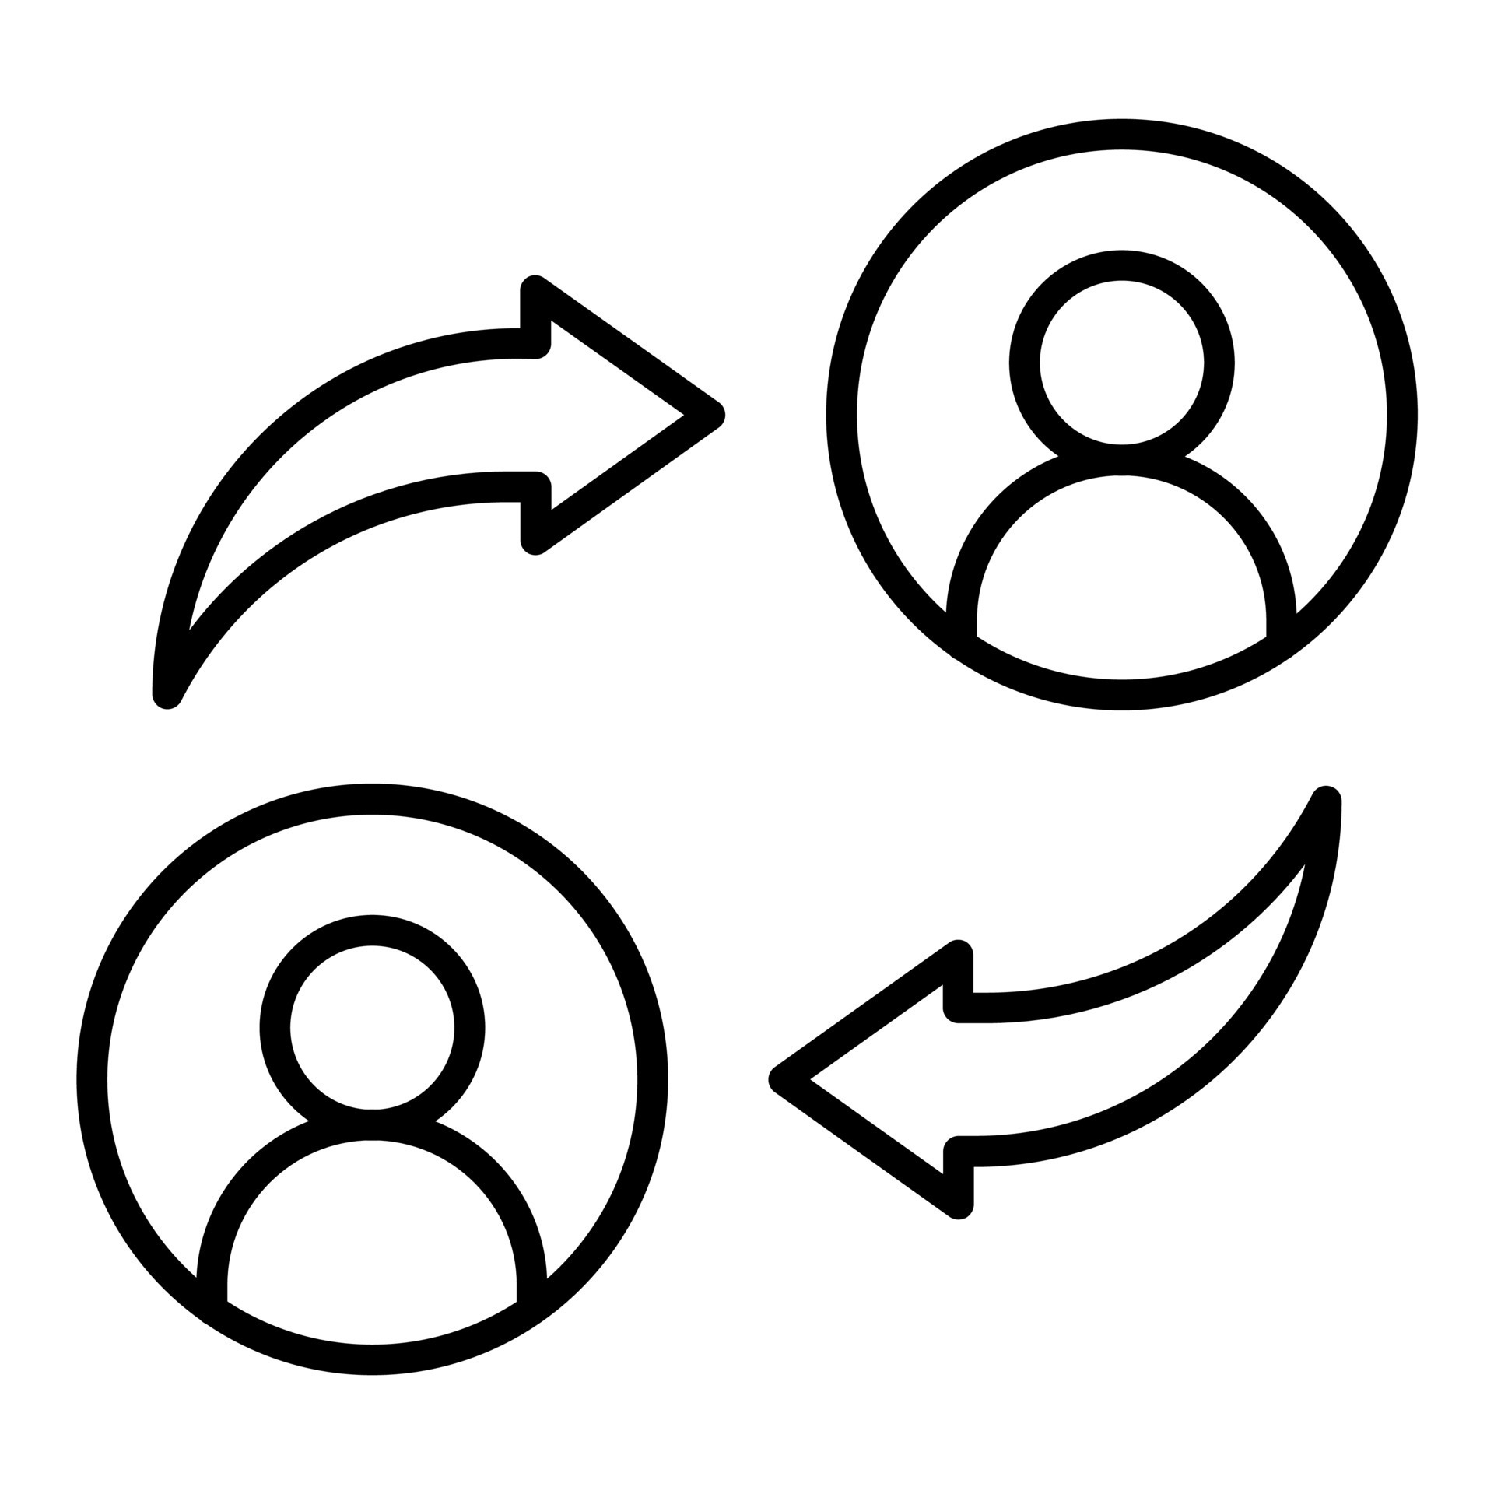
TTC-TB – Renewal Process
Periodic renewal is necessary to keep an active TTC-TB - It seems natural to renew when there is a change in the TTC Leadership – every three years – renewal every four TTCs
Expectation that a TB member shall attend >=50% of the in-person meetings
We have identified two strategies to initiate renewal
  Fill vacancies as members resign or assume other roles
  Prioritize membership based on past participation
The choice of new members is based on considerations on technical knowledge but also on regional and gender balance
TTC-2026 June 9, 2026 Bob Laxdal

Slide 13
TTC-TB departing members
Co-chairs
H. Sakai (KEK)
D. Reschke (DESY)
RF and tuning
F. Gerigk (CERN)
A. Wheelhouse (STFC)
C. Hovater (JLab)
Cryomodule and cryogenics
S. Aderhold (SLAC)
T. Arkan (FNAL→SLAC)
S. Barbanotti (DESY)
J. Mammosser (ORNL)
A. Neumann (HZB)
Han Li (IASF)
Integration and operation
M. Liepe (Cornell)
J. Branlard (DESY)
M. Nishiwaki (KEK)
Through this process we identified 13 departing members
13 departures
4 Europe
8 NA
1 Asia
Cavity and couplers
S. Calatroni (CERN)
R.L. Geng (JLAB)
J. Hao (PKU)
A. Romanenko (FNAL)
K. Umemori (KEK)
J.Y. Zhai (IHEP)
D. Longuevergne (IJCLab)
Z. Conway (BNL)
N. Sakamoto (RIKEN)
L. Monaco (INFN Milano)
L. Popielarski (FRIB)
M. Martinello (SLAC)
P. Dhakal (JLab)
We thank them for their service!
Boundary conditions in renewal
  Address regional balance
  Address gender balance
  New members chosen from nominations from TTC-CB and TTC-EC
TTC-2026 June 9, 2026 Bob Laxdal

Slide 14
TTC-TB – 2026-2029
  New members chosen from nominations from TTC-CB and TTC-EC
Technical Board
RF and tuning (3)
Guillaume Devanz (CEA)
Crispin Contreras-Martinez (FNAL)
Jinfang Chen (SARI)
Cryomodule and cryogenics (6)
S. Barbanotti (DESY)
Han Li (IASF)
Laura Popielarski (FRIB)
Yongkwon Kim (RAON)
Teng Tan (IMP)
Cecilia Maiano (ESS)
Integration and operation (3)
J. Branlard (DESY)
Silvia Verdu Andres (BNL)
Zhongyuan Yao (TRIUMF)
* Plus observers – includes TTC-EC plus honoris causa
Co-chairs
H. Sakai (KEK)
D. Reschke (DESY)
Here is the renewed TTC-TB for 2026-2029
Total members = 27
(EU=9, NA=9, Asia=9)
gender balance: 9/27 = 33%
Cavity and couplers (13)
R.L. Geng (JLAB)
J. Hao (PKU)
K. Umemori (KEK)
J.Y. Zhai (IHEP)
D. Longuevergne (IJCLab)
N. Sakamoto (RIKEN)
L. Monaco (INFN Milano)
P. Dhakal (JLab)
Franck Peauger (CERN)
Suba de Silva (ODU)
Kellen McGee (FNAL)
Yasmine Kalboussi (CEA)
Sang-Ho Kim (SNS)
 | Europe | NA | Asia | Total
Male | 5 | 5 | 8 | 18
Female | 4 | 4 | 1 | 9
Totals | 9 | 9 | 9 | 27
Thanks to the committee for their engagement during TTC2026!
TTC-2026 June 9, 2026 Bob Laxdal

Slide 15
TTC-TB Renewal - Discussion
Comments on the renewal process?
  The three-year renewal cycle was endorsed
Endorsement of the TTC-TB for 2026-2029
  The TTC-TB new membership was endorsed
15
TTC-2026 June 9, 2026 Bob Laxdal

Slide 16
Agenda
Updates on the Collaboration
Technical Board Renewal
Site for TTC-2027
Proposals for TTC2028
AOB
TTC-2026 June 9, 2026 Bob Laxdal

Slide 17
Regional rotation
Meeting | Host | Location | Date | Region | Δt (days)
TTC-2023 | Fermilab | Chicago | Dec. 2023 | NA | 160
TTC-2024 | ESS | Lund | Nov. 2024 | Europe | 343
TTC-2025 | IBS-RISP | Daejeon | April 2025 | Asia | 147
SRF2025 | RIKEN | Tokyo | Sept. 2025 | Asia | 166
TTC2026 | CEA/IJC-Lab | Paris | June 2026 | Europe | 261
TTC2027 | ???? | USA | ~Jan 20, 2027 | NA | 225
SRF2027 | INFN-LNL | Italy | June 25, 2027 | Europe | 155
TTC2028 | ???? | ??? | ~Feb. 15, 2028 | Asia | 240
TTC2028 | ???? | ??? | ~Nov. 1, 2028 | Europe? | 260
SRF2029 | ???? | ??? | ~July 1, 2029 | NA | 242
Normal rotation goes Asia, NA, Europe but given SRF2027 is in Italy we promoted TTC2026 to be in Europe and TTC2027 to be in NA.
TTC-2026 June 9, 2026 Bob Laxdal

Slide 18
TTC2027 SPC Schedule
12.5 months between TTC2026 and SRF2027
Would like a meeting in late Jan 2027
We will start our planning process in ~ August to expedite visa application process
  Example below assumes first week of Aug 2026
But where are we going!
TTC-2026 June 9, 2026 Bob Laxdal

Slide 19
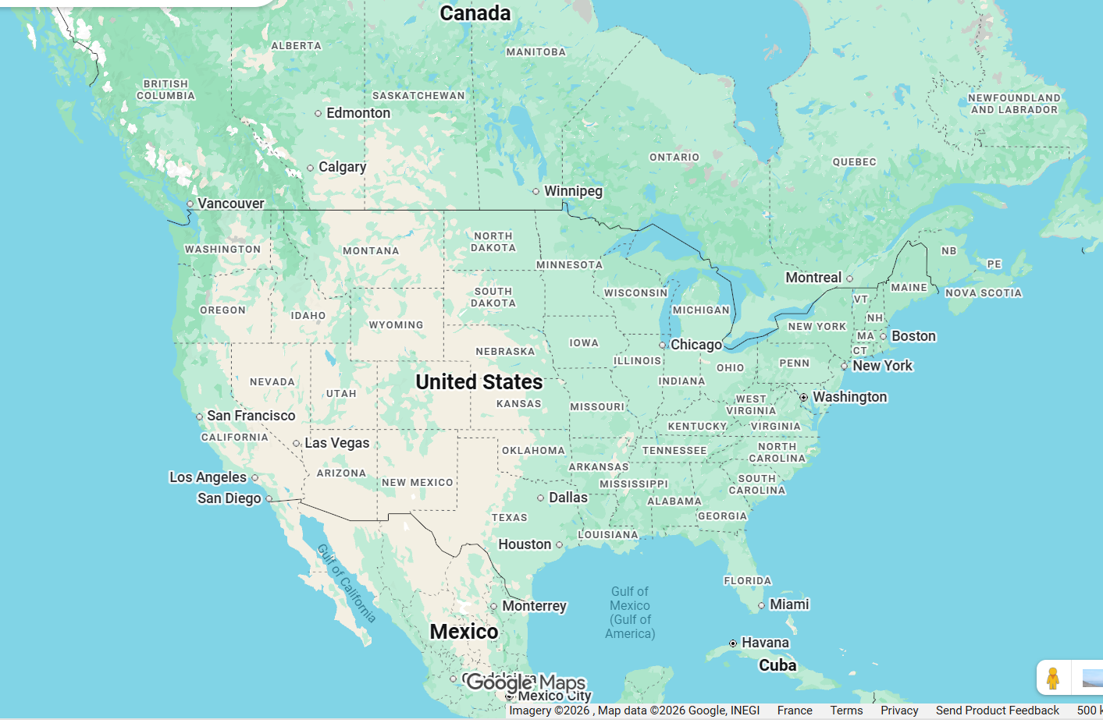
TTC2027 – Late Jan 2027 in North America
TTC2027

Slide 20
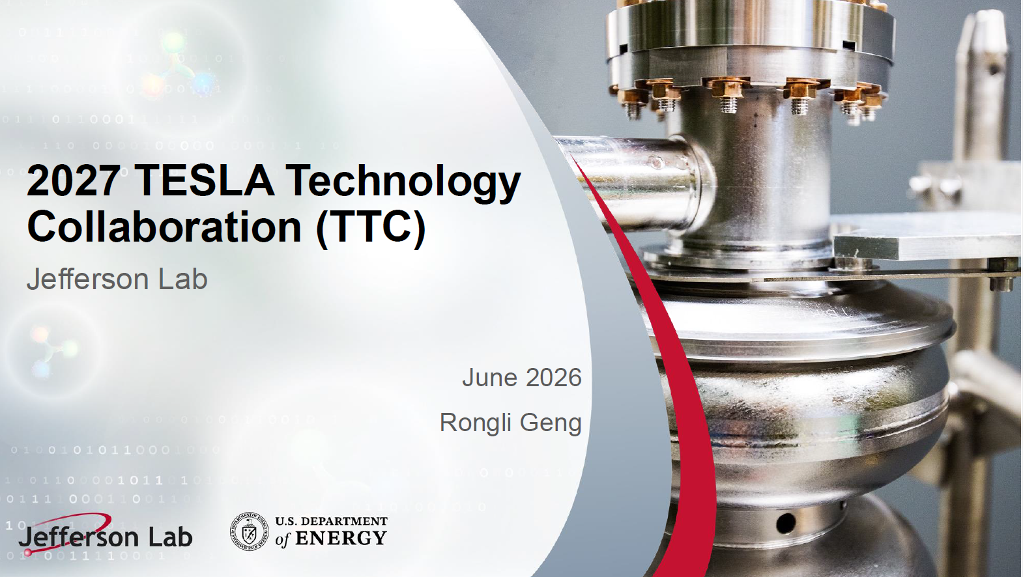
TTC-2027 Hosting decision
JLab proposal to host TTC2027 in late Jan 2027.
Endorsement of the TTC-2027 proposal?
  Proposal was endorsed
20
TTC-2026 June 9, 2026 Bob Laxdal

Slide 21
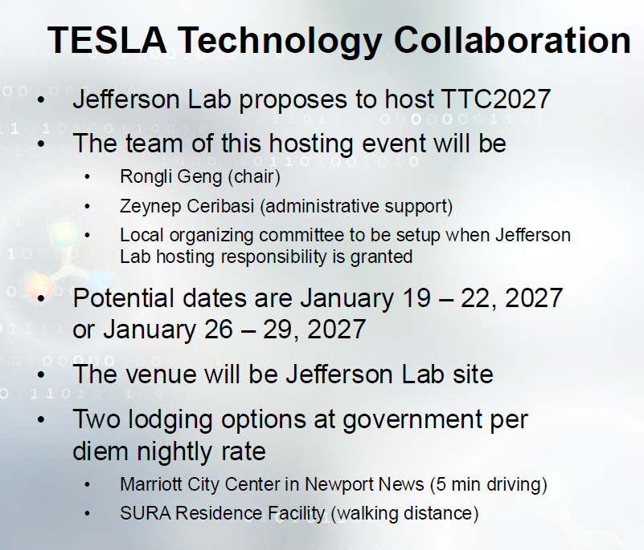
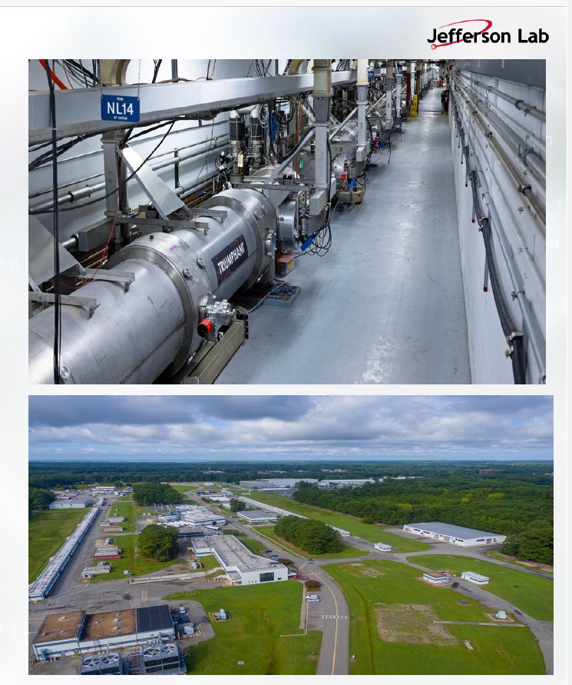
TTC2027 – JLab – Jan2027
TTC-2026 June 9, 2026 Bob Laxdal

Slide 22
Agenda
Updates on the Collaboration
Technical Board Renewal
Site for TTC-2027
Proposals for TTC2028
AOB
TTC-2026 June 9, 2026 Bob Laxdal

Slide 23
Regional rotation
Meeting | Host | Location | Date | Region | Δt (days)
TTC-2023 | Fermilab | Chicago | Dec. 2023 | NA | 160
TTC-2024 | ESS | Lund | Nov. 2024 | Europe | 343
TTC-2025 | IBS-RISP | Daejeon | April 2025 | Asia | 147
SRF2025 | RIKEN | Tokyo | Sept. 2025 | Asia | 166
TTC2026 | CEA/IJC-Lab | Paris | June 2026 | Europe | 261
TTC2027 | JLab | USA | ~Jan 20, 2027 | NA | 225
SRF2027 | INFN-LNL | Italy | June 25, 2027 | Europe | 155
TTC2028 | ???? | ??? | ~Feb. 15, 2028 | Asia | 240
TTC2028 | ???? | ??? | ~Nov. 1, 2028 | Europe? | 260
SRF2029 | ???? | ??? | ~July 1, 2029 | NA | 242
TTC2028 goes to Asia in early 2028.
We want two meetings in 2028
TTC-2026 June 9, 2026 Bob Laxdal

Slide 24
TTC2028 location (Asia region ~Feb. 2028)
TTC-2028 Location
We have received three expressions of interest for TTC2028 - ~ Feb. 15, 2028
Down select will be announced at TTC2027
TTC-2026 June 9, 2026 Bob Laxdal

Slide 25
Regional rotation
Meeting | Host | Location | Date | Region | Δt (days)
TTC-2023 | Fermilab | Chicago | Dec. 2023 | NA | 160
TTC-2024 | ESS | Lund | Nov. 2024 | Europe | 343
TTC-2025 | IBS-RISP | Daejeon | April 2025 | Asia | 147
SRF2025 | RIKEN | Tokyo | Sept. 2025 | Asia | 166
TTC2026 | CEA/IJC-Lab | Paris | June 2026 | Europe | 261
TTC2027 | JLAB | USA | ~Jan 20, 2027 | NA | 225
SRF2027 | INFN-LNL | Italy | June 25, 2027 | Europe | 155
TTC2028 | ???? | ??? | ~Feb. 15, 2028 | Asia | 240
TTC2028 | ???? | ??? | ~Nov. 1, 2028 | Europe? | 260
SRF2029 | ???? | ??? | ~July 1, 2029 | NA | 242
With SRF2029 in NA we propose to go back to Europe for the fall TTC2028
TTC-2026 June 9, 2026 Bob Laxdal

Slide 26
TTC2028 location (Europe region ~Nov. 2028)
Given that SRF2029 will be in N. America we propose to host TTC2028 (Nov) in Europe
  Agree that the TTC 2028 Nov meeting would be in Europe region
We have received one expression of interest – more welcome
TTC-2026 June 9, 2026 Bob Laxdal

Slide 27
Agenda
Updates on the Collaboration
Technical Board Renewal
Site for TTC-2027
Proposals for TTC2028
AOB
TTC-2026 June 9, 2026 Bob Laxdal

Slide 28

AOB … Many thanks
To the LOC:
Catherine, David, Juliette, Nicolas, Akira, Camille, Chahinez, Amoury, Amelle, Severine, …
Thanks for fantastic, seamless coordination and support!
To the WG conveners and SPC (TTC-EC, TTC-TB (Chairs), LOC chairs):
  WG1- Jinfang Chen (SARI), Daniel Bafia (FNAL), Lea Steder (DESY)
  WG2 - Zhongyuan Yao (TRIUMF), Tiancai Jiang (IMP), Enrico Cenni (CEA)
  WG3 - Laura Monaco (INFN), Matia Parise (FNAL), Takeshi Dohmae (KEK)
  WG4 - Cristian Pira (INFN), Teng Tan (IMP), Laura Popielarski (FRIB)
Thanks for your major commitment of time and community knowledge!
To the presenters:
Thanks for your all your input to our program and discussions!
You all have made our first TTC meeting as Chair and Deputy very easy!
TTC-2026 June 9, 2026 Bob Laxdal

Slide 29
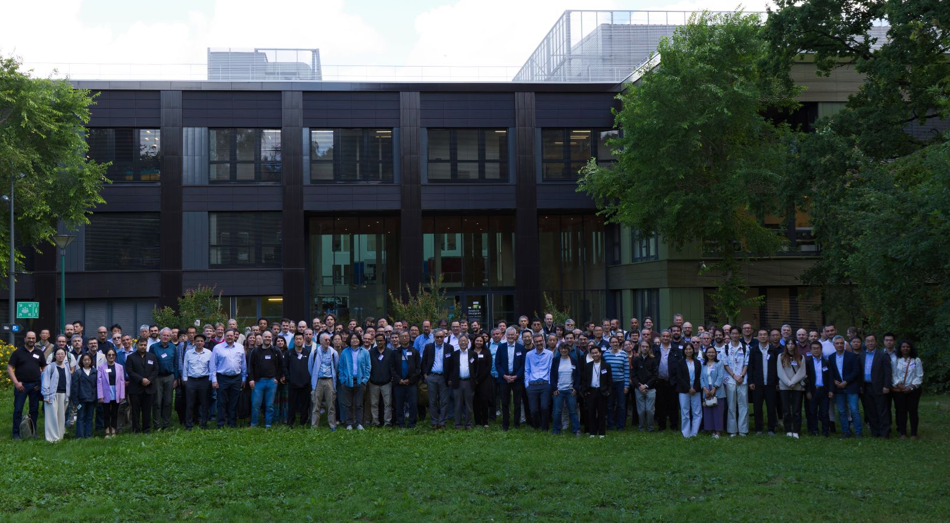

And to the participants – many thanks
This Photo by Unknown Author is licensed under CC BY-NC

