Slide 1
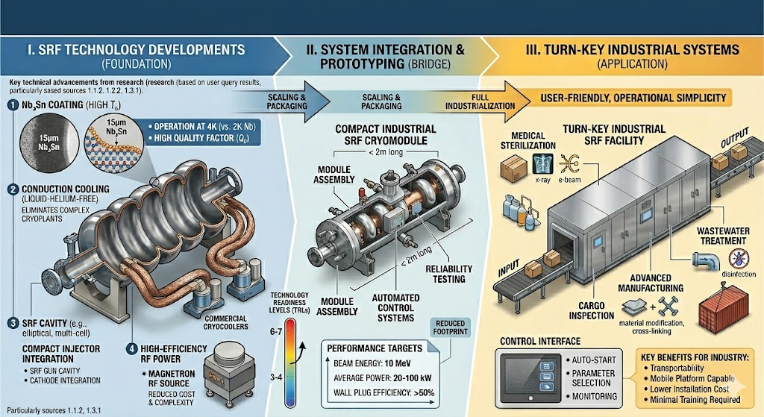
Hot topic Session
Developing SRF towards Turn-Key Industrial Systems
6/11/2026
Panelists: Cristian Pira, Teng Tan, Reza Valizadeh, Florian Hug, Andrew Burrill, Lucas Zweibaumer, Nikki Tagdulang

Slide 2
Hot topic Developing SRF towards Turn-Key Industrial Systems
Session Outline
Introduction
Grey Enid: operation of a Nb3Sn based cryomodule A-M Valente-Feliciano
Proving Conductive Cooling: 10,000 Hours of Trouble-Free Operation, Beam-Loss Design, and Degradation Recovery at IMP Teng Tan
High-Gradient "Turn-Key" SRF Systems for the MESA ERL Project Florian Hug
Engineering Gaps for Industrial SRF Adoption Nikki Tagdulang
Reliability for EUV FEL based systems Andrew Burrill
Nb3Sn based “Turn-Key“ SRF Systems – When is the technology ready for industrial ramp-up? Lucas Zweibaumer
Discussions
Technical Frontier
Engineering path for reliability
Strategic democratization
Preliminary considerations for a Roadmap towards an SRF "plug-and-play"

Slide 3
Hot topic Developing SRF towards Turn-Key Industrial Systems
Session Charge
Developing SRF towards Turn-Key Industrial Systems
The landscape of SRF technology is shifting beyond large instruments, specifically with advances with Nb3Sn and conduction cooling, enabling the perspective of SRF-based standalone industrial machines. However significant developments remain for repeatable production of consistent Nb₃Sn performance, successful application on various cavity shapes and for successful integration into compact, high-duty-cycle accelerators. The discussion should address the critical R&D and engineering required to move from promising R&D into a mainstream technology for the next generation of cryomodules. This session should also focus on the "vulgarization", or the strategic democratization, of SRF technology by transitioning from specialized laboratory physics to robust, mainstream industrial engineering. The hot-topic session should address the roadmap for making SRF "plug-and-play." What are the standardizations and simplifications that would be required to allow for industrialization and operation by non-specialist technicians in non-laboratory environments.
Keywords:
Nb₃Sn, SRF Industrial applications, conduction cooling, roadmap, strategic democratization, mainstream acceptance, turn-key
Google Form to gather input: https://forms.gle/65V3VwZnUgRfmVxHA

Slide 4



“Gray-Enid I” : Beam Acceleration with a Nb₃Sn cryomodule at JLab

Slide 5
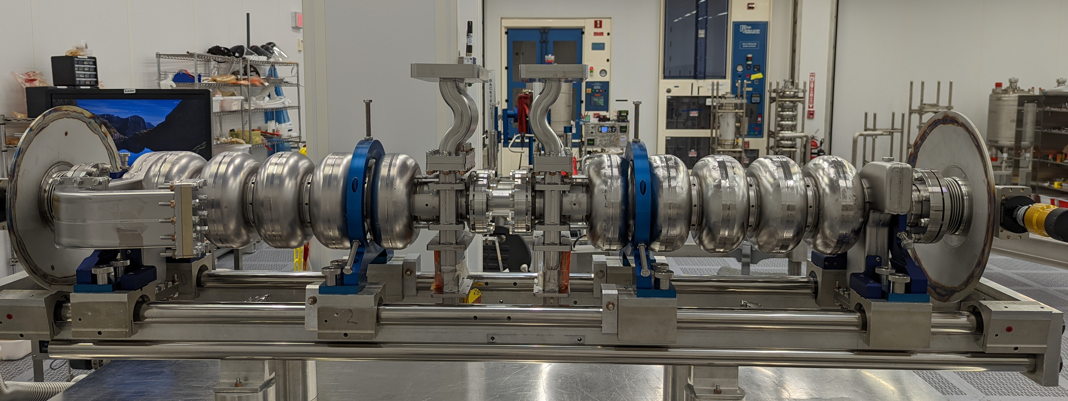
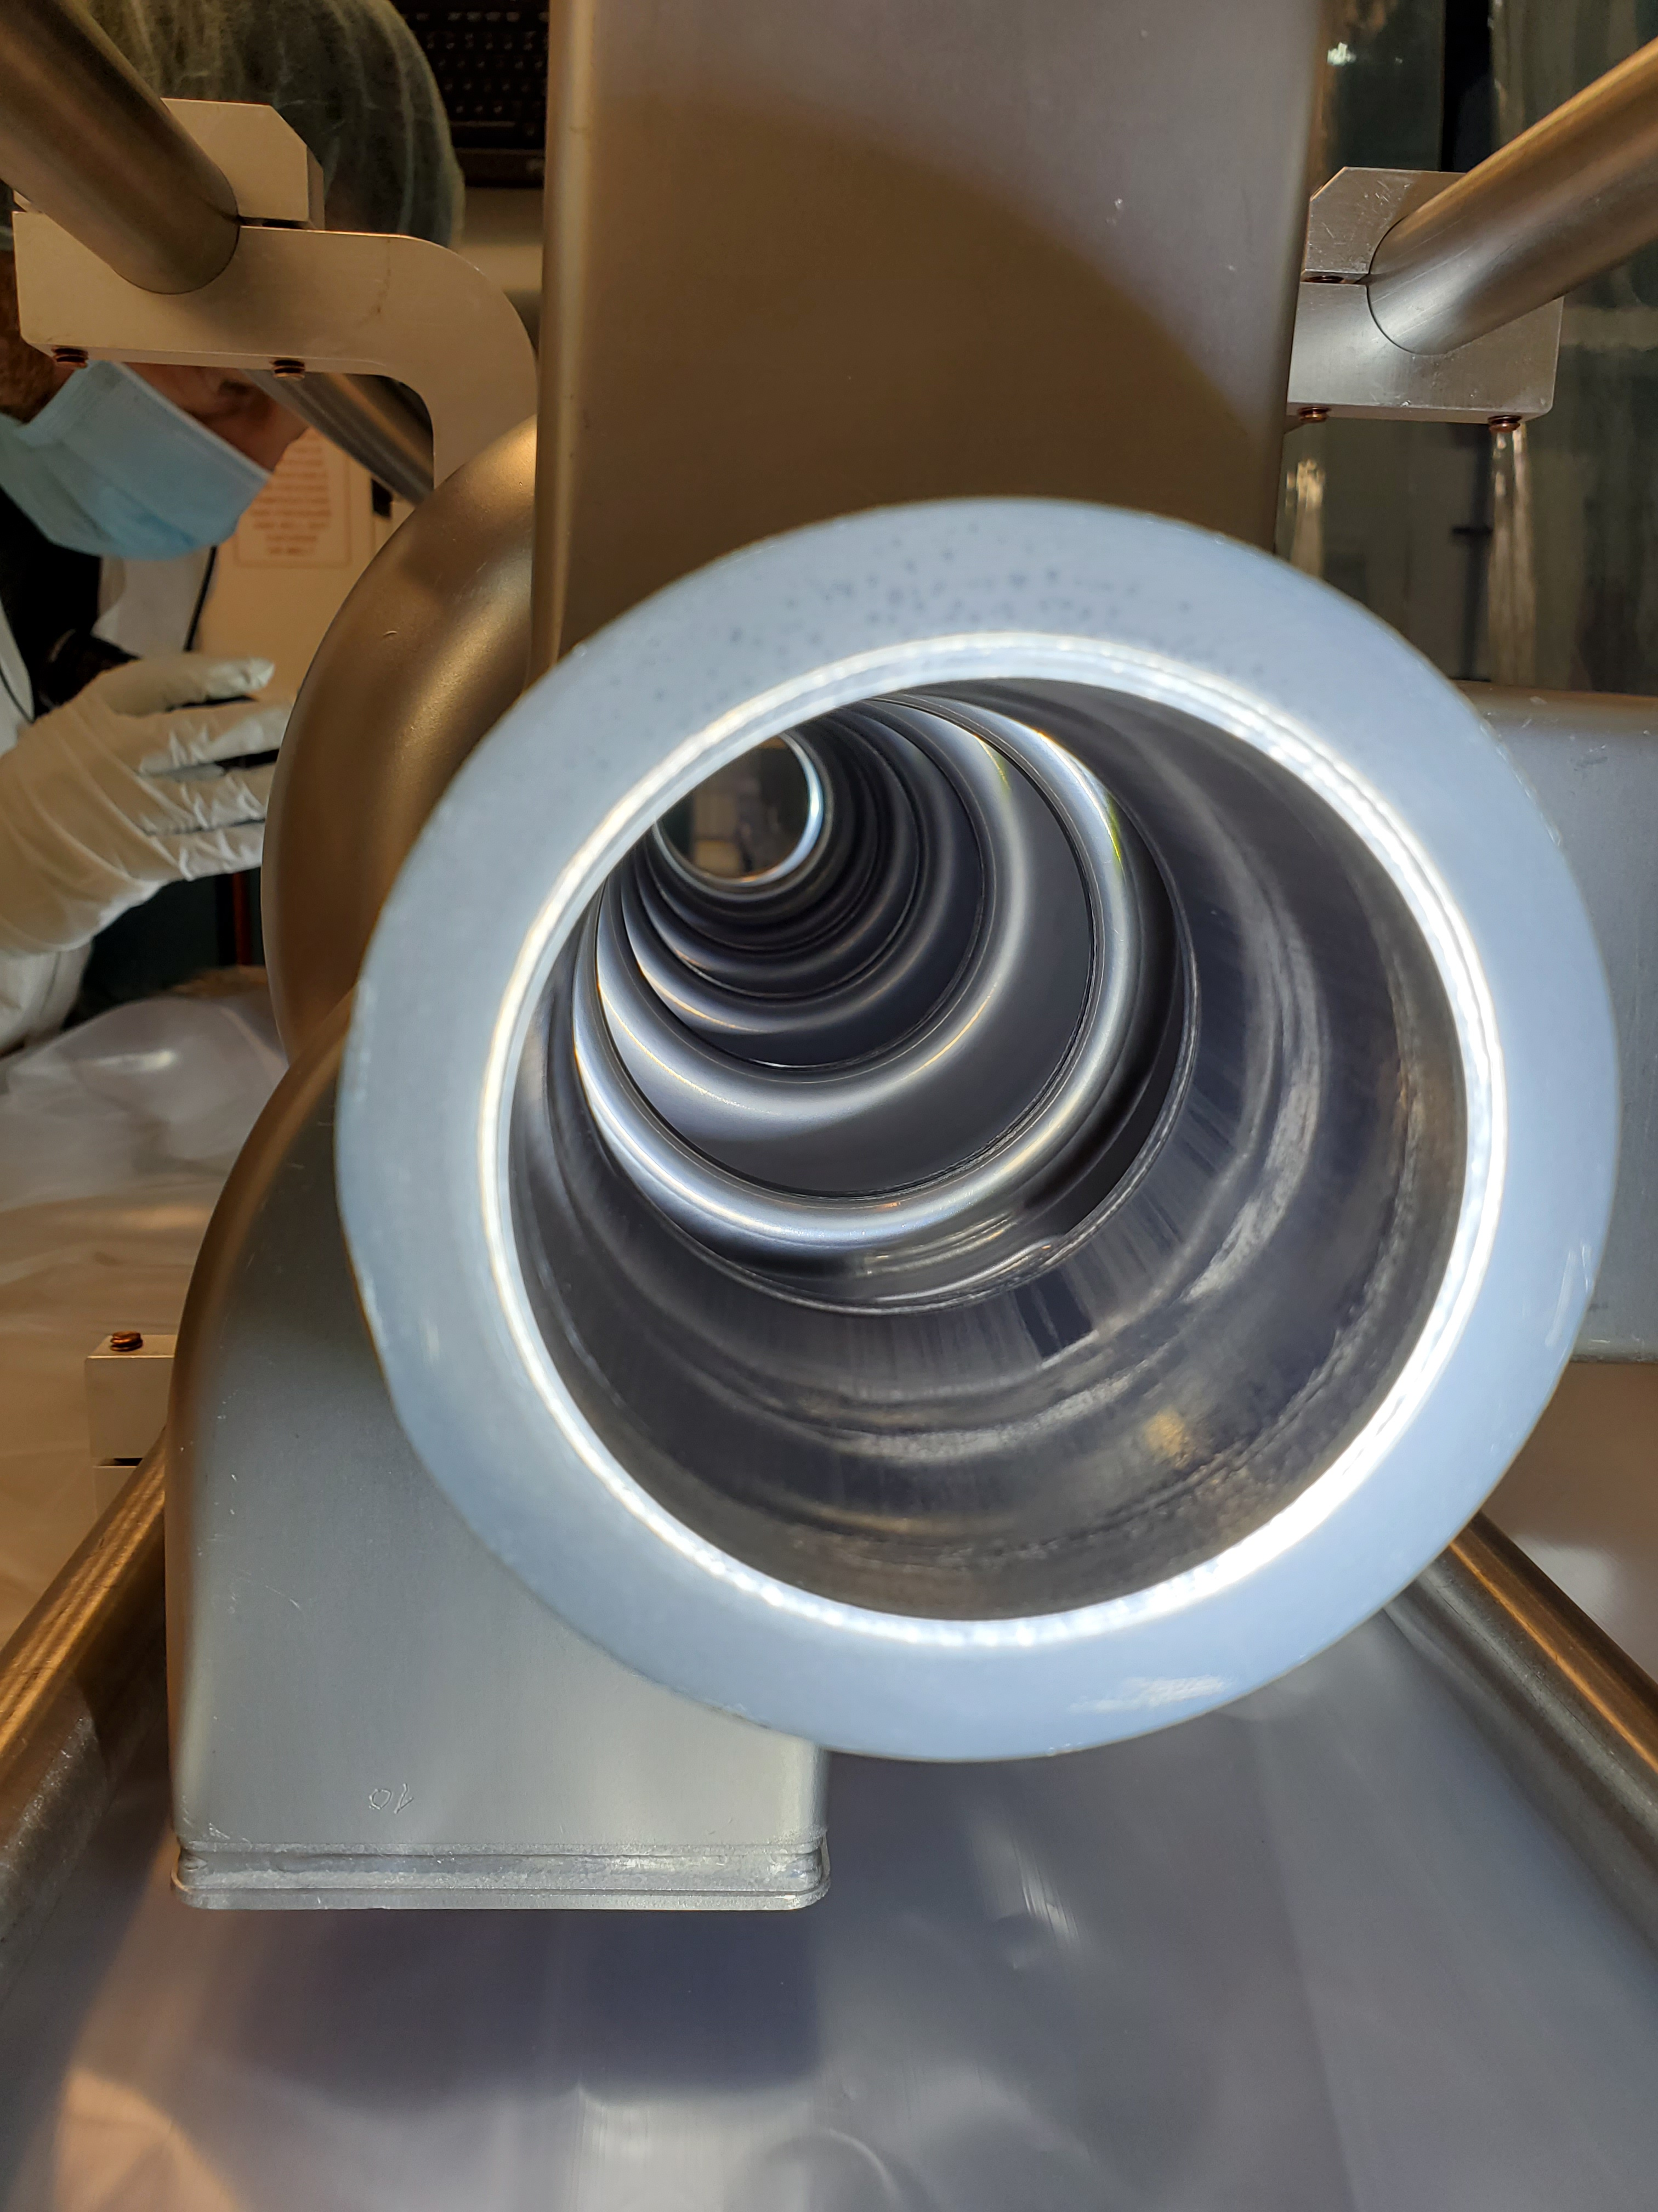
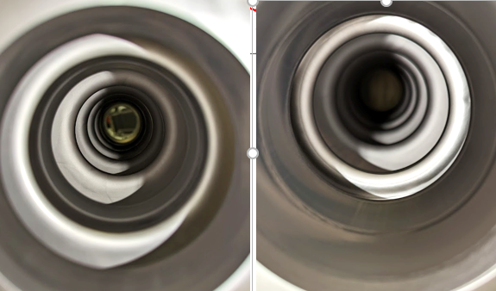
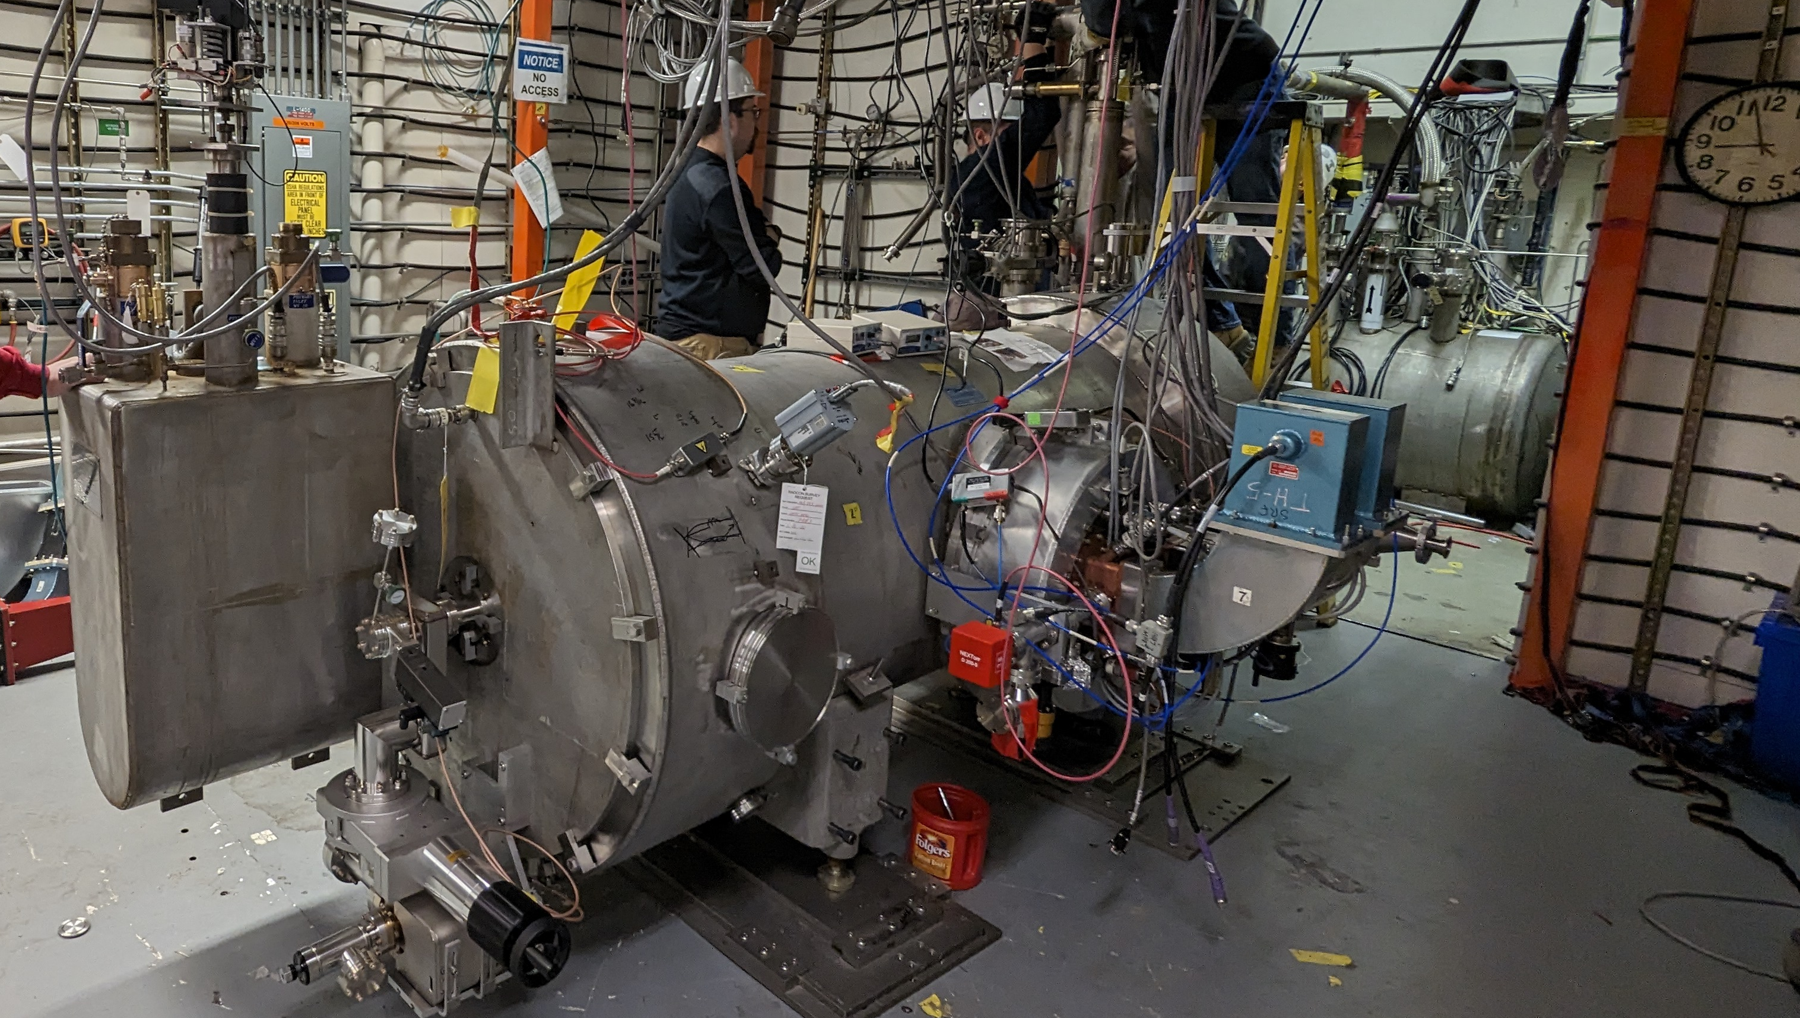
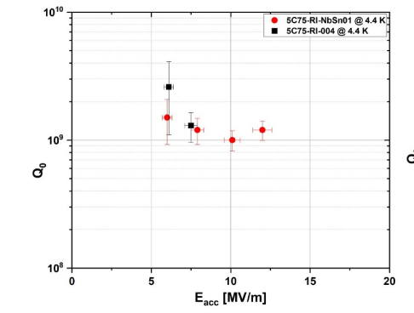
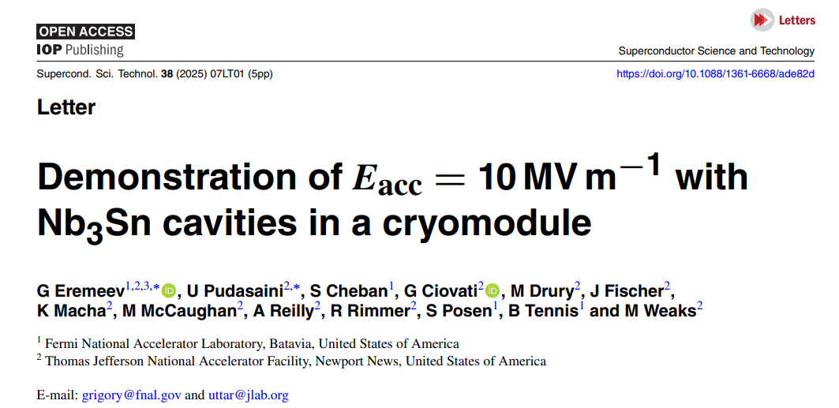
Background
Cryomodule development started in 2018, aiming for beam acceleration at UITF
One cavity coated at JLab, another at FNAL; both >13 MV/m, Q ~10¹⁰ @ 10 MV/m.
Pair assembled but disassembled due to RF window leak → one cavity degraded to 8 MV/m but accepted.
Cryomodule Assembled and tested
  Demonstrated >10 MV/m gradient in a cryomodule for the first time: lower Q₀ due to limiting cooldown control

Slide 6
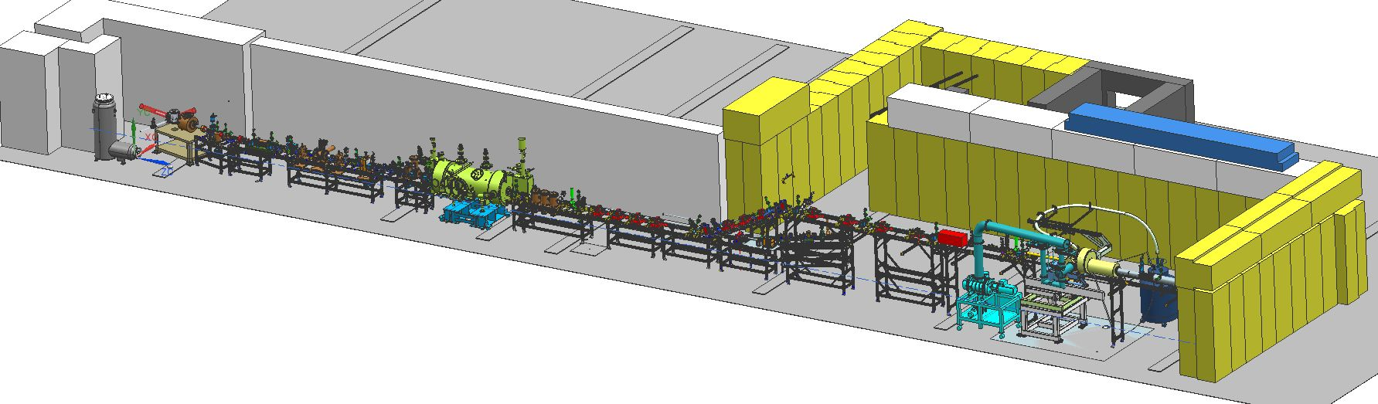
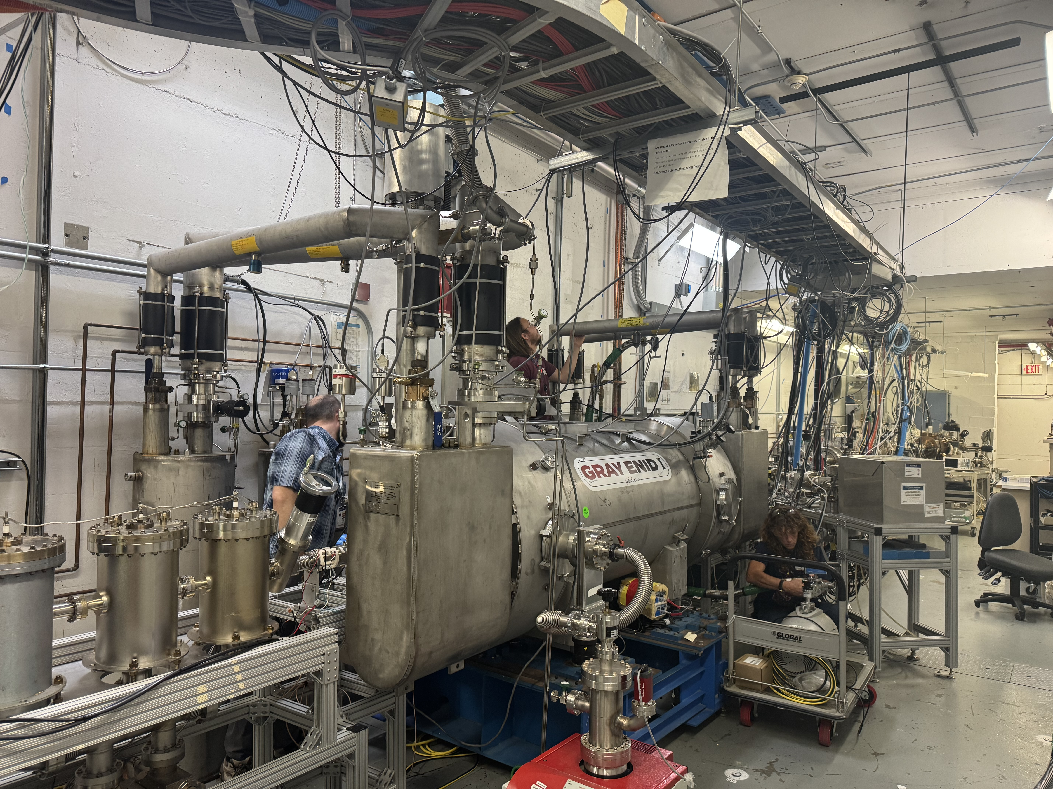
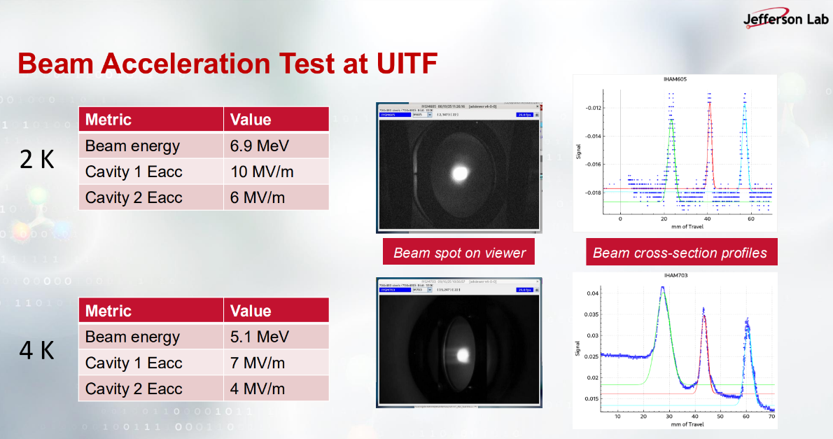
Beam Acceleration with Nb₃Sn Quarter Cryomodule in UITF
<10 MeV, <10 µA
First electron beam acceleration experiment at 2 K and 4.3 K in Sept. 2025, both cavities actively tuned with tuners and phase locked to the beam bunch rep rate of 1496.5 MHz
Phase II beam acceleration experiment, Feb – May, 2026, greatly improved the phase stability at 4.3 K
  achieving record beam energy up to 7.6 MeV –stay tuned!!
First user experiment carried out with a 1-hour beam delivery to a sample from industry
“Beam Acceleration with A Nb3Sn Cryomodule at JLab” SRF 2025, R. Geng et al.
Notes:
GEI has achieved a record beam energy of 7.6 MeV with a beam current of 5 uA with cavities operating at 10 MV/m and 7 MV/m stably operating at 4.3 K. The cooldown and cryogenic improvement produced above 1E10 Q0 at a lower gradient and >4E9 at 10 MV/m.

Slide 7
Proving Conductive Cooling at IMP
10,000 Hours of Trouble-Free Operation, Beam-Loss Design, and Degradation Recovery at IMP
Teng Tan, on behalf of the SRF team of IMP

Slide 8
Basic information about the machine

Slide 9
Basic information about the machine

Slide 10
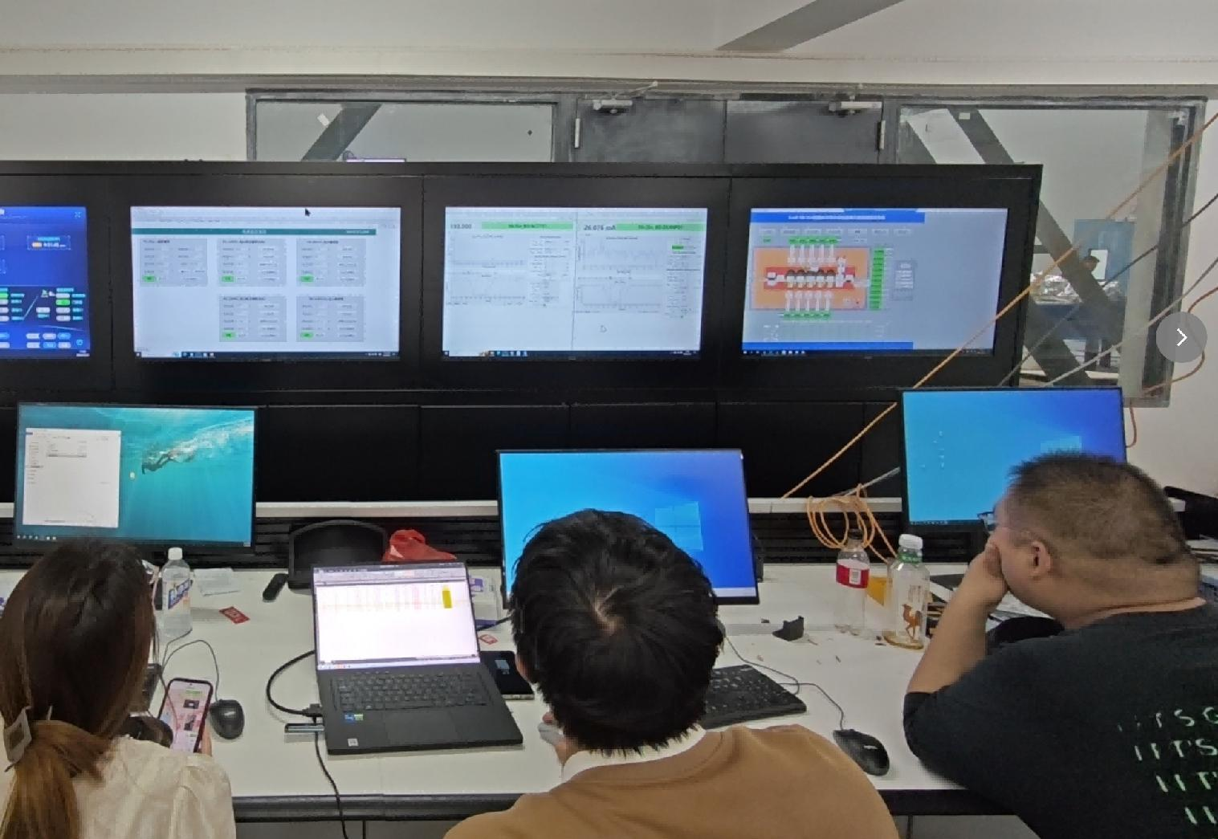
Basic information about the machine

Slide 11
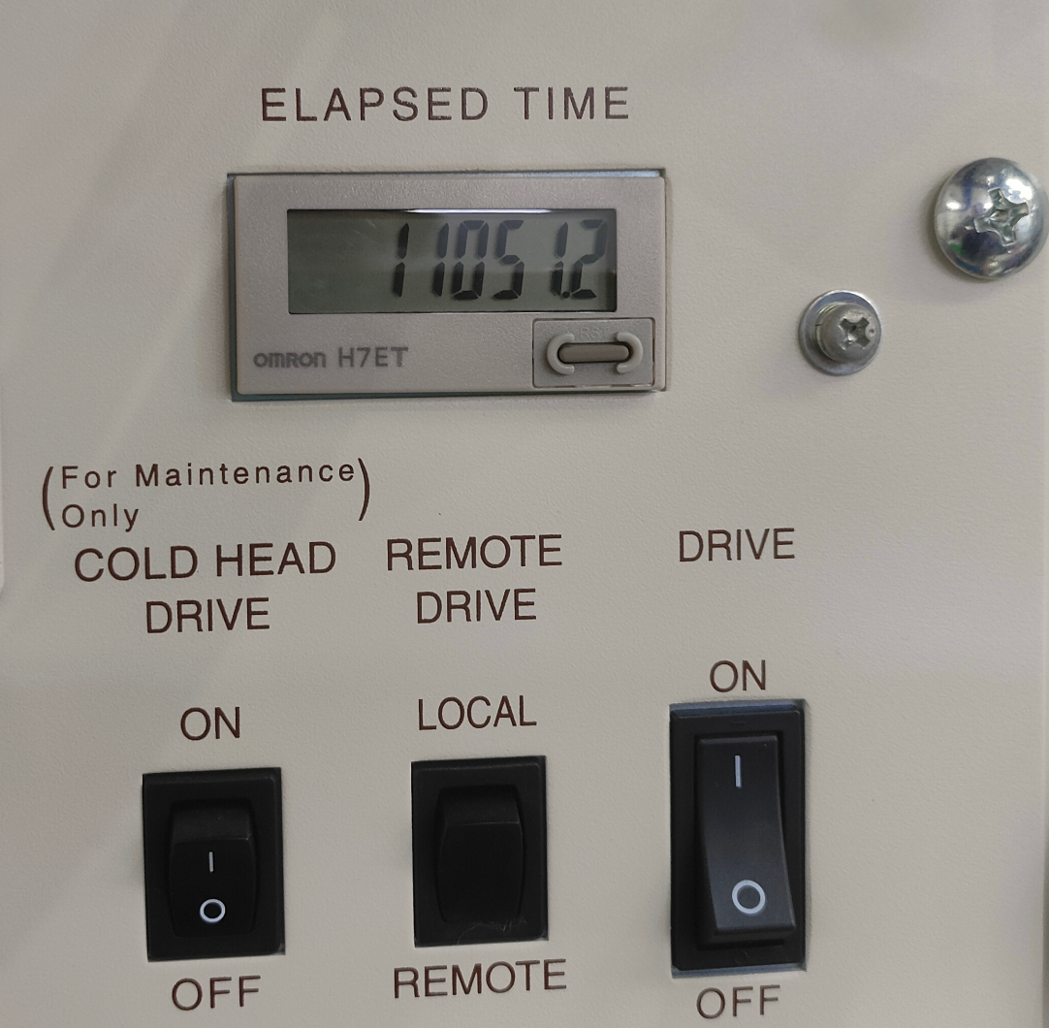
Operational Experience and Stability Assessment
The cryogenic system has been in operation for over 10,000 hours without any failures
After brief training, daily operation of the accelerator can be managed by only one person
Demonstrates excellent operational stability and convenience, which lower the application threshold of SRF technology

Slide 12
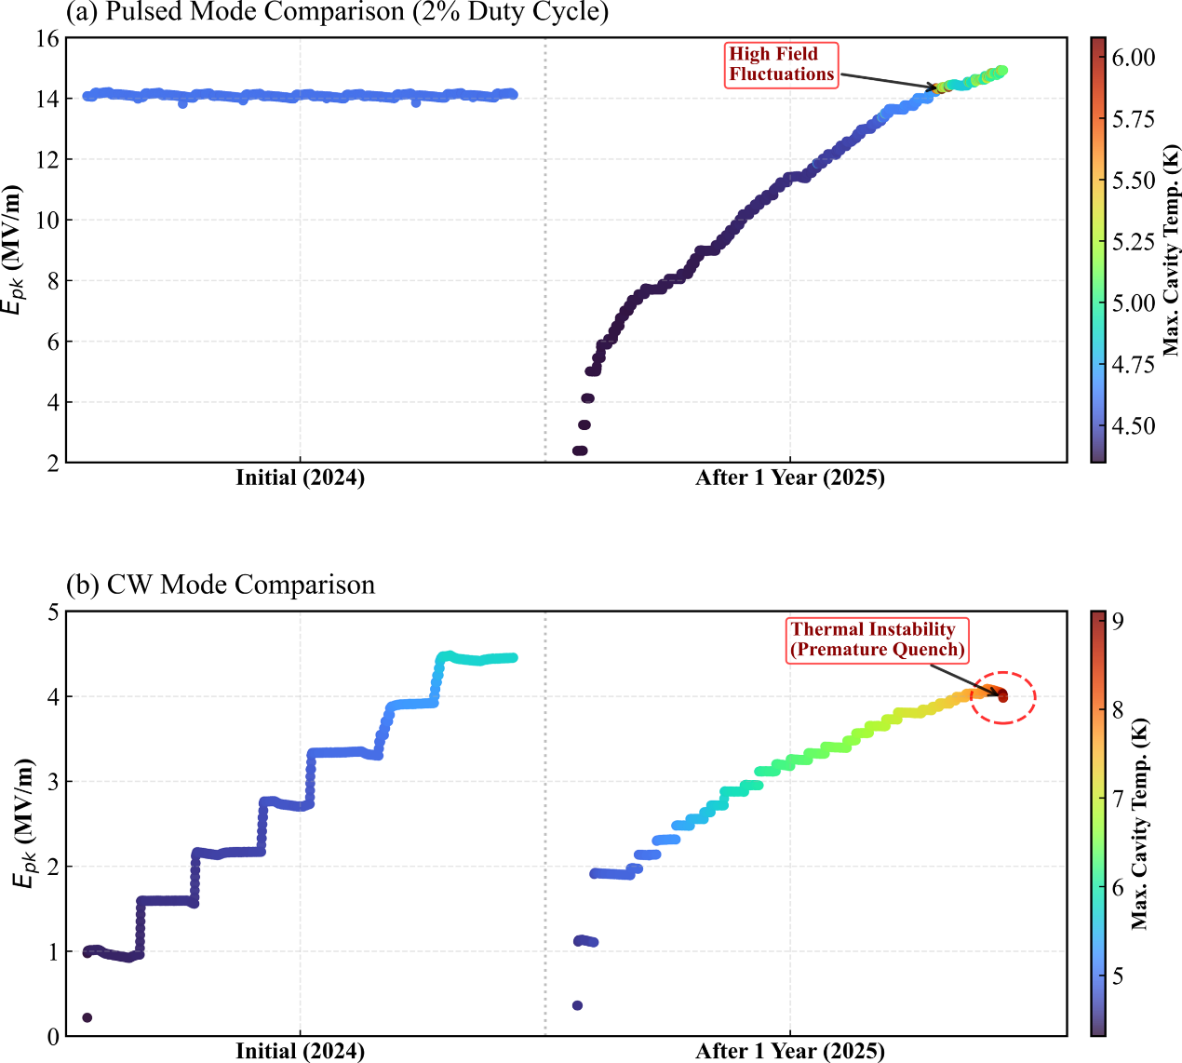
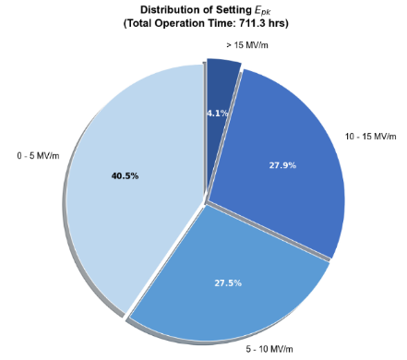
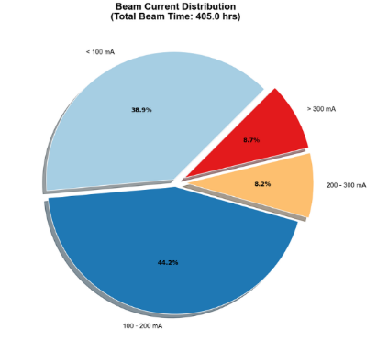
Possible reasons for performance degradation
1. The higher cavity temperature observed at the same gradient after one year of operation suggests degradation of the Nb₃Sn thin film;
2. Field emission behavior remained stable;
3. primarily caused by electron beam irradiation from escaping beam loss.
Longitudinal statistics of acceleration gradient and macropulse average beam current
Highlighting the necessity of loss-free physical design

Slide 13
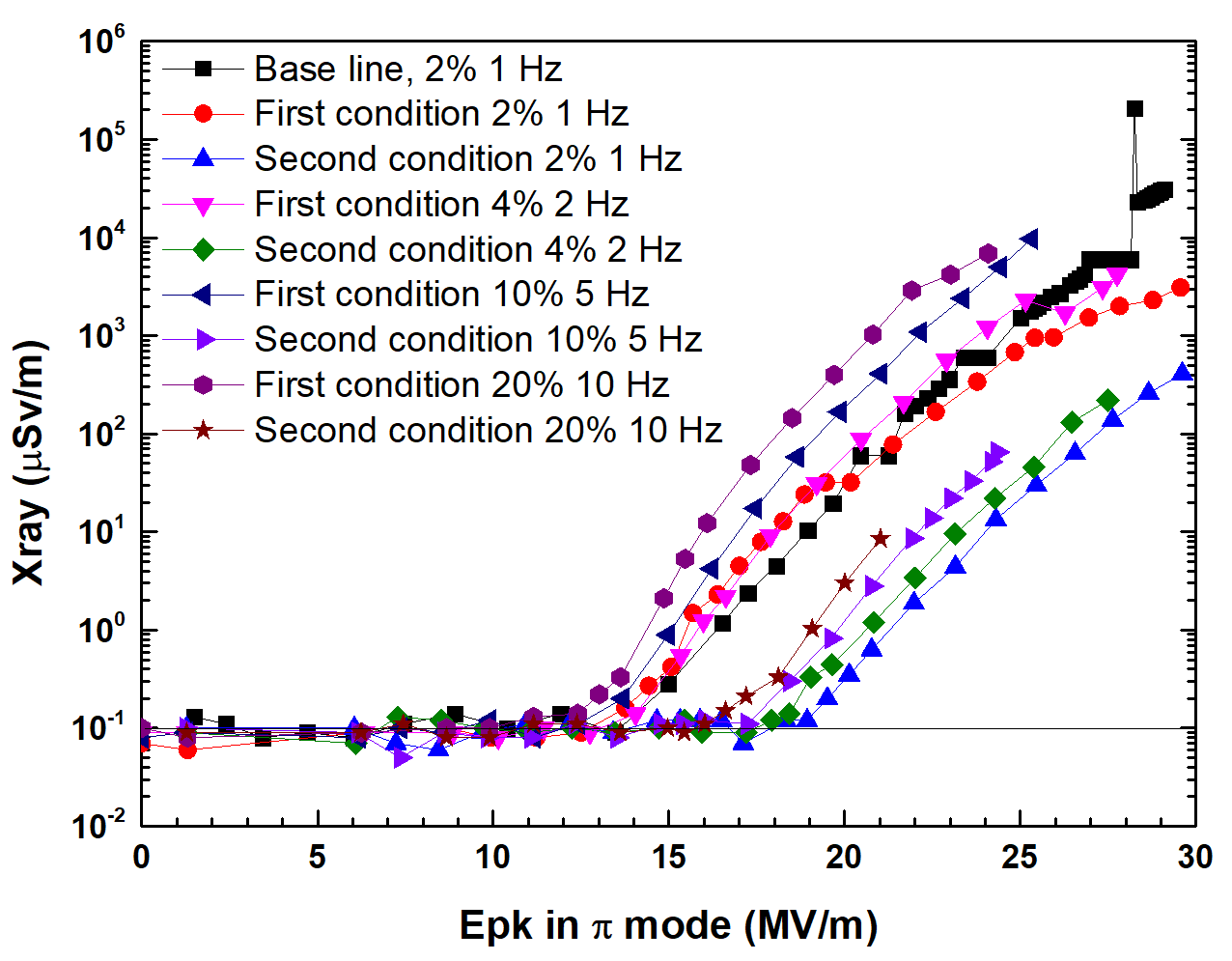
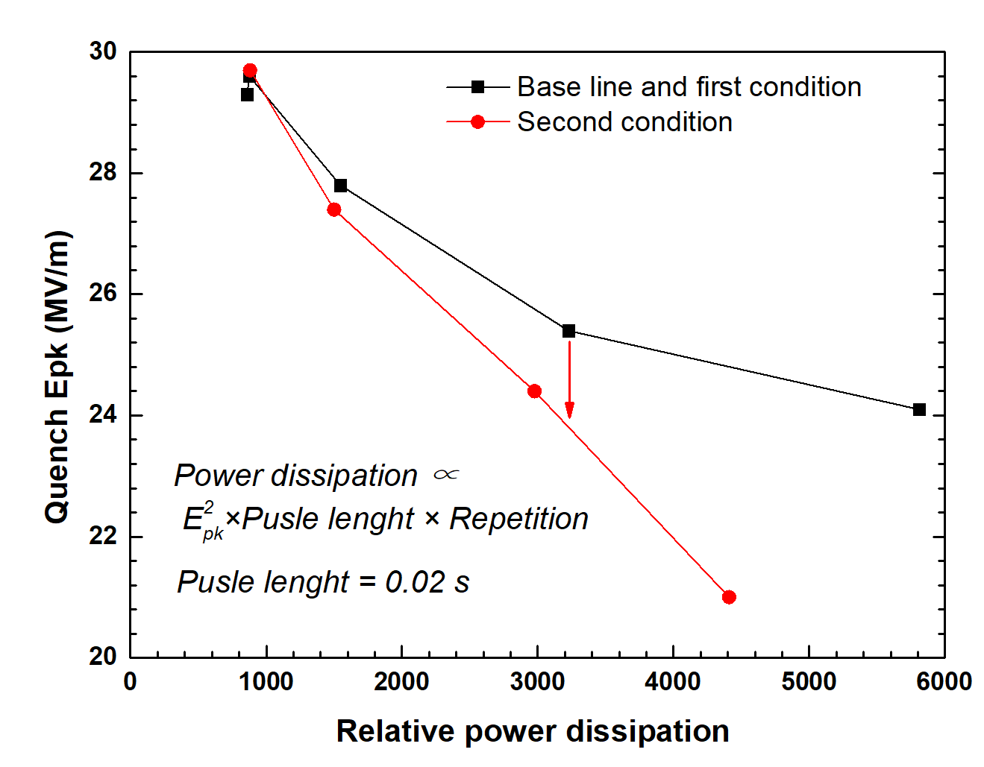
​​Nb₃Sn in-situ surface processing ​​
Surface modification of the cavity interior was performed via helium condition
First Condition:2 Hours，
Field electron emission remained largely unchanged；
Second Condition:8 Hours，
Field emission performance showed a dramatic enhancement.
Reason: Improved surface conditioning depends on RF pulse count, not breakdowns.
(arXiv:2502.03967v1)
At high repetition rates, field emission was improved while the maximum achievable gradient decreased.
The correlation between heat load and gradient was characterized using the relative power dissipation method.
Second helium processing reduced the maximum gradient at identical heat load.
Observation
Film damage from prolonged He‐processing reducing thermal conductivity.
Possible Cause
Helium processing suppresses FE of Nb₃Sn films, with film damage risk dependent on cleaning strength.

Slide 14



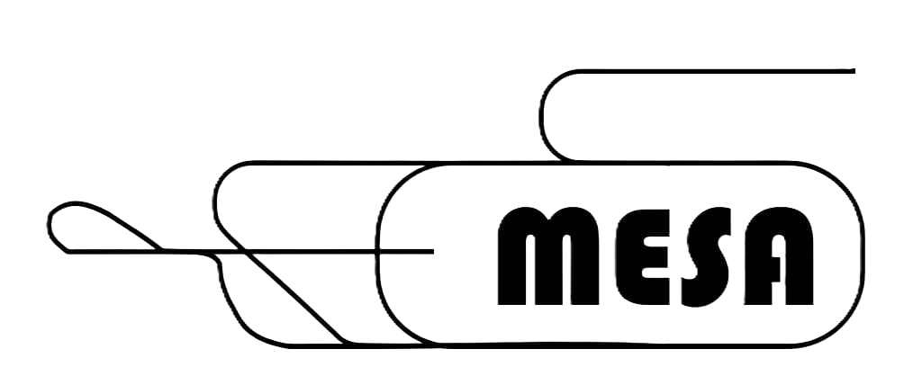
Experience with High-Gradient "Turn-Key" SRF Systems for the MESA ERL Project
F. Hug for the MESA group
Institut für Kernphysik
JGU Mainz
11.06.2026

Slide 15
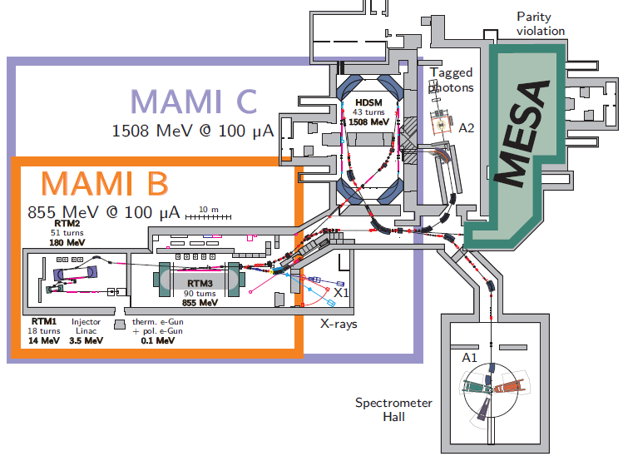
MAMI and MESA at KPH Mainz
MAMI microtron is operating since
>25 years at KPH
In 2012 funding of
PRISMA cluster of
excellence has been
granted including a new
accelerator project:
Mainz Energy Recovery Superconducting
Accelerator (MESA) to be built in the existing facility
In June 2015 DFG granted a research building to JGU „Center for Fundamental Physics (CFP)“ including an extension for MESA halls

Slide 16
MAMI and MESA at KPH Mainz
Main challenges in 2012 (regarding SRF plans):
A lot of experience in running normal-conducting cw accelerators was present at Mainz but almost no SRF knowledge
State-of-the-art ERL layouts (in 2012) were aiming on 100 mA beam current and required special cavities and cryomodules
Out of any reach for MESA group at university level
Decision: go for a turn-key cryomodule, not reaching highest beam current in ERL operation and build up a SRF group in parallel

Slide 17
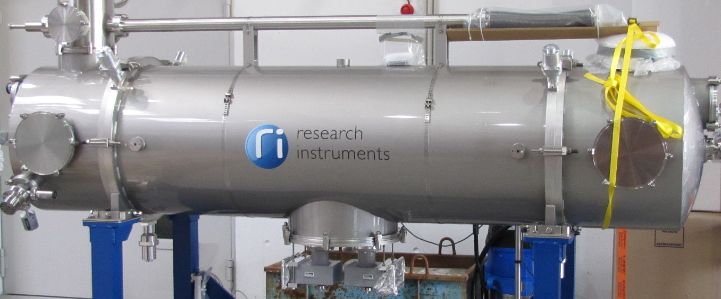
Production of 2 Cryomodules
2015: Ordered at RI Research Instruments GmbH
All changes incl.
  Cryogenic Components (valve box, 2K heat exchanger and JT valve, transfer line)
  Stand alone control system (for cryogenics/RF interlocks and connectable to EPICS)
  With expertise of DESY, HZDR and industry partners
Milestones
  VT at DESY AMTF
  FAT at Mainz
  SAT at Mainz

Slide 18
Production of 2 Cryomodules
Close cooperation between RI and Mainz University
  Weekly conference calls
  Personal meetings if necessary approx. 3 per year
  Approval of all changes
  Quality control: All RF measurements verified by JGU
  Effective cooperation between RI and JGU
  Close cooperation needed for project coordination

Slide 19
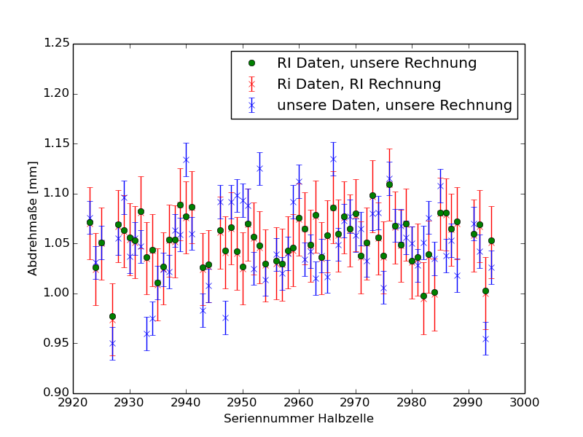
Quality Control of Cavity Production by JGU
Trimming measures calculated by using the different datasets show good consistency between the two calculations (RI and JGU):
Pictures: P. Weber

Slide 20
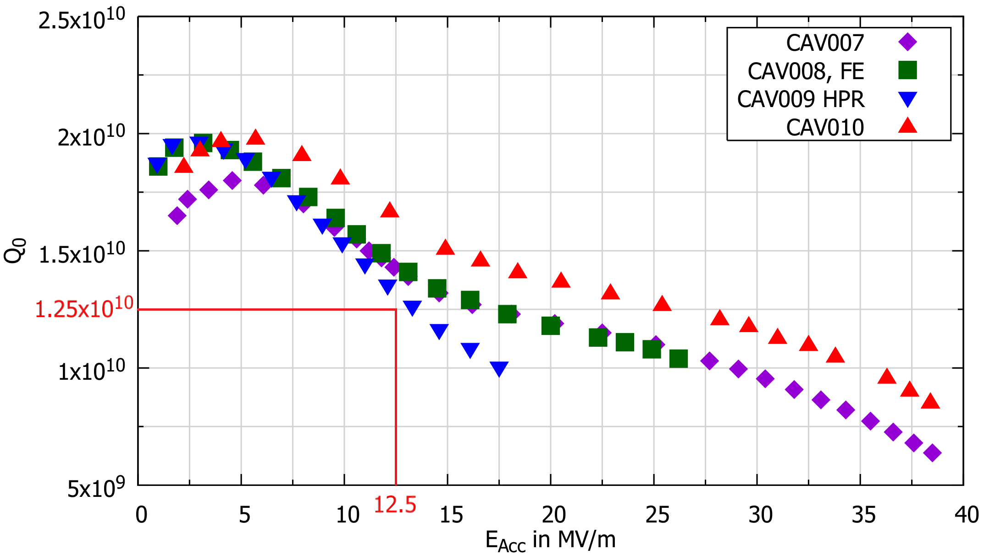
Vertical Tests were done @ DESY AMTF

Slide 21

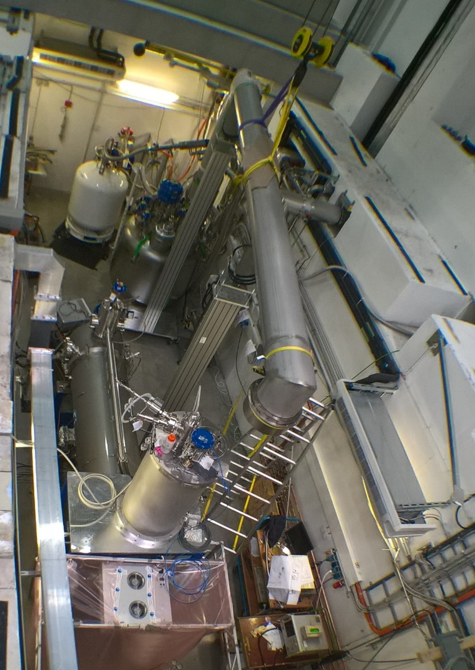
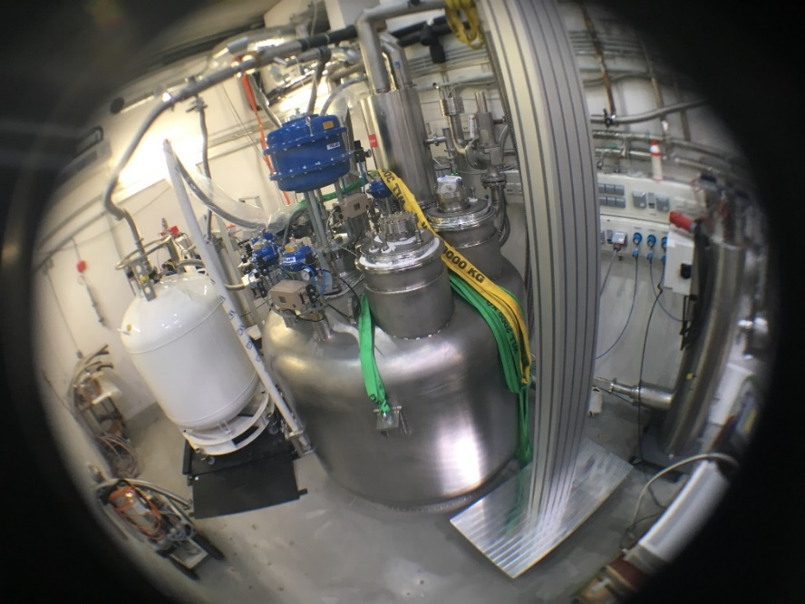
Site Acceptance Tests at HIM
Several successful cooldown cycles to 1.8 K at the HIM RF bunker with both cryomodules
CW measurements up to 12.5 MV/m
Static heat load more than 30% better
than design value for both modules
SAT for module #1 approved 30.4.2019

Slide 22
Production of 2 Cryomodules for mesa in Summary
2015: 2 MEEC’s ordered at RI Research Instruments GmbH
Until 2017 SRF testing infrastructure became available at HIM
9/2018: First cryomodule does not meet specs at HIM → refurbishment by vendor,
3/2019: Second tested cryomodule achieves specs during test at HIM/Mainz
8/2020 :refurbished cryomodule tested and fulfills specs.
(25 MeV Energy gain at <40 Watt thermal loss at 2 Kelvin)
2K operation
PhD thesis Timo Stengler
See also: T. Stengler et al. Proc. SRF 2019
doi:10.18429/JACoW-SRF2019-TUP041
Both Cryomodules fulfill specs→ On average the Helium consumption is estimated to be less than anticipated.

Slide 23
Summary and lessons learned
Cryomodule production:
Built up an SRF group at Mainz from scratch within a few years
Successful „turn key“ CM production by industry
CM1 with 2x 12.5 MV/m @ 𝑄₀=1.2∙10¹⁰
CM2 successfully refurbished and accepted
„Turn key“ experience:
Need of close contact to vendor and collaborative work
Successful project in the MESA case. Both partners gained a lot of experience
Modules and cavities might not be the ultimate ERL devices but good compromise for universities/small labs
This type of modules (medium gradient, cw possible, based on XFEL cavities) allows smaller groups to run SRF systems at all
Additional needs for “real” turn key systems:
LLRF systems and Amplifiers
Other labs maybe not capable/willing to contribute that much

Slide 24

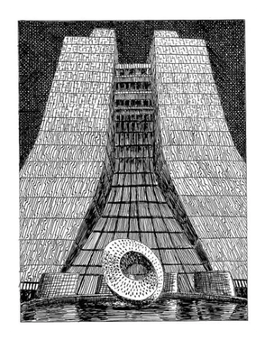

Engineering Gaps for Industrial SRF Adoption
Nikki Tagdulang
on behalf of
CHarles Thangaraj, Fermilab
Chris Edwards, Fermilab

Slide 25

IARC at Fermilab
Building Real Industrial SRF Machines — Today
What We Are Building
Machine | Notes (all conduction cooled) | Application
1.5-cell 1.3 GHz | 20 kW, internal injection | compact e-beam
5-cell 650 MHz | 100+ kW, external injection | env. Remediation
9-cell 1.3 GHz | 20 kW, external injection | Emerging application
Where We Stand: Technology Readiness
TRL 4–5
◄ We are here
Conduction-cooled cavity demo
Achievements at IARC
TRL 6
Next 3 years
First CW gradients in a conduction-cooled Nb₃Sn cavity — no liquid helium needed reaching 10 MeV/m with a “ringed” cavity
Prototype in a real environment
A technology development group focused on commercialization and industrialization of SRF accelerators
TRL 7–9
This session
Commercial system, field operation
What stands between TRL 5 and a real product is repeatability and standardization!

Slide 26



R&D Gap #1 — Nb₃Sn Reproducibility
High Q at 10 MV/m, every time, guaranteed
Nb₃Sn Process Database + AI Model
The Gap
A
▶ Converts process into a recipe anyone can follow.
Every coating run, track variables such as temperature, tin pressure, and time into a shared database. A simple AI model predicts the result before you coat. This turns artisanal coating into a data-driven process. Every new run at any lab improves the shared model.
Typical outcome:
10 MV/m, 1e10
Defined Coating Protocol (like an EP recipe)
B
▶ Industry cannot buy what it cannot specify.
Variation!!
A step-by-step standard that can be used for a quality check criterion → pass/fail decision. In such a way that any vendor can follow.
C
Community Data Sharing + Coordinated Runs
▶ The faster we accumulate coatings, the cheaper and more reliable they get for everyone.
All labs sharing coatings data multiply experience without multiplying cost.

Slide 27


R&D Gaps #2 & #3 — Standardize, Then Prove Reliability
An MRI magnet is operated by a hospital technician — not a physicist. SRF must get there too.
Gap #2 — Standard Cryomodule Platform
Gap #3 — Reliability Demonstration
STANDARD CRYOMODULE
Nb₃Sn cavity + cryocooler + LLRF tuner + diagnostics
⚠ No published dataset exists on a conduction-cooled Nb₃Sn cavity operating for more than a few hundred hours — or surviving repeated thermal cycles under controlled conditions.
What industrial customers require:
RF power in
Cryo in
Thermal links
MTBF data (mean time between failures)
Same design. Same vendors. Same manuals.
Documented failure modes ….so field techs know what to expect
Two standard frequencies: 650 MHz and 1.3 GHz
Every non-standard frequency is a custom project — custom projects do not industrialize. Modularity helps us learning curve.

Slide 28
Three suggestions to close the industrialization gap
1
Shared Nb₃Sn Process Database
Open coating database + AI surrogate model shared across institutions. Active learning identifies the best next experiment. Compresses the learning curve community-wide.
2
Standard Cryomodule Platform
Agreed design with defined external interfaces. Two frequencies: 650 MHz and 1.3 GHz. Modular design enables standardization and field serviceability.
3
Published Reliability Specification
Systematic failure-mode catalogue. Result: an MTBF number that gives confidence.
IARC @ Fermilab • TTC Saclay Hot Topics • Industrial SRF Session

Slide 29


Reliability for EUV FEL based Systems

Slide 30
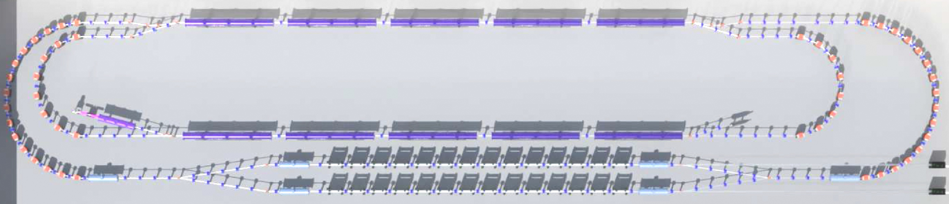
NEW APPLICATION OF PROVEN TECH
ELECTRON SOURCE
ACCELERATING CRYOMODULES
ELECTRON DUMP
CONVENTIONAL MAGNETS
OPTICS
UNDULATORS

Slide 31
Reliability Drivers
Customer Requirements
99% uptime – 87.6 hours/year not delivering photons to scanners
Internal Demands
We must move quickly
  No time to design everything from scratch
  No time to ramp up vendors on a new design
True prototypes must come before production designs are locked down, adding years to a project
Ability to utilize existing designs
  cavities, couplers, infrastructure

Slide 32
Reliability Challenges
Customer Demands
99% uptime – 87,6 hours/year not delivering photons to scanners
How much planned maintenance do you need?
High Power, High Current operations of an ERL
How hard do you push your systems?
Incomplete energy recovery implications
Multi-alkali photocathode operations
Electrical Grid
How many dips in electrical supply can the system stand before it trips?
Recovery
If you trip the machine, how fast can you get back online?

Slide 33
Reliability Solutions
Use existing demonstrated designs whenever possible
  Cavities
  Couplers
  Amplifiers
Keep operating point for cavities, couplers, magnets in very stable region
Include redundancy where necessary
Carry out detailed reliability analysis for every component based on previous operating experience

Slide 34
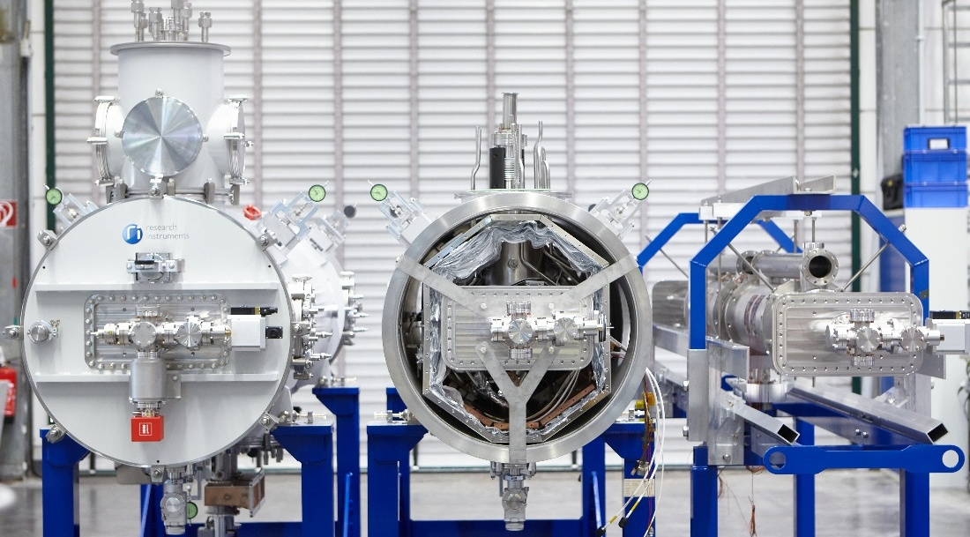
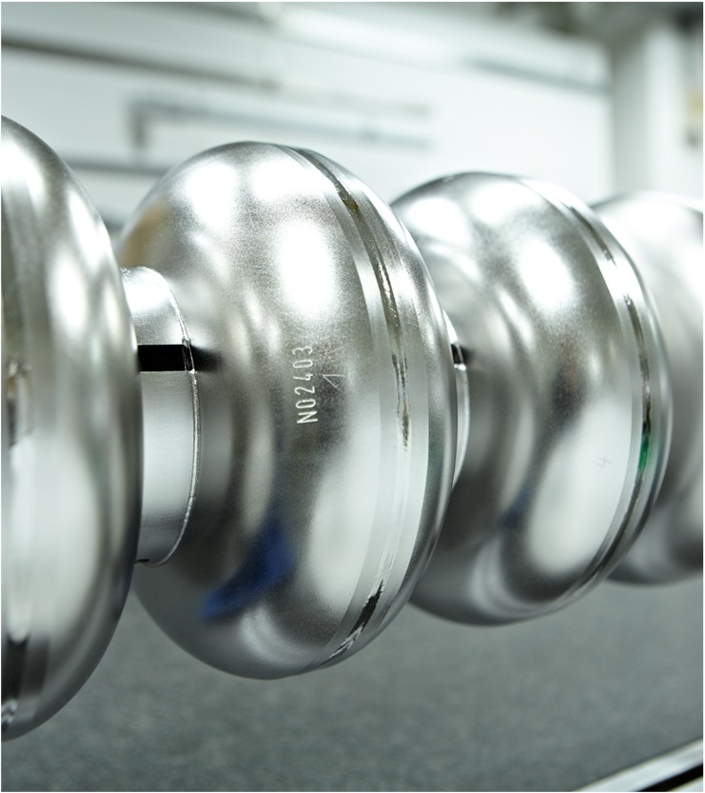
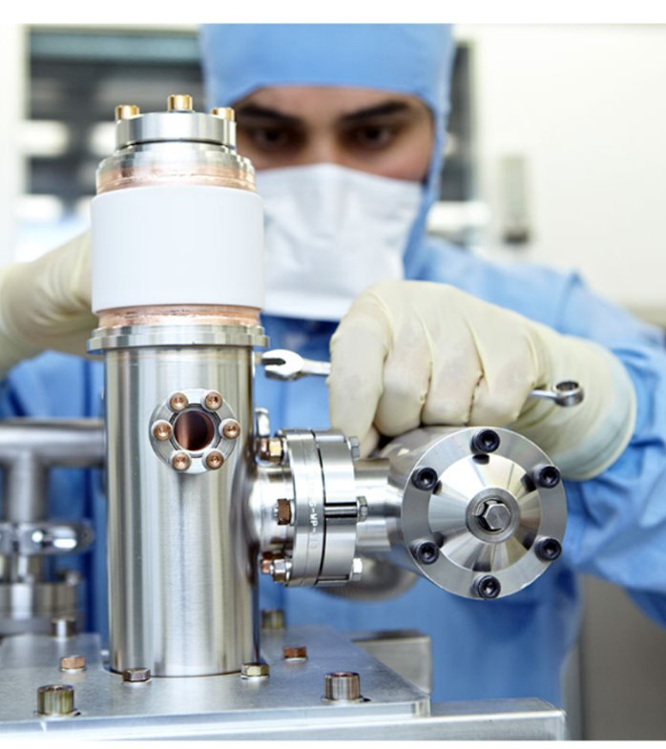
TTC 2026 Meeting, Gif sur Yvette, France
Nb₃Sn based “Turn-Key“ SRF Systems – When is the technology ready for industrial ramp-up?
Lucas Zweibäumer
June 11, 2026

Slide 35
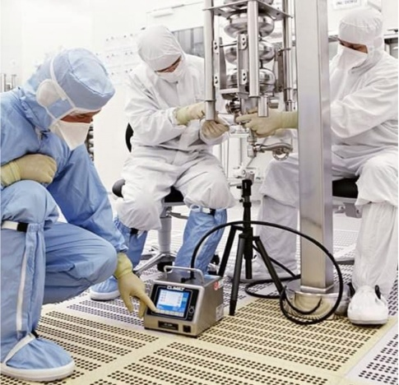
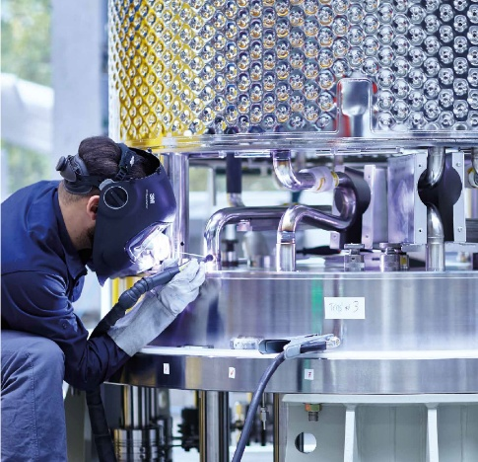
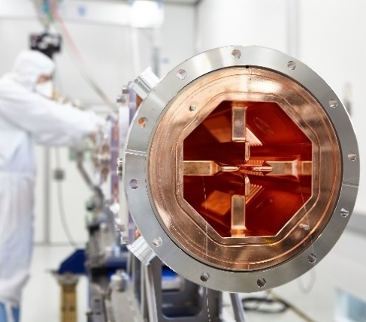
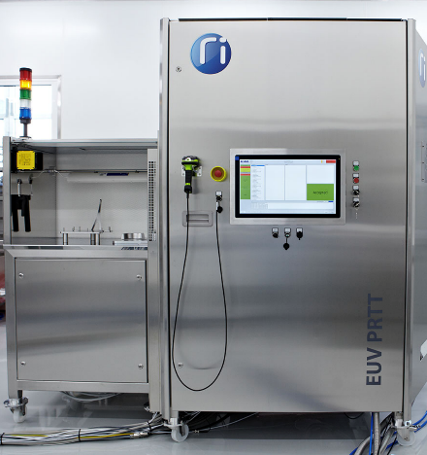
RI Research Instruments
RI at a glance
Founded in 1994 as ACCEL Instruments GmbH – since 2009 named RI Research Instruments GmbH
Annual revenue of 90 million EUR
Majority (52%) owned by Bruker EST, Management team are additional shareholders
Headquarters in Bergisch Gladbach, Germany,
very close to Cologne
3 main high-tech business fields
  Particle accelerators: Super and normal conducting
  Fusion: Systems and components supplier
  Semicon: EUV tools and Semicon supply chain
Bergisch Gladbach
& Dortmund,
Germany
Customers in
>25 countries
30 years of innovation

Slide 36
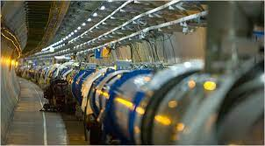
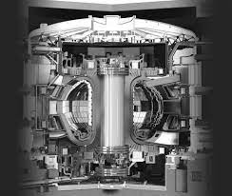
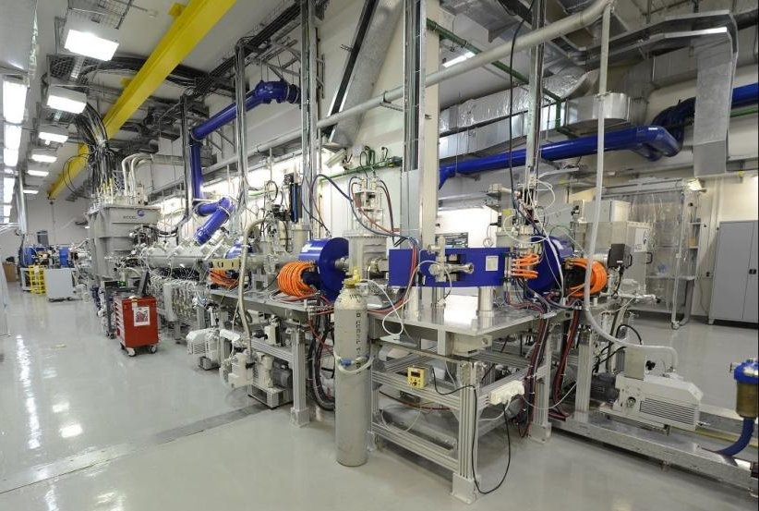
Our Customers
Diversified high-tech portfolio
„Big Science“: 70%
Superconducting RF cavities and
accelerator modules
Normal conducting RF cavities, RFQs, linacs, accelerators for medical isotopes & radiation therapy including pulsed power equipment
Fusion equipment (ITER, JT60…)
“High-tech industry” (partly confidential): 30%
EUV metrology tools including photon instrumentation
Components for EUV lithography machines
Others e.g. Nuclear, Pulsed Power, Space
Worldwide leading company in SRF cavities production
The only company in the world that can deliver turn-key SRF modules including controls and cryogenic supply valve boxes

Slide 37
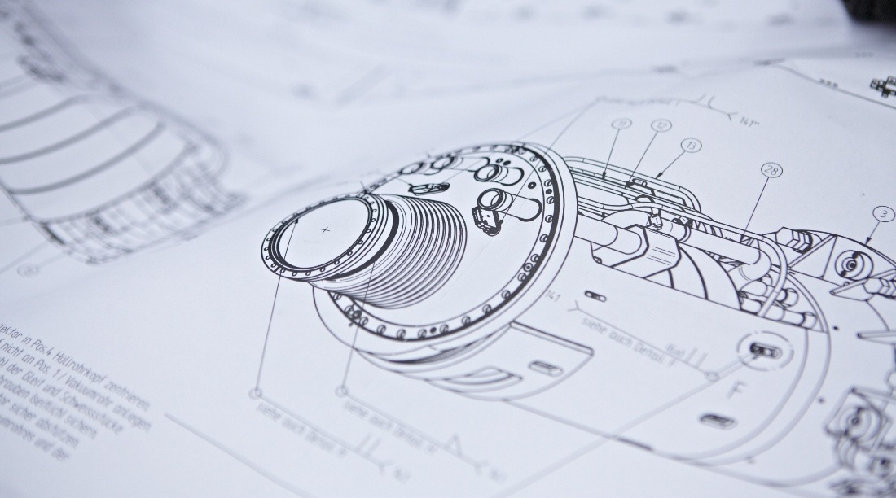
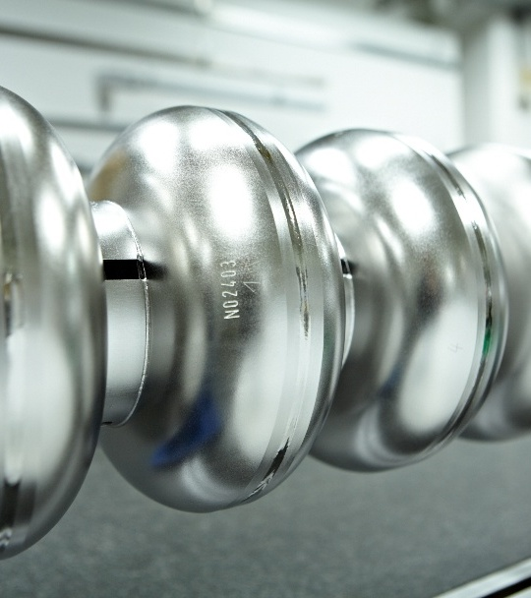
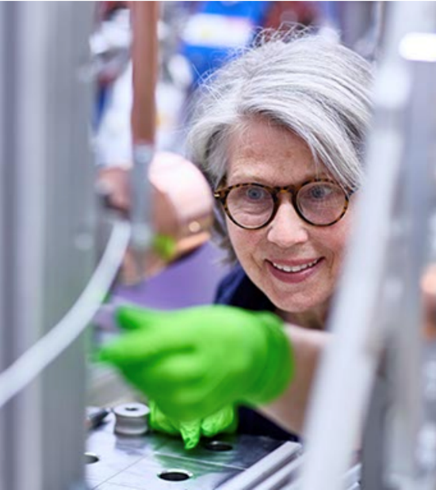
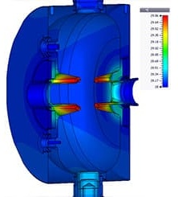
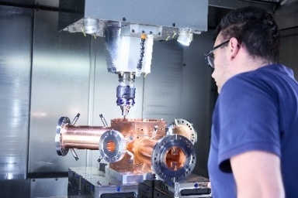
Hundreds of Experts /
Dozens of Technologies
Large enough to do complex projects & small enough to be flexible
400 Experts
140 Engineers & physicists
220 Craftspeople
40 Finances, HR, IT, …
End-to-end Engineering and Manufacturing Solutions
R&D
Engineering
Precision Manufacturing
Qualification & Testing
Assembly, Integration & Service
Series production
400
and growing

Slide 38
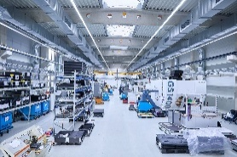
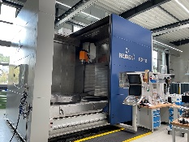
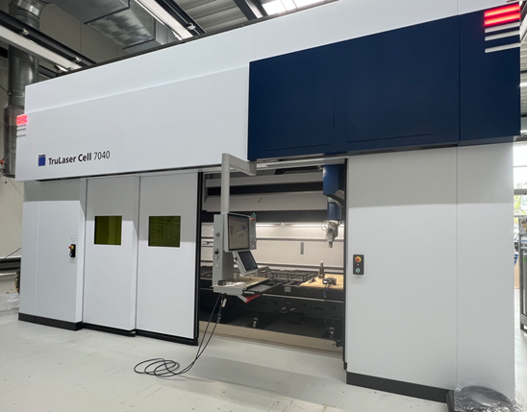
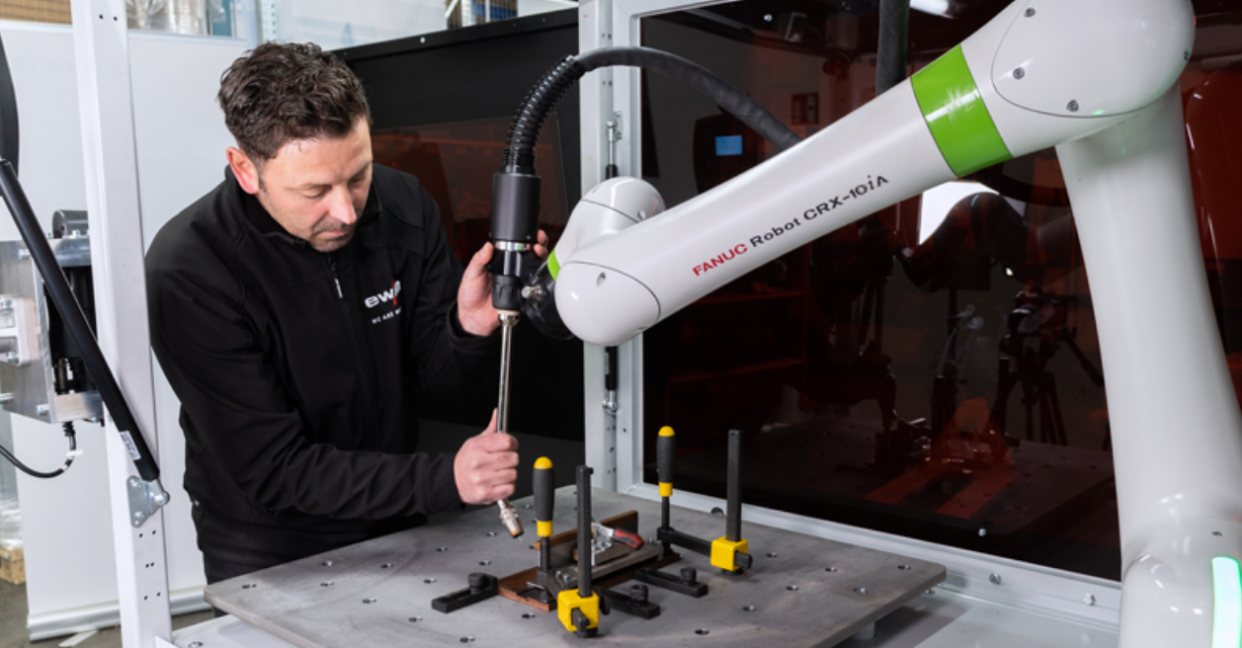
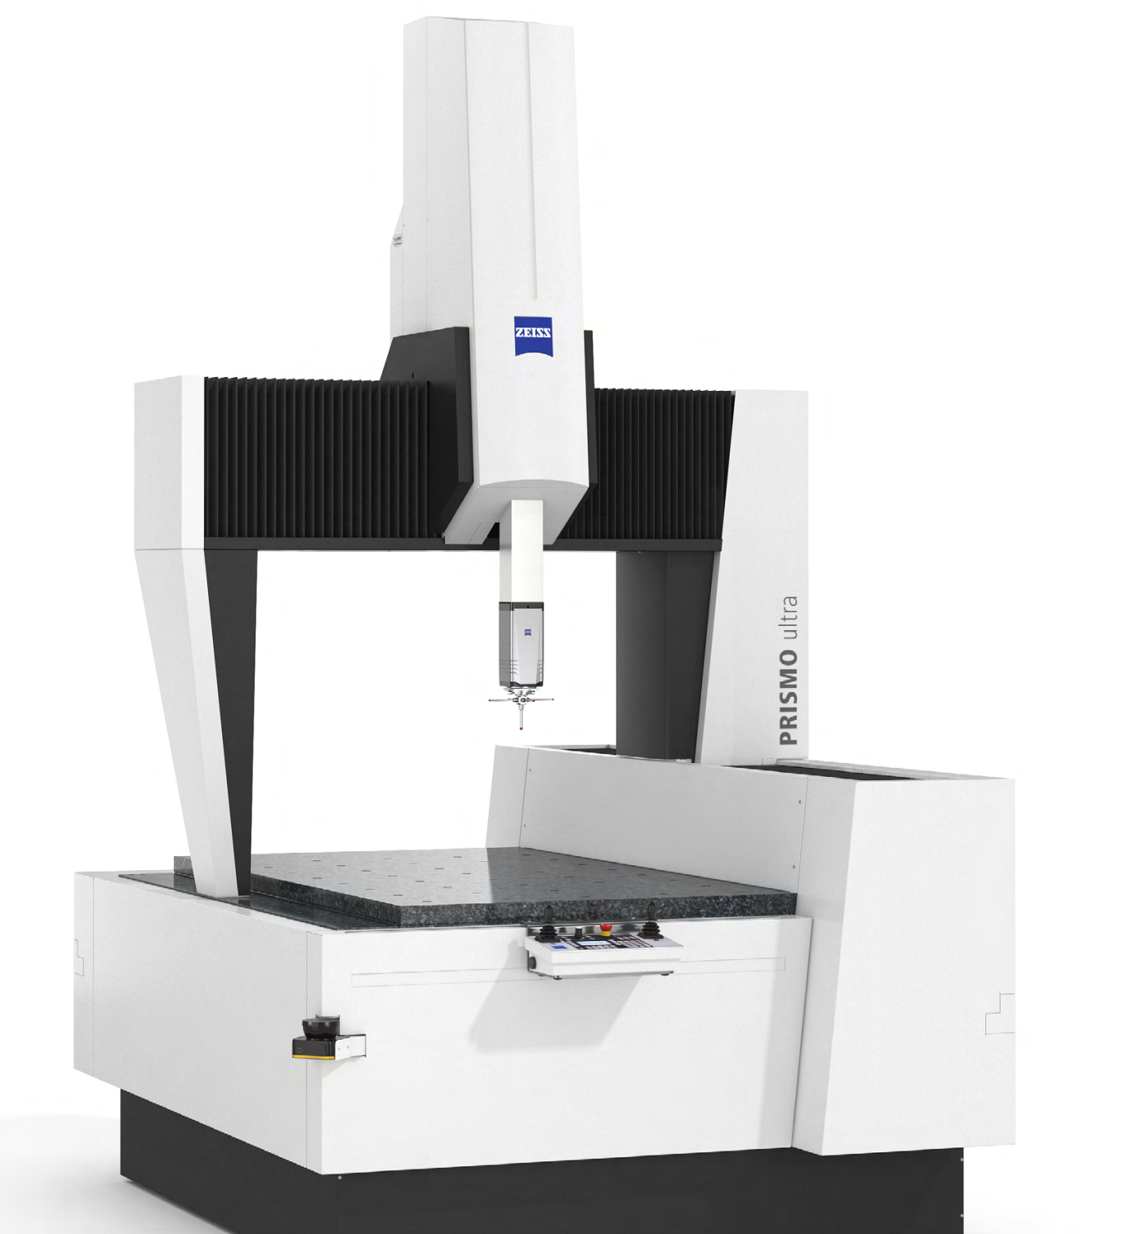
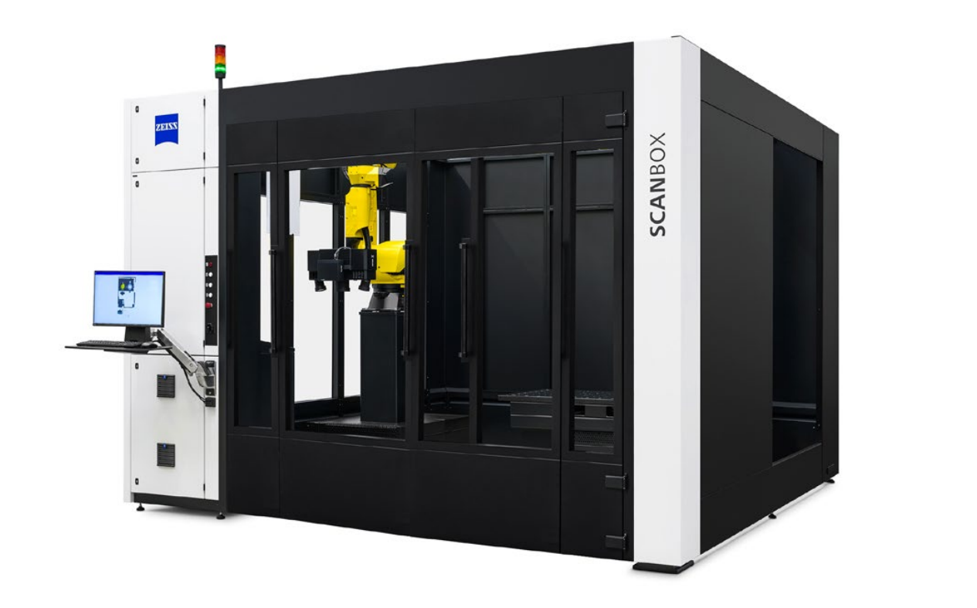
Deep Dive production capabilities
Discipline | Technologies | Pictures
CNC Milling & Turning | 10 5-axis precision milling machines 6 turning machining centers 5 CAM programmers, 20 CNC machine operators All relevant materials can be processed (from plastic to titanium, with niobium as a unique selling point)
Welding | TIG welding, Orbital Welding 1 Cobot Welding Machine 1 CNC laser welding TruLaser Cell 7040 with 4000W 2 CNC Electron-beam welding systems (Probeam, PTR), each with 30 kW (max. 150 kV, 200 mA) power Certified according to DIN EN ISO 3834-2 (and DGRL)
Leak Test | Leak testing with high sensitivity (< 1x10-11 mbar*l/s) Pressure testing Certificates: DIN EN ISO 20485 & DIN EN 1779
Surface Treatment | Various cleaning and pickling basins, flexibly adjustable in size to suit project requirements, with and without ultrasound
Dimensional Control | Measurement room classes 2 and 3 6 tactile portal measuring devices for component measurements with a length of up to 3 meters and an accuracy of up to (1.4 + L / 350) μm (L in mm), e.g. Zeiss Prismo ultra 2 optical stationary CMMs, GOM (Length deviation: 0.02 mm) + Zeiss O-Inspect >10 mobile CMM systems, e.g. Hexagon measuring arms (length deviation: 0.064 mm), Zeiss T-Scan (length deviation: 0.03 mm )
Final Inspection | Visual inspection with UV, white and ambient light Dark room VT testing

Slide 39
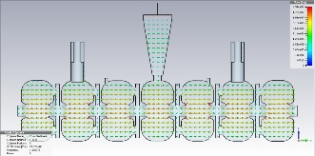
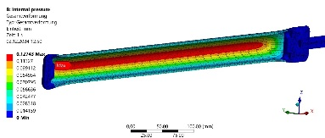
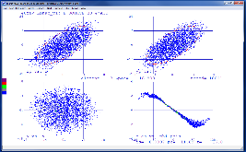





Deep Dive engineering capabilities
Discipline | Technologies | Pictures
Electro-magnetic design | Development of accelerator components like electromagnets, kickers and cavities incl. the magnetic field design (Poisson Superfish (2D) or CST Microwave Studio (3D)
Structural design & thermal simulations | Analyzes of stresses, displacements or mechanical eigenmodes, thermal problems using such software packages like ANSYS Workbench, CST Studio Suite incl. MPhysics Studio which contains structural mechanics as well as thermal solvers
Beam Dynamics simulation | Ray-transfer-matrix analysis-based code Trace3D is employed for fast bunched-beam envelope calculations (incl. linear space-change forces) of standard beam manipulating elements (solenoids, quadrupoles, bends, etc.) Detailed beam dynamics calc. by Tstep/PARMELA (multi-particle tracking + beam optics from SUPERFISH), ELEGENT (for e⁻ simulations), GPT, CST Particle Studio (multi-particle tracking + particle-in-cell (PIC) simulations
3D-CAD Design | 3D modelling and preparation of manufacturing drawings utilizing Autodesk Inventor Professional 2022
Control System Design | Development of control systems/software for own equipment & turn-key accelerators. Building Programable Logic controllers (PLCs) for hardware control (valves, pumps, power supplies) like Beckhoff TwinCAT, EPICS or Siemens SIMATIC, NI LabView
Cryogenic engineering | Process calculations, definition of pressure relief/safety systems, calculation of thermal insulations, heat load optimisation, choice of materials, testing at LT
E-Field on-axis coupled cavity
WG wall loading distribution
ANSYS Eigenmode simulation
of Control Rods
STEP Multi particle simulation
Cryopump in Autodesk Inventor Professional
Heat in diamond window
Heat load optimisation
EPlan and PLC of BCP system

Slide 40




Nb₃Sn related facts from our story
1980s: Cooperation with Uni. Wuppertal
  “RI team” was involved into pioneering experiments with Nb₃Sn coating of high-purity Nb cavities at Uni. Wuppertal.
1990s: Turn-key superconducting cryomodules for the JAERI FEL
  “RI team” performed final design, manufacturing, assembly and testing of 4 modules equipped with compact 40K/80K shield-cooler and 4K He-recondenser refrigerators.
  M. Peiniger et al. 1987 Proc. Workshop on RF superconductivity https://jacow.org/srf87/papers/SRF87E04.pdf
  E.J. Minehara 2002 Nucl. Instrum. Methods Phys. Res. A https://doi.org/10.1016/S0168-9002(02)00277-2

Slide 41



Nb₃Sn related facts from our story
1990s: Cooperation with CERN on Nb sputtering
  For the Large Hadron Collider (LHC) at CERN, 21x superconducting 400 MHz single cell cavities have been produced by ACCEL (later RI) using the technology of magnetron sputtering of niobium on copper cavities. This technology was developed by CERN and transferred to industry within the scope of the LEP 200 project.
  S. Bauer et al. 1999 Proc. Workshop on RF superconductivity https://proceedings.jacow.org/SRF99/papers/wep016.pdf?n=SRF99/papers/WEP016.pdf

Slide 42



What we bring to the Table
1. Experience in R&D, Prototyping, Series manufacturing & Industrialization
Contributor to: ITER, CERN, SLAC, DESY, and more
2. Cross-Domain Expertise
SRF, NCRF, Vacuum, Cryogenics, Fusion,
Pulsed Power, Welding,
Manufacturing, Testing…..
3. Vertically Integrated
One Partner for the entire project:
Design, Development, Manufacturing, Supply Chain, Assembly, Integration, Service
4. Strategic Positioning & Heritage
With roots in European mega-projects like CERN, ITER, GSI, and DESY, our work
bridges scientific innovation and industrial reliability.

Slide 43






Enabling technologies
Technologies to enable industrial Nb₃Sn-based “Turn-Key“ SRF Systems:
Reliable coating technique (diffusion, PVD, …) of high-quality Nb3Sn coating on Nb or Cu cavities
Method of efficient helium-free
conduction cooling / High-purity
thermal links
Mature ?
? K
Low Heat-Leak RF Couplers
Powerful reliable Cryocoolers
Example:
CryoMech PT450
– 40 W @ 45 K
– 1.5 W @4.2 K
Enough cooling?
Too high ?

Slide 44
Industrialization roadmap (TBD)
Industry scope
Science scope
- Provide cavities for coating
- Engineer and design He-free cryomodules
- Find business opportunities and first customers
- Mature systems for market entry
- Industrialized coating facility
- Provide turnkey cryomodule systems
- Mature recipes for coating
(reliability & repeatability)
- Coating and qualification of industry cavities for CM production
- Technology transfer/licensing to industry
- Support to industry on special topics
Continue technology improvement ;-)
short term
long term

Slide 45
Questions?
Feel free to contact us.
+492207-7674-100
www.research-instruments.de

Slide 46
Hot topic Developing SRF towards Turn-Key Industrial Systems
Discussion
Technical Frontier
Engineering path for reliability
Strategic democratization
Preliminary considerations for a Roadmap towards an SRF "plug-and-play"

Slide 47
Hot topic Developing SRF towards Turn-Key Industrial Systems
Technical Frontier
Performance Metrics
What performance level should we realistically consider today as a reproducible benchmark for Nb₃Sn-coated cavities at 4 K:
Q₀ ≈ 10¹⁰ at 15 MV/m is still a best-case result and Q₀ ≈ 10⁹ at 10 MV/m remains a more honest metric for routine production?
Have we reached a plateau where further improvements in Q₀ and accelerating gradient require fundamentally new approaches, or are we still limited mainly by coating process control?
Substrate & Deposition
Is compositional control of the A15 phase still the dominant obstacle preventing uniform Nb₃Sn coatings on complex geometries
(e.g., non-elliptical or high-frequency structures), or are other factors now equally limiting performance?
How would you address the stoichiometric variations in A15 phase growth to ensure consistent thermal and electromagnetic performance across batch production?
Lifetime Performance
Most Nb₃Sn discussions focus on initial performance. Based on the data available, do you observe evidence of performance degradation under prolonged RF operation or repeated thermal cycling?
If so, what are the dominant degradation mechanisms? How do you characterized it? How confident are we about long-term reliability under realistic operating conditions?

Slide 48
Hot topic Developing SRF towards Turn-Key Industrial Systems
Technical Frontier
Thermal Link Optimization
Which thermal-link technologies have demonstrated the best compromise between low thermal resistance, mechanical compliance, and long-term reliability: high-purity Al straps, Cu braids, rigid Cu links, or alternative architectures?
Many groups report practical heat extraction limits of only 1–3 W at 4 K. Is this a fundamental limitation of today's conduction-cooling approach, or simply an engineering challenge that has not yet been fully addressed?
  Does your experience differ?
  What is currently the main bottleneck: the cavity, the thermal link, the interfaces, or the cryocooler itself?
Vibration Mitigation
Are mechanical vibrations introduced by pulse-tube or GM-type cryocoolers a major concern for conduction-cooled cryomodule operation?
What decoupling techniques or damping strategies are required to preserve the phase and amplitude stability of superconducting cavities?
Cryocooler Duty Cycle Impact
How do you manage the transient thermal load on the cryocooler during the start-up phase compared with the steady-state load encountered during high-duty-cycle industrial operation?

Slide 49
Hot topic Developing SRF towards Turn-Key Industrial Systems
Engineering path for reliability
Operational Stability: What are the critical "failure points" when transitioning from a controlled laboratory environment to a high-duty-cycle industrial accelerator?
Key concerns revolve around long-term process repeatability, high-standard cleanliness, and power grid stability. Specific engineering vulnerabilities include the high brittleness of the Nb₃Sn layer during assembly, strict low-magnetic hygiene requirements, narrow cryogenic tuning margins, and sensitivity to pressure or microphonic fluctuations. The transition also faces human and environmental friction points like robust transportability and training non-expert industrial operators.
Cooling & Integration: Given the push for conduction cooling, what are the primary engineering bottlenecks in maintaining stable cryogenic temperatures under varying industrial load conditions?
The primary bottlenecks are the high capital cost of higher-capacity cryocoolers and the raw material quality of the Nb₃Sn coating. Designing specialized thermal links that support a controlled, uniform cooldown profile (as opposed to natural, uneven cooling) is vital to operate effectively within the tight power constraints of standard commercial cryocoolers.
Quality Control: What standardized diagnostic protocols (e.g., RF testing, surface inspection) should be adopted to ensure industrial-grade reliability before system deployment?
The community relies almost exclusively on comprehensive RF testing backed by strict manufacturing process controls and material analysis. There is a strong collective interest in developing predictive diagnostic tools capable of verifying cavity performance without requiring a full vertical or cryogenic test.

Slide 50
Hot topic Developing SRF towards Turn-Key Industrial Systems
Engineering path for reliability
Cryostat Design: What are the most significant obstacles to reducing the footprint and complexity of the cryostat/cryogenic distribution system while maintaining high-duty-cycle performance?
Major obstacles involve mitigating the coating's mechanical sensitivity, preventing magnetic flux trapping, and optimizing the integration of thermal links. Furthermore, the massive physical footprint of commercial compressors (often designed for standard MRI applications) means that the entire system needs a clean-sheet redesign optimized around conduction-cooled SRF requirements.
Vibration & Microphonics: For compact, industrial-grade accelerators, what vibration mitigation strategies (passive or active) are currently being validated to ensure stable operation in non-lab environments?
The community relies on a blend of active and passive methods, with passive methods taking priority. These include physical vibration decoupling, such as locating pumps and compressors on isolated slabs away from the cryomodule, though field validation data remains relatively scarce.
Power Couplers: Are current power coupler designs capable of handling the high average power required for industrial applications without frequent maintenance or failure?
Perspectives are split. Some express confidence that Fundamental Power Couplers (FPCs) can rapidly meet industrial demands (handling up to hundreds of kW with low maintenance overhead (less than once per year). Others note that true high-power capability remains unproven in commercial settings and that specialized couplers developed specifically for conduction cooling need more validation.

Slide 51
Hot topic Developing SRF towards Turn-Key Industrial Systems
Engineering path for reliability
Serviceability & Maintenance: What is the industry standard for the "Mean Time Between Maintenance" (MTBM) that would be considered acceptable for a turn-key industrial system (e.g., >20,000 hours)?
The minimum acceptable threshold is cited around 5,000--10,000 hours, while ambitious expectations for a competitive commercial commodity range from 30,000 to 60,000 hours.
Redundancy Models: For industrial environments where downtime is costly, what level of cryocooler redundancy (e.g., N+1 configuration) is required to ensure continuous operation without manual intervention?
While some models suggest fractional dependencies, the dominant sentiment points to an N+2 configuration to ensure continuous, hands-off industrial operation

Slide 52
Hot topic Developing SRF towards Turn-Key Industrial Systems
Strategic democratization
Cost Reduction: What specific component or process (e.g., vacuum systems, cryostat design, power couplers) represents the largest cost barrier to widespread commercial adoption?
The largest financial barriers are driven by the RF power source (dominating both Capex and Opex), the power couplers, reactor/vessel design, and the technical scaling up of the Nb₃Sn coating and cavity processing to a high-throughput industrial standard.
Skill-Set Barrier: What are the most essential features required to allow operation by technicians who are not specialized in accelerator physics?
True turn-key functionality is mandatory, relying on high automation, well-defined step-by-step procedures, and highly constrained manual interventions. Simplifying the control logic to a standardized framework would allow technicians from adjacent fields (e.g., radar technicians) to operate the hardware easily.
Regulatory Hurdles: Are there specific safety or regulatory standards (e.g., pressure vessel codes, radiation shielding certifications) that currently hinder the deployment of SRF systems in non-laboratory settings?
High-mass radiation shielding represents the largest logistical and regulatory bottleneck for new installations outside labs. Additionally, there is a lack of standardized mechanical design codes for next-generation SRF structures, though regulatory pressure may ease at modest energy outputs (e.g., 10 MV).

Slide 53
Hot topic Developing SRF towards Turn-Key Industrial Systems
Strategic democratization
Manufacturing Scaling: What manufacturing processes (e.g., additive manufacturing, automated welding, or robotic cavity processing) are necessary to shift from "one-off" production to "batch" production?
Shifting to industrial batch production demands automated assembly and welding lines alongside a simplified, robust recipe for cavity coating. While robotic processing and AI-driven automated coatings are highly desirable, the general consensus is that the technology is not yet mature enough for deployment.
Chain Maturity: Where do you identify the greatest bottlenecks in the supply chain for high-purity materials, specialized vacuum hardware, or cryo-component manufacturing?
The primary constraint is a systemic lack of reliable "market pull" from industry. This creates a highly specialized and fragile supply chain characterized by constrained high-purity material sources, custom cavity processing pipelines, and a minimal pool of commercial vendors for specialized cryocooler components.
On-Site Maintenance: What is the minimum level of on-site diagnostic equipment (e.g., remote monitoring, automated gas analysis) required to avoid the need for dedicated SRF expert personnel at industrial sites?
Robust, continuous remote monitoring is unanimously considered the most critical tool. The community envisions a commercial model similar to Transmission Electron Microscopes (TEMs)—combining general on-site maintenance with structured annual service contracts—enabling a single remote expert to manage compact accelerator installations.

Slide 54
Hot topic Developing SRF towards Turn-Key Industrial Systems
Preliminary considerations for a Roadmap towards an SRF "plug-and-play"
Modular Standardization: Which elements of an SRF cryomodule (e.g., interface dimensions, control logic, vacuum connectivity) are the most critical to standardize across the community?
Input points to a comprehensive need to standardize physical and system-level boundaries across the community, highlighting mechanical interface dimensions, control logic, vacuum connections, and standard operating frequencies.
Plug-and-Play Integration: What level of "autonomous operation" is realistically achievable in the next 5 years (e.g., automated cryo-management, self-tuning RF systems)?
High levels of autonomy are deemed achievable within a 5-year window. Driven by advancements in machine learning and AI, systems should be fully automated across cryo-management, RF conditioning, and tuning, requiring human intervention only for choosing top-level parameters like beam energy and current.
Standardized Control Architectures: Should the community move toward a common, open-source control platform (e.g., a specific EPICS implementation or PLC-based standard) to facilitate "plug-and-play" integration?
The community favors standardization, noting it would significantly aid system integration. However, experts raise concerns that industrial adopters typically prefer integrating hardware into their own proprietary, pre-existing control frameworks, and current open-source alternatives may lack industrial robustness. Early stakeholder input is heavily recommended.

Slide 55
Hot topic Developing SRF towards Turn-Key Industrial Systems
Preliminary considerations for a Roadmap towards an SRF "plug-and-play"
Transportability: What design changes are needed to ensure an assembled, vacuum-sealed cryomodule can withstand the rigors of transportation and installation without requiring a full re-commissioning/re-processing phase?
This topic received no definitive comments or expert feedback in this round of input, identifying it as an open question requiring further study.
System "Startup" Logic: If you were to design a "turn-key" system, what automated sequences (e.g., automated cool-down, auto-RF conditioning) are most essential to minimize the human element in operation?
The most essential automated operational blocks are automated cooldown sequences, auto-RF conditioning, automated fine-tuning, and robust automated recovery logic following a sudden power loss.
The 10-Year Vision: From your perspective, what are the top three milestones required to transition SRF from a custom-engineered scientific asset to a standardized industrial commodity?
Collective community vision highlights three overriding milestones:
  Establishing a reliable industrial supply chain for mass-produced Nb₃Sn cavities with predictable performance.
  Enforcing rigorous standardization across cryomodule designs, operating frequencies, physical interfaces, and processing recipes.
  Achieving a repeatable, high-duty demonstration of continuous MW-class operation (running >200 days/year) to definitively validate machine-grade reliability in an industrial environment.

Slide 56

Core Mission: Provide a dynamic forum to advance the next generation of superconducting RF (SRF) accelerators by focusing on innovative thin films and emerging technologies with enhanced superconducting properties (e.g., higher critical temperatures and fields).
Primary Objective: Foster international, cross-disciplinary collaboration by uniting experts from superconductivity, materials science, plasma physics, nanotechnology, RF engineering, and industry.
Program Focus: Share progress reports from global research groups, address current technical challenges through in-depth discussions, and strategically plan future R&D initiatives.
Setting the Horizon: welcome address, global perspectives & technical roadmaps
Pushing SRF thin films limits: theoretical advances, deposition modeling & DFT (Eliashberg, ..).
Latest advances in Nb thin film technology
Conventional PVD, energetic condensation from highly ionized plasmas (HiPIMS, Arc Deposition, ECR plasma deposition …), CVD...
Nb₃Sn Technology: recent technical advances & scaling horizons
Beyond Nb & Nb3Sn: alternate materials, multilayer SIS structures and functional layers – (B1 compounds (NbN, NbTiN...), A15 materials other than Nb₃Sn (V₃Si,Nb₃Al …), MgB₂ and other high-Tc superconductors (oxypnictides, FeSe monolayer…), SIS multilayer, cap, barrier layers and nano-engineered structures)
Tailored substrates for advanced film growth – (Surface cleaning, atmospheric plasmas; cavity substrate fabrication (electroplating, seamless cavities, 3D-manufacturing…))
Emerging frontlines in characterizion methods: advanced imaging & novel probes (ptychography (TEM), …)
Emerging Frontiers & Synergies in SRF Thin Films: from quantum sensing to AI-driven materials (including detector cavities and quantum and superconducting logic & sensing applications, perspectives for AI enabled material development )
Details concerning the program, registration and other practical details can be found on the dedicated Indico site: https://indico.stfc.ac.uk/event/1671/
Abstract Submission is open!
Deadline July 17th

