Slide 1

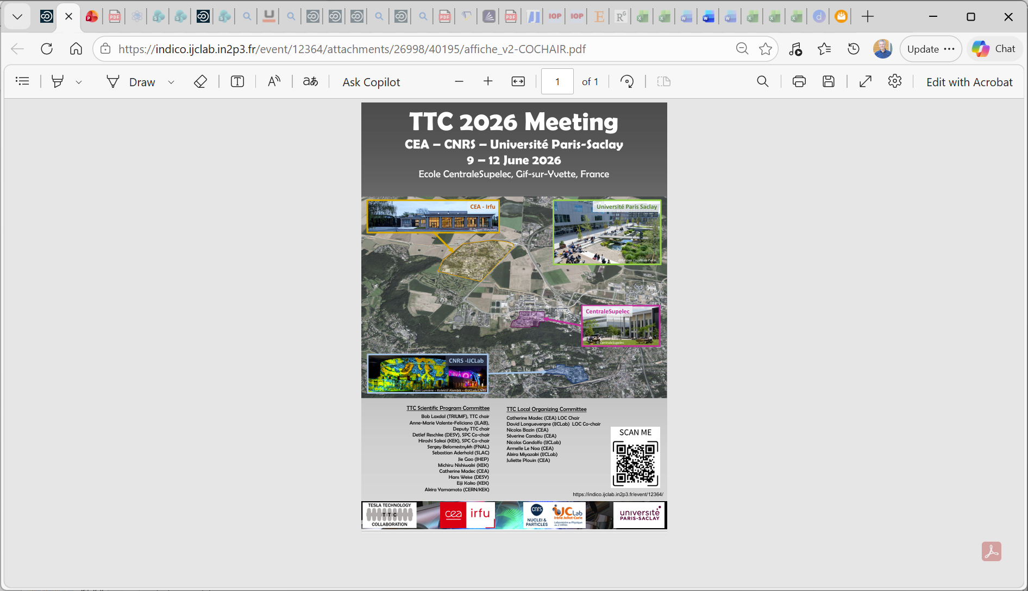
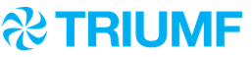
TTC2026 Opening
TTC 2026 Opening
Bob Laxdal (TRIUMF)
TTC Chair
June 9, 2026 Bob Laxdal

Slide 2
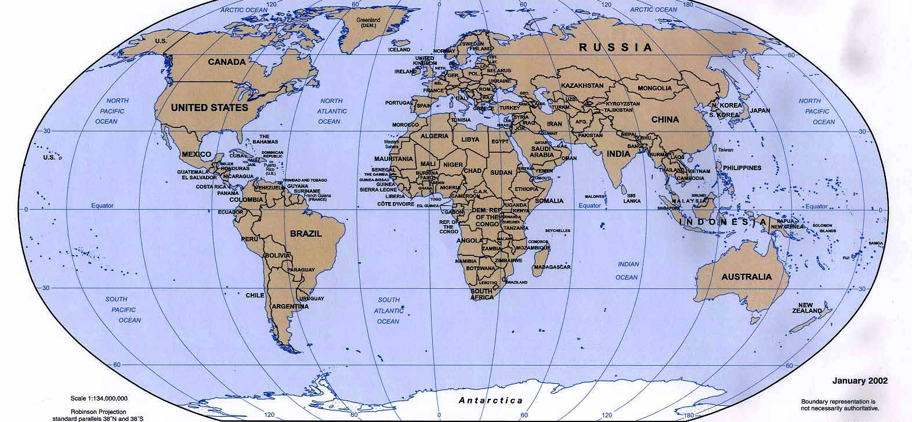
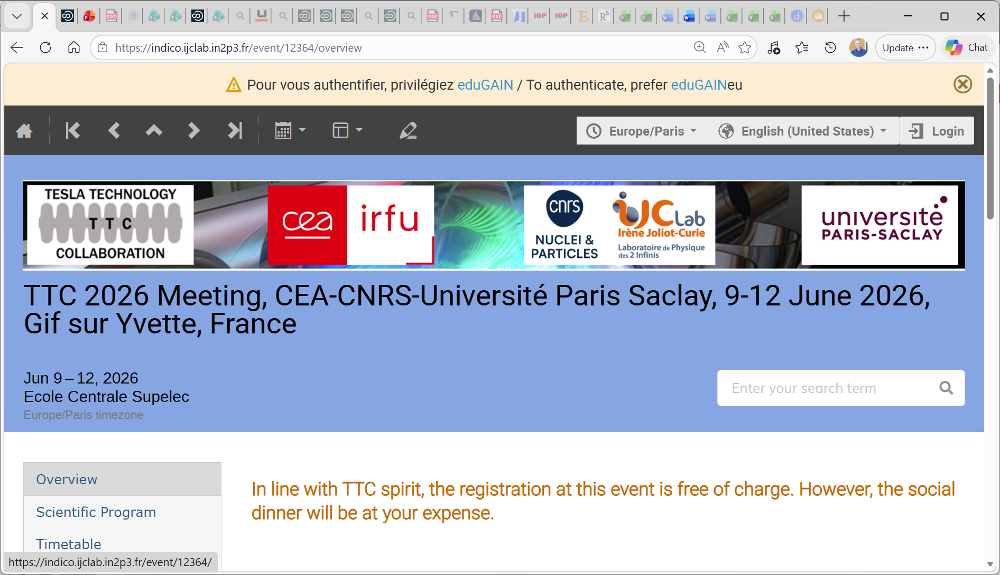
The TTC Global Family
Upp.U
ESS
BUW
TRIUMF
DESY
TUD
HZB
IFJPAN
FNAL
FRIB
STFC
HZDR
HZH
IHEP
ANL
Cornell
JAI
CANDLE
IMP
PKU
QST
JAEA
LBNL
IPN
CEA
CERN
IUAC
TU
KEK
SLAC
CNRS
IJCLab
Elettra
LNL
LNF
RIKEN
ORNL
BNL
IASF
JLab
LASA
RRCAT
SARI
IBS
NSRRC
BARC
VECC
TTC - 64 Institutes across 16 countries
Collaboration Members
TTC-2026 June 9, 2026 Bob Laxdal

Slide 3
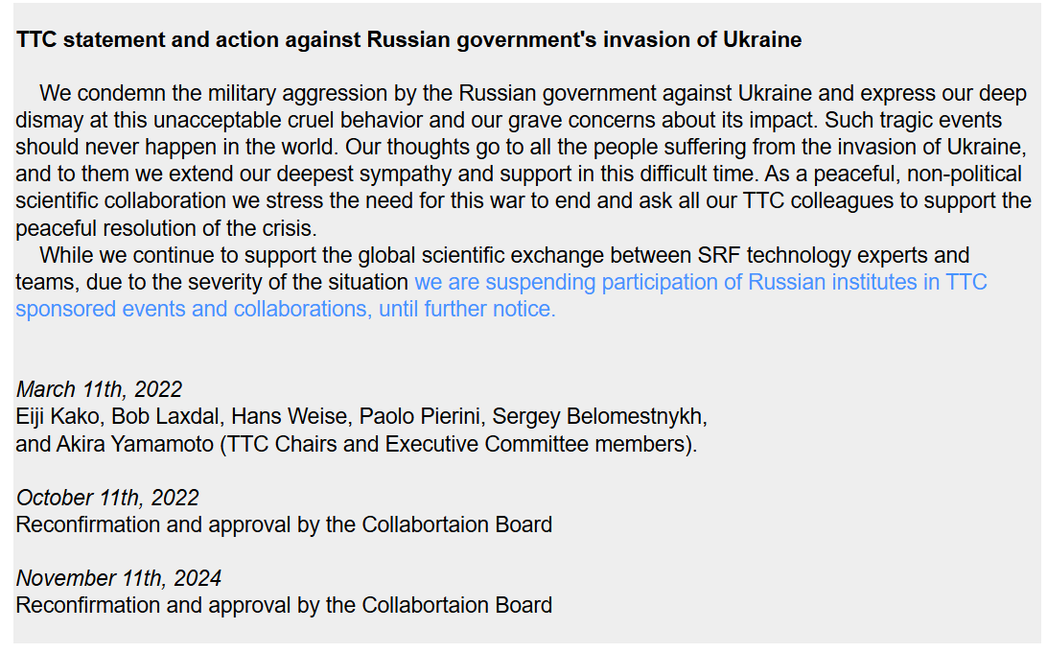
Status of Russia Members
TTC-2026 June 9, 2026 Bob Laxdal

Slide 4
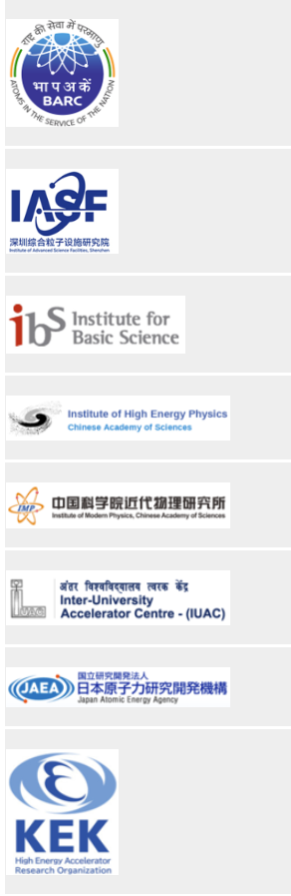
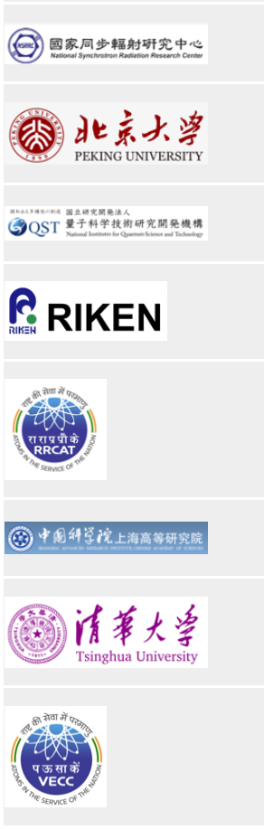
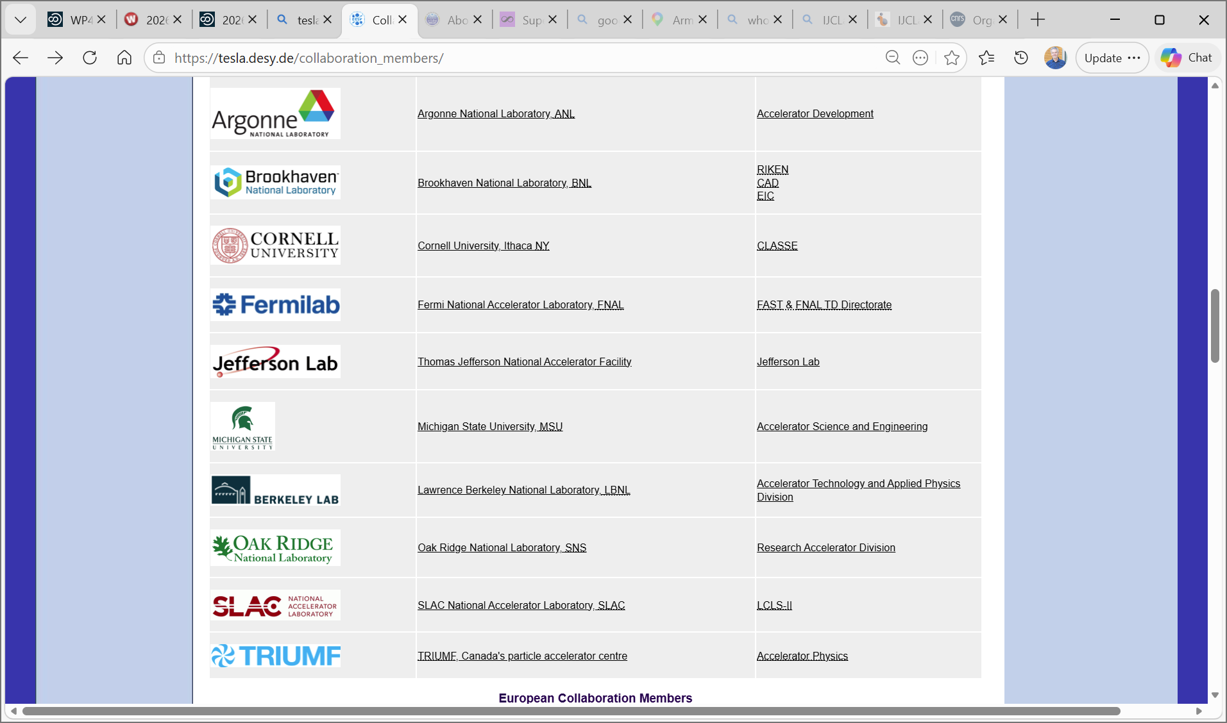
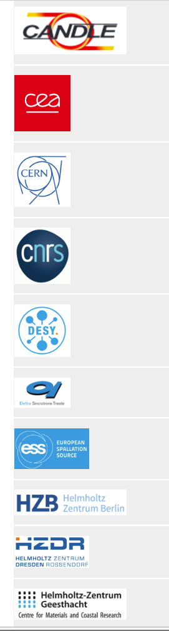
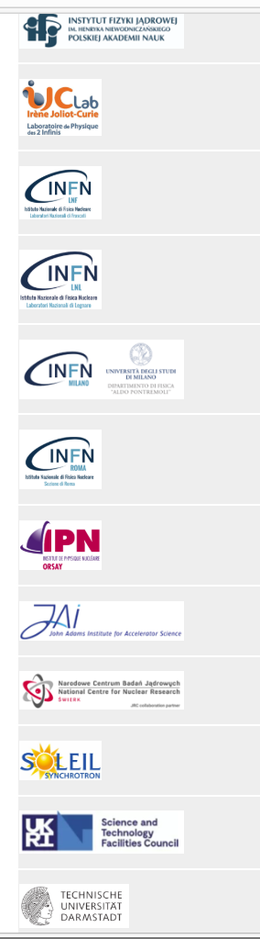
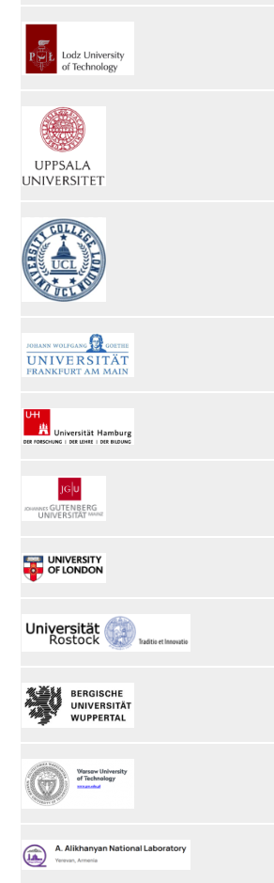
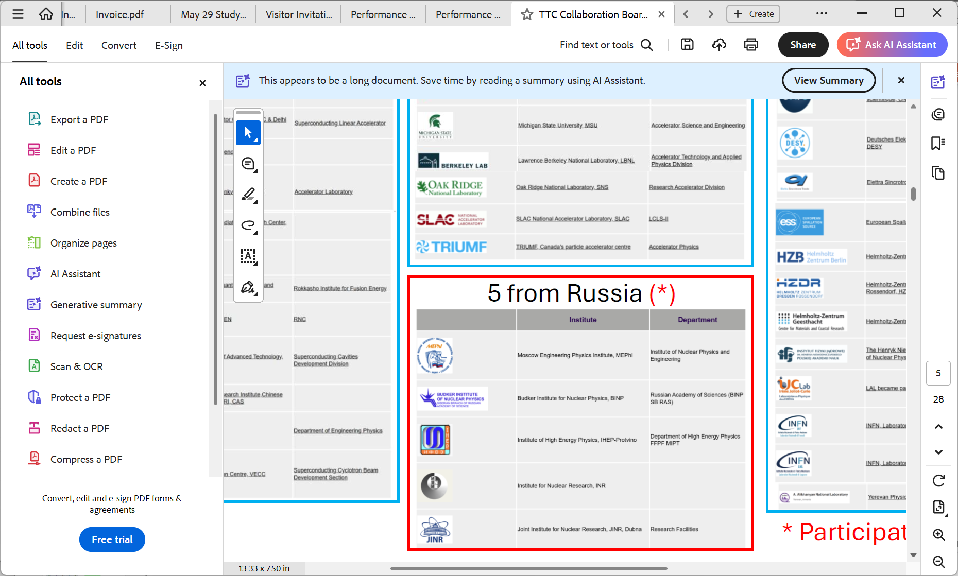
TTC by Region
Asia Region (16)
North America Region (10)
European Region (33)
Russia (5) *
* Presently suspended
TTC-2026 June 9, 2026 Bob Laxdal

Slide 5
Mission of TTC
The mission of the TESLA Technology Collaboration is to advance SCRF technology R&D and related accelerator studies across the broad diversity of scientific applications.
The TTC aims to keep open and provide a bridge for communication and sharing of ideas, developments, and testing across associated projects.
The TTC supports and encourages free and open exchange of scientific and technical knowledge, expertise, engineering designs, and equipment.
TTC-2026 June 9, 2026 Bob Laxdal

Slide 6
TTC Method
The TTC organizes regular collaboration meetings where new developments are reported and technical issues are discussed. We stress that this is a meeting to discuss real problems and not just polished findings.
Live presentation and in-person discussions are essential features in the TTC meeting. Please feel free to ask questions or provide comments in the Working Groups.
TTC-2026 June 9, 2026 Bob Laxdal

Slide 7
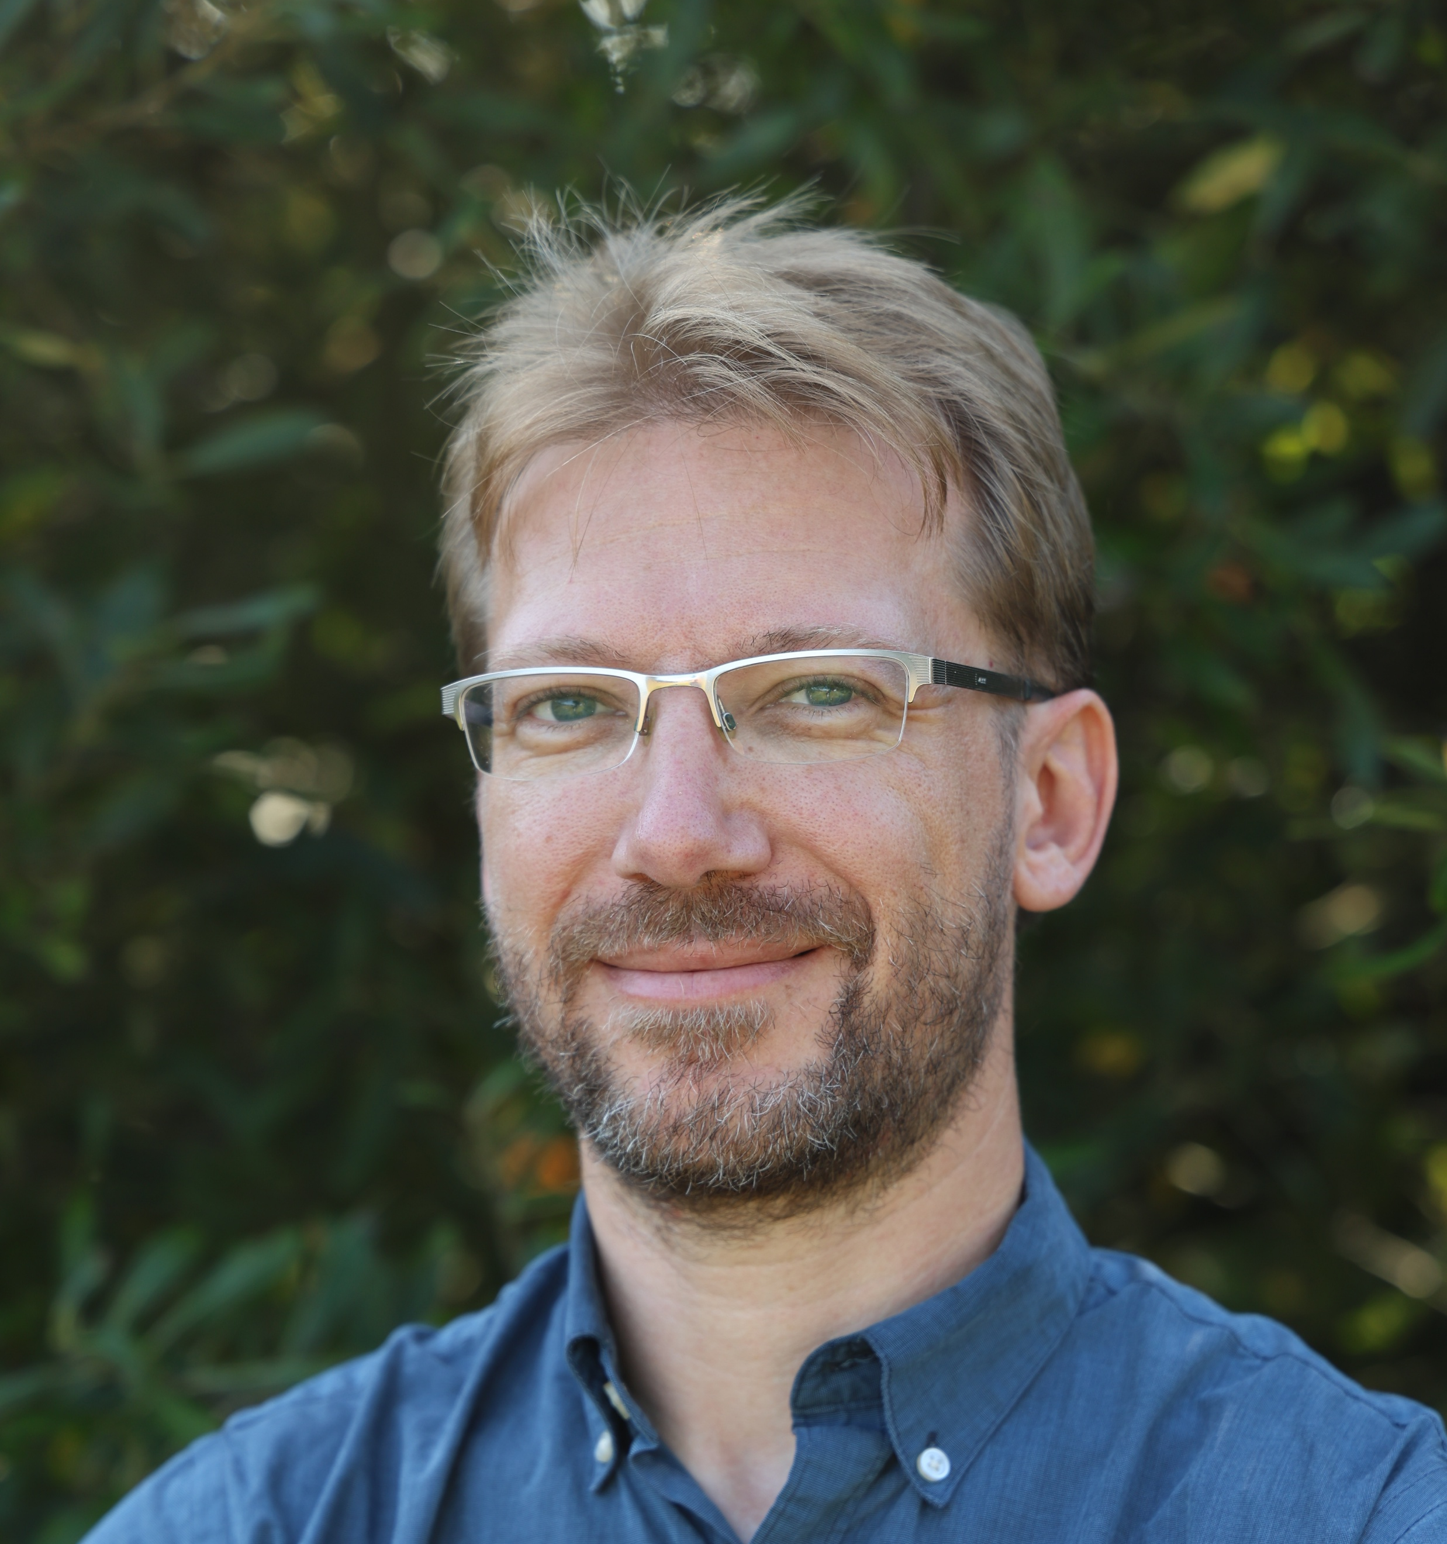
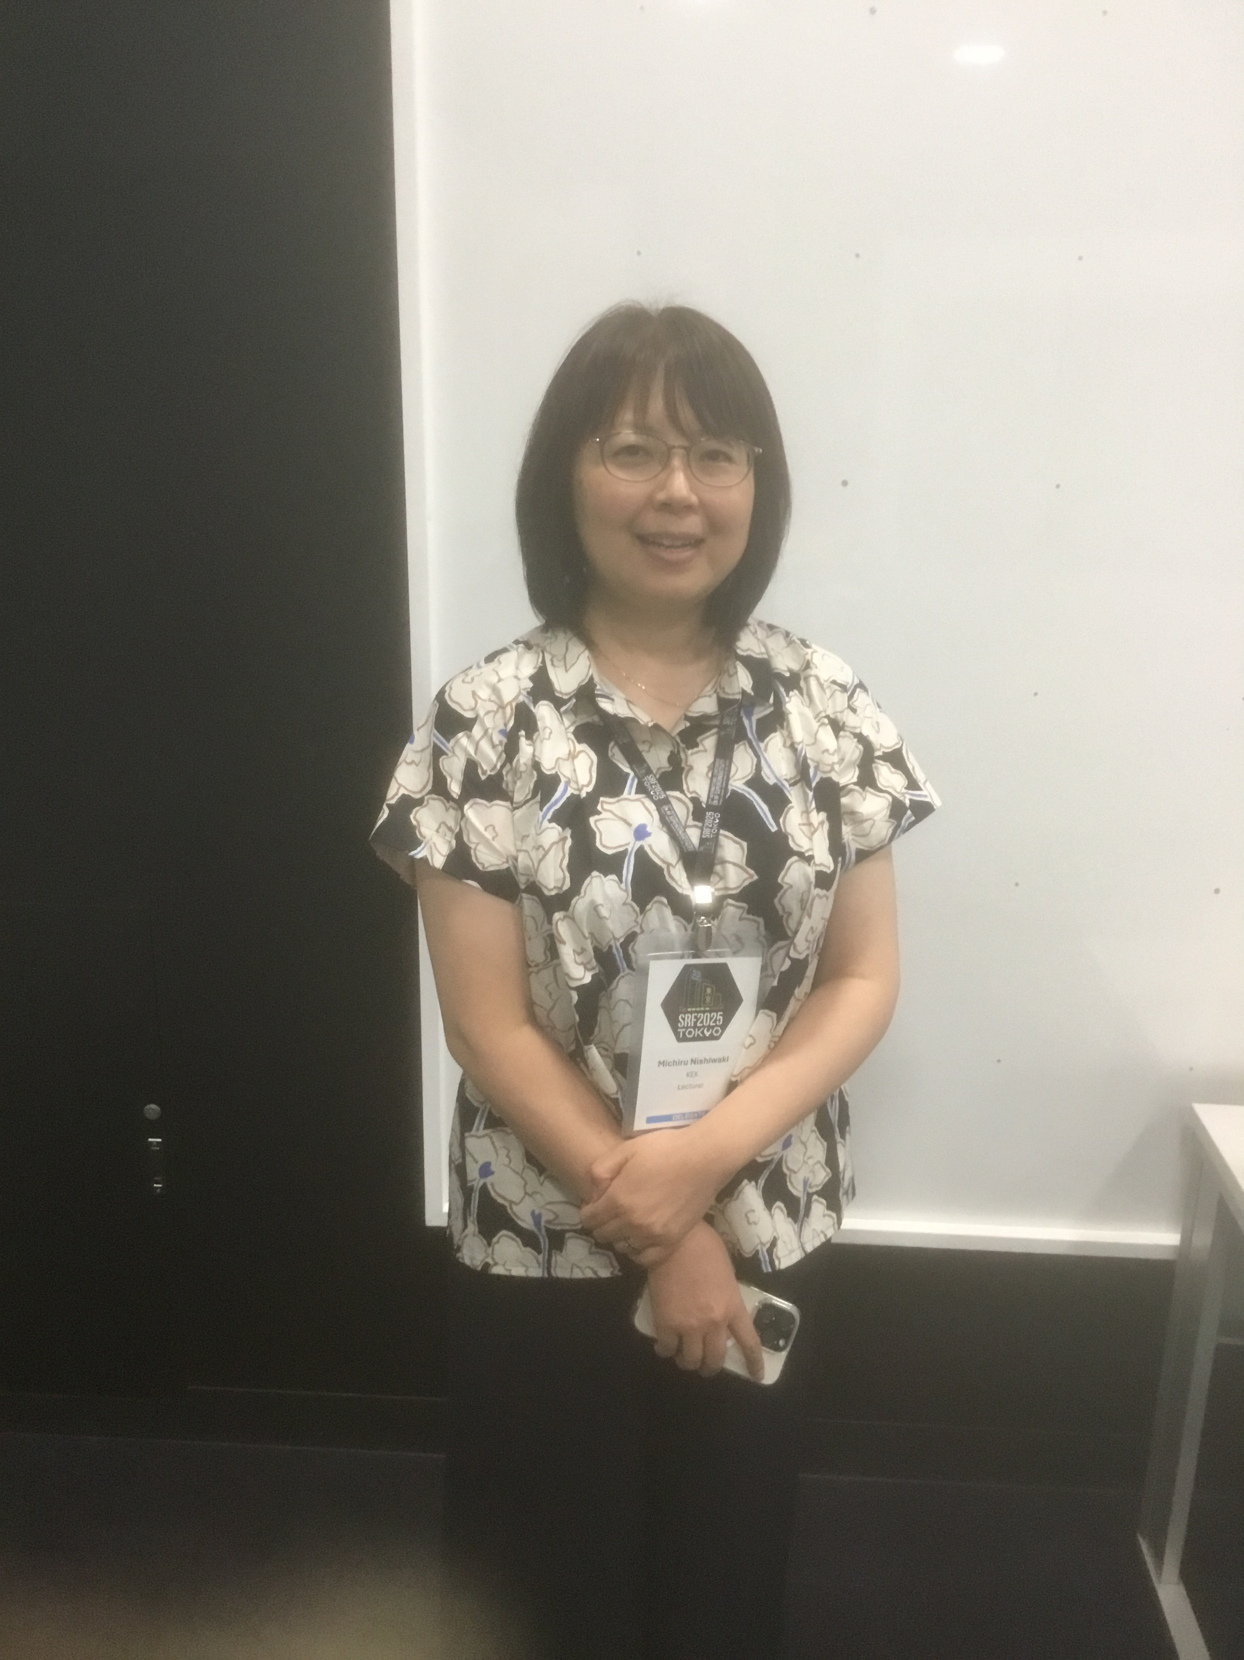
TTC Executive Committee
Executive committee during 2025-2028
Chair – Bob Laxdal
Deputy Chair – Anne-Marie Valente-Feliciano
North America
Sergey Belomestnikh
Sebastian Aderhold
Europe
Catherine Madec
Hans Weise
Asia
Jie Gao
Michiru Nishiwaki
Sebastian Aderhold and Michiru Nishiwaki have joined the Executive Committee after TTC2025.
The TTC-EC have Observer status on the TTC-TB and TTC-CB
A main task for the TTC-EC over the last six months is a renewal of the TTC-Technical Board and choosing a site for TTC2027.
Observers:
Akira Yamamoto
Eiji Kako
TTC-2026 June 9, 2026 Bob Laxdal

Slide 8
TTC-Technical Board renewed
The TTC Technical Board is made up of community experts who advise the TTC-EC about focus topics for the next TTC meeting and provide WG coordination – they are not lab representatives
The TTC-TB inputs are used to set the Working Group topics and inform the scientific program.
The TTC-TB has been renewed over the last six months with 13 new members with a focus to balance the regions and improve the gender balance.
27 Members (EU=9, NA=9, Asia=9)
Improved gender equity: now 9/27 (33% women from 22%)
Co-chairs
H. Sakai (KEK) and D. Reschke (DESY)
Cavity and couplers (13)
R.L. Geng (JLAB)
J. Hao (PKU)
K. Umemori (KEK)
J.Y. Zhai (IHEP)
D. Longuevergne (IJCLab)
N. Sakamoto (RIKEN)
L. Monaco (INFN Milano)
P. Dhakal (JLab)
Sang-Ho Kim (SNS)
Franck Peauger (CERN)
Suba de Silva (ODU)
Kellen McGee (FNAL)
Yasmine Kalboussi (Saclay)
RF and tuning (3)
Guillaume Devanz (Saclay)
Crispin Contreras-Martinez (FNAL)
Jinfang Chen (SARI)
Cryomodule and cryogenics (6)
S. Barbanotti (DESY)
Han Li (IASF)
L. Popielarski (FRIB)
Yongkwon Kim (RAON)
Teng Tan (IMP)
Cecilia Maiano (ESS)
Integration and operation (3)
J. Branlard (DESY)
Silvia Verdu Andres (BNL)
Zhongyuan Yao (TRIUMF)
 | Europe | NA | Asia | Total
Male | 5 | 5 | 8 | 18
Female | 4 | 4 | 1 | 9
Totals | 9 | 9 | 9 | 27
* observer status for full TTC-EC plus honoris causa
TTC-2026 June 9, 2026 Bob Laxdal

Slide 9
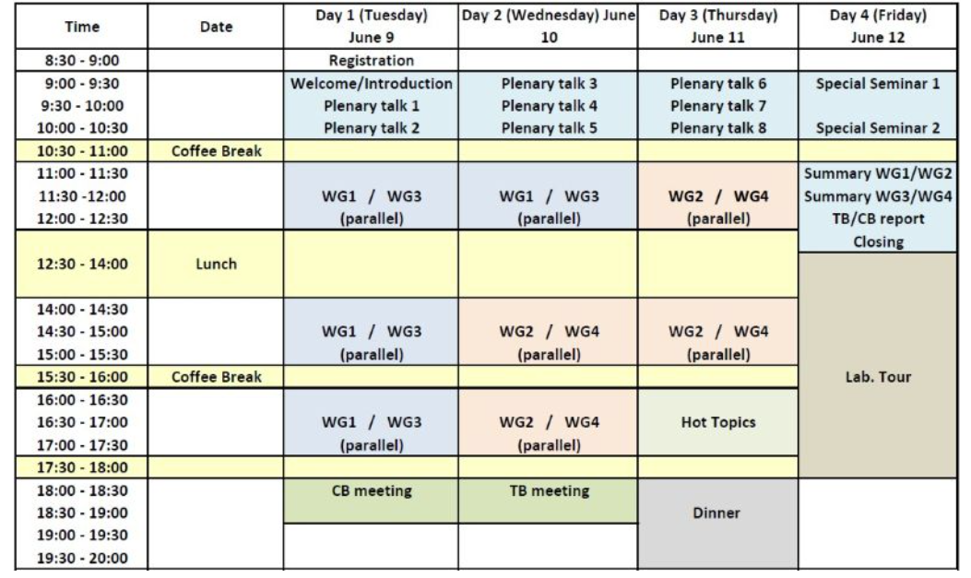
TTC2026 – Scientific Program
16 SPC meetings – TTC-EC, TTC-TB Chairs, LOC chairs and WG conveners – Thanks!
8 invited talks – one local, one European strategy and two project talks from each of the three regions
Four working groups
One hot topic session
Two special science talks
TTC-2026 June 9, 2026 Bob Laxdal

Slide 10
TTC2026 –Plenary talks
High Light Europe - Today
Highlights of SRF activities at CEA/IJCLab – C. Madec/A. Miyazaki
European Strategy for SRF development – P. McIntosh
Global Contributions (2 per region)
Asia
  Development, commissioning and high-current CW operation of 166.6 MHz HOM-damped SRF modules at HEPS – IHEP - ZHANG Pei
  RF commissioning of HIAF's iLINAC – IMP (Huizhou) – R. Zeng
Europe
  Experience with recommissioning of the European XFEL after Long Installation and Maintenance Period – DESY – M. Wiencek
  Commissioning and current Status of HELIAC Project at GSI – GSI – M. Miski-Oglu
North America
  LCLS-II-HE upgrade status/Recent Status of LCLS-II operation experience – SLAC – J. Maniscalco
  SRF Systems for the EIC Project – BNL/JLab – J. Matelevich
TTC-2026 June 9, 2026 Bob Laxdal

Slide 11
TTC2026 – Working groups
Four working groups (>100 presentations),
  WG1- Latest Activities on High-G and High-Q Performances
    Jinfang Chen (SARI), Daniel Bafia (FNAL), Lea Steder (DESY)
  WG2 - Effective operation of aging machines for performance and reliability
    Zhongyuan Yao (TRIUMF), Tiancai Jiang (IMP), Enrico Cenni (CEA)
  WG3 - R&D for Mass production and Quality assurance for accelerator modules
    Laura Monaco (INFN), Matia Parise (FNAL), Takeshi Dohmae (KEK)
  WG4 - R&D challenges for future advanced projects
    Cristian Pira (INFN), Teng Tan (IMP), Laura Popielarski (FRIB)
WG1/WG3 Tuesday-Wednesday
WG2/WG4 Wednesday/Thursday
Closing Summaries from the WG conveners on Friday
TTC-2026 June 9, 2026 Bob Laxdal

Slide 12
TTC2026 – Special sessions
Hot topic session
  Developing SRF towards Turn-Key Industrial Systems – AM Valente
Special science session
  Einstein Telescope, pushing the outer limits of gravitational waves detection – A. Lartaux
  Superconductivity and Cryogenics in Space : An active magnetic shield to protect astronauts for interstellar travels – B. Baudouy
TTC-2026 June 9, 2026 Bob Laxdal

Slide 13
TTC2026 – Special meetings
TTC Collaboration Board Meeting (by invitation)
  Tuesday 6-7 PM – Room E-071
  Chairs: Bob Laxdal (TRIUMF), Anne-Marie Valente (Jlab)
TTC Technical Board Meeting (by invitation)
  Wednesday 6-7 PM – Room E-071
  Chairs: Detlef Reschke (DESY), Hiroshi Sakai (KEK)
TTC-2026 June 9, 2026 Bob Laxdal

Slide 14
TTC2026 – Who are you?
194 registered, 13 Countries
43 Institutes, 10 companies
(97 Europe, 39 N. America, 58 Asia)
TTC-2026 June 9, 2026 Bob Laxdal

Slide 15
TTC Participation History
TTC-2026 - a new high for an in-person meeting at 194 participants
Virtual
TTC-2026 June 9, 2026 Bob Laxdal

Slide 16
Enjoy!
Please engage in and enjoy TTC2026!
Your participation is key to the success!
Thanks
Merci
TTC-2026 June 9, 2026 Bob Laxdal

