Slide 1
WELCOME at TTC2026
WELCOME at Université Paris-Saclay, CEA, CNRS
WELCOME in France!

Slide 2
This may be the first time in France!
Welcome in our…

Slide 3
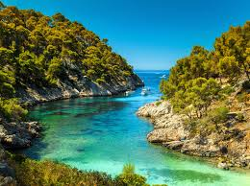
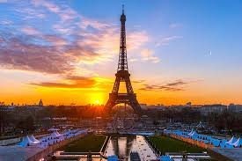

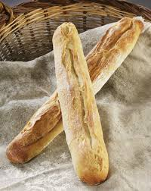

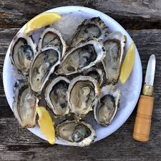
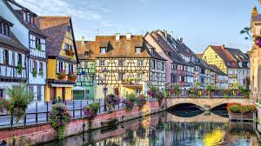
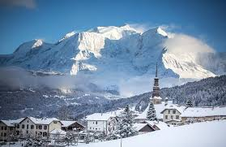
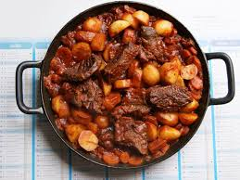

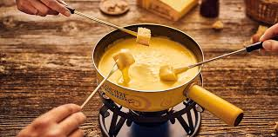

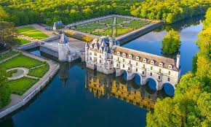


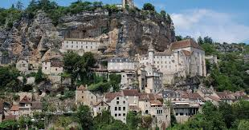
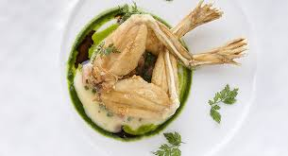
Delicious and beautiful country !

Slide 4
But at the same time…

Slide 5
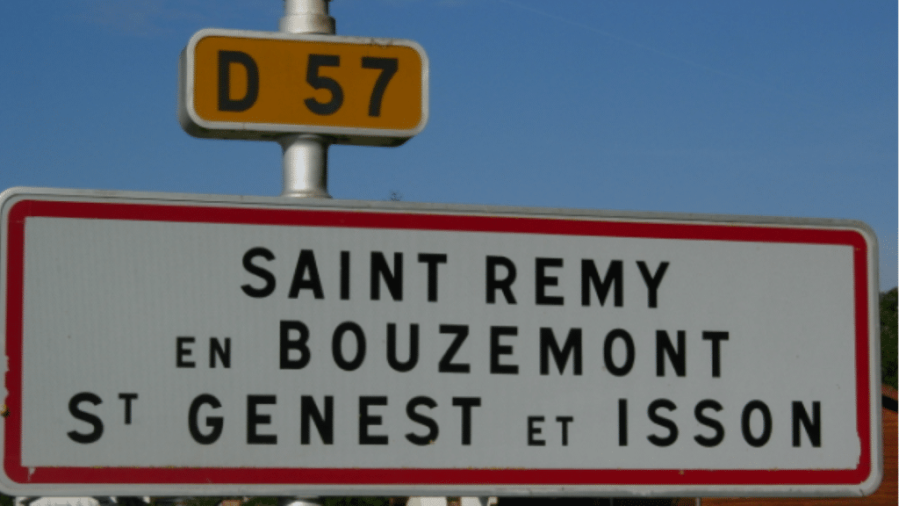
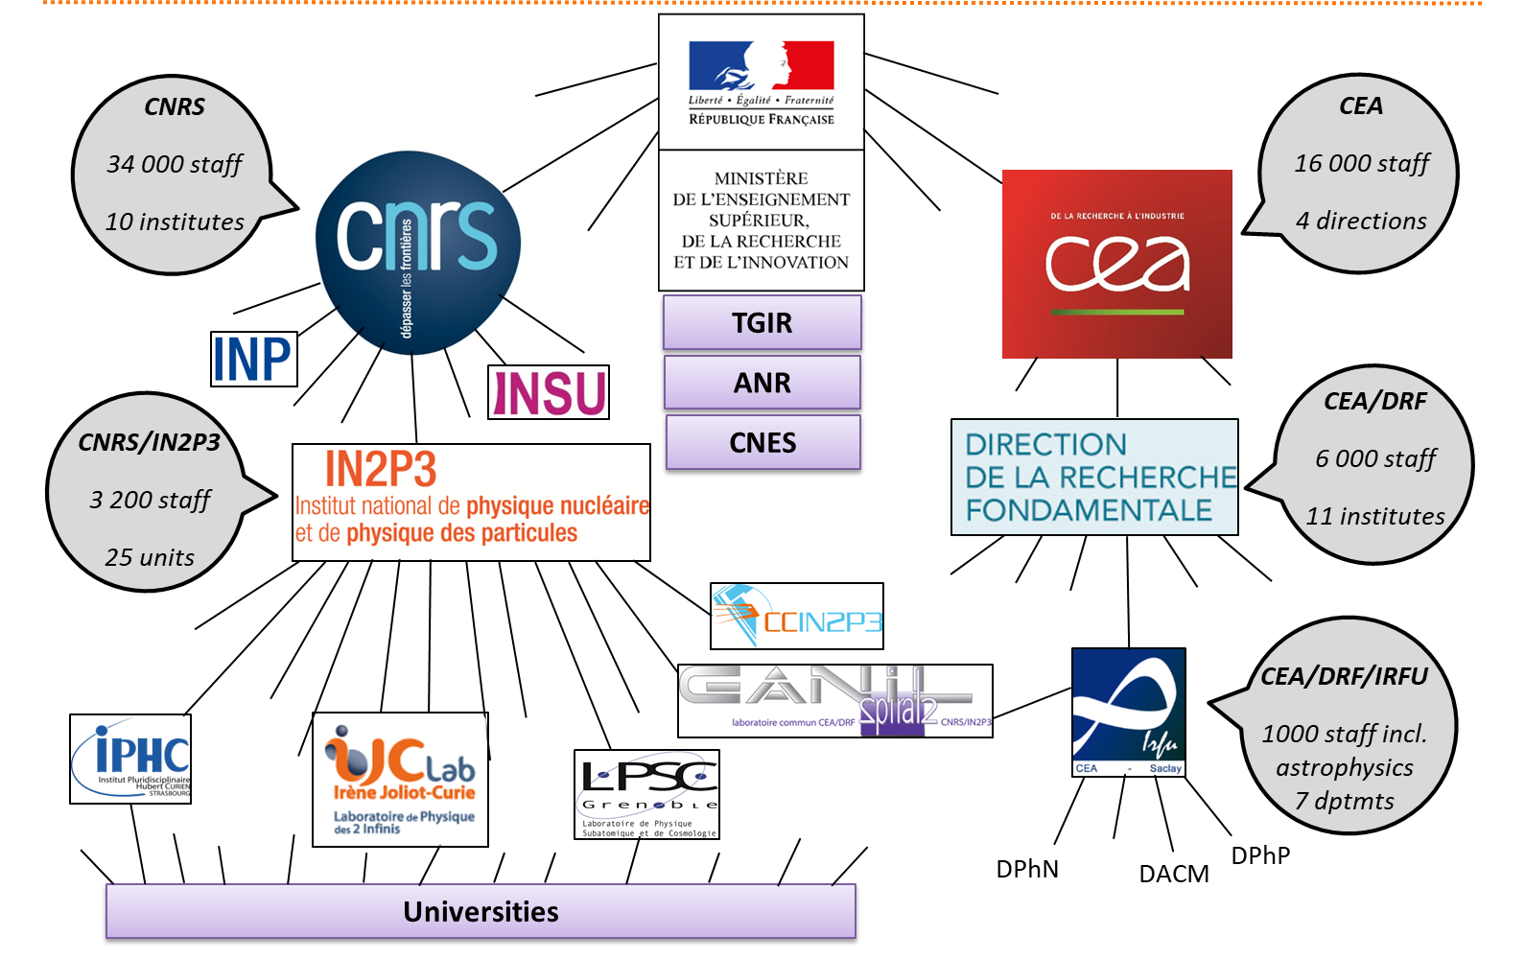
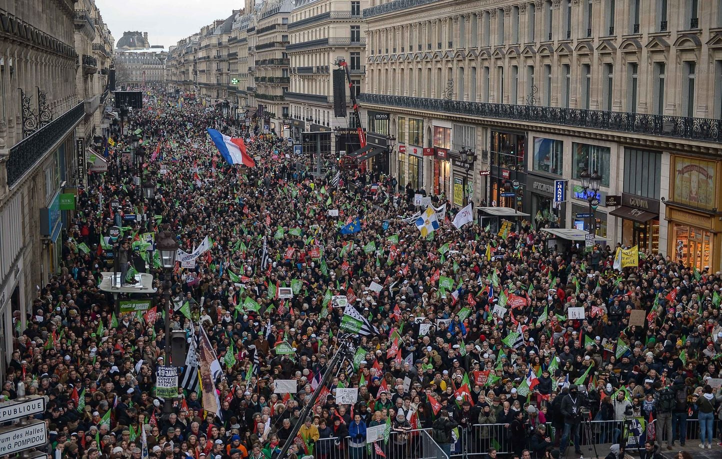
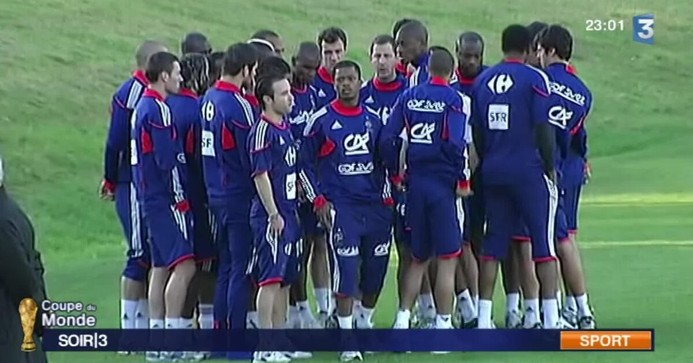
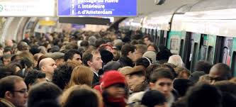
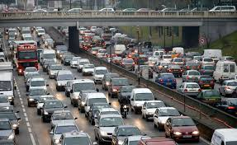
Messy and complex !
National strike on trains on Wednesday!!
We will try to get more information by the end of the day! Stay tuned!
Credits :
J.L. Biarrotte

Slide 6
So please let me help you with some useful information!

Slide 7
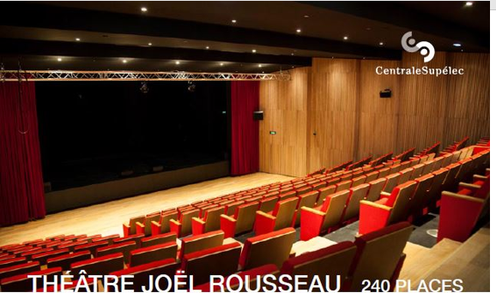
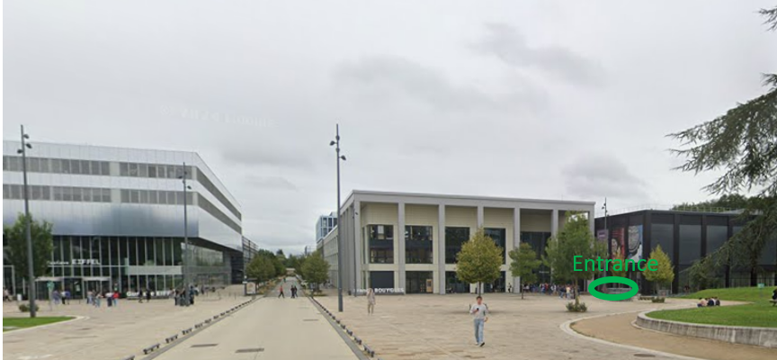
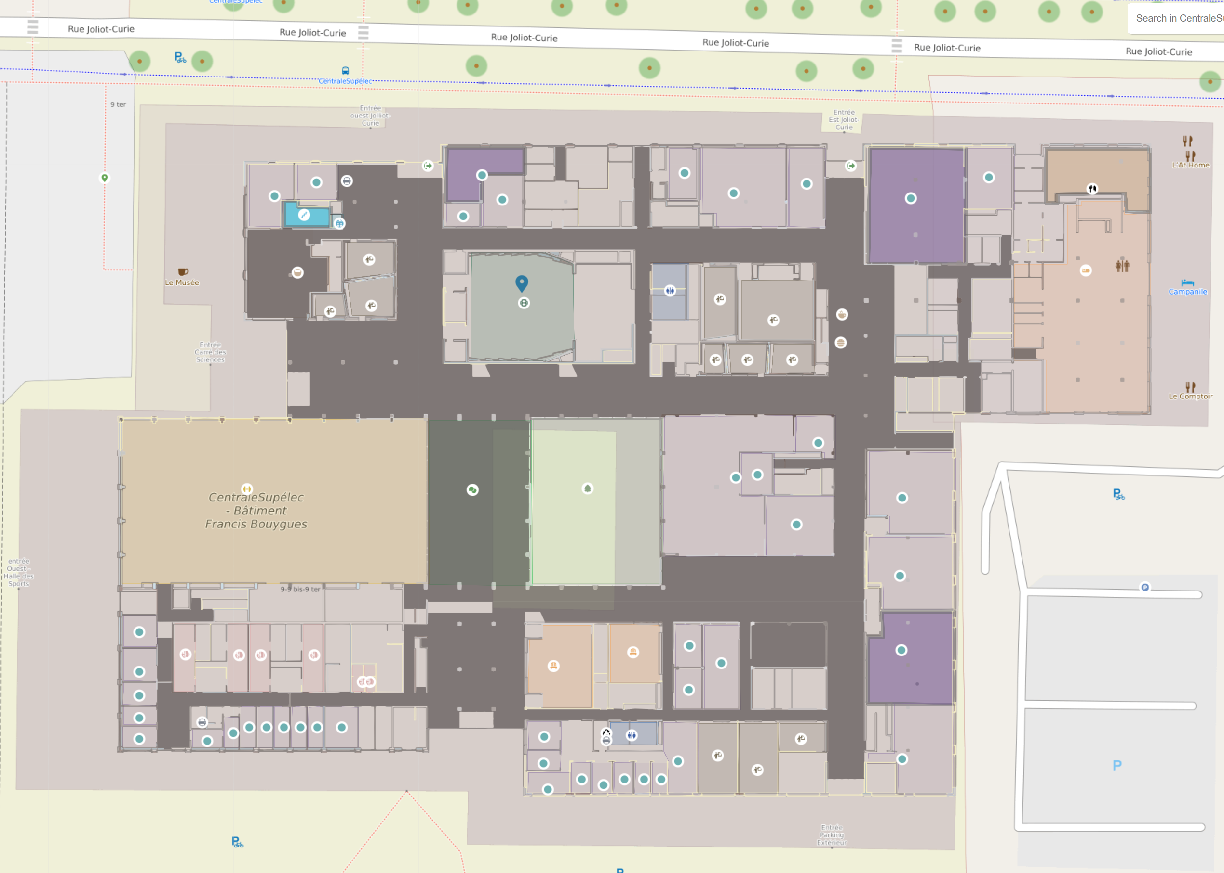
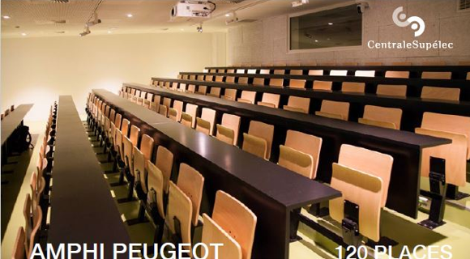
VENUE
Registration
Theater J. Rousseau (plenaries, WG1 and WG4)
Toilets
Coffee breaks
Room SC.071
(CB and TB)
Amphi Peugeot
(WG2 and WG3)
Toilets

Slide 8
WIFI
EDUROAM
DEDICATED WIFI:
      Wi-Fi network name: Workshop CEA - TTC 2026
      Password: Workshop!CEA2026

Slide 9
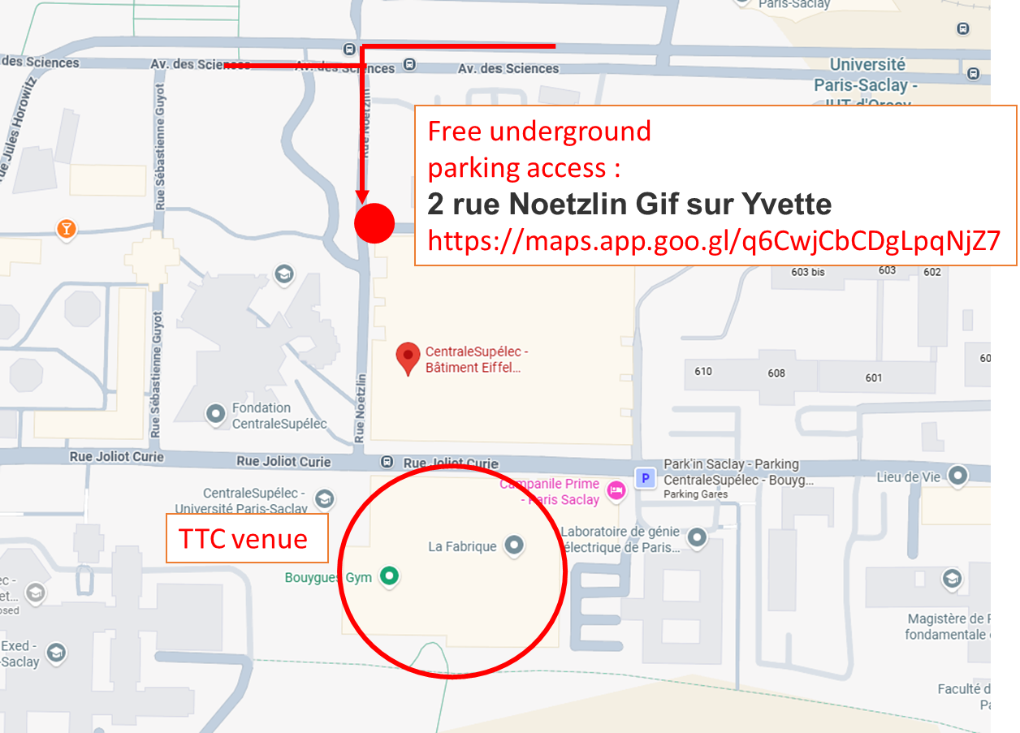
FREE PARKING :
PASSCODE :
7347 E
https://maps.app.goo.gl/q6CwjCbCDgLpqNjZ7

Slide 10
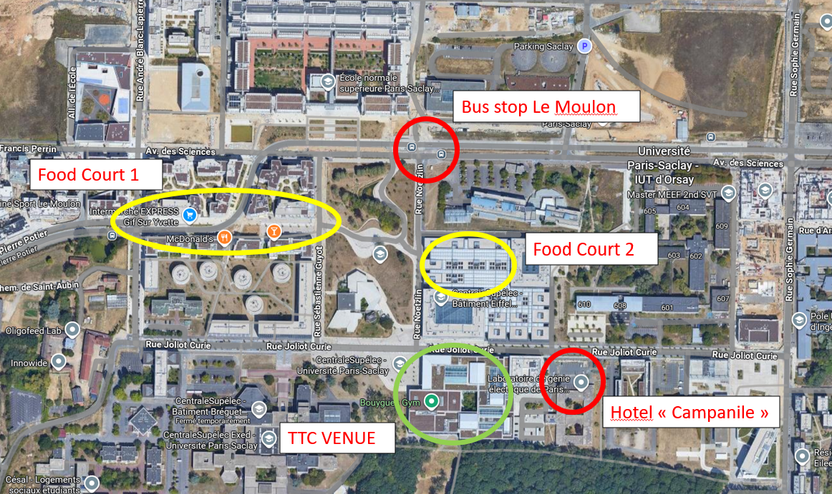
Lunch
Food court 1 : restaurants
https://maps.app.goo.gl/YVCPbz1jprFR6caV6
Food court 2 : CROUS Cafeteria
5 min walk

Slide 11
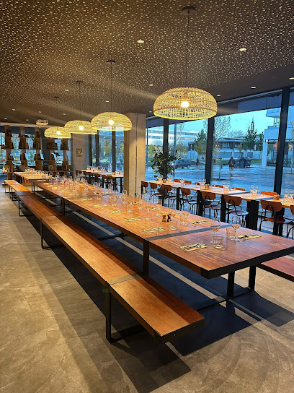
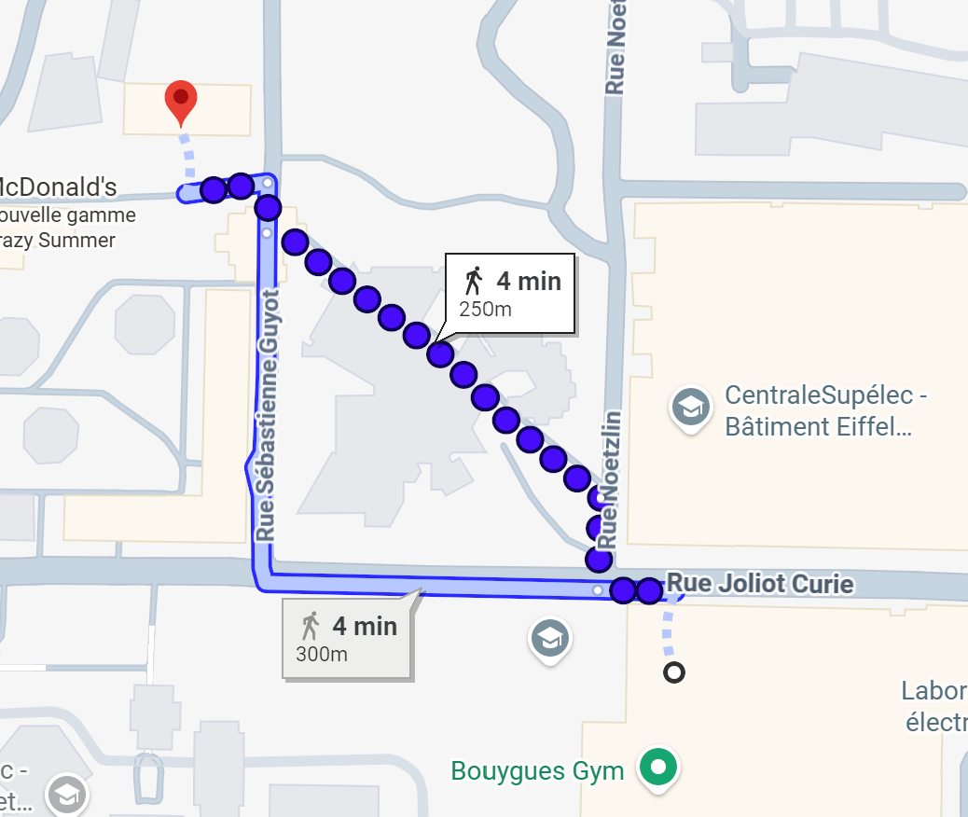
SOCIAL DINNER
COCKTAIL DINNER @ Brass&Co
Pre-payment was required (120 persons)
If you didn’t prepay, sorry you can’t access!
6.30pm – 9.30pm on Thursday
Drinks not included (craft beers from local brewery, soft drinks, cocktails and wine). Pay directly at counter!
If you paid but you can’t make it, please let us know, there might be some people to purchase your ticket

Slide 12
Platform visit (1)
3 buses will leave at 2pm from conference center
1 bus to Synergium @ CEA
  !! The bus will stay on site!!
  !! You have to leave your luggage + cell phone + computer in the bus!!
  !! The bus will leave at 5.30pm to go back to conference center !!

Slide 13
Platform visit (2)
1 bus to Supratech @ IJCLab
  !! The bus will not stay, take luggage with you for the visit. Another bus will come back at 4pm!!
1 bus to Vide&Surface @ IJCLab
  !! The bus will not stay, take luggage with you for the visit.
  ONLY ONE BUS WILL GO BACK TO CONFERENCE CENTER AFTER THE VISIT!!
  RERB is at walking distance from Supratech and Vide&Surface
  Please let us know ASAP if you can go directly to RER after the visit

Slide 14
GROUP PHOTO
A group photo will be organized during coffee break on Wednesday!

