Slide 1


WP3
Nb₃Sn on Cu films for 4.2K cavity operation
Industrial review kick-off meeting - 1
30.10.25
All information contained in this presentation and any accompanying documents is for iSAS project only and must be treated as strictly confidential.
Any dissemination, distribution or other use of this information without the consent of its owner is prohibited.
Funded by the European Union. Views and opinions expressed are however those of the authors only and do not necessarily reflect those of the European Union or the European Commission. Neither the European Union nor the granting authority can be held responsible for them.

Slide 2
Steering Committee Jan 2025
WP3: Nb₃Sn on Cu films for 4.2K cavity operation
INFN, CEA, HZB, UKRI
Convener: Cristian Pira (INFN), Deputy O. Malyshev (UKRI)
Main contacts with other partners:
T. Proslier (CEA), O.Kugeler (HZB), O. Malyshev (UKRI), R. Valizadeh (UKRI)
Task 3.1: Coordination of R&D on SC Cavities – M1-M48
• General coordination by INFN.
Task 3.2: Flux Trapping – M1-M32
Explore new coating parameters for planar samples and small resonators to minimize flux trapping in SC A15 films.
Upgrade the STFC choke cavity and the HZB QPR to support detailed flux trapping analyses of coated SC films.
Characterize trapped flux, flux viscosity and the interaction with the RF field with SC A15 films in small resonators and planar samples with the upgraded systems.
Task 3.3: RF Tunability – M1-M32
• Explore new coating parameters on planar samples and resonators to enhance the mechanical strength in SC A15 films.
• Mechanical film-stability tests with planar samples.
• Build cavity tuning system and perform vertical cryo-tests of coated cavities to explore RF performance limits and acceptable tuning without incurring film damage.
• Devise cavity tuning schemes for Nb3Sn cavities fulfilling the required tuning parameters while taking into account the constraints of Nb3Sn. The implementation of FE-FRT to assist will be considered.
Task 3.4: Adaptative layers – M1-M40
• Develop adaptative layers by atomic layer deposition on Cu that are stable up to 650 °C.
• Compare performance Nb3Sn on Cu with and without adaptive layers on planar samples and QPR.
Task 3.5: Working Cavity @4.2 K – M1-M48
• Improve I.FAST 1.3-GHz superconducting coating recipe based on Tasks 3.2-3.4 results.
• Prepare 1.3-GHz thin film cavities with an optimized coating recipe.

Slide 3
WP3 – Industrial review kick-off meeting - 1
Which companies are you collaborating with outside iSAS?
AZ Concept (FR) – PVD and PECVD coating machines
https://www.az-cpt.com/ ISAS Contact: Thomas Proslier (Task 3.4)
Mallard (FR) - Cold Spray
https://www.mallard-sa.fr/ ISAS Contact: Thomas Proslier (Task 3.4)
Shakespeare Engineering (UK) - CNC turning and milling , Prototyping, Assembly
https://www.shakespeareengineering.co.uk/ ISAS Contact: Reza Valizadeh (T 3.5)
Piccoli (IT) - Seamless cavity forming by spinning
https://www.piccolisrl.it/ ISAS Contact: Cristian Pira (Task 3.5)
Cinel (IT) - Mechanical design and manufacture of apparatuses in scientific and research fields
https://www.cinel.com/cinel/ ISAS Contact: Cristian Pira (Task 3.5)

Slide 4
WP3 – Industrial review kick-off meeting - 1
Some of these companies might have an interest in iSAS and which ones?
AZ Concept (FR) – Yes
Mallard (FR) - No
Shakespeare Engineering (UK) - N/A
Piccoli (IT) - Yes
Cinel (IT) - N/A

Slide 5
WP3 – Industrial review kick-off meeting - 1
Please identify at least 3 points in the development you are facing where you think you need support from industry.
Seamless copper cavities equipped with 2 or 4 flanges
3D printing full scale cavity development
Deposition targets in rods and tubes for Nb3Sn, NbTi, V3Si, etc.
HiPIMS deposition system for SRF cavities
Cryogenic 3d AMR sensors with µT resolution and 1-wire output
Cryogenic movers (for adjustable couplers)
Cryocoolers with >10 W at 4.2 K and above (without JT stage)
Commercially available pre-fabricated BCP solution
(avoid handling of >10% HF in chemlab)

Slide 6
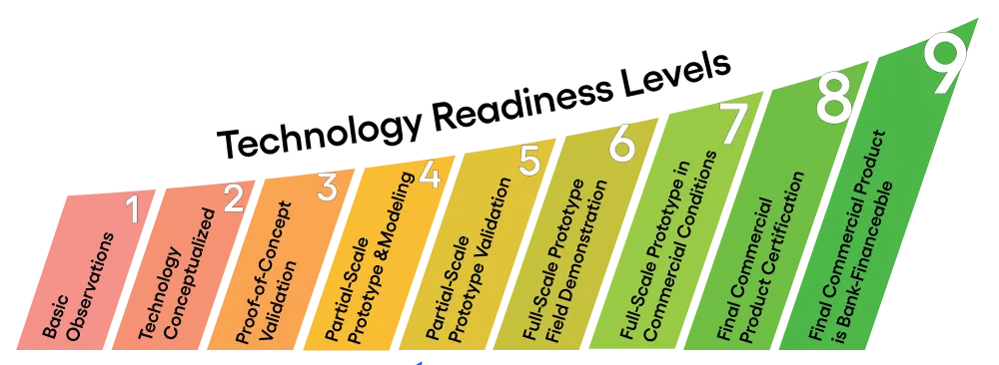
WP3 – Industrial review kick-off meeting - 1
How do you estimate your current TRL and do you foresee a reduction from your planned TRL?
TRL 5 as planned: First 1.3 GHz cavity prototype built (I.FAST)

