Slide 1
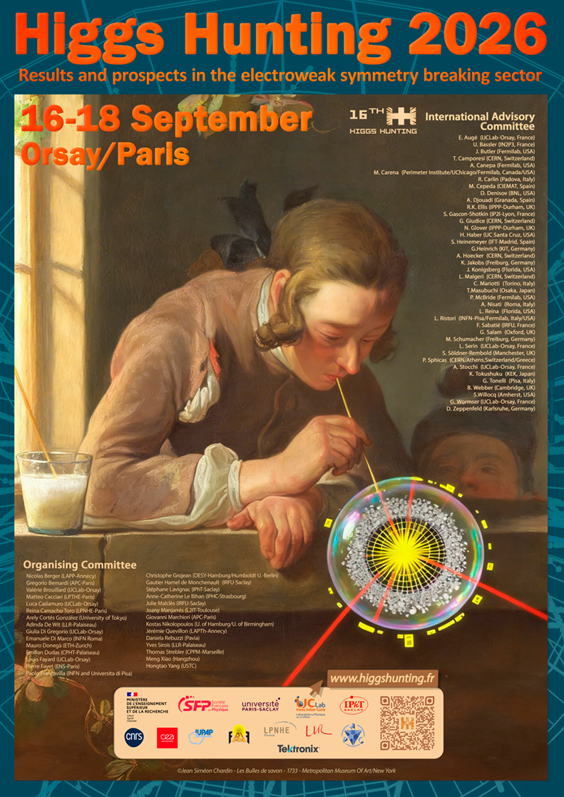
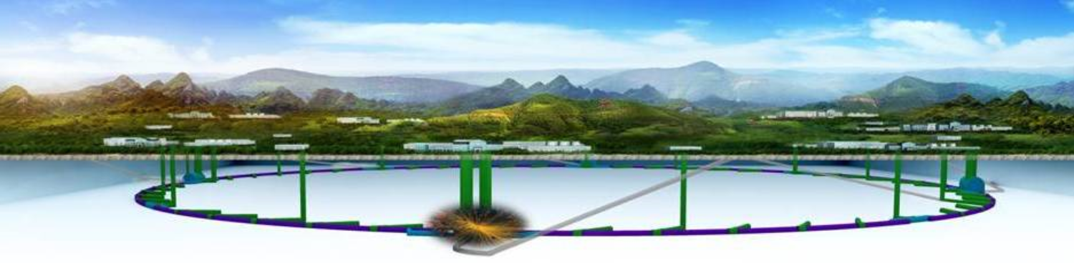
CEPC and the Future Plan of HEP in China
Yifang Wang
Orsay/Paris, Sep.18, 2026

Slide 2
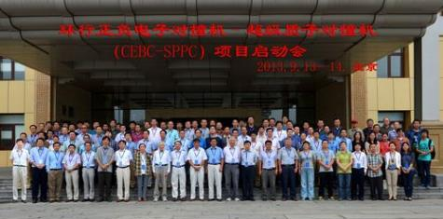
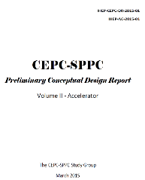
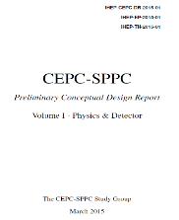
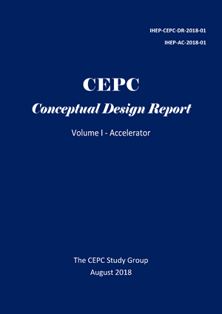
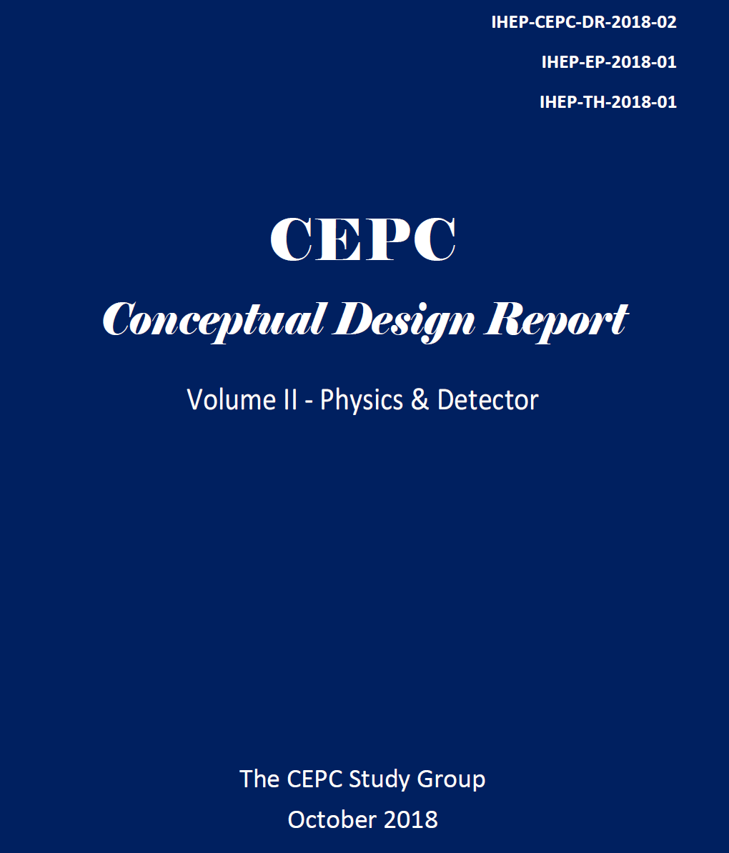
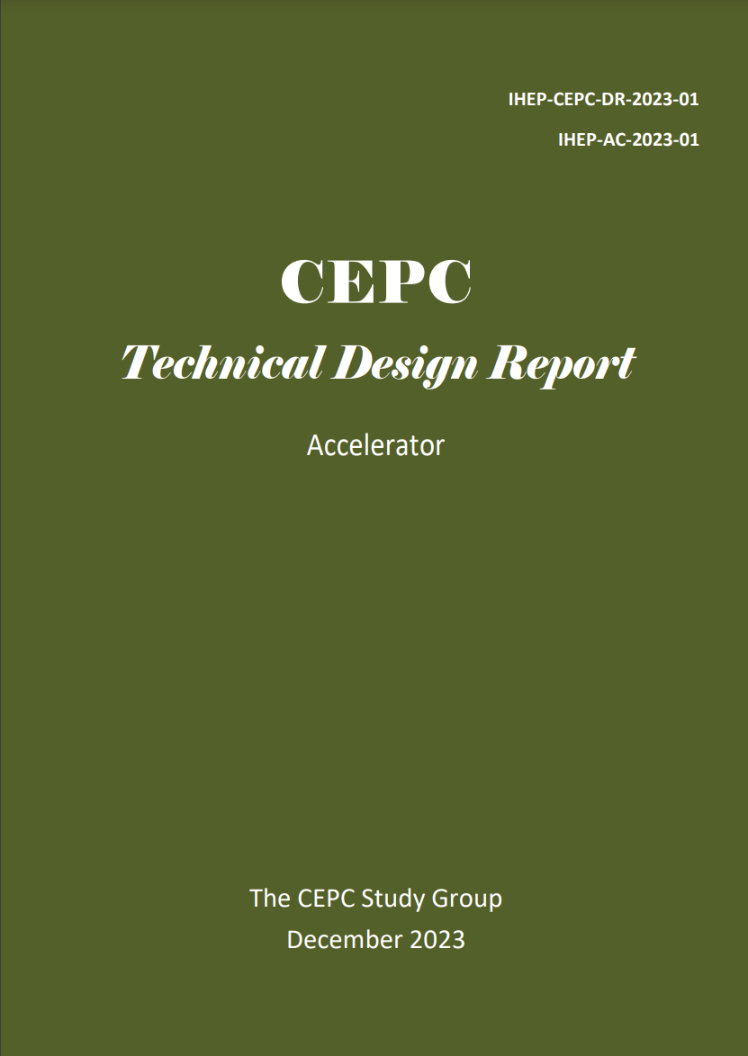
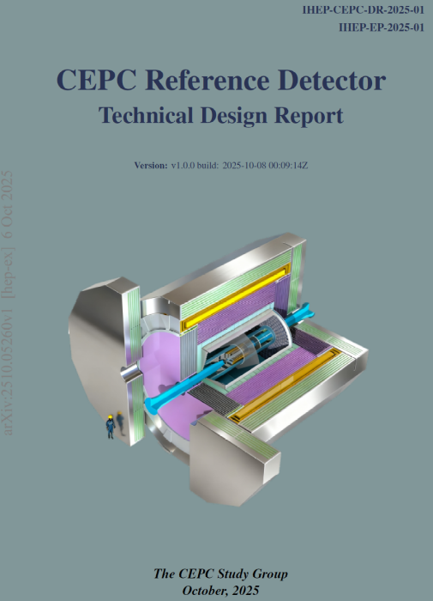
From Kick-off to TDR
2013
2015
CEPC physics white papers:
1. Higgs physics, arxiv:1810.09037
Chin. Phys. C 43(2019) 043002
2. Flavor physics, arxiv:2412.19743
3. New Physics Search arXiv.2505.24810
4. Electroweak physics, to be published
5. QCD, to be published
2018
2023
2025
http://cepc.ihep.ac.cn
2

Slide 3
CEPC was not put into the 15th 5-yrs（2026-2030） plan
A sad news but we will not stop pursueing HEP
An IB meeting at the last annual CEPC workshop held in Guangzhou concluded the following:
  Continue CEPC while looking forward to be a major partner of FCC
    Identify common interests and technologies, find a new way of collaboration
      In contact with CERN/FCC
      AGORA listed as one of the FCC detector concept
      already in DRD
    If FCC construction is not officially approved before 2030, we will propose again to the Chinese government
  Continue to explore the pp collider (~100 TeV) by working on Iron-based HTC superconducting materials (IBS) and magnet
    Only IBS has potential to contribute significantly to the society: new, metal, cheap
  Working for the high energy linear e+e- collider (1-10 TeV) and applications
    Established a PWFA test facility based on BEPCII
    Start to work on technologies, and applications for table-top light sources, injectors, FEL, etc.

Slide 4
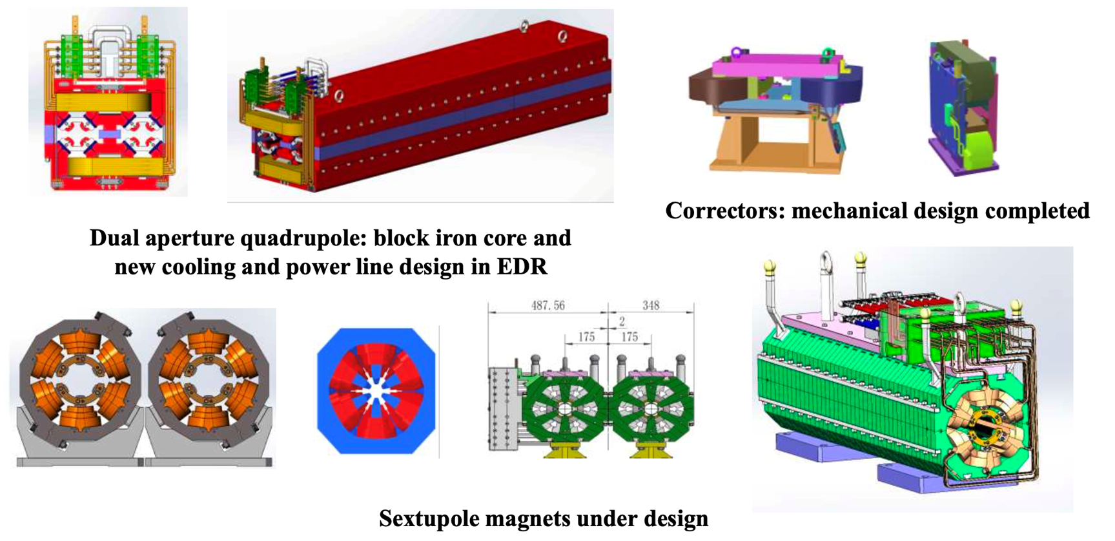
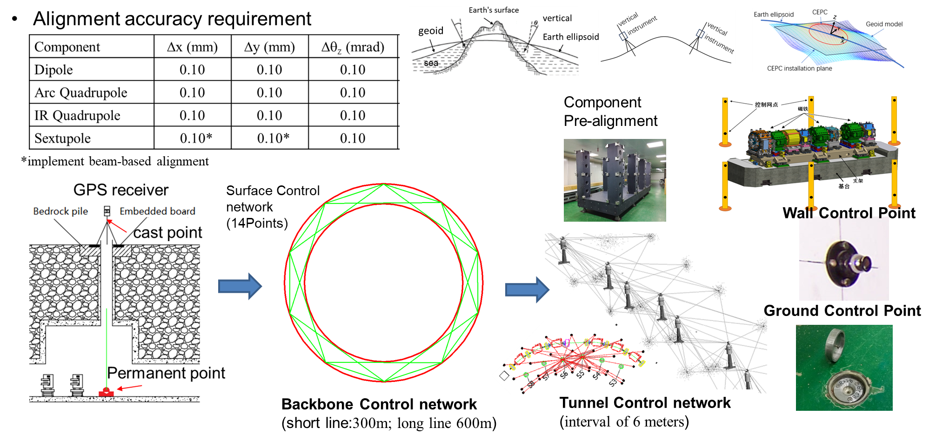
Continue Accelerator EDR
EDR tasks start with 35 WGs aiming for issues like further R&D of new technologies, mass production, mockup for installation, etc.
A full cryomodule containing six 650 MHz 2-cell cavities
Higher efficiency klystrons
Automatic production for NEG coated vacuum chambers
Automatic production for magnets
More prototypes of magnets
C-band LINAC test band
CCT type SC quadrupole magnet for final focusing
MDI design and background studies
Control and timing
Alignment and installation plan
Mockup for installation
….

Slide 5
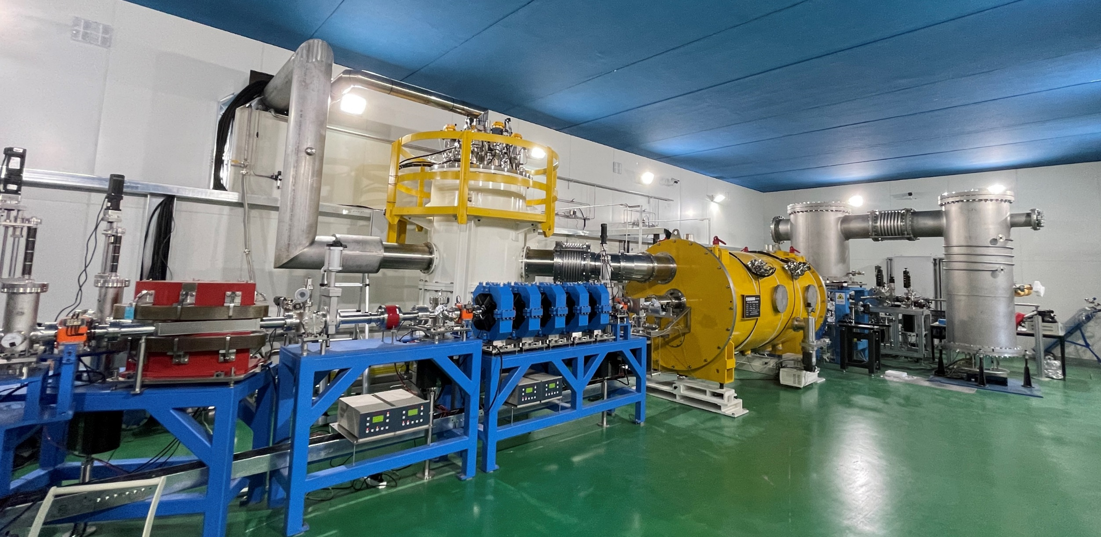
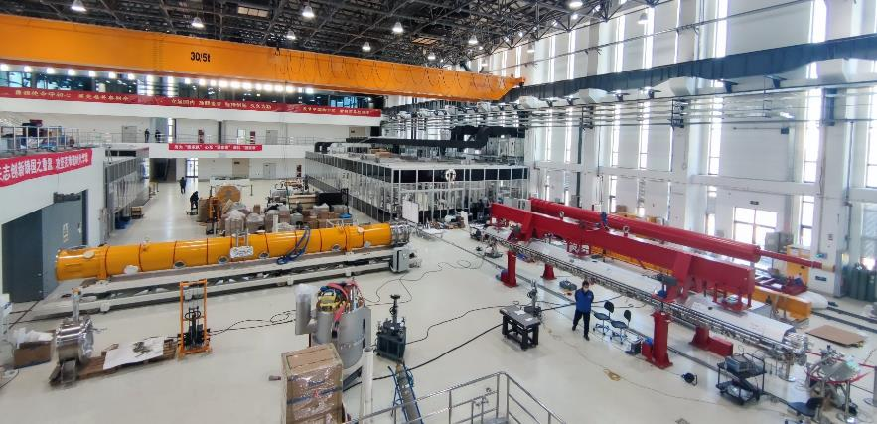
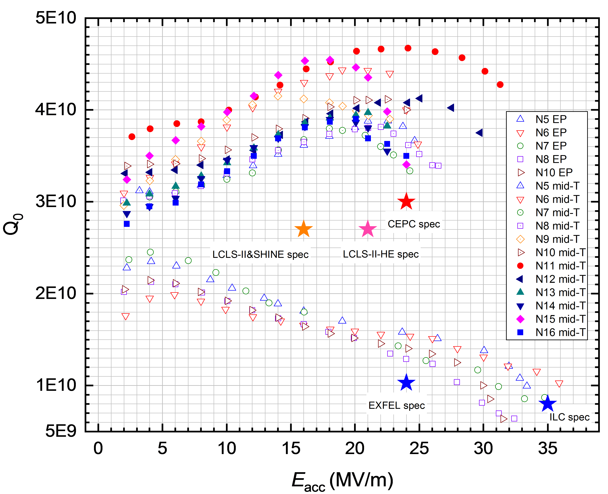
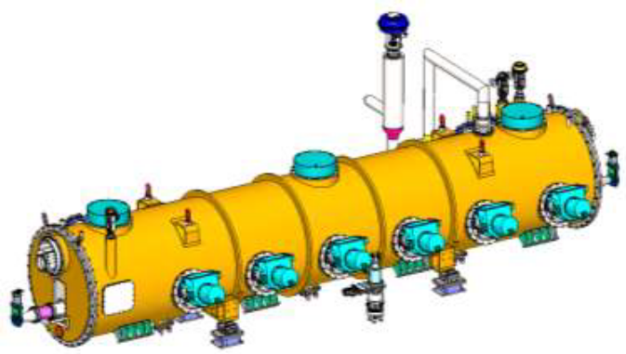
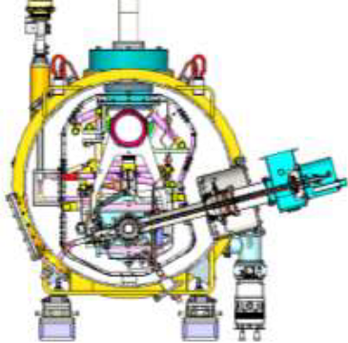
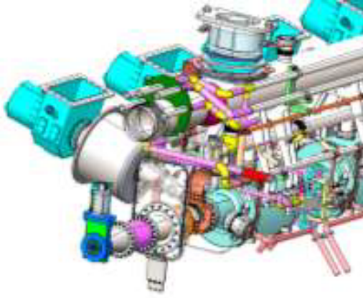
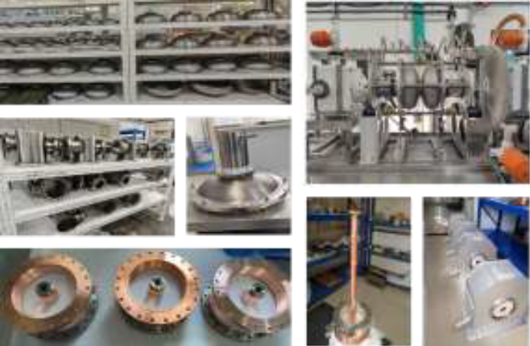
EDR Example 1: SRF Cavities and Modules
High G High Q 1.3GHz 9-cell Cavity
In TDR phase: successfully completed a 650MHz 2*cell short module and an 1.3GHz full module
In EDR: a full 11 m-long module with six 650 MHz 2-cell cavities
Status： construction in progress

Slide 6
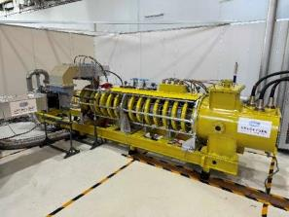
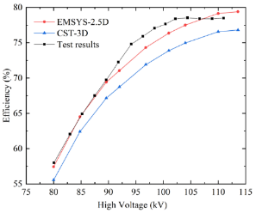
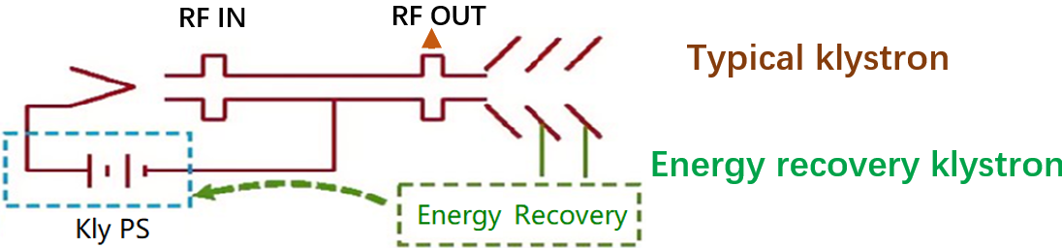
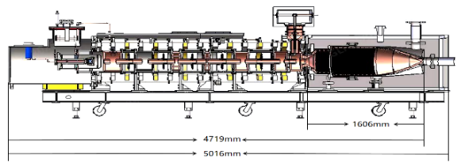
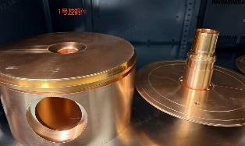
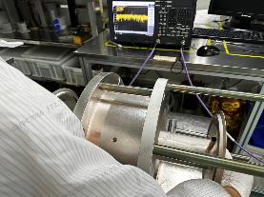
EDR Example 2: Higher Efficiency Klystrons
In TDR phase: CW 800 kW klystron reached effi. of ~78%
Cavity components
Cavity cold test
Parameter | Value
Frequency | 650 MHz
Beam Voltage | 113 kV
Output power | 800 kW CW
Efficiency | ≥85%
In EDR: An Energy Recovery Klystron (ERK) to be tested next year

Slide 7
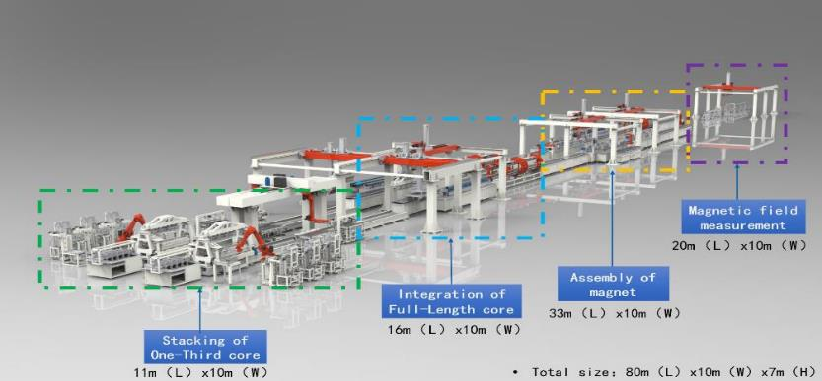
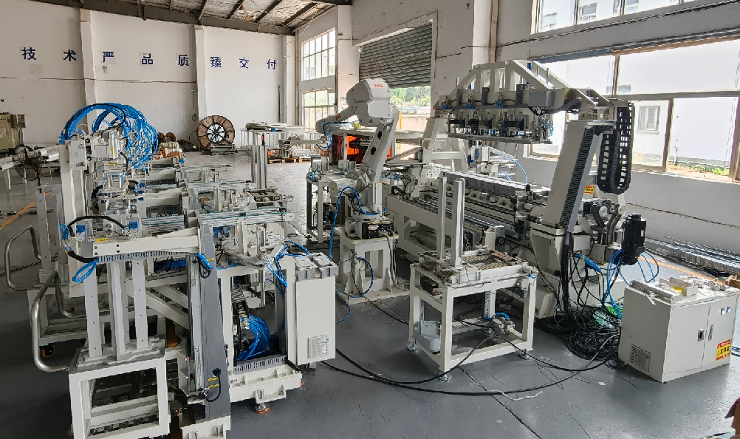
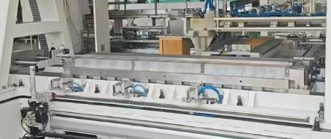
EDR Example 3: Automatic Production for Magnets
Starting from booster dipole magnet: ~15000 magnets needed
Can work 24h/day, 7days/week, may reduce the cost by ~30-50%
The first workstation for stacking the magnet core has been produced. Commissioning successful: a magnet core is successfully completed.
The full production line will be commissioned soon

Slide 8
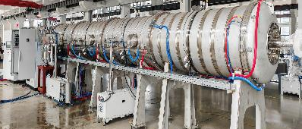
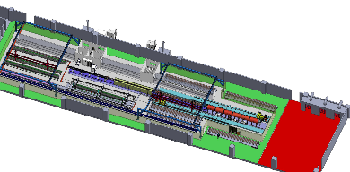
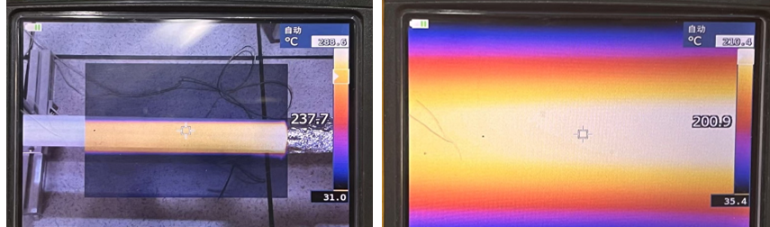
EDR Example 4: Automatic Production for NEG Coated Vacuum Chamber
A total of 200 km needed
Can work 24h/day, 7days/week, may reduce the cost by ~30-50%
Key challenges: automatic sealing of CF flanges, coating under extreme conditions at a length‑to‑diameter ratio of ~200, and heating‑layer implementation.
Heating layer spraying
NEG coating
Thanks for your attention
Assembly and commissioning completed, undergoing system‑level commissioning

Slide 9
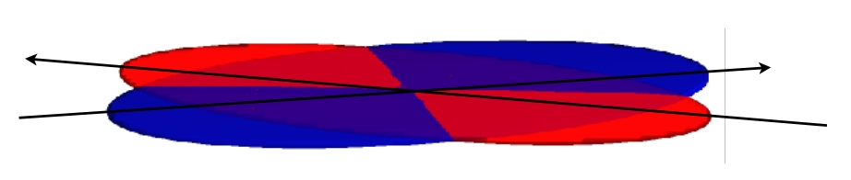

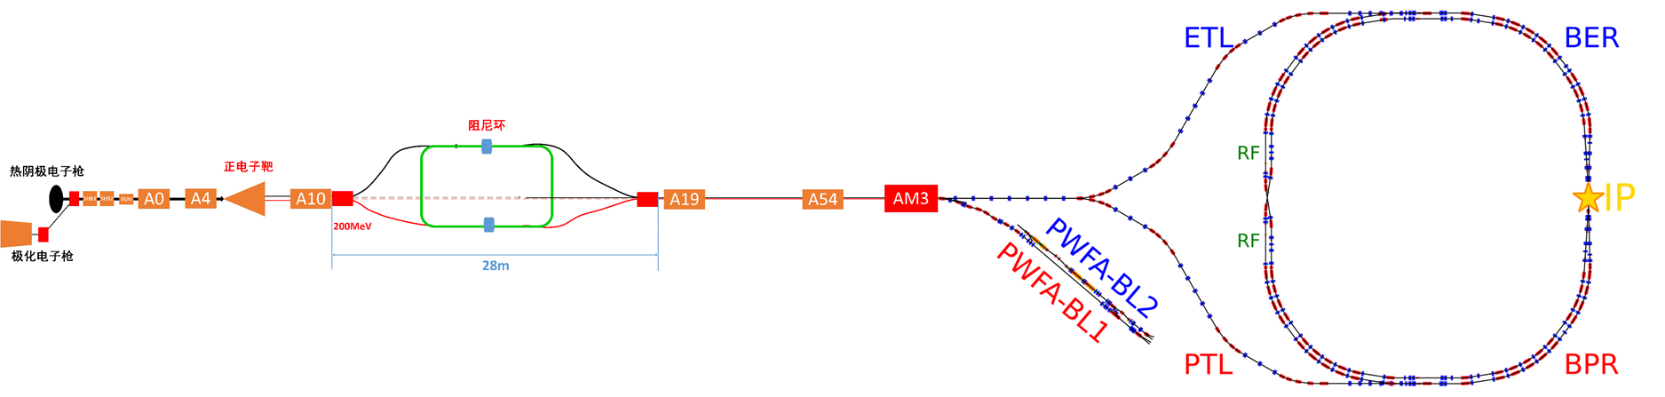
New：Testing the Crab Waist Scheme at BEPCII
BEPCII/U
1. IR: crab waist collision
2. Inner ring Injection region: insert SC wigglers
3. Linac: a new compact damping ring
BEPCII crab waist
PWFA TF

Slide 10
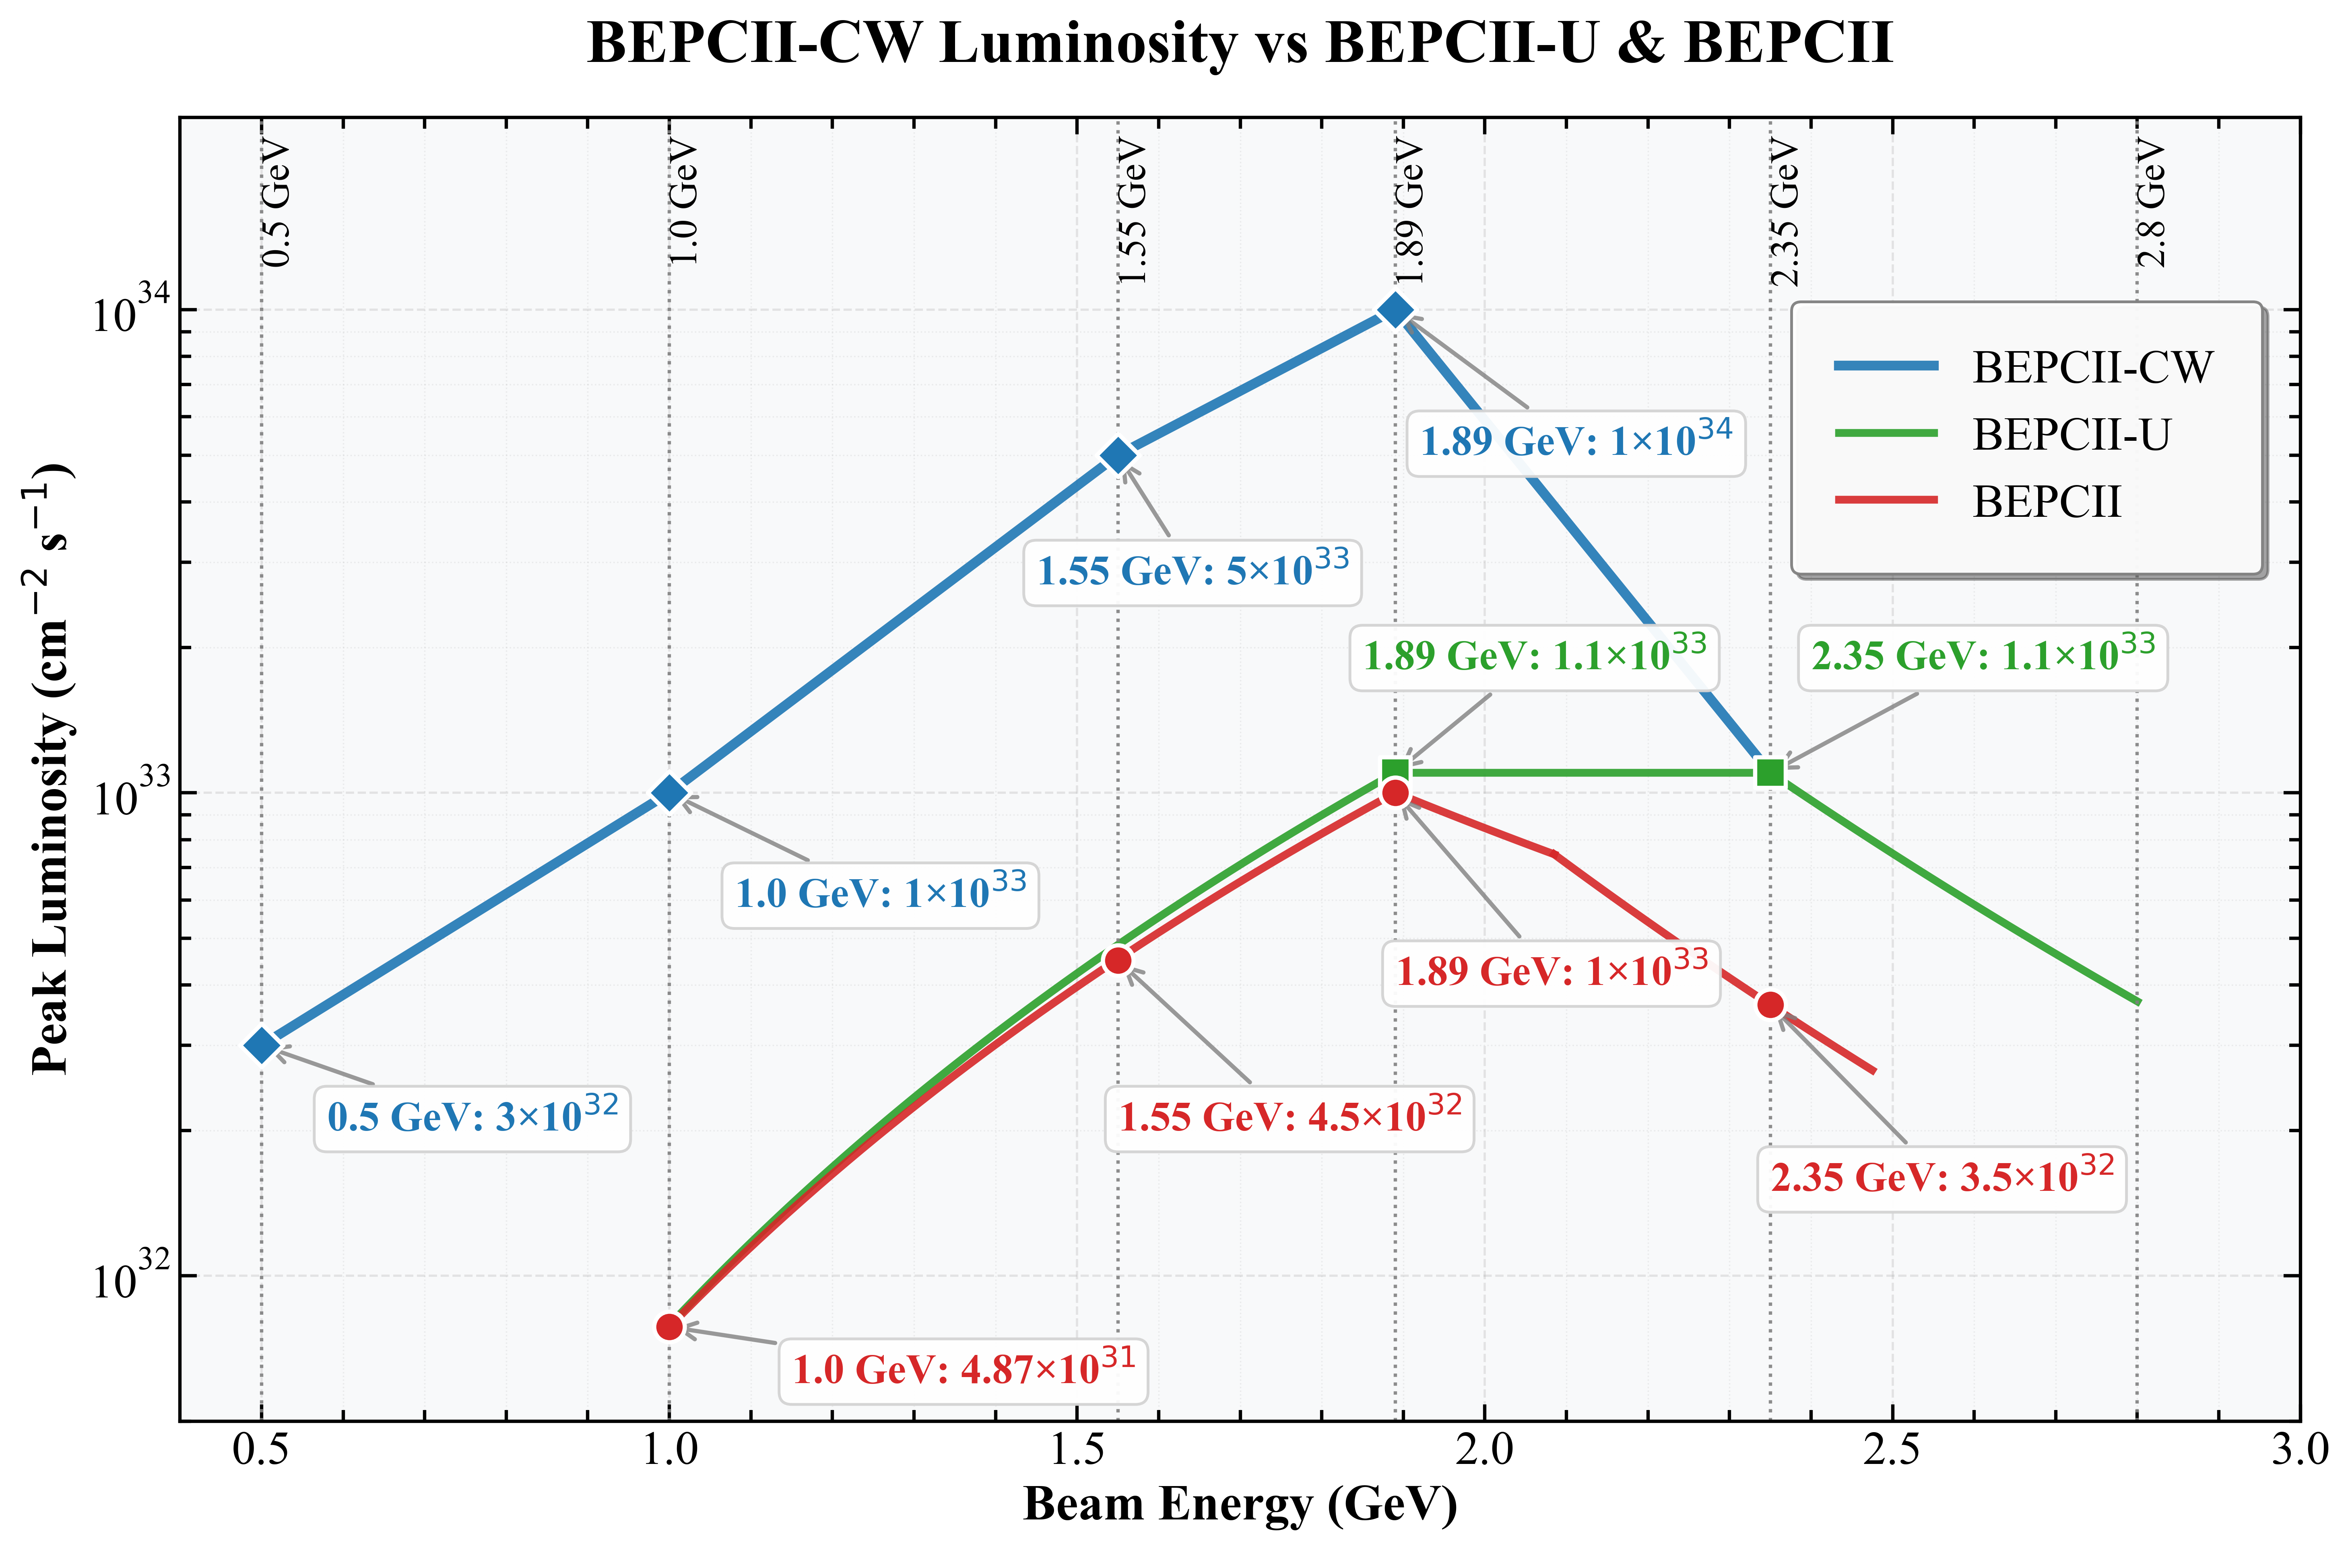
New BEPCII Luminosity
Main physics topics after upgrades:
XYZ and charmed baryons
Precise R-value scan in 0.5-2.0 GeV
More J/ψ events for glueballs
Charmonium physics at ψ’ and ψ(3770)
Luminosity can increase by ×10 below 1.89GeV.
Operation below 1GeV is enabled.

Slide 11
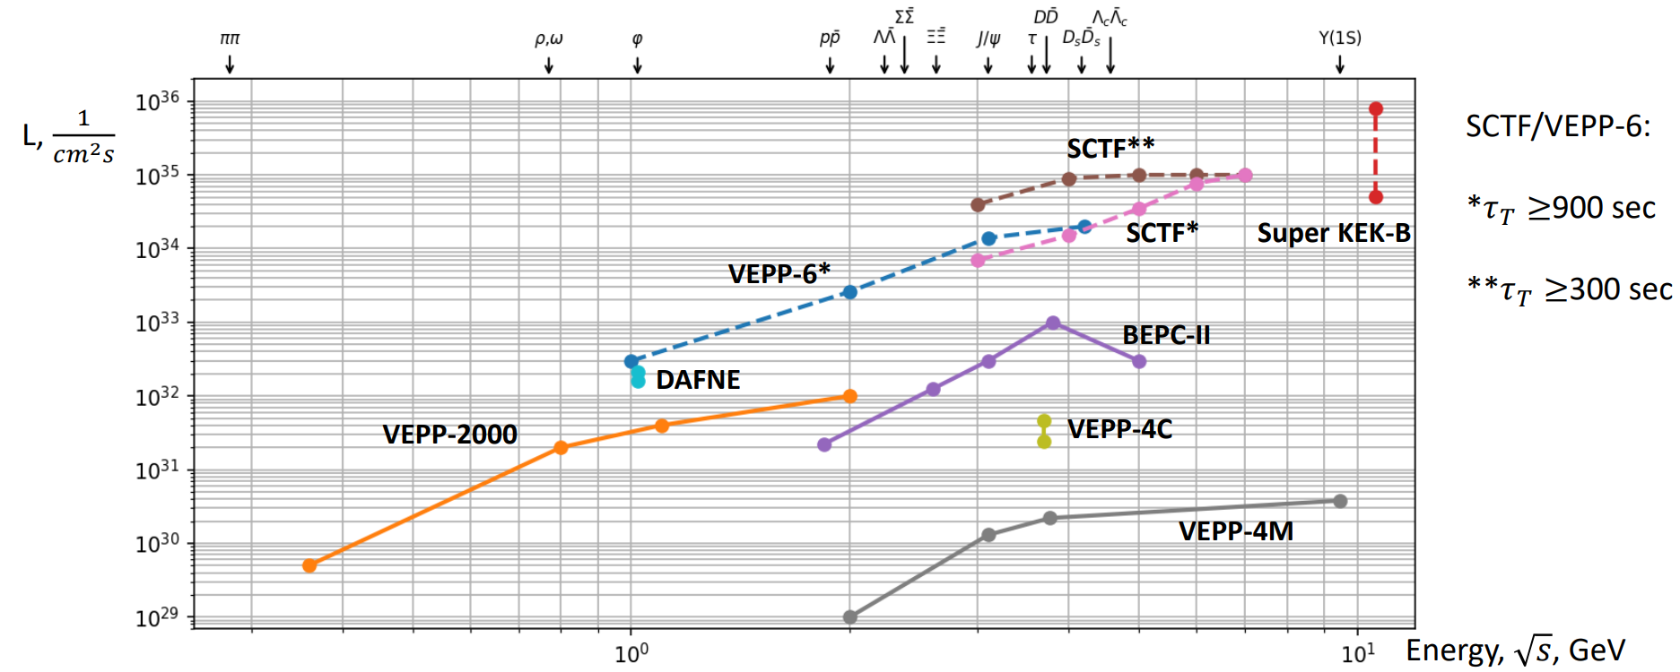
Landscape of Tau-Charm Factories
STCF
BEPCII-UP
Ref: Ivan Logashenko @FTCF2025（November 24, 2025）

Slide 12
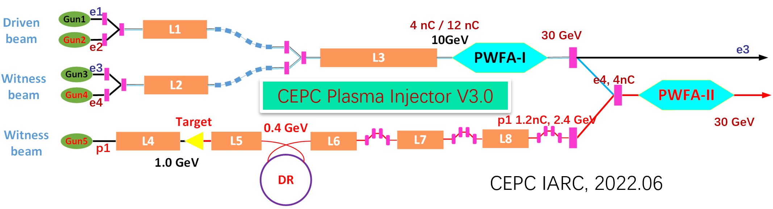
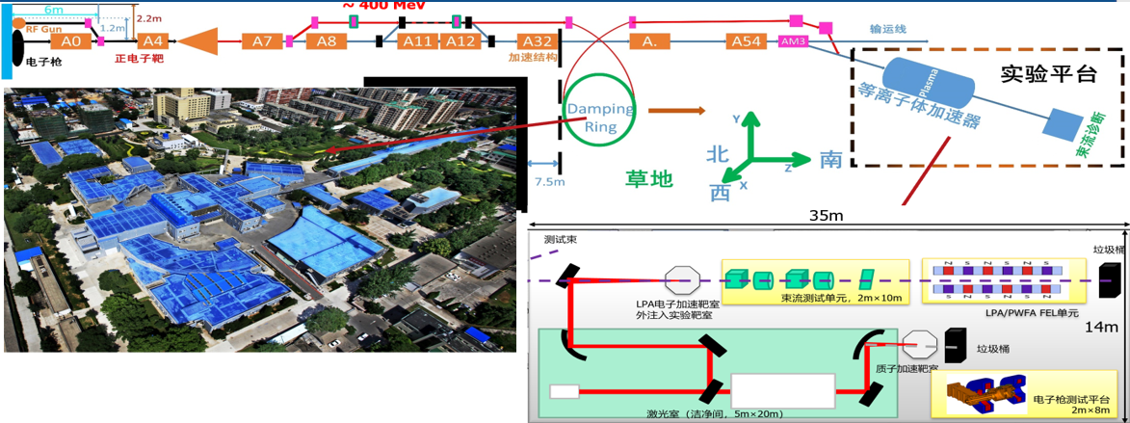
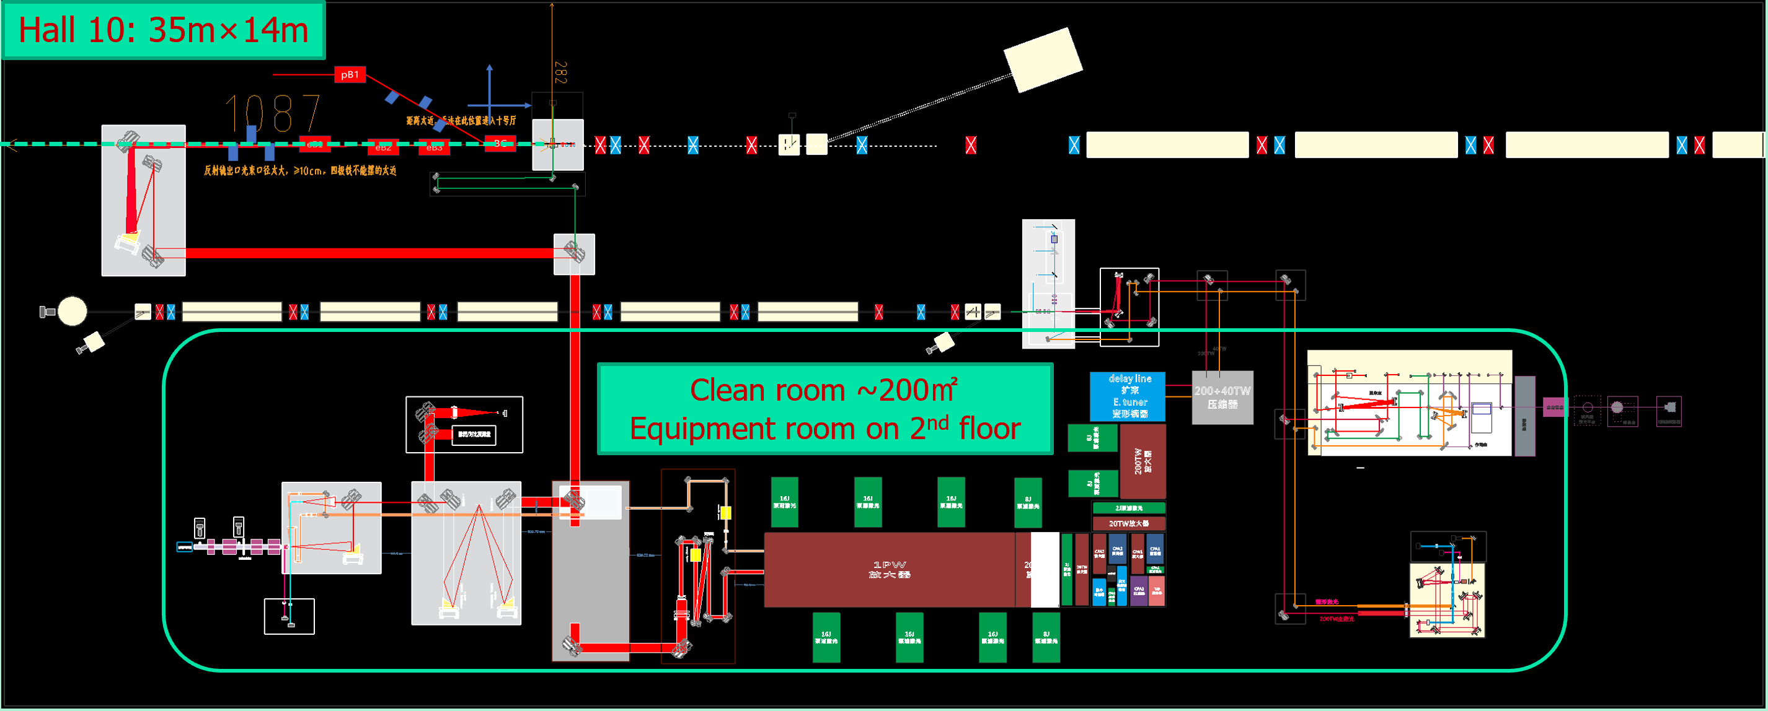
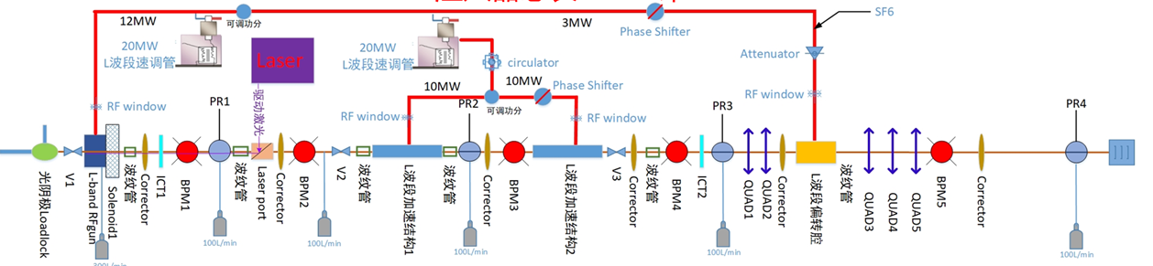
R&D for Future: Plasma accelerator as the CEPC Injector
  Conceptual design based on simulation
  For experimental proof and prototyping, a test facility based on the BEPCII LINAC is under construction:
    Cascading, positron acceleration,…
    Technology: electron gun, laser, …
~ 661 MeV
e+ target, ~240 MeV
PWFA lab
Diagnostics
2.5 GeV e-/e+ beamline + PW-level high performance laser system
12

Slide 13
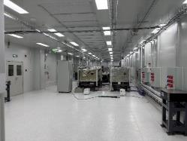
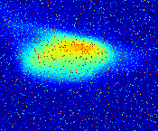
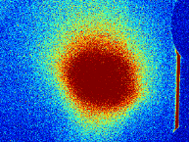
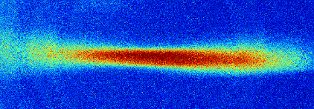
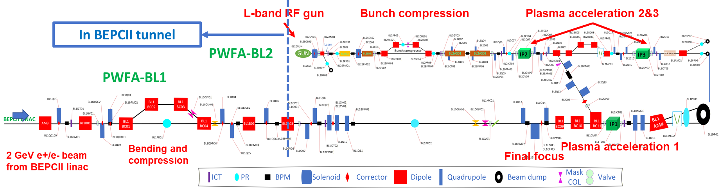
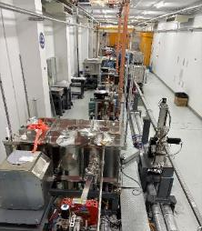
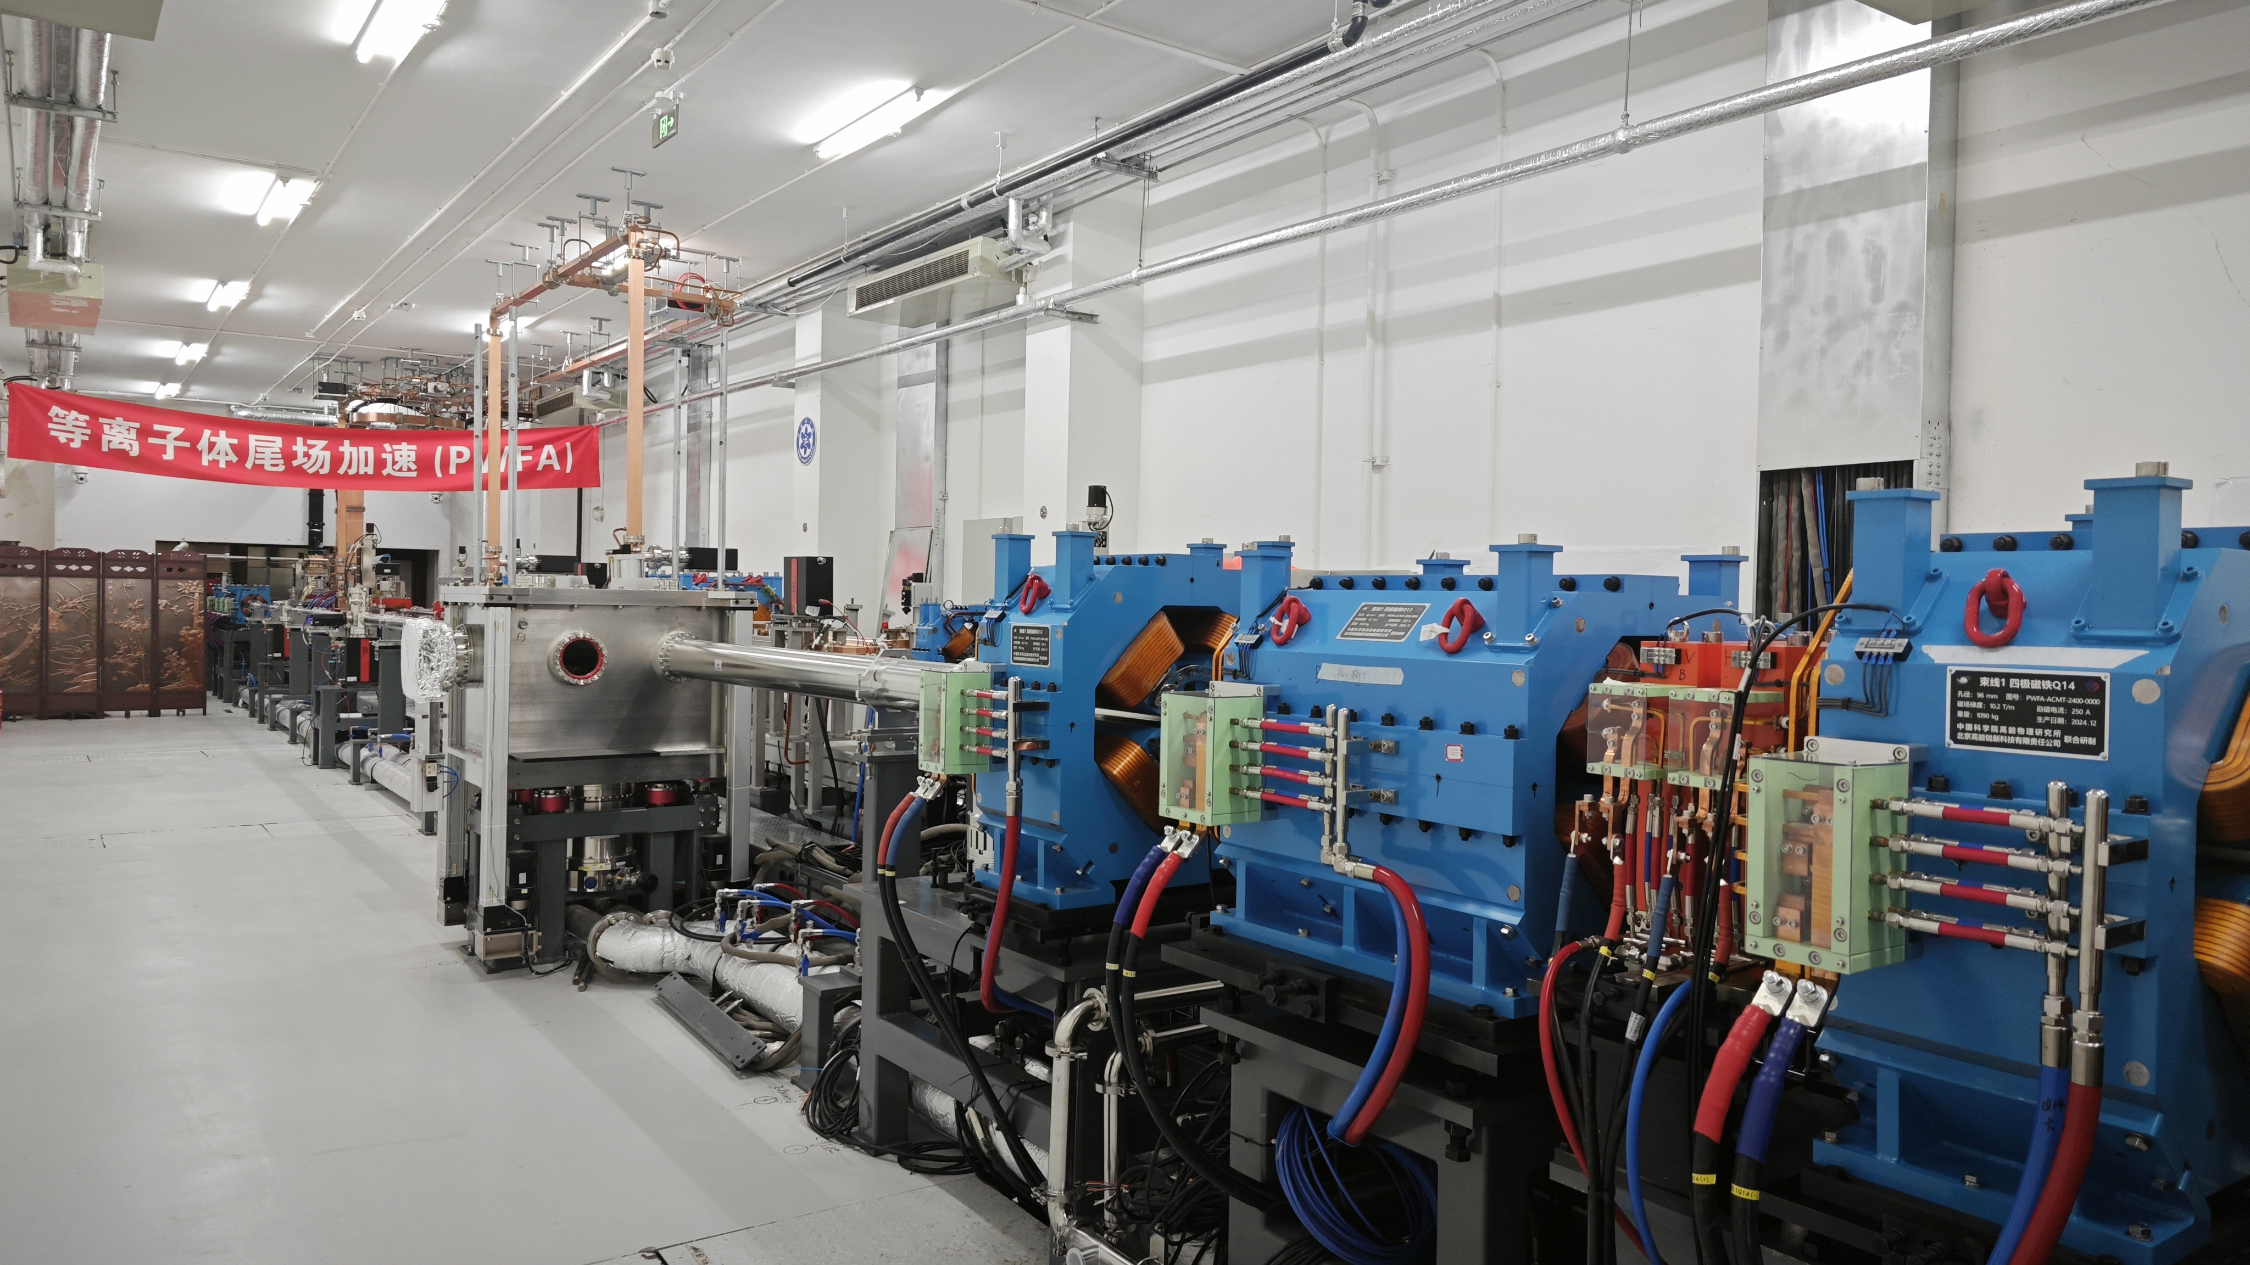
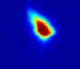
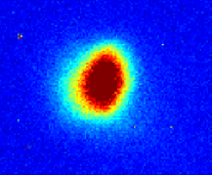
Progress: Beam Commissionning
~ 100 MeV, 2% @ PR08
e- Gun exit: 5.3 MeV
PW Laser clean room
5.6 nC
Beamline2
Beamline1
e- profile @ PR03
e+ profile @ PR03

Slide 14
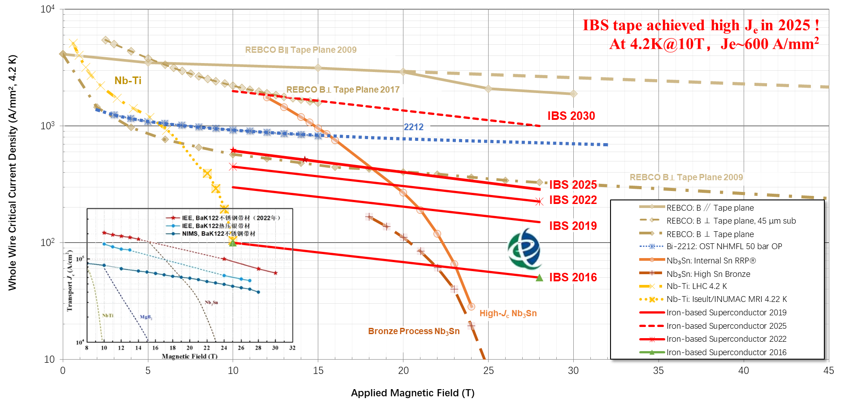
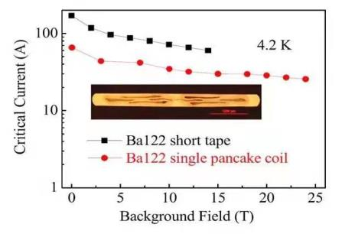
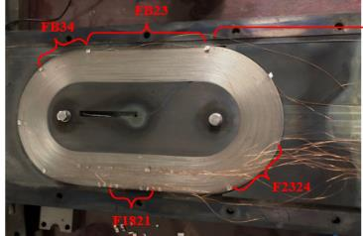
R&D for Further Future: Iron-Based HTS Magnet
IBS Data from IEECAS, others from https://nationalmaglab.org/magnet-development/applied-superconductivity-center/plots/
×8
Plan
Continue to improve Jc by × ~4
Mid-scale cable production
Test magnet
Advantages:
“Metal”, isotropic, …
Cheap: material(Ba_{0.6}K_{0.4}Fe₂As₂) and production(PIT, steel tube)
Status:
Cable length >1000m with good Jc
Small-scale cable production techniques understood
Test coil successful
1st Iron-based Superconducting solenoid Coil at 24T

Slide 15


Detector: From Ideas to the Reference Detector
New concept
 | CDR | RefDet-TDR
VTX | Inner radius of 16 mm | Inner radius of 11 mm
VTX | Material Budget: 0.15%*6+0.14%(beampipe)= 1.05% X0 | Material Budget: 0.06%*4(inner)+0.165%*2(outer)+0.2%(beampipe)= 0.77% X0
Gaseous Tracker | TPC with 1 mm* 6 mm readout, tracking 100 um, dE/dx ~ 6% | TPC with 0.5 mm* 0.5 mm readout tracking 100 um, dN/dx ~ 3%
ToF & Outer tracker | - | AC-LGAD, with 50 ps per MIP, 10 um
ECAL | Si-W-ECAL: 17%/√E ⊕ 1% | Crystal Bar-ECAL: 1.3%/√E ⊕ 0.7%
HCAL | RPC-Iron: 60%/√E ⊕ 2% | Glass-Steel: 30%/√E ⊕ 6.5%
ILD-like

Slide 16


AGORA: Advanced Glass Optimized Research Apparatus
Muon detector
Yoke
HCAL
ECAL
Solenoid (3 Tesla)
Timing (OTK)
TPC
Vertex detector (VTX)
LumiCal
Silicon inner tracker (ITK)
The name AGORA emphasizes the glass calorimeter at the heart of the detector.
The acronym AGORA derives from ancient Greek, referring to a central public square in city-states as the heart of the city's political, commercial, and social life.
It now means "gathering place" or "assembly", symbolize here the international collaboration that we expect to flourish.
16

Slide 17
CDR ➔ Ref-detector TDR ➔ AGORA
New concept
Newer concept
 | CDR | RefDet-TDR | AGORA
VTX | Inner radius of 16 mm | Inner radius of 11 mm
VTX | Material: 0.15%*6+ 0.14%(beampipe)=1.05% X0 | Material: 0.06%*4(inner)+ 0.165%*2(outer)+0.2%(beampipe)=0.77% X0
ITK | Monolithic HV-CMOS pixel, 10 um
Gaseous Tracker | TPC with 1 mm* 6 mm readout, tracking 100 um, dE/dx ~ 6% | TPC with 0.5 mm* 0.5 mm readout, tracking 100 um, dN/dx ~ 3%
ToF & OTK | - | AC-LGAD, 50 ps per MIP, 10 um
Cerenkov | - | - | Aerogel + SiPM
ECAL | Si-W-ECAL: 17%/√E ⊕ 1% | BGO Crystal: 1.3%/√E ⊕ 0.7% | Glass cubic: 3%/√E ⊕ 1%
HCAL | RPC-Iron: 60%/√E ⊕ 2% | Glass-Steel: 30%/√E ⊕ 6.5% | Glass cubic: <15%/√E ⊕ 4%
ILD-like

Slide 18






The Tracker and the Cherenkov Detector (RICH)
RICH coverage in
R–Z plane: 8.8°–20.3°
Very preliminary

Slide 19




Hadron Calorimeter
High density glass scintillator for HCAL: much higher sampling ratio(~30%) but difficult to make it big
Use small glass cubic: 3D shower reconstruction, good for PFA
Glass R&D for high density and high light yield:
  Novel Gadolinium Fluoro-Oxide glass
  Density: ~6g/cm³
  Light yield: ~1500 ph/MeV
  Decay time: 600 ns
  Cost: < 1$/cc
  Glass Size: 40*40*10 mm³
Simulation
Light yield of Glass scintillators

Slide 20


Next Step Beyond TDR: Full Absorption EM+H Calorimeter ?
Because of the success of GFO glass, we may use it for EM calorimeter
  Light Yield > 2000 ph/MeV
  Density ~6 g/cm³
  Decay time < 500 ns
  Attenuation length > 10-20 cm
Money saved allow us to build a full absorption HCAL
ECAL
HCAL
Incident particle
Goal: ECAL σ/E ~3%/√E, HCAL σ/E <15%/√E, and a lot more Info. for AI

Slide 21



Performance from Simulation
Back steel cover
PCB
Glass
ESR + air
Front steel cover
ECAL
HCAL
one 3×3 mm² SiPM in a dome shaped air housing for improving uniformity
Similar scheme will be tried for HCAL
(3.1/√E ⊕ 0.7) %
(10.9/√E ⊕ 4.0) %

Slide 22
Future Plan for the Glass Calorimeter
Optimize structure design: mechanics, modules, cells, SiPM, electronics, cables, cooling, etc.
Optimize Glass cells: size, shape, wrapping, glueing, …
Glass R&D: attenuation length, uniformity, light yield, decay time, production yield, cost
Performance study: readout electronics, PSD for E/H correction, calibration, …
Prototyping: EM 2027, HCAL 2028

Slide 23
Summary
Despite difficulties, we will continue to pursue High Energy Physics: road map is clear for us
Accelerator design, R&D and EDR in progress, in exchange with FCC
As an innovative concept, AGORA has been listed as a concept for FCC_ee: Glass scintillator is a very promising material, although a lot more R&D are needed
Looking forward to (more) collaborations !

Slide 24
AGORA - FCC-ee/CEPC Detector Concept
Website: https://agora.web.cern.ch
Email list: fcc-ped-detectorconcepts-agora@cern.ch
  Subscribe at: https://groups-portal.web.cern.ch/group/fcc-ped-detectorconcepts-agora/details
The AGORA seed: CEPC Reference Detector TDR:
  https://arxiv.org/abs/2510.05260
AGORA Weekly Plenary Meeting:
  Wednesday at 9 am, CERN time
  https://indico.cern.ch/category/21753/
CEPC Yearly Workshops:
  International Workshop, Shanghai, 22-26 October 2026: https://indico.ihep.ac.cn/event/28911/
  European Edition Workshop, Belgrade, Serbia, June 8-11, 2027
    (Last year's workshop, Lisbon, Portugal, April 2026: https://indico.cern.ch/event/1598929/)
Contact:
  Team leader: João Guimarães da Costa (guimaraes@ihep.ac.cn)
  Deputies: Jianchun Wang (jwang@ihep.ac.cn) , Miao He(hem@ihep.ac.cn) , and Haijun Yang (haijun.yang@sjtu.edu.cn)

