Slide 1

Prospects for Higgs boson physics at future circular colliders
Daniela Bortoletto
University of Oxford
Notes:
We have just heard three complementary perspectives on the future of Higgs physics at circular colliders: the theory roadmap, the experimental roadmap towards FCC, and the status and future plans of CEPC.
I don't want to repeat the talks. Instead, I want to briefly highlight what I think are the main messages.

Slide 2
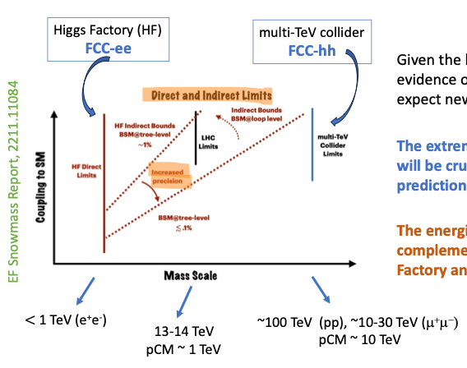
Future directions: precision and energy
The Higgs remains our central goal because is tied to many open questions
  EWSB, flavor, CP violation, hidden sector, and the stability of the universe
Given the level of consistency of the SM we expect new physics effects to be small
The extreme precision at e⁺e- collider is crucial to identify small deviations from SM predictions and point to the scale of new physics.
The energies available at a multi-TeV collider are complementary and they allow to probe directly multi-TeV new physics.
Notes:
Let me start with the big picture from Laura's talk.
The Higgs is still the central object because it connects to many of the open questions in particle physics. But the strategy for the future is not simply ‘build a Higgs factory’.
The point is really the combination of very high precision and, eventually, higher energy.
The e+e− programme looks for very small deviations from the Standard Model, while a high-energy machine gives us direct access to higher mass scales.
So the conceptual roadmap is precision first, and energy as the complementary next step

Slide 3
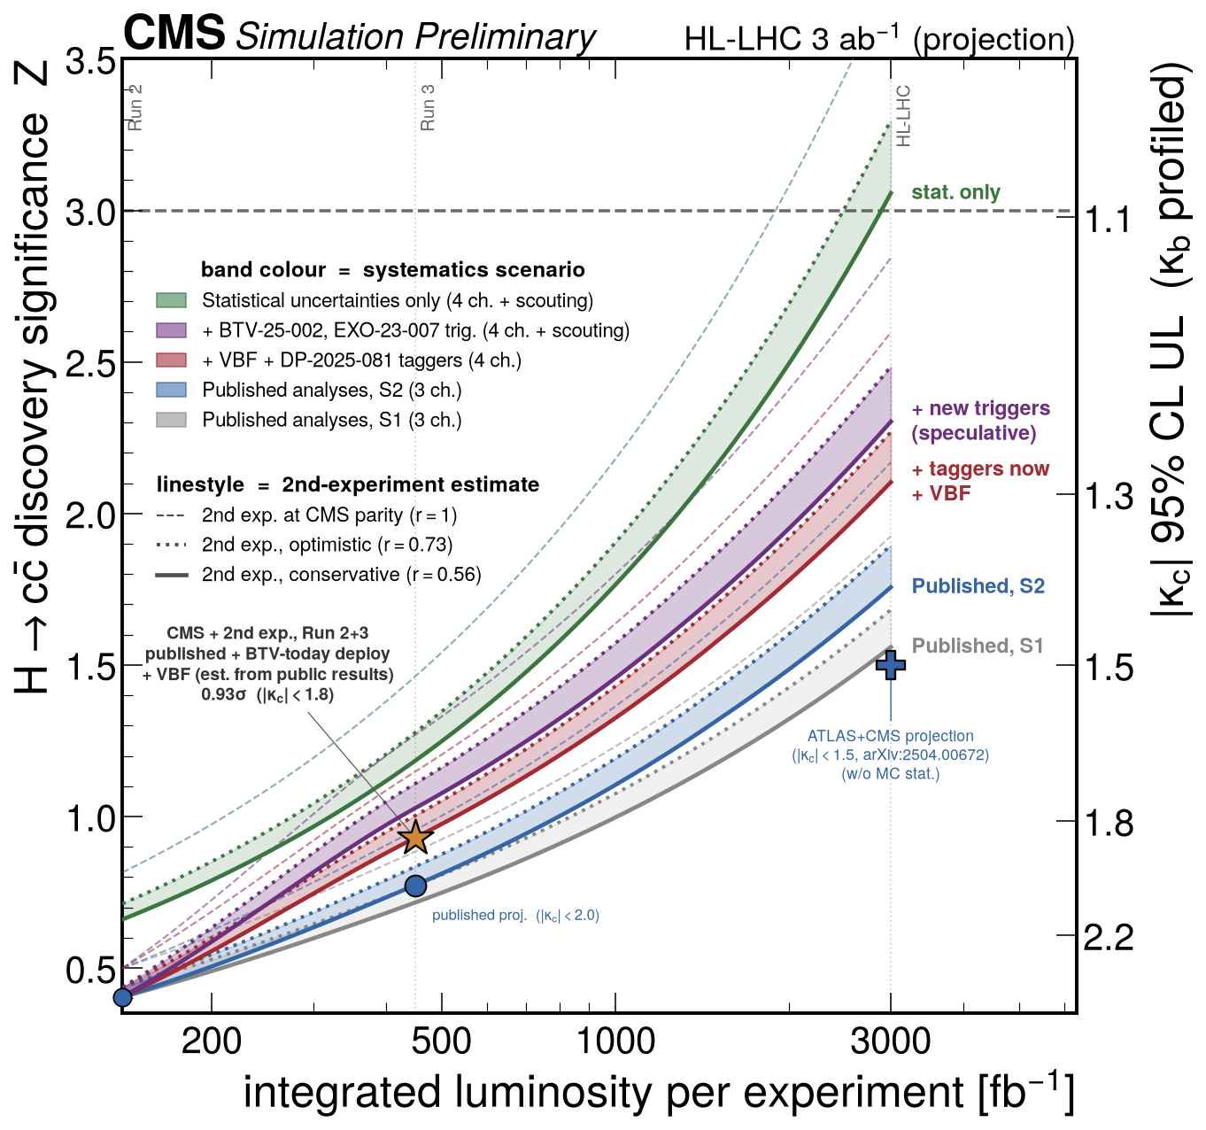
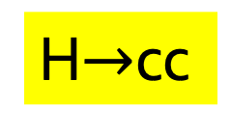
The HL-LHC Higgs programme
Run 1 (25/fb) : Higgs discovery
Improvements in tools will bring results beyond expectation
Run 2 (139/fb) : Higgs couplings
H$→$cc
Run 3 (332/fb) : Higgs precision program
Run4 and beyond (3000/fb) will bring a 6-fold increase in statistics
Notes:
And the starting point for this programme is, of course, the HL-LHC.
We have gone from discovery, to coupling measurements, and now into a precision programme.

Slide 4
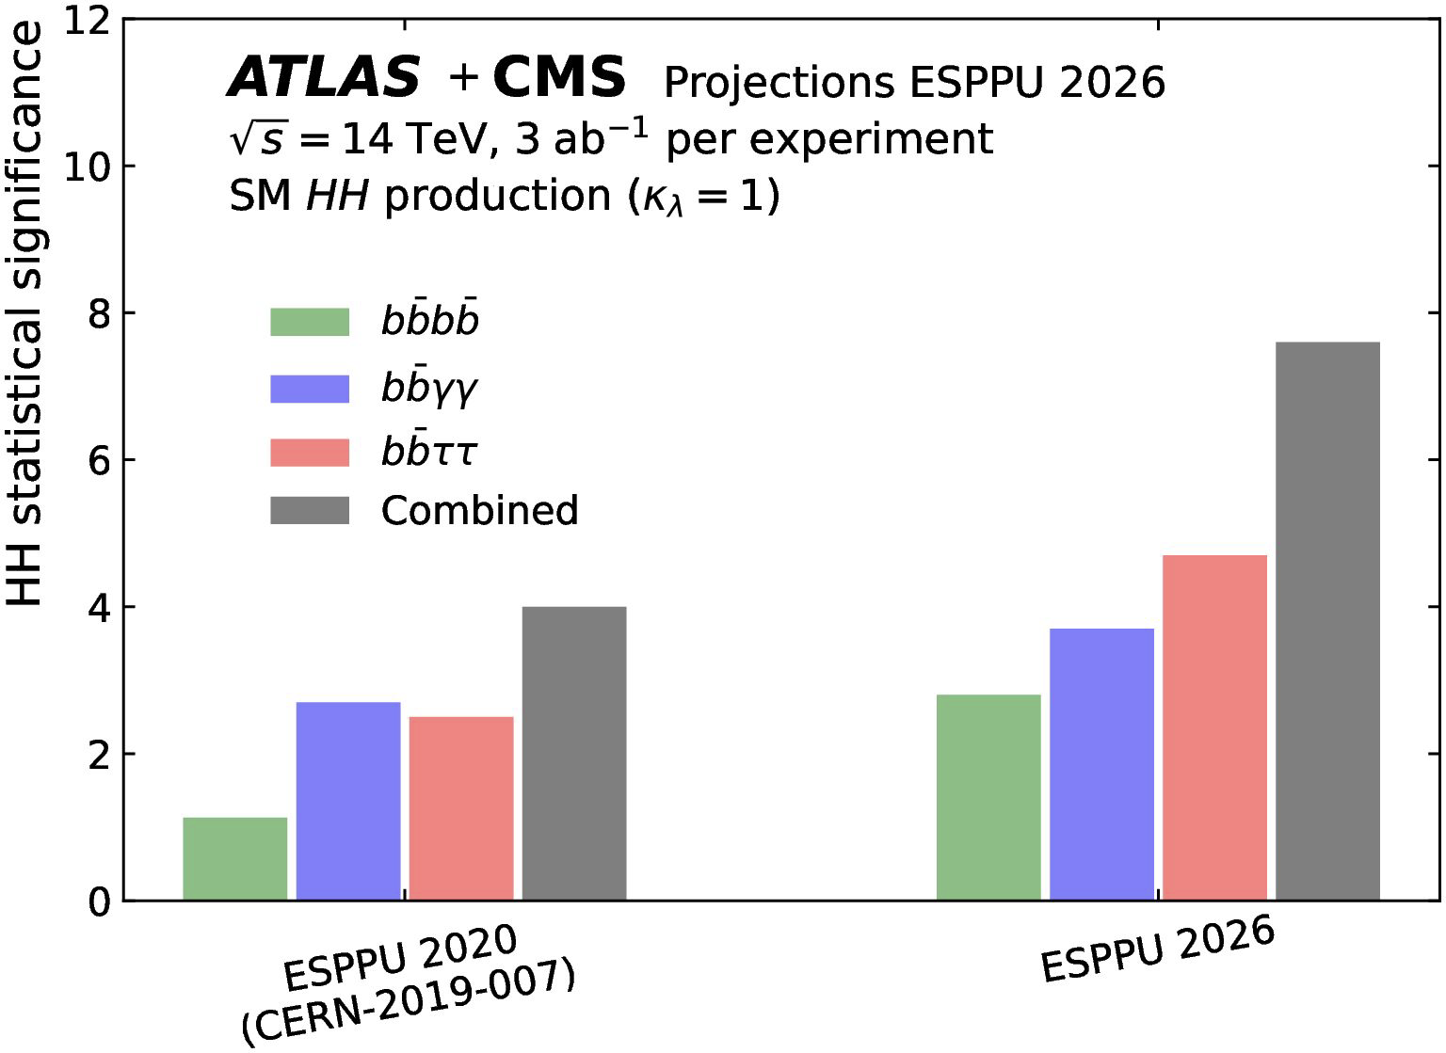
The legacy of the LHC + HL-LHC
HL-LHC projections for the ESPPU based on Run 2 data:
  1.6-3.6 % on main couplings
  3-7% on 𝑯 → 𝝁⁺𝝁⁻ and 𝑯 → 𝒁𝜸
  < 30% on Higgs (trilinear) self-coupling
Analyses and tools improving fast
Theory could become main limitation
Measurements of HH production/Higgs self coupling will remain unbeaten until FCC-hh
Notes:
The HL-LHC will be extremely powerful,
The expectation based on the full Rum2 analysis show that the HL-LHV will reach 1-3% preciosn on the main Higgs coupls, a about a 5% precision on rare higgs decays modes like H->mu+mu- and Z-gamma
And the Higgsselvf coupling will be measure to better than 30%.
This presediction are conservative since the tools and anlysis techniques are imporving fast.
But to arrive to fufill these expectation requires theoretical improvements. A theme that will reappear later on
We alos know that some areas will remain uniquely y accessible there for quite some time — in particular Higgs pair production and some rare processes.

Slide 5
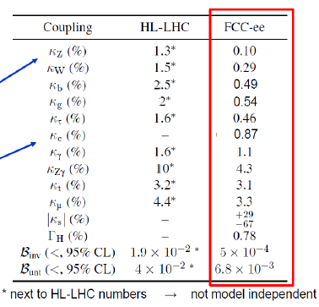
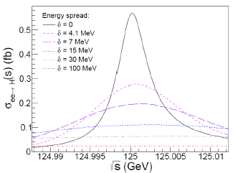
FCC-ee: a Higgs factory
Higgs Couplings
Unique possibility: direct access to the electron Yukawa through s-channel Higgs production?
Incredible precision
Model independent results
Notes:
So what is qualitatively new at FCC-ee?
First, of course, the very precise and largely model-independent Higgs programme.
And there is also this rather unusual possibility of direct access to the electron Yukawa through s-channel Higgs production.
I would stress that this is a possibility, not part of the baseline programme. It requires a very demanding monochromatisation scheme and excellent control of the beam energy.
But for me it is a nice example of the type of physics that becomes conceivable when machine performance and precision are pushed very far.

Slide 6
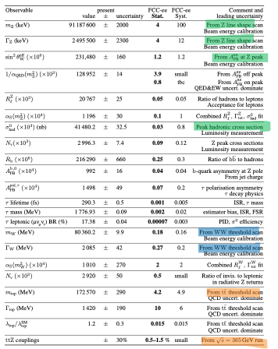
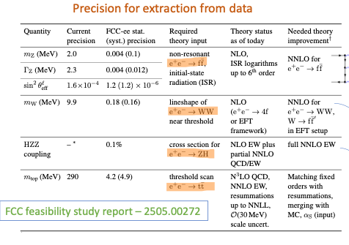
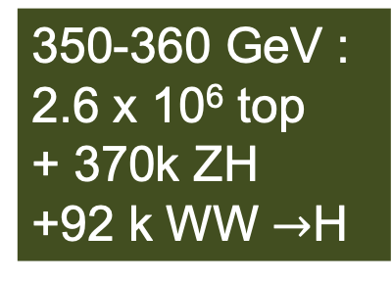
FCCee: More than a Higgs Factory
Z pole:
6 x 10¹² Z
Exploiting these huge samples requires understanding detector systematics, beam properties, backgrounds — and theory — at a completely new level.
WW Threshold:
2.4 x 10⁸ WW
ZH @ 240 :
2.2 x 10⁶ H
350-360 GeV :
2.6 x 10⁶ top
+ 370k ZH
+92 k WW $→$H
Operation at the Z pole poses the most demanding experimental challenges
Notes:
FCC-ee is much more than a Higgs factory.
We are talking about trillions of Z decays, hundreds of millions of WW events, millions of Higgs events, and a very substantial top programme.
So the Higgs measurements do not sit on their own. The electroweak, flavour and top programmes provide inputs that are essential for the interpretation of the Higgs measurements.
And there is a second message here: with these enormous samples, statistics stop being the only issue.
We have to understand detector systematics, beam properties, backgrounds — and theory — at a completely new level.
That is why I think the interesting question is not only whether FCC-ee can produce the events, but whether we are prepared to extract all the information from them.

Slide 7
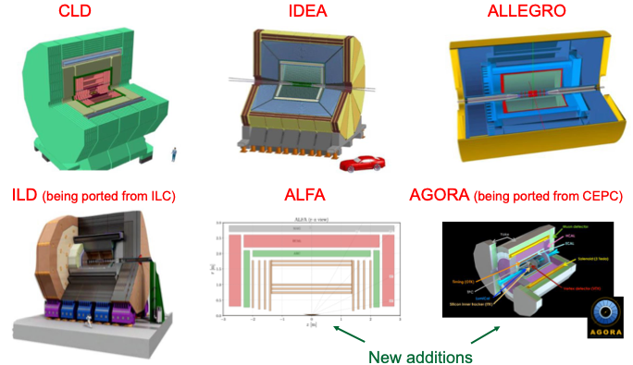
Detectors Concepts
Notes:
And this leads to the detector question.
We are still in a phase where there is a remarkable diversity of concepts.
That is healthy because there are still real technological choices: tracking, calorimetry, particle identification, timing, material budget, and the machine–detector interface.
But we are also approaching a point where these concepts have to become sufficiently mature that we can move rapidly towards real experiments.

Slide 8
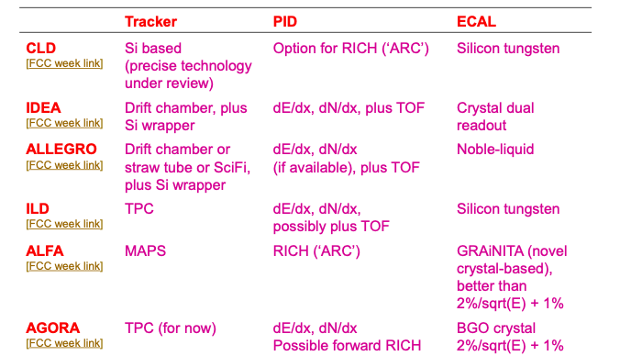
Detector Concepts
Notes:
So the question is not really which detector is the winner today.
The question is: are the current R&D programmes taking us far enough, fast enough, to make a TDR possible once there is approval?
And what needs to be demonstrated before that point — versus what can reasonably wait until after approval?

Slide 9
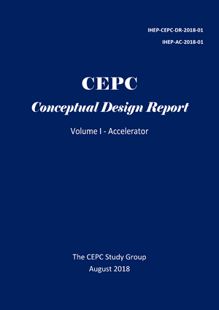
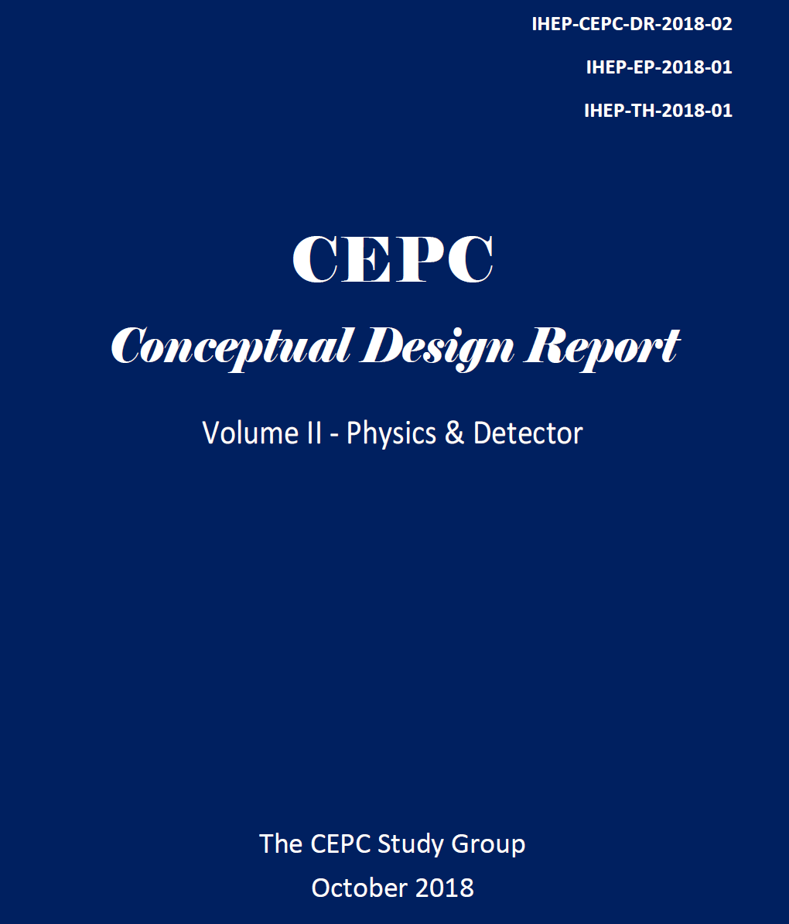
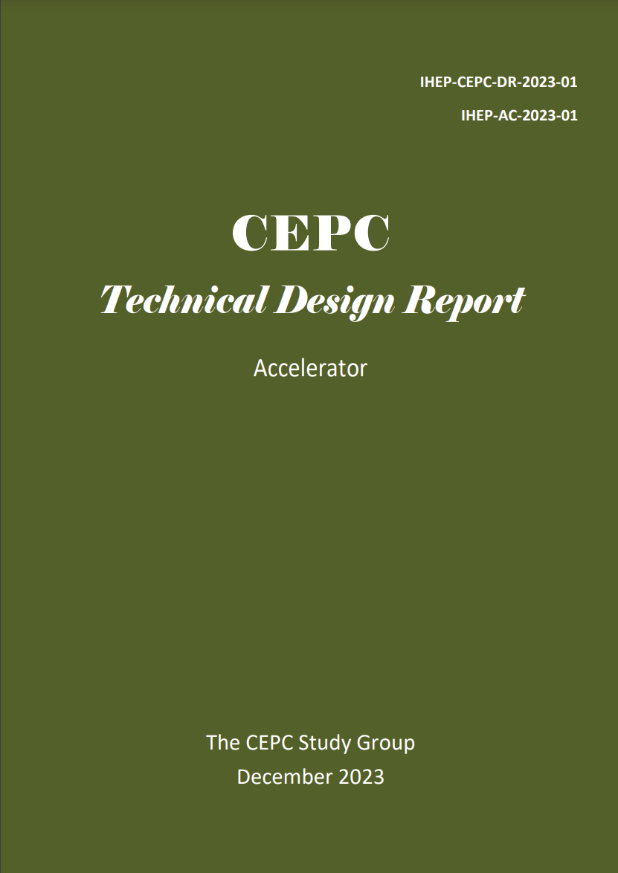
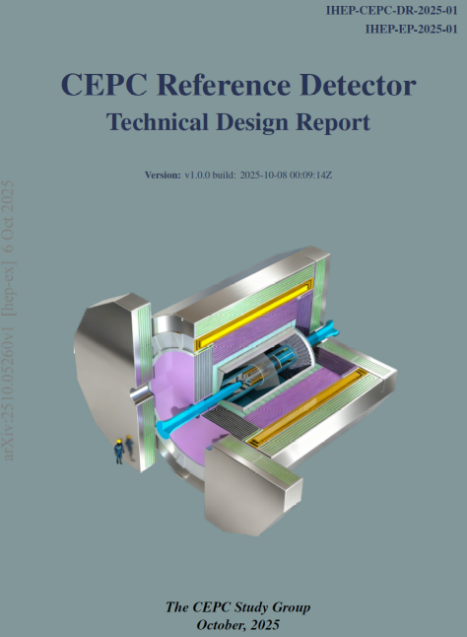
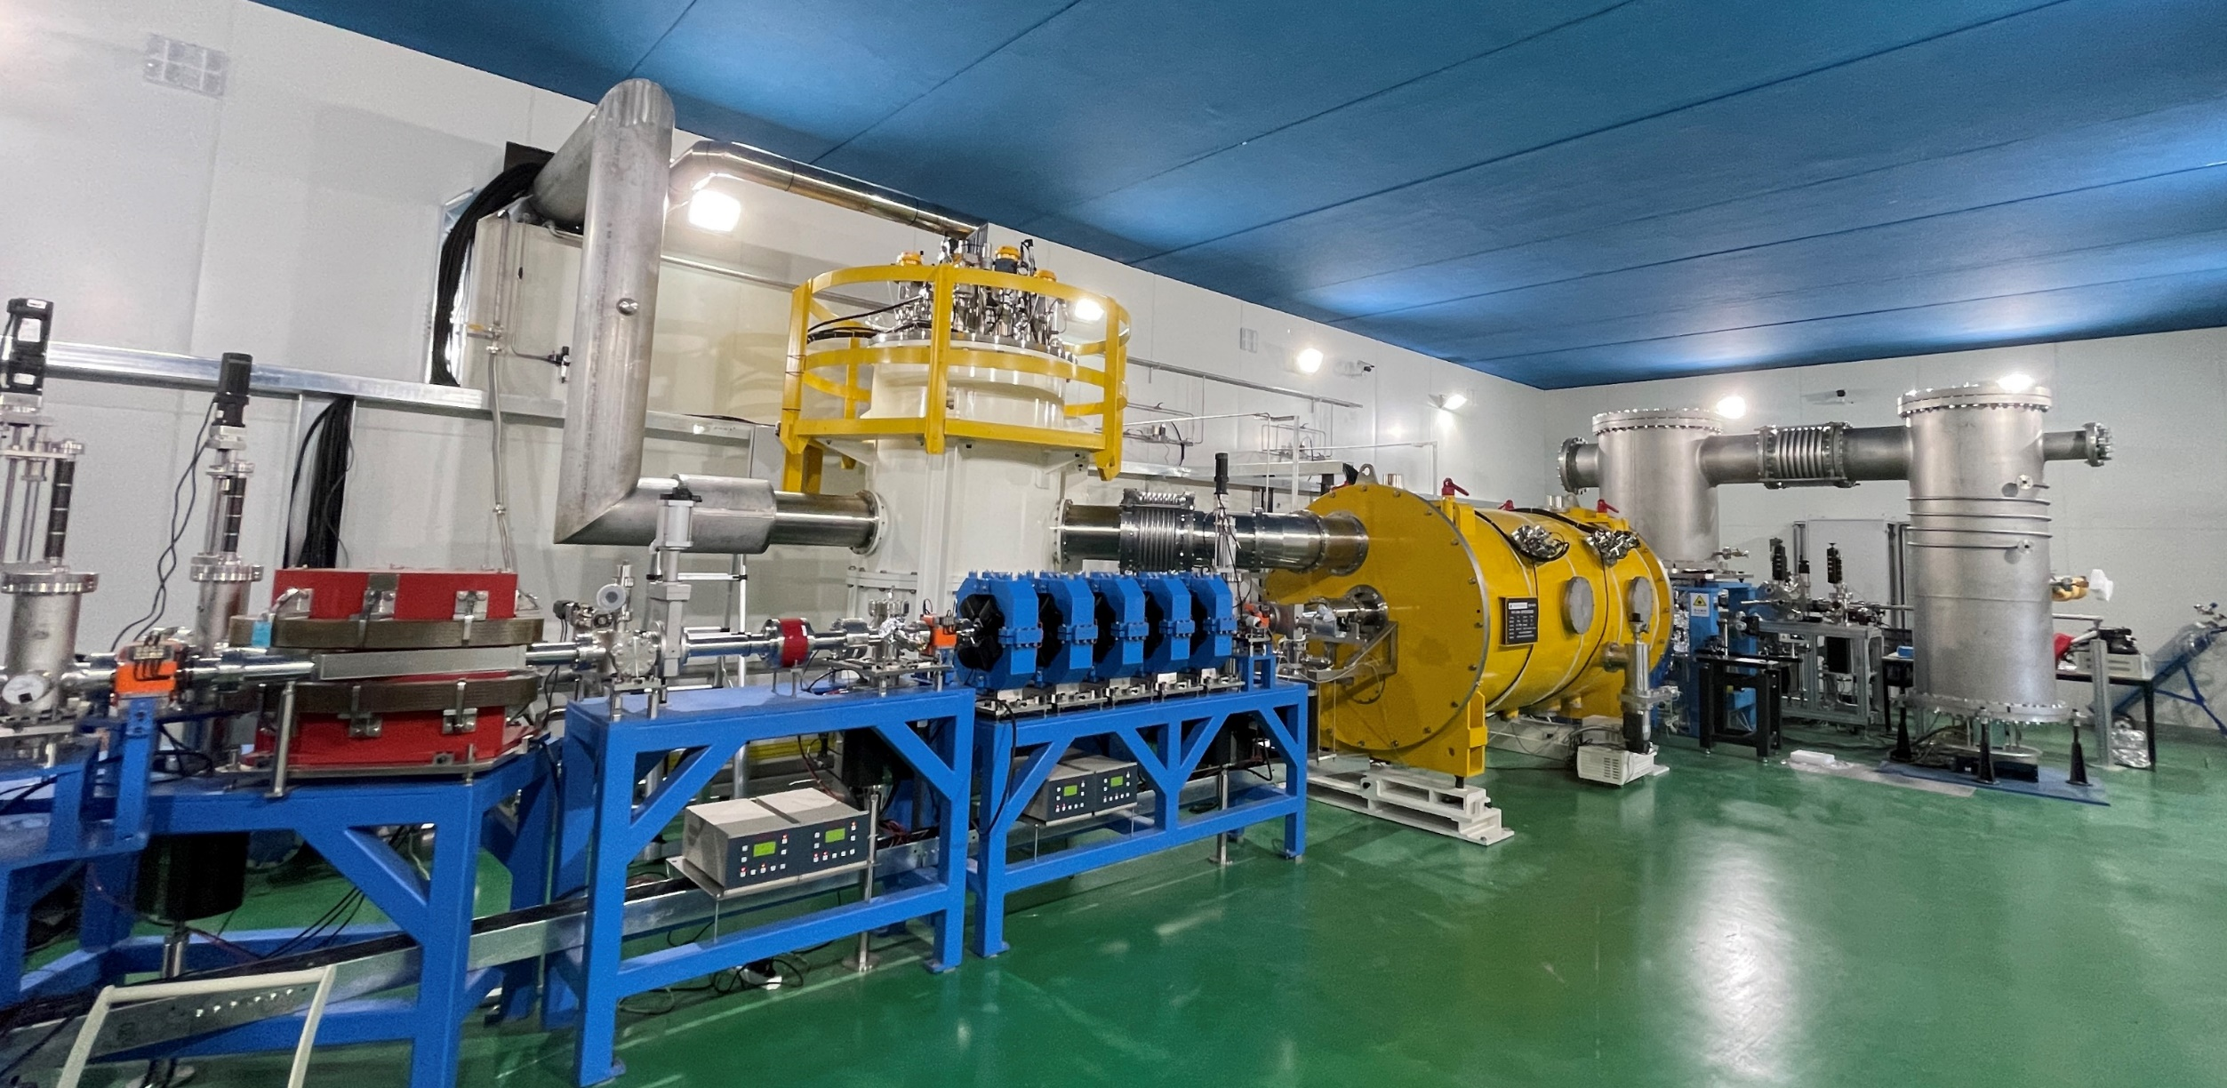
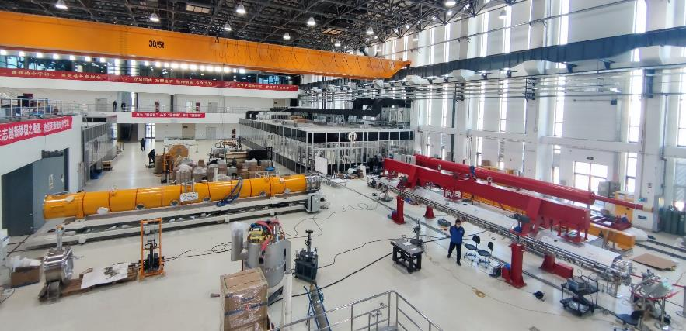
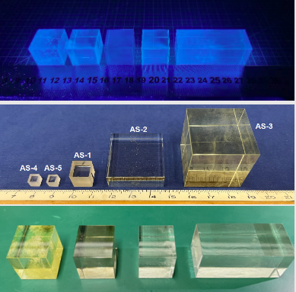
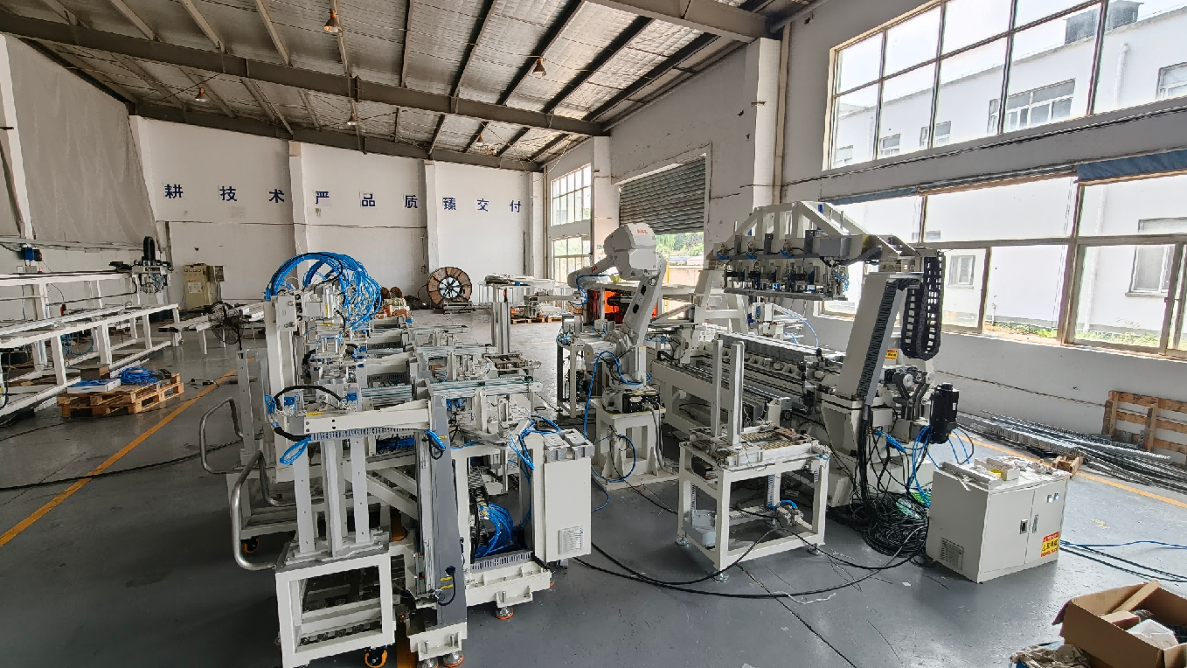
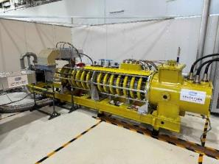
Impressive R&D for CEPC
2018
2023
2025
RF cavities
Modules
2018
2023
2025
9
Automatic production of magnets
More efficient Klystrons (87%)
Notes:
Yifang also showed that there is a substantial amount of R&D continuing in CEPC — in cavities, modules, klystrons, magnets, and detector technologies.
So even though the current planning situation for CEPC is different from the FCC timeline, the R&D programme continues.
And for me, the interesting point is what this means for the wider community:
which of these developments are specific to CEPC, and which are resources for a global future circular-collider programme?

Slide 10
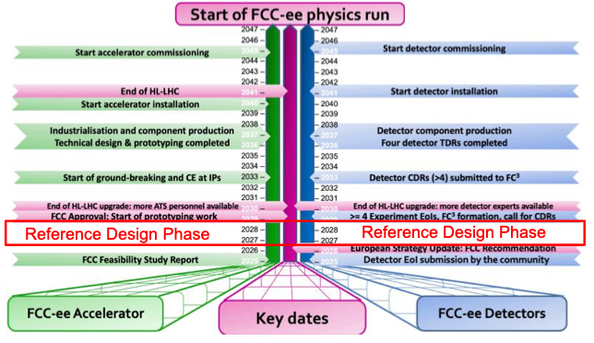
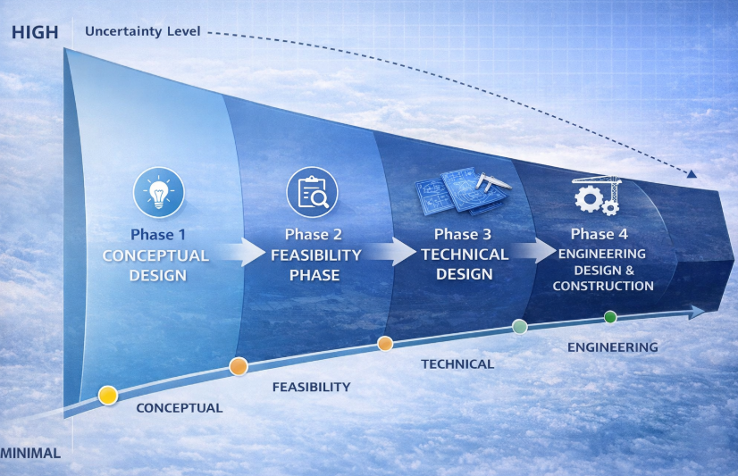
Reaching the goal
CEPC was not included in China’s 15th Five-Year Plan (2026–2030)
Accelerator and detector R&D continues, including applications/upgrades for BEPCII
Looking toward a major partnership with FCC and identifying common interests and technologies
If FCC construction is not officially approved before 2030, the CEPC proposal would be resubmitted to the Chinese government
The ESPPU has concluded.
Key points regarding FCC:
Overwhelmingly strong endorsement of the physics and strategic case for FCC-ee as the next flagship collider at CERN
A descoped/staged FCC-ee is preferred to other options as the alternative
Council has approved the strategy and given CERN a mandate to prepare FCC-ee for a 2028 decision
Notes:
So where does this leave us?
On the CEPC side, the current situation is that CEPC is not in the Chinese 2026–2030 five-year plan, but the accelerator and detector R&D continues, with an explicit interest in common technologies and collaboration with FCC.
On the FCC side, we are now in the period leading to a possible 2028 project decision.
So I think this gives us a very useful way of framing the discussion:
what does ‘being ready’ actually mean?
If there is a go-ahead in 2028, are we ready to move from concepts and R&D into experiments?”
Then click.
Time: ~50 sec
Slide 11 — Are we ready for 2028?
This is where I would slow down and engage the room.
Your current four categories are:
Detector readiness
Physics + theory readiness
Machine / running strategy readiness / possible descoping
Community / collaboration readiness
I think they are exactly the right four.
But don't read them as bullets. Say:
“I would like to structure the discussion around four questions.”
1. Detector readiness
“First, detectors.
We have the DRDs, we have several detector concepts, and a lot of impressive R&D.
But are we on a credible path from today's DRD activities to a TDR-ready detector?
What are the critical demonstrations that really need to happen before 2028?
And, importantly, are we developing the right things now so that we can move quickly after approval?”
Then ask Guy first.
A very good follow-up is:
“What is the single biggest detector-readiness gap today?”
2. Physics + theory readiness
Then turn to Laura:
“Second, physics and theory.
We are talking about extremely ambitious precision. Laura has shown that the challenge is not only calculating the Higgs cross section, but controlling electroweak corrections, QCD, ISR, generators, parametric uncertainties and the global EFT interpretation.
So how confident are we that theory will be ready when the data arrive?
And where should the community put the effort now?”
A sharper follow-up:
“Which theory uncertainty should we be most worried about today?”
That is much more likely to generate a concrete answer than “what are the theory challenges?”
3. Machine / running strategy / descoping
Then:
“Third, the machine and the physics programme.
We have a baseline running programme, but Guy has also emphasised that there is still flexibility.
So what really has to be decided by 2028, and what should deliberately remain open?
In particular, how do we protect future physics opportunities while the machine design is being optimised or potentially staged?”
Then the nice provocative question:
“If you were given one additional year of running, where would you put it?”
You can offer:
“Z? WW threshold? 240? 365? 125? another threshold?”
Guy explicitly presents these as areas where optimisation is still possible.
4. Community / collaboration readiness
Finally:
“And fourth, the community.
Suppose there is a go-ahead in 2028. Are we ready to form collaborations and move into TDR preparation rapidly?
How do the DRDs evolve into experiments?
Where should FCC and CEPC groups collaborate now, before formal collaborations exist?
And where is it actually useful to keep alternative approaches alive?”
Then bring in Yifang:
“From the CEPC perspective, what would a successful collaboration with the FCC community look like?”
His talk explicitly raises common technologies and new forms of collaboration.
And then I would have one final question
After you've let the four topics run for 40–50 minutes, don't end with “any final comments?”
Put up a very simple final slide:
What must happen before 2028?
And ask each speaker:
“What is the one thing that you think absolutely has to be achieved before a 2028 decision?”
Laura first.
Guy second.
Yifang third.
Then perhaps open that question to the room.
That gives your discussion a very clear endpoint.
One important thing about your role
You don't need to answer these questions yourself.
Your slides already establish the facts. Your job on slide 11 is to say:
“Here are the four things I think we need to resolve.”
Then make sure the speakers respond to each other rather than giving three independent mini-talks.
For example:
You: “Guy, what is the biggest detector gap?”
Guy answers.
You: “Laura, does that gap threaten any of the precision targets you described?”
Laura answers.
You: “Yifang, is that a technology area where CEPC R&D could contribute?”
Yifang answers.
Now you've created a discussion.
That is much more powerful than asking three speakers three separate questions.
In fact, your four discussion areas are strong enough that I would keep them exactly as the backbone:
Detector → Theory/Physics → Machine/Programme → Community
with the overarching question:
Are we ready for 2028?

Slide 11
Are we ready for 2028 ?
1. Detector readiness
  Are we on a credible path to TDRs?
2. Physics + theory readiness
  Can we exploit the precision that the machine promises?
3. Machine / Running strategies / Possible descoping
  Do we know enough to define the machine — while preserving physics flexibility?
4. Community / collaboration readiness
  Could we form strong experimental collaborations rapidly after approval?

