Slide 1

Testing Entropic Explanations of Cosmic Acceleration with DESI and Supernovae
Soumen Basak
Indian Institute of Science Education and Research Thiruvananthapuram
Kerala, India
GDR CoPHY 2026, June 1-3, 2026

Slide 2
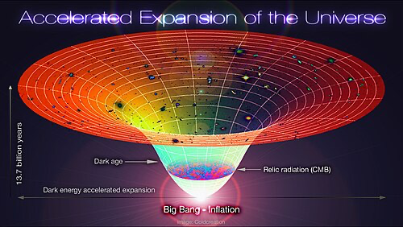
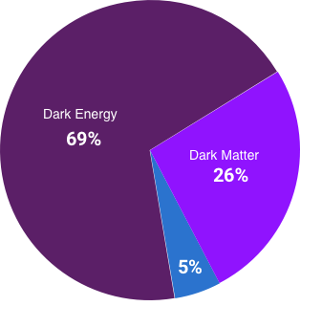
Can horizon thermodynamics inform dark energy?
Late-time cosmic acceleration is well described by ΛCDM, but the physical origin of dark energy remains open.
Can the thermodynamic nature of horizons give us a useful way to think about dark energy?
Compare two entropic routes:
  Holographic Dark Energy (HDE)
  Gravity Thermodynamics (GT)
Outline:
  Motivation for entropic cosmology
  Two theoretical routes
  Observational constraints on the model
  Main results obtained using large scale data sets
  Conclude and future directions
Udit K. Tyagi, Sandeep Haridasu, and Soumen Basak, “Holographic and gravity-thermodynamic approaches in entropic cosmology: Bayesian assessment using late-time data,” Physical Review D 110, 063503 (2024)
Udit K. Tyagi, Sandeep Haridasu, and Soumen Basak, “Constraints on generalized gravity-thermodynamic cosmology from DESI DR2,” Physical Review D 113, 063507 (2026).

Slide 3
Horizons are thermodynamic objects
Entropic cosmology is not introduced merely as a fitting function. It is motivated by the thermodynamic nature of spacetime horizons.
Black-hole physics teaches us that horizons are not just geometrical boundaries. They carry entropy and temperature. They are thermodynamic objects. The Bekenstein-Hawking entropy is proportional to the area of the horizon,
Entropy: Temperature:
Cosmology also has horizons:
Hubble radius Apparent Horizon Future event Horizon
Therefore, it is natural to ask whether cosmological horizons can influence cosmic expansion.

Slide 4
HDE and GT are physically different
Holographic dark energy (HDE)
  The horizon length directly controls the dark-energy density.
  HDE changes the dark-energy density directly through the horizon scale.
HDE: M. Li, Phys. Lett. B 603, 1 (2004).
GT: D. A. Easson, P. H. Frampton & G. F. Smoot, Phys. Lett. B 696, 273 (2011).
Gravity-Thermodynamics (GT)
  GT changes the Friedmann equation first and then reinterprets the correction as effective dark energy.

Slide 5
Late-time probes of H(z)
The analysis mainly uses late-time probes. Supernovae are standard candles. They constrain the luminosity distance,
so supernovae tell us about the integrated expansion history of the Universe.
BAO acts as a standard ruler. It constrains distance combinations and, in some cases, the Hubble rate directly. The commonly used BAO distance combination are
:

Slide 6
Good fit or good model?
A model must answer two different questions:
Best-fit: Can the model fit the data?
Do the data really prefer the model over the existing one ?
A lower \(\chi^2_{\rm min}\) shows a better best-fit point, but Bayesian evidence asks whether this improvement is worth the extra parameter volume

Slide 7
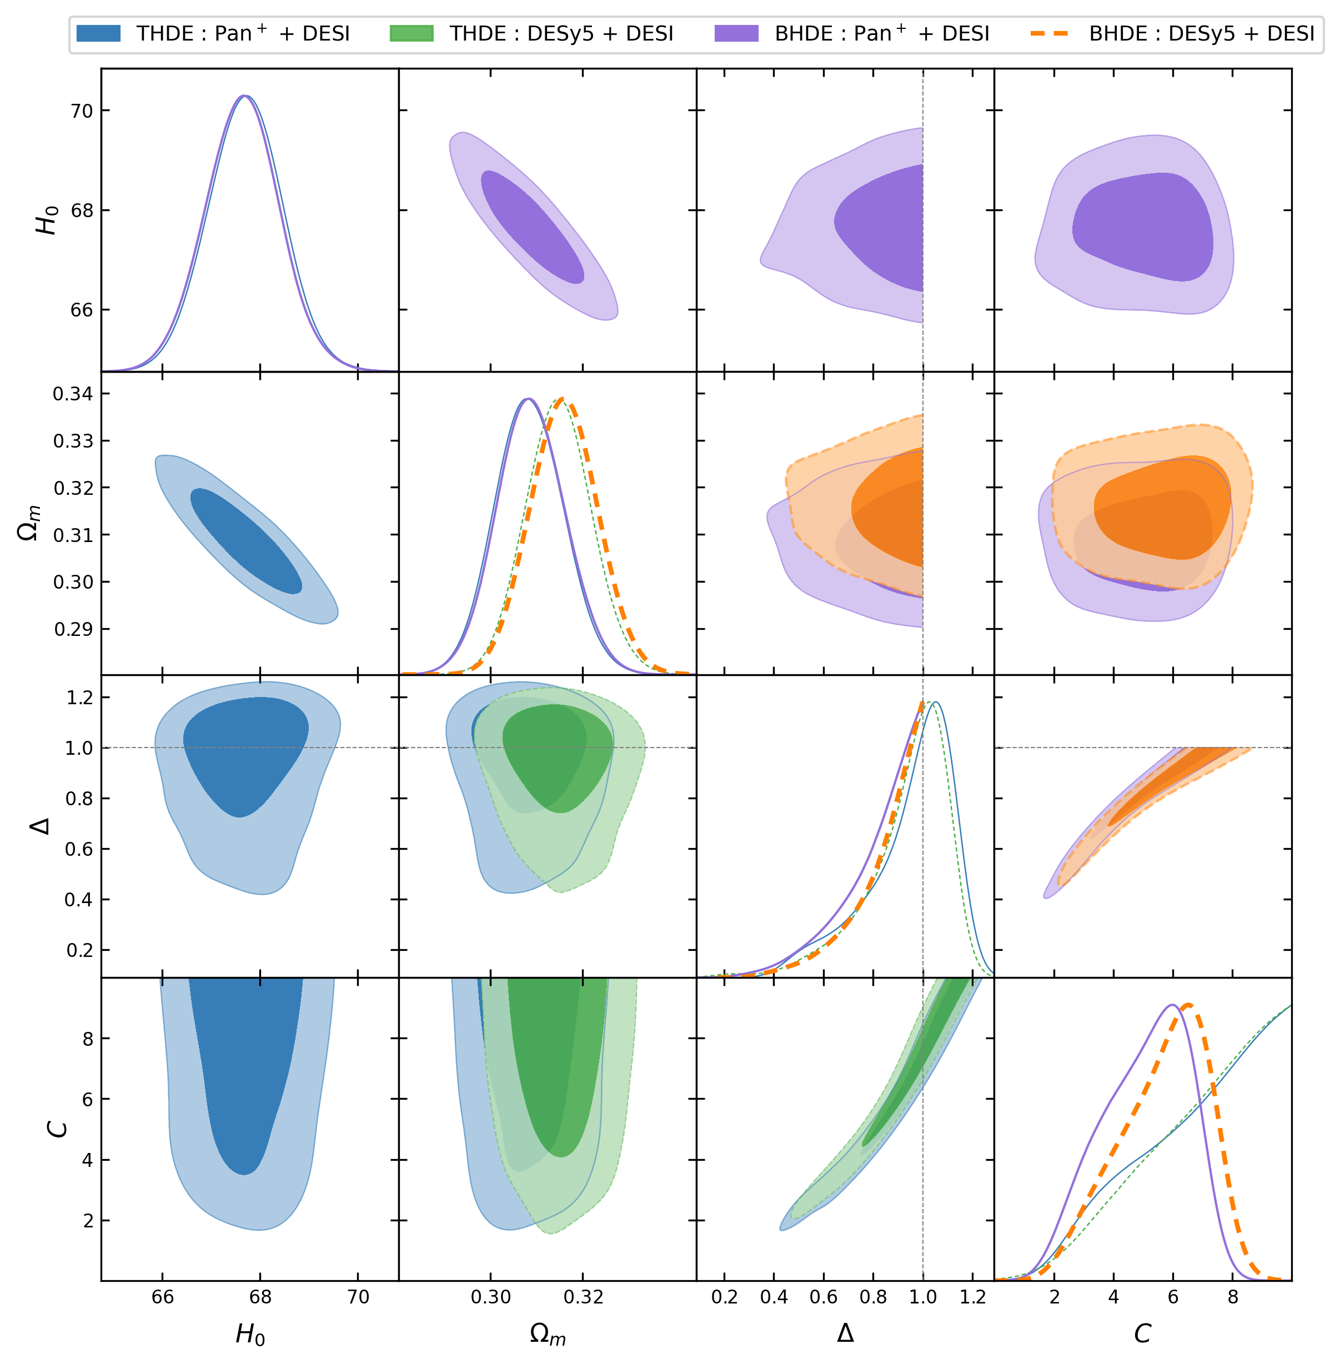
Holographic Dark Energy Parameter Constraints
Parameter space:
Upper triangle: Barrow prior
Lower triangle: Tsallis prior
Data combinations: Pan+DESI and DESy5+DESI
Contours show 68% and 95% confidence regions.
DESI+SNe tightly constrain H0​ and Ωm​.
DESy5+DESI gives slightly larger Ωm​ and lower H0​.
Main degeneracy is Physically, Δ changes the horizon-scaling power, while C renormalizes the HDE density.
Posteriors prefer positive Δ, not the simple Δ=0 limit.
Barrow Entropy
Tsallis Entropy
HDE is constrained mostly by the combined effect of Δ and C.

Slide 8
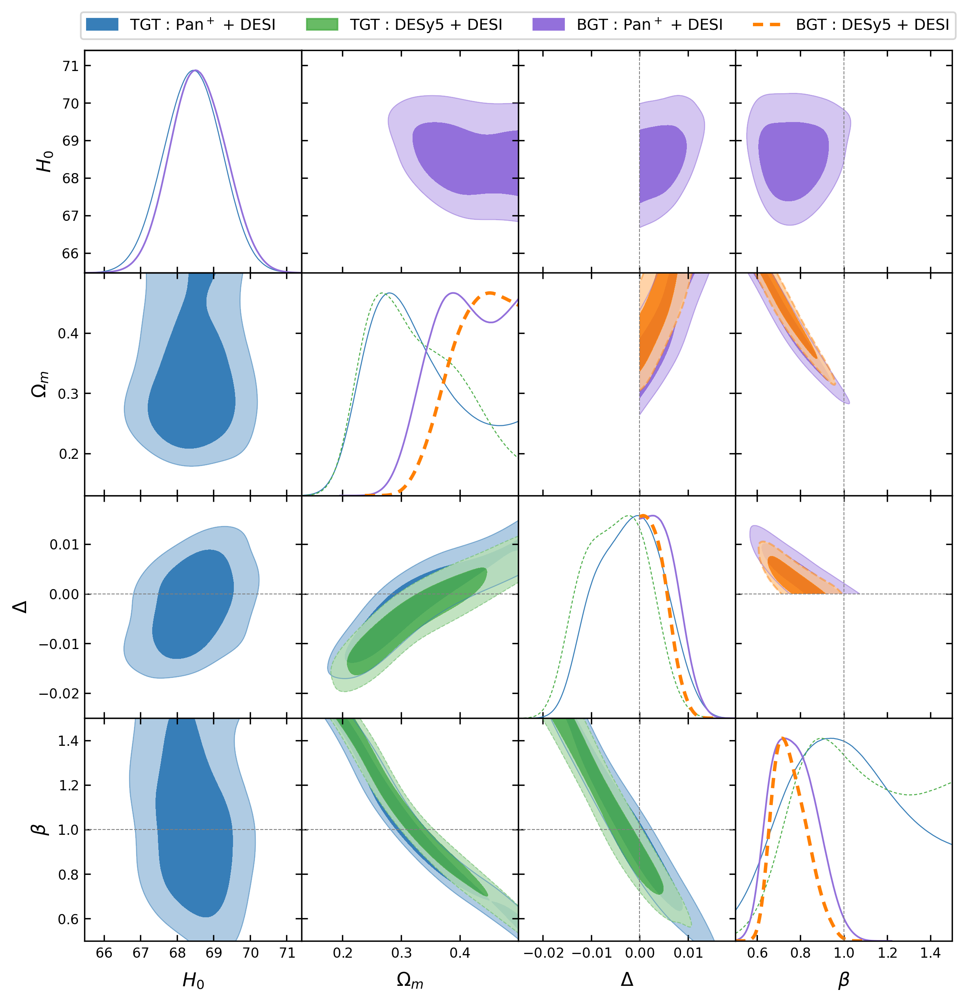
Gravity-thermodynamics Parameter Constraints
Parameter space:
Upper triangle: Barrow prior
Lower triangle: Tsallis prior
Data combinations: Pan+DESI and DESy5+DESI
Contours show 68% and 95% confidence regions.
DESI+SNe tightly constrain H0​ and Ωm​.
DESy5+DESI shifts the contours toward larger Ωm, lower H0, and lower β.
Main degeneracy is Physically, β changes the expansion normalization and can compensate changes in Ωm ​
Posteriors prefer positive Δ, not the simple Δ=0 limit.
Barrow Entropy
Tsallis Entropy
The data mostly constrain the combined effect of Ωm and β, rather than Δ by itself.

Slide 9
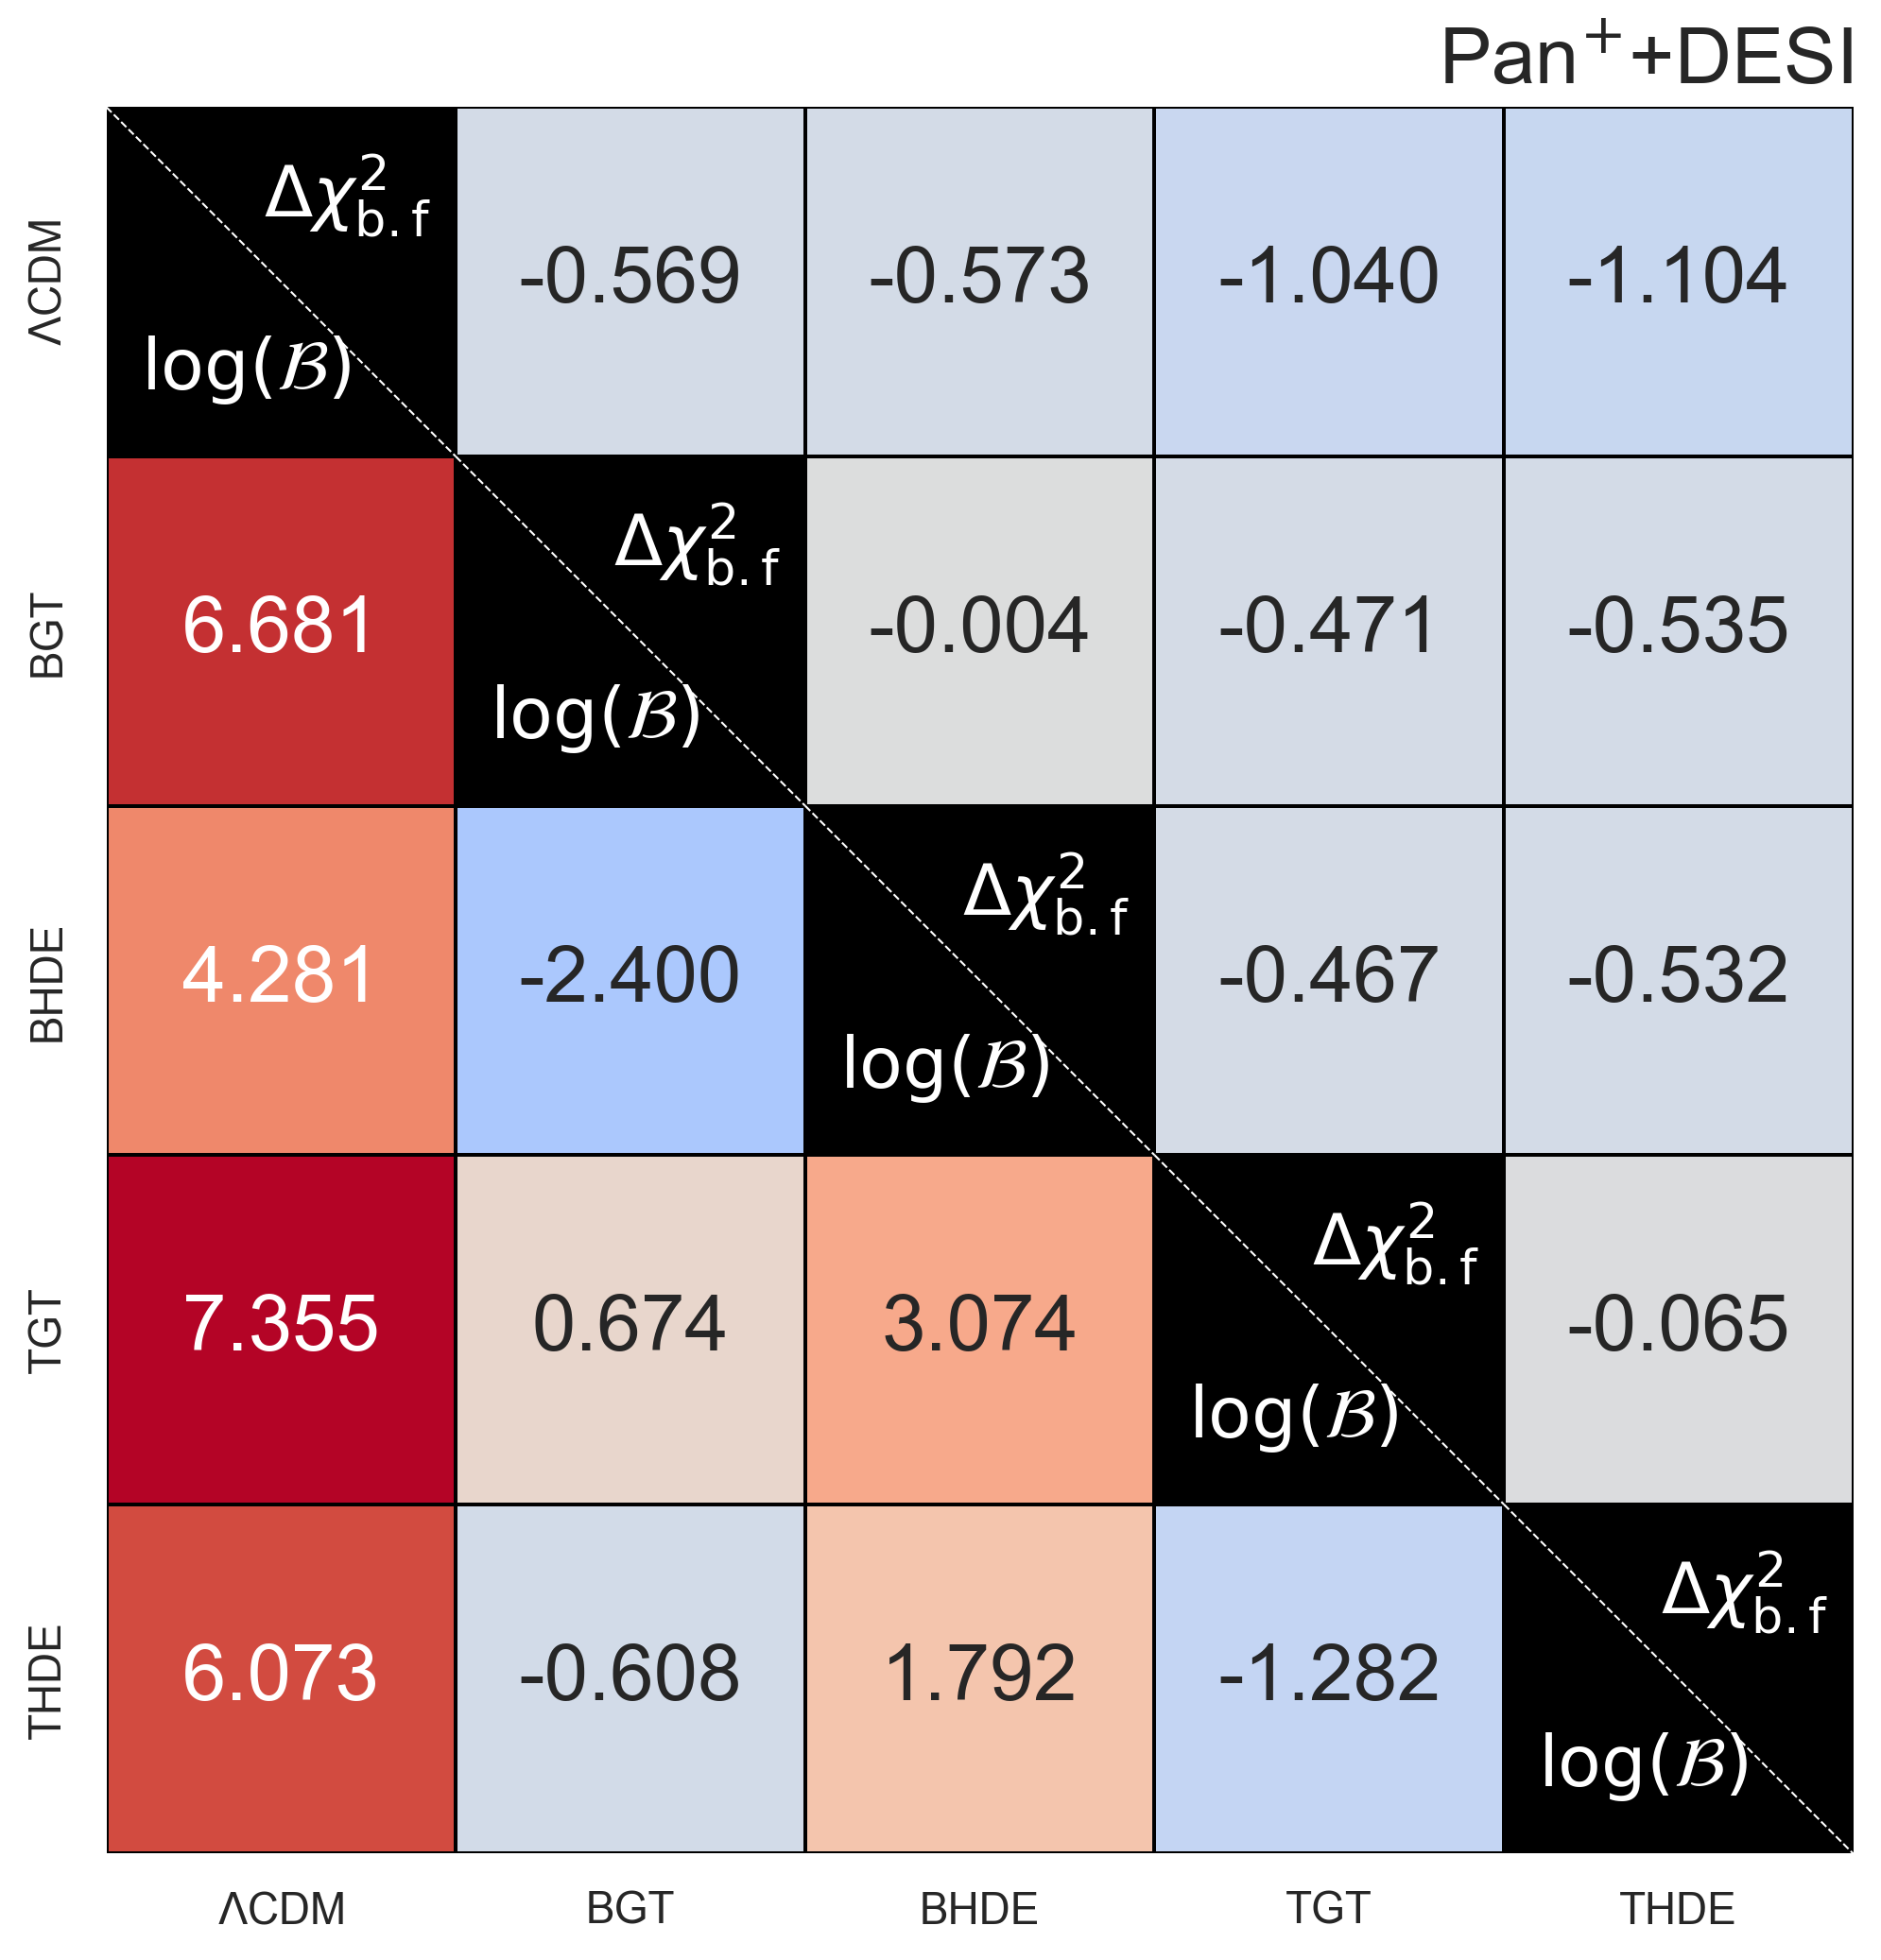
Best fit is not the same as evidence
Best-fit comparison
Bayesian evidence
Models compared

Slide 10
Best fit is not the same as evidence
Pantheon+ + DESI best-fit numbers
Pantheon+ + DESI evidence numbers
Models compared

Slide 11
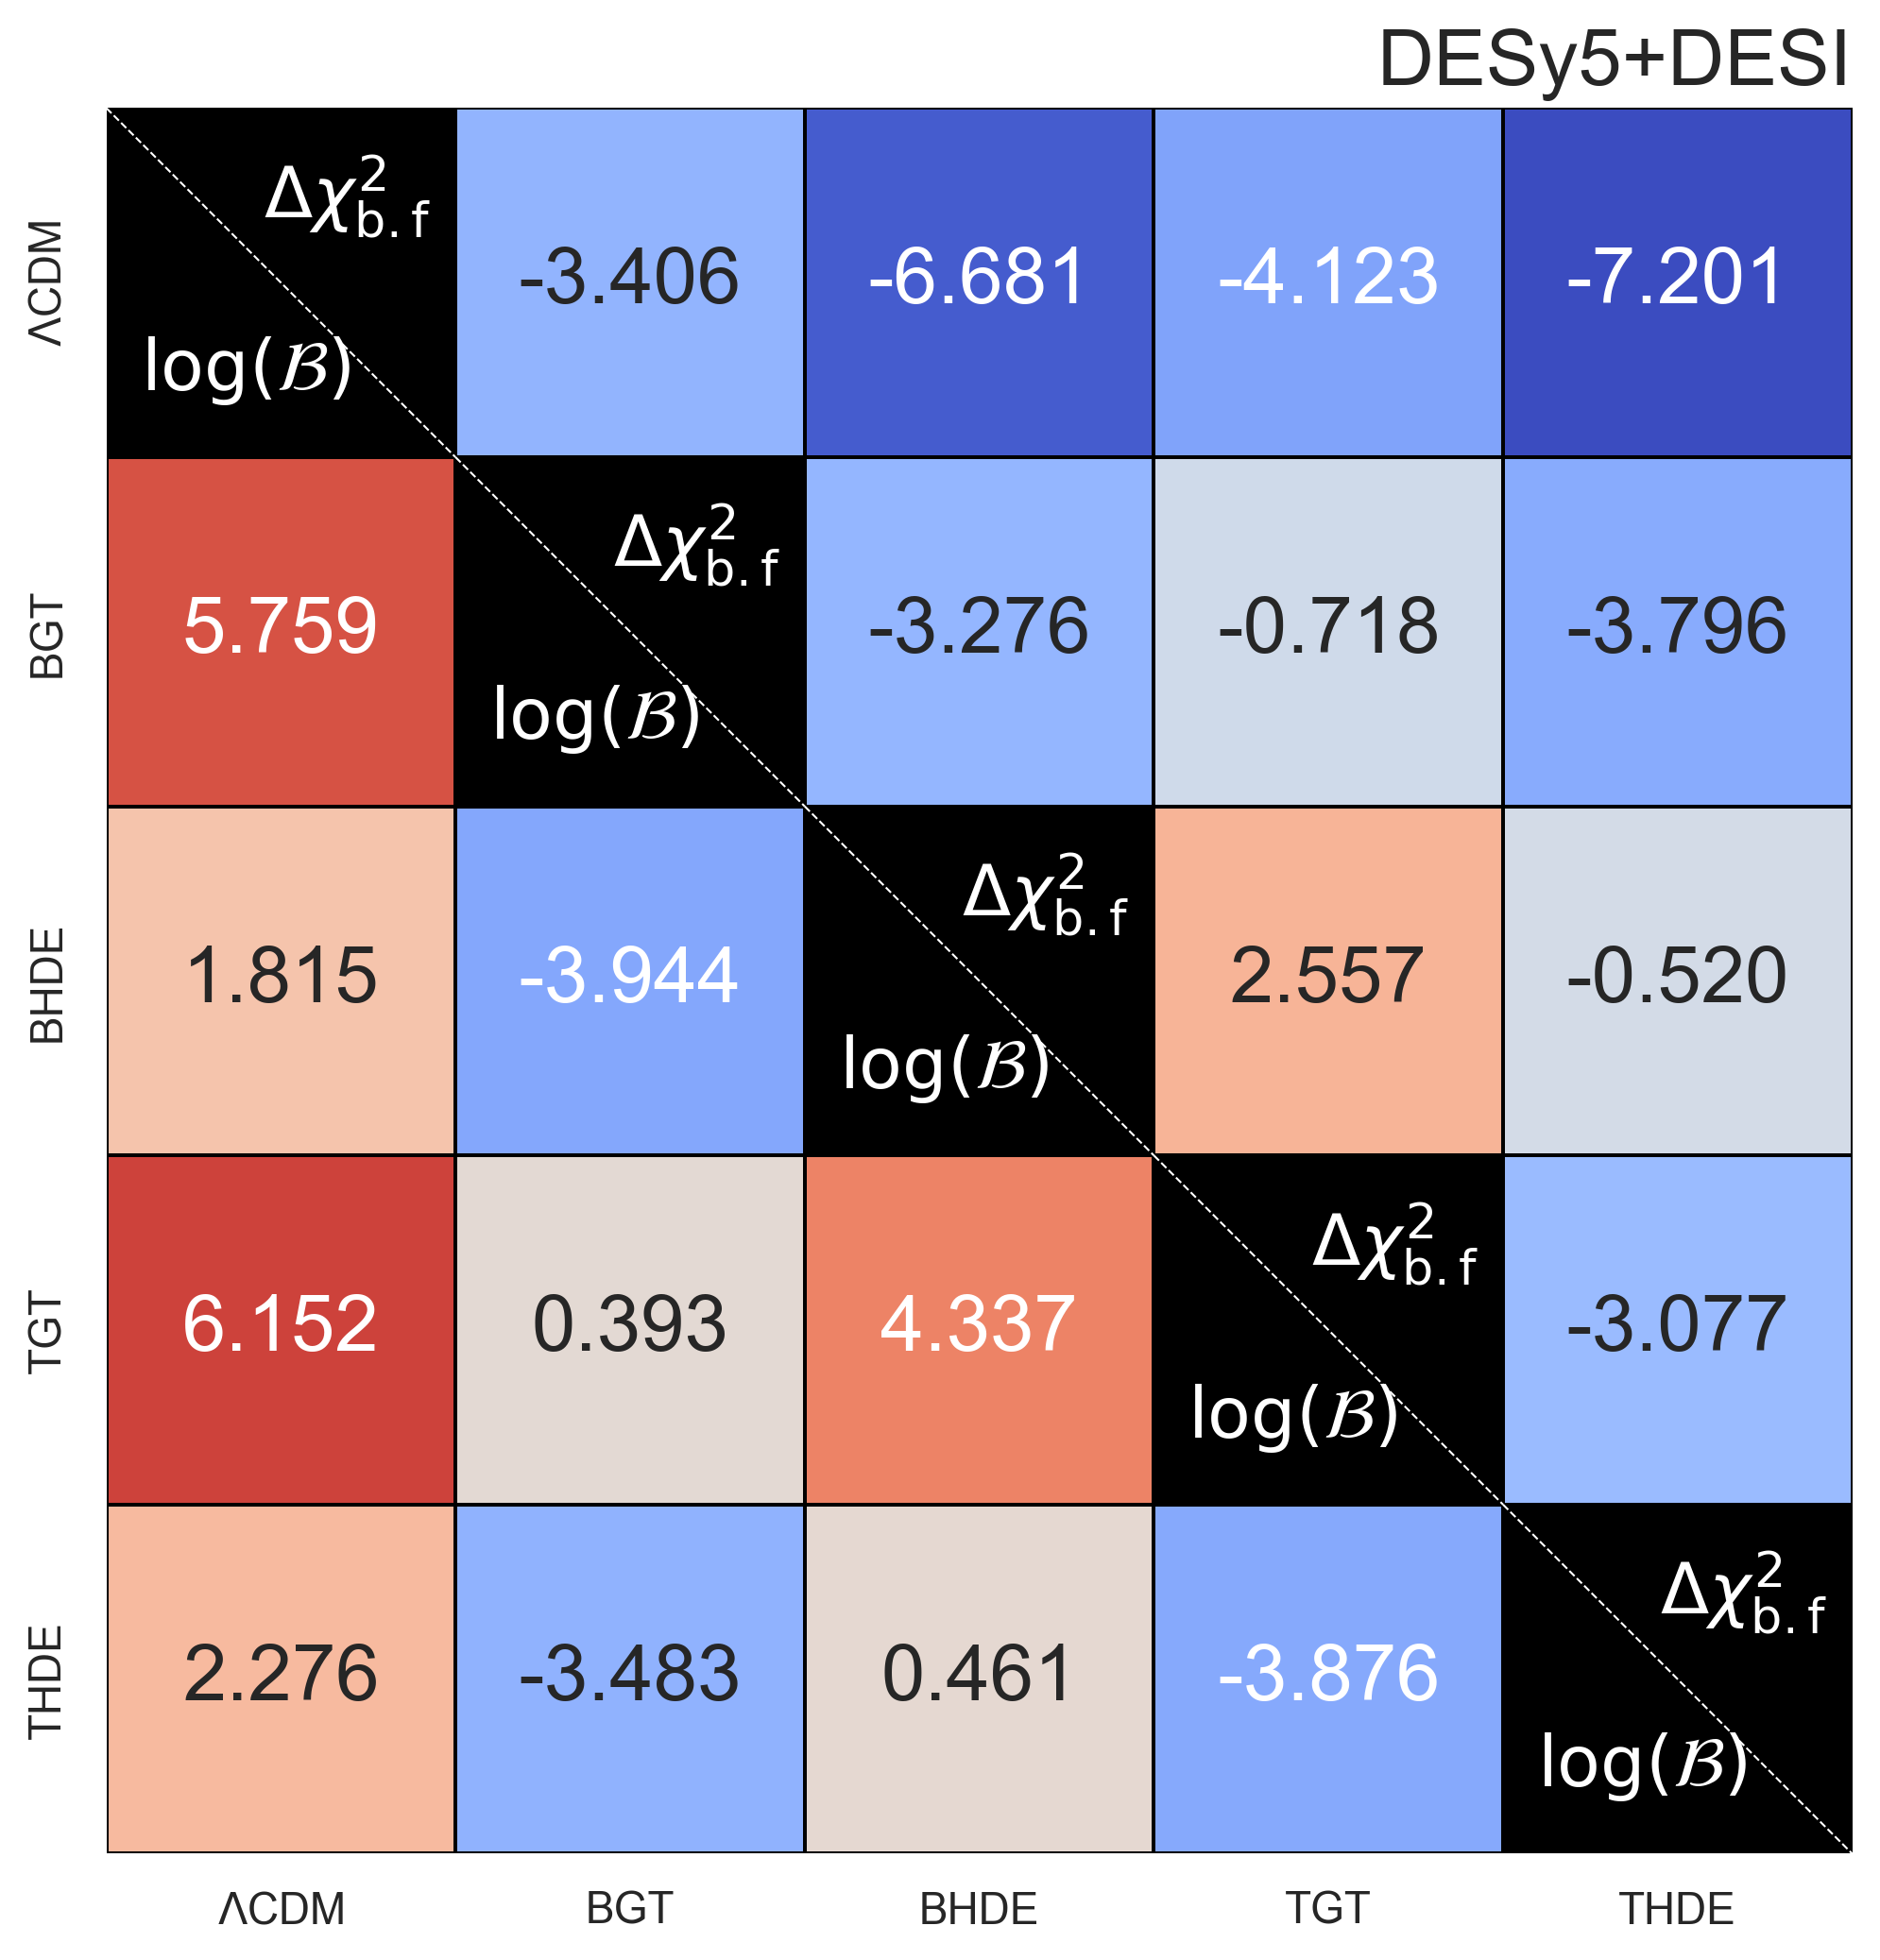
Best fit is not the same as evidence
DESy5 + DESI best-fit numbers
DESy5 + DESI evidence numbers
Models compared

Slide 12
Best fit is not the same as evidence

Slide 13
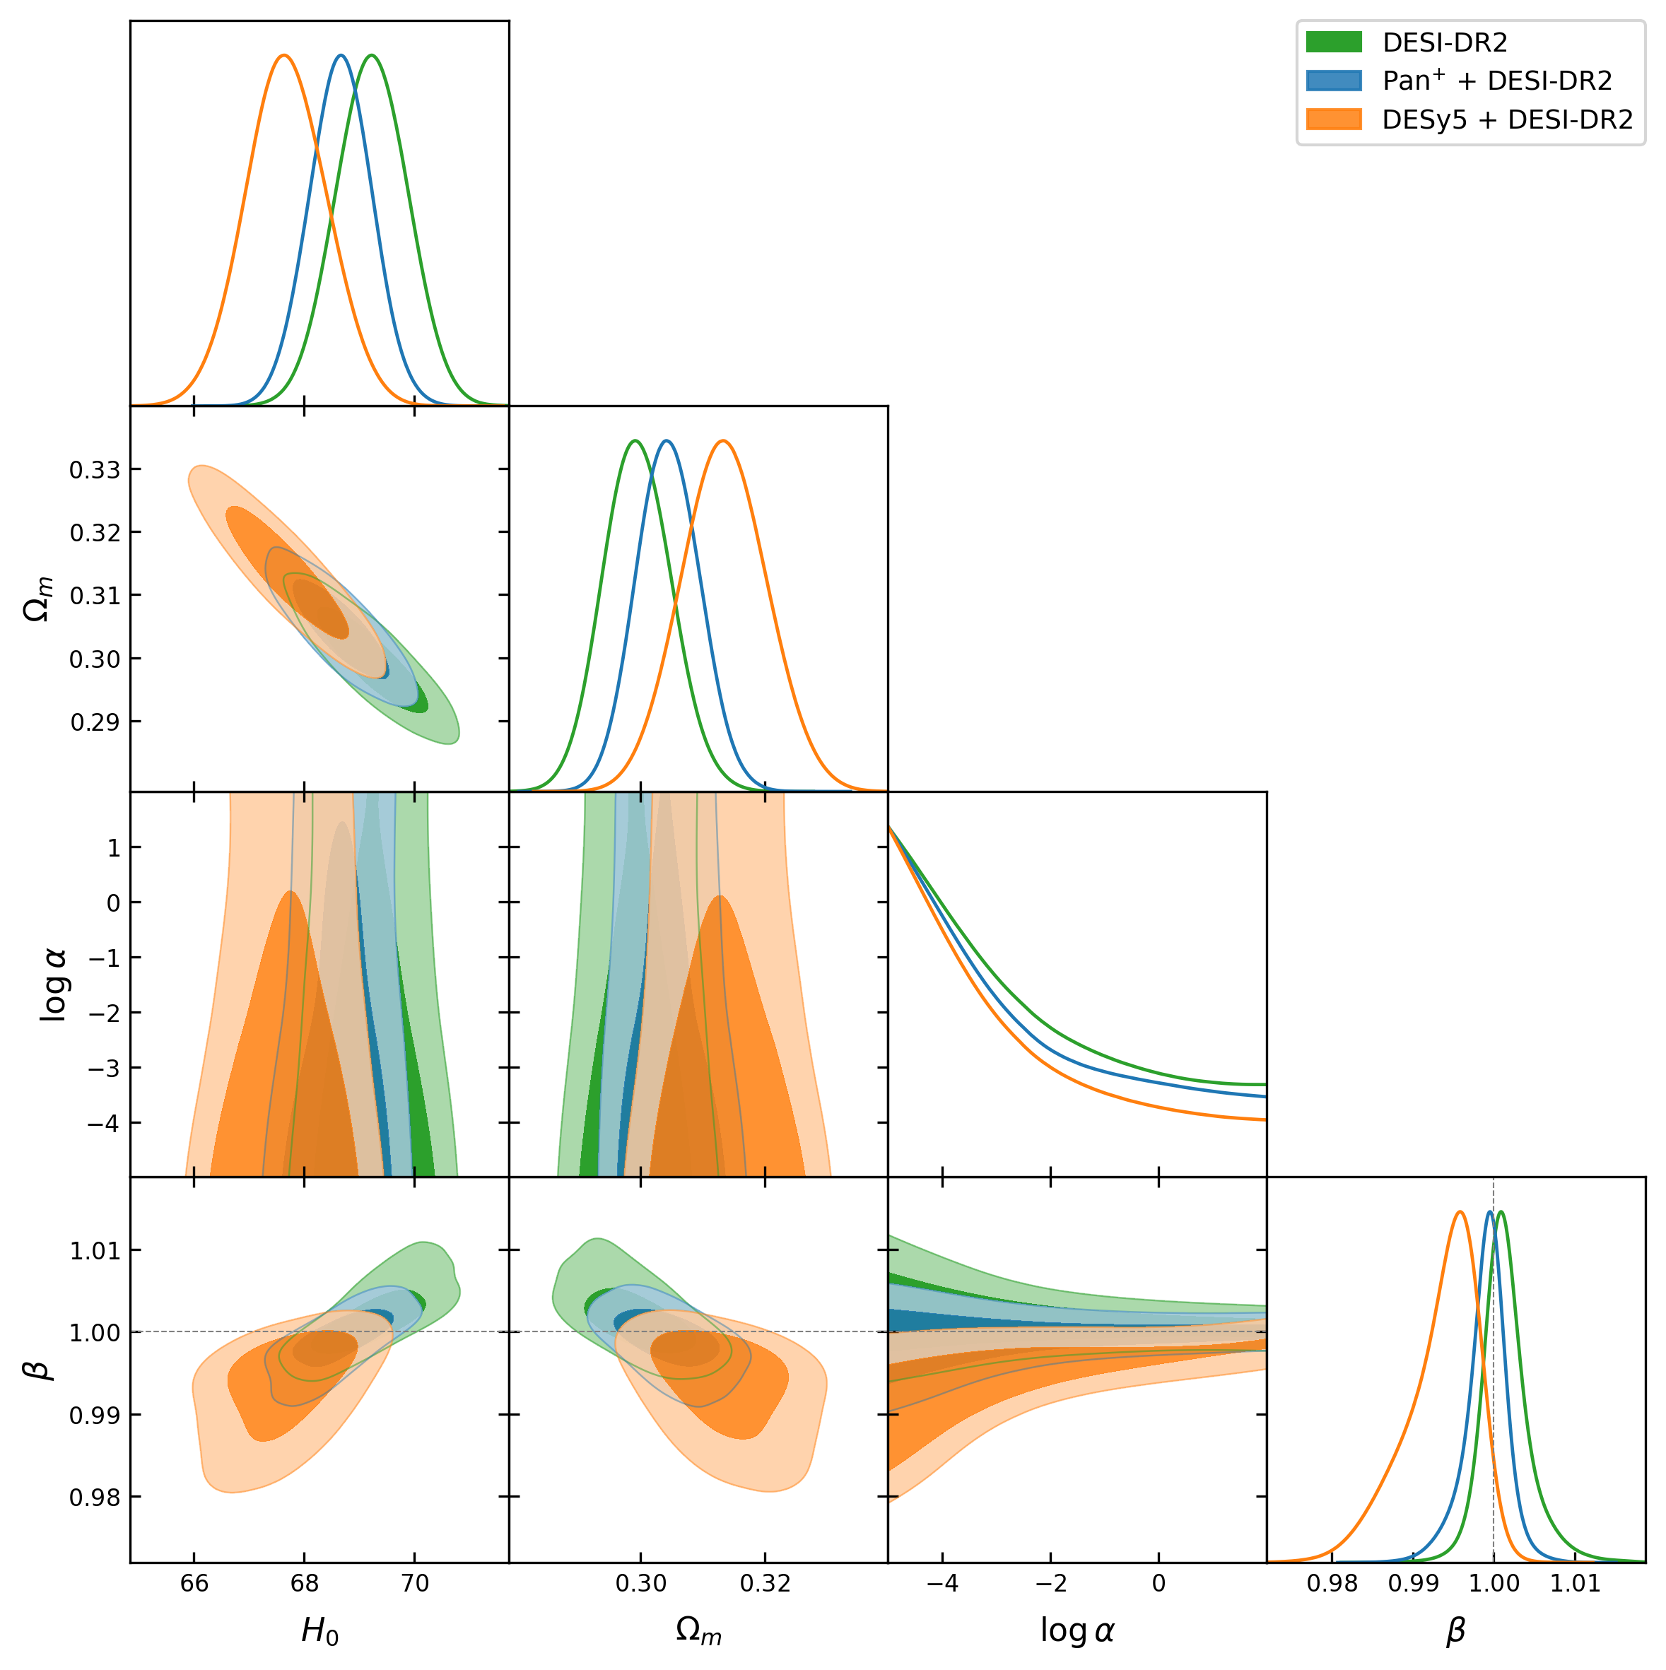
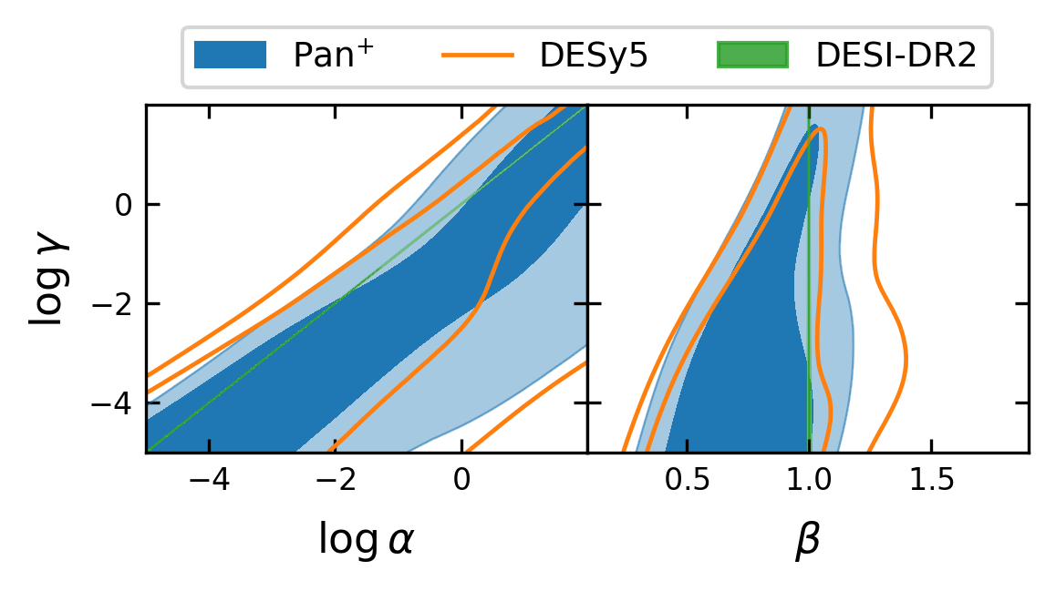
Three-parameter S3​ Model: Entropy Freedom
After simple GT models were disfavoured, we ask whether a broader entropy sector can improve GT.
The model is tested with DESI DR2 + Pantheon+ / DESY5 supernovae.
H0​ and Ωm​ are well constrained by DESI DR2. H0​ and Ωm\Omega_mΩm​ are anti-correlated.
Posterior pushes β≃1. logα is weakly constrained; mostly upper limits are obtained. α and γ are strongly correlated.

Slide 14
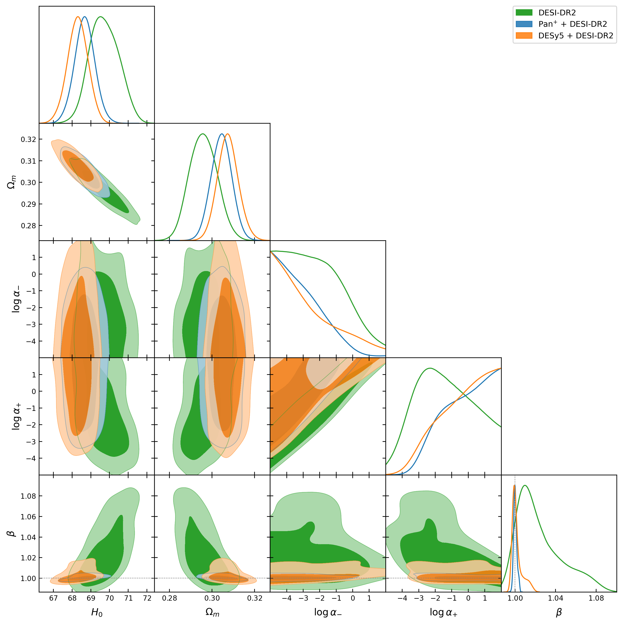
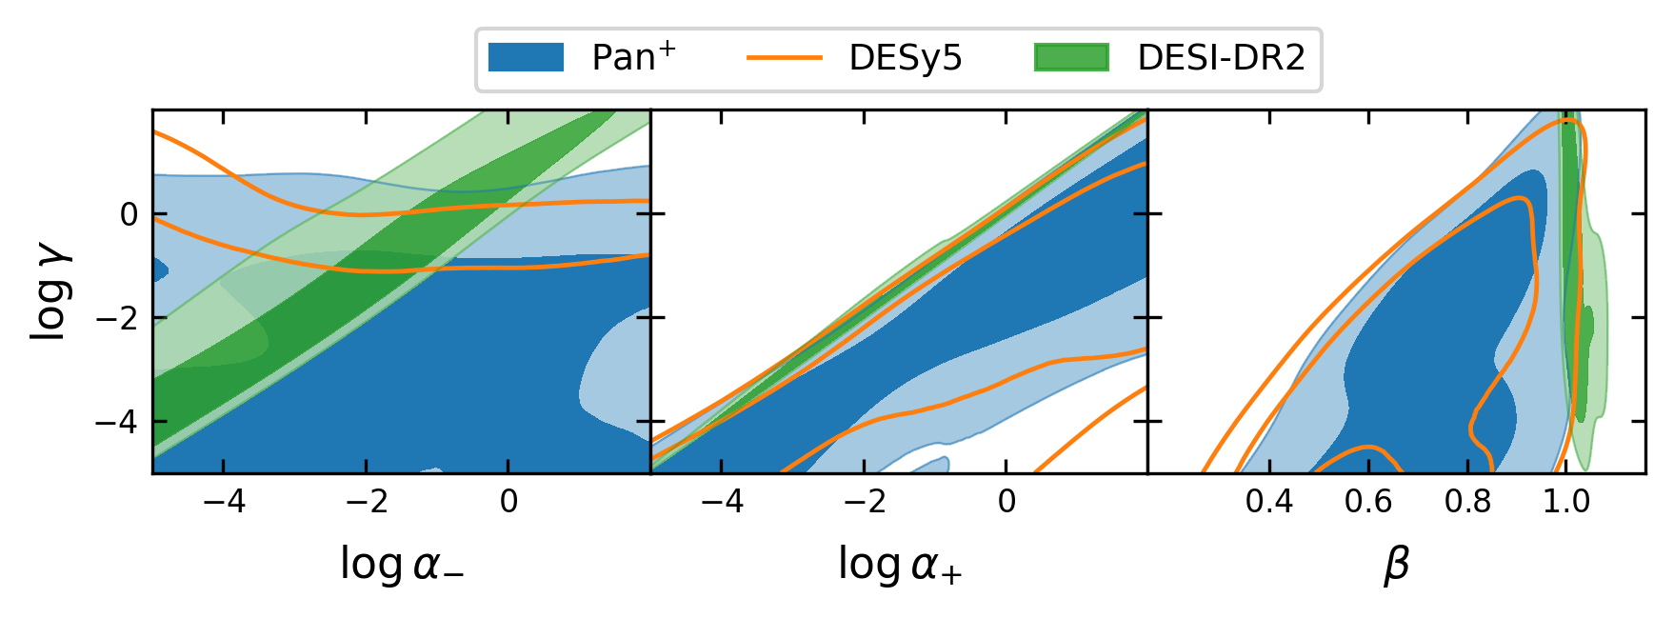
Four-parameter S4​ Model: More Freedom, Less Evidence Support
S4​ extends the generalized entropy sector beyond S3​.
The model is tested with DESI DR2 + Pantheon+ / DESY5 supernovae.
H0​ and Ωm​ are reasonably well constrained by DESI DR2. H0​ and Ωm​ are anti-correlated.
Posterior pushes β≃1. The internal entropy parameters, such as α−​,α+​,γ, mostly upper limits are obtained. α and γ are strongly correlated.

Slide 15
Summary and Future directions
Motivation remains strong
  Horizons carry entropy and temperature.
  Cosmological horizons may therefore contain thermodynamic information.
  Dark energy may emerge from spacetime thermodynamics, not only from an added fluid.
HDE performs better than GT
  HDE is directly linked to the horizon scale and entropy deformation.
  It describes the background expansion data better.
  GT modifies Friedmann dynamics more indirectly and is less supported by current data.
S3 and S4 give richer dynamics
  Three-parameter models allow more flexible late-time evolution.
  But extra freedom is not strongly favored by the evidence.
Background data may not be enough
  SN, BAO, and H(z) mainly probe the homogeneous expansion history.
  Different models can mimic similar distance-redshift behavior.

Slide 16
Summary and Future directions
Future tests should include structure
  Test structure growth: matter clustering, and CMB lensing.
  A viable model should explain both expansion and structure formation.
THANK YOU

