Slide 1
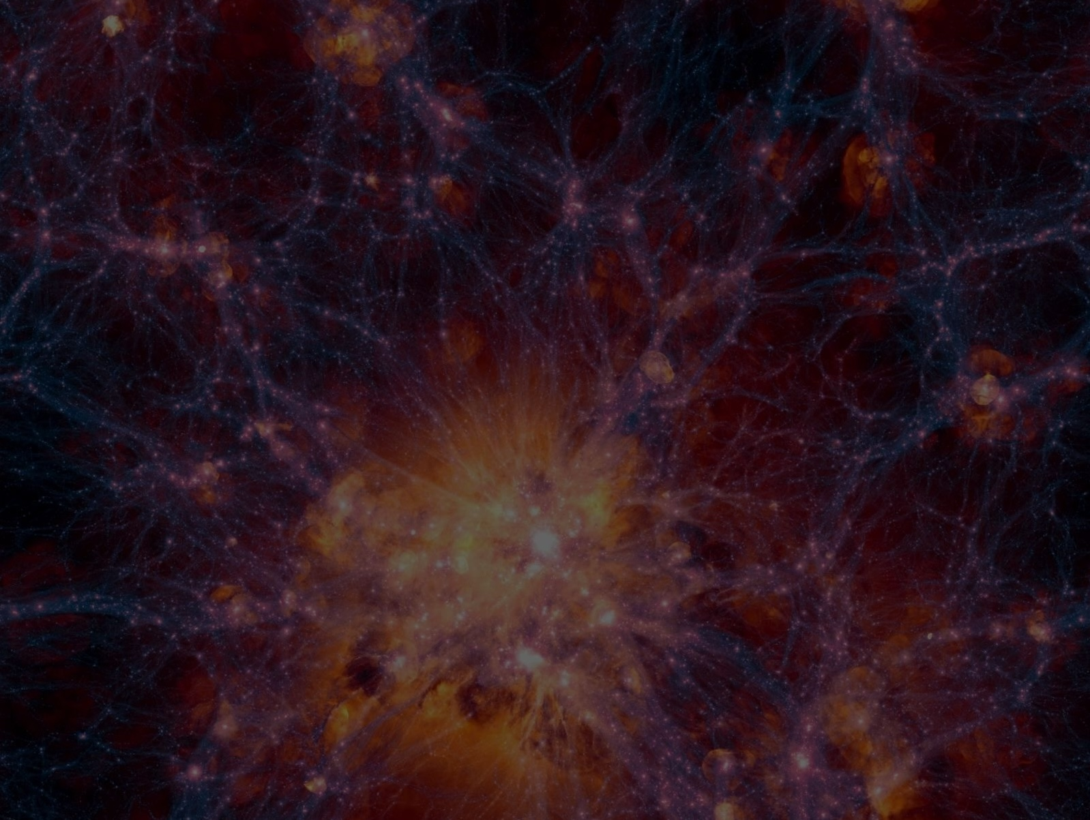




Cosmology with the Rubin
Void Size Function
Pierre Boccard
PhD supervised by Alice Pisani

Slide 2

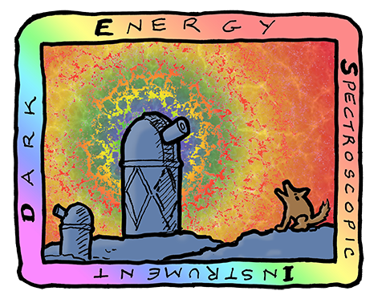



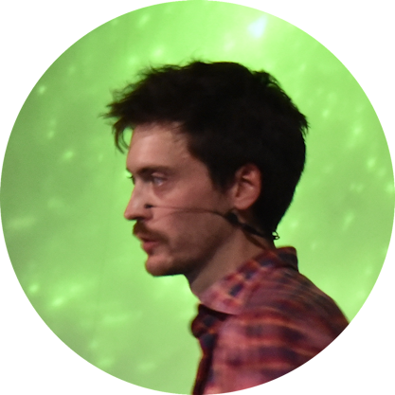

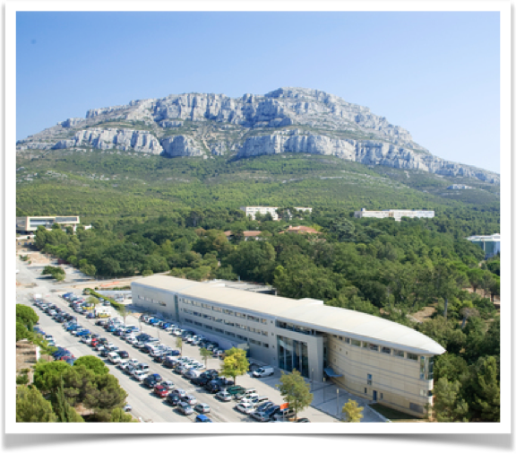


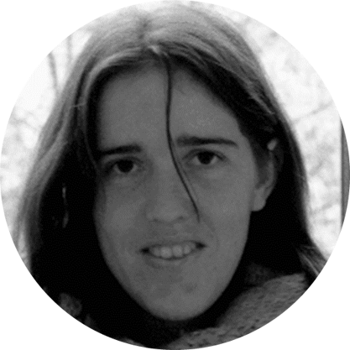





Voids@CPPM team:
Giulia Degni
Postdoc
Katayoon
Ghaemiardakani
PhD 2nd year
Pierre Boccard
PhD 2nd year
Nico Schuster
Postdoc
Julien Zoubian
Research Engineer
Alice Pisani
Professor
Stéphanie Escoffier
Senior Researcher
Pauline Vielzeuf
Researcher
Marie-Claude
Cousinou
Professor

Slide 3
Big picture

Slide 4

Photometric
redshifts
Introduction
LSST
2D voids
Cluster voids
VSF
LSST mocks & data
- Galaxy lightcones
- 10 years of observations
- Billions of galaxies
Photo-z uncertainties
Loss of LOS clustering
2 types of voids
- Cluster voids
- 2D voids
Void size function (VSF)
Abundance of voids as a function
of their size
$Ω_{m}$, $w$, $w_{0}−w_{a}$
06
GDR CoPhy
Pierre Boccard
02/06/26

Slide 5
LSST & The Vera C. Rubin Observatory

Slide 6
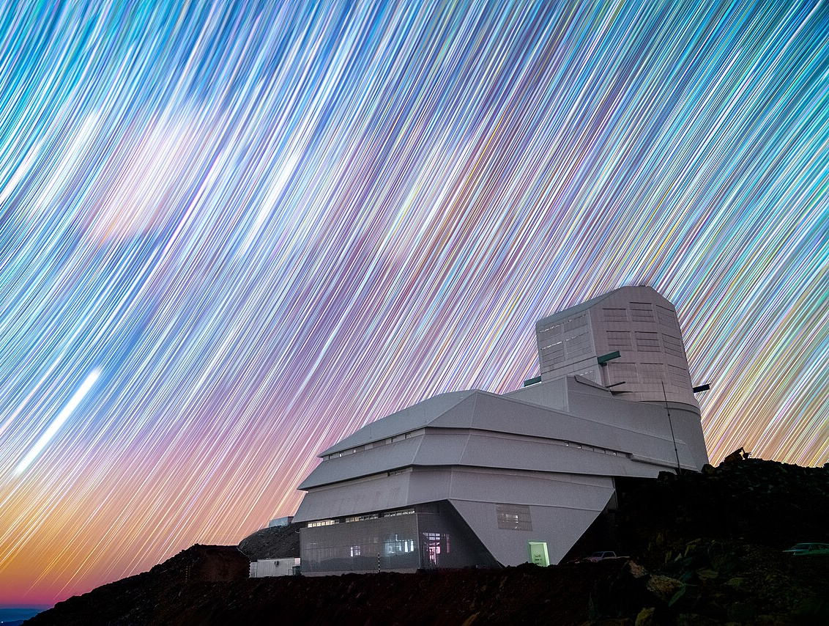
Photometric
redshifts
Introduction
LSST
2D voids
Cluster voids
VSF
Vera C. Rubin Observatory
Cerro Pachón, Chile
© NSF-DOE Vera C. Rubin Observatory
GDR CoPhy
Pierre Boccard
02/06/26

Slide 7
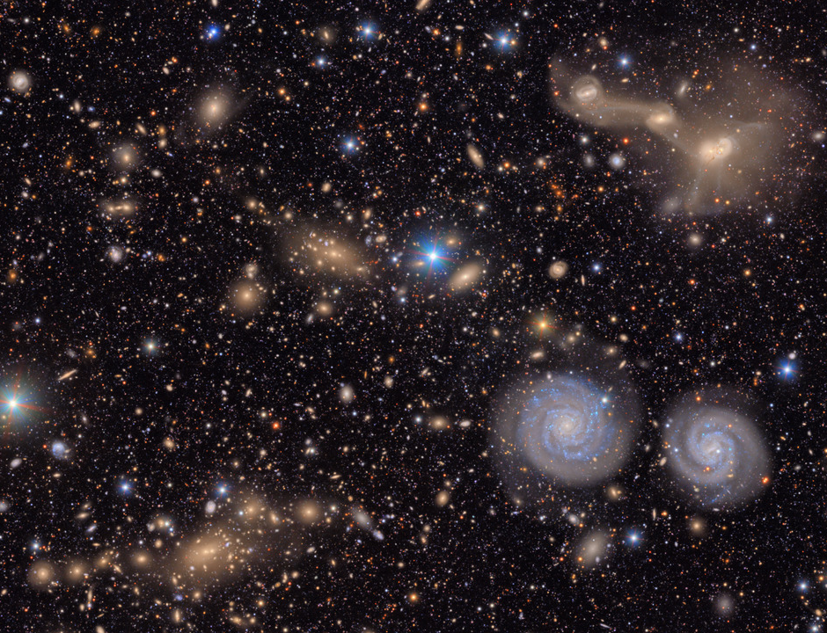
Photometric
redshifts
Introduction
LSST
2D voids
Cluster voids
VSF
© NSF-DOE Vera C. Rubin Observatory
GDR CoPhy
Pierre Boccard
02/06/26

Slide 8
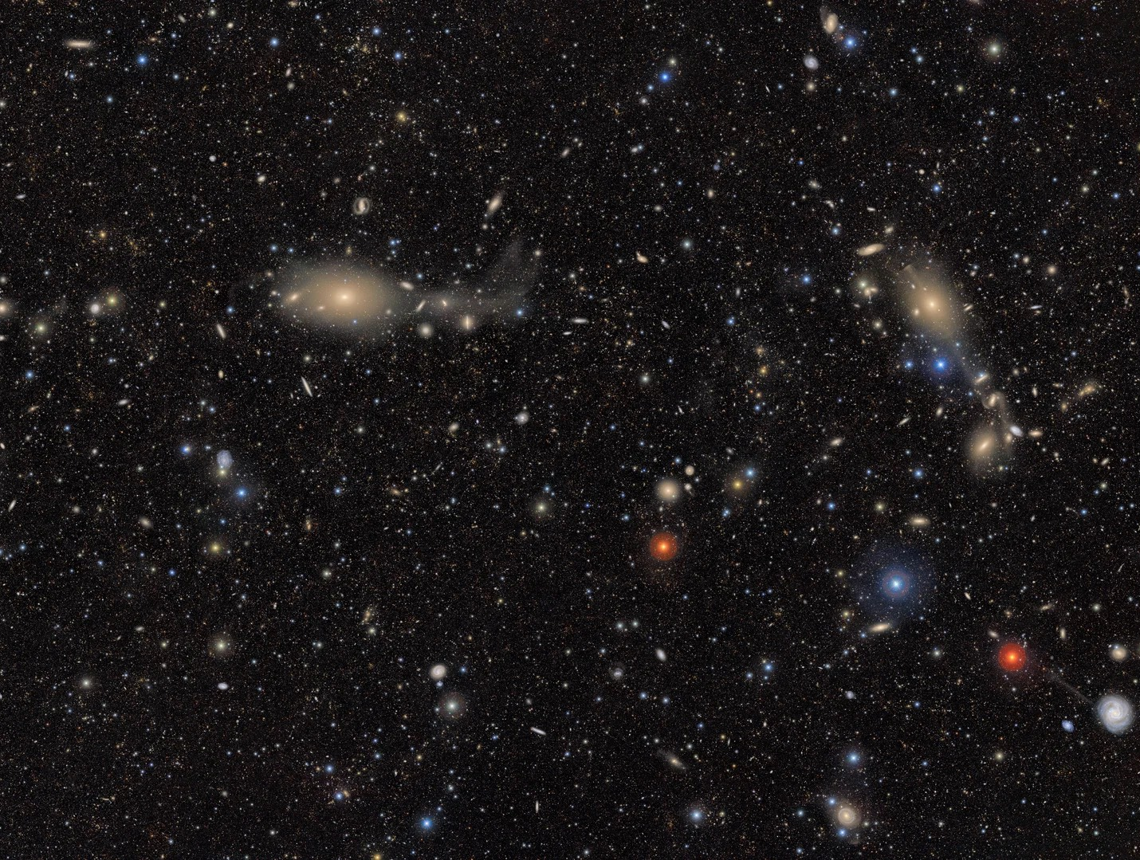
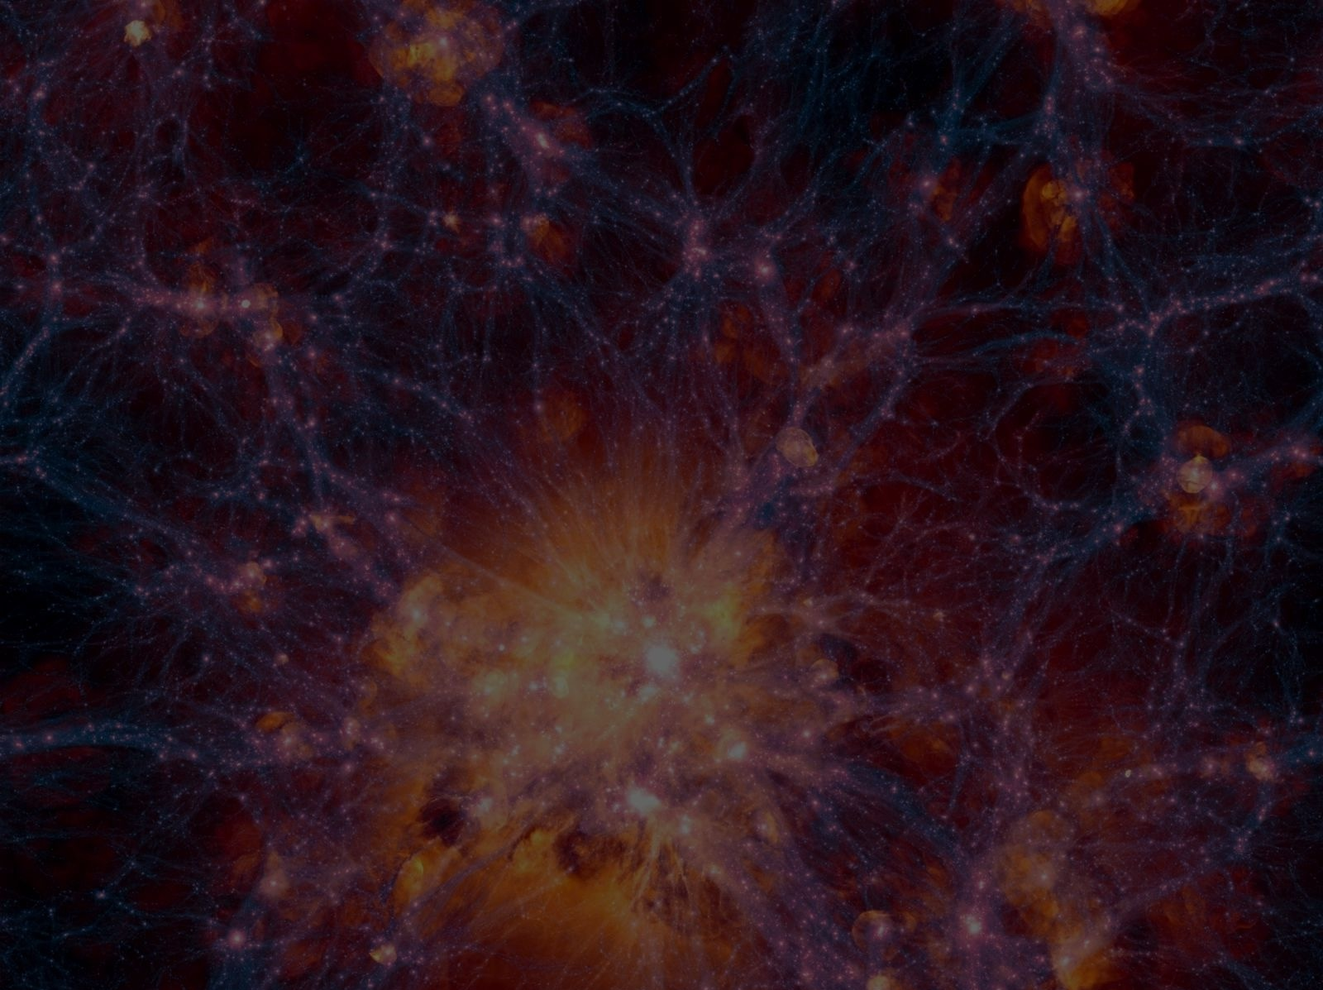
Photometric
redshifts
Introduction
LSST
2D voids
Cluster voids
VSF
© NSF-DOE Vera C. Rubin Observatory
GDR CoPhy
Pierre Boccard
02/06/26

Slide 9
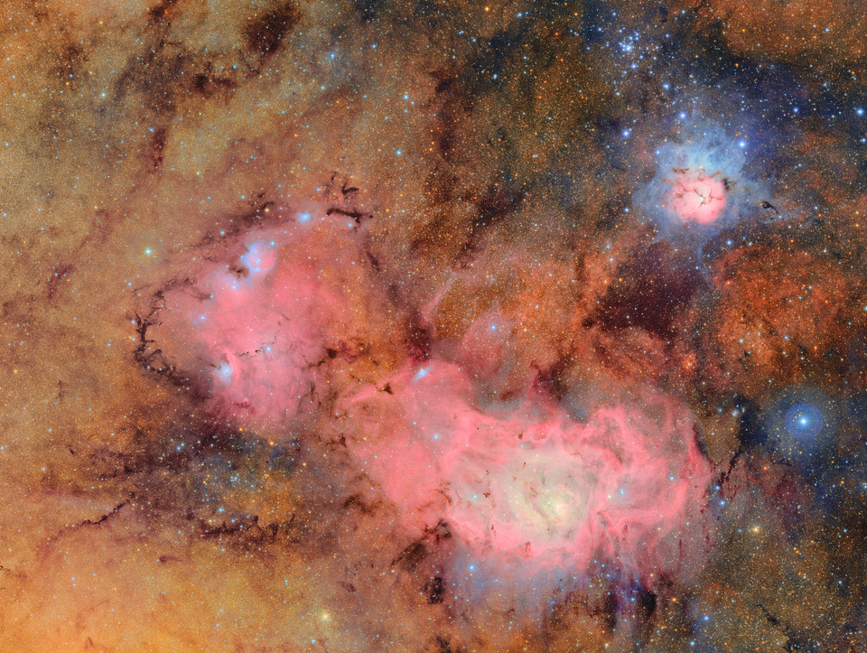
Photometric
redshifts
Introduction
LSST
2D voids
Cluster voids
VSF
PhD @ CPPM, CNRS
© NSF-DOE Vera C. Rubin Observatory
GDR CoPhy
Pierre Boccard
02/06/26

Slide 10
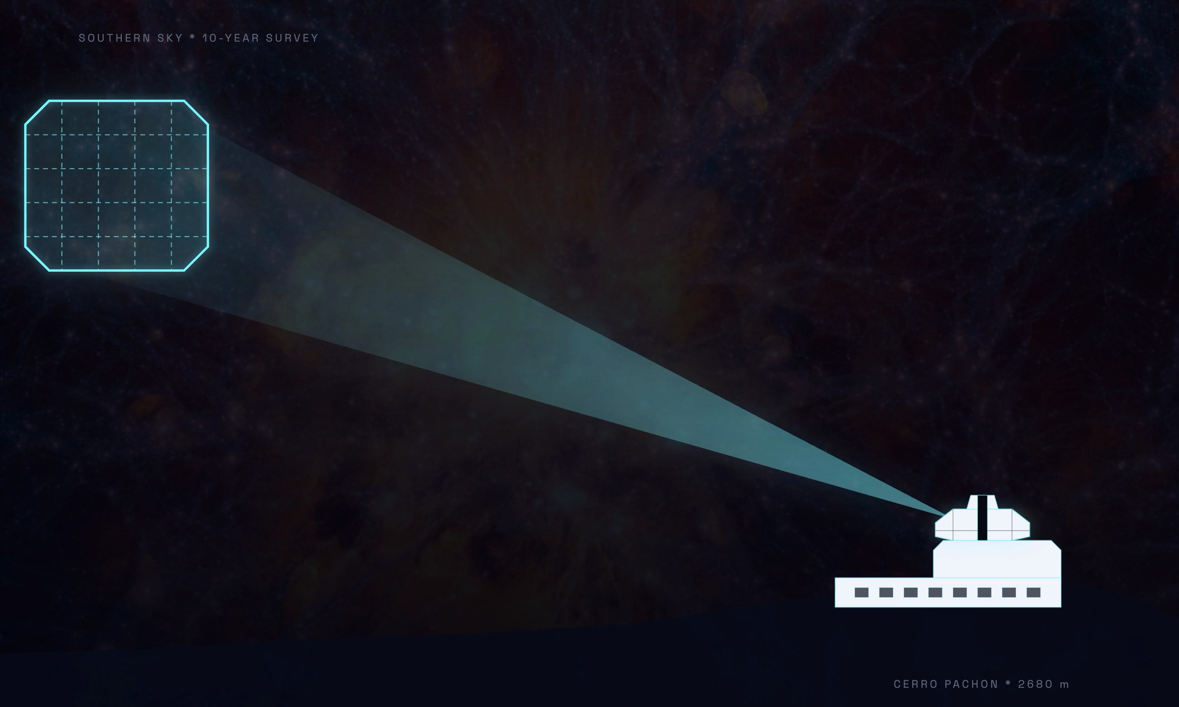
Photometric
redshifts
Introduction
LSST
2D voids
Cluster voids
VSF
GDR CoPhy
Pierre Boccard
02/06/26

Slide 11
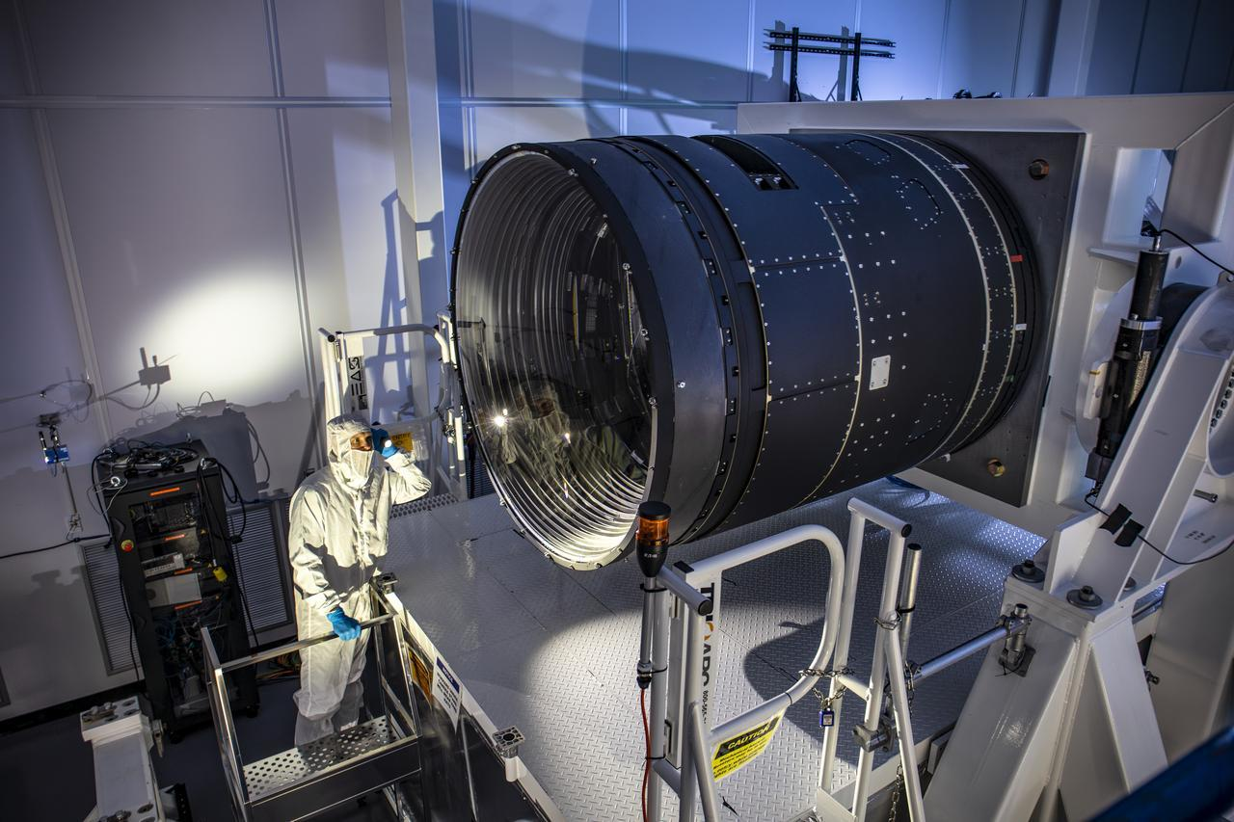
Photometric
redshifts
Introduction
LSST
2D voids
Cluster voids
VSF
Deep Multi-band photometry : Measures brightness and color of ~20B galaxies
Optics : 6 optical filters - u, g, r, i, z, y - spanning 320 to 1050nm
Timeline : Data release each year for 10 years starting in 2028
Data volume : ~20TB per night, ~60PB over 10 years
Science goal :
    Map the structure of the Universe
    Formation of Milky Way
    Detect Near-Earth Objects and asteroids
    Monitor transients (supernovas, variable stars)
GDR CoPhy
Pierre Boccard
02/06/26

Slide 12
Photometric redshifts

Slide 13
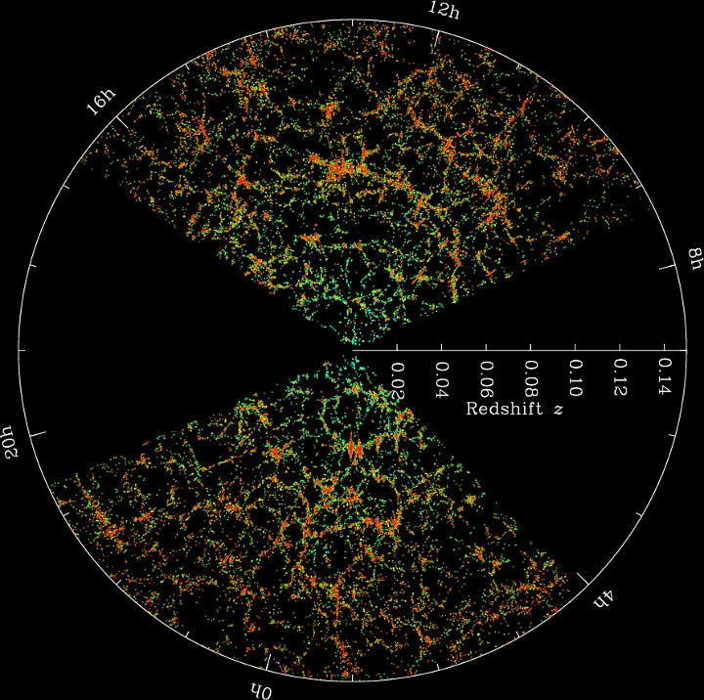
Photometric
redshifts
Photometric
redshifts
Introduction
Introduction
LSST
LSST
2D voids
2D voids
Cluster voids
Cluster voids
VSF
VSF
Credit : M. Blanton and the Sloan Digital Sky Survey
GDR CoPhy
Pierre Boccard
02/06/26

Slide 14
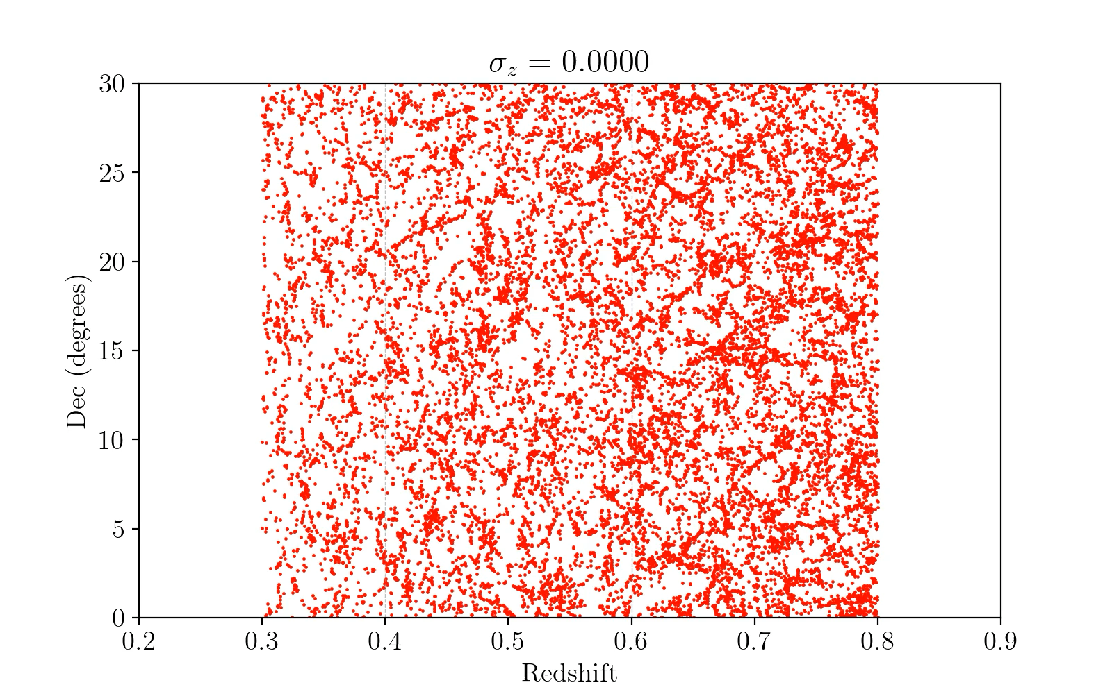
Photometric
redshifts
Introduction
LSST
2D voids
Cluster voids
VSF
GDR CoPhy
Pierre Boccard
02/06/26

Slide 15
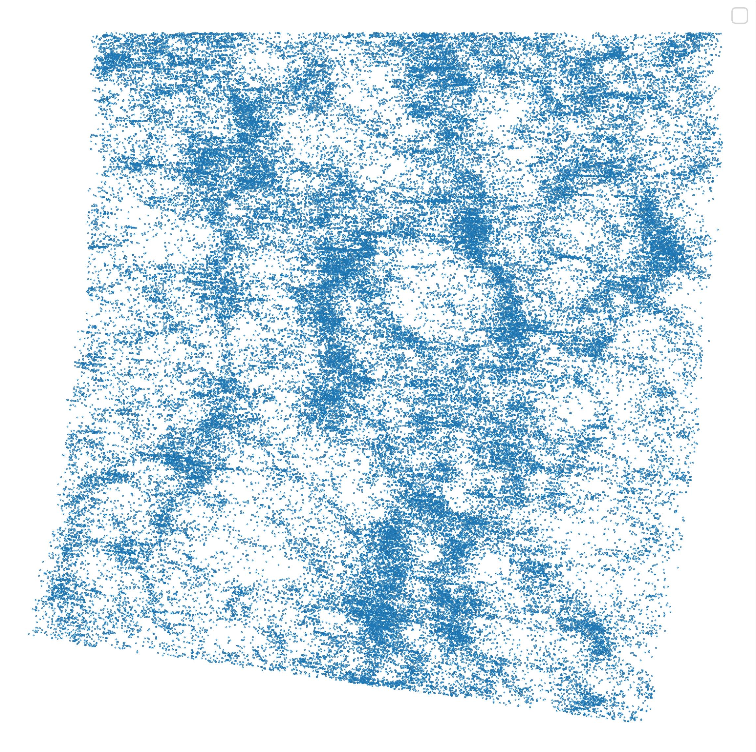
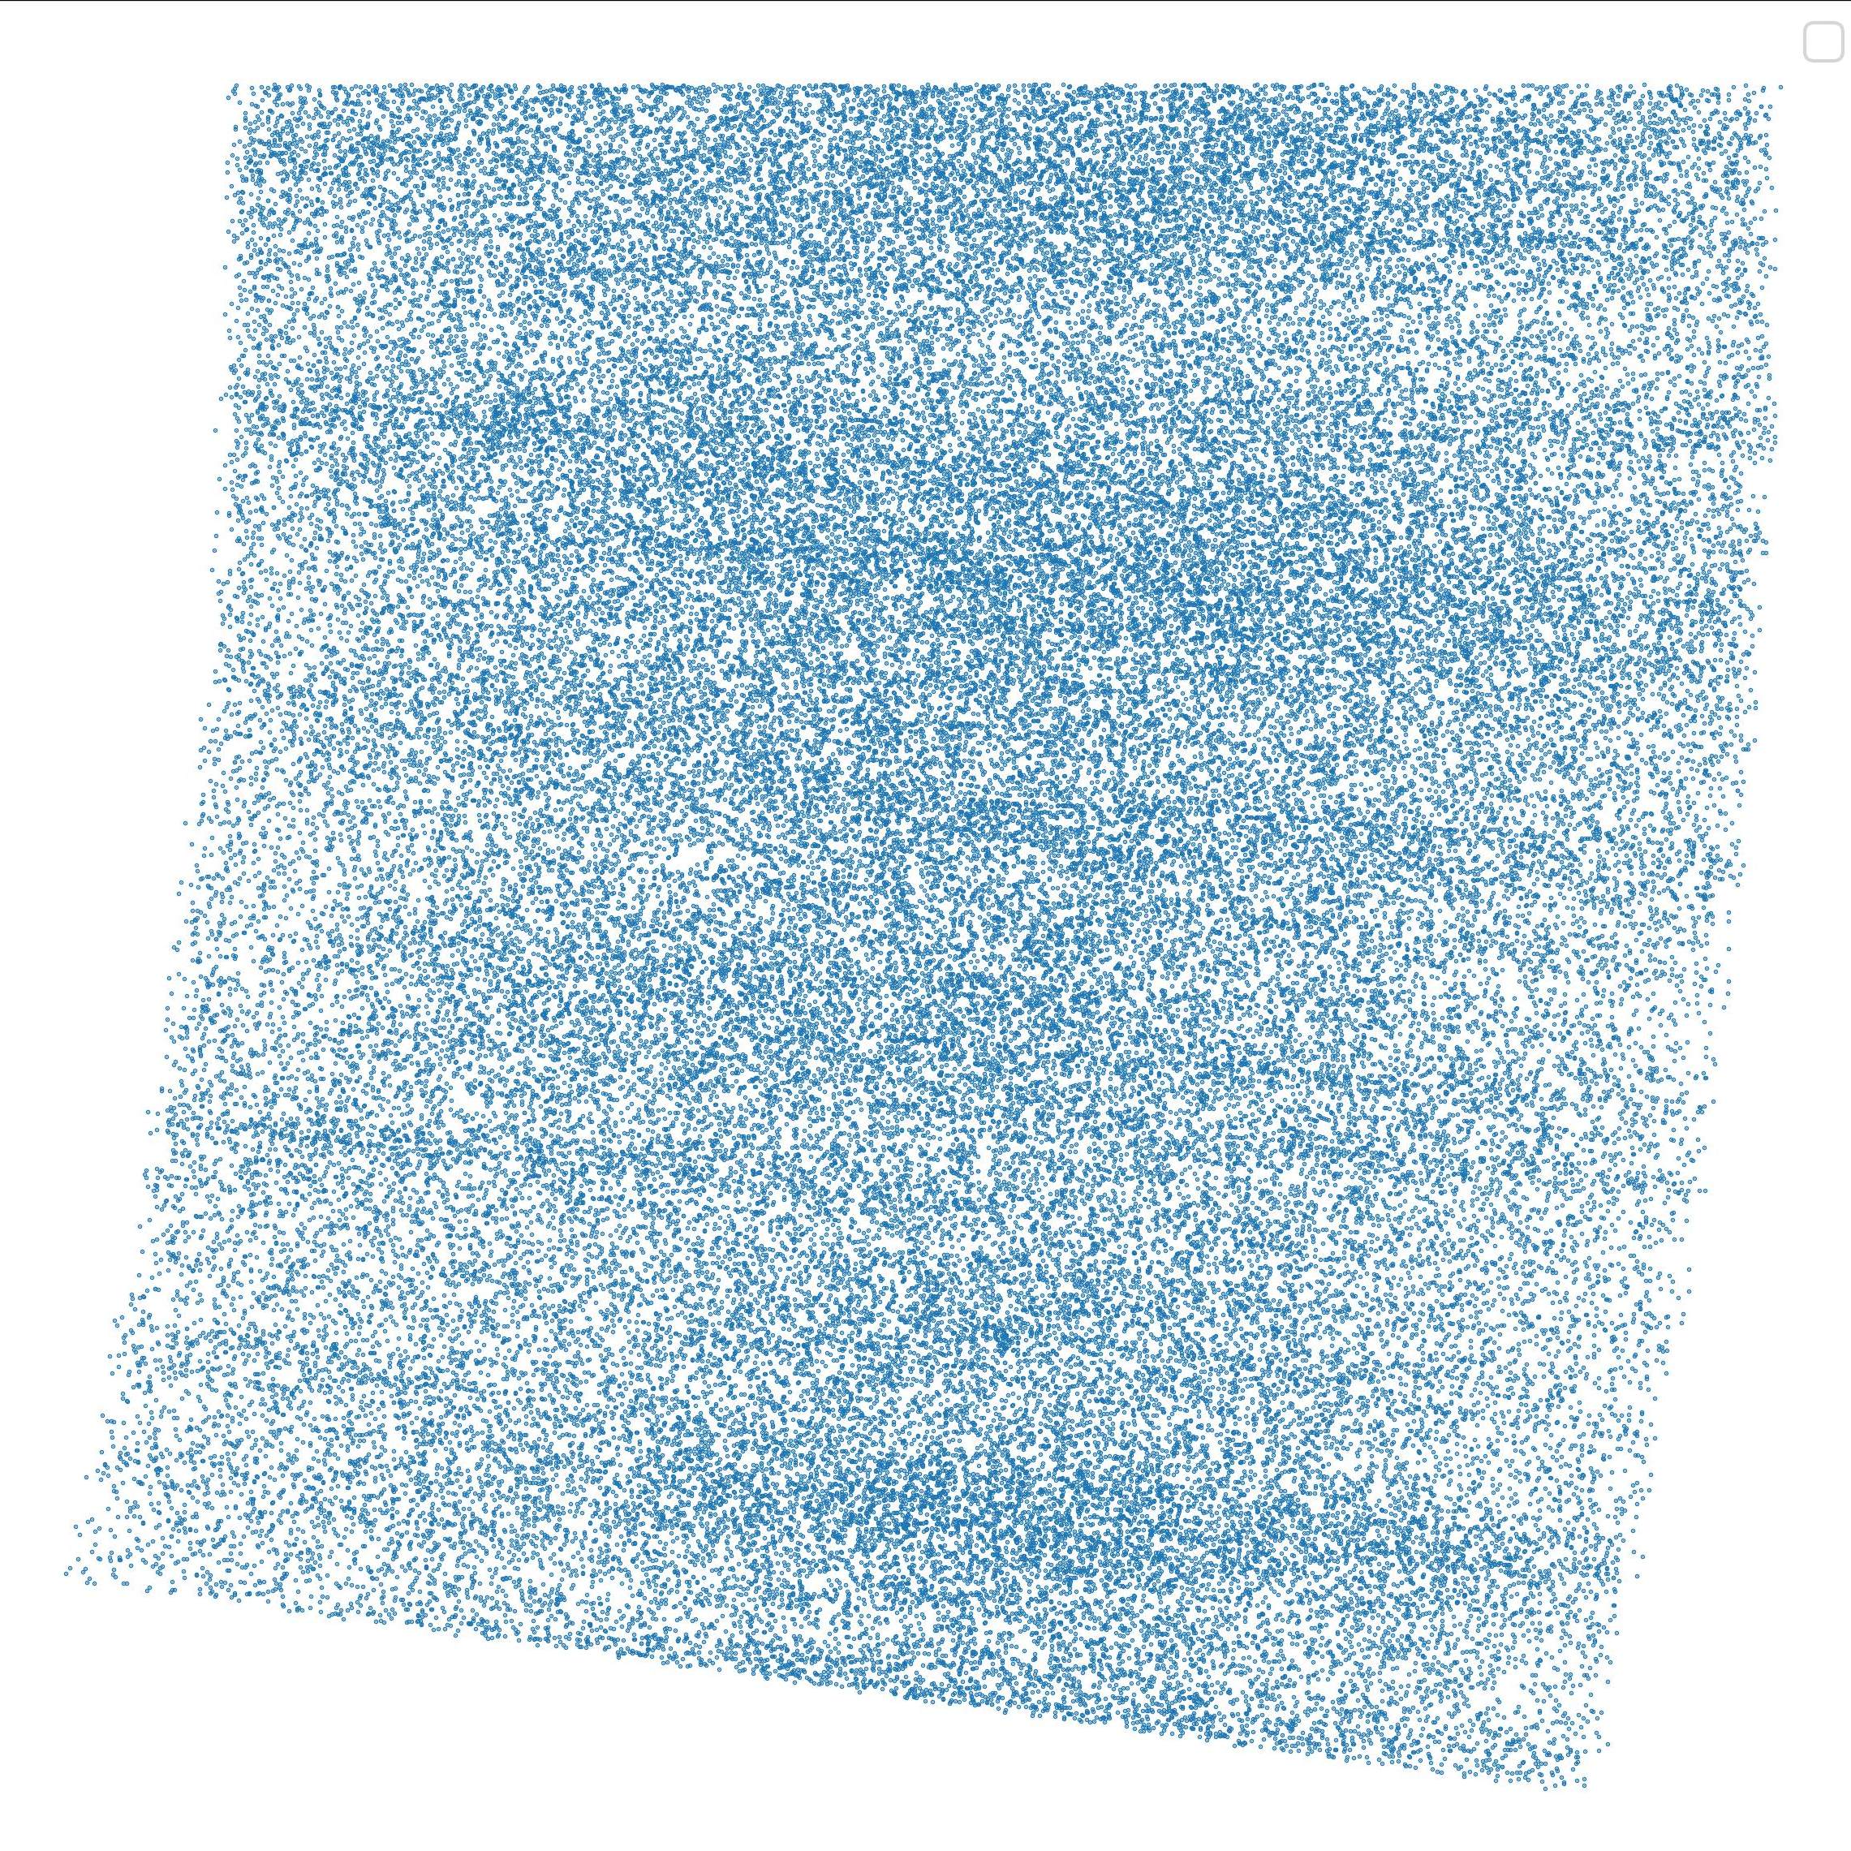
Photometric
redshifts
Introduction
LSST
2D voids
Cluster voids
VSF
Slice of Abacus lightcone
Without z-errors
With z-errors
Line-of-sight
GDR CoPhy
Pierre Boccard
02/06/26

Slide 16







Photometric
redshifts
Introduction
LSST
2D voids
Cluster voids
VSF
Mean displacement of galaxies (Mpc/h)
Assuming a Gaussian distribution
$$σ_{z}$$
$$z=0.5$$
$$z=1.0$$
$$z=1.5$$
$$0.005$$
17.0
16.8
15.9
$$0.01$$
34.0
33.5
31.7
$$0.02$$
68.0
67.1
63.4
GDR CoPhy
Pierre Boccard
02/06/26

Slide 17
How do you find voids in this mess ?

Slide 18
2D Voids

Slide 19
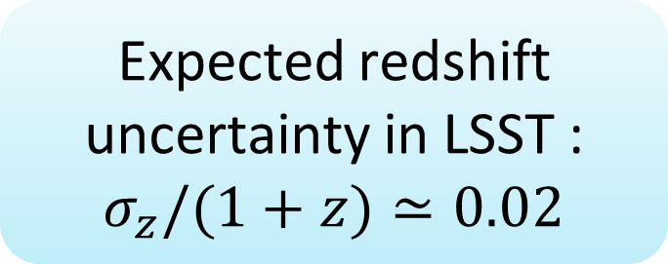
Photometric
redshifts
Introduction
LSST
2D voids
Cluster voids
VSF
We want to use as many galaxies as possible
Expected redshift uncertainty in LSST : $σ_{z}/(1+z)≃0.02$
Void Identification with VIDE is impossible
No LOS clustering
Use a 2D void finder
GDR CoPhy
Pierre Boccard
02/06/26

Slide 20
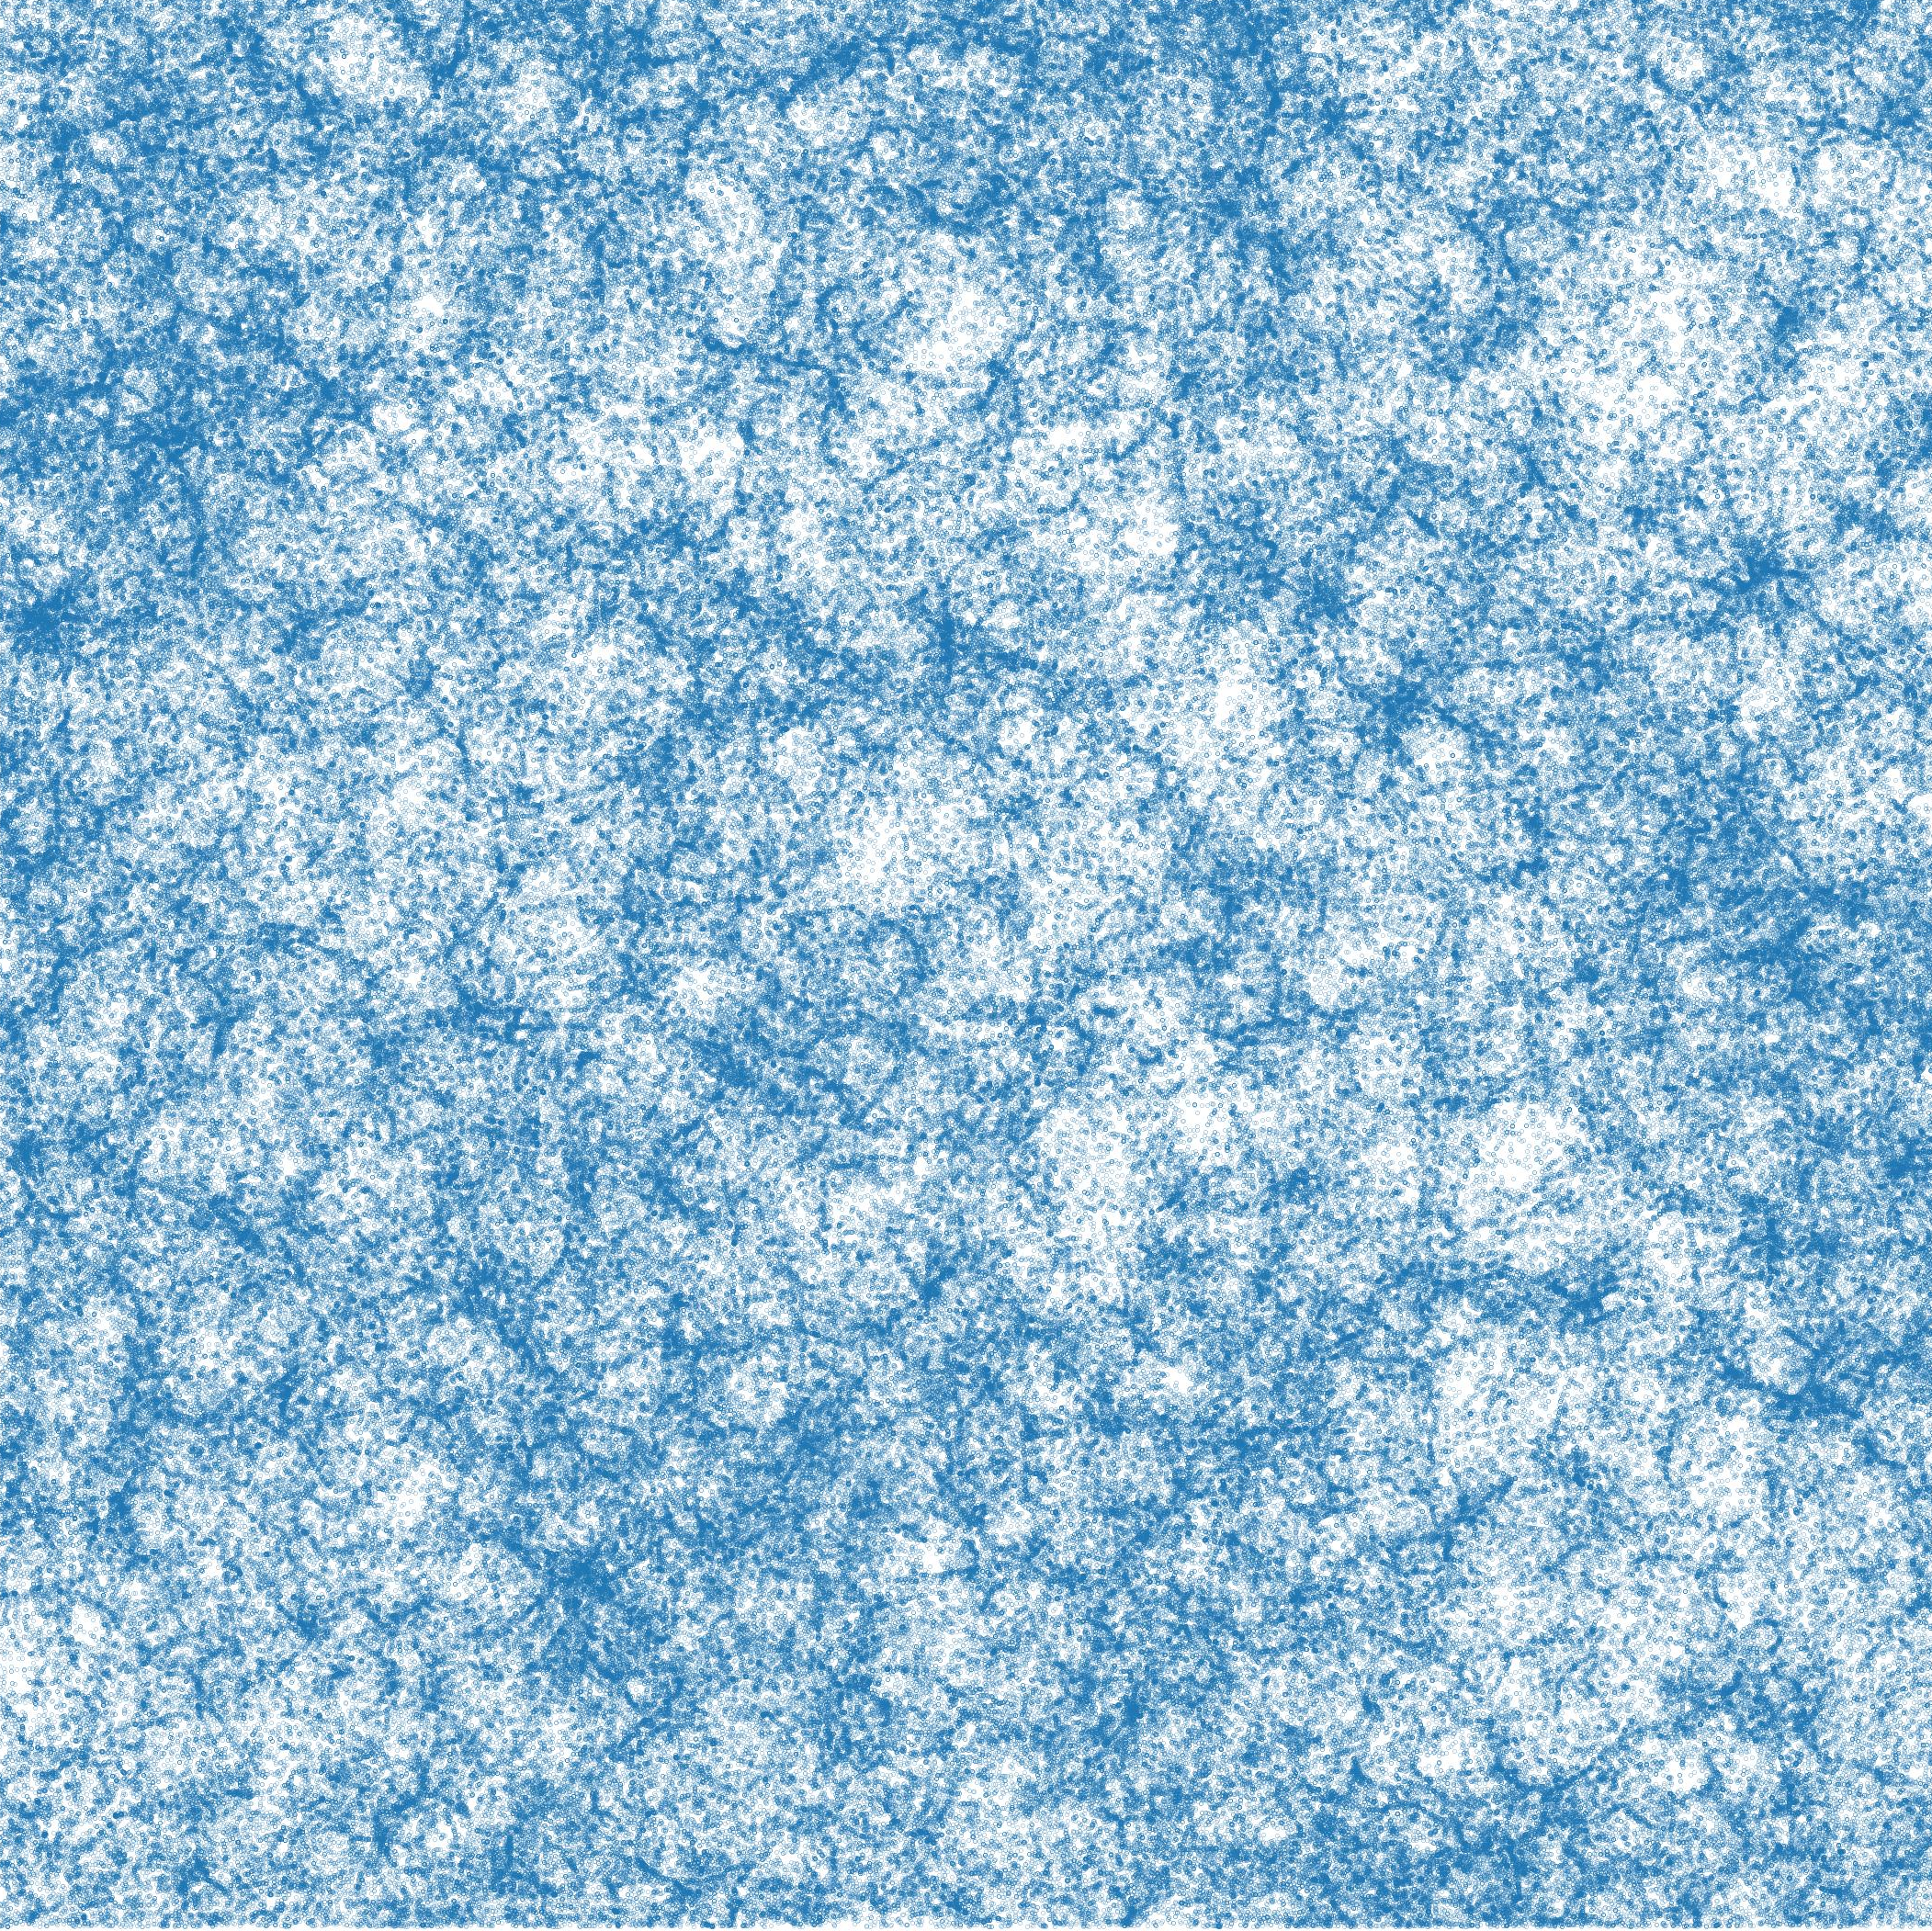
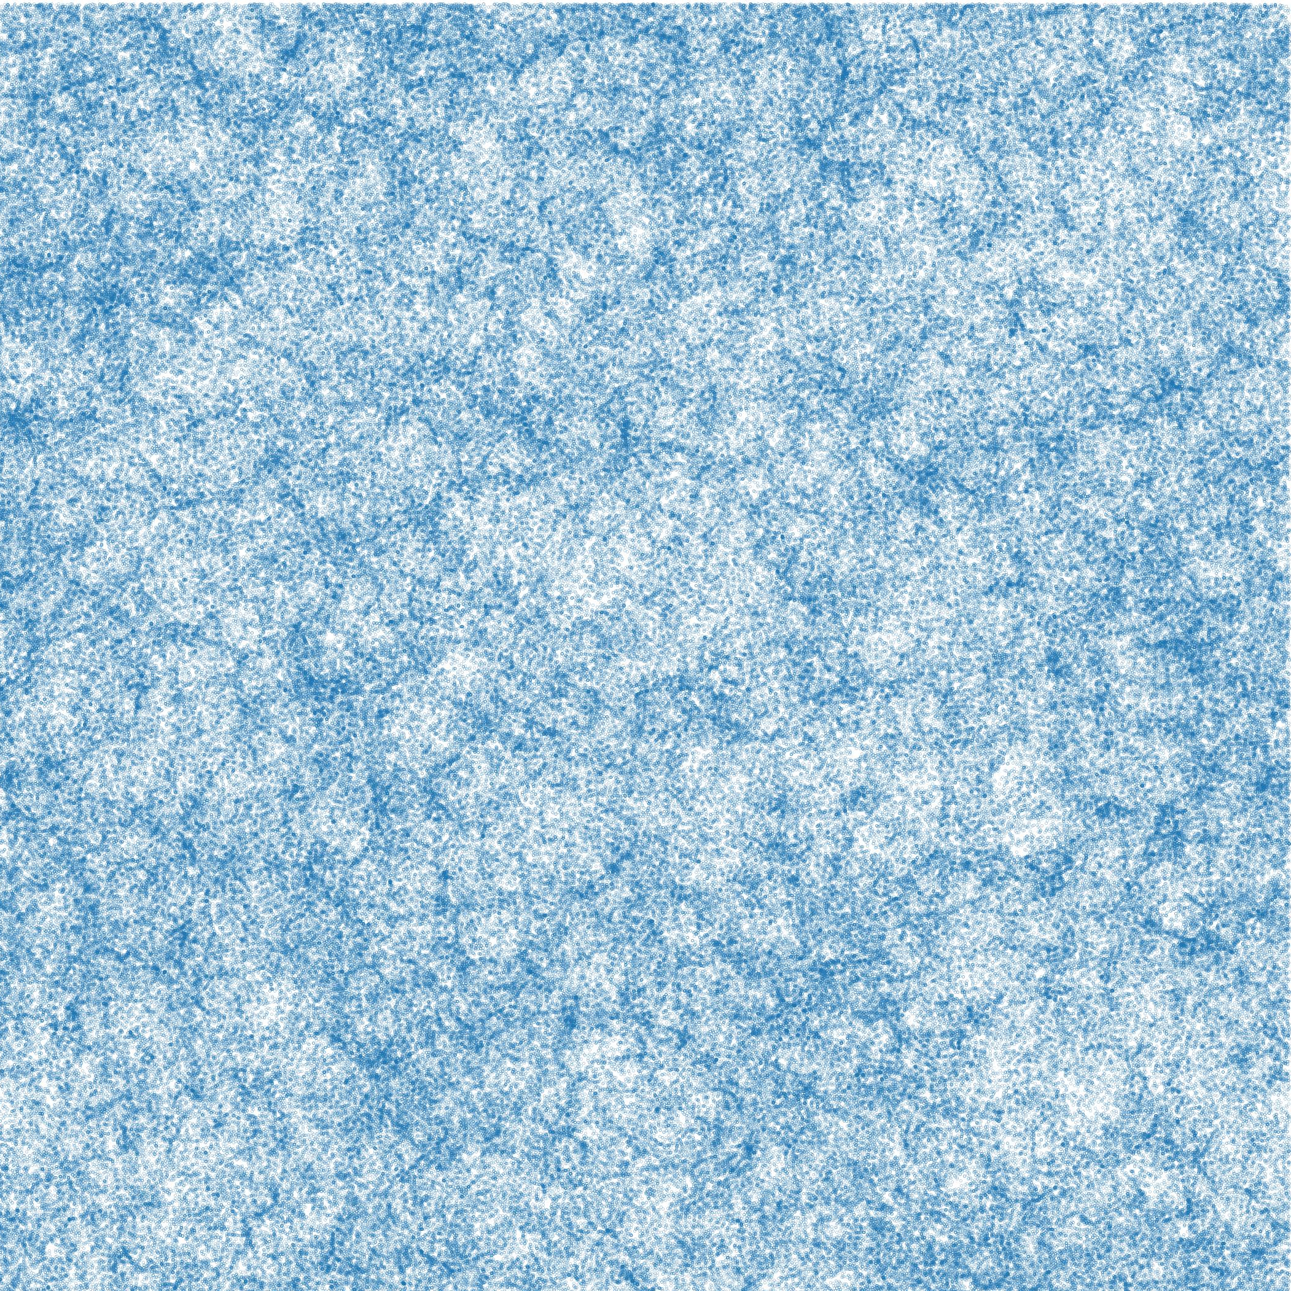
Photometric
redshifts
Introduction
LSST
2D voids
Cluster voids
VSF
Why does 2D work ?
True redshift
Photo-z
Slice 100 Mpc/h
GDR CoPhy
Pierre Boccard
02/06/26

Slide 21
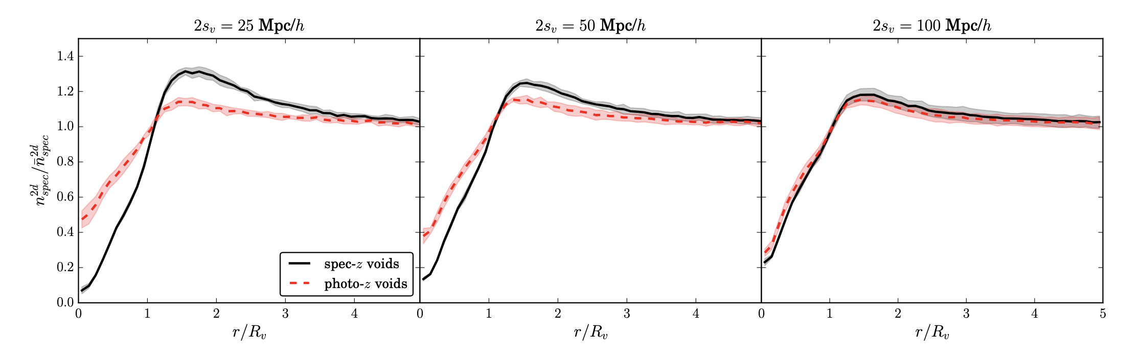
Photometric
redshifts
Introduction
LSST
2D voids
Cluster voids
VSF
Density profile in 2D
Sanchez et al. arxiv:1605.03982
GDR CoPhy
Pierre Boccard
02/06/26

Slide 22
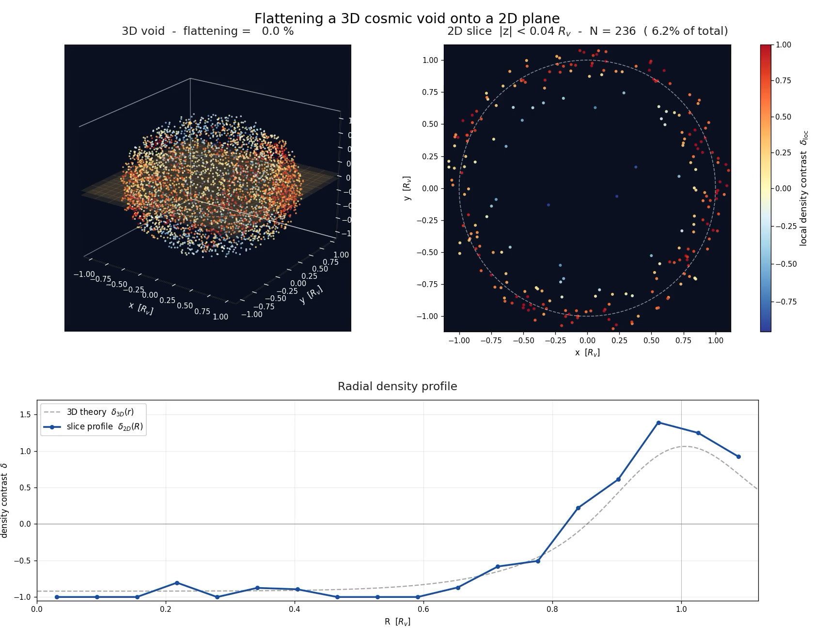
Photometric
redshifts
Introduction
LSST
2D voids
Cluster voids
VSF
GDR CoPhy
Pierre Boccard
02/06/26

Slide 23
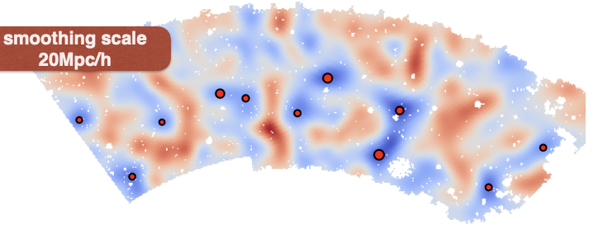
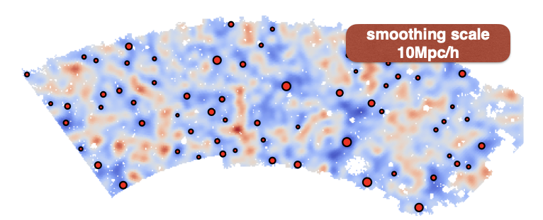
Photometric
redshifts
Introduction
LSST
2D voids
Cluster voids
VSF
Slice the sample in redshift bins of ~100 Mpc/h and project on a 2D plane.
Compute the density field and applying Gaussian smoothing
Identify the most underdense pixel and grow the void to a density threshold
Current work : establish an analytical connexion between the density contrast in 3D to the one in 2D
Sanchez et al. arxiv:1605.03982
GDR CoPhy
Pierre Boccard
02/06/26

Slide 24
Cluster Voids

Slide 25
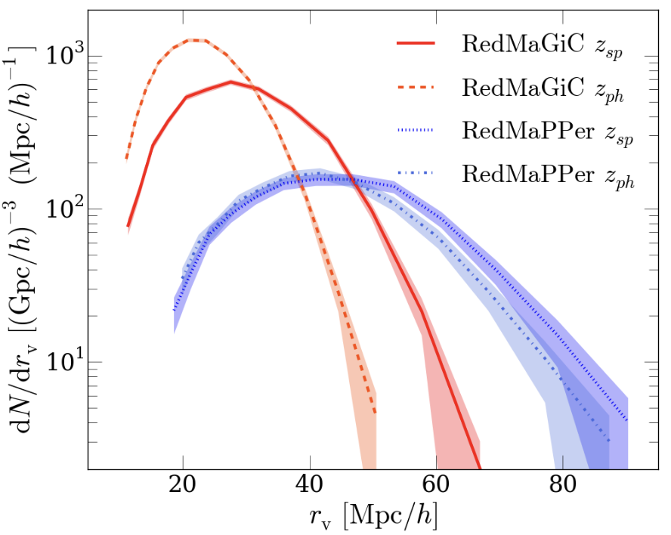



Photometric
redshifts
Introduction
LSST
2D voids
Cluster voids
VSF
$$σ_{z}/(1+z)=0.01$$
$$σ_{z}/(1+z)=0.017$$
$$M>{10}^{13}h^{−1}M_{⊙}$$
Cluster voids means using clusters
(= more biased tracers)
Some previous studies exist on the cluster VSF
Galaxy cluster VSF significantly different than galaxy VSF
More robust to photo-z errors
Pollina et al. arxiv:1806.06860
GDR CoPhy
Pierre Boccard
02/06/26

Slide 26
The Void Size Function
GDR CoPhy
Pierre Boccard
02/06/26

Slide 27
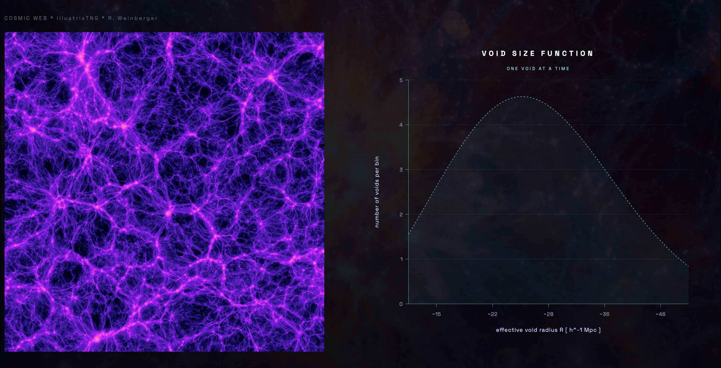
Photometric
redshifts
Introduction
LSST
2D voids
Cluster voids
VSF
GDR CoPhy
Pierre Boccard
02/06/26

Slide 28
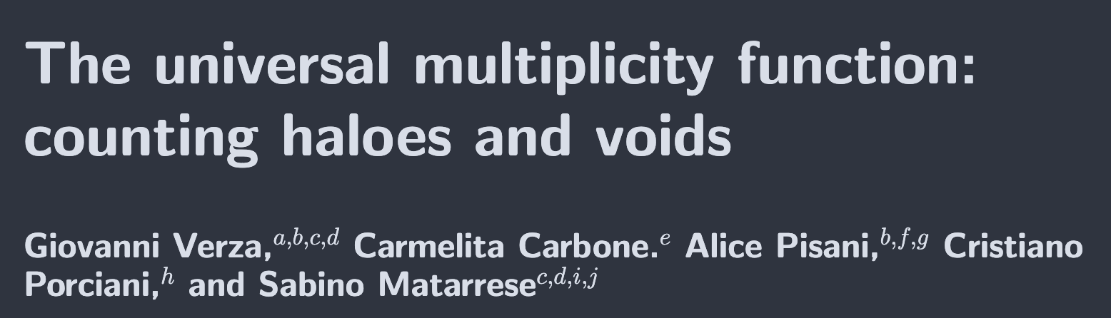
Photometric
redshifts
Introduction
LSST
2D voids
Cluster voids
VSF
Theoretical model
Verza et al. arxiv:2401.14451
GDR CoPhy
Pierre Boccard
02/06/26

Slide 29
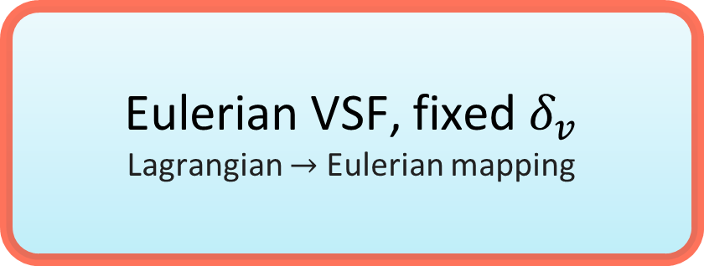
Photometric
redshifts
Introduction
LSST
2D voids
Cluster voids
VSF
Excursion set + peak theory
Lagrangian density peaks
Effective moving barrier
Multiplicity function
First-crossing distribution of the moving barrier
Lagrangian VSF
dn/dR in lagrangian space
Eulerian VSF, fixed $δ_{v}$
Lagrangian $→$ Eulerian mapping
GDR CoPhy
Pierre Boccard
02/06/26

Slide 30
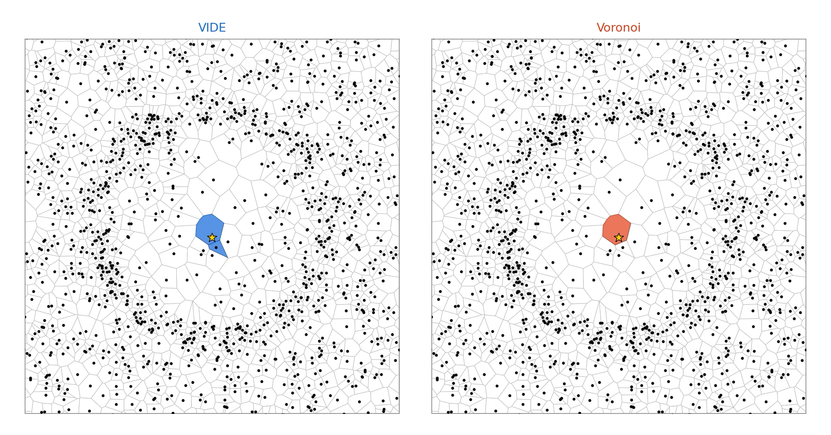
Photometric
redshifts
Introduction
LSST
2D voids
Cluster voids
VSF
VIDE voids are topological voids
In the model, voids have a density threshold
Post-process to reach density contrast used in the theoretical model to compare both
GDR CoPhy
Pierre Boccard
02/06/26

Slide 31
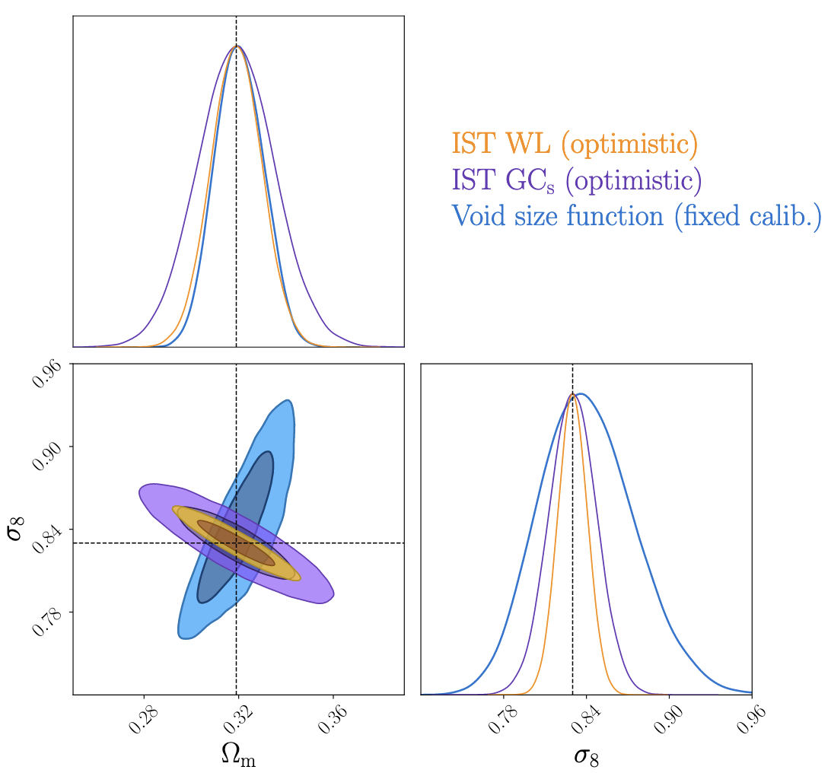
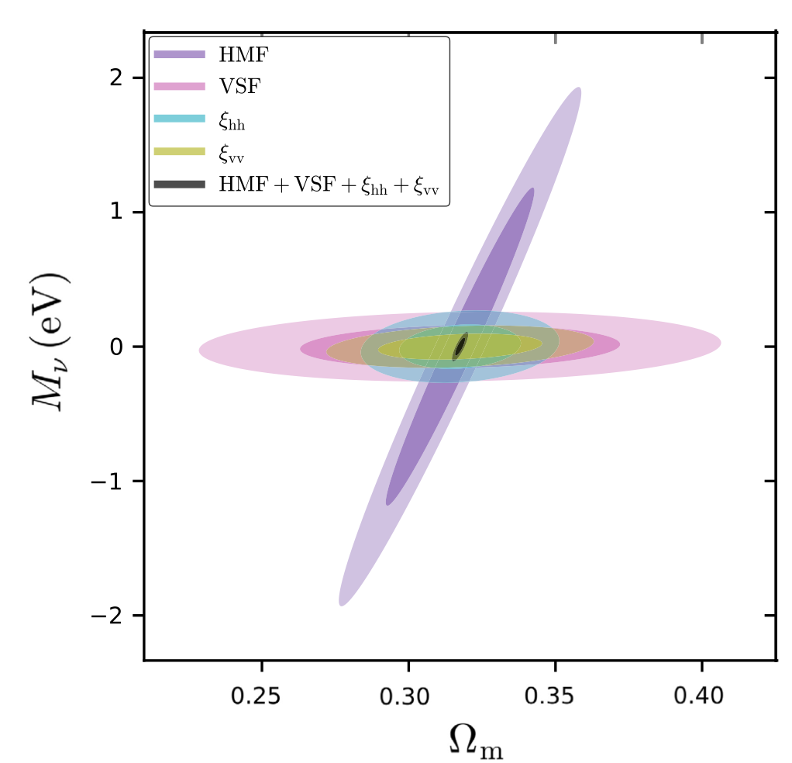

Photometric
redshifts
Introduction
LSST
2D voids
Cluster voids
VSF
Contarini et al. arxiv:2212.03873
VIDE voids are topological voids
In the model, voids have a density threshold
Post-process to reach density contrast used in the theoretical model to compare both
VSF is directly related to $P(k)$
Complementary to other classical probes
Powerful tool for physics beyond standard model : modified gravity and the sum of neutrinos masses
Kreisch et al. 2020
GDR CoPhy
Pierre Boccard
02/06/26

Slide 32
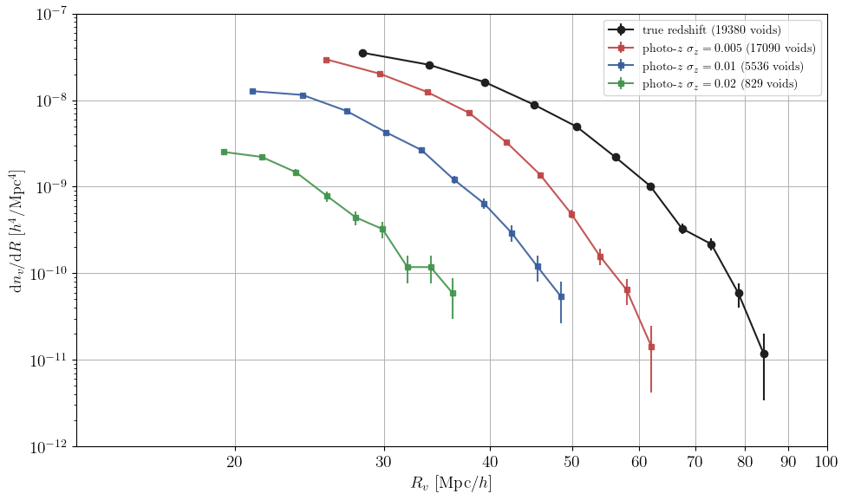

Photometric
redshifts
Introduction
LSST
2D voids
Cluster voids
VSF
Voronoi VSF in Abacus mock lightcone$M>2\text{x}{10}^{12}h^{−1}M_{⊙}$
GDR CoPhy
Pierre Boccard
02/06/26

Slide 33
Conclusion
LSST will provide enormous quantities of galaxies/clusters but photo-z are a real obstacle
Use 2D voids, connect those voids to true redshift 3D voids (in progress)
Use cluster voids to keep using VIDE+Voronoi (main work of PhD)
Several questions :
  How are the cosmological constraints affected by photo-z errors ?
  How many clusters and cluster voids should we expect in LSST observations ?
  Photo-z errors in LSST are not simply Gaussian (non-Gaussian tails, catastrophic outliers, systematic biases), how do we incorporate this in the model ?
Thank You
GDR CoPhy
Pierre Boccard
02/06/26

Slide 34
Appendix

Slide 35
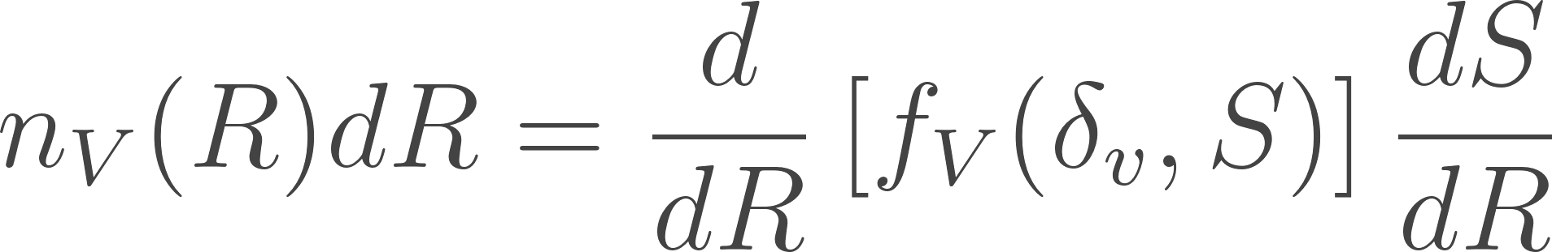
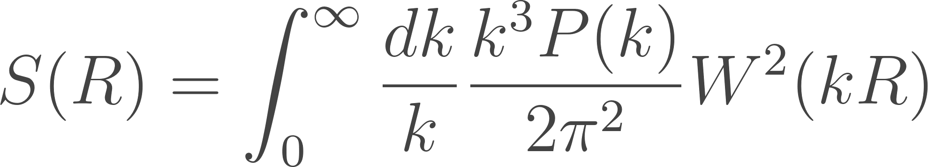

Slide 36
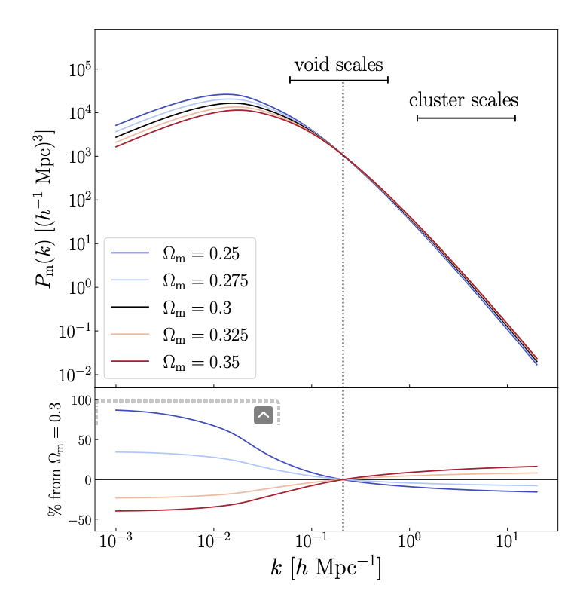
Contarini et al. arxiv:2212.03873

