Slide 1



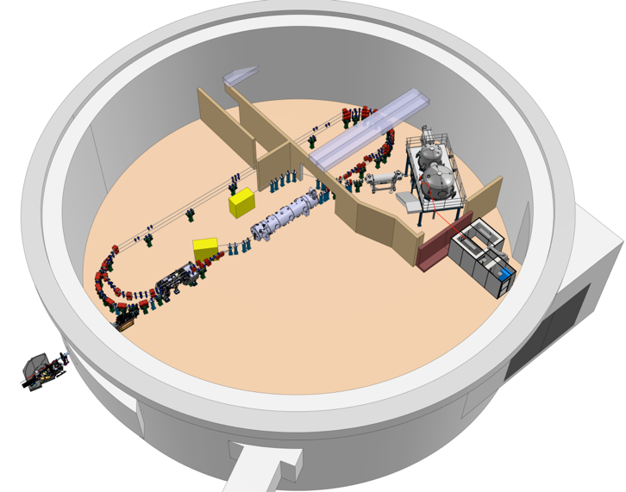


Project Progress Review (PPR) 1-2026
WP- 08: RF systems
Présenté par C. JOLY pour le compte de l’équipe
N. Belouchrani*, X. Lafay, S. Berthelot, J-F. Yaniche, O. Frossard, A. Martens, P. Gauron, F. Bouly, A. Buthod, C. Guérin with a strong interaction with the IDROGEN Team :
D. Charlet, A. Back, C. Esnault, M. Taurigna, C. Cheik-ali , C. Soulet, Gaetan Seuillot, Mathias Vecchio, Sid Ali Cherrati in collaboration with P-E. Potty , Michel Lours( LTE lab) , Cédric Viou (ORN lab).
PhD student CIFRE IJCLab & ASC

Slide 2
Etat d’Avancement TDR
TDR with a global definition of the RF systems in progress :
- VIII. RF systems (indicatif: ~ 25 pages max) → revision received ( standby)
A. Introduction
B. Requirements
C. Distributed Master Oscillator
D. Timing system
E. Frequency Tuning System
F. RF power system
LLRF system
And a chapiter on MPS : → in standby (in collaboration with Maud, Aurore and Fred )
- IX. Machine protection System
A. Introduction
B. Requirements
C. MPS architecture and solutions

Slide 3
Etat d’Avancement
Cavity qualification facility upgrade → 1 kW amplifier SAT : DAQ test bench development finished for additional tests with the RF components needed for the SRF cavity qualification test bench. Installation in progress. PLL improved must be tested. (S. Berthelot, N. Belouchrani, C. Joly)
MO & Timing : Use of IDROGEN board solution associated to one mezzanine board (FMC REFGEN) and a µRTM board locally providing the timings signal → Electronic design in progress and VHDL implantation in progress into the IDROGEN Board. (X. Lafay & C. Joly)

Slide 4
Etat d’Avancement
→ REFGEN prototype manufactured , firmware developed by Engineering pole. Firsts tests realized with REFGEN + IDROGEN. Improvements in progress with a new PLL allowing to generate RF signals until 3.2GHz and probably a new low noise amplifier per channel→ new version planned for the series. Tests of jitter of the new PLL realized (N .Belouchrani) but complementary tests needed with T° variation.
→ two IDROGEN v3 manufactured for our new LLRF test Bench. One is configured into master and
Another in Slave. The next measurements campaign is planned the two next weeks for improving the jitter in mode Slave. The new Phase noise analyser is received and several measurements are in progress to see the impact of different architecture of WR system with the IDROGEN (in mode slave) jitter on the LLRF system.
N. Belouchrani, D. Charlet, A. Back, C. CHEIK-Ali, C. joly
Écart type sur ~1h en Phase : 0.27° dans cette configuration
Test with only IDROGEN (Master and slave board in progress) with some difficulties.

Slide 5
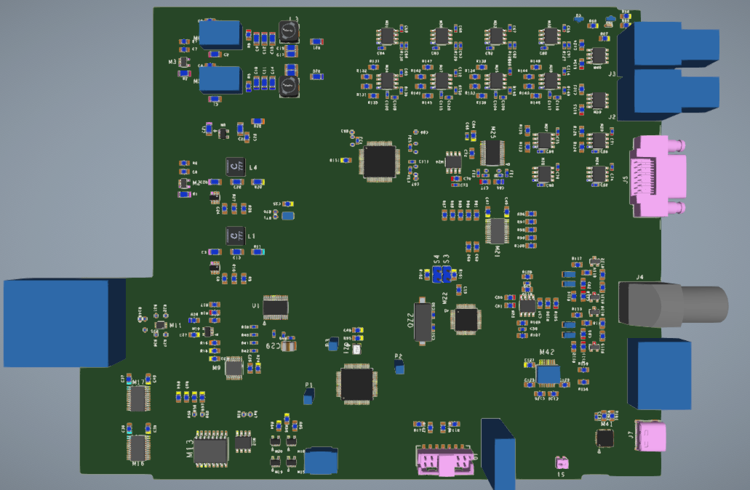
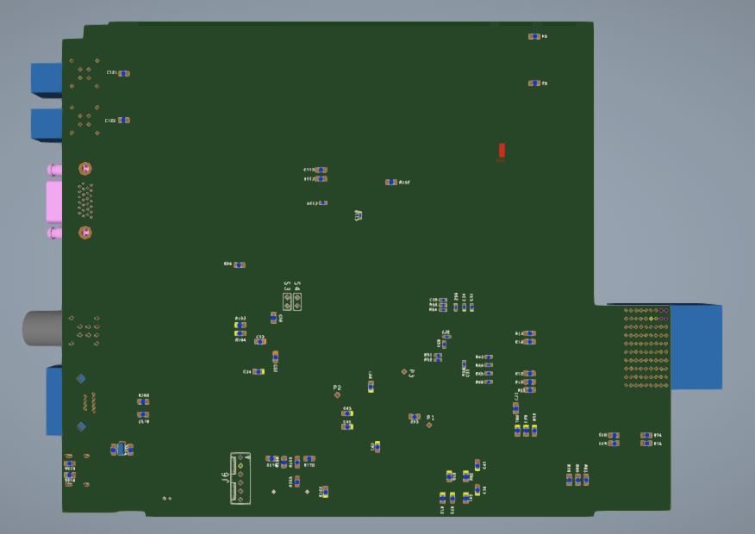
Etat d’Avancement
FTS (Frequency Tuning System) C&C board
→ The layout is in progress at IP2I Lyon with placement realized, Power plan too. (A. Buthod)
→ Power module design adaptation realized
and components received (J-F. Yaniche)
RF powers Amplifiers
→ a prototype of RF power SSA : Kick off meeting realized with a delivery planned end of November.
(M. Adnane, S. Berthelot & C. Joly)
LLRF
→ 4 RF front-end RDC1470 v2 received. Configuration is progress with a objective to use a distribution Debian 13 implying a new EPICS compilation (P. Gauron & C. Joly) before the characterization measurements at 801.58MHz for improving the performances in terms of SNR if it is possible using a RF reference providing by REFGEN+IDROGEN.

Slide 6
Planning et Principaux Jalons du WP-8 : RF systems
Design
First electrons
5 mA
Procuirement / Construction / Installation
DC Gun @350 keV
20 mA
Commissioning
DC gun
operation
Buncher installation
Booster installation
Booster
RF sources upgrade
Injector @ 7MeV
5 mA
20 mA
DMO & Timing
€
Board proto
series
FeedBack system
€€
Series proc.
Frequency tuning system
€
Pw mod proto
& Board proto
series
Cavity Sim. and algorithms opt.
PhD student work
Cryomodule
installation
First ERL
demonstration
0.5MW
€
Cavity Qualification facility upgrade
RF proc. & modification
PERLE 1-LOOP 89MeV
€€€
series
2MW
RF power Amplifiers (9 x SSA)
SSA prototype
8.8kW ordered
series
ERL 1-LOOP
TDR
Cryogenic
installed
IGLOO ready
2024
2025
2026
2027
2028
2029
2030
2031

Slide 7
Points de vigilance
Disponibilité des ressources:
Ing Conception → C. Joly, 1 T/AI CAO, routage → IP2I Lyon , suivi de prod
D. Charlet (~ mi 2027)
M. Taurigna (fin 2025)
Dépenses à prévoir ( à consolider) :
2025 ( budget demandé en en grande partie à reporter sur 2026 et 2027)
6k€ pour développement des cartes proto (TIMGEN et C&C FTS)
40k€ pour réaliser la série des modules de puissance FTS
30k€ pour réaliser la série des châssis d’interfaces RF
? Câbles
2026
116k€ approvisionnements cartes IOXOS (8 + 2 spares)
? Series IDROGEN+ REFGEN+ TIMGEN depending of needs (LLRF + others systems) +C&C FTS (8 + 2 spares)
80 k€ Châssis MTCA (9 native-R5 allowing to implement others needs )
? Lignes RF , RF cables and Timing
500k€ Circulateurs (nb: 8 for 60kW) and Loads (nb 8 : 240k€ for 80kW and RL = 30dB or 175k€ for 60kW and RL=26dB)
270k€ k€ Amplificateurs SSA (nb : 3 at 8.8kW) Phase 1 (~5mA) for the injector
2027
1.4M€ ? Amplificateurs SSA (nb 4 at 35kW) → Reflexion en cours avec G. Olry, R. Roux, …
2028
? Upgrade Amplificateurs SSA for the injector( power 10 kW to 50kW, bandwidth-dependent)
prototype racks Module puissance Piezo
~

