Slide 1
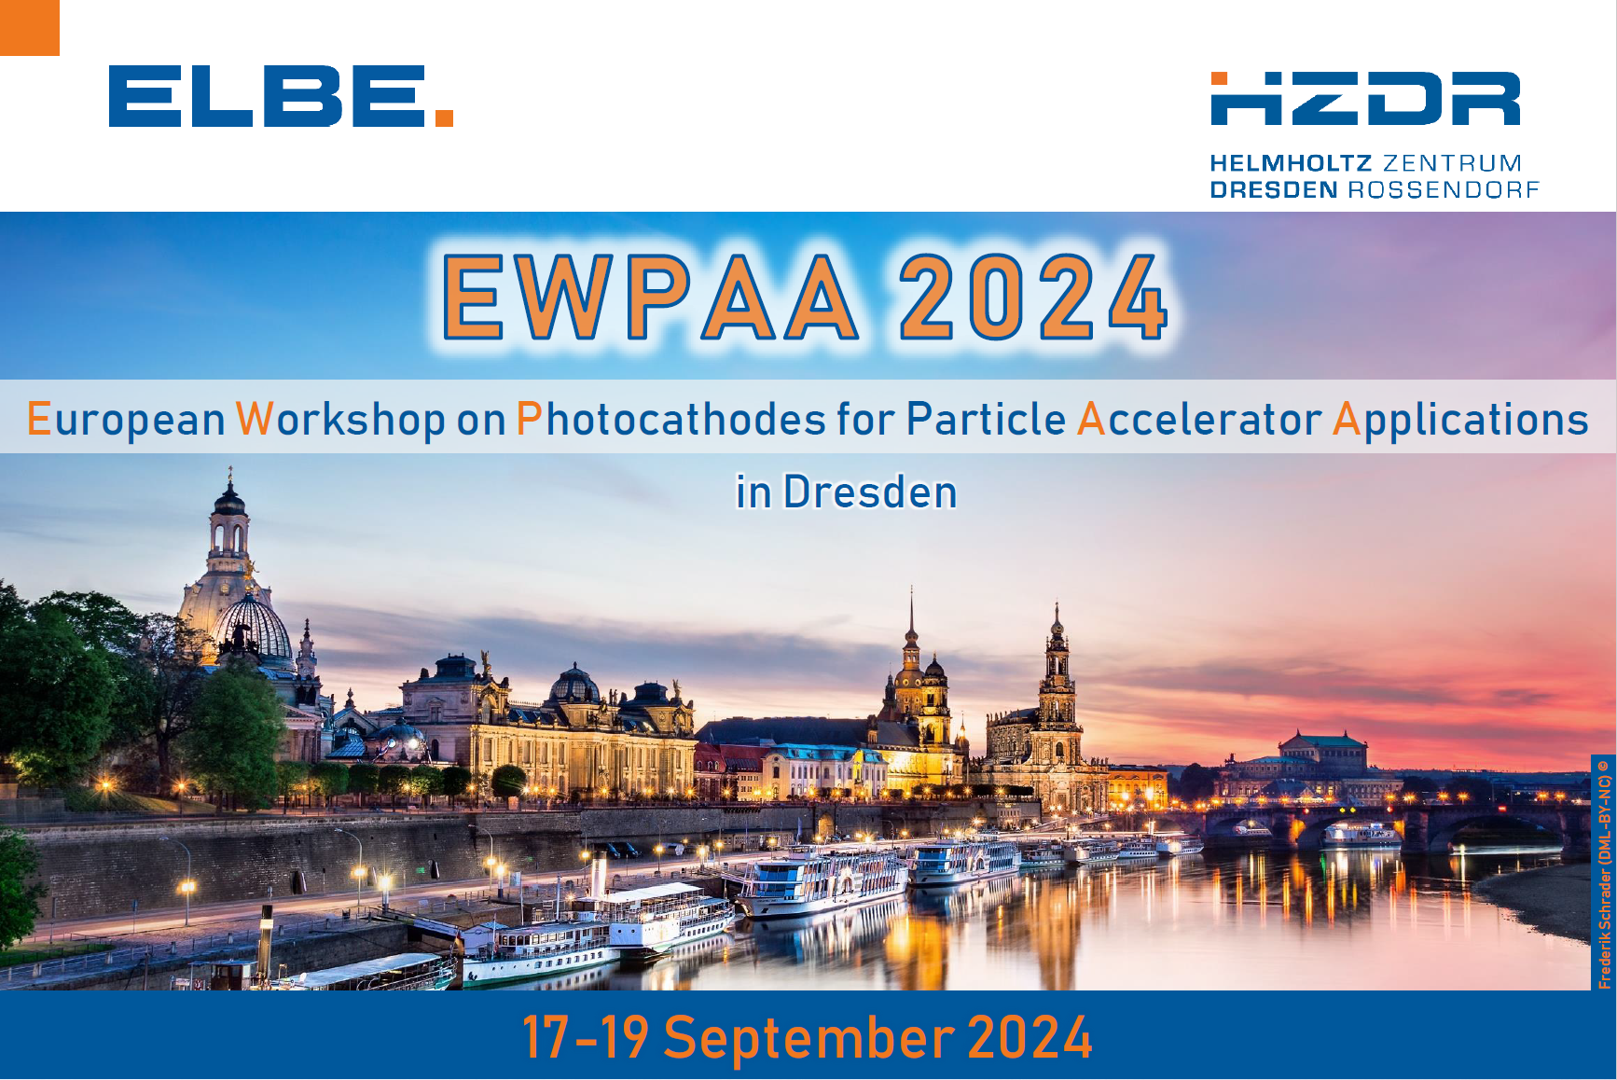
EWPAA 2024 Highlights
Rong Xiang (HZDR)

Slide 2
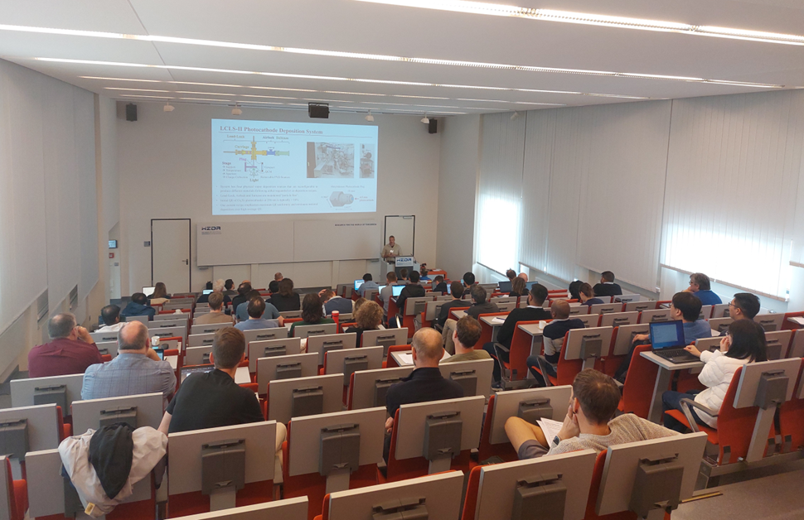
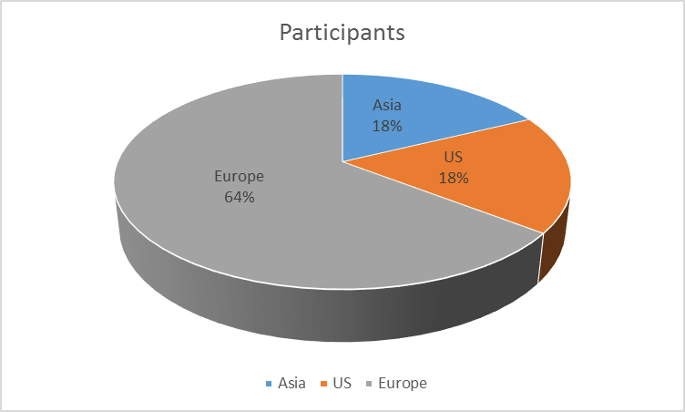
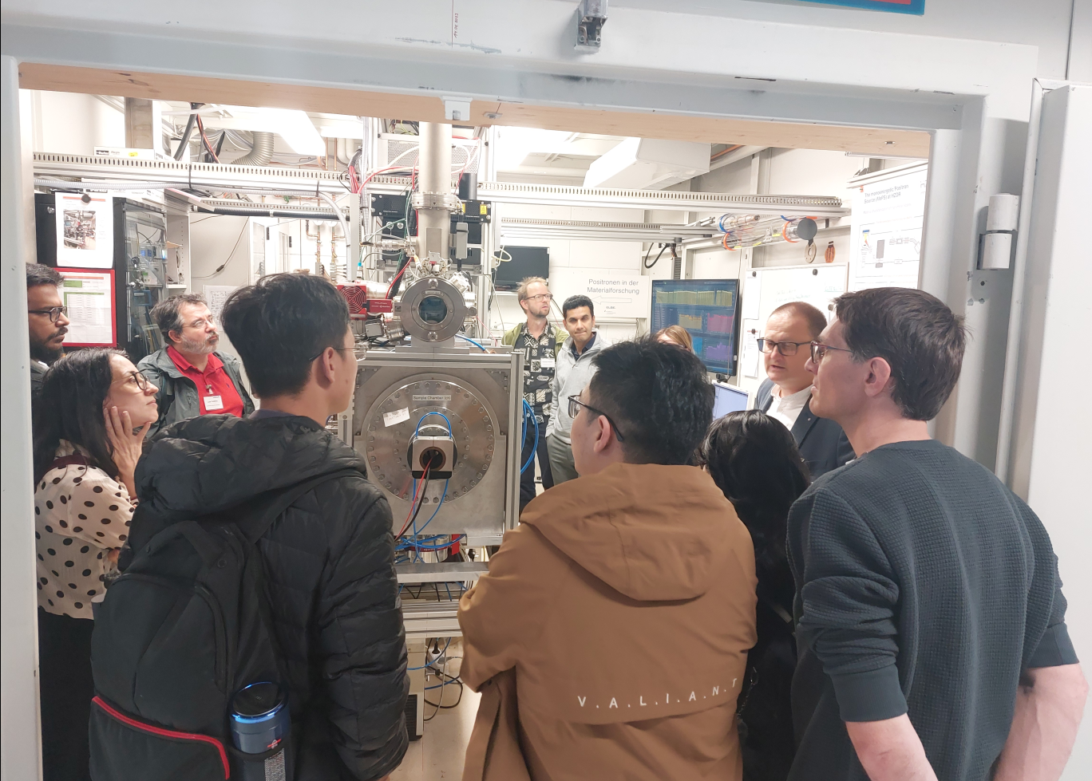
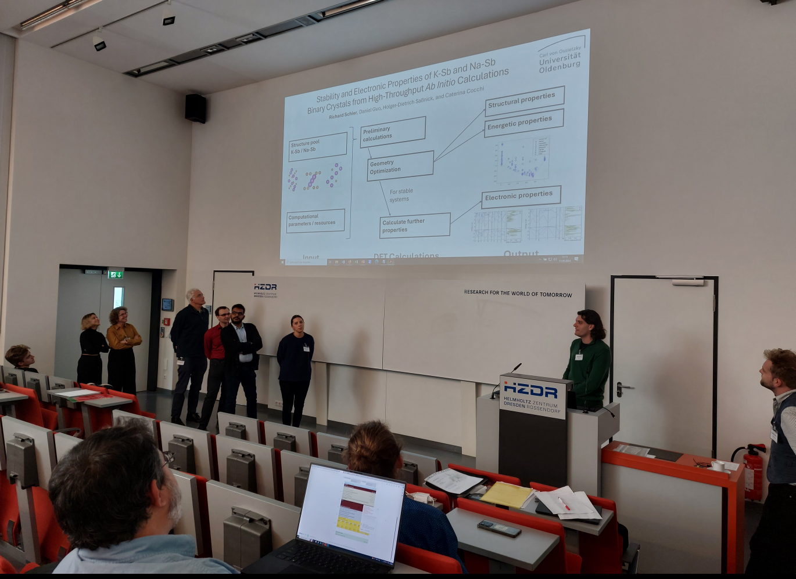
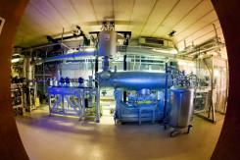

63 registered participants
7 oral sessions 26 presentations 1 speed talk session 1 Poster session lab tour

Slide 3
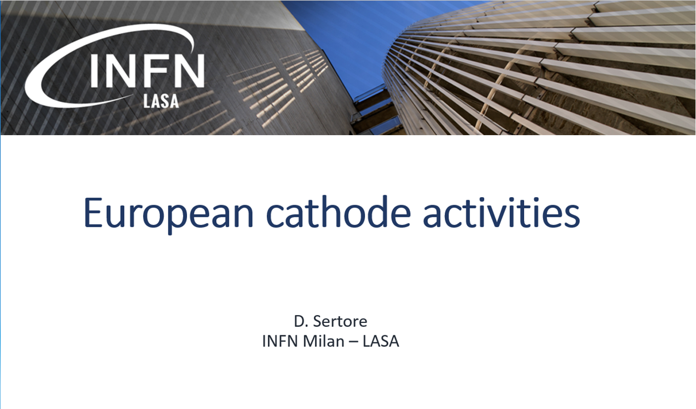
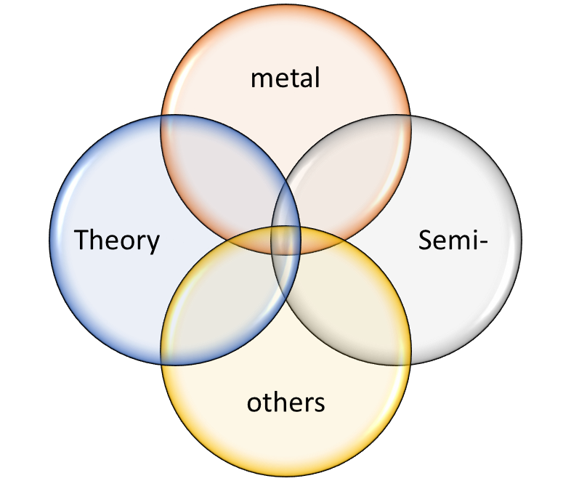
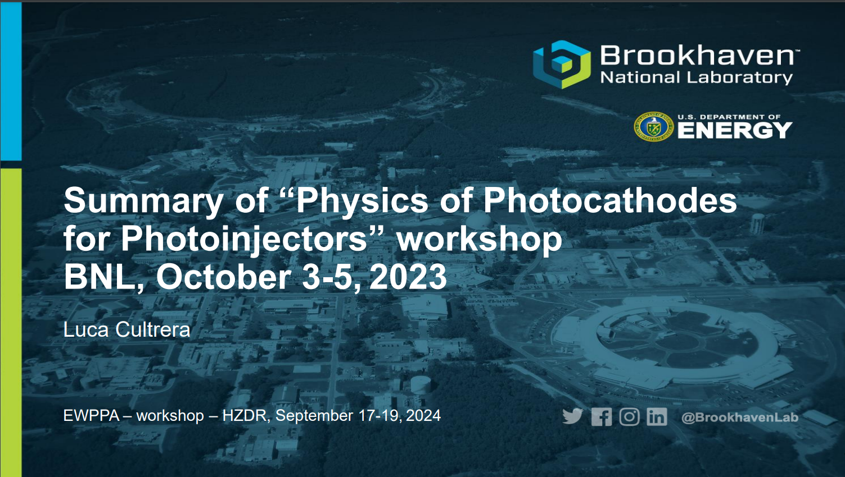


1. Overview session

Slide 4
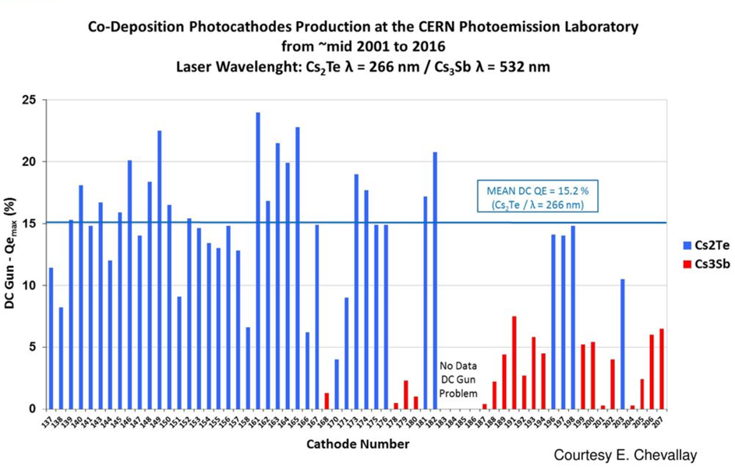
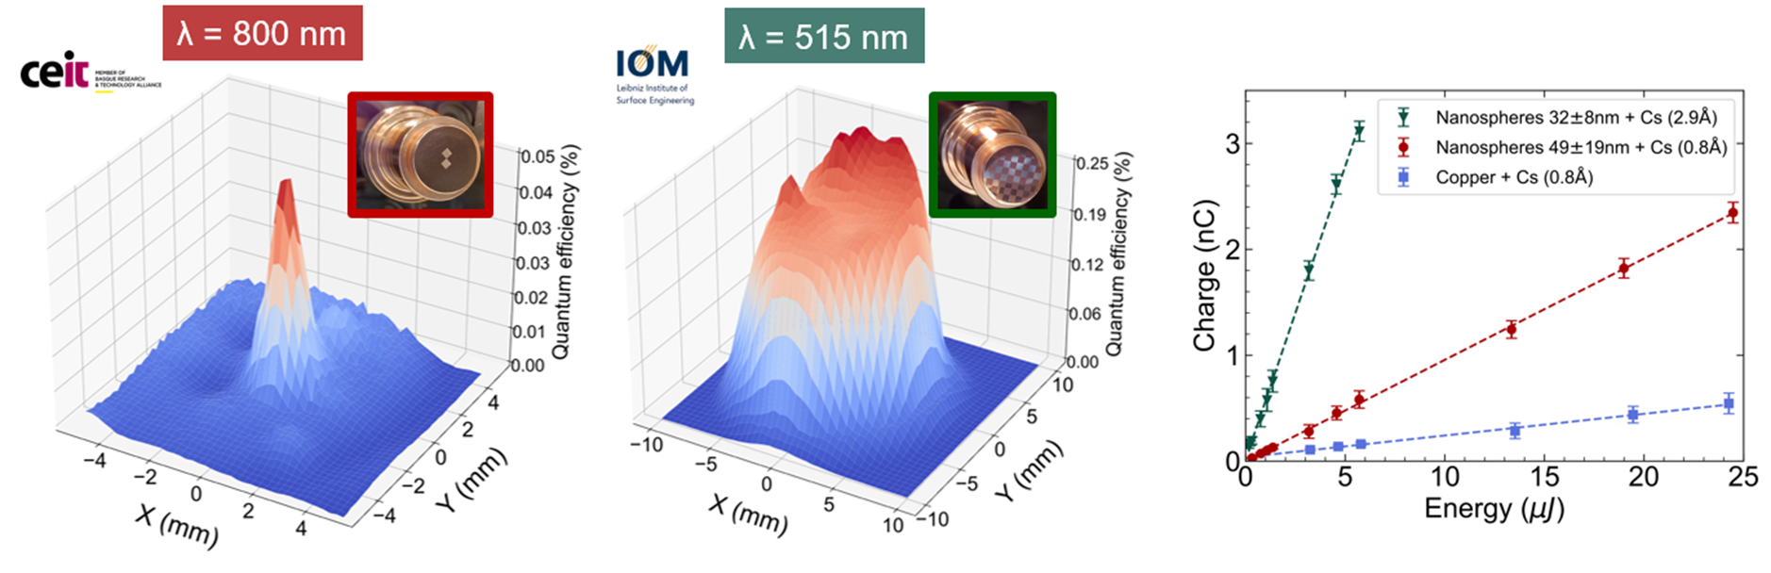
2. Photocathode Performance in Accelerator Applications
Boosting Photocathode Performance through Plasmonic Effects
and In-Situ Rejuvenation Techniques
Eduardo Granados (CERN)
photocathode lab been supporting accelerator operations for 25 years – Different cathodes, different accelerators
Rejuvenation of <aged> CsTe cathodes which have delivered nC bunches through re-deposition
Plasmonic photocathodes studied theoretically and experimentally
Notes:
CEIT’s photocathode shows consistent spatial distribution, but only 5x enhancement
IOM’s photocathode: wasn’t possible to spatially resolve the checkerboard, but 25x enhancement
Assessment of surface composition was realized with XPS, pointing at oxidation issues during laser treatment

Slide 5
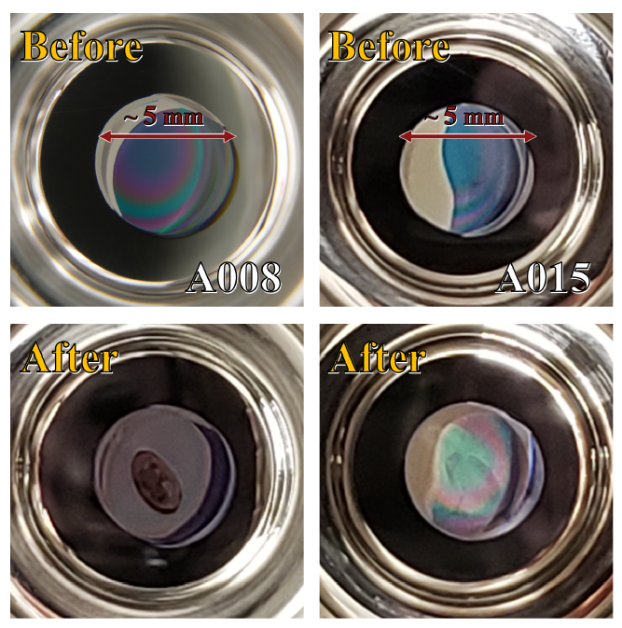
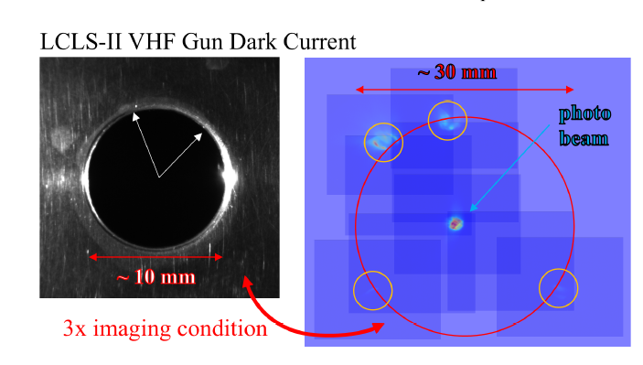
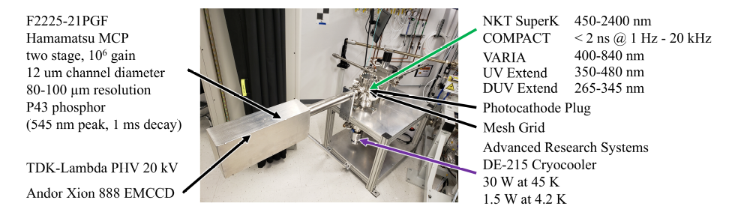
2. Photocathode Performance in Accelerator Applications
Photocathodes performance for LCLS-II
Theo Vecchione (SLAC)
Honest presentation, wanting to raise open questions and discuss solutions:
  LCLS Experiencing issues with dark current
  Cathode damage mechanism
A cryogenic ‘momentatron’ is currently being commissioned at SLAC.

Slide 6
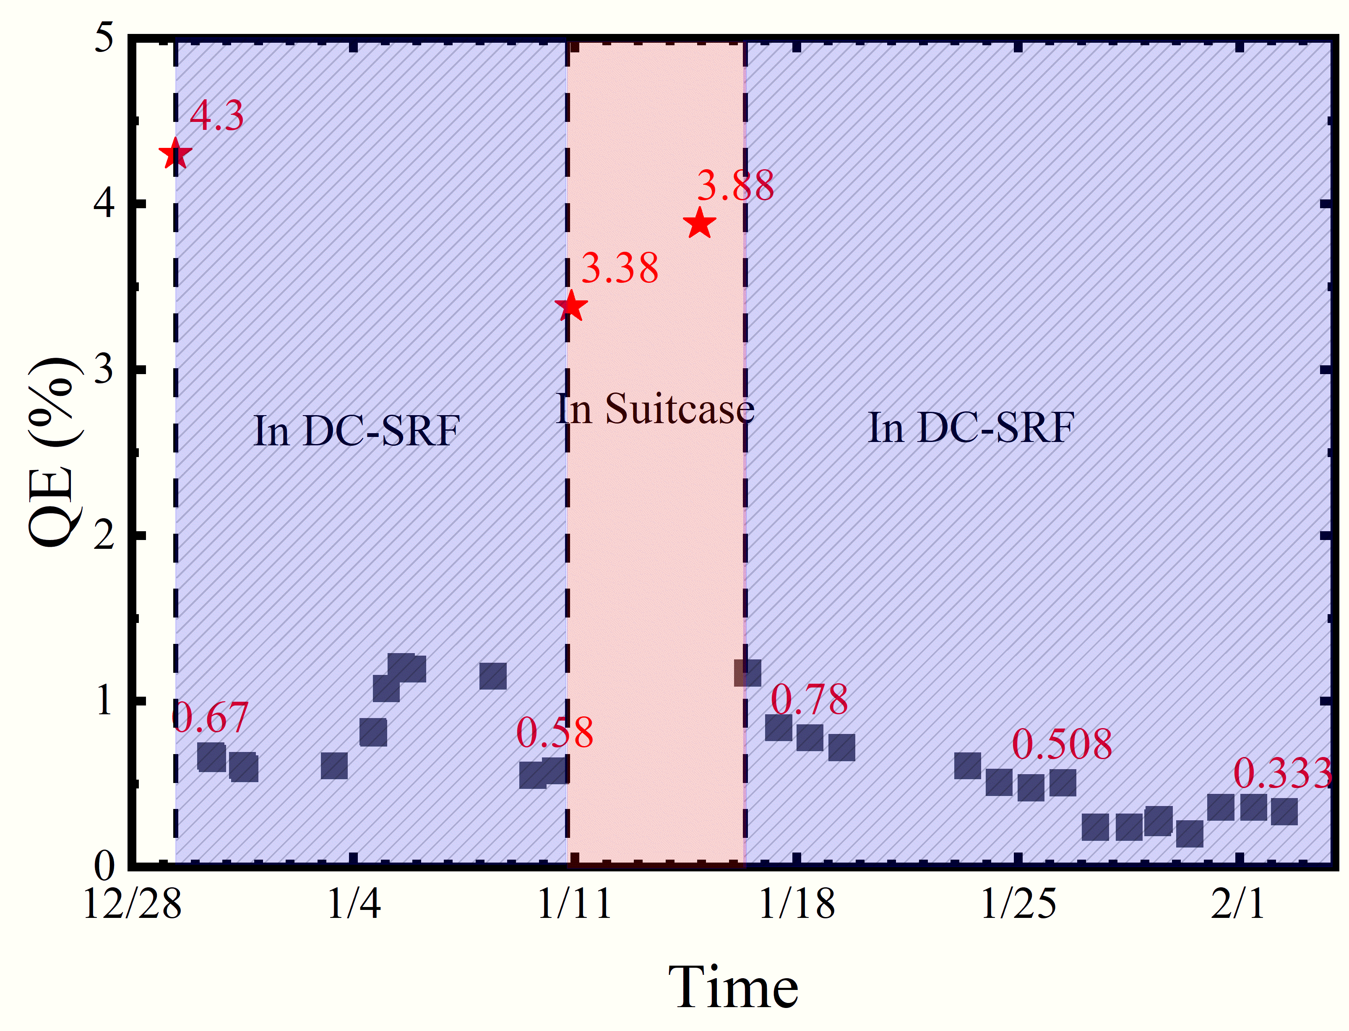
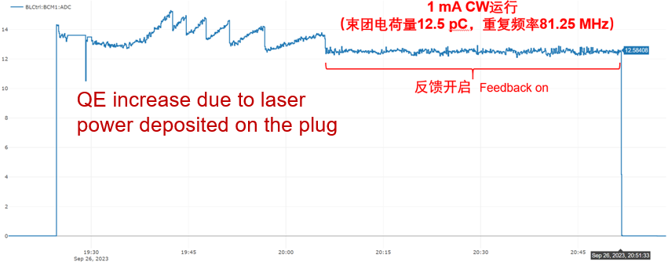
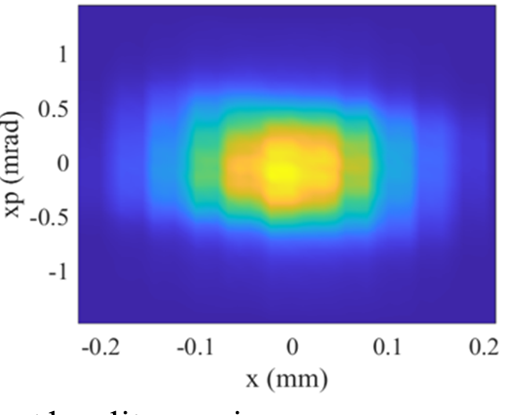
2. Photocathode Performance in Accelerator Applications
mA Current Level Operation of K₂CsSb Photocathode in DC-SRF-II
Huamu Xie (PKU)
Fast caesiation during cathode preparation
Successful operation in DC-SRF gun, CW Operation up to 3 mA demonstrated
Big loss of QE observed in low temperature, QE increased under high charge operations
Preliminary result: K₂CsSb intrinsic emittance ~ 0.5 μm at room temp., ~ 0.4 μm at 30 K

Slide 7
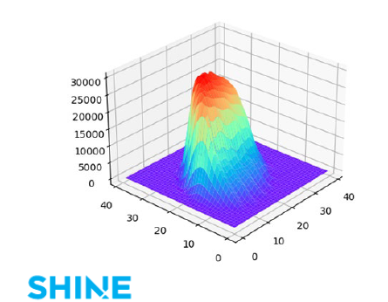
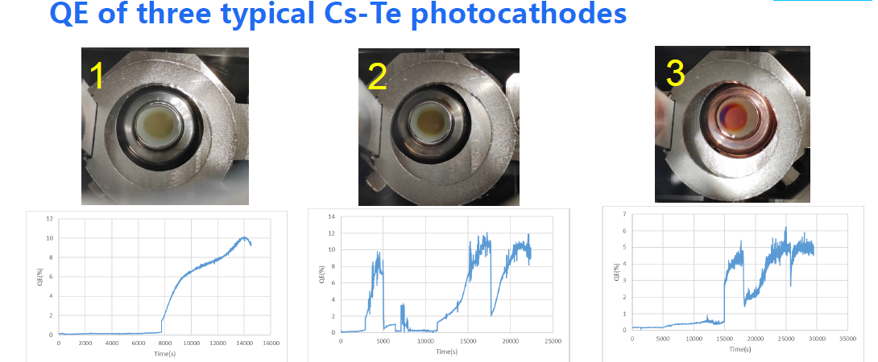
2. Photocathode Performance in Accelerator Applications
High QE photocathode preparations and tests at SHINE
Li Xudong (Shanghai Advanced Research Institute)
Two Cs-Te recipes were developed, and the QE is typically >5%@265nm.
1 MHz beam was generated at the SHINE gun.
Further optimize the cathode recipe based on the gun operation results (thermal emittance, lifetime, dark current, QE uniformity…).
Explore other high QE photocathodes (UV and green photocathodes).

Slide 8
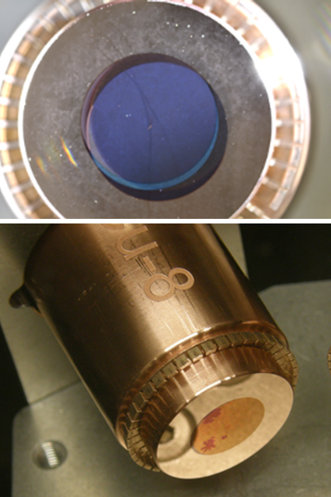
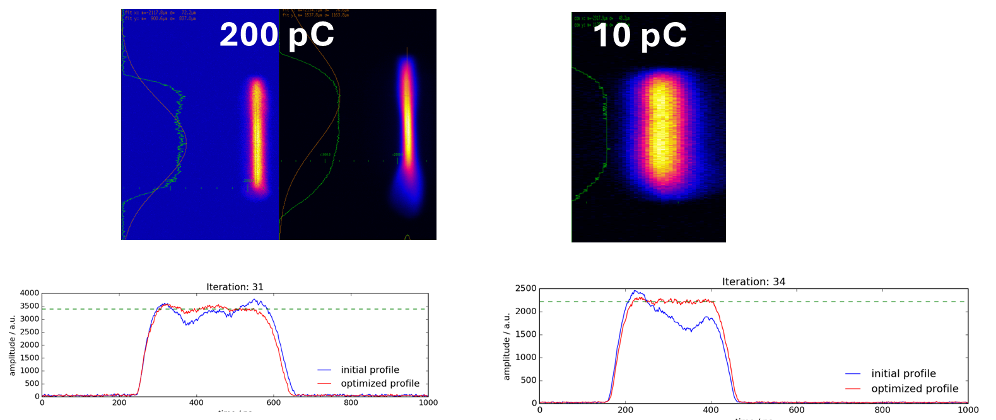
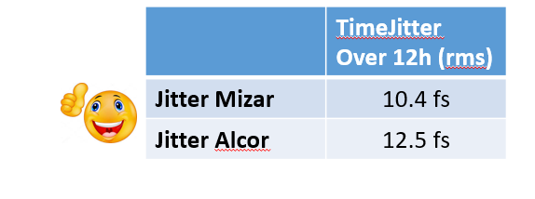

3. Novel Concepts and Lasers
Overview of the SwissFEL photocathode lasers and cathode R&D
Alexandre Trisorio (PSI)
Introduce Twins laser systems: Alcor (2014) and Mizar (2019)
Successful operation of the gun lasers: >99% uptime over 2019-2024
Laser arrival time stabilization
Excellent flattop current for high and low charge operation:
10 ps FWHM, 3.7 ps FWHM
Cu_31 co-evaporated
10 ps FWHM
3.7 ps FWHM

Slide 9
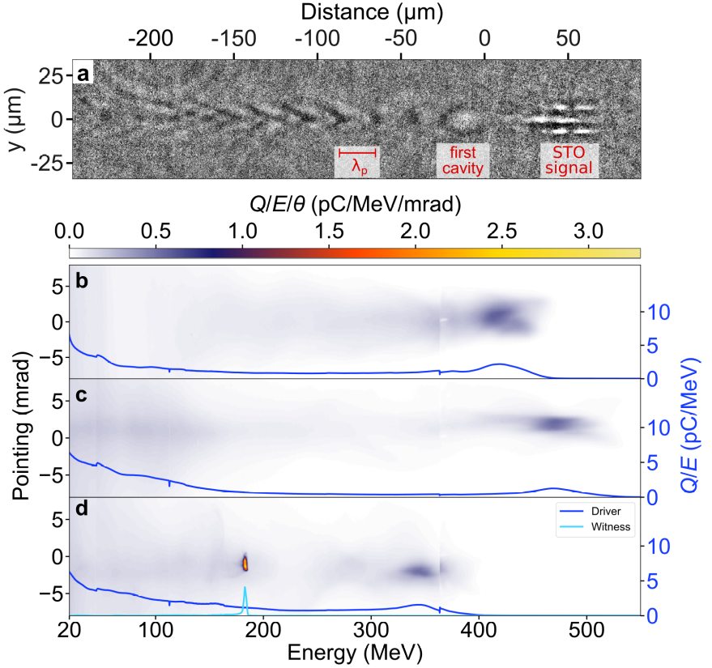
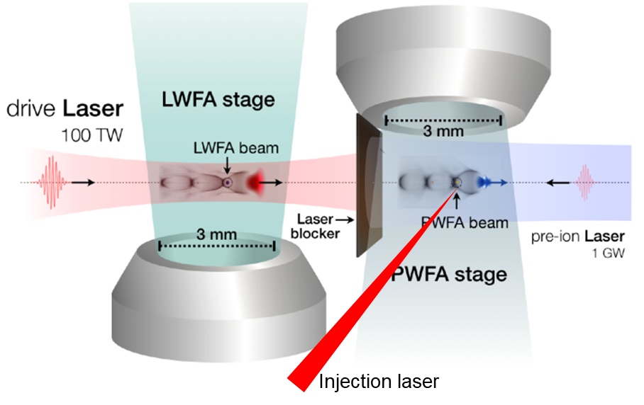
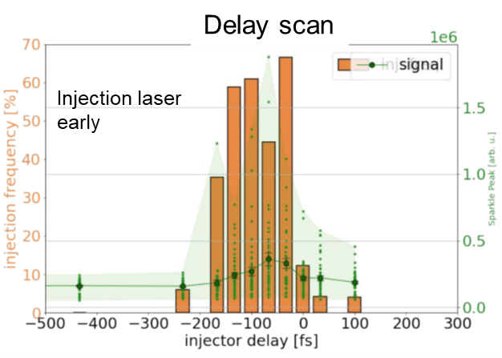
3. Novel Concepts and Lasers
Laser-plasma based electron sources for FEL applications
Arie Irman (HZDR)
Laser Plasma Accelerator → Compact electron source to drive free-electron laser (FEL)
Spatio-temporal overlap between plasma wave and injection laser → very tricky!
Plasma emission observed when the overlap achieved
Injection observed within ~ 100fs time window matching nicely with one plasma cavity
Gas target: 50% helium and 50% hydrogen

Slide 10
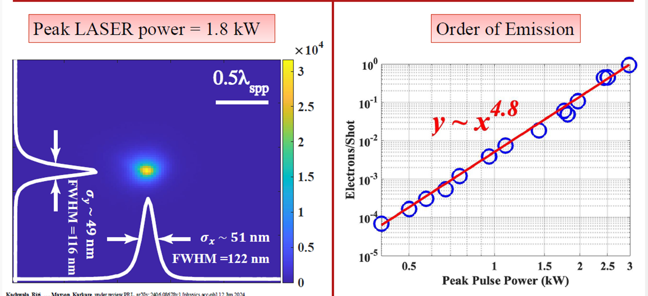
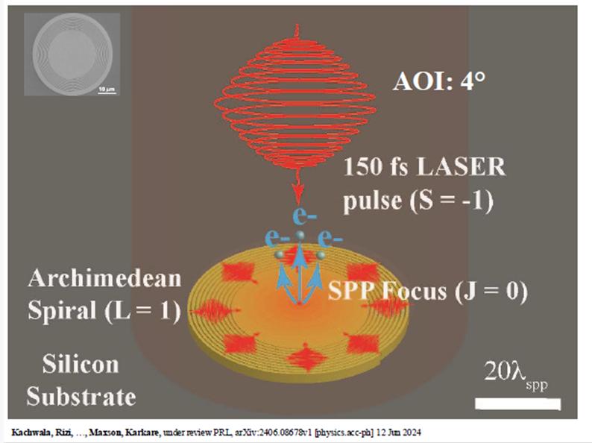

3. Novel Concepts and Lasers
Novel plasmonic and photonics integrated photocathodes
Alimohammed. S.H. Kachwala (ASU)
Small emission area plamonic photocathode
Achieve nanoscale electron emission area from plasmonic gold spiral
Confined emission down to 1 µm!

Slide 11
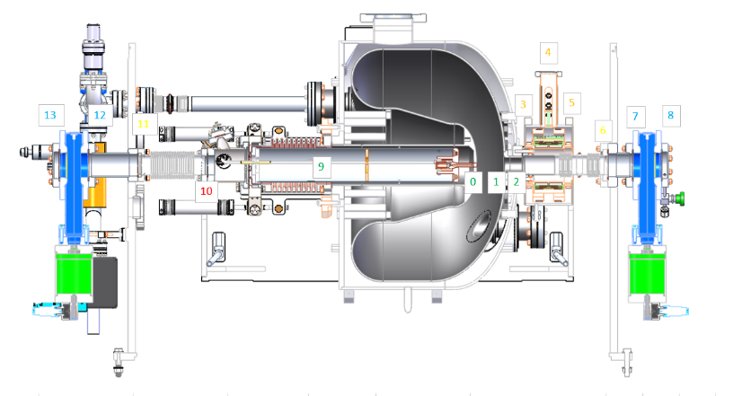
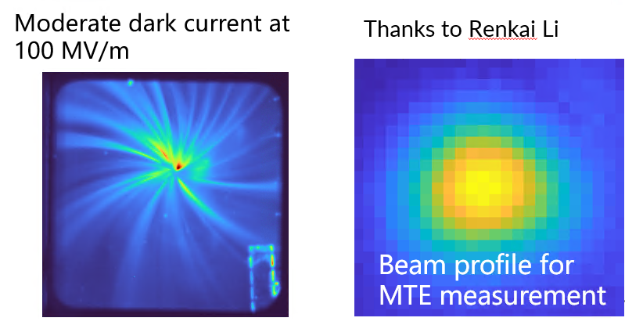
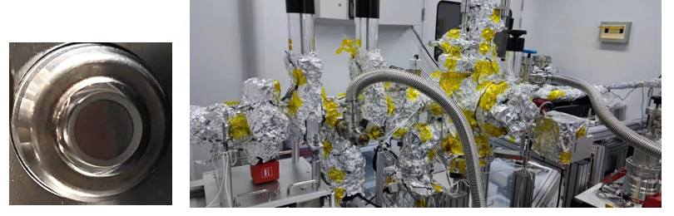
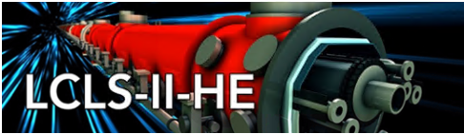
4. Low emittance application
Photocathodes for low emittance injector
John Smedley (LCLS)
LCLS-II HE Gun lower emittance => Electric field on cathode of 30 MV/m to achieve 0.1 um emittance for 100 pC
Epitaxial Green cathode (KCs₂Sb): low roughness, MTE < 184 meV
Overview of low emittance application. Outstanding questions:
How long will a cathode last in a real SRF gun?
Will MTE performance degrade in gun?
Will the cathode pose an operational risk to the SRF Gun?

Slide 12
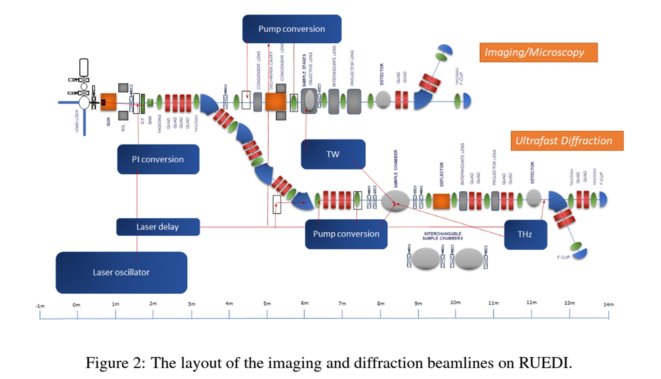
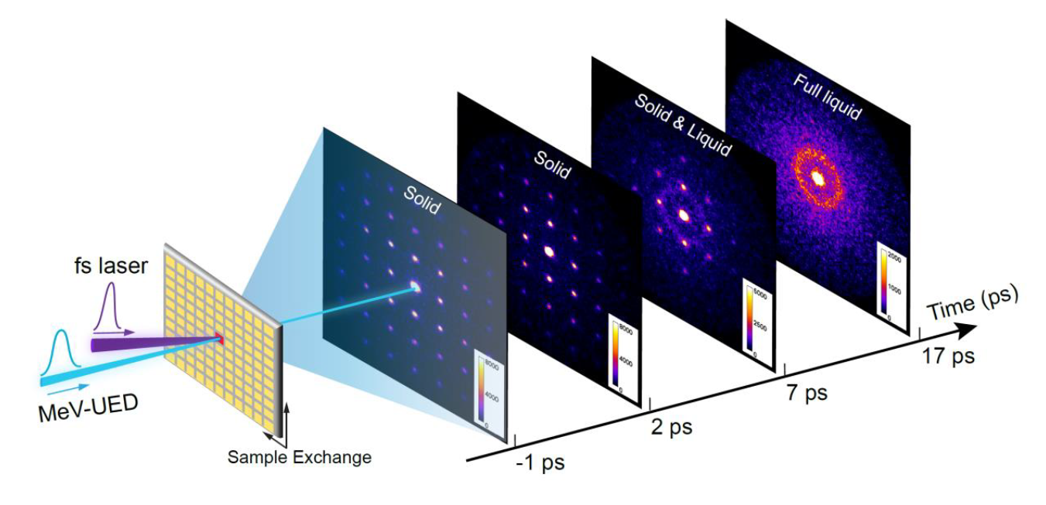

Relativistic Ultrafast Electron Diffraction and Imaging
Tim Noakes (STFC)
4. Low emittance application
New Facility for Ultra Fast Electron Diffraction :
S-band gun for 4 MeV and 8 fs pulses, copper gun back plane, 0.2 fC/mm²mrad²
New Facility of 130 M$, commissioning planned for 2029

Slide 13
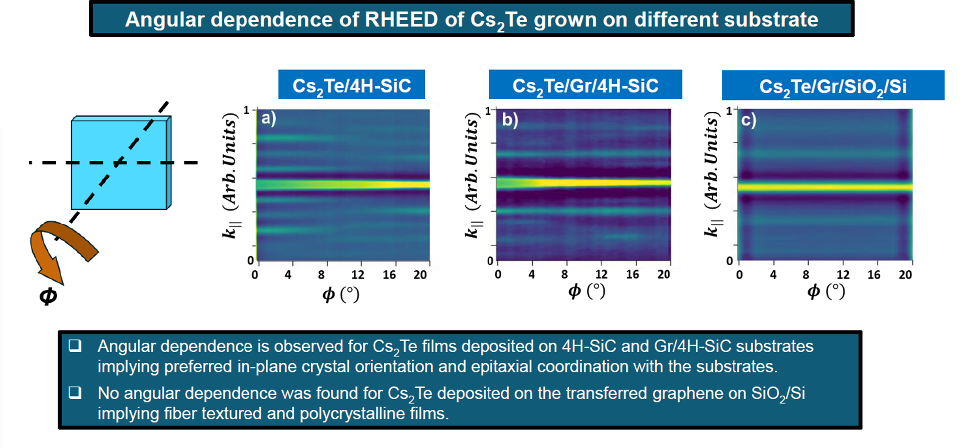
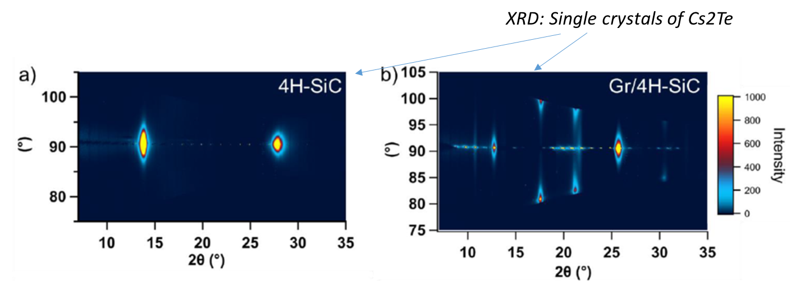
Pulsed laser deposition for epitaxial growth of photocathodes
Kali Prasana Mondal (BNL)
4. Low emittance application
BNL UHV photocathode growth system for Cs₂Te, Cs from effusion cell and Te from PLD
Large diagnostic capability: RHEED, XRD, XRR, XRF
Results:
Highly ordered crystaline domains obtained
Rougness less than 1 nm for 7 to 20 nm layer thicknesses
QE > 15% at 265nm for 4H-SiC, Gr/4H-SiC and Gr/SiO2/Si

Slide 14
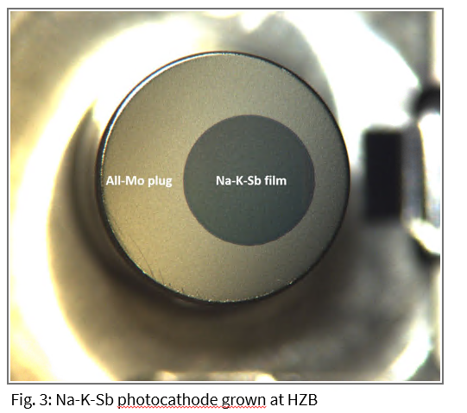
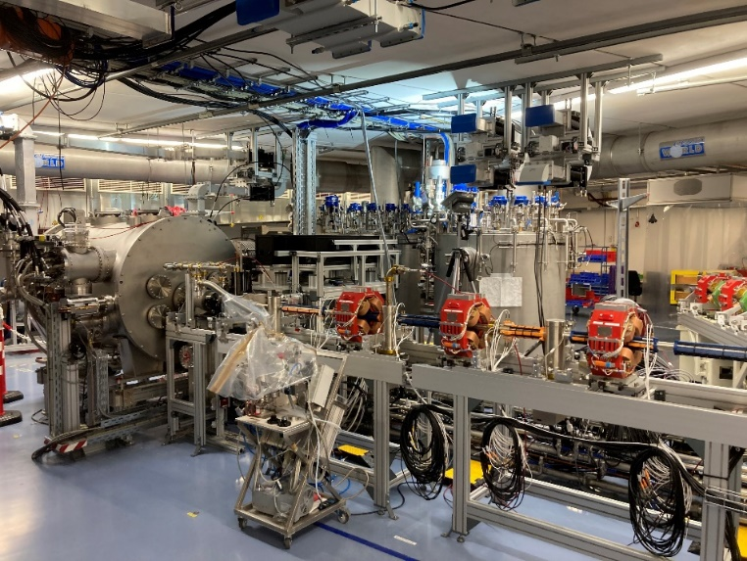
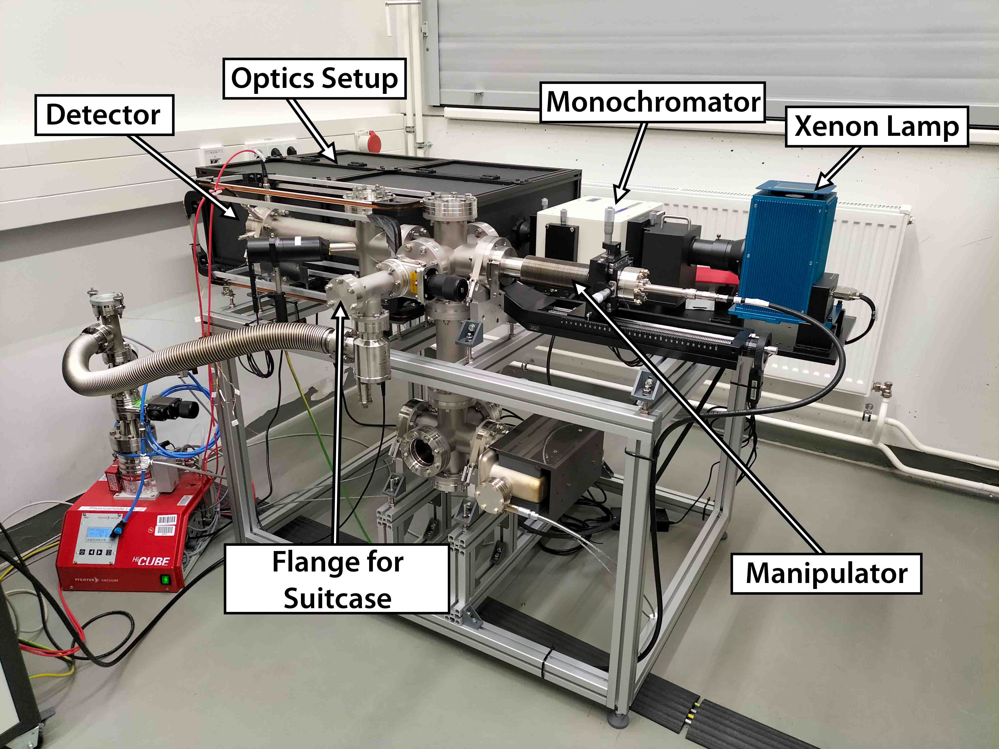

PhotEx Photoemission and Transverse Energy Experiment
Jonas Dube (HZB)
4. Low emittance application
Photoinjector of Superconducting RF Electron Accelerator Laboratory (SEALab) goes into operation this year
Emittance of the accelerator is limited by the electron source
PhoTEx allows characterization of photocathodes before they are transferred to the accelerator
New instrument to measure MTE, QE, reflection and lifetime: 40 meV < MTE <5600 meV
Fig. 2: Photoinjector at SEALab, Source: HZB

Slide 15
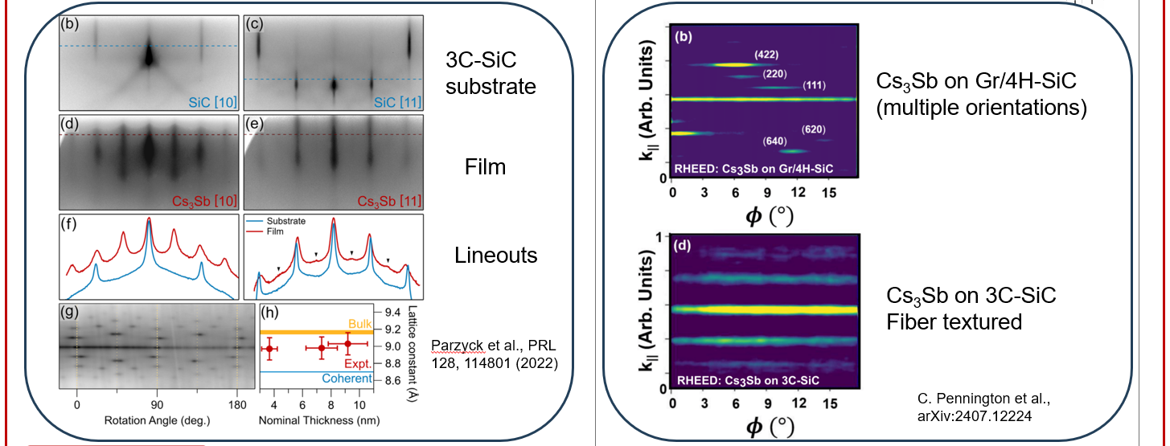
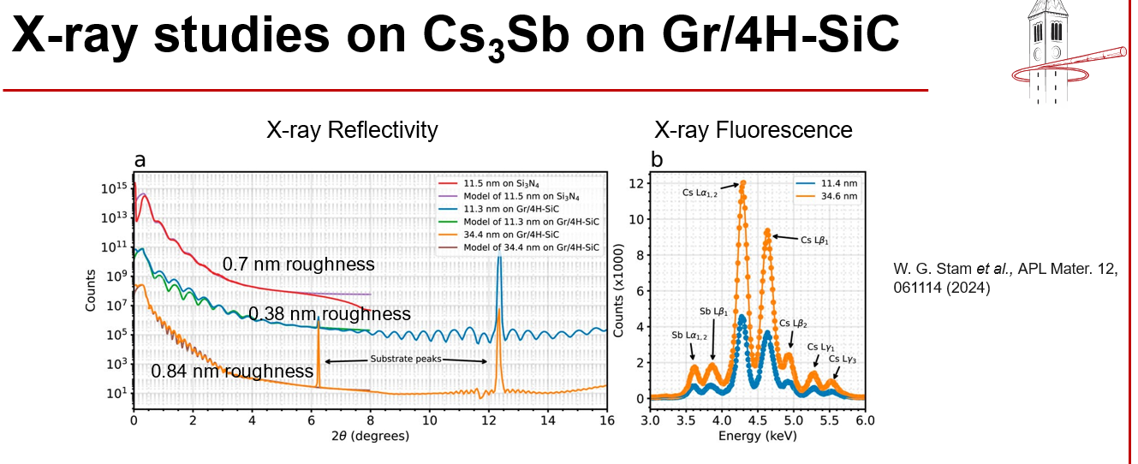
5. ‘Green’ Photocathodes
Promoting Epitaxy in Alkali Antimonides
Jared Maxson (Cornell University)
“Promoting epitaxy” in the alkali antimonides :
  Extremely flat surfaces, interference enhancement, high QE while very thin
  Atomic scale layer engineering: heterostructures, polarized cathodes?
  MTEs dominated by band structure? (Particularly for thin cathodes)
X-ray and electron beam probe suites are vital for epitaxial growth
Epitaxy enables precise understanding of materials properties and detailed comparison to ab-initio theory.

Slide 16
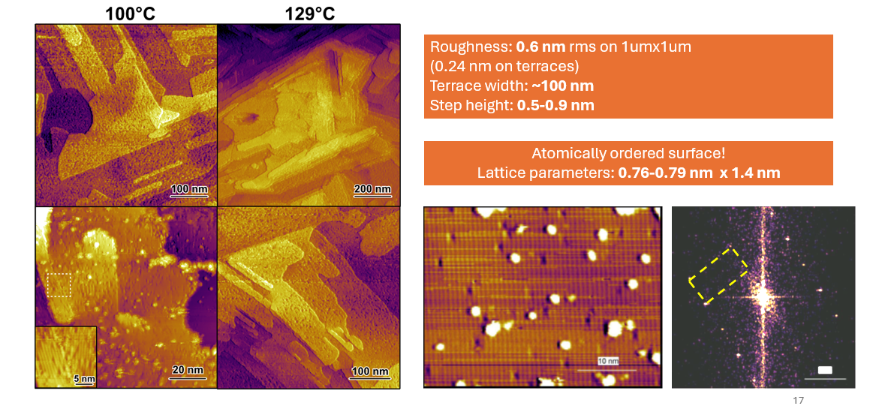
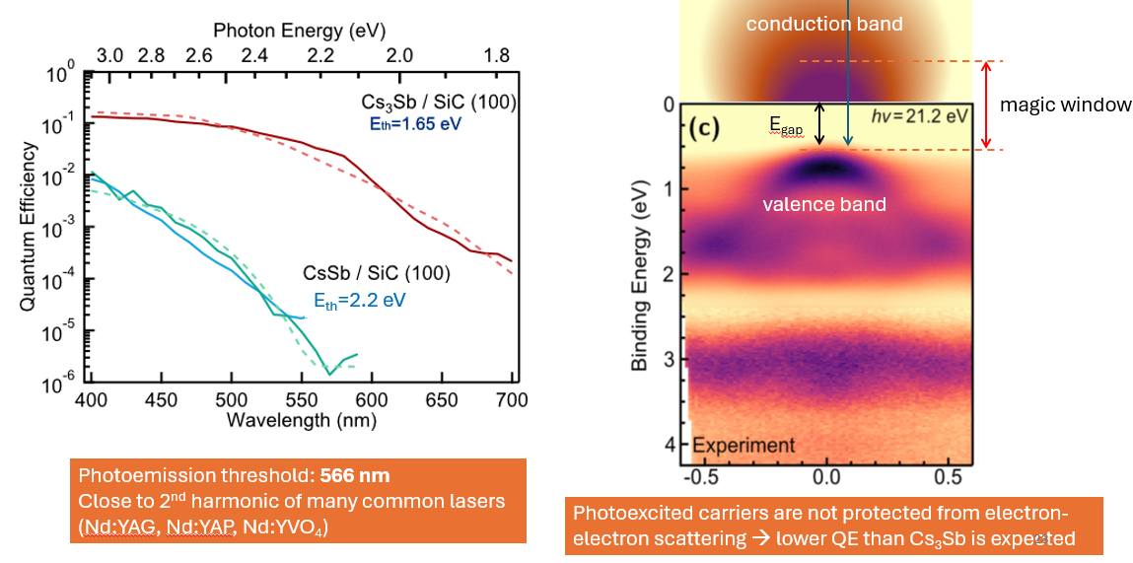
5. ‘Green’ Photocathodes
Atomically smooth films of CsSb: a chemically robust visible light photocathode
Alice Galdi (University of Salerno, Italy)
MBE can be used as an exploratory tool to discover new phases with desirable properties
Cs₁Sb is an example of an overlooked visible light photocathode
  atomically smooth surfaces, more robust than Cs₃Sb
  Low emittance? MTE measurements needed!
Band dispersion measured in ARPES despite in-plane disorder

Slide 17
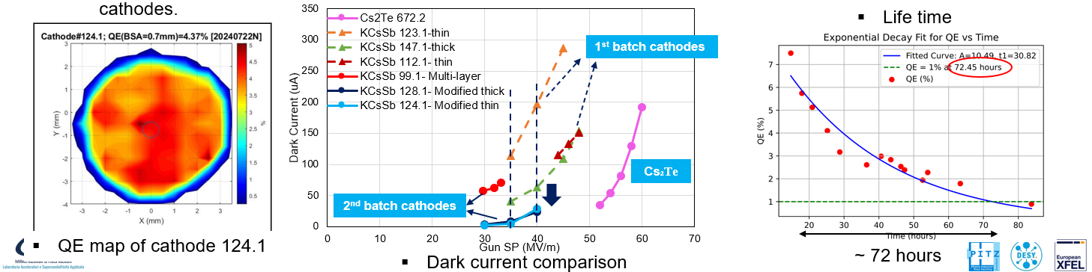
5. ‘Green’ Photocathodes
Development of Multialkali antimonides photocathodes
for high-brightness photoinjectors
Sandeep Kumar Mohanty (DESY)
3 KCsSb cathodes and 1 NaKSb(Cs) cathode have been produced for testing in the PITZ RF gun.
KCsSb cathodes with sequential deposition, recording QE of 8-9.6% at 514 nm.
Controlling K thickness was crucial for achieving cubic orientation in KSb compounds
Previous XRD confirms that Cs reacts effectively with cubic KSb to form predominantly cubic KCsSb

Slide 18
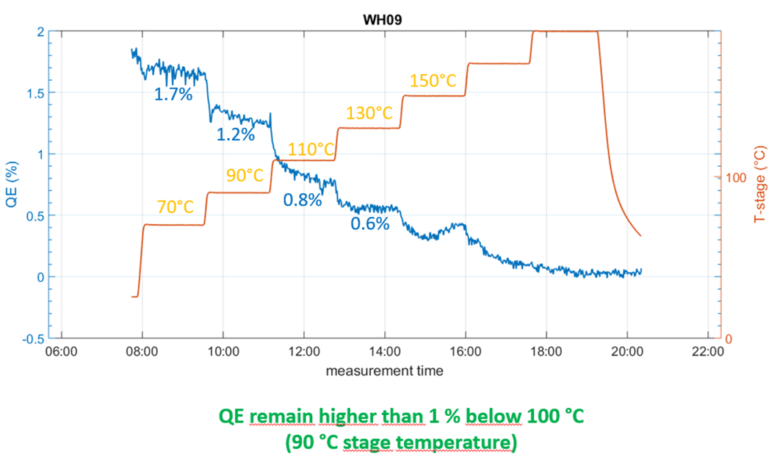
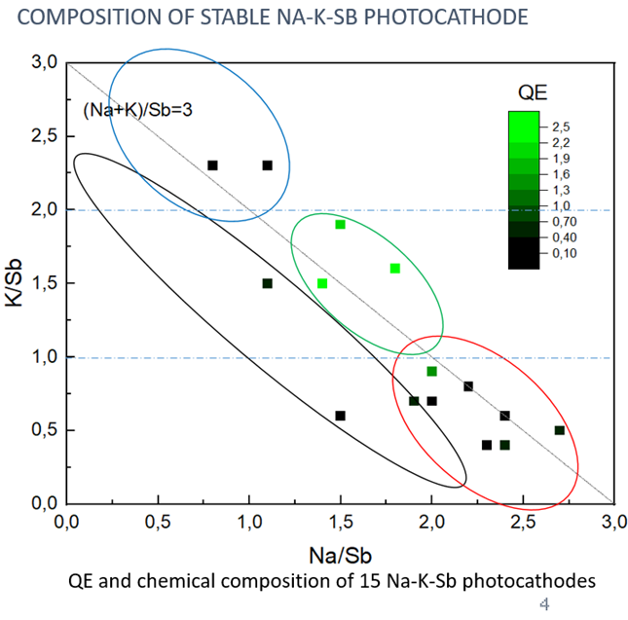
5. ‘Green’ Photocathodes
NaKSb Photocathodes for High Brilliant Electron Beams
Chen Wang (HZB)
Demonstrated development of NaKSb photocathodes (more chemically stable than CsKSb)
Crucial to achieve high QE with long lifetime and good thermal stability (25W laser power)
Study effects of temperature on QE, K/Sb : Na/Sb ratio is a good QE predictor

Slide 19
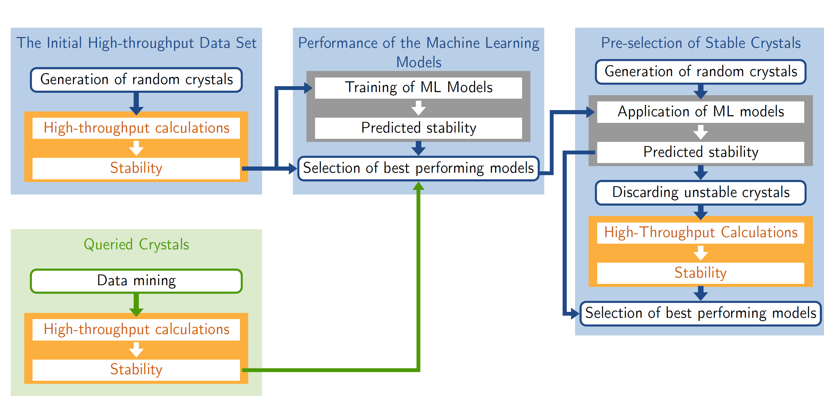
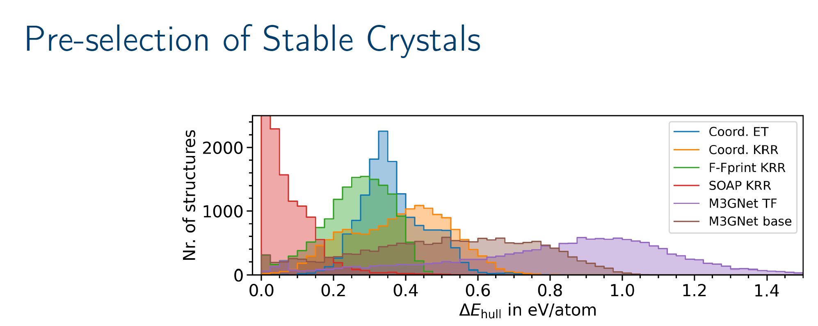
Machine learning-assisted design of Cesium-based photocathodes
Holger-Dietrich Sassnick (Univ. Oldenburg)
6. Photocathode theory and characterisation
Using machine learning to speed up scanning of structures
The Coord. ET and the M3GNet models show the best performance.
The implementation can be readily applied to any other material-system
The source code is published and freely available (https://aim2dat.github.io/aim2dat/).

Slide 20
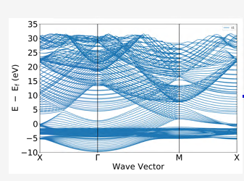
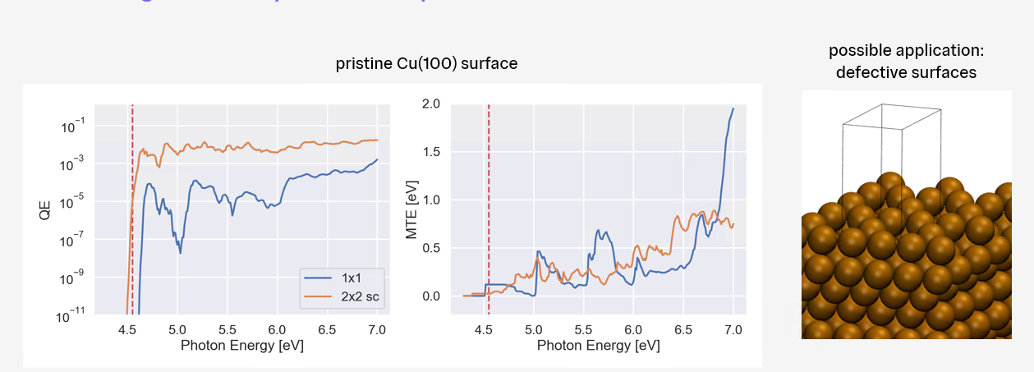
OptaDOS Photoemission- The Good, The Bad and The Interesting
Felix Mildner (Imperial college London)
6. Photocathode theory and characterisation
OptaDOS Photoemission: K-resolved modelling of Photoemission
currently working on: supercell representation, weighted MTE calculation
Good: Improved physics in the code (3-step and 1-step), fixed issue with vacuum gap, OptaDOS distribution freely available…
Bad: Issues with supercells related to band folding
Interesting: broad agreement between theory and experiment

Slide 21
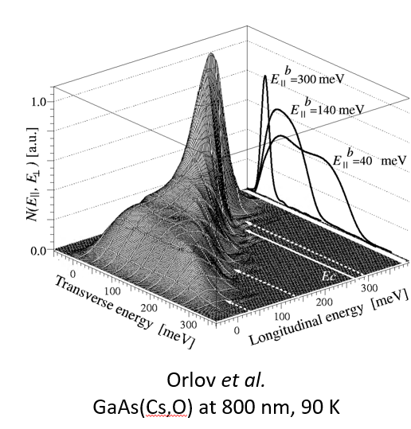


An overview of MTE measurement techniques and photocathode R&D at Daresbury Laboratory
Lee Jones (STFC Daresbury Laboratory)
6. Photocathode theory and characterisation
Overview MTE measurement techniques
Many different instrument have been developed (low energy, higher energy)
Photocathode R&D at Daresbury Laboratory
Cathodes for the CLARA accelerator
Cathode concepts for RUEDI and UK XFEL design project

Slide 22



Photocathode characterisation using a UV-tunable ultrashort pulse radiation source
Andreas Schroeder (University of Illinois Chicago)
6. Photocathode theory and characterisation
Photocathode characterization system at UIC
Key components: tunable UV radiation source, DC gun 10-20 kV DC gun, electron detection
Calibration and performance: QE ~ 10⁻¹⁰ and MTE 1-2meV
UV cleaning of metal photocathodes: reduction of the surface work function mechanisms (surface and ‘bulk’ desorption)?

Slide 23



7. Cathodes for polarized electron sources
Activation studies for GaAs photocathodes at Photo-CATCH
Maximilian Herbert (TU Darmstadt)
GaAs photocathodes require activation with NEA layer to reduce work function
Automated procedure successfully tested for cathode activation
  Using python, Co-deposition of Cs and O₂
Automated procedure for QE scan
Implementation of Lithium-enhanced activation, significant increase in lifetime
Activation cycle
Pulsed Li-enhanced activation cycle
Improved lifetime

Slide 24




7. Cathodes for polarized electron sources
High intensity polarized beam to drive a positron source
Carlos Hernandez-Garcia (Jefferson lab)
Driving a polarized positron source requires$\sim$1 mA CW beam of electron with high polarization (90%)
Considering the amount extracted charge, 1/e charge lifetime should be >1 kC
overcome ion-back bombardment on the delicate strained-superlattice photocathode (limiting factor)
JLab develops large conical inverted geometry insulators to operate at > 300 kV
Achieved!
500 kV
concept
Test performed with un-biased anode
4𝜎 ~ 10 mm
375 kV
R30
Days
250 kV
R28
Trend we want to realize
CEBAF
GTS
CEBAF (<1 mm²)
4𝜎 ~ 1 mm
SF₆ intervening volume test

Slide 25



7. Cathodes for polarized electron sources
Cathodes with optimized QE for driving a spin polarized positron source
Kurt Aulenbacher (J.G.-Mainz University)
Production of spin polarized positron beams well understood
  spin polarized electrons beams in the multi-MeV regime
  Large polarization transfer to positron, polarized positron beams with good beam quality
Sustainable supply of GaAs/GaAsP superlattice photocathodes is of vital importance
QE and Polarization tests to performed at Mainz (high current) & TU-Darmstadt
Superlatticecathodes

Slide 26



7. Cathodes for polarized electron sources
Photocathodes for electron sources for EIC
Omer Rahman (BNL)
Distributed Bragg Reflector (DBR) SSL GaAs developed (ODU, JLab and BNL)
Tested in 300 kV DC gun at BNL : peak QE ~1% at 780 nm with 90% polarization
Extraction of 11.6 nC bunch charge maximum ➔ Exceeds EIC requirement
For DBR SSL GaAs, lifetime is wavelength dependent
Increasing laser spot size did not linearly increase SCL ➔ consider SCL a 3D problem instead of 1D

Slide 27
  Acknowledgement
  Many thanks to EWPAA Scientific Program Committee
  Maud Baylac (CNRS-LPSC)
  Caterina Cocchi (Universitat Oldenburg)
  Romain Ganter (PSI)
  Lee Jones (UKRI STFC)
  Julius Kühn (HZB)
  Laura Monaco (INFN Milano - LASA)
  Tim Noakes (UKRI STFC)
  Daniele Sertore (INFN Milano - LASA)
  Rong Xiang (HZDR)
  Special thanks to the Local committee and ELBE colleagues
  Nicki Fischer (HZDR)
  Anton Ryzhov (HZDR)
  Henryk Berndt (TU Dresden)
  Martin Starek (TU Dresden)
  Andreas, Gowri, Raffael, Mike... (HZDR)

Slide 28


EWPAA2024 proceeding is published:
ISSN: 2191-8708, eISSN: 2191-8716
(https://www.hzdr.de/publications/PublDoc-25684.pdf)

